Slide 1
THz Indium Phosphide
Bipolar Transistor Technology
IEEE Compound Semiconductor IC Symposium, October 4-7, La Jolla, California
Mark Rodwell
University of California, Santa Barbara
Coauthors:
J. Rode, H.W. Chiang, P. Choudhary, T. Reed, E. Bloch, S. Danesgar,
H-C Park, A. C. Gossard, B. J. Thibeault, W. Mitchell
UCSB
M. Urteaga, Z. Griffith, J. Hacker, M. Seo, B. Brar
Teledyne Scientific Company
rodwell@ece.ucsb.edu 805-89-44, 805-89-5705 fax

Slide 2
Why
THz Transistors ?

Slide 3
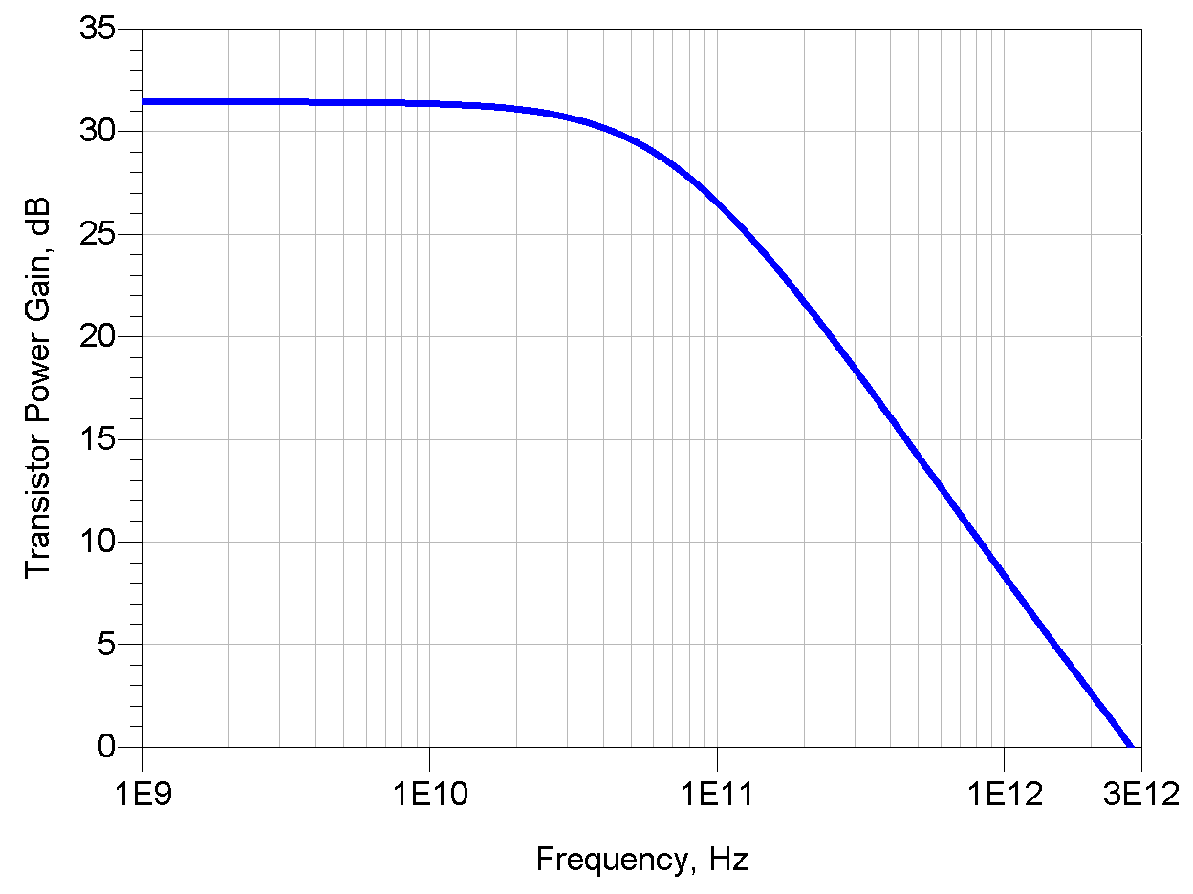
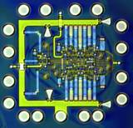
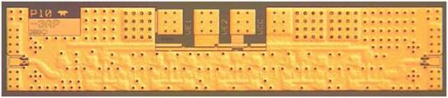
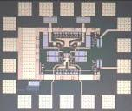
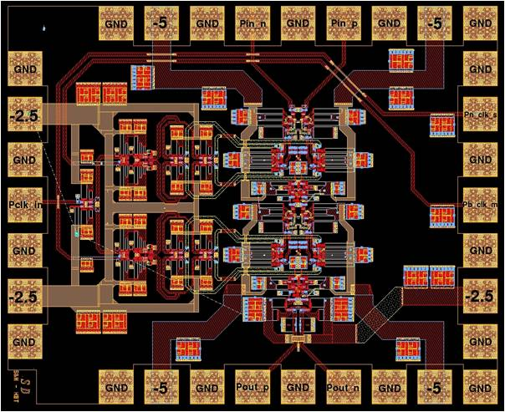
THz Transistors: Not Just For THz Circuits
500 GHz digital logic
→ fiber optics
THz amplifiers→ THz radios
→ imaging, communications
precision analog design
at microwave frequencies
→ high-performance receivers
Higher-Resolution
Microwave ADCs, DACs, DDSs

Slide 4
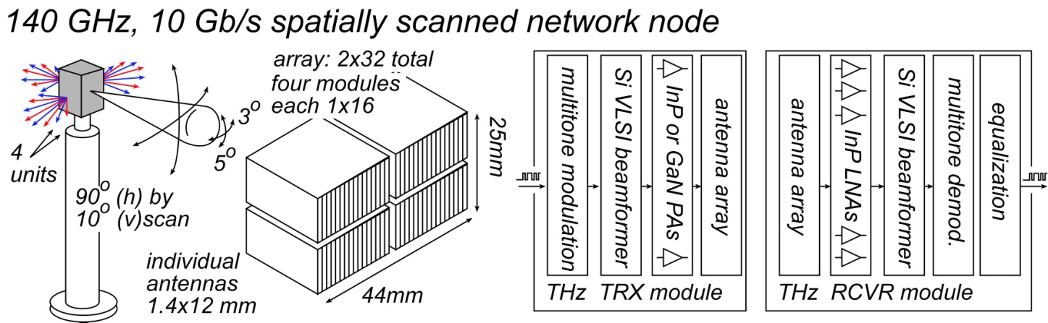
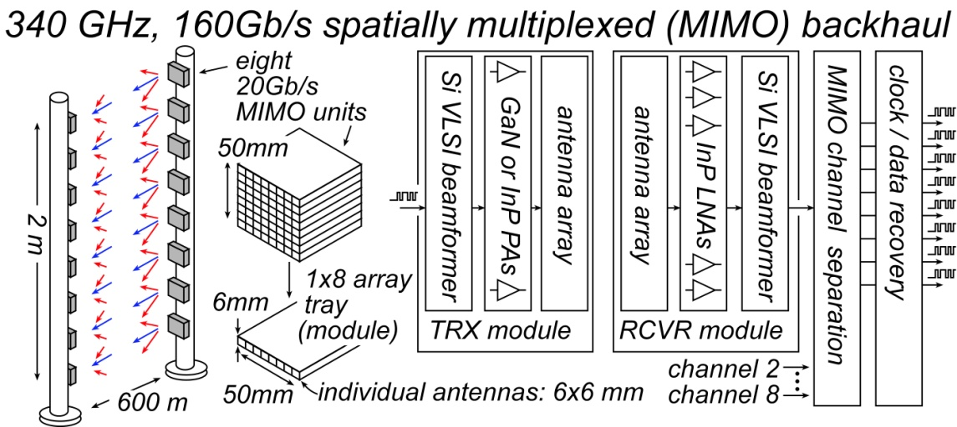
THz Communications Needs High Power, Low Noise
Real systems with real-world weather & design margins, 500-1000m range:
Will require:
3-7 dB Noise figure, 50-500 mW power/element, 64-256 element arrays
→ InP or GaN PAs and LNAs, Silicon beamformer ICs

Slide 5
THz InP HBTs

Slide 6
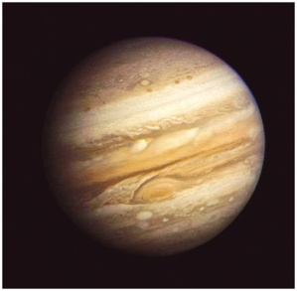
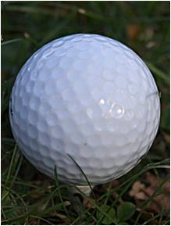
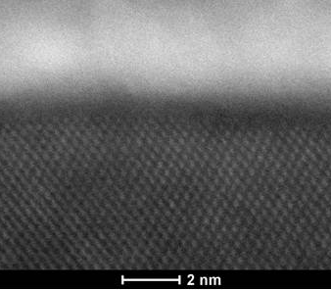
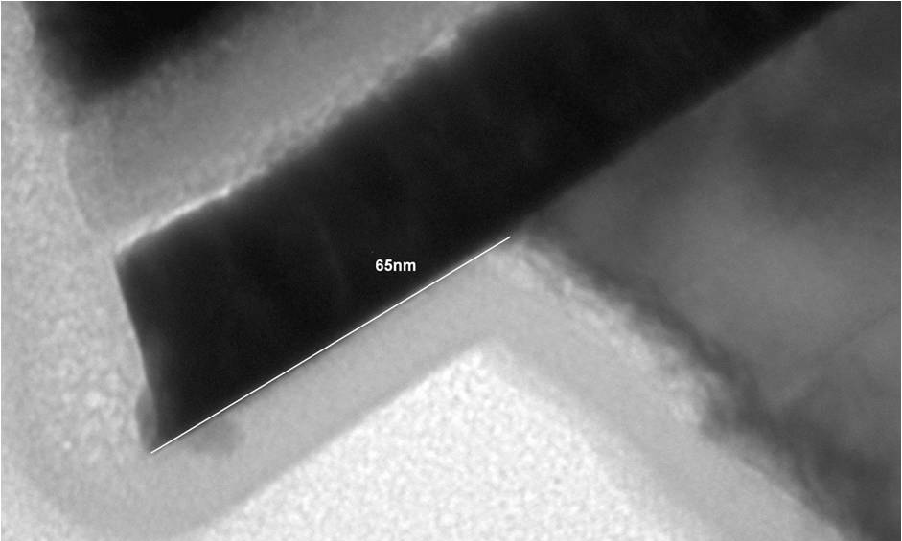
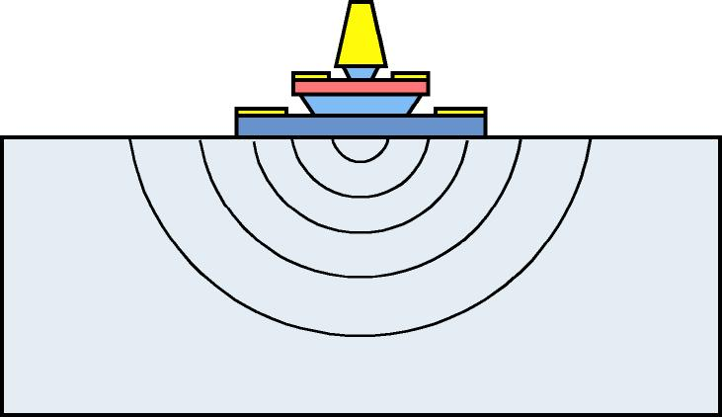
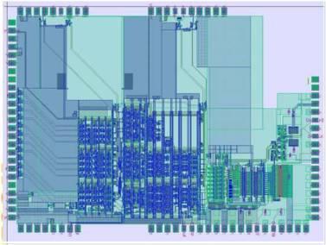
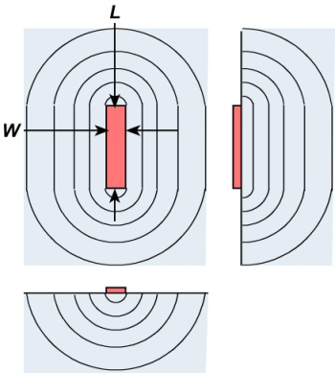
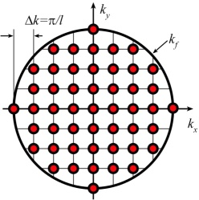
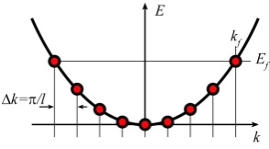
THz & nm Transistors: what it's all about
Metal-semiconductor interfaces (Ohmic contacts): very low resistivity
Dielectric-semiconductor interfaces (Gate dielectrics---FETs only): thin !
Ultra-low-resistivity (~0.25 Ω-μm² ), ultra shallow (1 nm), ultra-robust (0.2 A/μm² ) contacts
Mo
Ru
InGaAs
InGaAs
Heat
Available quantum states to carry current
→ capacitance,
transconductance
contact resistance

Slide 7
Bipolar Transistor Design

Slide 8
Bipolar Transistor Design: Scaling

Slide 9
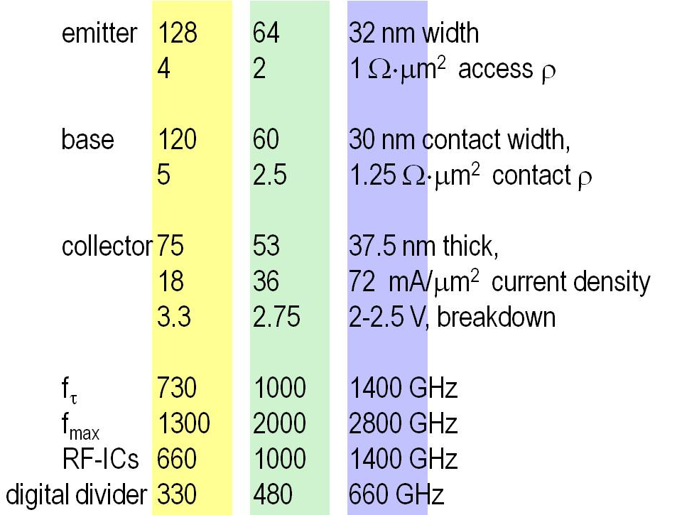
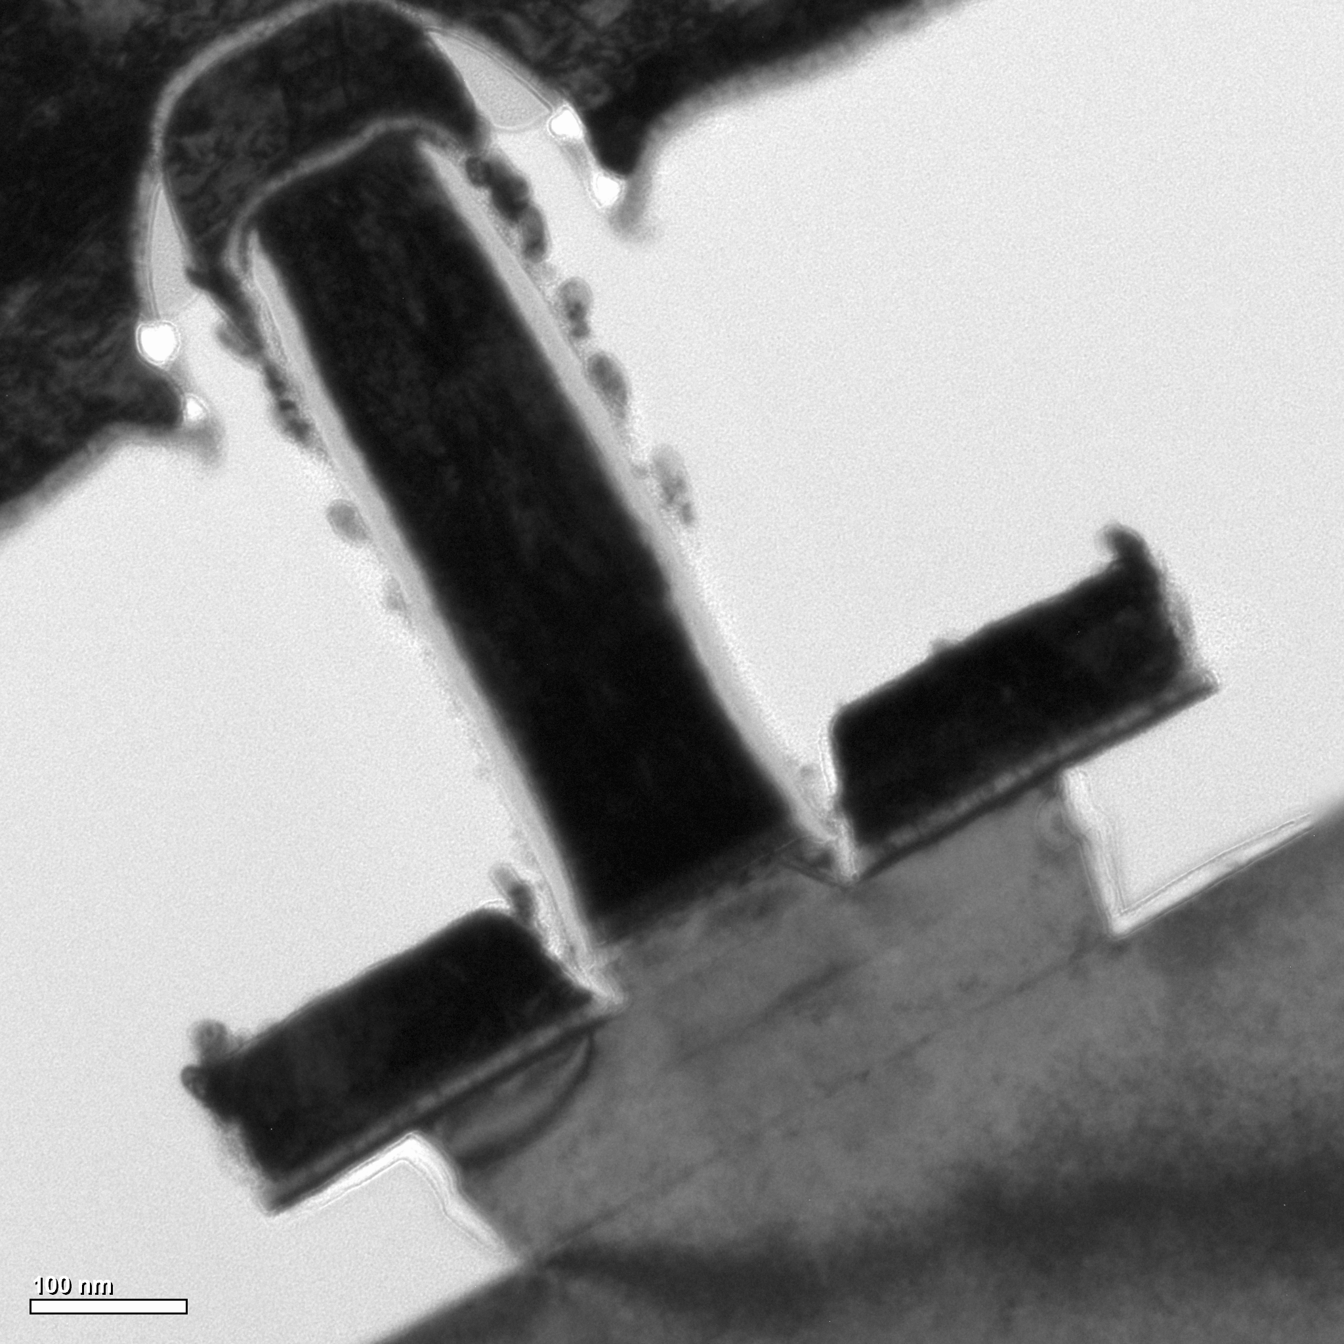
Scaling Laws, Scaling Roadmap
scaling laws: to double bandwidth
HBT parameter | change
emitter & collector junction widths | decrease 4:1
current density (mA/μm²) | increase 4:1
current density (mA/μm) | constant
collector depletion thickness | decrease 2:1
base thickness | decrease 1.4:1
emitter & base contact resistivities | decrease 4:1
150 nm device
150 nm device

Slide 10
HBT Fabrication Process Must Change... Greatly
32 nm width base & emitter contacts...self-aligned
32 nm width emitter semiconductor junctions
Contacts:
1 Ω-μm² resistivities
70 mA/μm² current density
~1 nm penetration depths
→ refractory contacts
nm III-V FET, Si FET processes have similar requirements

Slide 11
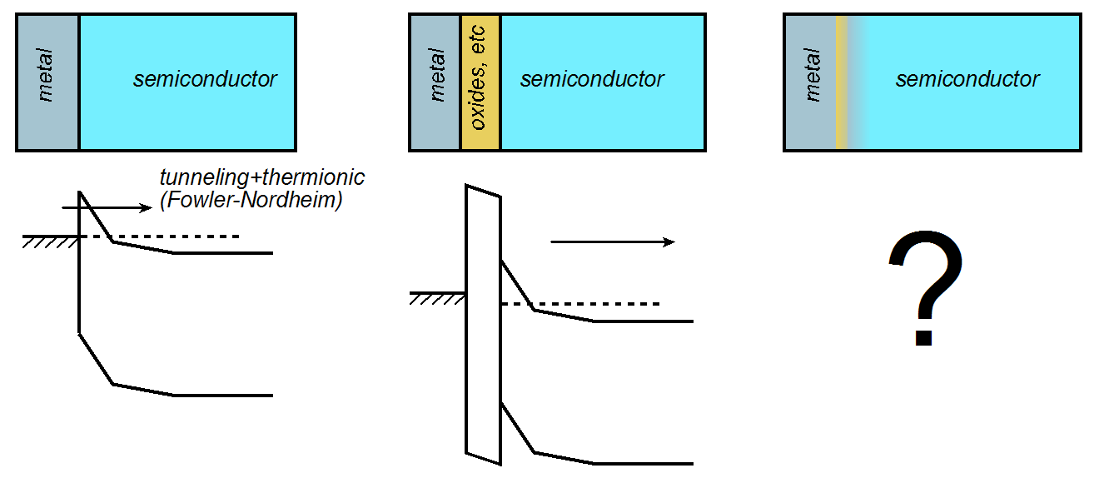
Needed: Greatly Improved Ohmic Contacts
textbook
with surface oxide
with metal penetration
Interface barrier → resistance
Further intermixing during high-current operation → degradation

Slide 12
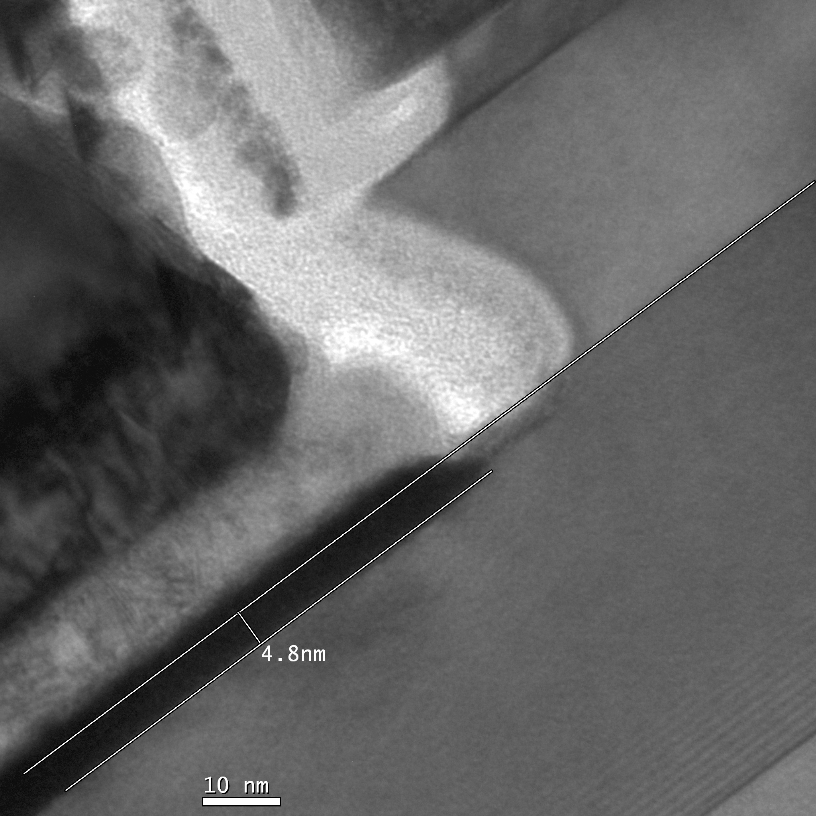
Needed: Greatly Improved Ohmic Contacts
Needed: Greatly Improved Ohmic Contacts
emitter
Pt/Ti/Pd/Au
emitter
Au
Au
~5 nm
Pt contact
penetration
(into 25 nm base)
Pd
Pd
Ti
Ti
base
base

Slide 13
Ultra Low-Resistivity Refractory In-Situ Contacts
Barasakar et al
IEEE IPRM 2012
Mo
Mo
32 nm node requirements
In-situ: avoids surface contaminants
Refractory: robust under high-current operation
Low penetration depth, ~ 1 nm
Contact performance sufficient for 32 nm /2.8 THz node.

Slide 14
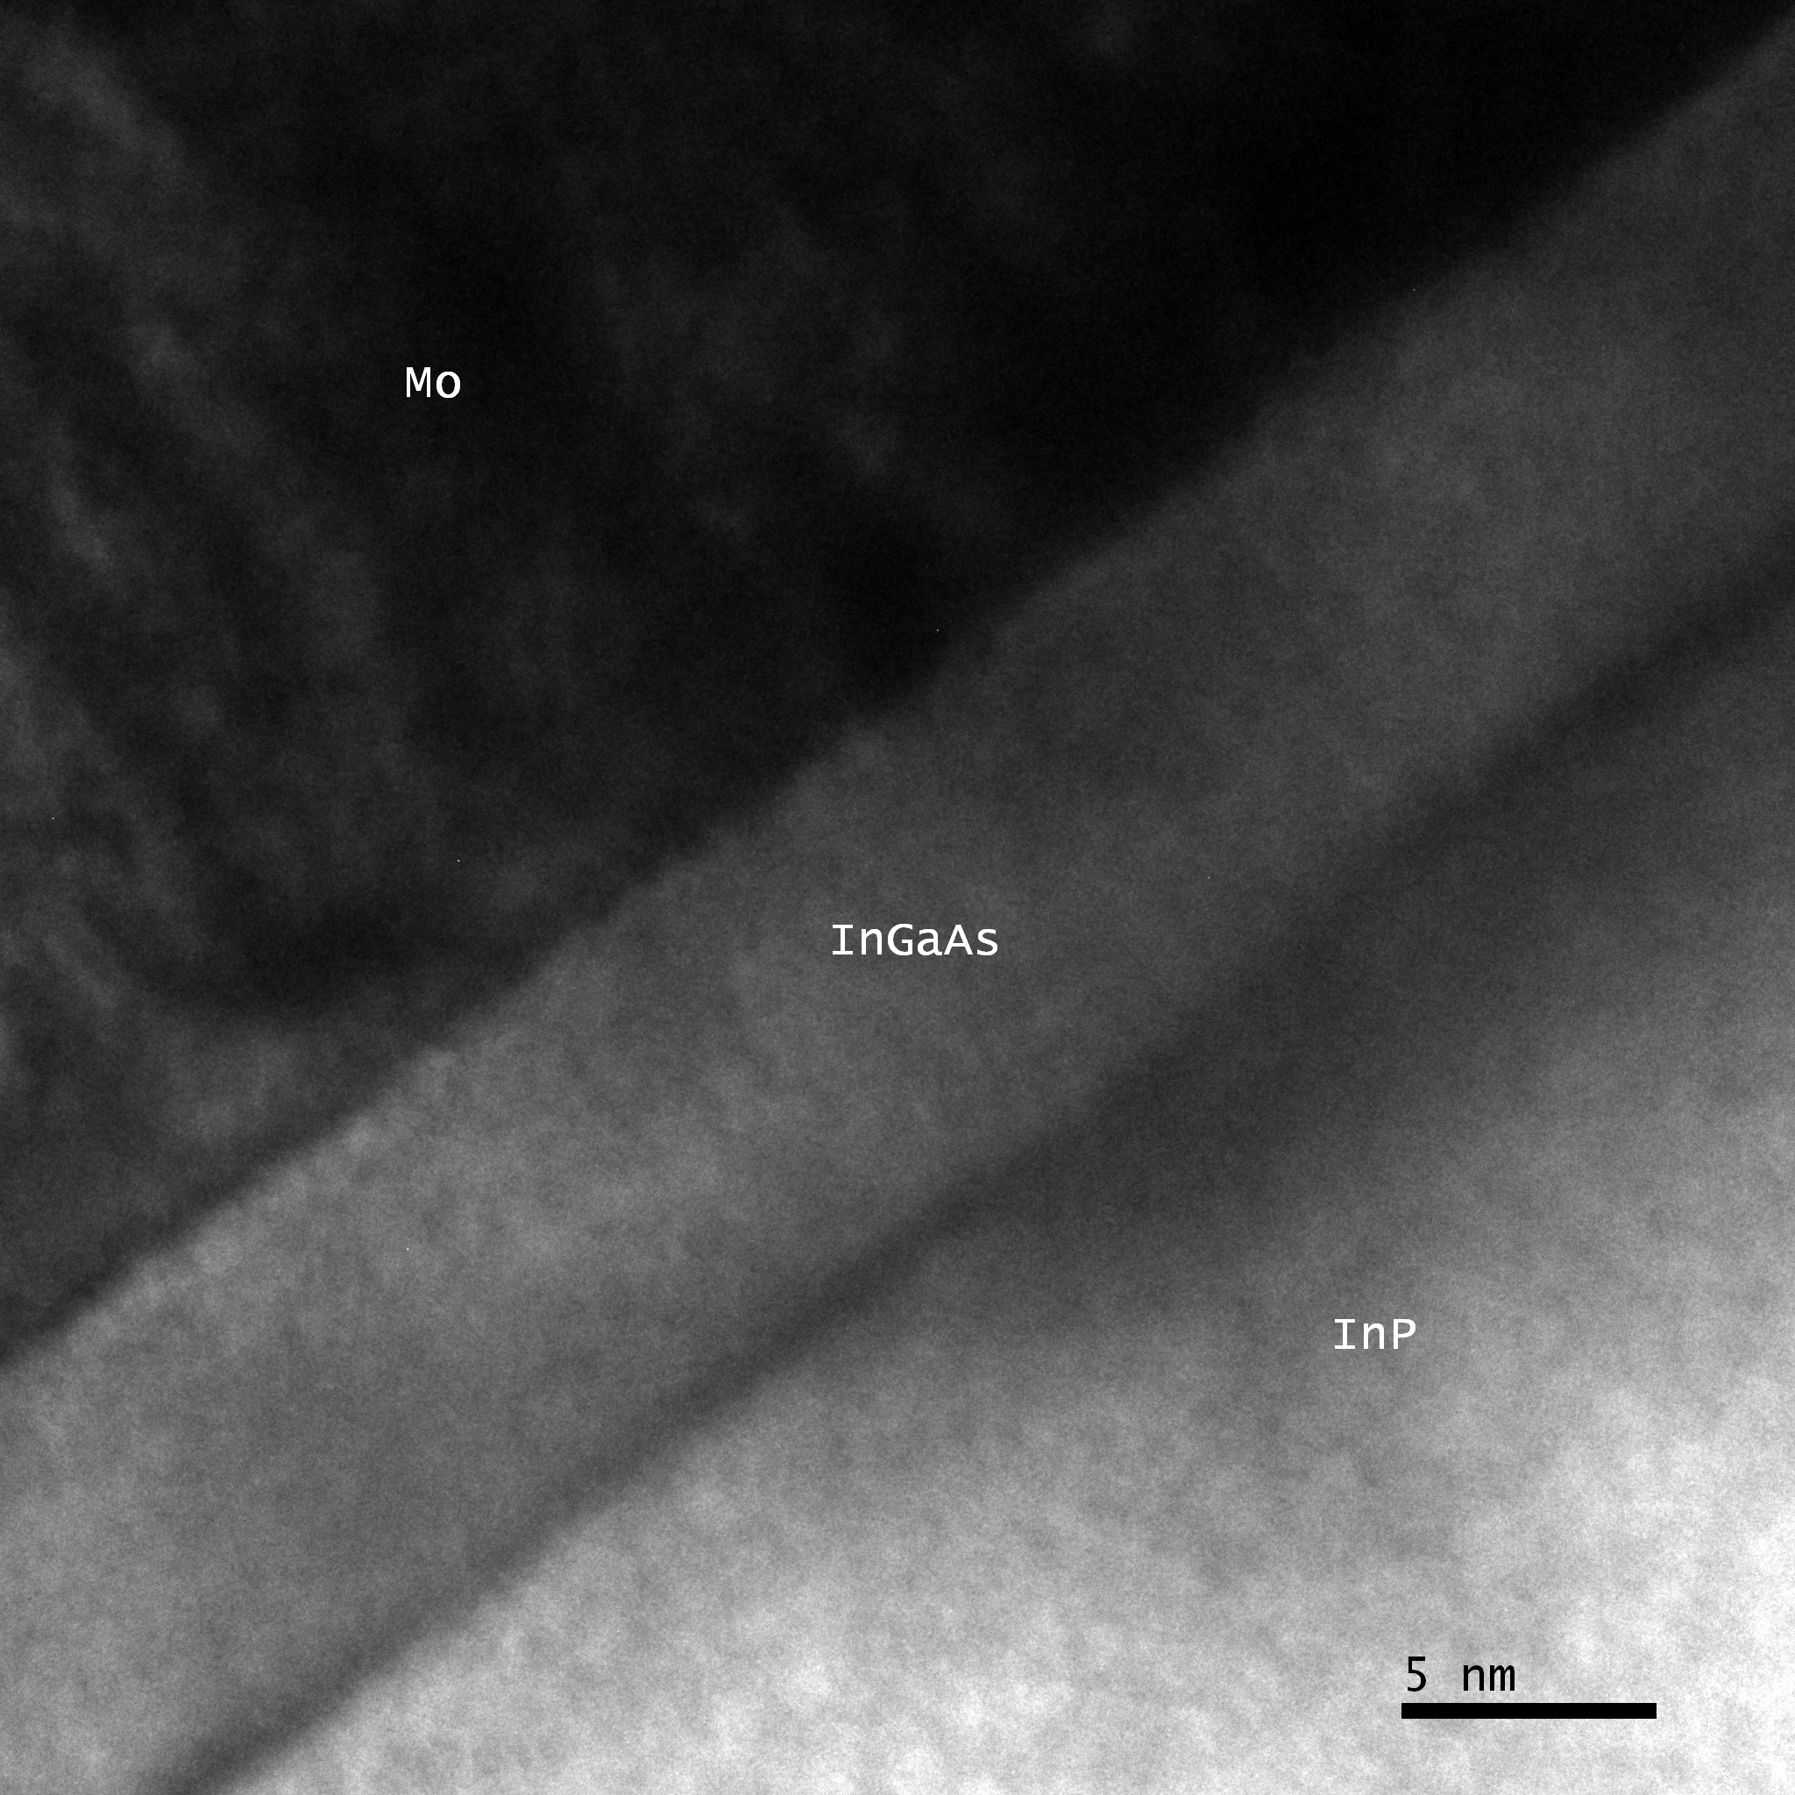
Needed: Greatly Improved Ohmic Contacts
Refractory Emitter Contacts
Mo
Mo
negligible
penetration
emitter cap
emitter cap
emitter
emitter

Slide 15
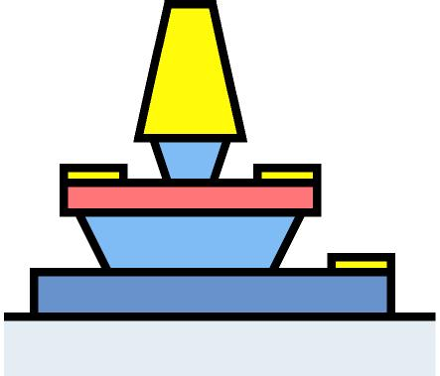
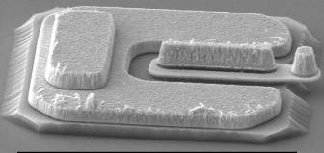
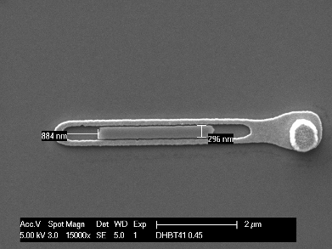
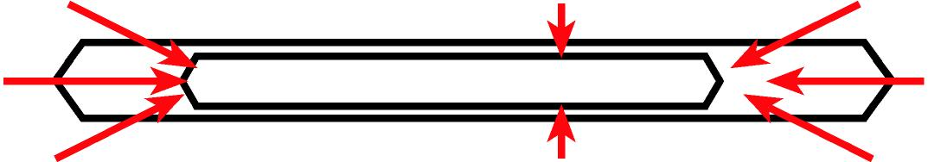
HBT Fabrication Process Must Change... Greatly
tall, narrow contacts: liftoff fails !
thinner base metal
→ excess base metal resistance
control undercut
→ thinner emitter
thinner emitter
→ thinner base metal
Undercutting of emitter ends
{101}A planes: fast
{111}A planes: slow

Slide 16
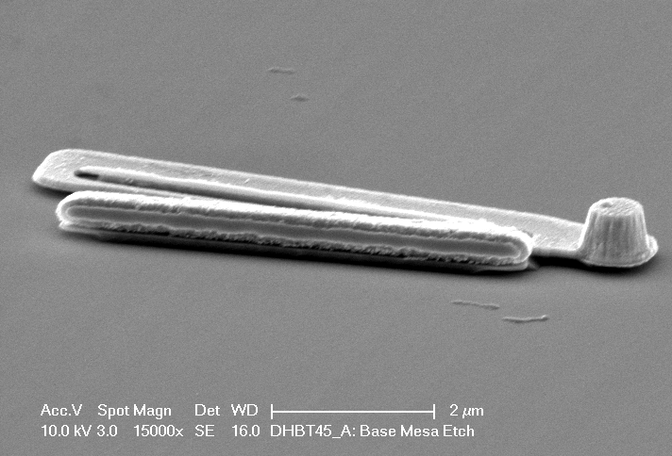
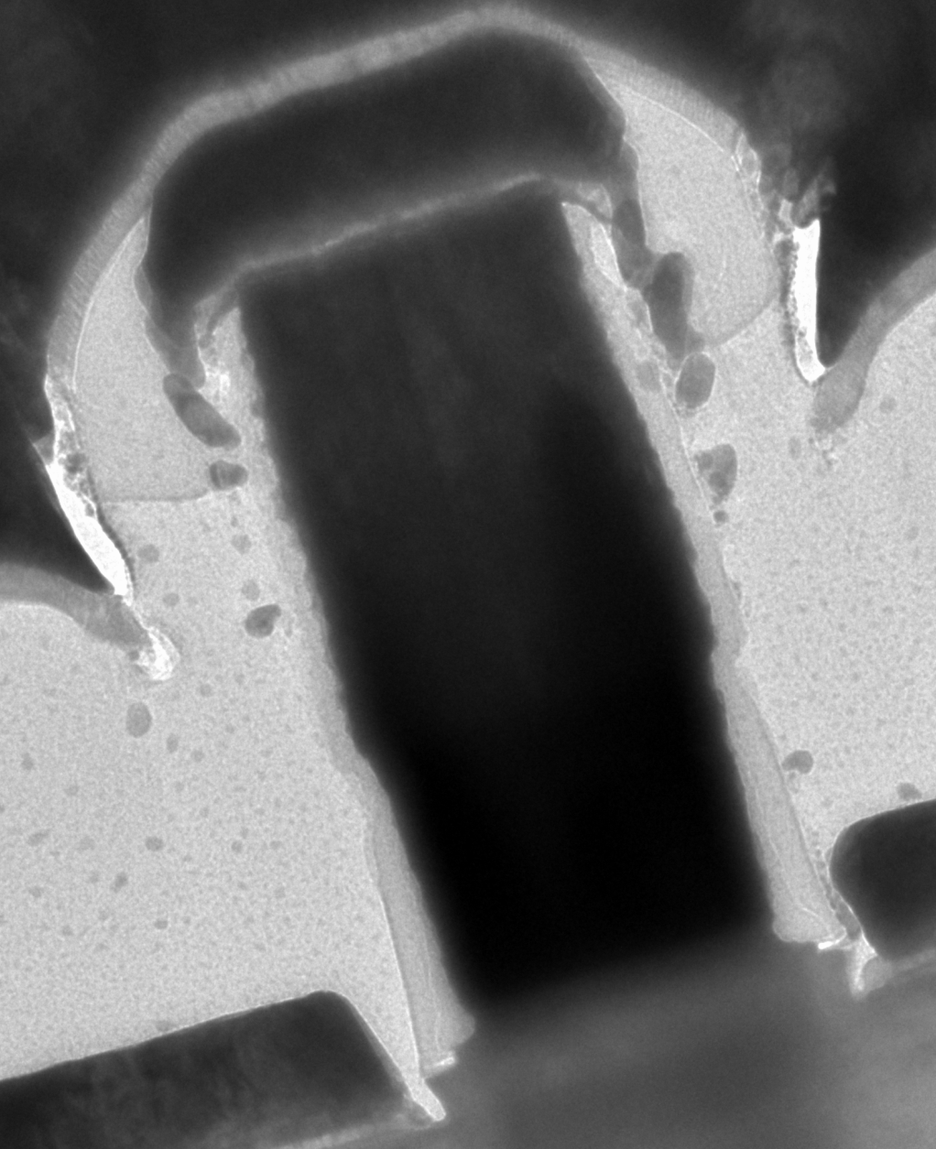
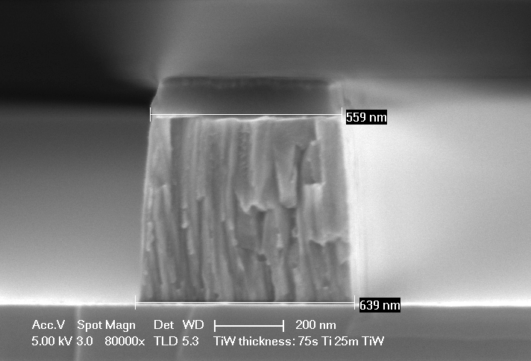
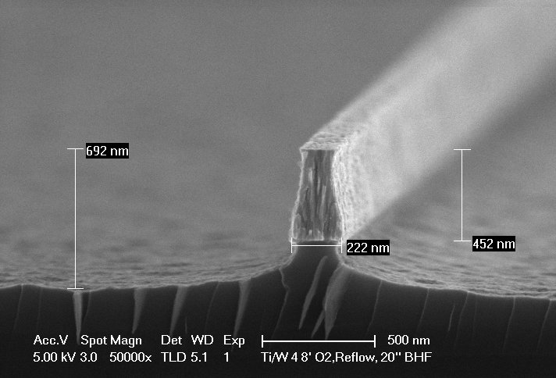
Sub-200-nm Emitter Anatomy
Refractory contact: high-J operation
Liftoff Sputter+dry etch→ sub-200nm contacts
High-stress emitters fall off during subsequent lift-offs
TiW
W
TiW
SiN_{x}
Single sputtered metal has non-vertical etch profile
100 nm
W
Mo
slide: E. Lobisser. HBT: V. Jain. Process: Jain & Lobisser

Slide 17
Sub-200-nm Emitter Anatomy
Hybrid sputtered metal stack for low-stress, vertical profile
W/TiW interfacial discontinuity enables base contact lift-off
Very thin emitter epitaxial layer for minimal undercut
TiW
Semiconductor wet etch undercuts emitter contact
SiN_{x}
Interfacial Mo blanket-evaporated for low ρ_{c}
SiNx sidewalls protect emitter contact, prevent emitter-base shorts during liftoff
100 nm
W
Mo
slide: E. Lobisser. HBT: V. Jain. Process: Jain & Lobisser

Slide 18
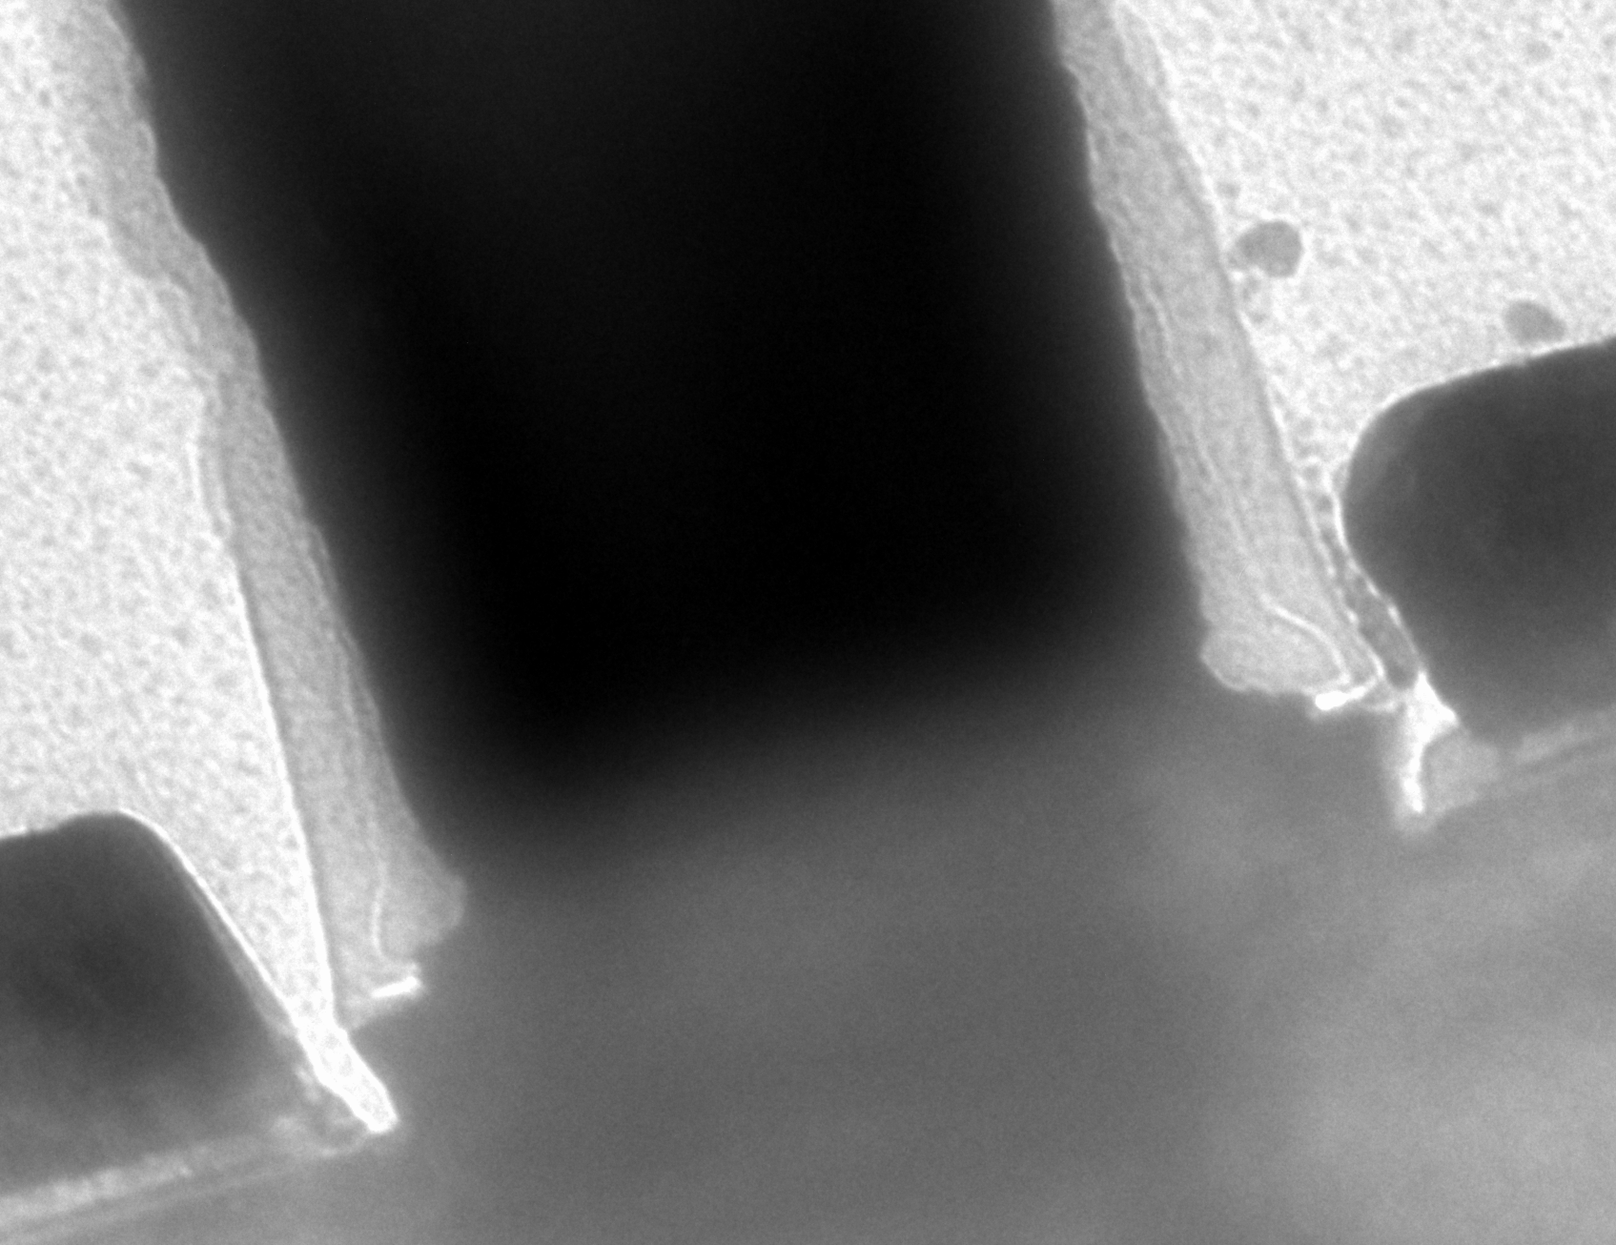
Sub-200-nm Emitter Anatomy
emitter-base gap: only ~10 nm
→ greatly reduces link component of R_{bb}
emitter-base gap: only ~10 nm
→ greatly reduces link component of R_{bb}.
slide: E. Lobisser. HBT: V. Jain. Process: Jain & Lobisser

Slide 19
TiW
SiNx sidewall
W
Pt/Ti/Pd/Au
W_{bc} = 150 nm
W_{eb} = 155 nm

Slide 20
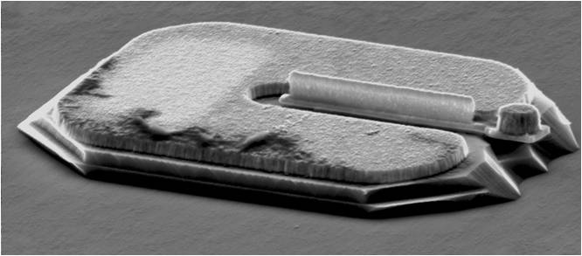
RF Data: 25 nm thick base, 75 nm Thick Collector
Required dimensions obtained
but poor base contacts on this run
E. Lobisser, ISCS 2012, August, Santa Barbara

Slide 21
DC, RF Data: 100 nm Thick Collector
Jain et al
IEEE DRC 2011

Slide 22
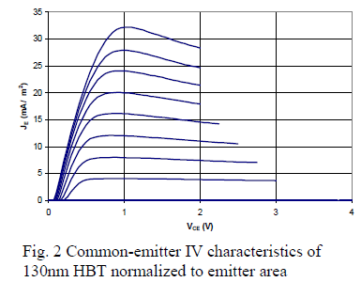
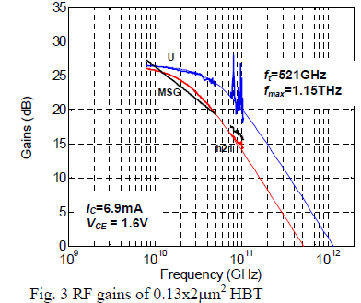
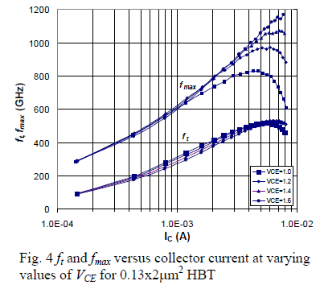

THz InP HBTs From Teledyne
Urteaga et al, DRC 2011, June

Slide 23
Towards & Beyond the 32 nm /2.8 THz Node
Base contact process:
Present contacts too resistive (4Ω−μm²)
Present contacts sink too deep (5 nm) for target 15 nm base
→ refractory base contacts
Emitter Degeneracy:
Target current density is almost 0.1 Amp/μm² (!)
Injected electron density becomes degenerate.
transconductance is reduced.
→ Increased electron mass in emitter

Slide 24
Base Ohmic Contact Penetration
Base Ohmic Contact Penetration
emitter
emitter
Au
Au
~5 nm
Pt contact
penetration
(into 25 nm base)
Pd
Pd
Ti
Ti
base
base

Slide 25
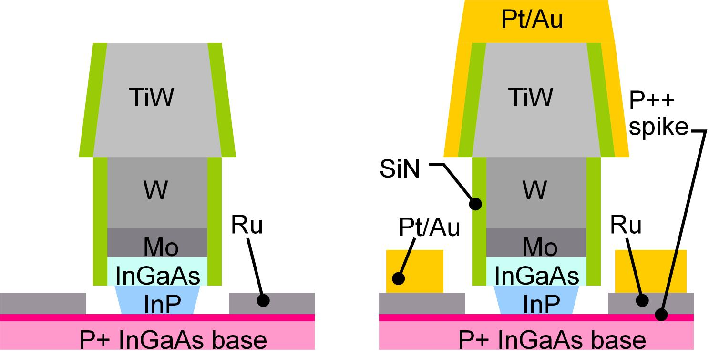
Refractory Base Process (1)
Blanket liftoff; refractory base metal
Patterned liftoff; Thick Ti/Au
low contact resistivity
low penetration depth
low bulk access resistivity
base surface not exposed to photoresist chemistry: no contamination
low contact resistivity, shallow contacts
low penetration depth allows thin base, pulsed-doped base contacts

Slide 26
Refractory Base Process (2)
32 nm node
requirement
Increased surface doping:
reduced contact resistivity,
but increased Auger recombination.
→ Surface doping spike at most 2-5 thick.
Refractory contacts do not penetrate; compatible with pulse doping.

Slide 27
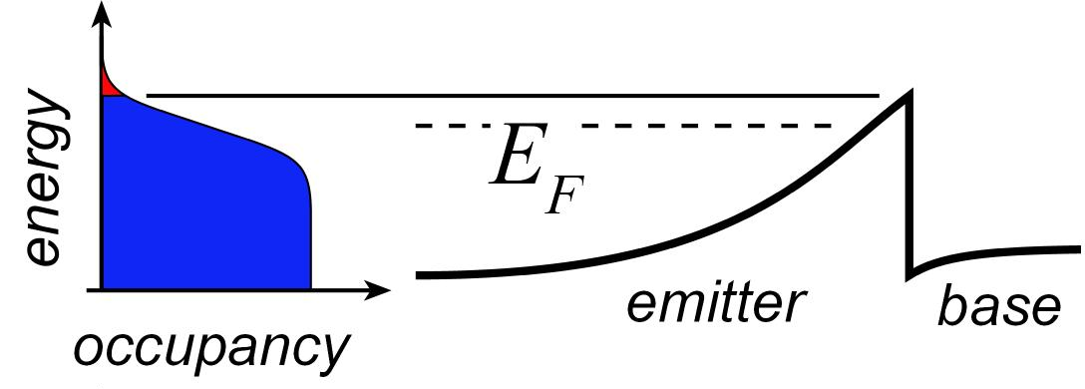
Degenerate Injection→ Reduced Transconductance
Current varies exponentially with V_{be}
Transconductance is high

Slide 28
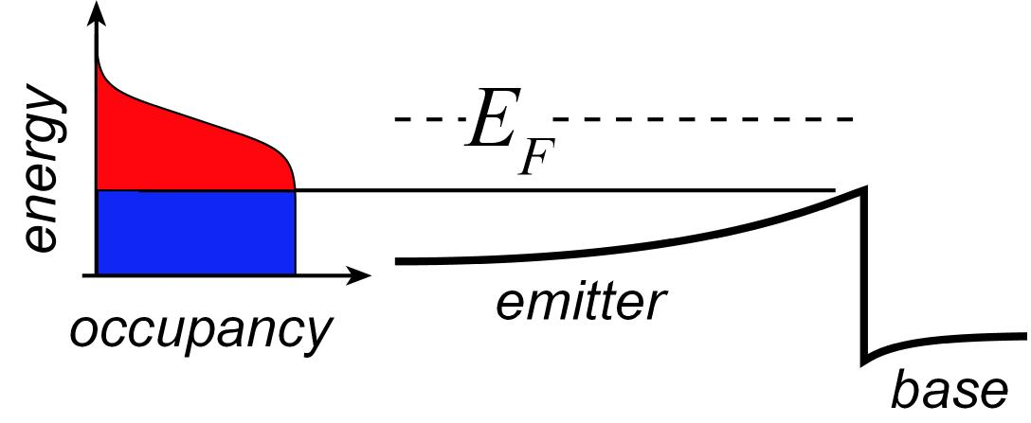
Degenerate Injection→ Reduced Transconductance
Current varies exponentially with V_{be}
Transconductance is reduced

Slide 29
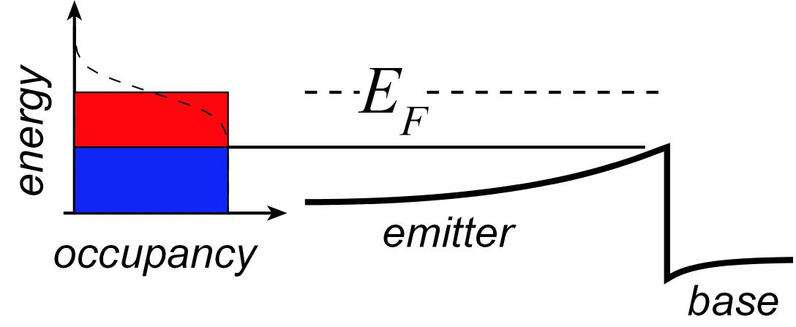
Degenerate Injection→ Reduced Transconductance
Highly degenerate limit:
current varies as the square of bias

Slide 30
Degenerate Injection→ Reduced Transconductance
Highly degenerate limit:
current varies as the square of bias
Transconductance varies as J^{1/2}
...and as (m*)^{1/2}
At & beyond 32 nm, we must increase the emitter effective mass.

Slide 31
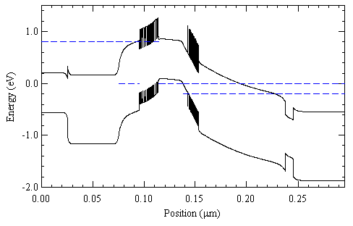
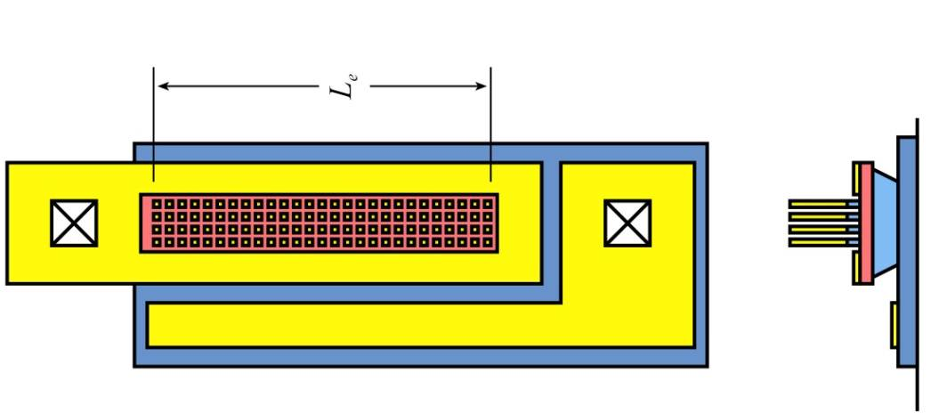
Degenerate Injection→Solutions
At & beyond 32 nm, we must increase the emitter (transverse) effective mass.
Other emitter semiconductors:
no obvious good choices (band offsets, etc.).
Emitter-base superlattice:
increases transverse mass in junction
evidence that InAlAs/InGaAs grades are beneficial
Extreme solution (10 years from now):
partition the emitter into small sub-junctions, ~ 5 nm x 5 nm.
parasitic resistivity is reduced progressively as sub-junction areas are reduced.

Slide 32
IC Results

Slide 33


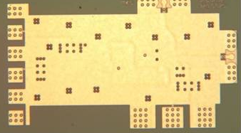
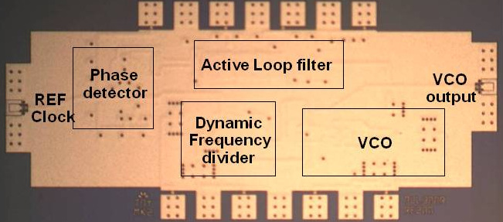

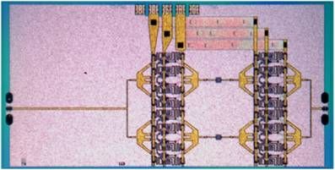
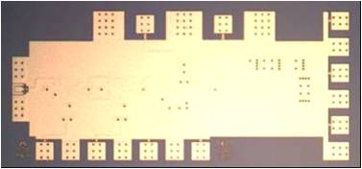
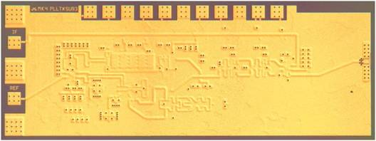
InP HBT Integrated Circuits: 600 GHz & Beyond
614 GHz
fundamental
VCO
340 GHz dynamic frequency divider
M. Seo,
M. Seo, UCSB/TSC
IMS 2010
565 GHz, 34 dB, 0.4 mW output power
amplifier
300 GHz fundamental
PLL
J. Hacker, TSC
M. Seo, TSC
IMS 2011
204 GHz static
frequency divider
(ECL master-slave
latch)
220 GHz
90 mW
power amplifier
Z. Griffith, TSC
CSIC 2010
T. Reed, UCSB
Integrated 300/350GHz Receivers:
LNA/Mixer/VCO
600 GHz
Integrated
Transmitter
PLL + Mixer
M. Seo
M. Seo

Slide 34
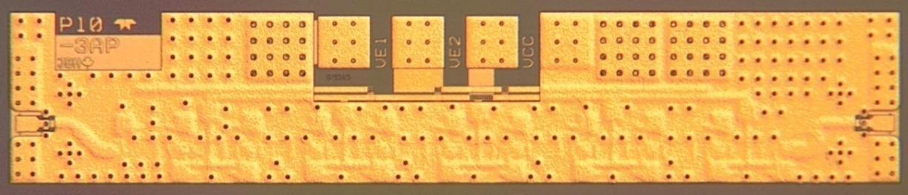
Teledyne: 560 GHz Common-Base Amplifier IC
S-parameters
Output Power
10-Stage Common-base using inverted CPW-G architecture
34 dB at 565 GHz
Psat -3.9 dBm at 560 GHz
1200x230 μm²
J Hacker et al, Teledyne Scientific

Slide 35
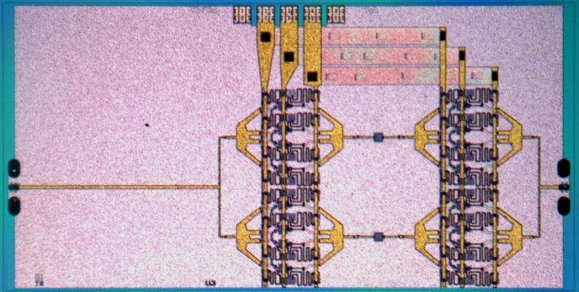
90 mW, 220 GHz Power Amplifier
Reed (UCSB) and Griffith (Teledyne): CSIC 2012
Teledyne 250 nm InP HBT
active area, 1.02 x 0.85 mm
die: 2.42 x 1.22 mm
RF output power densities
up to 0.5 W/mm @ 220 GHz.
→ InP HBT is a competitive mm-wave / sub-mm-wave power technology.
Notes:
when you show the IBM FET, you say:
"because we want a device with the geometry taken for granted in silicon VLSI"
..source/drain pitch at most a few times the gate length.

Slide 36
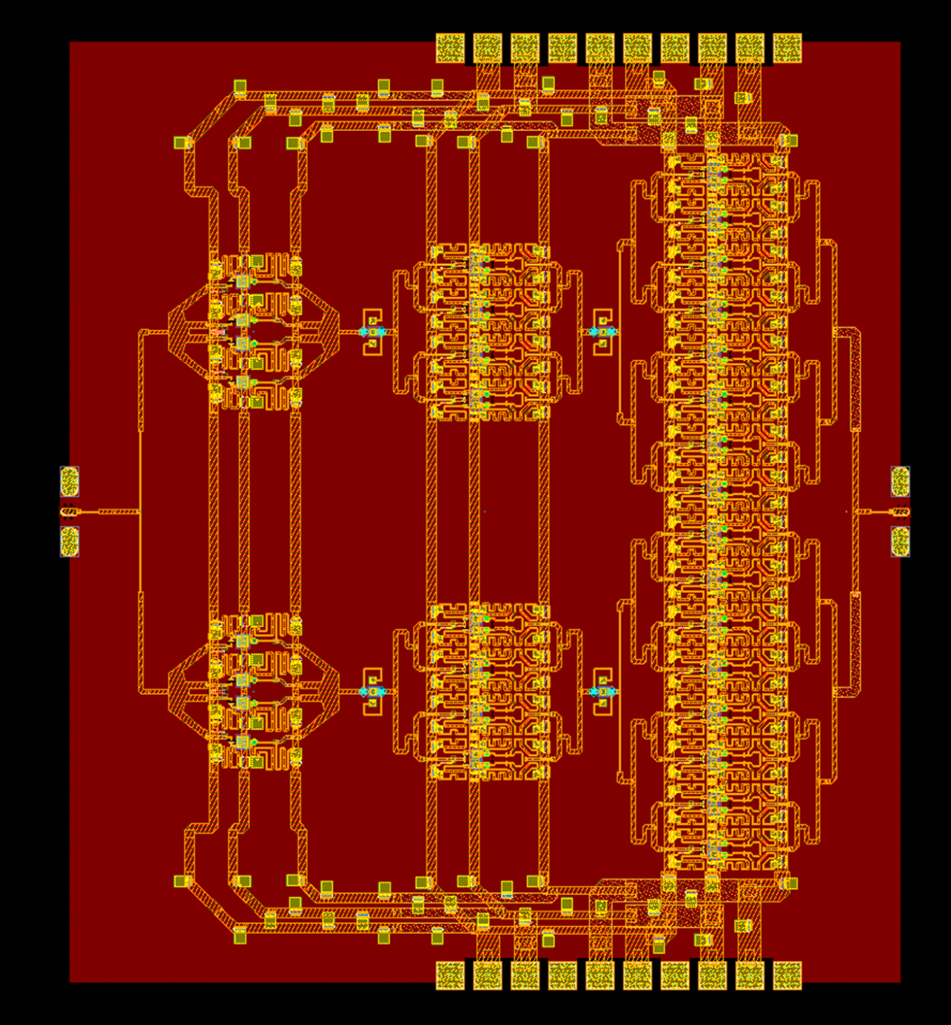
220 GHz 330mW Power Amplifier Design
2.3 mm x 2.5 mm
T. Reed, UCSB
Z. Griffith, Teledyne
Teledyne 250 nm InP HBT

Slide 37
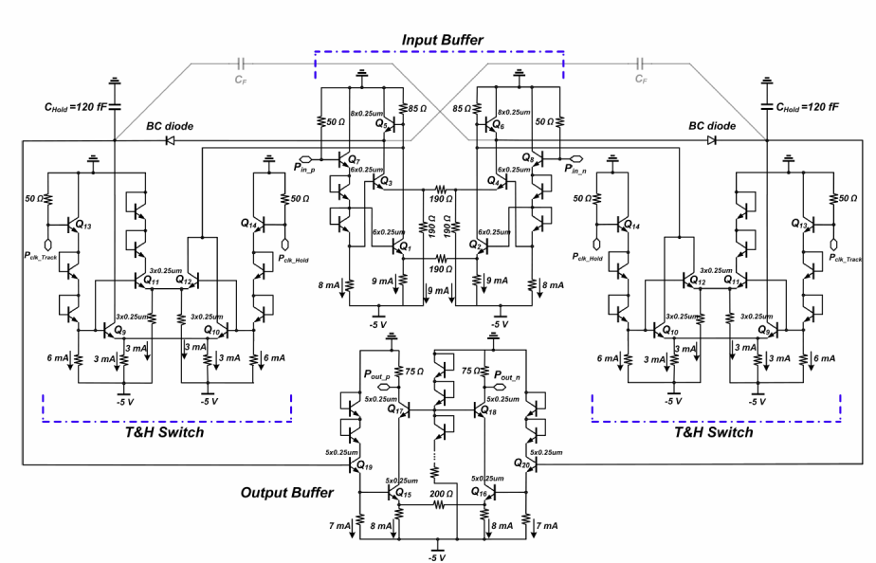
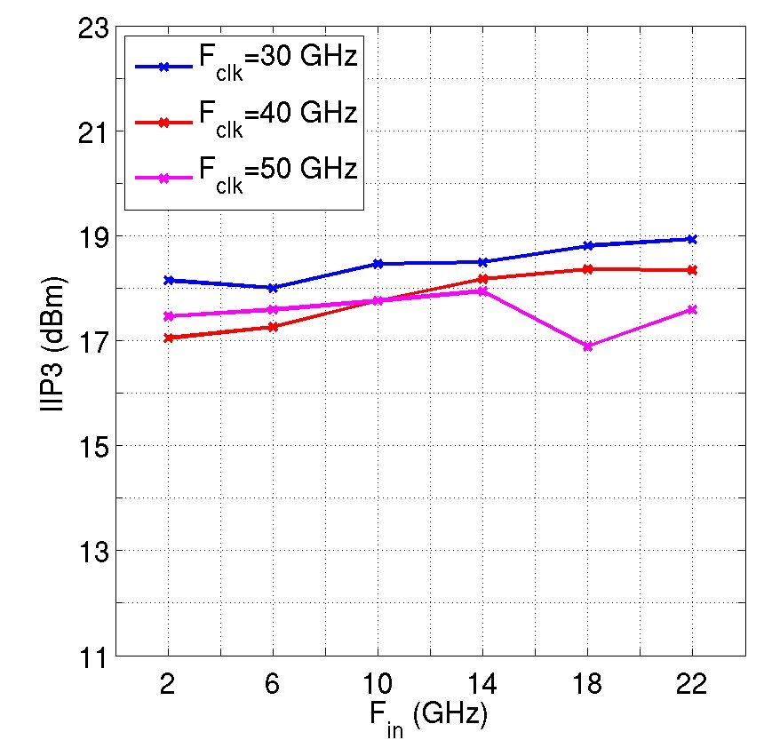

50-G/s Track/Hold Amplifier; 250 nm InP HBT
S. Daneshgar, this conference
20.5 GHz input, 10 GHz clock
Linearity test
(third-order intercept)

Slide 38



Where Next ? → 2 THz Transistors, 1 THz Radios.
transmitter
receiver
interconnects
circuits

Slide 39









THz and Far-Infrared Electronics
IR today→ lasers & bolometers → generate & detect
Far-infrared ICs: classic device physics, classic circuit design
It's all about classic scaling:
contact and gate dielectrics...
...wire resistance,...
Even 1-3 THz ICs
will be feasible
...heat,...
...& charge density.
band structure and density of quantum states
(new!).

Slide 40
(backup slides follow)

Slide 41

Weakly Degenerate→ Effective Added Resistance
At & beyond 32 nm, we must increase the emitter effective mass.

Slide 42
HBT Scaling Roadmap
emitter 128 64 32 nm width
4 2 1 Ω⋅μm² access ρ
base 120 60 30 nm contact width,
5 2.5 1.25 Ω⋅μm² contact ρ
collector 75 53 37.5 nm thick,
18 36 72 mA/μm² current density
3.3 2.75 2-2.5 V, breakdown
f_{τ} 730 1000 1400 GHz
f_{max} 1300 2000 2800 GHz
RF-ICs 660 1000 1400 GHz
digital divider 330 480 660 GHz

Slide 43

140 nm Device: RF Results
140 nm emitter junction
120 nm wide base contacts
75 nm thick collector
25 nm thick base
f_{max} impaired (780 GHz) : excessive contact penetration into base
433 GHz f_{τ}
780 GHz f_{max}
Chiang & Rode
unpublished

Slide 44





DC to Daylight. Far-Infrared Electronics
How high in frequency can we push electronics ?
...and what would be do with it ?
0.1-0.4 THz imaging systems
0.1-1 Tb/s
optical fiber links
0.3-3 THz radio: vast capacity
bandwidth, # channels

