Slide 1


International Symposium on Compound Semiconductors 2012
InGaAs/InP DHBTs with Emitter and Base Defined through Electron-beam Lithography for Reduced C_{cb}
and Increased RF Cut-off Frequency
Evan Lobisser^{1,*}, Johann C. Rode, Vibhor Jain², Han-Wei Chiang, Ashish Baraskar³, William J. Mitchell, Brian J. Thibeault, Mark J. W. Rodwell
Dept. of ECE, University of California, Santa Barbara, CA 93106, USA
(Now with ¹Agilent Technologies, Inc., CA, ²IBM Corporation, VT, ³GlobalFoundries, NY)
Miguel Urteaga
Teledyne Scientific & Imaging, Thousand Oaks, CA 91360
Dmitri Loubychev, Andrew Snyder, Ying Wu, Joel M. Fastenau, Amy W. K. Liu
IQE Inc., Bethlehem, PA 18015
*evan.lobisser@agilent.com, +1 (707) 577-5629

Slide 2
Outline
Motivation
HBT Design & Scaling
Fabrication Process & Challenge
Electrical Measurements
Conclusion
2

Slide 3
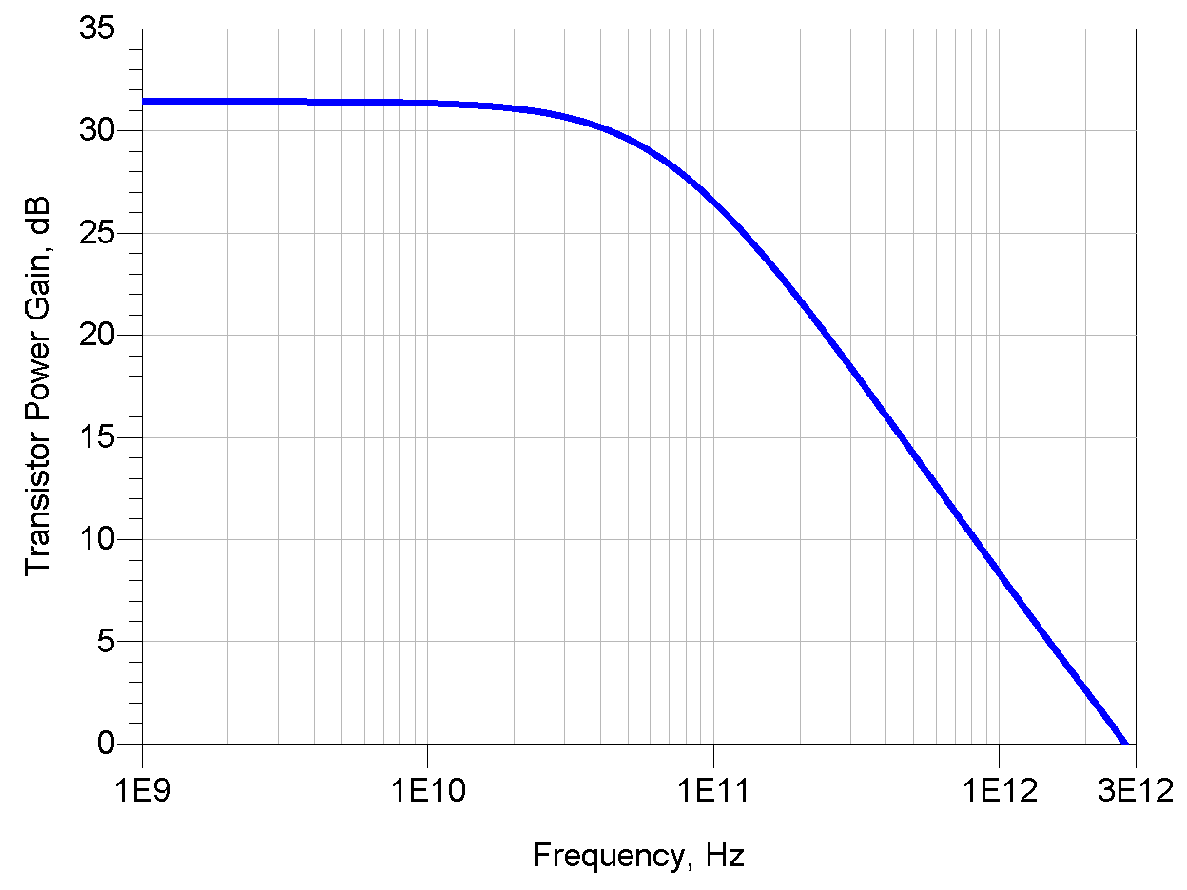
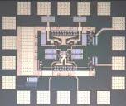
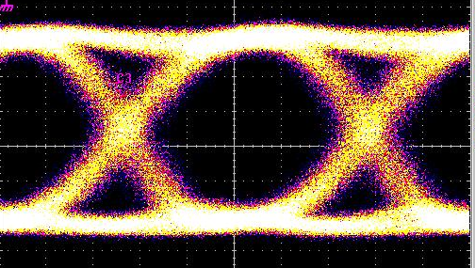
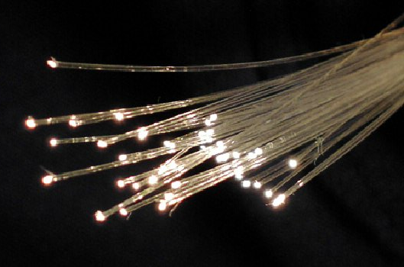


Why THz Transistors?
Digital logic for
optical fiber circuits
0.1-1 Tb/s
optical fiber links
0.3- 3 THz imaging systems
THz amplifiers for
imaging, communications
High gain at microwave frequencies:
Precision analog design, high resolution ADCs, DACs
3

Slide 4
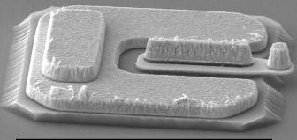
Type-I InP DHBTs at UCSB
Emitter:
n⁺⁺ InGaAs cap
n InP
XX’:
Base:
p⁺⁺ InGaAs
Doping grade
z
Drift collector:
n⁻ InGaAs/InAlAs grade
n⁻ InP
Sub-collector:
n⁺⁺ InGaAs cap
n⁺⁺ InP
Semi-insulating InP substrate
E
B
C
X’
Collector
BP
CP
Emitter
Base
X
z
4

Slide 5
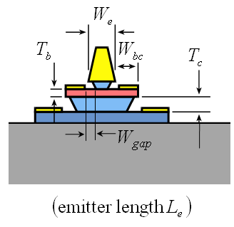
HBT Scaling Laws
To double bandwidth of a mesa DHBT:
Keep constant all resistances and currents
Reduce 2:1 all capacitances and transport delays
Parameter | Change
collector depletion layer thickness | decrease 2:1
base thickness | decrease 1.41:1
emitter junction width | decrease 4:1
collector junction width | decrease 4:1
emitter contact resistivity | decrease 4:1
base contact resistivity | decrease 4:1
current density | increase 4:1
Epitaxial scaling
Lateral scaling
Surface prep
& doping
Keep lengths the same, reduce widths 4:1 for thermal considerations
5

Slide 6
Epitaxial Design
T(nm) | Material | Doping (cm⁻³) | Description
10 | In_{0.53}Ga_{0.47}As | 8⋅10¹⁹ : Si | Emitter cap
15 | InP | 5⋅10¹⁹ : Si | Emitter
15 | InP | 2⋅10¹⁸ : Si | Emitter
25 | InGaAs | 1-0.5⋅10²⁰ : C | Base
9.5 | In_{0.53}Ga_{0.47} As | 1⋅10¹⁷ : Si | Setback
12 | InGaAs / InAlAs | 1⋅10¹⁷ : Si | B-C Grade
3 | InP | 5 ⋅10¹⁸ : Si | Pulse doping
45.5 | InP | 1⋅10¹⁷ : Si | Collector
7.5 | InP | 1⋅10¹⁹ : Si | Sub Collector
5 | In_{0.53}Ga_{0.47} As | 4⋅10¹⁹ : Si | Sub Collector
300 | InP | 1⋅10¹⁹ : Si | Sub Collector
3.5 | In_{0.53}Ga_{0.47} As | Undoped | Etch stop
Substrate | SI : InP
V_{be} = 1.0V, V_{cb} = 0.5V, J_{e} = 0, 27 mA/μm²
Thin (70 nm) collector for balanced f_{τ}/f_{max}
High emitter/base doping for low R_{ex}/R_{bb}
6

Slide 7
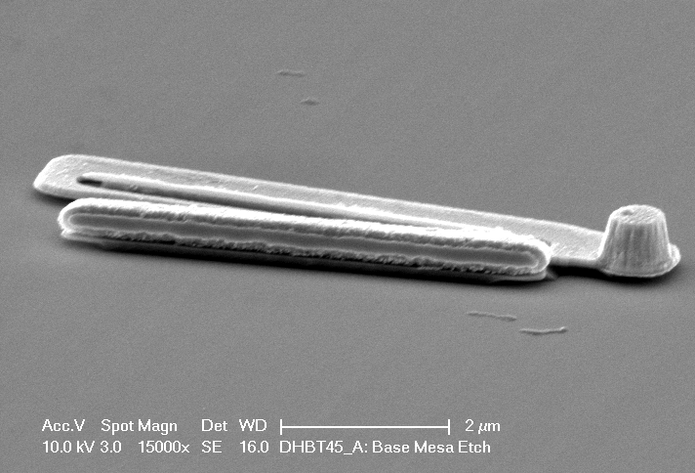
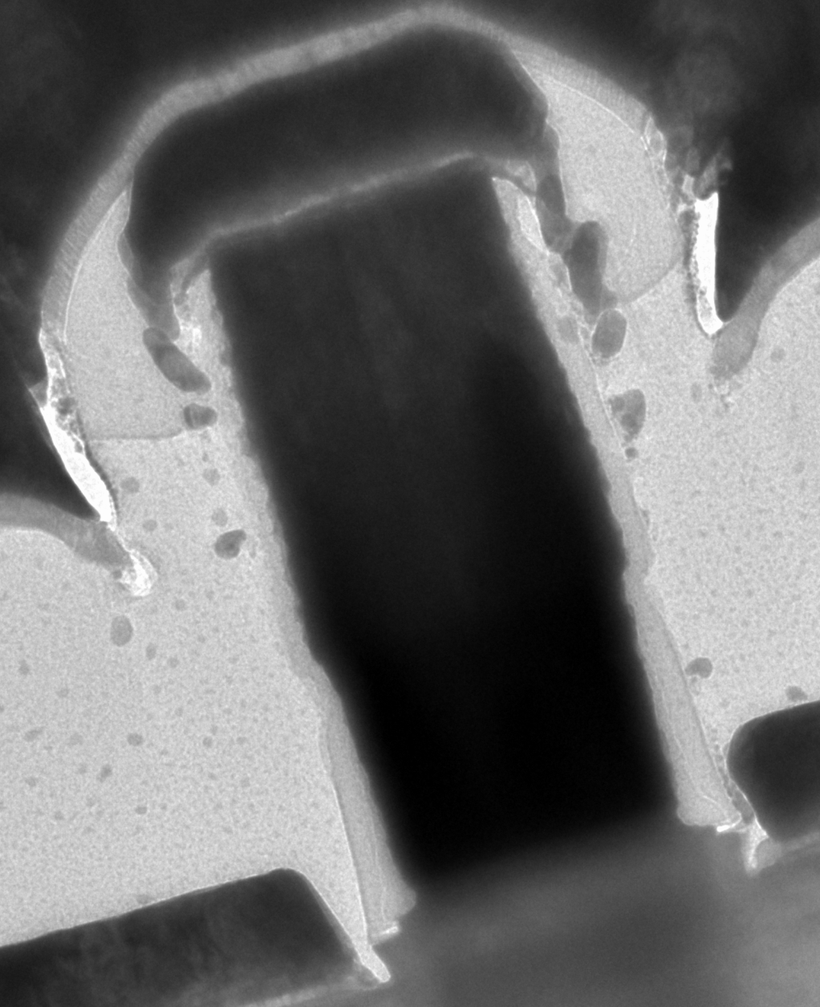
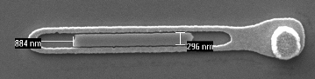
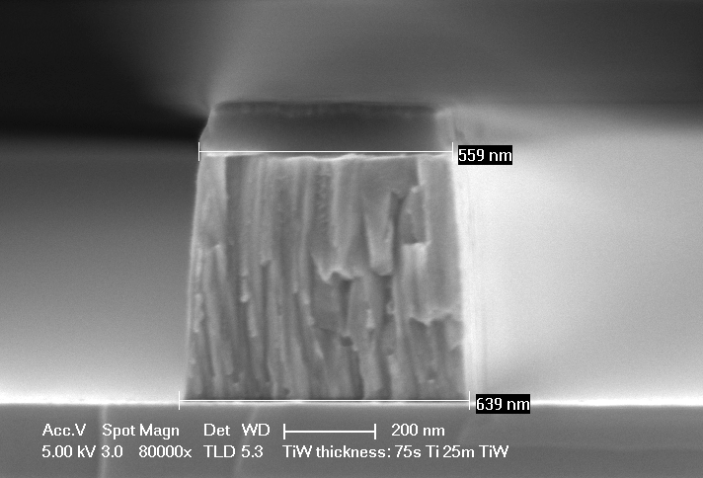
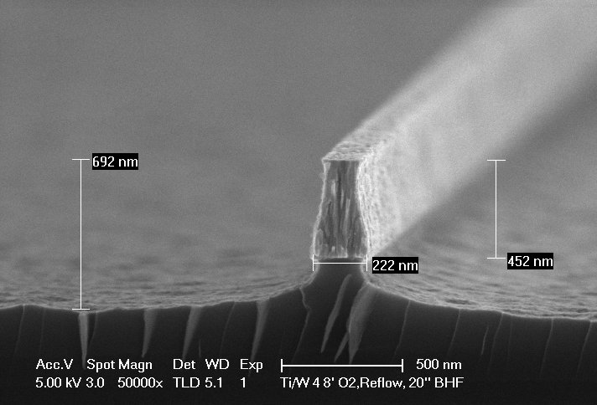
Sub-200 nm Emitter Anatomy
Hybrid sputtered metal stack for low-stress, vertical profile
W/TiW interfacial discontinuity enables base contact lift-off
High-stress emitters fall off during subsequent lift-offs
Very thin emitter epitaxial layer for minimal undercut
TiW
W
TiW
Semiconductor wet etch undercuts emitter contact
Interfacial Mo blanket-evaporated for low ρ_{c}
SiN_{x}
SiNx sidewalls protect emitter contact, prevent emitter-base shorts
Single sputtered metal has non-vertical etch profile
100 nm
W
Mo
7

Slide 8
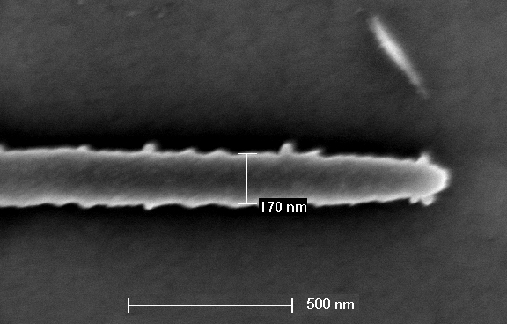
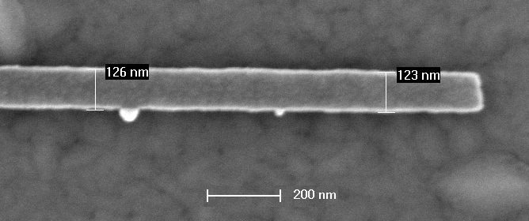
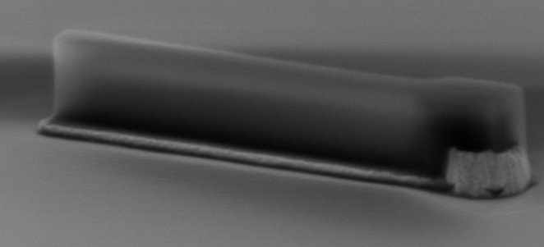
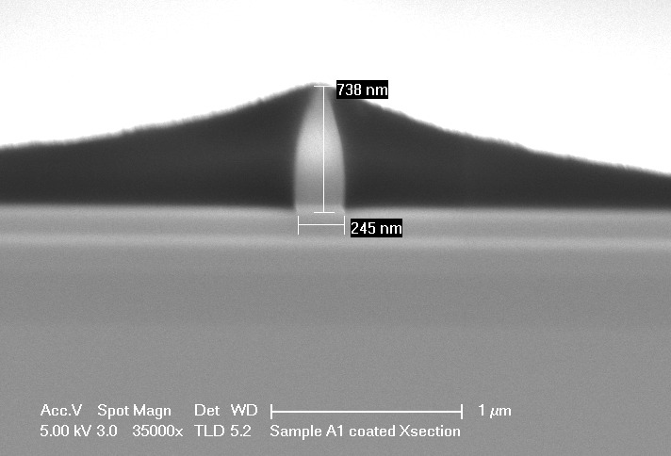
Lithographic Scaling and Alignment
Positive i-line lithography
Negative e-beam lithography
Emitter
Emitter
Base Mesa
E-beam lithography needed to define < 150 nm emitters and for
< 50 nm emitter-base contact misalignment
Base Contact
Positive e-beam lithography
Negative i-line lithography
8

Slide 9
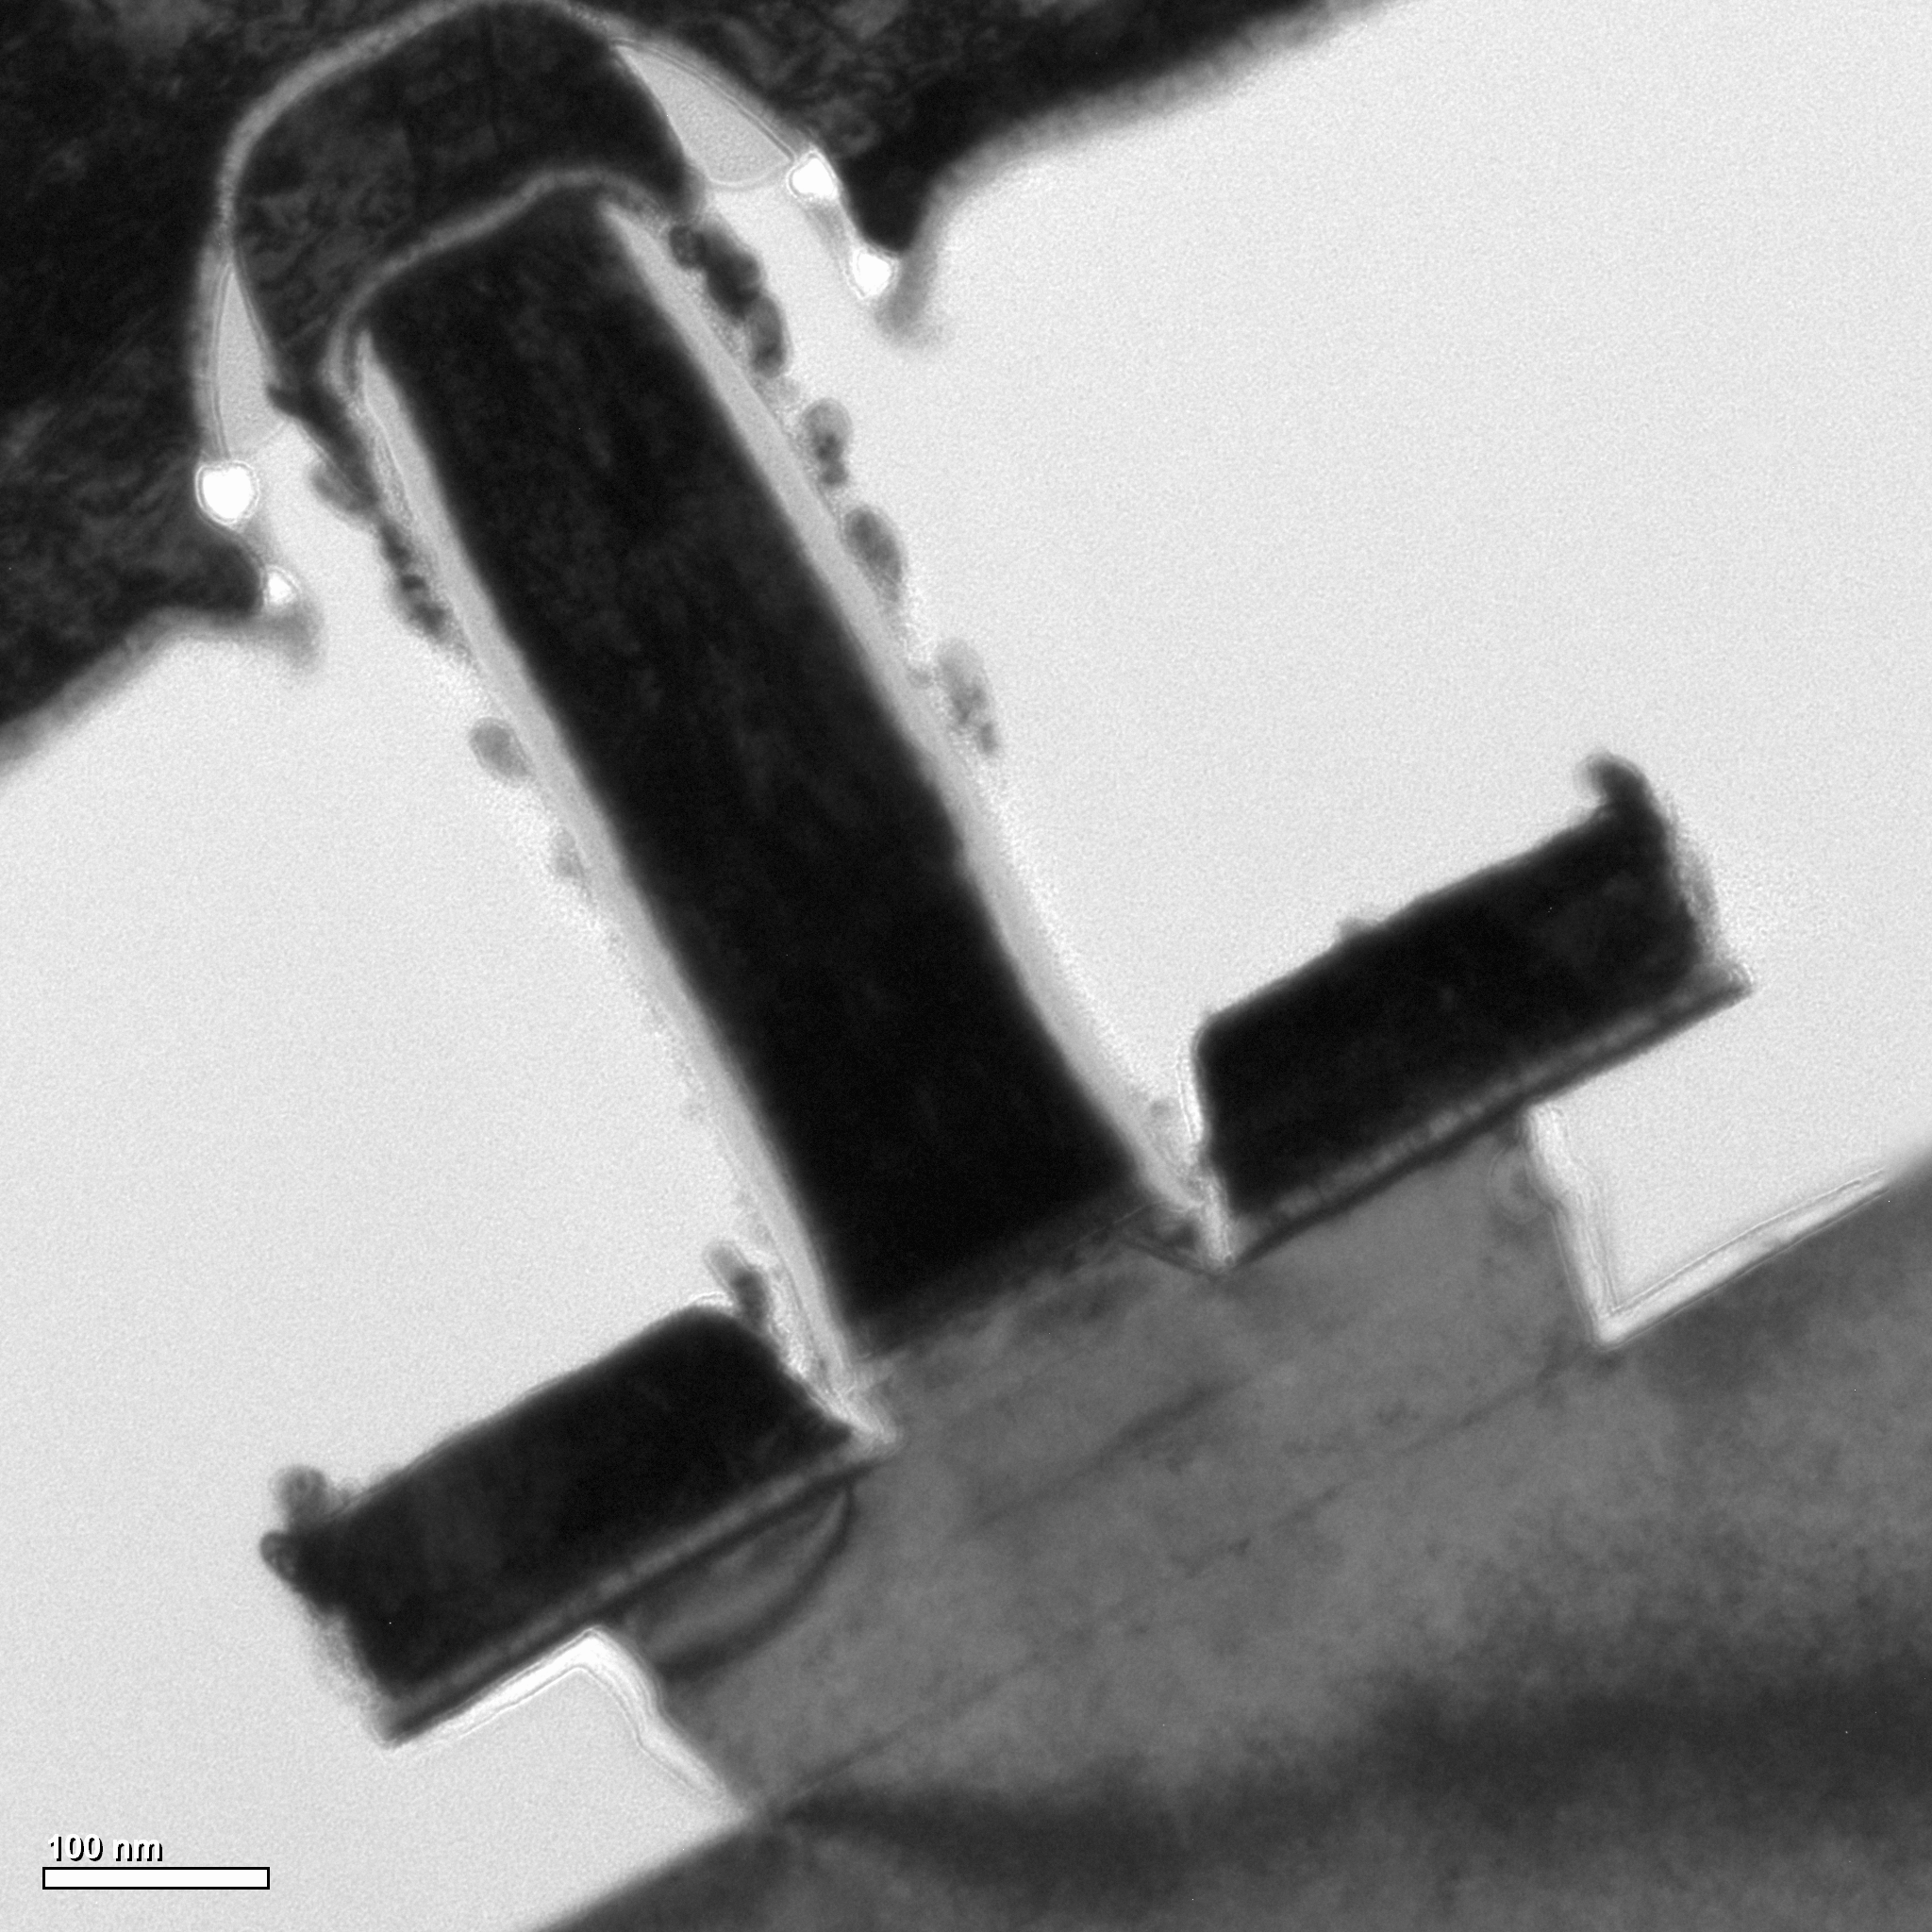
TiW
SiNx sidewall
W
Pt/Ti/Pd/Au
W_{bc} = 150 nm
W_{eb} = 155 nm
W_{bc} = 140 nm
T_{b} + T_{c} = 95 nm

Slide 10
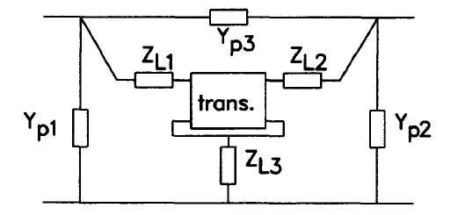
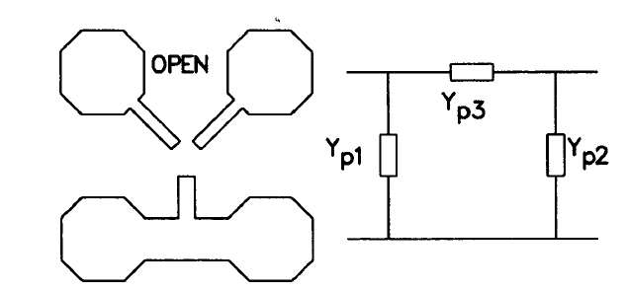
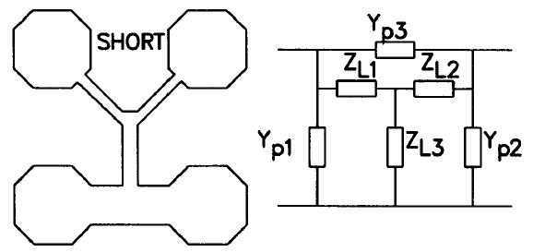
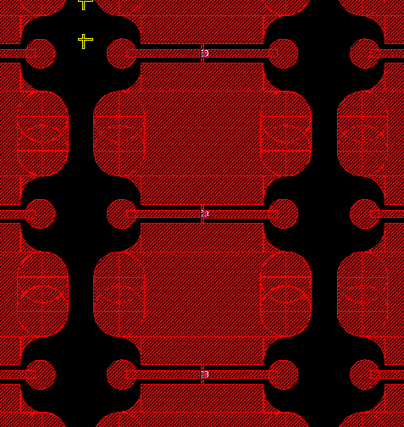
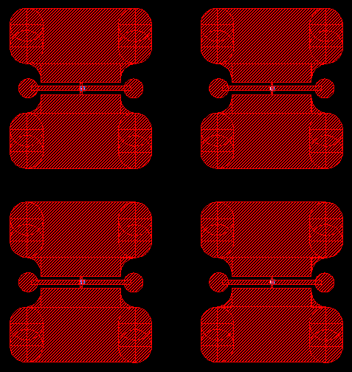

Measurement
RF measurements conducted using Agilent E8361A PNA from 1-67 GHz
DC bias and measurements made with Agilent 4155 SPA
Off-wafer LRRM calibration, lumped-element pad stripping used to
de-embed device S-Parameters
Isolated pad structures used to provide clean RF measurements
10

Slide 11
DC Data
β = 14 for 150 nm junction
VB_{ceo} = 2.44 V @ J_{e} = 15 kA/cm²
R_{ex} ≈ 2 Ω·µm² (RF extraction)
Collector ρ_{sheet} = 14 Ω/□, ρ_{c} = 12 Ω·µm²
11

Slide 12
RF Data
Peak RF performance at >40 mW/μm²
Kirk limit not reached
12

Slide 13
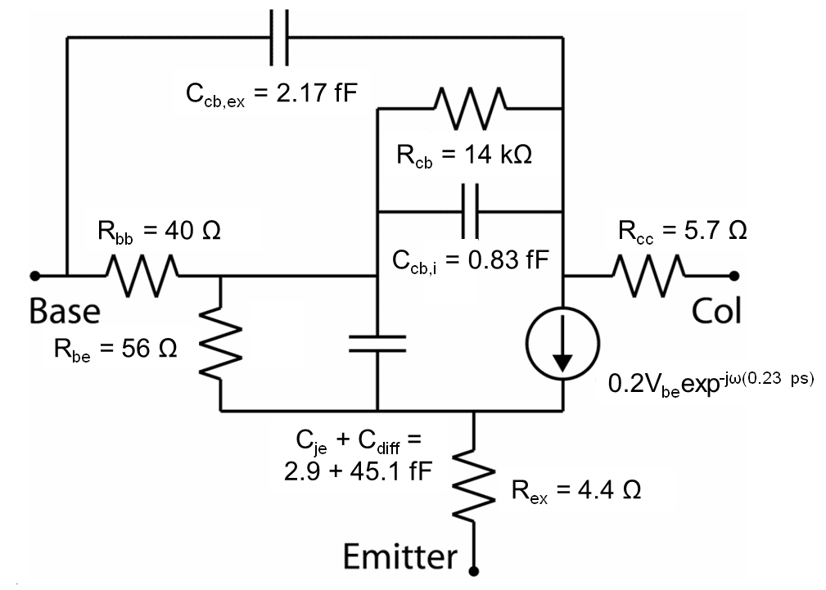
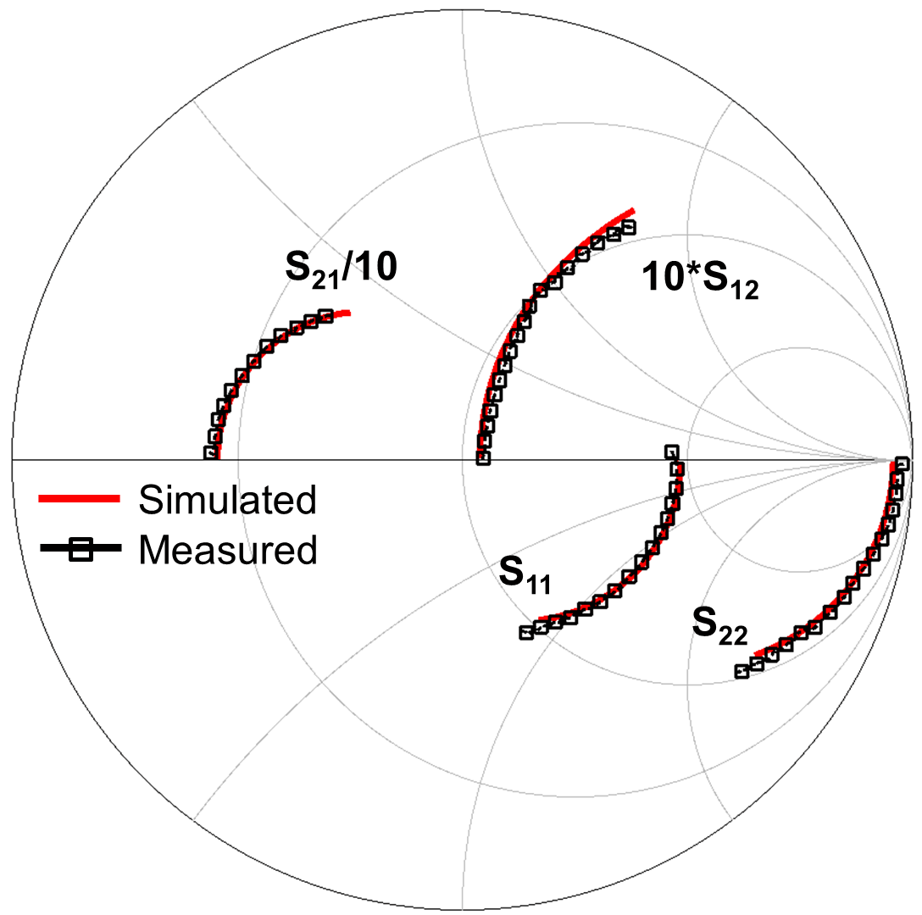
Equivalent Circuit Model
ρ_{ex} = 2 Ω·μm²
C_{cb} = 3.0 fF
A_{jc} = 1.86 μm² ~ 450 nm x 4 μm
(0.2 S)V_{be}exp ^{-jω(0.23 ps)}
I_{c} = 12.4 mA
V_{ce} = 1.5 V
Lowest ρ_{ex} to date due to Mo contact, highly doped epi
C_{cb} lower than 100 nm collector epi designs due to E-beam litho
13

Slide 14
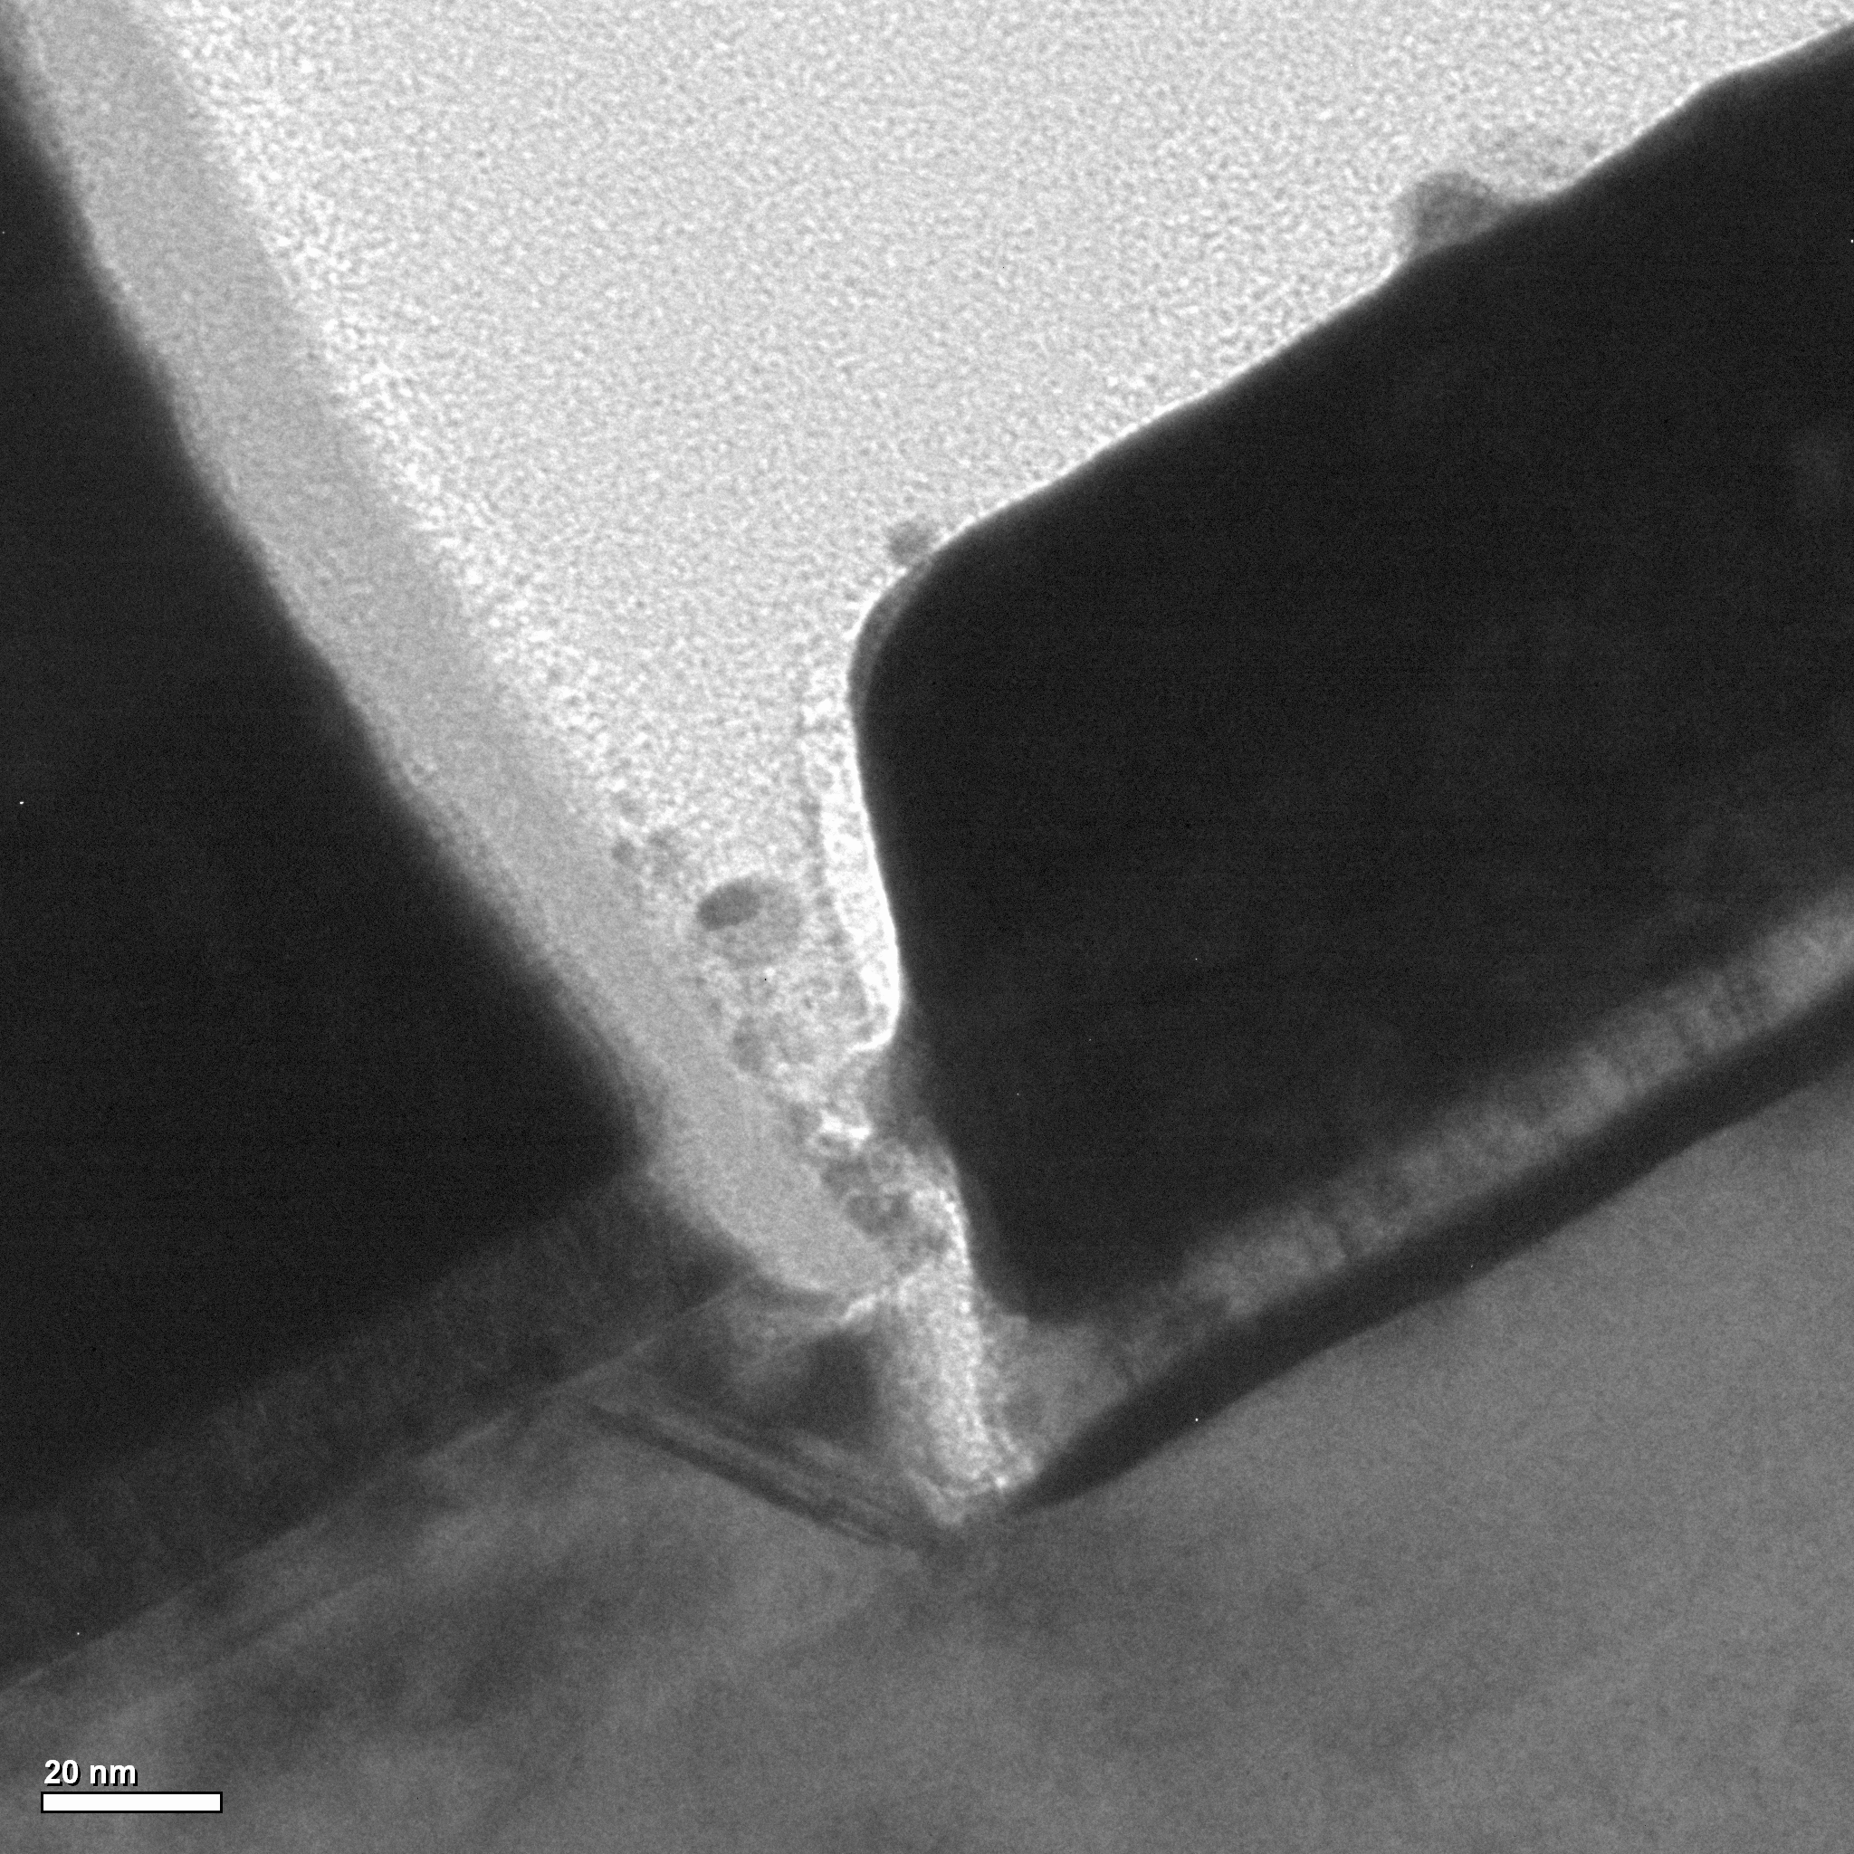
Performance Analysis
230 fs
15 fs
45 fs
τ_{ec} dominated by transit delays, high ideality factor reduces f_{τ} ~ 10%
Expected base ρ_{c} = 4 Ω·μm² and R_{sh} = 800 Ω/□
yields f_{max} > 1.0 THz for same f_{τ}
E
B
Epitaxial design, process damage explain
high η_{b}, R_{bb}
R_{sh} increased by base contacts reacting with
5 nm (20 %) of base
2.5 nm of Pt diffuses ~ 8 nm
14

Slide 15
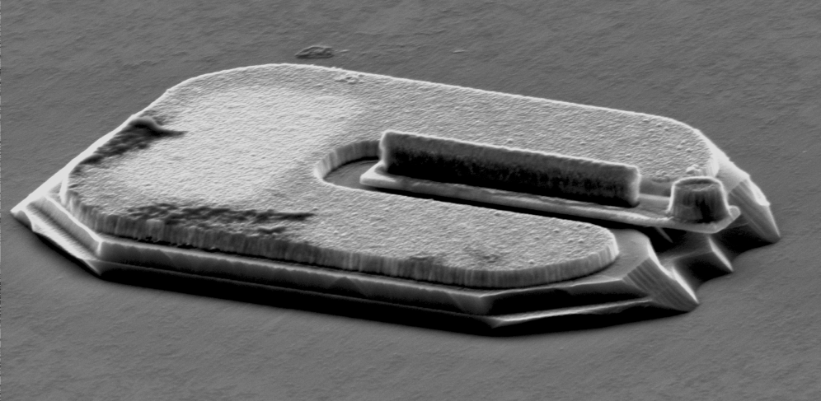
Conclusion
E-beam lithography used to define narrow emitter, narrowest base mesa reported to date
Narrow mesa, low emitter ρ_{c} enable 33% increase in f_{max} from previous UCSB results with 70 nm collector thickness
Epitaxial thinning increased f_{τ} by 10% from 100 nm UCSB designs
1 THz bandwidth possible with improved base contact process
This work was supported by the DARPA CMO Contract No. HR0011-09-C-0060.
Portions of this work were done in the UCSB nanofabrication facility, part of the NSF-funded NNIN network, and the MRL, supported by the MRSEC Program of the NSF under award No. MR05-20415.
15

Slide 16
Questions?

Slide 17
Extra Slides

Slide 18
Bipolar Scaling Laws
W_{gap}

Slide 19
V. Jain
Fabrication: Emitter contact
Cl₂/O₂ ICP etch
High power
SF₆/Ar ICP etch
Low power
SF₆/Ar ICP etch
EBL
PR
Cr
Cr
Cr
SiO_{x}
SiO_{x}
SiO_{x}
Ti_{0.1}W_{0.9}
Ti_{0.1}W_{0.9}
Ti_{0.1}W_{0.9}
W
W
W
Mo
n InGaAs, InP
n InGaAs, InP
n InGaAs, InP
p InGaAs
p InGaAs
p InGaAs
19

Slide 20
Fabrication: Emitter mesa
SiN_{x} PECVD deposition
CF₄/O₂ ICP etch
InGaAs wet etch
2nd SiN_{x} sidewall
InP wet etch
Cr
Ti_{0.1}W_{0.9}
Ti_{0.1}W_{0.9}
Ti_{0.1}W_{0.9}
W
W
W
n InGaAs, InP
p InGaAs
20

Slide 21
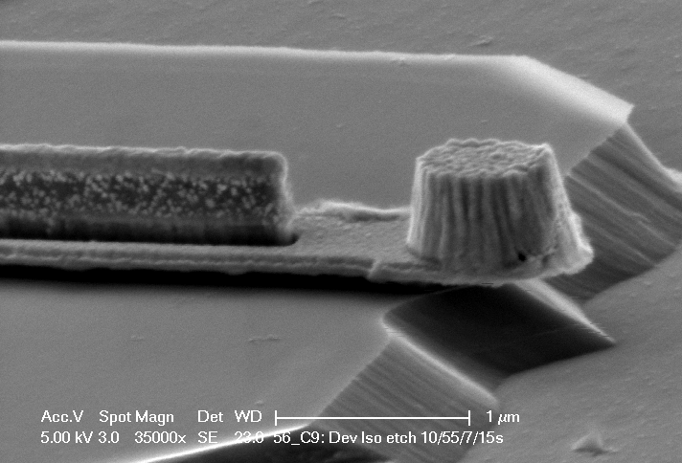
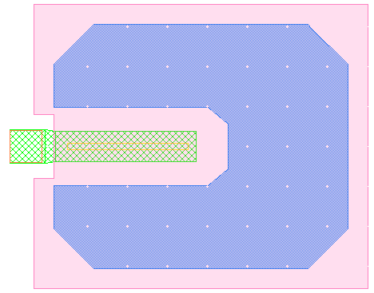
Base Post Cap
C_{cb,post} does not scale with L_{e}
Adversely effects f_{max} as L_{e} ↓
Need to minimize the C_{cb,post} value
Undercut below base post
No contribution of Base post to C_{cb}

Slide 22
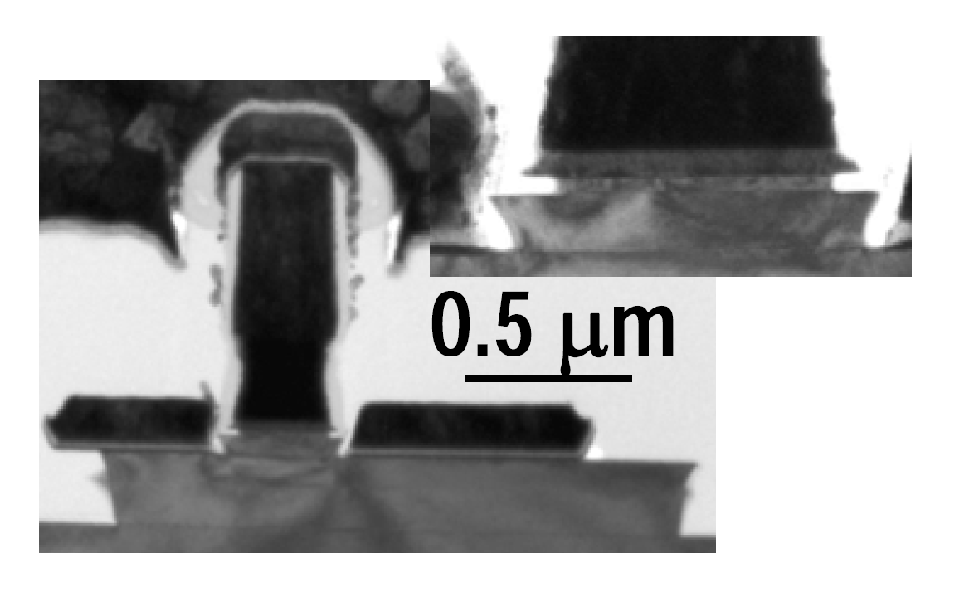

Slide 23
Transit time Modulation Causes C_{cb} Modulation
Camnitz and Moll, Betser & Ritter, D. Root

