Slide 1
High-Speed Track-and-Hold Circuit Design
Saeid Daneshgar, Prof. Mark Rodwell (UCSB)
Zach Griffith (Teledyne)
October 17th, 2012

Slide 2
Outline
250 nm InP HBT technology review
Applications and Motivation
Key design features and contributions
Review of circuit design and layout
Measurement results and comparison

Slide 3
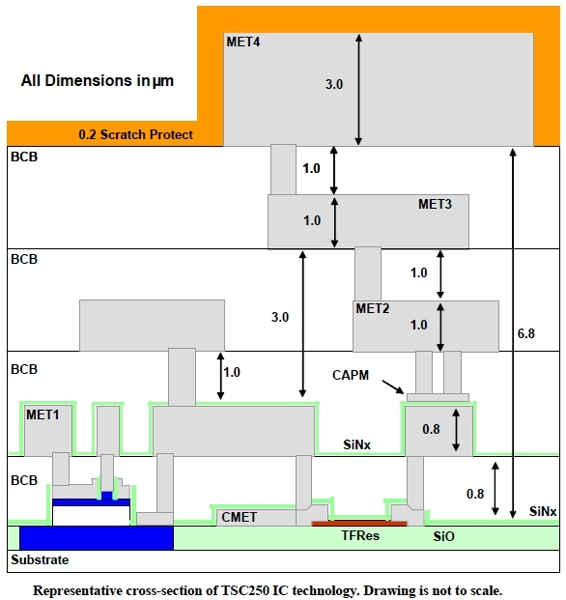
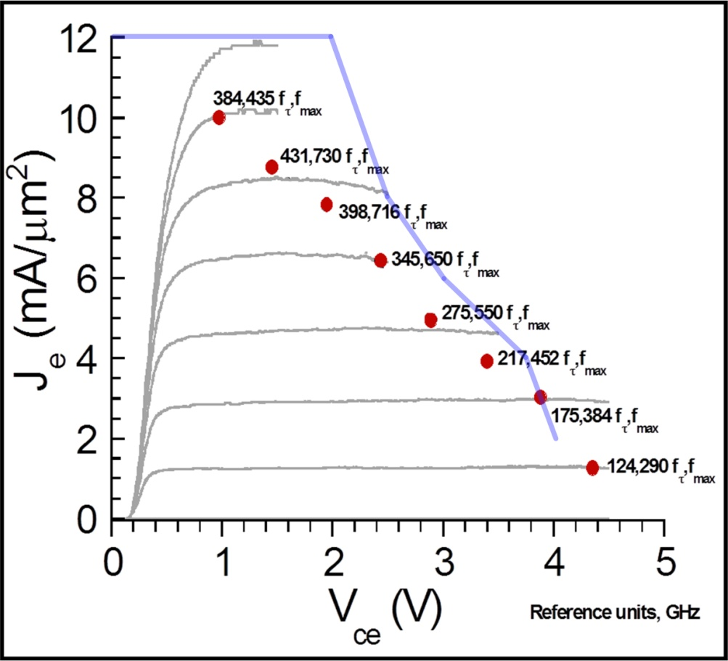
TSC 250nm InP HBT Process
Four metal interconnect stack
Peak bandwidth of f_{max} = 700 GHz & f_{t}=400 GHz
MIM caps of 0.3 fF/μm²
Thin-film resistors 50 Ω/square
Plot courtesy Zach Griffith, UCSB 250nm InP HBT, 2007

Slide 4
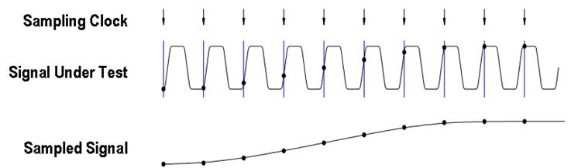
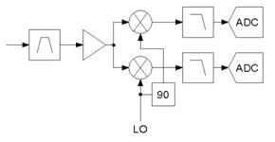
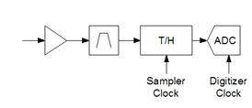
Wideband Sample & Hold Applications
Sub-sampling applications: automated test equipment (ATE), oscilloscope, jitter measurement …
Slide courtesy MJC Teledyne
Undersampling applications: undersampling receivers
Direct conversion receiver:
  Problems such as DC offset, noise, distortion, I/Q mismatch, etc
Undersampling receiver:
  T/H replaces downconversion mixer
  Elimintaes IF filter, IF gain stages, mixer and high frequency LO
  DC offset, IQ mismatch problem goes away
  Noise folding is a problem

Slide 5
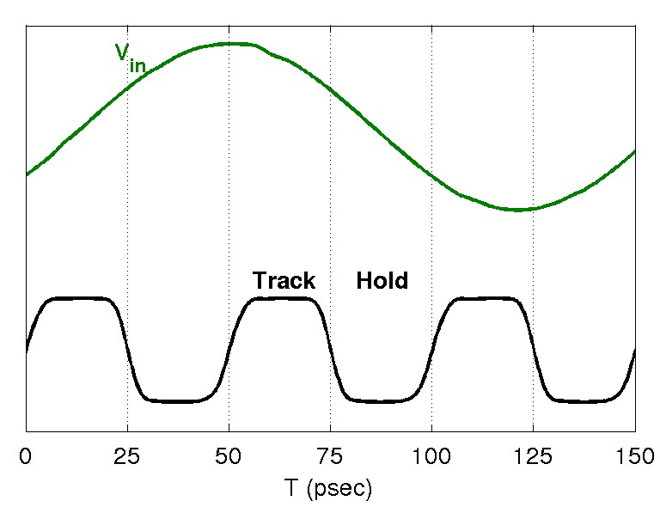
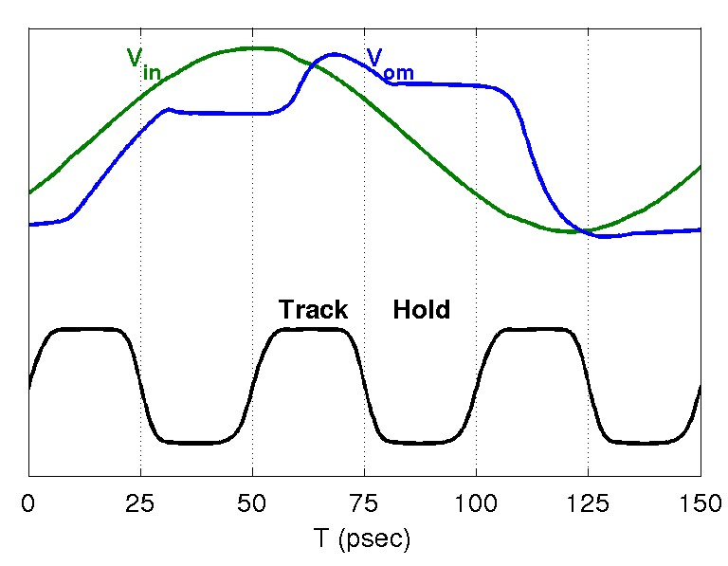
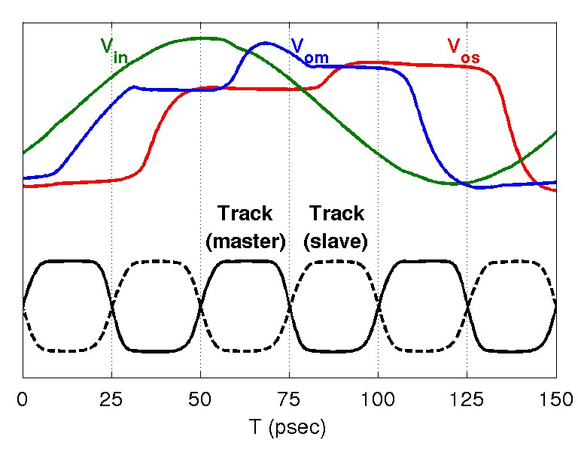
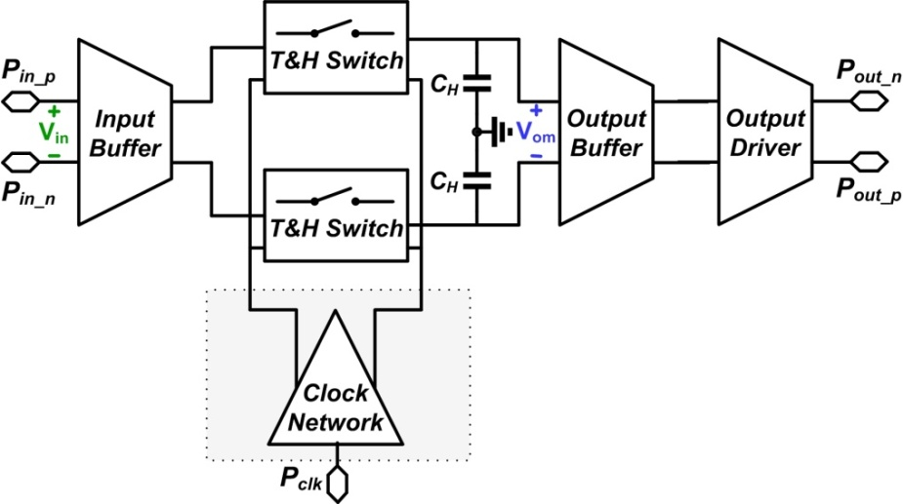
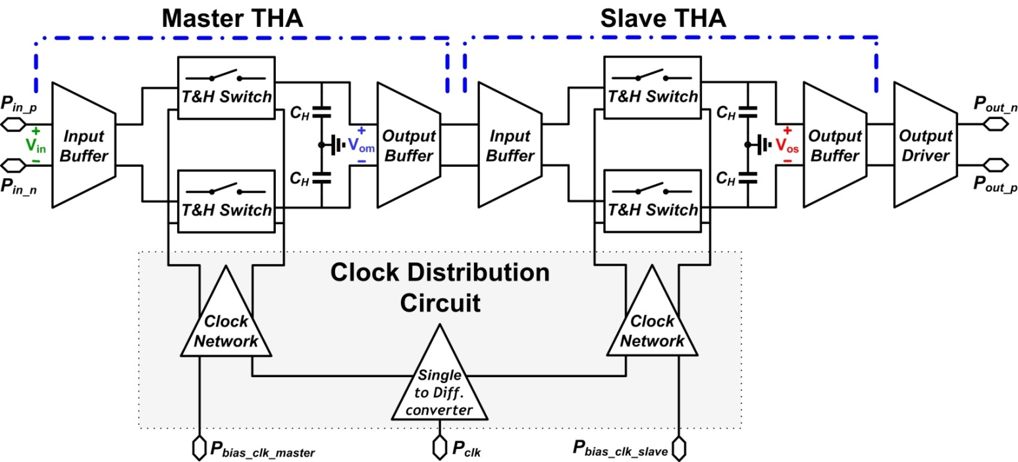
Motivation: Sample & Hold vs Track & Hold

Slide 6
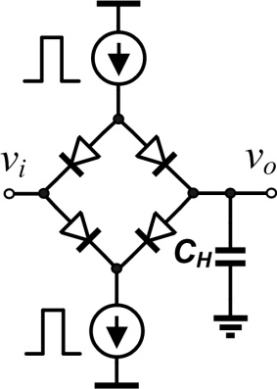
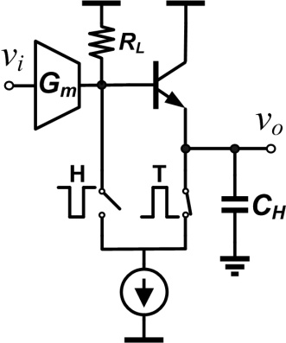
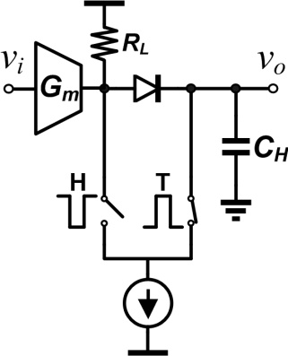
High Frequency Sampling Techniques
Diode bridge: [1]
Wide bandwidth
Linearity
Dynamic Range
Switched Emitter Follower (SEF): [2]
Good linearity
Better dynamic range
☹ Stability issues with EF
Base-collector diode:
Widest bandwidth
Good linearity
Highest dynamic range
No stability issues
Flat AC response
[1] J. C. Jensen and L. E. Larson, “A broadband 10-GHz track-and-hold in Si/SiGe HBT technology,” IEEE JSSC, Mar. 2001.
[2] S. Shahramian, A. C. Carusone and S. P. Voinigescu, “Design Methodology for a 40-GSamples/s Track and Hold Amplifier in 0.18-μm SiGe
BiCMOS Technology,” IEEE JSSC, Oct. 2006.

Slide 7
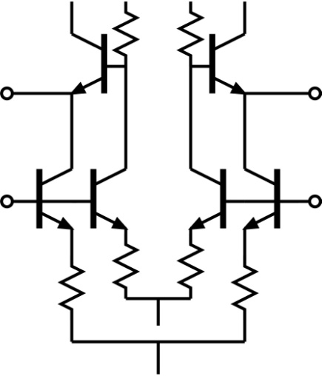
Key Design Features
Track & hold switch: base-collector diode
lower R_{on}, lower C_{off} than HBT e-b junction
minority carrier storage time approximately equal to base transit time
Common reports in the literature:
switch voltage swings set very small and fast,
but high IP3 only for f_{signal} <<f_{Nyquist}
Real-world design requires:
switch voltages set for high IP3 with Nyquist-frequency input
Linearization of input buffer for high IP3
cubic feedforward path cancels
IM3 from differential pair

Slide 8
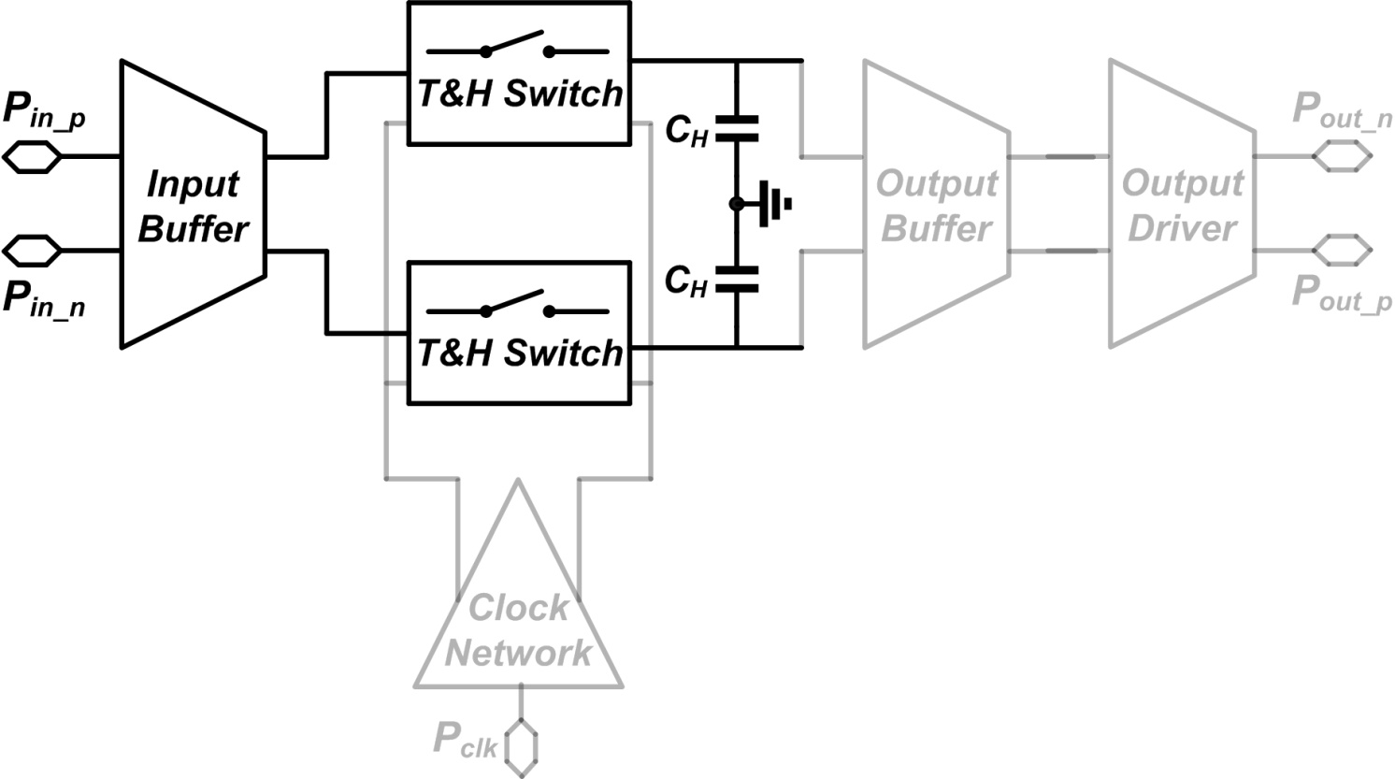
Input Buffer & TH Switch

Slide 9
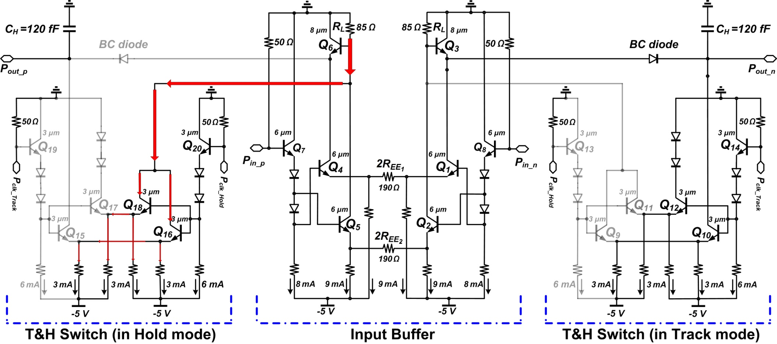
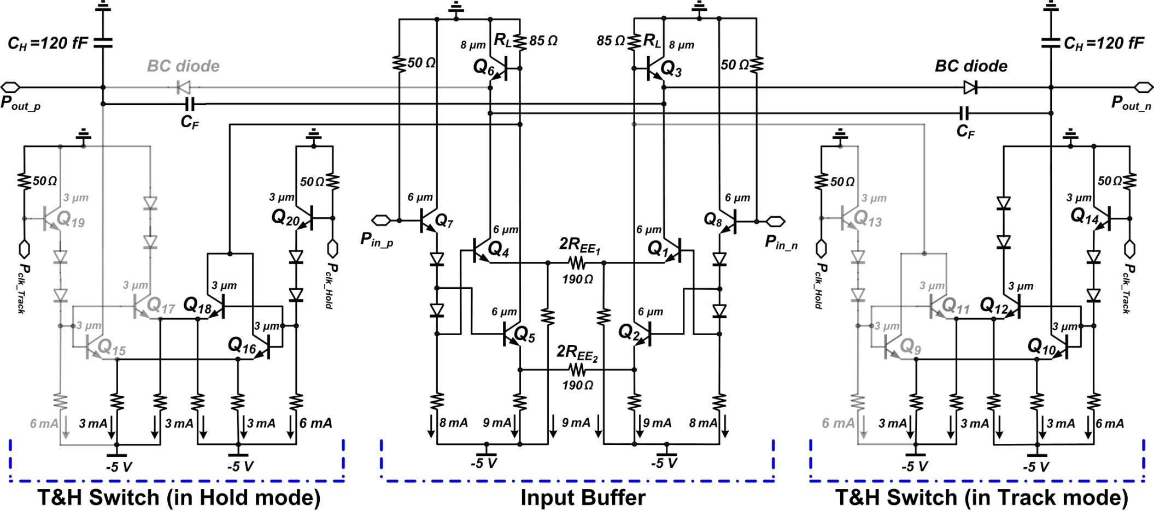
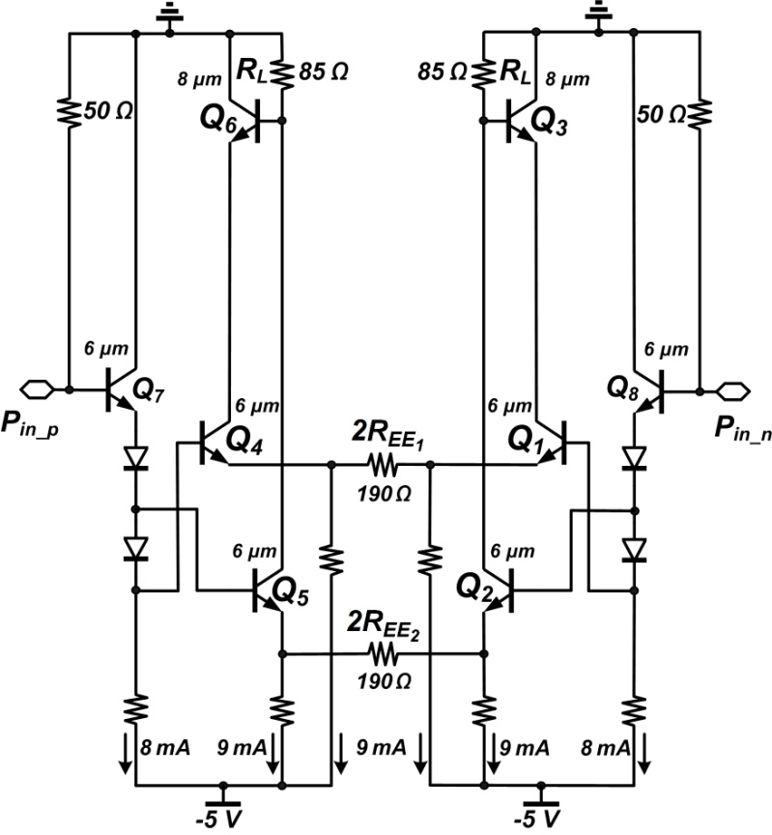
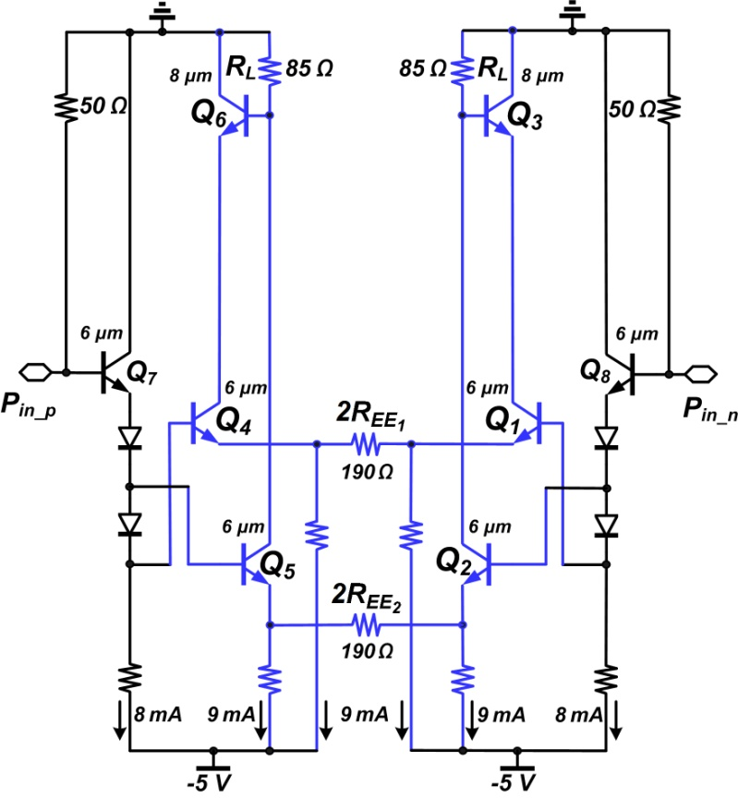
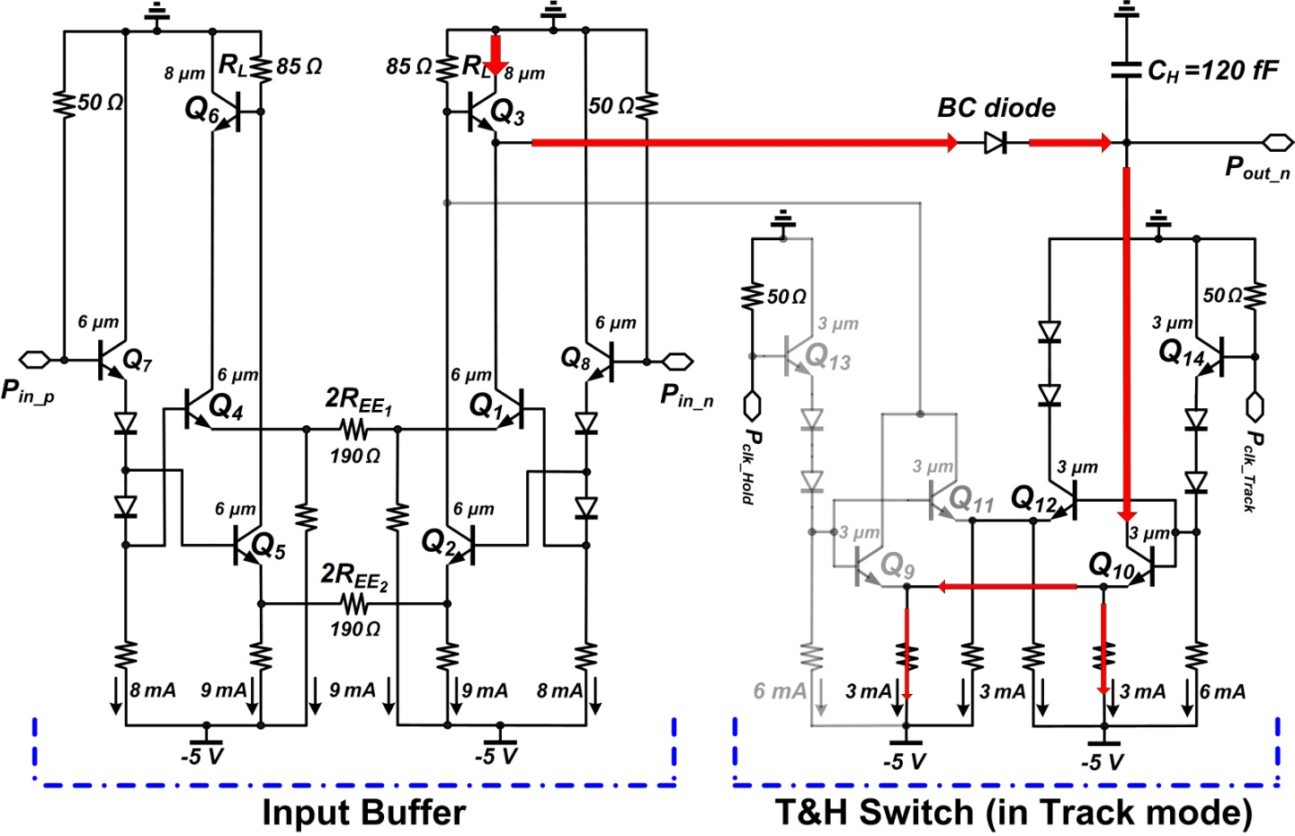
Input Buffer & TH Switch

Slide 10
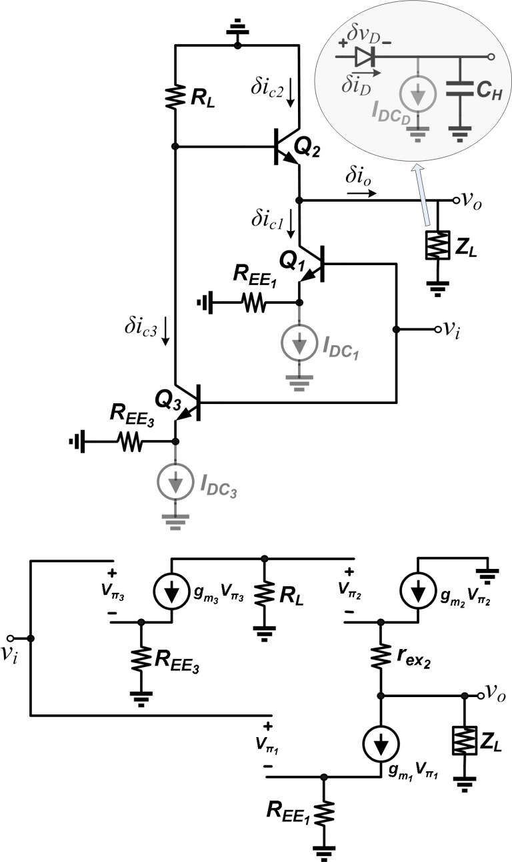
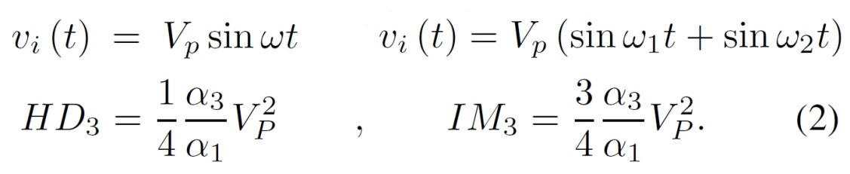
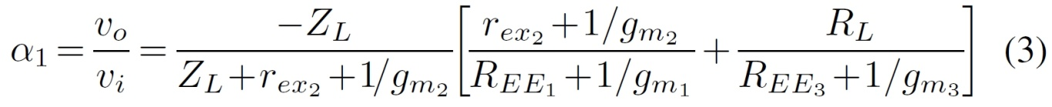
Nonlinearity Derivation - I
[1]
[1] W. Sansen, “Distortion in Elementary Transistor Circuits,” IEEE TCAS-II: Analog and Digital Signal Processing,
vol. 46, no. 3, pp. 315-325, Mar 1999.

Slide 11
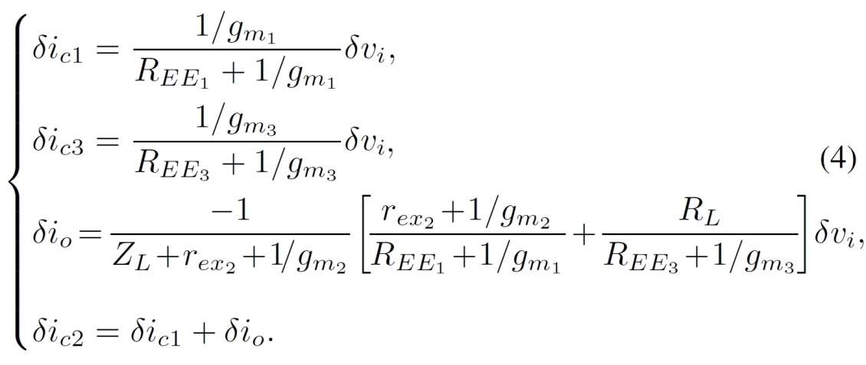
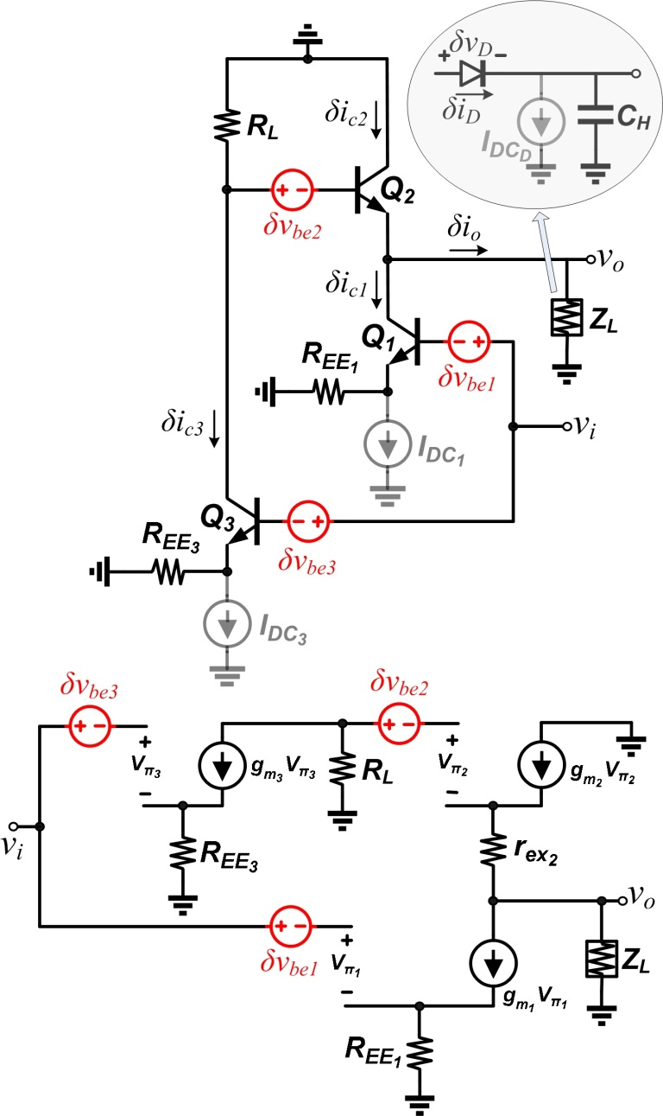
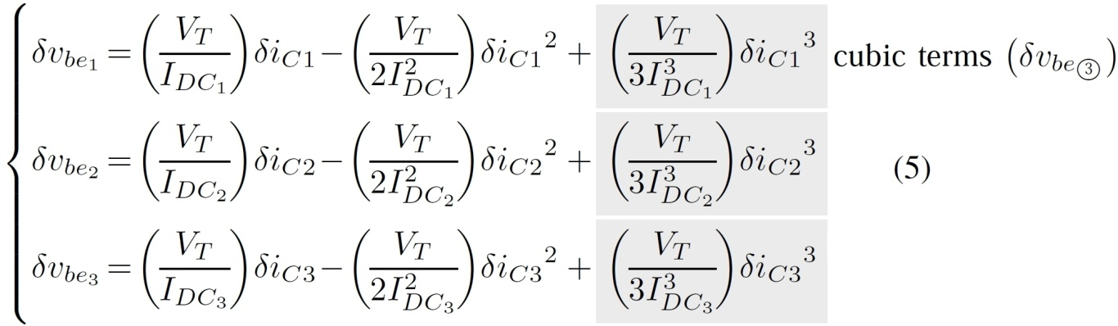
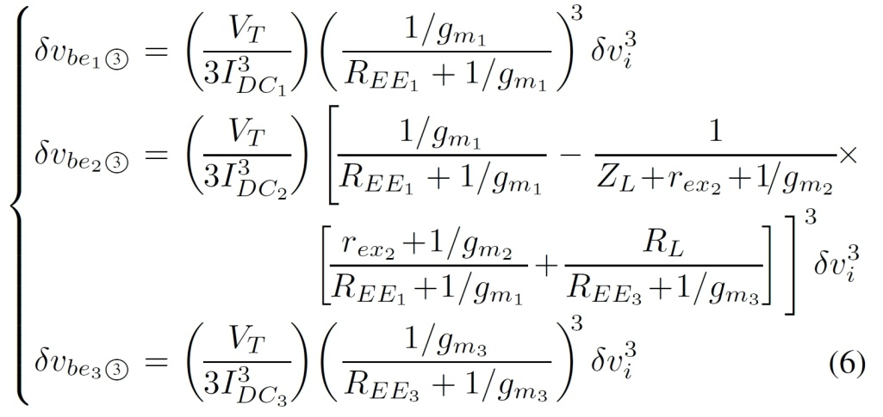
Nonlinearity Derivation-II

Slide 12
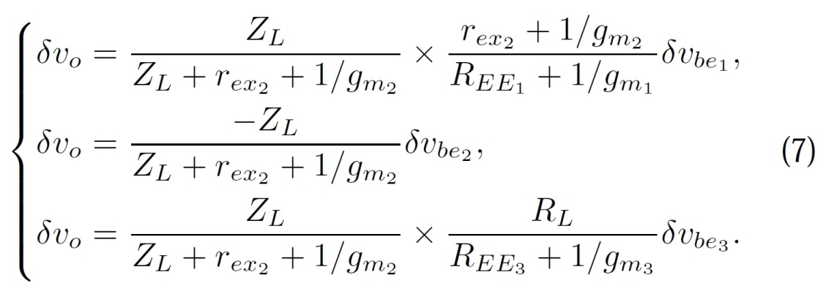
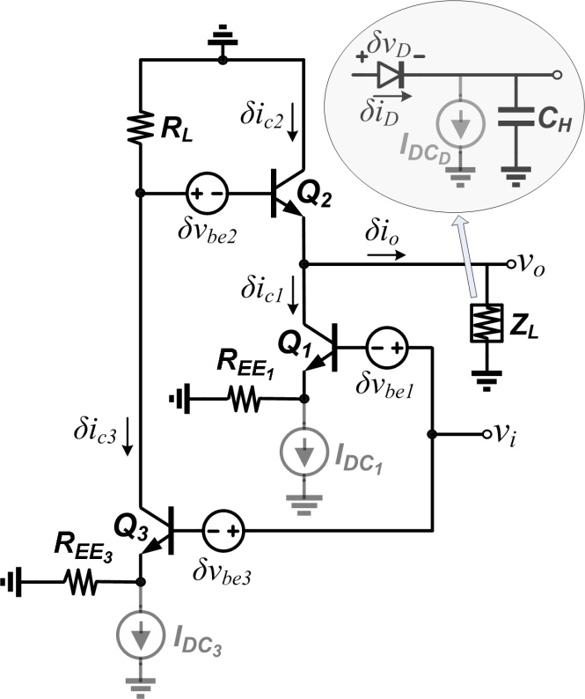
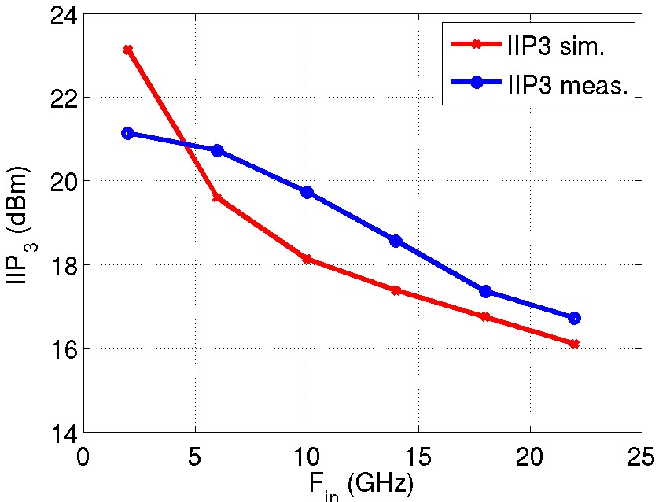
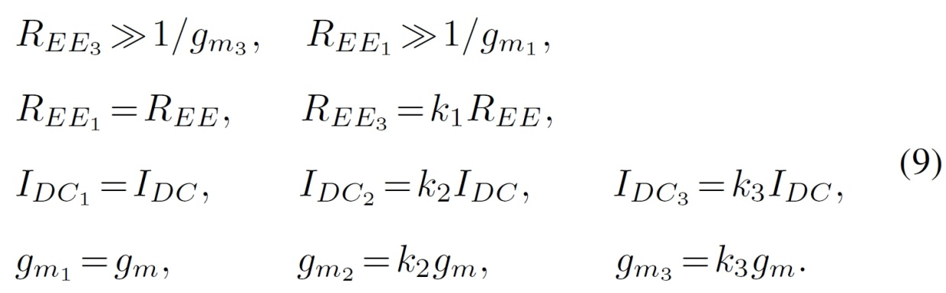
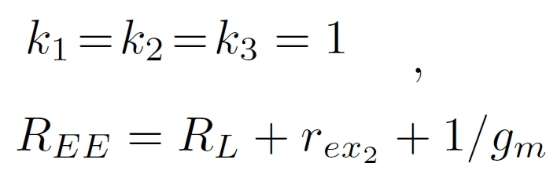
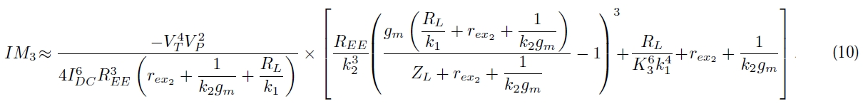
Nonlinearity Derivation - III

Slide 13
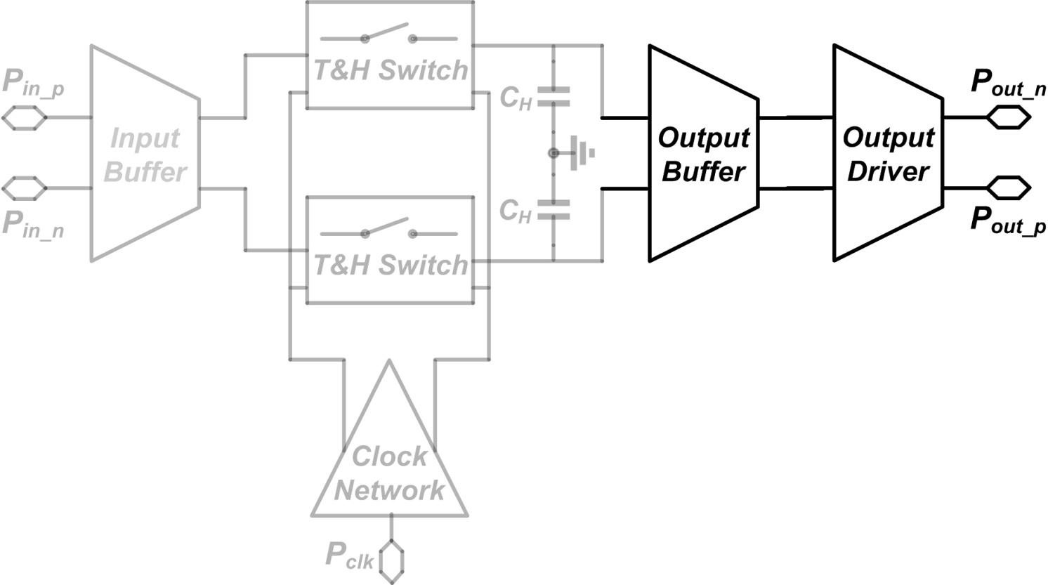
Output Buffer & Output Driver

Slide 14
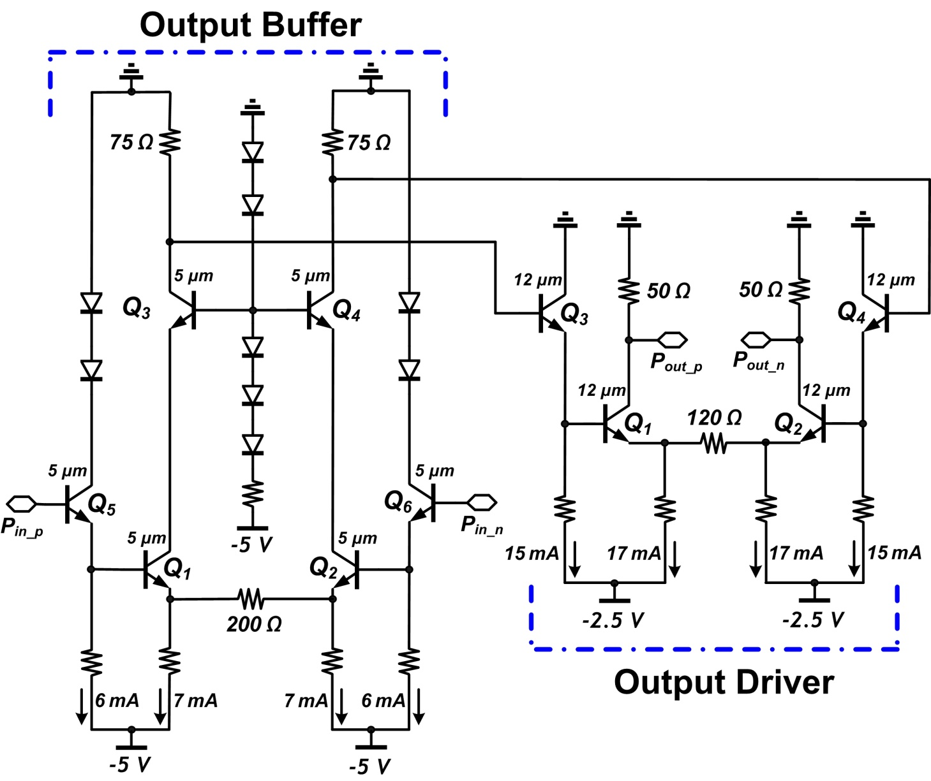
Output Buffer & Output Driver
Output buffer should always be on in Sample & Hold circuit
Output stage needs to be designed linear enough not to affect total nonlinearity of the circuit

Slide 15
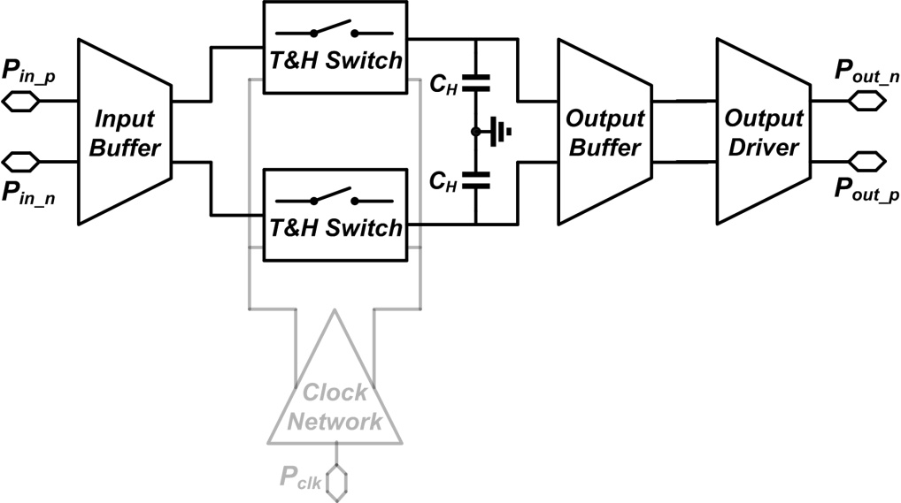
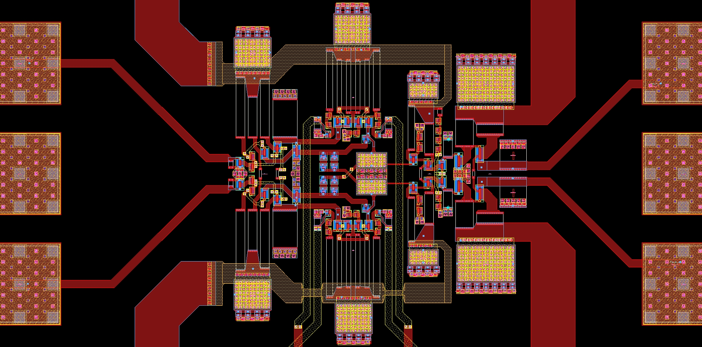
Layout (Signal path)
TH Switch
I.B.
O.B.
O.D.
TH Switch

Slide 16
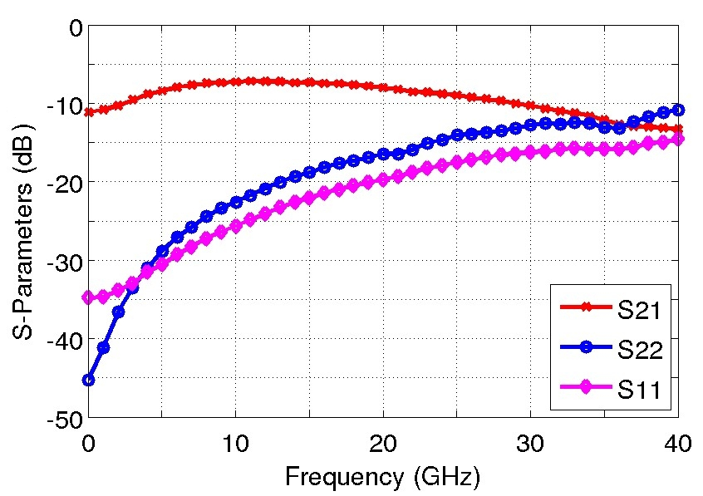
S-parameters measurement

Slide 17
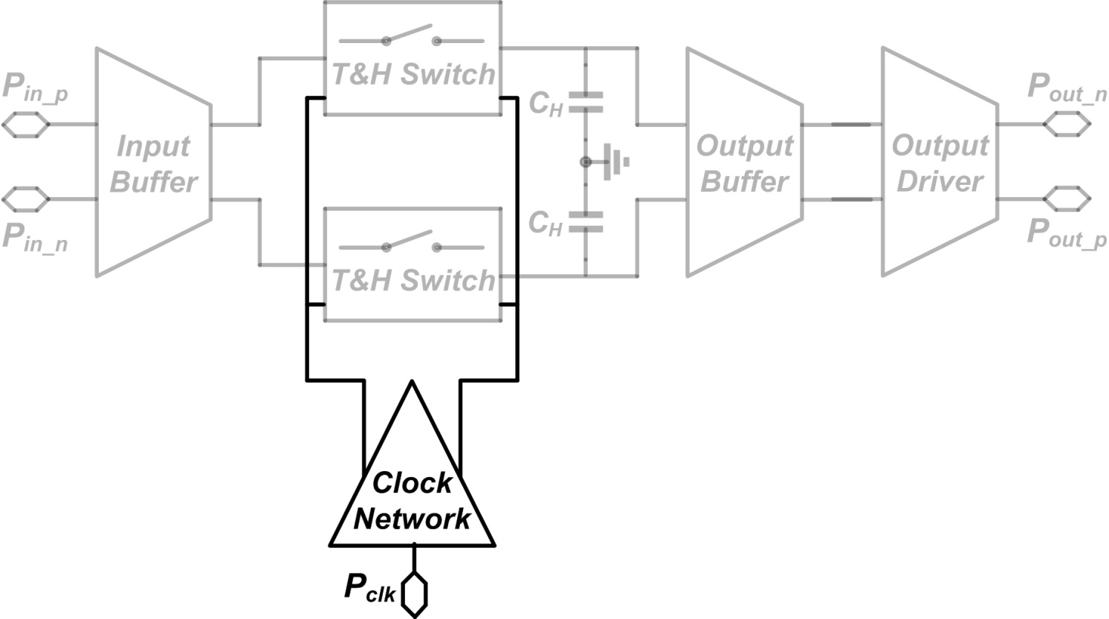
Clock Distribution Circuit

Slide 18
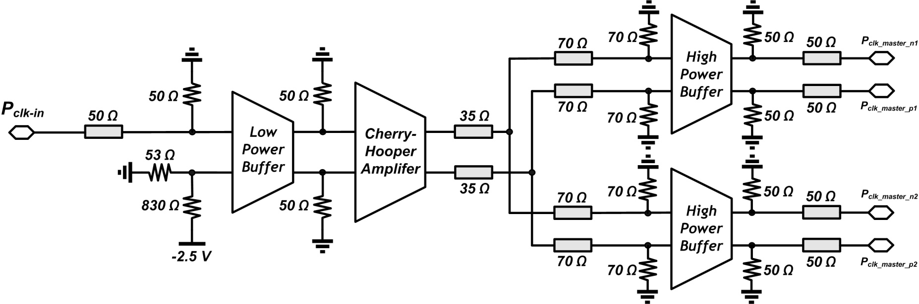
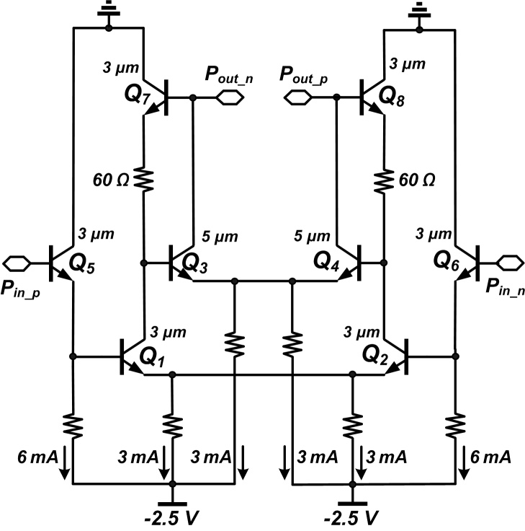
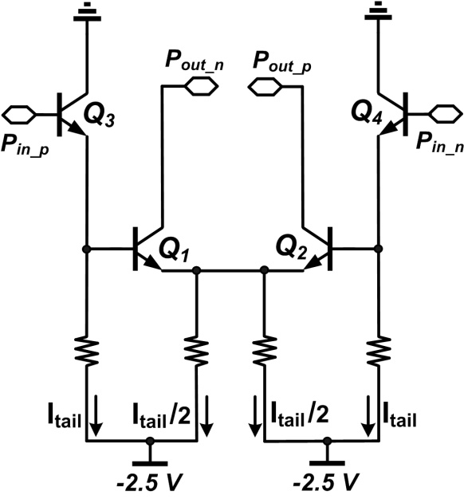
Clock Distribution Circuit
I_{tail}=6 mA
I_{tail}=12 mA

Slide 19

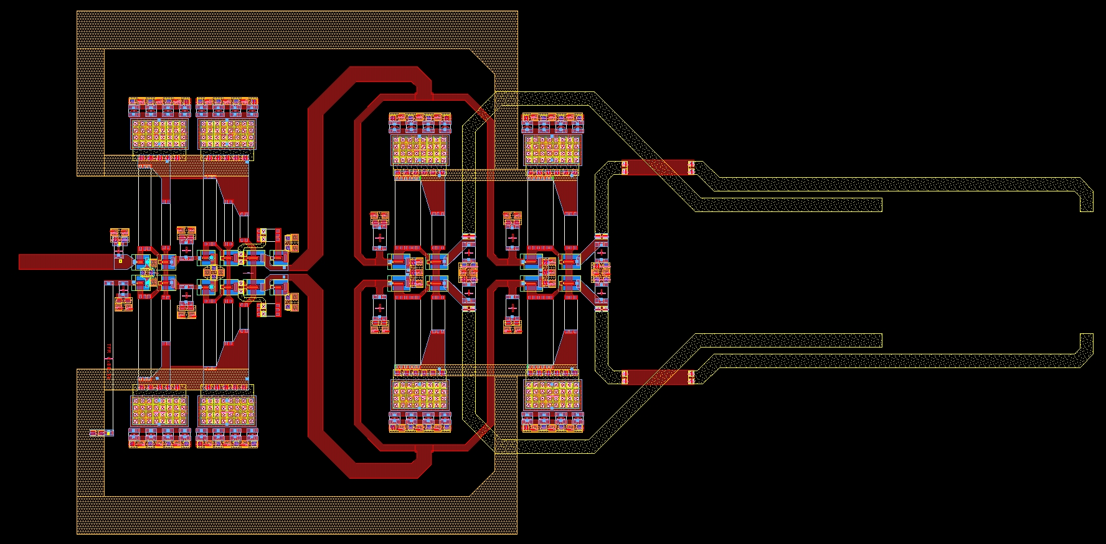
Clock Distribution Circuit - layout
LPB
C-H Amp.
HPB
HPB

Slide 20
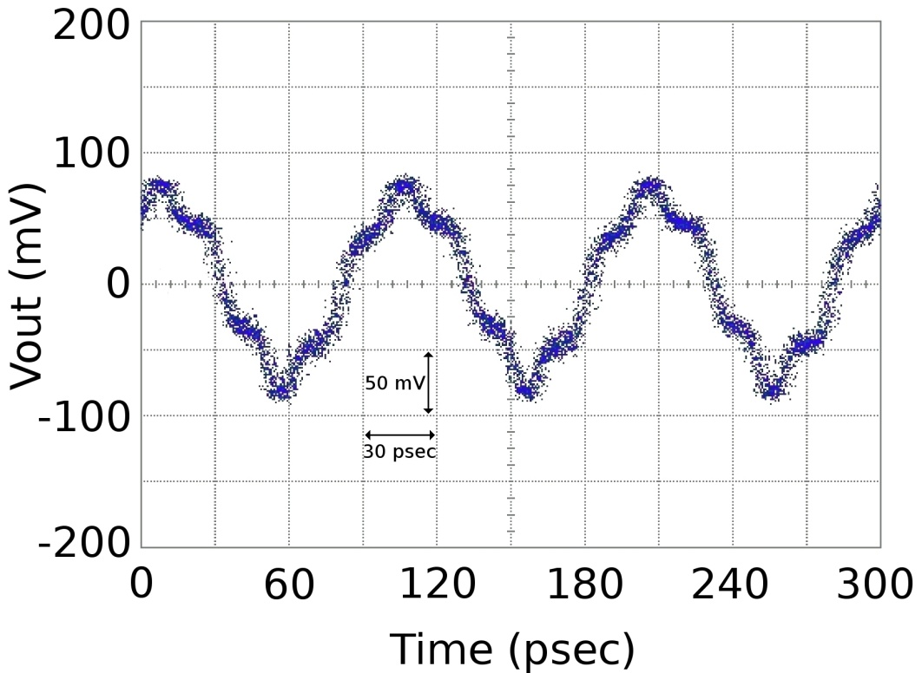
Transient and Linearity Measurements
IIP3 & OIP3 vs Fin for Fclk = 50GHz
10 GHz RF input signal with a 50 GHz clock

Slide 21
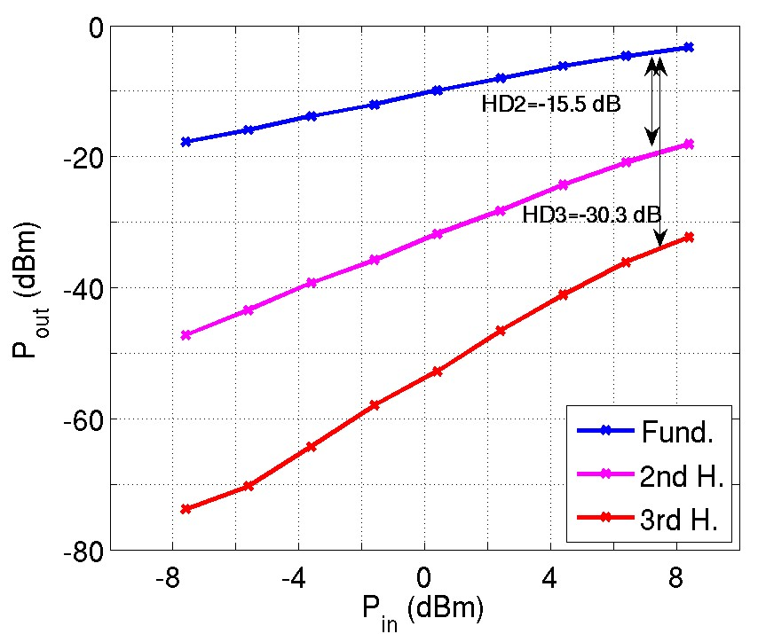
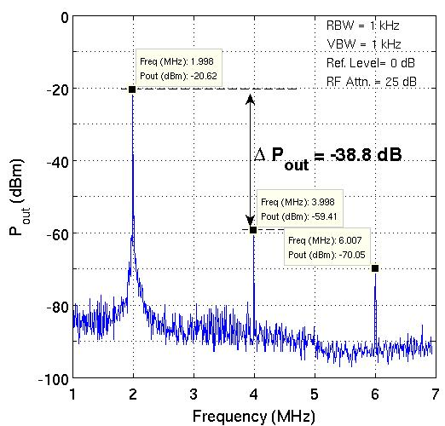
THD and Beat test Measurements
Measured HD₂ and HD₃
40.002 GHz input signal is being sampled by
40 GSamples/s sampling rate.
P1dB

Slide 22
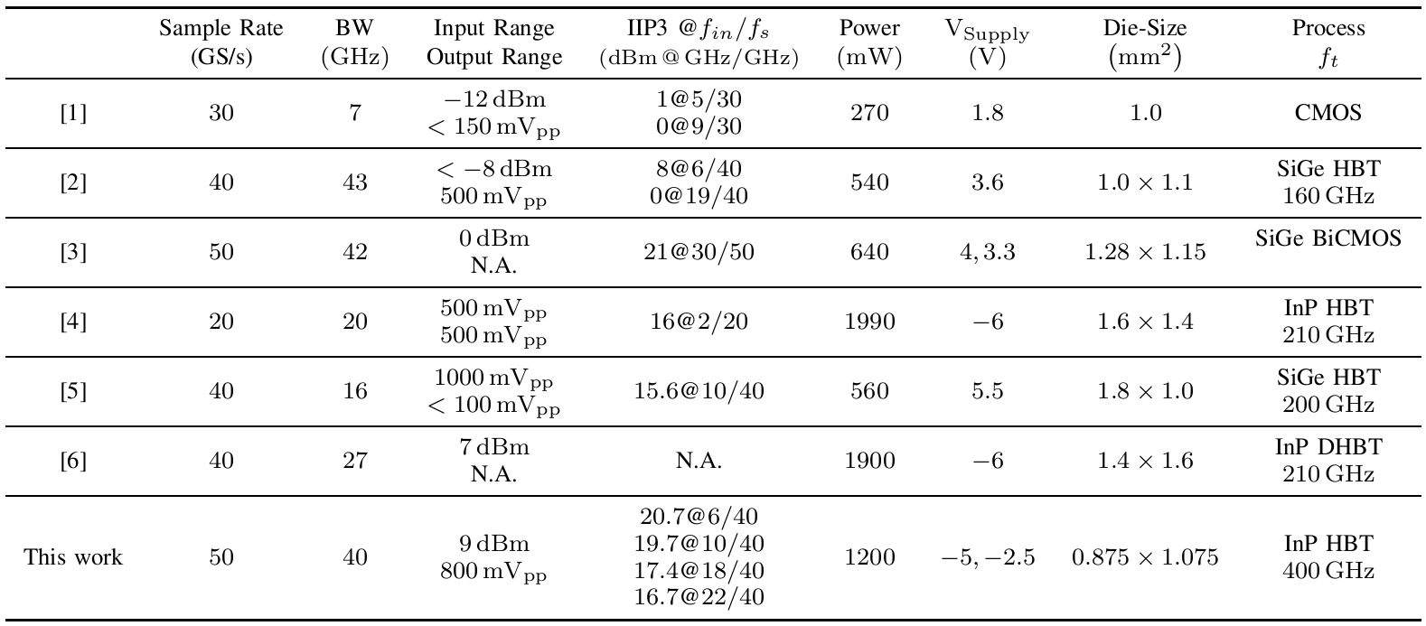
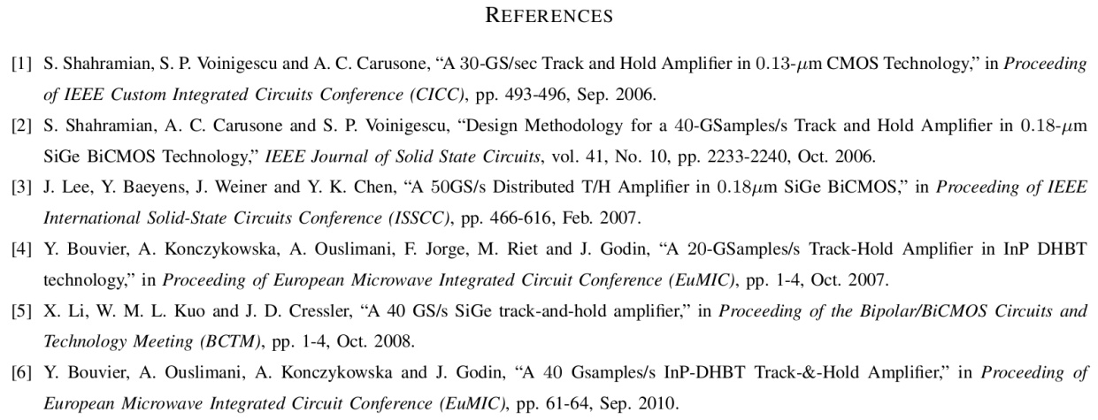
Comparison with the State of the Art Works

Slide 23
Questions?

Slide 24
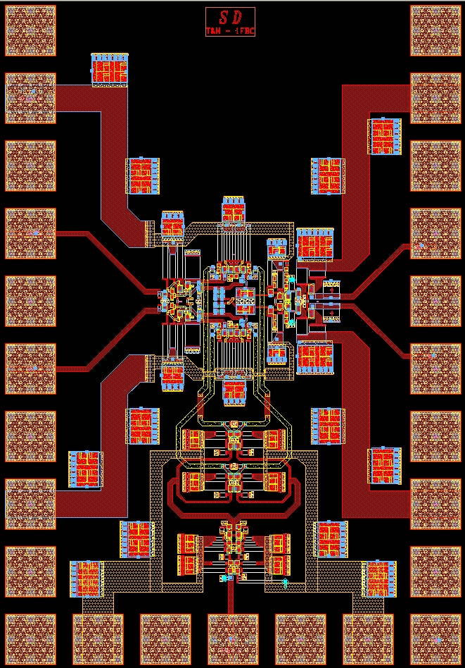
T&H Chip layout

Slide 25
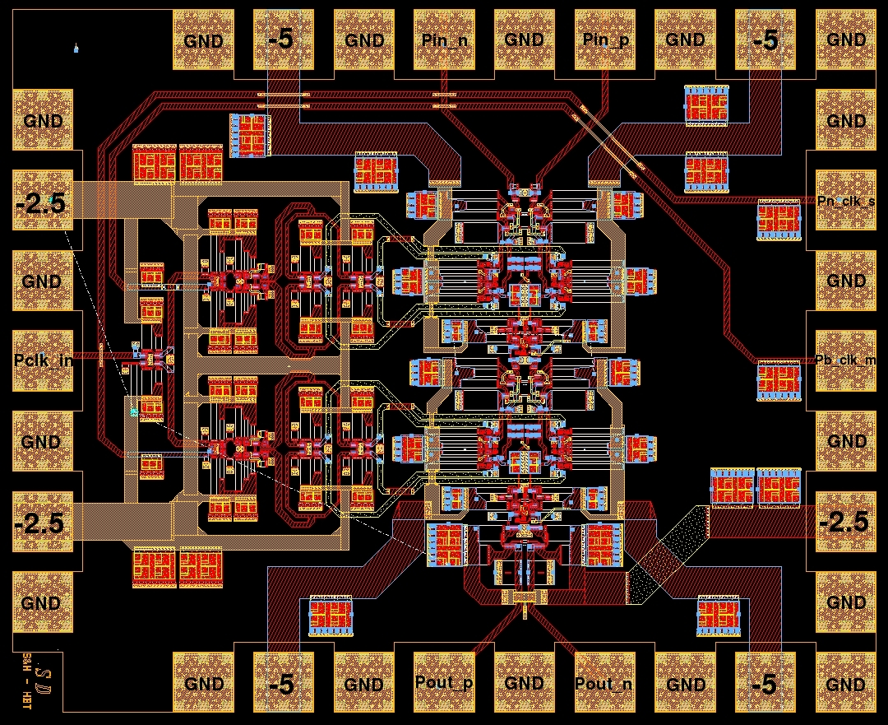
S&H Chip layout

Slide 26


Sample & Hold Transient waveforms
10 GHz RF input signal is being sampled by a 50 GHz clock
Differential
Single-ended

Slide 27




Sample & Hold Beat frequency test
Fin=20.5 GHz, Fclk=20 GHz
Fin=20.5 GHz, Fclk=10 GHz
Simulation
Experiment

Slide 28


Sample & Hold Linearity Measurements
Calculated ENOB using simulated noise figure of 20dB is more than 6bits.

Slide 29




Base-Collector Diode modeling - I
  $$W=0.6μm , { L}_{B}=2.4μm$$
  $$Area=1.6μm ×1.6μm+W×L_{B}$$
  D₁: $I_{S1}=\frac{2.45e−10}{Area}, N=1.9,{ T}_{t}=50 fsec$
  D₂: $I_{S2}=\frac{1.47e−12}{Area}, N=1.3$
  D₃: $I_{S3}=\frac{2.38e−9}{Area}, N=20.7$
  $$R_{1}=\frac{ρ_{cp}}{Area} =\frac{6e−12}{Area}$$
  $R_{2}=\frac{78e−12}{Area}, R_{1}+R_{2}=21Ω$.
  $$C=\frac{a_{5}{V_{C}}_{}^{5}+a_{4}{V_{C}}_{}^{4}+a_{3}{V_{C}}_{}^{3}+a_{2}{V_{C}}_{}^{2}+a_{1}{V_{C}}_{}^{1}+a_{0}}{Area}$$
  $$a_{5}=−0.007 fF$$
  $$a_{4}=0.209 fF$$
  $$a_{3}=2.345 fF$$
  $$a_{2}=7.705 fF$$
  $$a_{1}=9.557 fF$$
  $$a_{0}=7.637 fF$$

Slide 30

Base-Collector Diode modeling - II
Linear Scale
Log Scale
I-V Characteristic
Forward biased
I-V Characteristic
Reverse biased

