Slide 1
Integrated Circuits for Wavelength Division De-multiplexing in the Electrical Domain
¹H.C. Park, ¹M. Piels, ²E. Bloch, ¹M. Lu, ¹A. Sivanathan, ³Z. Griffith, ¹L. Johansson, ¹J. Bowers, ¹L. Coldren, and ¹M. Rodwell
¹University of California at Santa Barbara
²Technion, Israel Institute of Technology
³Teledyne Scientific & Imaging Company
23rd September, 2013
hcpark@ece.ucsb.edu
1
Notes:
1

Slide 2
Outline
Motivation
New Proposed WDM Receivers
Test Setups and Results
Two channel (SSB rejection) tests
Three channel (adjacent channel rejection) tests
Conclusion
2

Slide 3
Motivation
Network Traffics / High Data Rate Demands
More bandwidth
Higher spectral efficiency
Low power consumption
System complexity and cost
Long reach
Toward 1Tb/s using a Single Receiver (System)
System Directions:
Coherent (phase/amplitude) modulations (i.e. 16QAM)
Dual polarizations
Gridless channels
Super-channels
Photonic and electronic Integrations
Low power / high efficiency
High Speed Systems
High Efficiency Systems
3

Slide 4
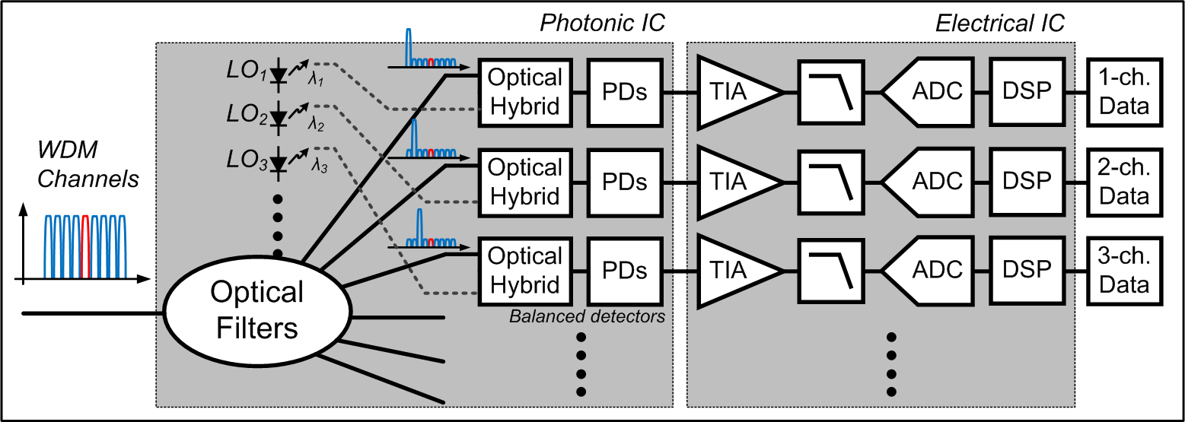
Conventional WDM Receivers
Configuration: Photonic IC + Electrical IC
WDM multi-channels
De-multiplexing using AWG
Integrated LO lasers
90° optical hybrids
Balanced photo-diodes (PDs)
EIC: TIAs + filters + ADCs + DSPs
Photonic IC
Complex PIC
Large die: expensive
Many interfaces between PIC & EIC
Fixed WDM channel spacing
4

Slide 5
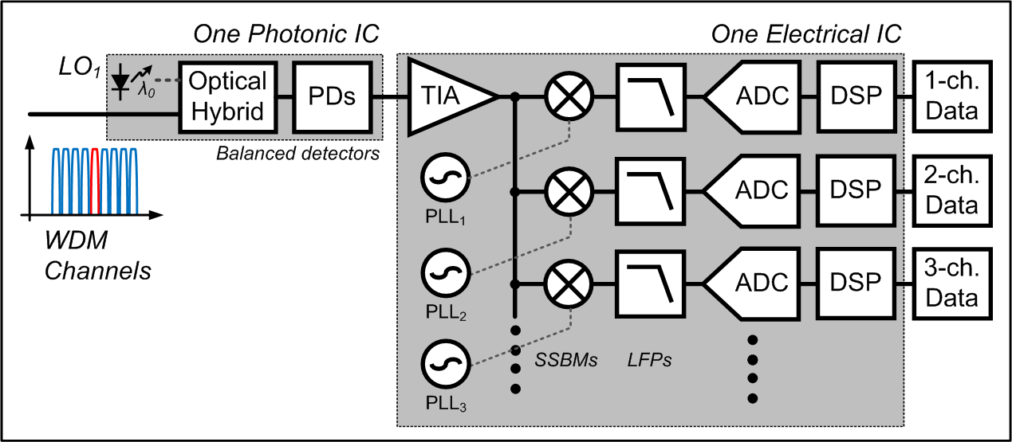
Proposed WDM Receivers
Single-chip Multi-channel WDM Receivers: Toward 1Tb/s
Simple PIC: one LO + one optical hybrid + one set of PDs
Complex EIC
TIAs + filters + ADCs + DSPs
SSB mixers
Electrical LOs
Challenges: high speed PDs¹⁾ and high speed EIC²⁾
References:
¹⁾ >300GHz PDs – Ishibashi et. al.
²⁾ 1THz TRs – Jain Vibhor et. al.
EIC
Complex EIC: OK!!
Small and simple PIC
One set of interface between PIC & EIC
Flexible WDM channel spacing
5

Slide 6
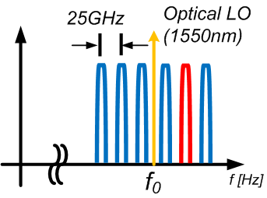
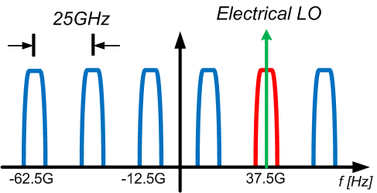
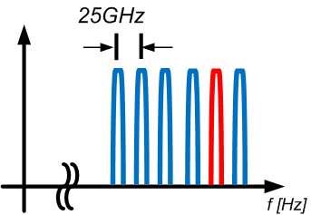
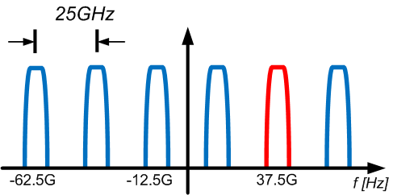
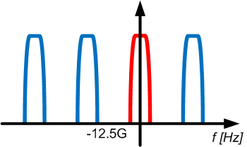
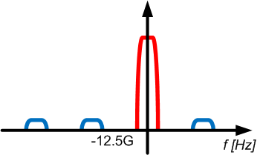
Two-Stage Down-conversion: Optical, then Electrical
1) Optical LO for optical down conversion for all WDM channels
→ Optical WDM channels become subcarriers in the electrical domain
2) Electrical LO for selected channel with SSB mixers
→ Selected channel down-converted to near DC
3) Other channels removed by filtering
→ Then, ADC + DSP
→ DATA recovery
6

Slide 7
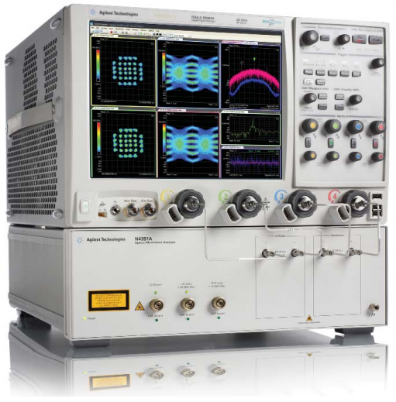
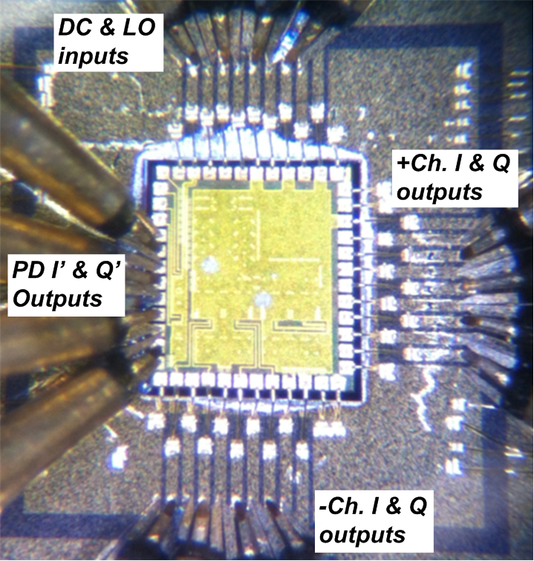
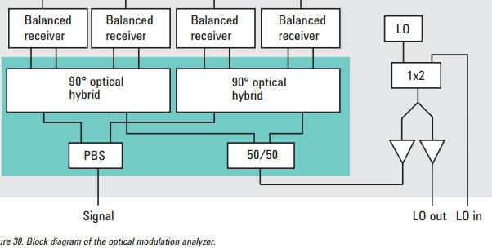
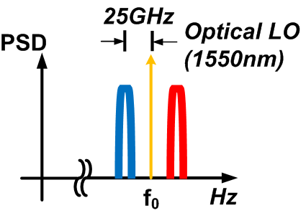
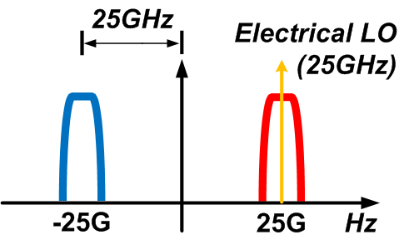
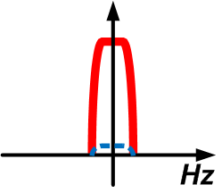
System Demonstration using OMA+EIC (2-channels)
Real-time
oscilloscope
OMA* as PICs
Free space optics
90° optical hybrid
& Balanced PDs
OMA* blocks
As PICs
2-channel electrical IC
*OMA – optical modulation analyzer
Ref. Agilent N4391A Optical Modulation Analyzer Measure with confidence
http://cp.literature.agilent.com/litweb/pdf/5990-3509EN.pdf
7

Slide 8
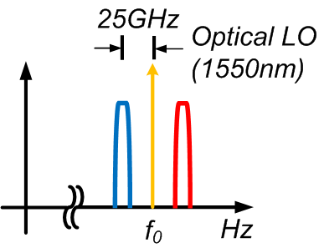
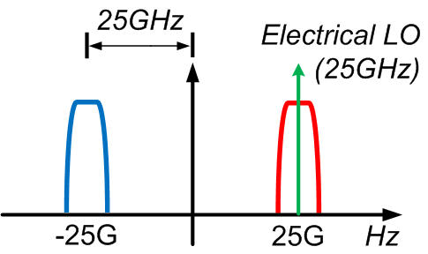
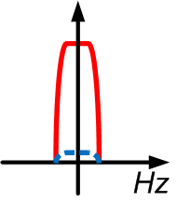
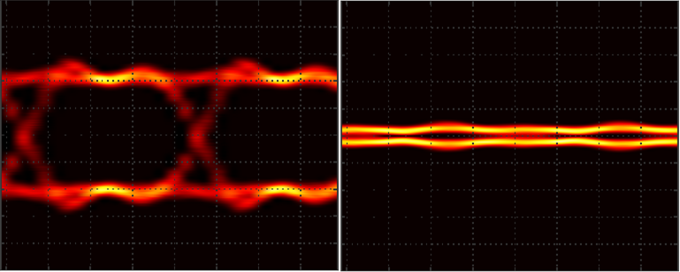
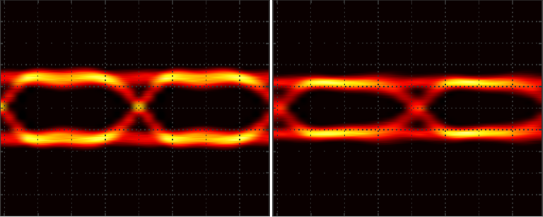
Two-channel Tests: Single-side-band Suppression
(+/- channels)
I & Q outputs
Activated channel
Suppressed channel
(+) channel
(-) channel
8

Slide 9
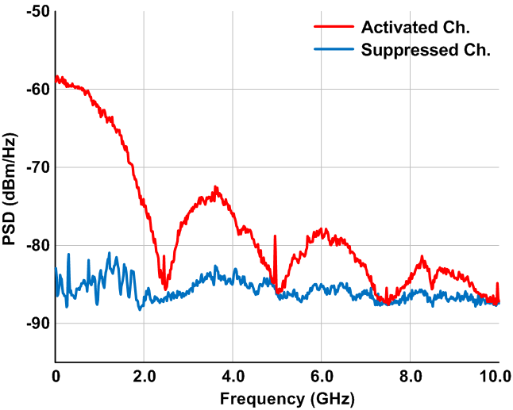
Two-channel Tests: Single-side-band Suppression
EIC outputs (Electrical Spectrum Analyzer)
9
About 25dB SSB suppression
Negligible channel interference
x2 more channels within the PDs and EIC bandwidth

Slide 10
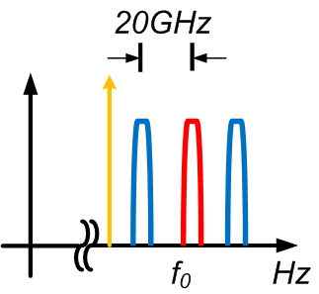
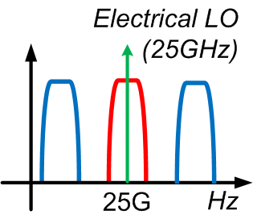
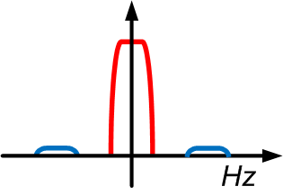
Three-channel Tests: Adjacent Channel Rejections
(+/- channels)
I & Q outputs
20GHz Spacing
10GHz Spacing
5GHz Spacing (no guard band)
Tested with different channel spacing !!
*Measured spectrums by an optical spectrum analyzer
10

Slide 11
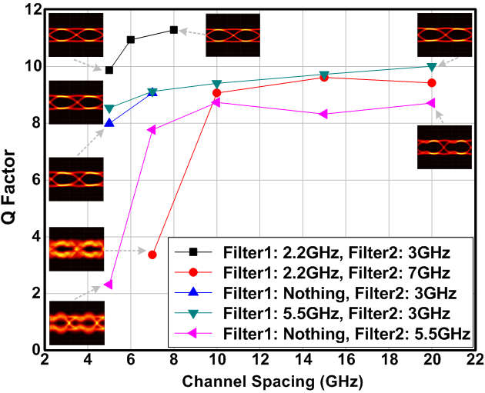
Three-channel Tests: Adjacent Channel Rejections
Eye Qualities with Different Filter Combinations
BER 1.0E-9
*Filter1: before optical modulators to suppress the side lobes
*Filter2: after EIC outputs to filter out the other channels
11

Slide 12
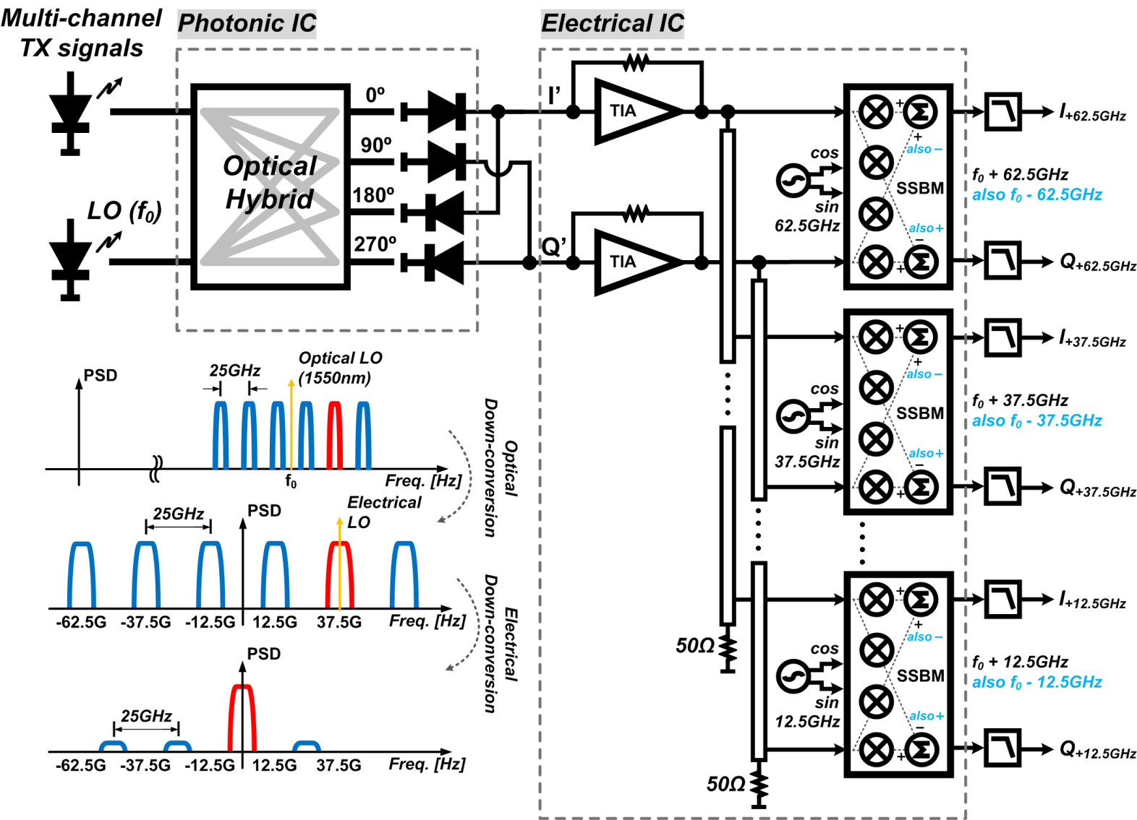
Future Tests: 6-channel WDM Receivers
Concept schematics (PIC + EIC)
EIC for 6-channel receivers is ready to test !
12

Slide 13
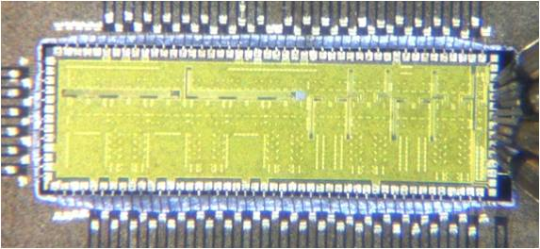
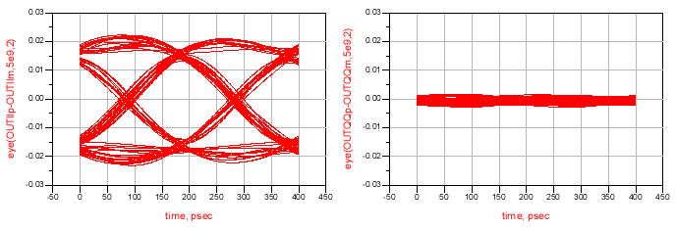
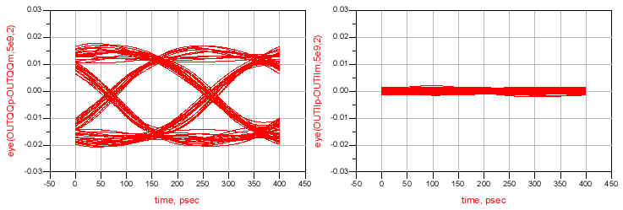
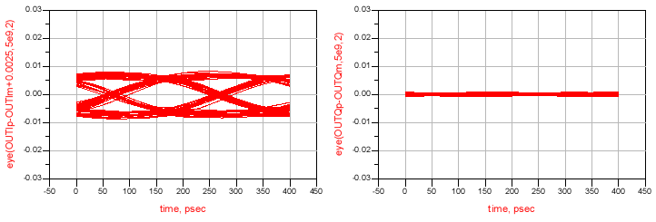
Future Tests: 6-channel WDM Receivers
6-channel WDM receiver IC
Teledyne 500 nm InP HBT: ~300GHz f_{τ} , f_{max}
1st design spin: no attempt to design for low power
Simulations (5Gb/s BPSK)
30Gb/s for BPSK, 60Gb/s for QPSK, 120Gb/s for 16QAM are feasible!
6-channel initial EIC only tests (done)
6-channel system demonstrations will be done (soon)!
4.8 x 1.5 mm²
±12.5GHz
±37.5GHz
±62.5GHz
I-output
Q-output
I-output
Q-output
I-output
Q-output
13

Slide 14
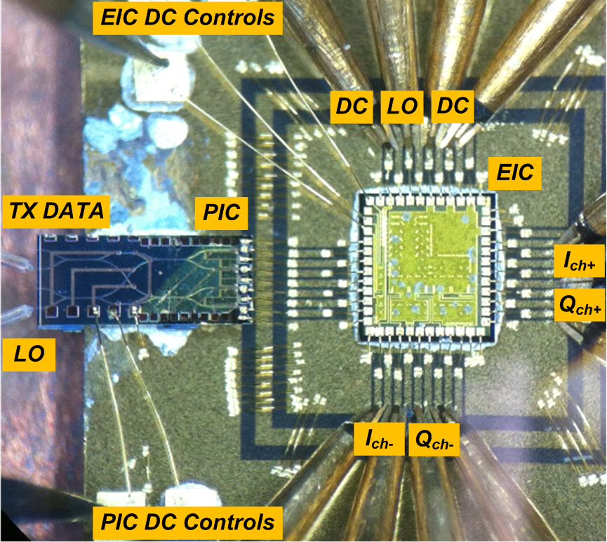
Conclusion
The first concept demonstration using two channel EIC receivers
Spectral efficiency is maximized using a minimum channel spacing
5Gb/s using two channel receivers
Using 8-channels / 25GHz spacing / 100GHz EIC / 100GHz PDs / PDM
0.8Tb/s for QPSK, 1.6Tb/s for 16QAM
5GHz spacing data recovery
Flexible channel (<10GHz) designs
Future Works
6-channel demonstration soon
PIC + EIC demonstration soon
Silicon based designs in near future
Low power consumption
Small IC size
14

Slide 15
Thanks for your attention!
Questions?
hcpark@ece.ucsb.edu
15

