Slide 1
THz Technologies:
Transistors, ICs, Systems
RFIC MTT Workshop: Signal Generation, Amplification, Detection and System Implementation at THz Frequencies (WSN)
Sunday, June 2, 2013, Seattle, Washington (8AM-5PM)
Mark Rodwell, UCSB
rodwell@ece.ucsb.edu
Co-Authors and Collaborators:
Teledyne HBT Team:
M. Urteaga, R. Pierson, P. Rowell, B. Brar, Teledyne Scientific Company
Teledyne IC Design Team:
M. Seo, J. Hacker, Z. Griffith, A. Young, M. J. Choe, Teledyne Scientific Company
UCSB HBT Team:
J. Rode, H.W. Chiang, A. C. Gossard , B. J. Thibeault, W. Mitchell
Recent Graduates: V. Jain, E. Lobisser, A. Baraskar,
UCSB IC Design Team:
S. Danesgar, T. Reed, H-C Park, Eli Bloch
WSN: Signal Generation, Amplification, Detection and System Implementation at THz Frequencies
IMS2013, Seattle, June 2-7, 2013
1

Slide 2
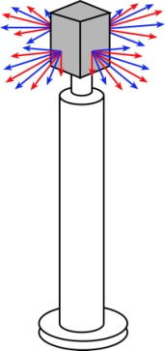


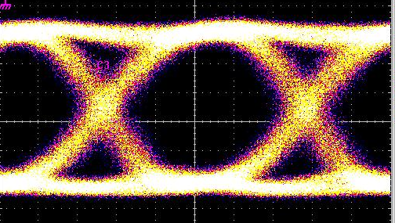
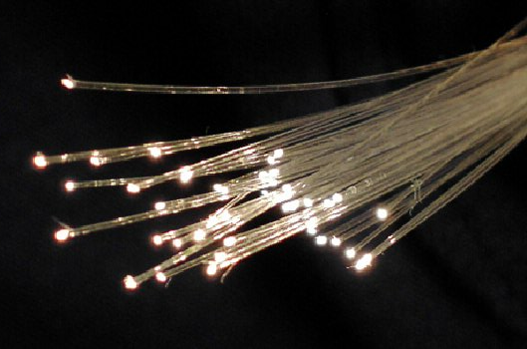

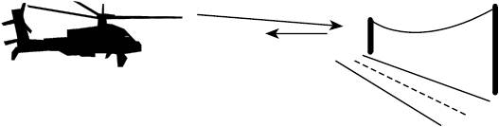
DC to Daylight. Far-Infrared Electronics
How high in frequency can we push electronics ?
*ITU band designations
** IR bands as per ISO 20473
1982: ~20 GHz
2012: 820 GHz
~2030: 3THz
...and what we would be do with it ?
100+ Gb/s wireless networks
Video-resolution radar
→ fly & drive through fog & rain
near-Terabit
optical fiber links
2

Slide 3
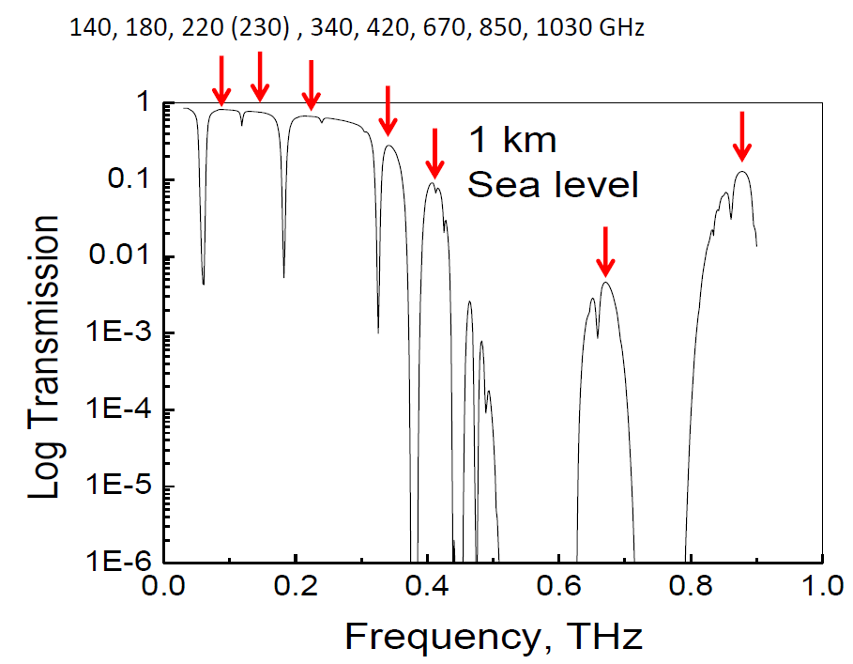
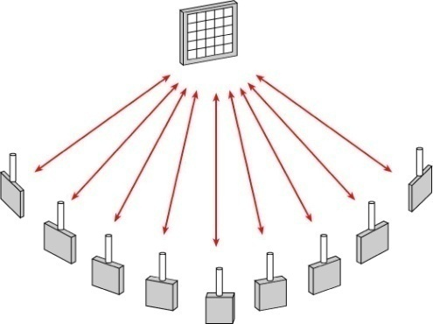
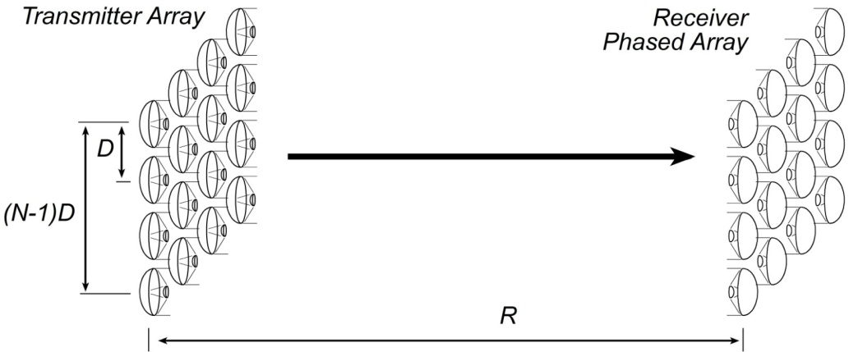
100-1000 GHz Wireless Has High Capacity
very large bandwidths available
short wavelengths→ many parallel channels
Sheldon IMS 2009
Torkildson : IEEE Trans Wireless Comms. Dec. 2011.
3

Slide 4

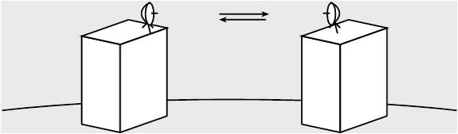
100-1000 GHz Wireless Needs Phased Arrays
isotropic antenna → weak signal →short range
highly directional antenna → strong signal, but must be aimed
no good for mobile
must be precisely aimed →too expensive for telecom operators
beam steering arrays → strong signal, steerable
32-element array → 30 (45?) dB increased SNR
4

Slide 5
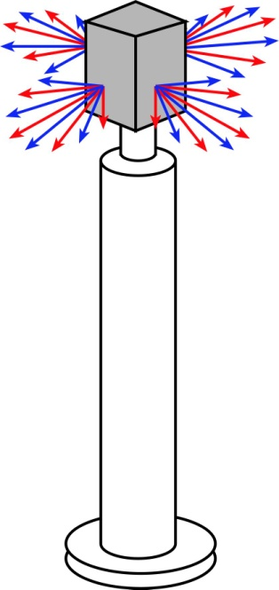
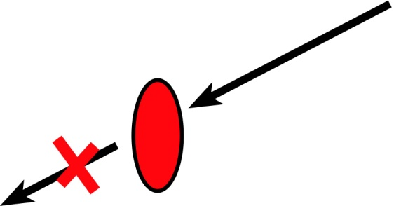

100-1000 GHz Wireless Needs Mesh Networks
Object having area
~λR
will block beam.
Blockage is avoided
using beamsteering
and mesh networks.
...high-frequency signals
are easily blocked.
...this is easier at high frequencies.
5

Slide 6
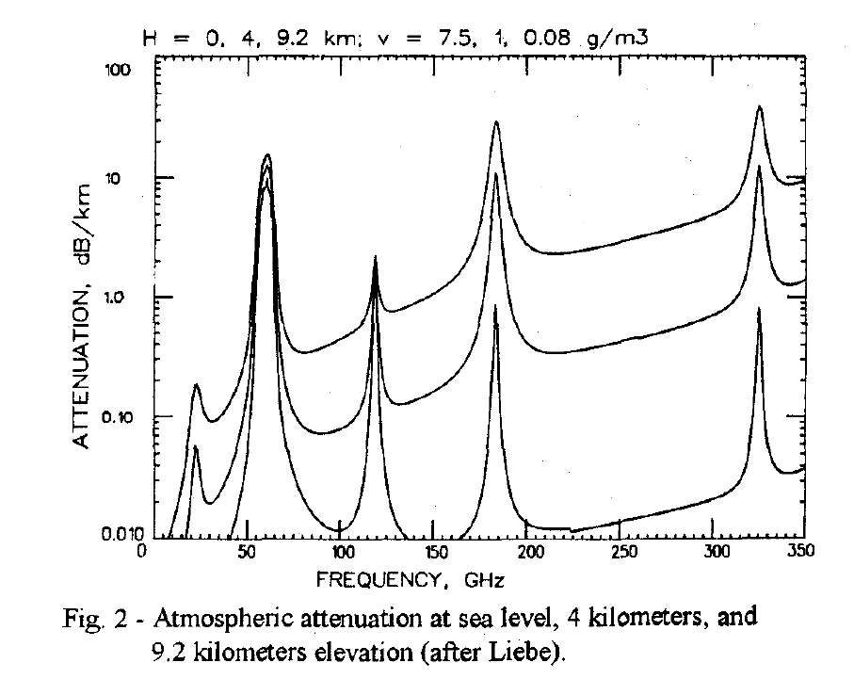
100-1000 GHz Wireless Has Low Attenuation ?
Wiltse, 1997 IEEE Int. APS Symposium, July
2-5 dB/km
200-300 GHz
125-165 GHz
75-110 GHz
Low attenuation on a sunny day
6

Slide 7
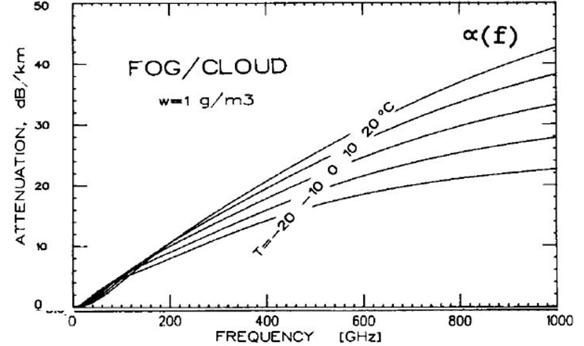
100-1000 GHz Wireless Has High Attenuation
High Rain Attenuation
High Fog Attenuation
very heavy fog
five-9's rain @ 50-1000 GHz:
→ 30 dB/km
~(25 dB/km)x(frequency/500 GHz)
50-500 GHz links must tolerate ~30 dB/km attenuation
Olsen, Rogers, Hodge, IEEE Trans Antennas & Propagation Mar 1978
Liebe, Manabe, Hufford, IEEE Trans Antennas and Propagation, Dec. 1989
7

Slide 8
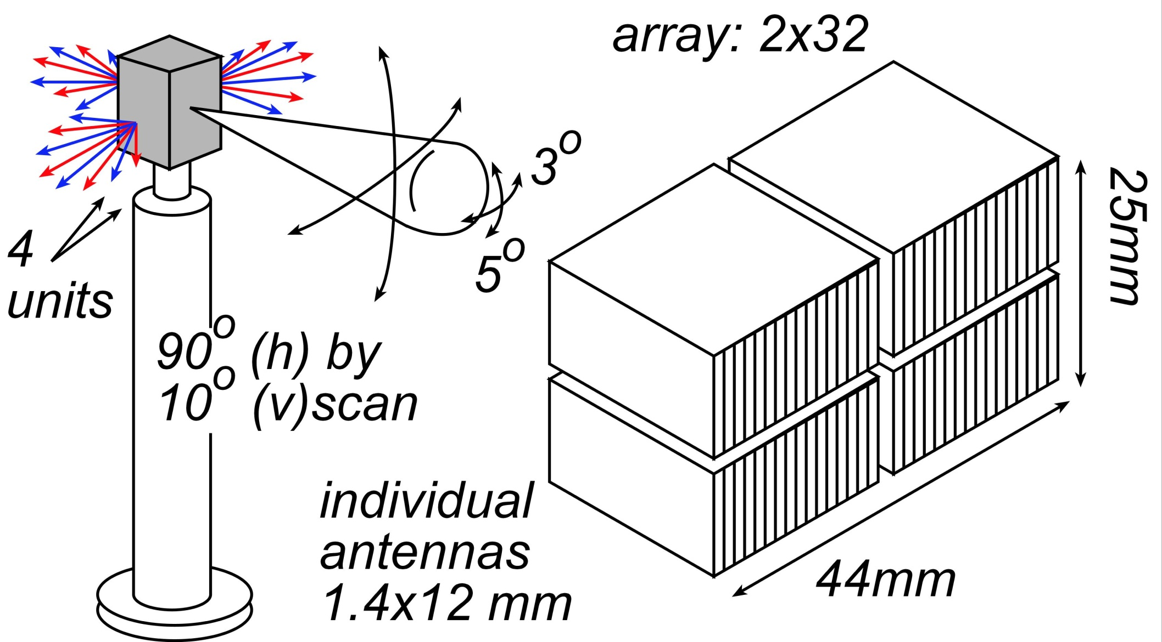
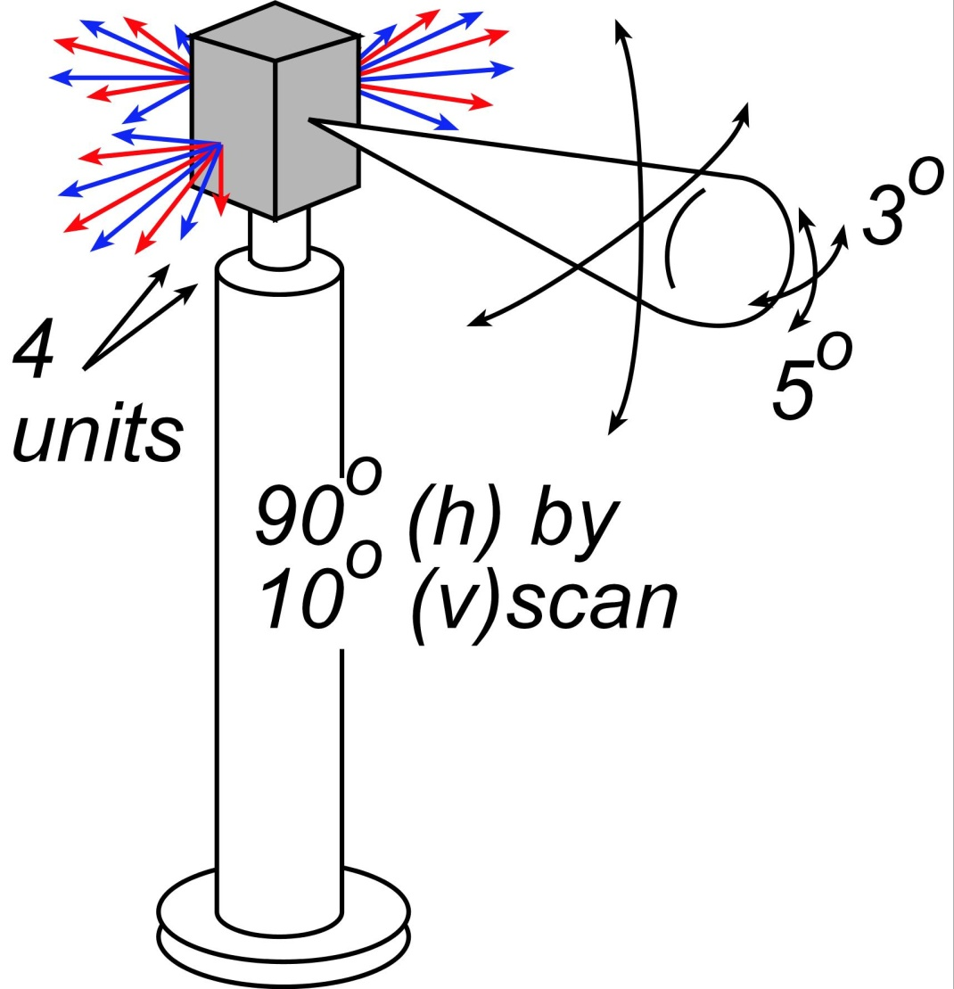
140 GHz, 10 Gb/s Adaptive Picocell Backhaul
8

Slide 9

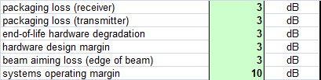
140 GHz, 10 Gb/s Adaptive Picocell Backhaul
350 meters range in five-9's rain
Realistic packaging loss, operating & design margins
PAs: 24 dBm P_{sat} (per element)→ GaN or InP
LNAs: 4 dB noise figure → InP HEMT
9

Slide 10
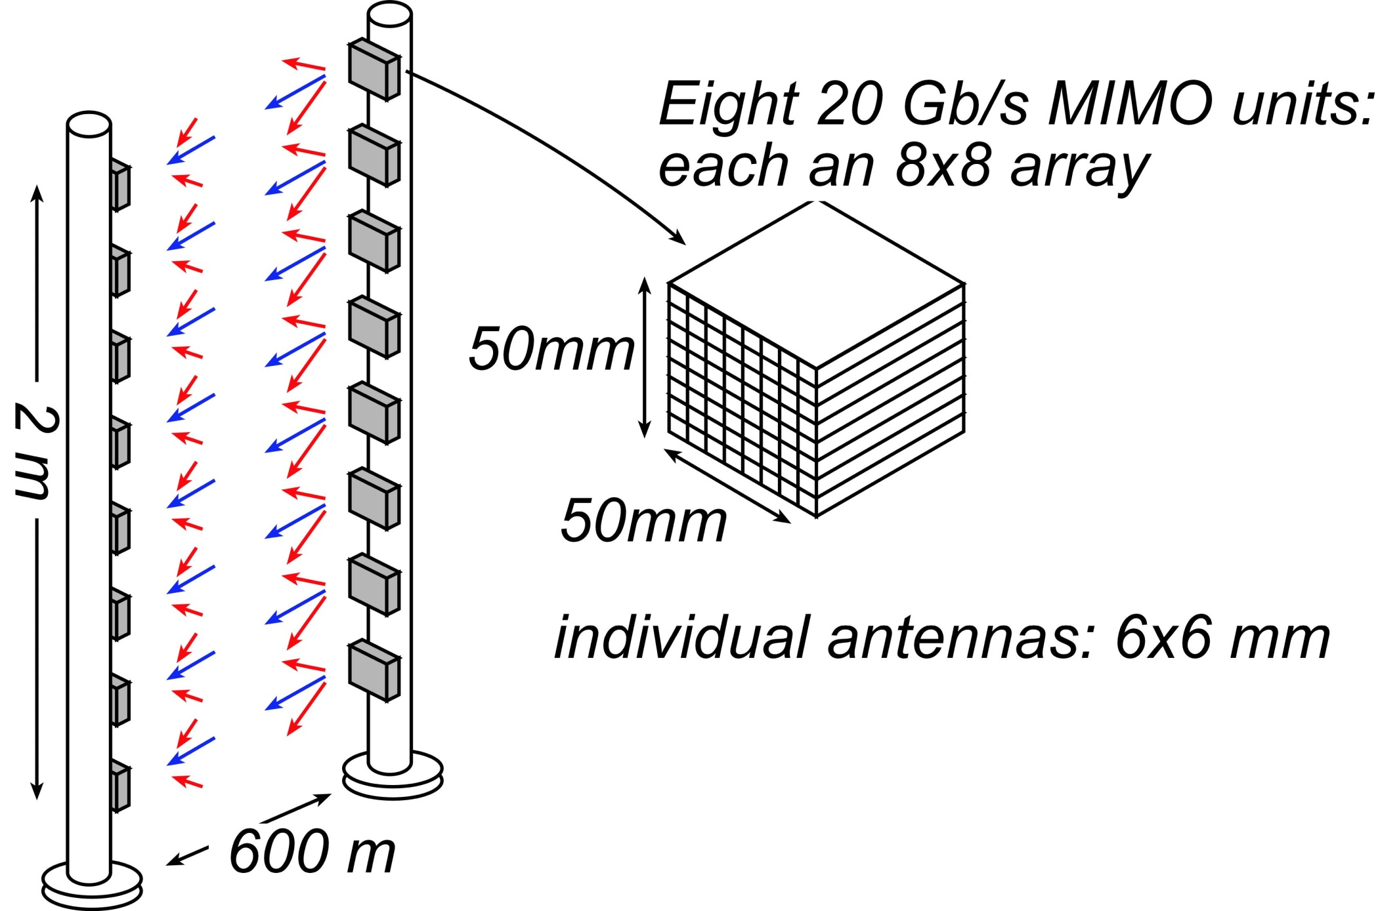
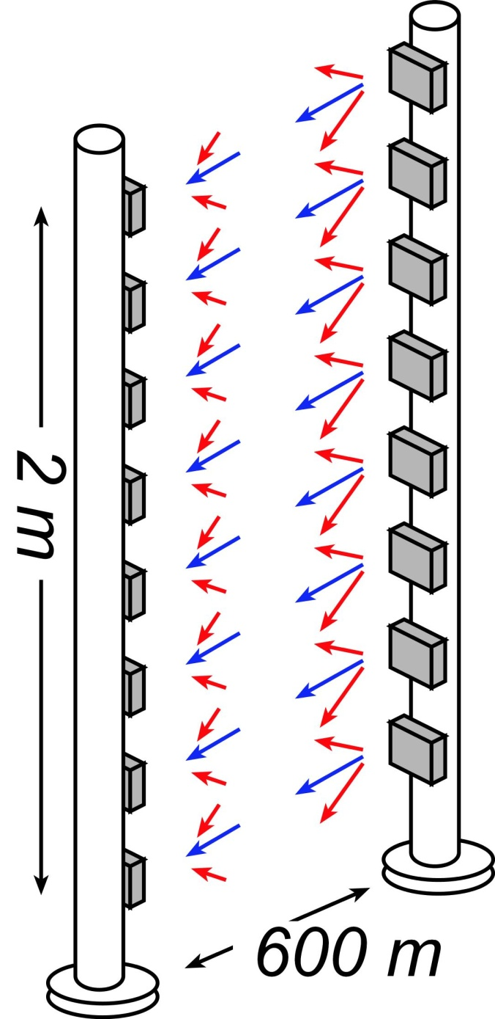
340 GHz, 160 Gb/s MIMO Backhaul Link
→ 1º beamwidth; 8º beamsteering
10

Slide 11
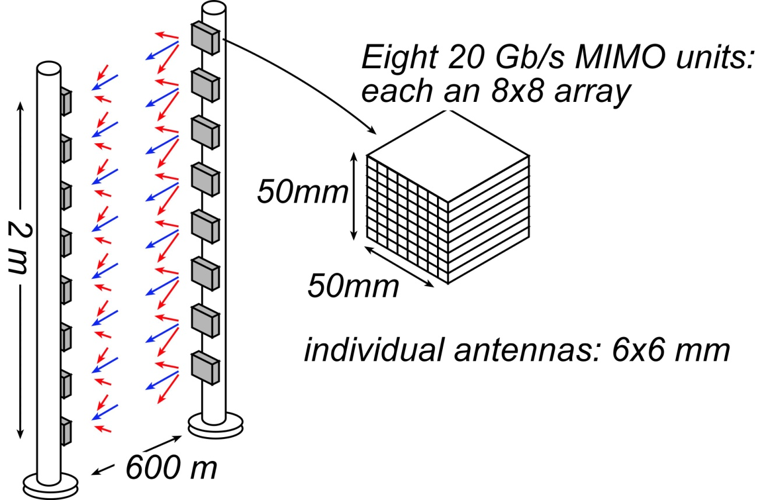
340 GHz, 160 Gb/s MIMO Backhaul Link
1º beamwidth; 8º beamsteering
600 meters range in five-9's rain
Realistic packaging loss, operating & design margins
PAs: 21 dBm P_{sat} (per element)→ InP
LNAs: 7 dB noise figure → InP HEMT
11

Slide 12

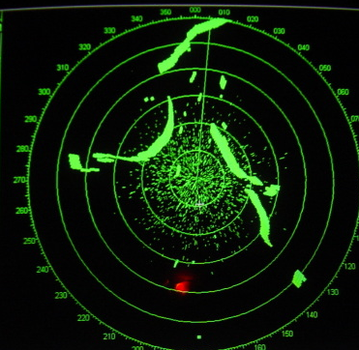

400 GHz frequency-scanned imaging radar
What your eyes see-- in fog
What you see with X-band radar
What you would like to see
12

Slide 13
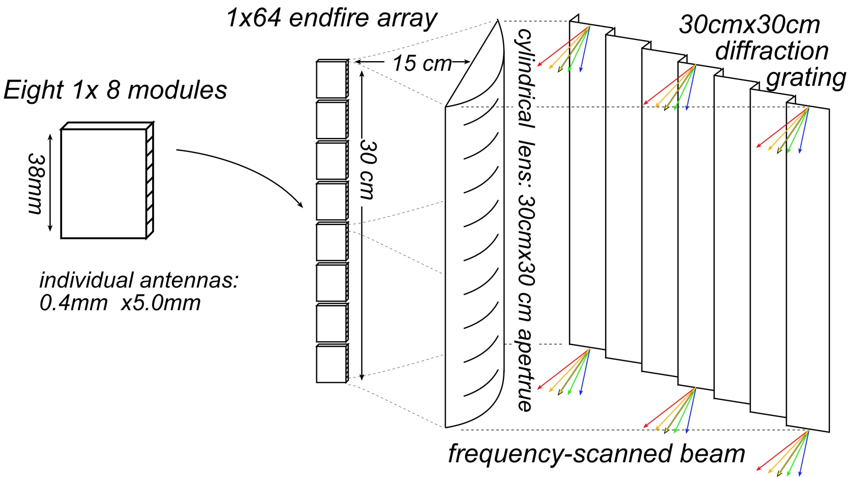
400 GHz frequency-scanned imaging car radar
13

Slide 14
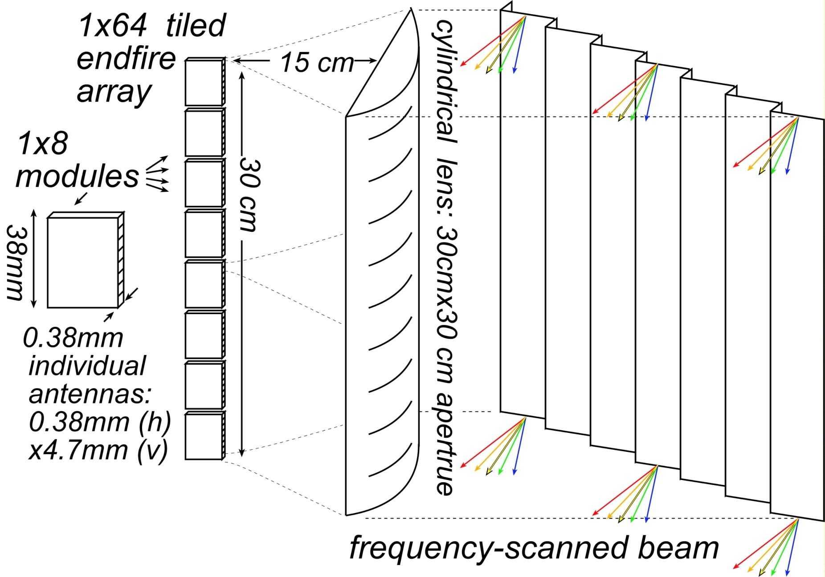
400 GHz frequency-scanned imaging car radar
Range: see a basketball at 300 meters (10 seconds warning) in heavy fog
(10 dB SNR, 28 dB/km, 1 foot diameter target, 65 MPH)
Image refresh rate: 60 Hz
Resolution 64×512=32,800 pixels
Angular resolution: 0.10 degrees
Angular field of view: 9 by 97 degrees
Aperture: 12" by 12"
Component requirements:
10 mW peak power/element,
3% pulse duty factor
6.5 dB noise figure,
5 dB package losses
5 dB manufacturing/aging margin
14

Slide 15
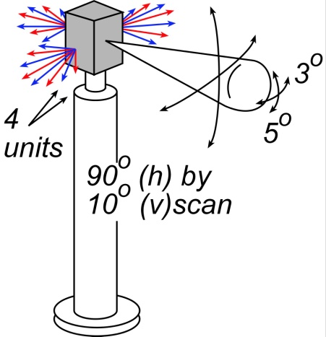
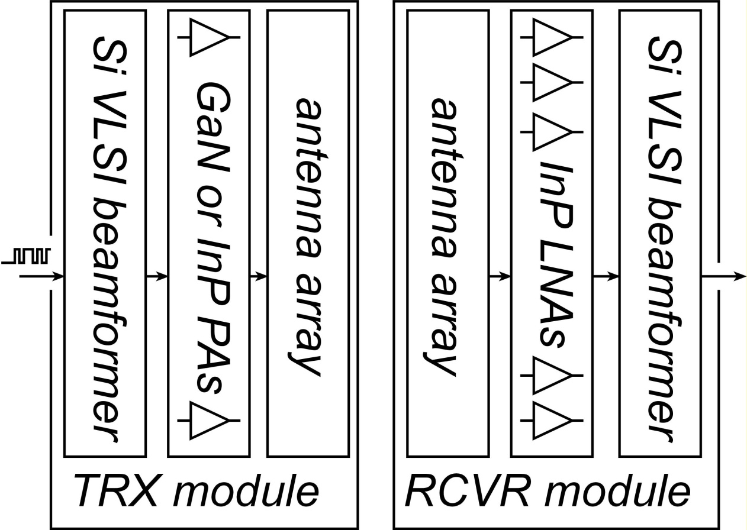
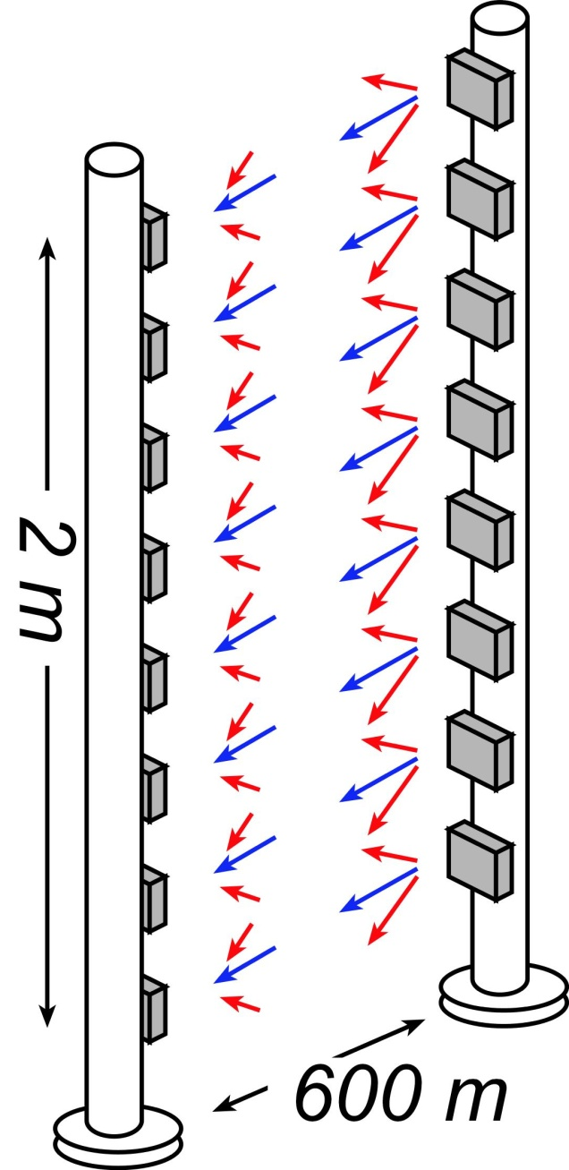
100-1000 GHz Wireless Transceiver Architecture
III-V LNAs, III-V PAs → power, efficiency, noise
Si CMOS beamformer→ integration scale
...similar to today's cell phones.
15

Slide 16
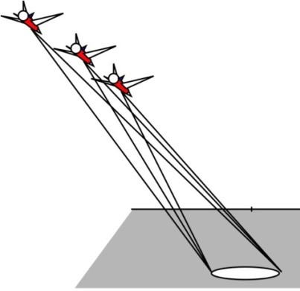
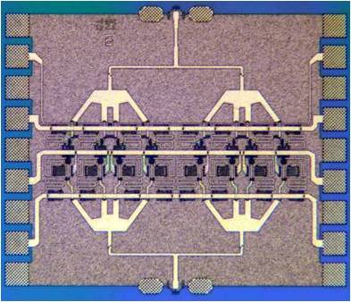
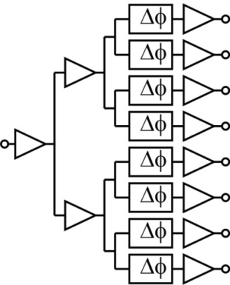
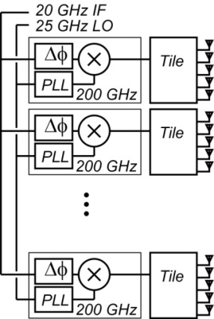

RADAR / Imaging Needs Watts of Power, Low Noise Figure
220 GHz
video-rate
synthetic aperture
radar
...to reach such levels with a solid-state source:
Present 220 GHz, 66 mW PA
Develop 200 mW PA
8-element array tile IC: 1.6 W
32 tiles/array→ 51 W
T. Reed, Z. Griffith
( 200 GHz PLL is existing
design by M. Seo)
As a function of range, weather, and data rate,
effective sub-mm-wave technologies must
low noise figure, high transmit power, and/or moderate to large phased arrays
16

Slide 17
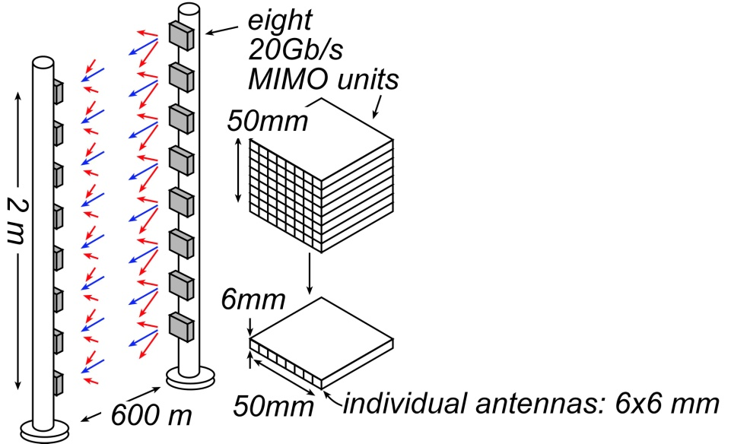
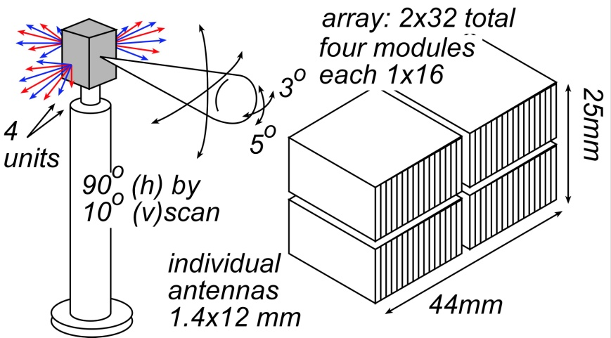
0.1-1 THz Comms Links: No Monolithic Arrays
On-wafer antennas
substantial die area, have high losses
For useful directivity, aperture areas are ~ 25 cm².
→ vastly too large for an IC
17

Slide 18
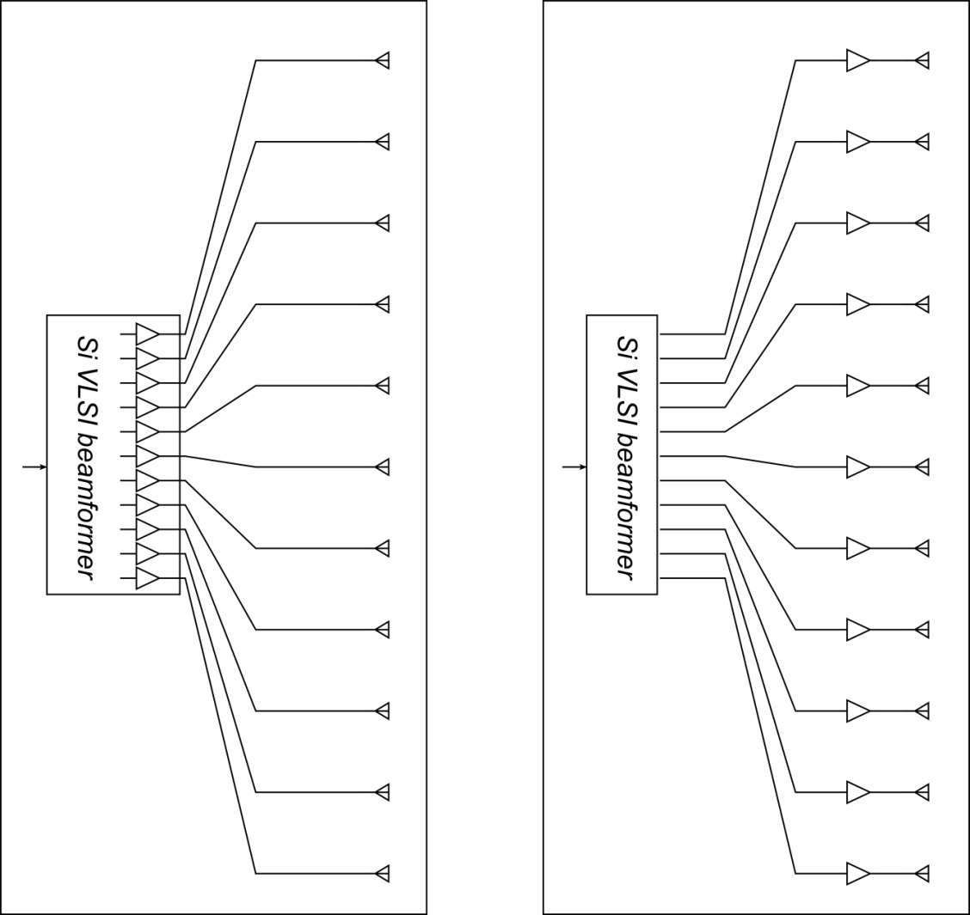
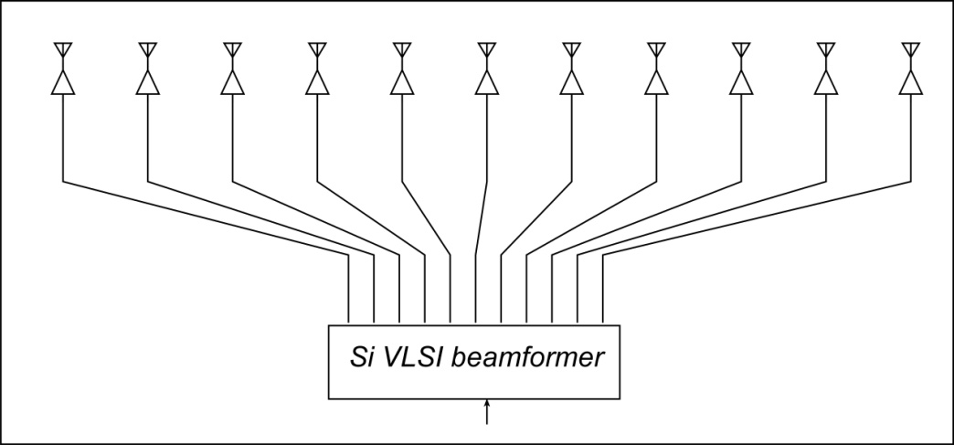
0.1-1 THz Comms Links: Discrete LNAs & PAs
~5 cm
Monolithic PAs & LNAs
long lines to antennas
many dB losses on transmit
many dB losses on transmit
degraded noise, degraded power
array package
Discrete LNAs and PAs
LNAs & PAs: adjacent to antennas
losses no longer impair link
array package
Given that we should not integrate the LNA and PA on the beamformer,
it is to our benefit to use high-performance GaN & InP LNAs and PAs.
18

Slide 19
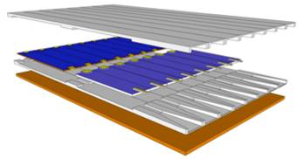
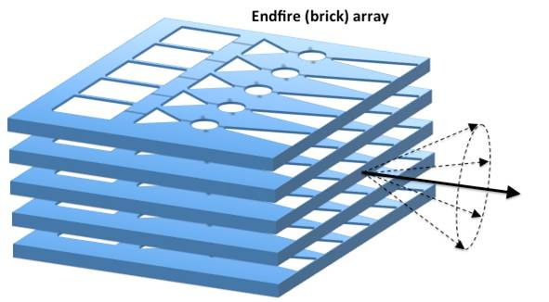
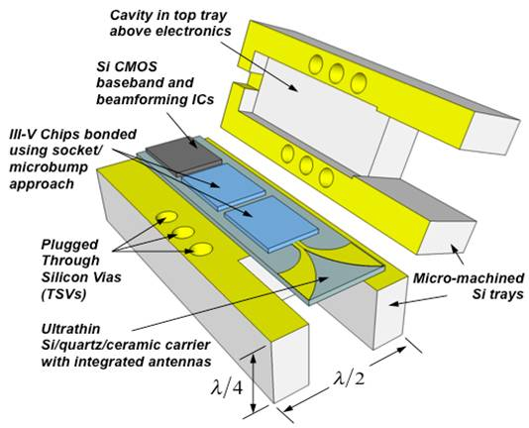
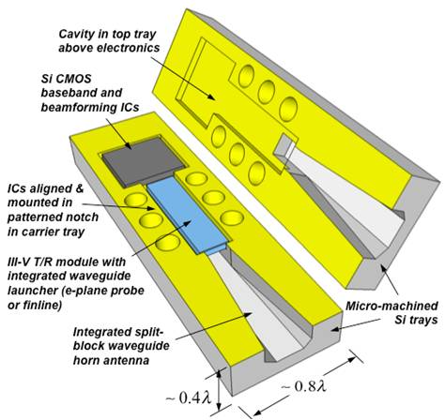
0.1-1 THz Comms Links: Array Design Concepts
Concepts: Robert York, UCSB
19

Slide 20
Effects of array size, Transmitter PAE, Receiver F_{min}
200 mW phase shifters in TRX & RCVR, 0.1 W LNAs
Large arrays:
more directivity, more complex ICs
Small arrays:
less directivity, less complex ICs
→ Proper array size minimizes DC power
Low transmitter PAE
& high receiver noise
are partially offset using arrays,
but DC power, system complexity still suffer
20

Slide 21

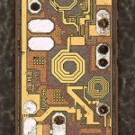
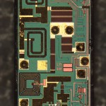
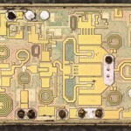
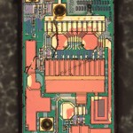
III-V PAs and LNAs in today's wireless systems...
http://www.chipworks.com/blog/recentteardowns/2012/10/02/apple-iphone-5-the-rf/

Slide 22
Devices for 100-1000 GHz systems: F_{min}, P_{sat}, PAE
LNA noise figure, Power amplifier power & efficiency:
All critically important in radio and radar
InP HBTs: strong THz MSI technology
efficient, high-power PAs,
up/down converters (VCOs, synthesizers, mixers)
InP HEMTs: best THz LNA technology
3 dB more noise → 2:1 more transmit power
GaN HEMTs vs. InP HBTs for power:
breakdown vs. gain→ power vs. PAE.
CMOS VLSI:
high bandwidth, high integration scales → bulk of signal processing
poor P_{sat}, PAE, F_{min}.
Harmonic techniques:
multiplication: low power, inefficient, nonlinear (16QAM ?, OFDM ?)
harmonic mixing: high noise figure
22

Slide 23
Transistors
for
100-1000 GHz
systems
23

Slide 24
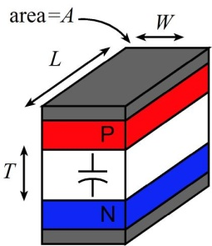
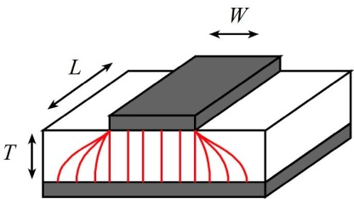
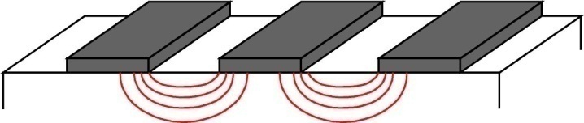
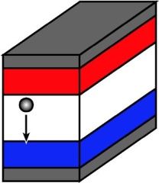
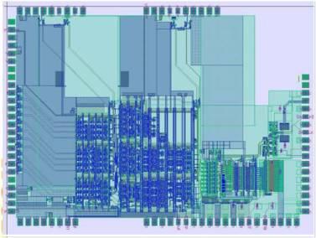
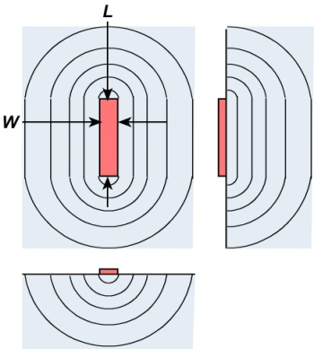
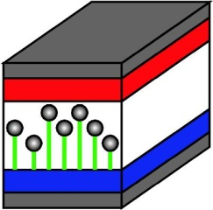
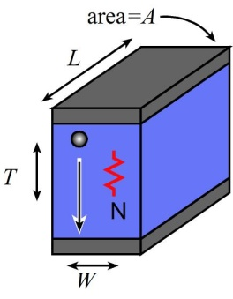
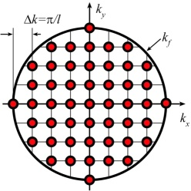
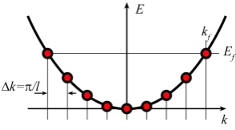


Transistor scaling laws: ( V,I,R,C,τ ) vs. geometry
Depletion Layers
Fringing Capacitances
Thermal Resistance
Bulk and Contact Resistances
Available quantum states to carry current
→ capacitance,
transconductance
contact resistance
24

Slide 25


Changes required to double transistor bandwidth
FET parameter | change
gate length | decrease 2:1
current density (mA/μm), g_{m} (mS/μm) | increase 2:1
transport effective mass | constant
channel 2DEG electron density | increase 2:1
gate-channel capacitance density | increase 2:1
dielectric equivalent thickness | decrease 2:1
channel thickness | decrease 2:1
channel density of states | increase 2:1
source & drain contact resistivities | decrease 4:1
fringing capacitance does not scale → linewidths scale as (1 / bandwidth )
HBT parameter | change
emitter & collector junction widths | decrease 4:1
current density (mA/μm²) | increase 4:1
current density (mA/μm) | constant
collector depletion thickness | decrease 2:1
base thickness | decrease 1.4:1
emitter & base contact resistivities | decrease 4:1
constant voltage, constant velocity scaling
nearly constant junction temperature → linewidths vary as (1 / bandwidth)²
25

Slide 26


THz Bipolar Transistors
150 nm device
H. W. Chiang
J. Rode
V. Jain
V. Jain
26

Slide 27
InP HBT: Key Features
512 nm node:
high-yield "pilot-line" process, ~4000 HBTs/IC
256 nm node:
Power Amplifiers: >0.5 W/mm @ 220 GHz
highly competitive mm-wave / THz power technology
128 nm node:
>500 GHz f_{τ} , >1.1 THz f_{max} , ~3.5 V breakdown
breakdown* f_{τ} = 1.75 THz*Volts
highly competitive mm-wave / THz power technology
64 nm (2 THz) & 32 nm (2.8 THz) nodes:
Development needs major effort, but no serious scaling barriers
1.5 THz monolithic ICs are feasible.
27

Slide 28


InP Bipolar Transistor Scaling Roadmap
3-4 THz Bipolar Transistors are Feasible.
4 THz HBTs realized by:
Extremely low resistivity contacts
Extreme current densities
Processes scaled to 16 nm junctions
Impact:
efficient power amplifiers
and complex signal processing
from 100-1000 GHz.
28

Slide 29



InP Field-Effect-Transistor Scaling Roadmap
2-3 THz InP HEMTs are Feasible.
2 THz FETs realized by:
Ultra low resistivity source/drain
High operating current densities
Very thin barriers & dielectrics
Gates scaled to 9 nm junctions
or
MOSFET
high-barrier HEMT
Impact:
Sensitive, low-noise receivers
from 100-1000 GHz.
3 dB less noise →
need 3 dB less transmit power.
29

Slide 30
Can we make a 1 THz SiGe Bipolar Transistor ?
InP SiGe
emitter 64 18 nm width
2 0.6 Ω⋅μm² access ρ
base 64 18 nm contact width,
2.5 0.7 Ω⋅μm² contact ρ
collector 53 15 nm thick
36 125 mA/μm²
2.75 1.3? V, breakdown
f_{τ} 1000 1000 GHz
f_{max} 2000 2000 GHz
PAs 1000 1000 GHz
digital 480 480 GHz
(2:1 static divider metric)
Simple physics clearly drives scaling
transit times, C_{cb}/I_{c}
→ thinner layers, higher current density
high power density → narrow junctions
small junctions→ low resistance contacts
Key challenge: Breakdown
15 nm collector → very low breakdown
Also required:
low resistivity Ohmic contacts to Si
very high current densities: heat
Assumes collector junction 3:1 wider than emitter.
Assumes SiGe contacts no wider than junctions
30

Slide 31





III-V vs. CMOS: A false comparison ?
UTB Si MOS
UTB III-V MOS
III-V THz
MOS/HEMT
III-V THz HEMT
III-V MOS has a reasonable chance of future use in VLSI
The real THz / VLSI distinction:
Device geometry optimized for high-frequency gain
vs. optimized for small footprint and high DC on/off ratio.
31

Slide 32
0.1-1THz
IC Design
32

Slide 33
Challenges: 100-1000 GHz IC design
33

Slide 34
III-V MIMIC Interconnects -- Classic Substrate Microstrip
W
Zero ground
inductance
in package
Thick Substrate
→ low skin loss
No ground plane
breaks in IC
H
k_{z}
High via inductance
TM substrate
mode coupling
12 pH for 100 μm substrate -- 7.5 Ω @ 100 GHz
Strong coupling when substrate approaches ~λ_{d} / 4 thickness
lines must be
widely spaced
ground vias must be
widely spaced
Line spacings must be
~3*(substrate thickness)
all factors require very thin substrates for >100 GHz ICs
→ lapping to ~50 μm substrate thickness typical for 100+ GHz
34

Slide 35




Coplanar Waveguide
No ground vias
No need (???) to thin substrate
Hard to ground IC
to package
+V
+V
+V
0V
Parasitic microstrip mode
ground plane breaks → loss of ground integrity
substrate mode coupling
or substrate losses
III-V:
semi-insulating substrate→ substrate mode coupling
Silicon
conducting substrate
→ substrate conductivity losses
k_{z}
-V
0V
+V
0V
Parasitic slot mode
Repairing ground plane with ground straps is effective only in simple ICs
In more complex CPW ICs, ground plane rapidly vanishes
→ common-lead inductance → strong circuit-circuit coupling
poor ground integrity
loss of impedance control
ground bounce
coupling, EMI, oscillation
40 Gb/s differential TWA modulator driver
note CPW lines, fragmented ground plane
35 GHz master-slave latch in CPW
note fragmented ground plane
175 GHz tuned amplifier in CPW
note fragmented ground plane
35

Slide 36
If It Has Breaks, It Is Not A Ground Plane !
signal line
signal line
ground plane
coupling / EMI due to poor ground system integrity is common in high-frequency systems
whether on PC boards
...or on ICs.
36

Slide 37


III-V MIMIC Interconnects -- Thin-Film Microstrip
narrow line spacing → IC density
no substrate radiation, no substrate losses
fewer breaks in ground plane than CPW
... but ground breaks at device placements
still have problem with package grounding
InP 34 GHz PA
(Jon Hacker , Teledyne)
...need to flip-chip bond
W
thin dielectrics → narrow lines
→ high line losses
→ low current capability
→ no high-Z_{o} lines
H
37

Slide 38





III-V MIMIC Interconnects -- Inverted Thin-Film Microstrip
narrow line spacing → IC density
Some substrate radiation / substrate losses
No breaks in ground plane
... no ground breaks at device placements
still have problem with package grounding
InP 150 GHz master-slave latch
...need to flip-chip bond
thin dielectrics → narrow lines
→ high line losses
→ low current capability
→ no high-Z_{o} lines
InP 8 GHz clock rate delta-sigma ADC
38

Slide 39

VLSI mm-wave interconnects with ground integrity
narrow line spacing → IC density
no substrate radiation, no substrate losses
negligible breaks in ground plane
negligible ground breaks @ device placements
Also:
Ground plane at *intermediate level* permits
critical signal paths to cross supply lines, or other
interconnects without coupling.
(critical signal line is placed above ground,
other lines and supplies are placed below ground)
still have problem with package grounding
...need to flip-chip bond
thin dielectrics → narrow lines
→ high line losses
→ low current capability
→ no high-Z_{o} lines
39

Slide 40






RF-IC Design: Simple & Well-Known Procedures
1: (over)stabilize at the design frequency
guided by stability circles
2: Tune input for F_{min} (LNAs) or output for P_{sat} (PAs)
3: Tune remaining port for maximum gain
4: Add out-of-band stabilization.
There are many ways to tune port impedances: microstrip lines, MIM capacitors, transformers
Choice guided by tuning losses. No particular preferences.
For BJT's, MAG/MSG usually highest for common-base.
→ preferred topology.
Common-base gain is however reduced by:
base (layout) inductance
emitter-collector layout capacitance.
40

Slide 41




Modeling Interconnects: Digital & Mixed-Signal IC's
longer interconnects:
lines terminated in Zo → no reflections.
Shorter interconnects:
lines NOT terminated in Zo .
But they are *still* transmission-lines.
Ignore their effect at your peril !
If length << wavelength,
or line delay<<risetime,
short interconnects behave
as lumped L and C.
41

Slide 42


Design Flow: Digital & Mixed-Signal IC's
All interconnects: thin-film microstrip environment.
Continuous ground on one plane.
2.5-D simulations run on representative lines.
various widths, various planes
same reference (ground) plane.
Simulation data manually fit to CAD line model
effective substrate ε_{r} , effective line-ground spacing.
Width, length, substrate of each line
entered on CAD schematic.
rapid data entry, rapid simulation.
Resistors and capacitors:
2.5-D simulation→ RLC fit
RLC model ---or simulation S-parameters --used in simulation.
42

Slide 43




High Speed ECL Design
Followers associated with inputs, not outputs
Emitters never drive long wires.
(instability with capacitive load)
Double termination for least ringing, send or receive termination for moderate-length lines, high-Z loading saves power but kills speed.
Current mirror biasing is more compact.
Mirror capacitance→ ringing, instability.
Resistors provide follower damping.
43

Slide 44




High Speed ECL Design
Layout: short signal paths at gate centers, bias sources surround core.
Inverted thin film microstrip wiring.
Key: transistors in on-state
operate at Kirk limited-current.
→ minimizes C_{cb}/I_{c} delay.
Key: transistors designed for minimum
ECL gate delay*, not peak (f_{τ} , f_{max}).
*hand expression, charge-control analysis
205 GHz divider, Griffith et al, IEEE CSIC, Oct. 2010
Example: 8:1 205 GHz static divider
in 256 nm InP HBT.
44

Slide 45

ICs in Thin-Film (Not Inverted) Microstrip
Note breaks in ground plane at transistors, resistors, capacitors
45

Slide 46

ICs in Thin-Film (Not Inverted) Microstrip
Note breaks in ground plane at transistors, resistors, capacitors
46

Slide 47

ICs in Thin-Film Inverted Microstrip
100 GHz differential TASTIS Amp. 512nm InP HBT
47

Slide 48
High Frequency Bipolar IC Design
Digital, mixed-signal, RF-IC (tuned) IC designs----at very high frequencies
Even at 670 GHz, design procedures differ little from that at lower frequencies:
Classic IC design extends readily to the far-infrared.
Key considerations: Tuned ("RF") ICs
Rigorous E&M modeling of all interconnects & passive elements
Continuous ground plane → required for predicable interconnect models.
Higher frequencies→ close conductor planes→ higher loss, lower current
Key considerations: digital & mixed-signal :
Transmission-line modeling of all interconnects
Continuous ground plane → required for predicable interconnect models.
Unterminated lines within blocks; terminated lines interconnecting blocks.
Analog & digital blocks design to naturally interface to 50 or 75Ω.
48

Slide 49
Design Examples,
IC Results
49

Slide 50








InP HBT Integrated Circuits: 600 GHz & Beyond
614 GHz
fundamental
VCO
340 GHz dynamic frequency divider
M. Seo, TSC / UCSB
M. Seo, UCSB/TSC
IMS 2010
565 GHz, 34 dB, 0.4 mW output power
amplifier
300 GHz fundamental
PLL
J. Hacker, TSC
M. Seo, TSC
IMS 2011
204 GHz static
frequency divider
(ECL master-slave
latch)
220 GHz
90 mW
power amplifier
Z. Griffith, TSC
CSIC 2010
T. Reed, UCSB
Integrated 300/350GHz Receivers:
LNA/Mixer/VCO
600 GHz
Integrated
Transmitter
PLL + Mixer
M. Seo TSC
M. Seo TSC
50

Slide 51






Digital Logic: 30 GHz to 204 GHz in 12 Years
1998: 30 GHz→ 48 GHz
2004: 118 GHz
2000: 66 GHz
2004: 142 GHz, 150 GHz
2001: 75GHz
2010: 204 GHz (with Teledyne)
2002: 87GHz
51

Slide 52









Other InP HBT ICs in Inverted Microstrip
Teledyne InP HBT
256 nm, 512 nm
InP 8 GHz clock rate delta-sigma ADC
(Krishnan, IMS 2003)
40 Gb/s coherent optically-phase-locked
BSPK optical receiver (Bloch, Park, ECOC 2012)
40 Gb/s coherent optically-phase-locked
QPSK optical receiver (E. Bloch, being tested)
30 GHz digital SSB mixer / PFD for optical PLL
(Bloch, IMS 2012)
10 Gb/s x 6-channel (+/- 12.5, +/- 37.5, +/- 62.5 GHz)
WDM receiver IC for coherent optical links
(H. Park, being tested )
50 GS/s Track/hold and sample/hold amplifiers
Daneshgar, IEEE CSICS Oct. 2012
52

Slide 53



Teledyne: 600 GHz Common-Base Amplifier IC
S-parameters
Output Power
12-Stage Common-base using inverted CPW-G architecture
2.8 dBm saturated output power
>20 dB gain up to 620 GHz
1360x340 μm²
M. Seo et al, Teledyne Scientific: IMS2013
53

Slide 54


90 mW, 220 GHz Power Amplifier
Reed (UCSB) and Griffith (Teledyne): CSIC 2012
Teledyne 250 nm InP HBT
active area, 1.02 x 0.85 mm
die: 2.42 x 1.22 mm
54
Notes:
when you show the IBM FET, you say:
"because we want a device with the geometry taken for granted in silicon VLSI"
..source/drain pitch at most a few times the gate length.

Slide 55
90 mW, 220 GHz Power Amplifier
Reed (UCSB) and Griffith (Teledyne): CSIC 2012
Teledyne 250 nm InP HBT
active area, 1.02 x 0.85 mm
die: 2.42 x 1.22 mm
RF output power densities
up to 0.5 W/mm @ 220 GHz.
→ InP HBT is a competitive mm-wave / sub-mm-wave power technology.
55
Notes:
when you show the IBM FET, you say:
"because we want a device with the geometry taken for granted in silicon VLSI"
..source/drain pitch at most a few times the gate length.

Slide 56

220 GHz 330mW Power Amplifier Design
2.3 mm x 2.5 mm
T. Reed, UCSB
Z. Griffith, Teledyne
Teledyne 250 nm InP HBT
56

Slide 57



84 GHz Power Amplifier Design #1: 250 nm InP HBT
Simulations:
HBT: 16 fingers x 6um x 0.25um= 96 um x 0.25 um
Gain: 9.2dB
PAE: 35%
P_{out}: 22.3 dBm (170 mW) → 1.75 W/mm
Chip size: 450 μm x 780 μm
57

Slide 58



84 GHz Power Amplifier Design #2: 250 nm InP HBT
Simulations:
HBT: 96 fingers x 6um x 0.25um= 576 um x 0.25 um
Gain: 16.5dB
PAE: 24%
P_{out}: 28.8 dBm (760 mW) → 1.3 W/mm
Chip size: 1100 μm x 980 μm
58

Slide 59

220 GHz Vector Modulator / Phase Shifter Design
0º
59

Slide 60

220 GHz Vector Modulator / Phase Shifter Design
0º
60

Slide 61




220 GHz Vector Modulator / Phase Shifter Design
intended operating range
Technology: 256nm InP HBT
9/2012 tapeout; ICs expected 12/2012
61

Slide 62


THz Electronics for Terabit fiber optics
Bandwidth of optical fiber: ~5 THz.
Bandwidth of modern ICs: ~800GHz.
→ With THz transistors, and new IC toplogies,
electrical ICs can access over 1 THz of the optical fiber spectrum
submitted to ECOC 2013
62

Slide 63
Closing
63

Slide 64



Where Next ? → 2 THz Transistors, 1 THz Radios.
transmitter
receiver
interconnects
circuits
64

Slide 65







THz and Far-Infrared Electronics
IR today→ lasers & bolometers → generate & detect
Far-infrared ICs: classic device physics, classic circuit design
Power, power-added efficiency, noise figure are all very important
fundamental-mode operation, not harmonic generation
The transistors will scale to at least 2 THz bandwidths
Even 1-3 THz ICs will be feasible
65

Slide 66
(backup slides follow)
66

