Slide 1
Transistors for THz Systems
IMS Workshop: Technologies for THZ Integrated Systems (WMD)
Monday, June 3, 2013, Seattle, Washington (8AM-5PM)
Mark Rodwell, UCSB
rodwell@ece.ucsb.edu
Co-Authors and Collaborators:
Teledyne HBT Team:
M. Urteaga, R. Pierson, P. Rowell, B. Brar, Teledyne Scientific Company
Teledyne IC Design Team:
M. Seo, J. Hacker, Z. Griffith, A. Young, M. J. Choe, Teledyne Scientific Company
UCSB HBT Team:
J. Rode, H.W. Chiang, A. C. Gossard , B. J. Thibeault, W. Mitchell
Recent Graduates: V. Jain, E. Lobisser, A. Baraskar,
UCSB IC Design Team:
S. Danesgar, T. Reed, H-C Park, Eli Bloch
WMD: Technologies for THZ Integrated Systems
RFIC2013, Seattle, June 2-4, 2013
1

Slide 2
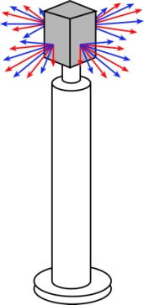


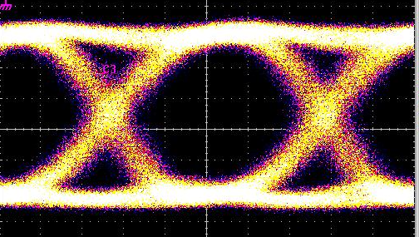
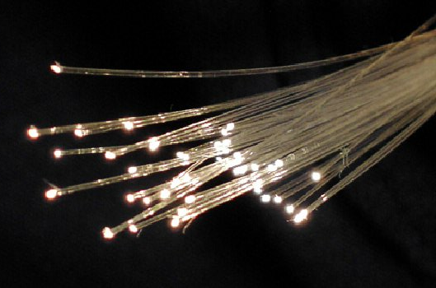

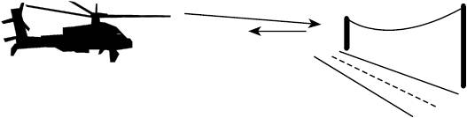
DC to Daylight. Far-Infrared Electronics
How high in frequency can we push electronics ?
*ITU band designations
** IR bands as per ISO 20473
1982: ~20 GHz
2012: 820 GHz
~2030: 3THz
...and what we would be do with it ?
100+ Gb/s wireless networks
Video-resolution radar
→ fly & drive through fog & rain
near-Terabit
optical fiber links
2

Slide 3
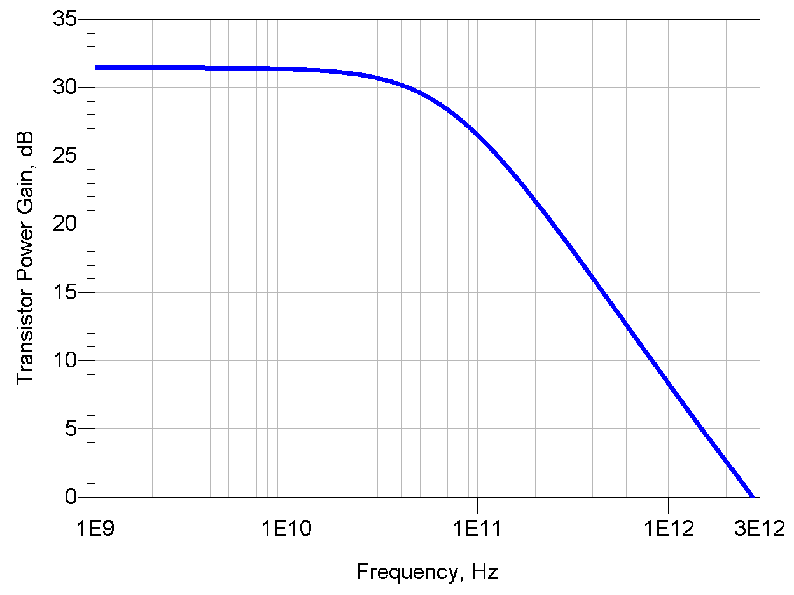
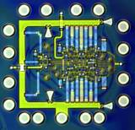
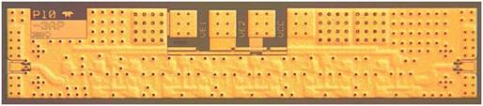
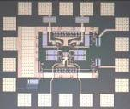
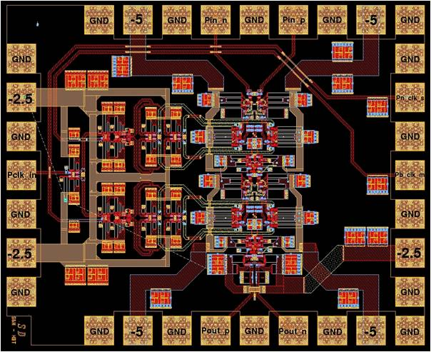
THz Transistors: Not Just For THz Circuits
500 GHz digital logic
→ fiber optics
THz amplifiers→ THz radios
→ imaging, communications
precision analog design
at microwave frequencies
→ high-performance receivers
Higher-Resolution
Microwave ADCs, DACs, DDSs
3

Slide 4
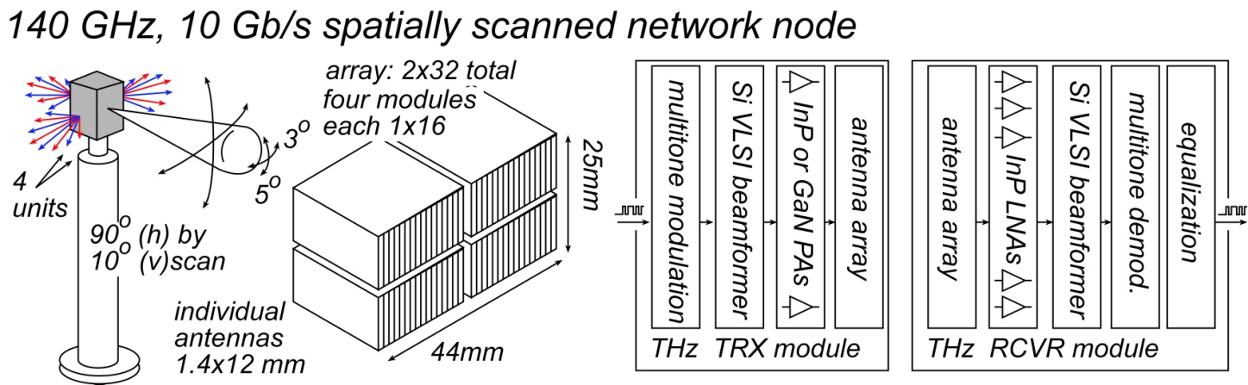
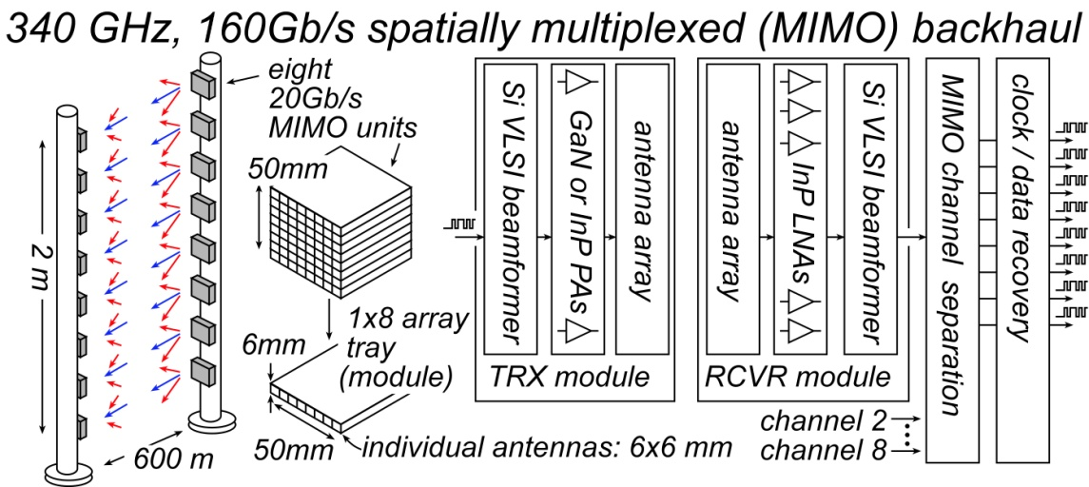
THz Communications Needs High Power, Low Noise
Real systems with real-world weather & design margins, 500-1000m range:
Will require:
3-7 dB Noise figure, 50mW- 1W output/element, 64-256 element arrays
→ InP or GaN PAs and LNAs, Silicon beamformer ICs
4

Slide 5
THz Communications Needs High Power, Low Noise
Real systems→ LNAs with low Fmin, PAs with high Psat & high PAE
Comparing technologies
InP HEMTs give the best noise. InP HBT & GaN HEMT compete for the PA.
CMOS is great for signal processing, but noise, power, PAE are poor.
Harmonic generation is low power, inefficient. Harmonic mixing is noisy.
5

Slide 6

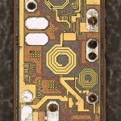
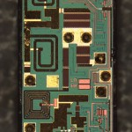
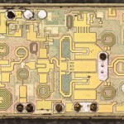
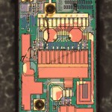
III-V PAs and LNAs in today's wireless systems...
http://www.chipworks.com/blog/recentteardowns/2012/10/02/apple-iphone-5-the-rf/

Slide 7
THz Device Scaling
7

Slide 8
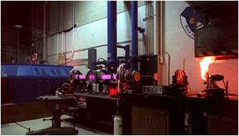
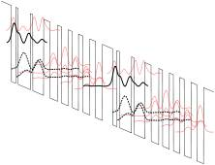

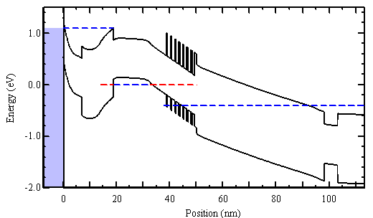
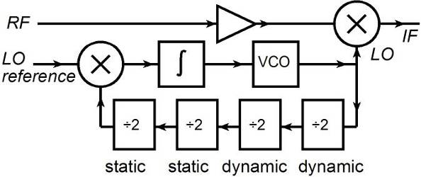
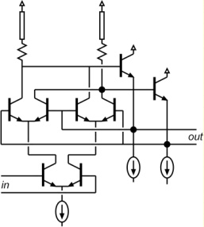
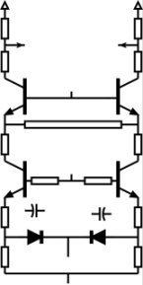
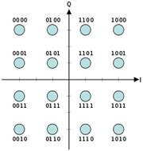
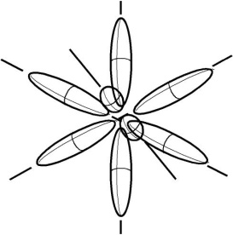
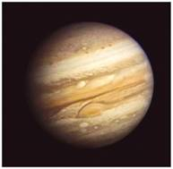
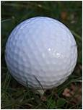
nm Transistors, Far-Infrared Integrated Circuits
IR today→ lasers & bolometers → generate & detect
Far-infrared ICs: classic device physics, classic circuit design
It's all about the interfaces:
contact and gate dielectrics...
...wire resistance,...
...& charge density.
...heat,...
band structure and density of states !
8

Slide 9
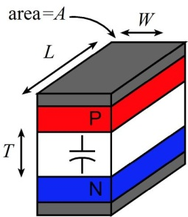
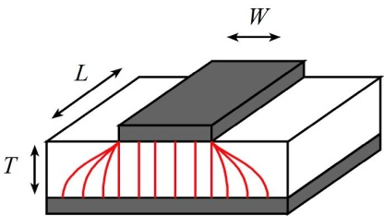
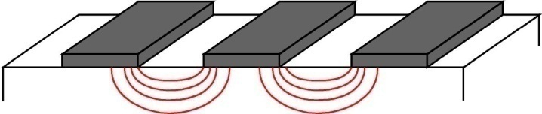
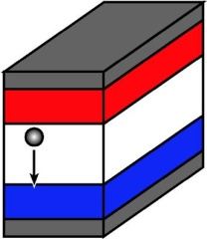
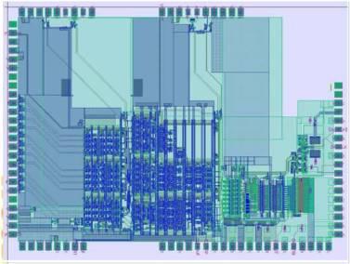
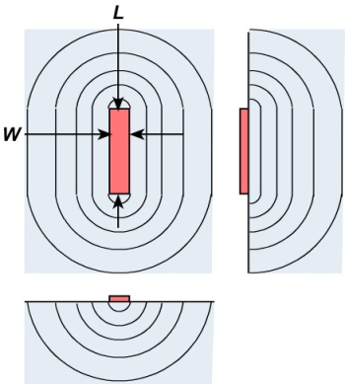
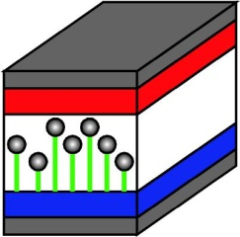
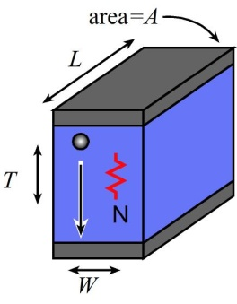
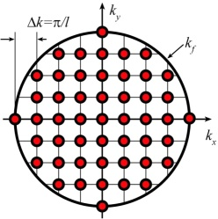
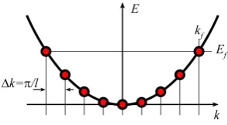
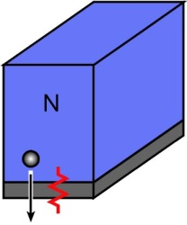
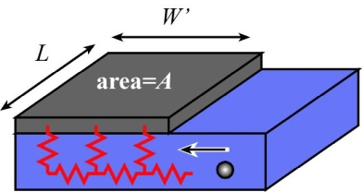
Transistor scaling laws: ( V,I,R,C,t ) vs. geometry
Depletion Layers
Fringing Capacitances
Thermal Resistance
Bulk and Contact Resistances
Available quantum states to carry current
→ capacitance,
transconductance
contact resistance
9

Slide 10
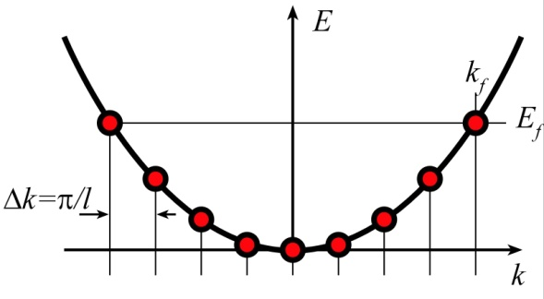
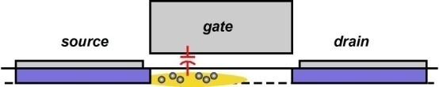
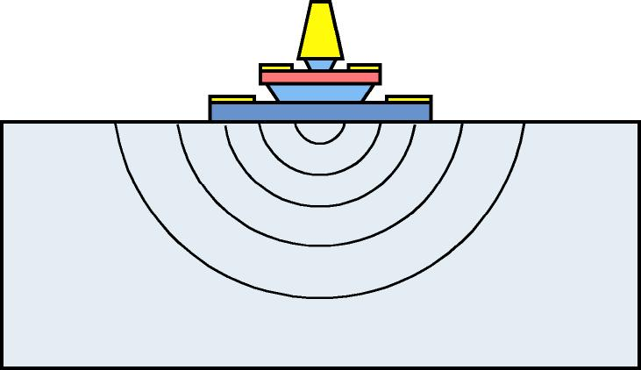
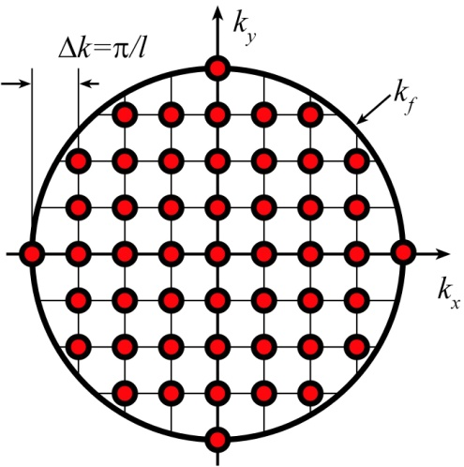
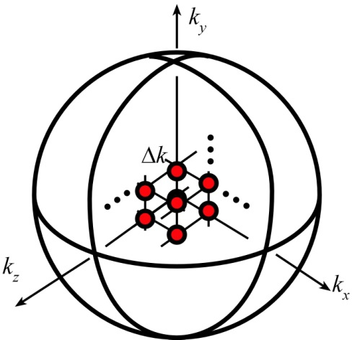
THz & nm Transistors: State Density Limits
2-D: FET
3-D: BJT
capacitance
current
conductivity
# of available quantum states / energy
determines FET channel capacitance
FET and bipolar transistor current
access resistance of Ohmic contact
10

Slide 11
Bipolar Transistor Design
11

Slide 12
Bipolar Transistor Design: Scaling
12

Slide 13
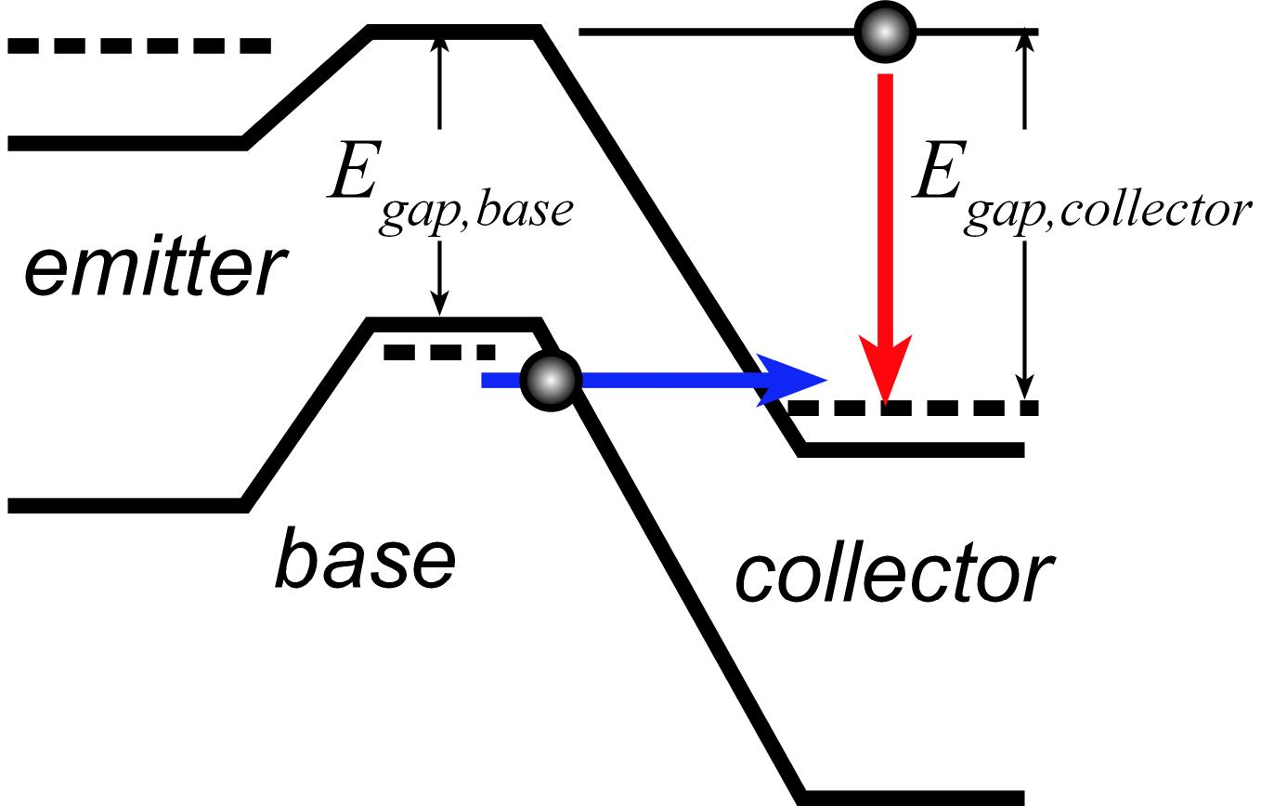
Breakdown: Never Less than the Bandgap
band-band tunneling: base bandgap
impact ionization: collector bandgap
13

Slide 14
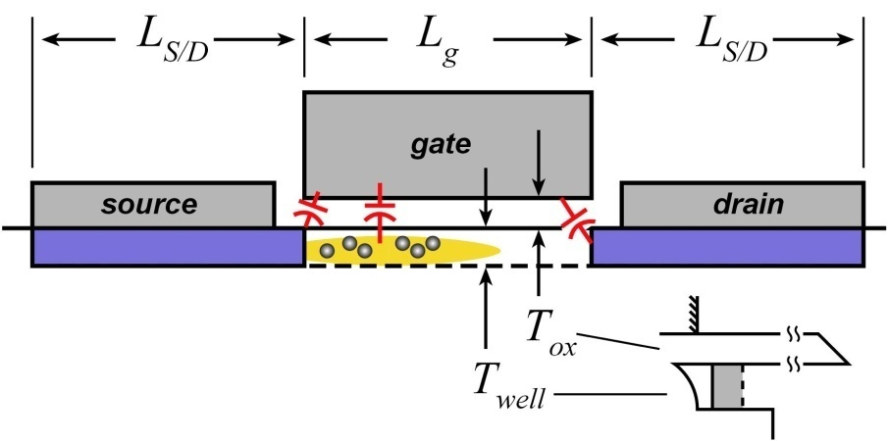
FET Design
14

Slide 15
FET Design: Scaling
15

Slide 16
FET Design: Scaling
2:1
2:1
constant
2:1
2:1
2:1
2:1
2:1
2:1
2:1
2:1
constant
constant
constant
constant
4:1
2:1
2:1
constant
2:1
2:1
16

Slide 17
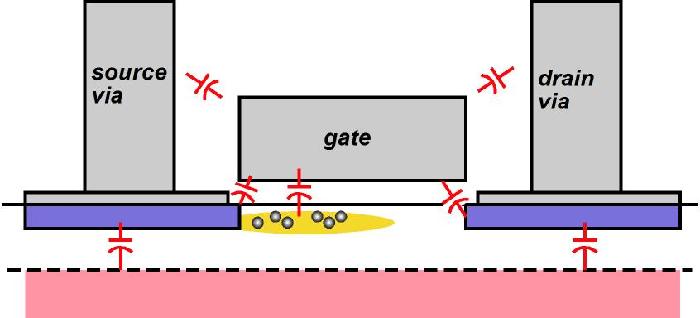
Changes required to double transistor bandwidth
FET parameter | change
gate length | decrease 2:1
current density (mA/μm), g_{m} (mS/μm) | increase 2:1
transport effective mass | constant
channel 2DEG electron density | increase 2:1
gate-channel capacitance density | increase 2:1
dielectric equivalent thickness | decrease 2:1
channel thickness | decrease 2:1
channel density of states | increase 2:1
source & drain contact resistivities | decrease 4:1
fringing capacitance does not scale → linewidths scale as (1 / bandwidth )
HBT parameter | change
emitter & collector junction widths | decrease 4:1
current density (mA/μm²) | increase 4:1
current density (mA/μm) | constant
collector depletion thickness | decrease 2:1
base thickness | decrease 1.4:1
emitter & base contact resistivities | decrease 4:1
constant voltage, constant velocity scaling
nearly constant junction temperature → linewidths vary as (1 / bandwidth)²
17

Slide 18

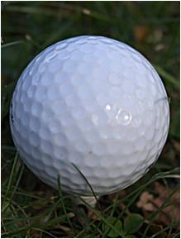
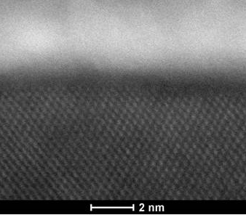
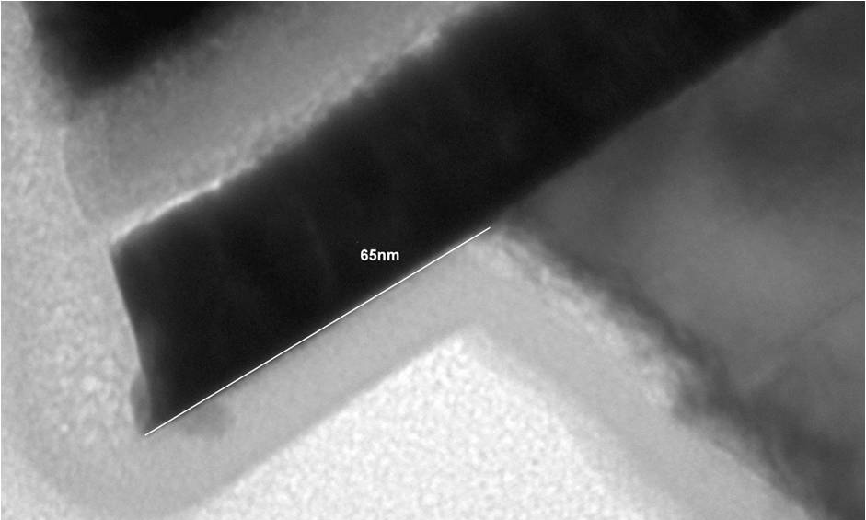
THz & nm Transistors: what needs to be done
Metal-semiconductor interfaces (Ohmic contacts): very low resistivity
Dielectric-semiconductor interfaces (Gate dielectrics---FETs only): thin !
Ultra-low-resistivity (~0.25 Ω-μm² ), ultra shallow (1 nm), ultra-robust (0.2 A/μm² ) contacts
Mo
Ru
InGaAs
InGaAs
Heat
Available quantum states to carry current
→ capacitance,
transconductance
contact resistance
18

Slide 19
THz InP HBTs
19

Slide 20
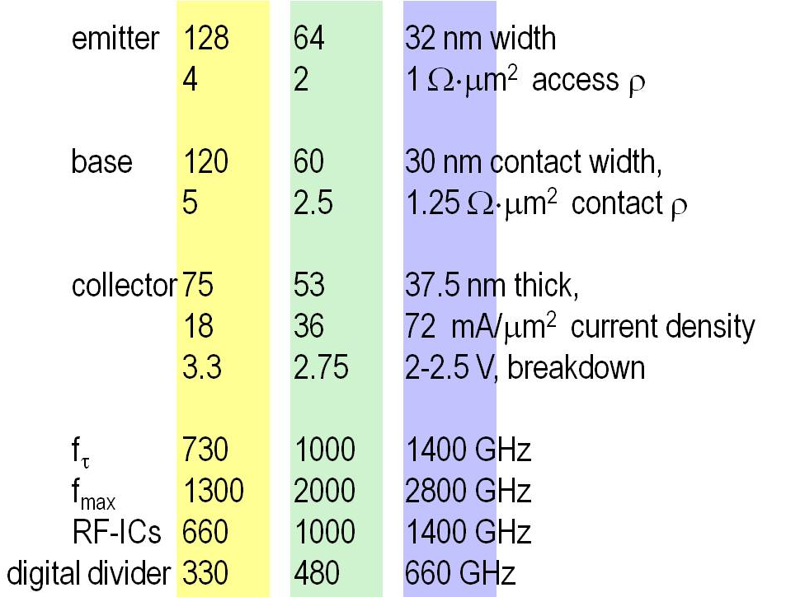
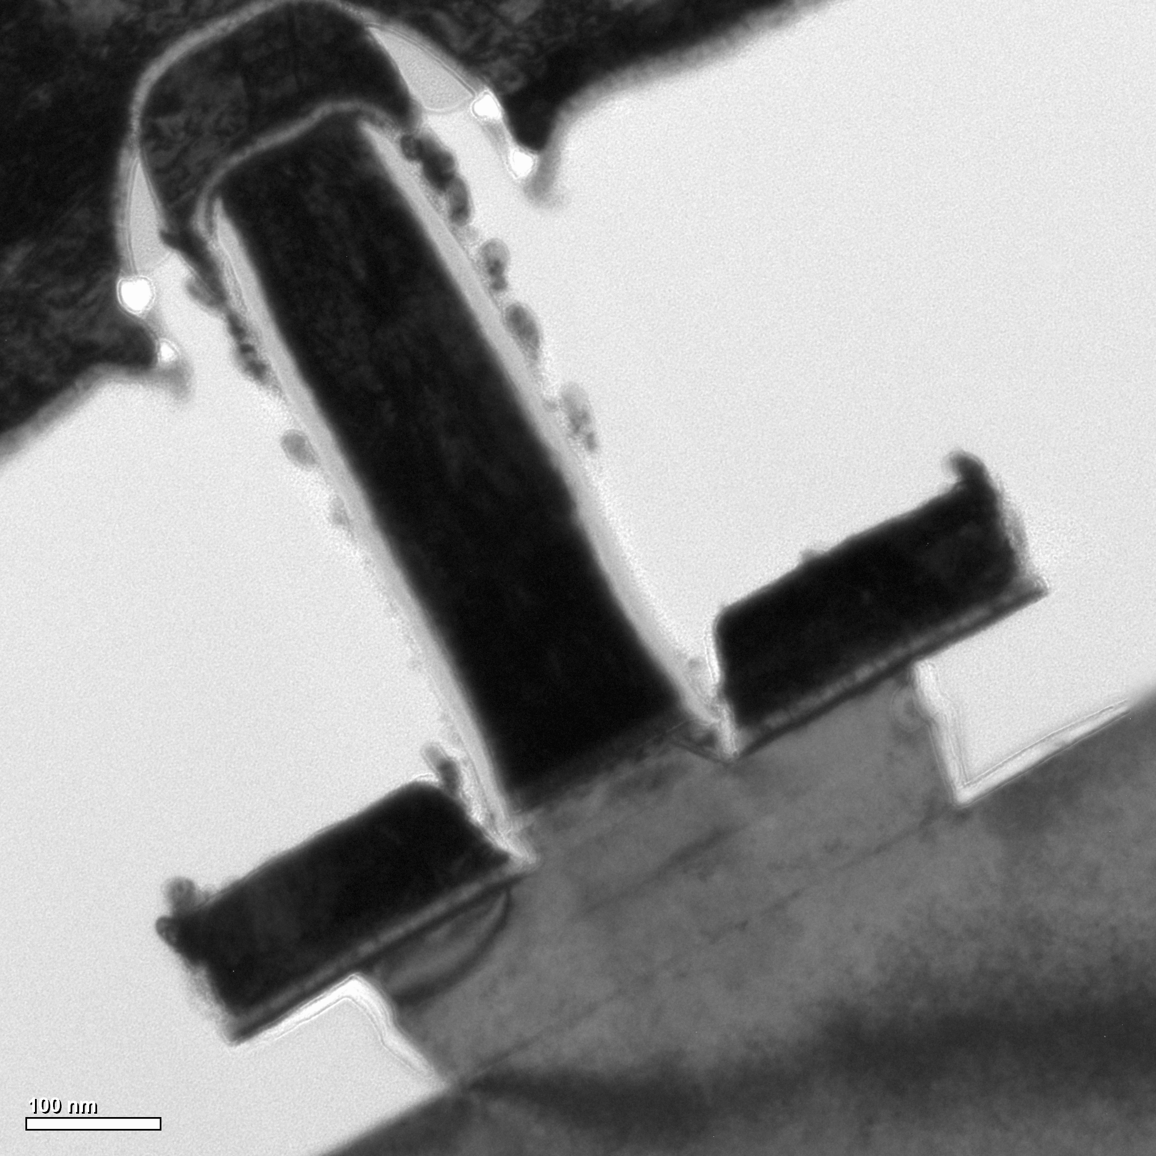
Scaling Laws, Scaling Roadmap
scaling laws: to double bandwidth
HBT parameter | change
emitter & collector junction widths | decrease 4:1
current density (mA/μm²) | increase 4:1
current density (mA/μm) | constant
collector depletion thickness | decrease 2:1
base thickness | decrease 1.4:1
emitter & base contact resistivities | decrease 4:1
150 nm device
150 nm device
20

Slide 21
HBT Fabrication Process Must Change... Greatly
32 nm width base & emitter contacts...self-aligned
32 nm width emitter semiconductor junctions
Contacts:
1 Ω-μm² resistivities
70 mA/μm² current density
~1 nm penetration depths
→ refractory contacts
nm III-V FET, Si FET processes have similar requirements
21

Slide 22

Needed: Greatly Improved Ohmic Contacts
Needed: Greatly Improved Ohmic Contacts
emitter
Pt/Ti/Pd/Au
emitter
Au
Au
~5 nm
Pt contact
penetration
(into 25 nm base)
Pd
Pd
Ti
Ti
base
base
22

Slide 23
Ultra Low-Resistivity Refractory Contacts
Barasakar et al
IEEE IPRM 2012
Mo
Mo
32 nm node requirements
In-situ: avoids surface contaminants
Refractory: robust under high-current operation
Low penetration depth, ~ 1 nm
Contact performance sufficient for 32 nm /2.8 THz node.
23

Slide 24

Ultra Low-Resistivity Refractory Contacts
Barasakar et al
IEEE IPRM 2012
Mo
Mo
32 nm node requirements
Schottky Barrier is about one lattice constant
what is setting contact resistivity ?
what resistivity should we expect ?
24

Slide 25
Ultra Low-Resistivity Refractory Contacts
Barasakar et al
IEEE IPRM 2012
Mo
Mo
32 nm node requirements
25

Slide 26

Needed: Greatly Improved Ohmic Contacts
Refractory Emitter Contacts
Mo
Mo
negligible
penetration
emitter cap
emitter cap
emitter
emitter
26

Slide 27




HBT Fabrication Process Must Change... Greatly
tall, narrow contacts: liftoff fails !
thinner base metal
→ excess base metal resistance
control undercut
→ thinner emitter
thinner emitter
→ thinner base metal
Undercutting of emitter ends
{101}A planes: fast
{111}A planes: slow
27

Slide 28


Sub-200-nm Emitter Contact & Post
Refractory contact, refractory post→ high-J operation
Sputter+dry etch→ 50-200nm contacts
Liftoff aided by TiW/W interface undercut
Dielectric sidewalls
TiW
SiN_{x}
100 nm
W
Mo
28
HBT: V. Jain. Process: Jain & Lobisser

Slide 29

RF Data: 25 nm thick base, 75 nm Thick Collector
Required dimensions obtained
but poor base contacts on this run
E. Lobisser, ISCS 2012, August, Santa Barbara
29

Slide 30
DC, RF Data: 100 nm Thick Collector
Jain et al
IEEE DRC 2011
30

Slide 31




THz InP HBTs From Teledyne
Urteaga et al, DRC 2011, June
31

Slide 32
Towards & Beyond the 32 nm /2.8 THz Node
Base contact process:
Present contacts too resistive (4Ω−μm²)
Present contacts sink too deep (5 nm) for target 15 nm base
→ refractory base contacts
Emitter Degeneracy:
Target current density is almost 0.1 Amp/μm² (!)
Injected electron density becomes degenerate.
transconductance is reduced.
→ Increased electron mass in emitter
32

Slide 33
Base Ohmic Contact Penetration
Base Ohmic Contact Penetration
emitter
emitter
Au
Au
~5 nm
Pt contact
penetration
(into 25 nm base)
Pd
Pd
Ti
Ti
base
base
33

Slide 34

Refractory Base Process (1)
Blanket liftoff; refractory base metal
Patterned liftoff; Thick Ti/Au
low contact resistivity
low penetration depth
low bulk access resistivity
base surface not exposed to photoresist chemistry: no contamination
low contact resistivity, shallow contacts
low penetration depth allows thin base, pulsed-doped base contacts
34

Slide 35
Refractory Base Process (2)
32 nm node
requirement
Increased surface doping:
reduced contact resistivity,
but increased Auger recombination.
→ Surface doping spike at most 2-5 thick.
Refractory contacts do not penetrate; compatible with pulse doping.
35

Slide 36

Refractory Base Ohmic Contacts
Refractory Base Ohmic Contacts
Ti
Ru / Ti / Au
Ti
Ru
Ru
2.0 nm
<2 nm
Ru contact
penetration
(surface removal
during cleaning)
2.6 nm
2.6 nm
base
base
emitter
emitter
36.2 nm
35.5 nm
38.1 nm
36

Slide 37

Degenerate Injection→ Reduced Transconductance
Current varies exponentially with V_{be}
Transconductance is high
37

Slide 38

Degenerate Injection→ Reduced Transconductance
Current varies exponentially with V_{be}
Transconductance is reduced
38

Slide 39

Degenerate Injection→ Reduced Transconductance
Highly degenerate limit:
current varies as the square of bias
39

Slide 40
Degenerate Injection→ Reduced Transconductance
Highly degenerate limit:
current varies as the square of bias
Transconductance varies as J^{1/2}
...and as (m*)^{1/2}
At & beyond 32 nm, we must increase the emitter effective mass.
40

Slide 41


Degenerate Injection→Solutions
At & beyond 32 nm, we must increase the emitter (transverse) effective mass.
Other emitter semiconductors:
no obvious good choices (band offsets, etc.).
Emitter-base superlattice:
increases transverse mass in junction
evidence that InAlAs/InGaAs grades are beneficial
Extreme solution (10 years from now):
partition the emitter into small sub-junctions, ~ 5 nm x 5 nm.
parasitic resistivity is reduced progressively as sub-junction areas are reduced.
41

Slide 42


3-4 THz Bipolar Transistors are Feasible.
4 THz HBTs realized by:
Extremely low resistivity contacts
Extreme current densities
Processes scaled to 16 nm junctions
Impact:
efficient power amplifiers
and complex signal processing
from 100-1000 GHz.
42

Slide 43
InP HBT: Key Features
512 nm node:
high-yield "pilot-line" process, ~4000 HBTs/IC
256 nm node:
Power Amplifiers: >0.5 W/mm @ 220 GHz
highly competitive mm-wave / THz power technology
128 nm node:
>500 GHz f_{τ} , >1.1 THz f_{max} , ~3.5 V breakdown
breakdown* f_{τ} = 1.75 THz*Volts
highly competitive mm-wave / THz power technology
64 nm (2 THz) & 32 nm (2.8 THz) nodes:
Development needs major effort, but no serious scaling barriers
1.5 THz monolithic ICs are feasible.
43

Slide 44
Can we make a 1 THz SiGe Bipolar Transistor ?
InP SiGe
emitter 64 18 nm width
2 0.6 Ω⋅μm² access ρ
base 64 18 nm contact width,
2.5 0.7 Ω⋅μm² contact ρ
collector 53 15 nm thick
36 125 mA/μm²
2.75 1.3? V, breakdown
f_{τ} 1000 1000 GHz
f_{max} 2000 2000 GHz
PAs 1000 1000 GHz
digital 480 480 GHz
(2:1 static divider metric)
Simple physics clearly drives scaling
transit times, C_{cb}/I_{c}
→ thinner layers, higher current density
high power density → narrow junctions
small junctions→ low resistance contacts
Key challenge: Breakdown
15 nm collector → very low breakdown
Also required:
low resistivity Ohmic contacts to Si
very high current densities: heat
Assumes collector junction 3:1 wider than emitter.
Assumes SiGe contacts no wider than junctions
44

Slide 45












THz InP Bipolar Transistor Technology
Goal:
extend the operation of electronics to the highest feasible frequencies
THz InP Heterojunction Bipolar Transistors
60-600 GHz IC examples; demonstrated & in fab
1 THz device
Scaling roadmap through 3 THz
220 GHz
power amplifiers
ultra-efficient 85 GHz
power amplifiers
100 GHz ICs for
*electronic*
demultiplexing
of WDM optical
communications
182 mW
188 mW, 33% PAE
50 GHz sample/hold
40 GHz op-amp
40 Gb/s phase-locked
coherent optical receivers
Enabling Technologies :
~30 nm fabrication processes, extremely low resistivity (epitaxial, refractory) contacts,
extreme current densities, doping at solubility limits, few-nm-thick junctions
Teledyne Scientific: moving THz IC Technology towards aerospace applications
1.1 THz pilot IC process
204 GHz digital logic (M/S latch)
670 GHz amplifier
300 GHz fundamental phase-lock-loop
614 GHz
fundamental
oscillator
(VCO)

Slide 46
THz InP HEMTs
and
III-V MOSFETs
46

Slide 47
Changes required to double transistor bandwidth
FET parameter | change
gate length | decrease 2:1
current density (mA/μm), g_{m} (mS/μm) | increase 2:1
transport effective mass | constant
channel 2DEG electron density | increase 2:1
gate-channel capacitance density | increase 2:1
dielectric equivalent thickness | decrease 2:1
channel thickness | decrease 2:1
channel density of states | increase 2:1
source & drain contact resistivities | decrease 4:1
fringing capacitance does not scale → linewidths scale as (1 / bandwidth )
HBT parameter | change
emitter & collector junction widths | decrease 4:1
current density (mA/μm²) | increase 4:1
current density (mA/μm) | constant
collector depletion thickness | decrease 2:1
base thickness | decrease 1.4:1
emitter & base contact resistivities | decrease 4:1
constant voltage, constant velocity scaling
nearly constant junction temperature → linewidths vary as (1 / bandwidth)²
47

Slide 48



FET scaling challenges...and solutions
Gate barrier under S/D contacts → high S/D access resistance
addressed by S/D regrowth
High gate leakage from thin barrier, high channel charge density
(almost) eliminated by ALD high-K gate dielectric
Other scaling considerations:
low InAs electron mass→ low state density capacitance → g_{m} fails to scale
increased m* , hence reduced velocity in thin channels
minimum feasible thickness of gate dielectric (tunneling) and channel
48

Slide 49

III-V MOS
Peak transconductance; VLSI-style FET:
2.5 mS/micron
~85% of best THz InAs HEMTs
III-V MOS will soon surpass HEMTs
in RF performance
L_{g} = 40 nm
(SEM)
Sanghoon Lee
40 nm devices are nearly ballistic
49

Slide 50
FET Drain Current in the Ballistic Limit
In ballistic limit, current and transconductance are set by:
channel & dielectric thickness, transport mass, state density
50

Slide 51
Transit delay versus mass, # valleys, and EOT
Si, GaN
InGaAs
Low m* gives lowest transit time, lowest Cgs at any EOT.
51

Slide 52
FET Scaling: fixed vs. increasing state density
f_{τ}
f_{max}
mA/μm→ VLSI metric
SCFL divider speed
Need higher state density for ~10 nm node
52

Slide 53



2-3 THz Field-Effect Transistors are Feasible.
3 THz FETs realized by:
Ultra low resistivity source/drain
High operating current densities
Very thin barriers & dielectrics
Gates scaled to 9 nm junctions
or
MOSFET
high-barrier HEMT
Impact:
Sensitive, low-noise receivers
from 100-1000 GHz.
3 dB less noise →
need 3 dB less transmit power.
53

Slide 54


4-nm / 5-THz FETs: Challenges
4 nm
Gate dielectric
0.1 nm EOT: UTB
0.2 nm EOT: fin
Channel thickness
0.8 nm: UTB
1.6 nm: fin
atomically flat
Estimated (WKB) tunneling current is just acceptable at 0.2 nm EOT.
How can we make
a 1.6 nm thick fin,
or a 0.8 nm thick body ?
54
Notes:
when you show the IBM FET, you say:
"because we want a device with the geometry taken for granted in silicon VLSI"
..source/drain pitch at most a few times the gate length.

Slide 55


Thin wells have high scattering rate
Sakaki
APL 51, 1934 (1987).
Need single-atomic-layer control of thickness
Need high quantization mass m_{q}.
55

Slide 56




III-V vs. CMOS: A false comparison ?
UTB Si MOS
UTB III-V MOS
III-V THz
MOS/HEMT
III-V THz HEMT
III-V MOS has a reasonable chance of future use in VLSI
The real THz / VLSI distinction:
Device geometry optimized for high-frequency gain
vs. optimized for small footprint and high DC on/off ratio.
56

Slide 57
Conclusion
57

Slide 58
THz and Far-Infrared Electronics
IR today→ lasers & bolometers → generate & detect
Far-infrared ICs: classic device physics, classic circuit design
It's all about classic scaling:
contact and gate dielectrics...
...wire resistance,...
Even 1-3 THz ICs
will be feasible
...heat,...
...& charge density.
band structure and density of quantum states
(new!).
58

Slide 59
(backup slides follow)
59

Slide 60



Electron Plasma Resonance: Not a Dominant Limit
60

