Slide 1
III-V MOS: Planar and Fin Technologies
2014 MRS Spring Meeting, April 23, San Francisco.
M.J.W. Rodwell, UCSB
III-V MOS: S. Lee, C.-Y. Huang, D. Elias, V. Chobpattanna, J. Law,
A.C. Gossard, S. Stemmer, UCSB; T. Kent, A. Kummel, UCSD;
P. McIntyre, Stanford.
Transport Modeling: P. Long, S. Mehrotra,
M. Povolotskyi, G. Klimeck, Purdue

Slide 2
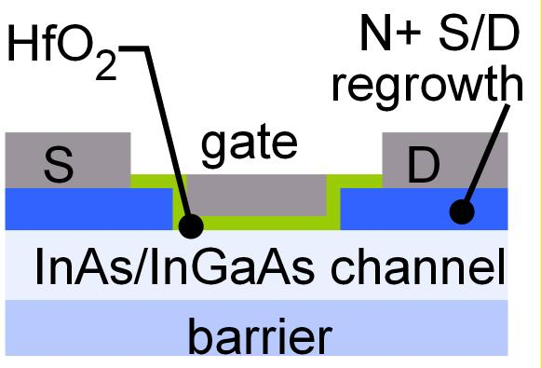
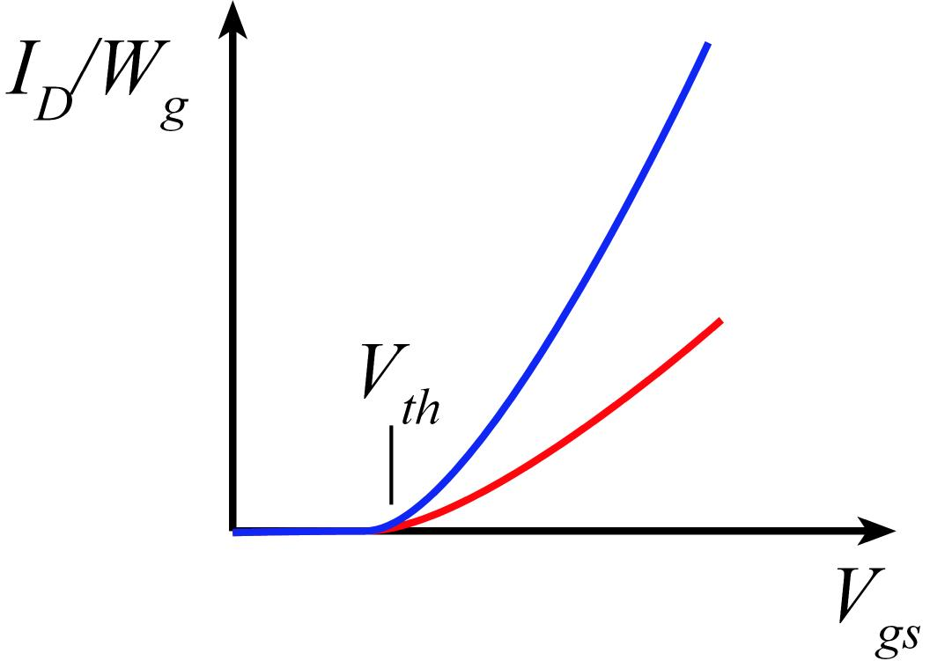
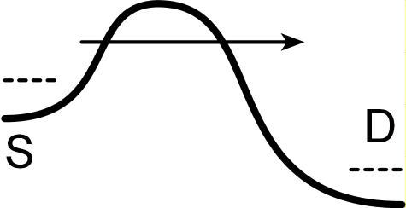
Why III-V MOS ?
III-V vs. Si: Low m*→ higher velocity. Fewer states→ less scattering
→ higher current. Can then trade for lower voltage or smaller FETs.
Problems: Low m*→ less charge. Low m* → more S/D tunneling.
Narrow bandgap→ more band-band tunneling, impact ionization.

Slide 3
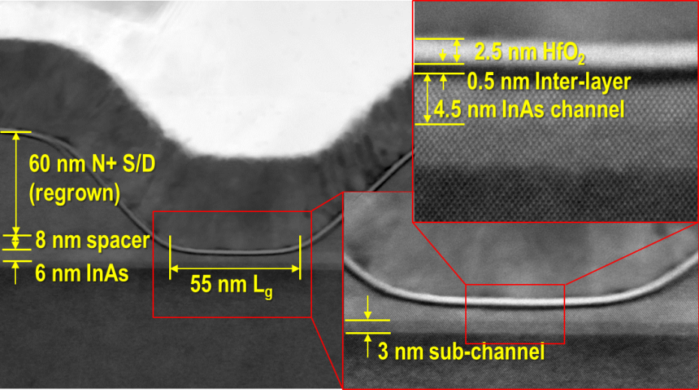
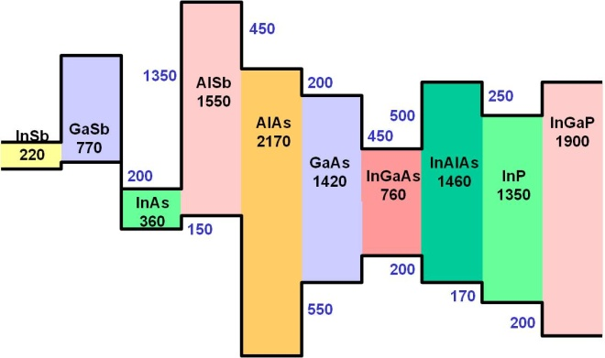
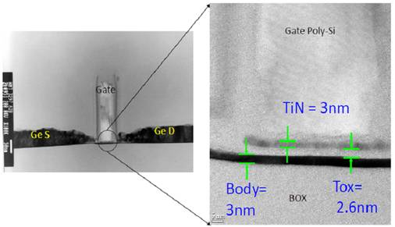
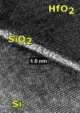
Why III-V MOS ? → important but less well-known reasons
nm-precise epitaxy, large heterojunction ΔE_{C}→ 1nm thick channels
Y-K. Choi et al, VLSI Tech. Symp., 2001
(1nm hard for SOI)
Excellent contacts now.
Better contacts feasible.
Dielectric-channel interface:
Large ΔE_{C}, no SiO₂ at interface→ smaller EOT
http://nano.boisestate.edu/research-areas/gate-oxide-studies/

Slide 4
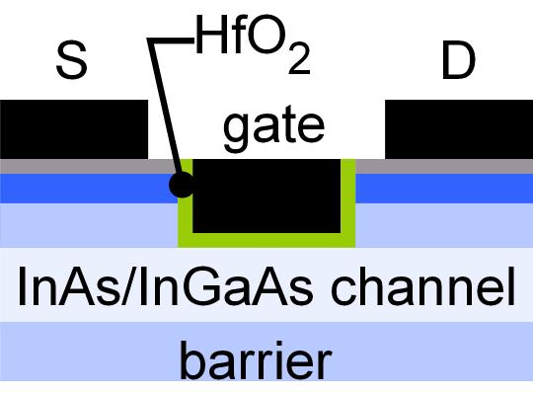
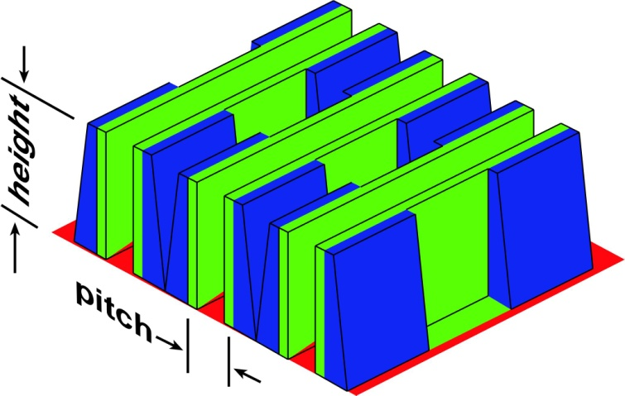
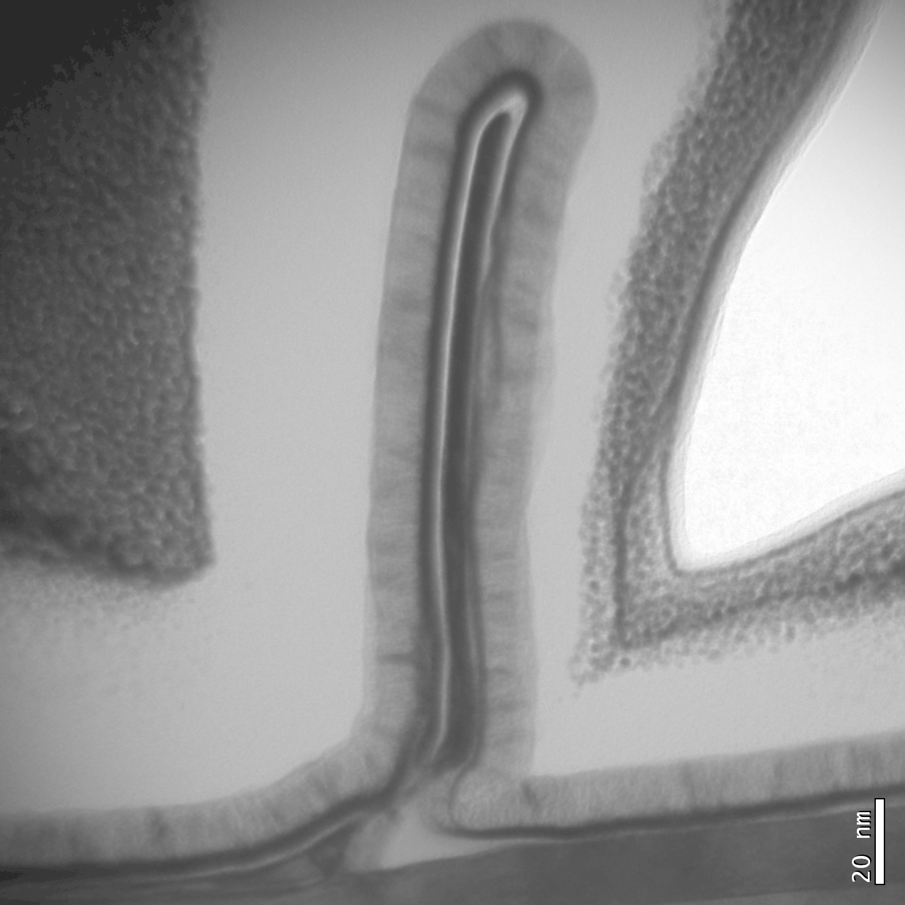
III-V MOS: how small can we make L_{g} ?
Planar UTB FETs might just scale to 10nm L_{g}:
nm epitaxial control of channel thickness
high-energy barriers (AlAsSb)
possibly thinner high-K than in Si.
vertical spacer greatly aids short-channel effects
simulations suggest that, with spacers, even S/D tunneling is OK.
And with ALE techniques, few-nm-L_{g} III-V finFETs are also feasible.

Slide 5
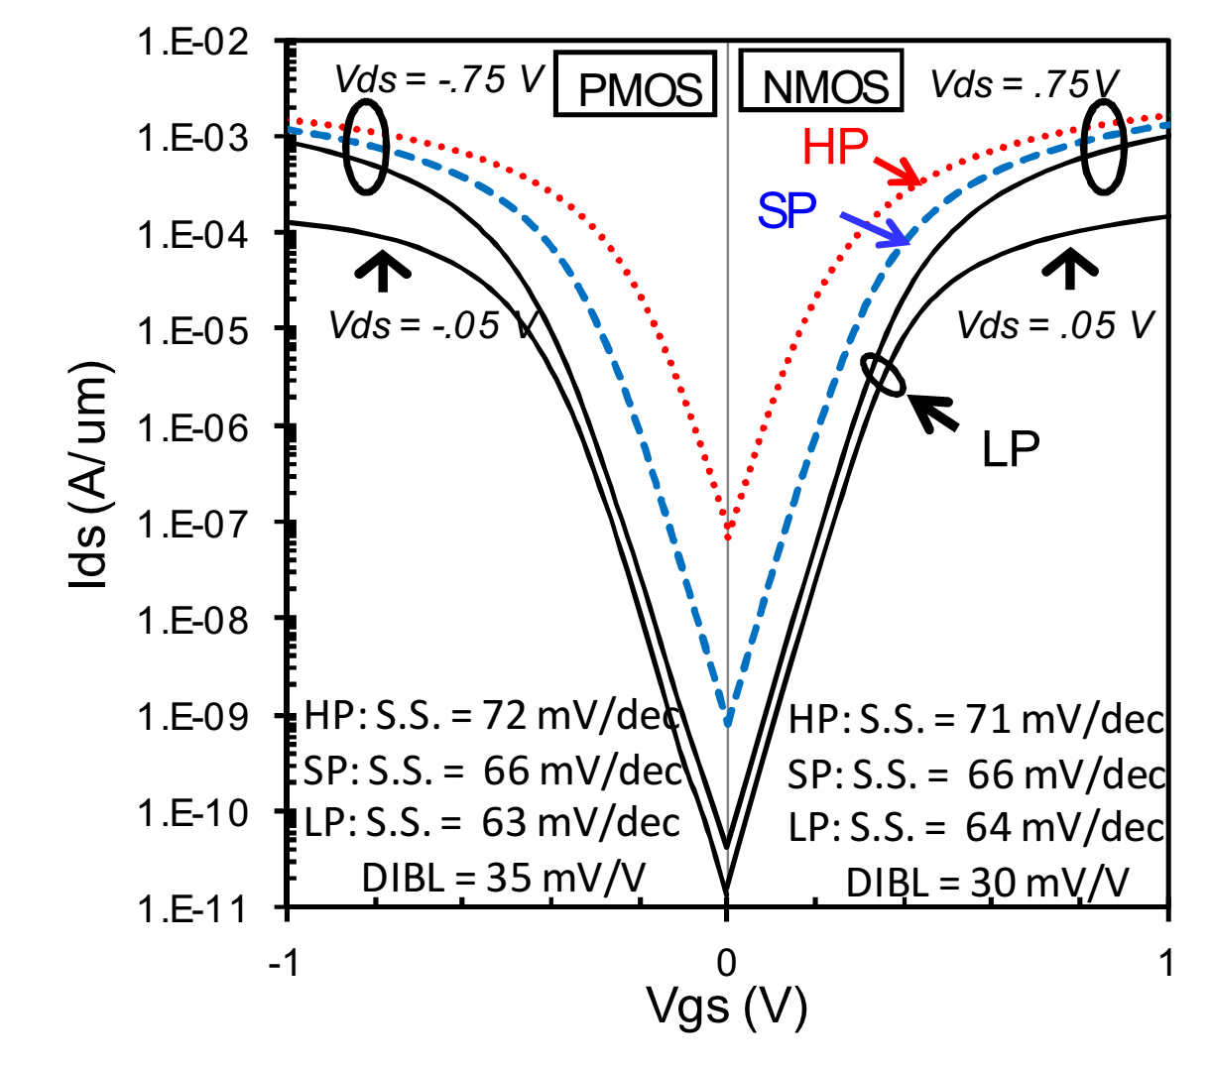
The Key question:
Intel 22nm finFETs Jan, IEDM 2012
Compared to Silicon MOS,...
...can we get high I_{on} ,
..and low I_{off} , and low V_{DD} ,
...at a VLSI-relevant (8-10nm) technology node ?
Performance @ e.g. 35nm is not important !
Small S/D pitch, not just small L_{g}, is essential !

Slide 6
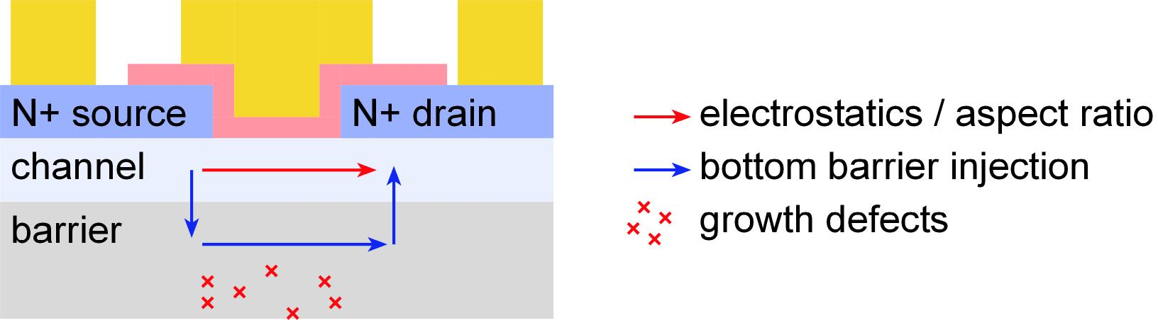
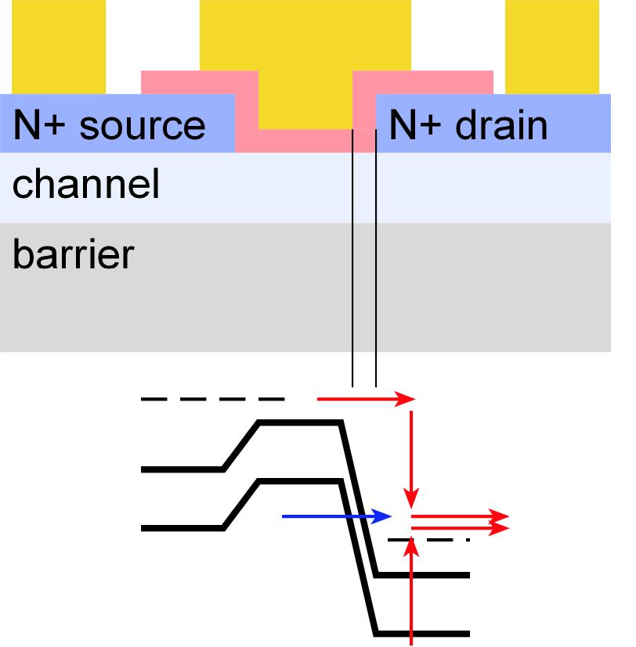
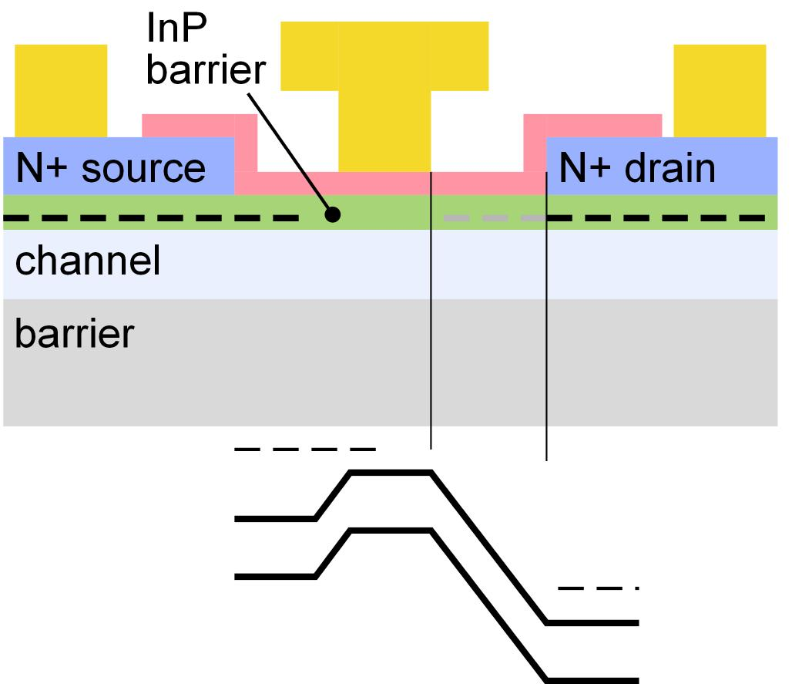
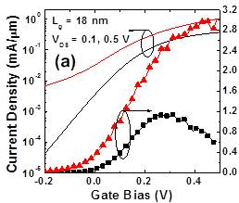
Leakage, short-channel effects, performance comparisons
off-state leakage mechanisms:
Band-band tunneling, S/D tunneling, impact ionization
Small S/D contact pitch
MOS-HEMT with large contact pitch
vs.
Lateral depletion region reduces severity of most short-channel effects (not VLSI-compatible)

Slide 7
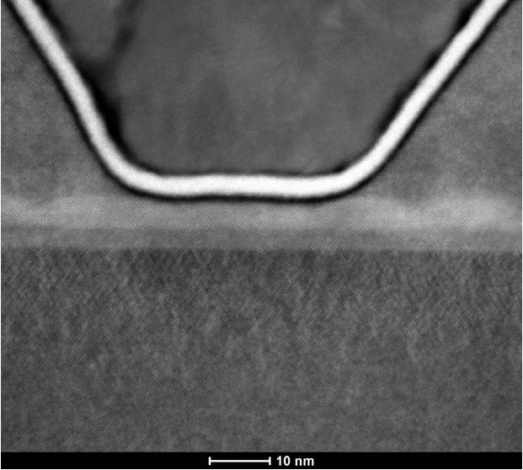
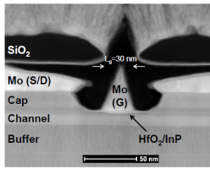
Leakage, short-channel effects, performance comparisons
off-state leakage mechanisms:
no lateral gate-drain space
Band-band tunneling, S/D tunneling, impact ionization
Small S/D contact pitch
MOS-HEMT with large contact pitch
UCSB
~20 nm gate-drain space
Lin, IEDM2012
Lateral depletion region reduces severity of most short-channel effects (not VLSI-compatible)

Slide 8
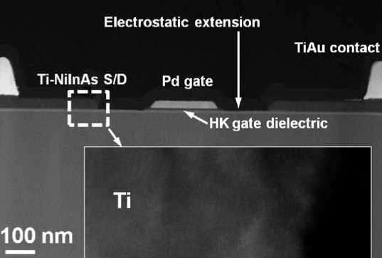
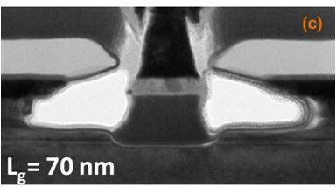
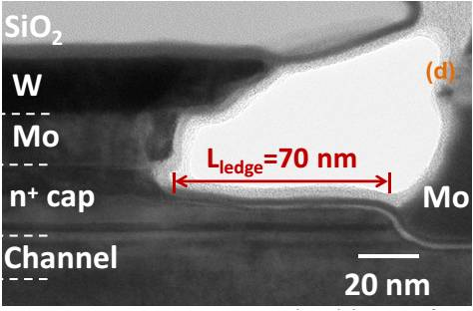
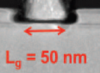
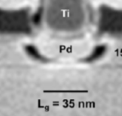
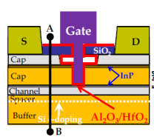
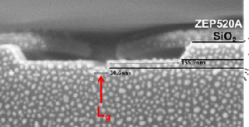
Examples from literature: gate-drain lateral spacers
Chang et al.: IEDM 2013:
150nm gate-drain spacer
Lin et al. : IEDM 2013: 70nm S/G, G/D spacers
T. W. Kim et al., IEDM2012
~16 nm S/G, G/D spacers
D. H. Kim et al., IEDM2012
~100nm S/G, G/D spacers

Slide 9
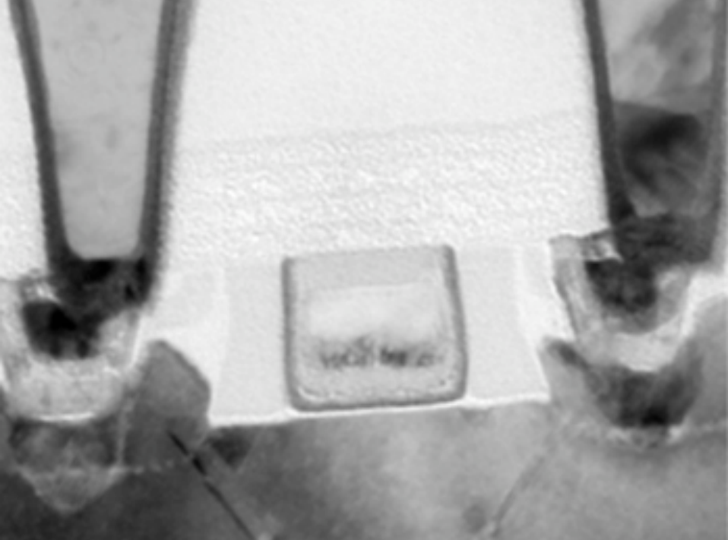
We must build devices with small S/D pitch.
contact pitch ~ 3 times lithographic half-pitch (technology node dimension)
Small S/D pitch hard to realize if we require ~20-50nm lateral gate-drain spacers !

Slide 10
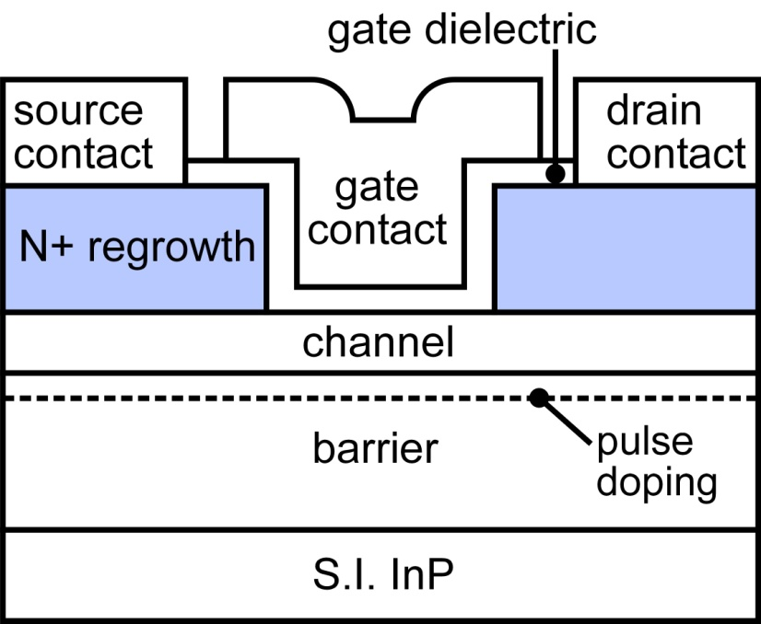
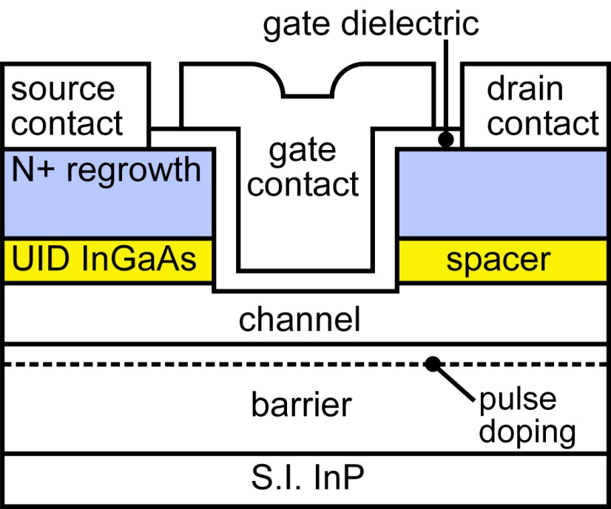
Vertical spacers: reduced leakage -- at small feasible S/D pitch
vs.

Slide 11
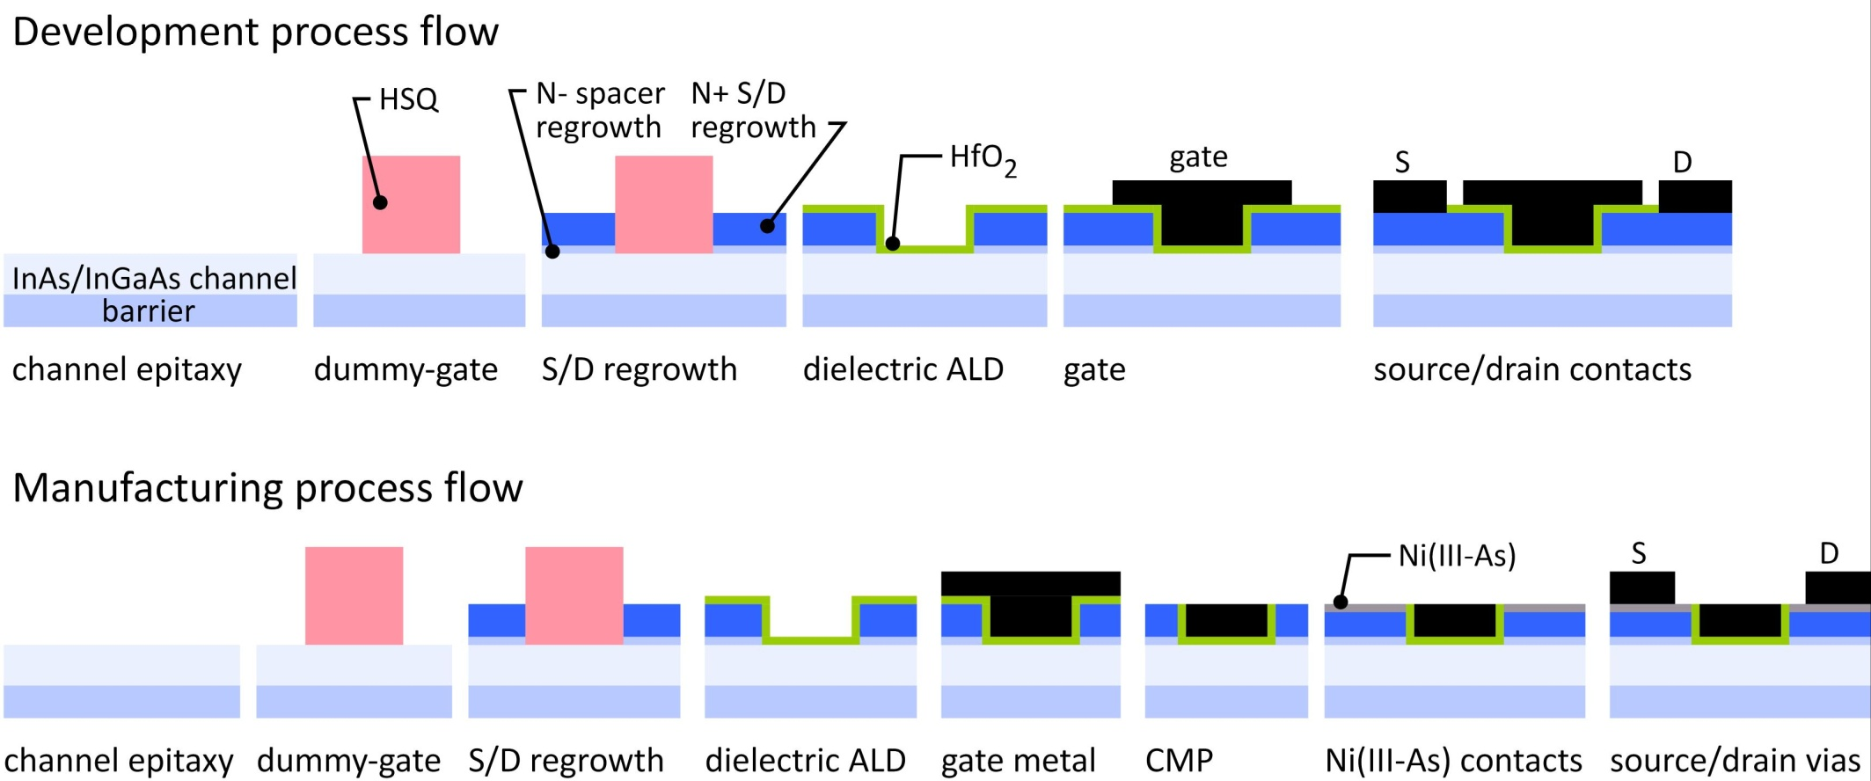
III-V MOSFET development process flow
While our fast development process flow does not provide a small S/D contact pitch,
in manufacturing, the vertical spacer will provide a small S/D contact pitch.

Slide 12
III-V MOSFET development process flow
Simple, 4-day, 16nm process→ learn quickly !
Low-damage: avoids confusing dielectric characterization.
Critical dimensions are scaled: L_{g}, channel thickness, (N+ S/D):G separations.
Process otherwise not scaled: large gate overlap, large S/D contact separations.
increases gate leakage, increases access resistance.
Process is not now self-aligned, but could be made self-aligned.

Slide 13
TEM Cross-Section, Summer 2013

Slide 14
High Transconductance III-V MOSFETS: 2013 VLSI Meeting
Lee et al, 2013 VLSI Symposium, May
8 nm channel (5 nm/3 nm InAs/In_{0.53}Ga_{0.47}As) and ~4 nm HfO₂ high-k dielectric
At time, record g_{m} over all gate lengths (i.e. 2.45 mS/μm at 0.5 V_{DS} for 40 nm-L_{g})

Slide 15
High Transconductance III-V MOSFETS: 2013 VLSI Meeting
Lee et al, 2013 VLSI Symposium, May
93 mV/dec @ 500 nm-L_{g} but > 400 mV/dec @ 40 nm-L_{g}.
Extremely Poor Short-Channel Effects

Slide 16


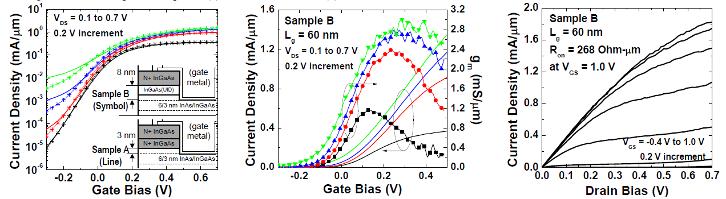
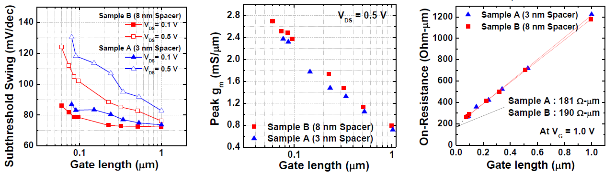
Reducing Leakage: 3nm vs. 8nm High-Field Spacer
result
Reduced off-state leakage, improved short-channel effects, very high g_{m} & I_{on}.

Slide 17
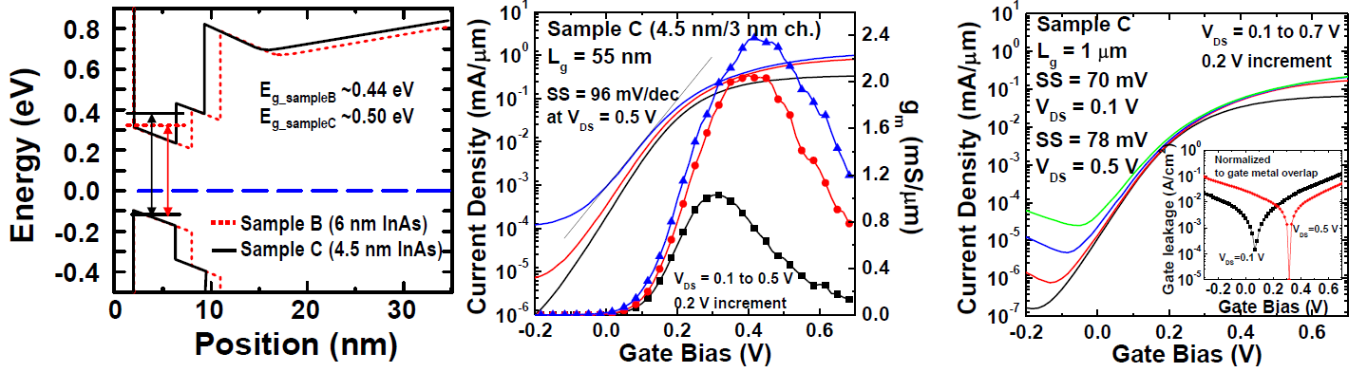
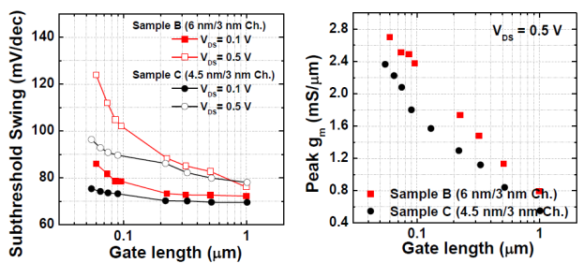
Reducing Leakage: 9nm vs. 7.5nm Channel Thickness
result
Better electrostatics, higher bandgap→ Reduced I_{off}, improved subthreshold swing, slightly less g_{m} & I_{on}.

Slide 18
Vertical spacers: some details
Minimum S/D contact pitch:
depends upon regrowth angle
we need to work on this.
[010] gate orientation should help
Spacer sidewalls are gated through the high-K.
Capacitance to UID sidewalls is negligible.
about 0.2 fF/μm
<< the ~1.0fF/μm interelectrode capacitances.
Capacitance to N+ contacts layers is large.
easy to eliminate: low-ε_{r} sidewall spacer.
Deliberate band offset between spacer & channel
compensates offset from strong quantization in channel.

Slide 19
Much Better Results to be Reported
To reduce off-state leakage:
thinner channels (quantization)→ less band-band tunneling
thinner channels & dielectrics → better electrostatics
To increase on-state current:
thinner channels & dielectrics
Much better results to be reported:
Lee et al.: EDL (in press)
Lee et al.: 2014 VLSI Symposium (June)

Slide 20
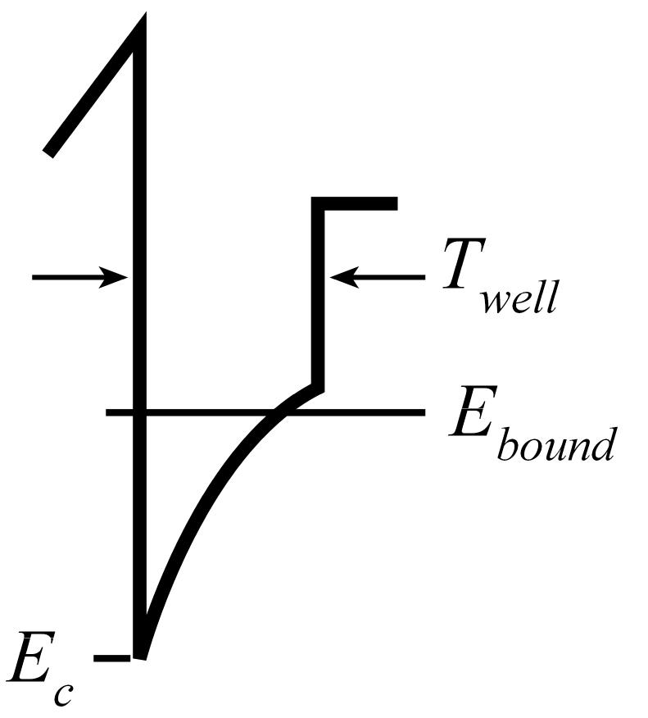
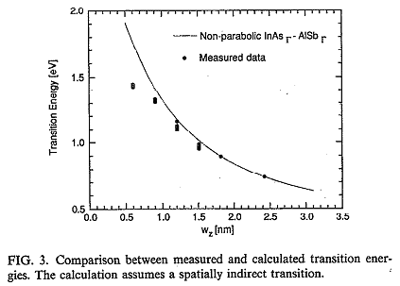
Thin Wells: Gate Leakage ?
In a thin InGaAs well, does the bound state energy rise
to the point that dielectric leakage becomes high ?
?
1.5nm well: (E_{bound}-E_{c})=0.5 eV
Brar data agrees well with:
1) Boykin, APL, 21 March 1994 (simulations)
2) Recent simulations by Povolotskyi (Purdue)
3) Recent unpublished UCSB FET data

Slide 21
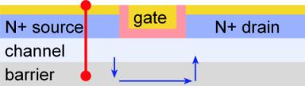
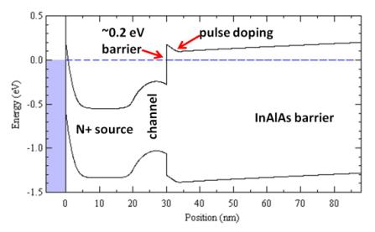
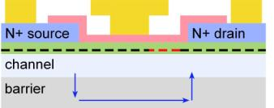
Thermal Emission from Source over Back Barrier.
InGaAs-InAlAs barrier is 0.5 eV
Fermi level is 0.3~0.5 eV above
conduction-band in the N+ source.
Barrier is only 0.1~0.25 eV above Fermi level.
Thermionic emission flux:
Need increased barrier energy.
Again, effect is less evident in MOS-HEMTs
due to larger N+ S/D separation.

Slide 22
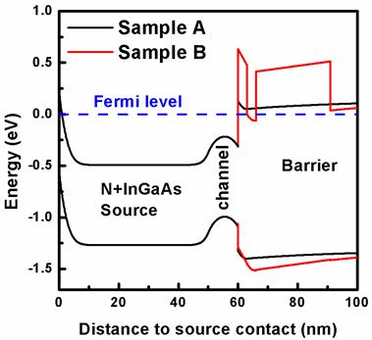
AlAsSb Back Barrier: Stops Barrier Thermal Leakage
InAlAs back barrier
130227C
InAlAs back barrier
60 nm N++ MOCVD RG InGaAs
60 nm N++ MOCVD RG InGaAs
AlAsSb back barrier
High-K
10 nm InGaAs channel
400 nm i-InAlAs
SI InP sub
AlAsSb back barrier
120807A
60 nm N++ MOCVD RG InGaAs
60 nm N++ MOCVD RG InGaAs
High-K
10 nm InGaAs channel
25 nm i-AlAsSb
AlAsSb layer:
0.5 eV increase in barrier.
Expect ~10⁸:1 less thermal emission from source.
375 nm i-InAlAs
SI InP sub

Slide 23
AlAsSb Back Barrier, P-doped layer, better isolation
caution: as-draw gate length and gate widths stated. Data not yet corrected for either.
InAlAs FET: 88 nm L_{g}, 25 micron drawn W_{g}, 8 nm InGaAs channel, 60 nm InGaAs Regrowth, 3.2 nm HfO₂, 0 deg
AlAsSb FET: 90 nm L_{g}, 25 micron drawn W_{g}, 8 nm InGaAs channel, 60 nm InGaAs Regrowth, 3.2 nm HfO₂, 0 deg
result
AlAsSb barrier shows lower off-state current and better SS as compared to P-InAlAs barrier.

Slide 24
III-V MOS: how small can we make Lg ?
Planar UTB FETs might just scale to 10nm L_{g}:
Unlike Si !
nm epitaxial control of channel thickness
high-energy barriers (AlAsSb)
possibly thinner high-K than in Si.
vertical spacer greatly aids short-channel effects
simulations suggest that, with spacers, even S/D tunneling is OK.
And with ALE techniques, few-nm L_{g} III-V finFETs are also feasible.
Cohen-Elias et al., DRC 2013

Slide 25
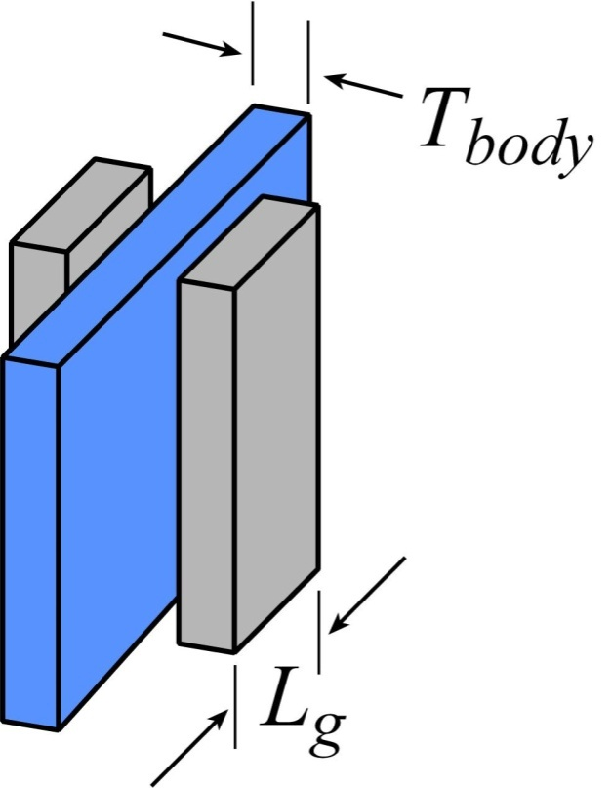
FinFETs by Atomic Layer Epitaxy: Why ?
Electrostatics:
body must be thinner than ~L_{g} /2
→ less than 4 nm thick body for 8 nm L_{g}
Problem:
threshold becomes sensitive to body thickness
Problem:
low mobility unless surfaces are very smooth
Implication: At sub-8-nm gate length, need :
extremely smooth interfaces
extremely precise control of channel thickness
side benefit: high drive current→ low-voltage, low-power logic

Slide 26
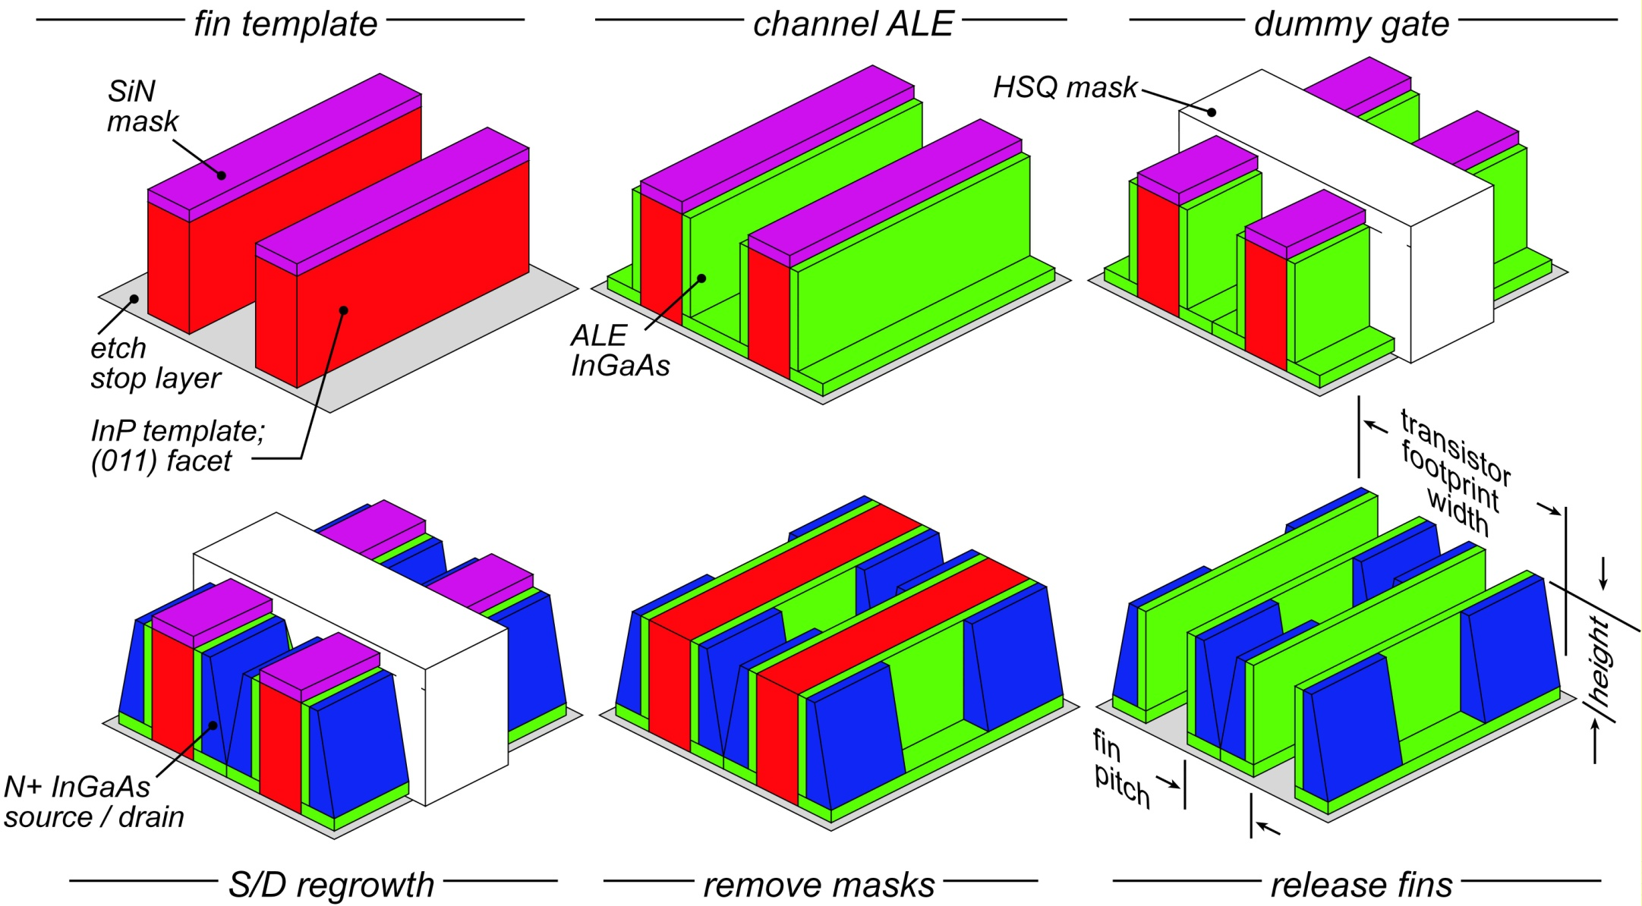
ALE-defined finFET
Fin template: formed by {110}-facet-selective etch→ atomically smooth
Channel thickness set by ALE growth→ atomically precise
Cohen-Elias et al., DRC 2013

Slide 27
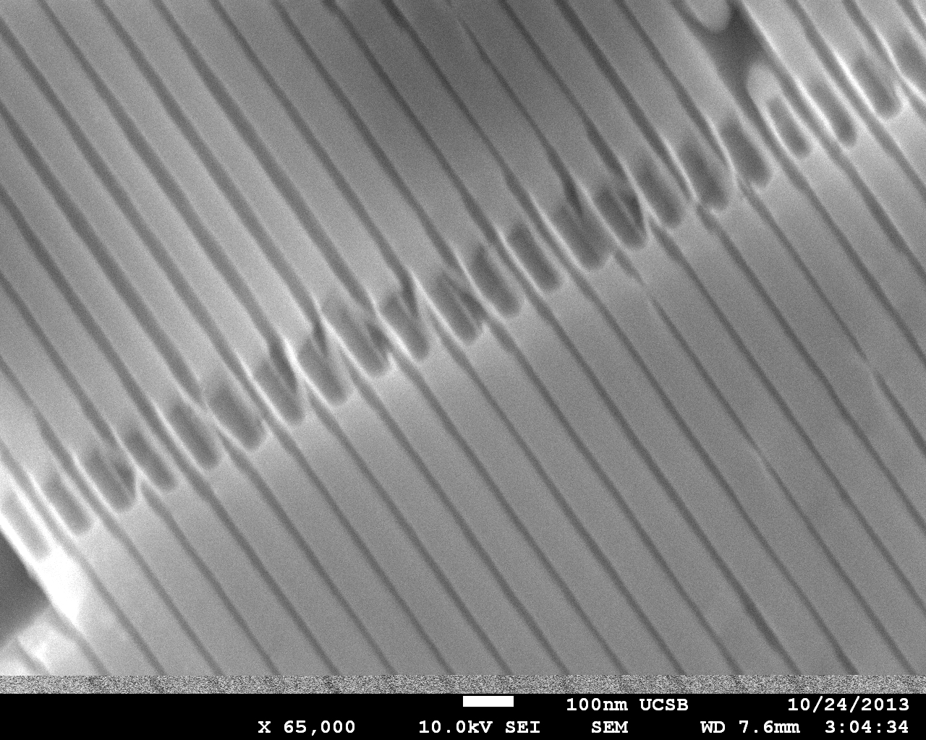
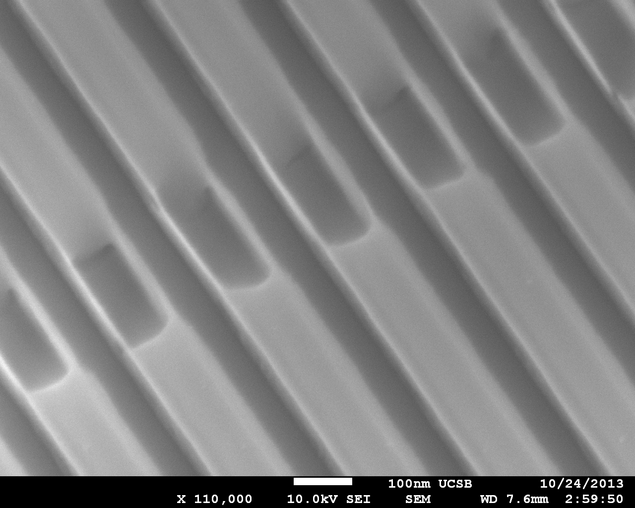

Images
HfO₂
50 nm fin pitch
fin, ~8nm
10 nm thick fins, 100 nm tall
TiN
source
channel
100 nm fin pitch
drain
Cohen-Elias et al., DRC 2013

Slide 28
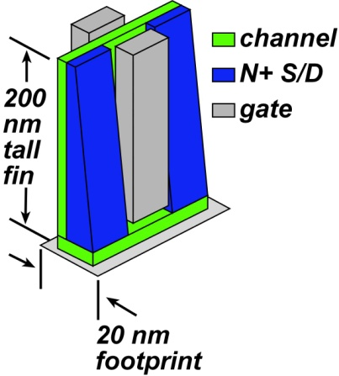
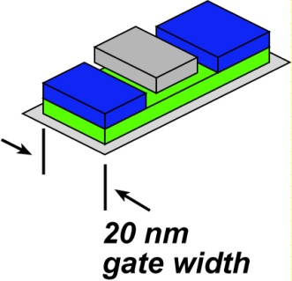
Tall Fins for Low-Power, Low-Voltage Logic
Low-voltage (near-V_{T} ) operation:
low CV² dissipation, but low current→ long interconnect delays
Increased fin height→ increased current per unit die area
→ interconnect charging delays reduced
Supply reduced from 500mV to 268 mV while maintaining high speed.
3.5:1 power savings ? Circa 2.5:1 when FET capacitances considered.

Slide 29
What is next ?
In progress:
thinner dielectrics, better contacts, better alignment→ greater I_{on}
10nm L_{g} FETs: prove that spacer kills S/D tunneling leakage.
ultra-thin InGaAs & InAs channels low off-current
If we can:
InAs ALE-finFETs @ 10nm L_{g}→ high performance
110-oriented PMOS finFET→ performance approaching NMOS
29

Slide 30
(end)

Slide 31
Backup slides

