Slide 1
Phase-Locked Coherent Optical Interconnects for Data Links
IEEE Optical Interconnects Conference, San Diego, 4 - 7 May 2014
M.J.W. Rodwell, H.C. Park, M. Piels, M. Lu, D. Elias,
A. Sivananthan, E. Bloch, Z. Griffith, L. Johansson,
J. E. Bowers, L.A. Coldren
University of California, Santa Barbara
Z. Griffith, M. Urteaga
Teledyne Scientific

Slide 2
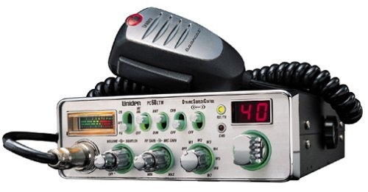
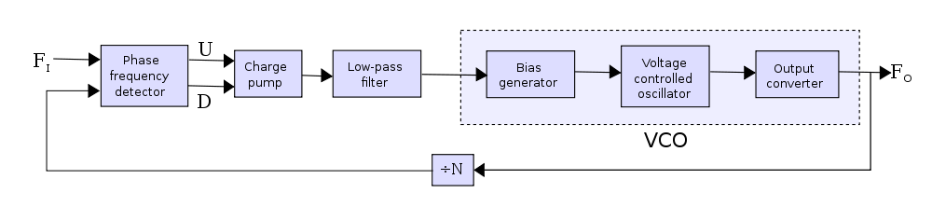


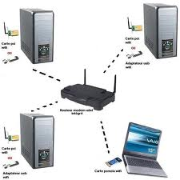
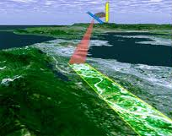
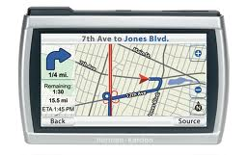
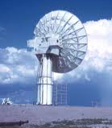
Wavelength synthesis: precise optical spectral control
1977 40-channel Citizen's band radio.
...had to purchase 40 quartz crystals
By 1980, frequency synthesis reduced this to one
Frequency synthesis enabled modern RF systems :
Precision phase/frequency control
→ efficient & controlled use of the spectrum
Today's optical systems look like a 1977 CB radio
Phase-locked coherent optical systems:
control optical channel spacings
over 100's of GHz,
with sub-Hz precision
→ sensitive, compact, spectrally efficient,
optical communications

Slide 3
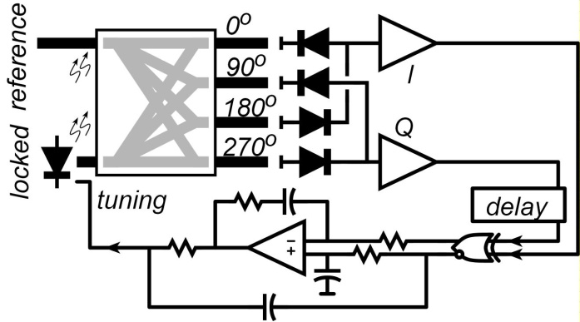
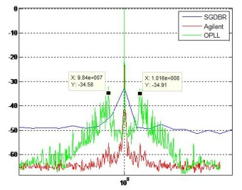
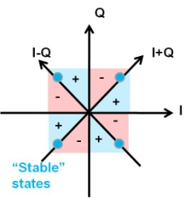
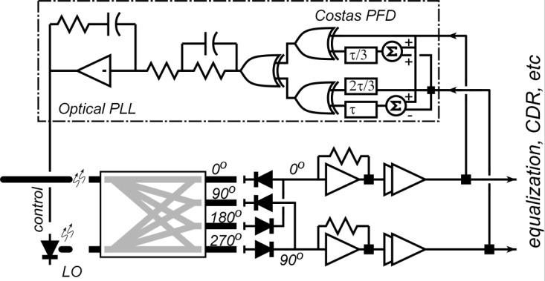
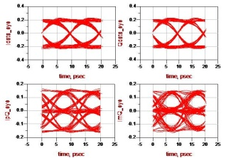
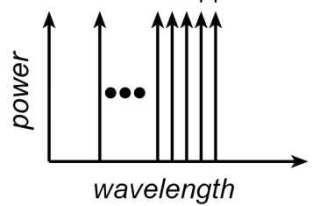
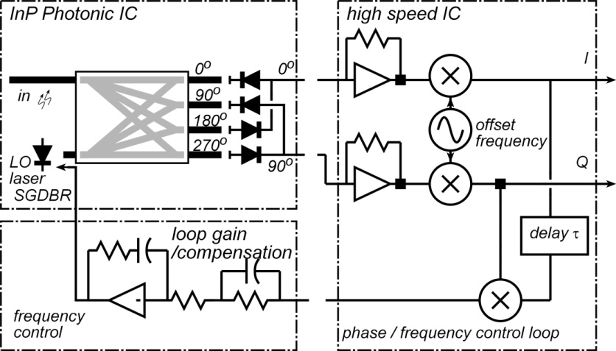
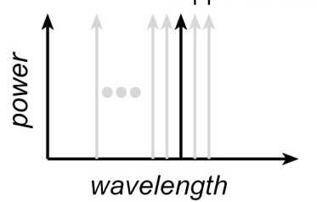
Optical Phase-Locked-Loops: Applications
Wideband laser locking
& noise suppression.
improved spectral purity
without external cavities.
BPSK/QPSK
Coherent Receivers
Short- to mid-range links,
no DSP,
inexpensive wide-linewidth lasers
Tunable
Wavelength-Selection
in Receivers
WDM: electronic channel selection.

Slide 4
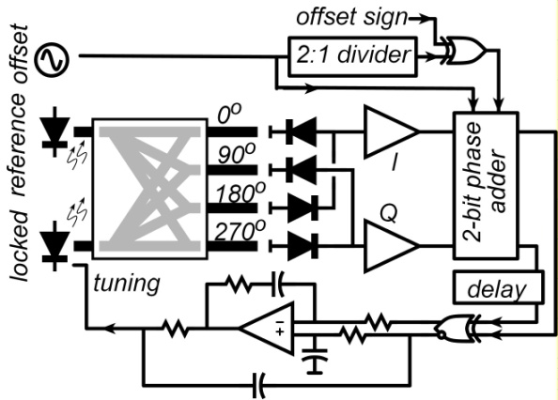
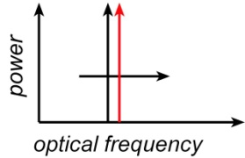
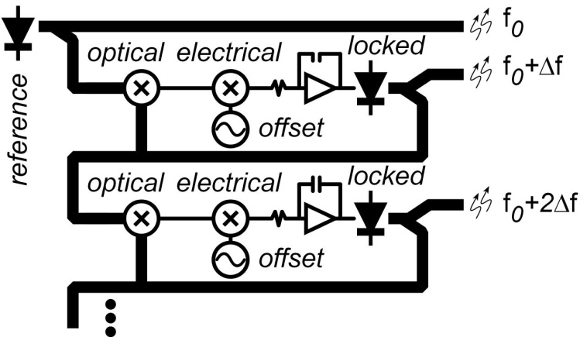
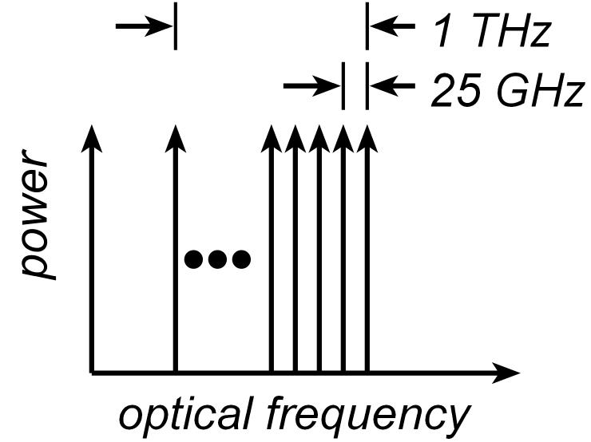
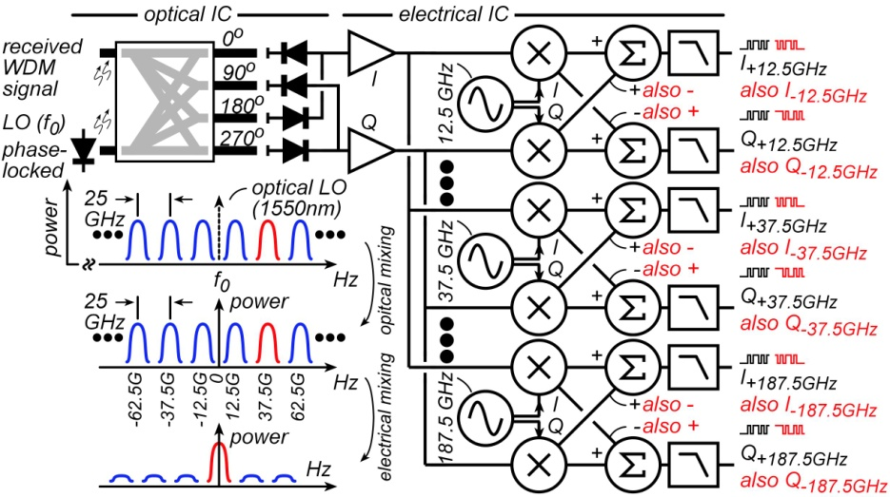
Optical Phase-Locked-Loops: Applications
Wavelength synthesis,
& sweeping
→ digital control
of wavelength spacings.
Synthesis, Sweeping
of Wavelength Combs
WDM: precise channel spacing,
no guard bands.
Single-Chip
Multi-Wavelength
Coherent Receivers
WDM

Slide 5
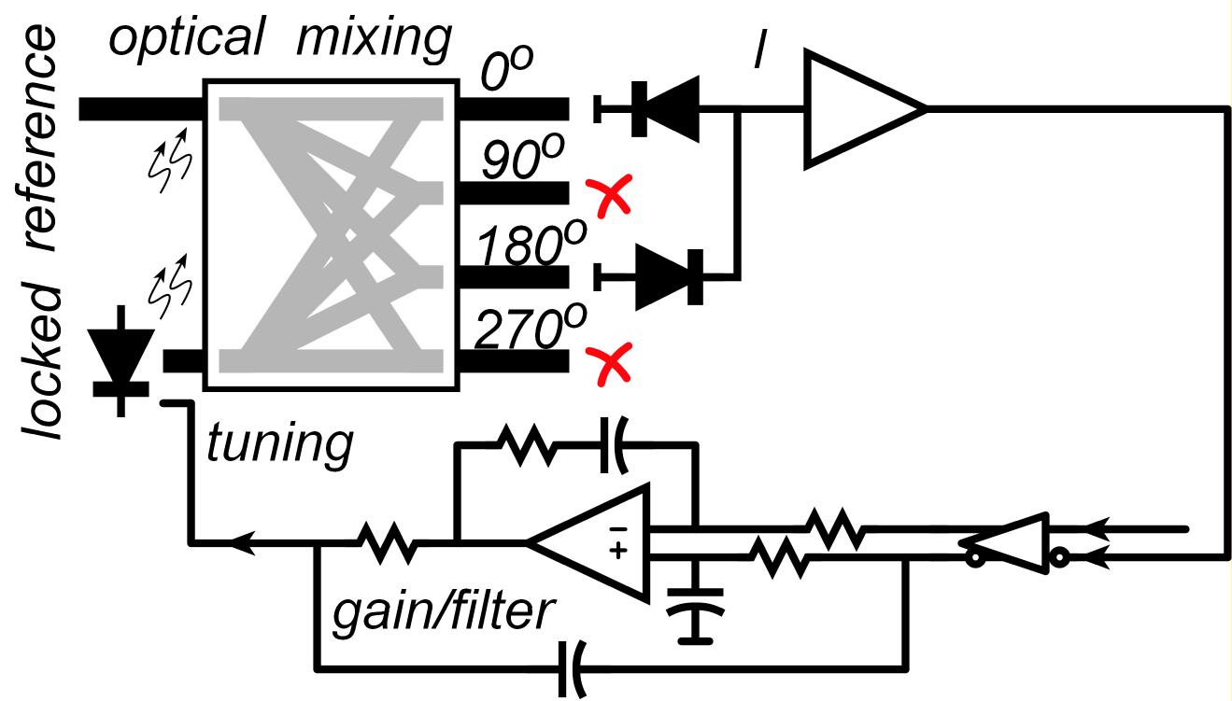
Optical PLLs: Basics
Phase-lock tunable laser to optical reference
Lock to one line + improve linewidth / SNR
Inexpensive laser with no external cavity ?
→ large laser linewidth
→ 1GHz loop bandwidth for noise suppression
→ tight optical/electrical integration

Slide 6
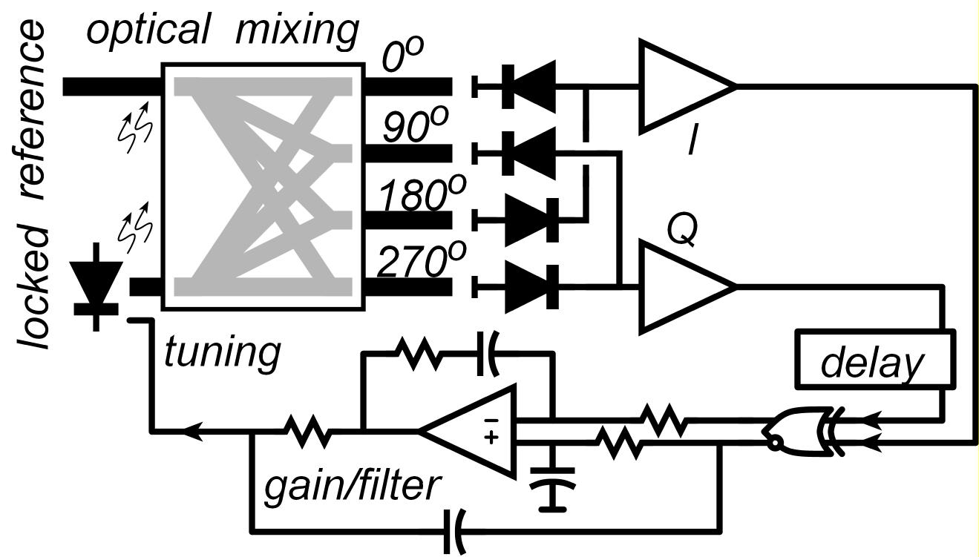
Optical PLLs: Frequency-Difference-Detector
~ 1 GHz loop bandwidth
~20 GHz initial frequency error
→ loop will not acquire lock
→Add frequency-difference detector
Requires I/Q (0º,90º) optical mixing
Full information of optical field is maintained
→ use later for other purposes

Slide 7
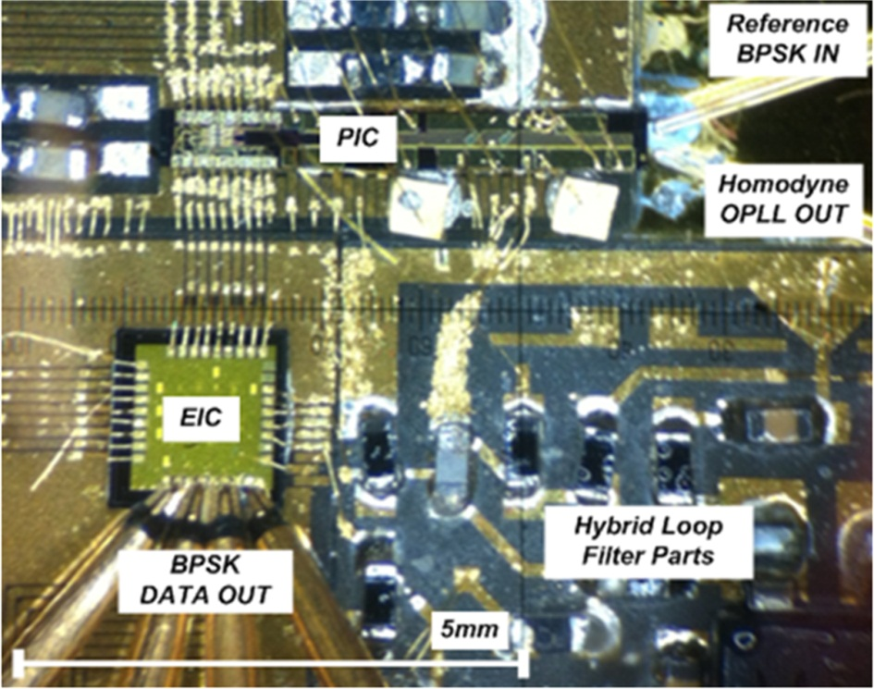
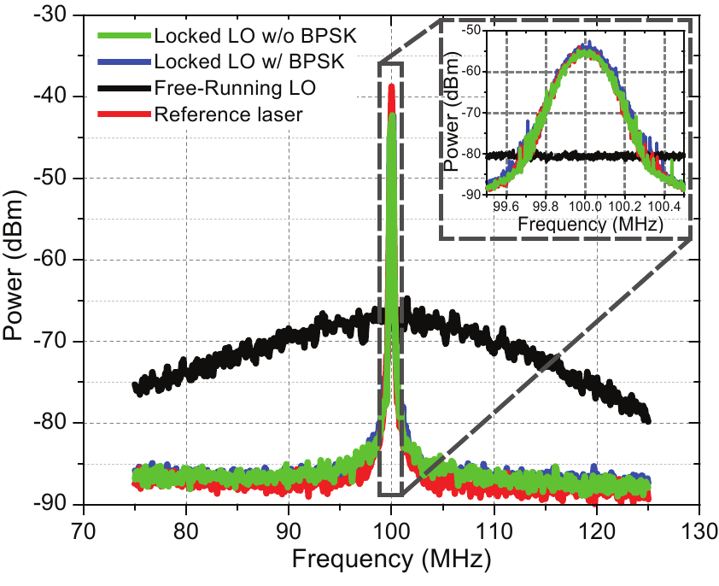
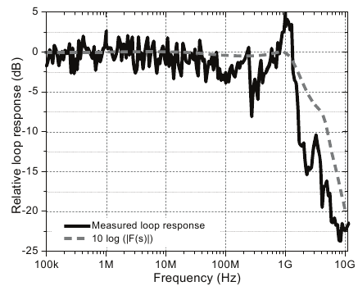
Optical PLLs: Demonstrated
H. Park, M. Lu, et al, ECOC’12, Th3A.2 (2012)
~1 GHz loop bandwidth

Slide 8
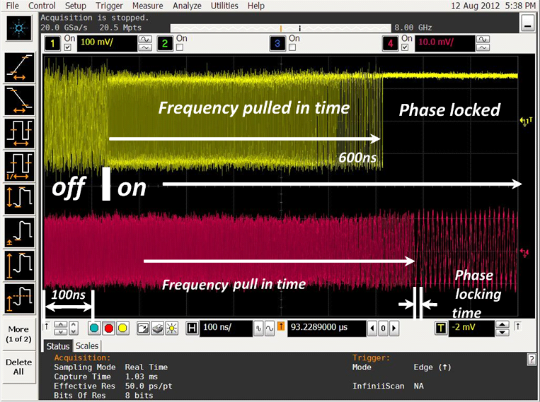
Optical PLLs: Frequency Acquisition
H. Park, M. Lu, et al, ECOC’12, Th3A.2 (2012)
High carrier frequency (200 THz) but limited OPLL bandwidth (1.1 GHz)
Slow frequency capture outside OPLL bandwidth
Need Optical Frequency Phase Lock Loop
Phase-Frequency Locking Demonstrated→ 50 GHz pull-in range
600ns frequency pull-in time
<10 ns optical phase lock time

Slide 9
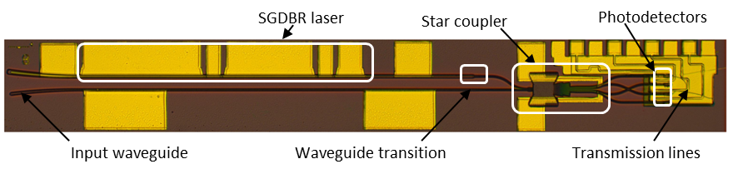
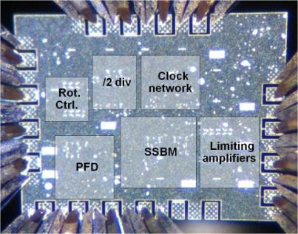
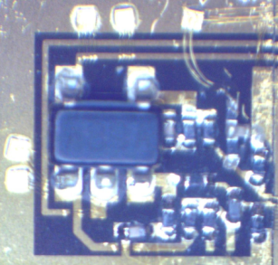
OPLL Components
Photonic IC
Coldren group
InP integration
Fast electrical IC
Design: Rodwell group
Fab: Teledyne InP HBT
details to follow
Hybrid loop filter
slow/fast design
slow: op-amp integrator
fast: passive feedforward

Slide 10
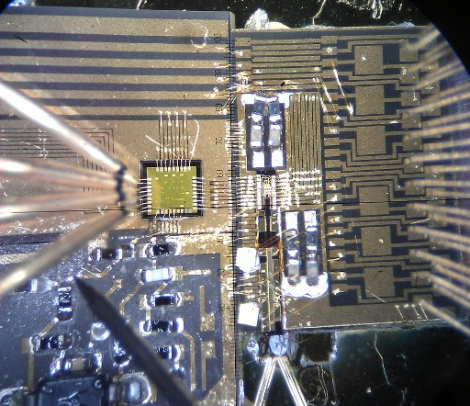
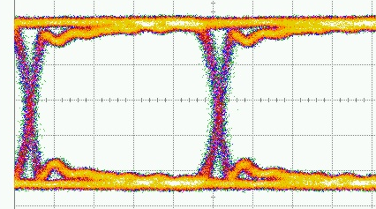
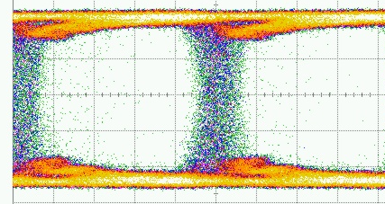
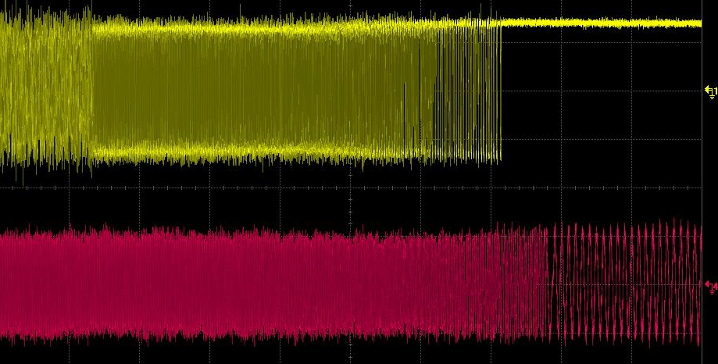
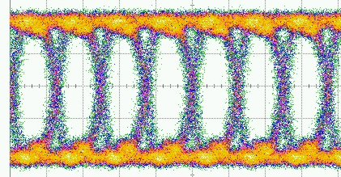
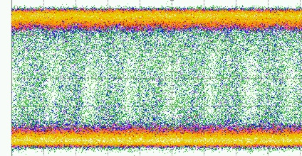
Optical PLLs: Phase-Locked BPSK Receiver
10Gb/s 0 km
10Gb/s 75 km
40Gb/s 0 km
40Gb/s 50 km
PLL locks in 650 ns

Slide 11
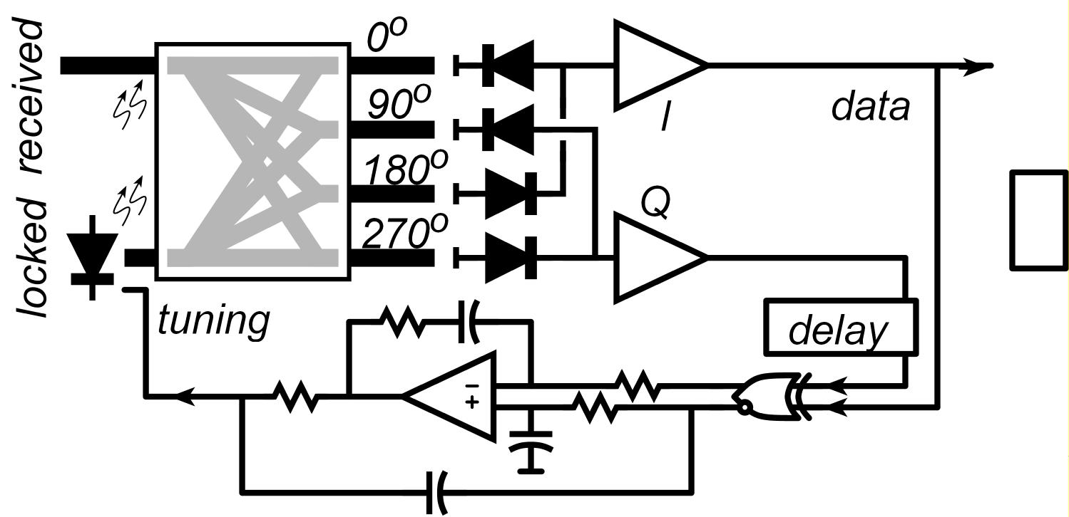

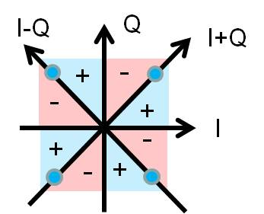
Optical PLLs: Phase-Locked QPSK Receiver
BPSK
receiver
QPSK
receiver
Designs attempted, ICs did not work properly
simply a design failure, should work just fine...

Slide 12
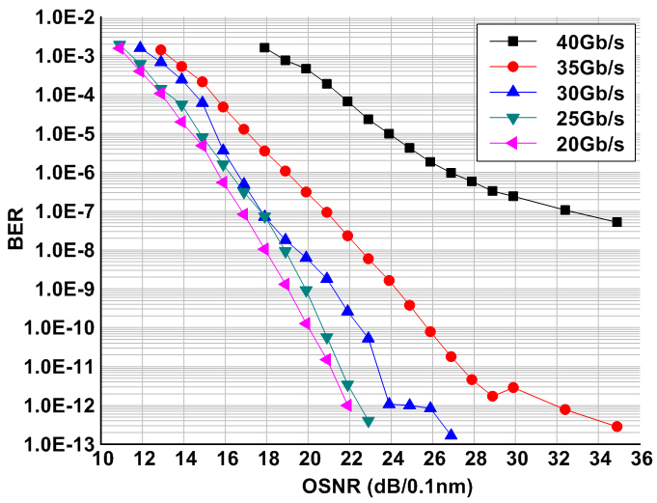
Phase-Locked B/QPSK Receivers: Good and Bad
Present coherent receivers: DSP coherent detection
DSP compensates dispersion
DSP compensates LO phase & frequency errors.
sophisticated, high DC power, expensive
Phase-locked receivers in short-range links
No DSP required ! → reduced cost, reduced DC power
Phase-locked receivers in long-range links
fiber dispersion will close eye→ optical PLL will not lock

Slide 13
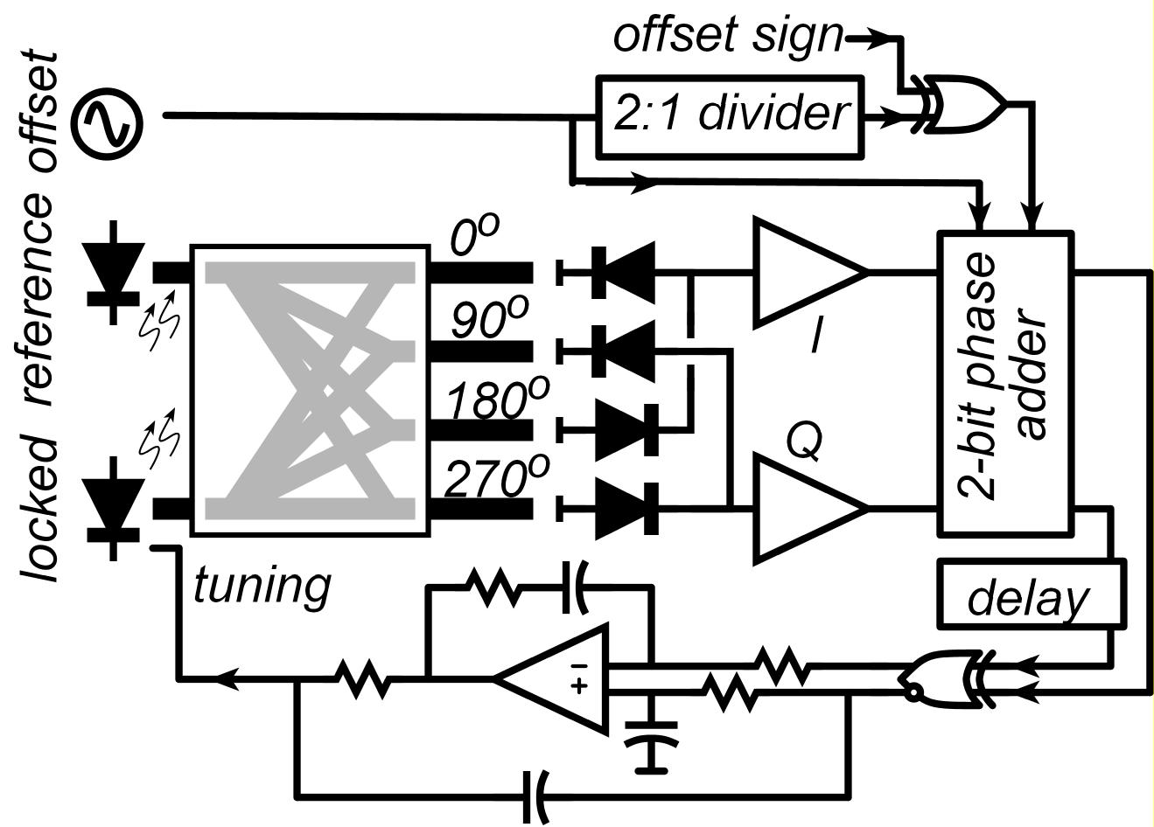
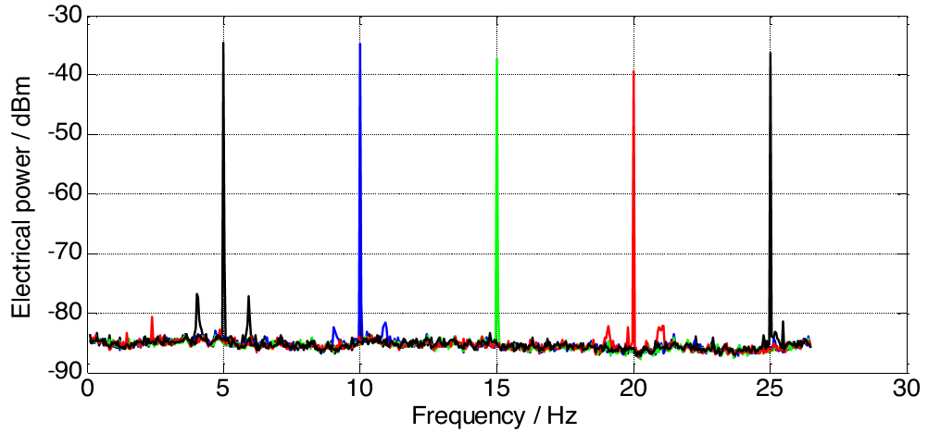
Offset Locking → Wavelength Synthesis
+/- ?
Offset locking to generate
any optical frequency
Mingzhi Lu, et. al, – Tu2H.4, OFC2014
Simple OPLL cannot distinguish
+/- frequency offsets
(0º/90º) optical mixing:
no lost optical information
IC digital single-sideband mixing
Frequency, GHz
300+ GHz offsets possible
fast UTC photodiodes, fast electronics

Slide 14


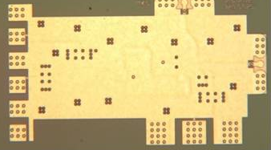
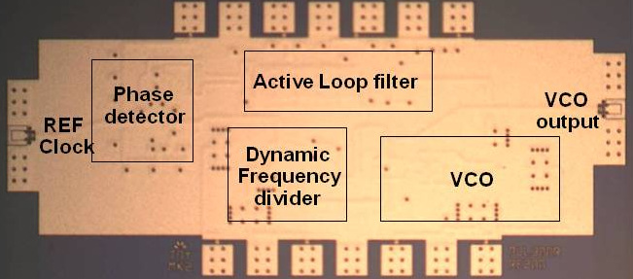
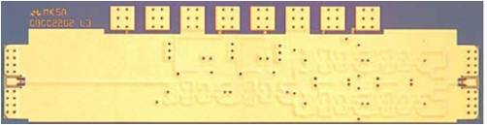

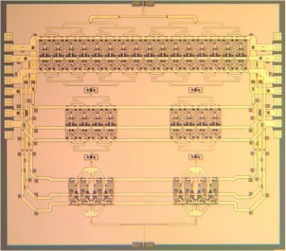
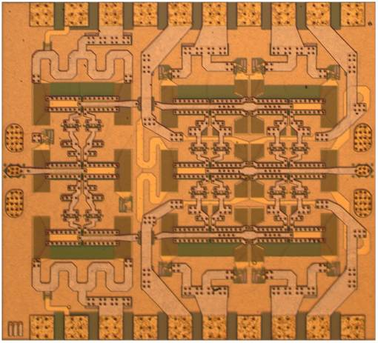
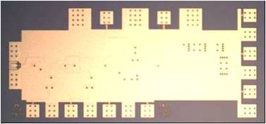
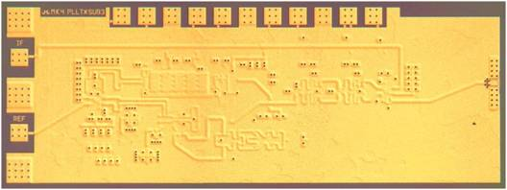
ICs Today: 670 GHz is done, 200 GHz is easy
614 GHz
fundamental
VCO
340 GHz dynamic frequency divider
M. Seo, TSC / UCSB
M. Seo, UCSB/TSC
IMS 2010
620 GHz, 20 dB gain amplifier
300 GHz fundamental
PLL
M Seo, TSC
IMS 2013
M. Seo, TSC
IMS 2011
Not shown: 670 GHz HBT amplifier
J. Hacker, TSC, IMS 2013
204 GHz static
frequency divider
(ECL master-slave
latch)
220 GHz
180 mW
power amplifier
81 GHz
470 mW
power amplifier
Z. Griffith, TSC
CSIC 2010
T. Reed, UCSB
CSICS 2013
H-C Park UCSB
IMS 2014
Integrated 300/350GHz Receivers:
LNA/Mixer/VCO
600 GHz
Integrated
Transmitter
PLL + Mixer
M. Seo TSC
M. Seo TSC

Slide 15
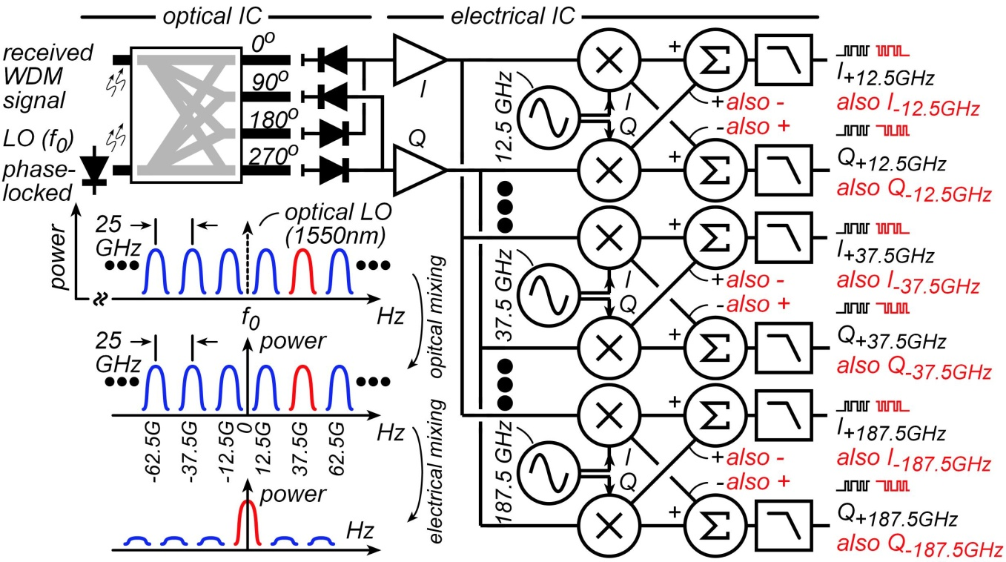
Electrical Recovery of WDM for compact Tb/s Links
Assume: 25GHz channel spacing, DC-200 GHz ICs , DC-200 GHz photodiodes
→ 800 Gb/s receiver= 50 Gb/s QPSK x 16 WDM channels
...one LO laser, one I/Q optical detector, one electrical receiver IC
OPLL can lock to optical pilot → works even with highly dispersive channels

Slide 16
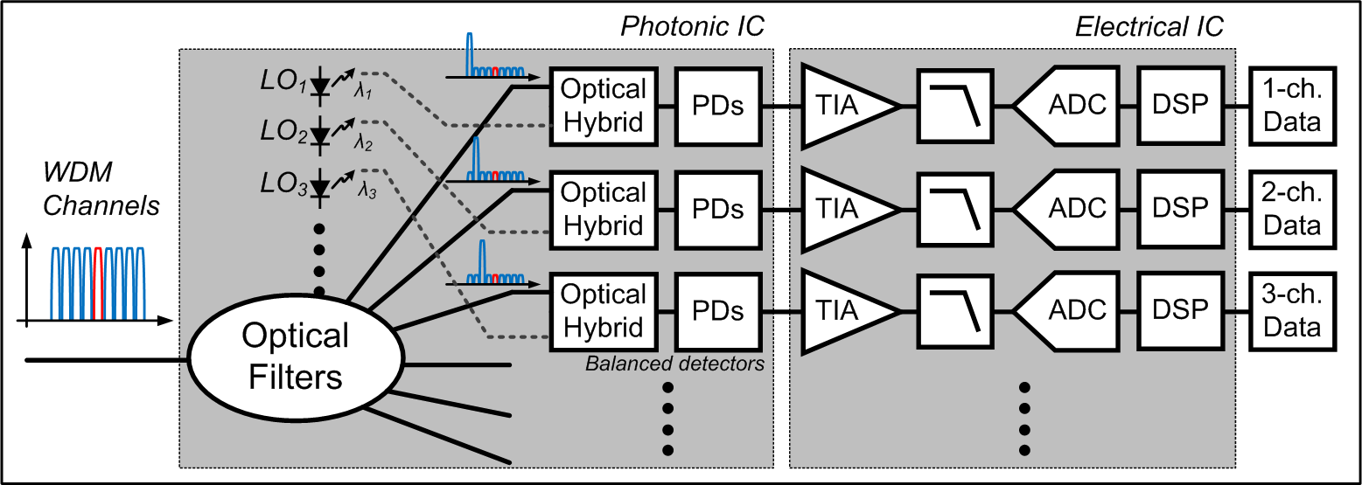
Optical-Domain WDM Receiver
Complex photonic IC.
One electrical receiver IC for each wavelength→ many in total.

Slide 17
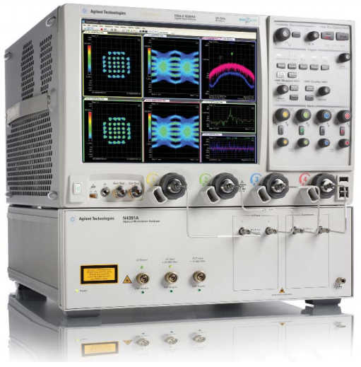
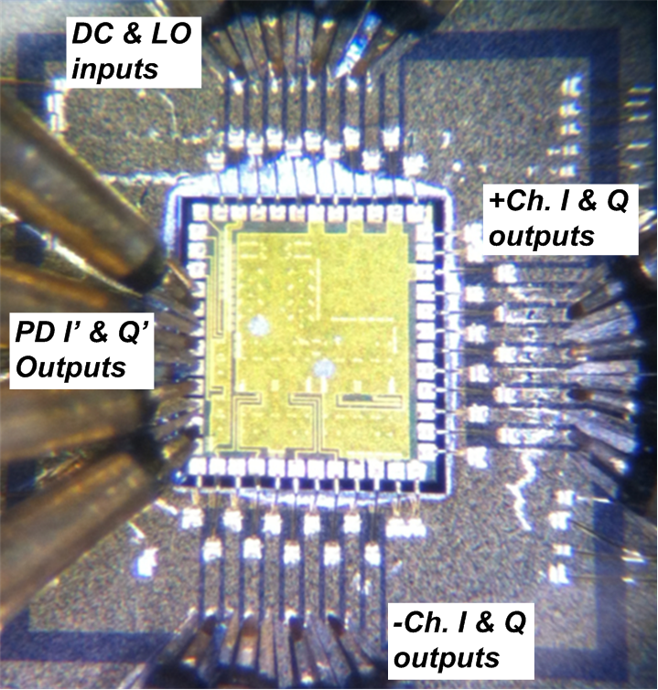






Electrical WDM: 2-Channel Demonstration
Real-time
oscilloscope
OMA* as PICs
Free space optics
90° optical hybrid
& Balanced PDs
OMA* blocks
As PICs
2-channel electrical IC
*OMA – optical modulation analyzer
Agilent N4391A

Slide 18






2-channel Tests: Opposite-sideband Suppression
(+/- channels)
I & Q outputs
Activated channel
Suppressed channel
(+) channel
(-) channel

Slide 19





3-channel Test: Adjacent Channel Rejection
(+/- channels)
I & Q outputs
20GHz Spacing
10GHz Spacing
5GHz Spacing (2.5Gb/s BPSK)
*spectra measured using optical spectrum analyzer
Tested with various channel spacings

Slide 20

3-channel Test: Adjacent Channel Rejection
Eye Quality with Different Transmitter/receiver filter bandwidths
*Filter1: transmitter
*Filter2: receiver
BER 1.0E-9
2.5 Gb/s BPSK per channel, 5 GHz channel spacing→ minimal interchannel interference

Slide 21




6-channel WDM Receiver Design
Teledyne 500nm InP HBT (350GHz f_{τ} , f_{max})
6 channels: +/- 12.5, 37.5, 62.5 GHz
Simulations look fine...
±12.5GHz
±37.5GHz
±62.5GHz
I-output
Q-output
I-output
Q-output
I-output
Q-output
But problems:
(1) very high DC power consumption (>10W)
(2) low IC yield...all ICs have at least one broken receive channel
Next steps ?

Slide 22


Electrical-Domain WDM Receiver: Reducing Power
Replace mixer array
with analog FFT
Use charge-domain
CMOS logic
Razavi, IEEE Custom IC Conference, Sept. 2013.
"Employing charge steering in 65-nm CMOS
technology, a 25-Gb/s CDR/deserializer consumes 5 mW"
→0.2 pJ/bit

Slide 23

Optical Phase-Locked-Loops: Applications
Wavelength synthesis
Phase-locked coherent receivers
Zero-guardband WDM generation
Single-chip Electrical WDM receivers
Electronic polarization DMUX ?
Analog polarization compensation ?

Slide 24
(end)

Slide 25
Backups

Slide 26

Electrical-Domain WDM Receiver
Small and simple photonic IC.
One electrical receiver IC covers all wavelengths.
IC might be complex;
can we design it for low power & low complexity ?

Slide 27








2-Stage Down-Conversion: Optical, Electrical
Phase-locked LO down-converts all WDM channels to RF @ 25 GHz spacing
Electrical receiver down-converts each channel separately to baseband
Note: OPLL can lock to narrow-spaced optical pilot tone
→ phase-locked receiver even with highly dispersive channels

Slide 28
Low-Voltage
Electrical
Signalling

Slide 29










Fast, Low-Power Interconnects for Digital Systems
Optical PLLs ? → mid-range coherent links for data centers ?
coherent OPLL receiver
optical synthesizer
WDM comb synthesis
electrical recovery of WDM
Short-range on-chip interconnects and the (CV² ,I_{off}V_{DD}) power crisis.
optical
interconnects
CV²
mA/um
→ standby
power
standby power
long-range on-chip
optical interconnects
tunnel FETs for low voltage ?
low-voltage signaling

Slide 30


Power Dissipation in Short-Range VLSI Interconnects
The CV²/2 dissipation limit
V_{dd}
With minimum C_{wire},
a minimum switching energy C_{wire}V_{dd}²/2 is set
V_{dd} set for target I_{on},
hence acceptable CV_{dd}/I_{on}.
Threshold set for acceptable
off-state dissipation I_{off}V_{dd}.
C_{wire}
Tunnel FETs
Subthreshold logic
V_{dd} is simply reduced.
Decreases energy CV_{dd}²/2.
Increases delay CV_{dd}/I_{on}.
Bandgap of P+ source
truncates thermal distribution.
Potential for low I_{off} at low V_{dd}.
Obtaining high I_{on} /V_{dd} is the challenge.
(band edges shift, m* increases in quantization.)

Slide 31



Optical for Short-Range VLSI Interconnects ?
roughness scattering
20 nm contact pitch ?
static dissipation
bend radius

Slide 32



Tall finFETs for Low-Power, Low-Voltage Logic
Low-voltage (near-V_{T} ) operation:
low CV² dissipation, but low current
→ long interconnect delays
InGaAs finFET:
8 nm thick fin
200 nm high
Increased fin height
→ increased current per unit die area
→ interconnect charging delays reduced
Supply reduced from 500mV to 270 mV while maintaining high speed.
3.5:1 power savings ? Circa 2.5:1 when FET capacitances considered.

Slide 33

Multiple Supplies for Low-Power Logic
Given 200 mV swings
on long interconnects,
Line receivers provide
0.1 mA/μm output
with 0.1 μA/μm leakage
Line drivers, and logic gates provide
3 mA/μm output
with 0.1 μA/μm leakage
Is cost in added die area acceptable ?

Slide 34
Fast, Low-Power Interconnects for Digital Systems
Optical PLLs → mid-range coherent links for data centers ?
coherent OPLL receiver
optical synthesizer
WDM comb synthesis
electrical recovery of WDM
Short-range on-chip interconnects and the (CV² ,I_{off}V_{DD}) power crisis.
optical
interconnects
CV²
mA/um
standby power
→ standby
power
long-range on-chip
optical interconnects
tunnel FETs for low voltage ?
low-voltage signaling

Slide 35
Technology
Details

Slide 36



Details: Electrical λ-Synthesis IC
Features
Phase detector
Frequency difference detector
forces loop to lock
Single-sideband mixer
introduces frequency shift
controlled sign of shift !
Implementation
Teledyne 350 GHz, 500 nm InP HBT
Robust all-digital implementation
Phase detector test: works over +/- 30 GHz
Frequency detector test: works over +/- 40 GHz

Slide 37




High Speed InP IC Technology
Teledyne Scientific & Imaging 512 nm InP HBT process.
300GHz f_{t} , f_{max} devices.
4 Metal layers, MIM capacitors, thin-film resistors
Up to 5000 transistor integration.
Teledyne 128 nm process (not yet Pilot-Scale) : 700 GHz f_{τ} , 1.2 THz f_{max}
Thank you !
100% first-pass
design success

Slide 38



OPLL with PFD and SSBM
Photonic IC
Laser LIV curve
Laser phase
pad tuning
90° hybrid
output
PD bandwidth

Slide 39
Details: Electrical λ-Synthesis IC
Features
Phase detector
Frequency difference detector
forces loop to lock
Single-sideband mixer
introduces frequency shift
controlled sign of shift !
Implementation
Teledyne 350 GHz, 500 nm InP HBT
Robust all-digital implementation
Phase detector test: works over +/- 30 GHz
Frequency detector test: works over +/- 40 GHz

Slide 40


Feedforward Loop Filter
High Gain yet High Speed
Schematic
Open Loop Gain Transfer Function
Loop needs high gain at DC → op-amp needed.
Commercial op-amps too slow to support needed ~500 MHz loop bandwidth
Solution: feedforward loop filter
low frequencies: op-amp for high gain
high frequencies: passive filter for low excess phase shift

