Slide 1
III-V HBT and (MOS) HEMT scaling
WSG Workshop: Performance Metrics for mm-Wave Devices and Circuits from the Perspective of the International Technology Roadmap for Semiconductors (ITRS), IEEE IMS Symposium, May 17, 2015, Phoenix
Mark Rodwell,
University of California, Santa Barbara
1

Slide 2
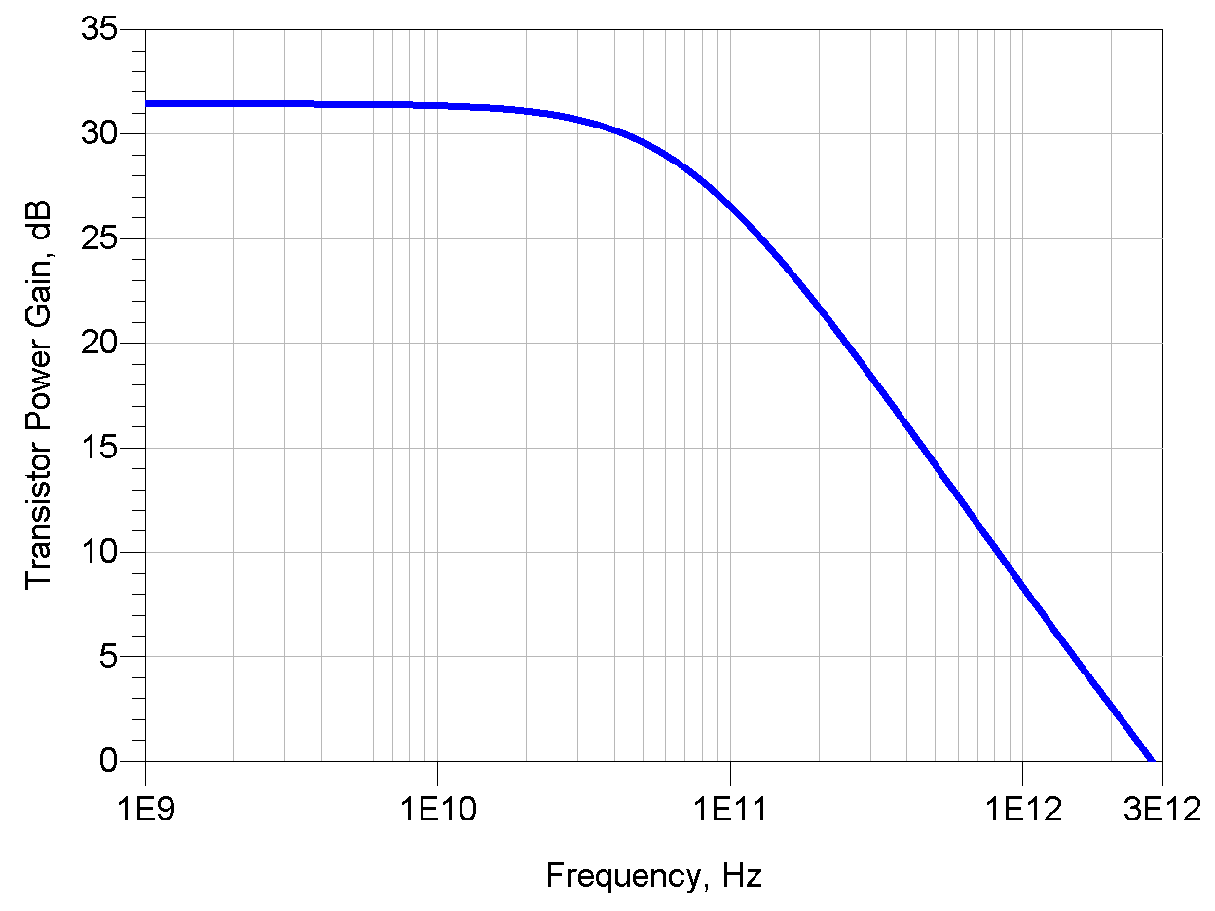
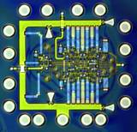
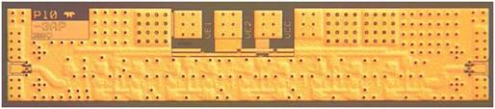
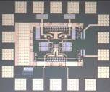
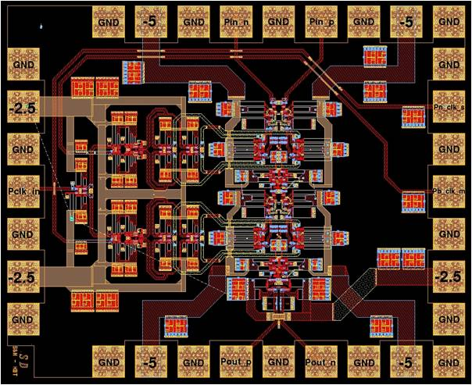
THz Transistors: Systems Benefit from 5-500 GHz
500 GHz digital logic
→ fiber optics
THz amplifiers→ THz radios
→ imaging, communications
precision analog design
at microwave frequencies
→ high-performance receivers
Higher-Resolution
Microwave ADCs, DACs, DDSs
2

Slide 3
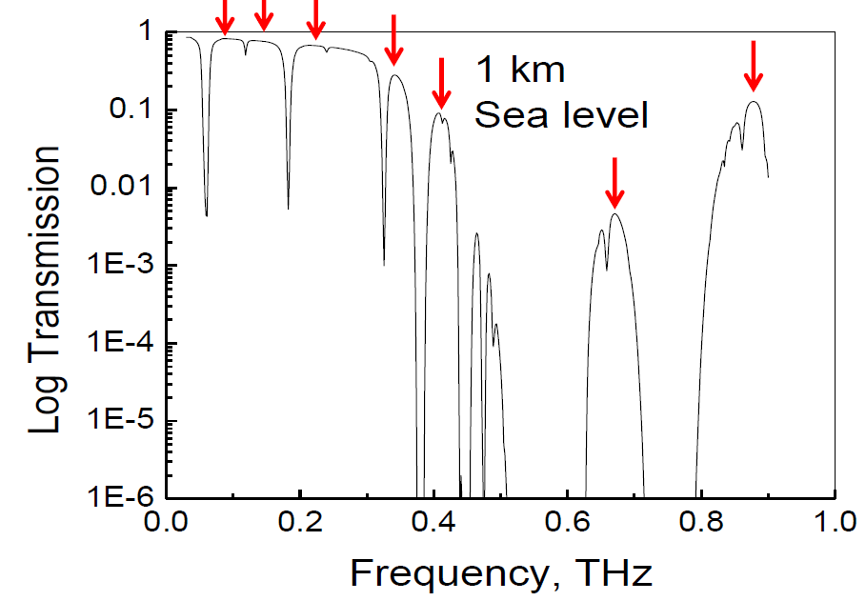
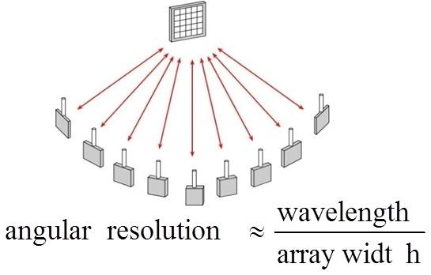
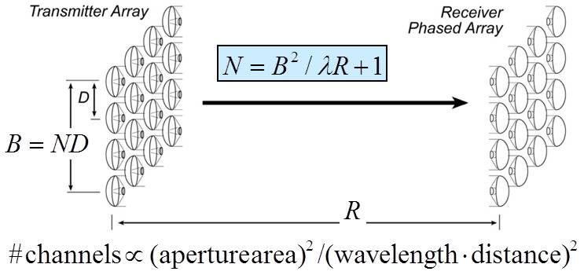
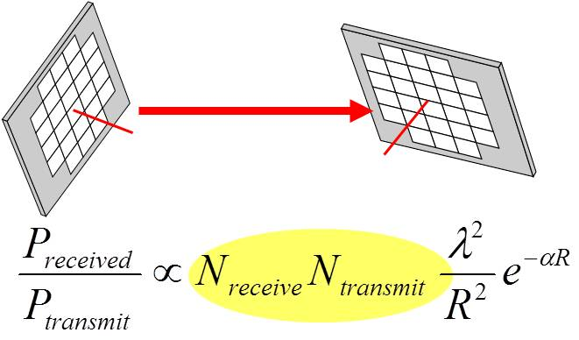
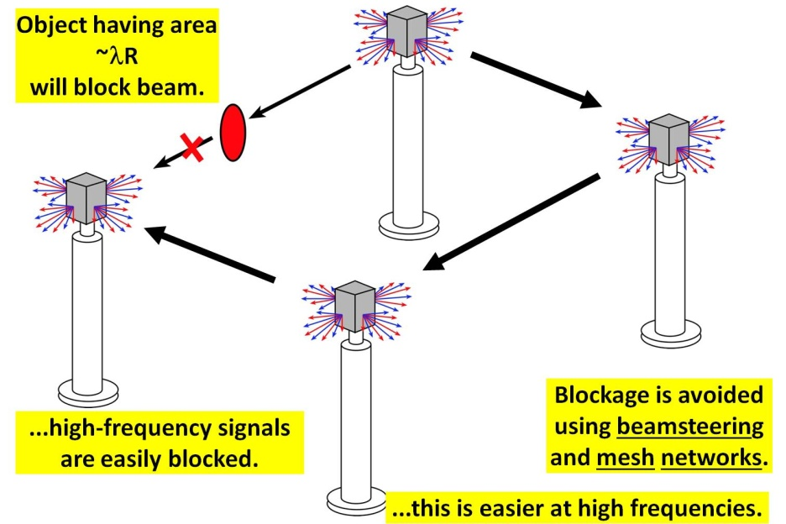
mm-Wave wireless: attributes & challenges
wide bandwidths available
short wavelengths→ many parallel channels
Need phased arrays
Need mesh networks
3

Slide 4
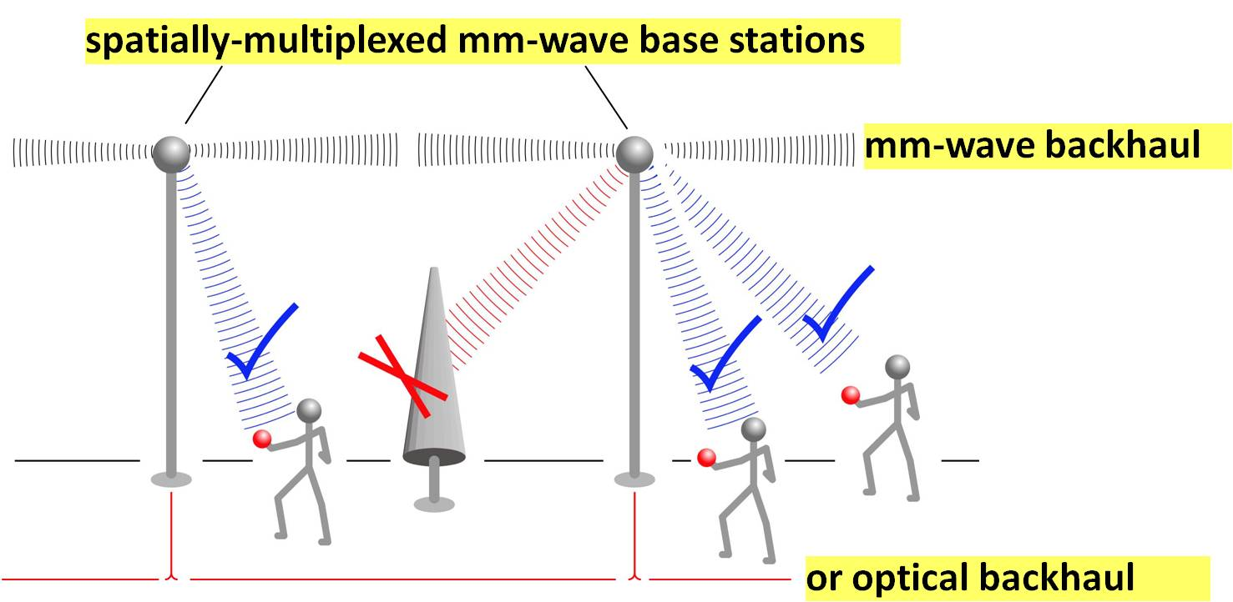
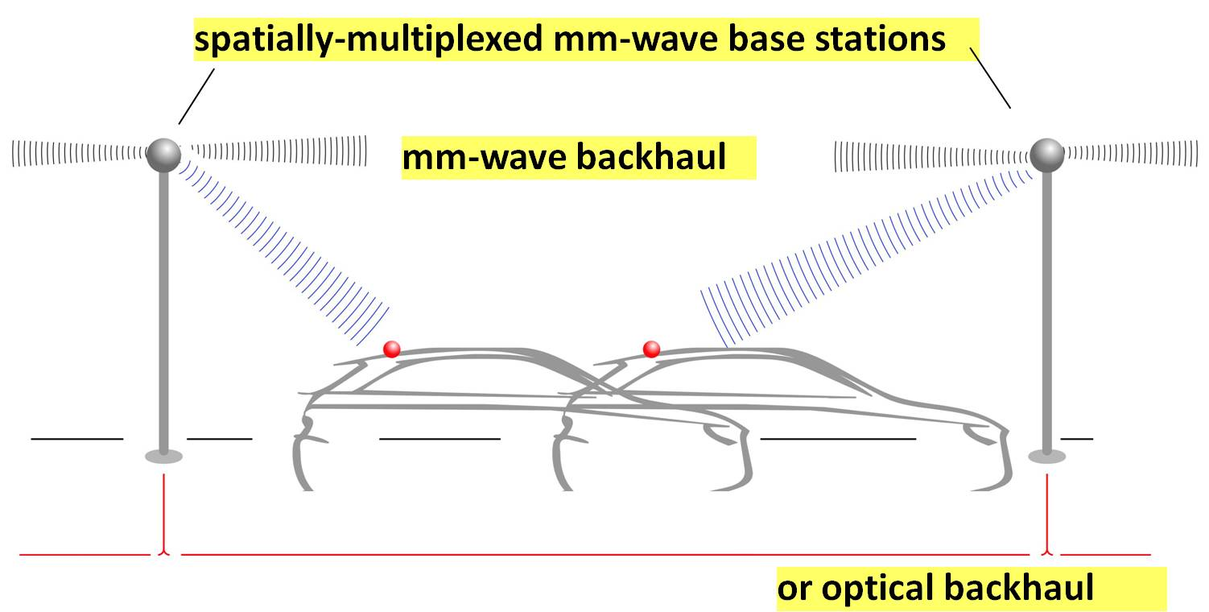
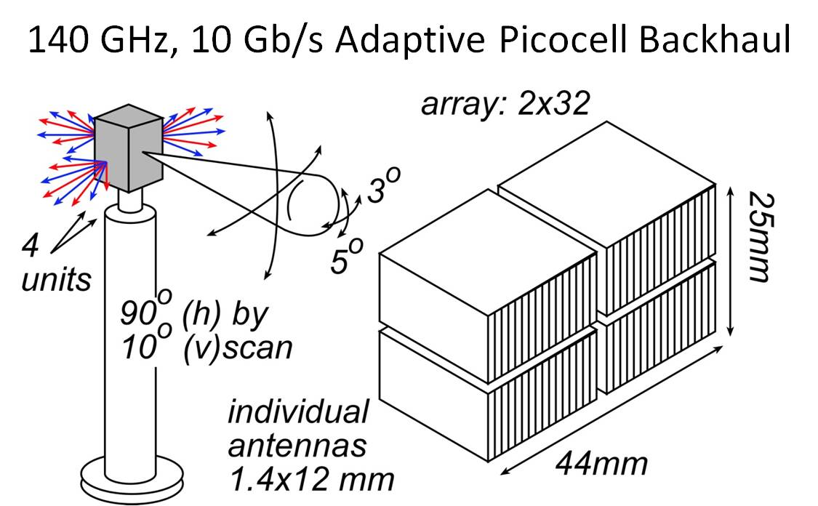
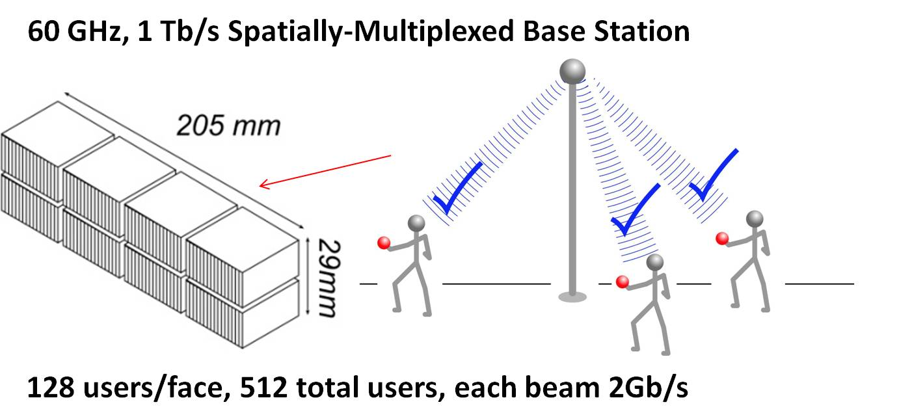
mm-Waves: high-capacity mobile communications
Needed: phased arrays, 50-500mW power amplifiers, low-noise-figure LNAs
4

Slide 5

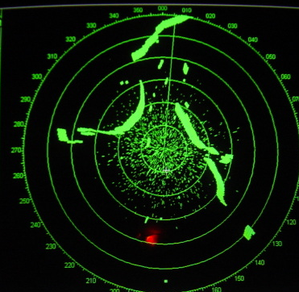

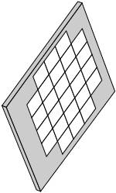
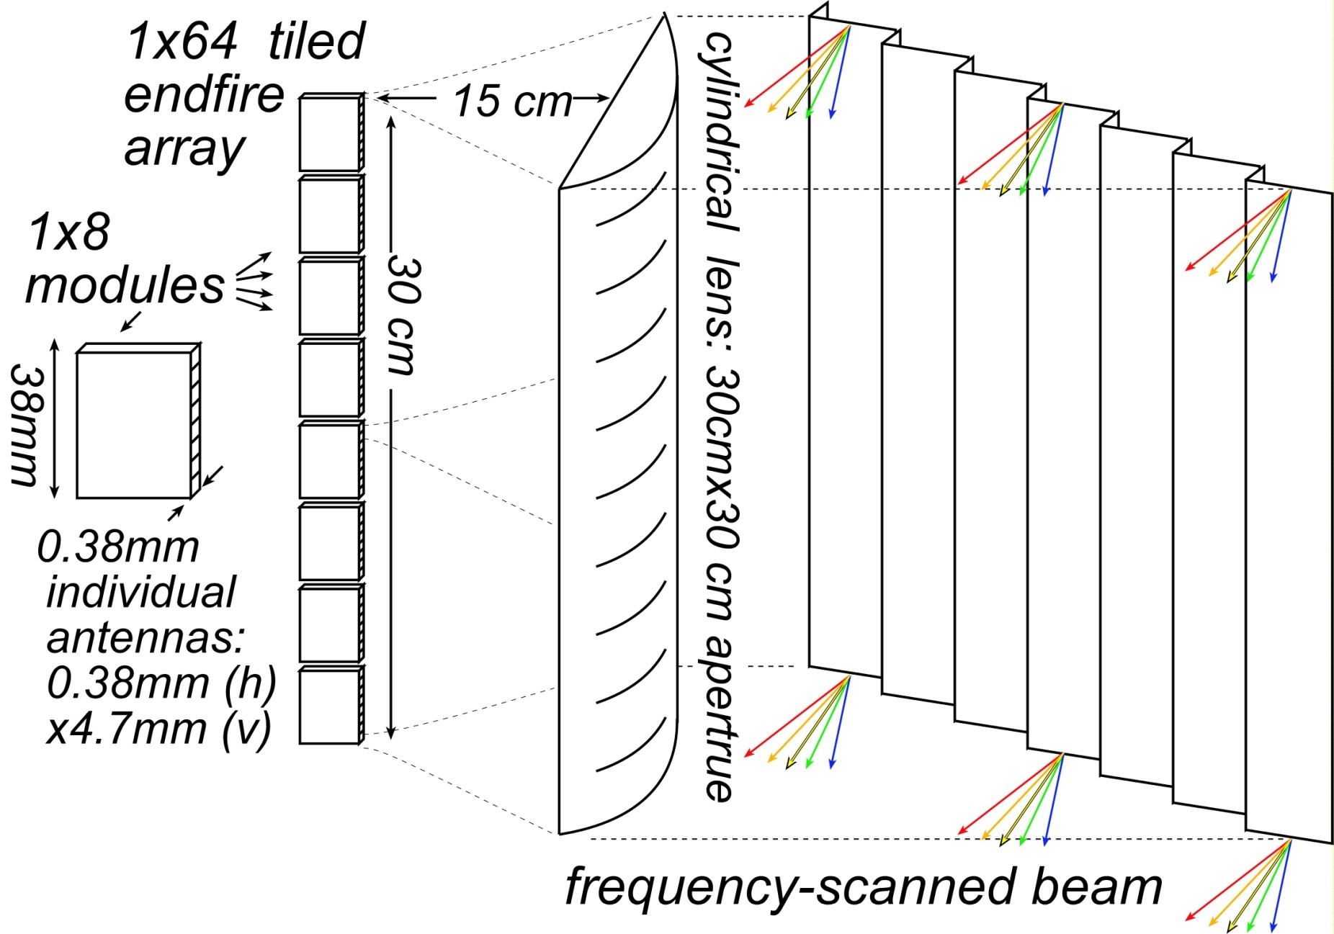
mm-wave imaging radar: TV-like resolution
mm-waves → high resolution from small apertures
What you see in fog
What 10GHz radar shows
What you want to see
needs: ~0.2º resolution, 10³-10⁶ pixels
Large NxN phased array
Frequency-scanned 1xN array
5

Slide 6
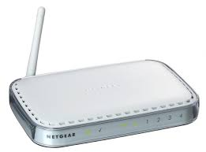

InP HBTs and HEMTs for PAs and LNAs
Cell phones and Higher-Performance WiFi sets:
GaAs HBT power amplifiers
GaAs PHEMT LNAs
29-34GHz: emerging bands for 5G
InP HBT PAs, InP HEMT LNAs ?
Later: 60, 71-76, 81-86, 140 GHz
6

Slide 7
Heterojunction
Bipolar Transistors
7

Slide 8
Bipolar Transistor Design
8

Slide 9
Bipolar Transistor Design: Scaling
9

Slide 10
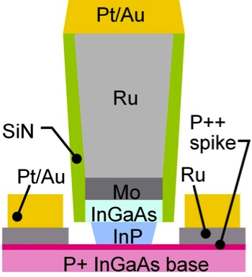
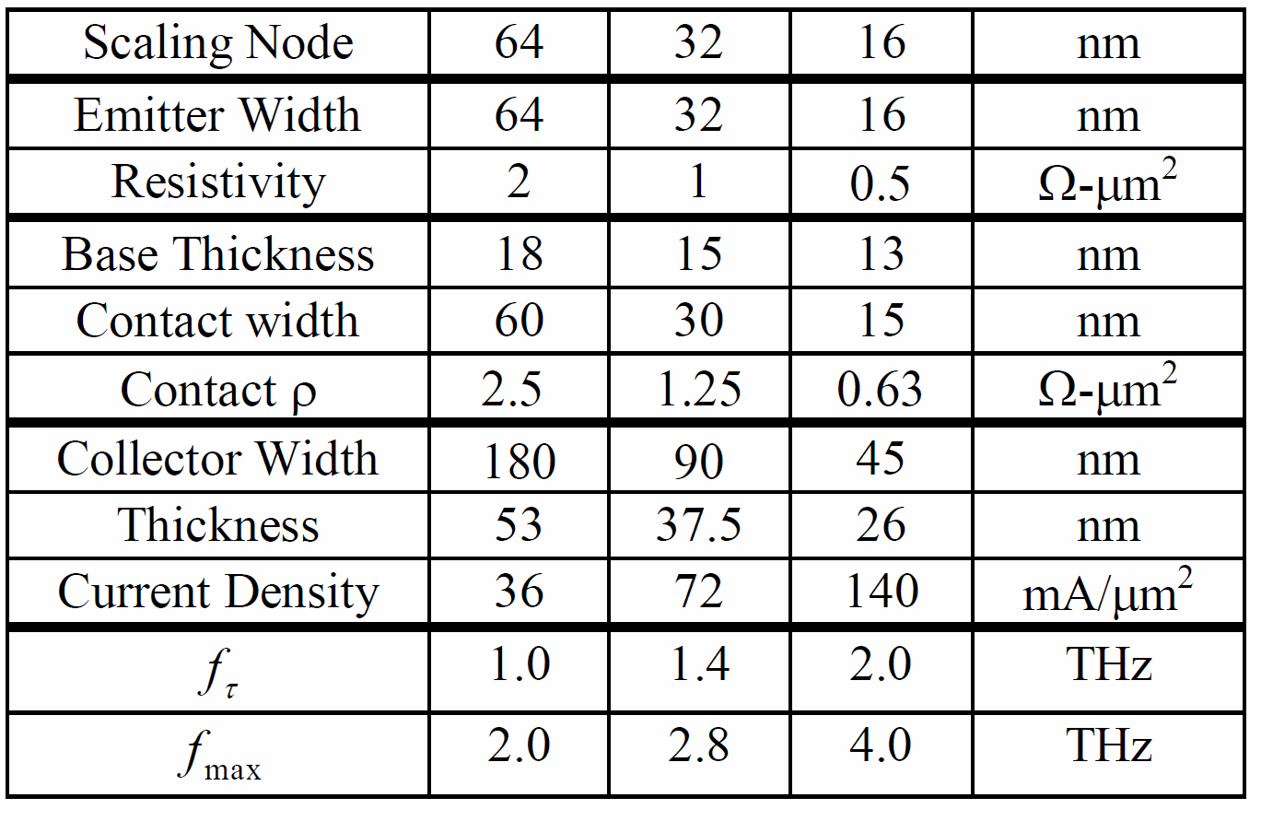
Scaling Laws, Scaling Roadmap
HBT parameter | change
emitter & collector junction widths | decrease 4:1
current density (mA/μm²) | increase 4:1
current density (mA/μm) | constant
collector depletion thickness | decrease 2:1
base thickness | decrease 1.4:1
emitter & base contact resistivities | decrease 4:1
Narrow junctions.
Thin layers
High current density
Ultra low resistivity contacts
10

Slide 11
Can we make a 2 THz SiGe Bipolar Transistor ?
InP SiGe
emitter 64 18 nm width
2 0.6 Ω⋅μm² access ρ
base 64 18 nm contact width,
2.5 0.7 Ω⋅μm² contact ρ
collector 53 15 nm thick
36 125 mA/μm²
2.75 1.3? V, breakdown
f_{τ} 1000 1000 GHz
f_{max} 2000 2000 GHz
PAs 1000 1000 GHz
digital 480 480 GHz
(2:1 static divider metric)
Simple physics clearly drives scaling
transit times, C_{cb}/I_{c}
→ thinner layers, higher current density
high power density → narrow junctions
small junctions→ low resistance contacts
Key challenge: Breakdown
15 nm collector → very low breakdown
Also required:
low resistivity Ohmic contacts to Si
very high current densities: heat
Assumes collector junction 3:1 wider than emitter.
Assumes SiGe contacts no wider than junctions
11

Slide 12
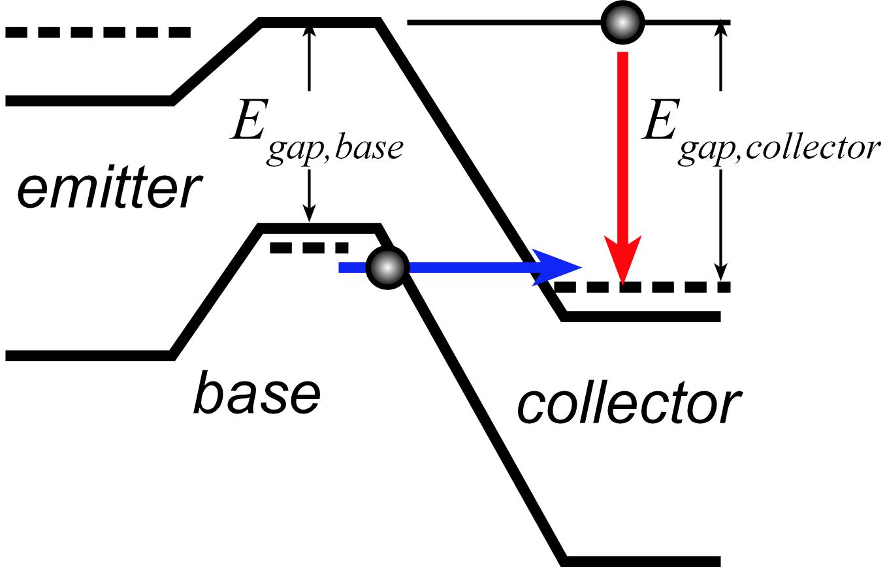
Energy-limited vs. field-limited breakdown
band-band tunneling: base bandgap
impact ionization: collector bandgap
12

Slide 13
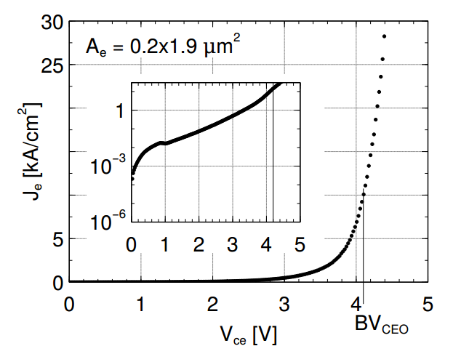
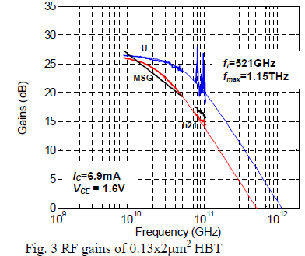
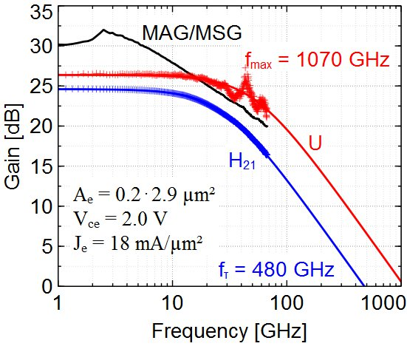
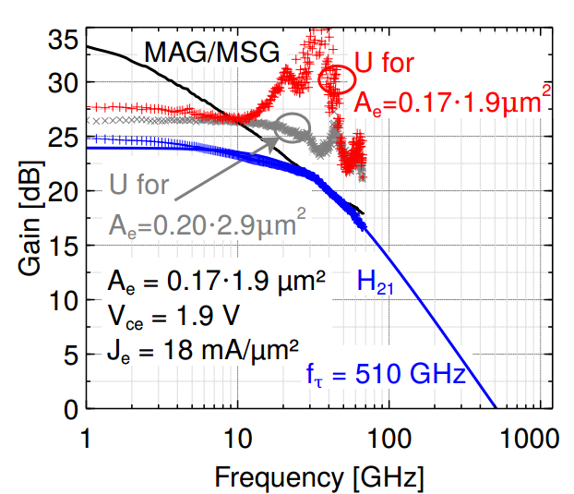
THz InP HBTs: Performance @ 130 nm Node
Teledyne: M. Urteaga et al: 2011 DRC
UCSB: J. Rode et al: in review
UCSB: J. Rode et al: in review
UCSB: J. Rode et al: in review
13

Slide 14
Refractory Contacts to In(Ga)As
Baraskar et al, Journal of Applied Physics, 2013
32 nm (2.8THz) node
requirements
Refractory: robust under high-current operation / Low penetration depth: ~ 1 nm / Performance sufficient for 32 nm /2.8 THz node.
Why no ~2THz HBTs today ?
Problem: reproducing these base contacts in full HBT process flow
14

Slide 15
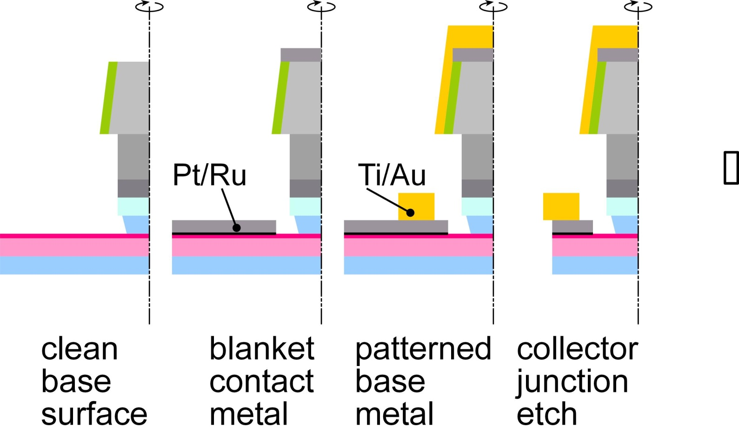
Refractory Blanket Base Metal Process (1)
Metal deposited on clean surface; no resist residue
Refractory Ru contact layer→ low penetration depth
2nm Pt reaction layer→ penetrate surface contaminants
15

Slide 16
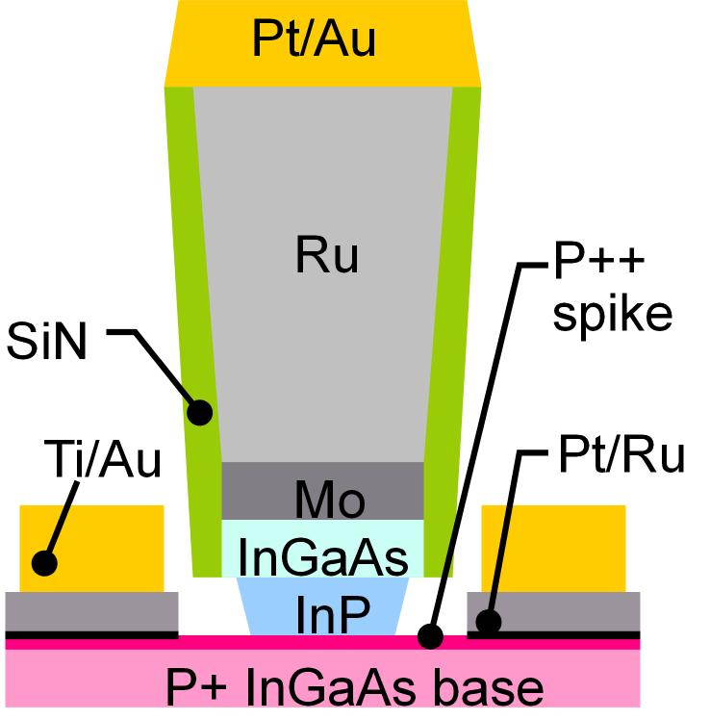
Refractory Blanket Base Metal Process (2)
32 nm node
requirement
Increased surface doping:
reduced contact resistivity,
but increased Auger recombination.
→ Surface doping spike at most 2-5 thick.
Refractory contacts do not penetrate; compatible with pulse doping.
16

Slide 17
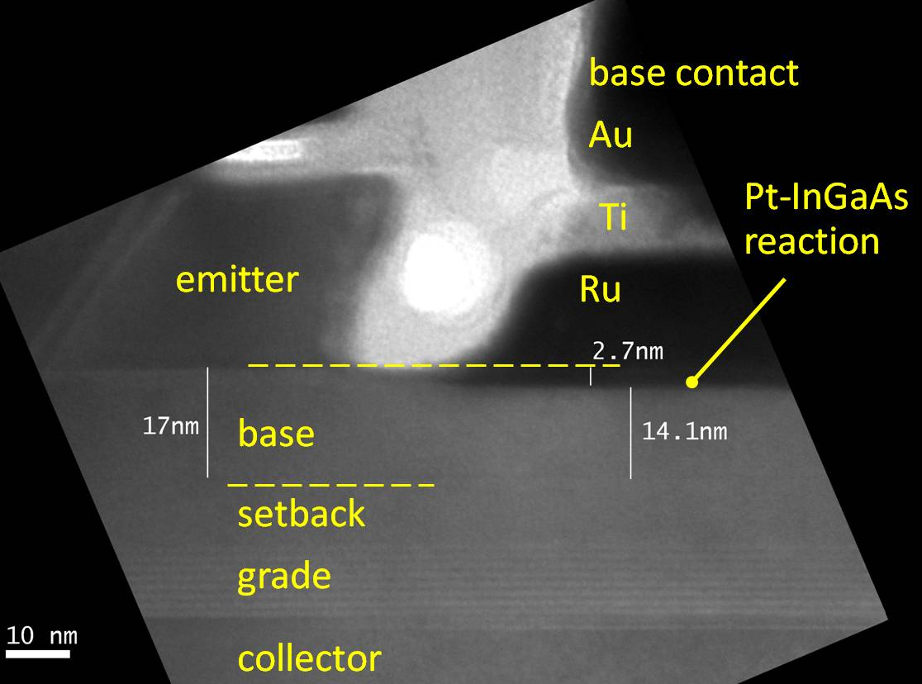
Blanket Base Metal Process
17

Slide 18
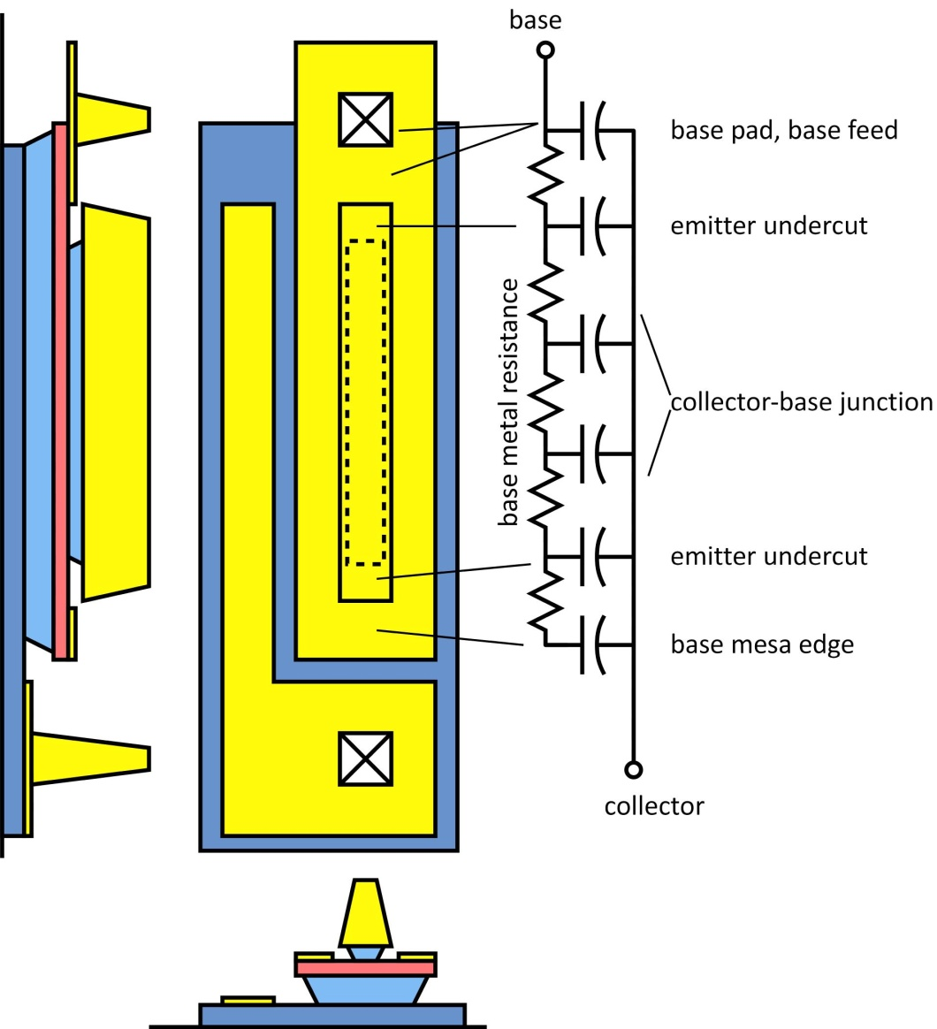
Parasitics along length of HBT emitter
Base pad & feed
increases C_{cb}
Emitter undercut
actual junction shorter than drawn.
→ excess C_{cb} , excess base metal resistance
Base metal resistance
adds to R_{bb}
all these factors decrease f_{max}
18

Slide 19
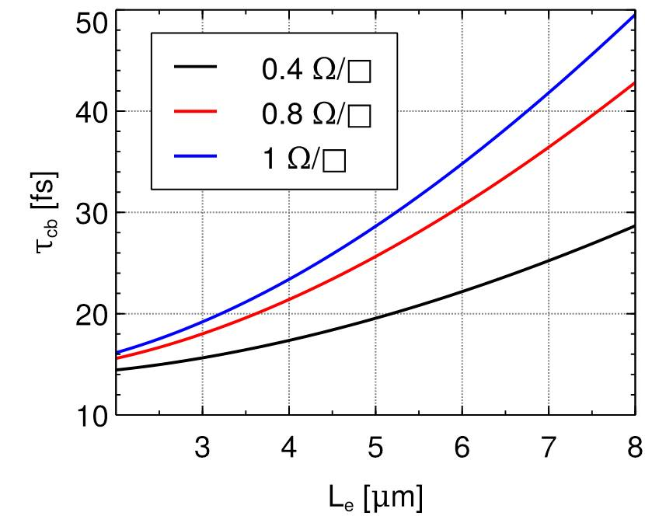
Emitter Length Effects: Decreased f_{max}
Results from finite-element modeling
base metal
sheet resistance
On a 2 μm emitter finger, effect of base metal resistance can be comparable to adding 3 Ω-μm² to the base contact resistivity !
19

Slide 20
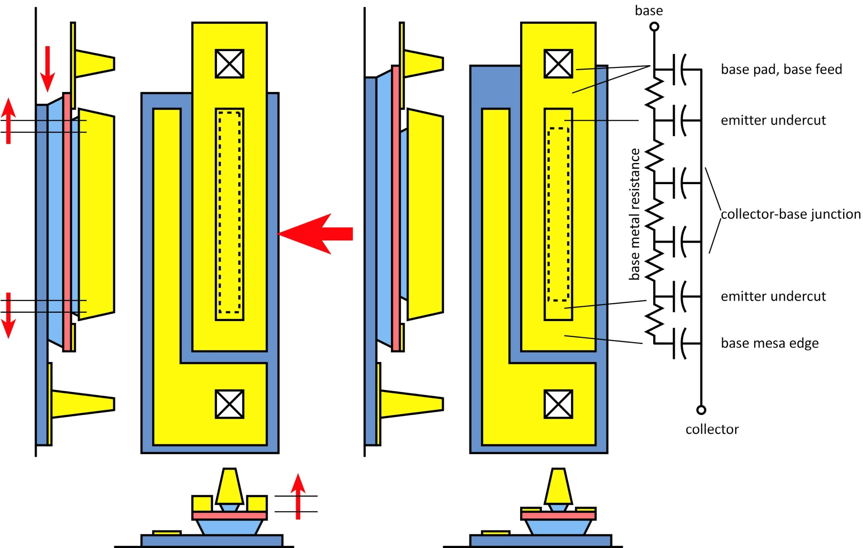
Reducing Emitter Length Effects
20

Slide 21
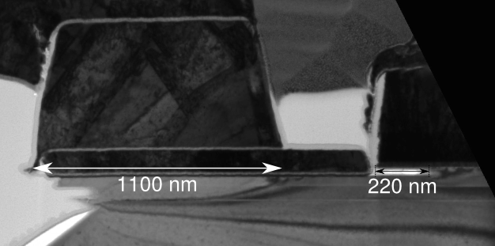
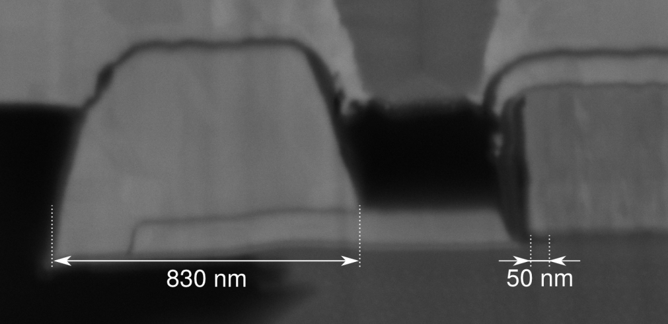
Reducing Emitter Length Effects
large
emitter end
undercut
large base post
J. Rode
in review
before
Small Base Post Undercut
small
emitter end
undercut
after
small base post
Large Base Post Undercut
21

Slide 22
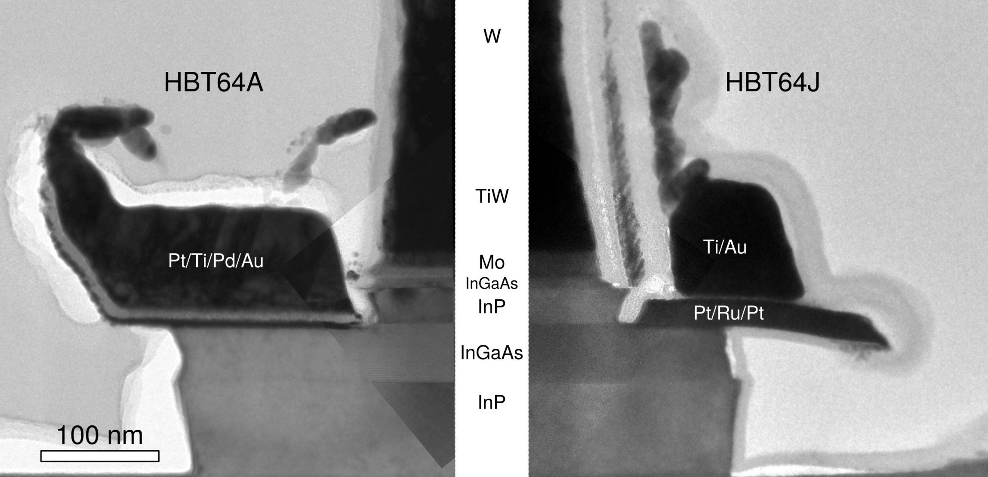
Reducing Emitter Length Effects
before
after
thicker Au layer
in base metal
→ smaller sheet
resistivity
narrower
collector-base
junction
smaller contact penetration into base
J. Rode
in review
22

Slide 23
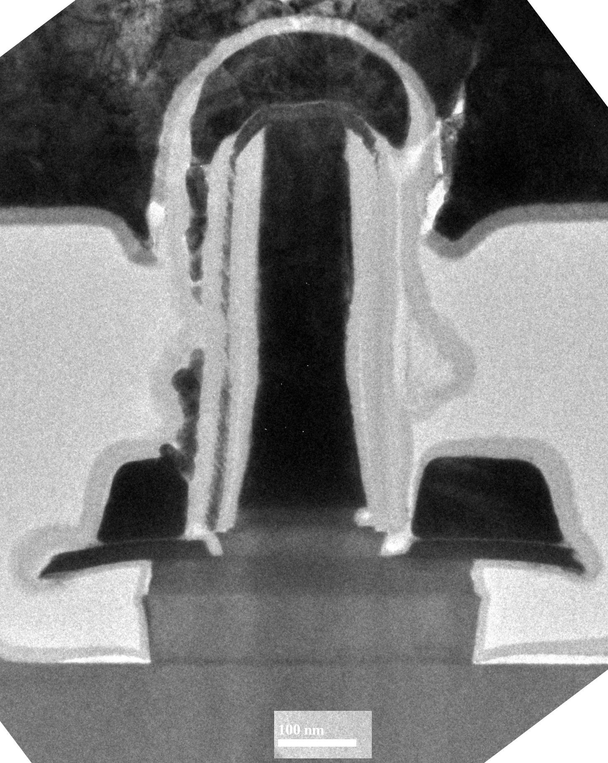
200nm emitter
InP HBT
23

Slide 24
200nm emitter width: High Fmax
f_{max} is high:
...even at 2.9 μm emitter length
...even at 200nm emitter width
_{J. Rode}
_{in review}
24

Slide 25
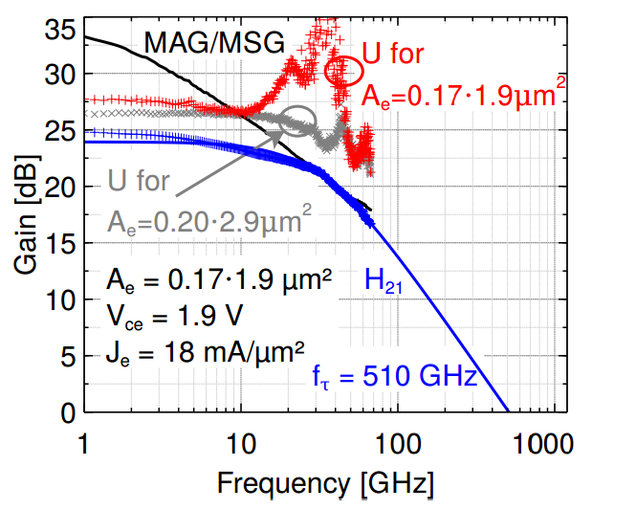
160nm emitter width: Unmeasurable Fmax
on HBTs with
...shorter 1.9 μm emitter length
...narrower 170nm emitter width
f_{max} cannot be measured because of calibration difficulties (small Y₁₂)
f_{max} probably above 1.1THz,
but we cannot prove this.
Better fmax measurement would require on-wafer LRL standards.
We no do not at present
have the resources to pursue this.
_{J. Rode}
_{in review}
25

Slide 26
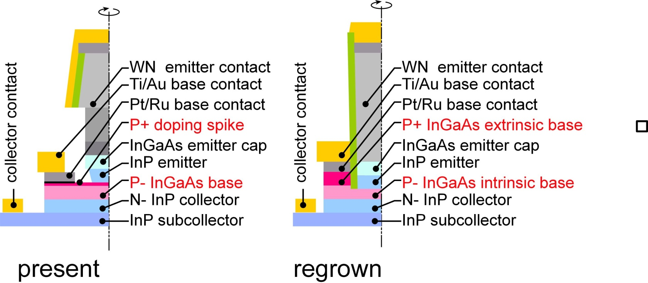
Regrowth for high β in THz HBTs ?
2-3 THz f_{max} HBTs need ~1.5*10²⁰ cm⁻³ doping under base contacts
→ high Auger recombination→ low β.
Desire: high doping under contacts, lower doping elsewhere.
Regrowth processes enable this.
26

Slide 27
THz InP HBT Scaling Roadmap
130nm node: 550GHz f_{τ} , 1100 GHz f_{max}
Are the 64 nm and 32nm nodes feasible ?
Key challenge: base contacts
Recent demonstration of <2 Ω−μm² contacts in HBT process flow.
Longer term challenge :
decoupling doping under contacts vs. under base
27

Slide 28
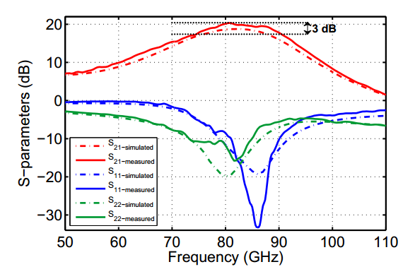
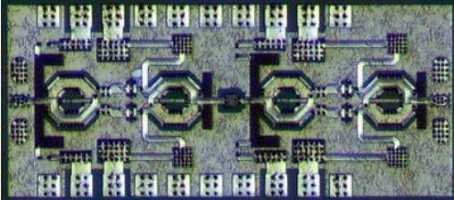
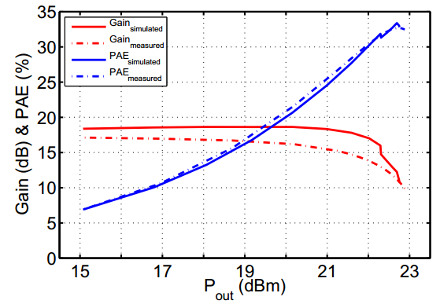
86 GHz InP HBT Power Amplifier
UCSB/Teledyne
Gain: 20.4dB S21 Gain at 86GHz
Saturated output power: 188mW at 86GHz
Output Power Density: 1.96 W/mm
PAE: 32.8%
Technology: 250 nm InP HBT
1.4 mm x 0.60 mm
High W/mm, very small die
Park et al, JSSC, Oct. 2014 http://ieeexplore.ieee.org/xpls/abs_all.jsp?arnumber=6847236&tag=1
28

Slide 29
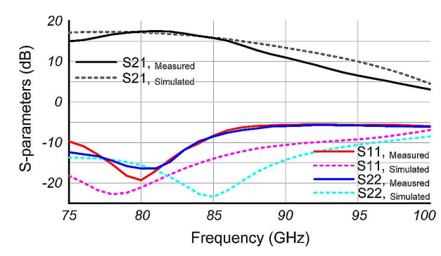
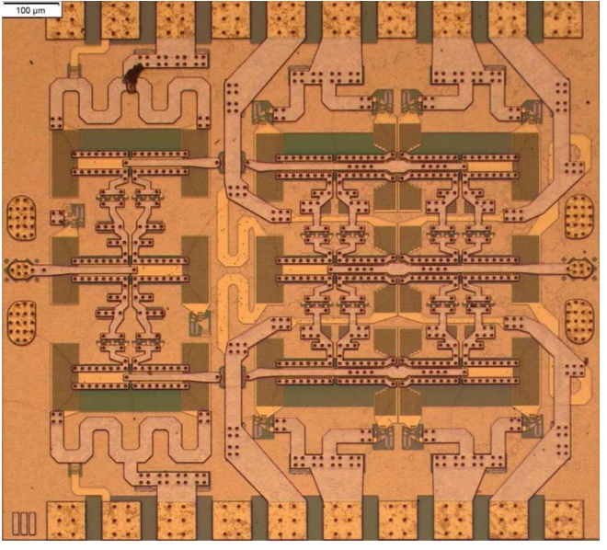
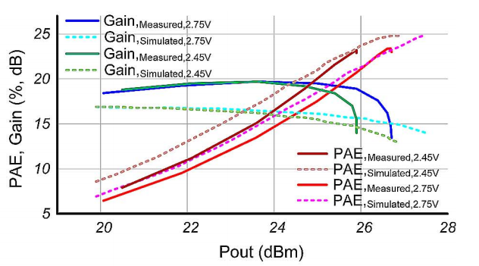
81 GHz InP HBT Power Amplifier
UCSB/Teledyne
Gain: 17.4dB S21 Gain at 81GHz
Saturated output power: 470mW at 81GHz
Output Power Density: 1.22 W/mm*
PAE: 23.4%
Power/(core die area): 1020W/mm²
Technology: 250 nm InP HBT
*design error: IC should have produced P_{sat}=700mW, ~2 W/mm
High Power, very small die
0.82mm x 0.82 mm
Park et al, JSSC, Oct. 2014 http://ieeexplore.ieee.org/xpls/abs_all.jsp?arnumber=6847236&tag=1
29

Slide 30
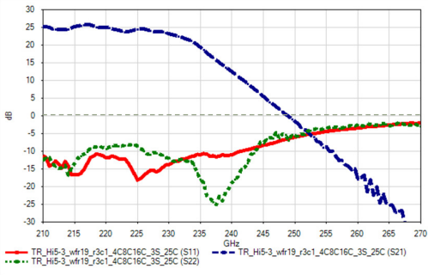
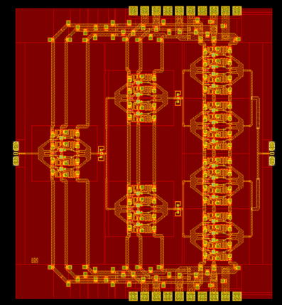
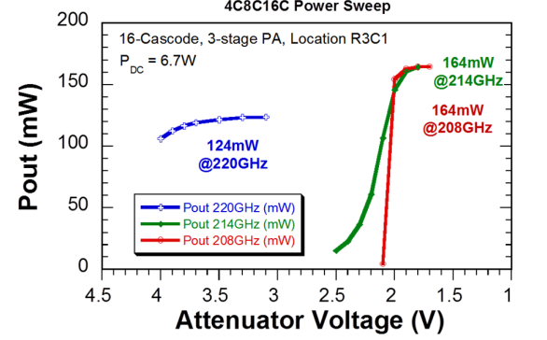
214 GHz InP HBT Power Amplifier
UCSB/Teledyne
Gain: 25dB S21 Gain at 220GHz
Saturated output power: 164mW at 214GHz
Output Power Density: 0.43 W/mm
PAE: 2.4%
Technology: 250 nm InP HBT
(no die photo) 2.5mm x 2.1 mm
Reed et al, 2014 CSICS http://ieeexplore.ieee.org/xpls/abs_all.jsp?arnumber=6659187&tag=1
30

Slide 31


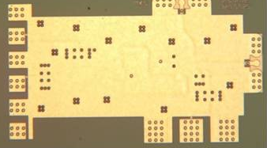
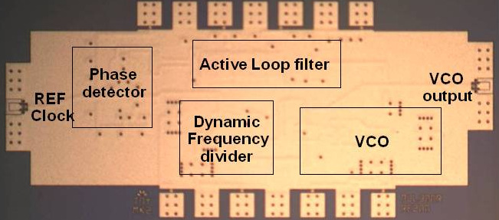
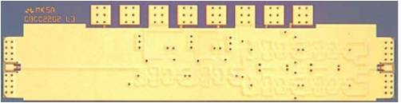

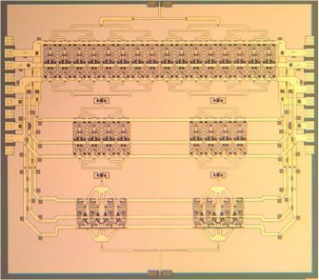



InP HBT Integrated Circuits: 600 GHz & Beyond
614 GHz
fundamental
VCO
340 GHz dynamic frequency divider
M. Seo, TSC / UCSB
M. Seo, UCSB/TSC
IMS 2010
300 GHz fundamental
PLL
620 GHz, 20 dB gain amplifier
M Seo, TSC
IMS 2013
Not shown: 670 GHz amplifier:
J. Hacker, TSC
IMS 2013
M. Seo, TSC
IMS 2011
204 GHz static
frequency divider
(ECL master-slave
latch)
220 GHz
180 mW
power amplifier
81 GHz
470 mW
power amplifier
Z. Griffith, TSC
CSIC 2010
T. Reed, UCSB
CSICS 2013
H-C Park UCSB
IMS 2014
Integrated 300/350GHz Receivers:
LNA/Mixer/VCO
600 GHz
Integrated
Transmitter
PLL + Mixer
M. Seo TSC
M. Seo TSC
31

Slide 32
Field-Effect Transistors
32

Slide 33





State of the Art (IMS 2014)
33

Slide 34
HEMTs: Key Device for Low Noise Figure
Hand-derived modified Fukui Expression, fits CAD simulation extremely well.
2:1 to 4:1 increase in f_{τ} → greatly improved noise @ 200-670 GHz.
Better range in sub-mm-wave systems; or use smaller power amps.
Critical: Also enables THz systems beyond 820 GHz
34

Slide 35

FET Design
35

Slide 36
FET Design: Scaling
36

Slide 37
FET Design: Scaling
2:1
2:1
constant
2:1
2:1
2:1
2:1
2:1
2:1
2:1
2:1
constant
constant
constant
constant
4:1
2:1
2:1
constant
2:1
2:1
37

Slide 38


Field-Effect Transistor Scaling Laws
FET parameter | change
gate length | decrease 2:1
current density (mA/μm), g_{m} (mS/μm) | increase 2:1
transport effective mass | constant
channel 2DEG electron density | increase 2:1
gate-channel capacitance density | increase 2:1
dielectric equivalent thickness | decrease 2:1
channel thickness | decrease 2:1
channel density of states | increase 2:1
source & drain contact resistivities | decrease 4:1
fringing capacitance does not scale → linewidths scale as (1 / bandwidth )
38

Slide 39
Field-Effect Transistors No Longer Scale Properly
FET parameter | change
gate length | decrease 2:1
current density (mA/μm), g_{m} (mS/μm) | increase 2:1
transport effective mass | constant
channel 2DEG electron density | increase 2:1
gate-channel capacitance density | increase 2:1
dielectric equivalent thickness | decrease 2:1
channel thickness | decrease 2:1
channel density of states | increase 2:1
source & drain contact resistivities | decrease 4:1
Gate dielectric can't be much further scaled.
Not in CMOS VLSI, not in mm-wave HEMTs
g_{m}/W_{g} (mS/μm) hard to increase→ C_{fringe} / g_{m} prevents f_{τ} scaling.
Shorter gate lengths degrade electrostatics→ reduced g_{m} /G_{ds}
39

Slide 40



Scaling roadmap for InP HEMTs
40

Slide 41

Why THz HEMTs no longer scale; how to fix this
HEMTs: gate barrier also lies under S/D contacts → high S/D access resistance
S/D regrowth→ no barriers under contacts→ low R_{S/D}→ higher f_{max}, lower F_{min}
As gate length is scaled, gate barrier must be thinned for high g_{m}, low G_{ds}
HEMTs: High gate leakage when gate barrier is thinned→ cannot thin barrier
ALD high-K gate dielectrics→ ultra-thin→ improved g_{m}, G_{ds} , increased (f_{τ},f_{max})
Solutions to key HEMT scaling challenges have been developed
during the development of III-V MOS for VLSI.
41

Slide 42

UCSB's Record VLSI-Optimized MOSFET @ 25nm L_{g}.
Lee et al, 2014 VLSI Symposium
42

Slide 43
UCSB's Record VLSI-Optimized MOSFET @ 25nm L_{g}.
~2.4 mS/μm Peak g_{m} at V_{DS}=0.5 V
~300 Ohm-µm on-resistance at V_{GS}=0.7 V
77 mV/dec Subthreshold Swing at V_{DS}=0.5 V, 76 mV/V DIBL at 1 µA/µm
0.5 mA/µm I_{on} at I_{off}=100 nA/µm and V_{DD}=0.5 V
61 mV/dec subthreshold swing @1 μm L_{g}
Lee et al, 2014 VLSI Symposium
43

Slide 44

High Transconductance III-V MOSFETs
Lee et al, EDL, June 2014
High g_{m}, with low G_{DS}, is critical for THz FETs
Here:
18nm gate length, 5nm InAs channel → 3mS/μm g_{m}.
These FETs have large access resistance from non-self-aligned contacts;
so g_{m} can be readily increased.
Future: shorter gates, thinner channels, better dielectrics better contacts
→ higher g_{m}.
44

Slide 45


THz III-V MOS: Not the same as VLSI III-V MOS
UTB Si MOS
UTB III-V MOS
III-V THz
MOS/HEMT
III-V THz HEMT
III-V MOS has a reasonable chance of use in VLSI at the 7nm node
These will *not* be THz devices
The real mm-wave / VLSI distinction:
Device geometry optimized for high-frequency gain (THz)
vs. optimized for small footprint & high DC on/off ratio (VLSI).
mm-wave / THz devices:
minimize overlap capacitances, drain offset for low C_{gd} & G_{ds}, thicker channels optimized for g_{m}, T-gates for low resistance
45

Slide 46



Prospects for Higher-Bandwidth CMOS VLSI
Recall:
Gate-dielectric can't scale much further.
That stops g_{m} (mS/μm) from increasing.
(end capacitance)/g_{m} limits achievable f_{τ} .
Also:
Given fixed dielectric EOT,
G_{ds} degrades with scaling.
FinFETs have better electrostatics,
hence better g_{m}/G_{ds}...
But in present technologies the end capacitances are worse.
And W via resistances reduce the gain
Inac et al, CSICS 2011 (45nm SOI CMOS)
46

Slide 47


InP Field-Effect-Transistor Scaling Roadmap
2-3 THz InP HEMTs are Feasible.
2 THz FETs realized by:
Ultra low resistivity source/drain
High operating current densities
Very thin barriers & dielectrics
Gates scaled to 9 nm junctions
or
MOSFET
high-barrier HEMT
Impact:
Sensitive, low-noise receivers
from 100-1000 GHz.
3 dB less noise →
need 3 dB less transmit power.
47

Slide 48
Conclusions

Slide 49
Roadmap for High-Frequency Transistors
Beware of physics-free roadmaps
20% improvement /year extrapolations are meaningless.
Real transistors are approaching scaling limits.
VLSI transistors are optimized for density & digital, not RF.
Lower standby power processes are slower RF processes.
Bandwidths of Si CMOS VLSI have leveled off.
There is market for application-specific high-frequency transistors.
LNAs, PAs, front-ends generally.
Just like cell phones today.
InP HBTs & HBTs have perhaps 2-3 scaling generations left.
Doubling of bandwidth, perhaps a little more.
Process technology development is getting quite hard.
49

