Slide 1
Transistors for VLSI, for Wireless:
A View Forwards Through Fog
Plenary, Device Research Conference, June 22, 2015, Ohio State
Mark Rodwell, UCSB
Low-voltage devices
P. Long, E. Wilson, S. Mehrotra, M. Povolotskyi, G. Klimeck: Purdue
III-V MOS
C.-Y. Huang, S. Lee*, A.C. Gossard,
V. Chobpattanna, S. Stemmer, B. Thibeault, W. Mitchell : UCSB
InP HBT:
J. Rode**, P. Choudhary, A.C. Gossard, B. Thibeault, W. Mitchell: UCSB
M. Urteaga, B. Brar: Teledyne Scientific and Imaging
Now with: *IBM, **Intel

Slide 2

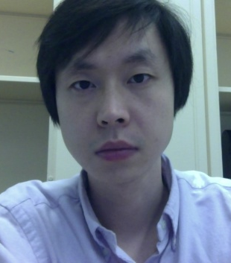
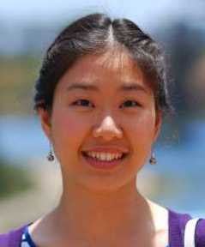
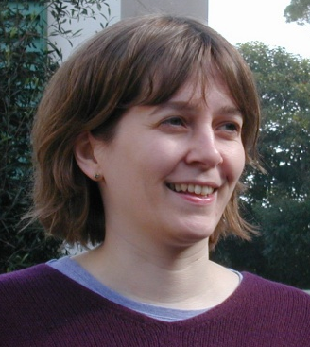



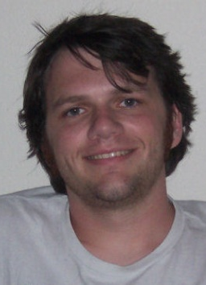

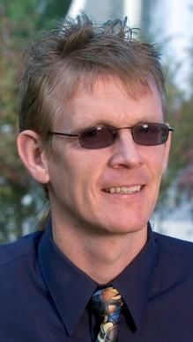
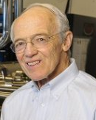
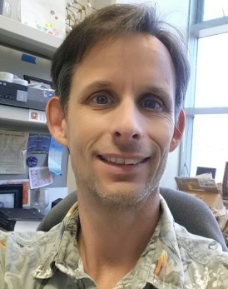

Co-authors
In(Ga)As MOS
THz InP HBT
Cheng-Ying
Huang
Sanghoon
Lee
Varista Chobpattanna
Prof. Susanne
Stemmer
Johann
Rode
Prateek
Choudhary
Steep FET design
III-V EPI
Process
Pengyu
Long
Evan
Wilson
Prof. Michael
Povolotski
Prof. Gerhard Klimeck
Prof. Art
Gossard
Brian
Thibeault
Bill
Mitchell
..and at Teledyne (HBT):
Miguel Urteaga, Bobby Brar

Slide 3
What's a Professor to do ?
Transistors approaching scaling limits
Process technology: it's getting hard.
extreme resolution, complex process, many steps
exhausted students
How can we steer the future of VLSI, of wireless ?
Beyond yet another new semiconductor (be it 3D or 2...)
let's explore other options.

Slide 4
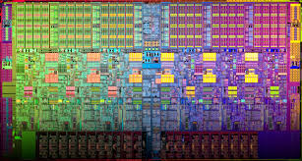
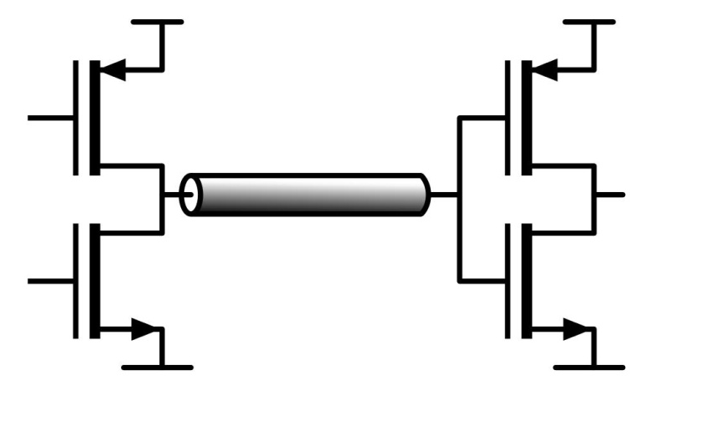
VLSI
4

Slide 5
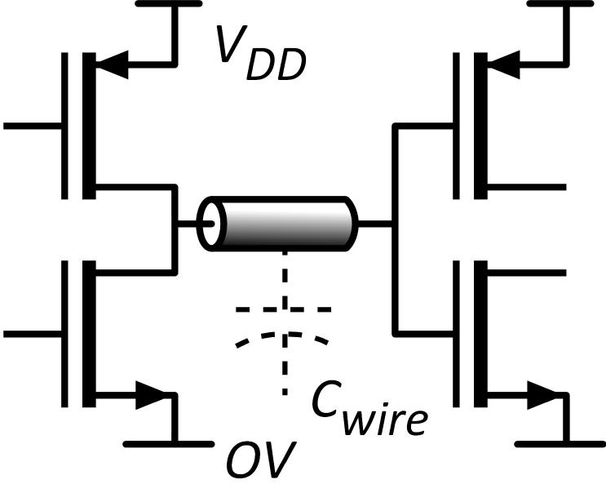
What does VLSI need ?
Small transistors: plentiful, cheap
Small transistors→ short wires
small delay CV_{DD} /I
low energy CV_{DD}²/2
Small-area electronics is key
Low leakage current
thermal: I_{off} > I_{on}*exp(-qV_{DD}/kT)
want low V_{DD} yet low I_{off}.
Want:
Large dI/dV above threshold
Steeper than thermal below threshold

Slide 6
First: Steep-subthreshold-swing transistors
Characteristics steeper than thermal→ lower supply voltage

Slide 7
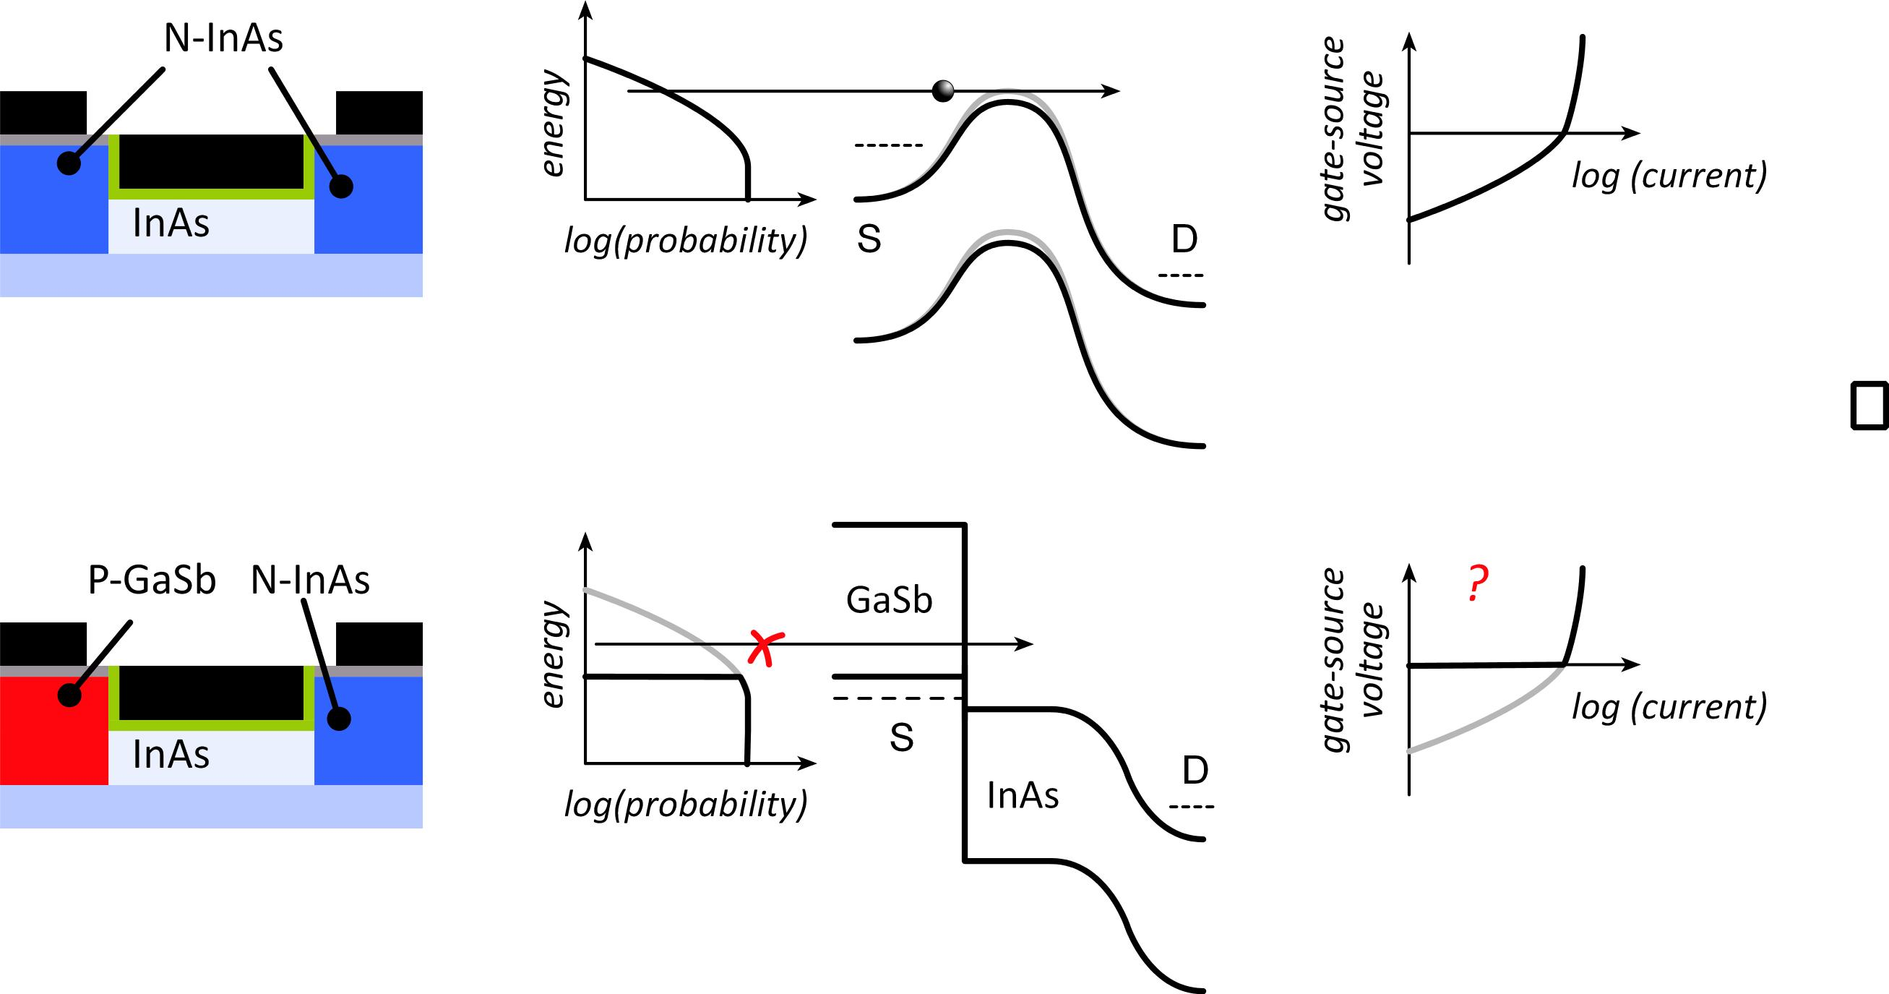
Tunnel FETs: truncating the thermal distribution
Normal
T-FET
J. Appenzeller et al.,
IEEE TED, Dec. 2005
Source bandgap truncates thermal distribution
Must cross bandgap: tunneling
Fix (?): broken-gap heterojunction

Slide 8
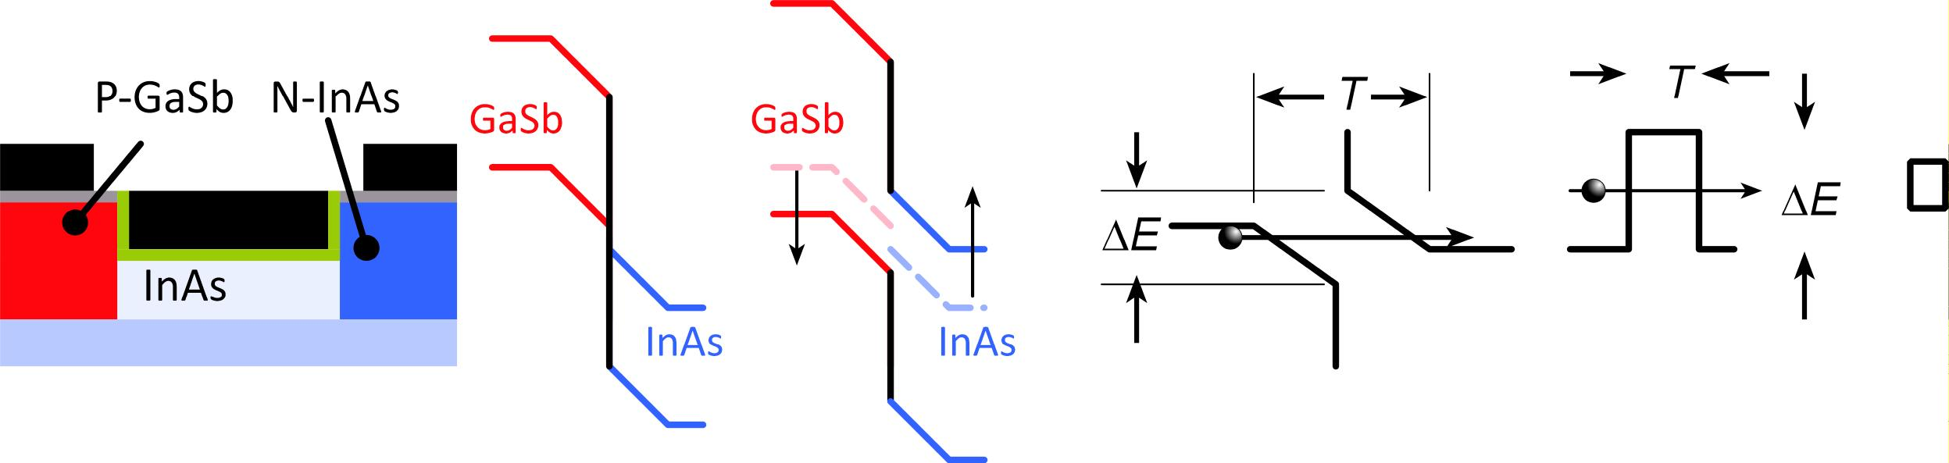
Tunnel FETs: are prospects good ?
Useful devices must be small
Quantization shifts band edges→ tunnel barrier
Band nonparabolicity increases carrier masses
Electrostatics: bands bend in source & channel
What actual on-current might we expect ?

Slide 9
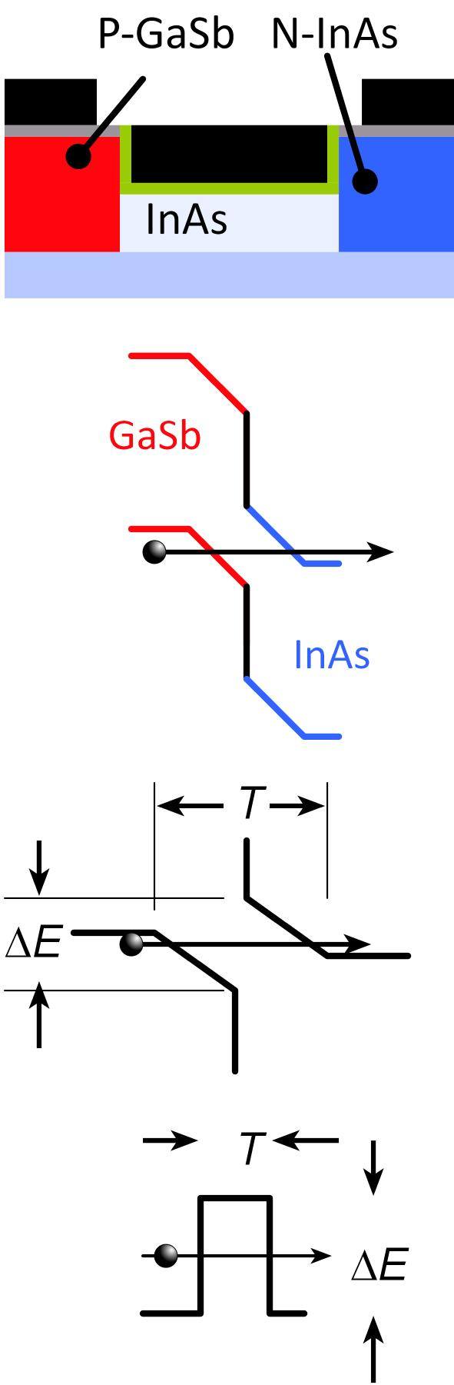
Tunneling Probability
For high I_{on}, tunnel barrier must be *very* thin.
~3-4nm minimum barrier thickness:
P+ doping, body & dielectric thicknesses

Slide 10
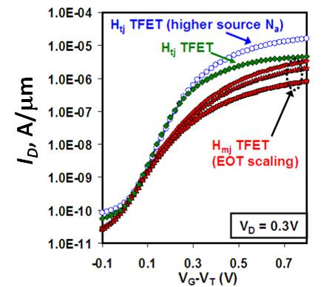
T-FET on-currents are low, T-FET logic is slow
NEMO simulation:
GaSb/InAs tunnel finFET: 2nm thick body, 1nm thick dielectric @ ε_{r}=12, 12nm L_{g}
10 μA/μm
3.0%
Experimental:
InGaAs heterojunction HFET;
Dewey et al,
2011 IEDM,
2012 VLSI Symp.
~15 μA/μm @0.7V
Low current
→ slow logic

Slide 11
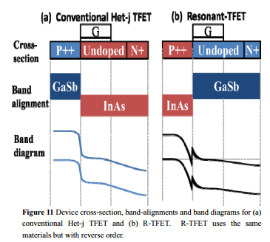
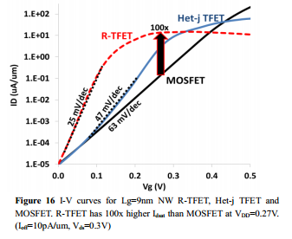
Resonant-enhanced tunnel FET
Avci & Young, (Intel) 2013 IEDM
2nd barrier: bound state
dI/dV peaks as state aligns with source
improved subthreshold swing.
Can we also increase the on-current ?

Slide 12
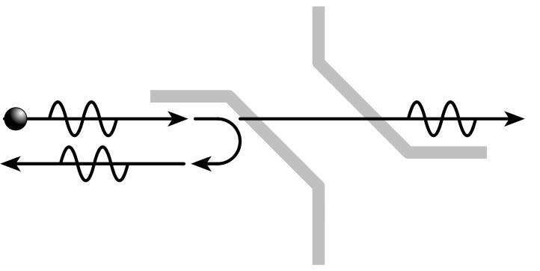
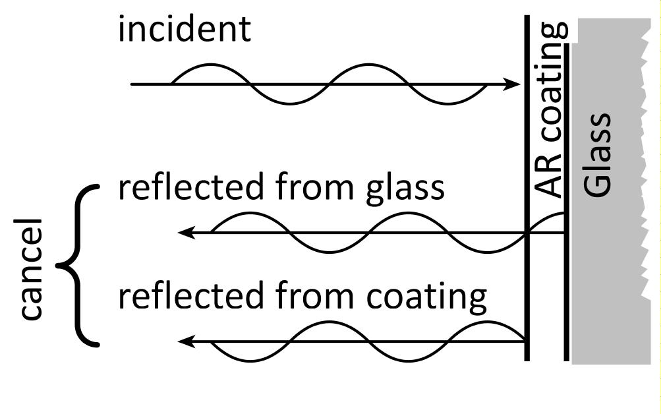
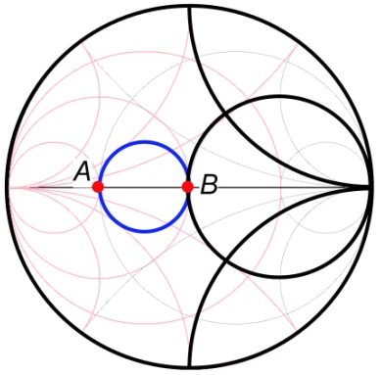
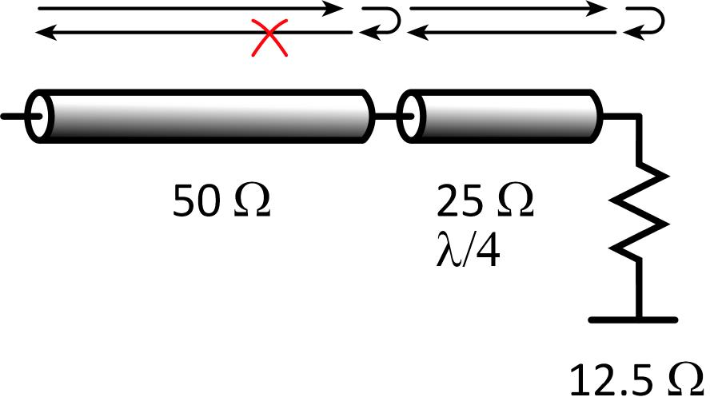
Electron anti-reflection coatings
Tunnel barrier:
transmission coefficient < 100%
reflection coefficient > 0%
want: 100% transmission, zero reflection
familiar problem
Optical coatings
reflection from lens surface
quarter-wave coating, appropriate n
reflections cancel
Microwave impedance-matching
reflection from load
quarter-wave impedance-match
no reflection
Smith chart.

Slide 13
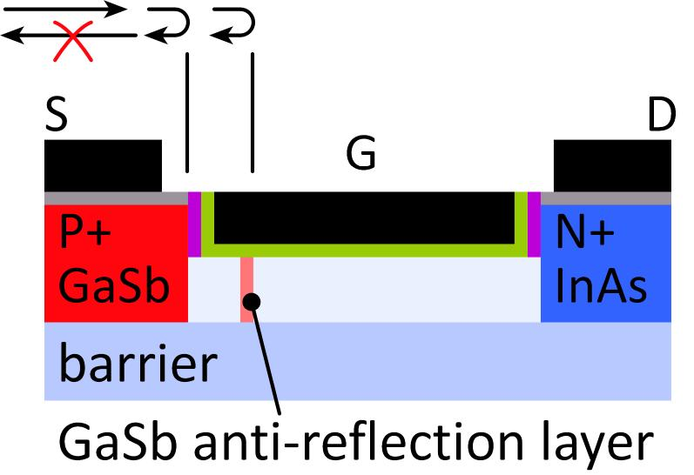
T-FET: single-reflector AR coating
Peak transmission approaches 100%
Narrow transmission peak; limits on-current
Can we do better ?

Slide 14
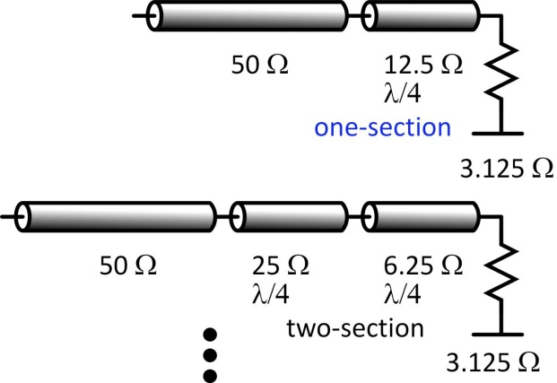
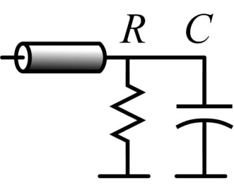
Limits to impedance-matching bandwidth
Microwave matching:
More sections→ more bandwidth
Is there a limit ?
Bode-Fano limits
R. M. Fano, J. Franklin Inst., Jan. 1960
Bound bandwidth for high transmission
example: bound for RC parallel load→
Do electron waves have similar limits ?
Yes ! Schrödinger's equation is isomorphic to E&M plane wave.
Khondker, Khan, Anwar, JAP, May 1988
T-FET design→ microwave impedance-matching problem
Fano: limits energy range of high transmission
Design T-FETs using Smith chart, optimize using filter theory
Working on this: for now design by random search
*

Slide 15
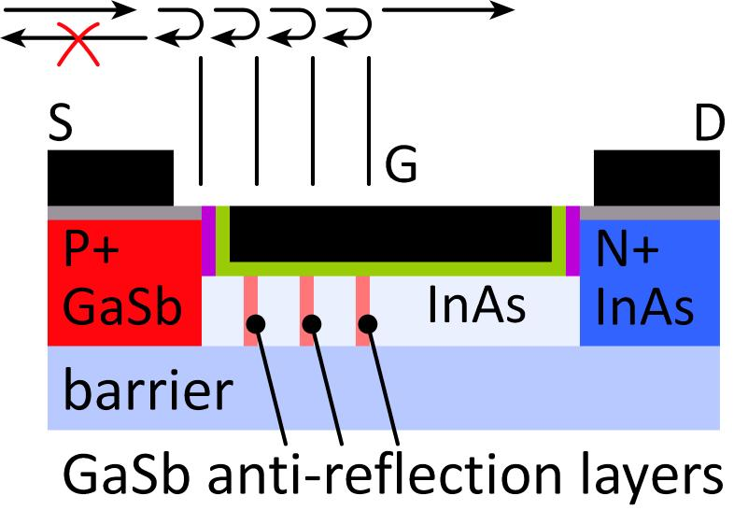
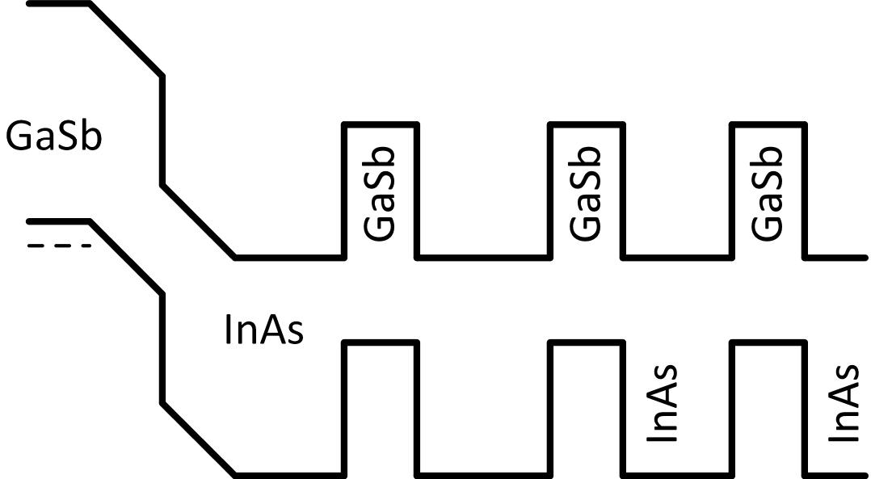
T-FET with 3-layer antireflection coating
Simulation
Interim result; still working on design

Slide 16
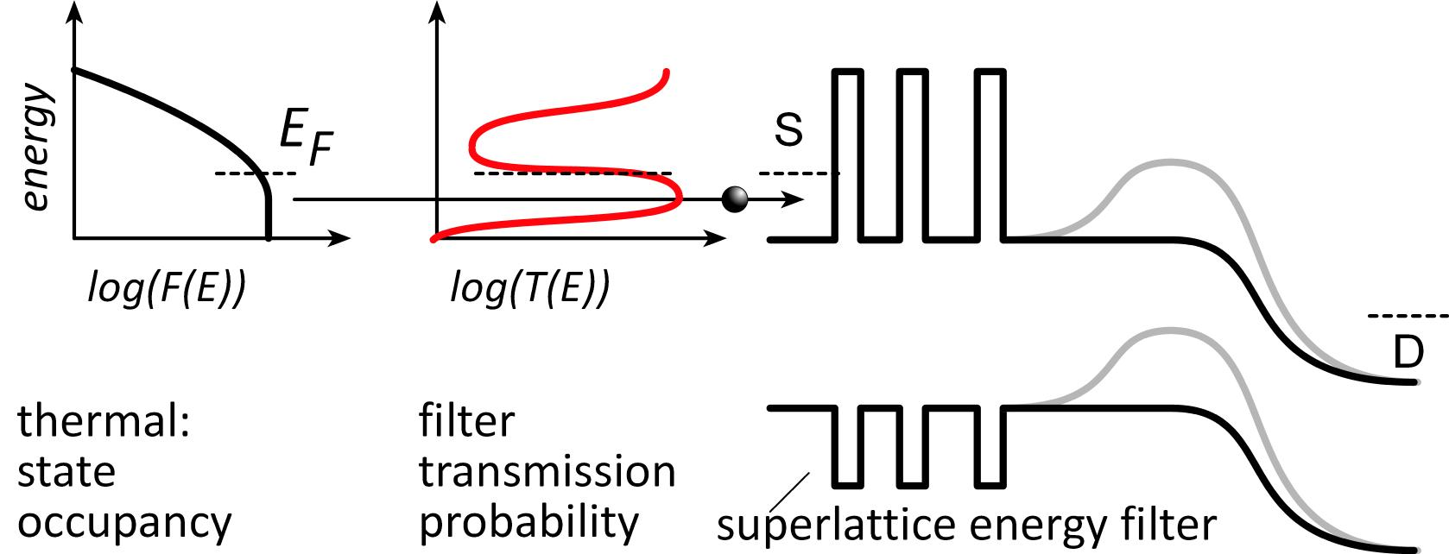
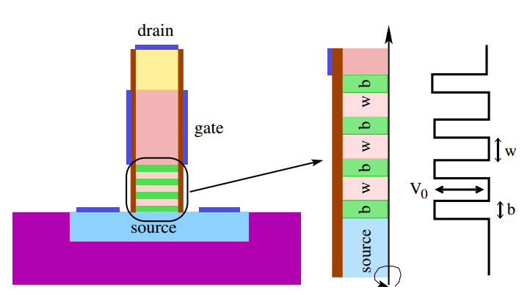
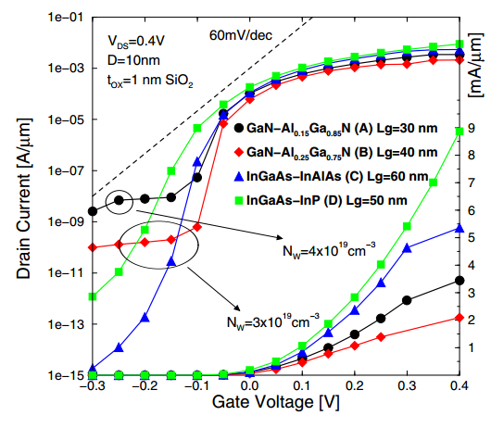
Source superlattice: truncates thermal distribution
Proposed 1D/nanowire device:
M. Bjoerk et al., U.S. Patent 8,129,763, 2012. E. Gnani et al., 2010 ESSDERC
Gnani, 2010 ESSDERC
Gnani, 2010 ESSDERC: simulation

Slide 17
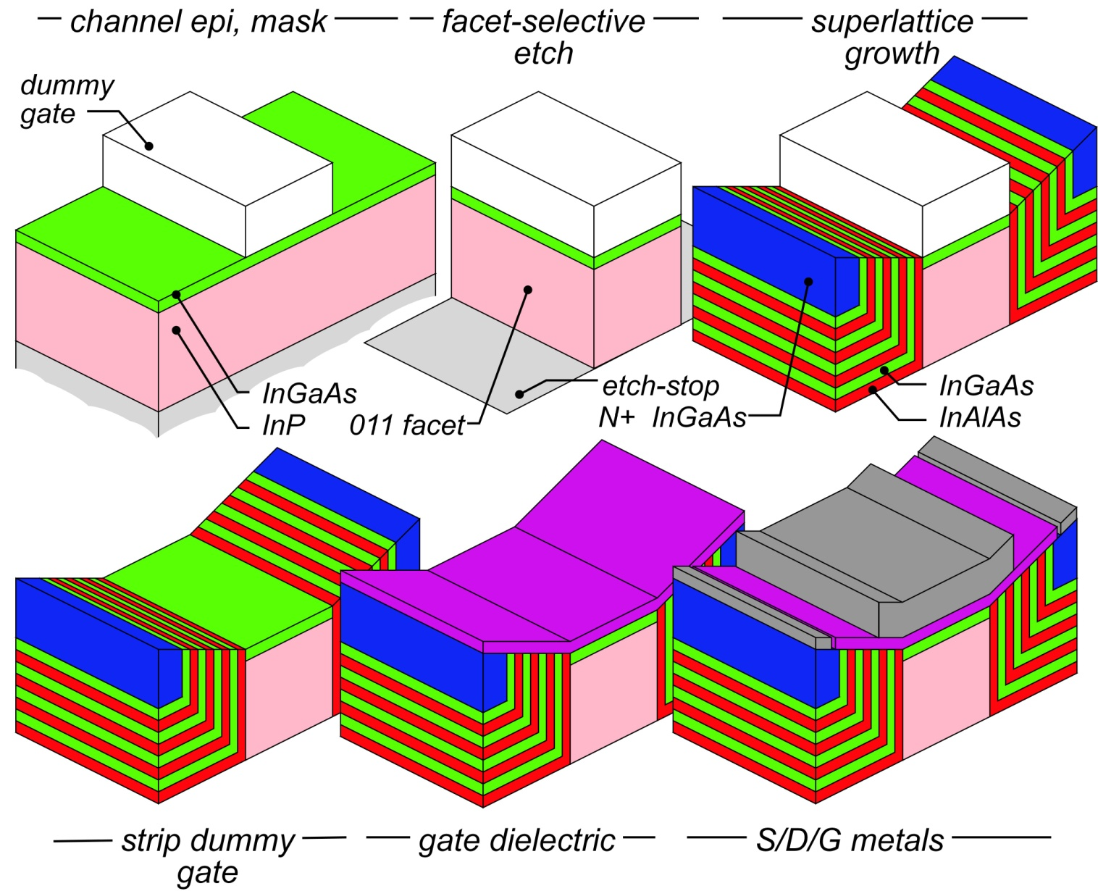
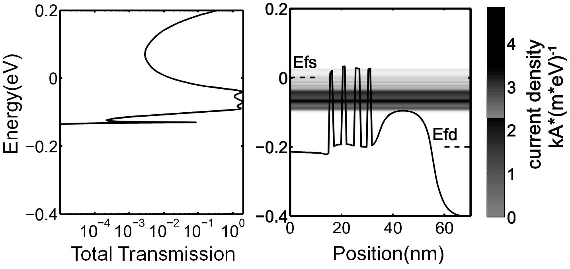
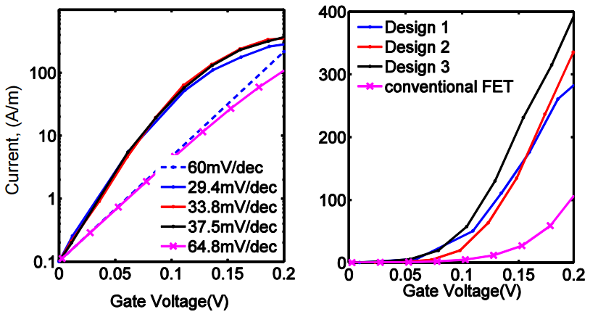
Planar (vs. nanowire) superlattice steep FET
Long et al., EDL, Dec. 2014
Planar superlattice FET
superlattice by ALE regrowth
easier to build than nanowire (?)
Performance (simulations):
~100% transmission in miniband.
0.4 mA/μm I_{on} , 0.1μA/μm I_{off} ,0.2V
Ease of fabrication ?
Tolerances in SL growth ?
Effect of scattering ?
simulation

Slide 18
What if steep FETs prove not viable ?
Steep FETs will not be easy.
Instead, increase dI/dV above threshold.
dI/dV: a.k.a. transconductance, g_{m}.
Reduced voltage, reduced CV²
First: III-V MOS as (potential) high-(dI/dV) device

Slide 19
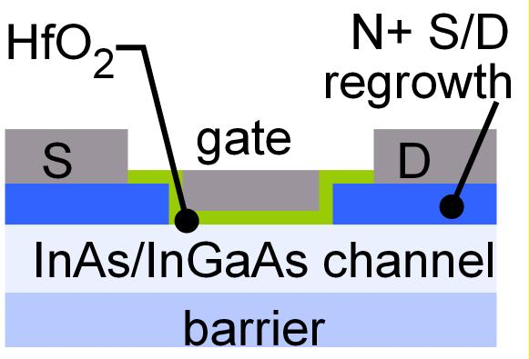
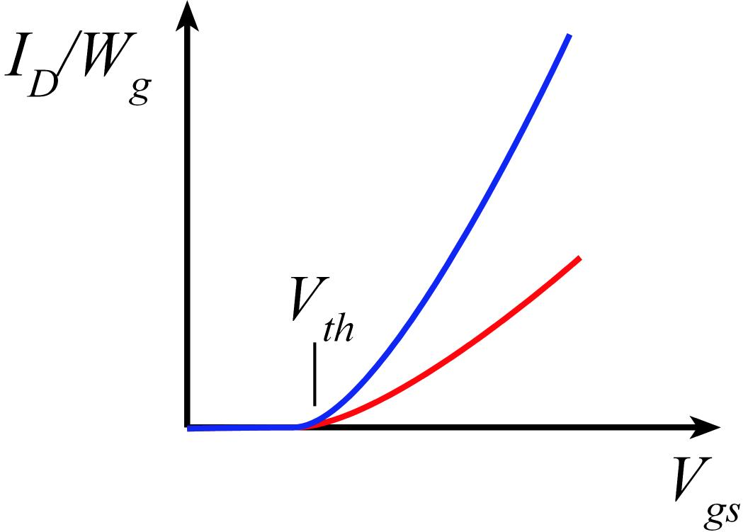
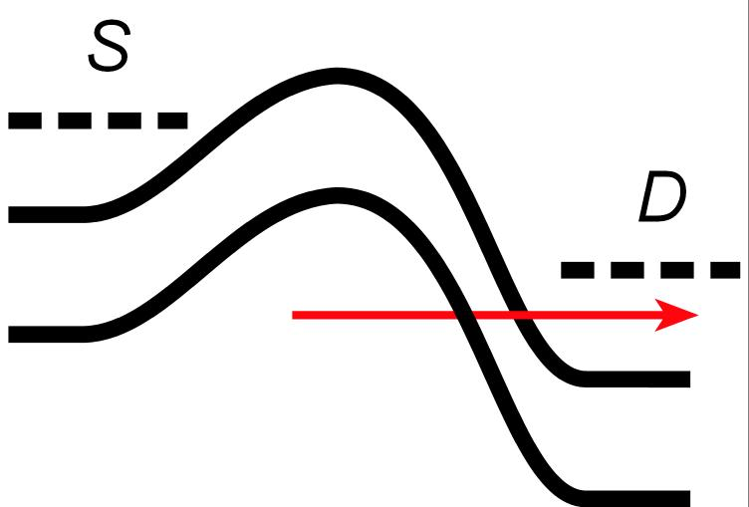
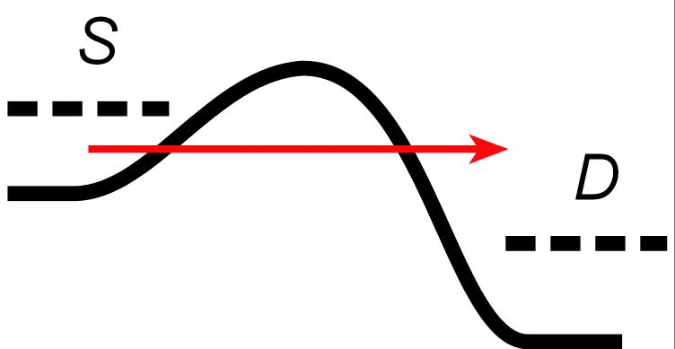
Why III-V MOS ?
III-V vs. Si: Low m*→ higher velocity. Fewer states→ less scattering
→ higher current. Then trade for lower voltage or smaller FETs.
Problems: Low m*→ less charge. Low m* → more S/D tunneling.
Narrow bandgap→ more band-band tunneling, impact ionization.

Slide 20
In(Ga)As: low m*→ high velocity → high current (?)
Ballistic on-current:
Natori, Lundstrom, Antoniadis (Rodwell)
More current
unless dielectric,
and body,
are extremely thin.

Slide 21
Excellent III-V gate dielectrics
2.5nm ZrO₂
1nm Al₂O₃
2.5nm InAs
V. Chobpattanna,
S. Stemmer
FET data: S Lee, 2014 VLSI Symp.
61 mV/dec Subthreshold swing at V_{DS}=0.1 V
Negligible hysteresis

Slide 22
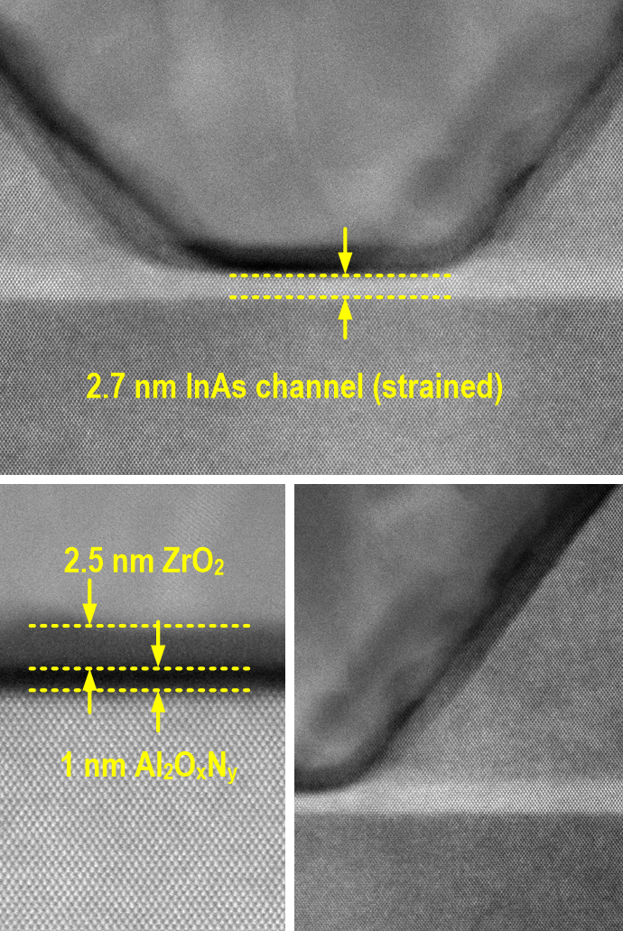
Record III-V MOS
S. Lee et al., VLSI 2014
L_{g}~25 nm
record
for III-V
N+ S/D
= best UTB SOI silicon
Vertical Spacer

Slide 23
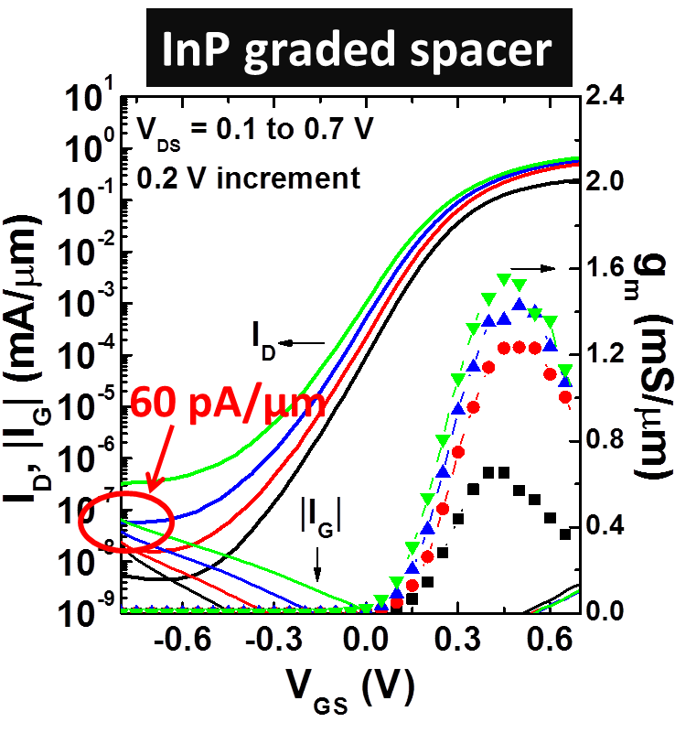
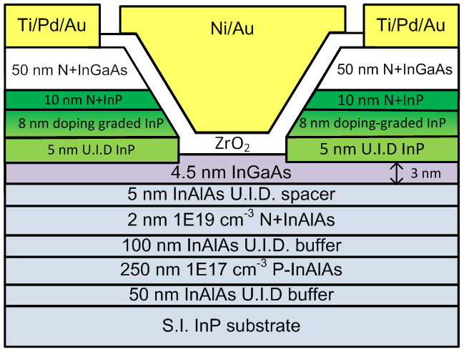
Double-heterojunction MOS: 60 pA/μm leakage
L_{g}-30nm
L_{g}-30nm
C. Y. Huang et al., IEDM 2014
Minimum I_{off}~ 60 pA/μm at V_{D}=0.5V for L_{g}-30 nm
100:1 smaller I_{off} compared to InGaAs spacer
BTBT leakage suppressed→isolation leakage dominates

Slide 24
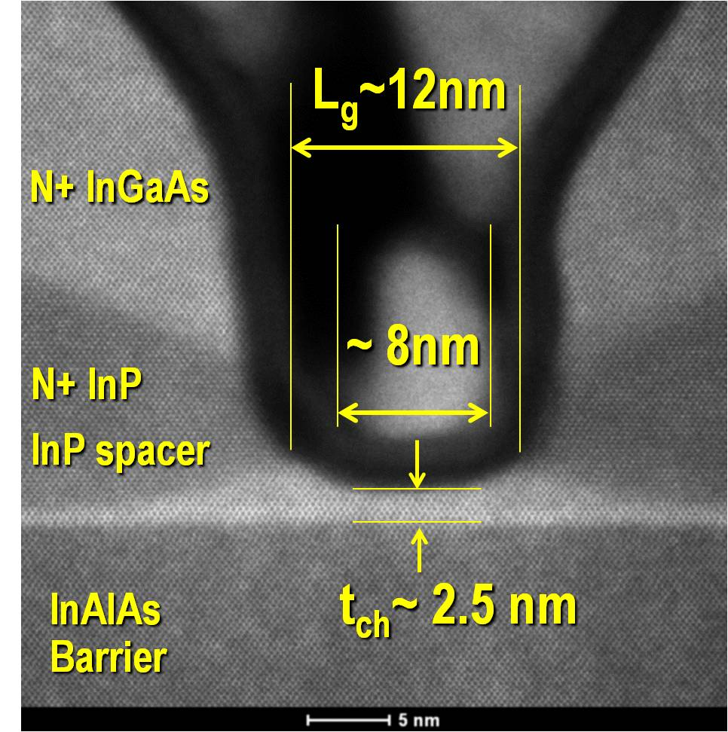
III-V MOS
@ L_{g} = ???
Huang et al.,
this conference
Courtesy of
S. Kraemer (UCSB)

Slide 25
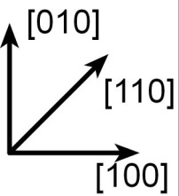
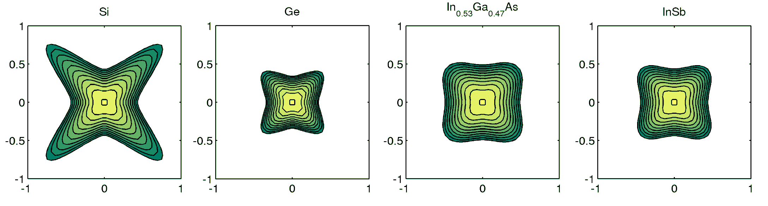

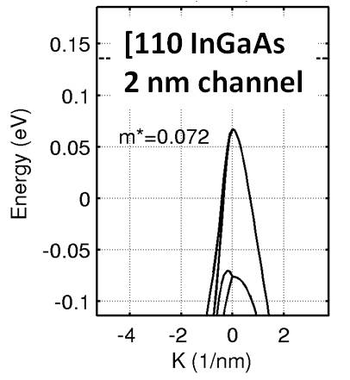
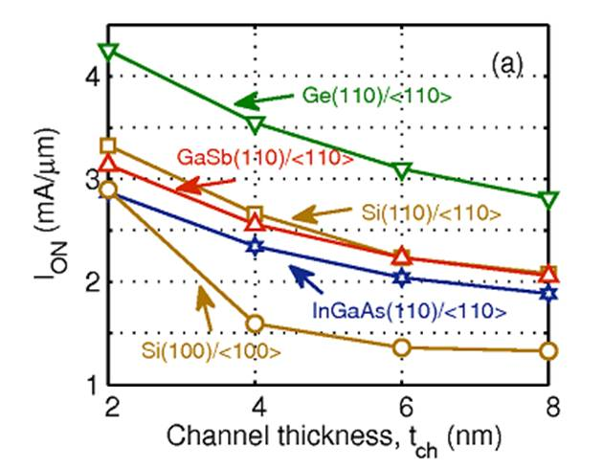
High-current III-V PMOS
Silicon PMOS: Wang et al., IEEE TED 2006 (Intel)
III-V: S. Mehrotra (Purdue), unpublished
nm thickness [110]-oriented PMOS channels→ low transport mass
simulation
Very low m*
Current approaching NMOS
finFETs are naturally [110]

Slide 26
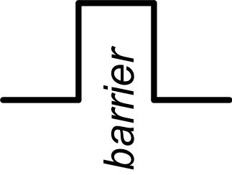
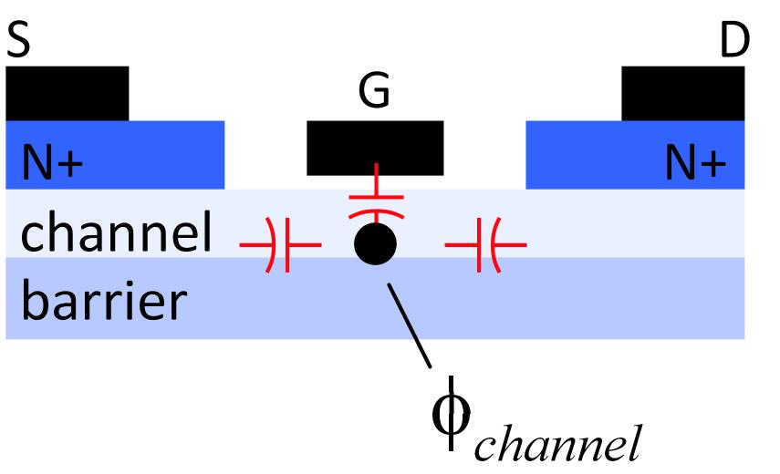
Minimum Dielectric Thickness & Gate Leakage
Thin dielectrics are leaky
High-ε_{r} materials have lower barriers
→ 0.5-0.7nm minimum EOT
constrains on-current
electrostatics degrades with scaling
→ fins, nanowires

Slide 27
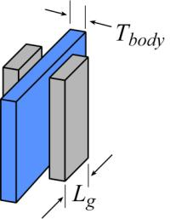
Quick check: scaling limits
NEMO ballistic simulations
finFET: 5 nm physical gate length.
Channel: <100> Si, 0.5, 1, or 2nm thick dielectric: ε_{r}=12.7, 0.5 or 0.7 nm EOT
simulation
Given EOT limits, ~1.5-2nm body is acceptable.
Source-drain tunneling often dominates leakage.
Notes:
N+ S/D: 5*10¹²/cm²

Slide 28
Do 2-D semiconductors help ?
3D: Is body thickness a scaling limit ?
recall the previous slide
Silicon
If oxides won't scale, we must make fins
with 2D, can we make fins ?
later, will need to make nanowires...
MoS₂
Ballistic drive currents don't win either
high m*, and/or high DOS
mobility sufficient for ballistic ?
Phosphorene

Slide 29



When it gets crowded, build vertically
Los Angeles: sprawl
Manhattan: dense
2-D integration:
wire length # gates^{1/2}
3-D integration:
wire length #gates^{1/3}
LA is interconnect-limited
1) Chip stacking (skip)
2) 3D transistor integration

Slide 30
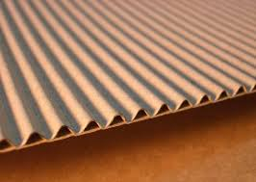
Corrugated surface→ more surface per die area

Slide 31
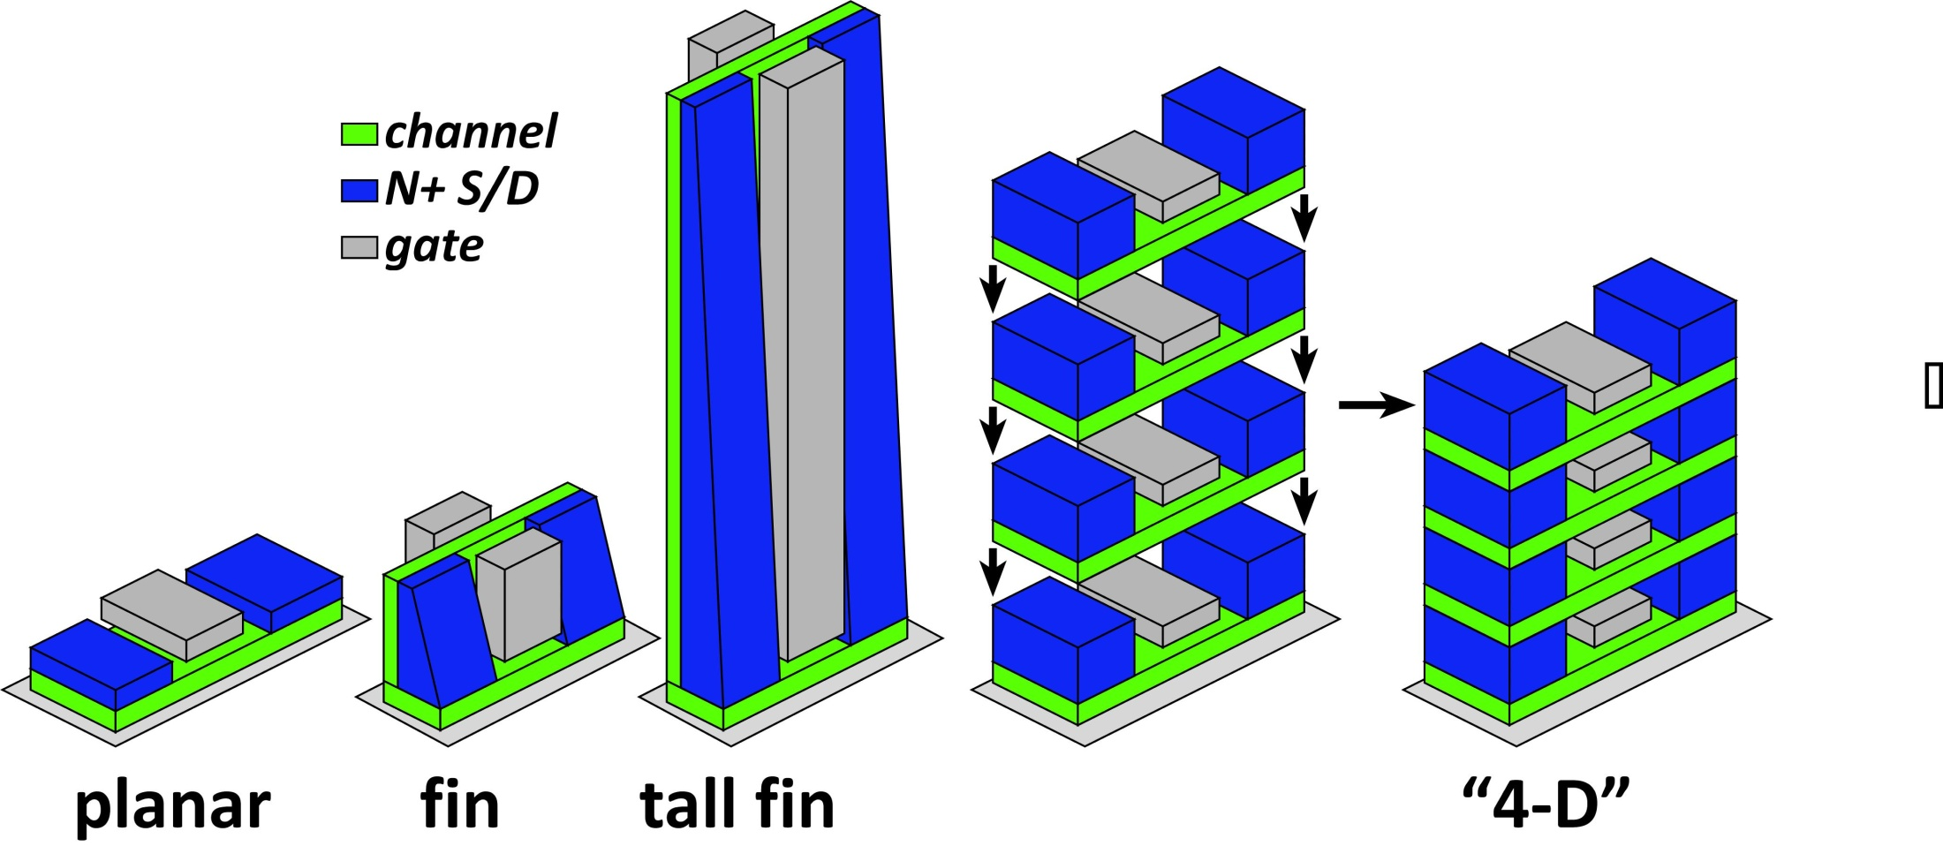
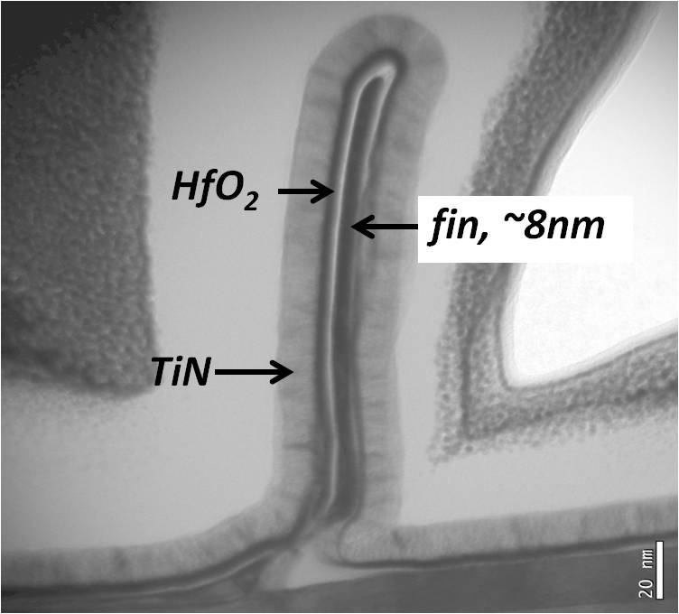
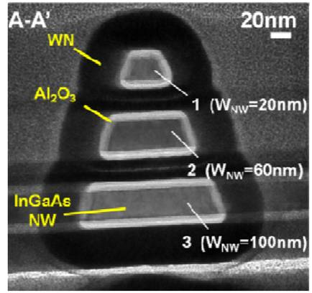
Corrugated surface→ more current per unit area
Cohen-Elias et al.,
UCSB
2013 DRC
J .J. Gu et al., 2012 DRC,
Purdue
2012 IEDM

Slide 32

3D→shorter wires→less capacitance→less CV²
All three have same drive current, same gate width
Tall fin, "4-D": smaller footprint→ shorter wires

Slide 33

Corrugation: same current, less voltage, less CV²

Slide 34

Industry is moving to taller fins.
http://techreport.com/review/26896/intel-broadwell-processor-revealed

Slide 35

Fixing source-drain tunneling by increasing mass ?
Source-drain tunneling leakage:
Fix by increasing effective mass ?
This will decrease the on-current:
(also increases transit time)
long gate→ big
shorter gate→ smaller
?
less current
!
wider→ more current
big again !

Slide 36

Fixing source-drain tunneling by corrugation
Transport distance > gate footprint length
Only small capacitance increase

Slide 37


RF/Wireless

Slide 38




mm-Waves: high-capacity mobile communications
wide, useful bandwidths from 60 to ~300 GHz
Needs→ research:
RF front end: phased array ICs, high-power transmitters, low-noise receivers
IF/baseband: ICs for multi-beam beamforming, for ISI/multipath suppression, ...

Slide 39


mm-Wave CMOS won't scale much further
Gate dielectric can't be thinned
→ on-current, g_{m} can't increase
Shorter gates give no less capacitance
dominated by ends; ~1fF/μm total
Maximum g_{m}, minimum C→ upper limit on f_{τ}.
about 350-400 GHz.
Tungsten via resistances reduce the gain
Inac et al, CSICS 2011
Present finFETs have yet larger end capacitances

Slide 40




III-V high-power transmitters, low-noise receivers
Cell phones & WiFi:
GaAs PAs, LNAs
mm-wave links need
high transmit power,
low receiver noise
0.47 W @86GHz
H Park, UCSB, IMS 2014
0.18 W @220GHz
T Reed, UCSB, CSICS 2013
1.9mW @585GHz
M Seo, TSC, IMS 2013

Slide 41


Making faster bipolar transistors
to double the bandwidth: | change
emitter & collector junction widths | decrease 4:1
current density (mA/μm²) | increase 4:1
current density (mA/μm) | constant
collector depletion thickness | decrease 2:1
base thickness | decrease 1.4:1
emitter & base contact resistivities | decrease 4:1
Teledyne: M. Urteaga et al: 2011 DRC
Narrow junctions.
Thin layers
High current density
Ultra low resistivity contacts

Slide 42

THz HBTs: The key challenges
Obtaining good base contacts
in full HBT process flow
(vs. in TLM structure)
RC parasitics along finger length
metal resistance, excess junction areas
Baraskar et al, Journal of Applied Physics, 2013

Slide 43




THz InP HBTs
blanket Pt/Ru base contacts:
resist-free, cleaner surface
→ lower resistivity
J. Rode, in review

Slide 44




THz HEMTs: one more scaling generation ?
First Demonstration of Amplification at 1 THz Using 25-nm InP High Electron Mobility Transistor Process
Xiaobing Mei, et al, IEEE EDL, April 2015 doi: 10.1109/LED.2015.2407193

Slide 45
nm & THz electronics

Slide 46













Electron devices: What's next ?
Problems:
oxide, S/D tunneling
lithography
interconnect energy
~ λ/n
deep UV absorption
& static dissipation
Why transistors are best:
our best
tools are:
..electrostatic control of charge
...and communicating
by E&M waves
http://en.wikipedia.org/wiki/Standard_Model
Opportunities:
low voltages
high currents
nm via 3D
RF→ THz

Slide 47
(backup slides follow)

