Slide 1
A Tunnel FET Design for High-Current, 120 mV Operation
P. Long, J. Z. Huang, M. Povolotskyi, J. Charles, T. Kubis, G. Klimeck, Purdue University
D. Verreck, Imec, KU Leuven
M. J.W. Rodwell, University of California, Santa Barbara
B. H. Calhoun, University of Virginia, Charlottesville

Slide 2
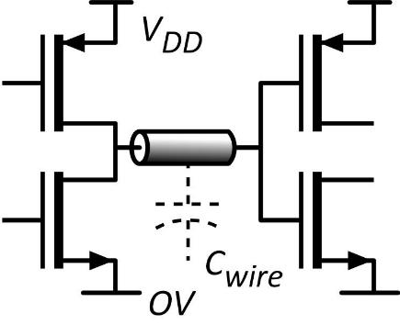
What does VLSI need ?
Low voltage low switching energy CV_{DD}²/2 .
Large on-current small delay CV_{DD} /I .
Low leakage current thermal: I_{off} ∝ exp(-qV_{DD}/kT) want low V_{DD} yet low I_{off} .
Large on-current
Low leakage current
Want: low supply voltage → Steeper than 60mV/dec below threshold → Large dI/dV above threshold

Slide 3
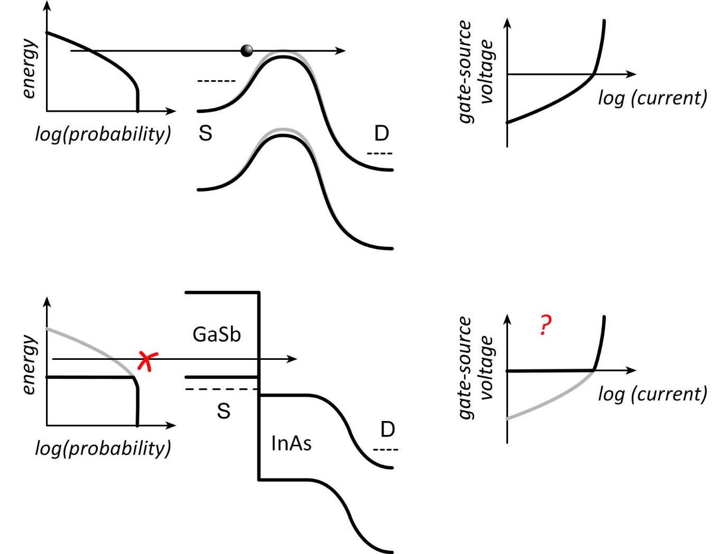
Tunnel FETs: truncating the thermal distribution
MOSFET
T-FET
J. Appenzeller et al., IEEE TED, Dec. 2005
✓
Source bandgap truncates thermal distribution→ steep S.S.
✘
Must cross bandgap: tunneling→ low I_{ON}
Fix (??): GaSb/InAs broken-gap heterojunction

Slide 4
Tunnel FETs: are prospects good ?
Useful devices must be small: short gate→ thin channel
Quantization shifts band edges→ tunnel barrier
Confinement also increases effective masses Transmission $≅exp(−2αT_{barrier})$, where $α≅\frac{{(2m^{∗}E_{barrier})}^{ 1/2} }{ℏ}$ ~10% for a 2nm barrier, 1% for a 4nm barrier
What actual on-current might we expect ?

Slide 5
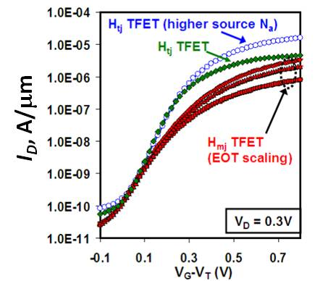
T-FET on-currents are low, T-FET logic is slow
NEMO simulation: GaSb/InAs tunnel finFET: 2nm thick body, 1nm thick dielectric @ ε_{r}=12, 12nm L_{g}
10 μA/μm
3.0%
Experimental: InGaAs heterojunction HFET; Dewey et al, 2011 IEDM, 2012 VLSI Symp.
~15 μA/μm @0.7V
Low current → slow logic
How to increase on-current?

Slide 6
Increasing the on-current
P. Long et al., EDL 3/2016
Reduces tunnel barrier height
Reduces hole mass
P. Long et al., EDL 3/2016
Reduces tunnel barrier thickness
Adds resonant state
Avci & Young, (Intel) 2013 IEDM
S. Brocard, et al., EDL, 2/2014
Reduces tunnel barrier thickness
Adds resonant state

Slide 7
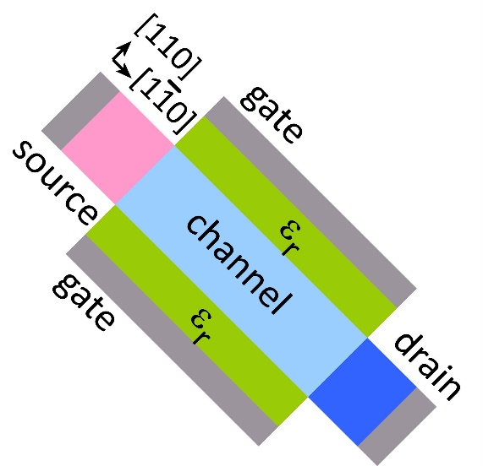
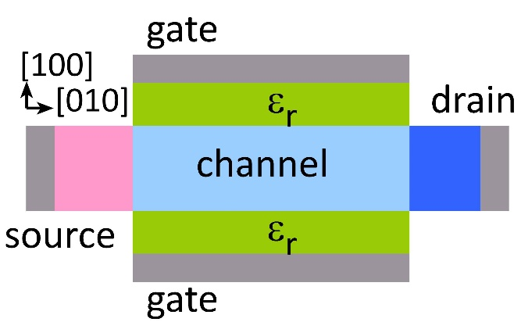
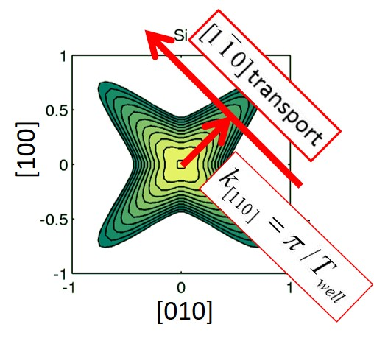
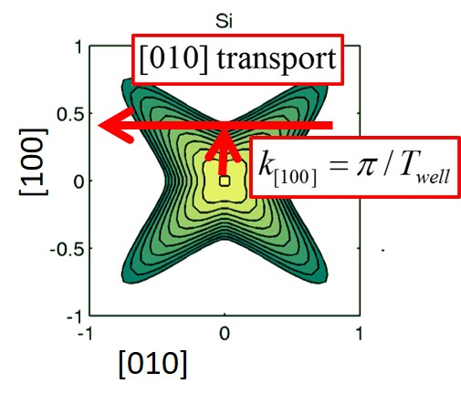
[110] gives more on-current than [100]
P. Long et al., EDL 3/2016
Valence Band
high confinement mass low transport mass
low confinement mass high transport mass

Slide 8
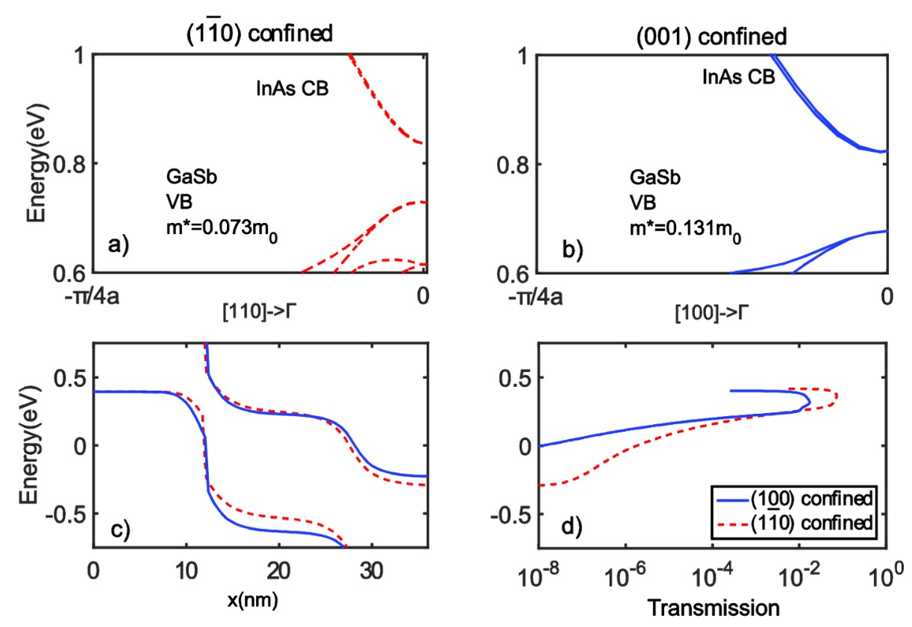
[110] gives more on-current than [100]
P. Long et al., EDL 3/2016
smaller m*
larger m*
smaller tunnel barrier
larger tunnel barrier
thinner barrier
greater transmission
larger hole confinement mass→ smaller barrier→ more current smaller hole transport mass→ more current

Slide 9
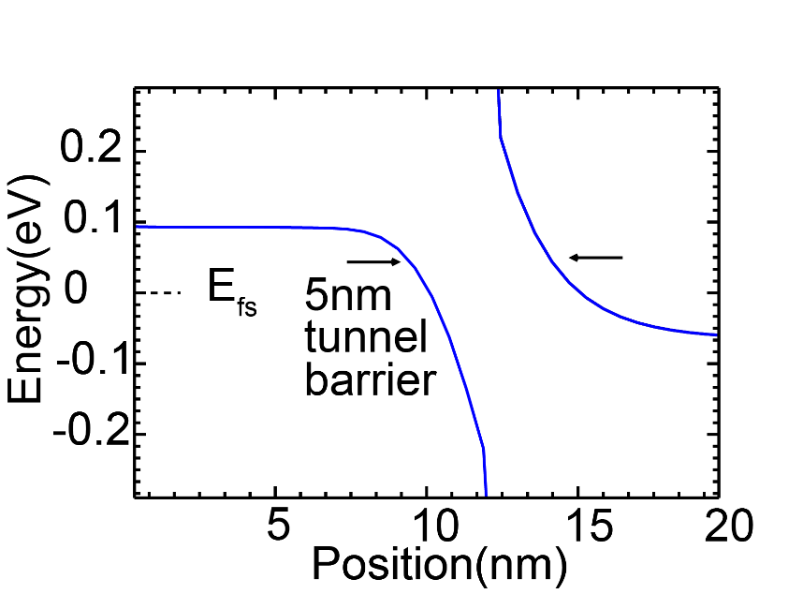
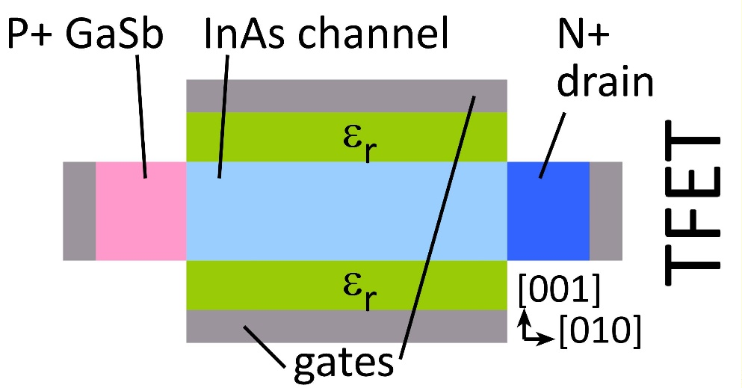
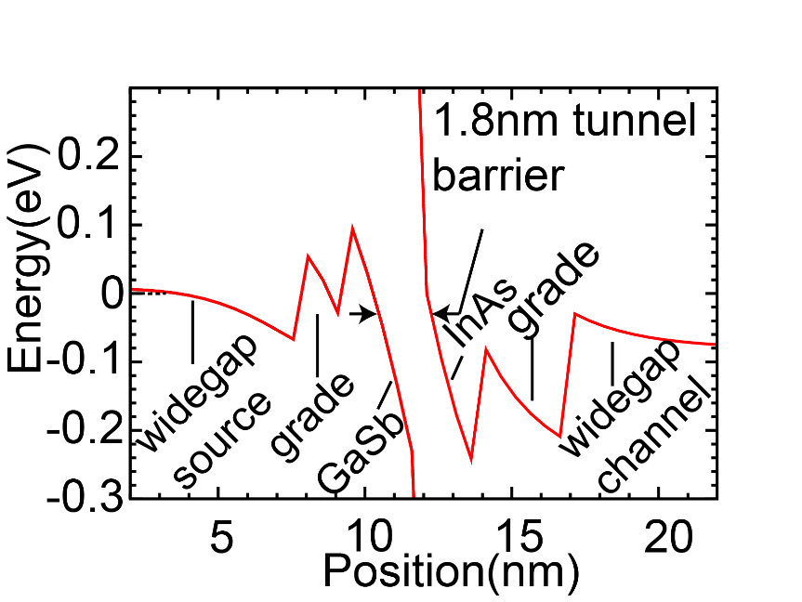
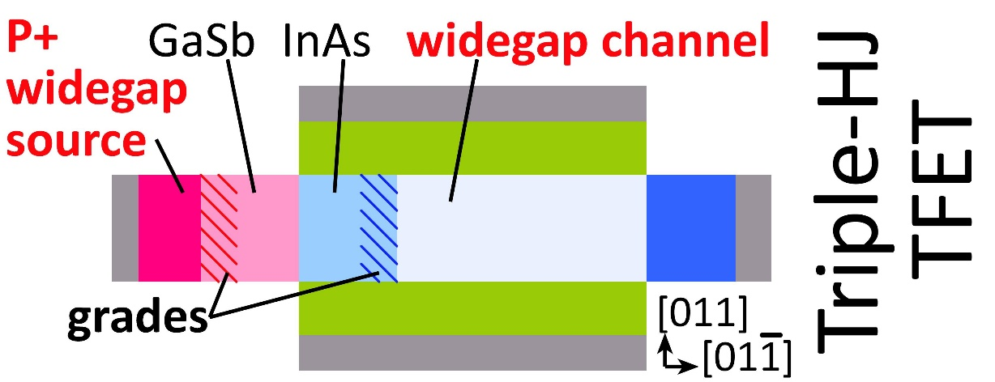
Heterojunctions increase the junction field
Source heterojunction: S. Brocard, et al., EDL, 2/2014; Channel heterojunction: P. Long et al., EDL 3/2016
Added heterojunctions→ greater built-in potential→greater field→ thinner barrier

Slide 10
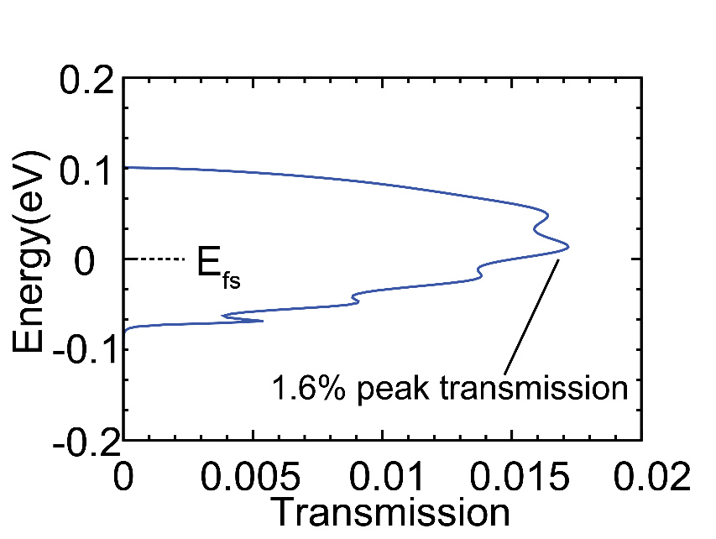
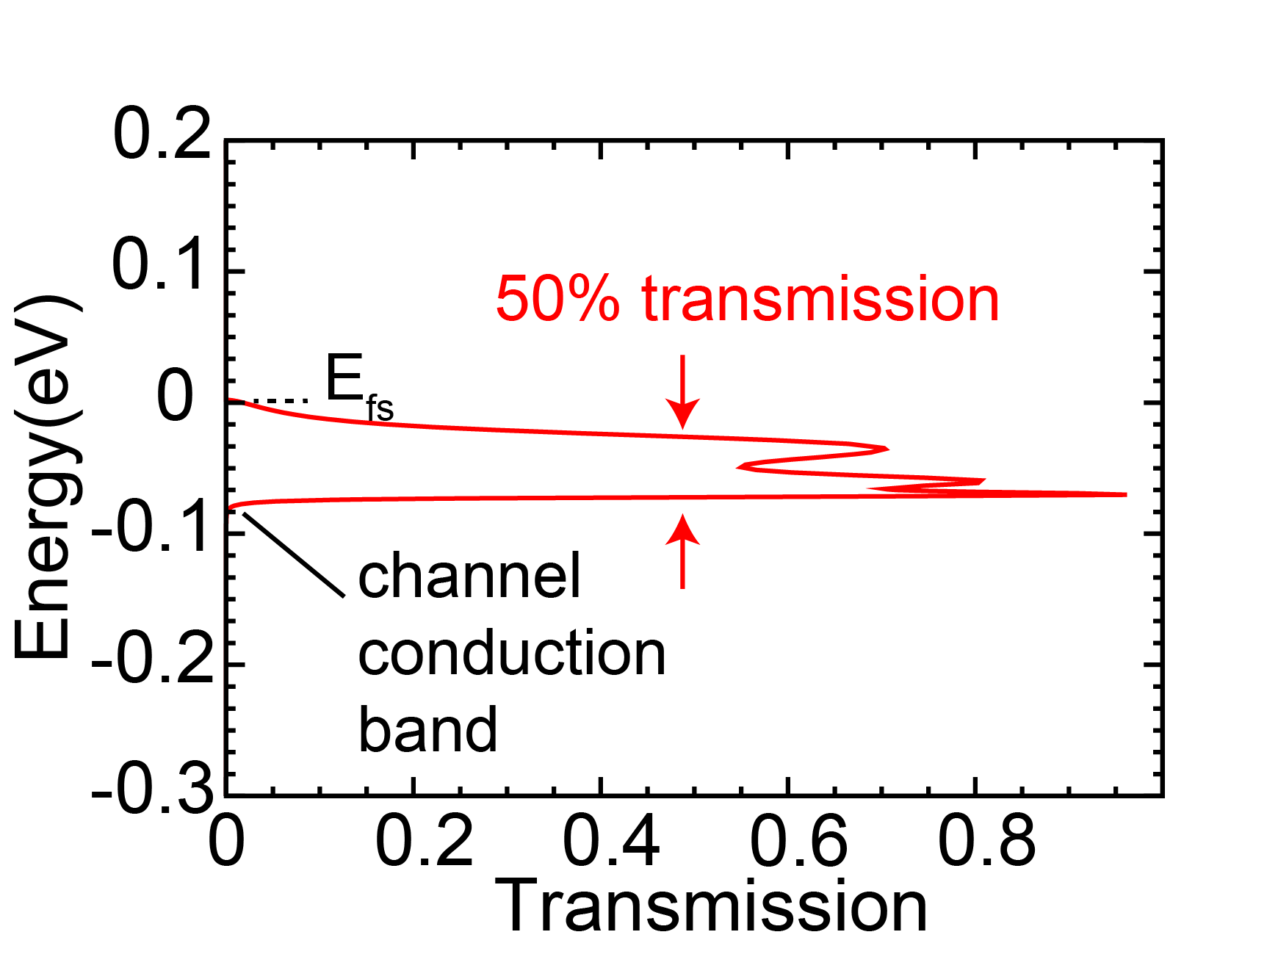
Heterojunctions increase the tunneling probability
Source heterojunction: S. Brocard, et al., EDL, 2/2014; Channel heterojunction: P. Long et al., EDL 3/2016
Added heterojunctions→ greater built-in potential→greater field→ thinner barrier

Slide 11
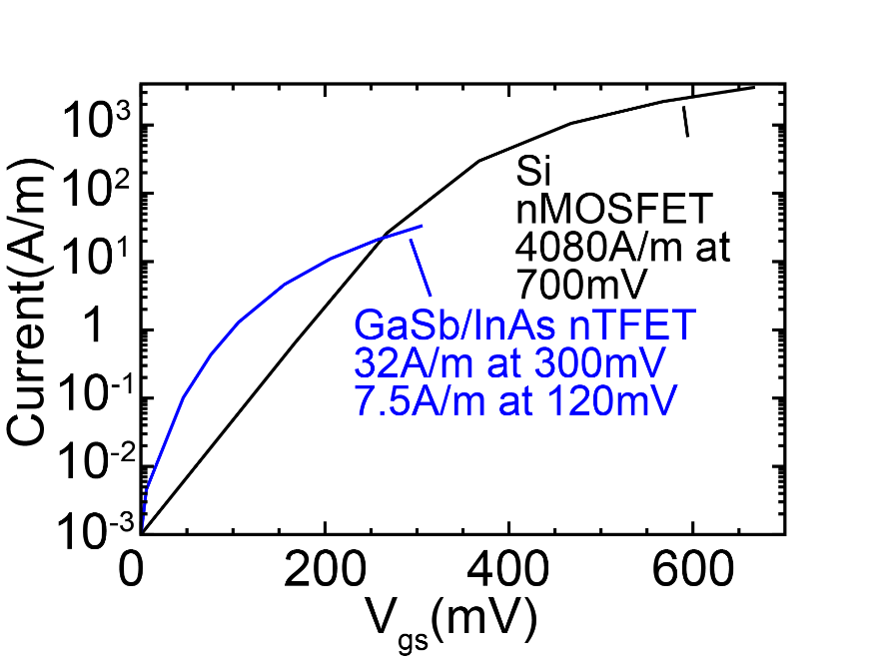
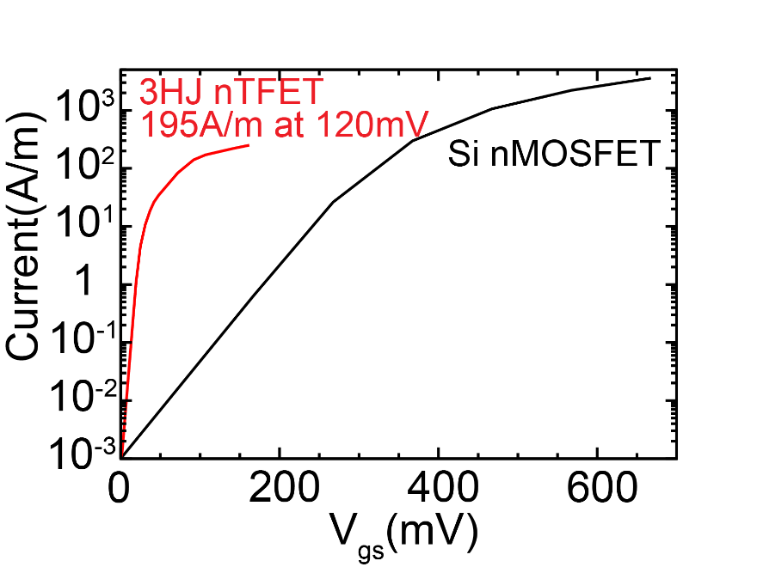
Heterojunctions increase the on-current
Source heterojunction: S. Brocard, et al., EDL, 2/2014; Channel heterojunction: P. Long et al., EDL 3/2016
Ballistic simulations
Added heterojunctions→ greater built-in potential→greater field→ thinner barrier

Slide 12
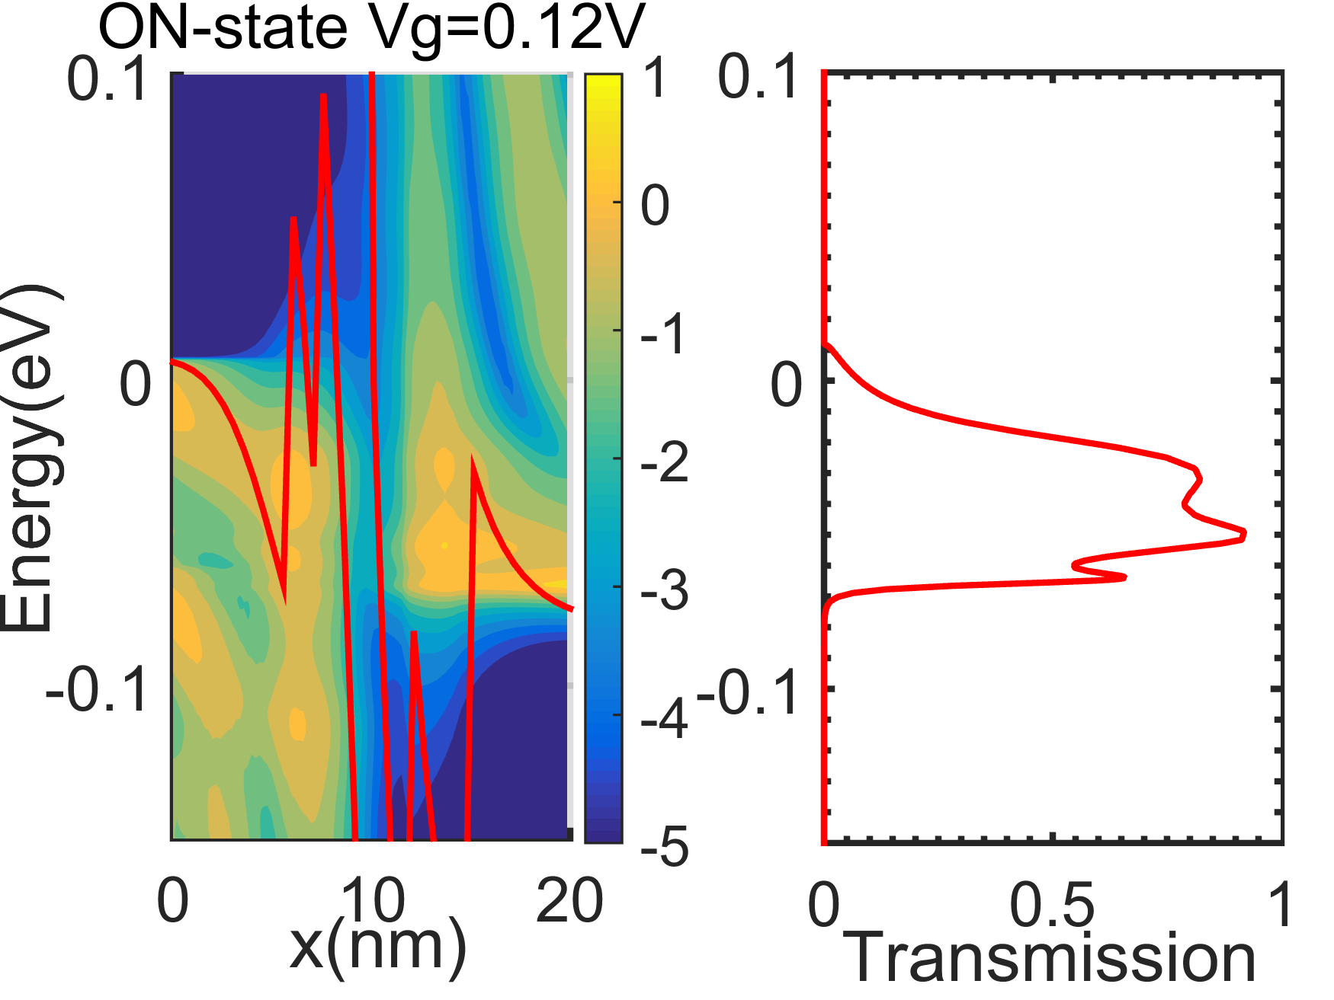
Role of the resonant bound states: ON-state
local density of states, 1/eV
10¹
Transmission > 50% over 80meV
10⁻¹
10⁻³
10⁻⁵
On-state: bound states increase transmission

Slide 13
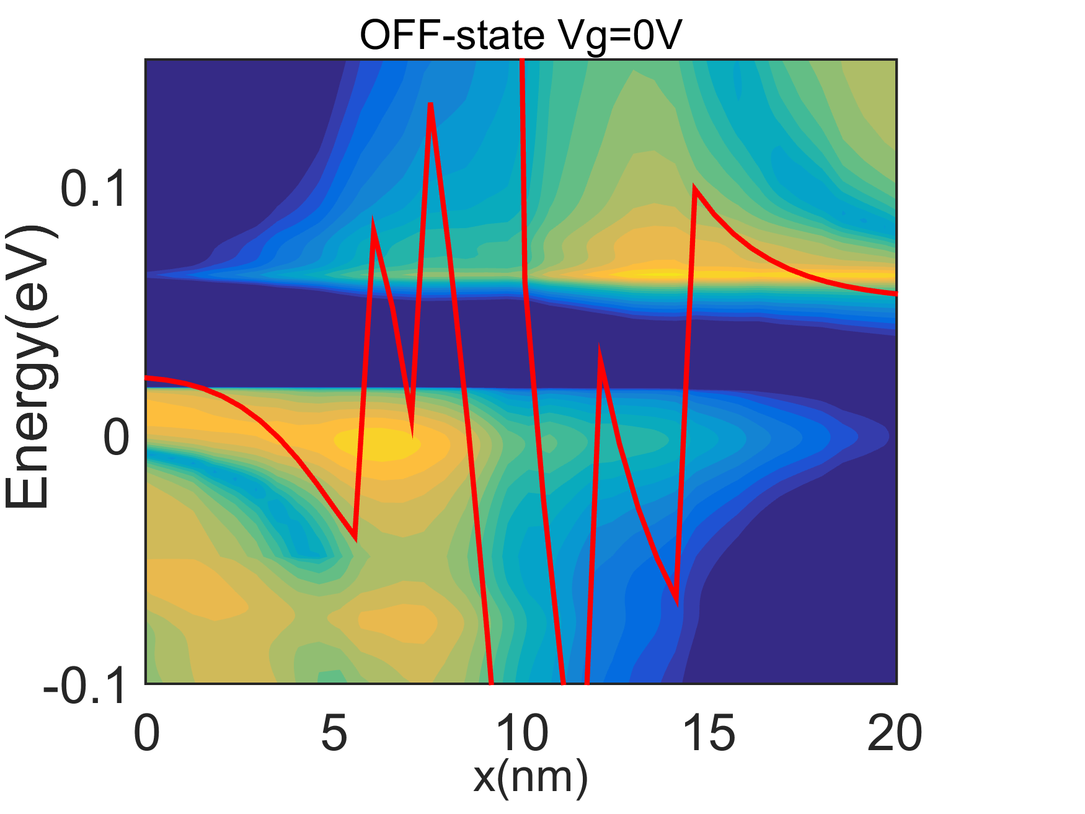
Role of the resonant bound states: OFF-state
Phonon scattering:
Off-sate: evanescent tails of bound states → leakage between two states → Keep the bound state energies near the well edge energies

Slide 14
L_{g}=30nm: I_{off} limited by scattering
L_{g}=15nm: I_{off} limited by S/D tunneling
need Vgs running up to (?) 120mV
60mV/dec
S/D tunneling
60mV/dec
scattering
0.04
At 30nm L_{g} , V_{DD} must be increased ~0.07V to maintain on/off ratio
At 15nm L_{g} , on/off ratio limited by S/D tunneling
Simulations use 220meV/nm optical deformation constant , consistent with μ=1.1x10⁵ cm²V^{‑1}s⁻¹.

Slide 15
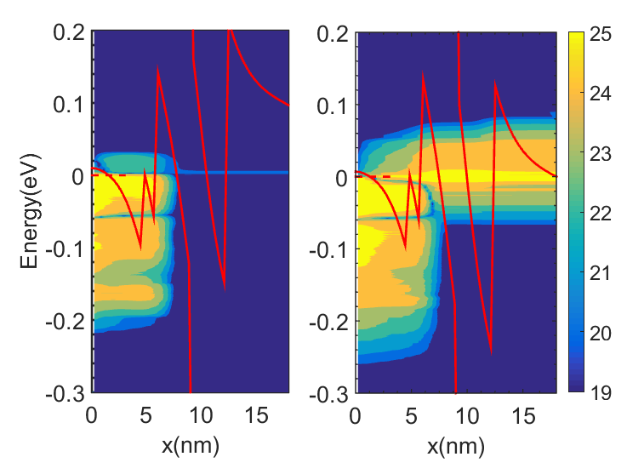
Leakage at L_{g}=15nm
Local current density
(absolute value of current)
10¹⁶
V_{g1}
V_{g2}
V_{g2}
10¹⁴
need Vgs running up to (?) 120mV
Current(A/m)
10¹²
V_{g1}
S/D tunneling
Phonon scattering
10¹⁰
0.04
A/(m*eV)
V_{g1} (close to off): current limited by S/D tunneling
V_{g2}: current limited by phonon scattering

Slide 16
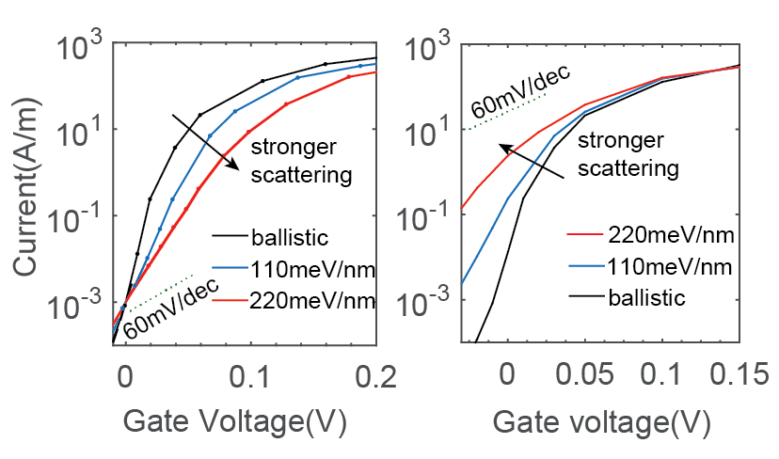
Phonon-Assisted Tunneling: 3HJ-TFET
V_{th} shifted
V_{th} not shifted
S.S. and I_{off} increased with intensity of phonon scattering

Slide 17
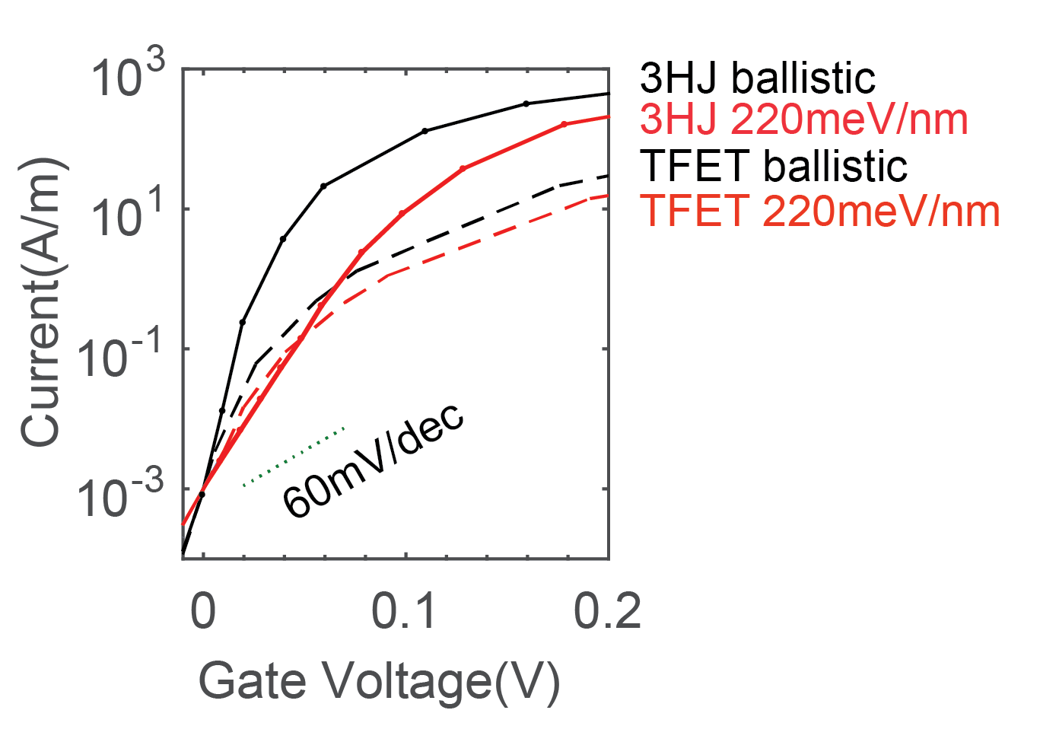
Phonon-Assisted Tunneling: TFET vs. 3HJ-TFET
V_{th} shifted
Even with P.A.T., 3HJ design provides much larger I_{ON} than TFET

Slide 18
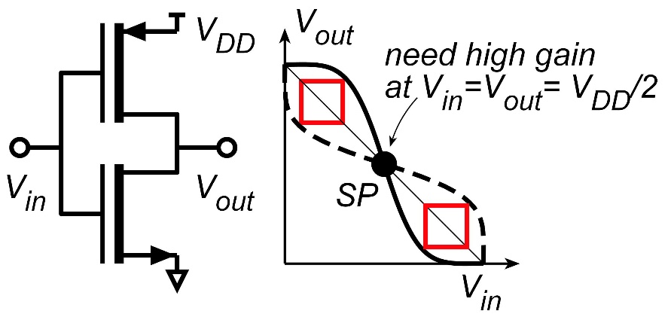
Noise margin sets a minimum threshold voltage
Need high voltage gain dV_{out}/dV_{in} at switching point
Gain = dV_{out}/dV_{in} = $\frac{\text{dI}\text{D}\text{/}\text{dV}\text{GS}}{\text{dI}\text{D}\text{/}\text{dV}\text{DS}}$
→ FET I_{D}-V_{DS} curve should be saturated (flat) at the switching point
I_{D}
V_{in}=V_{DD}
V_{in}=0
V_{in}=1/4V_{DD}
V_{in}=3/4V_{DD}
V_{in}=1/2V_{DD}
V_{in}=1/2V_{DD}
V_{in}=3/4V_{DD}
V_{in}=1/4V_{DD}
V_{out}

Slide 19
E_{F,drain} should be below E_{c} at switching point
Need low output conductance when biased at switching point output conductance: from drain-source reverse injection to avoid : need drain Fermi level below channel conduction band must decrease (V_{gs}-V_{th} ) → increase V_{th}
✘
✓
Increasing the threshold voltage: Improves the noise margin Reduces I_{ON}. Also reduces I_{OFF}

Slide 20
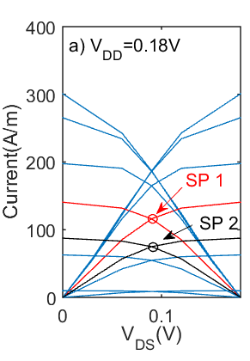
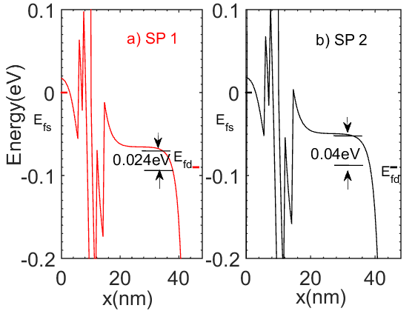
E_{F,drain} should be below E_{c} at switching point
Need low output conductance when biased at switching point output conductance: from drain-source reverse injection to avoid : need drain Fermi level below channel conduction band must decrease (V_{gs}-V_{th} ) → increase V_{th}
Vth increased xx mV
Fix graphs
Increasing the threshold voltage: Improves the noise margin Reduces I_{ON}. Also reduces I_{OFF}

Slide 21
Increasing V_{th} increases noise margin
SP1
SP2
Fix graph
SP1: FET not saturated →large dI_{D}/dV_{DS}→low gain, small noise margin
SP2: V_{th} increased 20 mV→FET is just saturated. Small dI_{D}/dV_{DS}→ large gain, large noise margin
Increasing V_{th} deceases I_{on} from 106 A/m to 60A/m at V_{DD}=0.08V

Slide 22
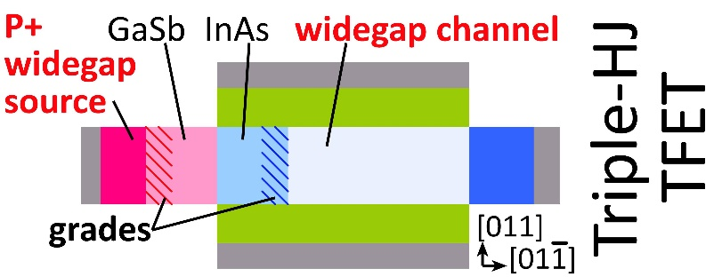
Tunnel FET Design for High-Current, 120 mV Operation
Low-energy computing is low-voltage computing
MOSFETs: 60 mV/dec. set minimum ~500mV operation. Tunnel FETs: subthreshold swing < 60 mV/dec. small on-currents→ slow logic ~120mV operation→ extremely slow logic
Triple-heterojunction FETs: increased junction field, resonant states. >50% tunneling probability; full energy range N-TFET & PTFET designs. Designs using semiconductors with good high-K's.
Future work: modeling leakage: scattering, defects.
you have all the wrong words here

Slide 23
(end)

Slide 24
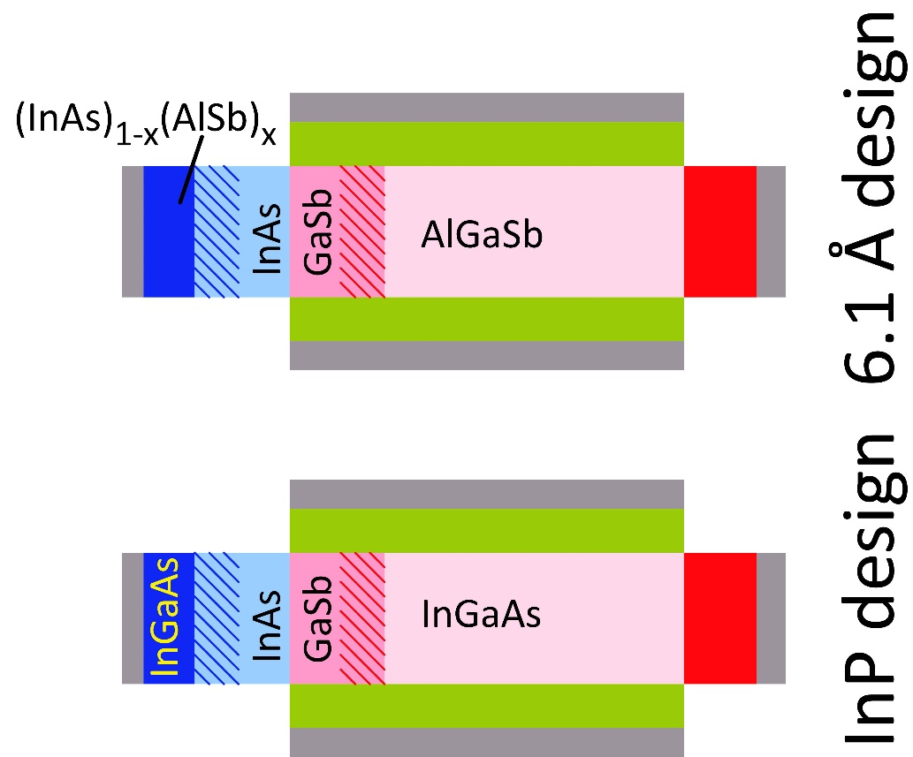
P-Channel designs
J. Huang et al., in review (also arXiv preprint 1605.07166)
6.1 Å design: No demonstrated high-quality dielectrics
InP-based design: channel is InAs/InGaAs/InP Some unpublished UCSB data suggesting good high-K interfaces on p-type InGaAs (Chobpattana, Stemmer) working to verify now Simulations: (10⁻³ A/m I_{OFF}, 300 mV V_{DD}) 6.1 Å design: 580 A/m I_{on.} comparable to N-TFET InP design: not yet simulated.
P-TFET performance is similar to that of the N-TFET
J.Z. Huang, et al, J-EDS, Vol 4, No.6, Nov 2016

Slide 25
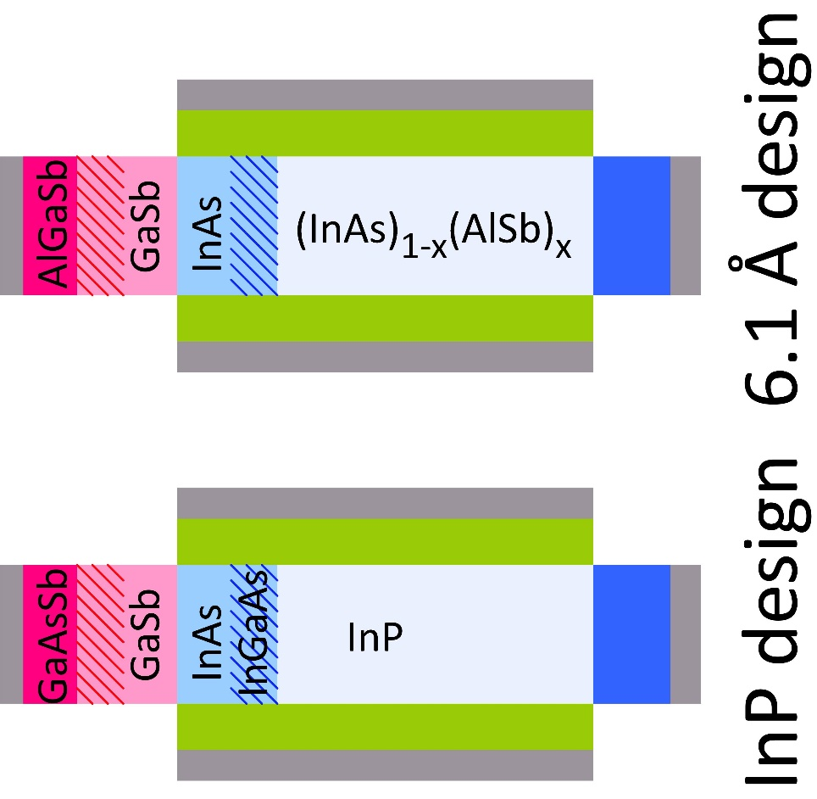
Designs compatible with high-quality dielectrics
P. Long et al., 2016 IEEE IPRM conference
6.1 Å design: No demonstrated high-quality dielectrics
InP-based design: channel is InAs/InGaAs/InP high-quality dielectrics for all of these Chobpattana, Stemmer, APL, 2014. MOSFETs: 61 mV/dec. InAs, 65mV/dec. InGaAs 67mV/dec. InP
Simulations: (10⁻³ A/m I_{OFF}, 300 mV V_{DD}) InP design: 380 A/m I_{on}. 6.1 Å design: 800 A/m I_{on.} (need to improve design)
Triple-heterojunction design can be realized with high-quality dielectrics.
Present designs can be further improved.

Slide 26
Performance comparisons (ideal ballistic case)
L_{g}=30nm
Design | V_{DD} | relative switching energy ∝V_{DD}² | I_{on}@ 10⁻³ A/m I_{off} | speed F.O.M. I_{on}/V_{DD}
Si NMOS (experimental) | 700 mV | 1 | ~1000 A/m | ~1400 S/m
Si NMOS (simulated) | 700 mV | 1 | 4080 A/m | 5830 S/m
GaSb/InAs TFET | 300 mV | 0.18 | 32 A/m | 107 S/m
GaSb/InAs TFET | 70 mV | 0.01 | 0.34 A/m | 4.86 S/m
3HJ-TFET; 0.3V design | 300 mV | 0.18 | 800 A/m | 2670 S/m
3HJ-TFET; 70mV design | 70 mV | 0.01 | 61 A/m | 871 S/m
70 mV operation→ 100:1 less switching energy than 700 mV CMOS 3HJ TFET @ 70 mV: 6.7:1 slower than CMOS GaSb TFET @70 mV: 1200:1 slower than CMOS
Caveats: Simulations ignore scattering: with it, what performance will we then obtain ? Structure is complex: can we make it ? Can we reduce threshold variations, or at least compensate for them ?

