Slide 1
Transistor and IC design for 50GHz and above
Short Course, July 26, 2017, Qualcomm San Diego
Mark Rodwell, UCSB
mm-wave systenms:
Prof. U. Madhow & group: UCSB
mm-wave ICs
S-K Kim, R. Maurer, A. Ahmed, H. Yu, H-C. Park, T. Reed, UCSB
Prof. J. Buckwalter & group, UCSB
J. Hacker, Z. Griffith: Teledyne Scientific and Imaging
M. Seo: Sungkyunkwan University
mm-Wave Transistors :
J. Rode, P. Choudhary, B. Markman, Y. Fang, J. Wu,
A.C. Gossard, B. Thibeault, W. Mitchell: UCSB
M. Urteaga, B. Brar: Teledyne Scientific and Imaging

Slide 2

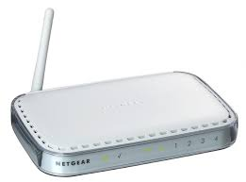
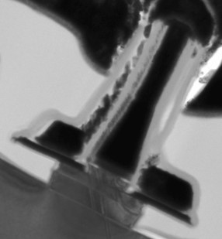
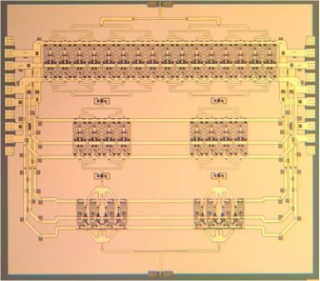
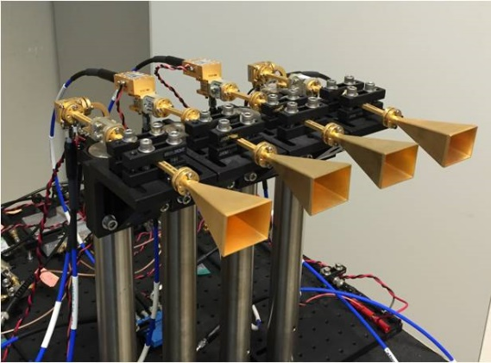
Why mm-wave wireless ?

Slide 3
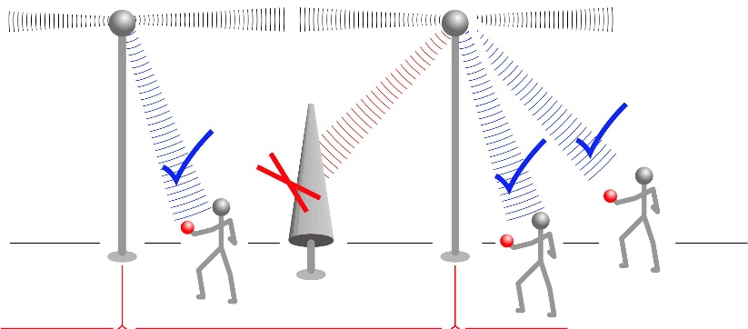
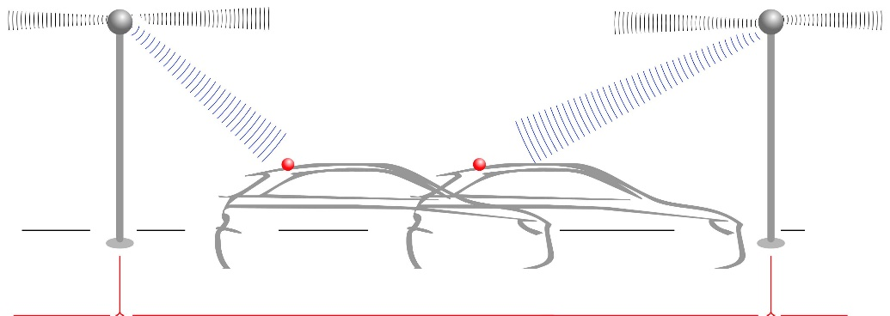
Overview

Slide 4
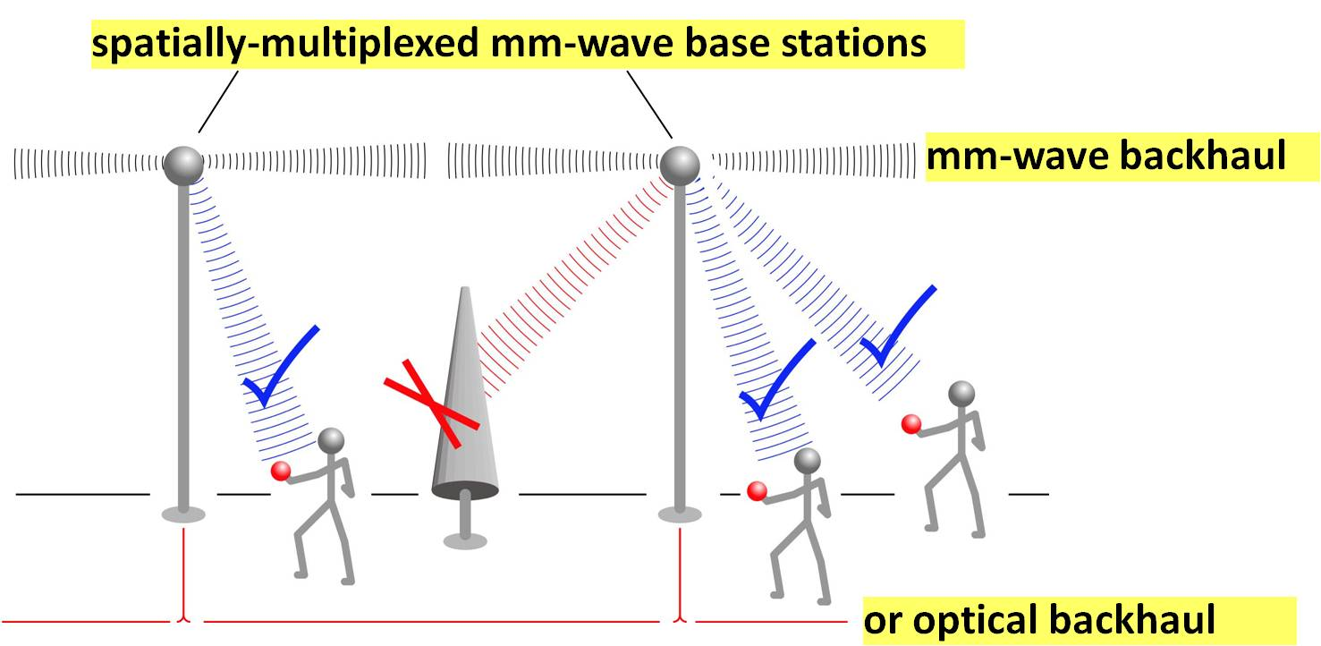
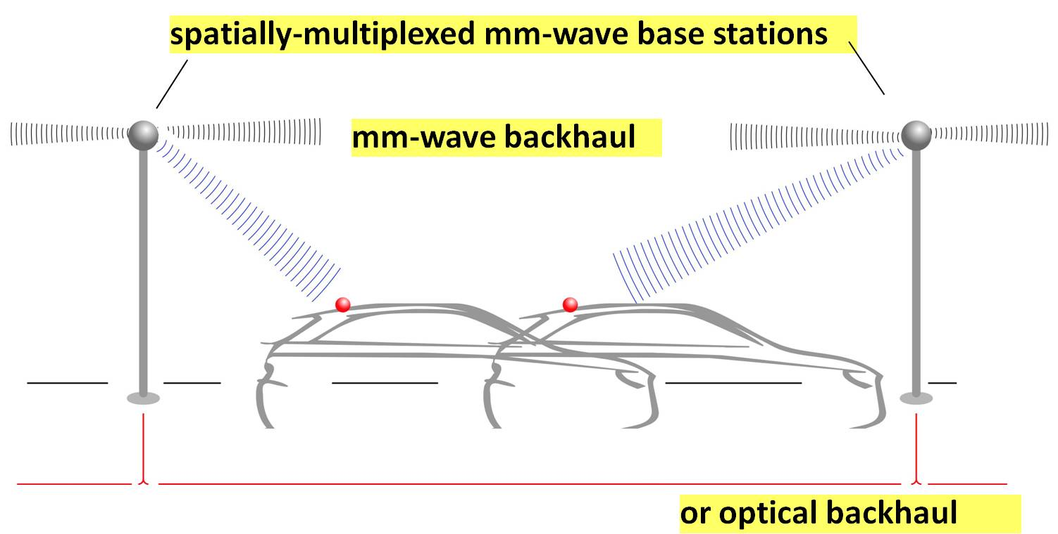
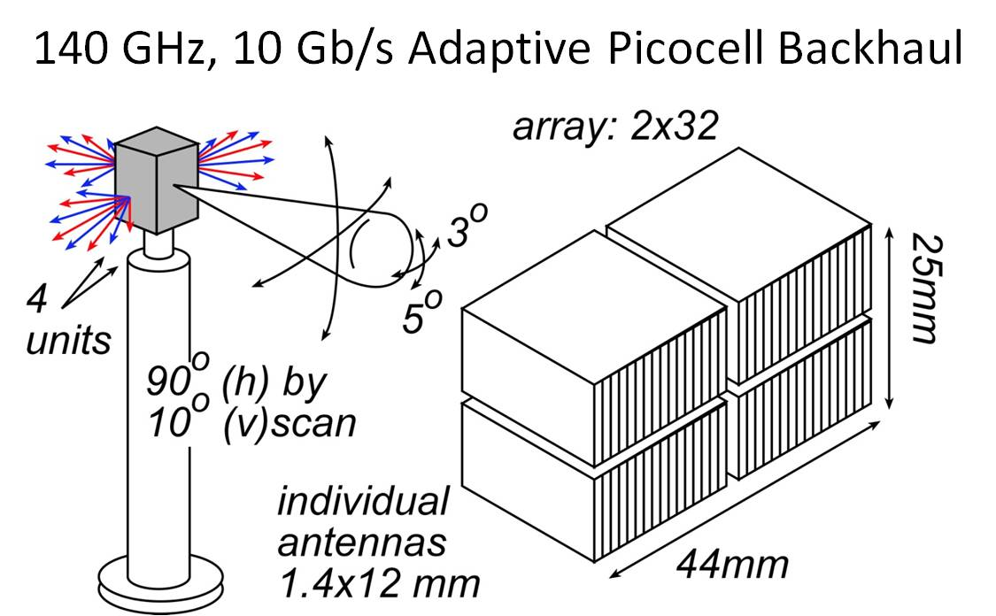
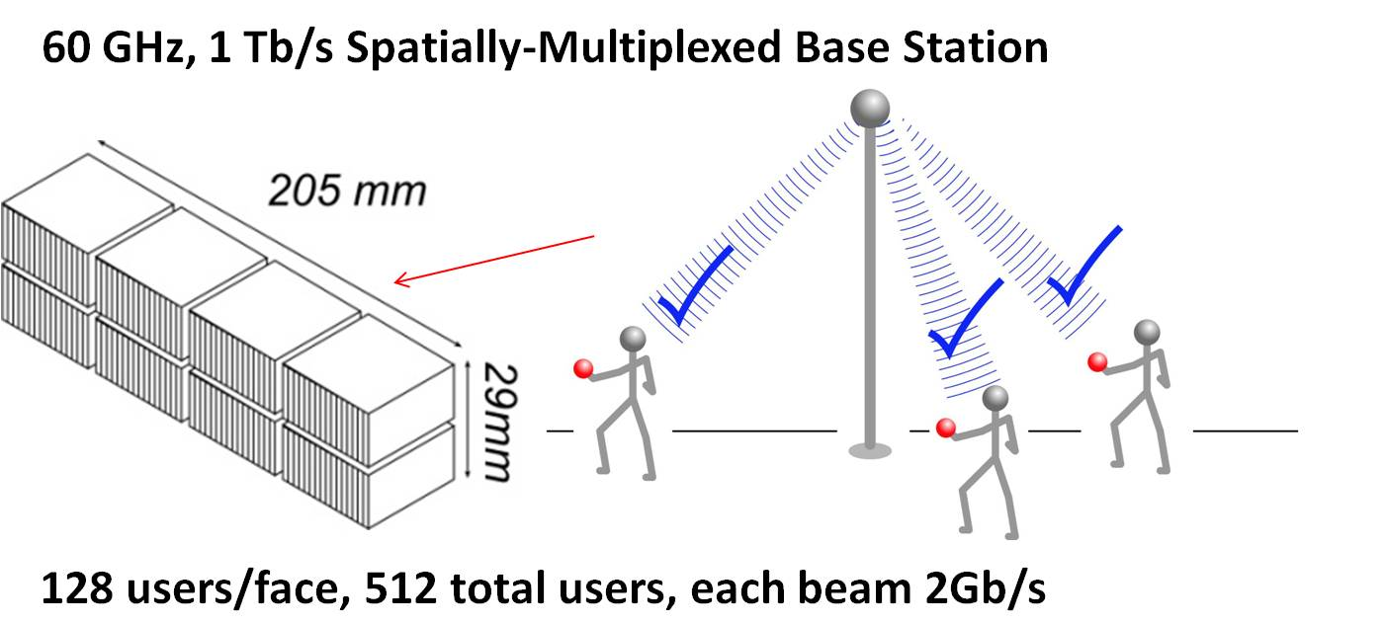
mm-Waves: high-capacity mobile communications
Needs→ research:
RF front end: phased array ICs, high-power transmitters, low-noise receivers
IF/baseband: ICs for multi-beam beamforming, for ISI/multipath suppression, ...

Slide 5
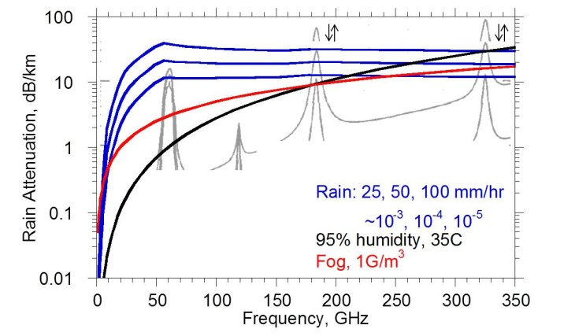
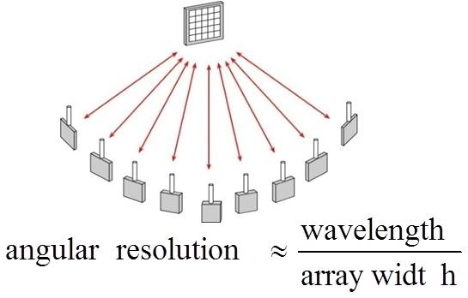
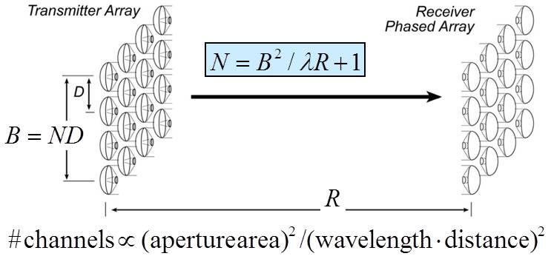
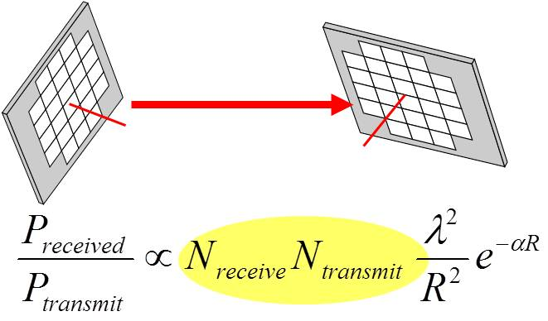
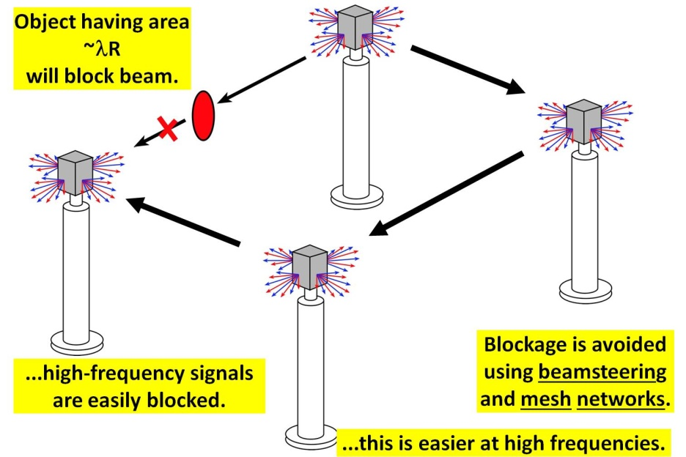
mm-Waves: benefits & challenges
Large available spectrum
Massive # parallel channels
spatial
multiplexing
line-of-sight MIMO
(note high attenuation in foul weather)
Need phased arrays (overcome high attenuation)
Need mesh networks
5

Slide 6

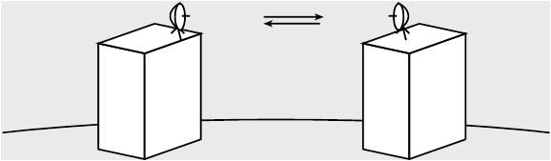
mm-Wave Wireless Needs Phased Arrays
isotropic antenna → weak signal →short range
highly directional antenna → strong signal, but must be aimed
no good for mobile
must be precisely aimed →too expensive for telecom operators
beam steering arrays → strong signal, steerable
32-element array → 30 (45?) dB increased SNR

Slide 7
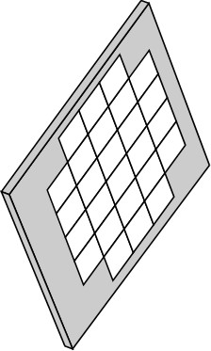
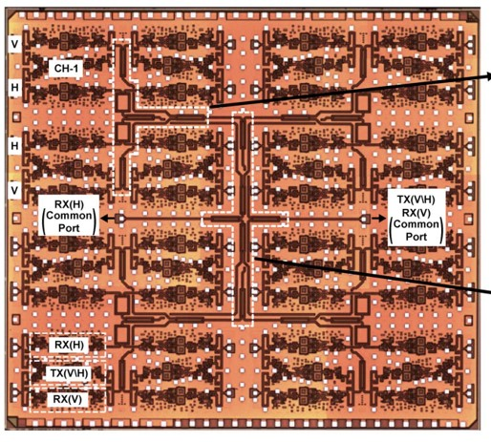
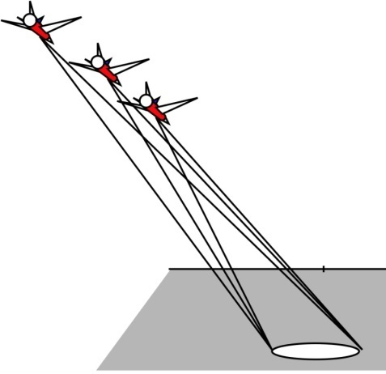
Millimeter-wave imaging
10,000-pixel, 94GHz imaging array→ 10,000 elements
Demonstrated:
SiGe (UCSD/Rebeiz)
~1.3kW: 10,000 elements
Lower-power designs:
InP, CMOS, SiGe
(UCSB, UCSD, Virginia Poly.)
Golcuk: Trans MTT, Aug 2014
235 GHz video-rate synthetic aperture radar
1 transmitter, 1 receiver
100,000 pixels
20 Hz refresh rate
5 cm resolution @ 1km
50 Watt transmitter
(tube, solid-state driver)

Slide 8

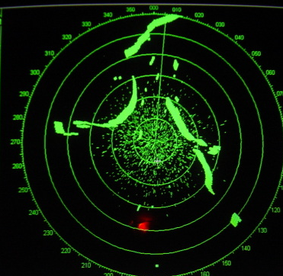

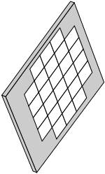

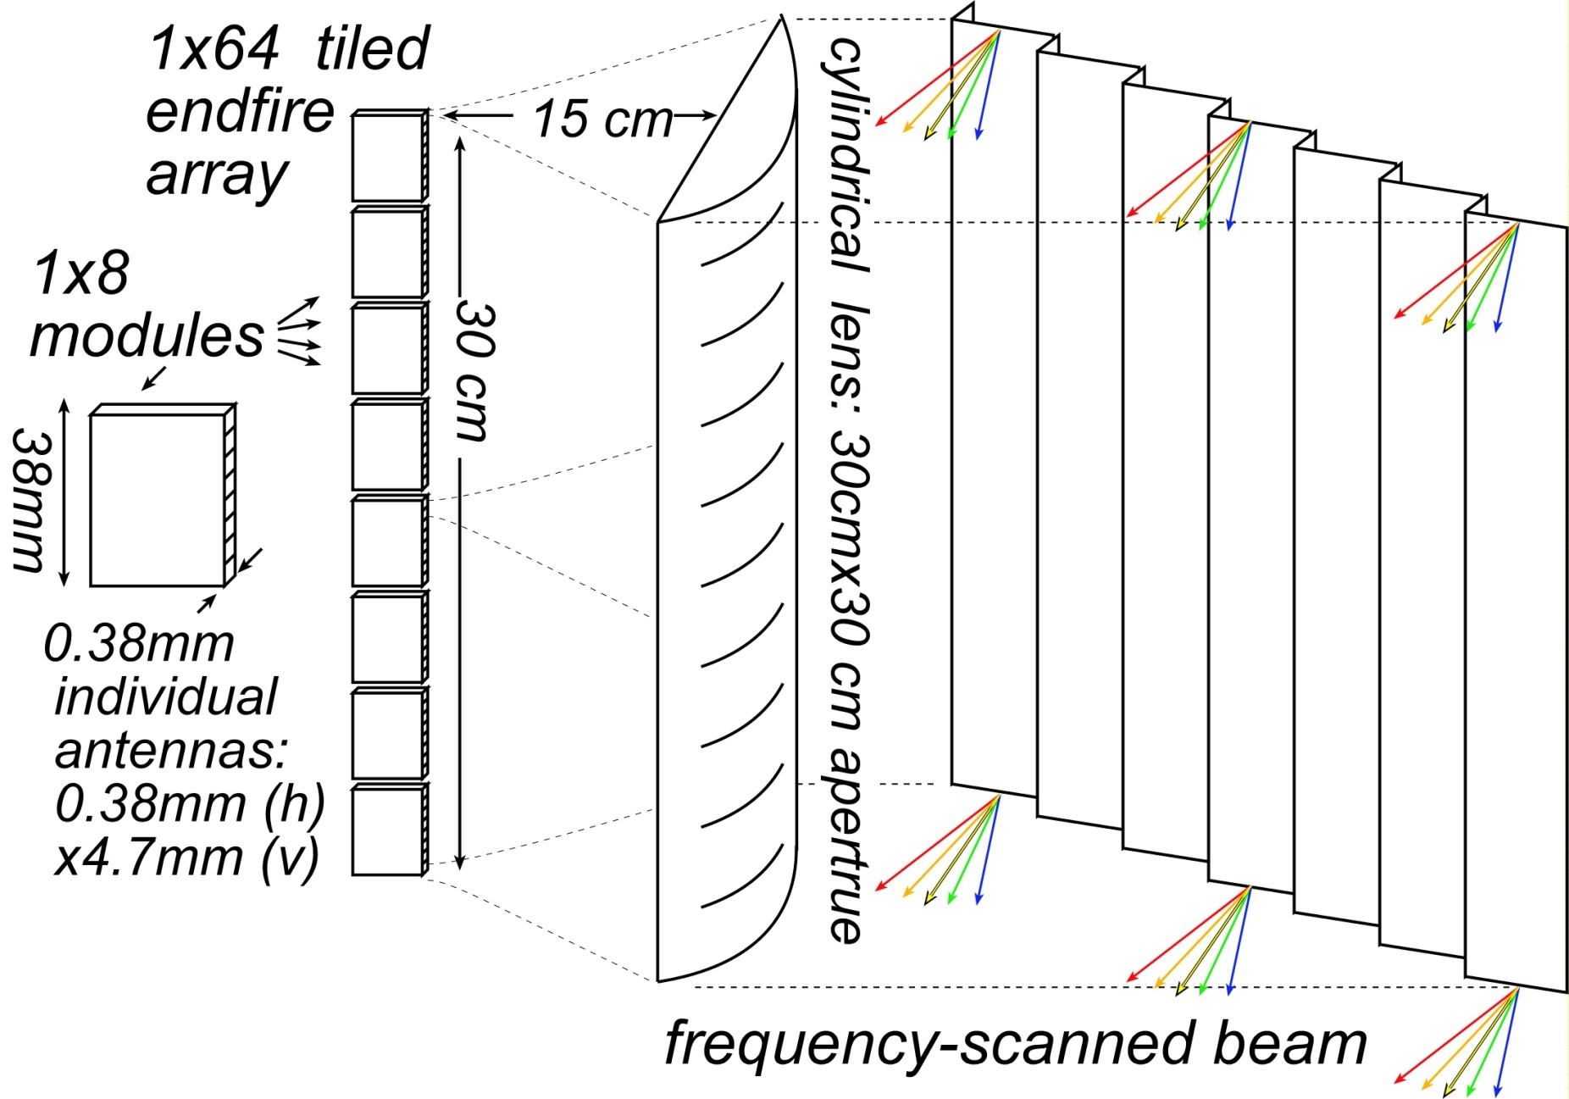
mm-wave imaging radar: TV-like resolution
mm-waves → high resolution from small apertures
What you see in fog
What 10GHz radar shows
What you want to see
goal: ~0.2º resolution, 10³-10⁶ pixels
Large NxN phased array
Frequency-scanned 1xN array
ultimate: ~400 GHz; intermediate: ~140 GHz

Slide 9
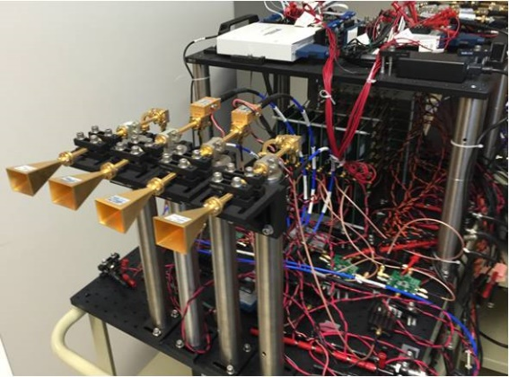
mm-wave
systems

Slide 10
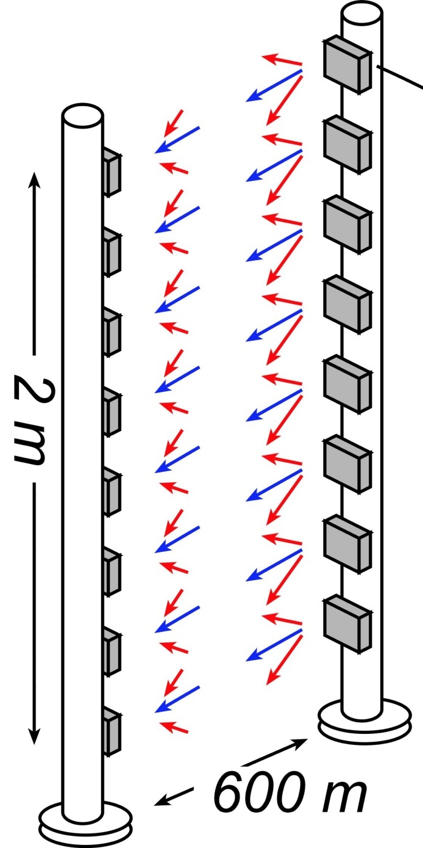
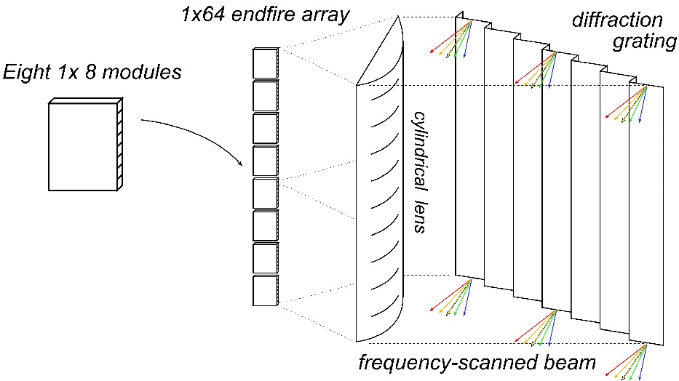
Target Systems
10

Slide 11
arrays

Slide 12
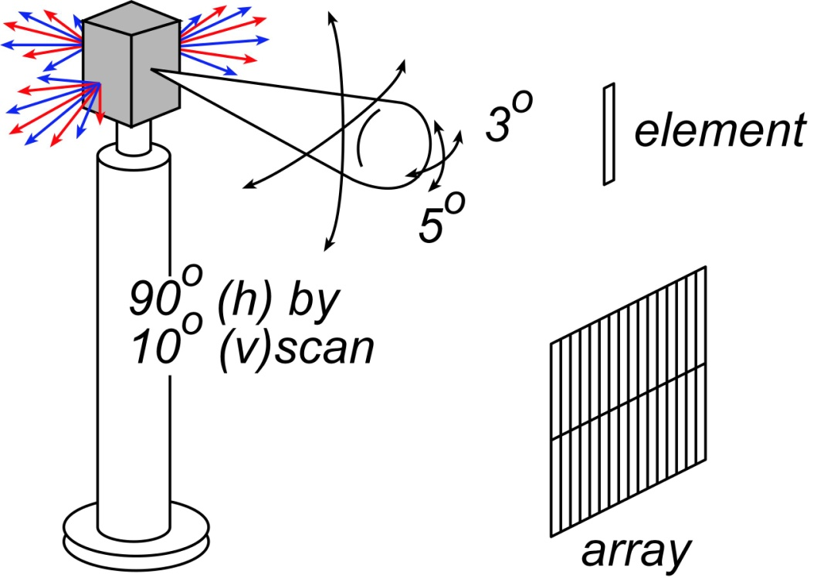
Antenna & array basics

Slide 13
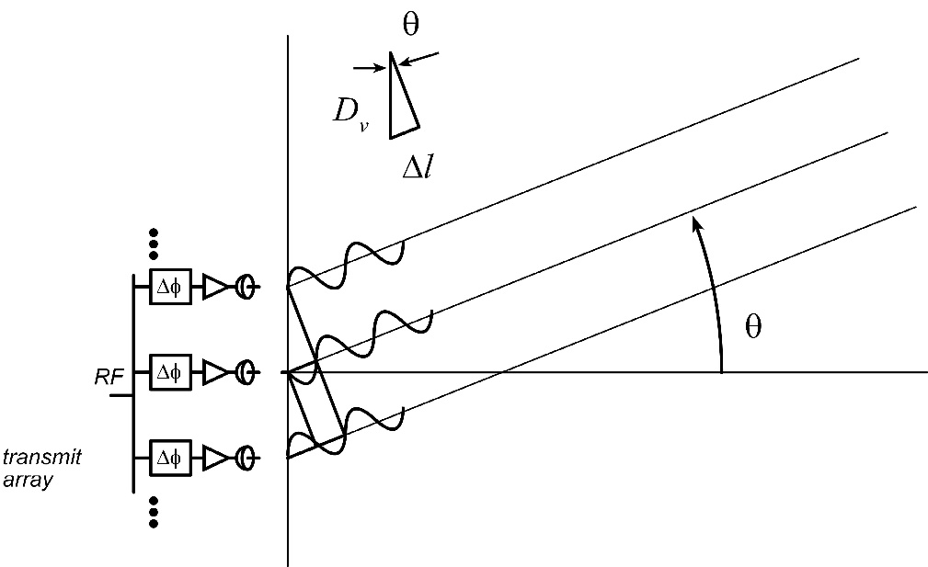
Electronic Beamsteering, a.k.a. phased array

Slide 14
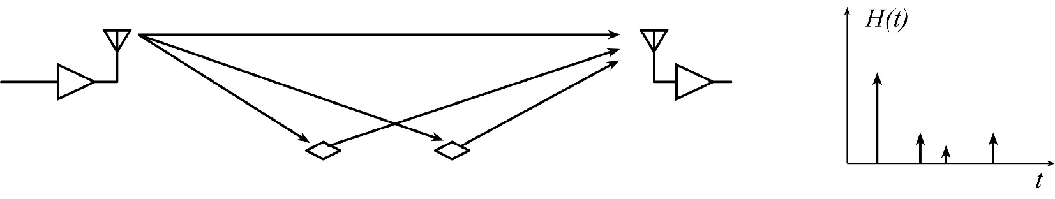
Reminder: Multipath Propagation

Slide 15
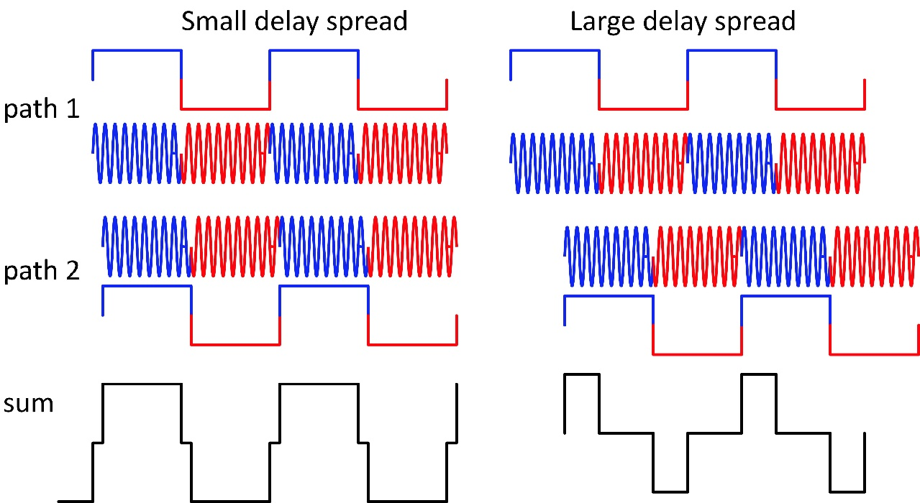
Fading vs Intersymbol interference

Slide 16
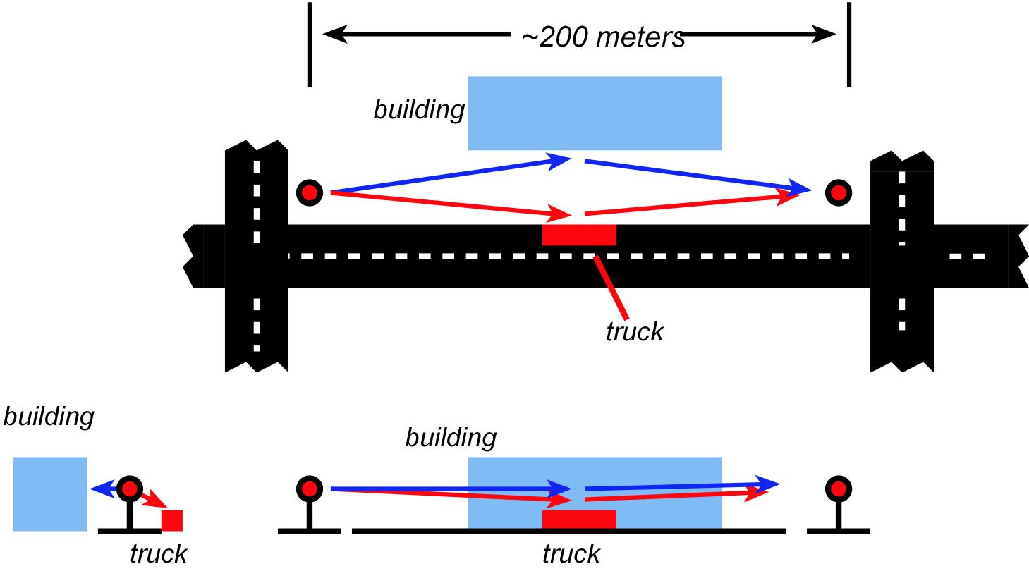

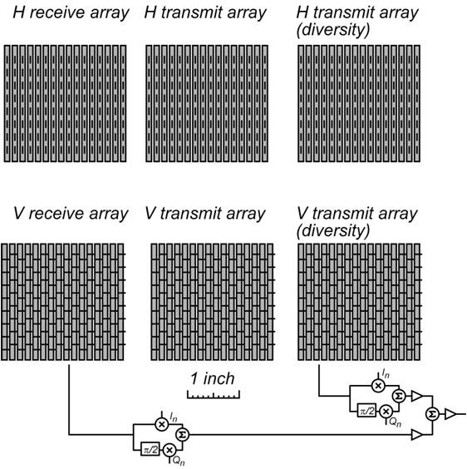
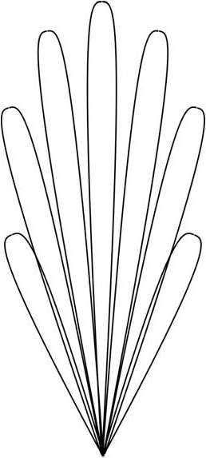
Beamforming can suppress ISI
1 Gbaud with 10º array beamwidth :
multipath mostly causes fading
not much ISI
10 Gbaud with 10º array beamwidth :
significant fading and significant ISI
Solution 1: larger arrays
narrower beamwidth
Solution 2: multiple arrays
multiple receivers to handle fading ?
can sum these to form narrow nulls!
also handles fading and ISI

Slide 17
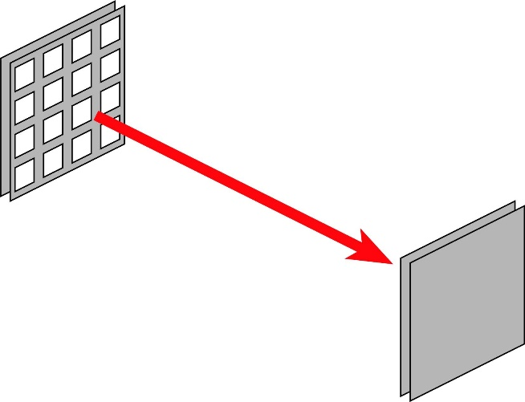
Optimum array size for low system power
At optimum-size array,
target PA output power
is typically 10-200 mW

Slide 18
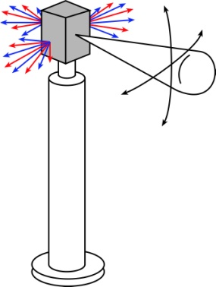
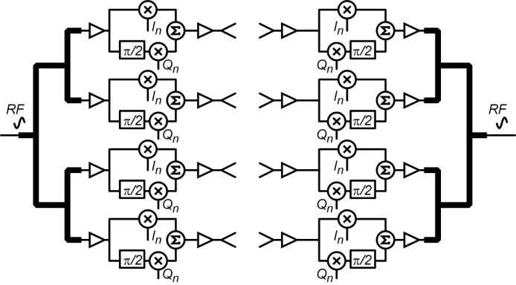
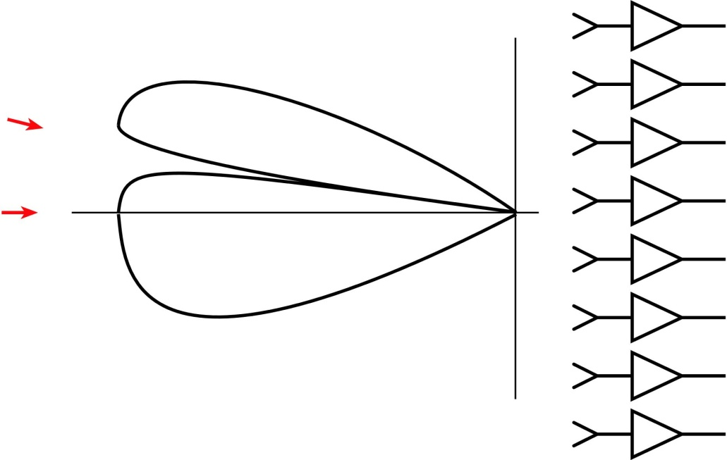
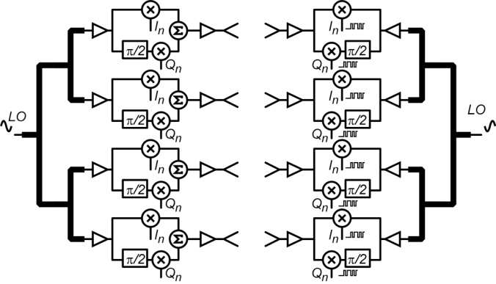
How big should be the array ?
Large arrays:
more directive→ less PA power needed
more channels→ cost, DC power
Large arrays:
more directive→
less SNR loss with NLOS nulling
eases multipath equalization

Slide 19
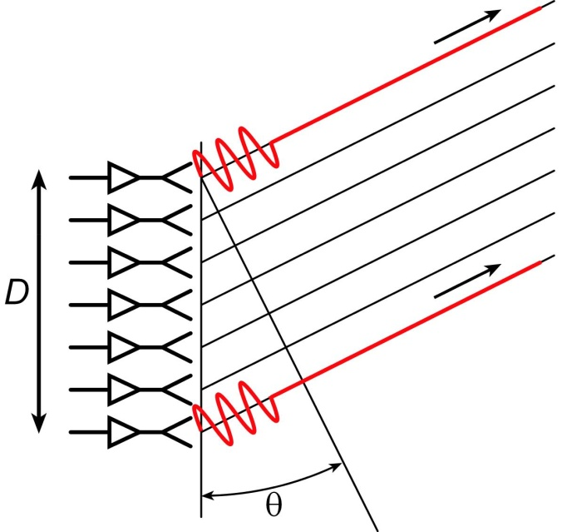
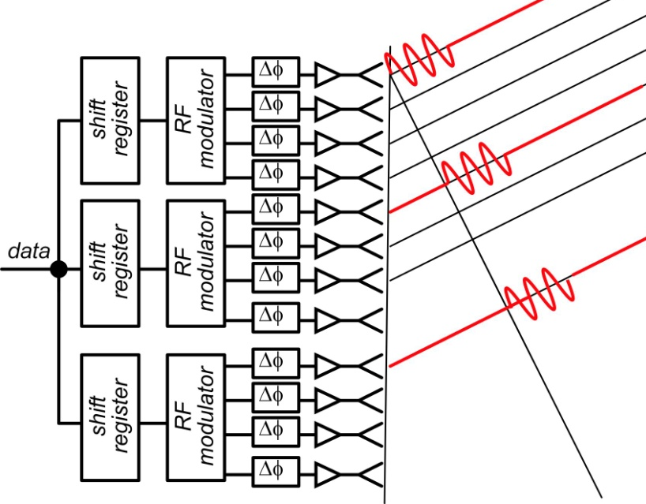
Data delay equalization in large arrays

Slide 20
systems

Slide 21
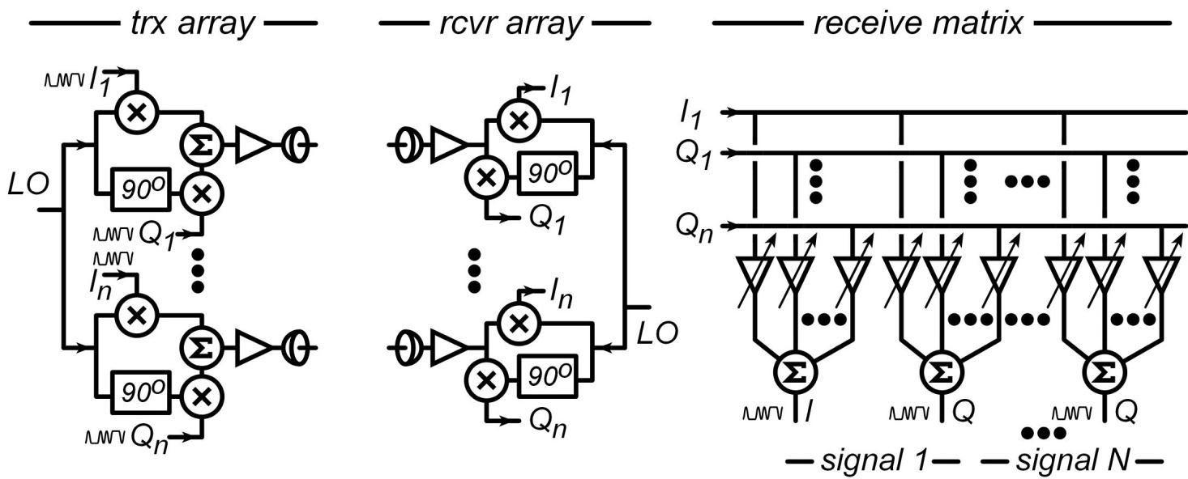
mm-Wave LOS MIMO: multi-channel for high capacity
Torklinson : 2006 Allerton Conference
Sheldon : 2010 IEEE APS-URSI
Torklinson : 2011 IEEE Trans Wireless Comm.

Slide 22
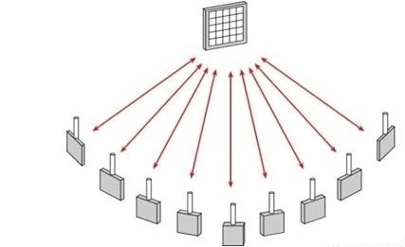
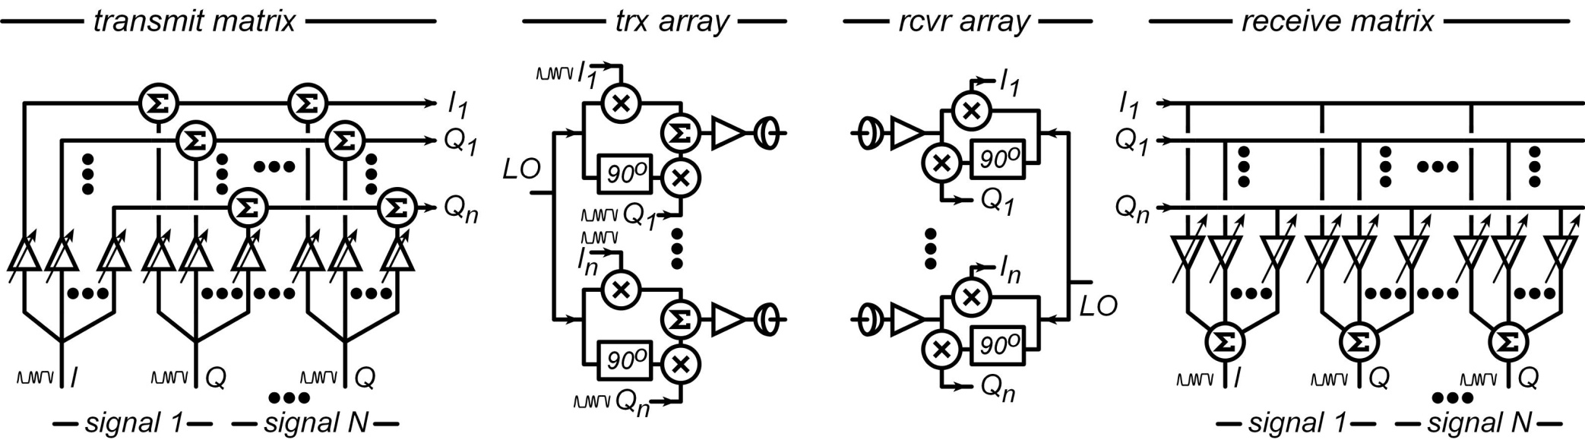
Spatial Multiplexing: massive capacity RF networks
multiple independent beams
each carrying different data
each independently aimed
# beams = # array elements
Hardware: multi-beam phased array ICs

Slide 23
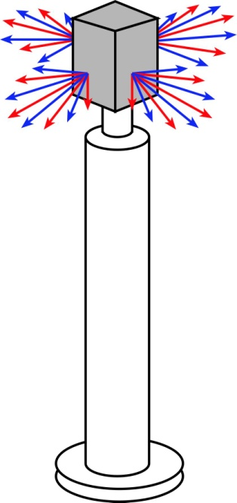
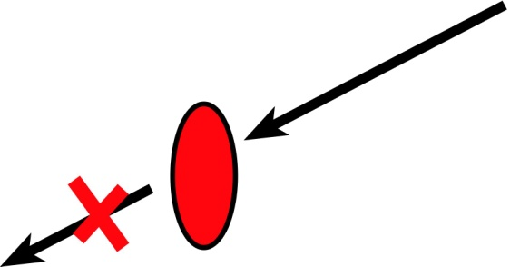
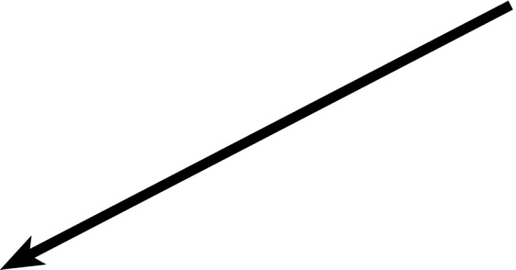
100-1000 GHz Wireless Needs Mesh Networks
Object having area
~λR
will block beam.
Blockage is avoided
using beamsteering
and mesh networks.
...high-frequency signals
are easily blocked.
...this is easier at high frequencies.

Slide 24
mm-wave
propagation

Slide 25
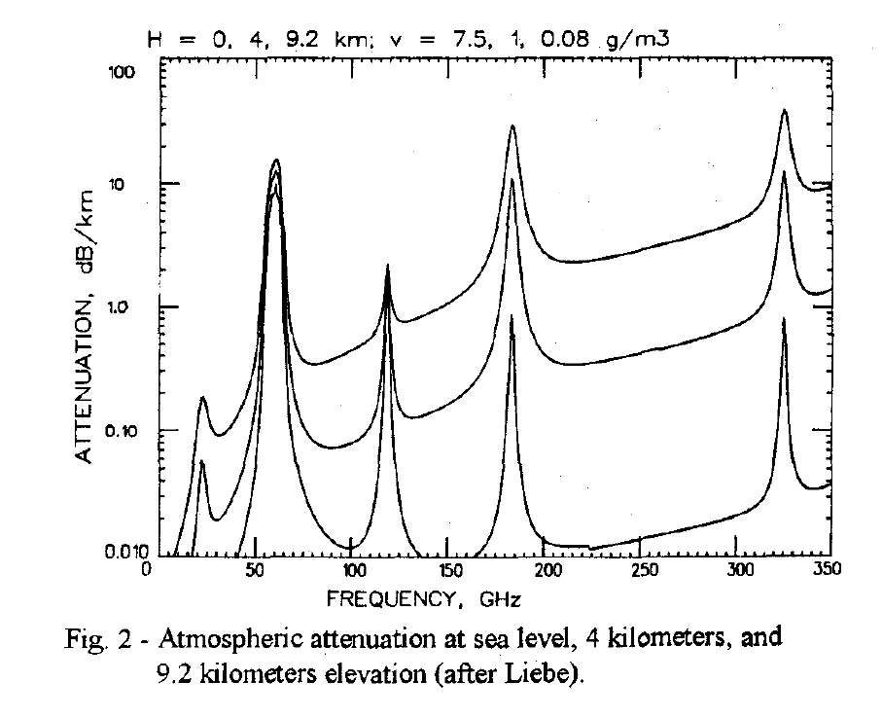
Fair-Weather Propagation
Fair weather
Wiltse, 1997 IEEE Int. APS Symposium, July
sea level
2-5 dB/km
200-300 GHz
125-165 GHz
4km elevation
75-110 GHz
9km elevation

Slide 26
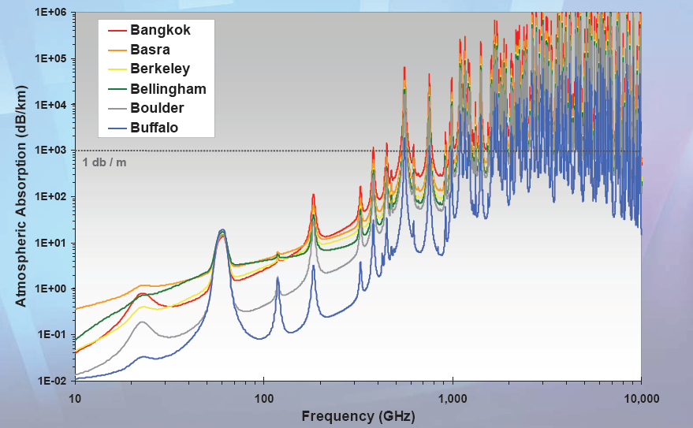
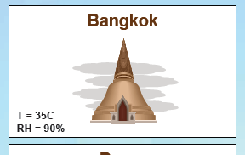
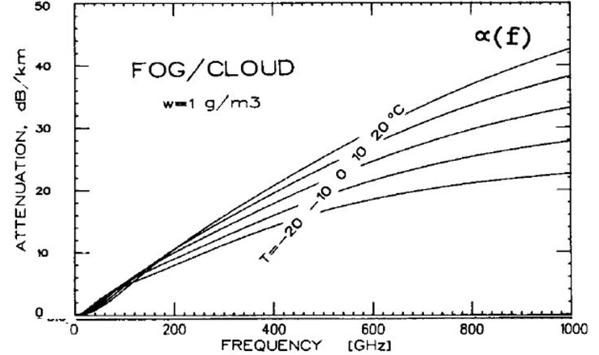
Foul Weather Propagation
35ºC, 95% Humidity
loss (dB/km)~(frequency/60GHz)²
11 dB/km@200 GHz, 5.5dB/km@140GHz
Rain:
10⁻³: 25mm/hr, 11dB/km
10⁻⁴: 50-85mm/hr, 19dB/km
10⁻⁵: 100+mm/hr: 30dB/km
Rosker; Wallace, 2007 IEEE IMS
Extreme Fog (1g/m³)
~(25 dB/km)x(frequency/500 GHz)
Olsen, Rogers, Hodge, IEEE Trans Antennas & Propagation Mar 1978
Liebe, Manabe, Hufford, IEEE Trans Antennas and Propagation, Dec. 1989
Liebe, IEEE Trans Ant and Pro, Vol 31, No. 1, Jan 1983
Karasawa, Maekawa, IEEE Proc, Vol 85 , #6 , June 1997

Slide 27
Atmospheric Attenuation: Implications
Worst-case attenuation roughly constant over 50-250 GHz.
10⁻⁵ outage rate: equal losses over 50-300 GHz
10⁻³ outage rate: equal losses over 50-200 GHz
target should be 50-250 GHz links.
Exclusive use of VLSI Si processes forces use of 50-180GHz

Slide 28
detailed
link analysis

Slide 29
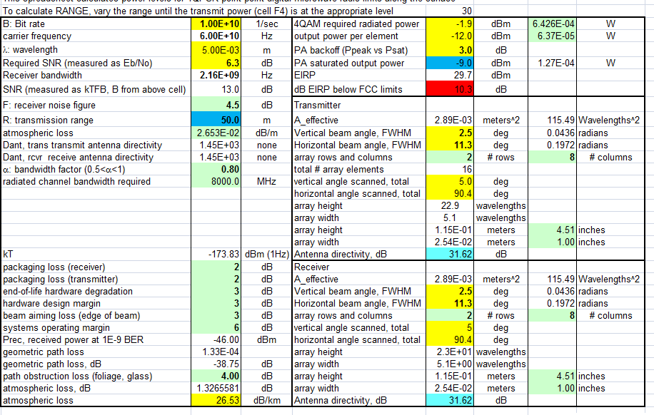

Example Link budgets (60 GHz)
array:
16 elements (2x8)
4.5 x 1.0 inches
11.5 x 2.54 cm
Note various margins allocated.
Rain losses calculated from rain rate.

Slide 30

Example Link budgets (140 GHz)
array:
16 elements (2x8)
1.9 x 0.43 inches
4.9 x 0.11 cm
Note various margins allocated.
Rain losses calculated from rain rate.

Slide 31
hardware:
rough numbers

Slide 32


140 GHz, 10 Gb/s Adaptive Picocell Backhaul

Slide 33


140 GHz, 10 Gb/s Adaptive Picocell Backhaul
350 meters range in 50mm/hr rain
Realistic packaging loss, operating & design margins
PAs: 24 dBm P_{sat} (per element)
LNAs: 4 dB noise figure

Slide 34


340 GHz, 160 Gb/s MIMO Backhaul Link
→ 1º beamwidth; 8º beamsteering

Slide 35

340 GHz, 160 Gb/s MIMO Backhaul Link
1º beamwidth; 8º beamsteering
600 meters range in five-9's rain
Realistic packaging loss, operating & design margins
PAs: 21 dBm P_{sat} (per element)
LNAs: 7 dB noise figure

Slide 36


60 GHz, 1 Tb/s Spatially-Multiplexed Base Station
2x64 array on each of four faces.
Each face supports 128 users, 128 beams: 512 total users.
Each beam: 2Gb/s.
200 meters range in 50 mm/hr rain
Realistic packaging loss, operating & design margins
PAs: 20 dBm P_{out} , 26 dBm P_{sat} (per element)
LNAs: 3 dB noise figure

Slide 37



mm-Wave Wireless Transceiver Architecture
custom PAs, LNAs → power, efficiency, noise
Si CMOS beamformer→ integration scale
...similar to today's cell phones.

Slide 38
400 GHz frequency-scanned imaging radar
What your eyes see-- in fog
What you see with X-band radar
What you would like to see
38

Slide 39

400 GHz frequency-scanned imaging car radar
39

Slide 40
400 GHz frequency-scanned imaging car radar
Range: see a basketball at 300 meters (10 seconds warning) in heavy fog
(10 dB SNR, 28 dB/km, 1 foot diameter target, 65 MPH)
Image refresh rate: 60 Hz
Resolution 64×512=32,800 pixels
Angular resolution: 0.10 degrees
Angular field of view: 9 by 97 degrees
Aperture: 12" by 12"
Component requirements:
10 mW peak power/element,
3% pulse duty factor
6.5 dB noise figure,
5 dB package losses
5 dB manufacturing/aging margin
40

Slide 41


Transistors
and IC technologies

Slide 42
Production Semiconductor Processes for mm-Wave
Silicon Germanium BiCMOS Processes
foundry | process | nominal f_{max} | useful range
IBM (GF !) | 9HP | 320 GHz | ~170 GHz
TowerJazz | SBC13H3 | 270 GHz | ~140 GHz
TowerJazz | SBC18H4 (near release) | 350 GHz | ~180 GHz
ST Microelectronics | S9MW | 270 GHz | ~140 GHz
ST Microelectronics | SB55 (development) | 340 GHz | ~180 GHz
"Useful (frequency) range" means those frequencies at which acceptable-performance IC blocks can be realized, not the highest frequency of a published research result.

Slide 43
Production Semiconductor Processes for mm-Wave
VLSI CMOS Processes
foundry | process | nominal f_{max} | useful range
various (IBM, GF, TSMC) | 65nm bulk CMOS | ~~250GHz | ~130GHz
IBM (GF !) | 45nm PD-SOI (high leakage power) | ~~300 GHz | ~150 GHz
IBM (GF !) | 32 nm UTB-SOI | ~~300 GHz | ~150 GHz
ST Microelectronics | 28 nm UTB-SOI | similar to above
various | 22nm, ~14nm UTB-SOI | poorer than above
Intel, IBM/GF | 22nm, ~14nm finFET | likely poorer than above,
Generations beyond 28/32nm:
progressively poorer performance in 100+ GHz ICs
progressively lower transmitter power at all frequencies

Slide 44
Semiconductor Processes for mm-Wave
Production III-V foundries
foundry | process | nominal f_{max} | useful range
Northrop-Grumman (low-volume) | 600nm InP HBT: 4V: higher-power transmitters | >300GHz | ~150 GHz
Northrop-Grumman (low-volume) | 100nm InP HEMT (FET) for very low noise receivers | >350GHz | ~200 GHz
Qorvo (Tri-Quint) | TQP13 HEMT power amps, low-noise -amps | ~~150GHz | 100 GHz
These processes are best for single-stage add-on power amps, low-noise amps;
both to increase system range.

Slide 45
Research Semiconductor Processes
Research institutions with some "foundry-like" access
foundry | process | nominal f_{max} | useful range
Teledyne | 250nm InP HBT | 700GHz | ~250 GHz
Teledyne | 130nm InP HBT | 1100 GHz | ~450 GHz
IHP | 130nm SiGe BiCMOS | 500GHz | ~250 GHz
microwave GaN HEMT is a production technology
mm-wave GaN HEMT may become a production technology
mm-wave InP HBT may become a production technology

Slide 46





mm-wave CMOS (examples)
260 GHz amplifier:
65nm bulk CMOS, Over-neutralized to reach G_{max}, 9.2 dB, 4 stages
Momeni ISSCC, March 2013
300 GHz f_{max}
150 GHz amplifier: 65 nm bulk CMOS, 8.2 dB, 3 stages (250GHz f_{max})
Seo et al. (UCSB), JSSC, December 2009

Slide 47


mm-Wave CMOS won't scale much further
Gate dielectric can't be thinned
→ on-current, g_{m} can't increase
Shorter gates give no less capacitance
dominated by ends; ~1fF/μm total
Maximum g_{m}, minimum C→ upper limit on f_{τ}.
about 350-400 GHz.
Tungsten via resistances reduce the gain
Inac et al, CSICS 2011
Present finFETs have yet larger end capacitances

Slide 48


III-V high-power transmitters, low-noise receivers
Cell phones & WiFi:
GaAs PAs, LNAs
mm-wave links need
high transmit power,
low receiver noise
0.47 W @86GHz
H Park, UCSB, IMS 2014
0.18 W @220GHz
T Reed, UCSB, CSICS 2013
1.9mW @585GHz
M Seo, TSC, IMS 2013

Slide 49
InP Bipolar Transistors

Slide 50

Why InP Bipolar Transistors ?
InP better electron transport than Si collectors
higher electron velocity 3.5 vs 1.0 × 10⁷ cm/s
plus wider bandgap→ higher breakdown field
InGaAs base, base-emitter heterojunction:
very low base sheet resistances
Implications:
~3:1 higher (f_{τ}, f_{max}) at a given scaling node
higher breakdown* at a given (f_{τ}, f_{max})
but...InP HBT not a production technology
*Breakdown is too complicated to summarize with BVCEO.
BVCBO vs. BVCEO vs. safe operating area ?
Bottom line: look at V_{ce} used in published IC data for a given IC technology.

Slide 51












Transistor scaling laws: ( V,I,R,C,τ ) vs. geometry
Depletion Layers
Fringing Capacitances
Thermal Resistance
Bulk and Contact Resistances
Available quantum states to carry current
→ capacitance,
transconductance
contact resistance

Slide 52


Bipolar Transistor: Structure & Models

Slide 53


Base-Collector Distributed RC Parasitics

Slide 54

R_{bb}C_{cb} Time Constant, F_{max} , Simple Hybrid-π model
Vaidyanathan & Pulfrey
IEEE Trans. Elect. Dev.
Feb. 1999

Slide 55

BJT Space-Charge-Limited Current (Kirk effect)

Slide 56



InP: Electron velocity modulation
More collector voltage→ less distance before scattering→ more transit time
less collector voltage
more collector voltage
✘
✘
heavy X valley
heavy L valley
light Γ valley
(f_{τ}, f_{max}) decrease with increased V_{ce}. C_{cb} is modulated by I_{c}.

Slide 57



Reduced g_{m} at extreme current densities
Boltzmann
130nm InP HBT
Fermi-Dirac
Highly Degenerate
High currents→ transconductance less than qI/kT → bandwidth decreases
Problem in InP, not silicon: silicon has larger electron effective mass, more valleys

Slide 58
Bipolar Transistor Design
58

Slide 59
Bipolar Transistor Design: Scaling
59

Slide 60

Energy-limited vs. field-limited breakdown
band-band tunneling: base bandgap
impact ionization: collector bandgap
60

Slide 61


Making faster bipolar transistors
to double the bandwidth: | change
emitter & collector junction widths | decrease 4:1
current density (mA/μm²) | increase 4:1
current density (mA/μm) | constant
collector depletion thickness | decrease 2:1
base thickness | decrease 1.4:1
emitter & base contact resistivities | decrease 4:1
Teledyne: M. Urteaga et al: 2011 DRC
Narrow junctions.
Thin layers
High current density
Ultra low resistivity contacts

Slide 62
Refractory Contacts to In(Ga)As
Baraskar et al, Journal of Applied Physics, 2013
32 nm (2.8THz) node
requirements
Refractory: robust under high-current operation / Low penetration depth: ~ 1 nm / Performance sufficient for 32 nm /2.8 THz node.
Why no ~2THz HBTs today ?
Problem: reproducing these base contacts in full HBT process flow
62

Slide 63

THz HBTs: The key challenges
Obtaining good base contacts
in HBT vs. in contact test structure
(emitter contacts are fine)
RC parasitics along finger length
metal resistance, excess junction areas
Baraskar et al, Journal of Applied Physics, 2013

Slide 64

THz HBTs: double base metal process
Blanket surface clean (UV O₃ / HCl)
strips organics, process residues, surface oxides
Blanket base metal
no photoresist; no organic residues
Ru refractory diffusion barrier
2 nm Pt : penetrates residual oxides
Rode et al., IEEE TED, Aug. 2015
Thick Ti/Au base pad metal liftoff
thick metal→ low resistivity

Slide 65


Reducing Emitter Length Effects
large base post
large emitter
end undercut
before
Rode et al., IEEE TED, Aug. 2015
small base post undercut
small emitter
end undercut
after
small base post
large base post undercut
65

Slide 66

Reducing Emitter Length Effects
before
after
thicker Au
base metal
narrower
collector
junction
Rode et al., IEEE TED, Aug. 2015
66

Slide 67


InP HBTs: 1.07 THz @200nm, ?? @ 130nm
?
Rode et al., IEEE TED, Aug. 2015

Slide 68








130nm /1.1 THz InP HBT: ICs to 670 GHz
614 GHz
fundamental
VCO
340 GHz dynamic frequency divider
M. Seo, TSC / UCSB
M. Seo, UCSB/TSC
IMS 2010
300 GHz fundamental
PLL
620 GHz, 20 dB gain amplifier
M Seo, TSC
IMS 2013
also: 670GHz amplifier
J. Hacker , TSC
IMS 2013 (not shown)
M. Seo, TSC
IMS 2011
204 GHz static
frequency divider
(ECL master-slave
latch)
220 GHz
180 mW
power amplifier
81 GHz
470 mW
power amplifier
Z. Griffith, TSC
CSIC 2010
T. Reed, UCSB
CSICS 2013
H-C Park UCSB
IMS 2014
Integrated 300/350GHz Receivers:
LNA/Mixer/VCO
600 GHz
Integrated
Transmitter
PLL + Mixer
M. Seo TSC
M. Seo TSC

Slide 69

Towards a 3 THz InP Bipolar Transistor
Extreme base doping→ low-resistivity contacts→ high f_{max}
Extreme base doping→ fast Auger (NP²) recombination→ low β.
Solution: very strong base compositional grading→ high β

Slide 70



1/2-THz SiGe HBTs
500 GHz f_{max} SiGe HBTs Heinemann et al. (IHP), 2010 IEDM
16-element multiplier array @ 500GHz (1 mW total output)
U. Pfeiffer et. al. (Wuppertal / IHP) , 2014 ISSCC

Slide 71
Towards a 2 THz SiGe Bipolar Transistor
 | InP | SiGe
emitter
junction width | 64 | 18 | nm
access resistivity | 2 | 0.6 | Ω−μm²
base
contact width | 64 | 18 | nm
contact resistivity | 2.5 | 0.7 | Ω−μm²
collector
thickness | 53 | 15 | nm
current density | 36 | 125 | mA/μm²
breakdown | 2.75 | 1.3? | V
f_{τ} | 1000 | 1000 | GHz
f_{max} | 2000 | 2000 | GHz
Similar scaling
InP: 3:1 higher collector velocity
SiGe: good contacts, buried oxides
Key distinction: Breakdown
InP has:
thicker collector at same f_{τ},
wider collector bandgap
Key requirements:
low resistivity Ohmic contacts
note the high current densities
Assumes collector junction 3:1 wider than emitter.
Assumes SiGe contacts no wider than junctions

Slide 72
InP Field-Effect Transistors

Slide 73




State of the art in InP HEMTs
First Demonstration of Amplification at 1 THz Using
25-nm InP High Electron Mobility Transistor Process
Xiaobing Mei, et al, IEEE EDL, April 2015 (Northrop-Grumman)

Slide 74
HEMTs: Key Device for Low Noise Figure
Hand-derived modified Fukui Expression, fits CAD simulation extremely well.
2:1 to 4:1 increase in f_{τ} → greatly improved noise @ 200-670 GHz.
Better range in sub-mm-wave systems; or use smaller power amps.
or enable yet higher-frequency systems

Slide 75

FET Design

Slide 76
FET Design: Scaling

Slide 77
FET Design: Scaling
2:1
2:1
constant
2:1
2:1
2:1
2:1
2:1
2:1
2:1
2:1
constant
constant
constant
constant
4:1
2:1
2:1
constant
2:1
2:1

Slide 78


FET Scaling Laws (these now broken)
FET parameter | change
gate length | decrease 2:1
current density (mA/mm) | increase 2:1
transport mass | constant
2DEG electron density | increase 2:1
gate-channel capacitance density | increase 2:1
dielectric equivalent thickness | decrease 2:1
channel thickness | decrease 2:1
channel state density | increase 2:1
contact resistivities | decrease 4:1
fringing capacitance does not scale → linewidths scale as (1 / bandwidth )
78

Slide 79
FET Scaling Laws (these now broken)
FET parameter | change
gate length | decrease 2:1
current density (mA/mm) | increase 2:1
transport mass | constant
2DEG electron density | increase 2:1
gate-channel capacitance density | increase 2:1
dielectric equivalent thickness | decrease 2:1
channel thickness | decrease 2:1
channel state density | increase 2:1
contact resistivities | decrease 4:1
Gate dielectric can't be much further scaled.
Not in CMOS VLSI, not in mm-wave HEMTs
g_{m}/W_{g} (mS/μm) hard to increase
→ C_{end} / g_{m} prevents f_{τ} scaling.
Shorter gate lengths degrade electrostatics
→ reduced g_{m} /G_{ds} → reduced f_{max}/ f_{τ}

Slide 80

Why THz HEMTs no longer scale
HEMTs: gate barrier also lies under S/D contacts → high S/D access resistance
As gate length is scaled, gate barrier must be thinned for high g_{m}, low G_{ds}
HEMTs: High gate leakage when gate barrier is thinned→ cannot thin barrier

Slide 81
Towards at 2.5 THz HEMT
First Demonstration of Amplification at 1 THz Using
25-nm InP High Electron Mobility Transistor Process
Xiaobing Mei, et al, IEEE EDL, April 2015 (Northrop-Grumman)
FET scaling laws; 2:1 higher bandwidth | change
gate length | decrease 2:1
current density (mA/mm), g_{m} (mS/mm) | increase 2:1
transport mass | constant
gate-channel capacitance density | increase 2:1
contact resistivities | decrease 4:1
Need thinner dielectrics, better contacts

Slide 82

Record III-V MOS
S. Lee et al., VLSI 2014
L_{g}~25 nm
record
for III-V
N+ S/D
= best UTB SOI silicon
Vertical Spacer

Slide 83
Excellent III-V gate dielectrics
2.5nm ZrO₂
1nm Al₂O₃
2.5nm InAs
V. Chobpattanna,
S. Stemmer
FET data: S Lee, 2014 VLSI Symp.
61 mV/dec Subthreshold swing at V_{DS}=0.1 V
Negligible hysteresis

Slide 84

III-V MOS
@ L_{g} = ???
Huang et al.,
2015 DRC
Image courtesy of
S. Kraemer (UCSB)

Slide 85



Towards at 2.5 THz HEMT
VLSI III-V MOS
C. Y. Huang et al., DRC 2015
THz III-V MOS

Slide 86
mm-wave measurements

Slide 87


On-Wafer Network Analysis: 750+ GHz
Agilent, Rhode/Schwarz network analyzer,
Oleson Microwave Lab or
Virginia Diodes
frequency extenders
micro-coax wafer probes with
waveguide connections
GGB Industries,
Cascade Microtech
University of Virgina.
Internal bias Tee’s in probes
Mostly on-wafer calibration standards.

Slide 88
On-Wafer Through-Reflect-Line (TRL) Calibration
reference plane
Through line should be long for large probe separation.
Minimizes probe-probe coupling.
Measurements normalized to the line characteristic impedance.
Through
225um
225um
open
short
Either open or short needed.
Standards need not be accurate.
"Open" must have Γ closer to that of open than that of short.
Ports 1 & 2 must be symmetric.
Reflect
225um
225um
ΔL
ΔL= 90 deg @center frequency.
λ/8<ΔL<3λ/8
Line
225um
Device
Under Test
DUT
225um
Please see also:
http://www.ece.ucsb.edu/Faculty/rodwell/publications_and_presentations/publications/204vg.ppt

Slide 89







On-Wafer Line Reflect Linie Calibration
Extended Reference planes
transistors placed at center of long on-wafer line
LRL standards placed on wafer
large probe separation → probe coupling reduced
still should use the best-shielded probes available
Problem: substrate mode coupling
method will FAIL if lines couple to substrate modes
→ method works very poorly with CPW lines
need on wafer thin-film microstrip lines
CPW

Slide 90
Difficulties with >100 GHz On-Wafer Calibration
Data on two layouts of 65 nm MOSFET
Measured Y-parameters correlate
reasonably with expected device model.
Small errors in measured 2-port parameters result in large changes in Unilateral gain and Rollet's stability factor; neither measurement is credible.
Y₁₂ appears to be the key problem.
IC S_{ij} measurements are fine.
Transistor f_{max} measurements are hard.
MAG/MSG, dB
( K<1 )
10*log₁₀|U| (?)
"Unilateral gain", linear
"Unilateral gain", dB
U < 0 (!)

Slide 91
Packaging
and
antennas

Slide 92




The Antenna Feed Loss Problem
array elements are many λ long
overall array can be very big
→ high feed line losses
Use distribution
amplifiers ?
One solution:
waveguide-fed arrays of slots
Use to feed array tile:
overall array needs steering

Slide 93



Using lenses to reduce feed loss
Lenses on
individual
array elements.
...or on the
overall array.
Here the challenge is
maintaining constant beamwidth
over wide steering angles.

Slide 94


mm-wave interfaces: packaging
Wire-bonds:
With care, >60GHz can be coupled over wire-bonds.
Coupling of multiple lines remains problematic .
Flip-chip bonds
Standard C4 bonds very capacitive; tuning OK @ 60GHz. Possibly higher.
Option: more highly scaled bonds. Must contact vendors.
Heat removal problematic in flip-chip ICs
Flexible polyimide interconnect substrate
Used in Cascade micotech multi-signal probes, in some 60GHz products.
Ground integrity, low inductance mm-wave connections.
Must identify vendor.
https://www.cmicro.com/products/probe-cards/the-technology/thin-film-technology/cascade-microtech-s-thin-film-technology

Slide 95


mm-wave interfaces: packaging
Through-silicon vias for RF grounding (TowerJazz, also IBM/GF)
very low ground inductance
low losses, low crosstalk in mm-wave IC-package connections

Slide 96
mm-wave
IC Design

Slide 97
Reactively-Tuned
IC Design:
Concepts

Slide 98
What's the most gain we can get ? Do we care ?
A. Singhakowinta & A. R. Boothroyd, International Journal of Electronics, Volume 21, Issue 6, 1966, pages 549-560, DOI:10.1080/00207216608937931
O. Momeni and E. Afshari, 2011 IEEE Custom Integrated Circuits Conference (CICC), San Jose, CA, 2011, pp. 1-4, doi: 10.1109/CICC.2011.6055322

Slide 99
What's the most gain we can get ? Do we care ?
Low-noise amplifiers
designed for low noise figure, fairly high IP3
Power amplifiers
designed for high Psat, PAE, sufficiently low IM3
IF amplifiers
designed for low noise figure, high IP3.
Practical amplifiers are rarely designed for highest gain.
Real-world relevance of G_{ma}, G_{ms}, G_{max,S} is not clear.
Practical designs would benefit from new theory
Quantities similar to G_{ma}, G_{ms}, G_{max,S} above
But under constraints of high-power or low-noise tuning.
I know of no such published work.

Slide 100






RF-IC Design: Simple & Well-Known Procedures
1: (over)stabilize at the design frequency
guided by stability circles
2: Tune input for F_{min} (LNAs) or output for P_{sat} (PAs)
3: Tune remaining port for maximum gain
4: Add out-of-band stabilization.
There are many ways to tune port impedances: microstrip lines, MIM capacitors, transformers
Choice guided by tuning losses. No particular preferences.
For BJT's, MAG/MSG usually highest for common-base.
Common-base gain is however reduced by:
base (layout) inductance
emitter-collector layout capacitance.
100

Slide 101


Low-Noise Amplifier Design
Inductive emitter/source degeneration
simultaneous S11 and noise match
reduces gain, improves IP3
Additional in-band stabilization (output port) as needed
Input tuning for F_{min}
Output match
Out-of-band stabilization

Slide 102



Power Amplifier Design (Cripps method)
For maximum saturated output power,
& maximum efficiency
device intrinsic output must see
optimum loadline set by:
breakdown, maximum current, maximum power density.
parasitic C's and R's represented
by external elements...
ammeter monitors intrinsic
junction current
without including
capacitive currents
...(V_{collector}-V_{emitter} )
measures voltage
internal to series parasitic
resistances...

Slide 103




PAs with corporate combining
W-band InP HBT power amplifier - UCSB
34 GH InP HBT power amplifier - J. Hacker Teledyne
34 GH InP HBT power amplifier - J. Hacker Teledyne

Slide 104
Power amplifier design: combiners
Even-mode equivalent circuit

Slide 105
mm-wave
IC Interconnects

Slide 106
Transmission Lines
A pair of wires with regular spacing, dielectric loading along the length.
These have inductance per unit length and capacitance per unit length.
Forward and reverse waves propagate.
Reflections will occur if lines are not terminated in Z_{o}

Slide 107
Transmission Lines for On-Wafer Wiring
geometry
voltages
currents
microstrip line
W
+V
I
H
0V
I
W+2S
I/2
I
I/2
coplanar waveguide
W
+V
0V
0V
H
0V
0

Slide 108
Skin loss
W
H
~W +2H

Slide 109

Lateral Modes (1)

Slide 110

Lateral Modes (2)

Slide 111

Lateral Modes (3)→ Junction Parasitics

Slide 112

Substrate Modes

Slide 113

Substrate Mode Coupling: Microstrip

Slide 114

Substrate Mode Coupling: CPW
k_{z}

Slide 115
Transmission lines: the problem

Slide 116
III-V MIMIC Interconnects -- Classic Substrate Microstrip
W
Zero ground
inductance
in package
Thick Substrate
→ low skin loss
No ground plane
breaks in IC
H
k_{z}
High via inductance
TM substrate
mode coupling
12 pH for 100 μm substrate -- 7.5 Ω @ 100 GHz
Strong coupling when substrate approaches ~λ_{d} / 4 thickness
lines must be
widely spaced
ground vias must be
widely spaced
Line spacings must be
~3*(substrate thickness)
all factors require very thin substrates for >100 GHz ICs
→ lapping to ~50 μm substrate thickness typical for 100+ GHz

Slide 117




Coplanar Waveguide
No ground vias
No need (???) to thin substrate
Hard to ground IC
to package
+V
+V
+V
0V
Parasitic microstrip mode
ground plane breaks → loss of ground integrity
substrate mode coupling
or substrate losses
III-V:
semi-insulating substrate→ substrate mode coupling
Silicon
conducting substrate
→ substrate conductivity losses
k_{z}
-V
0V
+V
0V
Parasitic slot mode
Repairing ground plane with ground straps is effective only in simple ICs
In more complex CPW ICs, ground plane rapidly vanishes
→ common-lead inductance → strong circuit-circuit coupling
poor ground integrity
loss of impedance control
ground bounce
coupling, EMI, oscillation
40 Gb/s differential TWA modulator driver
note CPW lines, fragmented ground plane
35 GHz master-slave latch in CPW
note fragmented ground plane
175 GHz tuned amplifier in CPW
note fragmented ground plane

Slide 118
If It Has Breaks, It Is Not A Ground Plane !
signal line
signal line
ground plane
coupling / EMI due to poor ground system integrity is common in high-frequency systems
whether on PC boards
...or on ICs.

Slide 119


No clean ground return ? → interconnects hard to model
35 GHz static divider
interconnects have no clear local ground return
interconnect inductance is non-local
interconnect inductance has no compact model
8 GHz clock-rate delta-sigma ADC
thin-film microstrip wiring
every interconnect can be modeled as microstrip
some interconnects are terminated in their Zo
some interconnects are not terminated
...but ALL are precisely modeled
InP 8 GHz clock rate delta-sigma ADC

Slide 120
III-V MIMIC Interconnects -- Thin-Film Microstrip
narrow line spacing → IC density
no substrate radiation, no substrate losses
fewer breaks in ground plane than CPW
... but ground breaks at device placements
still have problem with package grounding
InP 34 GHz PA
(Jon Hacker , Teledyne)
...need to flip-chip bond
W
thin dielectrics → narrow lines
→ high line losses
→ low current capability
→ no high-Z_{o} lines
H

Slide 121


III-V MIMIC Interconnects -- Inverted Thin-Film Microstrip
narrow line spacing → IC density
Some substrate radiation / substrate losses
No breaks in ground plane
... no ground breaks at device placements
still have problem with package grounding
InP 150 GHz master-slave latch
...need to flip-chip bond
thin dielectrics → narrow lines
→ high line losses
→ low current capability
→ no high-Z_{o} lines
InP 8 GHz clock rate delta-sigma ADC

Slide 122

VLSI mm-wave interconnects with ground integrity
narrow line spacing → IC density
no substrate radiation, no substrate losses
negligible breaks in ground plane
negligible ground breaks @ device placements
Also:
Ground plane at *intermediate level* permits
critical signal paths to cross supply lines, or other
interconnects without coupling.
(critical signal line is placed above ground,
other lines and supplies are placed below ground)
still have problem with package grounding
...need to flip-chip bond
thin dielectrics → narrow lines
→ high line losses
→ low current capability
→ no high-Z_{o} lines

Slide 123




Modeling Interconnects, Passives in Tuned IC's
Interconnects are tuning elements
Narrow bandwidths→ precision is critical
Initial IC simulation uses CAD-systems' library of passive element models.
Second design cycle: 2.5-Dimensional electromagnetic simulation of:
lines, junctions, stubs, capacitors, resistors, pads.
Third design cycle: 2.5-D simulation of entire IC wiring (if possible);
otherwise, of large blocks (gain stages)
150-200 GHz HBT amplifier, Urteaga et al, IEEE JSSCC , Sept. 2003
1-180GHz HBT amplifier, Agarwal et al,
IEEE Trans MTT , Dec.. 1998
185GHz HBT amplifier, Urteaga et al,
IEEE IMS, May. 2001

Slide 124

ICs in Thin-Film (Not Inverted) Microstrip
Note breaks in ground plane at transistors, resistors, capacitors

Slide 125

ICs in Thin-Film (Not Inverted) Microstrip
Note breaks in ground plane at transistors, resistors, capacitors

Slide 126

ICs in Thin-Film Inverted Microstrip
100 GHz differential TASTIS Amp. 512nm InP HBT

Slide 127


Power supply problems
local resonances between bypass cap and supply interconnects
global LC standing-wave resonances on supply bus
Detuning of individual stages
Coupling, feedback via supply→ oscillation, loss of path isolation

Slide 128

Power supply problems
The supply impedance will
detune individual stages.

Slide 129

Power supply problems
Model the supply in all simulations.
"If it is on the {IC, PCB, probe station}, put it in the simulation."
Here, the supply is terminated by 50 Ohms through a bias T.
This avoids resonances.
More generally, we must simulate system
for wide range of external supply impedance.

Slide 130


Transmission-lines in 500+ GHz ICs
Inverted microstrip: the problem is ground via inductance

Slide 131

Transmission-lines in 500+ GHz ICs
Grounded CPW: lower ground inductance,
metal 3 ground plane suppresses ground bounce
J. Hacker , Teledyne IMS 2013

Slide 132


Differential mm-wave stages
Common-emitter
Common-base
M. Seo, Teledyne
M. Seo, 2013 IMS
Virtual ground→ avoids ground via inductance ✓
Avoids power-supply coupling ✓
Potential problems with common mode ✘

Slide 133

mm-wave common-mode instability
In all amplifiers, stability must be ensured from DC-f_{max}.
Differential & common-mode stability must be ensured from DC-f_{max}
Simple LNA inductive tuning is, for example, problematic

Slide 134


Pseudo-Differential Stages
No common-mode instability problem.
Power-supply is virtual ground.
No supply detuning of output network
Improved power-supply isolation (oscillation, unwanted signal coupling)

Slide 135
20+ GHz
digital &
mixed-signal
design

Slide 136




Modeling Interconnects: Digital & Mixed-Signal IC's
longer interconnects:
lines terminated in Zo → no reflections.
Shorter interconnects:
lines NOT terminated in Zo .
But they are *still* transmission-lines.
Ignore their effect at your peril !
If length << wavelength,
or line delay<<risetime,
short interconnects behave
as lumped L and C.
Modeling: 2.5D, library Tline, or L-C

Slide 137


Design Flow: Digital & Mixed-Signal IC's
All interconnects: thin-film microstrip environment.
Continuous ground on one plane.
2.5-D simulations run on representative lines.
various widths, various planes
same reference (ground) plane.
Simulation data manually fit to CAD line model
effective substrate ε_{r} , effective line-ground spacing.
Width, length, substrate of each line
entered on CAD schematic.
rapid data entry, rapid simulation.
Resistors and capacitors:
2.5-D simulation→ RLC fit
RLC model used in simulation.

Slide 138




High Speed ECL Design
Followers associated with inputs, not outputs
Emitters never drive long wires.
(instability with capacitive load)
Double termination for least ringing, send or receive termination for moderate-length lines, high-Z loading saves power but kills speed.
Current mirror biasing is more compact.
Mirror capacitance→ ringing, instability.
Resistors provide follower damping.

Slide 139



High Speed ECL Design
Layout: short signal paths at gate centers, bias sources surround core.
Inverted thin film microstrip wiring.
Key: transistors in on-state
operate at Kirk limited-current.
→ minimizes C_{cb}/I_{c} delay.
Key: transistors designed for minimum
ECL gate delay*, not peak (f_{τ} , f_{max}).
*hand expression, charge-control analysis
205 GHz divider, Griffith et al, IEEE CSIC, Oct. 2010
Example: 8:1 205 GHz static divider
in 256 nm InP HBT.

Slide 140

Differential stages: schematic vs. floorplan

Slide 141



Example: 40 GS/s S/H clock buffer
I_{tail}=6 mA
I_{tail}=12 mA

Slide 142




Example: 40 GS/s S/H clock buffer

Slide 143

Example: 40 GS/s S/H clock buffer

Slide 144




20GHz Op-Amps for Linear 2 GHz Amplification
Griffith et al, IEEE IMS, June. 2011
Reduce distortion with
strong negative feedback
linear response
output power, dBm
increasing feedback
2-tone
intermodulation
Even for 2 GHz operation,
loop bandwidths must 20-40 GHz.
R. Eden
need very fast transistors
input power, dBm
physically small feedback loop;
bias components surround active core.

Slide 145
86 GHz
Power Amplifier

Slide 146
mm-Wave Power Amplifier: Challenges
needed: High power / High efficiency / Small die area ( low cost)
Extensive power combining
Compact power-combining
Class E/D/F are poor @ mm-wave
insufficient f_{max} ,
high losses in harmonic terminations
Efficient power-combining
Goal: efficient, compact mm-wave power-combiners

Slide 147




Parallel Power-Combining
Output power: P_{OUT} = N x V x I
Parallel connection increases P_{OUT}
Load Impedance: Z_{OPT} = V / (N x I)
Parallel connection decreases Z_{opt}
High P_{OUT}→ Low Z_{opt}
Needs impedance transformation:
lumped lines, Wilkinson, ...
High insertion loss
Small bandwidth
Large die area

Slide 148



Series Power-Combining & Stacks
Parallel connections: I_{out}=N x I
Series connections: V_{out}=N x V
Output power: P_{out}=N² x V x I
Load impedance: Z_{opt}=V/I
Small or zero power-combining losses
Small die area
How do we drive the gates ?
Local voltage feedback:
drives gates, sets voltage distribution
Design challenge:
need uniform RF voltage distribution
need ~unity RF current gain per element
...needed for simultaneous compression of all FETs.
Shifrin et al., 1992 IEEE-IMS; Rodwell et al., U.S. Patent 5,945,879, 1999; Pornpromlikit et al., 2011 CSICS

Slide 149

Ideal Tri-axial Line
Two separate transmission lines (m₃-m₂, m₂-m₁)
→ E, H fields between m₃ and m₁ perfectly shielded

Slide 150

Sub-λ/4 Baluns for Series Combining
Balun combiner:
2:1 series connection
each source sees 25 Ω
→ 4:1 increased P_{out}
Standard λ/4 balun :
long lines
→ high losses
→ large die
Sub-λ/4 balun :
stub→ inductive
tunes transistor C_{out} !
short lines→ low losses
short lines → small die
Park et al., 2013 CSICS, 2014 IEEE-IMS

Slide 151

Baluns in Real ICs
1)
2)
3)
4)
  1) M₁ as a GND
  2) Slot-type transmission lines (M₁-M₂), AC short (2 pF MIM)
  3) Microstrip line (M₂-M₃), E-field shielding NOT negligible
  4) Sidewalls between M₃-M₁ (Faraday cages), λ/16 length

Slide 152

Two-Stage PA IC Test Results (86GHz)
Large signal measurements
  IC size: 825 x 820 um²
  Gain: 17.5 dB
  P_{SAT}: >200 mW @ 3.0 V
  PAE: >30 %
  Power density (power/die area)
  = 307 mW/mm² (including RF pads)
  = 927 mW/mm² (core area)
[H. Park et al, CSICS 2013]
30% PAE W-Band InP Power Amplifiers Using Sub-Quarter-Wavelength Baluns for Series-Connected Power-Combining

Slide 153


4:1 series-connected 81GHz power amplifier
17 dB Gain
470 mW P_{sat}
23% PAE
Teledyne 250 nm InP HBT
2 stages, 1.0 mm²(incl pads)
Park et al., 2014 IEEE-IMS

Slide 154
IC example:
220 GHz
power amplifier

Slide 155
Millimeter-wave imaging
10,000-pixel, 94GHz imaging array→ 10,000 elements
Demonstrated:
SiGe (UCSD/Rebeiz)
~1.3kW: 10,000 elements
Lower-power designs:
InP, CMOS, SiGe
(UCSB, UCSD, Virginia Poly.)
Golcuk: Trans MTT, Aug 2014
235 GHz video-rate synthetic aperture radar
1 transmitter, 1 receiver
100,000 pixels
20 Hz refresh rate
5 cm resolution @ 1km
50 Watt transmitter
(tube, solid-state driver)

Slide 156


90 mW, 220 GHz Power Amplifier
Reed (UCSB) and Griffith (Teledyne): CSIC 2012
Teledyne 250 nm InP HBT
active area, 1.02 x 0.85 mm
die: 2.42 x 1.22 mm
156
Notes:
when you show the IBM FET, you say:
"because we want a device with the geometry taken for granted in silicon VLSI"
..source/drain pitch at most a few times the gate length.

Slide 157



214 GHz InP HBT Power Amplifier
UCSB/Teledyne
Gain: 25dB S21 Gain at 220GHz
Saturated output power: 164mW at 214GHz
Output Power Density:0.43 W/mm
PAE: 2.4%
Technology: 250 nm InP HBT
(no die photo) 2.5mm x 2.1 mm
Reed et al, 2014 CSICS http://ieeexplore.ieee.org/xpls/abs_all.jsp?arnumber=6659187&tag=1

Slide 158



214 GHz 180mW Power Amplifier (330 mW design)
2.3 mm x 2.5 mm
Reed, Griffith CSICS2013
Teledyne 250 nm InP HBT
Reed et al, 2014 CSICS http://ieeexplore.ieee.org/xpls/abs_all.jsp?arnumber=6659187&tag=1
158

Slide 159


220 GHz power amplifiers; 256nm InP HBT

Slide 160
ICs in Thin-Film (Not Inverted) Microstrip
Note breaks in ground plane at transistors, resistors, capacitors

Slide 161

220 GHz measurement

Slide 162

Power combined modules
Slide from Z. Griffith IMS 2016 Presentation

Slide 163
mm-Wave power

Slide 164



Teledyne: 1.9 mW, 585 GHz Power Amplifier
M. Seo et al., Teledyne Scientific: IMS2013
S-parameters
Output Power
12-Stage Common-base
2.8 dBm P_{sat}
>20 dB gain up to 620 GHz
What limits output power in sub-mm-wave amplifiers ?

Slide 165


Sub-mm-wave PAs: need more current !
3 μm max emitter length (> 1 THz f_{max})
2 mA/μm max current density
I_{max}= 6 mA
Maximum 3 Volt p-p output
Load: 3V/6mA= 500 Ω
Combiner cannot provide 500 Ω loading
common-base HBT
HBTs with microstrip combiner
collector
base
ground
plane
emitter

Slide 166



Multi-finger HBTs: more current, lower f_{max}
More current
→ lower cell load resistance
one-finger common-base HBT
collector
base
ground
plane
Reduced f_{max}, reduced RF gain:
common-lead inductance→ Z₁₂
feedback capacitance→ Y₁₂
phase imbalance between fingers.
emitter
two-finger power cell
collector
base
Worse at higher frequencies:
less tolerant of cell parasitics
less current per cell
higher required load resistance
Can optimum load be reached ?
emitter
four-finger power cell: parasitics
collector
base
emitter-collector capacitance
unequal emitter inductances
emitter

Slide 167

Sub-mm-wave transistors: need more current
InP HBTs:
thinner collector→ more current
hotter→ improve heat-sinking
or: longer emitters→ thicker base metal
GaN HEMTs:
much higher voltage
100+ GHz: large multi-finger FETs not feasible
Need high current to exploit high voltage.
Example:
2mA/μm, 100 μm max gate width, 50 Volts
200mA maximum current
50 Volts/200mA= 250 Ω load→ unrealizable.
Need more mA/μm or longer fingers

Slide 168


50-500GHz Wireless

Slide 169
IC example:
150 GHz
CMOS amplifier

Slide 170



3-stage 150-GHz Amplifier; IBM 65 nm CMOS
Acknowledgement:
IBM
M. Seo, B. Jagannathan, J. Pekarik, M. Rodwell, IEEE JSSCC, Dec. 2009
Dummy-prefilled microstrip lines

Slide 171

IC example:
140 GHz
spatial multiplexing

Slide 172

Massive Spatial Multiplexing
Two applications:
Spatially multiplexed networks
multiple independent beams
carrying independent data
→ spectral re-use for massive capacity
mm-wave line-of-sight MIMO
spatial multiplexing
for increased capacity
These use similar signal processing hardware

Slide 173

Arrays for single-beam links
Single-beam arrays:
steerable, high gain, for mm-wave links.
Simple hardware:
one RF port for IC, one phase-shifter for each element

Slide 174
Multi-beam links: hardware design
multiple independent beams
each carrying different data
each independently aimed
# beams = # array elements
Hardware: multi-beam phased array ICs

Slide 175


Multi-Beam Links: Analog Beamformer Matrix
I/Q matrix at baseband
varying coefficients
→ track/aim beams
Designs: March tapeout
GF (ex IBM) 45nm SOI
16 beams: 32 x 32 matrix
1024 matrix elements
area: 2.25 mm²
power: 2.25W
bandwidth: ~5 GHz ?
aggregate ~160 Gb/s.
Also for tapeout
140 GHz front-ends for these

Slide 176



Multi-Beam Links: Analog Beamformer Matrix

Slide 177



Multi-Beam Links: Analog Beamformer Matrix
I/Q matrix at baseband
varying coefficients
→ track/aim beams
Designs: March tapeout
GF (ex IBM) 45nm SOI
16 beams: 32 x 32 matrix
1024 matrix elements
area: 2.25 mm²
power: 2.25 W
bandwidth: ~5 GHz ?
aggregate ~160 Gb/s.
Also for tapeout
140 GHz front-ends for these
later: RF for 38GHz, 60 GHz
array
cell
switched g_{m} block

Slide 178

140 GHz MIMO receiver front-end
Size: 1075 x 1760 um²
Ch.1
RF
Ch.2
RF
Single-channel layout
Ch.3
LO
RF
Ch.4
RF
Power div.

Slide 179
Single-ended vs differential
 | Single-ended | Differential
Gain | - | -
Power consumption | Low | High
Design complexity | Low | High (Balun is required)
Isolation (S12) & Stability | Low | High (C_{gd} cancellation)
Power supply (VDD & VSS) immunity | Poor | Good
Power supply immunity is critical → differential structure

Slide 180
Low noise amplifier
24 x 1um
LNA design:
3-stage differential CS amplifier
C_{gd} cancellation
Transformers for matching networks and sing.-to-diff.

Slide 181
SGF vs PGF
Simulation results includes BSIM model and PEX results
(PEX → capacitance and resistance due to PC, CA and M1)
*PC: poly, CA: connection between poly and metal 1, M1: metal 1

Slide 182


FET footprint
Gate
(M1)
Drain
(M2)
Source
(M2)
Drain
(M2)
Gate
(M2)
Source
(M1)
Gate
Series gate feeding
Parallel gate feeding

Slide 183
FET footprint - PGF
Gate
PGF
- PGF and SGF have similar performances (MSG, NF)
- SGF is hard to extract the inductance of the gate
feeding line
- Source can directly connect to ground
(M1 is the ground plane)
Gate
SGF

Slide 184

FET modeling
LB
Drain
(M2)
Gate
(M2)
Source
(M1)
M1
BEOL: M1-M2-M3-C1-C2-B1-B2-B3-UA-UB-LB
Parallel Gate Feeding
Transistor modeling:
BSIM + PEX + EM simulation
(BSIM & PEX from the foundry)

Slide 185

FET differential pair layout
Drain+
(LB)
Gate+
(LB)
Cgd cancellation
: MOM Cap
Drain-
(LB)
Gate-
(LB)
M1 ground plane
BEOL: M1-M2-M3-C1-C2-B1-B2-B3-UA-UB-LB
C_{gd} cancellation – better isolation & gain

Slide 186

Matching networks
M1 ground plane
UB-LB
Gate bias: M2
VDD: M2-M3-C1-C2
BEOL: M1-M2-M3-C1-C2-B1-B2-B3-UA-UB-LB
For matching:
Optimize transistor size & transformer diameter
Center-tapped transformer for DC biasing (VDD, VGS)

Slide 187

LNA layout
Size: 315 x 170 um²

Slide 188
Gain & NF
Gain 19.2 dB (peak gain 20 dB @ 145 GHz)
NF: 5.2 dB

Slide 189
Linearity
IIP3: -5.84 dBm, Input P1dB: -13.87 dBm

Slide 190
Summary - LNA
Gain | 19.2 dB (Peak 20 dB @ 145 GHz)
NF | 5.2 dB
IIP3 | -5.8 dBm
Input P1dB | -13.87 dBm
Power consumption | 41 mA @ 1 V
Size | 315 x 170 um²

Slide 191

Down-conversion mixer
LO_I
I/Q mixer
LO_Q
Mixer design:
Single-balanced active I/Q mixer
CS buffer for testing (buffer gain ≈ 1)
Size: 140 x 230 um²

Slide 192

Mixer core layout
IF output
(C1)
LO +
(LB)
M1 ground plane
LO –
(LB)
RF input
(LB)
FET
BEOL: M1-M2-M3-C1-C2-B1-B2-B3-UA-UB-LB

Slide 193
Four-channel receiver
(12 dBm)
LO distribution network:
Wilkinson power divider
Quadrature hybrid (I/Q generation)

Slide 194

Layout
Ch.1
RF
Ch.2
RF
Single-channel layout
Ch.3
LO
RF
Wilkinson power divider
Ch.4
RF
Power div.
Size: 1075 x 1760 um²

Slide 195
Conversion gain & NF (single-channel)
Gain 17 dB (single-channel IF_I output)
NF : 5.8 dB (dsb)

Slide 196
Linearity (single-channel)
IIP3: -10.7 dBm, Input P1dB: -18.74 dBm

Slide 197
Summary - receiver
Gain | 17 dB (Single-channel IF_I output)
NF | 5.8 dB
IIP3 | -10. 7 dBm
Input P1dB | -18.7 dBm
Power consumption | 41 mA (LNA) + 2 mA (I/Q mixer) + 14 mA (IF-I/Q buffers) @ 1 V (Single-channel)
Size | 1075 x 1760 um²

Slide 198
IC example:
94 GHz
low-power-array

Slide 199


Millimeter-wave imaging
10,000-pixel, 94GHz imaging array→ 10,000 elements
Demonstrated:
SiGe (UCSD/Rebeiz)
~1.3kW: 10,000 elements
Lower-power designs:
InP, CMOS, SiGe
(UCSB, UCSD, Virginia Poly.)
Golcuk: Trans MTT, Aug 2014
System concept: Bruce Wallace DARPA. 1st ICs (SiGe) Rebeiz, UCSD.

Slide 200
Millimeter-wave imaging
10,000-pixel, 94GHz imaging array→ 10,000 elements
Demonstrated:
SiGe (UCSD/Rebeiz)
~1.3kW: 10,000 elements
Lower-power designs:
InP, CMOS, SiGe
(UCSB, UCSD, Virginia Poly.)
Golcuk: Trans MTT, Aug 2014
100 pixel × 100 pixel image→ 10,000 array elements.
~130 mW DC power per element → 1.3 kW system power requirement.
Problem: required size and weight of heat sink.

Slide 201
94 GHz low-power IC design: transistors
Teledyne: 130nm InP HBT: high-f_{max} bias
Teledyne: 130nm InP HBT: low-power bias
Teledyne: M. Urteaga et al: 2011 DRC
130nm × 3 μm emitter
At 1mW dissipation, ~17 dB gain is feasible→ low power ICs.

Slide 202
94 GHz low-power IC design: transistors
BJTs
FETs

Slide 203

Phased array
1770 um x 1550 um
IC can transmit on vertical (V) or horizontal (H) polarizations (one at a time)
IC can receive on vertical (V) and horizontal (H) polarizations (simultaneously)
Each mode has phase-shifter, VGA.
Signal distribution on backplane.
InP IC: requires low-speed CMOS digital control IC

Slide 204
Low-power, low-voltage mm-wave design
Extensive use of current mirrors, translinear techniques
Gain & switching
Low-power T/R switching
VGA / switch
Multiplier→ mixer, modulator,
phase-shifter

Slide 205
Low-power, low-voltage mm-wave design
Antenna switch
LNA
backplane T/R switch
PA & V/H switch

Slide 206

Phase-shifter and control circuits
760 um x 640 um

Slide 207
Phase-shifter measurement results (1 V)
Power consumption: 4.2 mA @ 1 V

Slide 208
Low-noise amplifier
660 um x 510 um
Noise matching for input
Conjugate matching for inter-stage
Gain matching for output
Power consumption: 2 mA @ 1.5 V

Slide 209
LNA Measurement results (1 V)
Power consumption: 2.0 mA @ 1 V
Gain: 16.3 dB @ 94 GHz (peak gain)

Slide 210

Noise measurement setup
Noise source
W-band
Amp.
Mixer
(LO @ 94 GHz)
Calibration
-1 dB
Measurement
-1 dB
Loss before the DUT: compensated using the NFA’s internal function
therefore, measured gain should be subtracted by -1 dB

Slide 211
Transceiver measurement results

Slide 212
Receiver noise

Slide 213
94 GHz transceiver: performance summary
 |  |  | @Vcc=1.5V | @Vcc=1.0V
Power Amplifier + V/H SW | Output Power P3dB | dBm | 6.9 | 3.5
 | Power Gain @P3dB | dB | 14 | 14
 | PAE | % | 17 | 12.7
 | Pdiss @ P3dB | mW | 27.2 | 16.9
 | Pdiss (small-signal) | mW | 22.5 | 16.4
 | Pdiss (core exclude bias ckt) | mW | 17.55 | 11.45
 | Size (exclude Pads) | µm | 475*475 | 475*475
VGA | Power Gain (Rx/Tx) | dB | 12.5/10.9 | 13.4/11.5
 | NF (max gain) | dB | 4.8/7.8 | 4.6/7.7
 | NF (max gain - 6dB) | dB | 7.1/9.4 | 6.6/9.3
 | Input P1dB | dBm | -12.4/-9.6 | -15.9/-15
 | OIP3 | dBm | 6.7/7.6 | -1.8/-3
 | Pdiss | mW | 9 | 6.4
 | Pdiss (core exclude bias ckt) | mW | 6.9 | 4.6
 | Size (exclude Pads) | µm | 530*900 | 530*900
LNA | Power Gain | dB | 15.1 | 16.3
 | NF | dBm | 5 | 5
 | Input P1dB | dBm | -21.9 | -24.5
 | OIP3 | dBm | -1.7 | -3
 | Pdiss | mW | 4.95 | 3.95
 | Pdiss (core exclude bias ckt) | mW | 3.5 | 2
 | Size (exclude Pads) | µm | 480*280 | 480*280
Phase Shifter | Power Gain (Rx/Tx) | dB | -5±1.5 | -5±1.5
 | NF | dB | 14.9 | 14.6
 | Input P1dB | dBm | 9 | 6
 | OIP3 | dB | 10.9 | 2
 | Pdiss | mW | 6.5 | 4.2
 | Pdiss (core exclude bias ckt) | mW | 6.5 | 4.2
 | Size (exclude Pads) | µm | 660*340 | 660*340
SPDT Antenna T/Rx SW | Loss | dB | 2 | 1.8
 | Isolation | dB | 19.5 | 18.5
 | P1dB | dBm | 14 | 14
 | Pdiss | mW | 6.8 | 4.8
 | Pdiss (core exclude bias ckt) | mW | 4.8 | 2.8
 | Size (exclude Pads) | µm | 200*680 | 200*680
Rx Channel | Power Gain | dB | 21 | 22.7
 | NF | dB | 8.5 | 8
 | Fractional BW | % | 7.6 | 7.5
 | Input P1dB | dBm | -22.9 | -27.9
 | IIP3 | dBm | -16.3 | -24.3
 | Pdiss | mW | 19.2 | 12.9
 | Pdiss (core exclude bias ckt) | mW | 17.25 | 11
Tx Channel | Power Gain | dB | 22.2 | 22.4
 | Pout (P3dB) | dBm | 3.8 | 0.1
 | Fractional BW | % | 6.7 | 6.7
 | Output P1dB | dBm | 0.8 | -3.4
 | OIP3 | dBm | 10 | 3.8
 | Pdiss | mW | 39.7 | 28.7
 | Pdiss (core exclude bias ckt) | mW | 31.5 | 20.5
Simulation

Slide 214
IC example:
1-25 GHz
dual-conversion
receiver

Slide 215


Dual Conversion: Wide Tuning
Low (2GHz) IF→ image & LO responses close to RF carrier
High (100GHz) IF→ image & LO responses far from RF carrier
Dual conversion: a standard approach in RF receivers.
Modern THz IC processes→ 100 GHz IF easily feasible
→ Image-response-free 1-50 GHz receiver

Slide 216


W-band Waveguide Filters
1 GHz filter bandwidth is easy; 100 MHz should be just feasible.
our effort: design the ICs, purchase the filter.

Slide 217


Choice of Frequency Plan
LO below IF:
triplers have residual output @ 2f_{in}
→ maximum 1.5:1 tuning ratio
→ maximum 67-100 GHz LO tuning
~1-33 GHz RF tuning
Need 67-100GHz LO driver PA
present designs (lower-risk)
LO above IF:
maximum 100-150 GHz LO tuning
~1-50 GHz RF tuning
Need 100-150GHz LO driver PA
At ~200-300mW output power
higher-risk.
Distribution Statement
217

Slide 218

Full receiver configuration: 2 chips to ease testing

Slide 219


Receiver: down-conversion block
5240 um x 1160 um

Slide 220


Receiver: up-conversion block
1 GHz
-25 GHz
4300 um x 1160 um

Slide 221


Mixer
Diode mixer:
High dynamic range.
base-collector diodes: no saturation
series-connected→ high IP3
requires high LO drive power
Baluns:
tri-plane design
some are sub-quarter-wavelength

Slide 222


9:1 LO Multiplier
measured
2500 um x 1160 um
simulation

Slide 223


Differential LO Driver Amplifier: 67-100GHz
Ultra-broadband LO driver
limited by 67GHz substrate mode ?
data shows otherwise.
High Power
required by high-IP3 mixer
>100mW over full bandwidth
> 250mW at most frequencies.
Topology
4:1 series connected by baluns
compact, efficient, ultra-broadband
2 cascaded stages

Slide 224
Differential LO Driver Amplifier: 67-100GHz

Slide 225
High dynamic range IF amplifier
low noise figure
high third-order intercept
low/moderate gain
Common-emitter
Pseudo-differential
Strong inductive degeneration
high IP3.
partly converges noise & S₁₁ tuning

Slide 226



First IF Amplifier
WITHOUT PADS: 551 um X 575 um,
100 mW DC power
baluns for probe testing only
Simulations
5.5-6 dB gain
95-105GHz
6.5 dB noise figure
20.7dBm IIP3
(26.7dBm OIP3)
Distribution Statement
226

Slide 227


IF Amplifier measurement results
Low-gain (high-IIP3) design
Power consumption: 94 mA @ 2 V
Peak gain: 4.3 dB @ 95 GHz, 4.0 dB @ 100 GHz
Low-gain (high-IIP3) design
Power consumption: 97 mA @ 2 V
Peak gain: 5.9 dB @ 95 GHz, 5.7 dB @ 100 GHz

Slide 228
IF Amplifier measurement results

Slide 229
Performance: upconversion block

Slide 230


Upconversion measurement: Gain, IM3
Harmonic mixer
LO = (RF+IF)/n
In our test:
n=10 and IF = 1 GHz
Harmonic
mixer
1
Coupler
Power
sensor
Frequency measurement: Harmonic mixer
Power measurement: power meter
*Harmonic mixer LO frequency was
adjusted to measure LO feedthrough
(Harmonic mixer IF =1 GHz)
Signal
generator
(Multiplier, LO)
Signal
generator (RF)
Spectrum
analyzer
Power meter

Slide 231

Downconversion measurement: IP3

Slide 232
mm-Wave Wireless

Slide 233




mm-Wave Wireless Electronics
Mobile communication @ 2Gb/s per user, 1 Tb/s per base station
Requires: large arrays, complex signal processing, high P_{out} , low F_{min}
VLSI beamformers
VLSI equalizers
III-V LNAs & PAs (?)

Slide 234
(backup slides follow)

