Slide 1
Making better transistors: beyond yet another new materials system
Dagstul Worshop, Feb 6-11, 2017.
Mark Rodwell,
University of California, Santa Barbara
Notes:
Making better transistors: beyond yet another new materials system.
In ~55 years of IC development, industry has concentrated on making switches smaller; universities have mostly concentrated on the complementary role of making them from new materials. Thus has university electron device research progressed from silicon to germanium and SiGe, the arsenide, phosphide and then antimonide III-V's, then carbon nanotubes, and today 2D semiconductors. Beyond SiGe, there seems but little hope that these more recent materials might benefit transistors in computer ICs.
Perhaps we should focus instead on improving their shape ? Corrugating a FET channel, in the style of a folded piece of paper, produces a device with transport distance much larger than its footprint; we can use this to improve electrostatics and suppress source-drain tunneling currents in few-nm-footprint transistors. Corrugating the channel in the perpendicular direction increases the drive current per unit IC area, which we then might trade for lower-voltage, lower-power operation. With FETs, making low-resistance yet small contacts is as much a problem as is making short gates: should we corrugate the metal-semiconductor interface to reduce the interface resistance ?
Or, should we change their band structure ? In tunnel FETs, we can add several heterojunctions, and so increase the desired on-state tunneling currents while decreasing the unwanted off-state leakage currents. Yet, I can offer nothing beyond this single example, albeit one that I presently find of great interest.
Finally, perhaps we might change their function ? One focus of this workshop is to explore the merging of logic and memory. We might do this at either within the transistor or within low-level logic design. It is not yet clear to this circuit designer that a logic-plus-memory transistor would be markedly more useful than, for example, simple merged logic using pass transistors and gate capacitances. I will do my best to examine their potential utility.

Slide 2
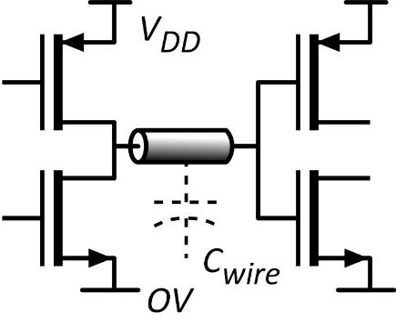
What does VLSI need ?
Small transistors: plentiful, cheap
Small transistors→ short wires
small delay CV_{DD} /I
low switching energy CV_{DD}²/2
I_{on}
Large on-currents
small delay CV_{DD} /I
Low supply voltages
low energy CV_{DD}²/2
Low leakage current
thermal: I_{off} > I_{on}*exp(-qV_{DD}/kT)
want low V_{DD} yet low I_{off}.

Slide 3
Transistor Research
Make the switch smaller (scaling)
Make it from different materials
Change its shape
Change its internal operation:
bandgap engineering
Change what we do with it.

Slide 4
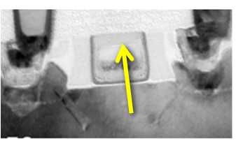
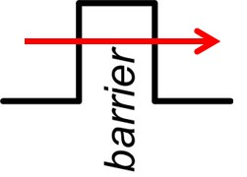
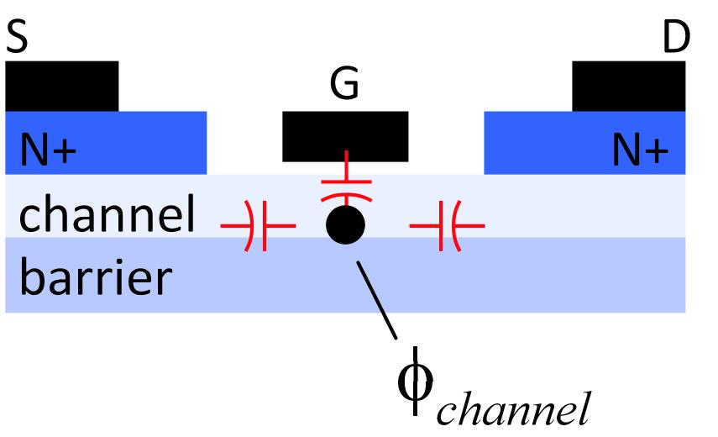
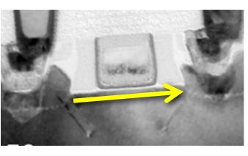
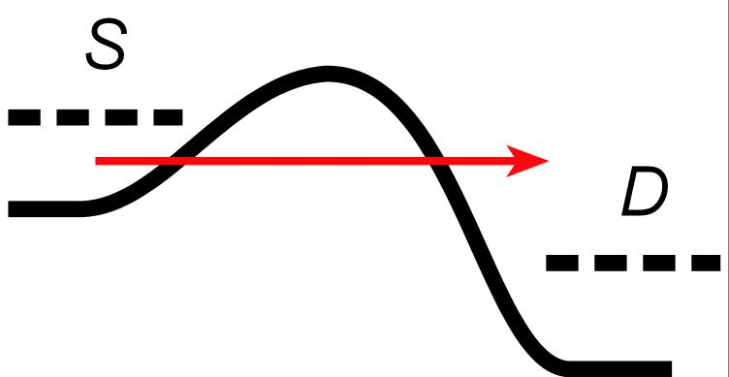
We can't make MOSFETs much smaller
Tunneling: can't make gate insulator any thinner
→ smaller devices have poor electrostatic control, don't turn off
Tunneling: can't make channel much shorter
→ smaller devices have high source-drain tunneling, don't turn off
Expensive lithography: EUV, multiple patterning

Slide 5
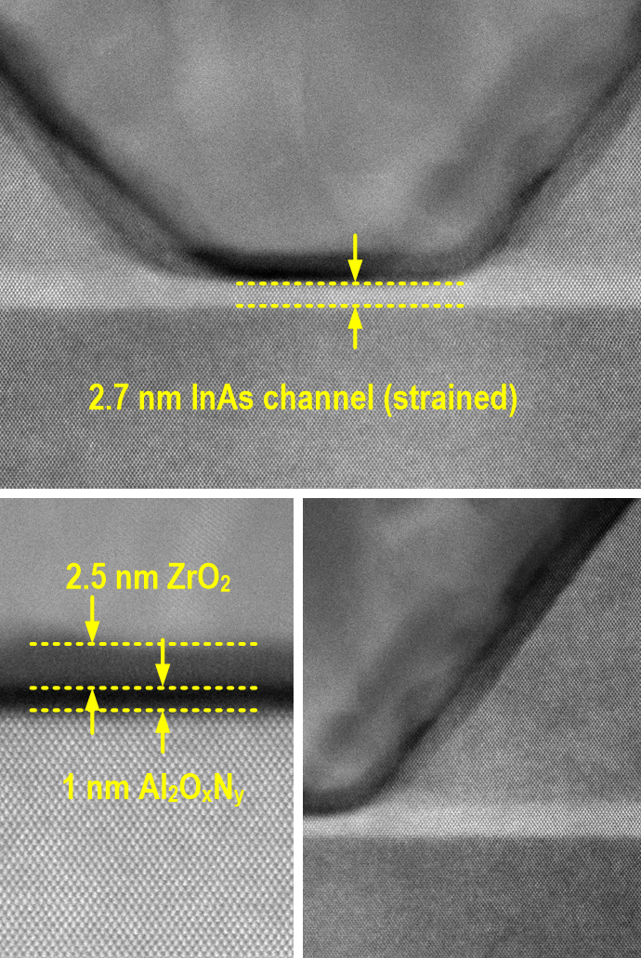
New Materials: III-V semiconductors ?
S. Lee et al., VLSI Symp. 2014
L_{g}~25 nm
record for III-V
N+ S/D
Vertical Spacer
= best UTB SOI silicon

Slide 6
New Materials: 2-D semiconductors ?
Does 1-atom-thick channel help ?
2D or 3D: the gate oxide won't scale
the oxide sets a minimum gate length
1-atom-thick channels don't help much
Silicon
If oxides won't scale, we must make fins
with 2D, can we make fins ?
later, will need to make nanowires...
MoS₂
Ballistic drive currents don't win either
high m*, and/or high DOS
mobility sufficient for ballistic ?
Phosphorene

Slide 7
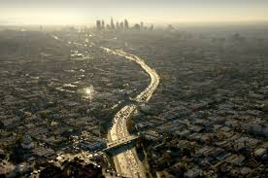
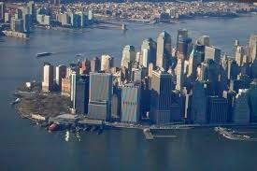

When it gets crowded, build vertically
Los Angeles: sprawl
Manhattan: dense
2-D integration:
wire length # gates^{1/2}
3-D integration:
wire length #gates^{1/3}
LA is interconnect-limited
1) Chip stacking (skip)
2) 3D transistors: corrugation (change the shape)

Slide 8
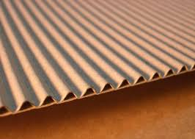
Corrugated surface→ more surface per die area

Slide 9
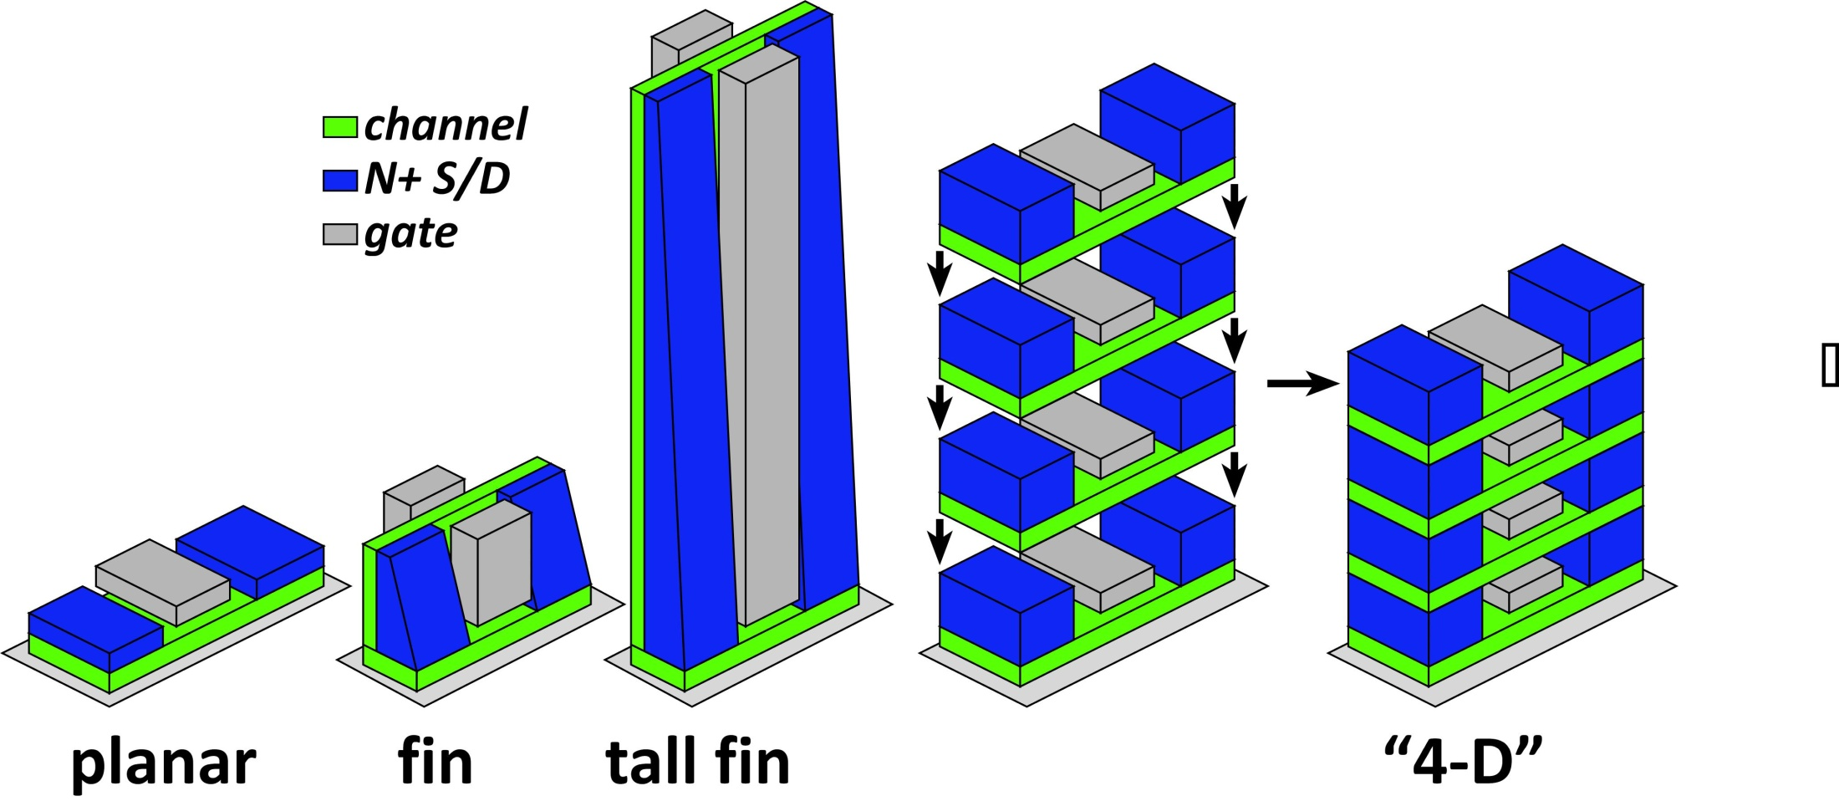
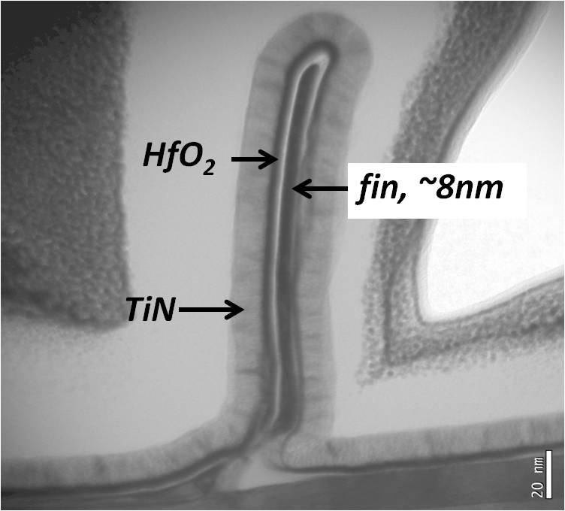
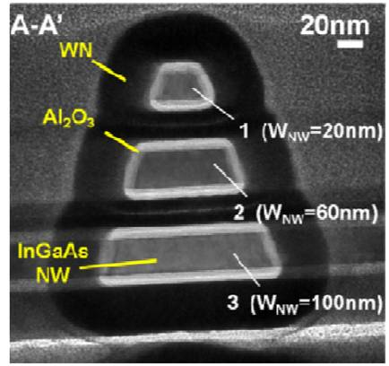
Corrugated surface→ more current per unit area
Cohen-Elias et al.,
UCSB
2013 DRC
J .J. Gu et al., 2012 DRC,
Purdue
2012 IEDM

Slide 10
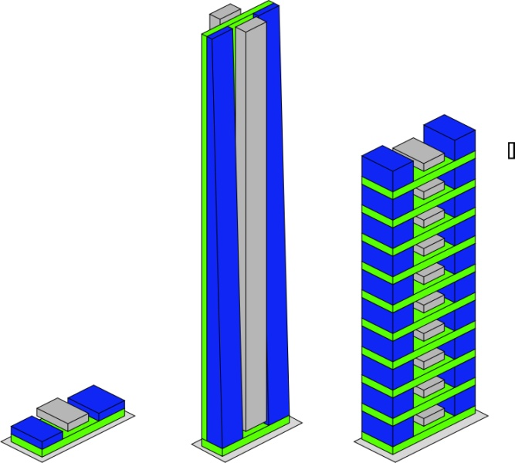
Corrugation: same current, less voltage, less CV²

Slide 11
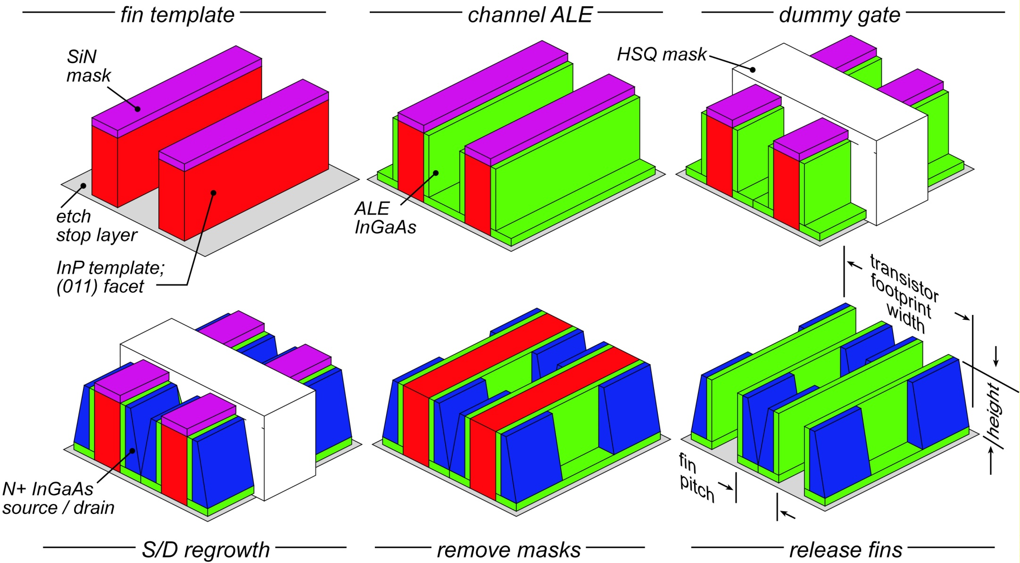
Forming tall fins by sidewall regrowth (ugly)
Cohen-Elias et al.,
2013 DRC

Slide 12
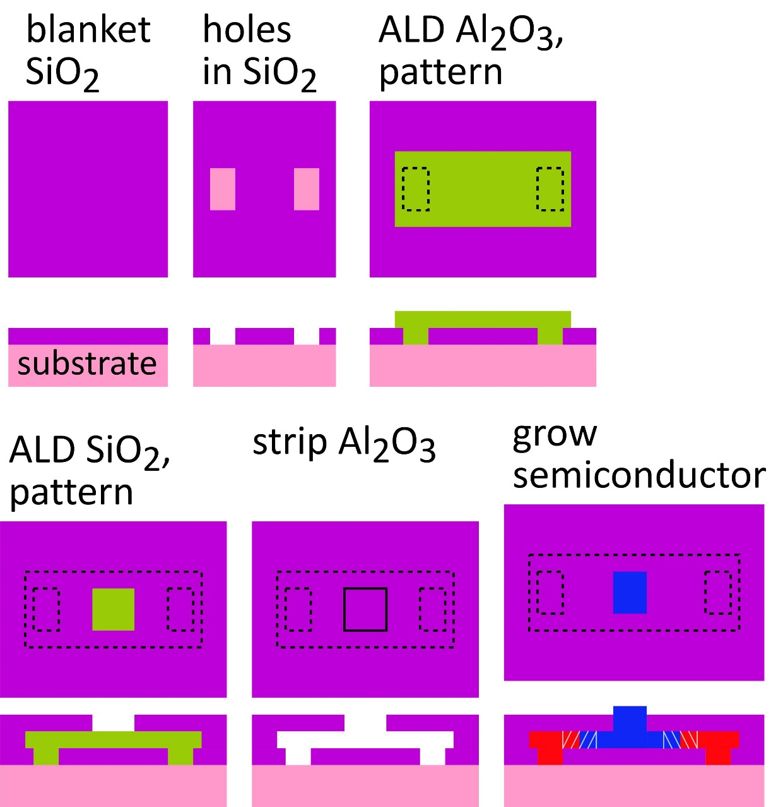
Confined Epitaxial Lateral Overgrowth
L. Czornomaz et. al, (IBM)
2015 & 2016 VLSI Symposia
Semiconductor regrowth into hollow glass boxes formed on wafer surface
Semiconductor thicknesses controlled by ALD layer thickness: atomic precision

Slide 13
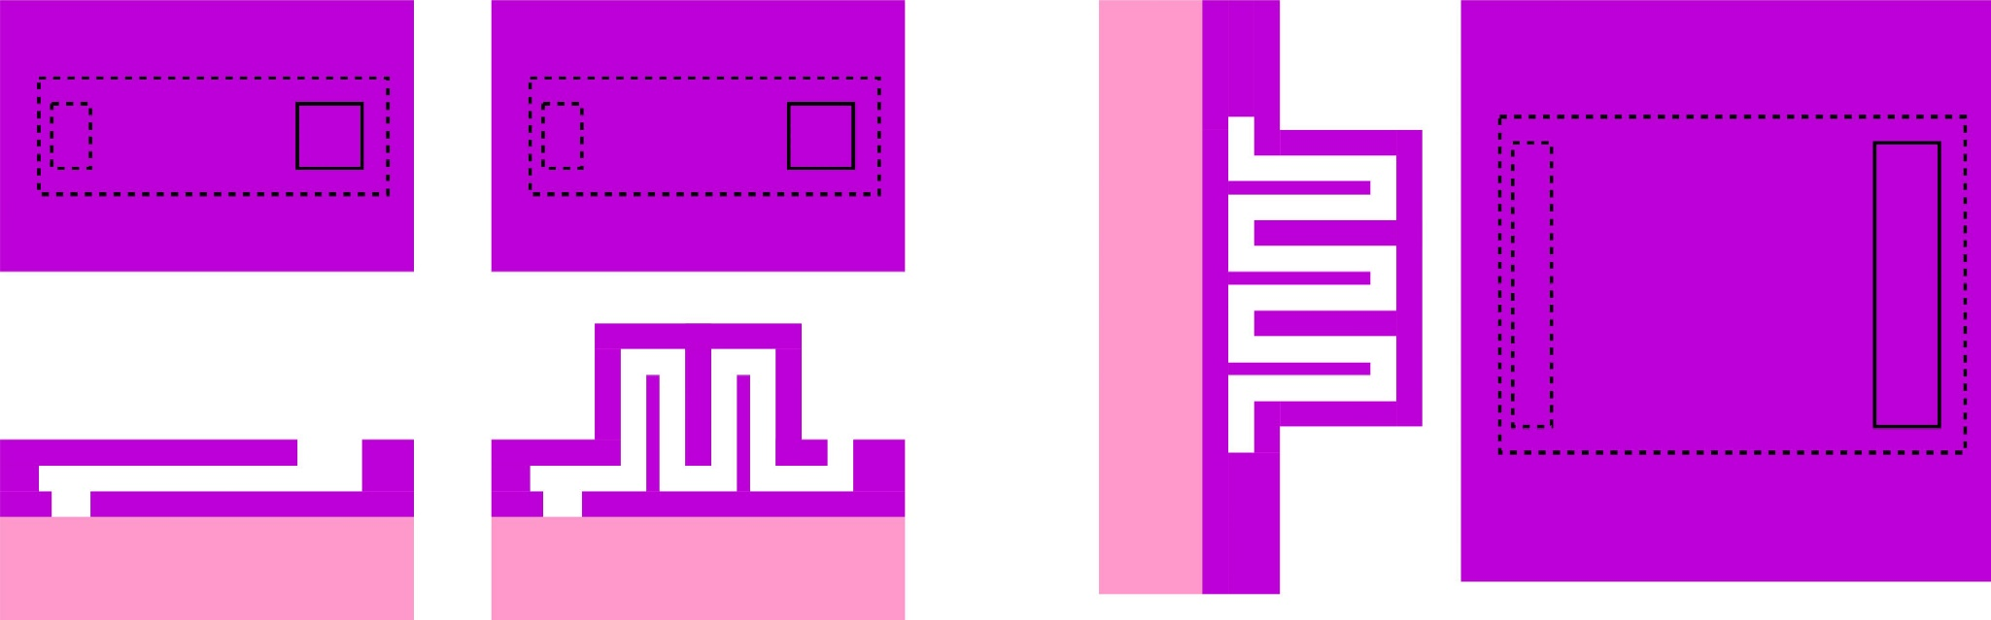
CELO: Can we grow 3-D structures ?
With a few process tricks,
can we make growth templates for 3-D structures ?

Slide 14
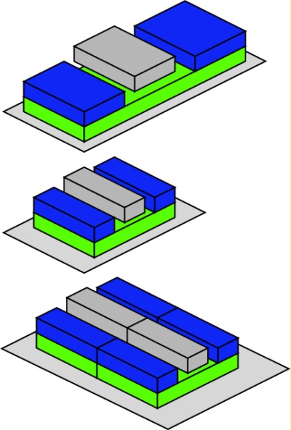
Fixing source-drain tunneling by increasing mass ?
Source-drain tunneling leakage:
Fix by increasing effective mass ?
This will decrease the on-current:
(also increases transit time)
long gate→ big
shorter gate→ smaller
?
less current
!
wider→ more current
big again !

Slide 15
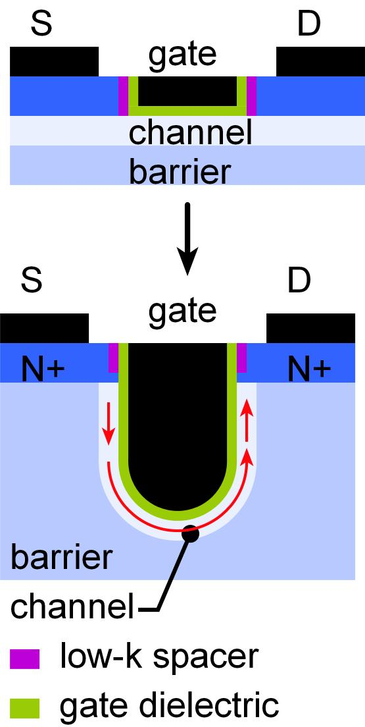
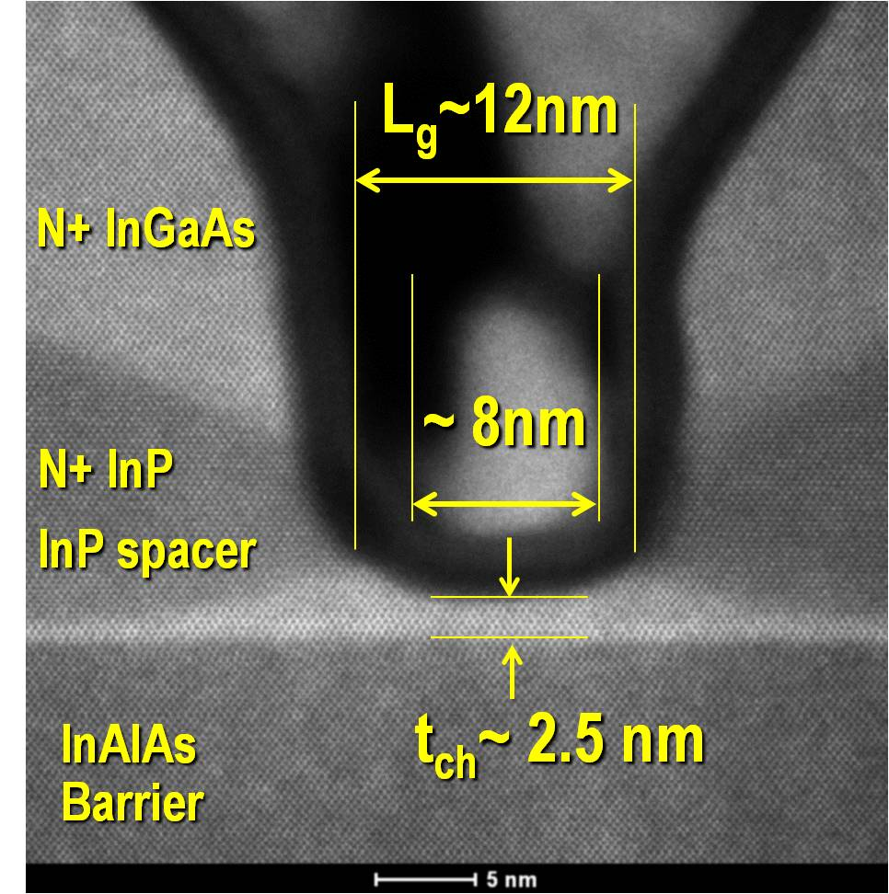
Fixing source-drain tunneling by corrugation
CY Huang et al, 2015 DRC
Transport distance > gate footprint length
Only small capacitance increase

Slide 16
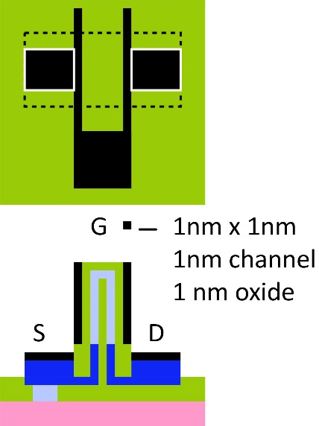
Fixing source-drain tunneling by corrugation ?
CELO growth over ridge
3D structure
transport length >> footprint
improves electrostatics
...like finFET
improves S/D tunneling
...unlike finFET
Gate oxide is SiO_{x}N_{y} , not HfO₂ → thinner @ given leakage
How to reduce gate footprint below ~5nm ?

Slide 17
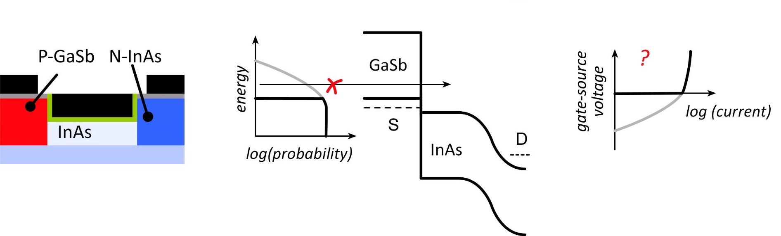
Changing the band structure: tunnel FETs
TFET: bandgap of p-type source truncates source thermal distribution:
Problem: 4-6nm tunnel barriers→ ~3% tunneling probability→ very low current.

Slide 18
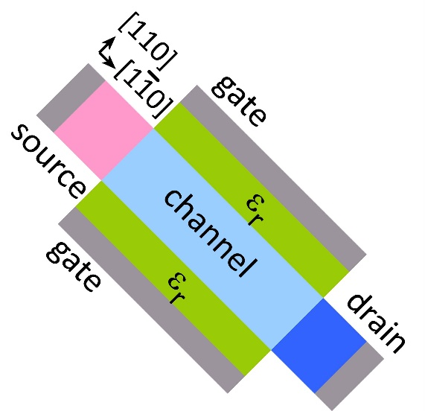
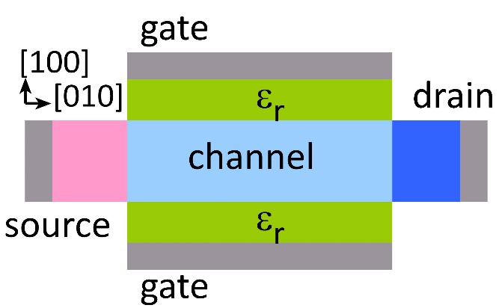
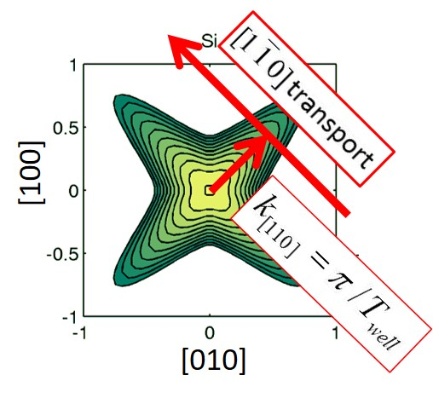
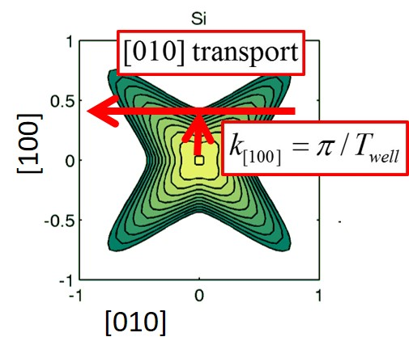
[110] gives more on-current than [100]
P. Long et al., EDL 3/2016
valence band
high confinement mass
low transport mass
low confinement mass
high transport mass

Slide 19
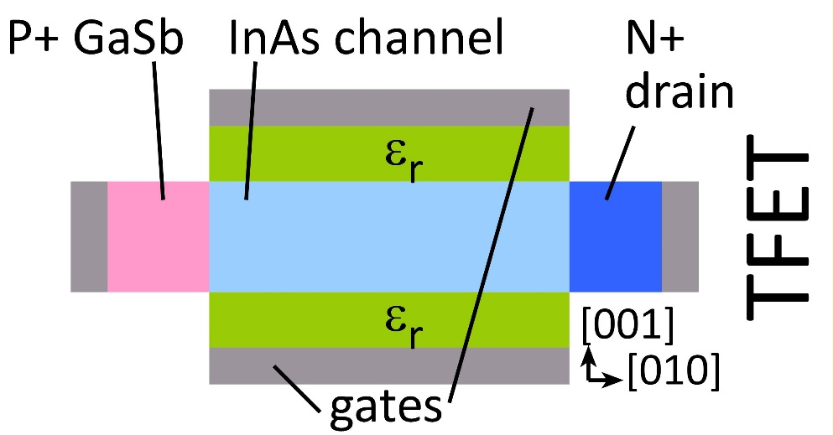
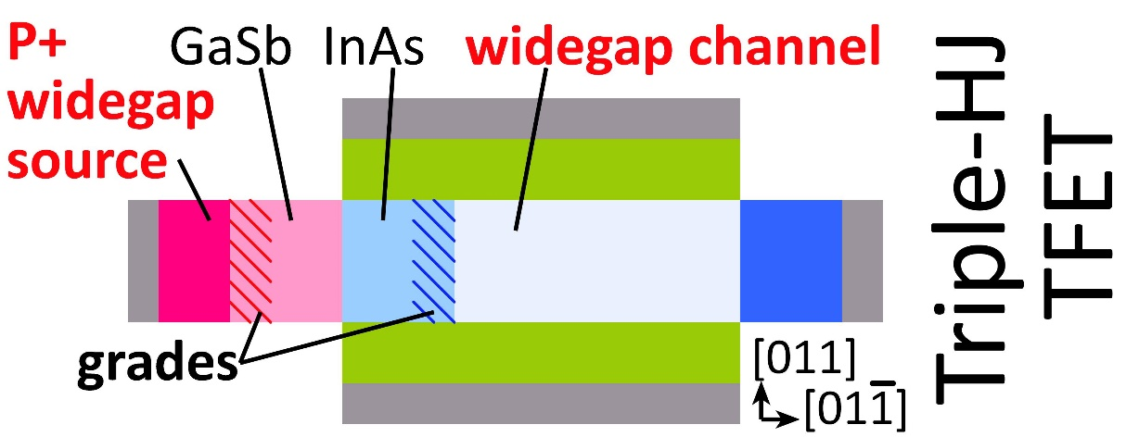
Add more Heterojunctions: much more current.
Source HJ: S. Brocard, et al., EDL, 2/2014; Channel HJ: P. Long et al., EDL 3/2016
Added heterojunctions→ greater built-in potential→greater field→ thinner barrier
→ higher tunneling probability (~80%)→ 30:1 more current.

Slide 20
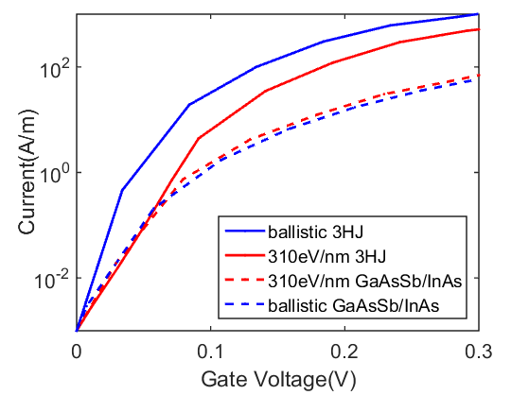
3HJ still have higher ON/OFF ratio than GaAsSb/InAs
3HJ 516A/m
GaAsSb/InAs 75A/m
P. Long, J. Huang,
M. Povolotski: Purdue, Unpublished
3HJ still have higher ON/OFF ratio than GaAsSb/InAs when acoustic and non-polar optical phonon scattering are considered.

Slide 21
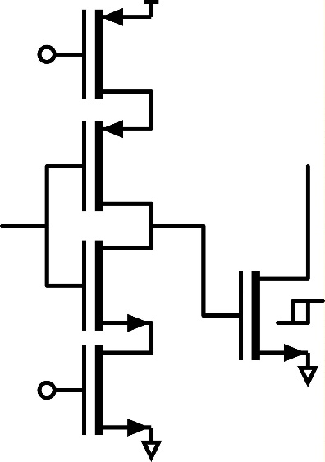
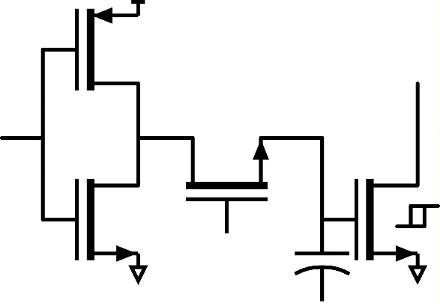
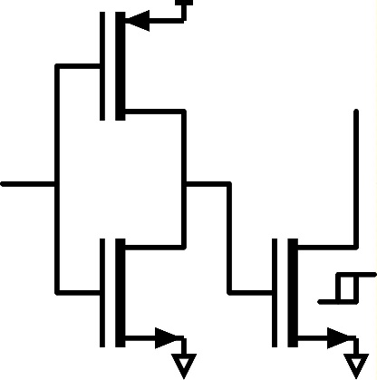
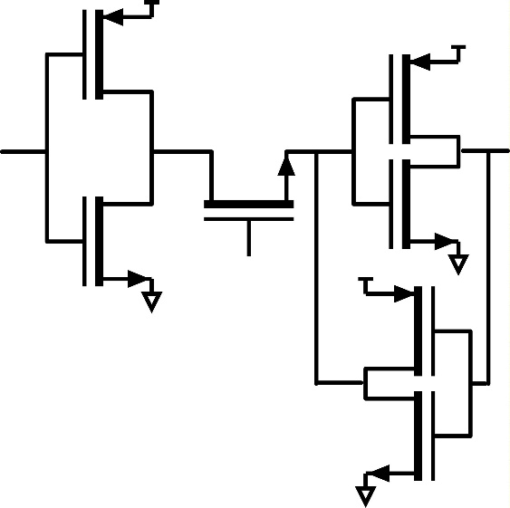
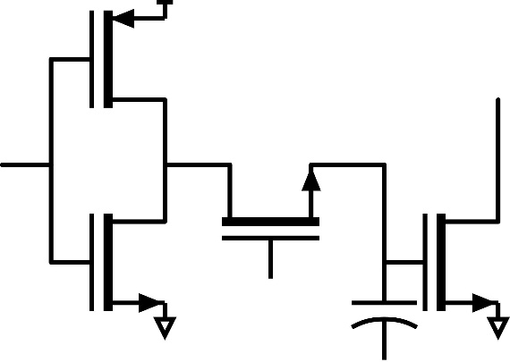
Changing the function: ferroFETs ?
This won't work
need tri-state driver
or an input switch.
why not this ?
or this ?

Slide 22
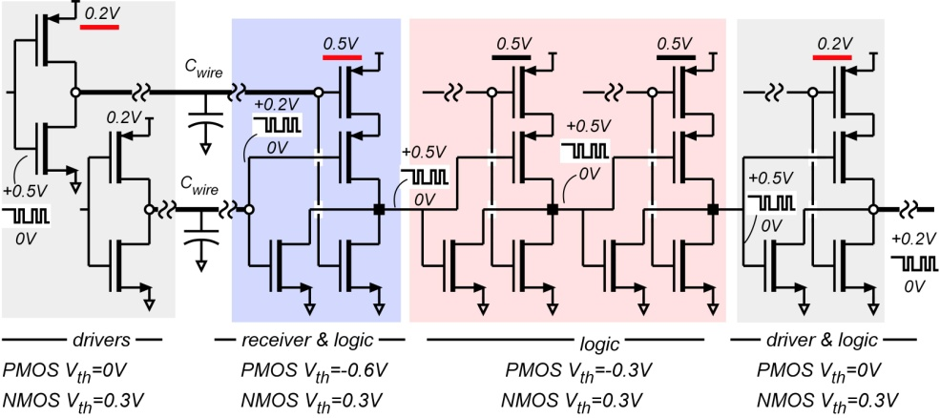
Multiple Supplies for Low-Power Logic
Given 200 mV swings
on long interconnects,
Line receivers provide
0.1 mA/μm output
with 0.1 μA/μm leakage
Line drivers, and logic gates provide
3 mA/μm output
with 0.1 μA/μm leakage
Is cost in added die area acceptable ?

Slide 23
(backup slides follow)

Slide 24
Record III-V MOS
S. Lee et al., VLSI 2014
L_{g}~25 nm
record
for III-V
N+ S/D
= best UTB SOI silicon
Vertical Spacer

Slide 25
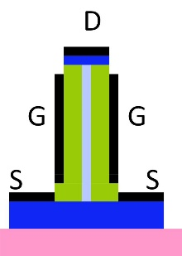
Vertical FETs ????
Can have a smaller footprint.
No clue how to make it !
III-V nanowire growth: much too big

Slide 26
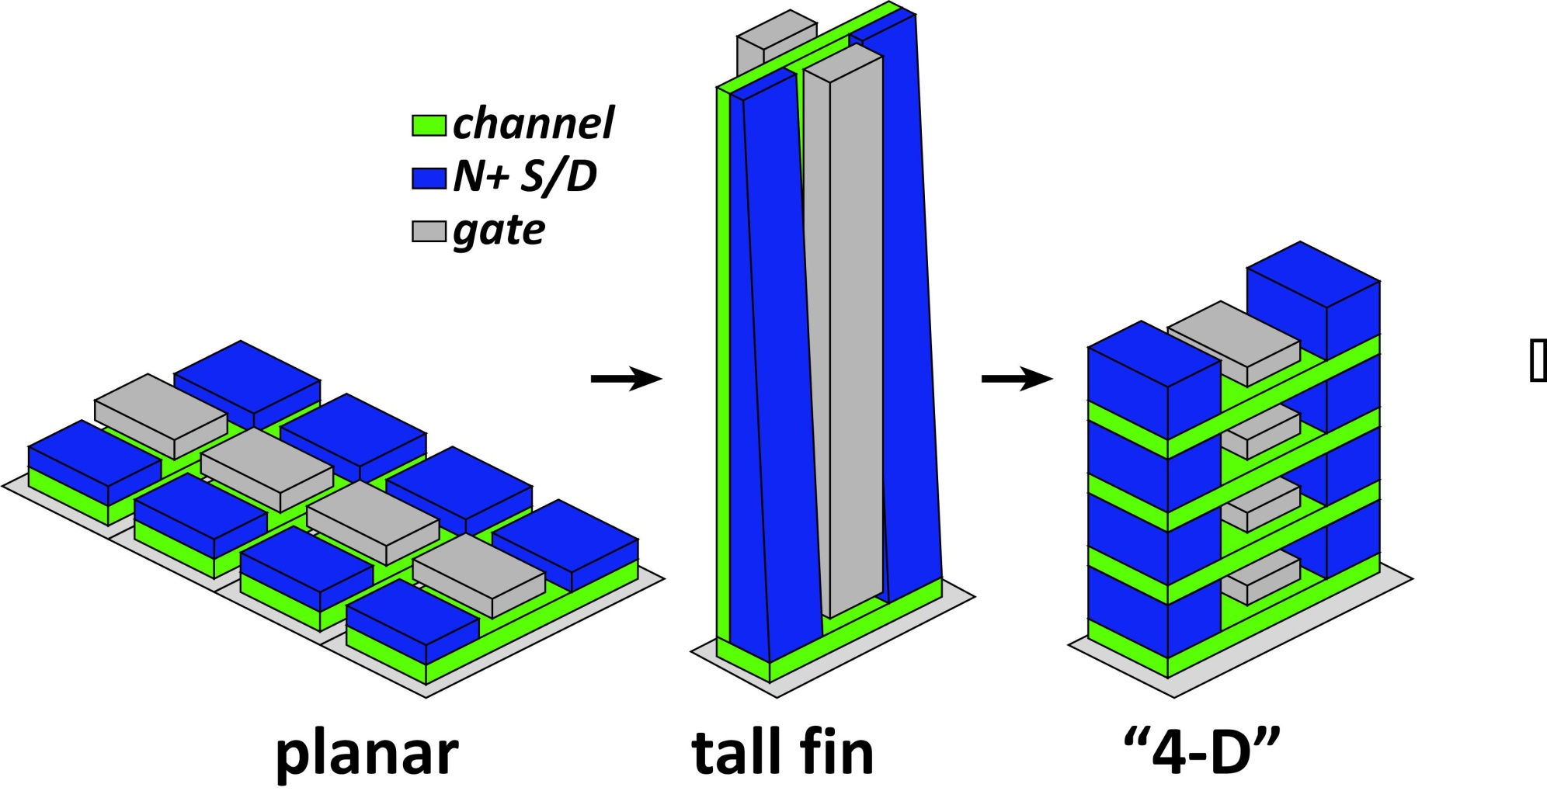
3D→shorter wires→less capacitance→less CV²
All three have same drive current, same gate width
Tall fin, "4-D": smaller footprint→ shorter wires

Slide 27
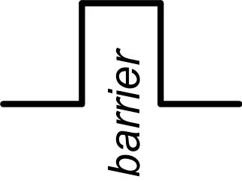
Minimum Dielectric Thickness & Gate Leakage
Thin dielectrics are leaky
High-ε_{r} materials have lower barriers
→ 0.5-0.7nm minimum EOT
constrains on-current
electrostatics degrades with scaling
→ fins, nanowires

Slide 28
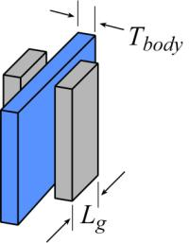
Quick check: scaling limits
NEMO ballistic simulations
finFET: 5 nm physical gate length.
Channel: <100> Si, 0.5, 1, or 2nm thick dielectric: ε_{r}=12.7, 0.5 or 0.7 nm EOT
simulation
Given EOT limits, ~1.5-2nm body is acceptable.
Source-drain tunneling often dominates leakage.
Notes:
N+ S/D: 5*10¹²/cm²

Slide 29
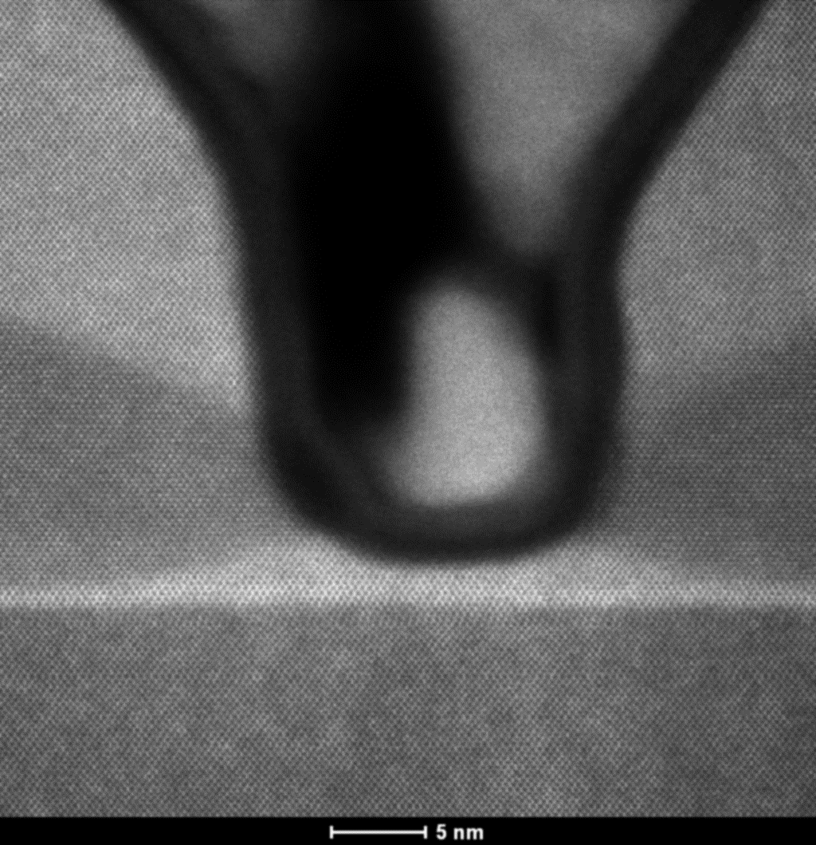
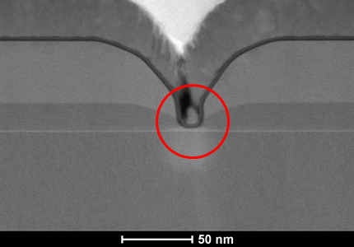
TEM images of L_{g}~12 nm devices
L_{g}~12nm
N+InGaAs
~ 8nm
Cross-setion
N+InP
Ni
InP spacer
Top View
InAlAs
Barrier
t_{ch}~ 2.5 nm
(1.5/1 nm InGaAs/InAs)
29

Slide 30
I_{D}-V_{G} and I_{D}-V_{D} curves of 12nm L_{g} FETs
L_{g}-12nm
I_{off}~1.3 nA/μm
I_{on}~1.1 mA/μm
I_{on}/I_{off} > 8.3∙10⁵
30

Slide 31
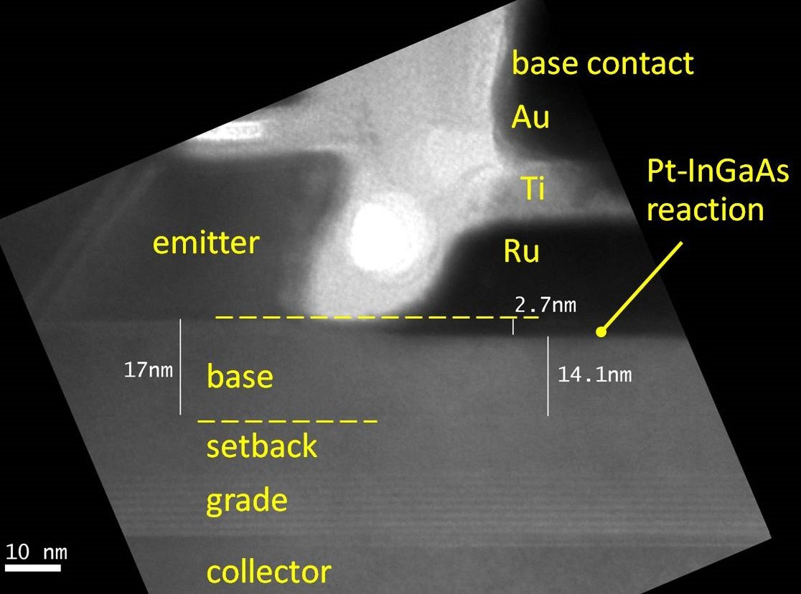
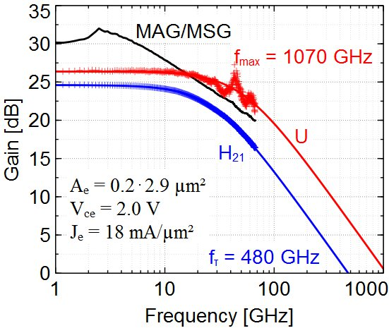
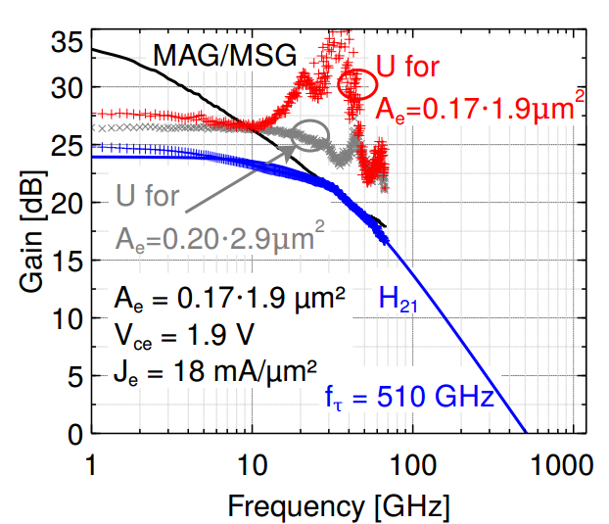
InP HBTs: 1.07 THz @200nm, ?? @ 130nm
?
Rode et al., IEEE TED, Aug. 2015

Slide 32


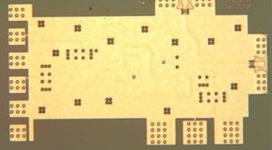
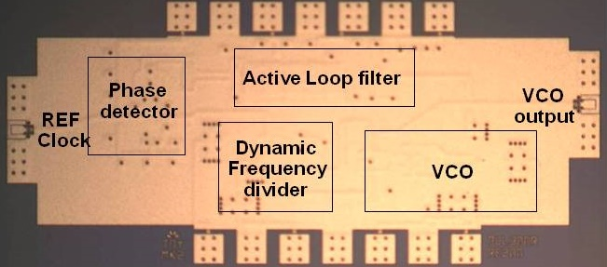
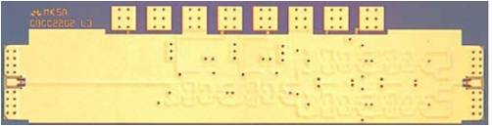

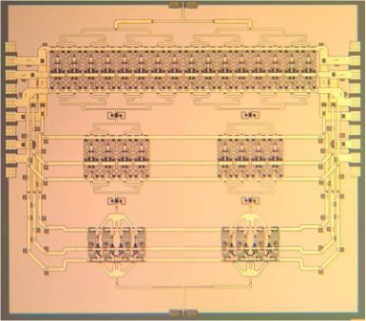
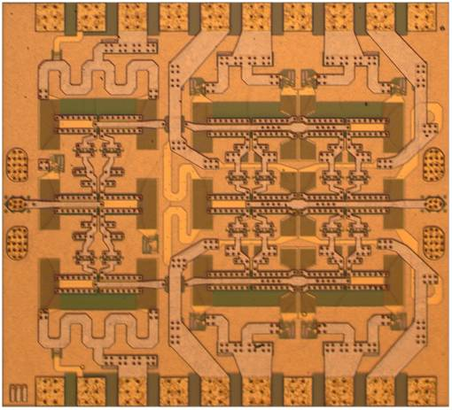
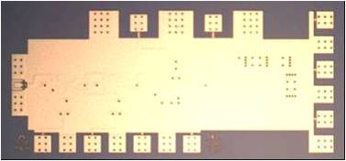

130nm /1.1 THz InP HBT: ICs to 670 GHz
614 GHz
fundamental
VCO
340 GHz dynamic frequency divider
M. Seo, TSC / UCSB
M. Seo, UCSB/TSC
IMS 2010
300 GHz fundamental
PLL
620 GHz, 20 dB gain amplifier
M Seo, TSC
IMS 2013
also: 670GHz amplifier
J. Hacker , TSC
IMS 2013 (not shown)
M. Seo, TSC
IMS 2011
204 GHz static
frequency divider
(ECL master-slave
latch)
220 GHz
180 mW
power amplifier
81 GHz
470 mW
power amplifier
Z. Griffith, TSC
CSIC 2010
T. Reed, UCSB
CSICS 2013
H-C Park UCSB
IMS 2014
Integrated 300/350GHz Receivers:
LNA/Mixer/VCO
600 GHz
Integrated
Transmitter
PLL + Mixer
M. Seo TSC
M. Seo TSC

