Slide 1


(Paper 15.3)
  A 140 GHz MIMO Transceiver in
  45 nm SOI CMOS
  Arda Simsek¹, Seong-Kyun Kim², and Mark J. W. Rodwell¹
¹University of California, Santa Barbara, USA
²Teledyne Scientific and Imaging, USA
Notes:
The slide guide is meant to be used with PowerPoint.

Slide 2
Acknowledgements
Contact support: NSF Giganets program.
IC Fabrication: Global Foundries. 45nm SOI
Notes:
Please follow the allowed time so the program runs on schedule

Slide 3
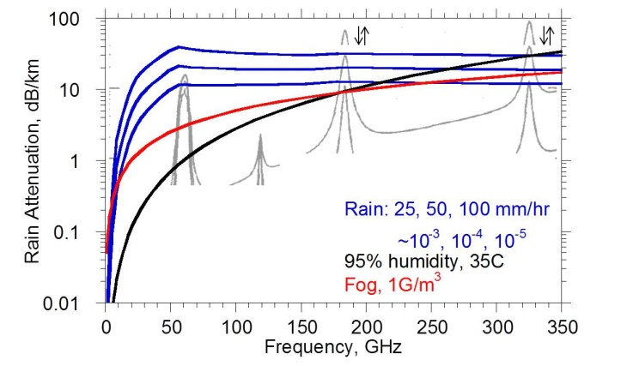
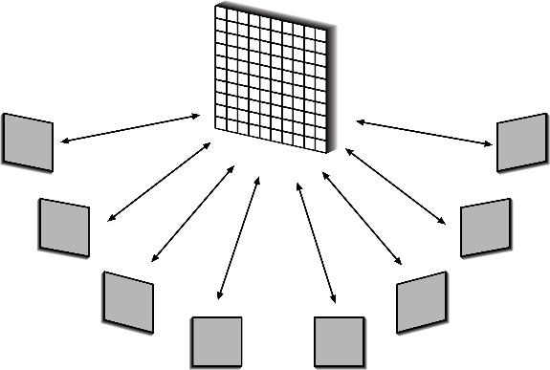
Motivation
Large available spectrum at mm-waves
Shorter wavelength – small IC, antenna arrays
Massive # of parallel channels – multiple independent beams
Notes:
Please follow the allowed time so the program runs on schedule

Slide 4
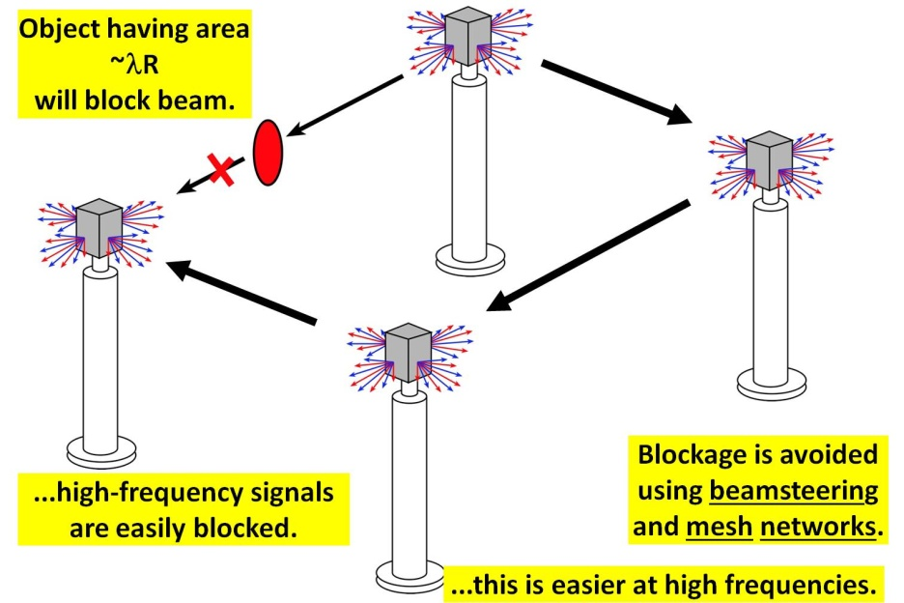
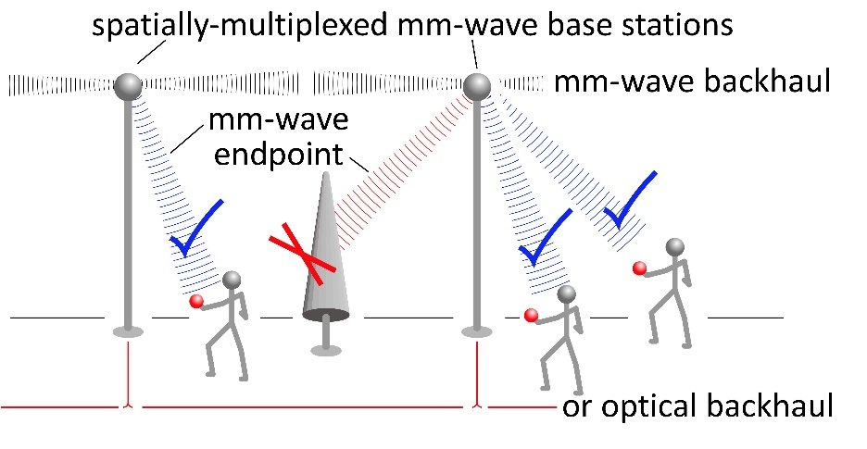
Applications and Challenges
High capacity mobile communications
Problems: Solutions:
High attenuation Phased arrays
High blockage Mesh networks & beam steering
Notes:
Please follow the allowed time so the program runs on schedule

Slide 5
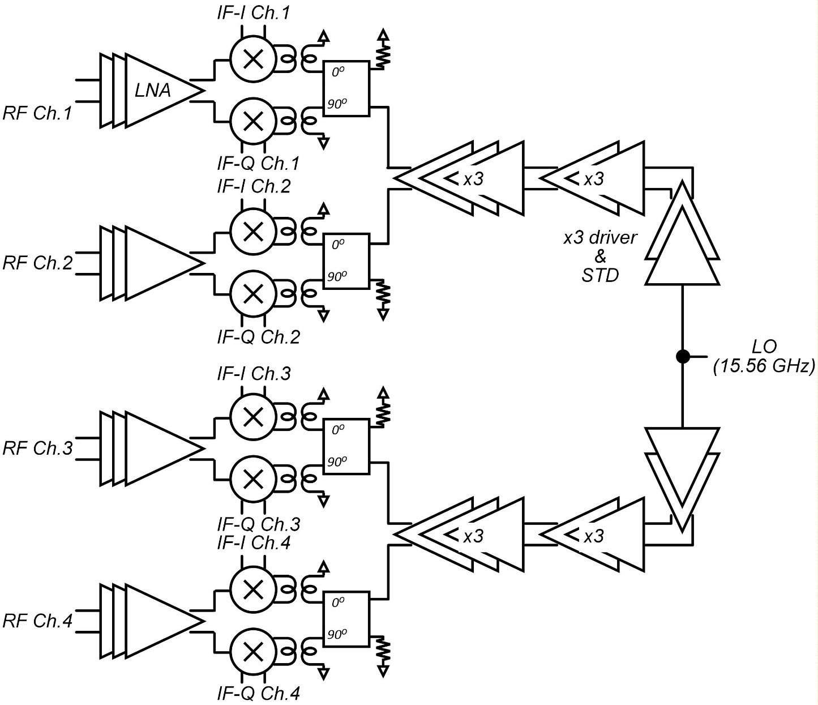
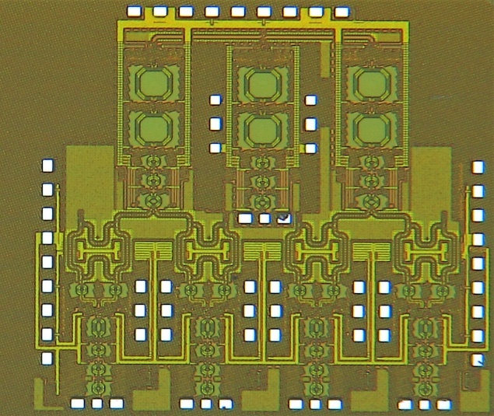
4-Channel MIMO Receiver
Direct conversion receiver
140 GHz LNA, double balanced passive mixer
LO distribution through two x9 multipliers from common LO port
1.69 mm x 1.76 mm

Slide 6
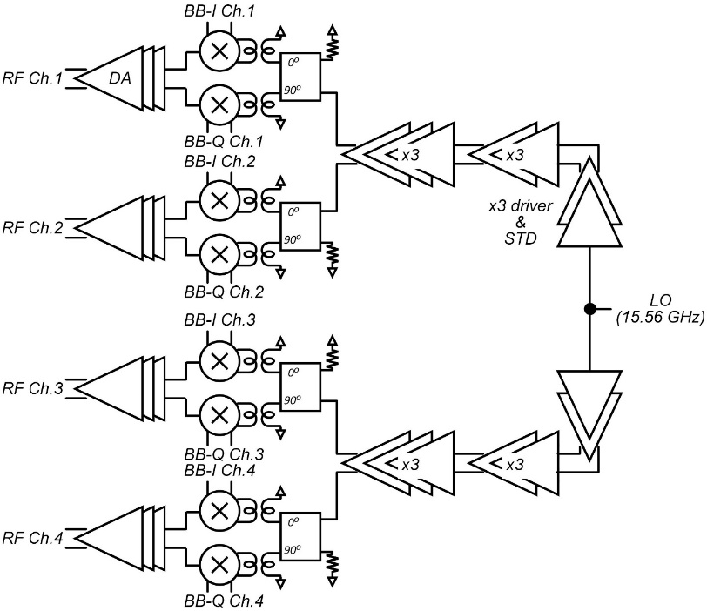
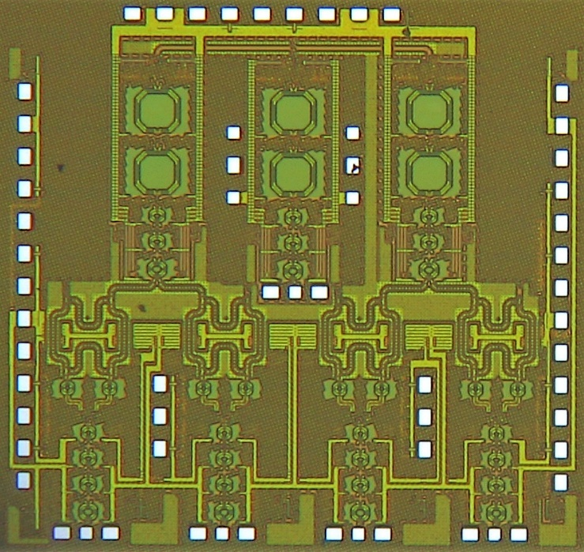
4-Channel MIMO Transmitter
Direct conversion transmitter
140 GHz PA (same with LNA), I/Q Gilbert Cell Active Mixer
LO distribution thru two x9 multiplier from common LO port
1.67 mm x 1.76 mm

Slide 7
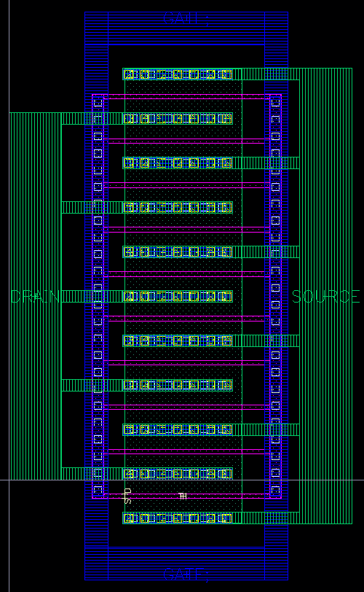
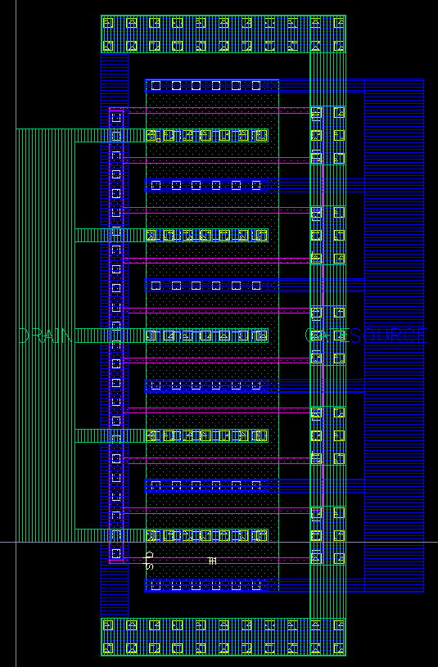
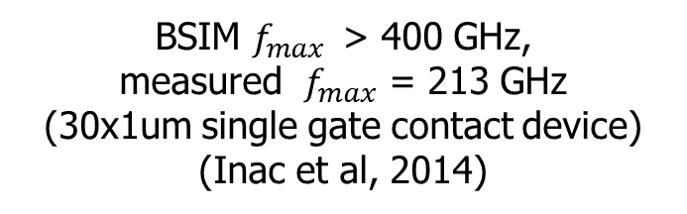
Design Details – Transistor Modeling
45 nm CMOS SOI
Gate
Drain (M2)
Drain (M2)
Source (M1)
Source (M2)
Gate (M2)
Gate
Gate
Series Gate Feeding
Parallel Gate Feeding
Similar performances (MSG, NF)
SGF is hard to extract the gate inductance
PGF - Source can directly connect to ground
BSIM $f_{max}$> 400 GHz,
measured $f_{max}$ = 213 GHz
(30x1um single gate contact device) (Inac et al, 2014)

Slide 8
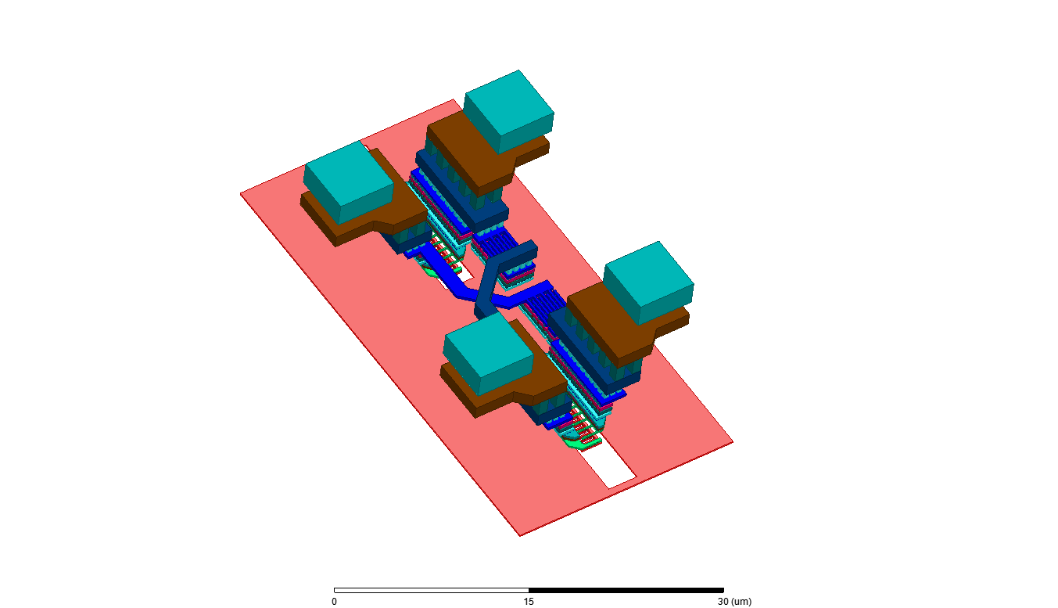
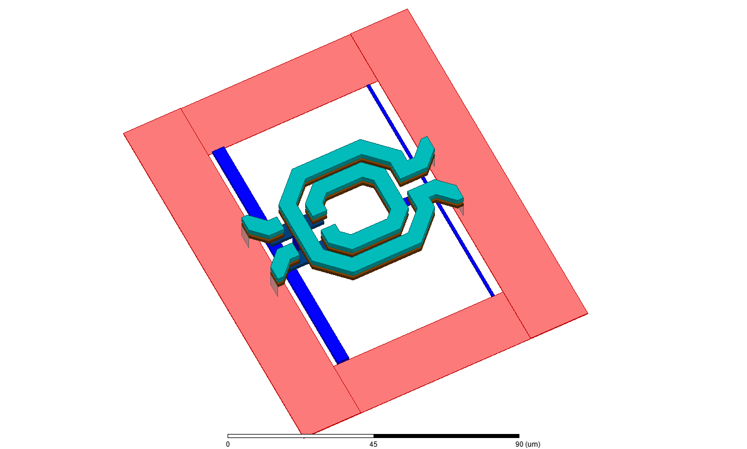
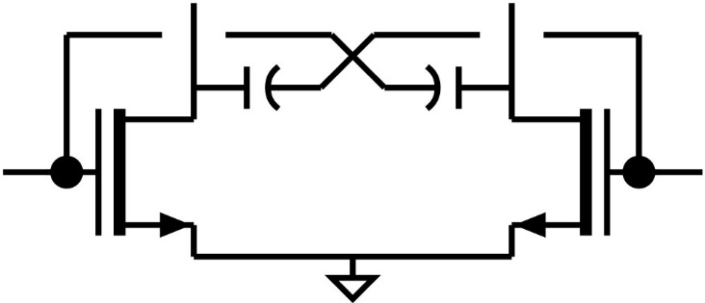
Design Details – Transistor and Matching Modeling
45 nm CMOS SOI
M1 ground plane
UB-LB
Cgd cancellation
: MOM Cap
Gate bias: M2
VDD: M2-M3-C1-C2
M1 ground plane
BSIM + PEX + EM simulation
(BSIM & PEX from the foundry, HFSS for EM)
C_{gd} cancellation – better isolation & gain

Slide 9
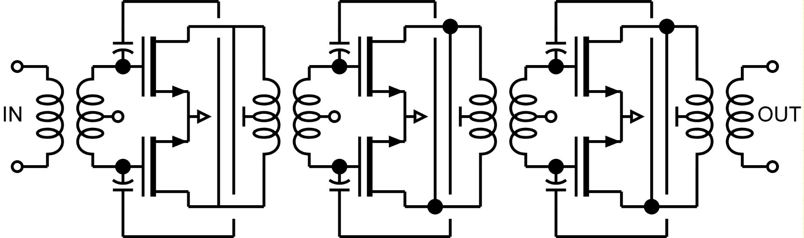
Design Details – Low Noise Amplifier (LNA)
315 x 170 um² without pads
~ 415 x 370 um² with pads
3-stage differential CS amplifier
C_{gd} cancellation
Transformers for matching networks and sing.-to-diff.

Slide 10
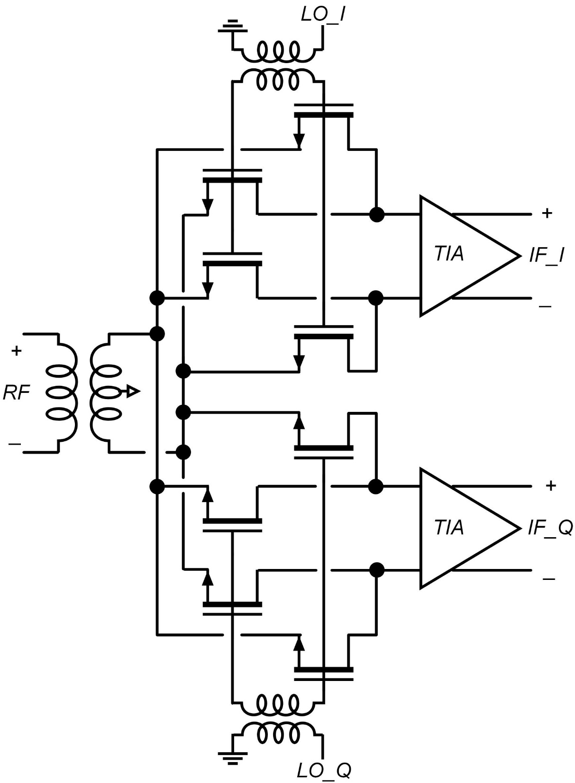
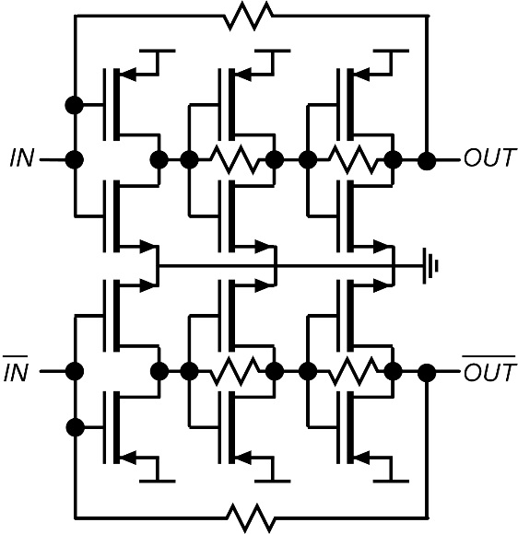
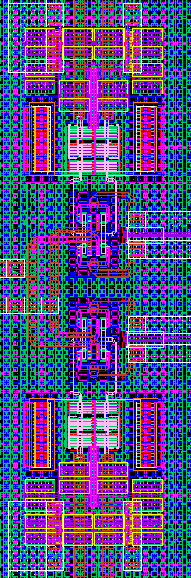
Design Details – Down-conversion Mixer
TIA
LO_I
RF
LO_Q
Double balanced passive mixer
Better linearity and low flicker noise
Pseudo-differential TIA
Total width of each transistor (TIA) = 30 µm

Slide 11
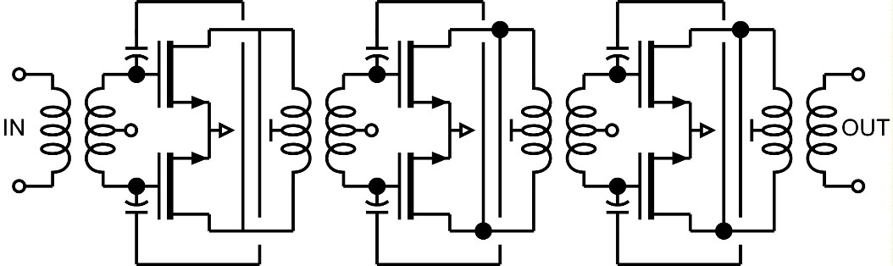
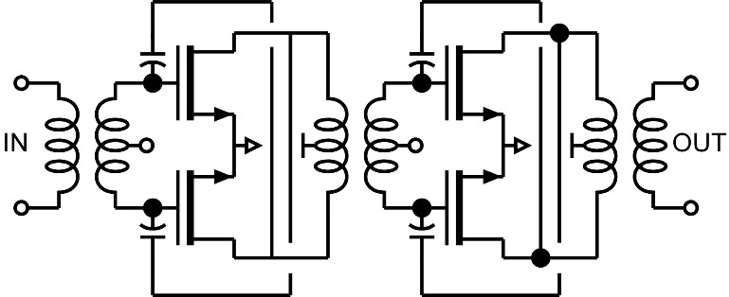
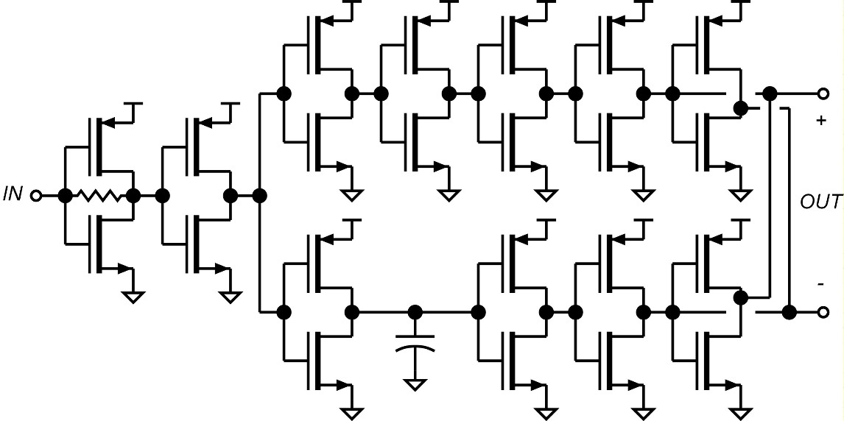
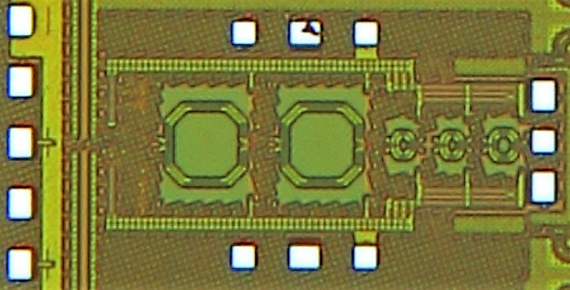
Design Details – x9 Multiplier
X3 (140 GHz)
X3 (47 GHz)
Inverter based single-to-differential conversion & 3rd harmonic generation
47 GHz and 140 GHz triplers use similar topology with LNA
80 mA @ 1V
LO Input stage

Slide 12
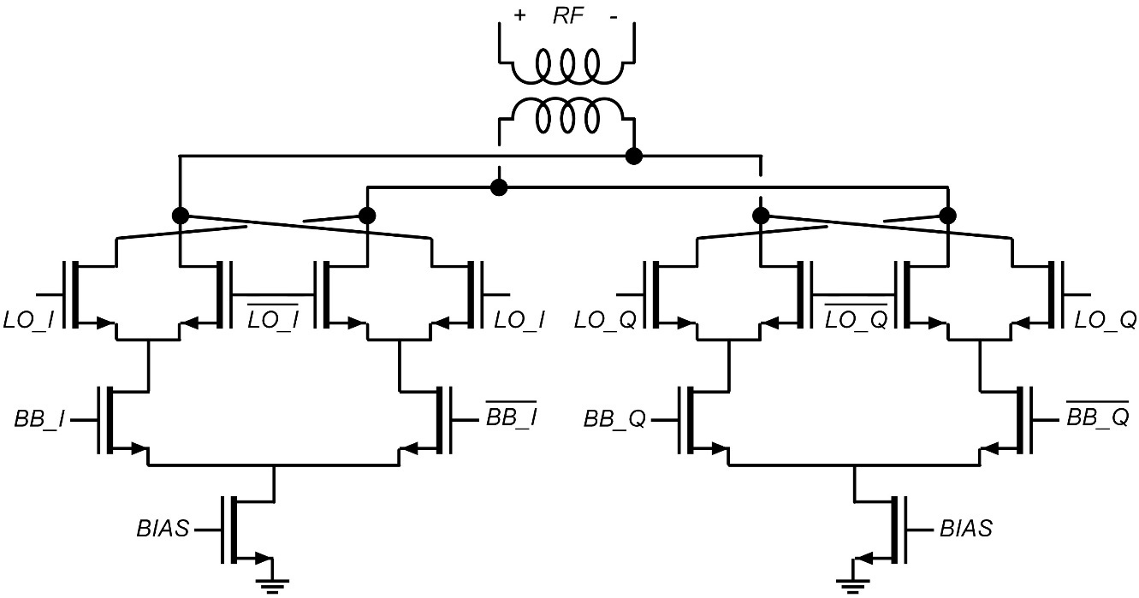
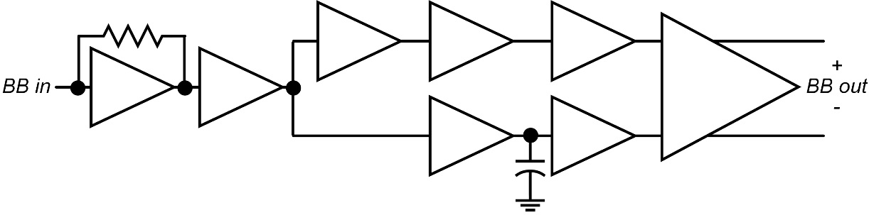
Design Details – Up-conversion Mixer / DA
Active double balanced Gilbert cell design
Lower conversion loss
Digital baseband inputs - Limited to QPSK
DA is same with LNA
IQ modulator
BB input stage
Output power: 5 dBm
P1dB = 4.3 dBm

Slide 13
Measurements – Circuit Blocks
LNA
x9 LO Multiplier
41 mA @ 1V
Peak Gain = 19.9 dB @ 145 GHz
3-dB BW = 10GHz
98 mA @ 1V
Peak output power = 1.5 dBm
@ 148 GHz

Slide 14
Measurements – Receiver Channel
18 dB conversion gain
12 GHz 3-dB BW
Narrow-band notch in RF response - limits the data rate
163 mA + 109 mA + 223 mA = 495 mA @ 1V

Slide 15
Measurements – Transmitter Channel
LO-BB
LO+BB
LO
3-dB modulation bandwidth ~ 6 - 8 GHz
Total transmitter output power: -2 dBm with 1 V supply,
3 dBm with 1.2 V supply @ 145 GHz
161 mA + 94 mA + 208 mA = 463 mA @ 1V

Slide 16
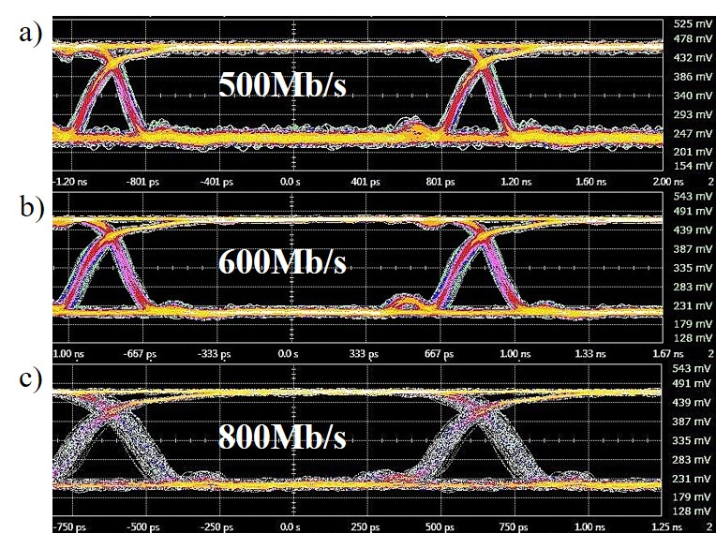
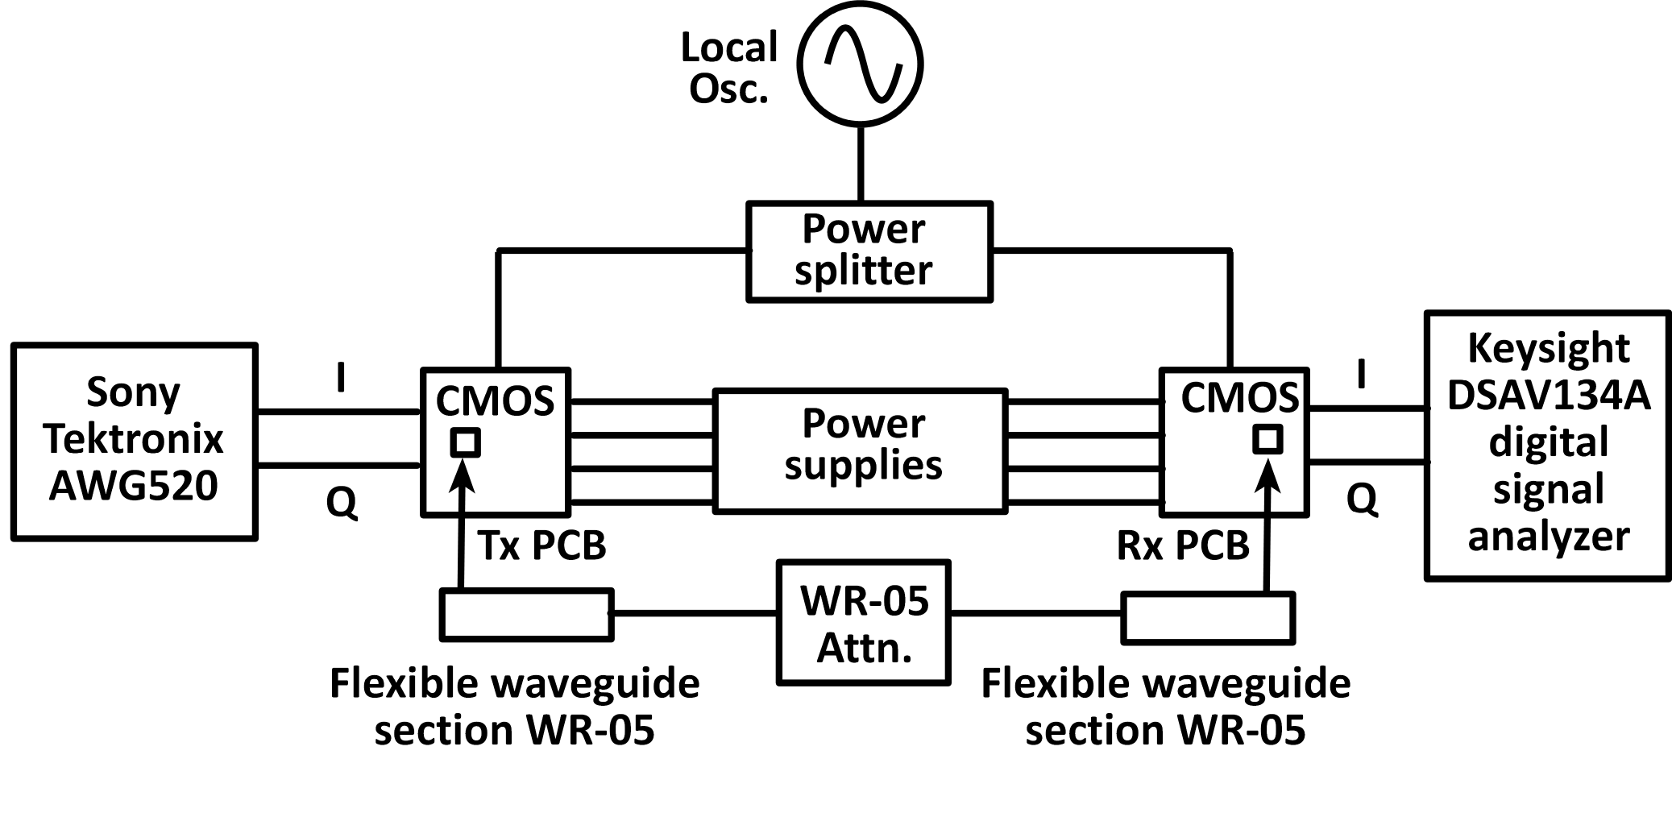
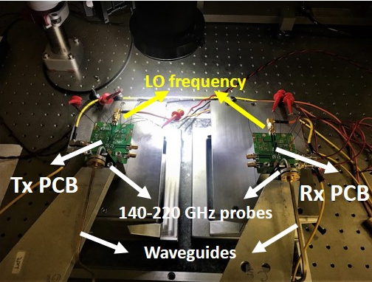
Measurements – Link Experiment
Measurement Setup
Wired link: G-band (140-220 GHz) waveguide probes, ~1 meter waveguide connection and a waveguide attenuator (20 dB)
common 16.6 GHz LO subharmonic drive signal
mm-wave carrier is at 16.6 x 9 = 149.4 GHz

Slide 17
State of the Art Transceivers
 | UC Berkeley (2014) | Tel Aviv Uni. (2016) | UCSD (2014) | Chalmers Uni. (2016) | This Work (UCSB)
Technology | 65nm CMOS | 28nm CMOS | 45nm CMOS | 250nm InP DHBT | 45nm CMOS
Freq. [GHz] | 240 | 102-128 | 155 | 110-170 | 140
Gain [dB] | 25 | 36-39 | 23 | 26 | 18
NF [dB] | 15# | 8.4-10.4 | 20* | 9.5 | 5.5*
Pdc [mW] | 260 (1 TRx) | 51 (1 Rx) | 345 (1 TRx) | 357 (1 TRx) | 958 (4 TRx)
Area [mm²] | 2 (1 TRx) | 0.89 (1 Rx) | 3.92 (1 TRx) | 3.64 (1 TRx) | 5.91 (4 TRx)
Integration | Full | Rx Front End | Tx/Rx | Tx/Rx | Tx/Rx
*: simulated
#: calculated from measurerements

Slide 18
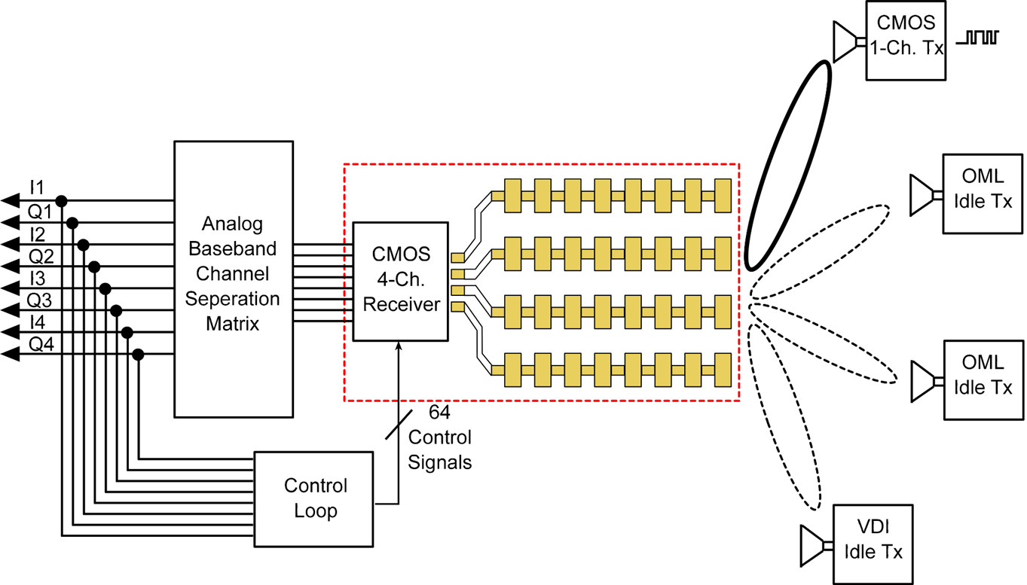
Conclusion and Future Work
A 140 GHz QPSK transceiver front-end
with four channels per IC to support MIMO
One channel transceiver measurements
Initial link experiment results up to 800 Mb/s
Work in Progress
Wireless link measurements
with higher data rate
Antenna and package designs
4-channel MIMO receiver hub experiment.
Baseband
Processing
Packaged 4-channel Rx

Slide 19
Backup Slides

Slide 20
LNA Measurements
Simulation vs Measurements (trap-rich)
Substrate: High (trap-rich) vs Low resistivity
3-dB bandwidth: 11 GHz (138 – 149 GHz)
Power consumption: Trap-rich 42.4 mW @ 1 V
Low-res. 41.7 mW @ 1 V

Slide 21
LNA Linearity Simulations
IIP3: -5.84 dBm, Input P1dB: -13.87 dBm

Slide 22
TIA Breakout measurements
*TIA: total width of each transistor: 30 um
Simulation: Ideal
Measurement: VDD without
50 Ω termination
Simulation: Ideal
Measurement: VDD with
50 Ω termination
Power consumption
- Simulation 12 mA @ 1 V
- Measurement 11.9 mA @ 1 V
In/output feeding lines are not de-embedded in the measurement
Simulation results doesn’t include the feeding lines
Notch due to the bias network (next slide)
Simulation: VDD with 50 Ω termination

Slide 23
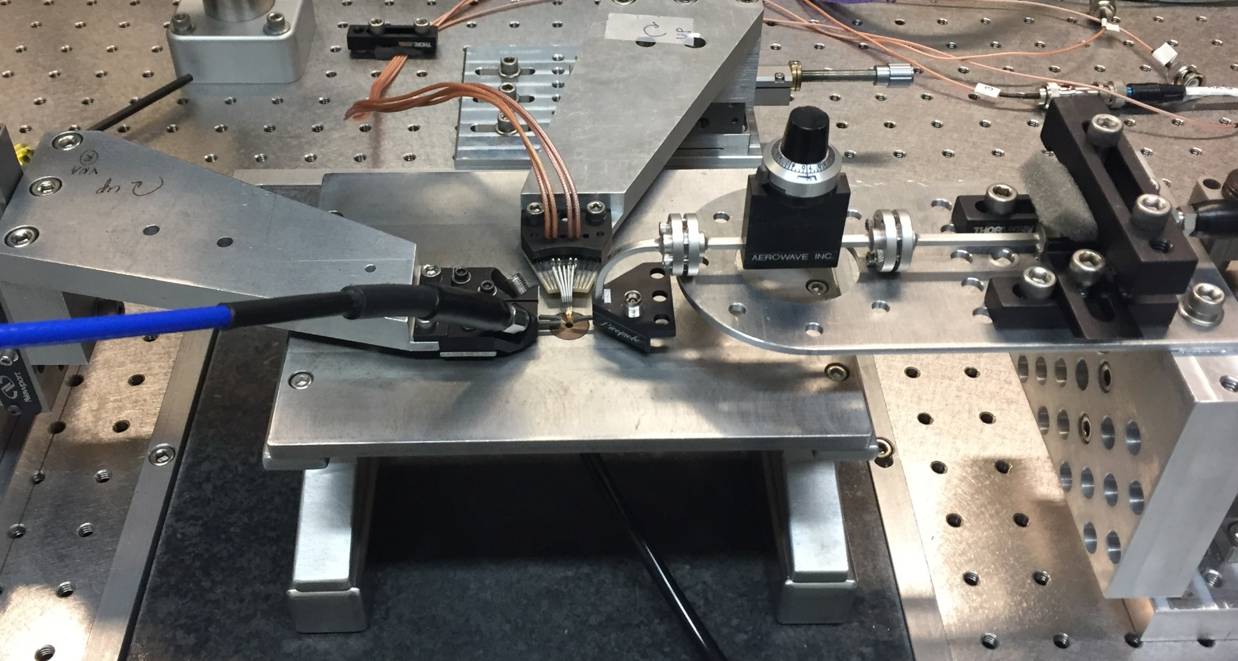
Multiplier chain (x9) measurement setup
20 dB attenuation
LO Input
WR-05 probe
Harmonic mixer
(OML,WR-05)
Harmonic mixer:
- Harmonic number: 16, IF @ 404.4 MHz

Slide 24
Receiver Simulations

Slide 25
Receiver measurements
IF spectrum: span 100 MHz
LO feedthrough

Slide 26
Transmitter Simulations
LO feedthrough: Q-mixer is unbalanced
Lower output power ~ 6 dB
0 V quadrature input

Slide 27
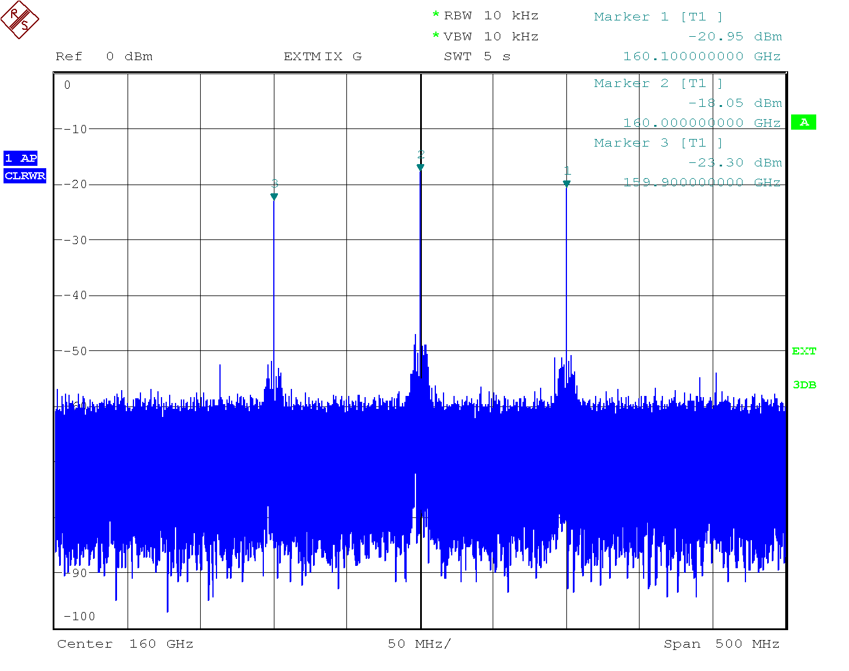
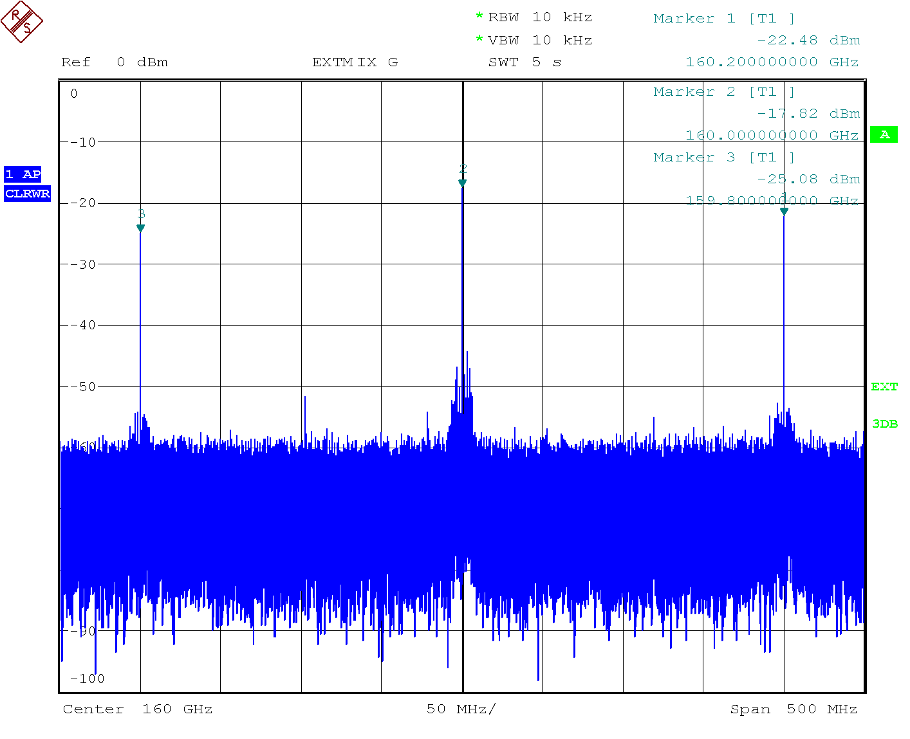
Transmitter measurements
BB @ 0.1 GHz, LO @ 160 GHz
BB @ 0.2 GHz, LO @ 160 GHz
BIAS | VDD (V) | Current (mA)
 |  | Chip1 | Chip2
Driver amp. | 1 | 160 | 161
Mixer | 1 | 89 | 94
Multiplier chain | 1 | 204 | 208
Measurement setup: BB-I input is open, all channels are in the on state

Slide 28
Transmitter measurements

