Slide 1




100-340GHz Systems:
Transistors and Applications
M.J.W. Rodwell¹, Y. Fang¹, J. Rode^{1,2}, J. Wu^{1,3}, B. Markman¹,
S. T. Suran Brunelli¹, J. Klamkin¹, M Urteaga⁴
¹University of California, Santa Barbara
²Now with Intel
³Now with GlobalFoundries
⁴Teledyne Scientific and Imaging

Slide 2
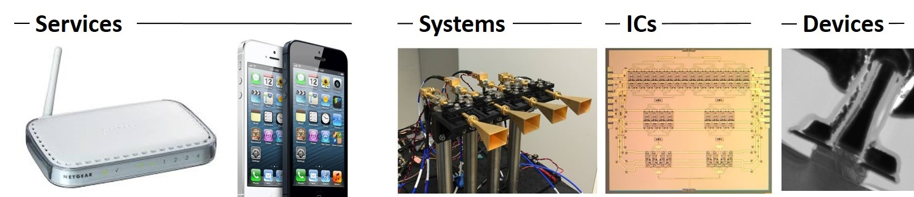
Why 100-340GHz Wireless ?
Wireless networks: exploding demand.
Immediate industry response: 5G.
28, 38, 57-71(WiGig), 71-86GHz
increased spectrum, extensive beamforming
Next generation (6G ??): above 100GHz.
greatly increased spectrum, massive spectral multiplexing
Plus, TV-like imaging/sensing/radar: cars, airplanes, drones

Slide 3
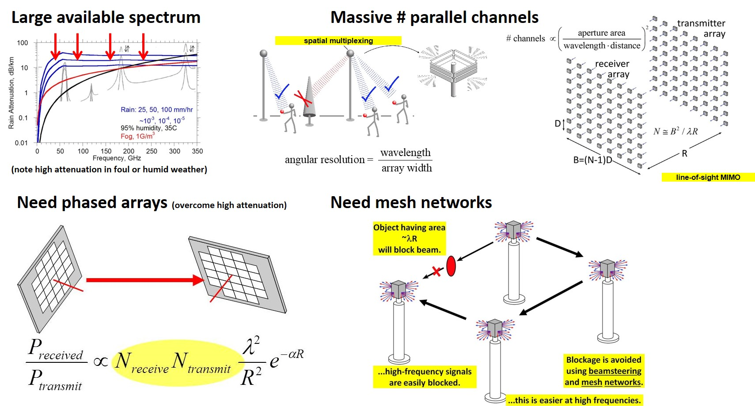
100-340GHz: Benefits & Challenges

Slide 4
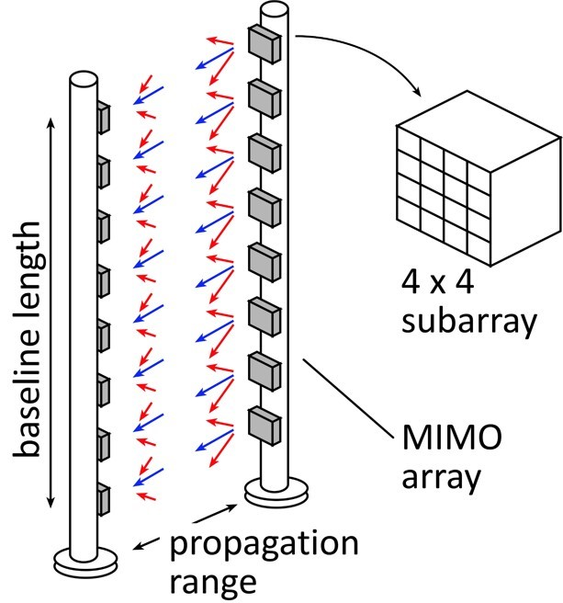
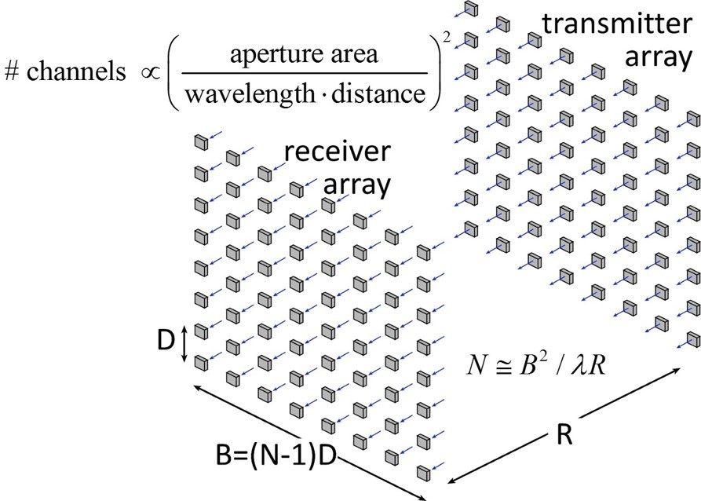
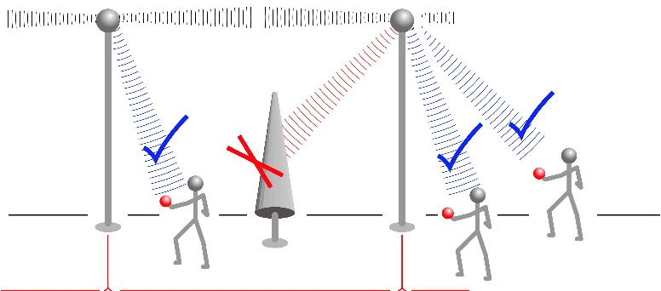
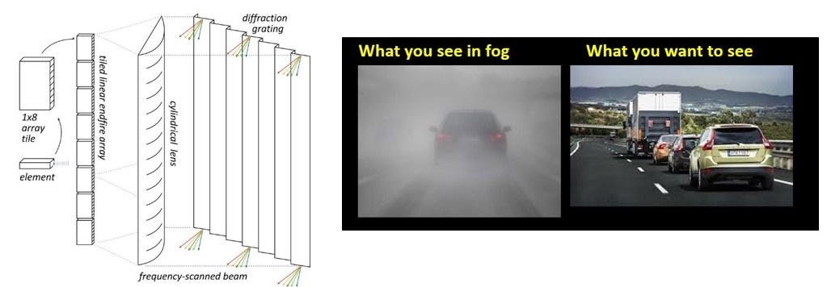
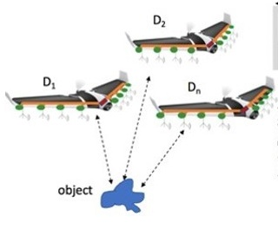
100-340GHz: Potential Applications
MIMO hub: 128 beams/face, 1Gb/s/user
140 GHz
Point-point MIMO: 340GHz: Tb/s links
massive spatial multiplexing
220, 340GHz imaging: drive/fly in fog/rain/snow
300m, 512×64 image, 60Hz, 15dB SNR
Ultra-compact imaging: drones
unlike visible: image through fog/smoke/rain

Slide 5
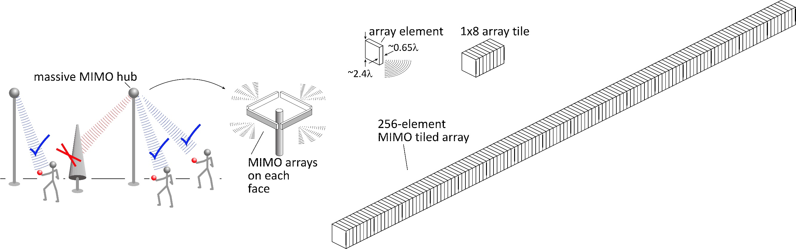
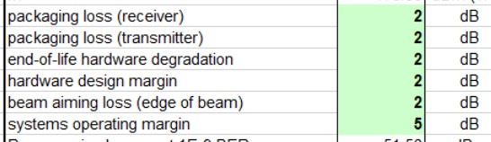
140 GHz Spatially Multiplexed Base Station
Each face supports 128 beams @ 1Gb/s/beam.
225 meters range in 50 mm/hr rain
Realistic packaging loss, operating & design margins (20dB total)
PAs: 16 dBm P_{out} (per element)
LNAs: 3 dB noise figure

Slide 6
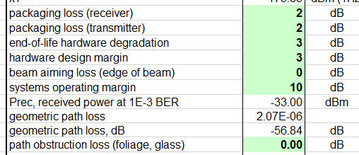
340 GHz 640 Gb/s MIMO Backhaul
1.6m MIMO array: 8-elements, each 80 Gb/s QPSK; 640Gb/s total
4 × 4 sub-arrays → 8 degree beamsteering
500 meters range in 50 mm/hr rain; 29 dB/km
Realistic packaging loss, operating & design margins
PAs: 82mW P_{out} (per element)
LNAs: 4 dB noise figure

Slide 7
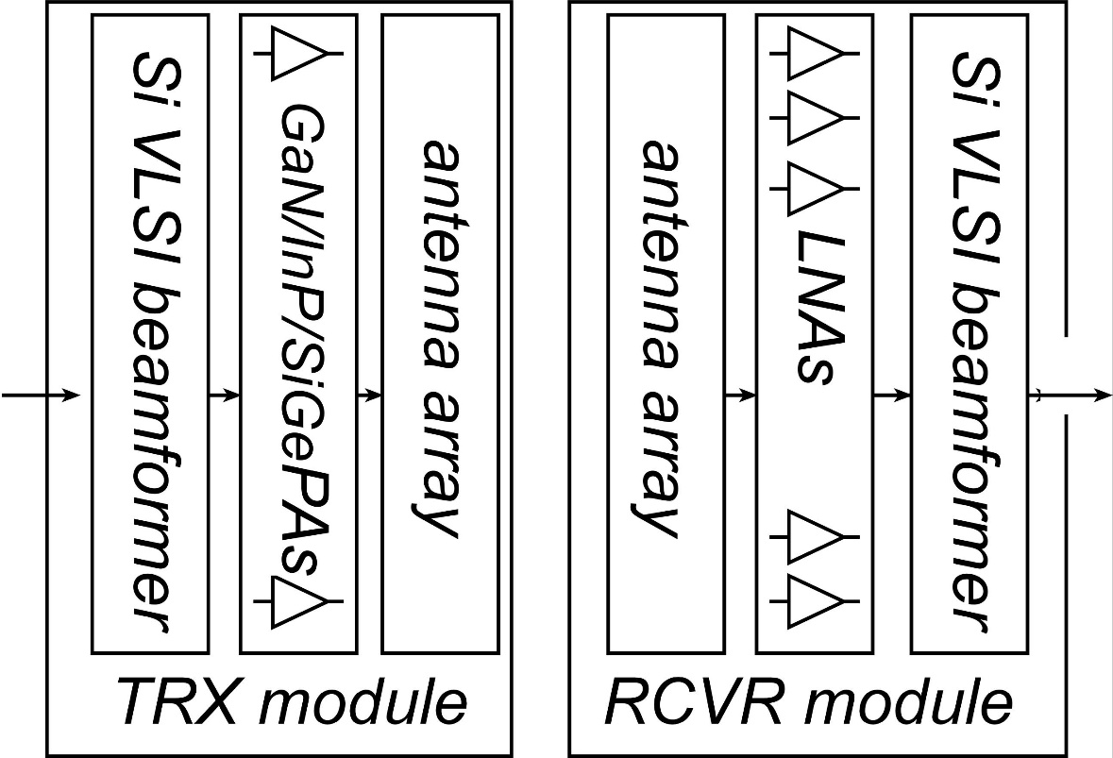

Millimeter-Wave Wireless Transceiver Architecture
custom PAs, LNAs → power, efficiency, noise
Si CMOS beamformer→ integration scale
...similar to today's cell phones.

Slide 8
100-1000 GHz Transistors and ICs
 | f_{max} GHz | Good ICs to (GHz) | complexity | LNAs | PAS | increased bandwidth ?
CMOS | 350 | 150/200 | transceivers | ok | poor: 1-5 mW | not easy
Production SiGe | 300 | 200/250 | transceivers | good | OK: 20-100 mW | depends on $$
R&D SiGe | 700 | 300/500 | transceivers | good | OK: 20-100 mW | 2-3THz
R&D InP HBT | 1150 | 400/650 | PA, converters | poor | good: 100-200 mW | 2-3THz
R&D InP HEMT | 1500 | 500/1000 | LNA | great | weak: 20-50 mW | 2-3THz
R&D GaN | 400 | 120/140 | PAs | good | excellent: 0.1-1W | 600GHz
ICs with useful performance, hero experiments
There are THz transistors today; their bandwidth will increase
Challenge: reducing costs, increasing market size

Slide 9
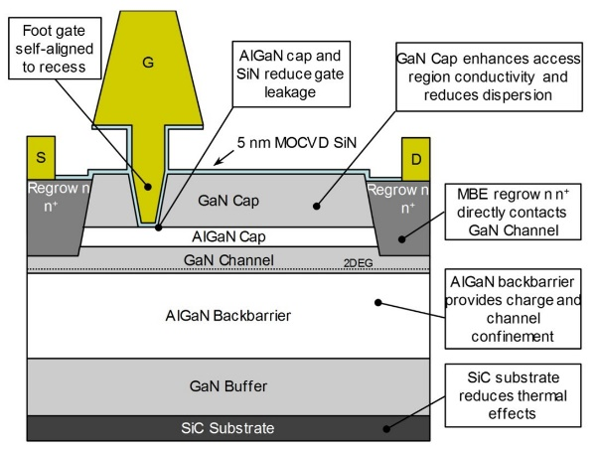
Gallium Nitride Power Technologies
GaN is the leading high-frequency power technology
N-polar GaN: Mishra, UCSB

Slide 10
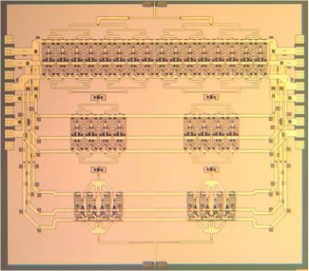
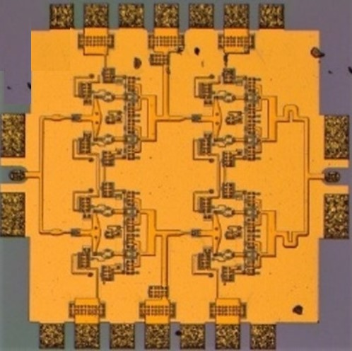
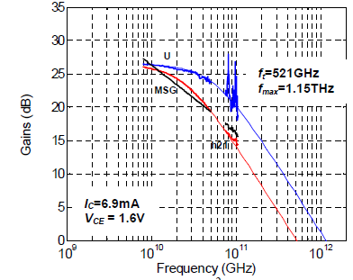
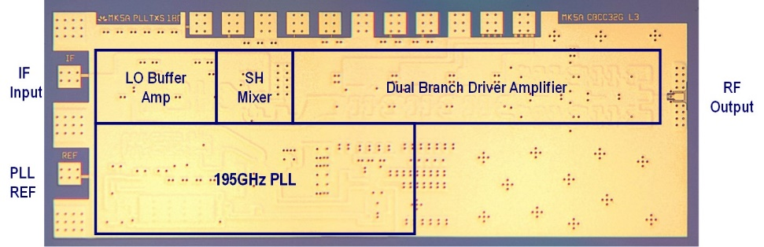
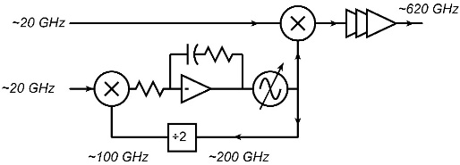
130nm / 1.1THz InP HBT Technology
1.1THz f_{max} HBT,
3.5 V breakdown
220 GHz, 0.18W
power amplifier
325 GHz, 16mW
power amplifier
Teledyne/UCSB: M. Urteaga et al: 2011 DRC
UCSB/Teledyne: T. Reed et al: 2013 CSICS
UCSB/Teledyne:
A. Ahmed, 2018 EuMIC Symp.
Integrated ~600GHz transmitter
Teledyne: M. Urteaga et al: 2017 IEEE Proceedings

Slide 11
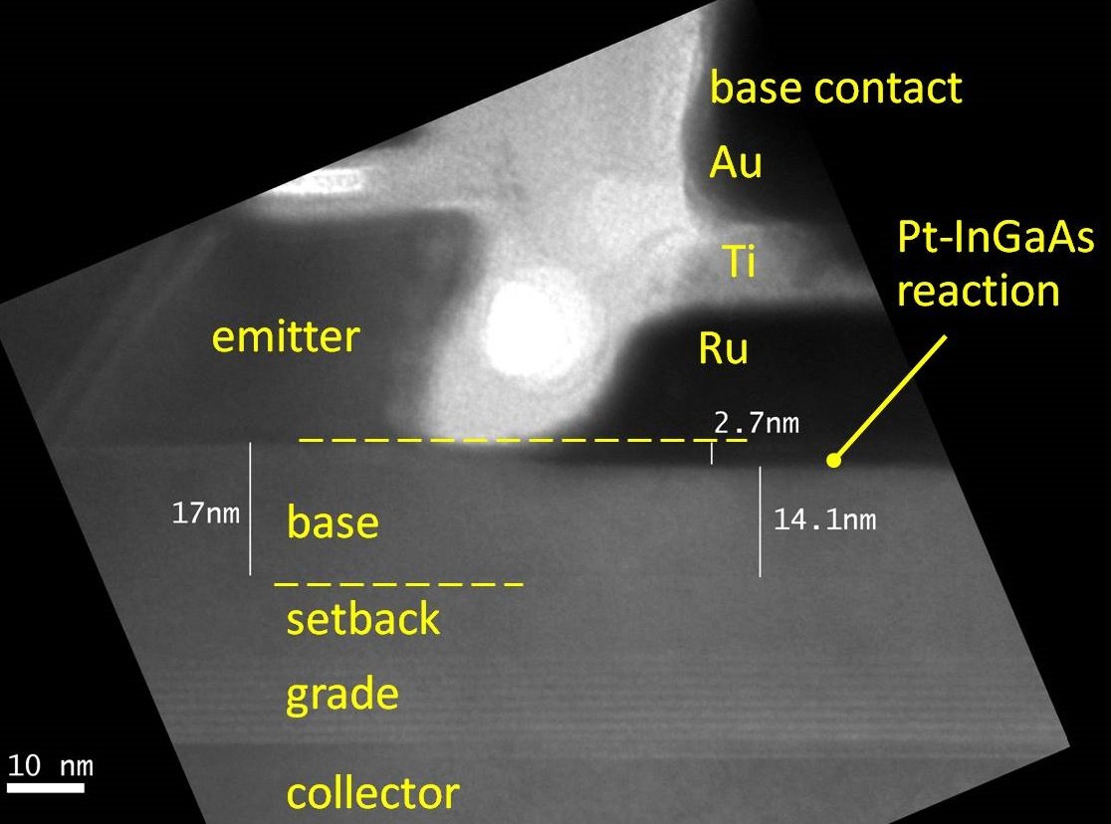
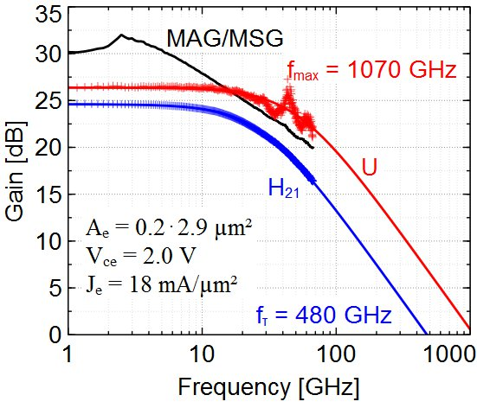
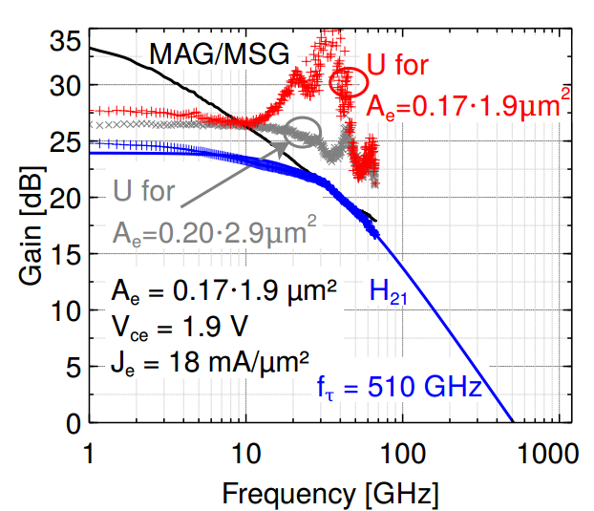
InP HBTs: 1.07 THz @200nm, ?? @ 130nm
?
Rode et al., IEEE TED, Aug. 2015

Slide 12
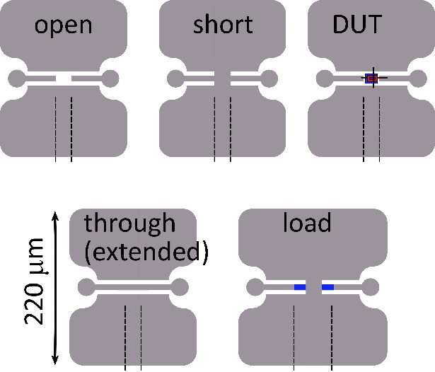
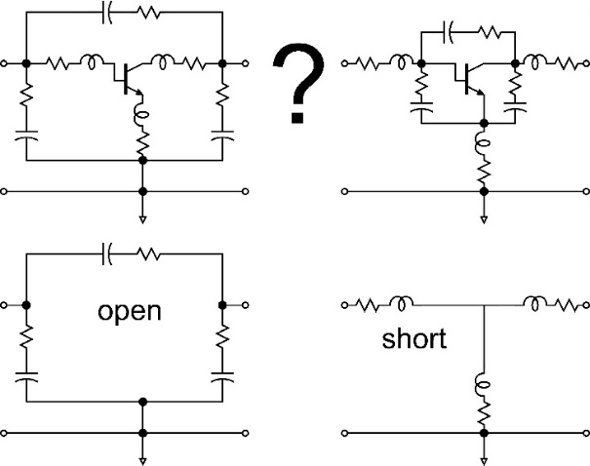
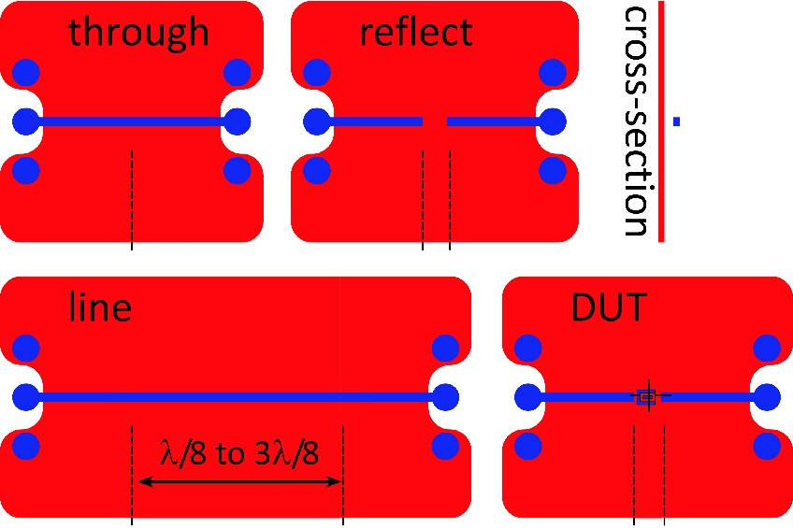
THz Transistor Measurements
Simple pads:
Substrate coupling: need small pads, narrow CPW
Ambiguity in pad stripping order.
UCSB 130nm HBTs: order not important.
Add through & load to remove ambiguity
On-wafer through-reflect-line:
No ambiguity from pad stripping.
Calibration to line Zo
Still must avoid substrate resonances
CPW does not work.
needs thin-film microstrip
or ~25 μm substrate with TSV's
(publication used parallel elements outside)

Slide 13
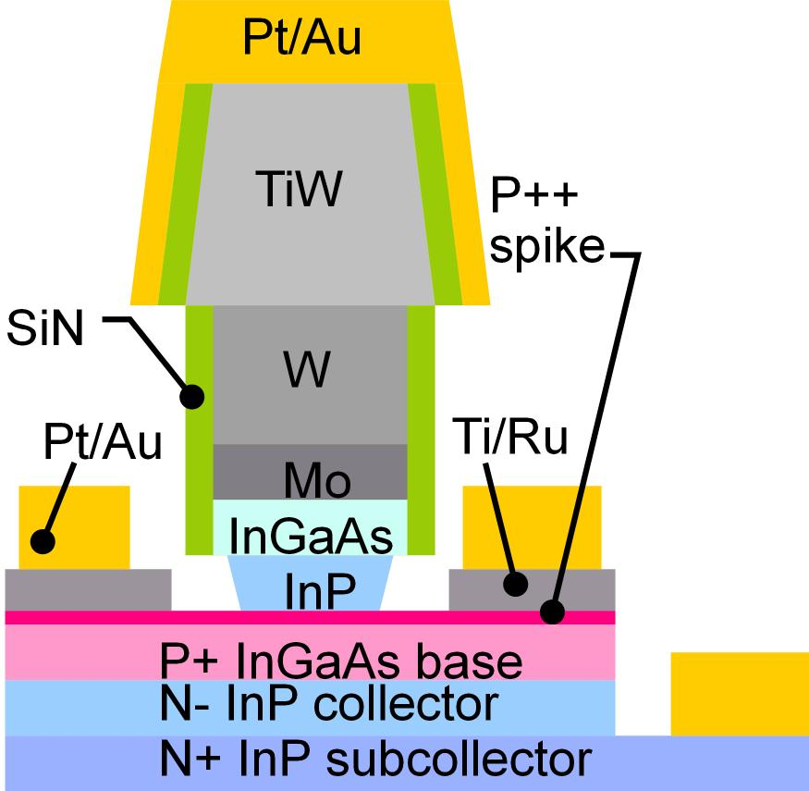
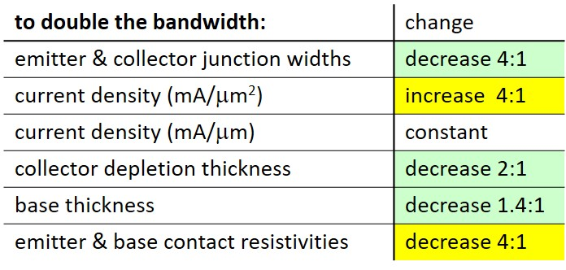
Bipolar Transistor Scaling Laws
Narrow junctions.
Thin layers
High current density
Ultra low resistivity contacts

Slide 14
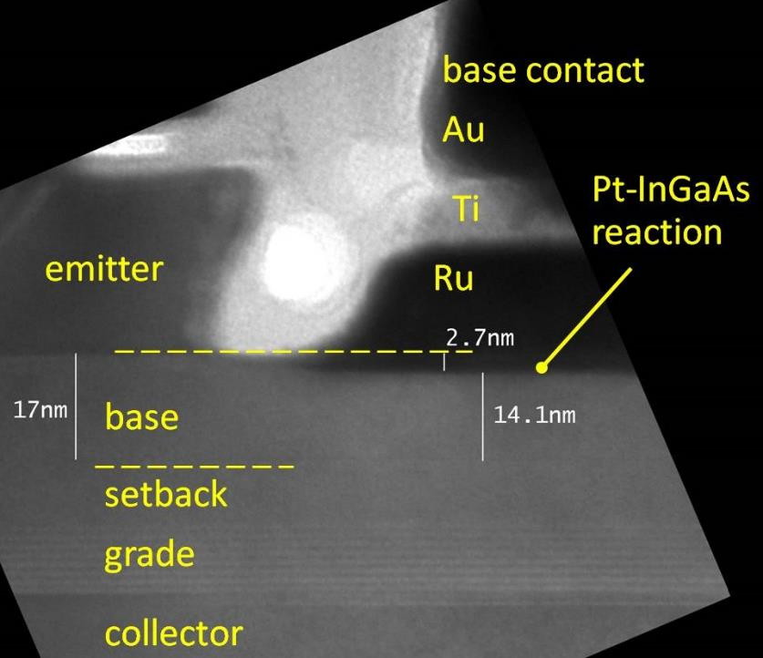
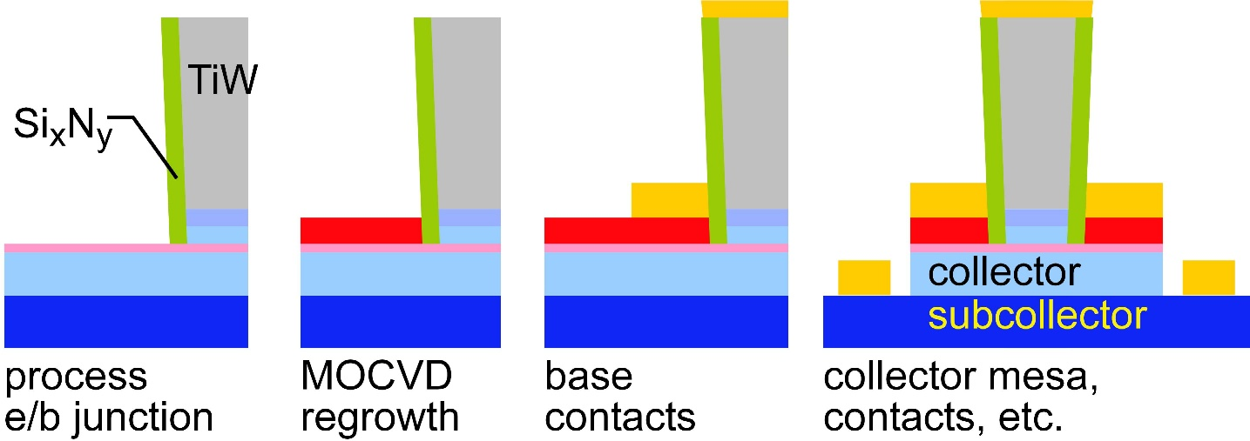
Challenges at the 64nm/2THz & 32nm/3THz Nodes
Need high base contact doping
>10²⁰/cm³ for good contacts
high Auger recombination
very low β.
Need moderate contact penetration
Pd or Pt contacts
react with 3++ nm of base
penetrate surface contaminants
too deep for thin base
Solution: base regrowth:
thin, moderately-doped intrinsic base
thick, heavily-doped extrinsic base
Baraskar et al, Journal of Applied Physics, 2013
Rode et al., IEEE TED, Aug. 2015

Slide 15
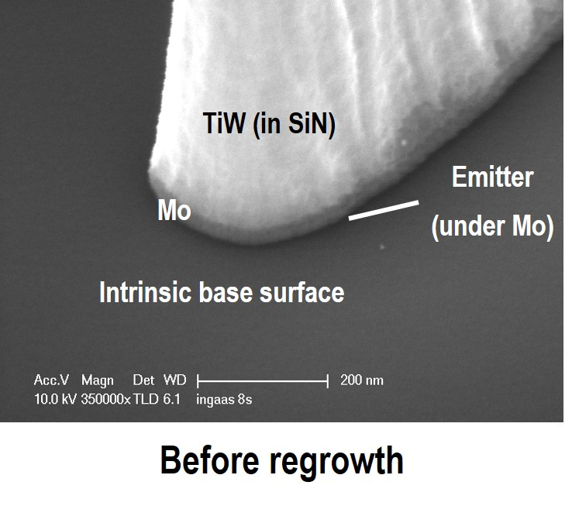
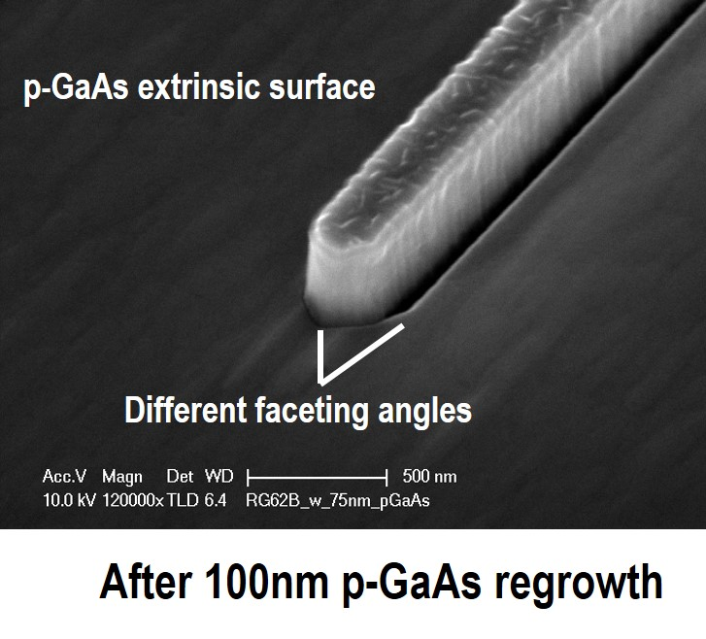
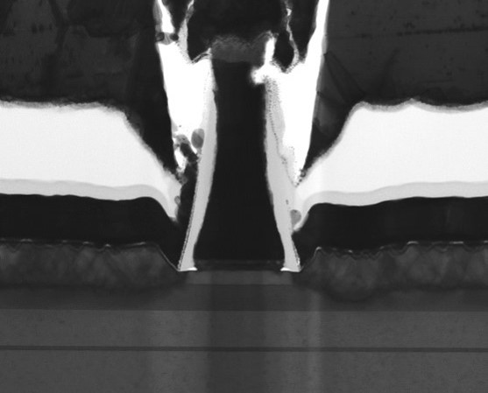
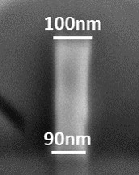
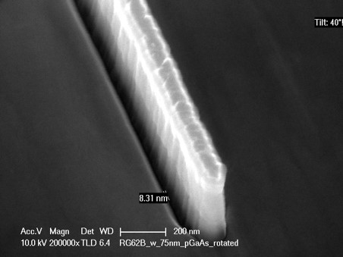
Regrown-Base InP HBTs: Images
Cross-section
Dry-etched
TiW emitter contact
100nm emitter
after base regrowth

Slide 16
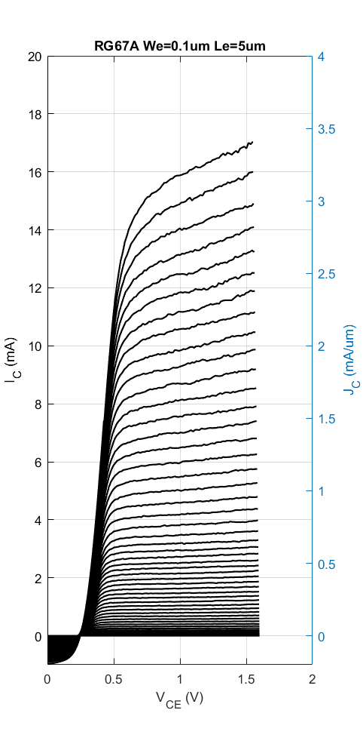
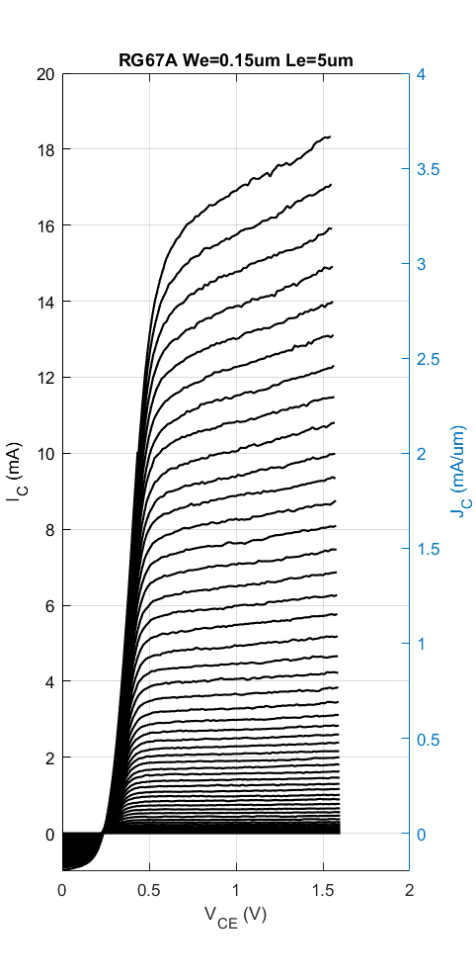
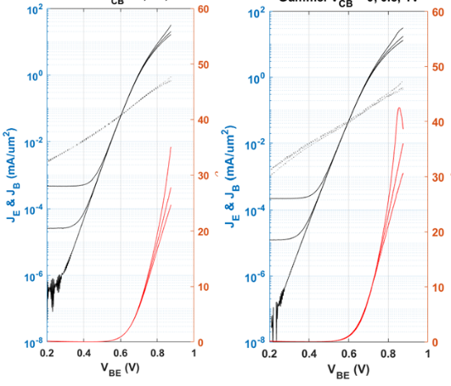
Regrown-Base InP HBTs: DC Data
0.1× 5μm
emitter
0.2× 5μm
emitter
0.2× 5μm
emitter
0.4× 5μm
emitter
Good β, low R_{ex}, high-current operation

Slide 17

Regrown-Base InP HBTs: Base Resistance
0.9Ω−μm² resistivity for GaAs/metal contact✓
294Ω sheet resistivity for regrown base ✓
1.0Ω−μm² resistivity for InGaAs/GaAs contact✓
4300Ω/ sheet resistivity for intrinsic base ✘
Base contact resistivity sufficient for 64nm/2THz node.
Improvements: anneal after regrowth, grade interface
Regrowth: base contacts suitable for 64nm/2THz & 32nm/3THz nodes

Slide 18
FETs (HEMTs): key for low noise
2:1 to 4:1 increase in f_{τ} :
improved noise
less required transmit power
smaller PAs, less DC power
or higher-frequency systems
First Demonstration of Amplification at 1 THz Using
25-nm InP High Electron Mobility Transistor Process
Xiaobing Mei, et al, IEEE EDL, April 2015 (Northrop-Grumman)

Slide 19
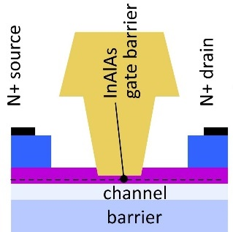
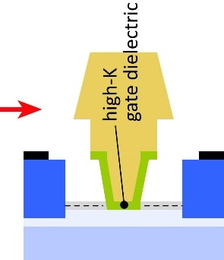
Towards faster HEMTs: MOS-HEMTs
1st demonstration: Fraunhofer IAF
Scaling limit: gate insulator thickness
HEMT: InAlAs barrier: tunneling, thermionic leakage
solution: replace InAlAs with high-K dielectric
2nm ZrO₂ (ε_{r}=25): adequately low leakage
Scaling limit: source access resistance
HEMT: InAlAs barrier is under N+ source/drain
solution: regrowth, place N+ layer on InAs channel
Target ~10nm node
~0.3nm EOT, 3nm thick channel
1.2 to 1.5 THz f_{τ}.

Slide 20
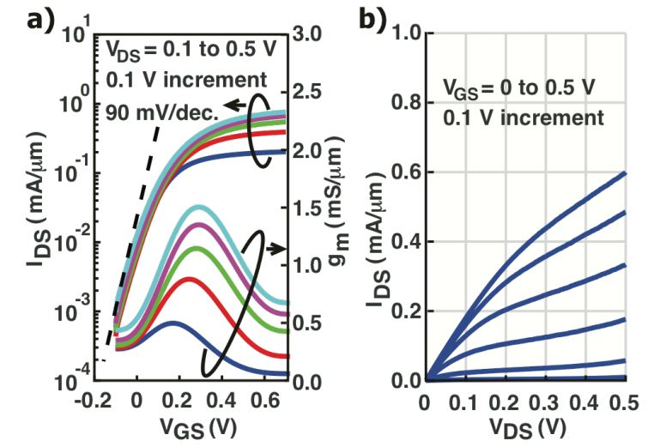
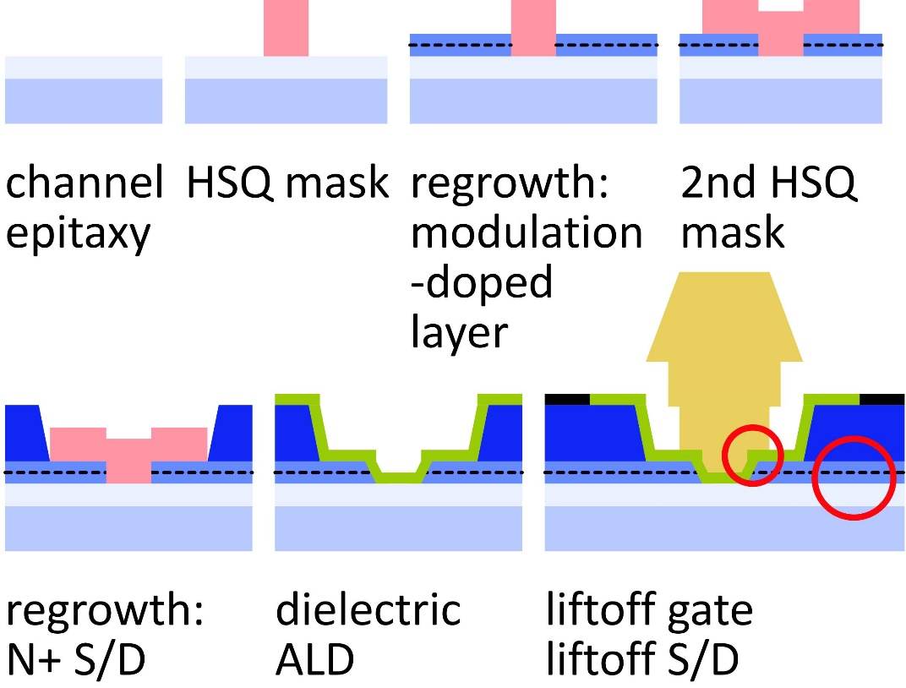
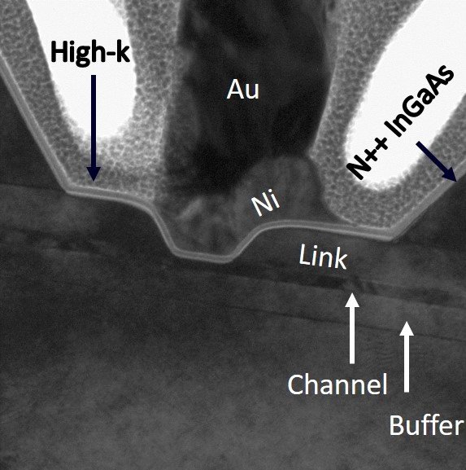
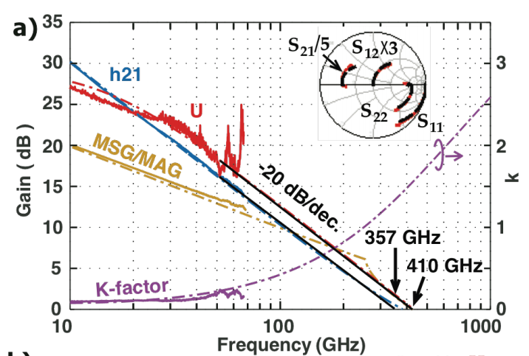
Towards Faster HEMTs: MOS-HEMTs
Jun Wu, UCSB, IEEE EDL, 2018
Double regrowth
modulation-doped access regions
N+ contacts
High-K gate dielectric: 3 nm ZrO2.
Highly scaled
5nm InAs channel, 10-30nm gate lengths

Slide 21
100-340GHz Wireless Systems:
100-340 GHz wireless systems
massive capacities via spatial multiplexing
compact, high-resolution imaging systems
short range: few 100 meters
Many challenges
spatial multiplexing: computational complexity, dynamic range
packaging: fitting signal channels in very small areas
IC Technology
All-silicon for short ranges below 250 GHz.
III-V LNAs and PAs for longer-range links. Just like cell phones today
III-V frequency extenders for 340GHz and beyond
Device opportunity: better PAs, LNAs for 140, 220, 340GHz.

Slide 22
In case of questions

Slide 23
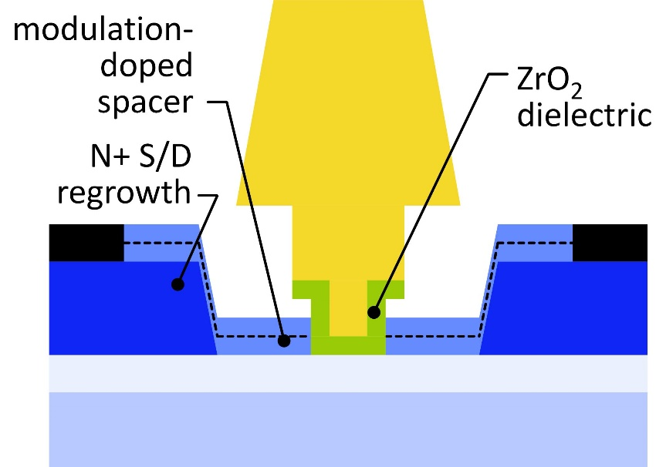
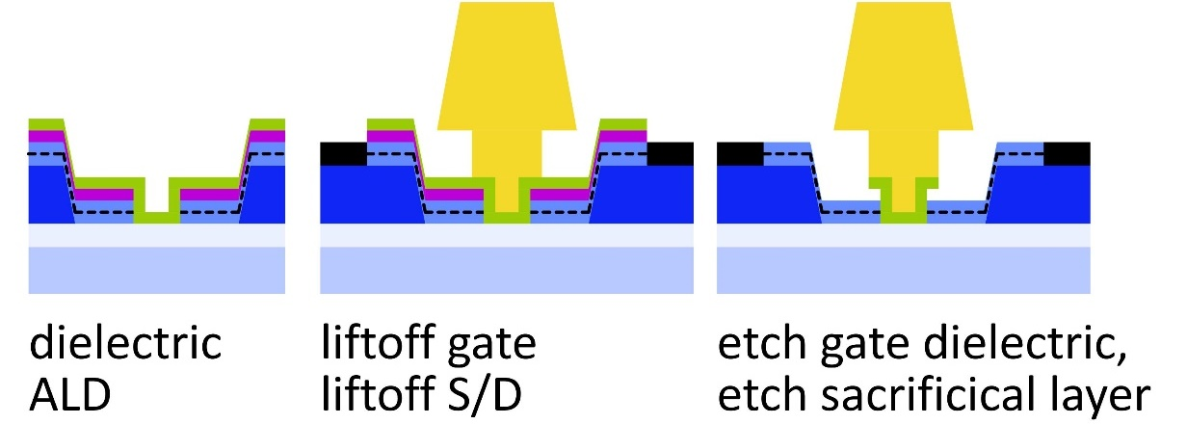
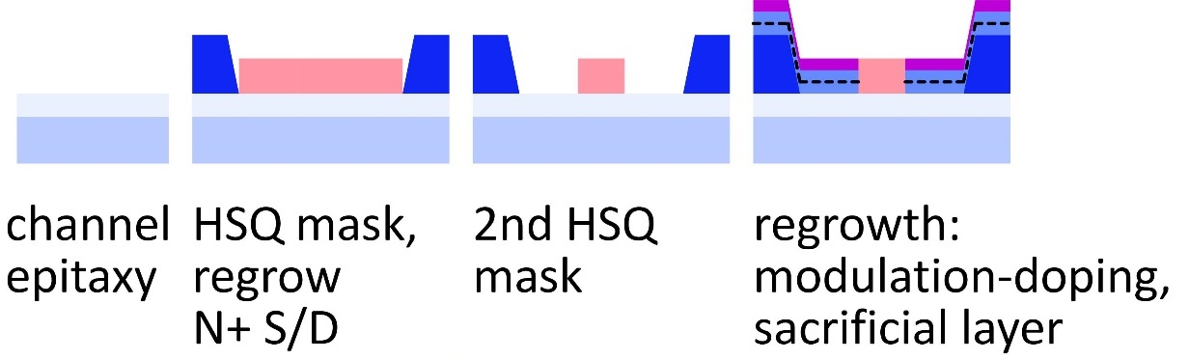
Towards faster HEMTs: next step
No N- material between channel and contacts
reduced source/drain access resistance
Sacrificial layer
reduces parasitic gate-channel overlap
less gate-source capacitance
2.5nm ZrO₂ dielectric, 3nm InAs channel
higher g_{m} , lower g_{ds}

Slide 24
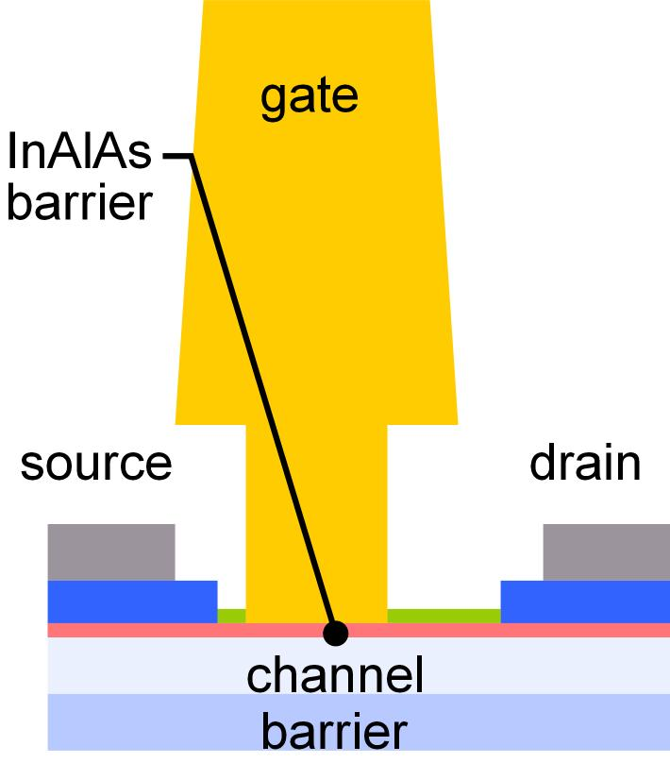


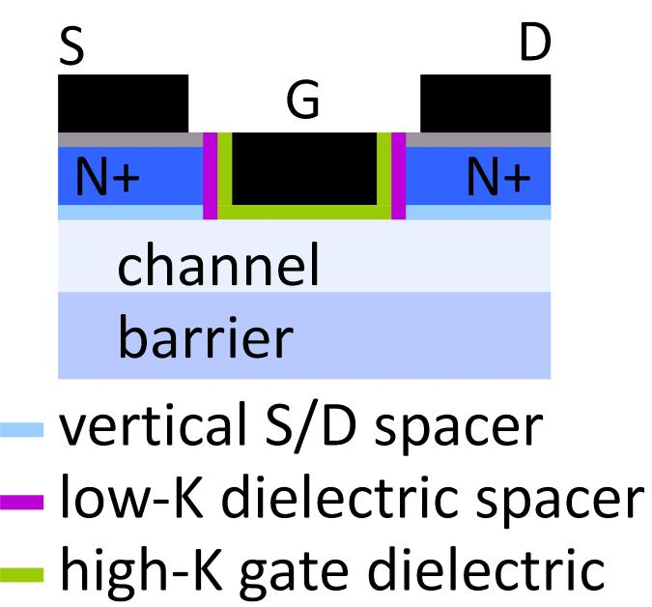
FET Scaling Laws (these now broken)
FET parameter | change
gate length | decrease 2:1
current density (mA/mm) | increase 2:1
specific transconductance (mS/mm) | increase 2:1
transport mass | constant
2DEG electron density | increase 2:1
gate-channel capacitance density | increase 2:1
dielectric equivalent thickness | decrease 2:1
channel thickness | decrease 2:1
channel state density | increase 2:1
contact resistivities | decrease 4:1
Gate dielectric can't be much further scaled.
g_{m}/W_{g} hard to increase→ C_{end} / g_{m} prevents f_{τ} scaling.
Shorter L_{g}→ poor electrostatics→ reduced g_{m} /G_{ds}

Slide 25
Towards faster HEMTs: MOS-HEMTs
1st demonstration: Fraunhofer IAF
Scaling limit: gate insulator thickness
HEMT: InAlAs barrier: tunneling, thermionic leakage
solution: replace InAlAs with high-K dielectric
2nm ZrO₂ (ε_{r}=25): adequately low leakage
Scaling limit: source access resistance
HEMT: InAlAs barrier is under N+ source/drain
solution: regrowth, place N+ layer on InAs channel
Target ~10nm node
~0.3nm EOT, 3nm thick channel
1.2 to 1.5 THz f_{τ}.

