Slide 1
Wireless Above 100GHz
Radio and Wireless Week, January 14, 2018, Anaheim, CA
Mark Rodwell,
University of California, Santa Barbara
Ali Niknejad
University of California, Berkeley

Slide 2

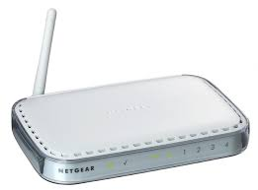
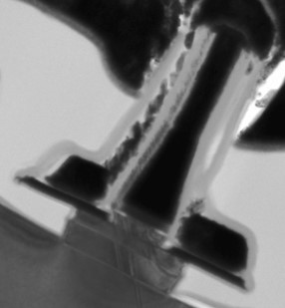
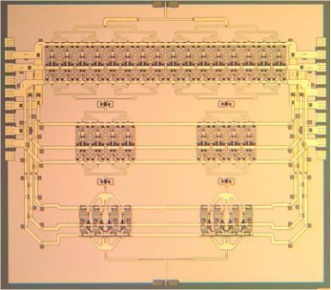
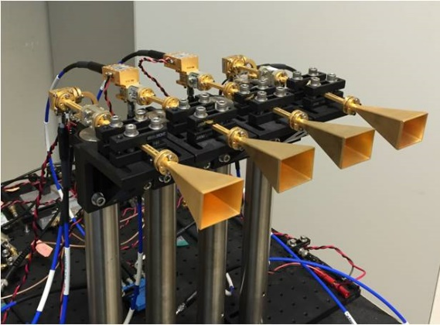
Why 100+ GHz wireless ?

Slide 3
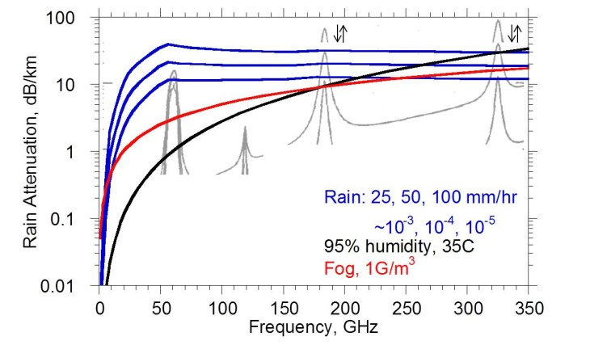
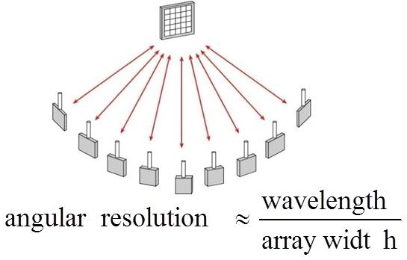
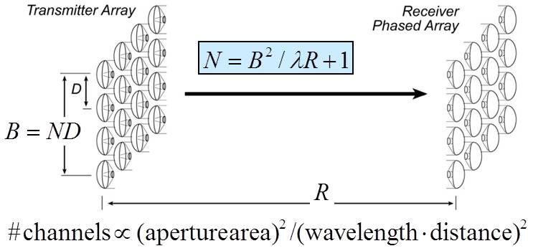
140-340 GHz
properties

Slide 4
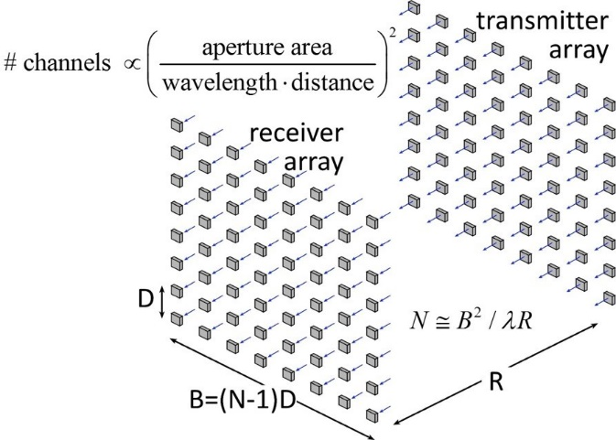
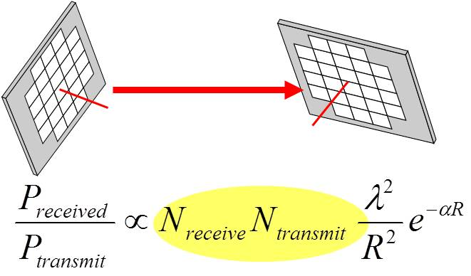
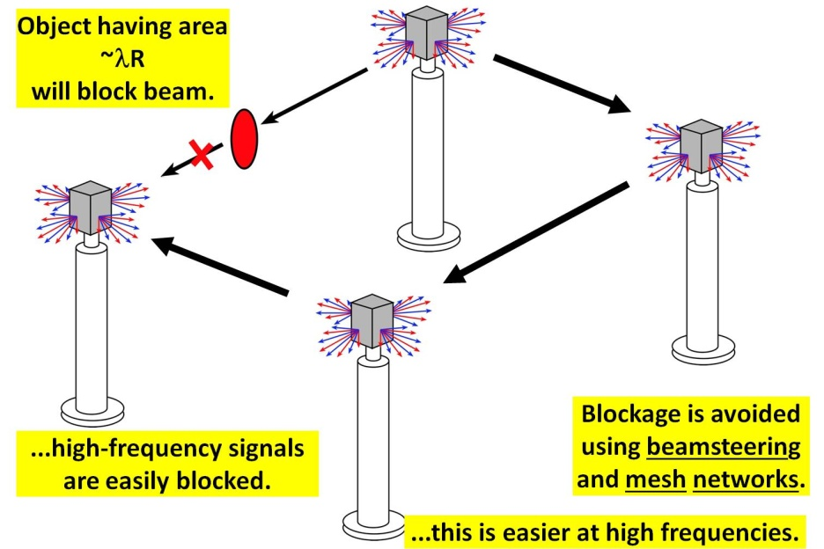
140-340 GHz: benefits & challenges
Large available spectrum
Massive # parallel channels
spatial
multiplexing
line-of-sight MIMO
(note high attenuation in foul weather)
Need phased arrays (overcome high attenuation)
Need mesh networks
4

Slide 5
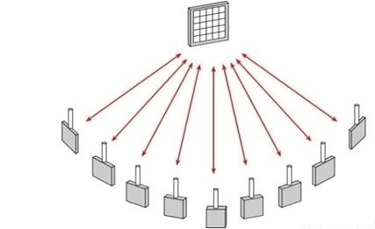
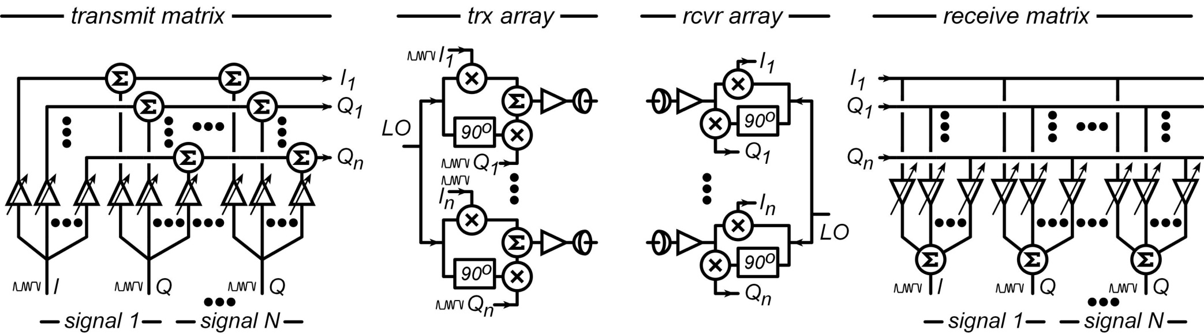
Spatial Multiplexing: massive capacity RF networks
multiple independent beams
each carrying different data
each independently aimed
# beams = # array elements
small: 1000 elements @220 GHz=3 square inches
Hardware: multi-beam phased array ICs

Slide 6

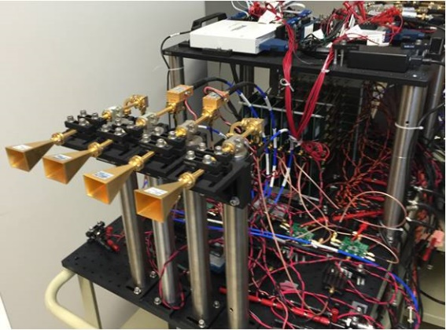
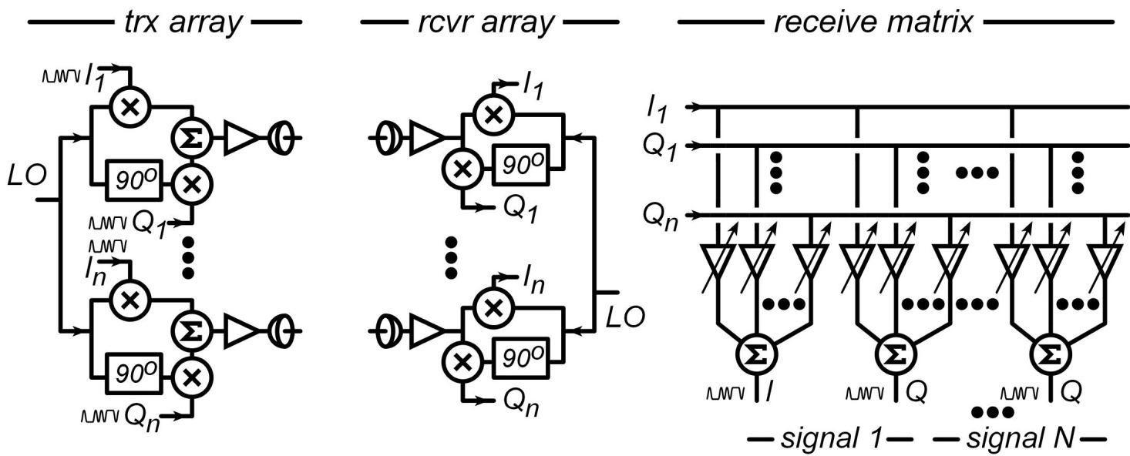
mm-Wave LOS MIMO: multi-channel for high capacity
Massive capacity wireless; physically small
Torklinson : 2006 Allerton Conference
Sheldon : 2010 IEEE APS-URSI
Torklinson : 2011 IEEE Trans Wireless Comm.
2012 IEEE Marconi prize paper award

Slide 7

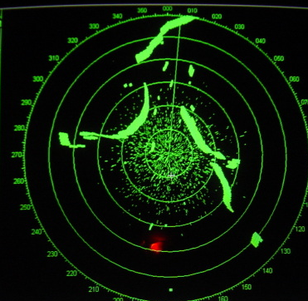

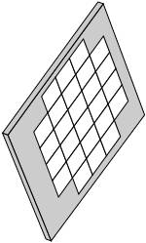
140-340GHz imaging: TV-like resolution
mm-waves → high resolution from small antenna apertures
What you see in fog
What 10GHz radar shows
What you want to see
goal: ~0.2º resolution, 10³-10⁶ pixels
NxN phased array
D
angular resolution = λ /D (radians)
340 GHz, 35 cm/14 inch aperture → 0.14 degree resolution
HDTV-like resolution, yet fits in car, plane, or UAV
D

Slide 8
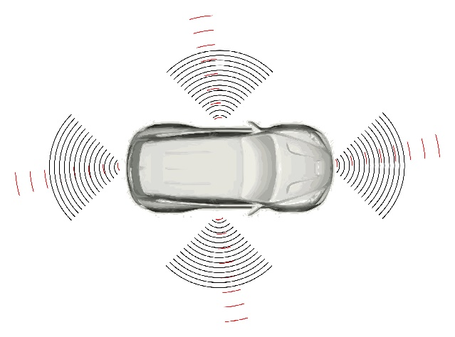
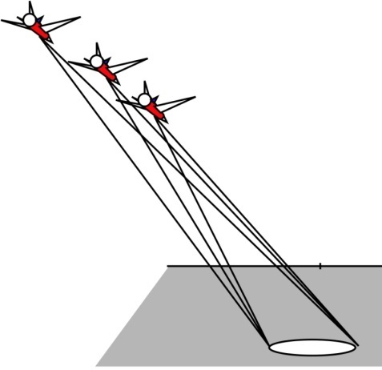
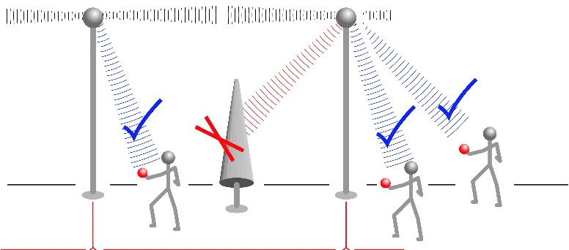
140-340 GHz
applications

Slide 9
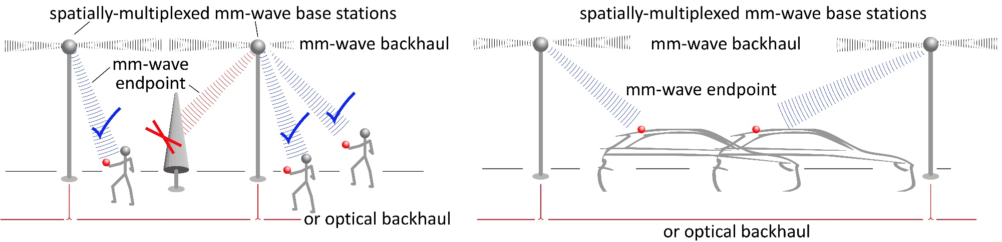
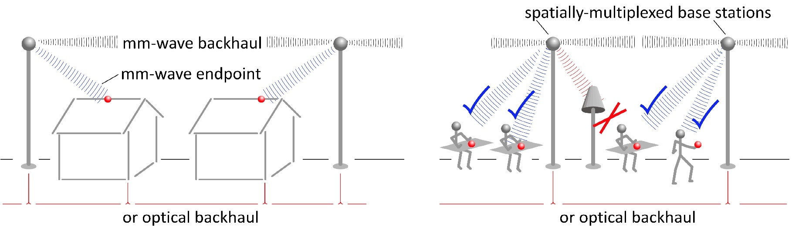
140-340GHz: high-capacity communications
Gigabit mobile communication.
Mobile information Access
Gigabit residential/office communication.
Cellular/internet convergence

Slide 10
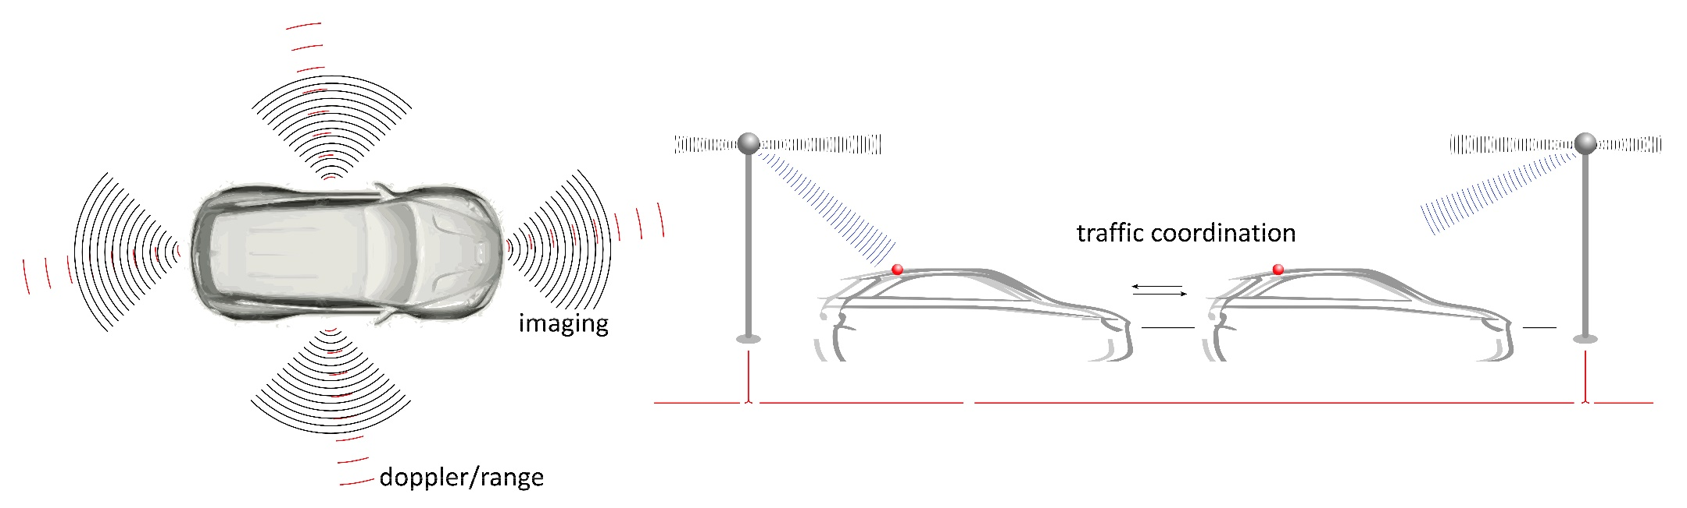
140-340GHz: automotive applications
340 GHz HDTV-resolution sub-mm-wave imaging radar: see through fog and rain.
assist driver: drive safely in fog at 100 km/hr
self-driving: complements LIDAR, but works in bad weather.
60 GHz Doppler / ranging radar.
object near ? approaching ? Avoid collision.
Intelligent highway: coordinate traffic
anticipate & manage interactions, avoid collisions

Slide 11
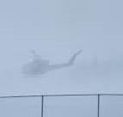

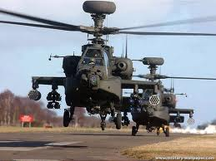

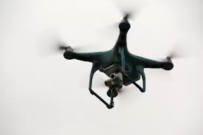
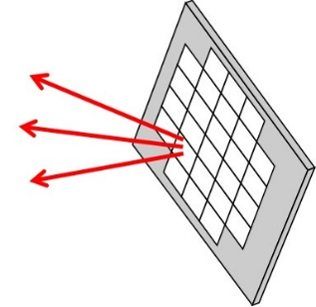
140-340 GHz: sensing and imaging radar
Fog, dust, smoke: what you see
What 10GHz radar shows
What you want to see
Radar: See threats through fog/smoke/dust, when you can't see in the optical.
30/70/ 94 GHz early-warning radar: threat detection = something is there
Longer range→ lower resolution: something's there, can't tell what.
140-340GHz imaging radar: threat identification= what is it ?
Shorter range (500m in fog), TV-like resolution. Small and light.
Imaging for UAVs, drones, small planes.
small, light aperture, high resolution.
sub-mm-wave SAR: see through fog, optical-like resolution, kilometers range
mm-wave PAR: imaging/ranging/Doppler

Slide 12
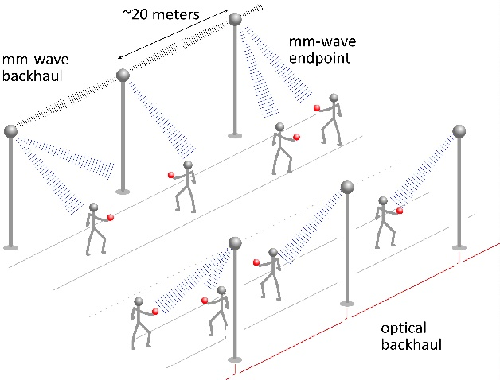
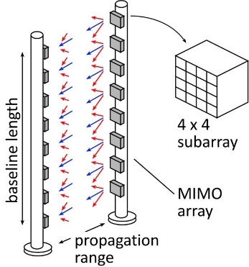
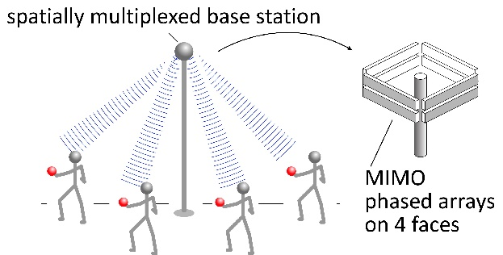
140-340 GHz:
Possible Systems

Slide 13
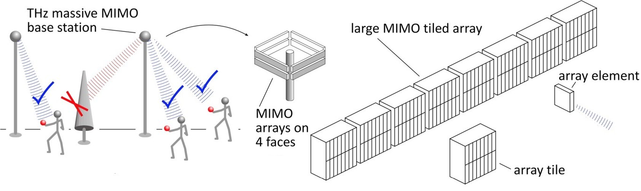
140/220 GHz spatially multiplexed base station
1 Tb/s spatially-multiplexed base station
256 users/face, 4 faces
1024 total users @ 1 user/beam, 1 Gb/s/beam;
200 m range
Link budget is feasible, but...
Required component dynamic range ?
Required complexity of back-end beamformer ?

Slide 14
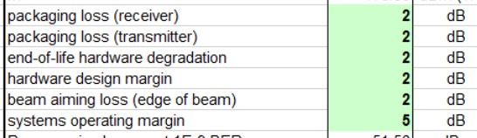
140 GHz spatially multiplexed base station
Each face supports 256 beams @ 1Gb/s/beam.
100 meters range in 50 mm/hr rain
Realistic packaging loss, operating & design margins
PAs: 16 dBm P_{out} (per element)
LNAs: 3 dB noise figure

Slide 15
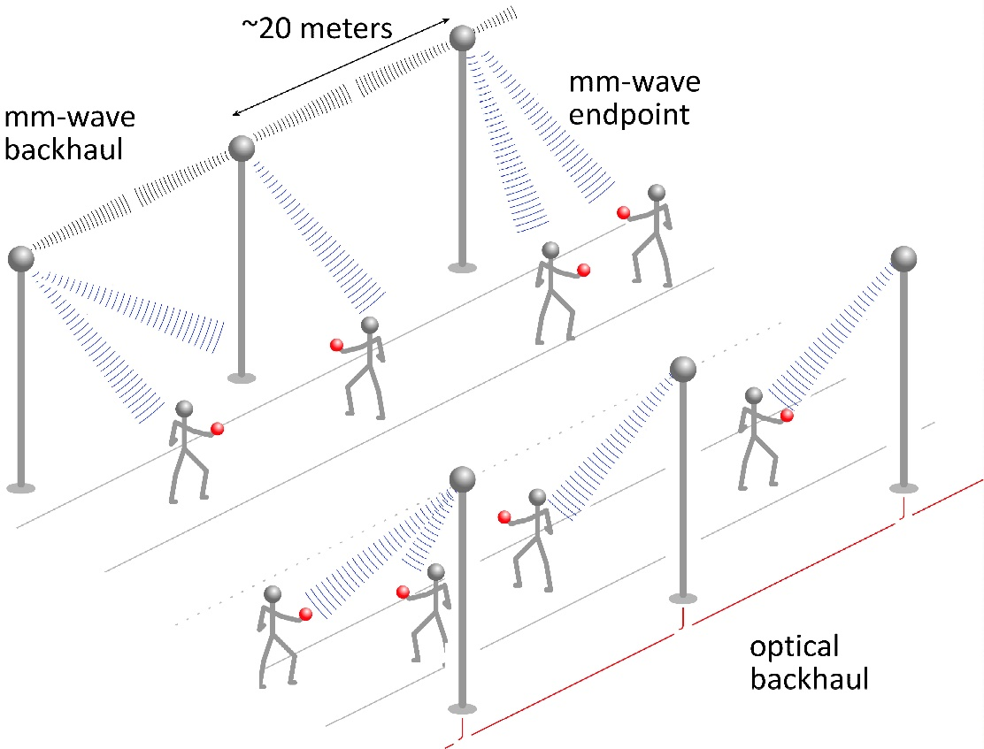
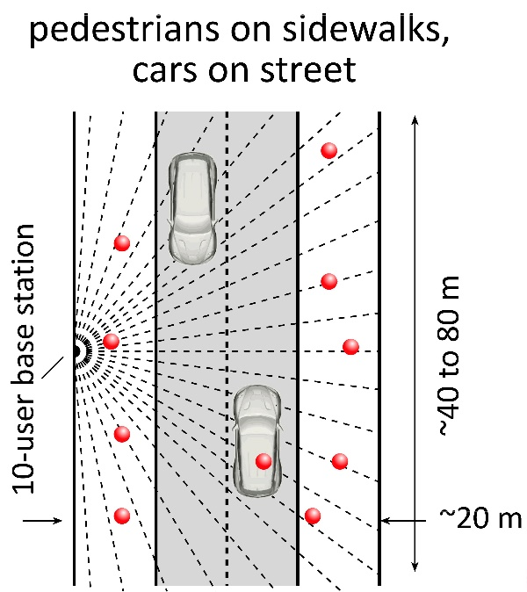
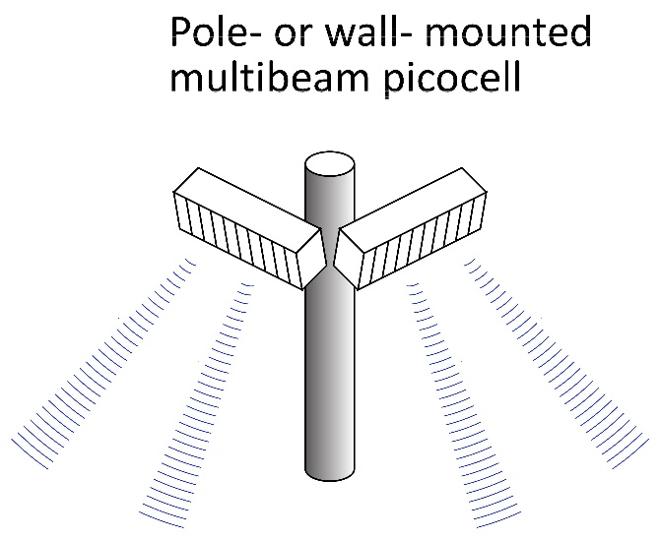
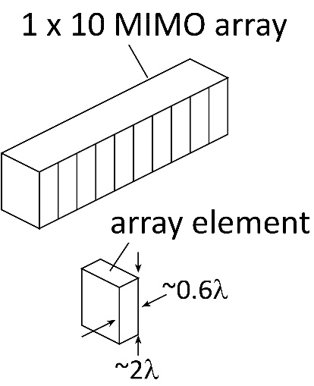
140/220 GHz femtocells

Slide 16
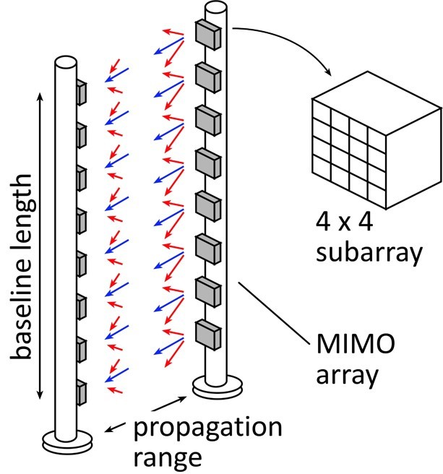
340 GHz or 650 GHz backhaul
linear array
square array
Sub-mm-wave line-of-sight MIMO network backbone
wireless @ optical speed; backhaul when you can't run fiber
340 GHz: 640Gb/s @ 240 meters; 1.2 meter, 8-element array
650 GHz: 1.28Tb/s @ 240 meter; 1.2 meter, 16-element array

Slide 17
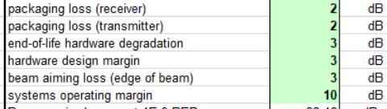
340 GHz 640 Gb/s MIMO backhaul
1.2m MIMO array: 8-elements, each 80 Gb/s QPSK; 640Gb/s total
4 × 4 sub-arrays → 8 degree beamsteering
250 meters range in 50 mm/hr rain; 29 dB/km
Realistic packaging loss, operating & design margins
PAs: 10 dBm P_{out} (per element)
LNAs: 4 dB noise figure

Slide 18
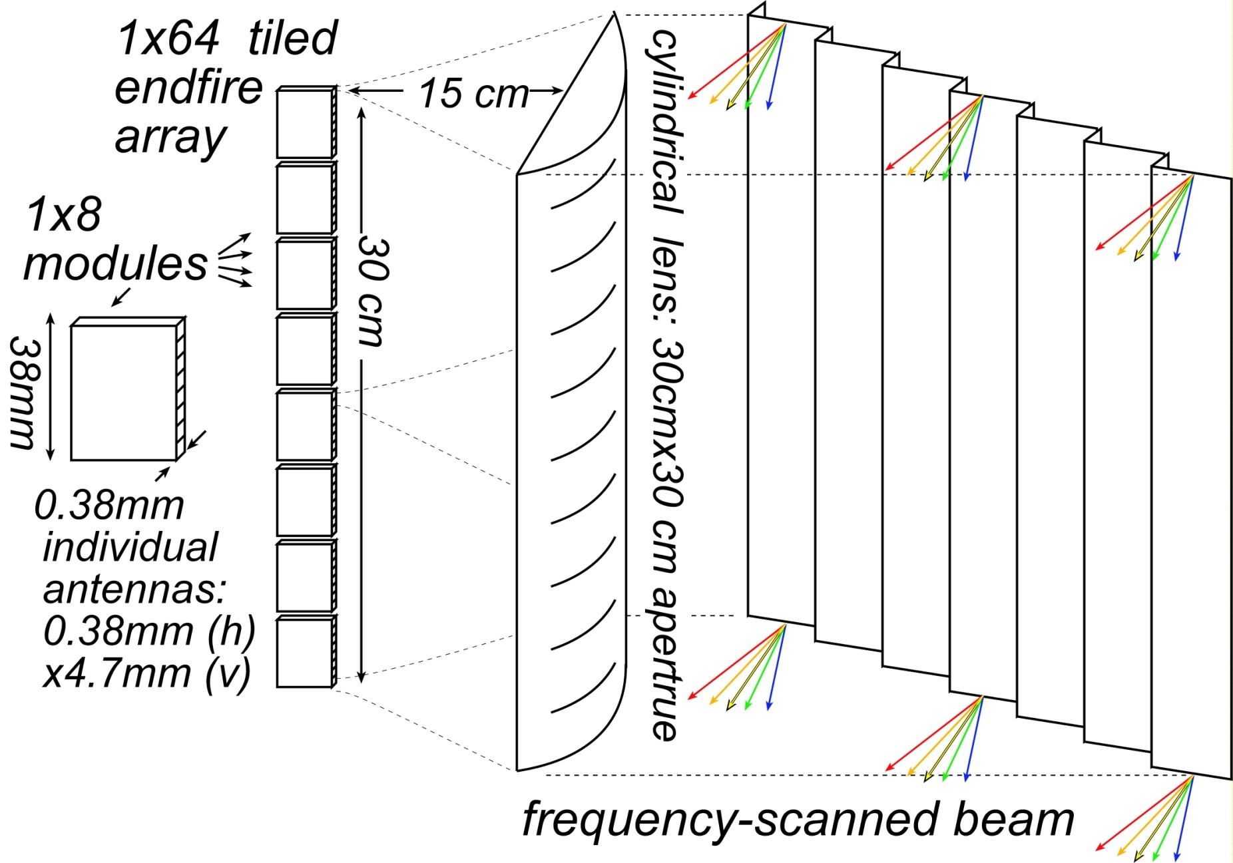

340 GHz frequency-scanned imaging car radar
Range: see a soccer ball at 300 meters (10 seconds warning) in heavy fog
(15 dB SNR, 35 dB/km, 30cm diameter target, 10% reflectivity, 100 km/Hr)
Image refresh rate: 60 Hz
Resolution 64×512 pixels
Angular resolution: 0.14 degrees
Angular field of view: 9 by 73 degrees
Aperture: 35 cm by 35 cm
Component requirements:
35 mW peak power/element,
3% pulse duty factor
6 dB noise figure,
5 dB package losses
5 dB manufacturing/aging margin

Slide 19
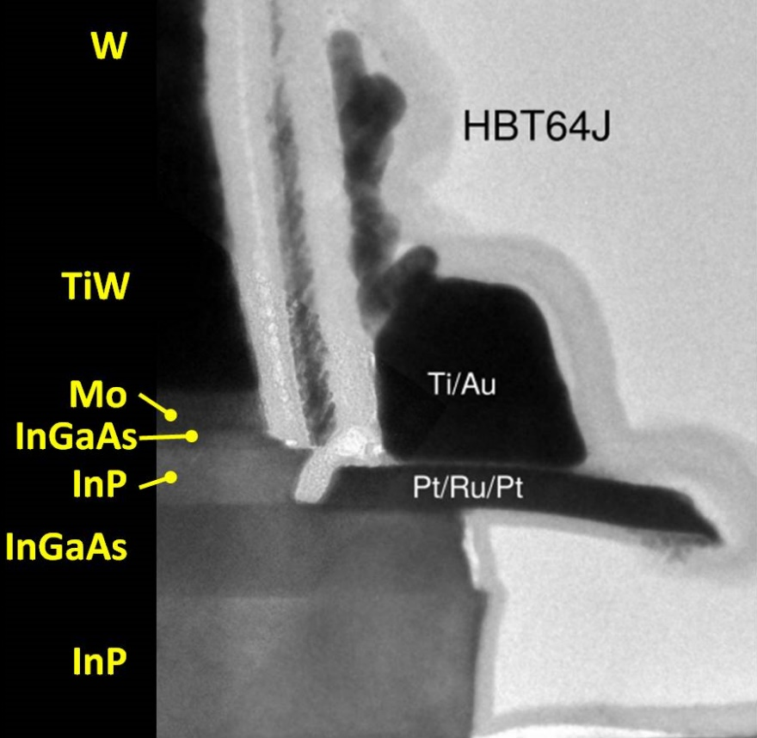
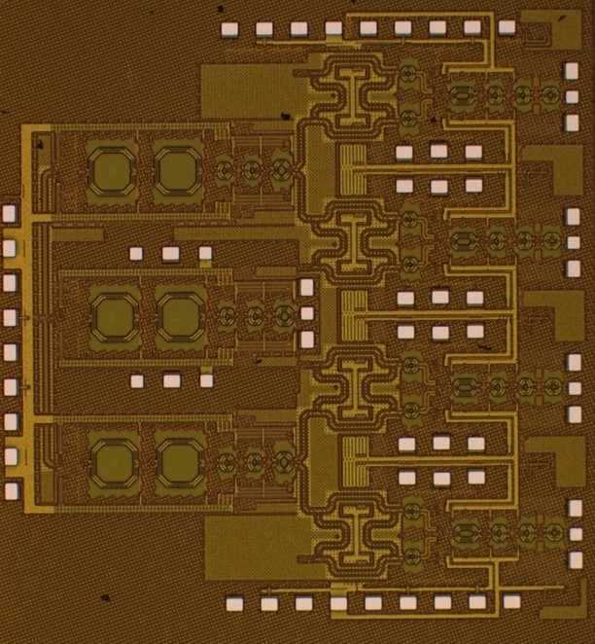
Transistors & ICs

Slide 20
IC Technologies for 100 + GHz systems
Si VLSI CMOS, SiGe HBT
Baseband signal processing at any carrier frequency
high-frequency interfaces to ~220 GHz
low power, high noise → long range needs large arrays.
GaN
High-power amplifiers for long-range links
Several Watts @94 GHz, likely will evolved to Watts at 220 GHz
InP HBT
up/downconvert to 340, 650 GHz from 220 GHz Si VLSI
medium-power amplifiers at 140, 220 GHz.
InP MOS-HEMT
Lowest-noise amplifiers at any frequency
low receiver noise→ less transmit power→ less system power

Slide 21
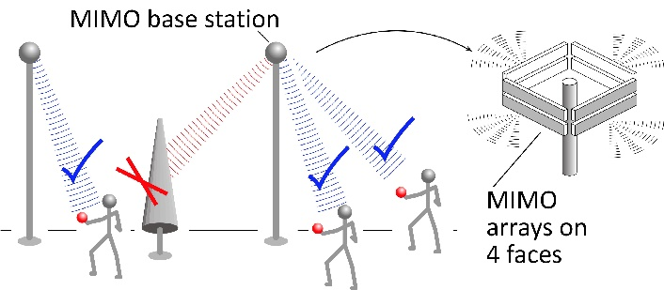
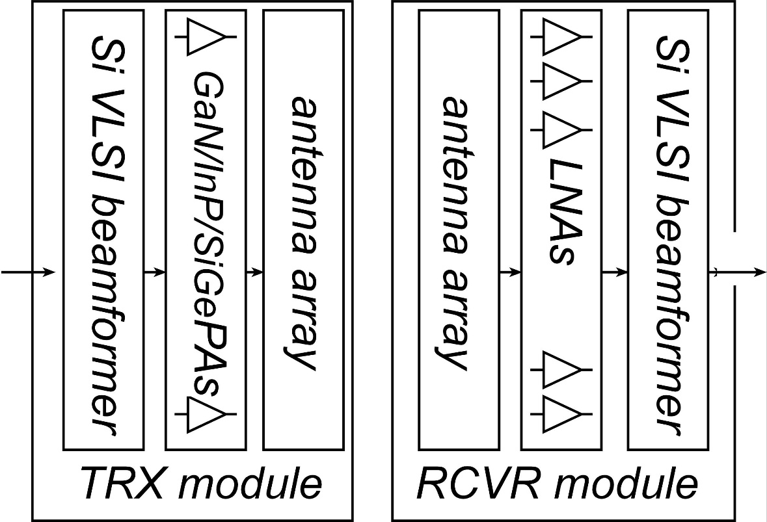
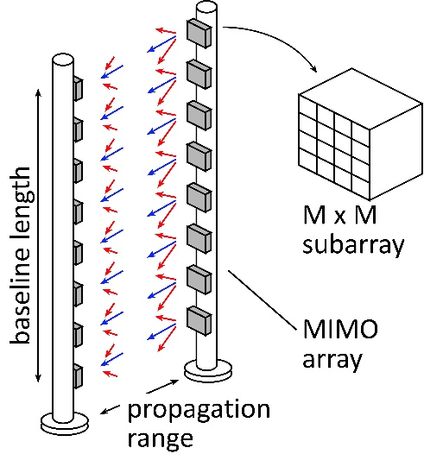
mm-Wave Wireless Transceiver Architecture
custom PAs, LNAs → power, efficiency, noise
Si CMOS beamformer→ integration scale
...similar to today's cell phones.

Slide 22
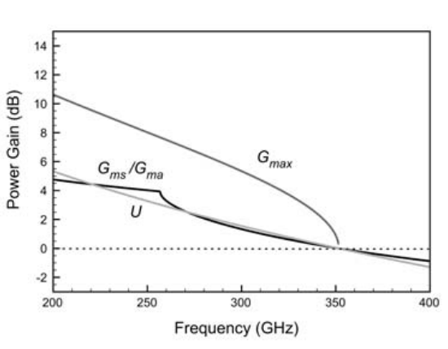
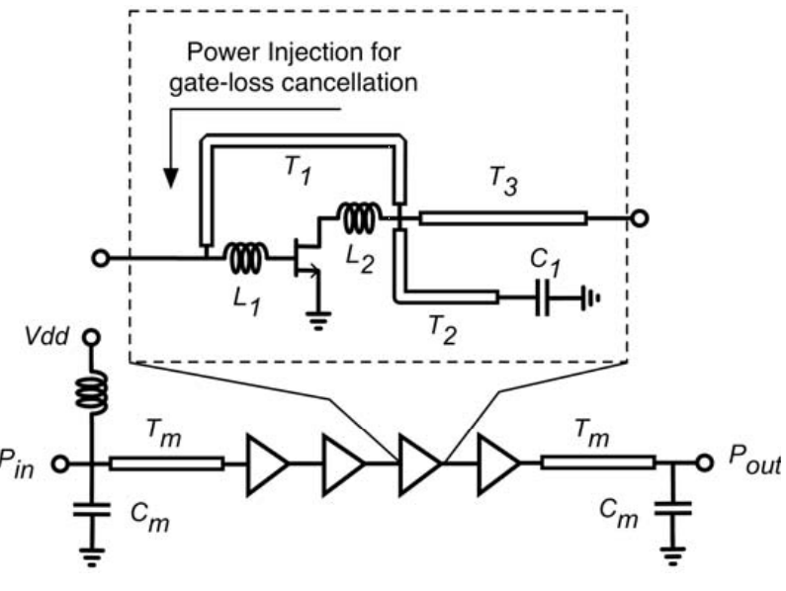
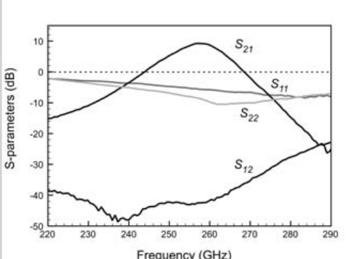
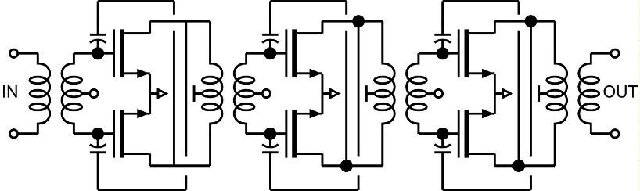
mm-wave CMOS (examples)
260 GHz amplifier, Feedback-enhanced-gain:
65nm bulk CMOS, 2.3 dB gain per stage (350GHz f_{max})
Momeni ISSCC, March 2013
350 GHz f_{max}
145 GHz amplifier, conventional neutralized design:
45 nm SOI CMOS, 6.3 dB gain per stage
Kim et al. (UCSB), unpublished

Slide 23
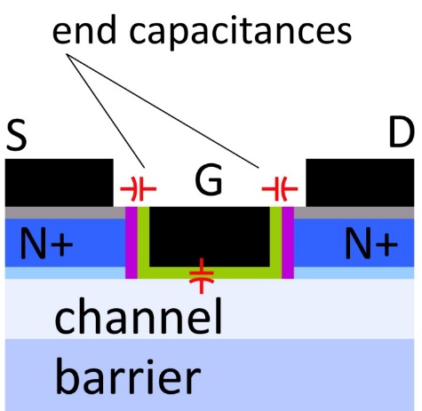

mm-Wave CMOS won't scale much further
Gate dielectric can't be thinned
→ on-current, g_{m} can't increase
Shorter gates give no less capacitance
dominated by ends; ~1fF/μm total
Maximum g_{m}, minimum C→ upper limit on f_{τ}.
about 350-400 GHz.
Tungsten via resistances reduce the gain
Inac et al, CSICS 2011
Present finFETs have yet larger end capacitances

Slide 24
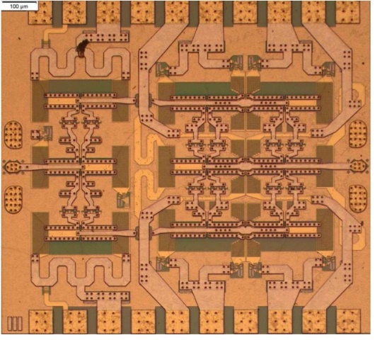
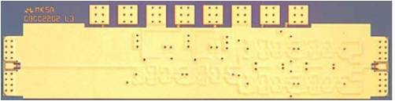
III-V high-power transmitters, low-noise receivers
Cell phones & WiFi:
GaAs PAs, LNAs
mm-wave links need
high transmit power,
low receiver noise
0.47 W @86GHz
H Park, UCSB, IMS 2014
0.18 W @220GHz
T Reed, UCSB, CSICS 2013
1.9mW @585GHz
M Seo, TSC, IMS 2013

Slide 25



130nm / 1.1THz InP HBT Technology
Teledyne: M. Urteaga et al: 2011 DRC
Rode (UCSB), IEEE TED, 2015
3.5 V breakdown

Slide 26



130nm / 1.1THz InP HBT: IC Examples
220 GHz 0.18W power amplifier
325 GHz power amplifier
UCSB/Teledyne: T. Reed et al: 2013 CSICS
UCSB/Teledyne: (being tested)
Integrated ~600GHz transmitter
Teledyne: M. Urteaga et al: 2017 IEEE Proceedings

Slide 27


InP HBT: Towards the 2 THz / 64nm Node
Narrow junctions.
Thin semiconductor layers
High current density
Ultra low resistivity contacts
Yihao Fang, UCSB, unpublished

Slide 28
HEMTs: key for low noise
Hand-derived modified Fukui Expression, fits CAD simulation extremely well.
2:1 to 4:1 increase in f_{τ} → improved noise
→ less required transmit power→ easier PAs, less DC power
or enable higher-frequency systems

Slide 29


HEMTs: State of the art
First Demonstration of Amplification at 1 THz Using
25-nm InP High Electron Mobility Transistor Process
Xiaobing Mei, et al, IEEE EDL, April 2015 (Northrop-Grumman)

Slide 30


Towards faster HEMTs
Gate barrier:
Key scaling limit
Solution
replace InAlAs barrier
with high-K dielectric
Target ~10nm node
~0.5nm EOT, ~1.5 THz f_{τ}.
Jun Wu, UCSB, unpublished

Slide 31


Systems & Packages

Slide 32

Beamforming for massive spatial multiplexing
Pure digital beamforming:
massive dynamic range throughout signal chain
massive computational complexity
Pure RF beamforming: (focal plane, Butler matrixes, RF beamforming)
Physically complex. Component precision. Lack of adaptation.
Likely best approach is tiled
Butler or RF beamforming in the tile. Analog or digital in overall array

Slide 33

Sectoral phased arrays for size, dynamic range
At a given beamwidth
and a given angular steering range,
as we increase the # of sectors,
we increase the element size (and array size),
and reduce the # of beams per sector.
mm-wave arrays become easier to construct
Dynamic range is vastly improved.

Slide 34



The mm-wave module design problem
How to make the IC electronics fit ?
100+ GHz arrays: λ₀/2 element spacing is very small.
Antennas on or above IC → IC channel spacing = antenna spacing
→ limited IC area to place circuits
How to avoid catastrophic signal distribution losses ?
long-range, high-gain arrays: array size can be large.
ICs beside array → very long wires between beam former and antenna
→ potential for very high signal distribution losses
How to remove the heat ?
100+ GHz arrays: element spacing is very small.
If antenna spacing = IC channel spacing, then power density is very large

Slide 35

background: split-block waveguides
Waveguides are manufactured (milled or die cast) from a set of pieces
Precision pins aid alignment

Slide 36

Concept: Tile for mm-wave arrays
Split-block assembly. Modules tile into larger array
IC area can be much larger than antenna area→ electronics can fit
Low-loss waveguide feeds, efficient waveguide horn antennas
Efficient heat-sinking: permits W-level GaN, InP, SiGe PAs for long range

Slide 37
Wireless Above 100 GHz

Slide 38
Wireless above 100 GHz
Massive capacities
large available bandwidths
massive spatial multiplexing in base stations and point-point links
Very short range: few 100 meters
short wavelength, high atmospheric losses. Easily-blocked beams.
IC Technology
All-silicon for short ranges below 250 GHz.
III-V LNAs and PAs for longer-range links. Just like cell phones today
III-V frequency extenders for 340GHz and beyond
The challenges
spatial multiplexing: computational complexity, dynamic range
packaging: fitting signal channels in very small areas

Slide 39
(backup slides follow)

Slide 40
Talk is 30 min
plus 10 min for questions…
25-30 slides

