Slide 1
IC, Package, and System Technologies for 140GHz MIMO hubs and 210/280GHz MIMO backhaul links
Silicon Monolithic Integrated Circuits in RF Systems (SiRF2021), San Diego, CA, 21 January 2021
Mark Rodwell, Ahmed Ahmed, Ali Farid, Utku Solyu,
University of California, Santa Barbara
Munkyo Seo
Sungkyunkwan University (on sabbatical at UCSB)
This work was supported in part by the Semiconductor Research Corporation (SRC) and DARPA.

Slide 2

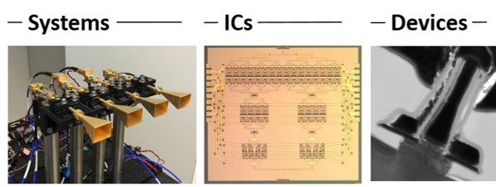
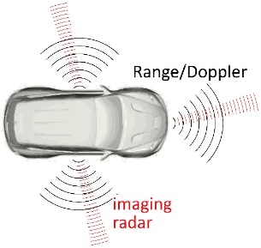
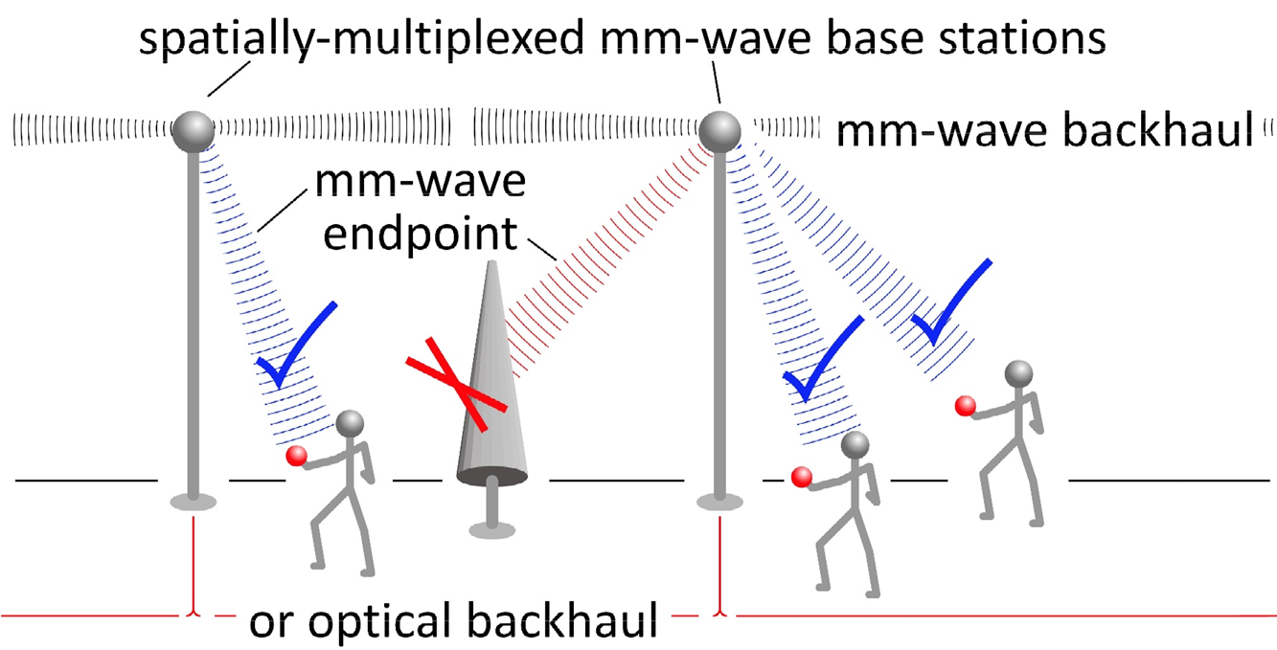
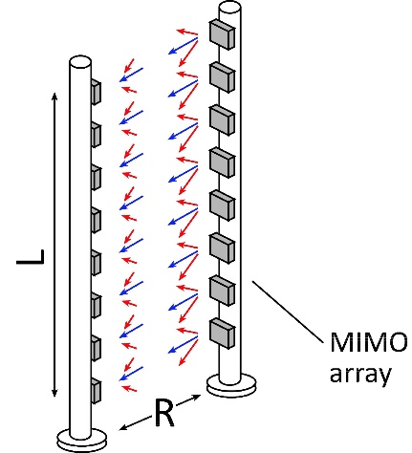
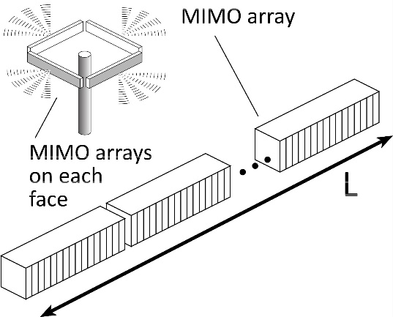
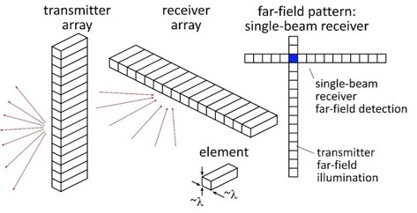
Beyond-5G Wireless
Wireless networks: exploding demand.
Immediate industry response: 5G.
~10-100GHz carriers.
increased spectrum, extensive beamforming
Next generation (6G ??): above 100GHz..
greatly increased spectrum, massive spatial multiplexing
JUMP Centers: research commercialized in 15 years
ComSenTer: 100-300GHz carriers, massive spatial multiplexing
→ Terabit hubs and backhaul links, high-resolution imaging radar

Slide 3
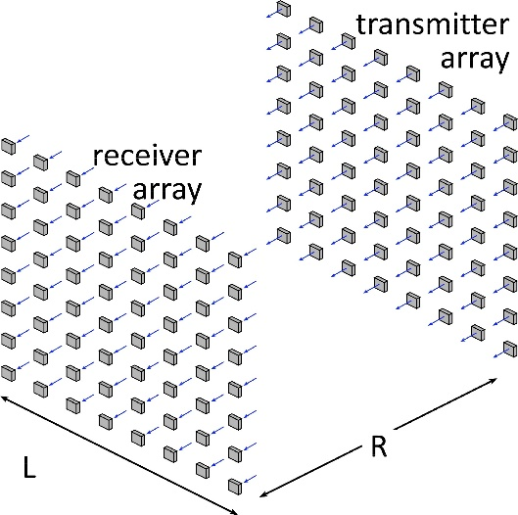
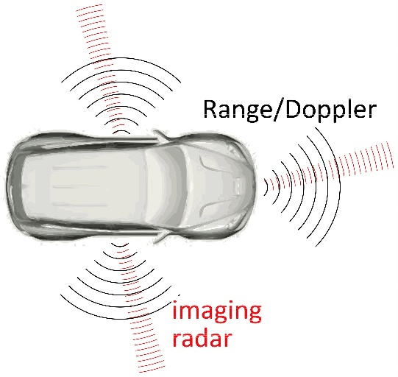

Benefits of Short Wavelengths
Communications: Massive spatial multiplexing, massive # of parallel channels. Also, more spectrum!
Imaging: very fine angular resolution
But:
High losses in foul or humid weather.
High λ²/R² path losses.
ICs: poorer PAs & LNAs.
Beams easily blocked.
100-340GHz wireless:
terabit capacity,
short range,
highly intermittent

Slide 4
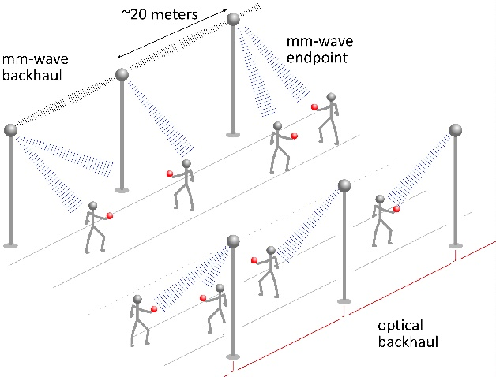
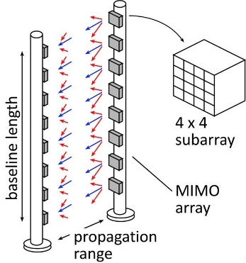
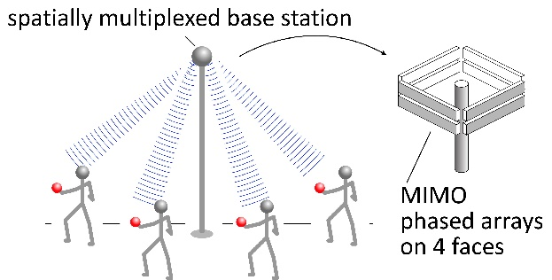
100-300 GHz:
Applications

Slide 5
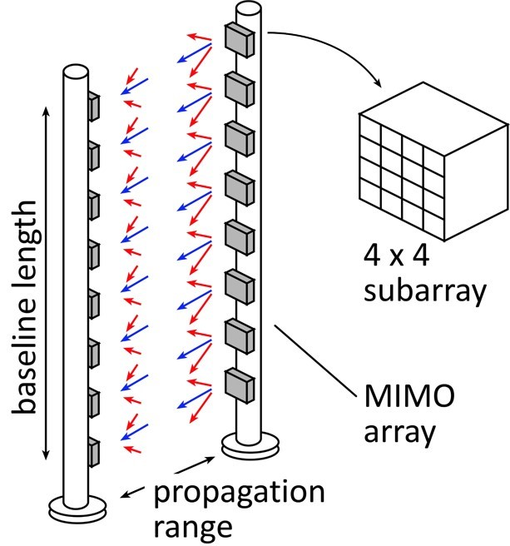
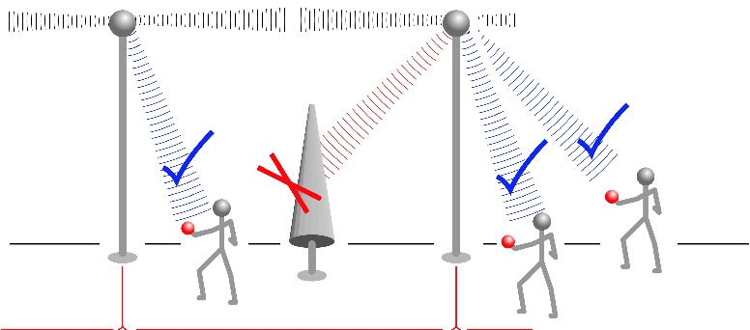

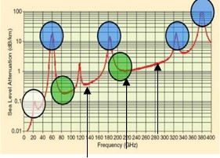
100-300GHz: Demonstration Systems
MIMO hub: 140GHz
Point-point MIMO: 210, 280GHz
Cross-linear-array imaging: 210, 280GHz
UCSB FCC permit: 137 +/- 15 GHz, 210 +/- 15 GHz, 280 +/- 15 GHz

Slide 6
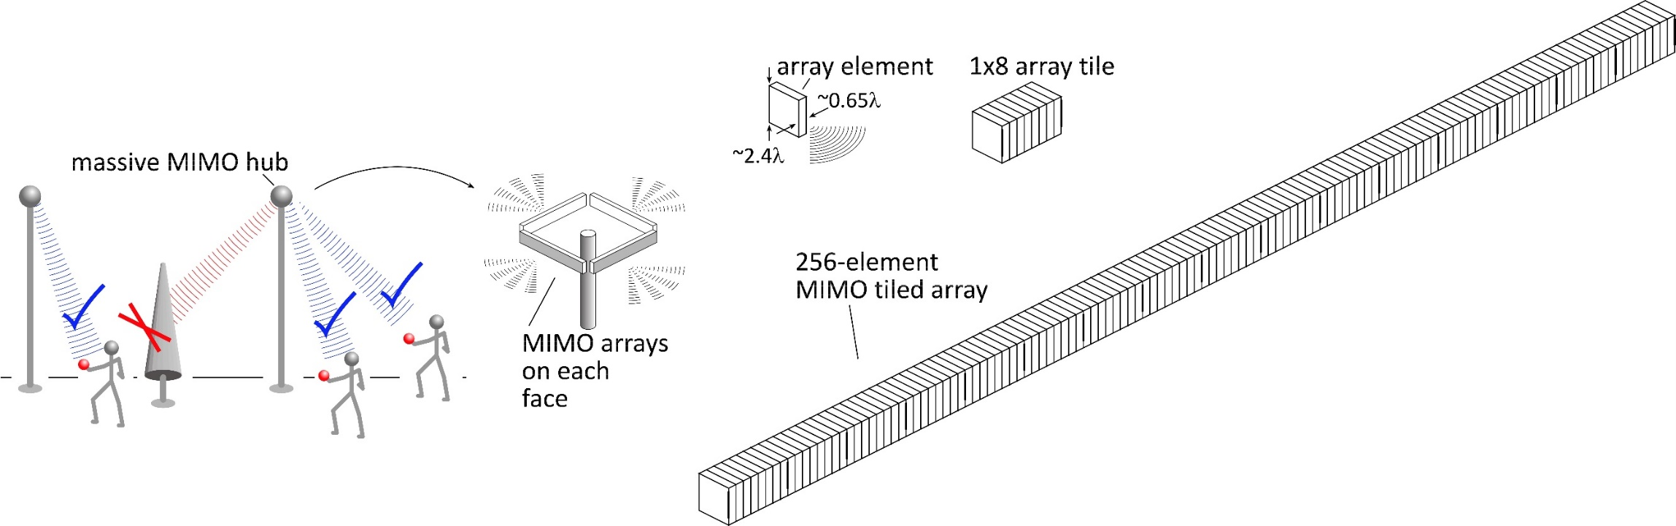
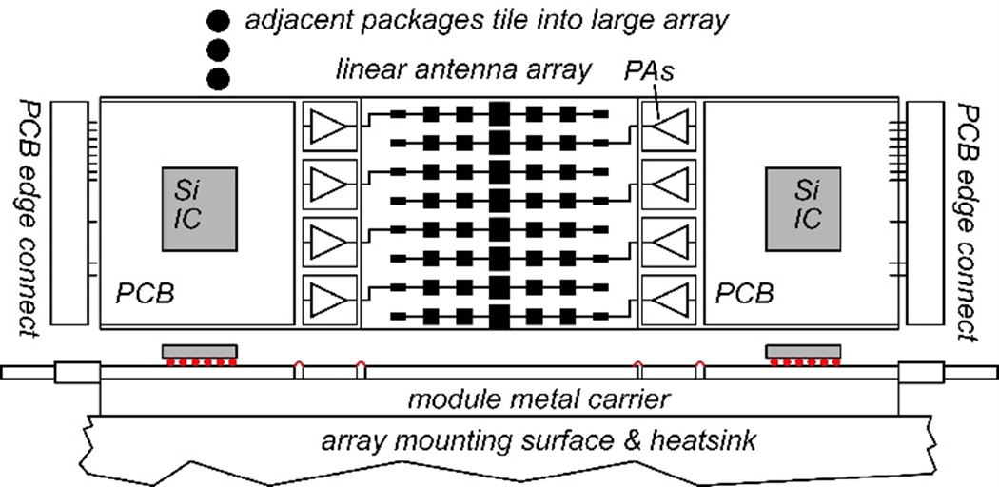
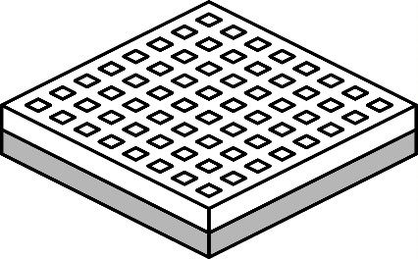
140GHz massive MIMO hub
Handset:
8 × 8 array
(9×9mm)
0.5-5 Tb/s spatially-multiplexed 140GHz base station
128 users/face, 4 faces. P_{1dB}=21 dB_{m} PAs, F=8dB LNAs
512 total users @ 1 user/beam, 1,10 Gb/s/beam;
230, 100 m range in 50mm/hr rain with 17dB total margins

Slide 7
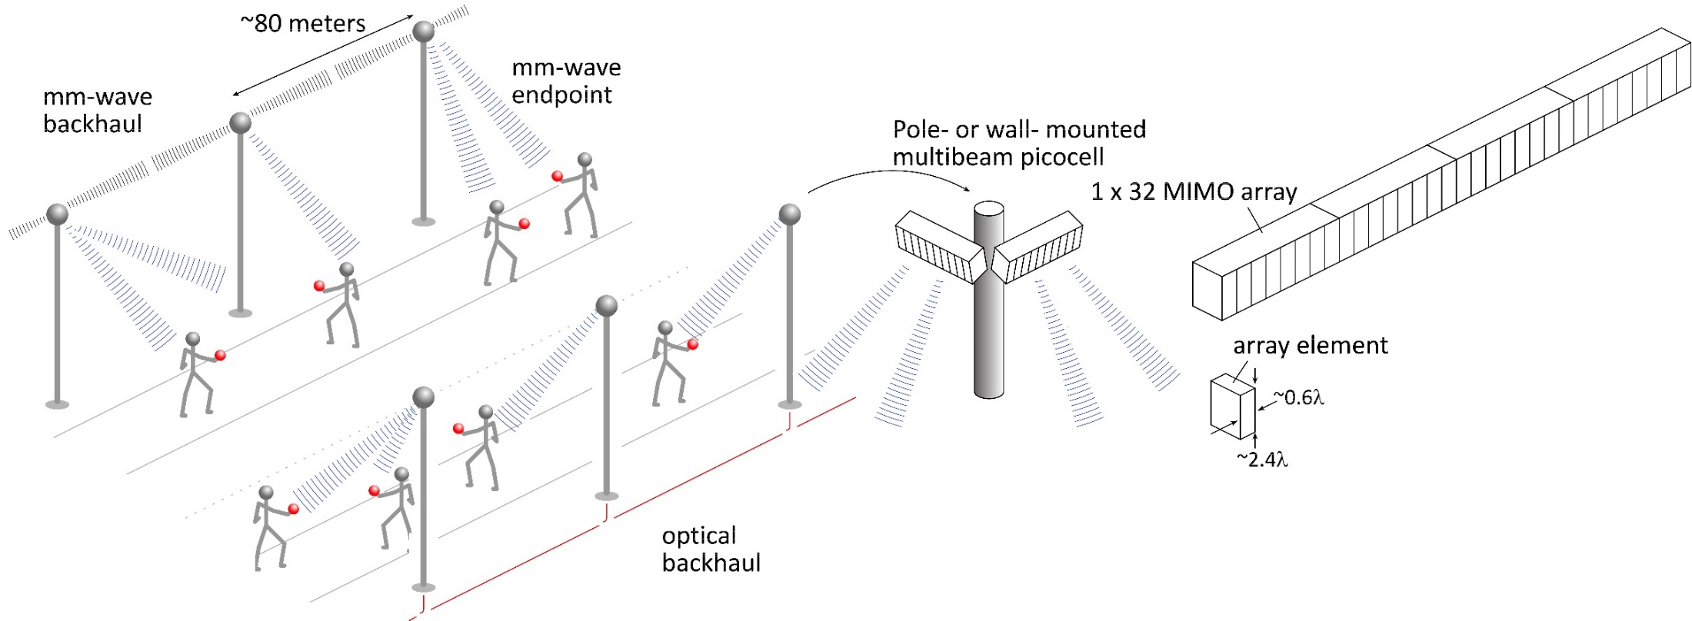
140GHz moderate-MIMO hub
If demo uses 32-element array (four 1×8 modules):
16 users/array. P_{1dB}=21 dB_{m} PAs, F=8dB LNAs
1,10 Gb/s/beam→ 16, 160 Gb/s total capacity
40, 70 m range in 50mm/hr rain with 17dB total margins
Range varies as (# hub elements)^{0.5} → (Service area/element) is constant
Handset:
8 × 8 array
(9×9mm)

Slide 8
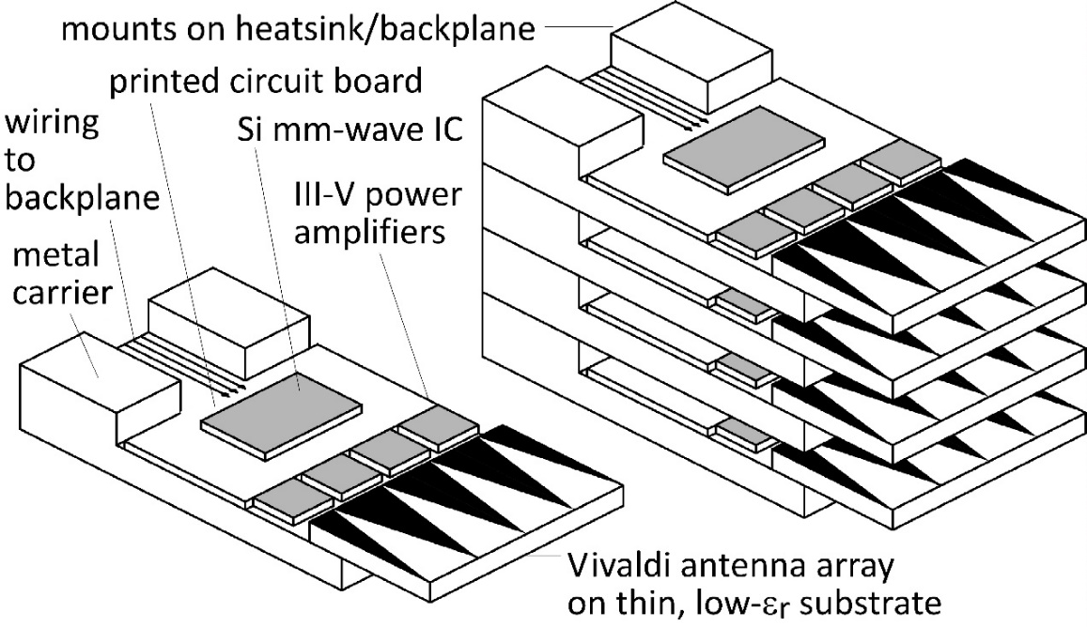
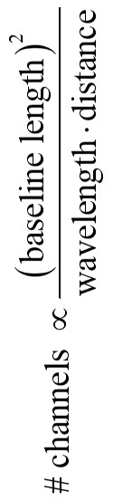
210 GHz, 640 Gb/s MIMO Backhaul
8-element MIMO array
3.1 m baseline.
80Gb/s/subarray→ 640Gb/s total
4 × 4 sub-arrays → 8 degree beamsteering
Key link parameters
500 meters range in 50 mm/hr rain; 23 dB/km
20 dB total margins:
packaging loss, obstruction, operating,
design, aging
PAs: 18dBm =P_{1dB} (per element)
LNAs: 6dB noise figure

Slide 9
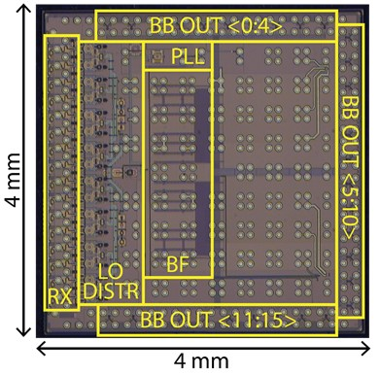
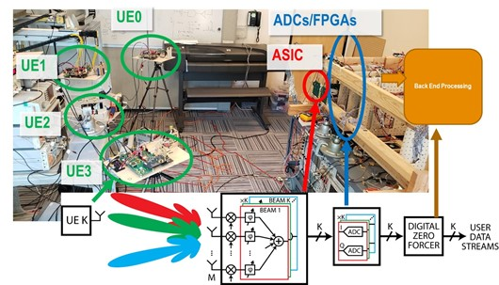
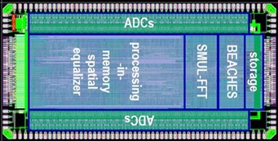
Overall ComSenTer Research

Slide 10



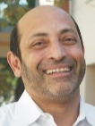



















ComSenTer: Wireless Research
Systems
ICs
Transistors
Networks, Applications,
MIMO, Power
mm-wave CMOS:
hub
mm-wave arrays
mm-wave MIMO
mm-wave CMOS:
handset
mm-wave arrays
N-polar GaN HEMTs
for 140, 210GHz
Sundeep
Rangan
Ali Niknejad
UC Berkeley
Gabriel Rebeiz
UC San Diego
Umesh Mishra
UC Santa Barbara
Upamanyu
Madhow
UC Santa Barbara
MIMO algorithms
Imaging algorithms
Compressive imaging
efficient PAs
III-V arrays
Alyosha Molnar
Cornell
N-path mixers
MIMO ADCs
Huili (Grace) Xing
Cornell
AlN/GaN HEMTs
for 140, 210GHz
James Buckwalter
UC Santa Barbara
MIMO algorithms
VLSI MIMO processors
200-300GHz
passive CMOS
design automation
equalizers
GaN HEMTs
on Si
Christoph Studer
Cornell
Kenneth O
UT Dallas
Elad Alon
UC Berkeley
Debdeep Jena
Cornell
Andreas
Molisch
USC
100-300GHz
propagation
measurements
Harish Krishnaswamy
Columbia
STAR
Novel MIMO
photonic links
Diamond cooling
for GaN
Vladimir
Stojanovic
UC Berkeley
Srabanti Chowdhury
UC Davis
Applications:
VR, cars, …
acoustic filters
Susanne Stemmer
UC Santa Barbara
transistors in
novel materials
Dina Katabi
MIT
Hossein Hashemi
USC
Massive
MIMO demo.
VLSI design automation
VLSI MIMO processors
Danijela Cabric
UCLA
Borivoje Nikolic
UC Berkeley
140/210/290GHz arrays for demos.
THz HBTs for PAs
THz HEMTs for LNAs
MIMO algorithms
Mark Rodwell
UC Santa Barbara
Compressive
imaging
140GHz radar chipsets
and arrays
Amin Arbabian
Stanford

Slide 11
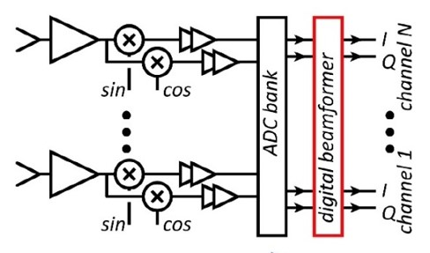
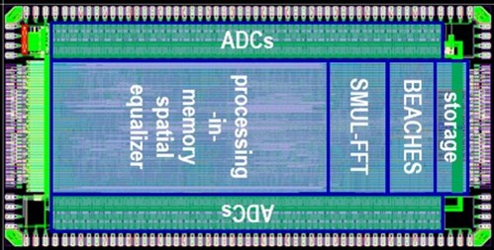
ComSenTer Research: Systems
Digital beamforming:
ADCs/DACs: only 3-4 bit ADC/DACs required (Madhow, Studer)
Linearity: Amplifier P_{1dB} need be only 3dB above average power (Madhow).
Phase noise: Requirements same as for SISO (Alon, Madhow, Niknejad, Rodwell)
Efficient digital beamforming: beamspace algorithm=complexity ~N× log(N) (Madhow, Studer)
Efficient digital beamforming: low-resolution matrix (Studer, Molnar)
Efficient channel estimation : fast beamspace algorithm (Studer)
Efficiently addressing true-time-delay problem: "rainbow" FFT algorithm (Madhow, Cabric)
Other issues:
Propagation models and measurements
Blockage probability, mesh networks, network protocols

Slide 12
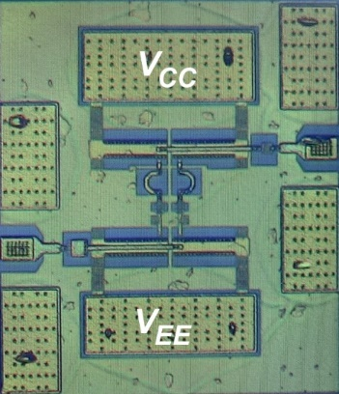
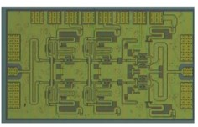
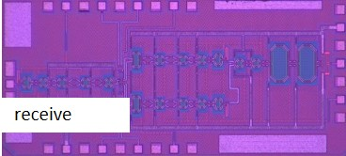
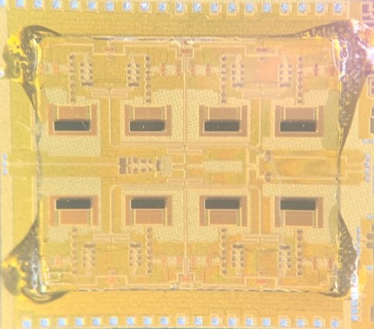
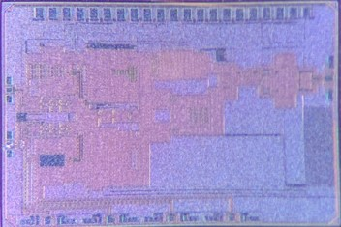
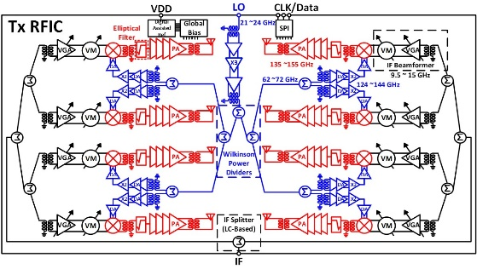
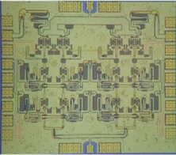
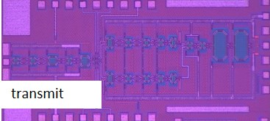
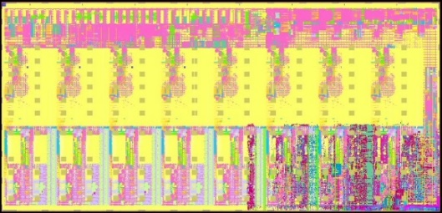
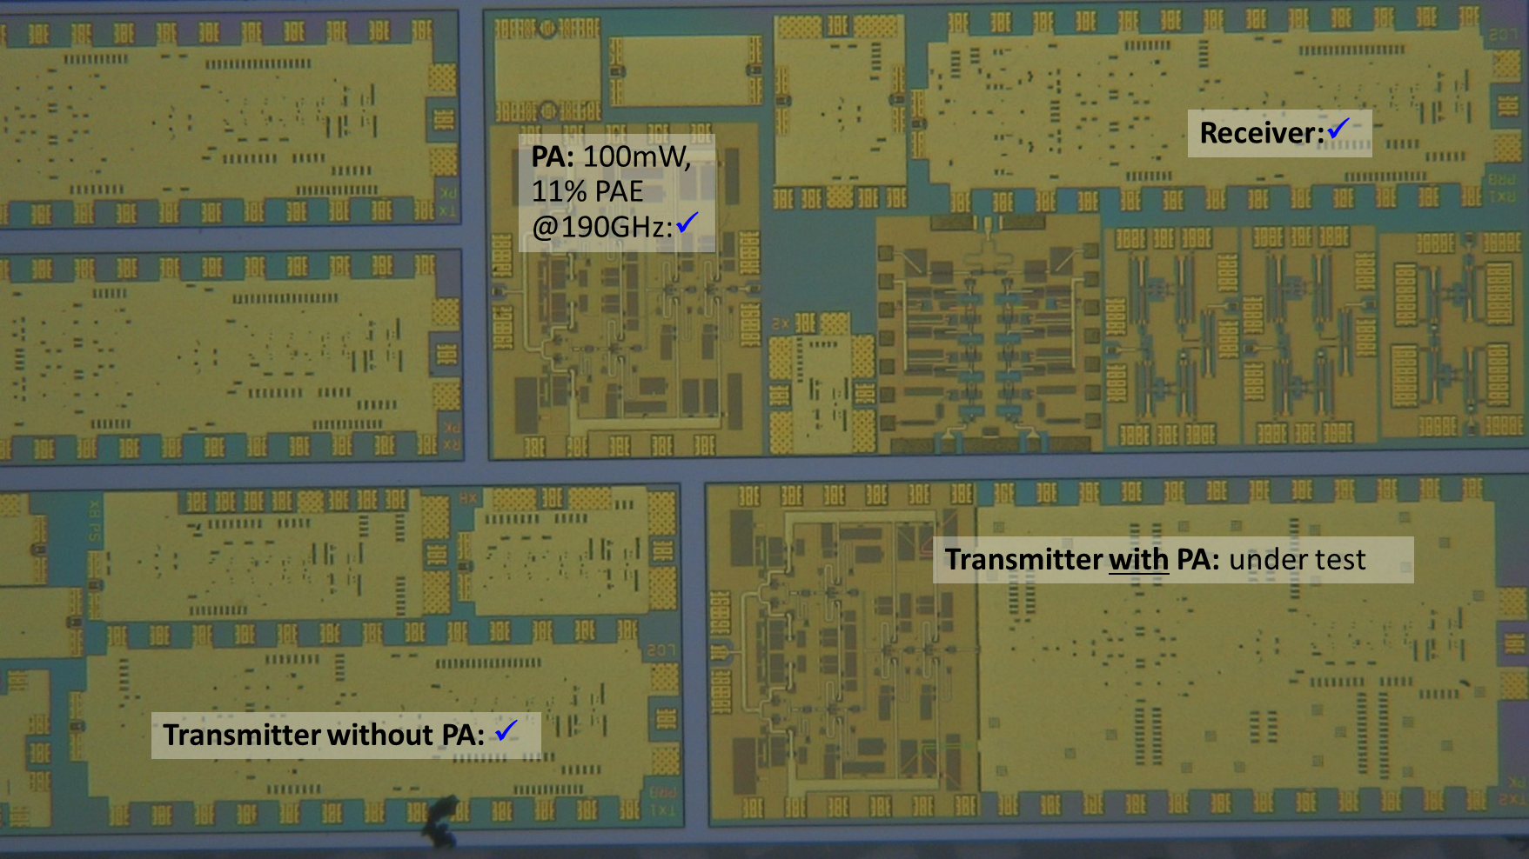
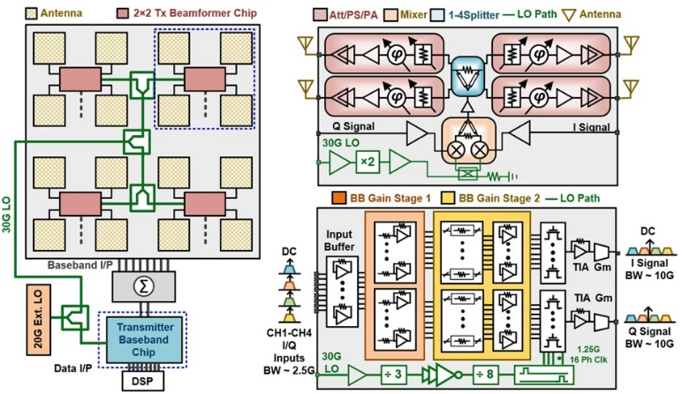
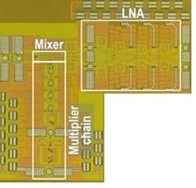
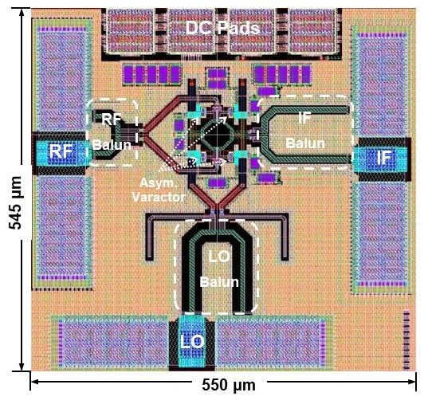
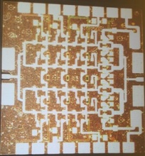
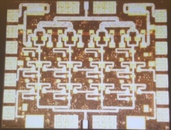
ComSenTer Research: ICs
Record-PAE Class B
140GHz PAs Buckwalter
Record-PAE Class A
100-200mW
140GHz PAs Rodwell
140GHz CMOS handset ICs Rodwell
140GHz 8-element handset TRX, RCVR arrays and PAs Rebeiz
210GHz InP transceivers and arrays, 210, 280GHz PAs Seo/Rodwell
Hydra digital processor (beamformer)
Nikolic
60GHz CMOS channel
aggregation transceiver
Krishnaswamy
280GHz CMOS upconvert mixers
420 GHz CMOS receiver O
Beamspace digital beamformer Studer/Molnar
75GHz MIMO front-ends
Niknejad, Alon, Nikolic
Not shown:
140GHz, 210GHz outphasing transmitters Buckwalter
mm-wave N-path mixers Molnar
GaN active circulators Krishnaswamy
140GHz GaN PAs Buckwalter

Slide 13
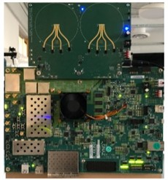
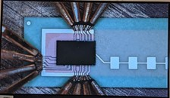
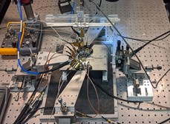
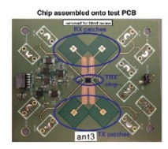

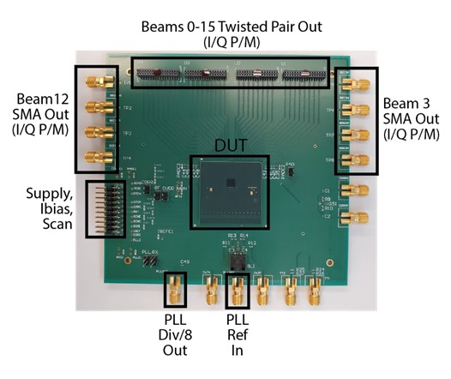
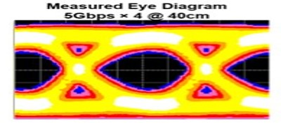
ComSenTer Research: Demos
BWRC Testbed:
RF: 75GHz BWRC & 140GHz UCSB
Digital: FPGA, COTS Hydra, ASIC Hydra
NYU Testbed:
RF: 60GHz SDR (NYU) & 140GHz UCSB
Digital: FPGA
140GHz MIMO hub modules UCSB
Hydra digital processor
Nikolic
75GHz MIMO Module
Niknejad
75GHz MIMO IC
Niknejad
ICs for 210GHz Demo Rodwell
120GHz MIMO link Niknejad
130GHz MIMO link Arbabian

Slide 14
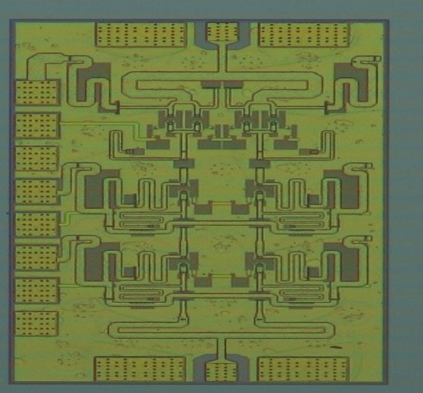
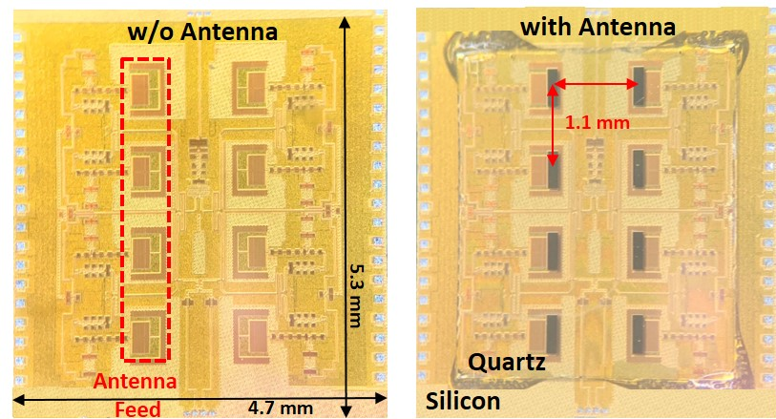
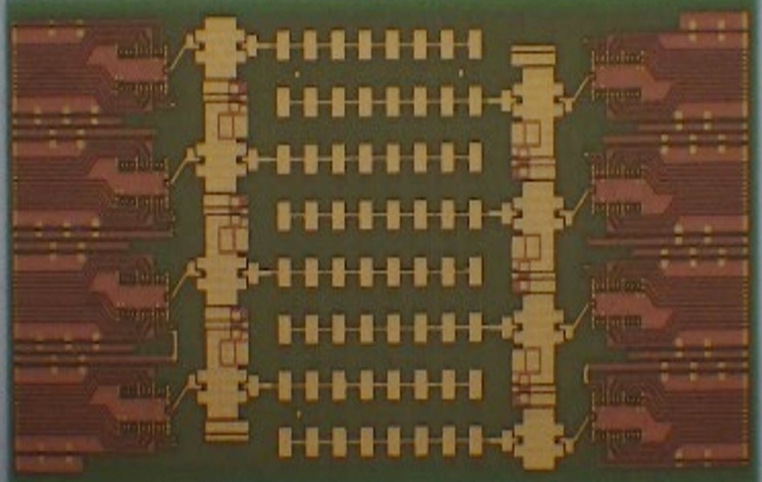
140GHz ICs and Modules

Slide 15





The mm-wave module design problem
How to make the IC electronics fit ?
How to avoid catastrophic signal losses ?
How to remove the heat ?
Not all systems steer in two planes...
...some steer in only one.
Not all systems steer over 180 degrees...
...some steer a smaller angular range

Slide 16





140GHz hub: packaging challenges
IC-package interconnects
Difficult at > 100 GHz
Removing heat
Thermal vias are marginal
Interconnect density
Dense wiring for DC, LO, IF, control.
Hard to fit these all in.
Economies of scale
Advanced packaging standards require sophisticated tools
High-volume orders only
Hard for small-volume orders (research, universities)
Packaging industry is moving offshore

Slide 17





100-300GHz IC-package connections
type | Frequency | technology | cost | heatsinking
micromachined waveguide interface | 1000 GHz | Research. Cheap one day ? | high ✘ | good
ribbon, mesh bond | 200 GHz | Handcrafted. | high ✘ | good
patch antennas on superstrate | 1000 GHz | Straightforward | low | good
Cu stud flip-chip | >200 GHz | Industry standard | low | ok, marginal for PA ✘
hot vias | 200 GHz | Development | low ? | good
(ball) wirebonds | 100 GHz ✘ | Industry standard | low | good
Deal, IEEE Trans THz,
Sept 2011
G. Rebeiz

Slide 18


Cu Pillars vs. C4 Solder-bonds
Cu pillars:
Small geometry: 50 μm diameter
Excellent 140GHz characteristics: ~0.7dB loss without tuning.
Requires solder mask with very small openings (<75 μm).
Requires tight lithographic resolution on interposer.
C4 bonds:
Readily handled by LTCC and PCB board and assembly firms.
140GHz parasitics require impedance-tuning on LTCC carriers.
0.5dB loss feasible after tuning

Slide 19









140GHz massive MIMO hub modules
140GHz InP PAs
140GHz CMOS ICs
transmit
P_{sat} ~100mW
receive
8 CMOS ICs, 8 InP PAs
LTCC-based array tile
…
…
connector interface board
Kyocera LTCC carrier
connector interface board
Farid, Ahmed, Rodwell, UCSB; Flynn, Dunn, Niknejad, Nikolic, BWRC; Rebeiz, UCSD

Slide 20


140GHz hub: ICs & Antennas
110mW InP Power Amplifier
20.8% PAE
LTCC Array module
CMOS Transmitter IC
22nm SOI CMOS.
190mW InP Power Amplifier
16.7% PAE
Receiver IC
22nm SOI CMOS.
GlobalFoundries 22nm SOI CMOS
1 cm
Teledyne InP HBT
Kyocera

Slide 21



140GHz Receiver, GlobalFoundries 22nm SOI CMOS
~15GHz bandwidth,
~8dB Noise Figure
A. Farid UCSB, 2019 RFIC symposium
0.76 mm
1.9 mm

Slide 22



140GHz Transmitter, GlobalFoundries 22nm SOI CMOS
~10GHz bandwidth,
~2dBm output power
A. Farid UCSB, 2019 RFIC symposium
0.76 mm
1.9 mm

Slide 23




140GHz InP PA: 20.5dBm, 20.8% PAE
17dBm, 9.7% PAE @ P_{1dB}
A. S. Ahmed UCSB, 2020 IMS
Teledyne 250nm InP HBT
1.08 mm x 0.63 mm
Capacitively-degenerated
common-base stages

Slide 24
140GHz InP PA: 23dBm, 17.8% PAE
20.2dBm, 9.4% PAE @ P_{1dB}
A. S. Ahmed UCSB, 2020 EuMiC
Teledyne 250nm InP HBT
1.23 mm x 1.09 mm
Capacitively-degenerated
common-base stages

Slide 25


140GHz Single-Channel CMOS-Only Transmitter
A. Farid, A. S. Ahmed, UCSB, results in review

Slide 26


140GHz Single-Channel CMOS+InP Transmitter
A. Farid, A. S. Ahmed, UCSB, modules being tested

Slide 27

140GHz 8-Channel All-CMOS Transmitter Array
Presently learning how to assemble complex modules…

Slide 28


210GHz ICs
and Modules

Slide 29
210 GHz MIMO backhaul demo
8-element MIMO array
3.1 m baseline for 500m link.
80Gb/s/subarray→ 640Gb/s total
4 × 4 sub-arrays → 8 degree beamsteering
Key link parameters
500 meters range in 50 mm/hr rain; 23 dB/km
20 dB total margins:
packaging loss, obstruction, operating,
design, aging
PAs: 63mW =P_{1dB} (per element)
LNAs: 6dB noise figure

Slide 30





InP ICs for 210GHz Point-Point MIMO
Transceivers & Arrays
for 210GHz MIMO links
Planned packaging approaches
2/2020 tapeout:
210 GHz TX front-end w/ +20 dBm Psat
210 GHz TX front-end w/ +2 dBm Psat
210 GHz RX front-end
280GHz PAs and LNAs
InP IC bonding to patch antenna arrays on quartz.
plan: ribbon bonds using wedge bonder
5/2020 tapeout:
Improved 210, 280GHz LNAs and PAs
210 GHz transmitters, receivers using these
2x2 transmitter array with superstrate antenna
2x2 receiver array with superstrate antenna
2x2 array with UCSD SiO₂ antenna superstrate
simple, expensive in die area
limits array size to 2x2 (or 2x4).
Seo, UCSB & Sungkyunkwan Univ.; Ahmed, Solyu, Rodwell, UCSB; Li, Zhang, Rebeiz, UCSD

Slide 31
InP ICs for 210GHz Point-Point MIMO
Transceivers & Arrays
for 210GHz MIMO links
Planned packaging approaches
2/2020 tapeout:
210 GHz TX front-end w/ +20 dBm Psat
210 GHz TX front-end w/ +2 dBm Psat
210 GHz RX front-end
280GHz PAs and LNAs
InP IC bonding to patch antenna arrays on quartz.
plan: ribbon bonds using wedge bonder
5/2020 tapeout:
Improved 210, 280GHz LNAs and PAs
210 GHz transmitters, receivers using these
2x2 transmitter array with superstrate antenna
2x2 receiver array with superstrate antenna
2x2 array with UCSD SiO₂ antenna superstrate
simple, expensive in die area
limits array size to 2x2 (or 2x4).
Seo, UCSB & Sungkyunkwan Univ.; Ahmed, Solyu, Rodwell, UCSB; Li, Zhang, Rebeiz, UCSD

Slide 32

210 GHz MIMO backhaul: ICs
ICs being tested;
some to be submitted, others need re-design.
LNA
Receiver:✓
PA ✓
Teledyne 250nm (650GHz) InP HBT.
Transmitter with PA: ✘
Transmitter without PA: ✓

Slide 33

210GHz Power Amplifier
Design goal: high PAE @ 1dB gain compression
Teledyne 250nm InP HBT
A. S. Ahmed, UCSB, results in review

Slide 34

300GHz Power Amplifier
Design goal: high PAE @ 1dB gain compression
Teledyne 250nm InP HBT
Measured S-parameters on target
Large-signal (power) data pending.
280GHz design also being tested.
A. S. Ahmed, UCSB

Slide 35
100-300GHz Wireless

Slide 36
Wireless above 100 GHz
Massive capacities
large available bandwidths
massive spatial multiplexing in base stations and point-point links
Very short range: few 100 meters
short wavelength, high atmospheric losses. Easily-blocked beams.
IC Technology
All-CMOS for short ranges below 200 GHz.
SiGe, GaN, or III-V LNAs and PAs for longer-range links. Just like cell phones today
SiGe or III-V frequency extenders for 220GHz and beyond
The challenges
digital beamformer computational complexity
packaging: fitting signal channels in very small areas
mesh networking to accommodate beam blockage
driving the technologies to low cost

Slide 37
(backup files follow)

