Slide 1

A compact H-band Power Amplifier with High Output Power
A. Ahmed^{1,2}, U. Soylu², M. Seo³,
M. Urteaga⁴, and M. Rodwell²
a_s_ahmed@ucsb.edu
¹Marki Microwave Inc., CA
²ECE, University of California, Santa Barbara, USA
³ECE, Sungkyunkwan University, South Korea
⁴Teledyne Scientific Company, Thousand Oaks, CA, USA

Slide 2
Outline
Motivation for sub-THz frequencies.
Prior work at H-band.
Potential applications for the amplifier.
Amplifier design
  unit cell and low-loss compact combiner
Measurement results
Summary and conclusion

Slide 3
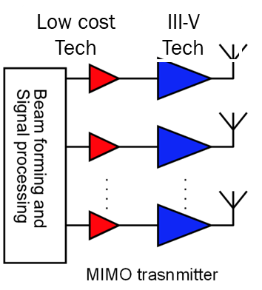
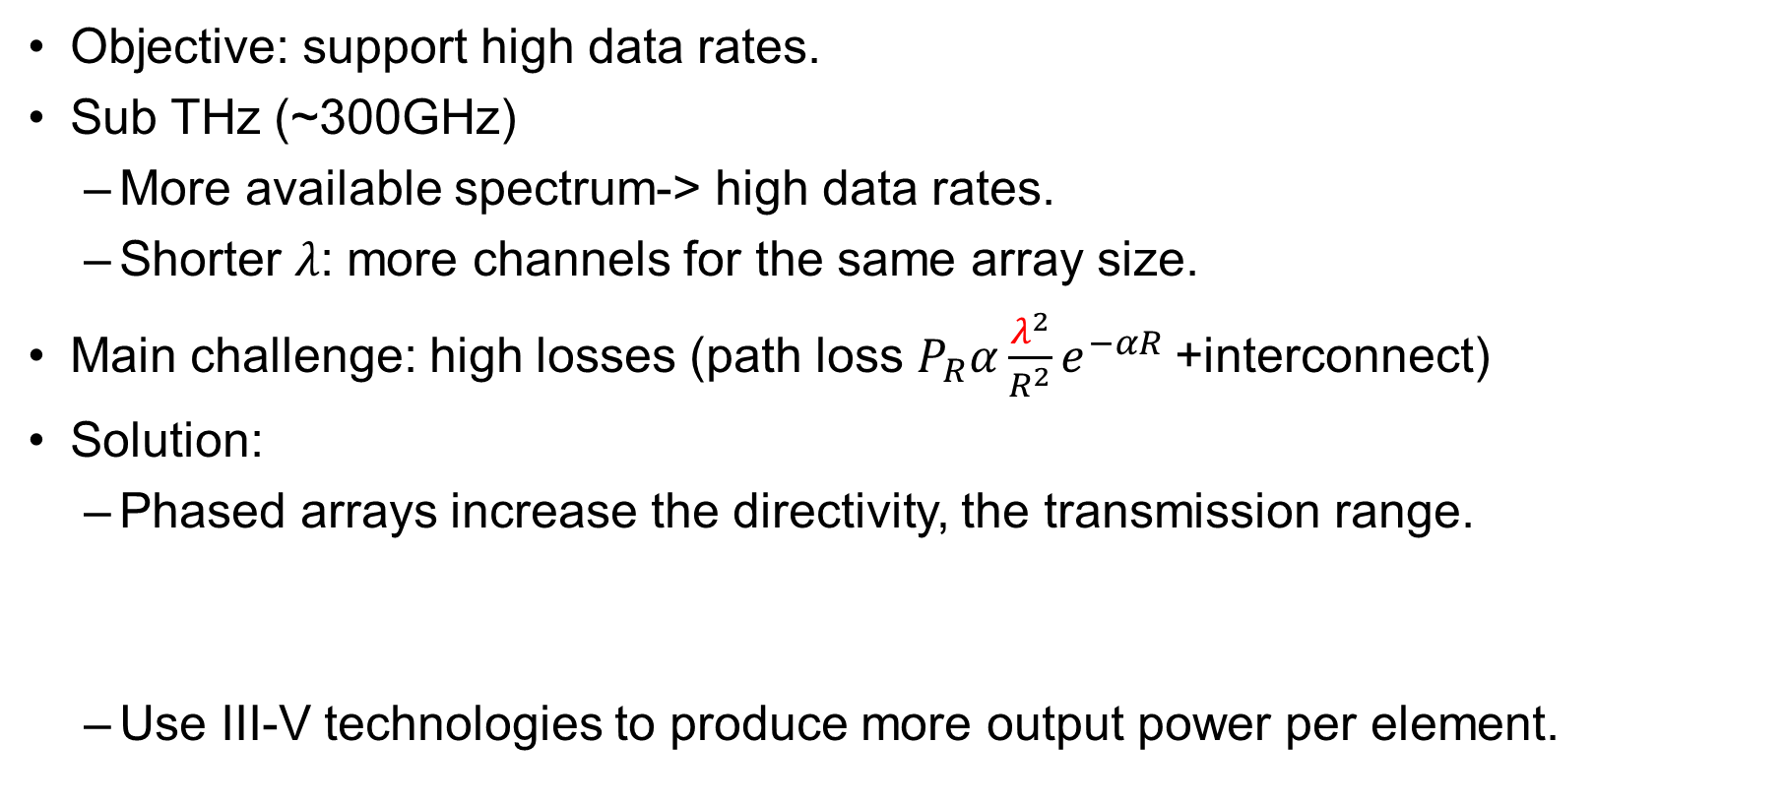
Motivation
Objective: support high data rates.
Sub THz (~300GHz)
  More available spectrum-> high data rates.
  Shorter 𝜆: more channels for the same array size.
Main challenge: high losses (path loss $P_{R}α\frac{λ^{2}}{R^{2}}e^{−αR}$+interconnect)
Solution:
  Phased arrays increase the directivity, the transmission range.
  Use III-V technologies to produce more output power per element.

Slide 4
Prior Work at H-band
CMOS shows -3.9dBm at 257GHz [1].
III-V technologies show better performance, though power and efficiency are still low.
Compact, low –loss combiner and high-efficiency power cell
-> increase the efficiency and P_{sat}/area.
Ref | [1] | [5] | [7] | [8] | [2] | [10] | [9] | [4] | [6] | [11] | [3]
Freq, GHz | 257 | 240 | 185-255 265 | 325 | 275-320 | 338 | 300-305 | 300 | 290-307.5 | 301 | 280-328
P_{sat}, dBm | -3.9 | >10.8 | 20-23.9 17.2 | 11.3 | 2.7-4.8 | 10 | 9.5-9.8 | 8 | 7.8-10 | 13.5 | 9.6-13.7
PAE at P_{sat}% | 1.35 | 5 | 4.1 0.95 | 1.1 | 2.3 | 1.8 | 1.1 | 2.97 | 1.1 | 1.5 | 0.8-2.4
Technology | 65nm CMOS | 35 nm GaAs mHEMT | 250-nm InP HBT | 130-nm InP HBT | 35 nm InAlAs/InGaAs | 50 nm InP HEMT | 250-nm InP HBT | 35 nm InGaAs mHEMT | 250-nm InP HBT | 250-nm InP HBT | 35 nm InGaAs mHEMT

Slide 5

This Work and Potential Applications
Target ~ 17dBm output power with 4%PAE.
P_{out}~17dBm output power per element extends the link range to ~50m*
(8x8 array, vertical and horizontal beam angles=7º)*
Candidate PA for subTHz transmitters for long-range applications
Drivers could be designed in InP or low-cost technologies.
Measuring equipment->boost the output power of the sources.
*https://web.ece.ucsb.edu/Faculty/rodwell/Classes/ece218c/ECE218c.htm

Slide 6
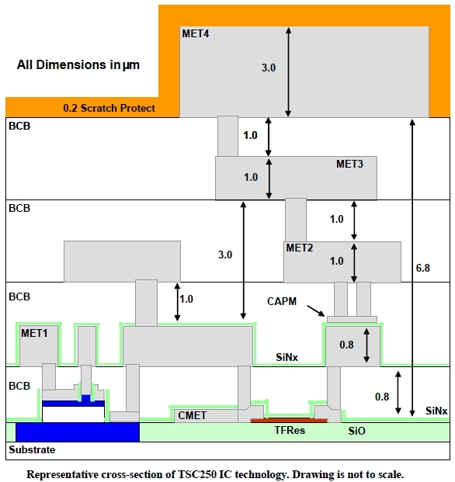
250nm InP HBT Process, Teledyne [12]
subTHz amplifier requires fast technologies.
f_{max}=650GHz.
BV_{CEo}=4.5V.
J_{max}=3mA/µm.
Four Au interconnect.
MIM cap (0.3fF/µm2).
TFR (50Ω/square).
Cross section of TSC250 IC

Slide 7
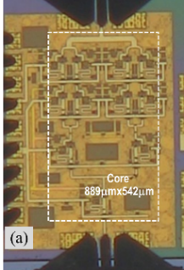
Power Amplifier Design
Four-stage amplifier.
Combine four power cells.
Driver scaling sustains good PAE.
Power combining techniques
  Parallel combining: 4:1 transmission line combiner.
  Series combiner: stacked unit cell.
Chip micrograph of the amplifier
Block diagram of the amplifier

Slide 8
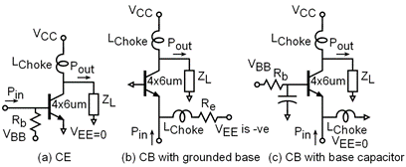
Unit Cell Comparison
Comparison between CE, grounded CB
and CB with base capacitor
Simulation under same bias condition
Large signal simulation is more relevant
in power amplifier
CB with base capacitor shows the highest
OP_{1dB} with associated PAE
Design is still challenging.
At 270GHz
 | Gain*, dB | PAE @ OP_{1dB}**, % | OP_{1dB}, dB_{m}
CE | 4.9 | 13.6 | 13.1
Grounded CB | 10.8 | 8.4 | 9.6
CB with 208f cap | 5.6 | 16 | 13.7
P_{out}, gain, and PAE for CE, grounded CB, and CB with base capacitor.
*under opt load line condition without compression

Slide 9
Unit Cell Design
Shunt inductor: tunes the transistor parasitics.
The cell requires resistive load impedance (~18Ω).
Base capacitance is significantly reduced (~208fF).
  Lower parasitic inductance → higher self resonance frequency.
  Avoid gain uncertainty and stability problems.
ZL~18Ω
Schematic of the unit cell

Slide 10
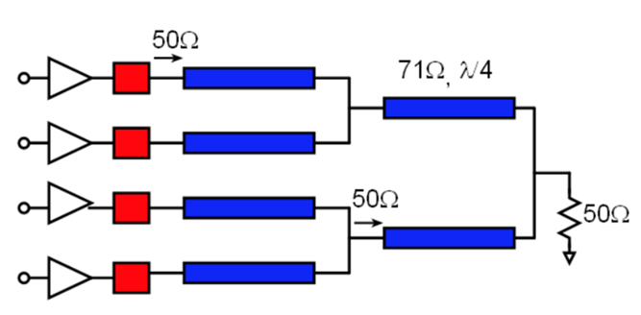
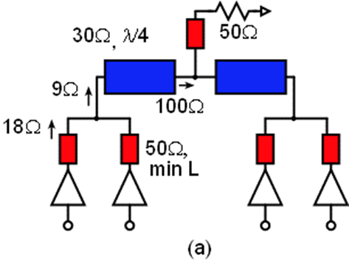


Combiner Design
Wilkinson
  Two $λ/4$ sections-> Bulky
  High loss and skinny line
  Works only with 50Ω cells
  Higher BW
Proposed combiner
  Single $λ/4$ section->very compact
  Low loss
  Works with non 50Ω cells
  Smaller BW compared to Wilkinson
Wilkinson combiner
Proposed combiner

Slide 11

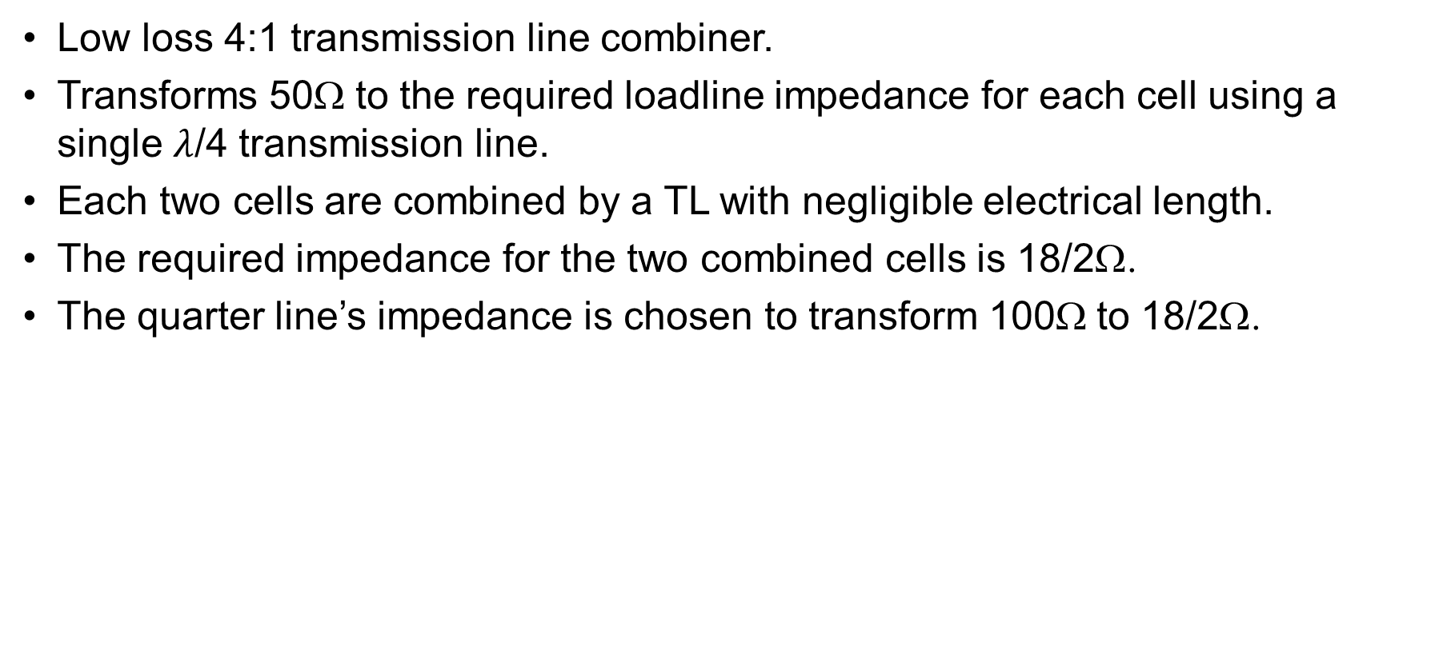
Combiner Design
Low loss 4:1 transmission line combiner.
Transforms 50Ω to the required loadline impedance for each cell using a single $λ$/4 transmission line.
Each two cells are combined by a TL with negligible electrical length.
The required impedance for the two combined cells is 18/2Ω.
The quarter line’s impedance is chosen to transform 100Ω to 18/2Ω.
Chip micrograph of the proposed combiner
Chip micrograph of the proposed combiner

Slide 12
Measurement Results: s-parameters
Setup: PNA with 220-325GHz Oleson extender modules.
Measured 3-dB bandwidth=48GHz.
V_{CCPA} | V_{BBPA} | V_{CCdriver} | V_{BBdriver}
2.2V | 2.3V | 2.5V | 2.1V
I_{CCPA} | I_{BBPA} | I_{CCdriver} | I_{BBdriver}
172mA | 9.4mA | 275.5mA | 14.8mA
S-parameters

Slide 13
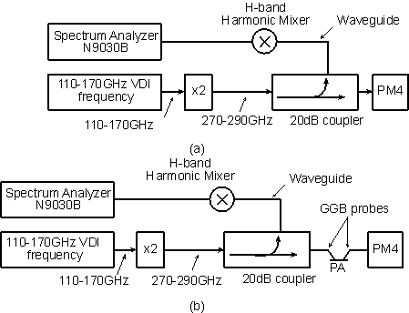
Power Measurement: setup
110-170GHz VDI+ doupler->270-290GHz-> coupler
Input power is sensed by the coupler and monitored by the spectrum analyzer
Power is varied by changing the signal generator power.

Slide 14
Calibration phase
Correction factor=power difference between the power meter and spectrum analyzer readings.
Calibration

Slide 15
Measurement Phase
Sweep the signal generator power.
Report the spectrum analyzer readings + correction factors=input power.
Report the power meter reading.
The power meter readings +probe losses= amplifier output power
Measurement

Slide 16
Power Measurement Results
Many points are recorded at different frequencies.
At 270GHz: P_{out}=16.8dBm, 4%PAE
No heatsink was used.
Better performance is expected
with proper heatsinking.
V_{CCPA} | V_{BBPA} | V_{CCdriver} | V_{BBdriver}
2.2V | 2.5V | 2.4V | 2.2V
I_{CCPA} | I_{BBPA} | I_{CCdriver} | I_{BBdriver}
173.3mA | 10.8mA | 274.8mA | 16.2mA
Pout, Gain, and PAE vs Pin at 270GHz

Slide 17
Power Measurement Results
More points are taken at different frequencies.
P_{sat}=14-16.8dB_{m}, with PAE=2.2-4% over 266-285GHz
Measured Pout vs Pin at various frequencies.
Measured P_{out} with the associated PAE and gain vs. frequency reported at the peak PAE.

Slide 18
State-of-the-art results
ªmodule results
Ref | [5] | [7] | [8] | [2]ª | [10] ª | [9] | [4] | [6] | [11] | [3] | This work
Freq, GHz | 240 | 185-255 265 | 325 | 275-320 | 338 | 300-305 | 300 | 290-307.5 | 301 | 280-328 | 266-285
P_{sat}, dBm | >10.8 | 20-23.9 17.2 | 11.3 | 2.7-4.8 | 10 | 9.5-9.8 | 8 | 7.8-10 | 13.5 | 9.6-13.7 | 14-16.8
Gain at P_{sat} (dB) | 15 | 12.2-17 11.7 | 9.4 | 13.5-15 | 3.3 | 7.5-7.8 | 11 | 10-12 | 11.8 | 11.5-13.8 | 9.6-10.9
PAE at P_{sat}% | 5 | 4.1 0.95 | 1.1 | 2.3^{d} | 1.8 | 1.1 | 2.97 | 1.1 | 1.5 | 0.8-2.4 | 2.2-4
BW_{3dB}, GHz | 55 | 53^{c} | 9 | ~100^{c} | 10 | 40 | 57 | 21 | 15^{c} | 48^{c} | 48
Chip Size (mmxmm) | 1.5x0.75 | 2.14x1.58 | 0.98x1 | 0.5x1.35 | 2x0.75 | 0.55x0.55^{b} | 2x0.75 | 1.45x0.44 | 0.67x0.68 | 0.6x1.3^{b} | 1.08x0.77
P_{DC} (W) | - | 5.24 | 1.12 | 0.129^{d} | 0.29 | 0.72 | 0.2 | 0.85 | 1.49 | - | 1.09
P_{sat}/Area mW/mm² | 10.6 | 72.5 15.7 | 13.9 | 4.5 | 6.66 | 31.6 | 4.2 | 15.7 | 22.3 | 30 | 57.6
Technology | 35 nm GaAs mHEMT | 250-nm InP HBT | 130-nm InP HBT | 35 nm InAlAs/InGaAs | 50 nm InP HEMT | 250-nm InP HBT | 35 nm InGaAs mHEMT | 250-nm InP HBT | 250-nm InP HBT | 35 nm InGaAs mHEMT | 250-nm InP HBT
This work shows a record P_{sat}/mm² over 266-285GHz frequency range.

Slide 19
Summary
Record P_{sat}/area at H-band
Common base cell with finite base impedance shows a good performance at subTHz frequency.
Transmission line combiner are compact and have low losses
Careful EM simulation is necessary to get accurate results
Millimeter wave communication becomes more feasible.

Slide 20
Acknowledgement
This work was supported in part by the Semiconductor Research Corporation and DARPA under the JUMP program.
The authors thank Teledyne Scientific & Imaging for the IC fabrication.

Slide 21
Thank You

Slide 22
References
[1] O. Momeni, "A 260GHz amplifier with 9.2dB gain and −3.9dBm saturated power in 65nm CMOS," 2013 IEEE ISSCC Digest of Technical Papers, San Francisco, CA, 2013, pp. 140-141.
[2] A. Tessmann et al., “A broadband 220–320 GHz medium power amplifier module,” in Proc. IEEE Comp. Semicond. Integr. Symp., La Jolla, CA, USA, Dec. 2014, pp. 1–4.
[3] L. John et al., "Broadband 300-GHz Power Amplifier MMICs in InGaAs mHEMT Technology," in IEEE Transactions on Terahertz Science and Technology, vol. 10, no. 3, pp. 309-320, May 2020.
[4] B. Schoch, A. Tessmann, A. Leuther, S. Wagner and I. Kallfass, "300 GHz broadband power amplifier with 508 GHz gain-bandwidth product and 8 dBm output power," 2019 IEEE MTT-S International Microwave Symposium (IMS), Boston, MA, USA, 2019, pp. 1249-1252
[5] A. B. Amado-Rey et al., "Analysis and Development of Submillimeter-Wave Stacked-FET Power Amplifier MMICs in 35-nm mHEMT Technology," in IEEE Transactions on Terahertz Science and Technology, vol. 8, no. 3, pp. 357-364, May 2018
[6] Z. Griffith, M. Urteaga, P. Rowell and R. Pierson, "A 6–10 mW Power Amplifier at 290–307.5 GHz in 250 nm InP HBT," in IEEE MWCL, vol. 25, no. 9, pp. 597-599, Sept. 2015.
[7] Z. Griffith, M. Urteaga and P. Rowell, "180–265 GHz, 17–24 dBm output power broadband, high-gain power amplifiers in InP HBT," 2017 IEEE MTT-S International Microwave Symposium (IMS), Honololu, HI, 2017, pp. 973-976.
[8] A. S. H. Ahmed, A. Simsek, M. Urteaga and M. J. W. Rodwell, "8.6-13.6 mW Series-Connected Power Amplifiers Designed at 325 GHz Using 130 nm InP HBT Technology," 2018 IEEE BiCMOS and Compound Semiconductor Integrated Circuits and Technology Symposium (BCICTS), San Diego, CA, 2018, pp. 164-167
[9] H. G. Yu, S. H. Choi, S. Jeon, and M. Kim, “300 GHz InP HBT amplifier with 10 mW output power,” Electron. Lett., vol. 50, no. 5, pp.
377–379.
[10] V. Radisic et al., "A 10-mW Submillimeter-Wave Solid-State Power-Amplifier Module," in IEEE Transactions on Microwave Theory and Techniques, vol. 58, no. 7, pp. 1903-1909, July 2010
Fig. 9. Measured output power with the associated PAE and compressed gain vs. frequency reported at the peak PAE.
[11] J. Kim, S. Jeon, M. Kim, M. Urteaga and J. Jeong, "H-Band Power Amplifier Integrated Circuits Using 250-nm InP HBT Technology," in IEEE Transactions on Terahertz Science and Technology, vol. 5, no. 2, pp. 215-222, March 2015.
[12] M. Urteaga, et al., “InP HBT Technologies for THz Integrated Circuits”, Proc. of the IEEE, vol. 105, no. 6, pp 1051-1067, June 2017.
[13] A. S. H. Ahmed, M. Seo, A. A. Farid, M. Urteaga, J. F. Buckwalter and M. J. W. Rodwell, "A 140GHz power amplifier with 20.5dBm output power and 20.8% PAE in 250-nm InP HBT technology," 2020 IEEE/MTT-S International Microwave Symposium (IMS), Los Angeles, CA, USA, 2020, pp. 492-495.
[14] A. S. H. Ahmed, M. Seo, A. A. Farid, M. Urteaga, J. F. Buckwalter and M. J. W. Rodwell, "A 200mW D-band Power Amplifier with 17.8% PAE in 250-nm InP HBT Technology," 2020 15th European Microwave Integrated Circuits Conference (EuMIC), Utrecht, Netherlands, 2021, pp. 1-4.
[15] A. S. H. Ahmed, U. Soylu, M. Seo, M. Urteaga, J. F. Buckwalter and M. J. W. Rodwell., " A 190-210GHz Power Amplifier with 17.7-18.5dBm Output Power and 6.9-8.5% PAE.," in press, Proc. IMS2021.
[16] A. S. H. Ahmed, et al., "204GHz Stacked-Power Amplifiers Designed by a Novel Two-Port Technique," 2018 13th European Microwave Integrated Circuits Conference (EuMIC), Madrid, 2018, pp. 29-32.
[17] H. Dabag, et al., "Analysis and Design of Stacked-FET Millimeter-Wave Power Amplifiers," in IEEE Transactions on Microwave Theory and Techniques, vol. 61, no. 4, pp. 1543-1556, April 2013
[18] A. Davidson, E. Strid and K. Jones, "Achieving greater on-wafer S-parameter accuracy with the LRM calibration technique," 34th ARFTG Conference Digest, Ft. Lauderdale, FL, USA, 1989, pp. 61-66.

Slide 23
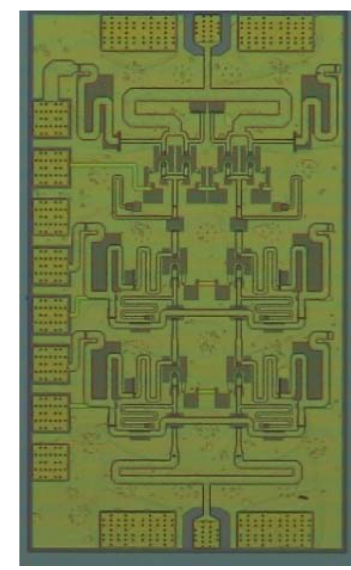
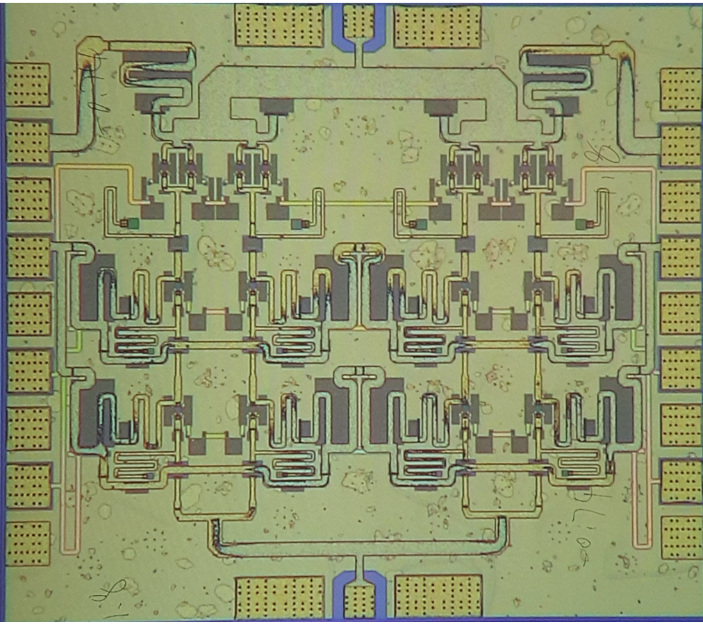
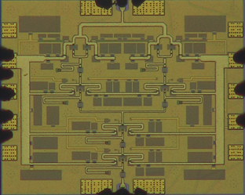
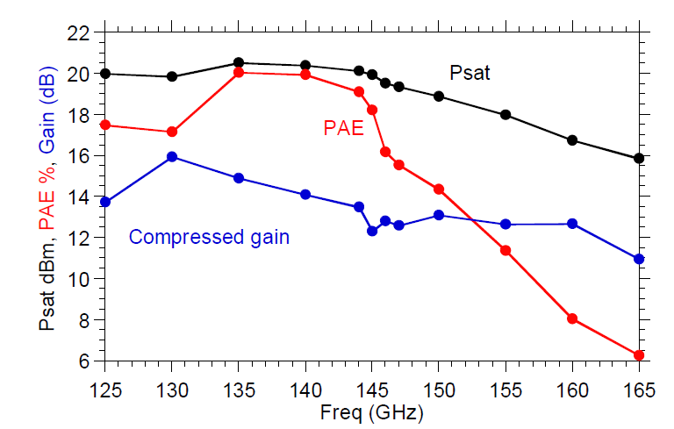
More Details: power amplifier family
Record output power and efficiency (125-285GHz)
[13] 140GHz, 20.5dBm, 20.8% PAE
[14] 130GHz, 200mW, 17.8%PAE
[15] 194GHz, 17.4dBm, 8.5%PAE
This work

