Slide 1

A Packaged 135GHz 22nm FD-SOI Transmitter on an LTCC Carrier
Ali A. Farid¹, Ahmed S. H. Ahmed^{1,2}, Arda Simsek^{1,3}, Mark J. W. Rodwell¹
¹University of California Santa Barbara, CA, USA
²Marki Microwave Inc., USA, ³Movandi Inc., USA

Slide 2
Outline
Motivation
Ceramic interposer design/ transition loss
On package Antenna design
Integrated Transmitter module on an LTCC carrier
Link measurement
Conclusion

Slide 3
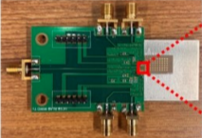
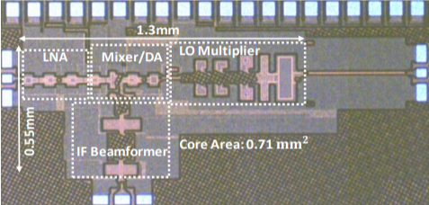
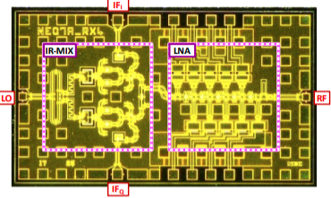
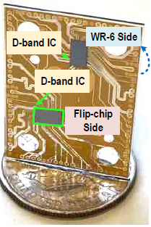
Packaging technologies at sub-THz frequencies
IC technologies
Packaging technologies
High performance laminate
IL= 2.5dB @140GHz
22FDSOI
45SOI
[Farid et. al.]
[Siwei et. al.]
[Simsek et. al.]
55nm SiGe
GaAs HEMT
Radio on Glass
IL= 1dB @140GHz
[Sawaby et. al.]
[Ito et. al.]
[Singh et. al.]

Slide 4
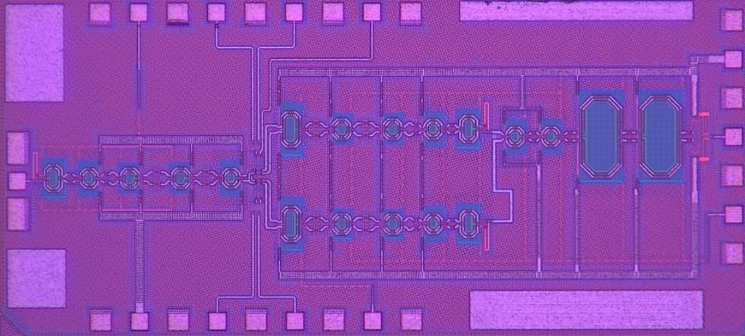
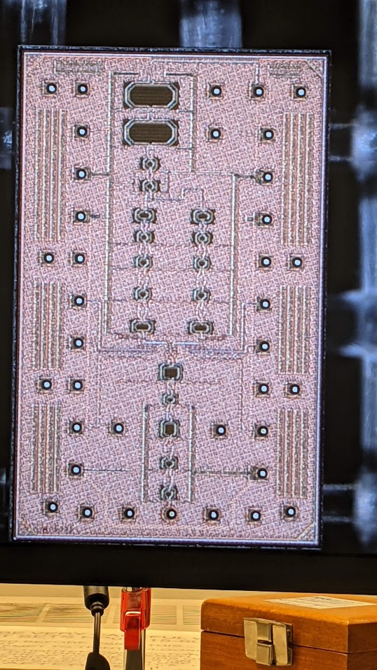
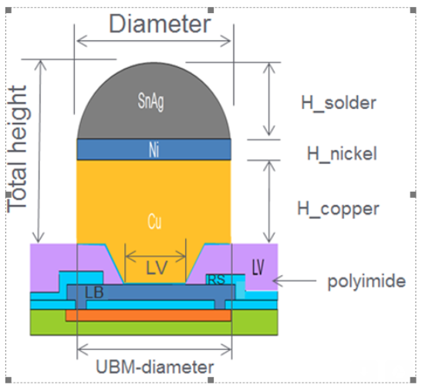
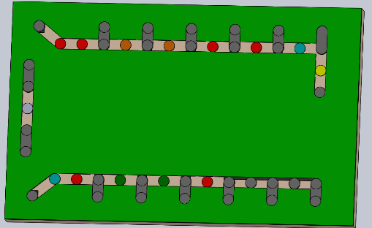
Transmitter IC design
Direct conversation transmitter using GF 22FDSOI
Tx chip is flipchip bonded to LTCC interposer using 50μm diameter copper pillar
22FDX Chip micrograph
22FDX Chip with Copper pillars
Copper pillars are equally spaced at 175μm distance
PCB with copper pads

Slide 5
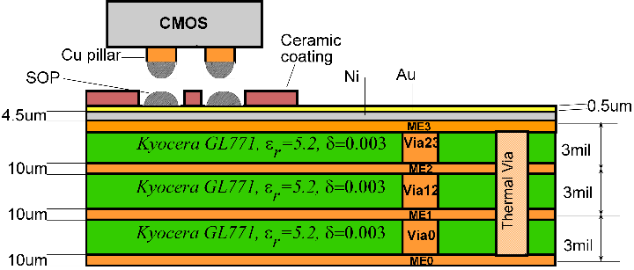
Ceramic Interposer design
3 dielectric layers of Kyocera GL771
4 metal layers (ME3 for I/Q routing and LO signal)
How to secure landing copper pillars precisely?
Ceramic coat with 75μm opening
SOP on the ceramic carrier

Slide 6
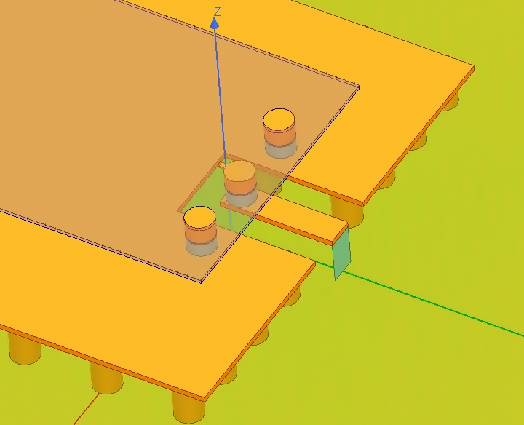
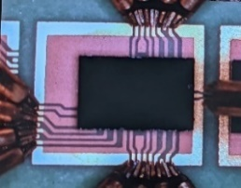
CMOS/Interposer transition
Simulated transition loss=1.15dB at 135GHz
Transition loss includes
  Copper pillar
  220μm CPW section
220μm
Ansys-HFSS
Simulated transition loss
Measured transition loss~=0.85dB
measured transition loss

Slide 7
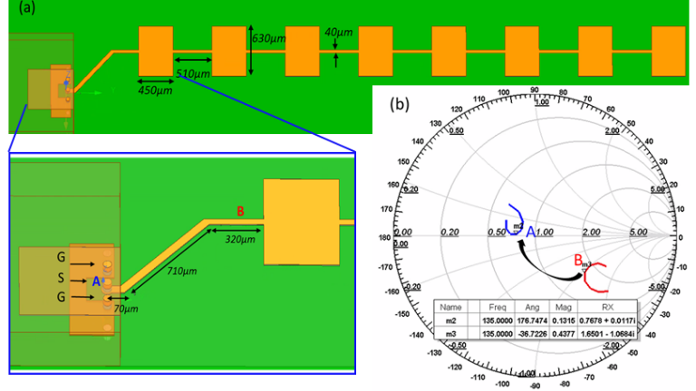
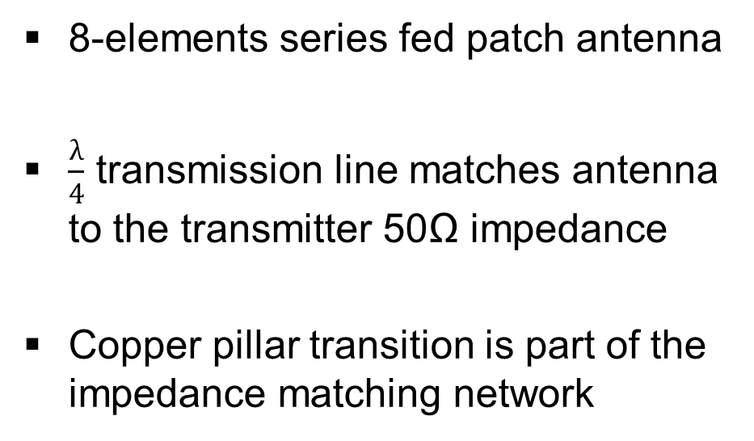
Series Fed Patch Antenna on LTCC carrier
8-elements series fed patch antenna
$\frac{λ}{4}$ transmission line matches antenna to the transmitter 50Ω impedance
Copper pillar transition is part of the impedance matching network

Slide 8
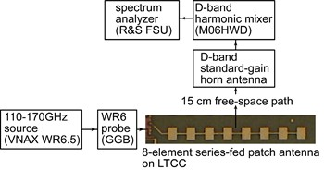
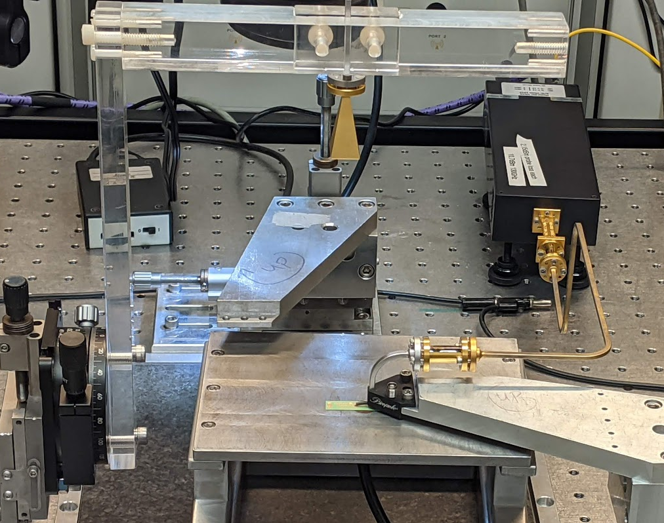
Measured Antenna performance
11dB gain, 5.5GHz bandwidth
12º E-plane 3-dB beam width
Sidelobes suppressed by 12-dB

Slide 9
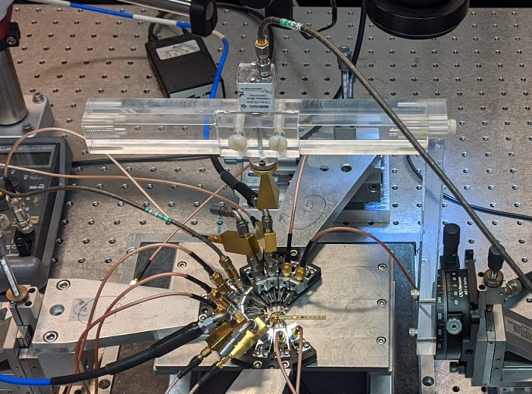
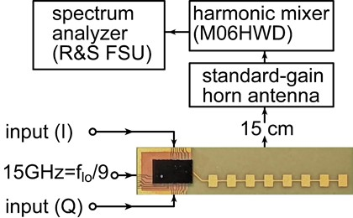
Integrated Transmitter module testing
Tx Input signal swept from 0.1G to 10GHz (either I or Q)
LO signal fixed at 135GHz
Tx upper sideband captured using Harmonic mixer and spectrum analyzer

Slide 10
Integrated Transmitter module
Module has 6GHz 3-dB modulation BW
Conversion gain=24dB
EIRP at Psat =12.8dB / EIRP at P1dB=8.4dB

Slide 11
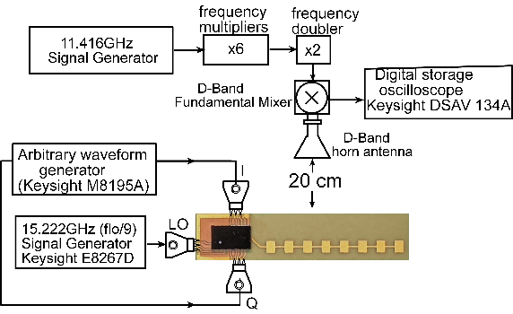
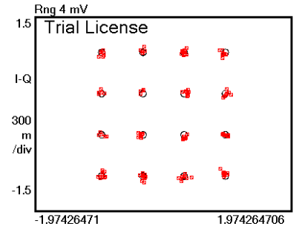
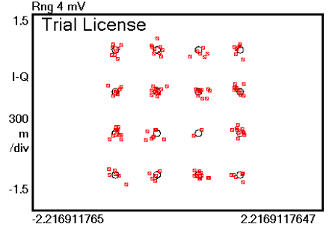
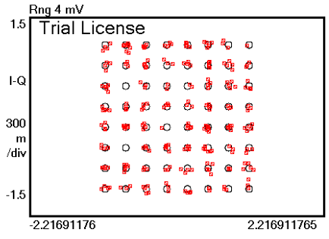
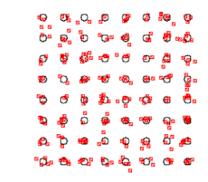
Module Link Measurement
Transmitter (I,Q) data driven by AWG at 2GHz IF
EVM measurements with equalization at DSO.
16QAM (6dB-BO)
1GBaud | 4GBaud
5.44% RMS | 9.2% RMS
64QAM (8dB-BO)
1GBaud | 2GBaud
5.6% RMS | 7.4% RMS

Slide 12
Comparison with state of the art
 | Sawaby [SSCL 2018] | Singh [RFIC 2020] | Simsek [RWS2020] | This Work
Package | RO4350 | Radio on Glass | Astra MT77 | LTCC GL771
IC Tech | 55nm SiGe HBT | 0.13μm SiGe-BICMOS | 45nm CMOS SOI | 22nm FDSOI
Antenna Integration | No | No | Yes | Yes
Frequency (GHz) | 110-150 | 115-155 135-170 | 142-147 | 131-137
EIRP at Psat | - | - | 14dBm/ channel | 13dBm
Tx-Psat | -0.5dBm | 13dBm | 2dBm | 1.95dBm
Tx Pdc (mW) | 220 | 1350 2100 | - | 210
Package Loss | 3dB | 1dB | 2.5dB | 0.85~1.1dB
Supported Modulation | QPSK | 256QAM | BPSK | 64QAM

Slide 13
Conclusion
High performance package with loss transition loss <1dB at 135GHz
Transmitter module has 6GHz 3-dB BW limited by series fed patch antenna BW
EIRP at psat=13dBm (limited by the CMOS TX output power of 2dBm)

Slide 14
Acknowledge
Kyocera Japan for LTCC carrier fabrication
Kyocera San Diego for module assembly
GF for free access to 22FDX technology and free access to GF advanced copper pillars

Slide 15
Questions?

