Slide 1
IC and Array Technologies for 100-300GHz Wireless
M. J. W. Rodwell¹, Ali A. Farid¹, A. S. H. Ahmed¹, M. Seo², U. Soylu¹, A. Alizadeh¹, N. Hosseinzadeh¹ ¹University of California, Santa Barbara ²Sungkyunkwan University
April 25, 2022

Slide 2
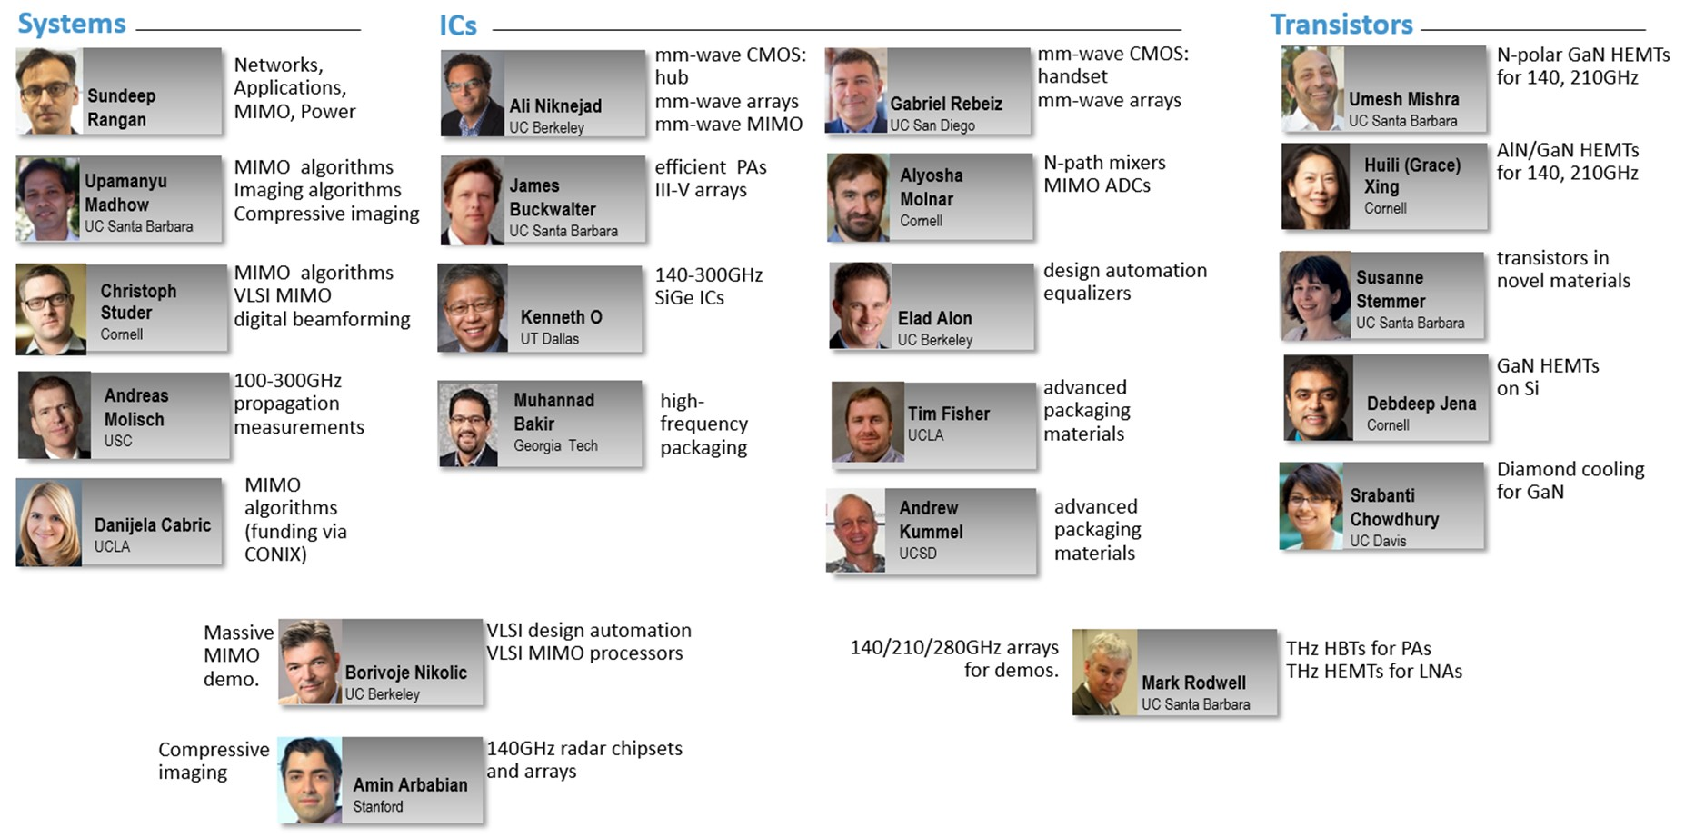
Acknowledgements
Also: Kyocera: D. Kim, H. Horikawa, M. Imayoshi. Samsung: G. Xu, N. Sharma, S. Abu-Surra, W. Choi Pi-Radio: A. Dhananjay, GlobalFoundries: 22nm SOI CMOS ICs

Slide 3
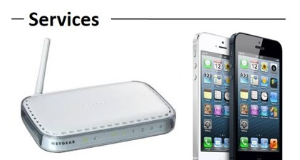
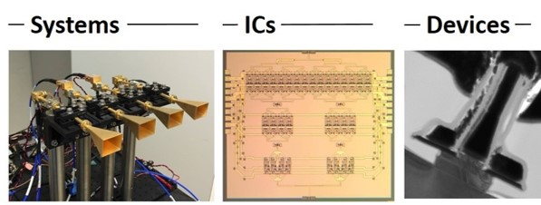
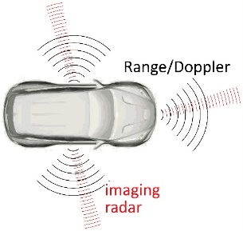
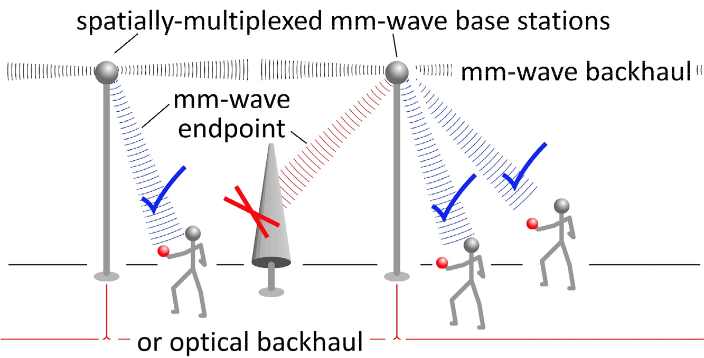
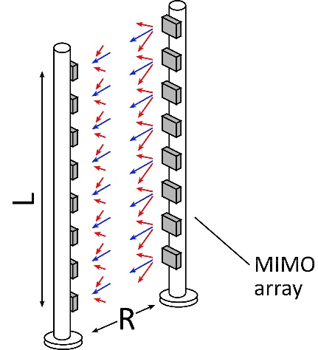
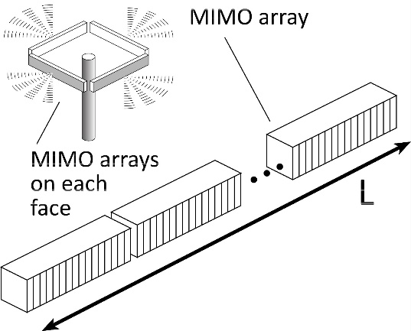
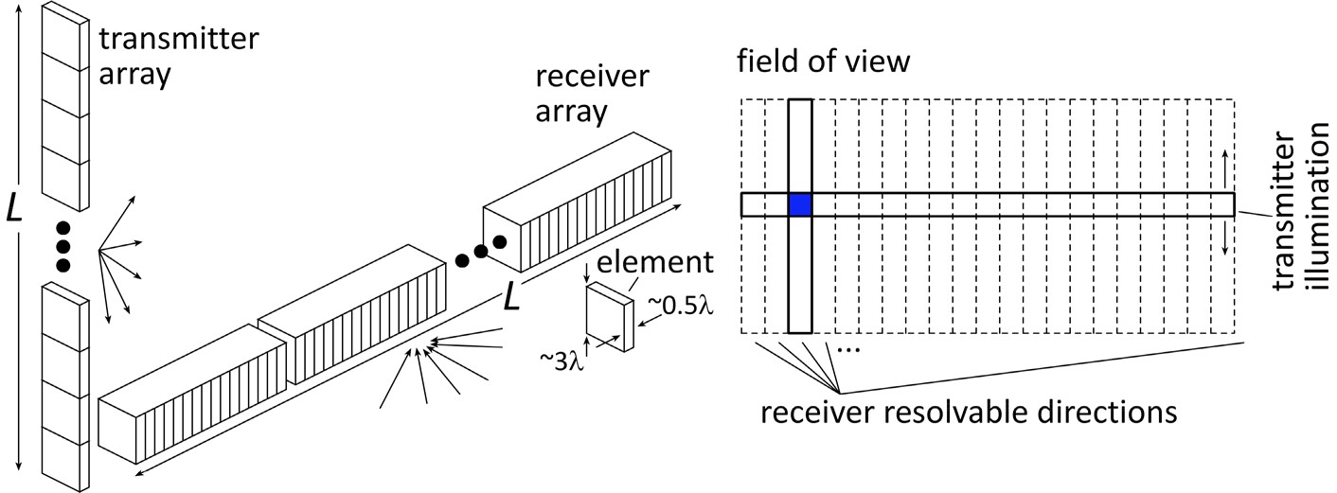
100-300GHz Wireless
Wireless networks: exploding demand.
Immediate industry response: 5G. ~1~40 GHz ("5G?") ~40~100GHz ("5.5G ?") increased spectrum, extensive beamforming
Next generation might be above 100GHz.. (?) greatly increased spectrum, massive spatial multiplexing
100-300GHz carriers, massive spatial multiplexing → Terabit hubs and backhaul links, high-resolution imaging radar

Slide 4
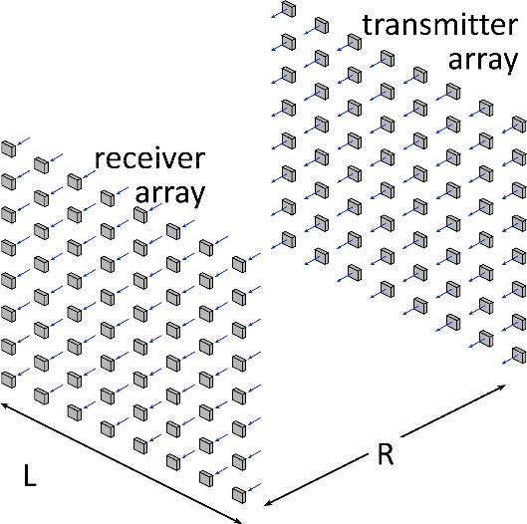
Benefits of Short Wavelengths
Communications: Massive spatial multiplexing, massive # of parallel channels. Also, more spectrum!
Imaging: very fine angular resolution
But: High losses in foul or humid weather. High λ²/R² path losses. ICs: poorer PAs & LNAs. Beams easily blocked.
100-340GHz wireless: terabit capacity, short range, highly intermittent

Slide 5
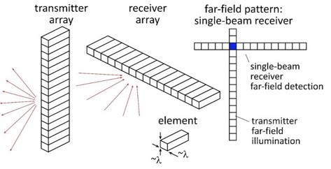
Applications

Slide 6
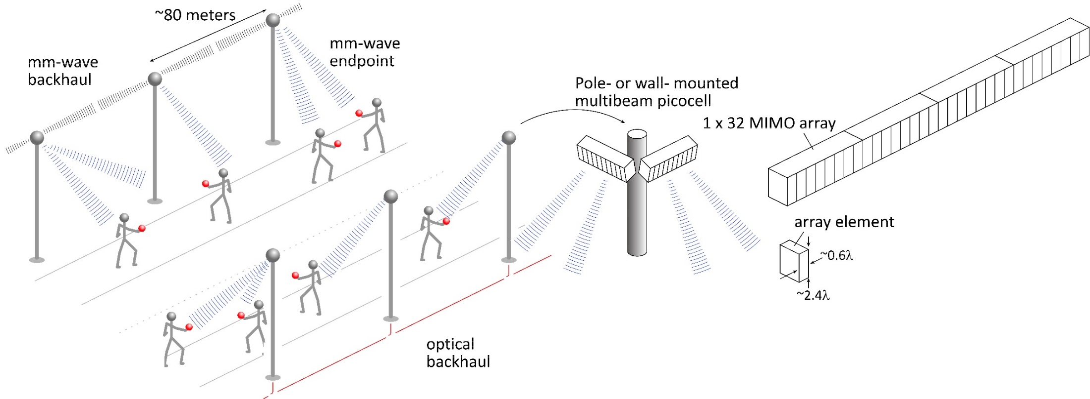
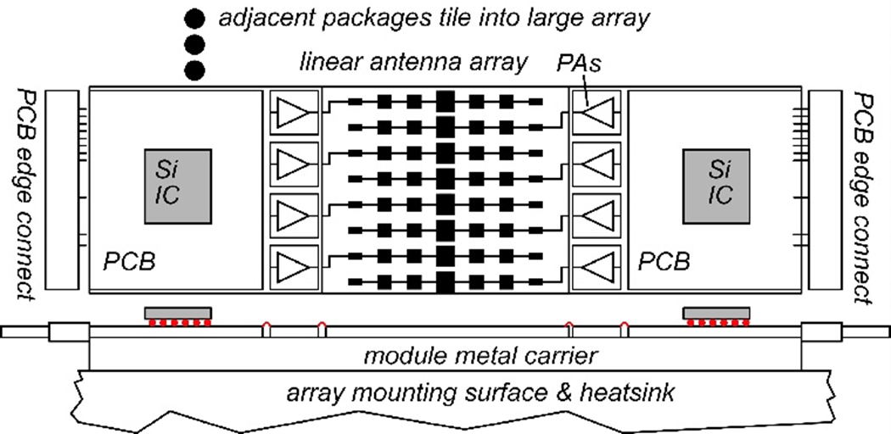
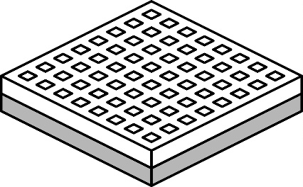
140GHz Moderate-MIMO hub
Handset: 8 × 8 array (9×9mm)
If demo uses 32-element array (four 1×8 modules): 16 users/array. P_{1dB}=21 dB_{m} PAs, F=8dB LNAs 1,10 Gb/s/beam→ 16, 160 Gb/s total capacity 70, 40 m range in 50mm/hr rain with 17dB total margins

Slide 7
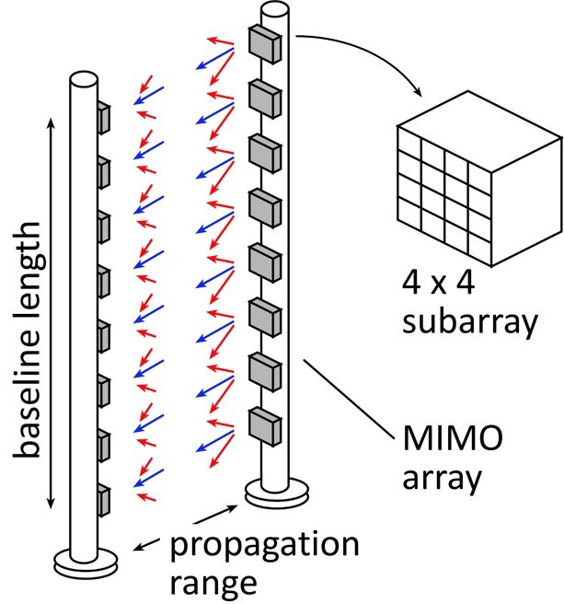
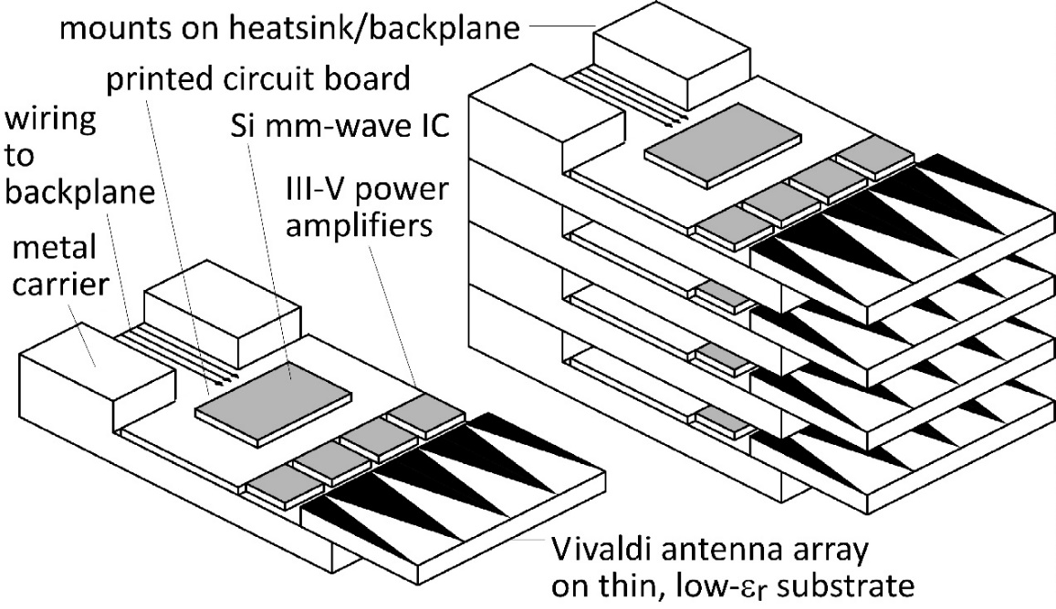
210 GHz, 640 Gb/s MIMO Backhaul
Key link parameters 500 meters range in 50 mm/hr rain; 23 dB/km 20 dB total margins: packaging loss, obstruction, operating, design, aging PAs: 18dBm =P_{1dB} (per element) LNAs: 6dB noise figure
8-element MIMO array 2.1 m baseline. 80Gb/s/subarray→ 640Gb/s total 4 × 4 sub-arrays → 8 degree beamsteering

Slide 8
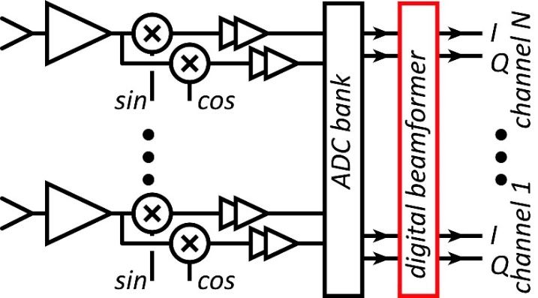
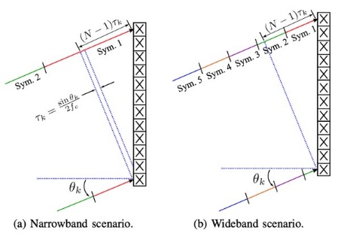
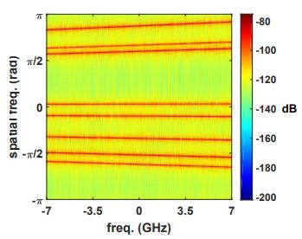
Systems

Slide 9
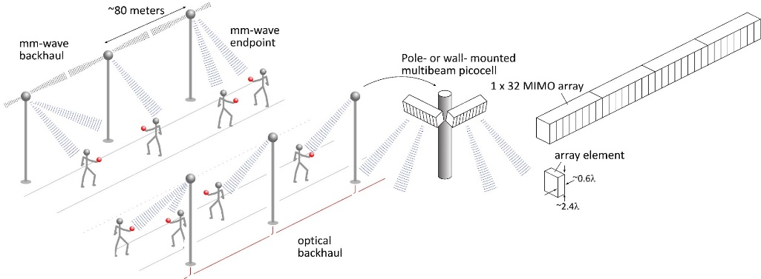
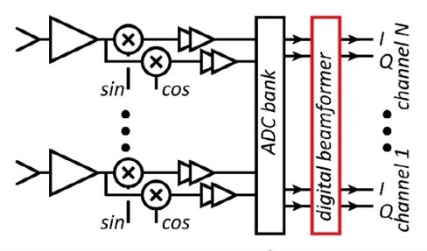
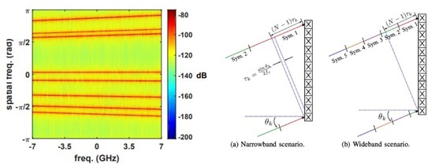
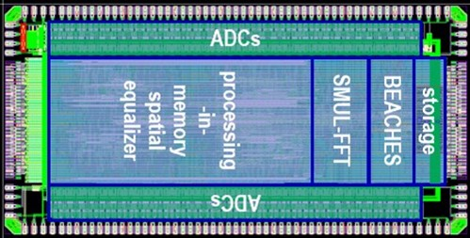
MIMO System Design
ADCs/DACs¹: QPSK needs only 3-4 bit ADC/DACs N ADC bits, M antennas, K signals: SNR=6N+1.76+10.log₁₀(M/K) 3 bits, (M/K)=2→ SNR=23 dB. QPSK needs 9.8 dB.
Linearity¹: Amplifier P_{1dB} need be only 4 dB above average power
Phase noise^{2,3}: Requirements same as for SISO
Efficient digital beamforming^{4,5}: beamspace algorithm
Efficient VLSI digital beamformer implementation⁶: low-resolution matrix
Efficient beamforming in broadband arrays⁷: combined spatial & temporal FFTs.
1) M. Abdelghany et al, IEEE Trans. Wireless Comm, Sept. 2021 2) M. E. Rasekh et al, IEEE Trans. Wireless Comm, Oct. 2021 3) A. Puglielli et al, 2016 IEEE ICC 4) M. Abdelghany, et. al, , 2019 IEEE SPAWC 5) S. H. Mirfarshbafan et al, IEEE Trans CAS 1, 2020 6) O Castañeda Fernández et. al, 2021 ESSCIRC 7) M. Abdelghany et al 2019 IEEE GLOBECOM

Slide 10
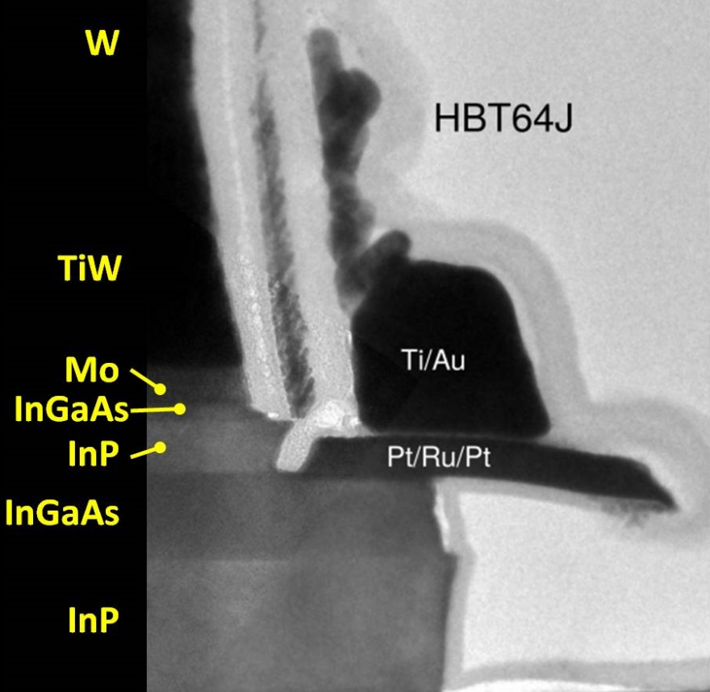
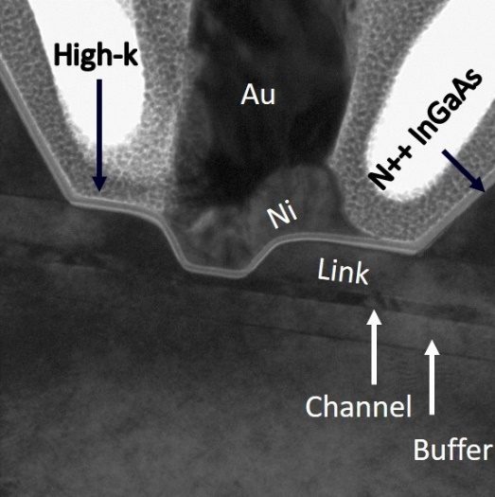
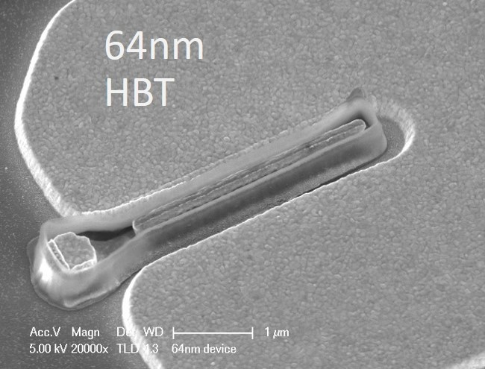
Transistors

Slide 11
Transistors for 100-300GHz
CMOS: good power & noise up to ~150GHz. Not much beyond. 65-22nm nodes are best.
InP HBT: record 100-300GHz PAs
SiGe HBT: out-performs CMOS above 200GHz
GaN HEMT: record power below 100GHz. Bandwidth improving
InGaAs-channel HEMT: world's best low-noise amplifiers
Results with low power but high PAE, or low PAE but high power, are not shown
Results compiled 9/9/2021

Slide 12
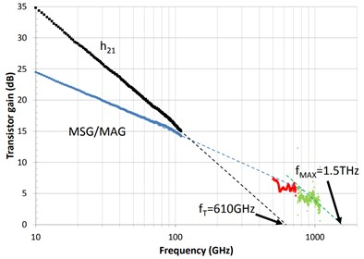
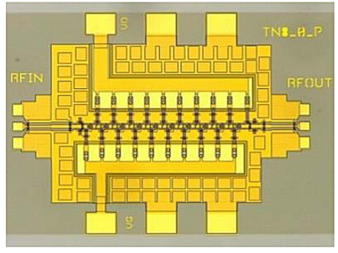
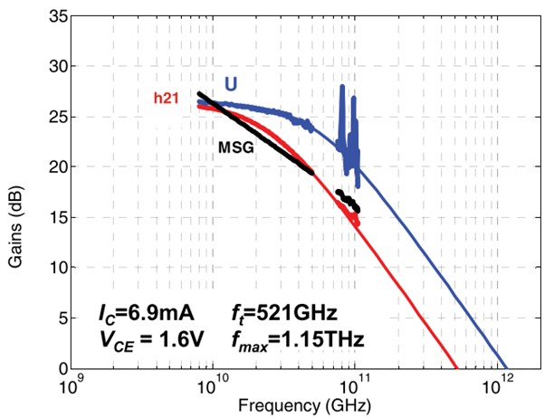
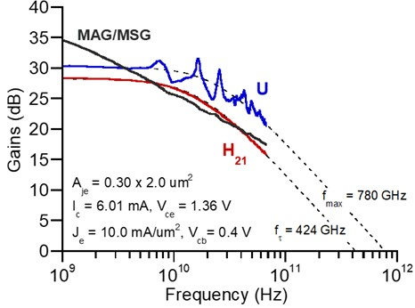
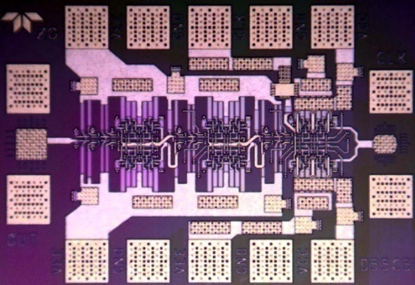
Summary: InP Transistors & ICs
InP HEMTs: 1.5THz f_{max}, 1.0THz amplifiers
W. Deal et al, 2016 IEDM (Northrop-Grumman)
130nm InP HBTs: 1.1THz f_{max}, 3.5V. 670 GHz amplifiers
M. Urteaga, et al, IEEE Proceedings June 2017 (Teledyne)
250nm InP HBTs: 650GHz f_{max}, 4.5V.
Z. Griffith et al, 2007 IPRM conference (UCSB)
M. Urteaga, et al, IEEE Proceedings June 2017 (Teledyne)
204 GHz static frequency divider Z. Griffith et al, 2010 IEEE CSICS

Slide 13
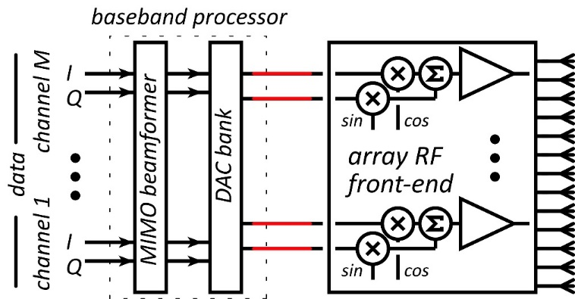
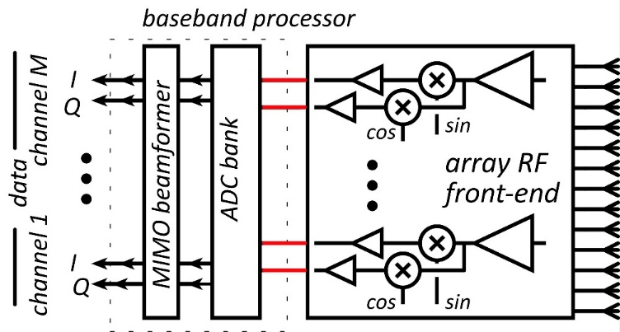
100-300GHz Wireless: Transistor Requirements
Transmitters need: high power-added efficiency $PAE=(P_{out}−P_{in})/P_{DC}$ high added power density (P_{out}-P_{in})/(gate width, emitter length) Receivers need: low cascaded noise $F_{casc}=F+{(F−1)}/G+{(F−1)}/{G^{2}+…}$
Need reasonable gain/stage. die area, power, accumulated gain compression
(gain in PAs, LNAs is less than MAG/MSG, U, ... )

Slide 14
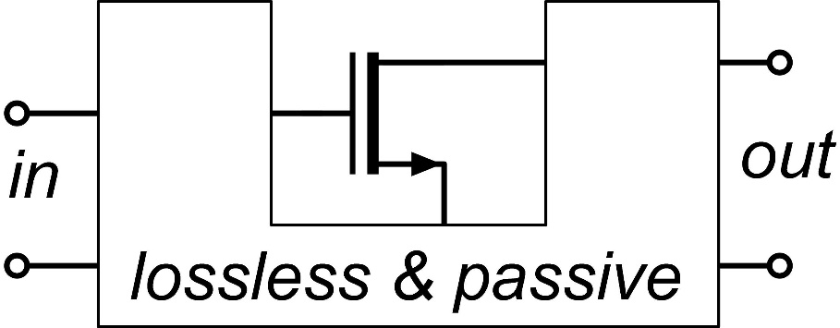
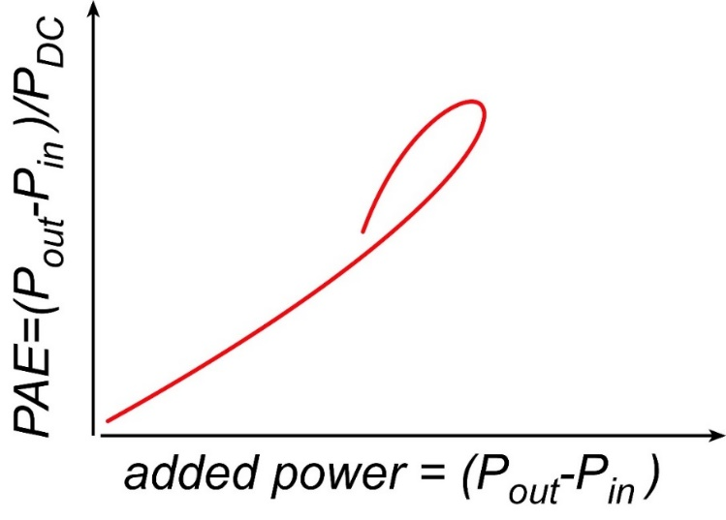
Where the IC designer can't help
mm-wave transistor gain is low: gain-boosting is common Common-source vs. common-gate. Capacitive neutralization. Unconditionally stable positive feedback (Singhakowinta, Int. J. Electronics, 1966) Such circuits don't improve the parameters that matter the most.
The circuit* doesn't change the transistor minimum cascaded noise figure. (Haus, Adler, Proc. IRE, 1958) The circuit* doesn't change the transistor maximum efficiency vs. added power curve.
$$F_{casc}=1+M=F+{(F−1)}/G+{(F−1)}/{G^{2}+…}$$
*If lossless, and given the correct source and load impedances.

Slide 15
Interconnects

Slide 16
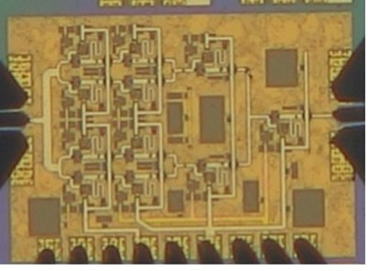
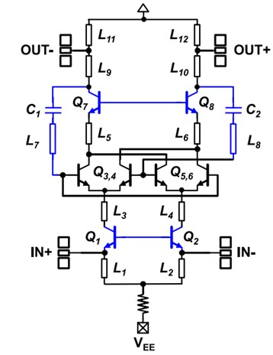
Normal & Inverted Microstrip
Normal: PAs, LNAs smaller skin-effect losses ✓ ground-plane holes at transistors✘
Inverted: high-density blocks (mixers, phase shifters,…) higher skin-effect losses✘ no ground-plane breaks: better ground integrity✓
266GHz, 16.8dBm PA: A. Ahmed et. al, 2021 IMS
529GHz dynamic divider: M. Seo et al, IEICE Electronics Express, Feb. 2015

Slide 17
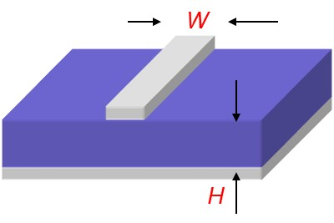
On-Wafer Interconnect Losses

Slide 18
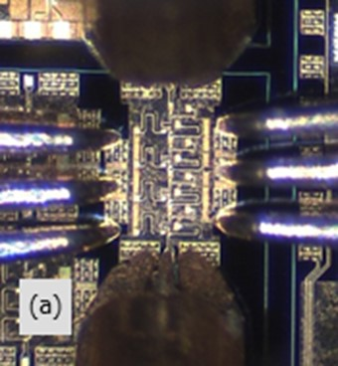
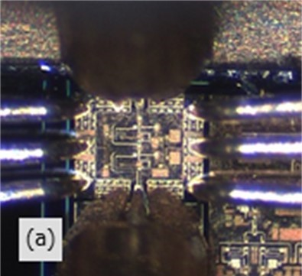
Low-Noise Amplifiers

Slide 19
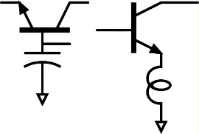
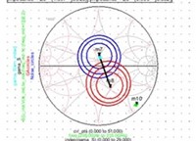
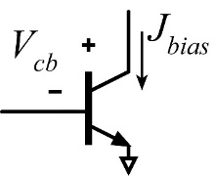
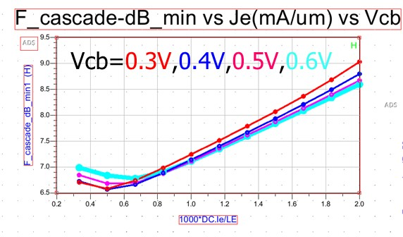
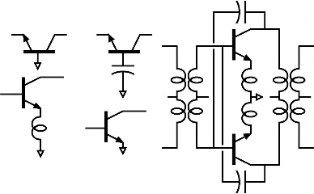
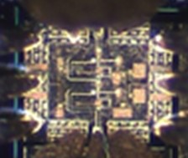
LNA Design: Noise Close To Transistor Limits
1) Goal: low noise measure, not noise figure
4) Capacitance in common-base; just like inductance in common-emitter, allows simultaneous tuning for zero reflection coefficient and minimum M.
5) Write ADS Python code to display source impedance for minimum M.
2) Find bias current density for lowest noise measure
6) Scale transistor size to eliminate series tuning element. Less input tuning→ less noise from passive element loss.
@210GHz, F_{cascade,min}= 6.57 dB given: J_{e}=0.5 mA/um, V_{cb}=0.3V
U. Solyu et. al, to be presented, 2021 EuMIC Conference
3) Minimum M is independent of circuit configuration*; pick for high bandwidth or high gain/stage (= low P_{DC})
Result: 7.2-7.4dB LNA noise given 6.6dB transistor F_{cascade}.
<-- all give the same minimum M…
…but common-base gives highest gain (InP HBT @210GHz).
*HA Haus, RB Adler, Proceedings of the IRE, 1958

Slide 20
Power Amplifiers

Slide 21
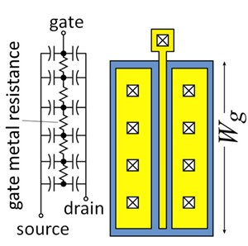
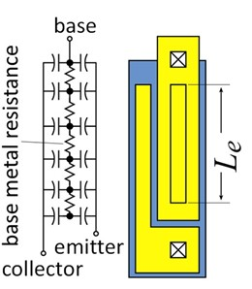
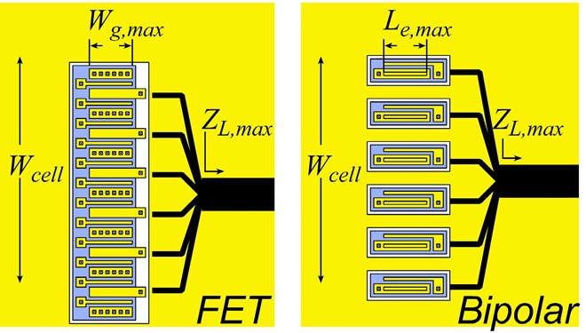
Current density, finger pitch limit cell output power

Slide 22
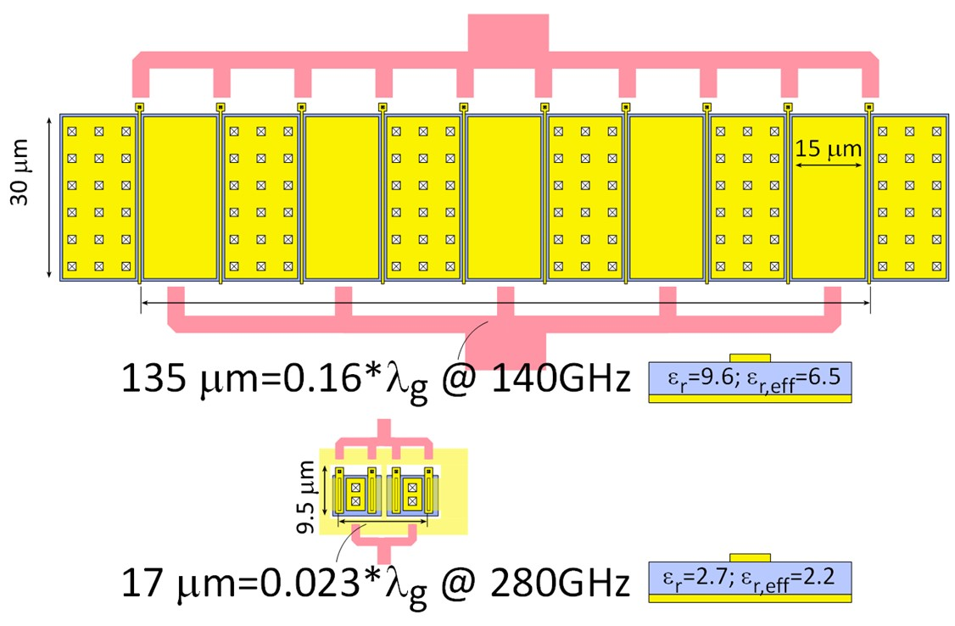
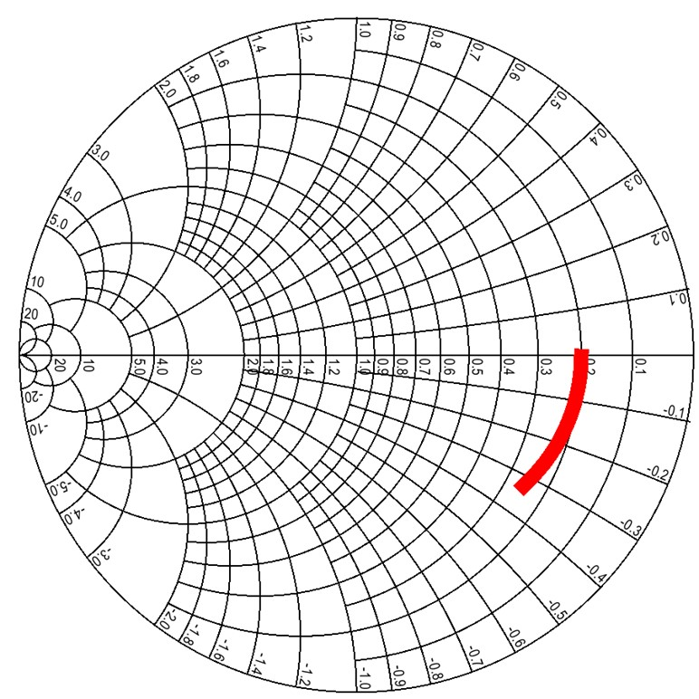
Current density, finger pitch limit cell output power
50Ω GaN PA cell @ 140GHz (1.6W) 25V swing, 1.67mA/μm, gates: 30 μm width, 15 μm pitch
K. Shinohara, Teledyne: GaN HEMT thermal analysis
50Ω InP HBT PA cell @ 280GHz (40mW) 4V swing, 3.3mA/μm, emitters: 6 μm length, 6 μm pitch
High V_{br}, low I_{max} ? Device sized to drive 50Ω might approach λ_{g}/4 width. Small finger pitch is critical; limited by thermal design

Slide 23
Low-Loss 100-300GHz Corporate Combining
Wilkinson trees are lossy: Signal passes through *many* 70.7Ω, λ/4 lines. λ/4 lines are long. 70.7Ω lines are narrow…and lossy→ High loss.
Single-(λ/4) combiners are much less lossy Each design uses a single effective λ/4 section. Shorter lines, low-Z_{o} lines → lower loss But, low loss only if transistor cells fit.

Slide 24
100-300GHz Power combining: what is best ?
Corporate T-line
Direct series-connected M. Shifrin: 1992 IEEE μWave/mmWave Monolithic Circuits Symp. (Raytheon)
Cascaded combining A. Ahmed 2018 EuMIC, 2021 RFIC (UCSB)
Distributed Active Transformer I. Aoki, IEEE Trans MTT, Jan. 2002 (CalTech)
Balun series-connected λ/4 baluns: Y. Yoshihara, 2008 IEEE Asian Solid-State Circuits Conference (Toshiba) sub-λ/4 baluns: H. Park, et al, IEEE JSSC, Oct. 2014 (UCSB)

Slide 25
Transistor stacking. Why ? Why not ?
 | Lower frequencies | Higher frequencies
Corporate combining | length $∝1/f$→ large die area ✘ dB loss $∝1/\sqrt{f}$→ high loss ✘ | length $∝1/f$→ small die area ✓ dB loss $∝1/\sqrt{f}$→ low loss ✓
Series-connected | more transistor fingers per cell → ok ✓ | more transistor fingers per cell→ parasitics ✘

Slide 26
Series combining using sub-λ/4 baluns
λ/4 baluns: Y. Yoshihara, 2008 IEEE Asian Solid-State Circuits Conference (Toshiba) sub-λ/4 baluns: H. Park, et al, IEEE JSSC, Oct. 2014 (UCSB)
81GHz, 17 dB Gain 470 mW P_{sat} , 23% PAE Teledyne 250 nm InP HBT 2 stages, 1.0 mm²(incl pads)

Slide 27
Sub-λ/4 Balun Combiners. Why ? Why not ?
 | Lower frequencies | Higher frequencies
Corporate combining | length $∝1/f$→ large die area ✘ dB loss $∝1/\sqrt{f}$→ high loss ✘ | length $∝1/f$→ small die area ✓ dB loss $∝1/\sqrt{f}$→ low loss ✓
Sub-λ/4 Balun | more transistor fingers per cell → ok ✓ | more transistor fingers per cell→ parasitics ✘ impedance shift of transistor-balun interconnect ✘

Slide 28
Cascade combining as stacking plus matching
A. S. H. Ahmed et al, 2018 EuMIC (UCSB)

Slide 29
Generalized cascade combining
A. S. H. Ahmed et al, 2018 EuMIC (UCSB) A. S. H. Ahmed, et al, 2021 RFIC Symposium
266GHz, 16.8dBm, 4.0% PAE

Slide 30
Cascade Combining: Why ? Why not ?
 | Lower frequencies | Higher frequencies
Corporate combining | length $∝1/f$→ large die area ✘ dB loss $∝1/\sqrt{f}$→ high loss ✘ | length $∝1/f$→ small die area ✓ dB loss $∝1/\sqrt{f}$→ low loss ✓
Series-connected | more transistor fingers per cell → ok ✓ | more transistor fingers per cell→ parasitics ✘
Cascade combining | large interstage matching networks✘ | small interstage matching networks ✓ small # transistor fingers per cell → ok ✓ cascade cell pass-though losses ✘

Slide 31
Recent high-efficiency 100-300GHz PAs
Teledyne 250nm InP HBT technology
Ahmed et al, 2020 IMS, 2020 EuMIC, 2021 IMS, 2021 RFIC
140GHz, 20.5dBm, 20.8% PAE
130GHz, 200mW, 17.8% PAE
194GHz, 17.4dBm, 8.5% PAE
266GHz, 16.8dBm, 4.0% PAE

Slide 32
140 GHz Array Modules

Slide 33
The mm-wave module design problem
How to make the IC electronics fit ? How to avoid catastrophic signal losses ? How to remove the heat ?
Not all systems steer in two planes... ...some steer in only one.
Not all systems steer over 180 degrees... ...some steer a smaller angular range

Slide 34
Do we need 2D arrays ? 1D steering might be fine.
1/sin²φ sidelobes provide strong signals to tall buildings.
Providing sidelobes reduces broadside gain by less than 3dB.
→ Don't need 2D arrays to serve tall buildings

Slide 35
2D vs. 1D: user spatial distribution
uniform horizontal & vertical user distributions
uniform horizontal, nonuniform vertical
design 1: 2D array
✘
✓
design 2: 1D array
✓
✓
Spatial distribution of users, and of scattering objects, guides choice of array geometry.

Slide 36
140GHz hub: packaging challenges
IC-package interconnects Difficult at > 100 GHz
Removing heat Thermal vias are marginal
Interconnect density Dense wiring for DC, LO, IF, control. Hard to fit these all in.
Economies of scale Advanced packaging standards require sophisticated tools High-volume orders only Hard for small-volume orders (research, universities) Packaging industry is moving offshore

Slide 37
100-300GHz IC-package connections

Slide 38
140GHz hub: ICs & Antennas
Receiver: A. Farid et. al, 2021 IEEE BCICTS; Transmitter: A. Farid et. al, 2022 IEEE Trans. MTT 10.1109/TMTT.2022.3161972

Slide 39
135GHz 8-channel MIMO hub array tile modules
140GHz MIMO hub receiver array modules, 4-element, 8-element MIMO beamforming Data transmission up to 1.9Gb/s
140GHz MIMO hub transmitter array modules, 8-element 38.5dBm EIRP Data transmission up to 1.9Gb/s Performance limited by assembly yield. Data rate limited by connector.
Receiver: A. Farid et. al, 2021 IEEE BCICTS; Transmitter: A. Farid et. al, 2022 IEEE Trans. MTT 10.1109/TMTT.2022.3161972
110mW InP PA 20.8% PAE
CMOS TX, RX ICs GlobalFoundries 22nm SOI CMOS.
Teledyne 250nm InP HBT

Slide 40
210 GHz and 280 GHz Array Modules

Slide 41
210 GHz MIMO backhaul modules
Key link parameters 500 meters range in 50 mm/hr rain; 23 dB/km 20 dB total margins: packaging loss, obstruction, operating, design, aging PAs: 63mW =P_{1dB} (per element) LNAs: 6dB noise figure
8-element MIMO array 3.1 m baseline for 500m link. 80Gb/s/subarray→ 640Gb/s total 4 × 4 sub-arrays → 8 degree beamsteering

Slide 42
210 GHz Transmitter and Receiver ICs
M. Seo et al, 2021 IMS; Teledyne 250nm InP HBT
Size: 2.9 x 0.75 mm²
Size: 2.3 x 0.85 mm²

Slide 43
280GHz Transmitter and Receiver IC Designs
Solyu, Alz, Ahmed, Seo; UCSB/Sungkyunkwan
Teledyne 250nm InP HBT technology
Receiver
Transmitter
simulations: 11dB noise figure, 40GHz bandwidth
simulations: 17dB saturated output power.
Application: point-point MIMO backhaul links

Slide 44
100-300GHz Wireless

Slide 45
Wireless above 100 GHz
Massive capacities large available bandwidths massive spatial multiplexing in base stations and point-point links
Very short range: few 100 meters short wavelength, high atmospheric losses. Easily-blocked beams.
IC Technology All-silicon for short ranges below 200 GHz. SiGe or III-V LNAs and PAs for longer-range links. Just like cell phones today III-V frequency extenders for 340GHz and beyond
The challenges computational complexity packaging: fitting signal channels in very small areas mesh networking to accommodate beam blockage driving the technologies to low cost

Slide 47
In case of questions

Slide 48
70 GHz spatially multiplexed base station
If we use instead a 70GHz carrier, the range increases to 70 meters (vs. 40 meters) but the handset becomes 16mm×16mm (vs. 8mm×8mm), and the hub array becomes 19mm×612mm (vs. 10mm×328mm)
Or, use a 4×4 (8mm×8mm) handset array, and the range becomes ..about 40 meters.
Same handset area (more handset elements)→ same link budget Easier to obtain license for 140±2.5GHz than 70±2.5GHz

Slide 49
75 GHz, 640 Gb/s MIMO backhaul (16QAM)
Why not use a lower-frequency carrier, e.g. 75 GHz ? Must use at least 16QAM, given 80Gb/s/channel…
8-element 640Gb/s linear array:
requires 16dB_{m} transmit power/element (P_{out})
requires 3.5m linear array
Similar RF power output, physically larger

