Slide 1

Paper 2b.2
  A 280 GHz (x8) Frequency Multiplier Chain
  in 250 nm InP HBT Technology
Utku Soylu¹
Amirreza Alizadeh¹, Munkyo Seo², Mark J. W. Rodwell¹
¹ECE, University of California, Santa Barbara, USA
²ECE, Sungkyunkwan University, South Korea
Notes:
The slide guide is meant to be used with PowerPoint.

Slide 2
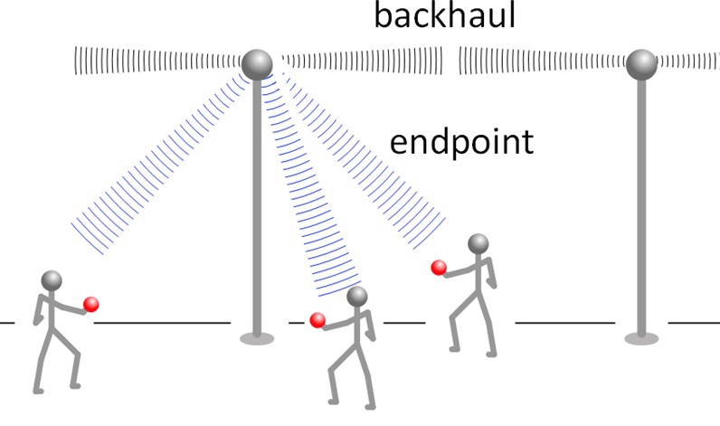
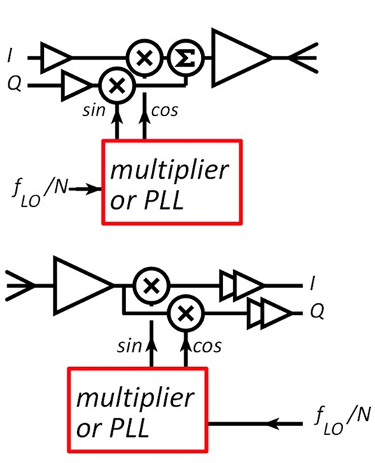
200-300 GHz Wireless Backhaul
Growing demand for wireless communications: endpoint and backhaul
200-300 GHz backhaul: 100+ Gb/s feasible over ~km range.
→ develop 200-300 GHz transceivers
Notes:
Please follow the allowed time so the program runs on schedule

Slide 3
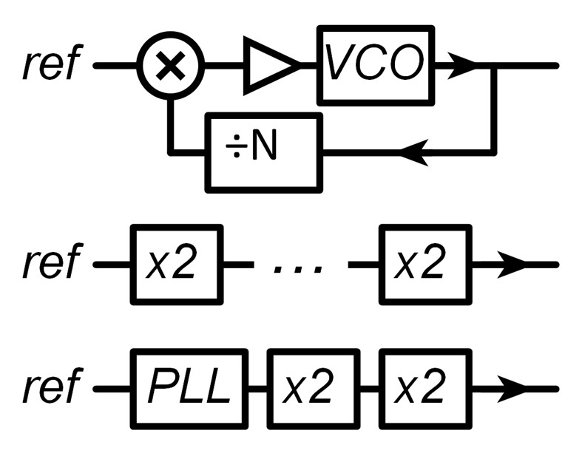
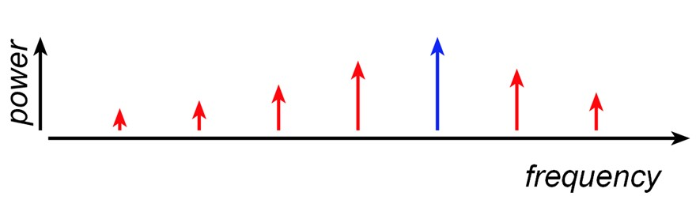
mm-wave LO generation
PLLs:
in-band phase noise: N²×reference (plus additive noise)
out-of-band phase noise: VCO
challenge: low-noise mm-wave VCO
Multipliers:
phase noise: N²×reference (plus additive noise)
spurious harmonics: out-of-band response
Notes:
Please follow the allowed time so the program runs on schedule

Slide 4
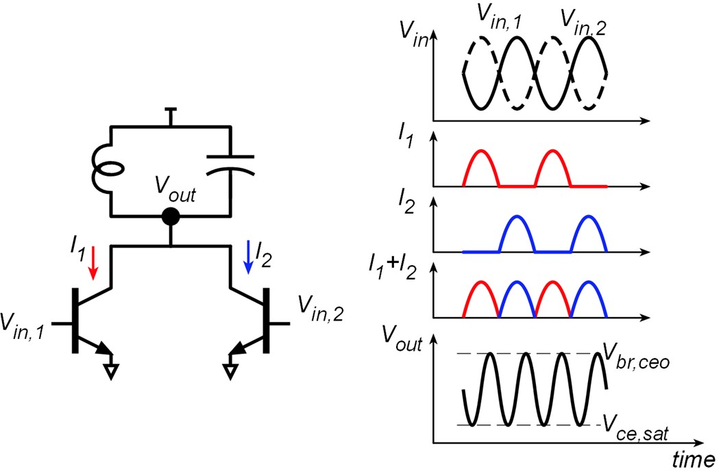
Push-Push Frequency Doubler
Push-push: odd harmonic suppression.
Maximum P_{out} design: voltage swing between V_{ce,sat} and V_{br,ceo}.
Here: loadline instead tuned for maximum PAE (smaller V_{max}).
Notes:
Please follow the allowed time so the program runs on schedule

Slide 5
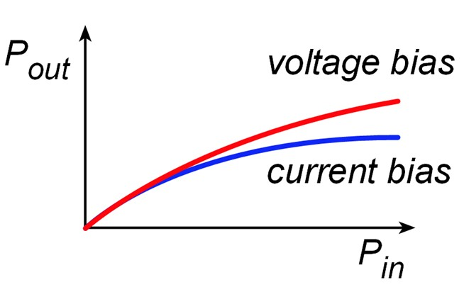
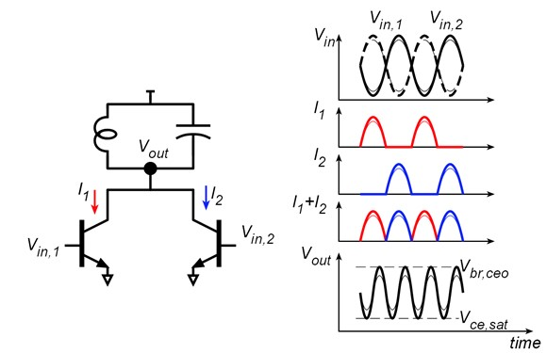
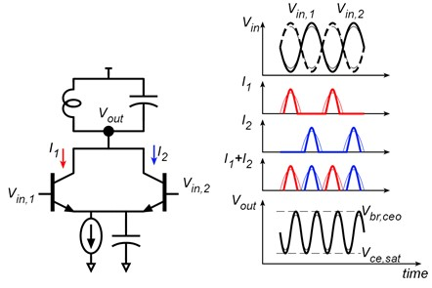
Doubler: Voltage vs. Current Bias
Voltage bias: output current & charge increase with P_{in}.
Current bias: output charge independent of P_{in}.
→ less variation of P_{out} with P_{in}.
Notes:
Please follow the allowed time so the program runs on schedule

Slide 6
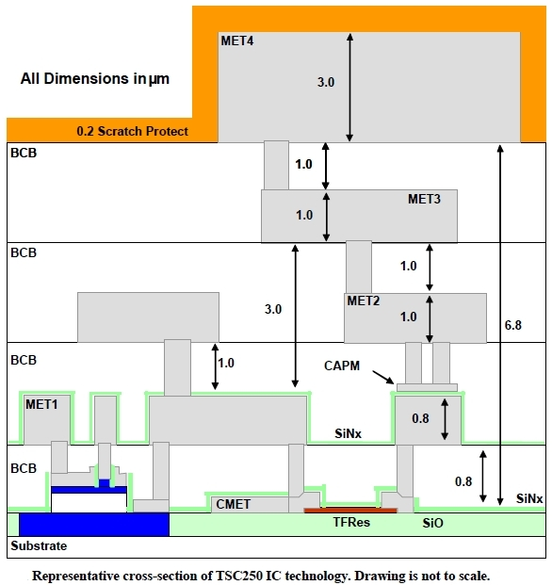
Teledyne 250 nm InP HBT
f_{max} = 650 GHz.
J_{max} = 3 mA/µm.
B_{VCEo}= 4.5 V.
Four interconnect levels
Microstrip lines (M4 signal, M1 ground)
1.0 dB/mm @ 280 GHz
Resistors: 50 Ω/square
MIM capacitors: 0.3 fF/µm²
Notes:
Please follow the allowed time so the program runs on schedule

Slide 7
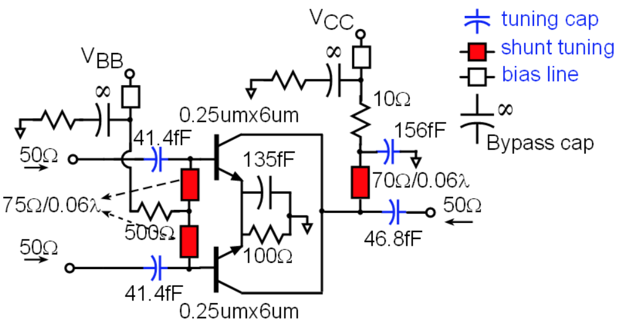
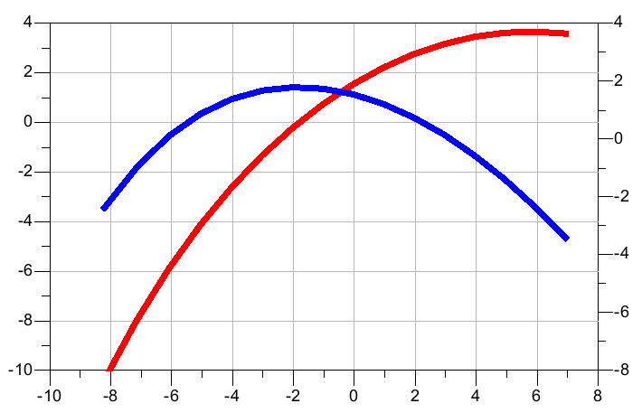
Doubler Area Scaling/Bias Condition
Pout, dBm
Gain, dB
Pin, dBm
HBT emitter length set such that P_{out} > P_{in}.
→ Cascaded doublers don't need inter-stage amplifiers .
Notes:
Please follow the allowed time so the program runs on schedule

Slide 8
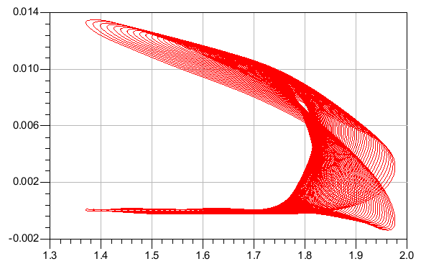
Input/Output Matching
140 GHz input tuning: 50 Ω large-signal match
280 GHz output (50 Ω load):
current swing at HBT safe limits (2.3 mA/μm)
voltage swing below HBT (V_{BRCEO}-V_{CE,sat}) limits:
less saturated ouput power but greater gain.
Emitter RC network improves low-frequency common-mode stability.
Transistor Current, mA
Transistor Output Voltage, V
Notes:
Please follow the allowed time so the program runs on schedule

Slide 9
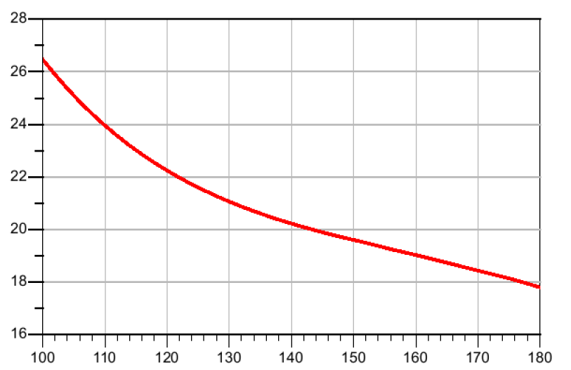
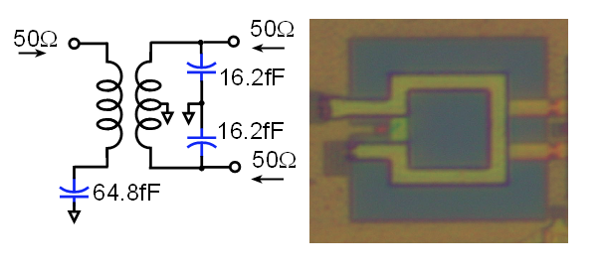
Single-ended to Differential Conversion
CMRR, dB
Freq, GHz
0.5 dB loss at 140 GHz.
Simulated phase imbalance: 10º & Simulated amplitude imbalance: 0.2 dB
Single-ended input to differential output amplifier with high CMRR:
Better spurious harmonic rejection at the expense of DC power consumption.
Notes:
Please follow the allowed time so the program runs on schedule

Slide 10
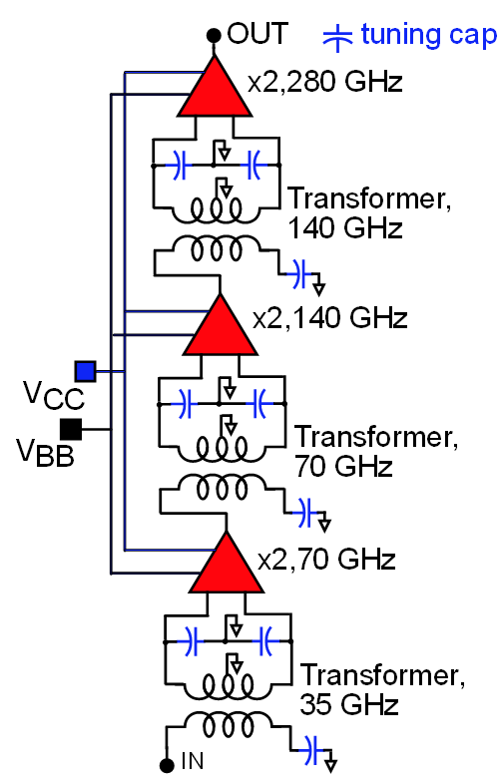
x8 Frequency Multiplier Chain
280GHz Pin = -2 dBm | 0.25um x 6um, 3 cascaded x2
Multiplication | x8
BW_{3dB} | 48 GHz
P_{out} | -0.6 dBm
P_{DC} | 112 mW
Die Area | 0.4 mm²
Spurious Harmonic Suppression | 28 dBc
Notes:
Please follow the allowed time so the program runs on schedule

Slide 11
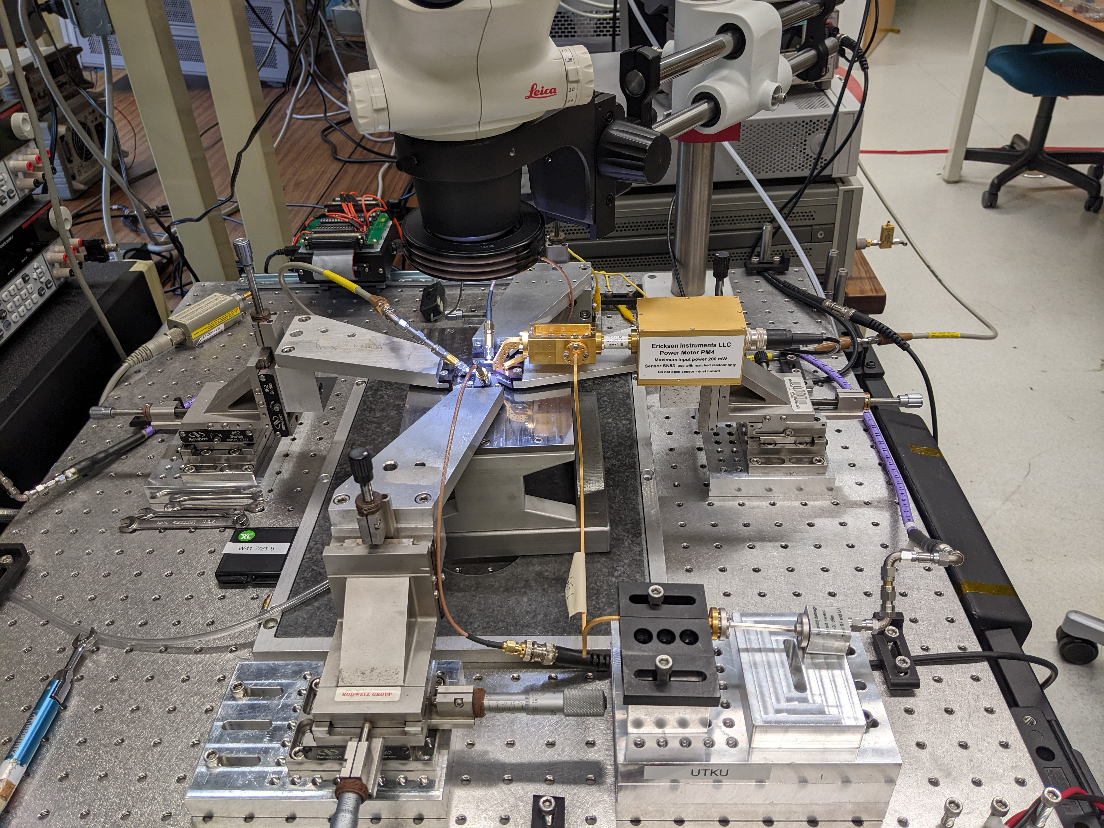
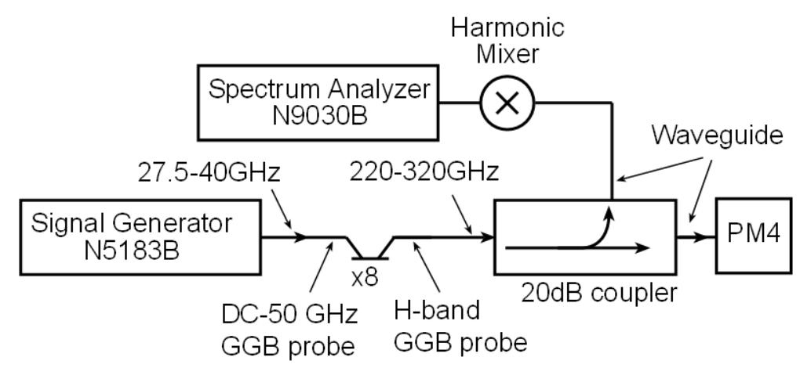
Power Measurement Setup
Simultaneous power and spectrum measurement.
Spurious-free tone to calculate cross-calibration coefficient generated by FMC.
High-order passive harmonic mixer limits minimum detectable signal power.
Notes:
Please follow the allowed time so the program runs on schedule

Slide 12
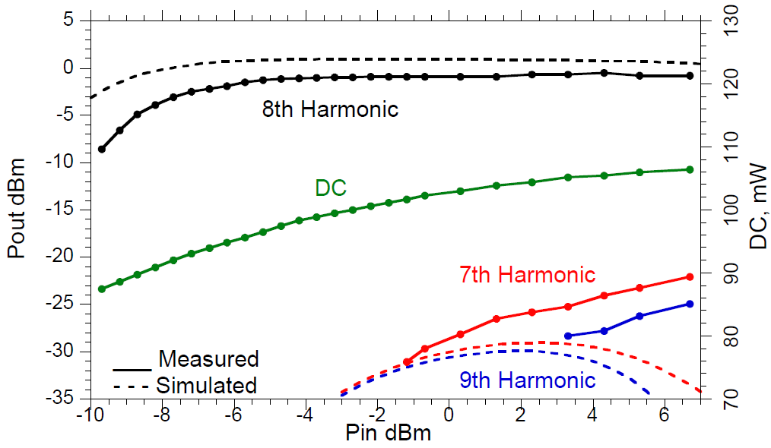
Measurement Results: Pout vs Pin
280 GHz
P_{in} = -1.2 dBm → P_{out(@7th harmonic)} = -31 dBm
P_{in} = 3.3 dBm → P_{out(@9th harmonic)} = -28.3 dBm
Notes:
Please follow the allowed time so the program runs on schedule

Slide 13
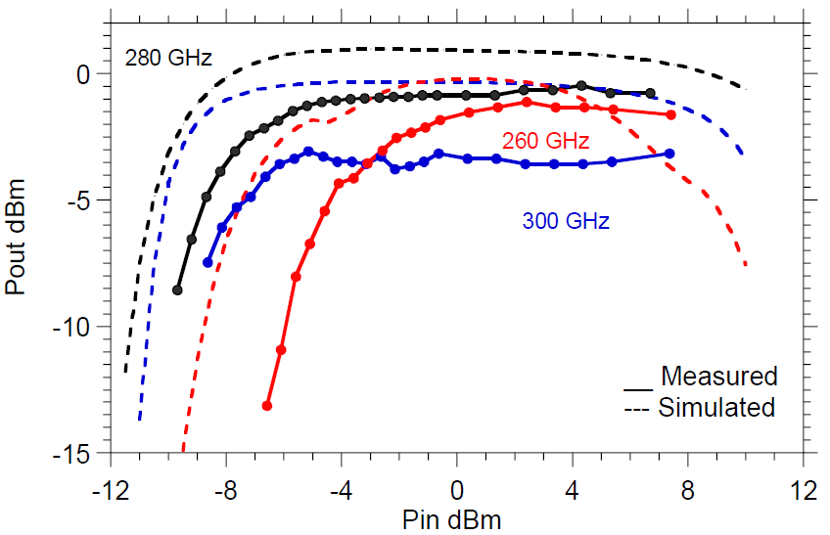
Measurement Results: Pout vs Pin
P_{in} = 0 dBm:
280 GHz: Measured P_{out} : -0.8 dBm, Simulated P_{out} : 0.9 dBm
300 GHz: Measured P_{out} : -3.3 dBm, Simulated P_{out} : -0.3 dBm
Inaccurate large-signal device modelling at high frequencies.
Notes:
Please follow the allowed time so the program runs on schedule

Slide 14
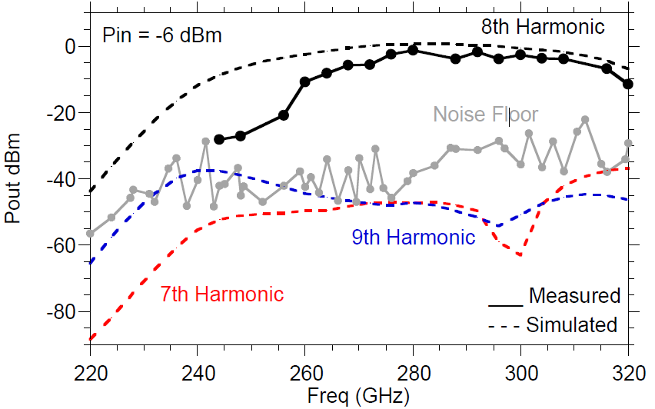
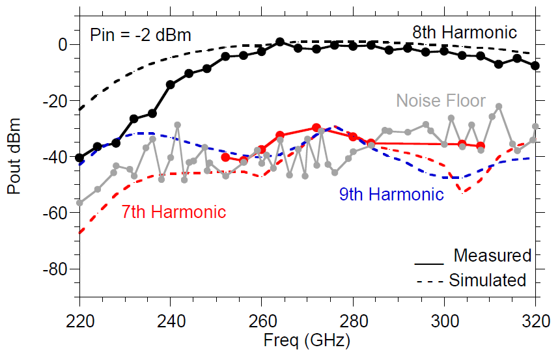
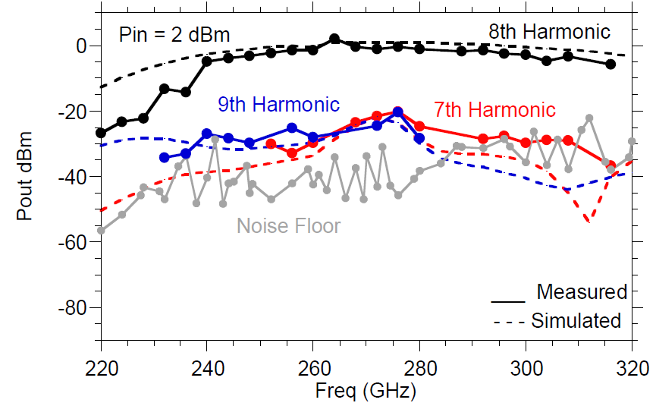
Measurement Results: Pout vs freq
P_{in} = -2 dBm → 2 dBm:
3-dB bandwidth: 48 GHz → 60 GHz.
Harmonic suppression: 28 dBc → 20 dBc
Set P_{in} for high spectral purity or wider operating bandwidth.
Notes:
Please follow the allowed time so the program runs on schedule

Slide 15
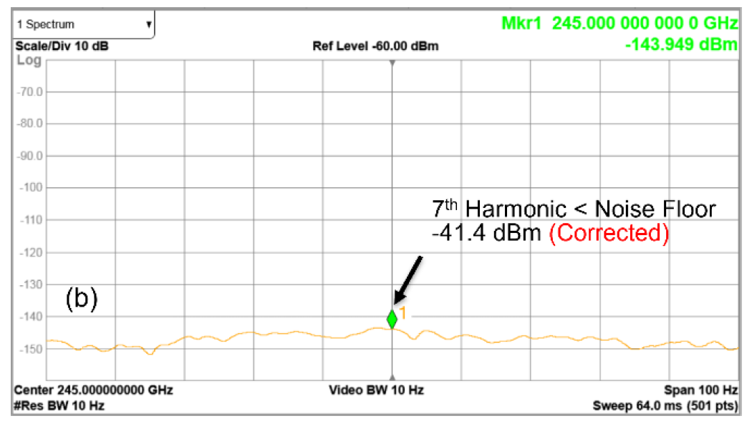
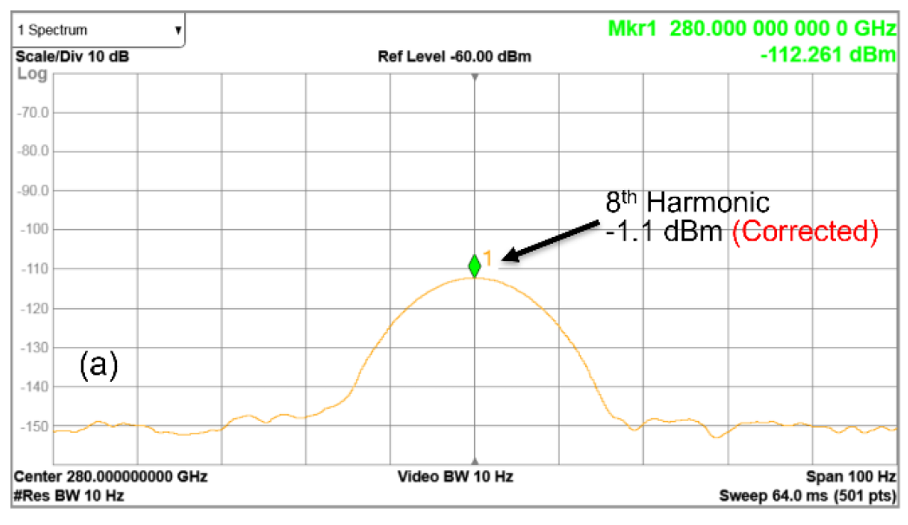
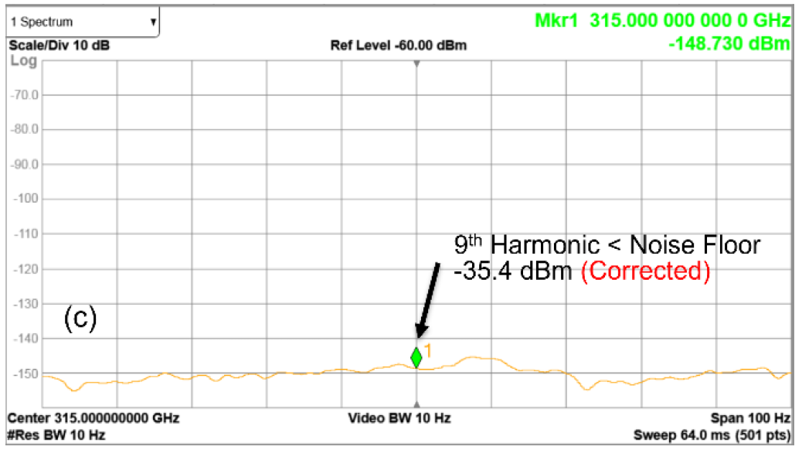
Measurement Results: Output Spectrum
P_{in} = -6 dBm: Spurious harmonics are below the noise floor.
Low order/fundamental mixer → better dynamic range.
Notes:
Please follow the allowed time so the program runs on schedule

Slide 16
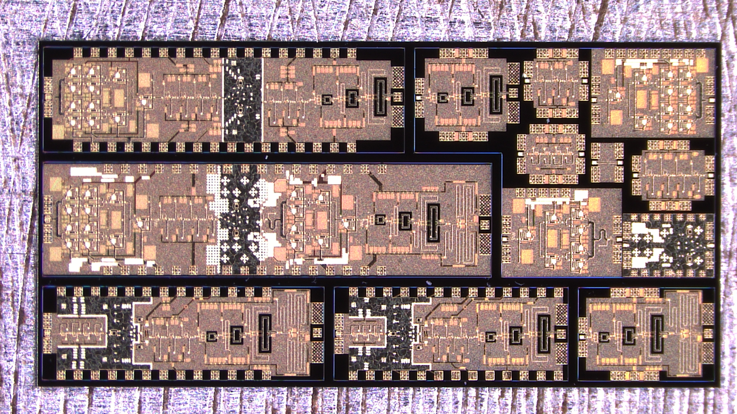
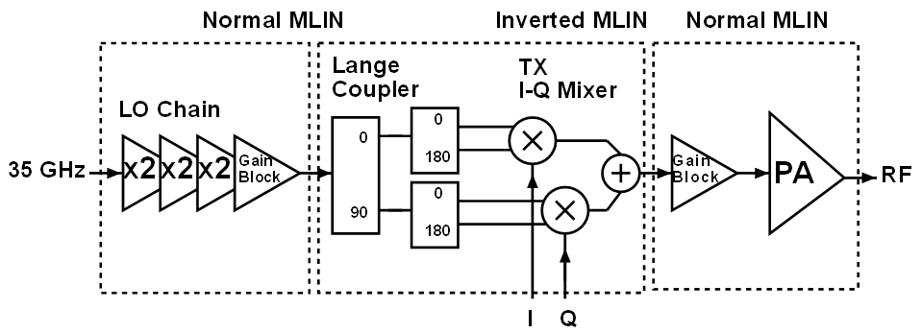
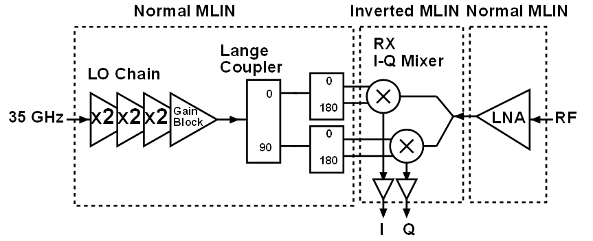
Transmitter/Receiver with x8 FMC
280 GHz direct-conversion TX
280 GHz direct-conversion RX
Notes:
Please follow the allowed time so the program runs on schedule

Slide 17
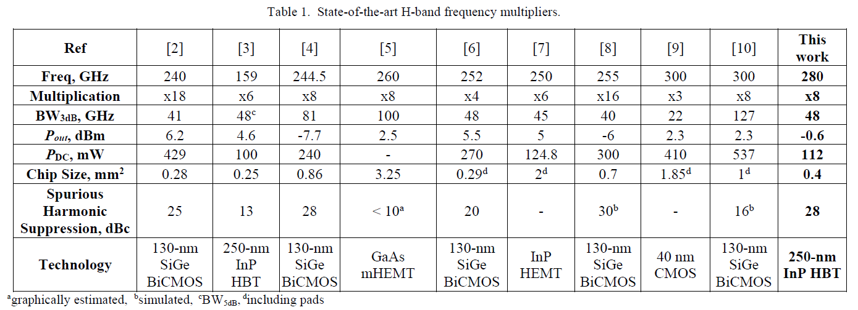
Performance Comparison
This work shows record spectral purity among H-band frequency multipliers.
Notes:
Please follow the allowed time so the program runs on schedule

Slide 18
Acknowledgement
This work was supported by ComSenTer, a JUMP program sponsored by the Semiconductor Research Corporation.
The authors thank Teledyne Scientific & Imaging for the IC fabrication.
Notes:
Please follow the allowed time so the program runs on schedule

Slide 19
THANK YOU
Notes:
Please follow the allowed time so the program runs on schedule

Slide 20
References
M. J. W. Rodwell et al., "100-300GHz Wireless: ICs, Arrays, and Systems," 2021 IEEE BiCMOS and Compound Semiconductor Integrated Circuits and Technology Symposium (BCICTS), 2021, pp. 1-4.
E. Turkmen, I. K. Aksoyak, W. Debski, W. Winkler and A. Çaǧri Ulusoy, "A 220-261 GHz Frequency Multiplier Chain (x18) With 8-dBm Peak Output Power in 130-nm SiGe," in IEEE Microwave and Wireless Components Letters.
M. Bao, T. N. Thi Do, D. Kuylenstierna and H. Zirath, "A 135–183GHz Frequency Sixtupler in 250nm InP HBT," 2020 IEEE/MTT-S International Microwave Symposium (IMS), 2020, pp. 480-483.
T. Buecher, S. Malz, K. Aufinger and U. R. Pfeiffer, "A 210–291-GHz (8×) Frequency Multiplier Chain With Low Power Consumption in 0.13-μm SiGe," in IEEE Microwave and Wireless Components Letters, vol. 30, no. 5, pp. 512-515, May 2020.
U. J. Lewark, A. Tessmann, S. Wagner, A. Leuther, T. Zwick and I. Kallfass, "A 220 to 320 GHz broadband active frequency multiplier-by-eight MMIC," 2014 9th European Microwave Integrated Circuit Conference, 2014, pp. 132-135.
J. Yu, J. Chen, Z. Li, D. Hou, Z. Chen and W. Hong, "A 212–260 GHz Broadband Frequency Multiplier Chain (×4) in 130-nm BiCMOS Technology," 2021 IEEE MTT-S International Microwave Symposium (IMS), 2021, pp. 454-457.
K. Lee, H. Hamada, H. Matsuzaki, H. Nosaka and H. -J. Song, "220 – 265 GHz Active x6 Frequency Multiplier MMIC with InP HEMT Technology," 2018 IEEE/MTT-S International Microwave Symposium - IMS, 2018, pp. 765-768.
N. Sarmah, B. Heinemann and U. R. Pfeiffer, "235–275 GHz (x16) frequency multiplier chains with up to 0 dBm peak output power and low DC power consumption," 2014 IEEE Radio Frequency Integrated Circuits Symposium, 2014, pp.
K. Katayama, K. Takano, S. Amakawa, T. Yoshida and M. Fujishima, "2.37-dBm-output 288–310 GHz frequency multiplier in 40 nm CMOS," 2017 IEEE International Symposium on Radio-Frequency Integration Technology (RFIT), 2017, pp. 28-30.
A. Ali, J. Yun, M. Kucharski, H. J. Ng, D. Kissinger and P. Colantonio, "220–360-GHz Broadband Frequency Multiplier Chains (x8) in 130-nm BiCMOS Technology," in IEEE Transactions on Microwave Theory and Techniques, vol. 68, no. 7, pp. 2701-2715, July 2020.
M. Urteaga, et al., “InP HBT Technologies for THz Integrated Circuits”, Proc. of the IEEE, vol. 105, no. 6, pp 1051-1067, June 2017.
Juo-Jung Hung, T. M. Hancock and G. M. Rebeiz, "High-power high-efficiency SiGe Ku- and Ka-band balanced frequency doublers," in IEEE Transactions on Microwave Theory and Techniques, vol. 53, no. 2, pp. 754-761, Feb. 2005.
A. S. H. Ahmed, U. Soylu, M. Seo, M. Urteaga and M. J. W. Rodwell, "A compact H-band Power Amplifier with High Output Power," 2021 IEEE Radio Frequency Integrated Circuits Symposium (RFIC), 2021, pp. 123-126.
Notes:
Please follow the allowed time so the program runs on schedule

Slide 21
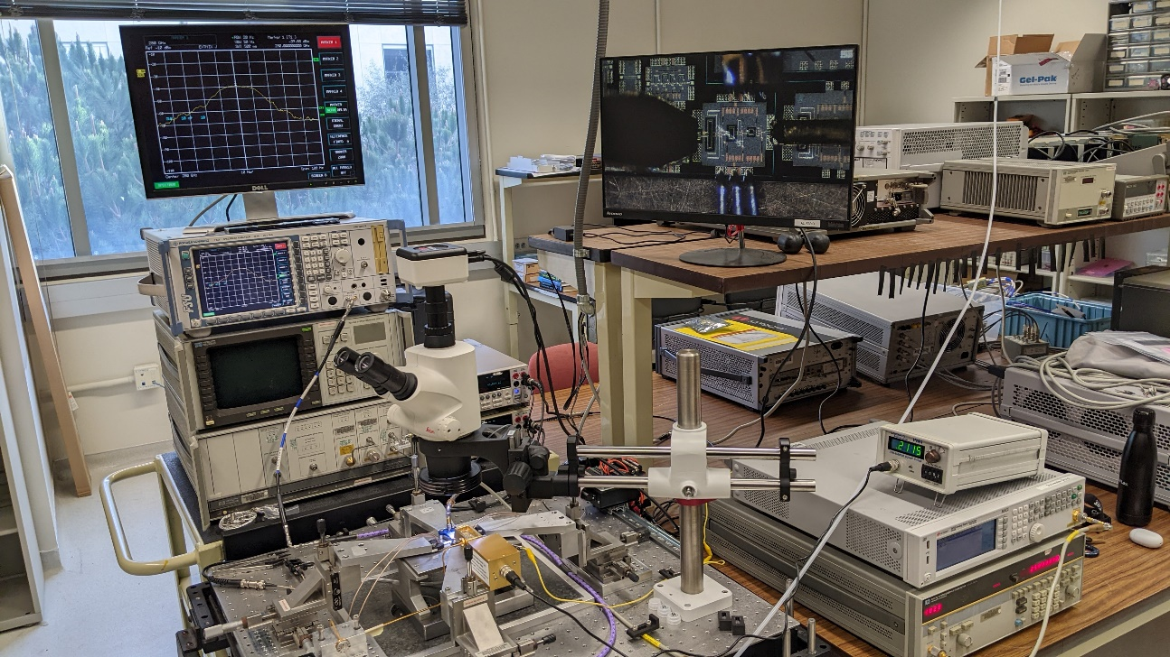
Power Measurement Setup (Pictures)
Notes:
Please follow the allowed time so the program runs on schedule

