Slide 1





(Paper 9b.2)
D-Band Power Amplifier
with 27 dBm Peak Output Power and 14.9% PAE
in 250-nm InP HBT Technology
Amirreza Alizadeh¹, Utku Soylu¹, Navneet Sharma²,
Gary Xu², Mark J. W. Rodwell¹
¹University of California, Santa Barbara, USA
²Samsung Research America, Plano, TX, USA
rodwell@ucsb.edu
10/18/2023
Notes:
The slide guide is meant to be used with PowerPoint.

Slide 2
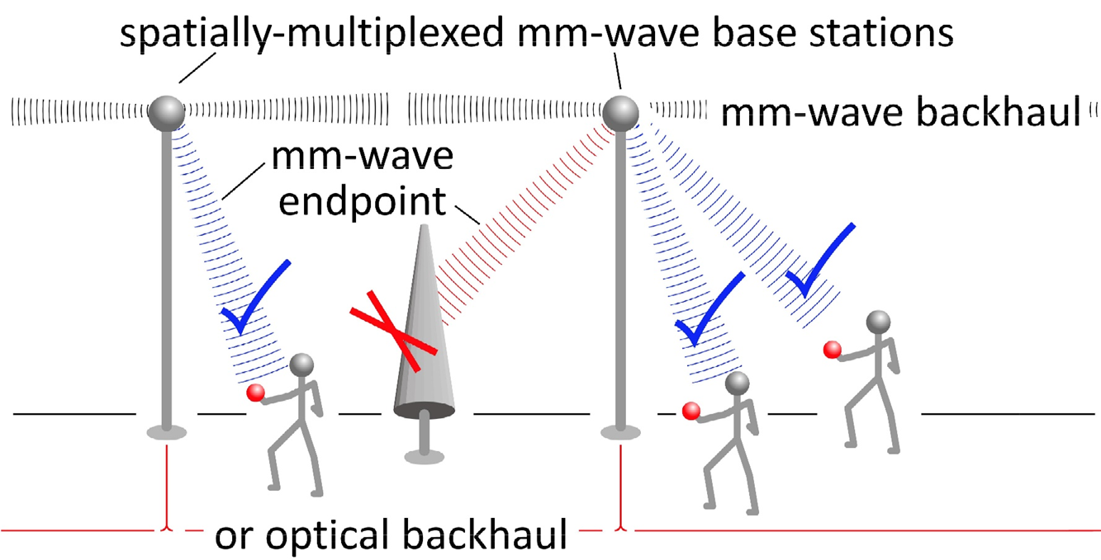
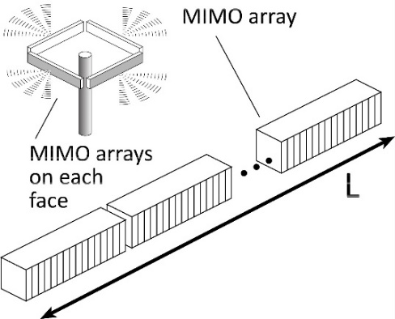
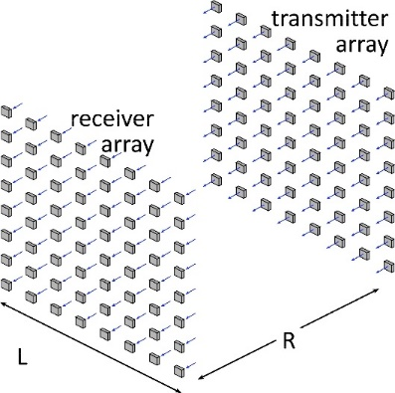
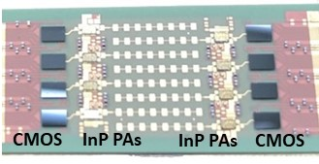
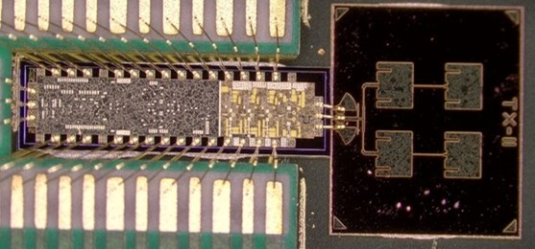
100-300 GHz Wireless
High capacity:
potentially wide available bandwidth
massive spatial multiplexing even with compact arrays
Limited range:
high λ²/R² path losses
high worst-case atmospheric attenuation
Need:
arrays with many elements
low receiver noise figure
compact, efficient, 100-300 GHz power amplifiers
140 GHz MIMO Hub
200 GHz backhaul
Abu-Surra,
Samsung/UCSB
2022 IEEE ICC
Soylu, UCSB
2023 IEEE BCICTS

Slide 3
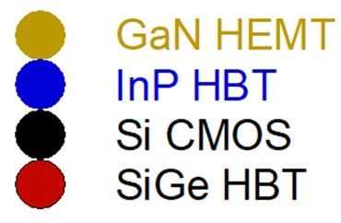
Technology Comparison: 100-220 GHz PAs
110-200 GHz: InP HBT provides leading output power vs. efficiency
200-300 GHz: InP HBT and InP HEMT are both excellent
Results compiled 8/16/2023

Slide 4
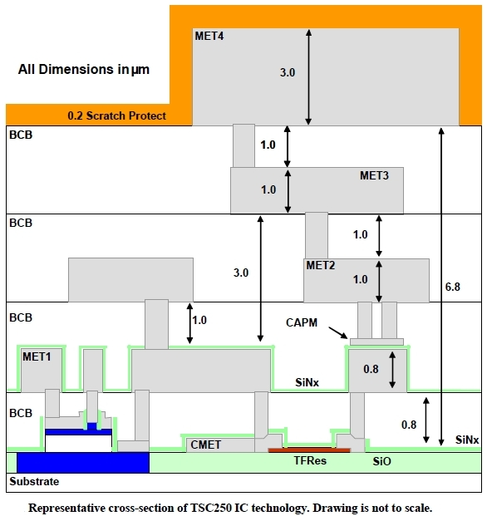
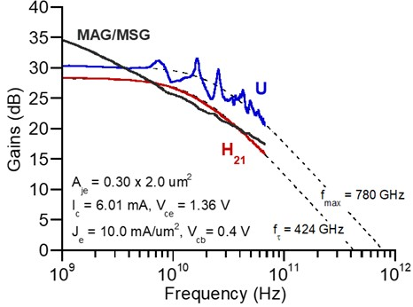
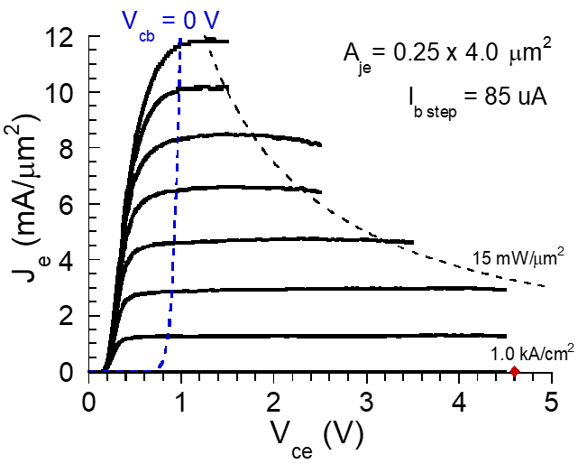
Teledyne 250 nm InP HBT Technology
HBTs:
~200-400 GHz f_{τ}; varies with V_{ce}, I_{c}
~650 GHz f_{max}
~3 mA/μm maximum current
~4.5 V breakdown
~0.6 V minimum at 2mA/μm (Kirk effect)
Back end:
4 Au wiring layers, BCB dielectric (ε_{r}=2.65)
5 μm M1-M4 separation→ ~0.9 dB/mm loss @ 140 GHz
MIM capacitors: 0.3 fF/μm²
Thin-film resistors: 50 Ω/square
Griffith, 2007 IEEE IPRM
Urteaga, 2017 IEEE Proceedings

Slide 5
500 mW, 150 GHz PA Design Challenges
Overheating (~3 W dissipation):
minimum output transistor power cell spacing, IC bonded to metal heat sink
~1 Amp DC supply currents:
electromigration, I²R losses→ wide conductors
Efficiency:
minimize tuning & power-combining losses
Electrothermal self-destruction:
power cell ballasting
Efficient class-AB operation:
electrothermally stable adaptive bias circuits

Slide 6
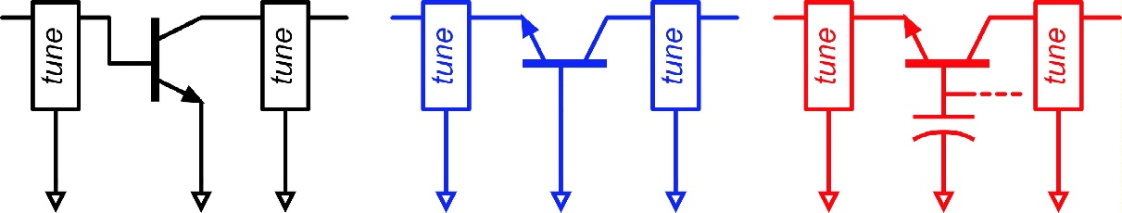
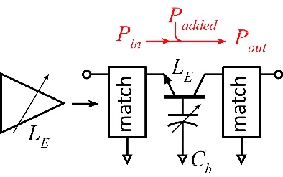
Capacitively Degenerated Common-Base
Common-base with AC grounded base :
more small-signal gain than common-emitter
Capacitively degenerated common base
finite base capacitance
smaller gain, same peak PAE at same (P_{out}-P_{in})
less gain compression @ peak PAE.
broadband stability with no loss in PAE
Power from previous stages contributes to P_{out}.
…similar to stacking
4x 6 μm HBT cell; no cell parasitics

Slide 7
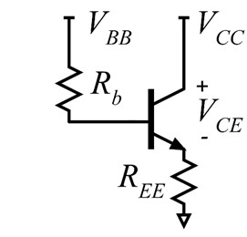
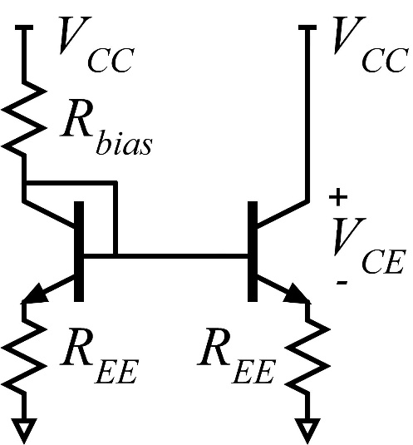
Bipolar Transistor Electrothermal Runaway
W. Liu, IEEE TED, March 1996

Slide 8
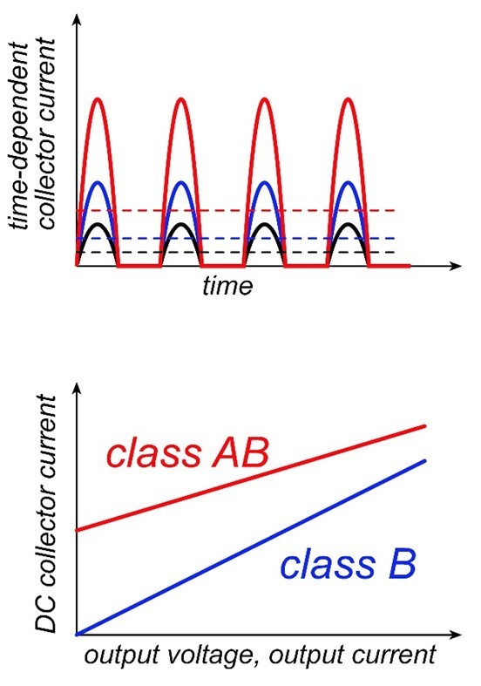
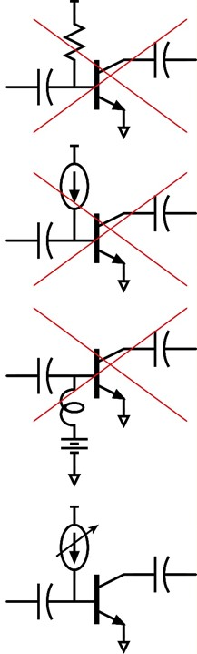
Class-B biasing of HBT power amplifiers

Slide 9
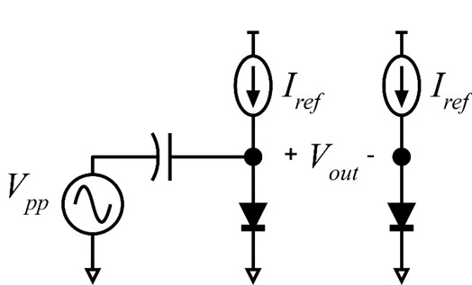
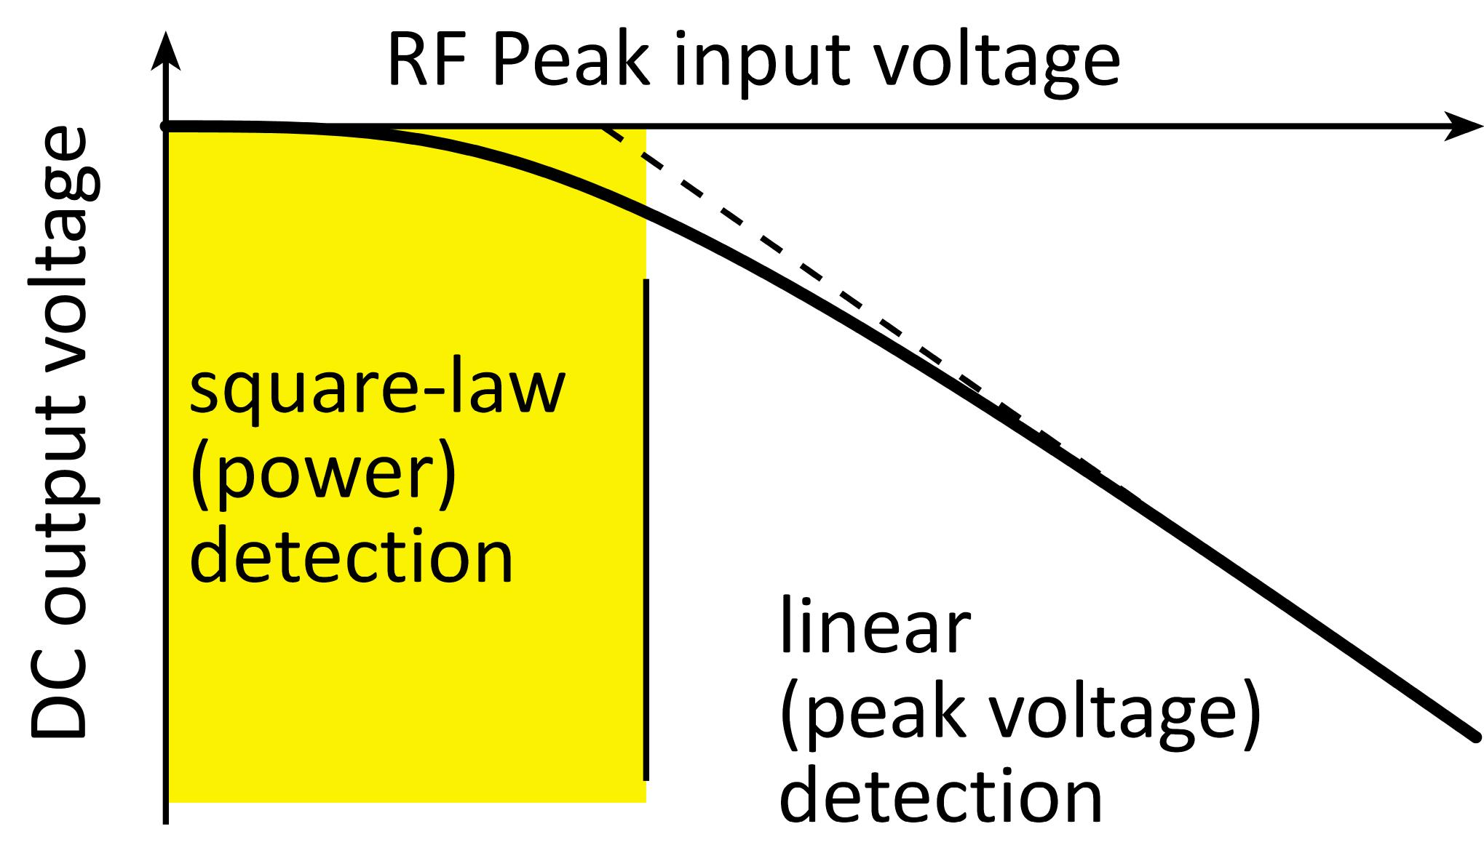
Power detectors & peak detectors

Slide 10
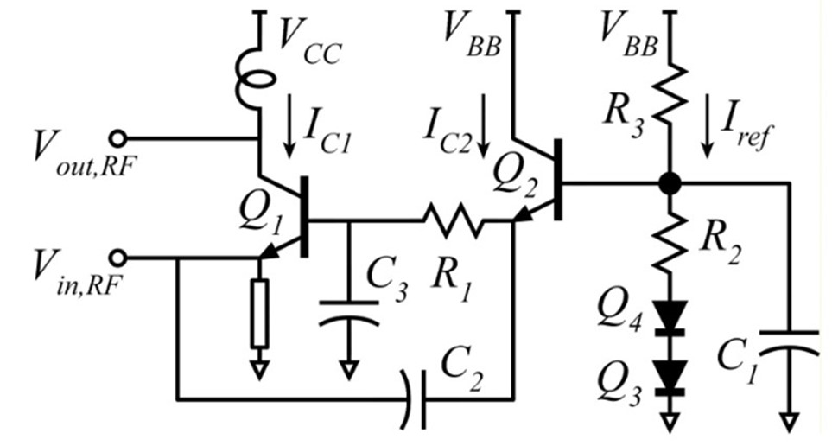
Common-base class-AB adaptive bias circuit
Low-power operation:
current I_{ref} produces voltage across R₂.
→ produces equal voltage across R₁
→ forces base current I_{b1}, produces collector current I_{c1}
I_{c1} is independent of ambient temperature
High power operation
V_{be1,DC} and V_{b2,DC} both decrease by (V_{in,RF,peak})²/4V_{t}.
→ increases the voltage drop across R₁.
→ increases I_{b1,DC} , I_{c1,DC}
I_{c1,DC} varies as k₁+k₂P_{RF} ; increases with RF power
Why two rectifying elements ?
doubles the rectified DC voltage.
R₁ can be 2:1 larger for a given variation of I_{c1,DC} with P_{RF} .
→ increases electrothermal stability factor.
Adaptive bias also reduces gain variation vs. output power.
Q1: RF gain; Q2: DC bias.

Slide 11
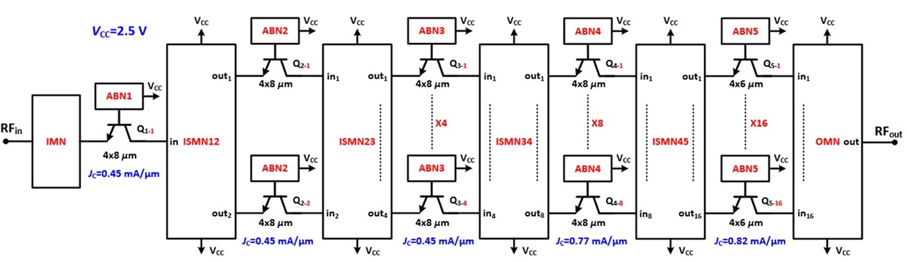
High-power D-band class-AB amplifier
ABN = Active Bias Network ISMN = Inter-stage Matching Network
IMN = Input Matching Network ONM= Output Matching Network
Simulated bias currents shown at peak RF power.

Slide 12
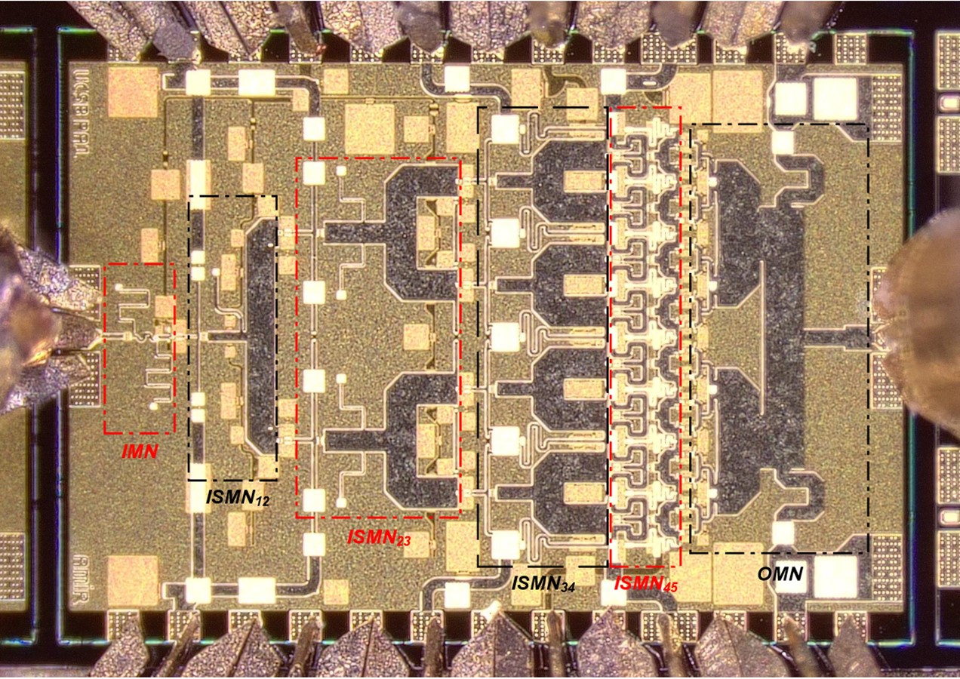
die photo
2 mm x 1.5 mm:
designed to fit in
140 GHz linear array
1 active bias network
for each 4-finger HBT
Each bias network
is very close to
the HBT being biased.

Slide 13
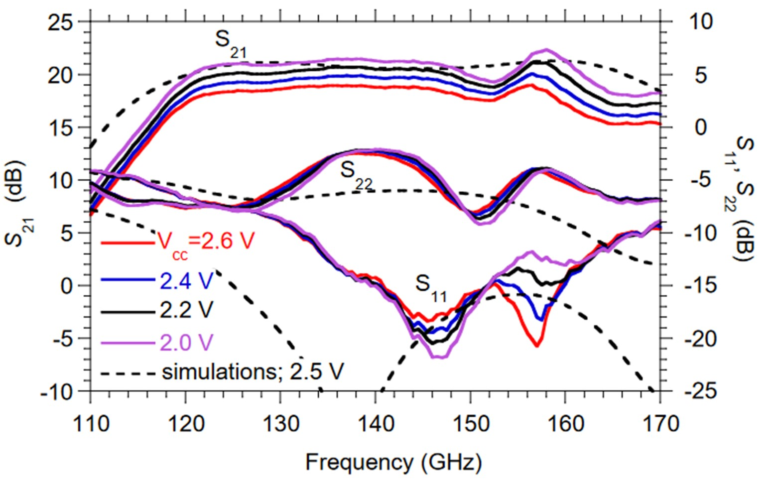
Measured Small-Signal Parameters
V_{cc}=2.4 V:
~20 dB midband gain
119–162 GHz bandwidth (-3 dB)
As V_{cc} increases:
→ more P_{DC} (more I_{C}, more V_{CE})
→ more heating
→ decreased gain S₂₁ .
Bias currents will be greater
under high-power operation.

Slide 14
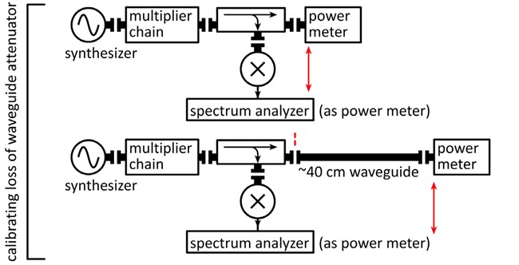
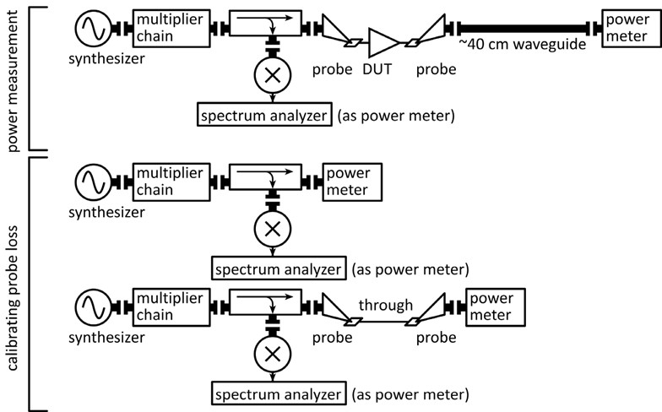
Power Measurements
Amplifier overloads power meter
Add 40 cm waveguide attenuator
Calibration: σ=0.33 dB (6 repeated measurements)
Amplifier output power measurement
IC bonded with high-K_{th} adhesive to Cu heat sink
Determining probe losses:
Measure loss of probe/line/probe (negligible line loss)
Weaknesses: division by 2, on-wafer structures near DUT
variability estimate: σ=1 dB (typical of D-band power data)
To be conservative, focus on 150 GHz data,
where probe loss correction is smallest (2.24 dB)

Slide 15
150 GHz Power Characteristics
14.9% peak PAE
27.2 dBm output power
at peak PAE

Slide 16
125-155 GHz Power Characteristics
P_{out} > 26 dBm
over 126-150 GHz

Slide 17
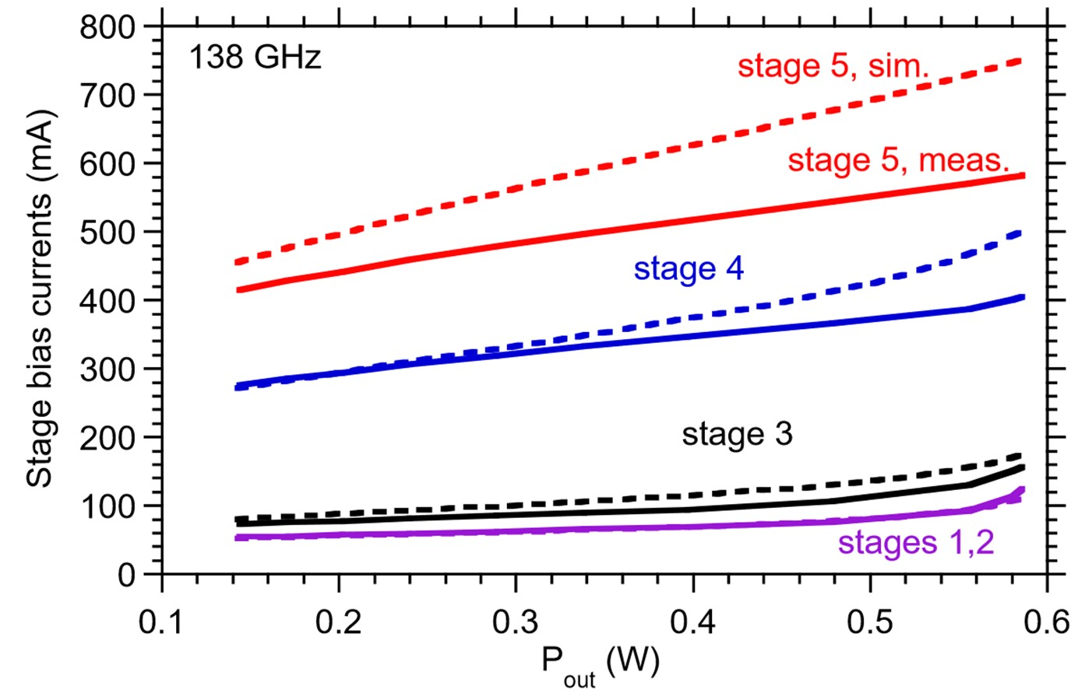
Adaptive Bias Circuit Operation: 138 GHz
IC shows expected
linear variation
of bias currents vs. RF power

Slide 18
High-Power InP D-band Amplifier
Record 27 dBm output power at 150 GHz; 14.9% associated PAE
> 26 dBm over 126-150 GHz
2 mm x 1.5 mm die; fits in 140 GHz, 0.6λ-pitch linear array
Teledyne 250 nm InP HBT technology.
Adaptive bias circuits: class-AB bias, electrothermal stabilization.
4x 6 μm HBT cell; no cell parasitics

Slide 19
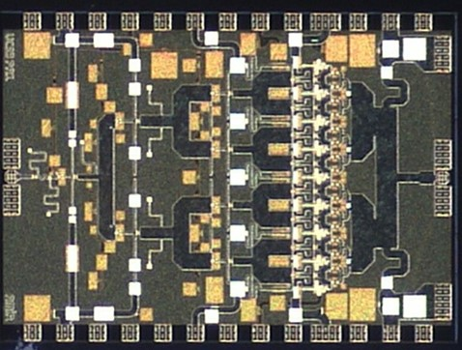
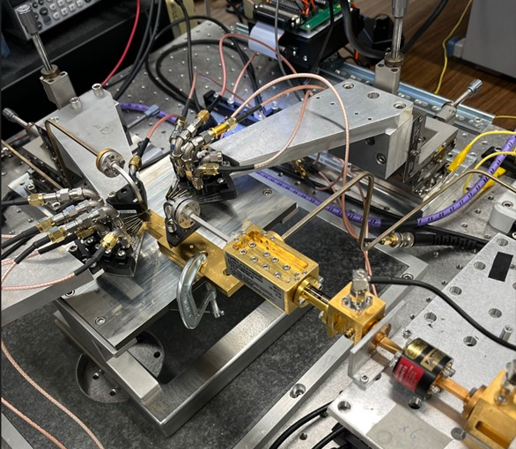
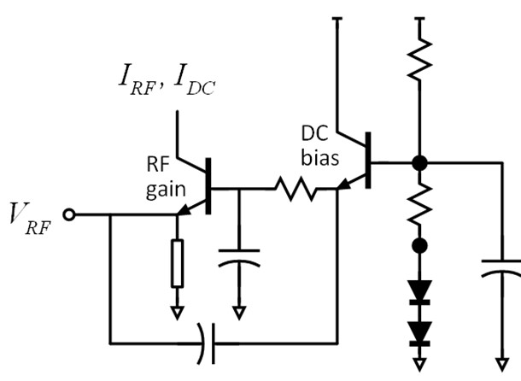
Questions ?
adaptive class-AB bias
2 mm x 1.5 mm

Slide 20
backup slides

Slide 21
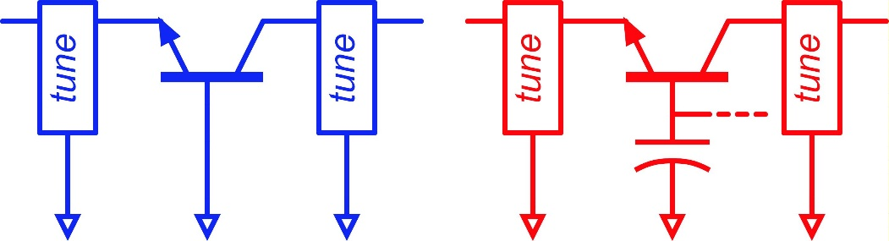
Capacitive Degeneration: Optimum Gain
Capacitive degeneration:
no effect on peak PAE….given lossless embedding
No capacitive degeneration:
more gain compression @ P_{1dB}. ✘
more gain @ P_{1dB} ✓
input matching losses have less effect on PAE ✓
With capacitive degeneration:
less gain compression @ P_{1dB}. ✓
less gain @ P_{1dB} ✘
input matching losses have more effect on PAE ✘
Design for greatest PAE @ P_{1dB}
balances these two considerations.
4x 6 μm HBT cell; no cell parasitics

Slide 22
