Slide 1
Self-Aligned InGaAs Channel MOS-HEMTs for High Frequency Applications
Logan Whitaker
UCSB Department of Electrical and Computer Engineering
June 28th, 2023
Advisor: Prof. Mark Rodwell
Funding: SRC & DARPA

Slide 2
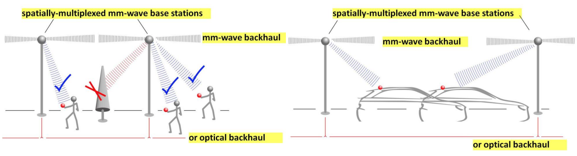
Motivation – Beyond 5G
Reprinted with permission of Mark Rodwell
Industry currently introducing 5G (20-80 GHz)
Beyond 5G requires 100-300 GHz communication systems
  More bandwidth
  Higher data rates
Requires transistors operate “easily” at these frequencies:

Slide 3
FETs – Reduce Noise Figure
Increase in f_{τ} :
Current frequency
  Improved noise
higher-frequency systems
  Same noise
Reprinted with permission of Mark Rodwell

Slide 4
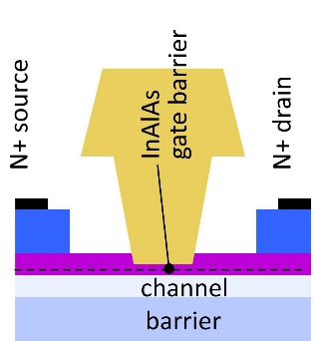
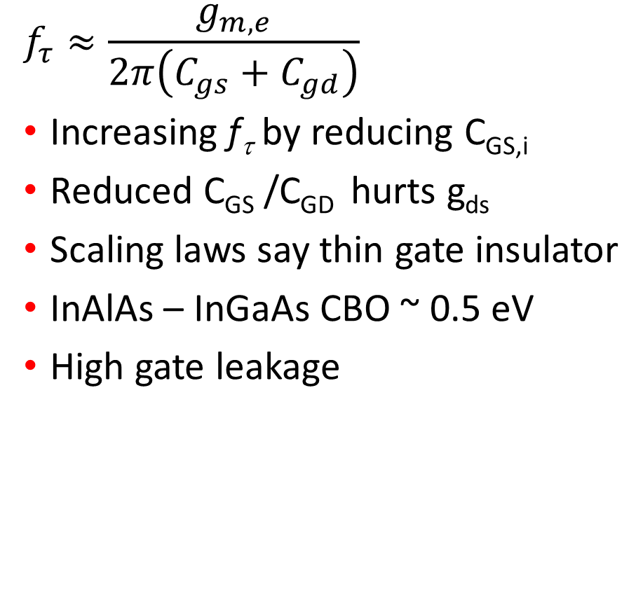
Why not HEMT?
$$f_{τ}≈\frac{g_{m,e}}{2π\left(C_{gs}+C_{gd}\right)}$$
Increasing f_{τ} by reducing C_{GS,i}
Reduced C_{GS} /C_{GD} hurts g_{ds}
Scaling laws say thin gate insulator
InAlAs – InGaAs CBO ~ 0.5 eV
High gate leakage

Slide 5
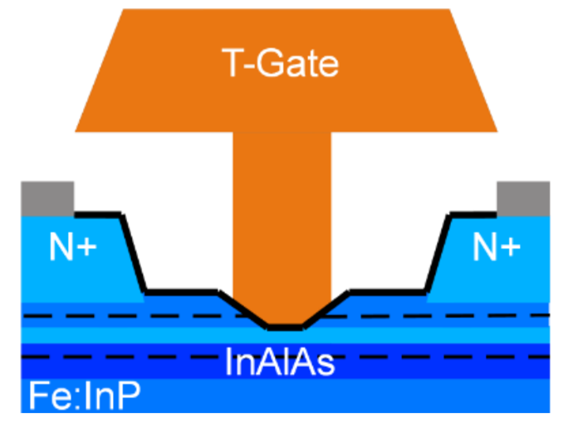
MOS-HEMTs
Institution | L_{g} (nm) | g_{m,e} (mS/µm) | g_{ds,e} (mS/µm) | C_{GS} (fF/um) | C_{GD} (fF/um) | f_{τ} (GHz) | f_{max} (GHz)
Markman et al. | 40 | 2.9 | 0.15 | 0.8 | 0.2 | 403 | 594
Add gate dielectric
Improve C_{GS} /C_{GD}
Improve g_{ds}
Reprinted with permission of Brian Markman

Slide 6
MOS-HEMTs
Institution | L_{g} (nm) | g_{m,e} (mS/µm) | g_{ds,e} (mS/µm) | C_{GS} (fF/um) | C_{GD} (fF/um) | f_{τ} (GHz) | f_{max} (GHz)
Markman et al. | 40 | 2.9 | 0.15 | 0.8 | 0.2 | 403 | 594
Ft, fmax limited by CGS, CGD
Fringe capacitance from gate-link overlap
  T-gate filling
  Gate alignment
Extra capacitance from thick link
Reprinted with permission of Brian Markman

Slide 7
MOS-HEMTs
Institution | L_{g} (nm) | g_{m,e} (mS/µm) | g_{ds,e} (mS/µm) | C_{GS} (fF/um) | C_{GD} (fF/um) | f_{τ} (GHz) | f_{max} (GHz)
Markman et al. | 40 | 2.9 | 0.15 | 0.8 | 0.2 | 403 | 594
Ft, fmax limited by CGS, CGD
Fringe capacitance from gate-link overlap
  T-gate filling
  Gate alignment
Extra capacitance from thick link
Need:
  Self aligned process
  Structure that’s easier to fill
  Thinner Link
Reprinted with permission of Brian Markman

Slide 8
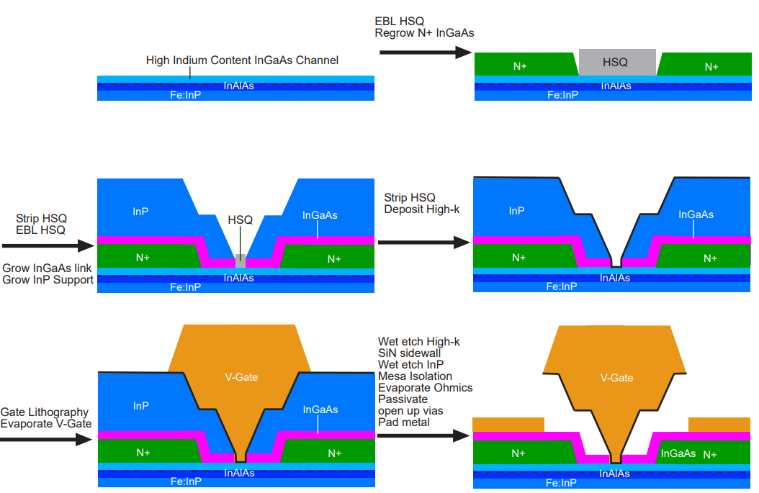
MOS-HEMTs 2.0
Self aligned
  Removes gate-link overlap
  Reduces C_{GS,f}
V-Gate
  Easier to fill with metal
  Better L_{g} scaling
Thin link
  More є₀
  Less є_{S}
  Reduces C_{GS,f}
$$ε_{0}$$
$$ε_{s}$$

Slide 9
What is my variable?
Link thickness
  3 nm minimum (source starvation)
  20 nm maximum (maximized mobility)

Slide 10
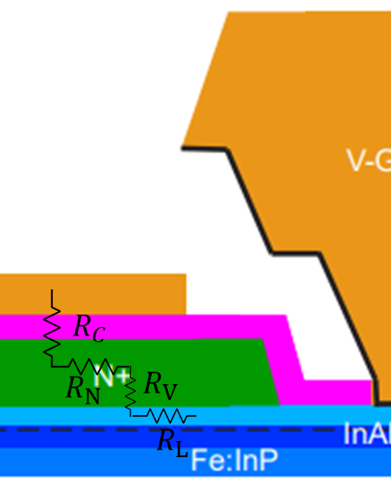

Rs breakdown
$R_{S}=R_{C}+R_{N}+R_{V}+R_{L}$
$$R_{Sheet}={\left(q∗μ_{Link}∗n_{link}\right)}^{−1}$$
$$R_{L}=R_{sheet}∗L_{sg}$$
$$t_{link}↓ → μ_{link}↓$$

Slide 11
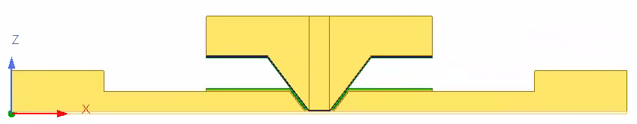
Capacitance
Create model in HFSS
Find capacitance of the model
Vary Lg
Find y intercepts
Divide by 2 to find CGS
Repeat with variations on the model

Slide 12
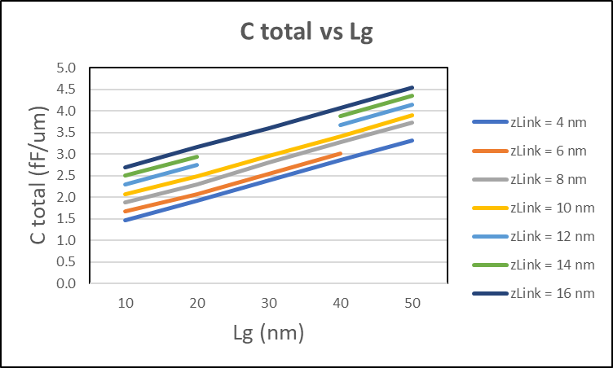
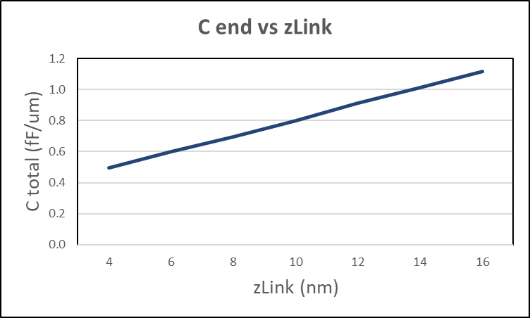
Cgs end vs Link Thickness
Vary the thickness of the link
  Assume channel is perfectly conducting (pessimistic)
  Assume topside link doping is a perfect insulator (optimistic)
  Results in a STRONG linear relationship between link thickness and end capacitance
Thinner (low mobility) links could be better?

Slide 13
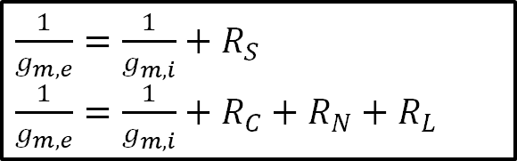
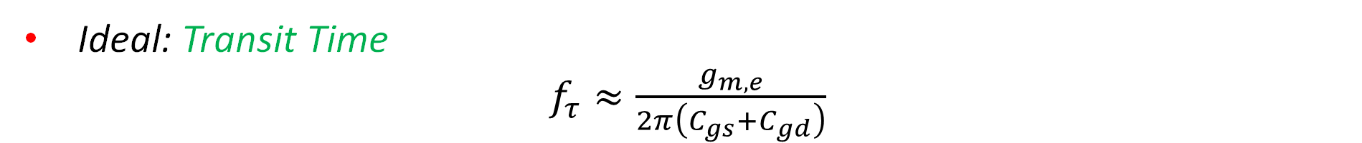
So What?
$\frac{1}{g_{m,e}}=\frac{1}{g_{m,i}}+R_{S}$
$\frac{1}{g_{m,e}}=\frac{1}{g_{m,i}}+R_{C}+$ $R_{N}+R_{L}$
Ideal: Transit Time
$f_{τ}≈\frac{g_{m,e}}{2π\left(C_{gs}+C_{gd}\right)}$

Slide 14
So What?
$\frac{1}{g_{m,e}}=\frac{1}{g_{m,i}}+R_{S}$
$\frac{1}{g_{m,e}}=\frac{1}{g_{m,i}}+R_{C}+$ $R_{N}+R_{L}$
Ideal: Transit Time
$f_{τ}≈\frac{g_{m,e}}{2π\left(C_{gs}+C_{gd}\right)}$

Slide 15
So What?
$\frac{1}{g_{m,e}}=\frac{1}{g_{m,i}}+R_{S}$
$\frac{1}{g_{m,e}}=\frac{1}{g_{m,i}}+R_{C}+$ $R_{N}+R_{L}$
Ideal: Transit Time
$f_{τ}≈\frac{g_{m,e}}{2π\left(C_{gs}+C_{gd}\right)}$

Slide 16
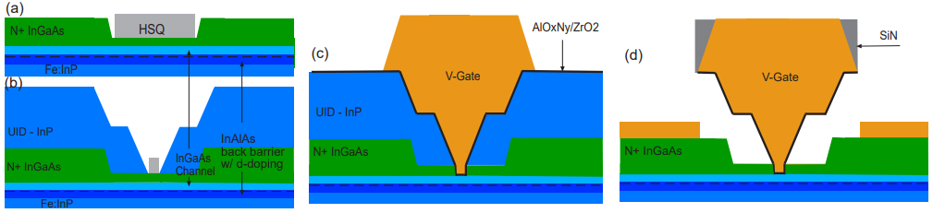
Process Flow
Epi + Regrowth 1
Regrowth 2
c) Digital etch, high-k, and gate metal
d) high-k etch, sidewall, sacrificial etch, mesa isolation, and contacts

Slide 17
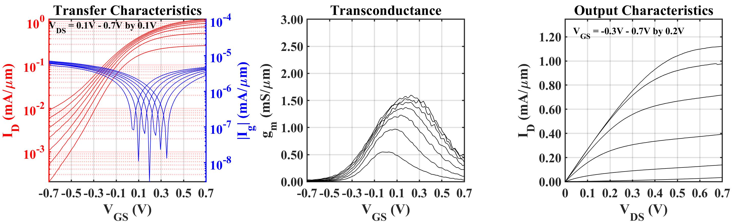
DC results – Lg = 22 nm

Slide 18
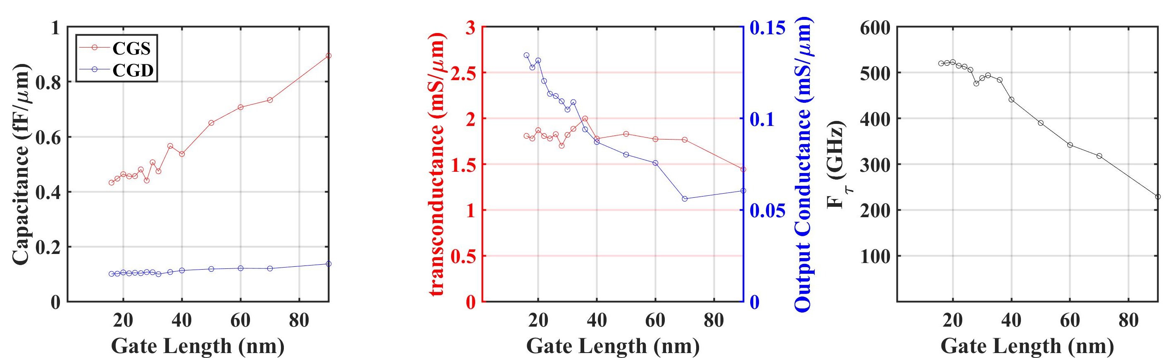
RF results vs Gate Length

Slide 19
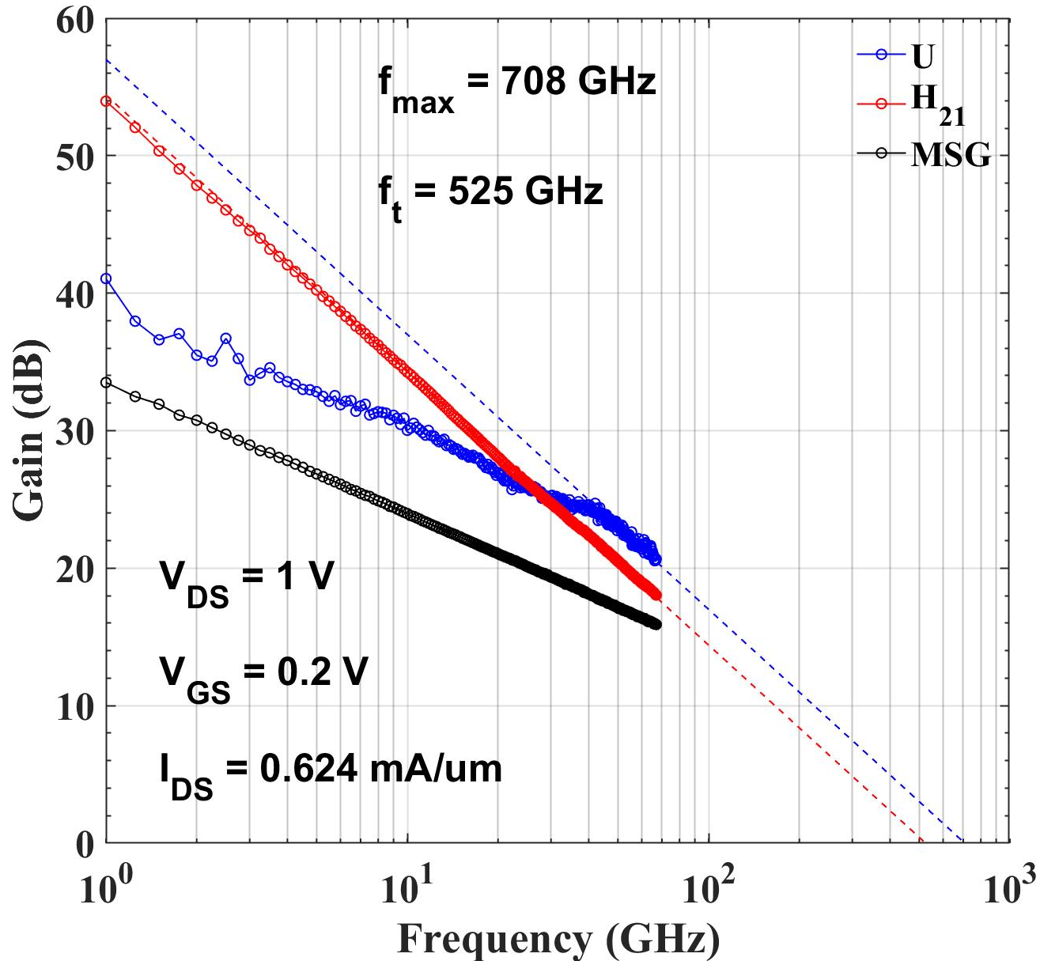
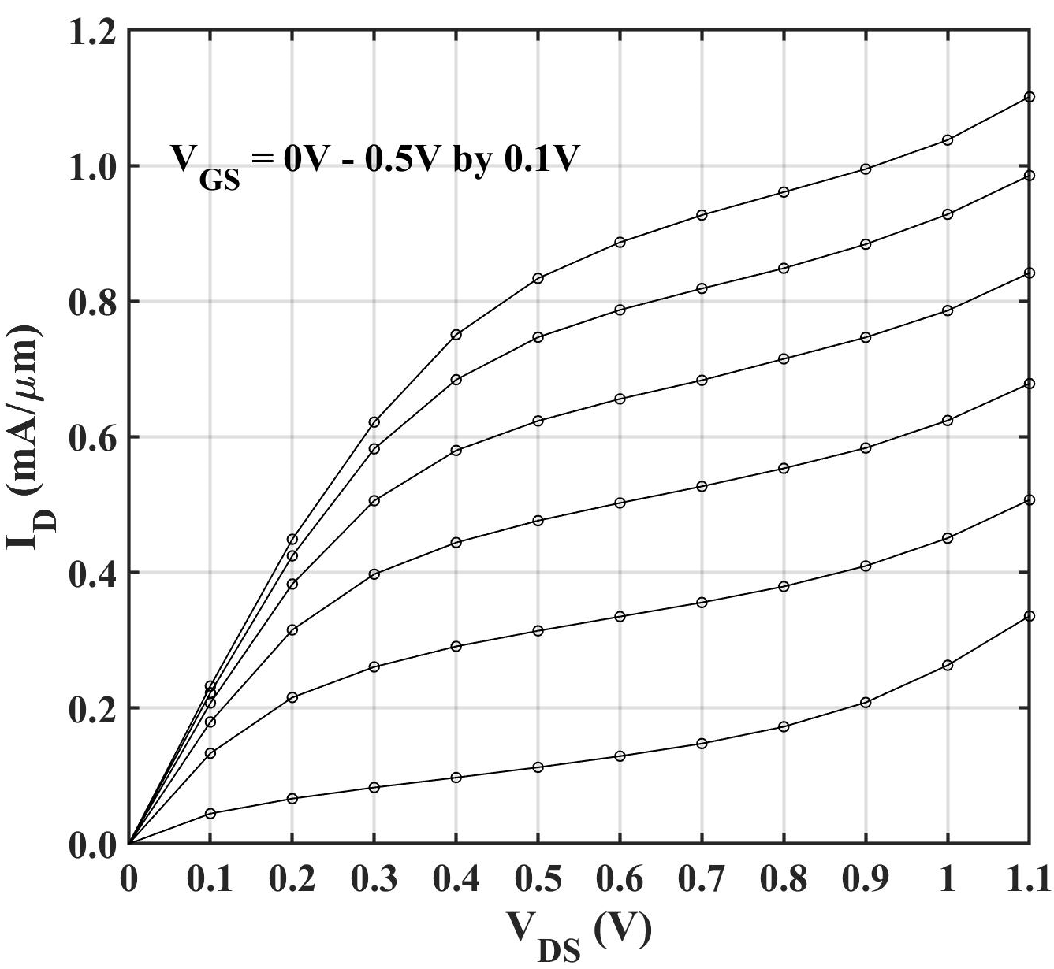
Mixed Results – Lg = 20 nm

Slide 20
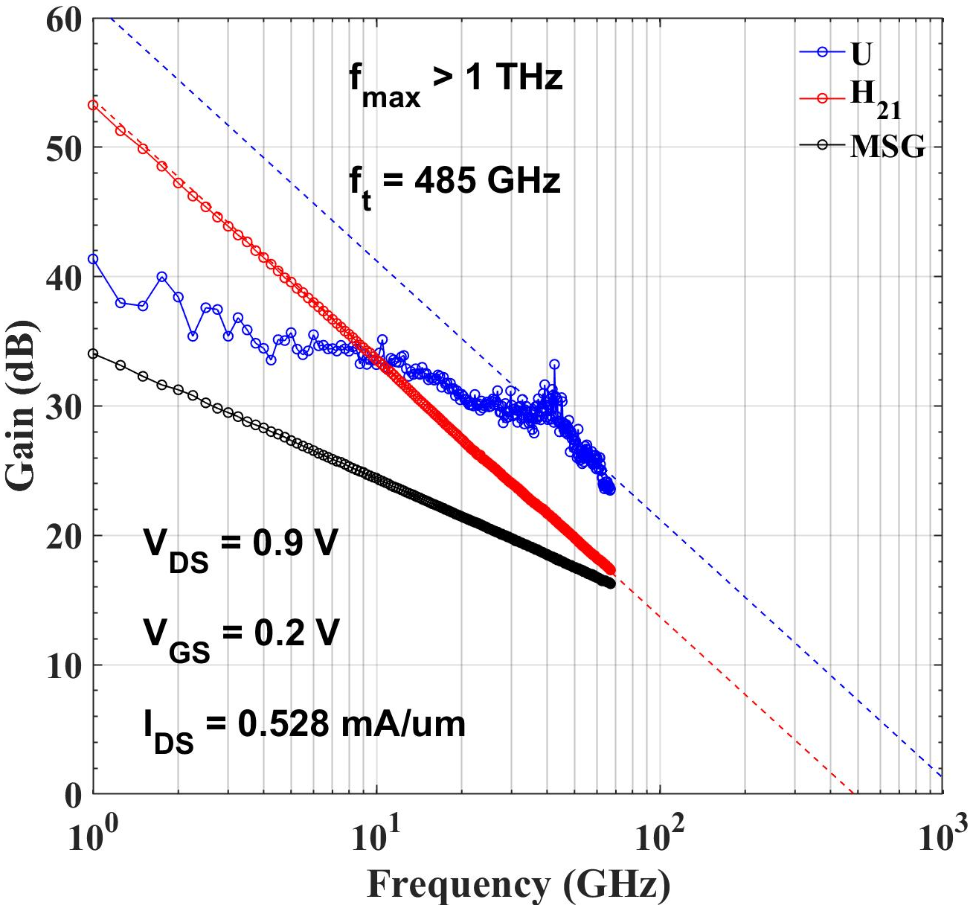
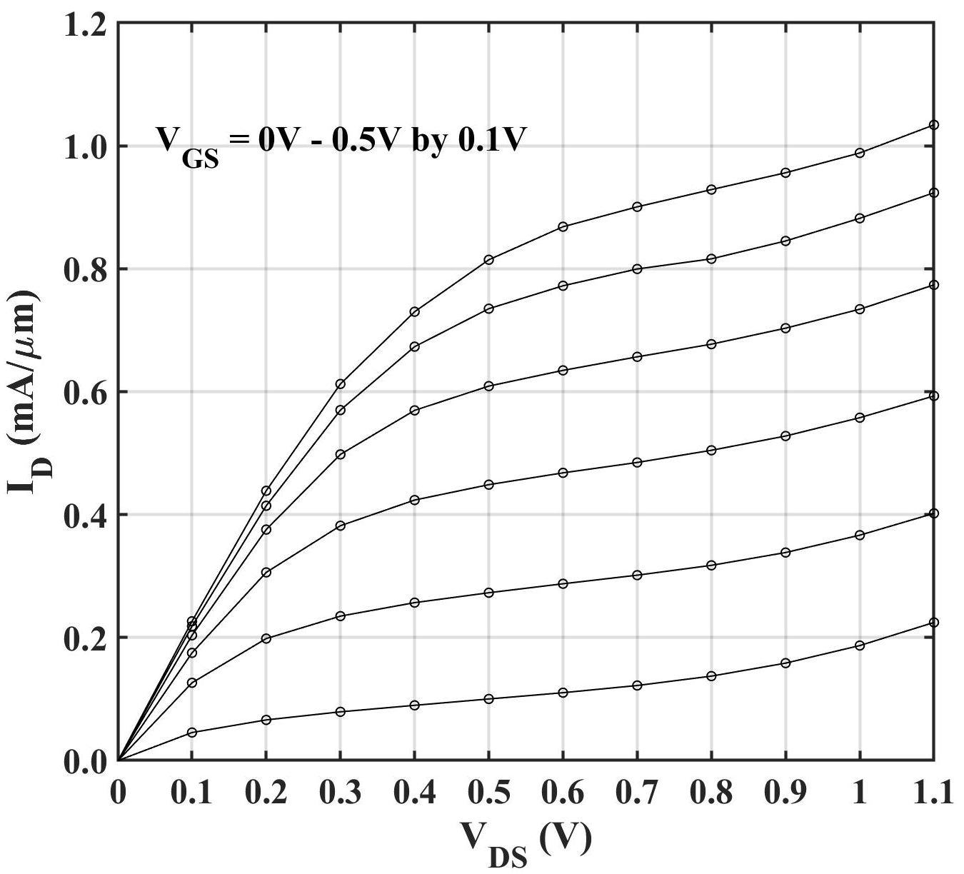
Mixed Results – Lg = 36 nm

Slide 21
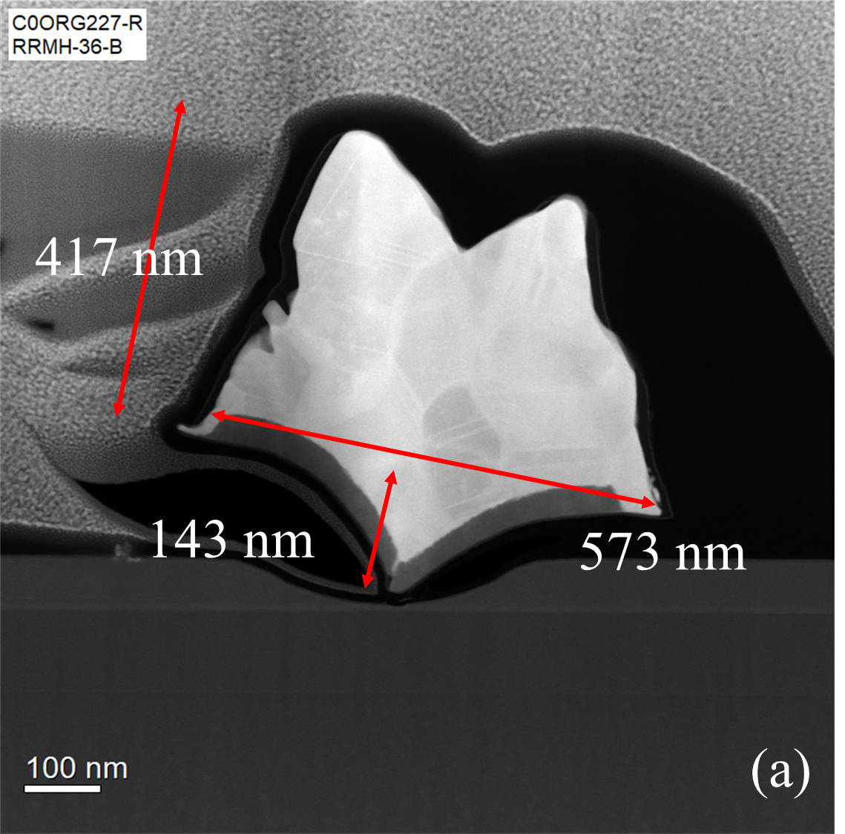
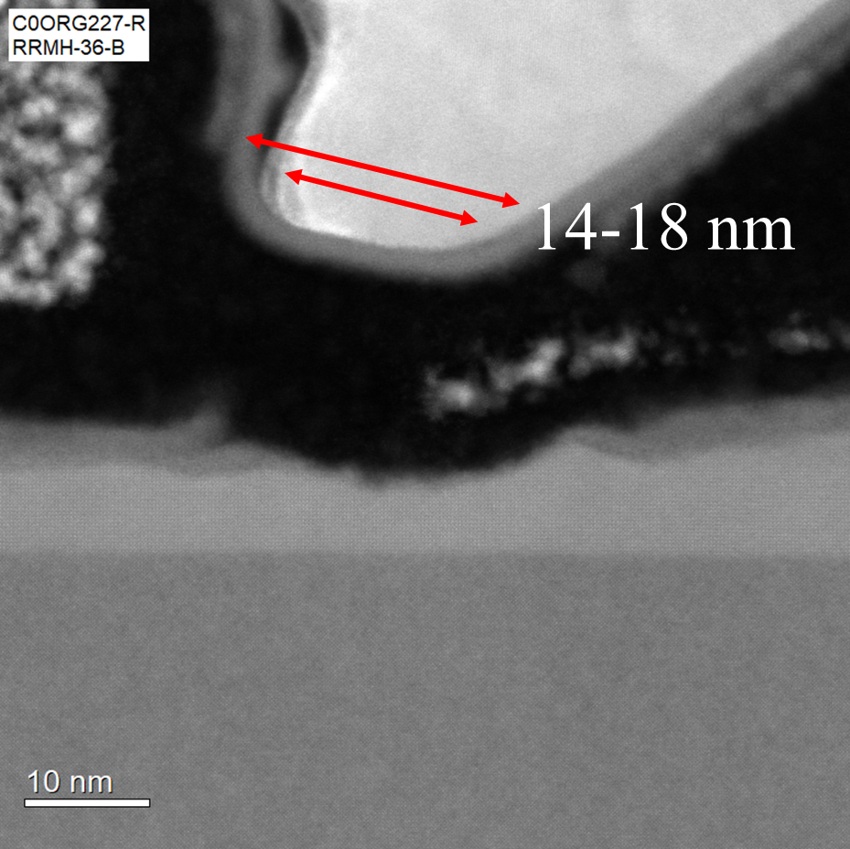
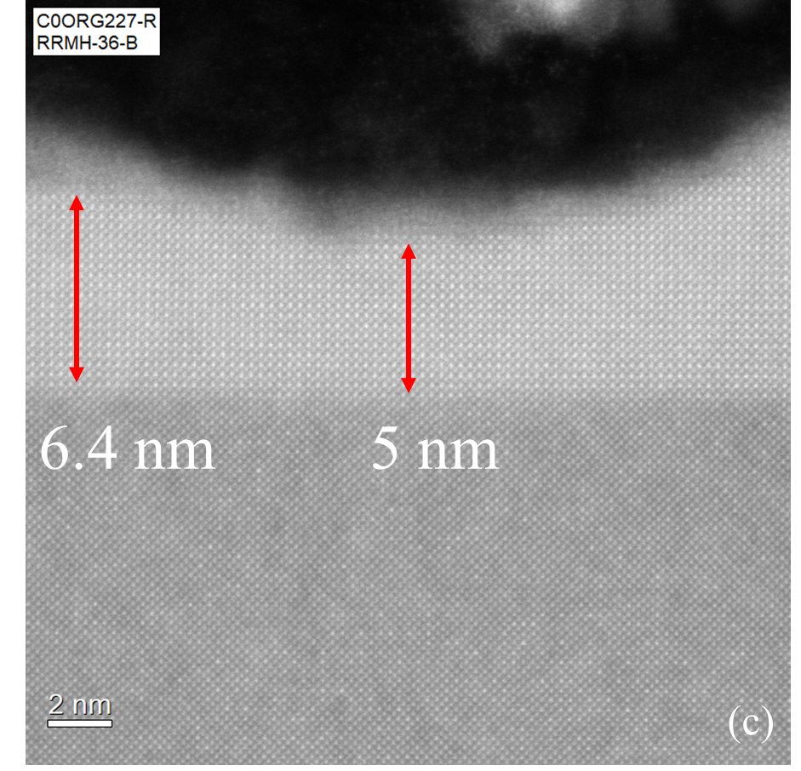
TEM – Lg = 18 nm

Slide 22
Acknowledgements
Funding Support: SRC, DARPA (ComSenTer, JUMP)
Nanofab: Cleanroom staff
MOCVD Growth: Klamkin Group and MOCVD staff
HFM Testing Lab: Matt Guidry and Christopher Clymore
Lund University: Erik Lind and Lars-Erik Wernersson
Special Thanks: Brian Markman

Slide 23
Self-Aligned InGaAs Channel MOS-HEMTs for High Frequency Applications
Logan Whitaker
UCSB Department of Electrical and Computer Engineering
June 28th, 2023
Advisor: Prof. Mark Rodwell
Funding: SRC & DARPA

Slide 24
References
[1] M. Egard et al., IEEE-EDL, vol. 33, no. 3, p. 369, (2012).
[2] B. Markman et al., DRC, (2021).
[3] D. F. William et al., IEEE-TSAT, vol. 3, no. 4, p. 433, (201).
[4] S. Kee et al., IEEE-EDL, vol. 35, no. 6, p. 621, (2014).
[5] S. Lee et al., IEEE Microw. Guid. Wave Lett., 1997.
[6] W. S. Park & H. B. Jo et al., IEEE-IEDM, (2022).

