Slide 1

Paper 5a.1
LNA in 130-nm InP HBT with 15.5 dB Gain and Record 5.3 dB Noise-Figure at 212 GHz
A. Alizadeh*, K. Park, S. Hassanzadehyamchi,
U. Soylu, M. Urtega, and M. Rodwell
*University of California at Santa Barbara
Santa Barbara, CA, USA

Slide 2
Outline
Noise Measure
Motivation / Technology
Noise-Measure in TSC130
Circuit Design
Results
Comparison
Conclusion

Slide 3
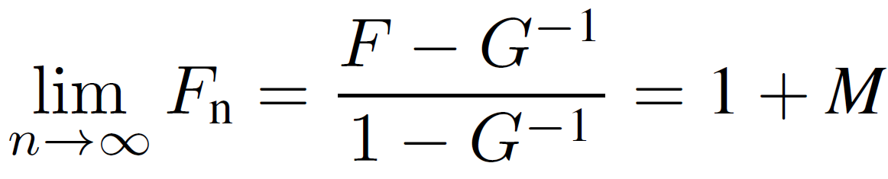

Noise Measure
RF_{in}
1
2
n-1
n
G, F
G, F
G, F
G, F
50 Ω
$$→M=\frac{F−1}{1−G^{−1}}$$
Noise Measure
M is independent of the circuit topology (e.g., common-emitter vs. common-base)
M is independent of embedding or pre-embedding (passive, lossless) circuits that might be used for gain boosting or degeneration [11].
A multi-stage LNA will have the same M as that of the transistors used in it.
The goal is to find an LNA circuit whose passive element loss degrades M the least.

Slide 4

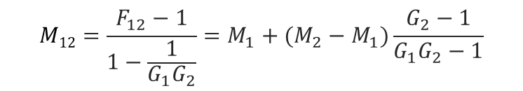

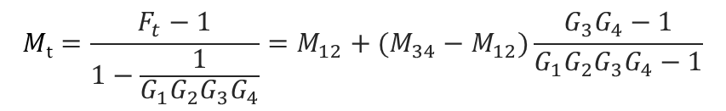

Noise Measure
G₁, F₁
G₂, F₂
$$M12=\frac{F_{12}−1}{1−\frac{1}{{G_{1}G}_{2}}}=M_{1}+(M_{2}−M_{1})\frac{G_{2}−1}{{G_{1}G}_{2}−1}$$
$$If M1=M2 →$$
$$M12=M1$$
G₁₂ , F₁₂
$$Mt=\frac{F_{t}−1}{1−\frac{1}{{G_{1}G}_{2}{G_{3}G}_{4}}}=M_{12}+(M_{34}−M_{12})\frac{G_{3}G_{4}−1}{{G_{1}G}_{2}{G_{3}G}_{4}−1}$$
G₁₂ , F₁₂
G₃₄ , F₃₄
$$Mt=M12=M1 if M12=M34$$
G_{t} , F_{t}
F_{t} is minimum if all stages have same noise measures.
Only minimize the noise measure of the 1st stage.

Slide 5
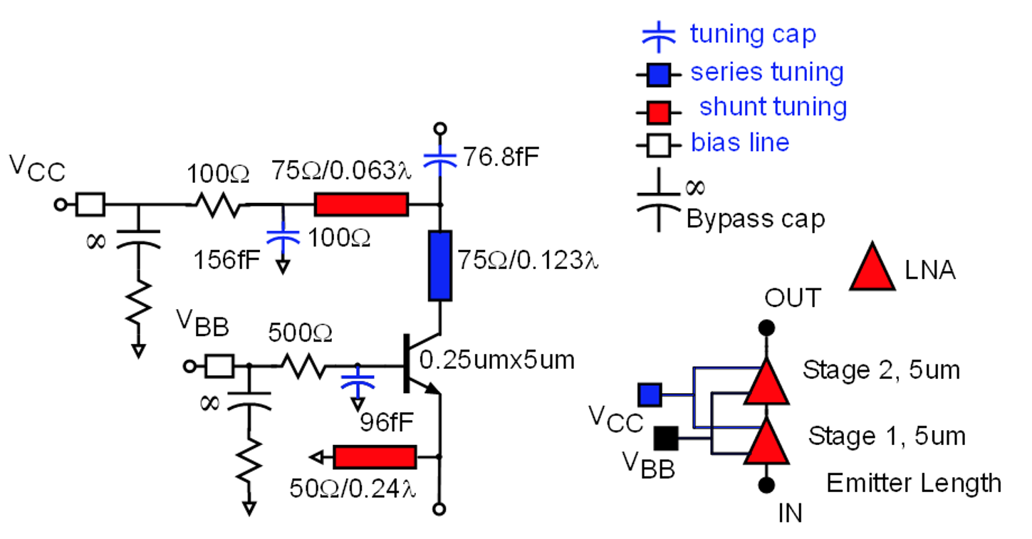
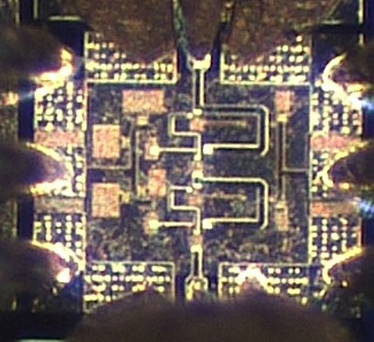
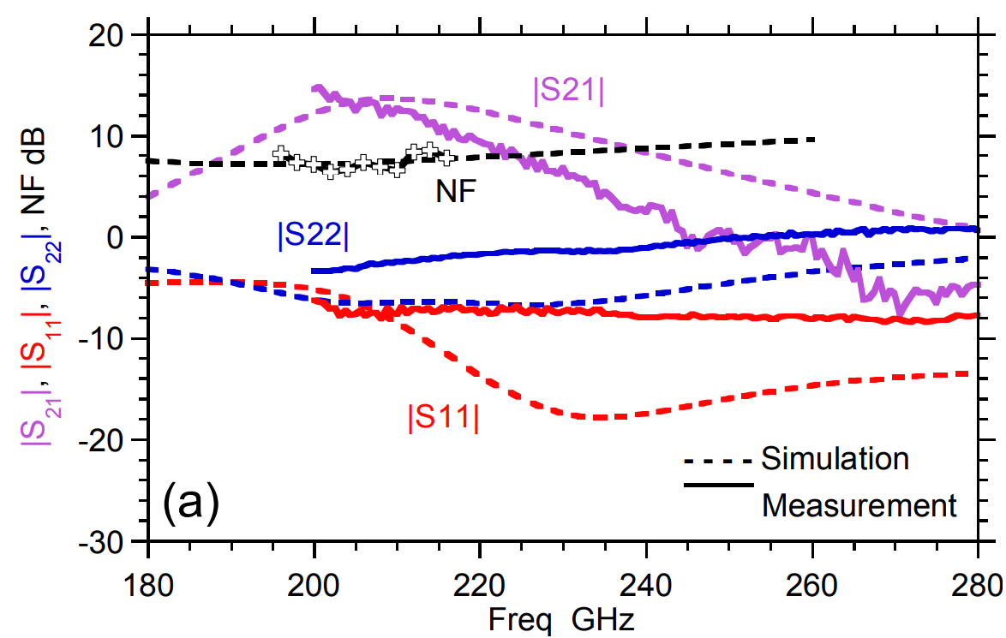
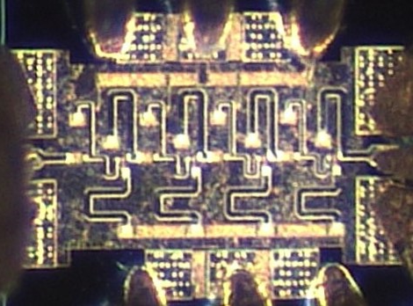
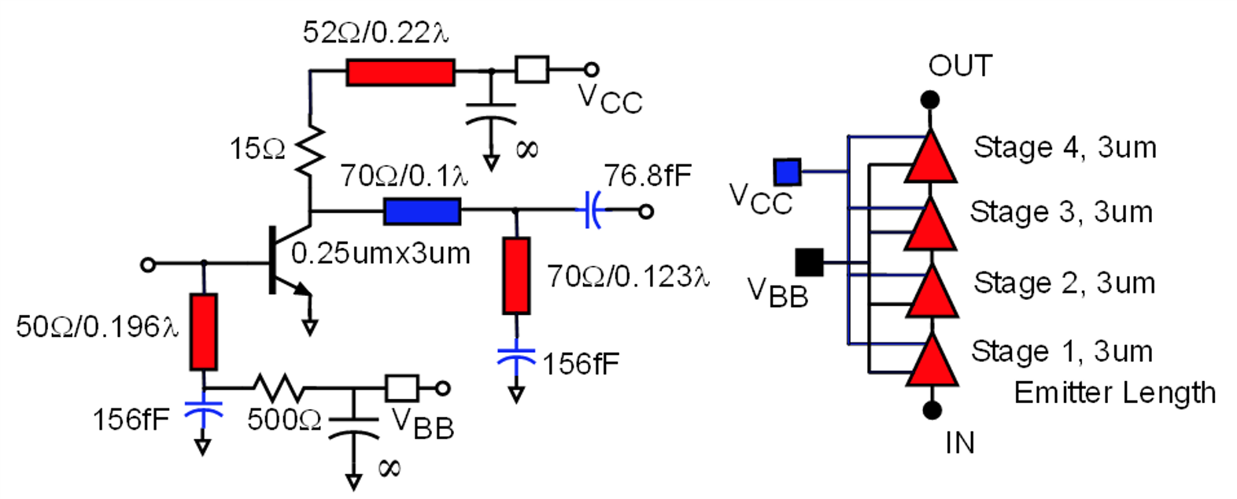
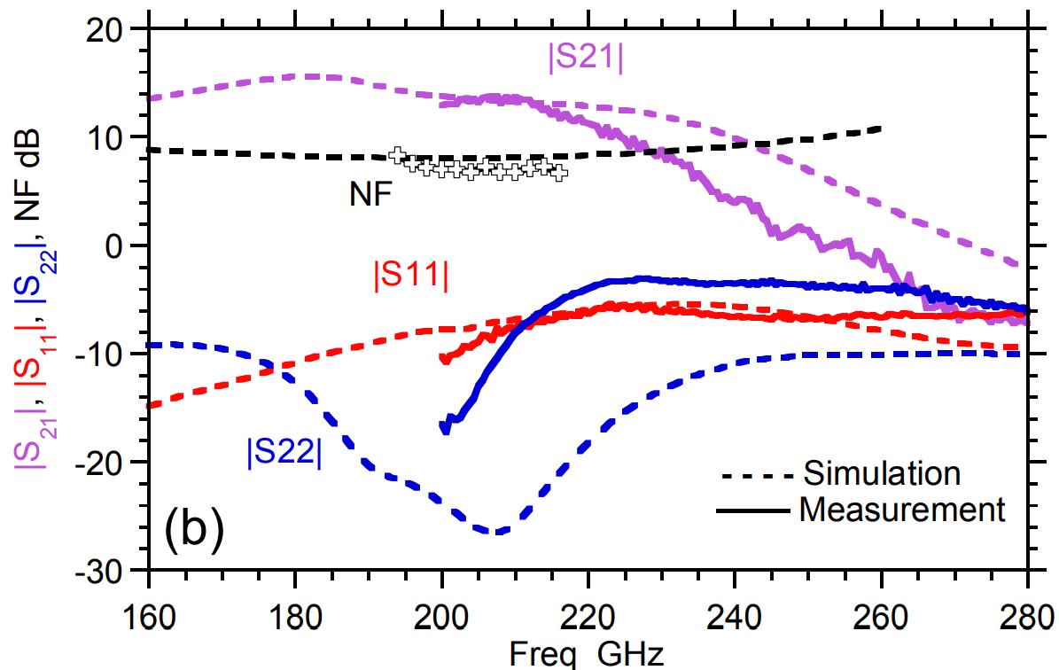
Motivation / Previous Work
CB
CE

Slide 6
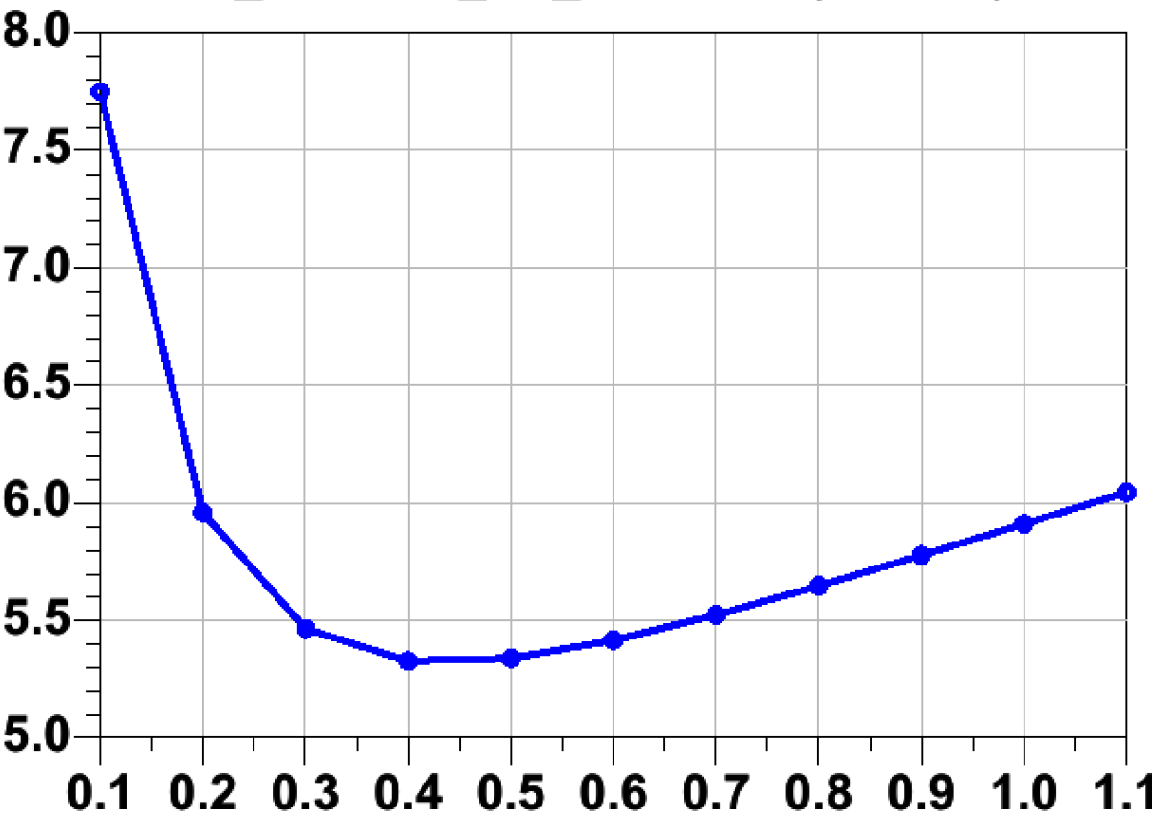
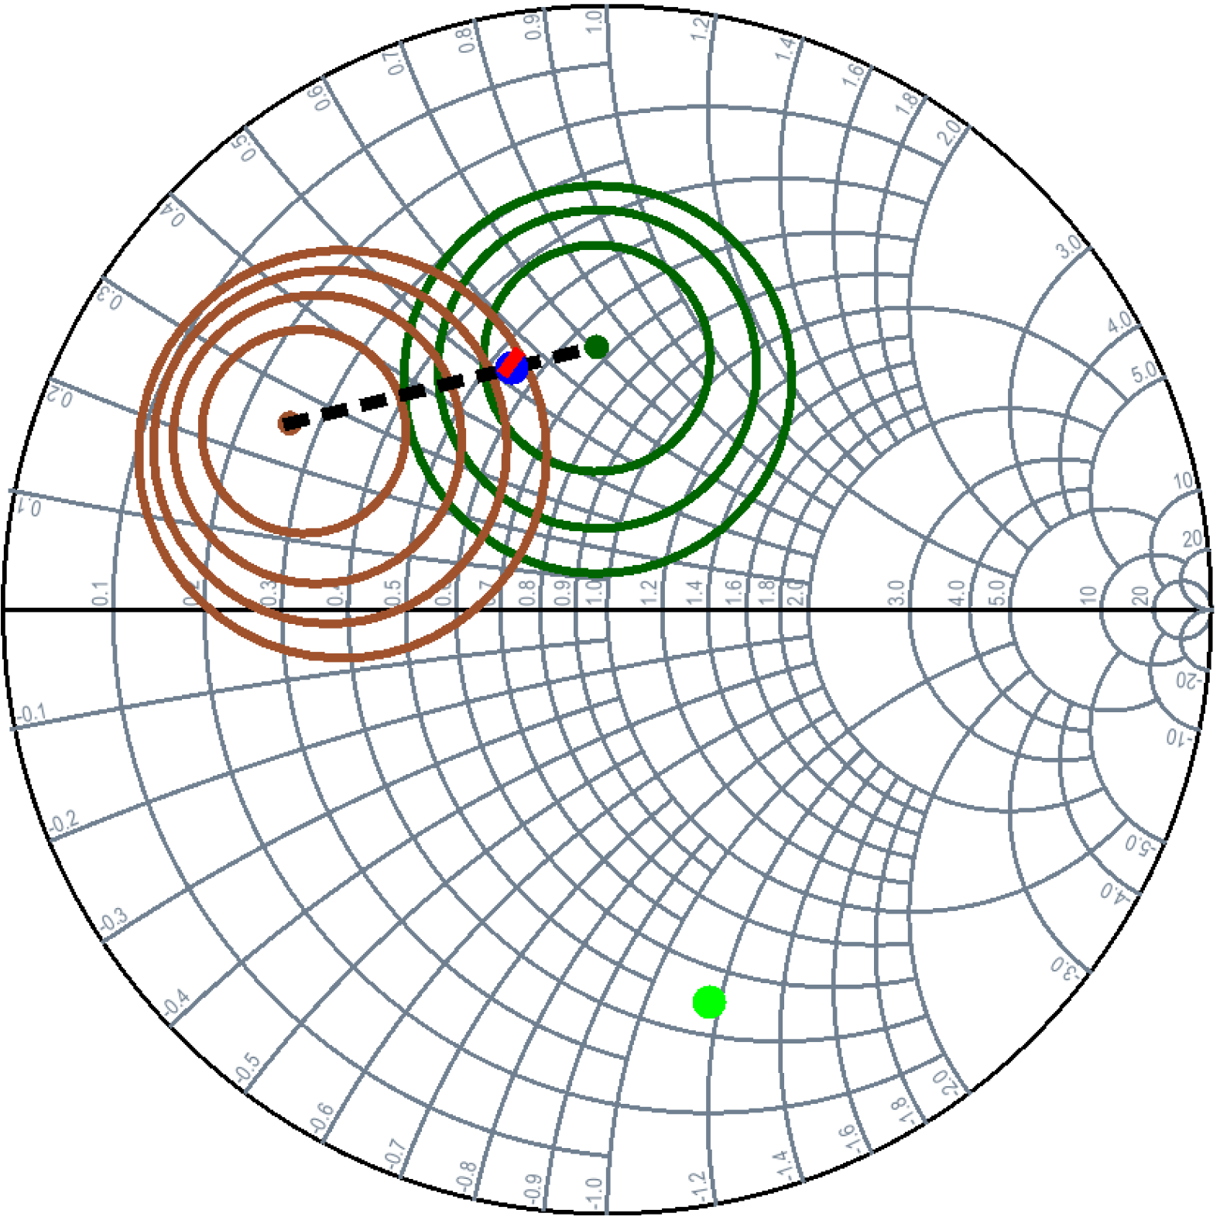
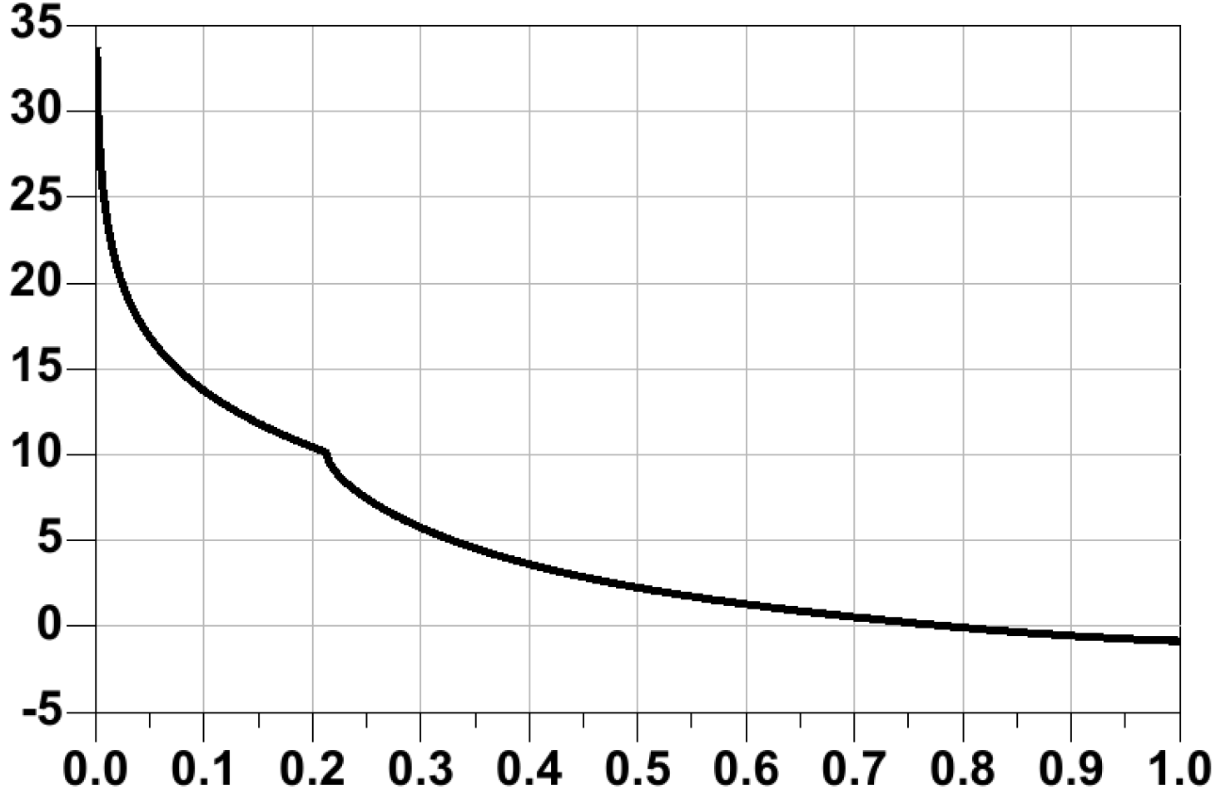
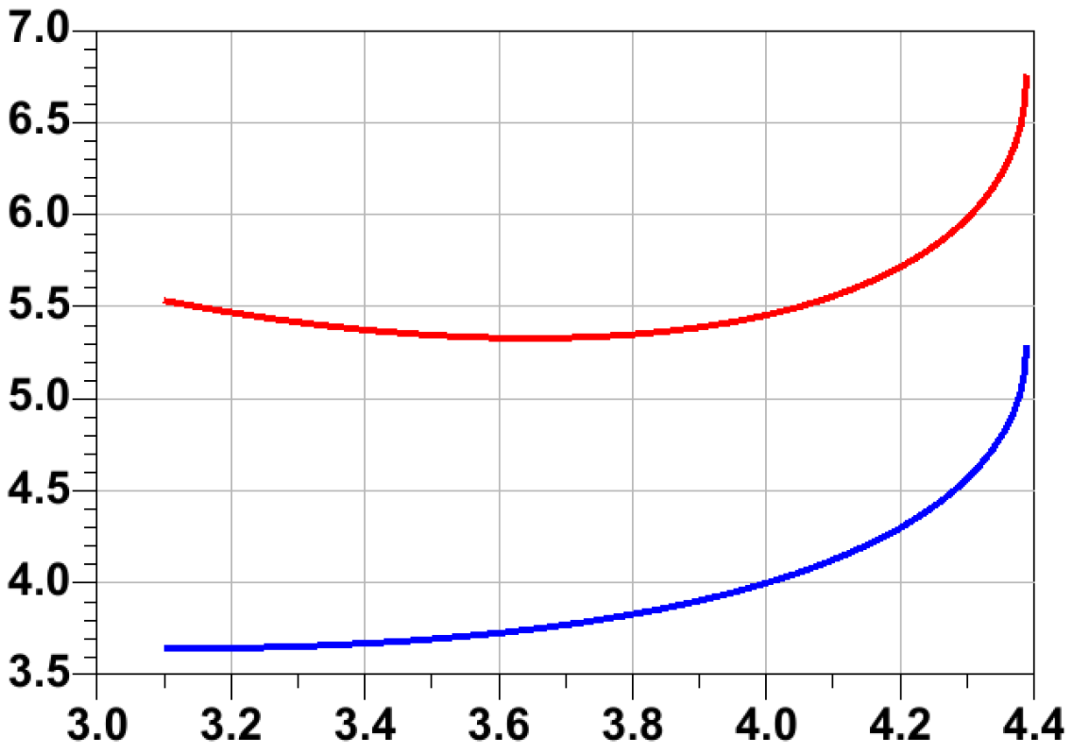
Noise Measure in TSC130
V_{CB}=0.2 V
Common Emitter Transistor
220 GHz
S₁₁*
S_{optM}
V_{CE}=0.5V_{CEO-BR}= 1.75 V , J_{E}=2.5 mA/µm
(dB)
F_{cascade}
G_{A}
G_{ma}/G_{ms}
(dB)
≈ 790 GHz
J_{E} (mA/µm)
NF
220 GHz
F_{cascade}
(dB)
S₂₂
Frequency (THz)
NF_{min}
220 GHz
L_{deg}=8 fH
G_{A} (dB)

Slide 7
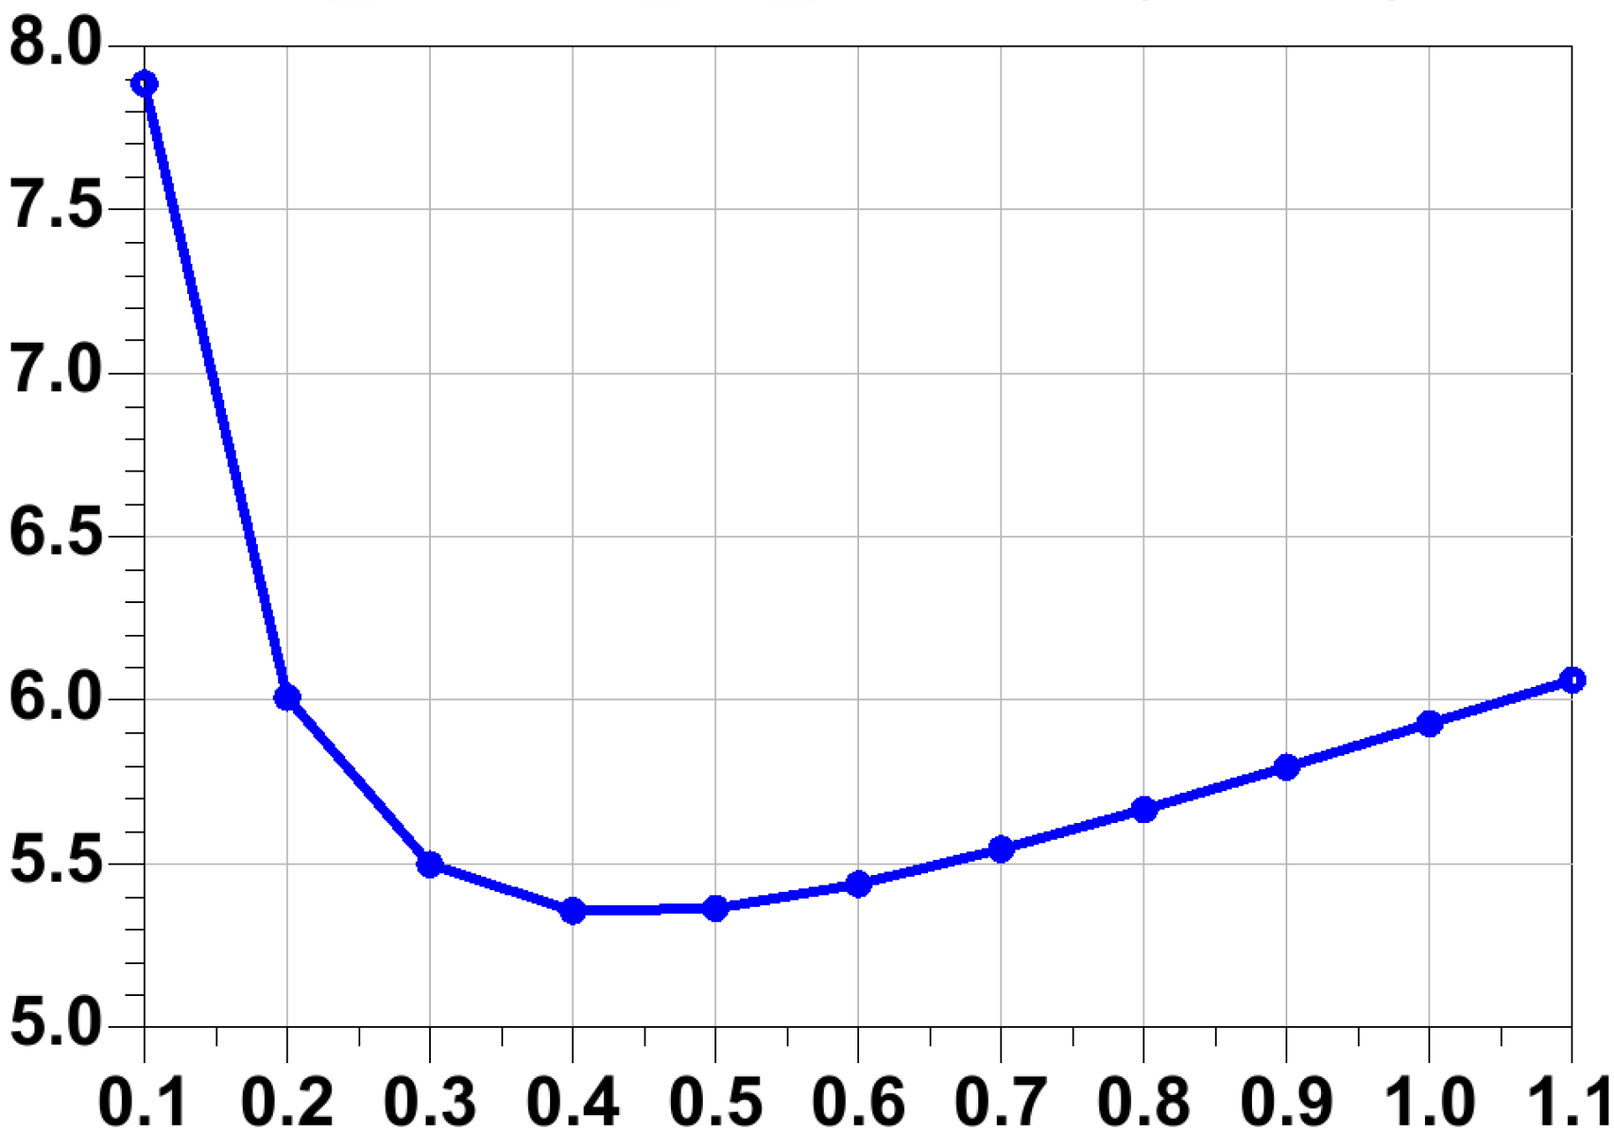
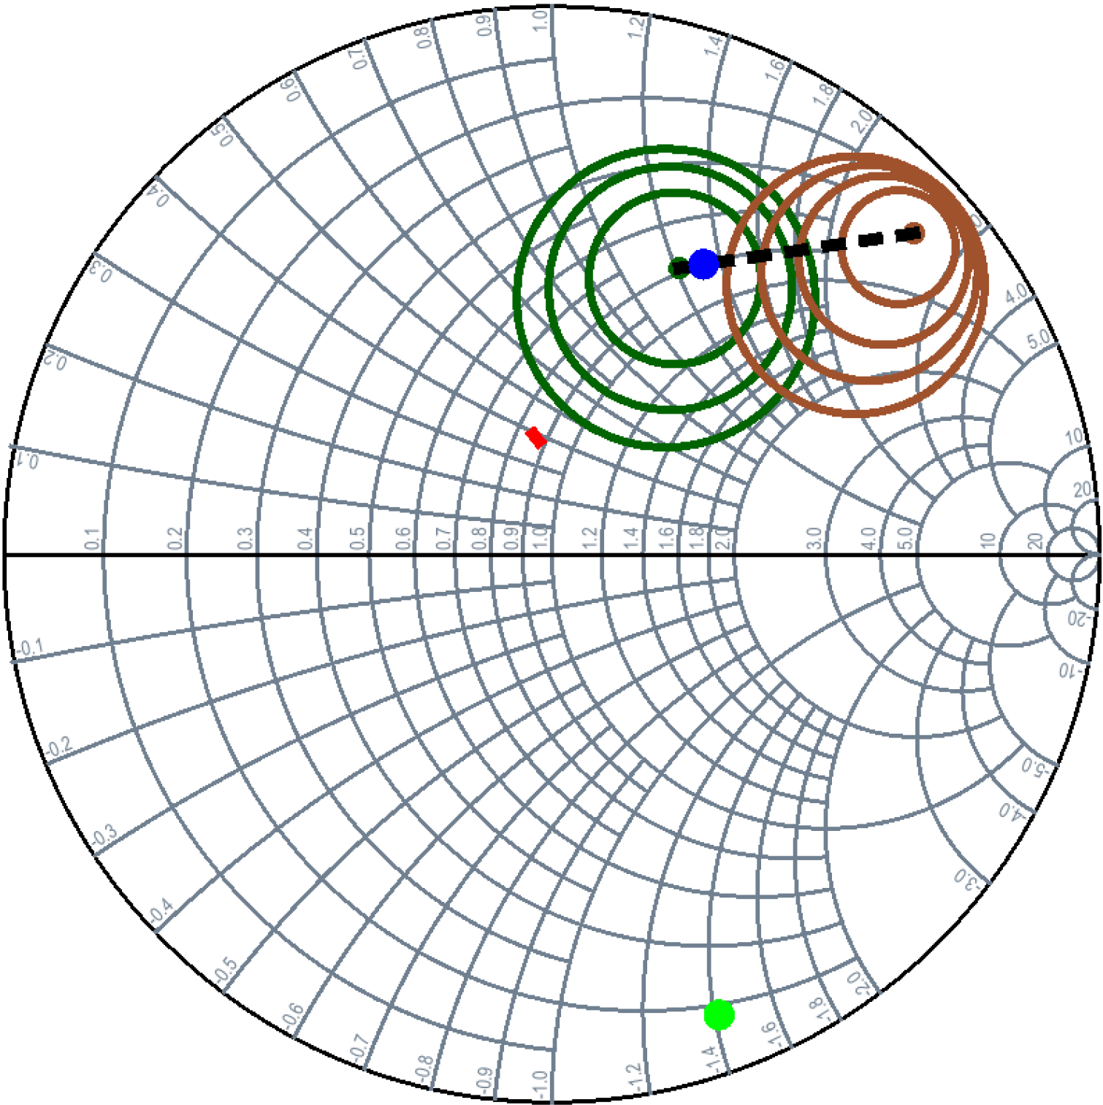
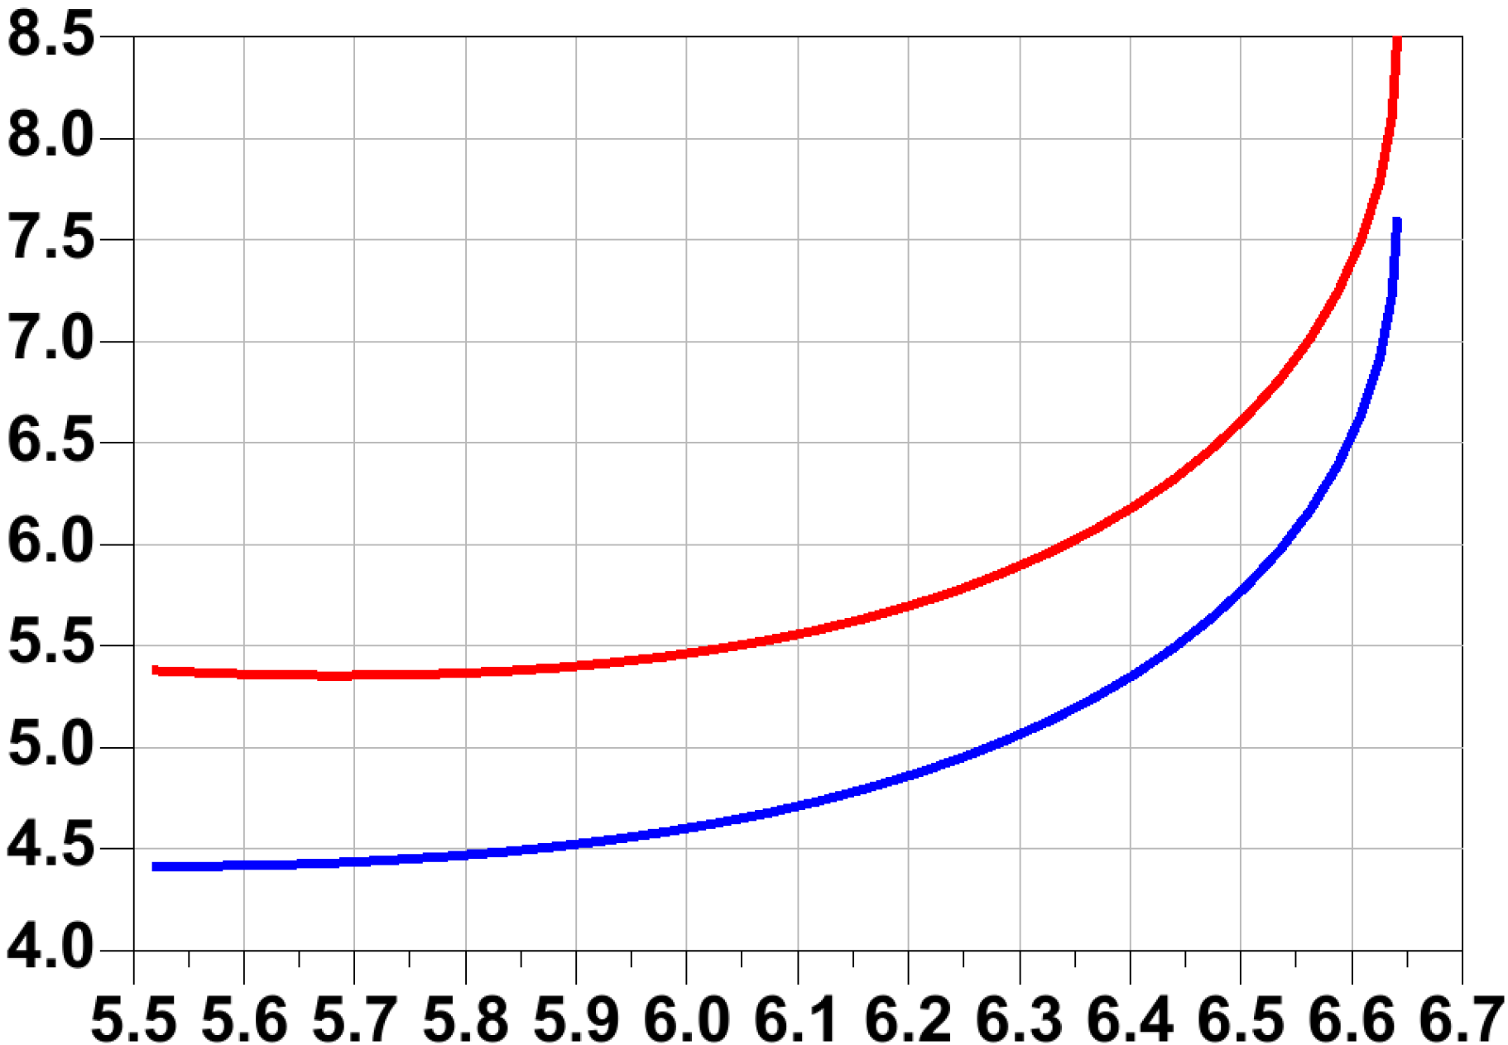
Noise Measure in TSC130
V_{CB}=0.2 V
Common Base Transistor
220 GHz
S_{optM}
G_{A}
(dB)
F_{cascade}
NF
S₁₁*
J_{E} (mA/µm)
220 GHz
(dB)
F_{cascade}
S₂₂
NF_{min}
220 GHz
C_{deg}=15 fF
G_{A} (dB)

Slide 8
Noise Measure in TSC130
V_{CB}=0.2 V
Common Base Transistor
CE
220 GHz
S_{optM}
G_{A}
S₁₁*
S_{optM}
(dB)
F_{cascade}
NF
G_{A}
S₁₁*
J_{E} (mA/µm)
NF
220 GHz
(dB)
F_{cascade}
S₂₂
NF_{min}
S₂₂
220 GHz
220 GHz
C_{deg}=15 fF
L_{deg}=8 fH
G_{A} (dB)

Slide 9

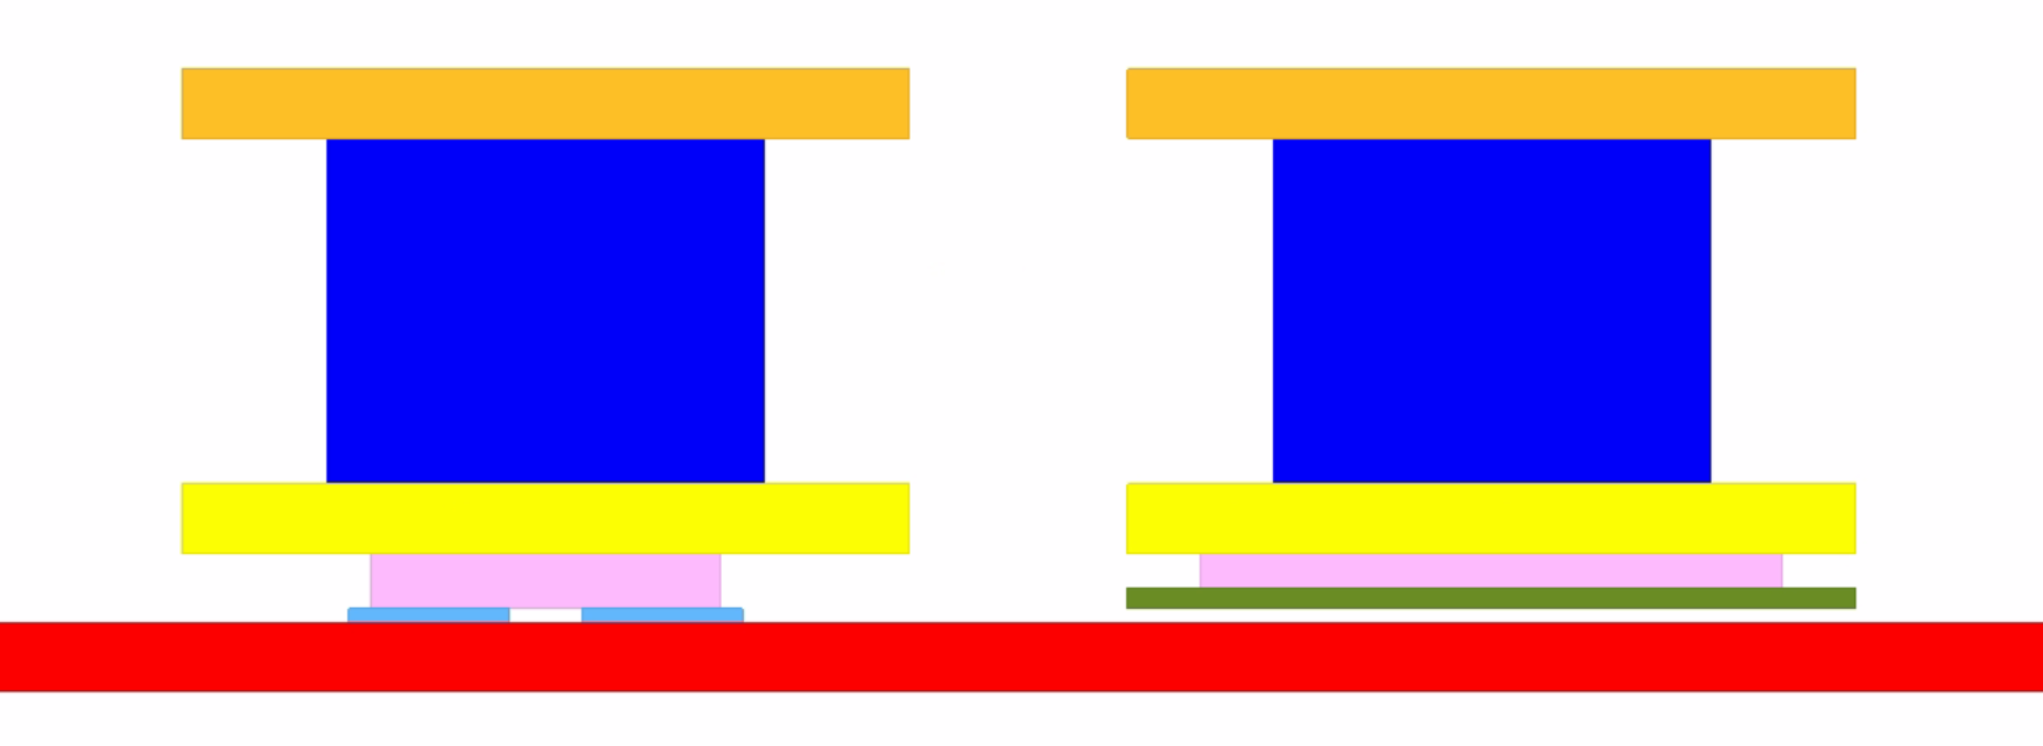
Design Considerations

Slide 10
Design Considerations
≈ 0.3 dB

Slide 11
LNA Schematic
Identical Stages.
Slight tuning to compensate for coupling and EM parasitic.

Slide 12
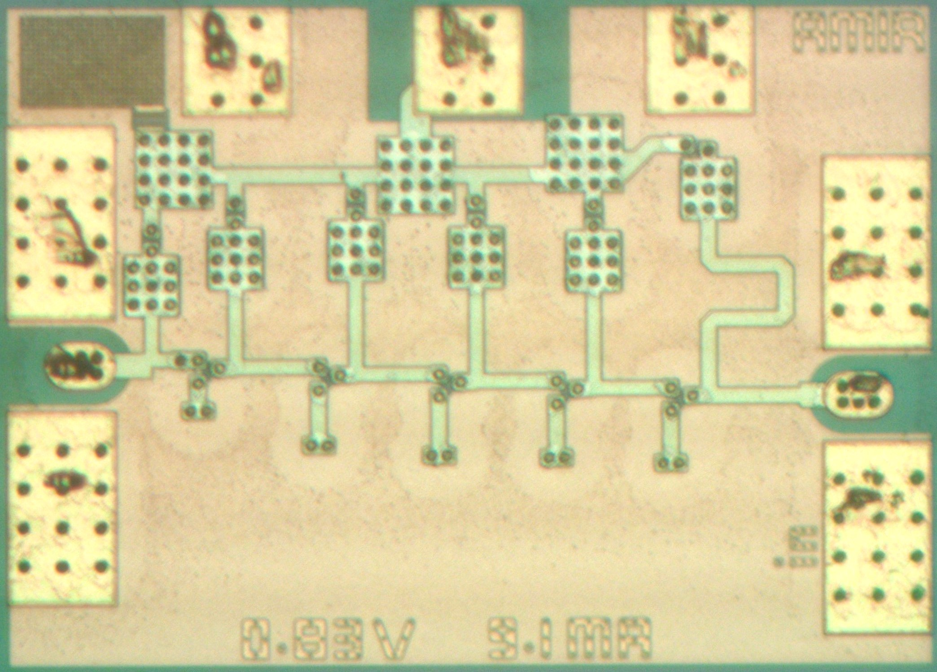
LNA Layout
Technology:
Teledyne Scientific
130-nm InP DHBT
Chip Dimensions:
0.6 mm×0.41 mm
Power Dissipation:
0.83×9.1=7.55 mW

Slide 13
Results
Keysight PNA-X (N5245A) and OML extenders used.
For WR-05 Measurements: power at probe tip (−15 dBm) > LNA’s input P_{1-dB} (−23 dBm).

Slide 14
Results
200 GHz

Slide 15
Results
TSC’s InP HBT processes have consistently shown a lower NF in measurements.
This includes designs reported by UCSB [9], [15], Teledyne [7], [16], and others [17].

Slide 16
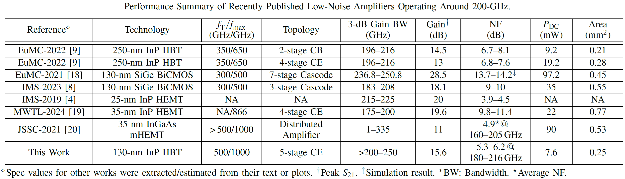
Comparison

Slide 17
CONCLUSION
Common-emitter is the optimal choice for mm-wave LNA design.
  Better noise-measure and S₁₁ match, better S₂₂, wideband, lower matching losses
DC coupled design results in a lower NF by eliminating series capacitors.
At 220-GHz, a 3-µm device in TSC130 features a simulated noise-measure of 5.3 dB, which is ≈1.5 lower than its counterparts in TSC250.
An LNA with NF of 5.3~6.2 dB over 180-216 GHz, and ≈12~15 dB gain over 180-250 GHz were presented.
  Lowest NF reported above 200-GHz for bipolar LNAs

Slide 18
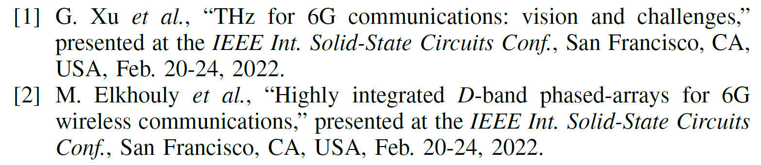
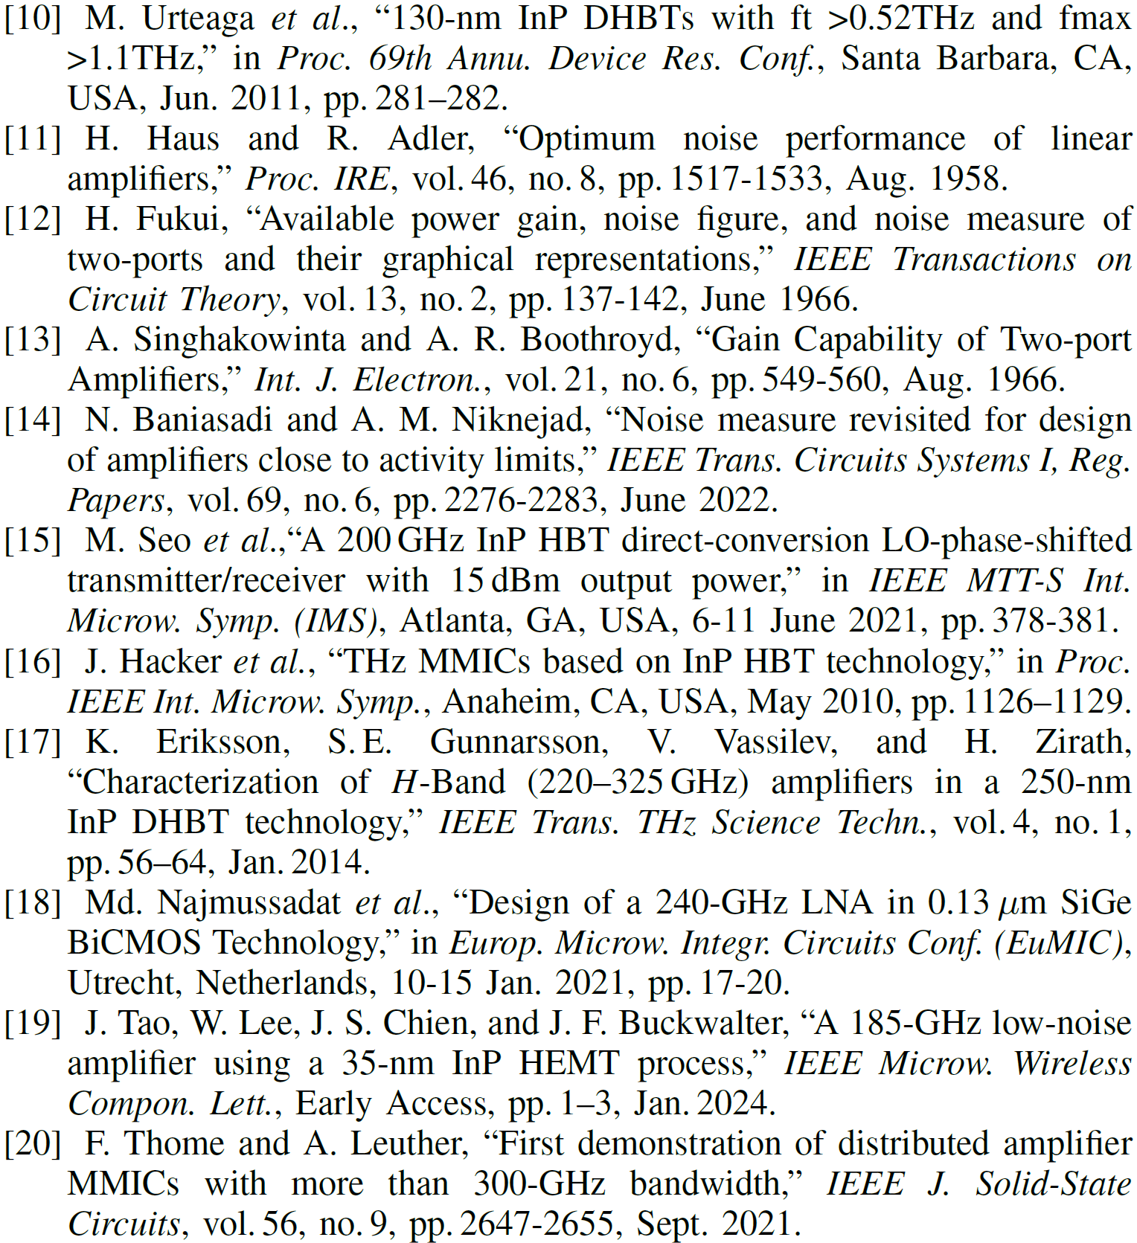
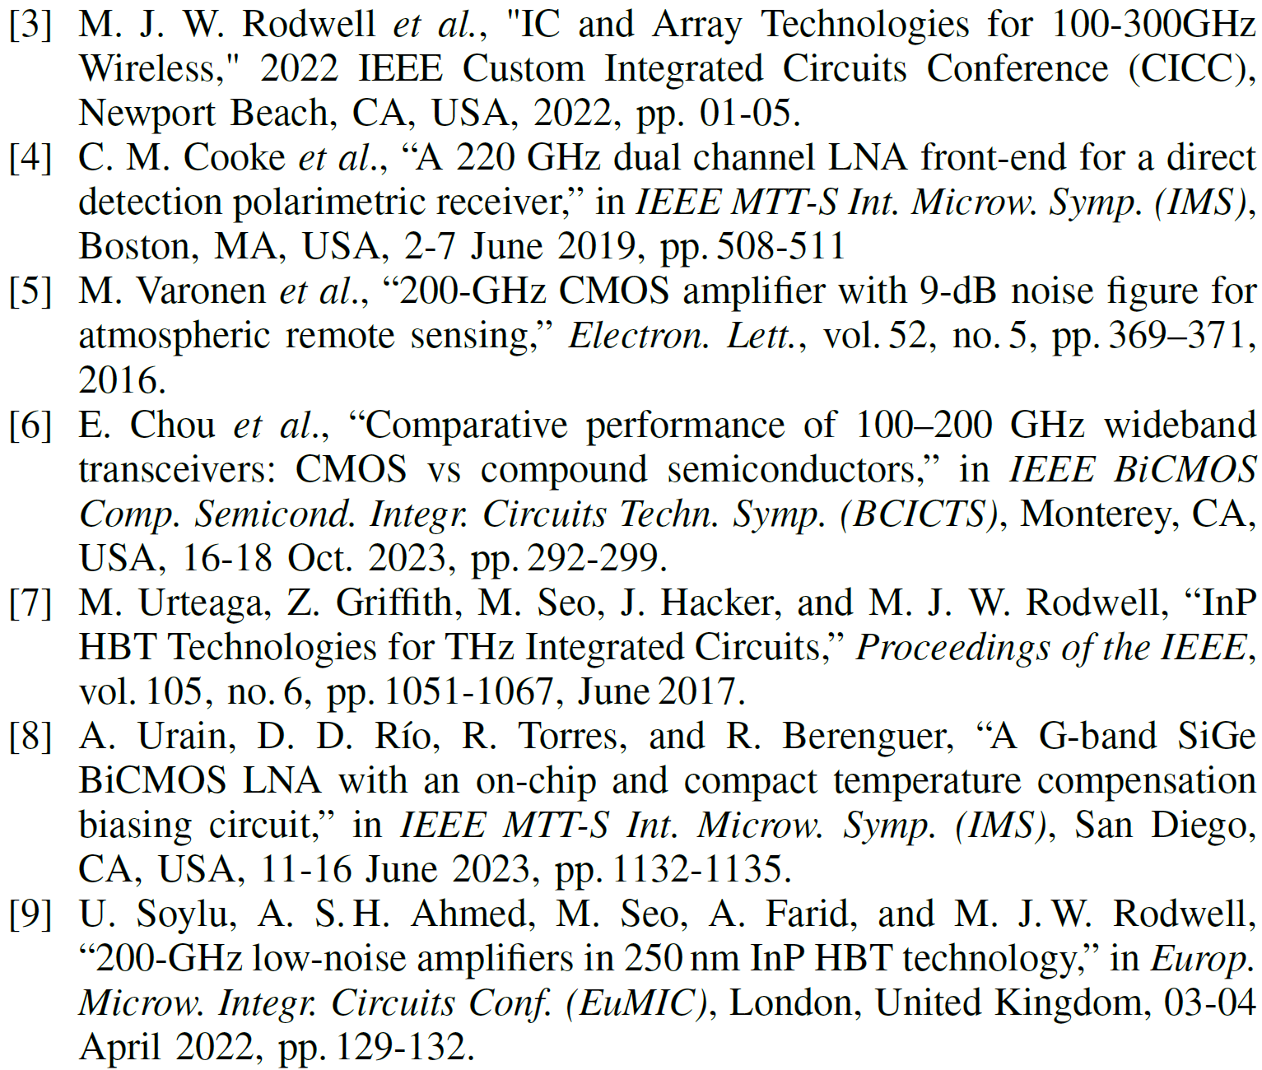
References

Slide 19
Thank You!
Questions?

Slide 20
Noise Measure
How can we minimize the NF of a multi-stage LNA?
G₁, F₁
G₂, F₂
G₁, F₁
G₂, F₂
G₂, F₂
G₁, F₁
G_{t}, F_{t}
What arrangement is best for noise?

Slide 21
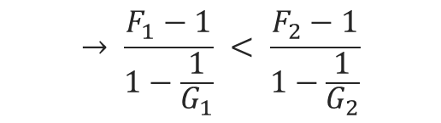
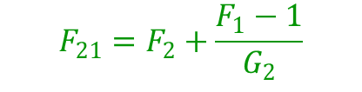

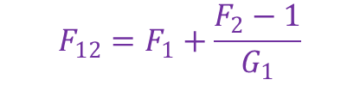
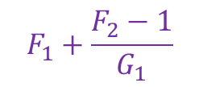
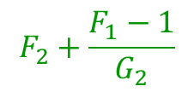
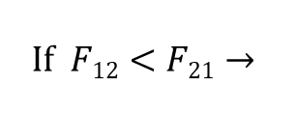
Noise Measure
How can we minimize the NF of a multi-stage LNA?
G₁, F₁
G₂, F₂
$$F_{12}=F_{1}+\frac{F_{2}−1}{G_{1}}$$
$$F_{21}=F_{2}+\frac{F_{1}−1}{G_{2}}$$
$$If F12<F21→$$
$$F_{1}+\frac{F_{2}−1}{G_{1}}$$
$$F_{2}+\frac{F_{1}−1}{G_{2}}$$
$$<$$
G₁, F₁
G₂, F₂
M₁
M₂
$$→ \frac{F_{1}−1}{1−\frac{1}{G_{1}}} < \frac{F_{2}−1}{1−\frac{1}{G_{2}}}$$
G₂, F₂
G₁, F₁
Noise Measure
G_{t}, F_{t}
What arrangement is best for noise?
Stage with smaller M should be used as the first stage!

