Slide 1
WSQ-4
ICs and Transceivers for 100–300 GHz Wireless
Mark J. W. Rodwell, Doluca Family Chair, University of California, Santa Barbara
With acknowledgements to
U. Soylu^{1,2}, A. Alizadeh^{1,3}, A. S. S. Ahmed^{1,4}, A. Farid^{1,5}, M. Urteaga⁶, M. Seo⁷, K. Park¹, C. Seo¹, Y. Nemoto¹, E. C. Bormali¹
¹University of California, Santa Barbara
²Now with IBM Yorktown
³Now with Keysight Technologies
⁴Now with Cairo University
⁵Now with Intel
⁶Teledyne Scientific
⁷Sungkyunkwan University

Slide 2
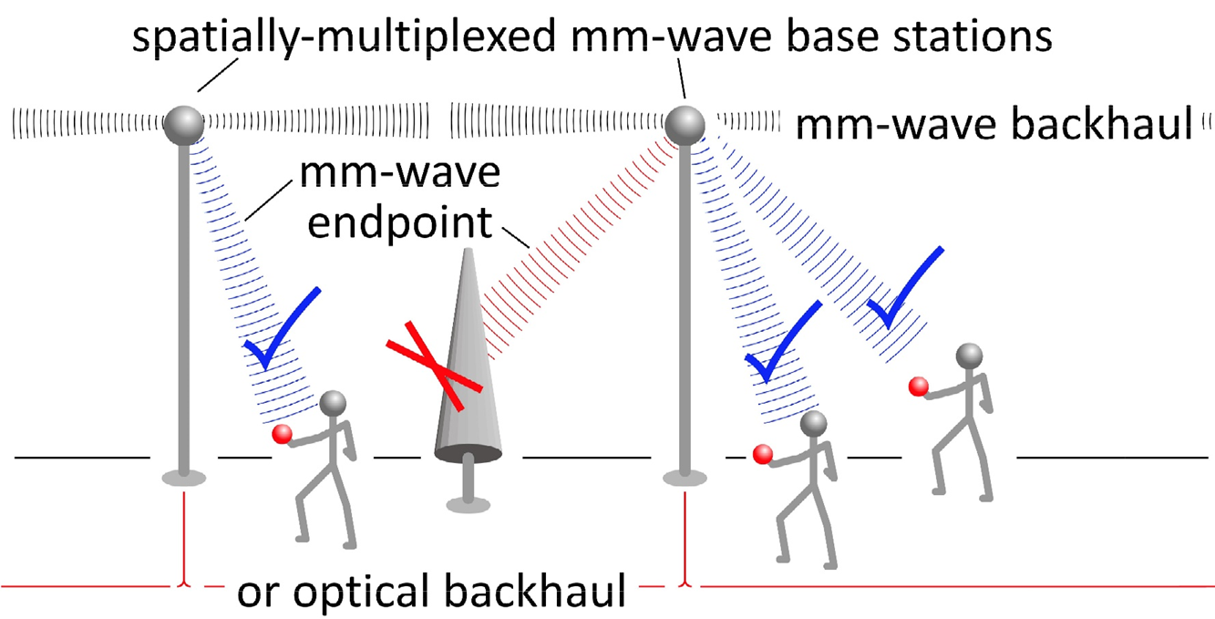
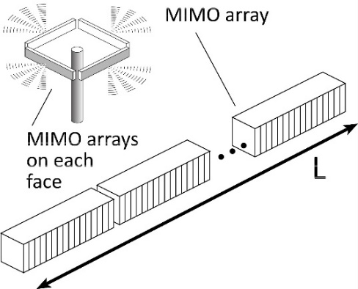
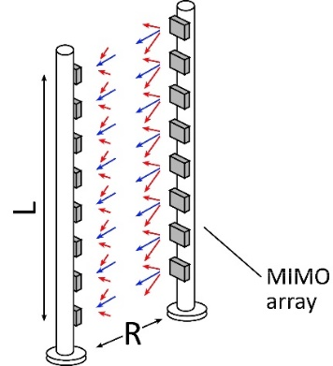
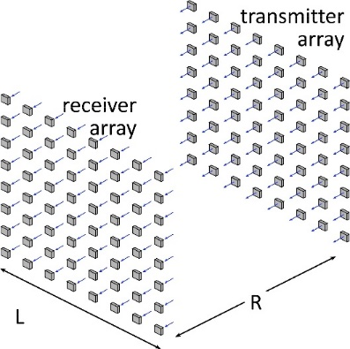
100-300 GHz Wireless
High capacity:
potentially wide available bandwidth
massive spatial multiplexing even with compact arrays
Limited range:
high λ²/R² path losses
high worst-case atmospheric attenuation
Need:
arrays with elements
low receiver noise figure
compact, efficient, medium-power amplifiers
Nomenclature:
30-300 GHz = 10 mm to 1 mm wavelengths
* millimeter-waves *

Slide 3
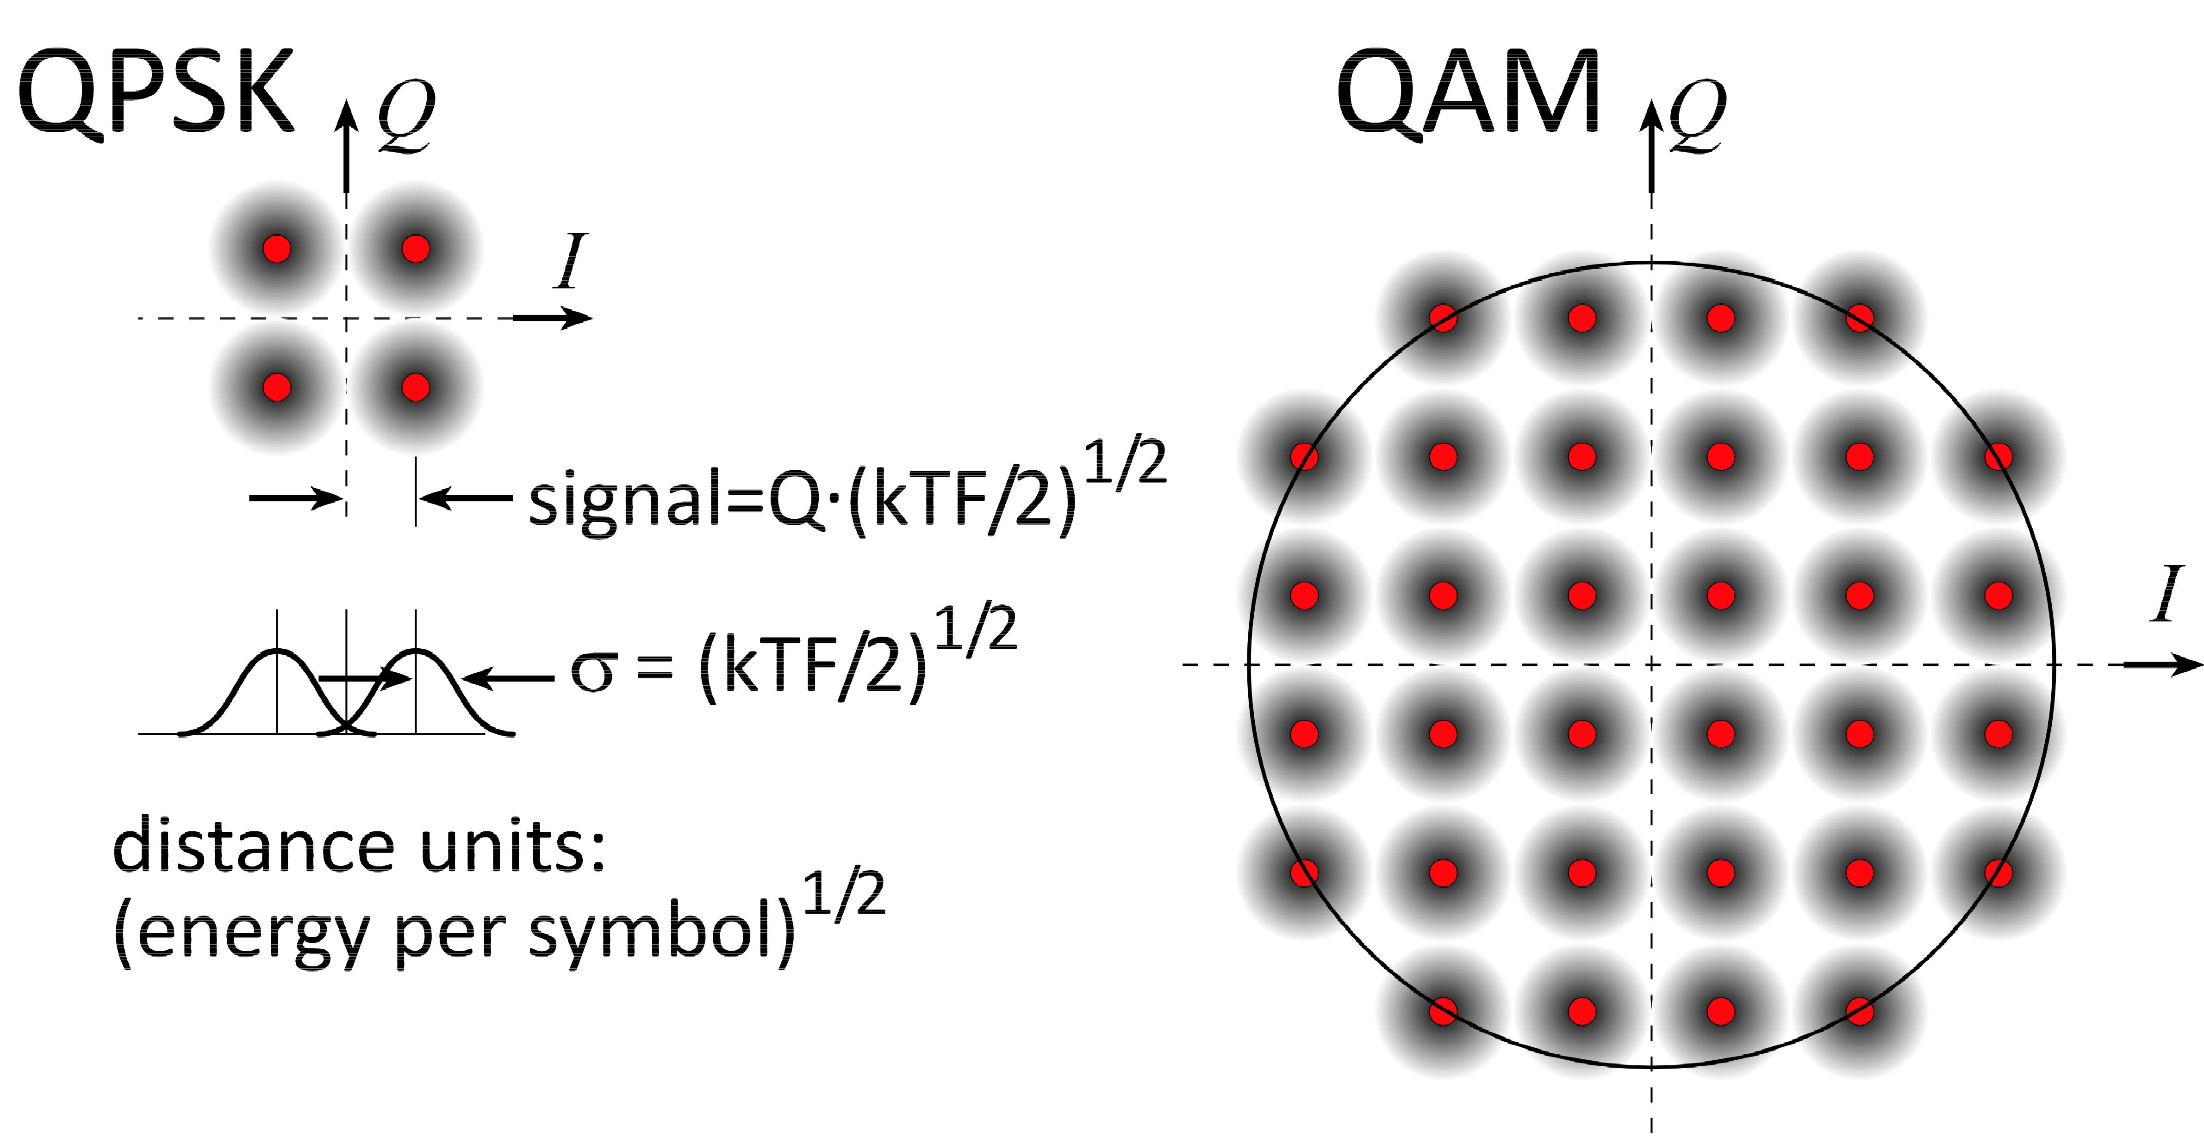
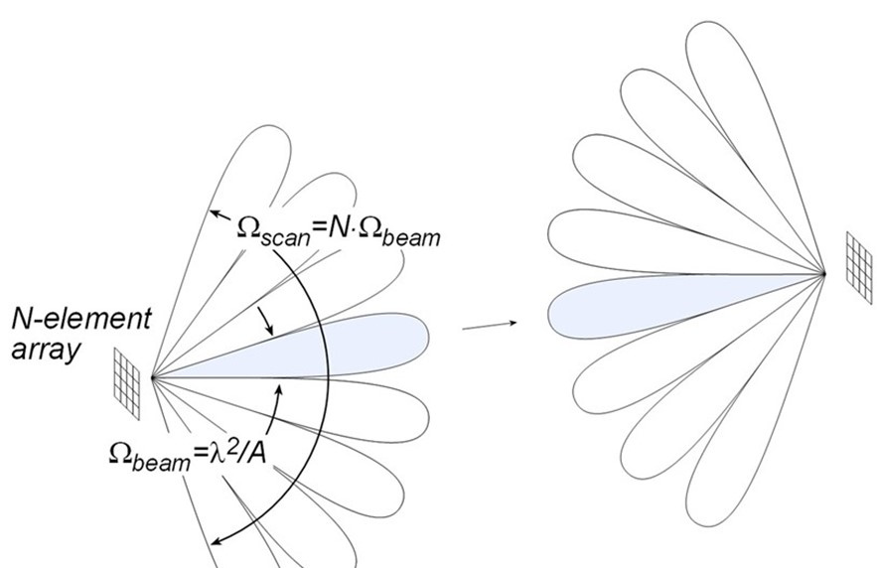
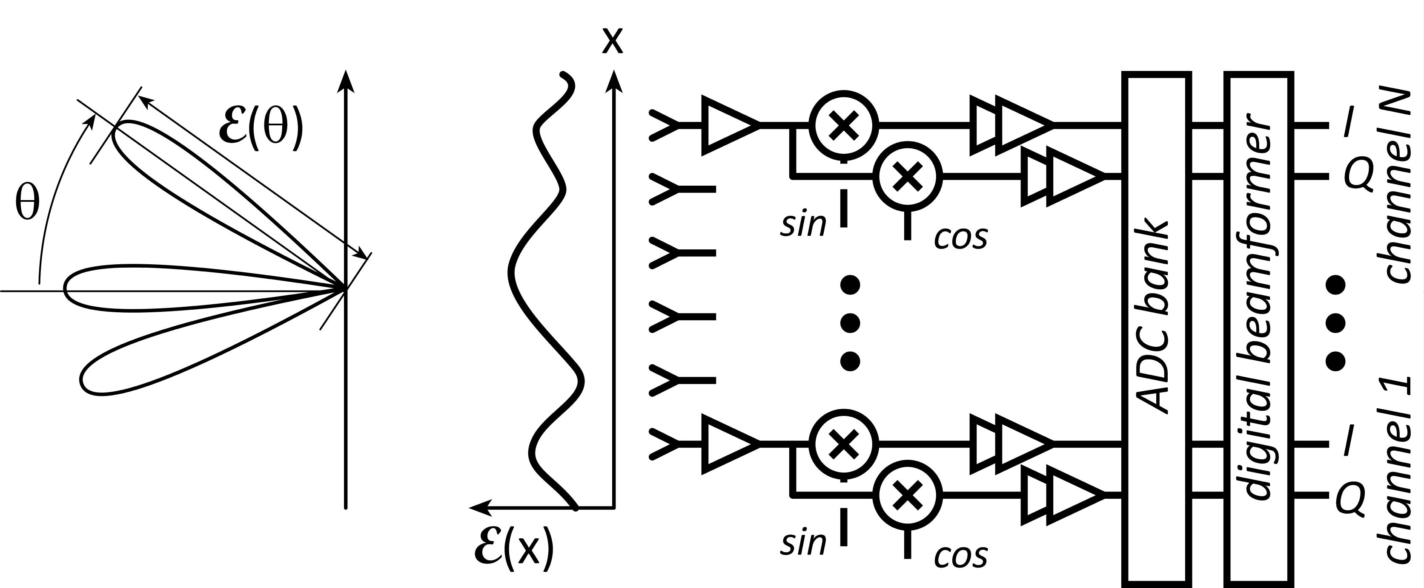
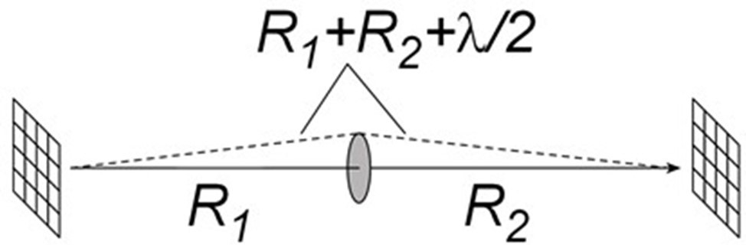
High-Capacity Radio Links

Slide 4
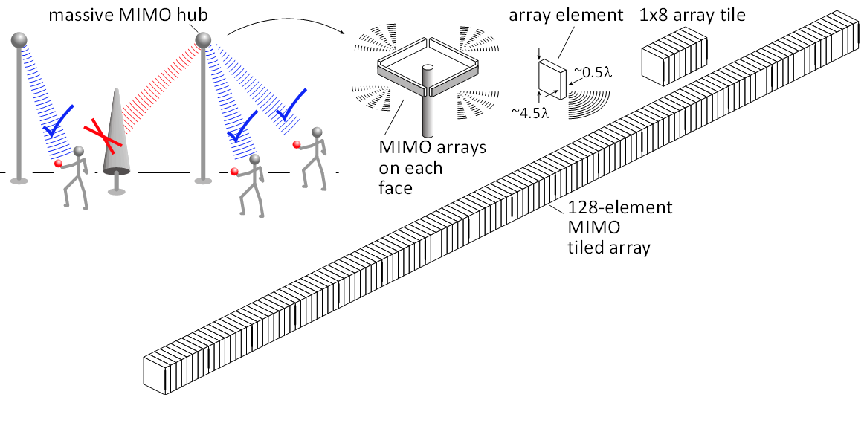
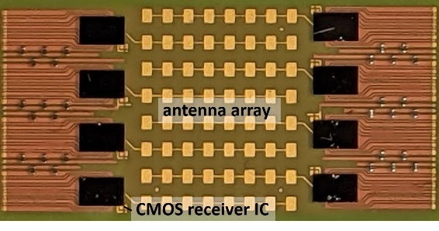
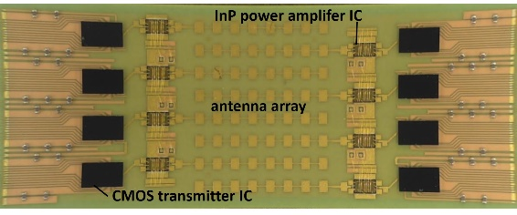
Concept: 640 Gb/s, 140 GHz MIMO hub
Farid: 2021 IEEE BCICTS
Farid: 2022 IEEE Trans MTT
Abu-Surra : 2022 IEEE ICC
Concept
64 beams at 10 Gb/s/beam
128 antennas, each (9λ x λ/2)
70 meters range in 50 mm/hr. rain
17 dB margins: (obstruction, operating, aging, packaging)
LNAs: 8 dB noise figure
PAs : 100 mW =P_{1dB} (per element)
Actual demos (with Samsung, Pi-Radio)
8-element arrays
Kyocera: LTCC interposers.
Globalfoundries 22FDX SOI CMOS
Teledyne 250 nm InP HBT

Slide 5
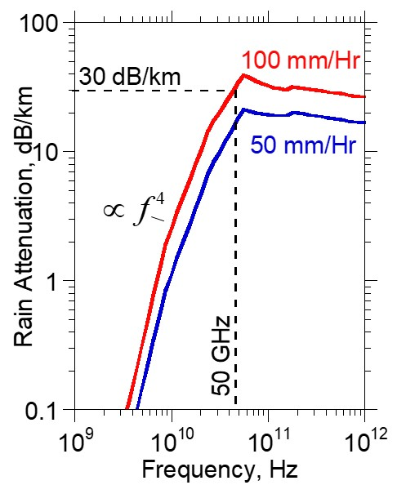
70 m, 64 × 10 Gb/s hub: 140, 70, 35 GHz
Frequency |  | 140 GHz | 70 GHz |  | 35 GHz
Handset | size | 9 mm x 9 mm | 9 mm x 9 mm |  | 9 mm x 9 mm
 | # elements | 8 x 8 | 4 x 4 |  | 2 x 2
Hub | size | 13 cm x 1.0 cm | 26 cm x 2.0 cm |  | 52 cm x 4.0 cm
 | # elements | 128 x 1 | 128 x 1 |  | 128 x 1
Modulation |  | QPSK | QPSK | 16QAM | QPSK | 64QAM
Channel Bandwidth |  | 5 GHz | 5 GHz | 2.5 GHz | 5 GHz | 1.7 GHz
Transmit P_{1dB} /element |  | 20.1 dBm | 20.1 dBm | 24.2 dBm | 19.5 dBm | 27.8 dBm
 | high capacity | moderate capacity
long range | ----- | moderate frequency
short range | high frequency | moderate frequency
High frequencies are advantageous if αR < 1.
Assumptions: Hub to handset downlink. Link parameters as per previous slide. Same range, noise figure, rain rate, margins.

Slide 6
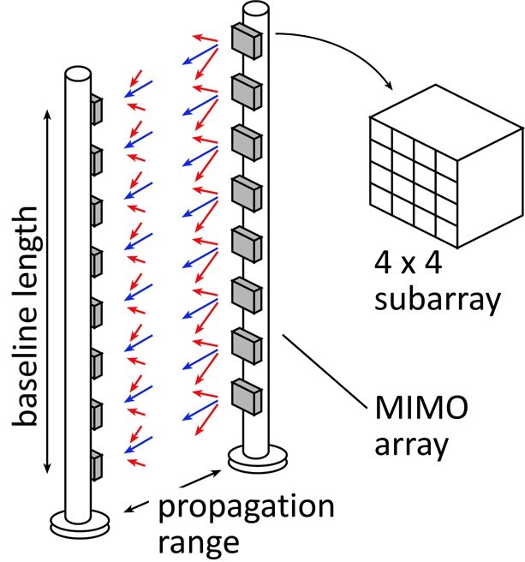
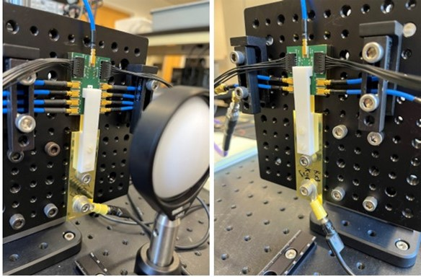
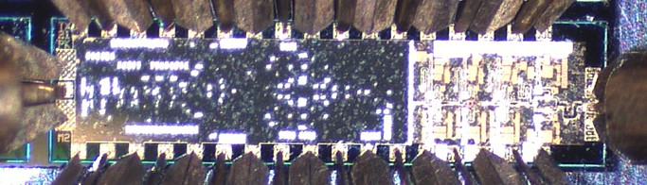
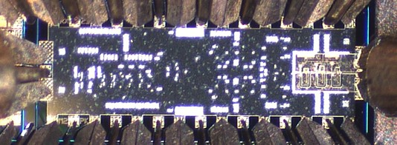
Concept: 640 Gb/s, 210 GHz MIMO backhaul
Concept
8x 80 Gb/s MIMO with 2.1 m baseline
16-element subarrays (7λ x 7λ antennas)
500 meters range in 50 mm/hr. rain
14 dB margins: (obstruction, operating, aging, packaging)
LNAs: 8 dB noise figure
PAs: 50 mW =P_{1dB}
Demonstrated to date:
no subarrays, 1 channel
Ongoing demonstration efforts:
no subarrays, 4 x 4 MIMO

Slide 7
500 m, 640 Gb/s backhaul: 280, 140, 90, 35 GHz
Frequency |  | 280 GHz | 140 GHz | 90 GHz |  | 35 GHz
1 x 8 MIMO array length, L |  | 1.8 m | 2.6 m | 3.2 m |  | 5.1 m
subarrays | size | 3.1 x 3.1 cm² | 6.2 x 6.2 cm² | 9.5 x 9.5 cm² |  | 25 x 25 cm²
 | # elements | 4 x 4 | 4 x 4 | 4 x 4 |  | 4 x 4
Modulation |  | QPSK | 16QAM | 16QAM | 64QAM | 64QAM | 4096QAM
Channel Bandwidth |  | 40 GHz | 20 GHz | 20 GHz | 13 GHz | 13 GHz | 6.7 GHz
Transmit P_{1dB}/element |  | 19.7 dBm | 16.1 dBm | 12.3 dBm | 16.5 dBm | 4.1 dBm | 19.2 dBm
 | high capacity | moderate capacity
long range | ----- | moderate frequency
short range | high frequency | moderate frequency
High frequencies are advantageous if αR < 1.
Assumptions: Link parameters as per previous slide. All carrier frequencies analyzed with same range, transmit power/element, noise figure, rain rate, margins.

Slide 8
Radio link design: Implications
Worst-case atmospheric losses similar at 50 GHz & 200 GHz
Same link budgets, if
# array elements are moderately increased @ 200 GHz
If comparable PA and LNA performance can be obtained.
→ work on LNAs, PAs,
work on realizing much larger arrays
But, any terrestrial > 50 GHz system will be short-range.

Slide 9
100-300 GHz Wireless ?? Even 39 GHz is hard !
Viable 100-300 GHz wireless systems need:
acceptable range, useful capacity, low DC power, low hardware & deployment costs
issues: λ²/R² (beam diffraction) and atmospheric losses, beam blockage
Low communications density (Gb/s/km²) ? → widely spaced hubs
Lower deployment costs
Long distances, high propagation losses
Lower frequencies are much better.
High communications density (Gb/s/km²) ? → densely packed hubs
Less Gb/s/hub
Short distances, smaller propagation losses
Higher frequencies can work well, can provide very high capacity
Research for future high-capacity communications:
(1) demonstrate high data rates
(2) reduce cost, reduce DC power, increase range and operating margins.

Slide 10
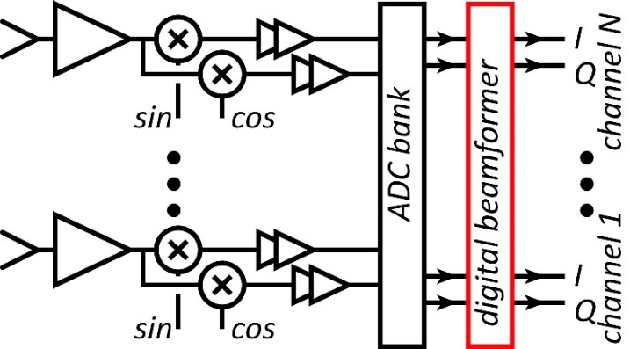
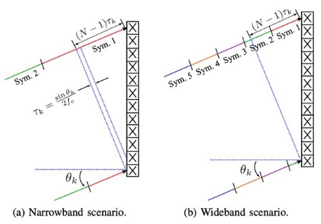
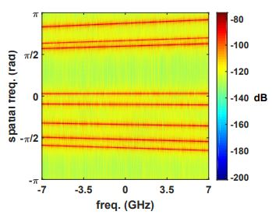
Systems

Slide 11
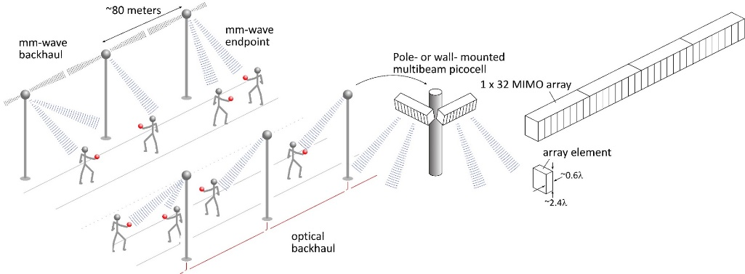
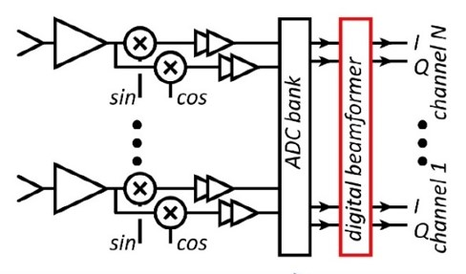
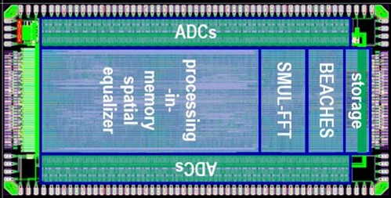
MIMO System Design
Beamspace algorithm, Dynamic range: Madhow, UCSB
Beamformer ICs: Christoph Studer, ETHZ
More antennas than signal beams: spatial oversampling (averaging).
Given QPSK, 2:1 spatial oversampling:
ADCs/DACs only need 3-4 bits
RF/IF/baseband chain needs P_{1dB} only 4 dB above average power
Phase noise requirements similar to single beam system
Efficient digital beamforming using beamspace
First compute (low-resolution) spatial FFT.
Then cancel crosstalk between closely-spaced users
Wideband MIMO arrays: use spatial & temporal FFTs
"true time delay"
M. Abdelghany et al, IEEE Trans. Wireless Comm, Sept. 2021
M. E. Rasekh et al, IEEE Trans. Wireless Comm, Oct. 2021
A. Puglielli et al, 2016 IEEE ICC
M. Abdelghany, et. al, , 2019 IEEE SPAWC
S. H. Mirfarshbafan et al, IEEE Trans CAS 1, 2020
O Castañeda Fernández et. al, 2021 ESSCIRC
M. Abdelghany et al 2019 IEEE GLOBECOM

Slide 12
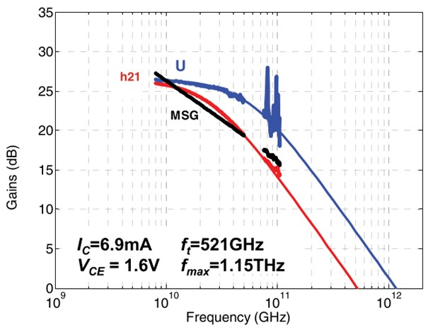
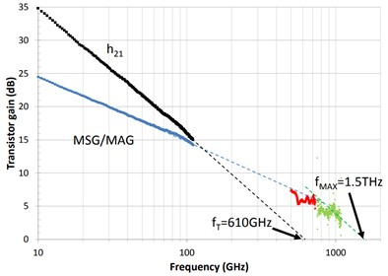
Transistors

Slide 13
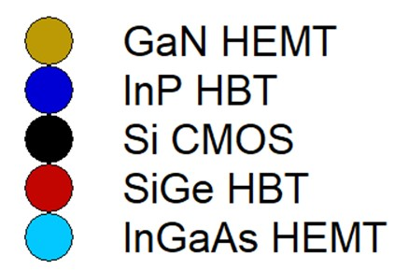
Transistors for 100-300 GHz
CMOS: good power & noise up to ~150GHz. Not much beyond. Best published mmwave results at 65-16 nm nodes.
InP HBT: record 100-300 GHz PAs, record integrated transceivers
SiGe HBT: power better than CMOS, worse than InP HBT
GaN HEMT: record power below 100GHz. Bandwidth improving
InGaAs HEMT: world's best low-noise amplifiers
Results compiled 8/16/2023

Slide 14
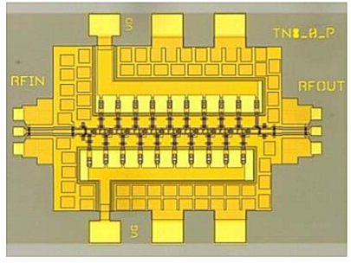
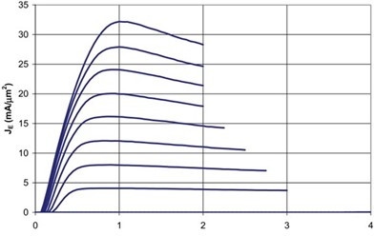
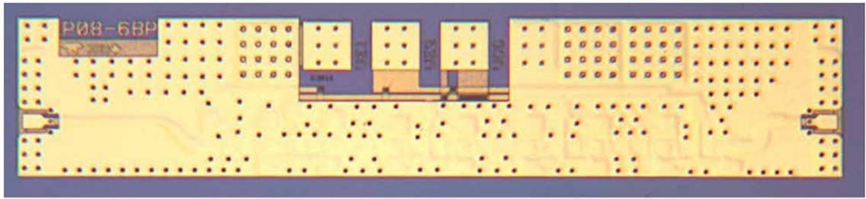
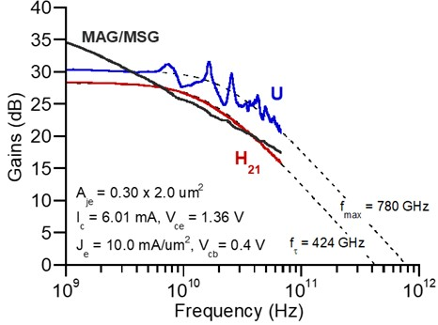
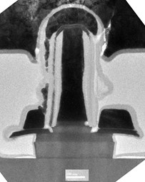
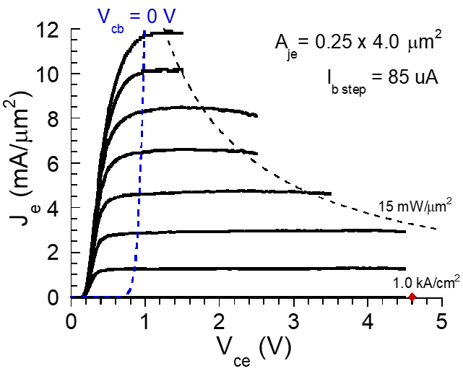
InP Transistors and ICs
30 nm InP HEMTs: 1.5THz f_{max}, 1.0THz amplifiers
W. Deal et al., 2016 IEDM (Northrop-Grumman)
130nm InP HBTs: 1.1THz f_{max}, 3.5V. 670 GHz amplifiers
M. Urteaga, et al., IEEE Device Research Conference, 2011.
M. Urteaga, et al., IEEE Proceedings, 2017 (Teledyne, UCSB)
250nm InP HBTs: 650GHz f_{max}, 4.5V.
Z. Griffith et al., 2007 IPRM conference (UCSB)
M. Urteaga, et al., IEEE Proceedings, 2017 (Teledyne)
THz HBT Scaling Laws
Rodwell, et al., IEEE Proceedings June 2008 (UCSB, Teledyne)
Contacts: Baraskar et al., Journal of Applied Physics 2013 (UCSB)

Slide 15
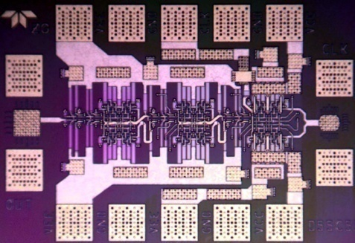
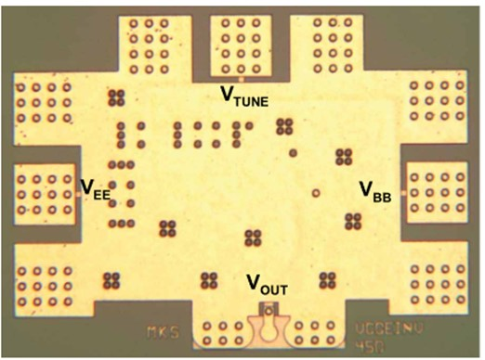
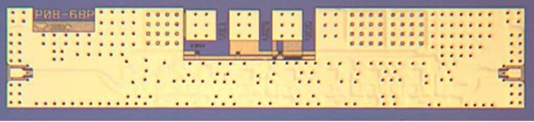
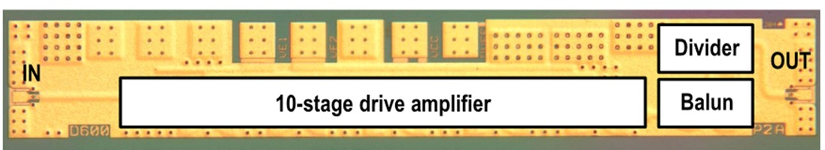
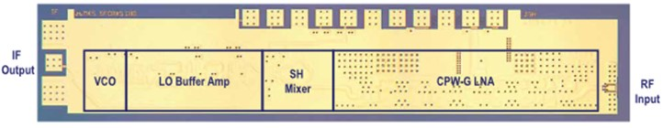
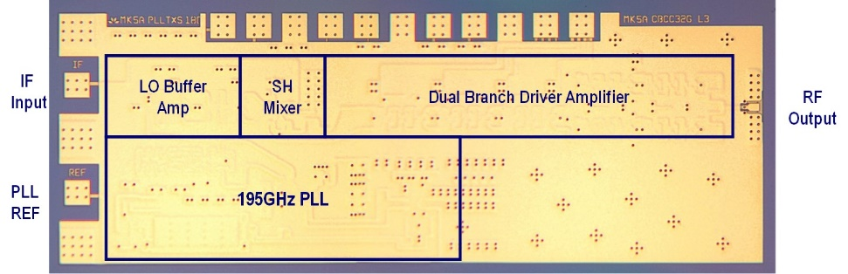
InP HBT ICs: 60-670 GHz
M. Urteaga, et al., IEEE Proceedings, 2017 (Teledyne)
Z. Griffith et al., IEEE CSICS, 2010 (Teledyne)
M. Seo et al., IEICE Electronics Express, 2015 (Teledyne)
208 GHz master-slave latch
688 GHz fundamental oscillator
670 GHz amplifier
529 GHz dynamic divider
570 GHz receiver
600 GHz transmitter

Slide 16
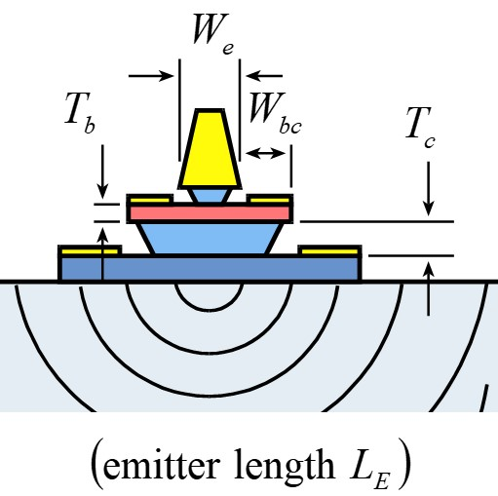
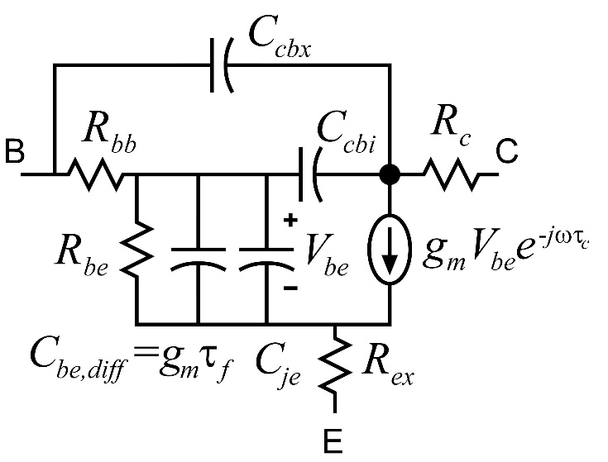
Bipolar Transistor Design
Rodwell, IEEE Proceedings, 2007

Slide 17
Bipolar Transistor Design: Scaling
Rodwell, IEEE Proceedings, 2007

Slide 18
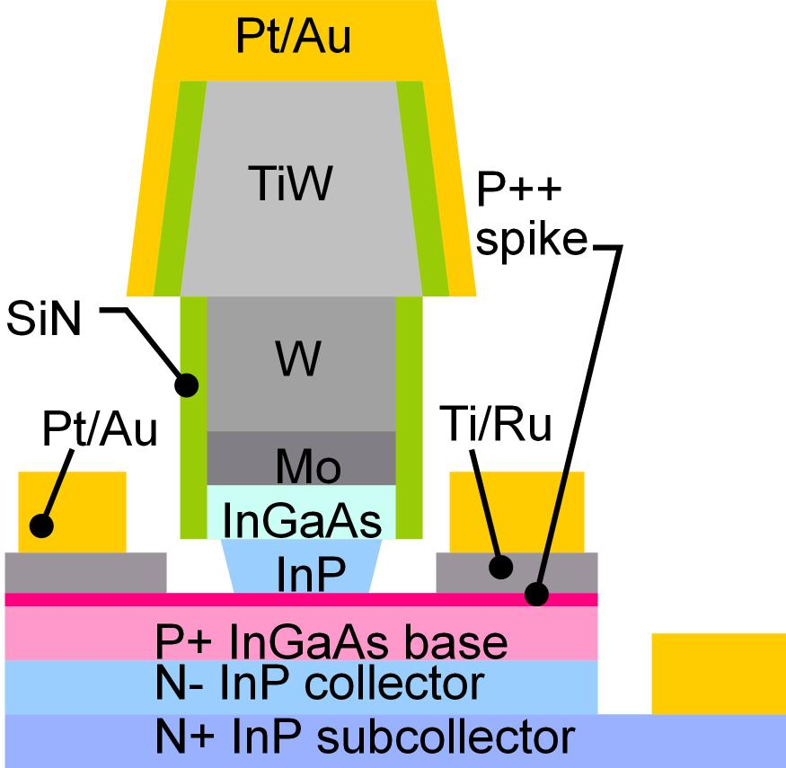
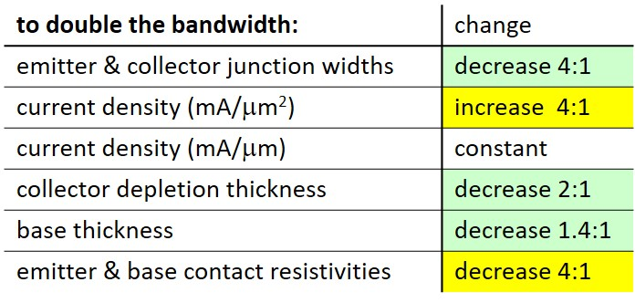
Bipolar Transistor Scaling Laws
Rodwell, IEEE Proceedings, 2007
Narrow junctions.
Thin layers
High current density
Ultra low resistivity contacts

Slide 19
Ultra low resistivity refractory contacts for THz HBTs
Baraskar et al, Journal of Applied Physics, 2013 (UCSB)
Ohmic contact resistivity:
the key challenge for THz HBTs.
Refractory contacts:
robust under high-current operation
Low penetration depth: ~ 1 nm
Performance sufficient for 32 nm /2.8 THz node.
Why no ~2 THz HBTs today ?
Can't reproduce such base contacts
in full HBT process flow.
32 nm (2.8THz) node
requirements

Slide 20
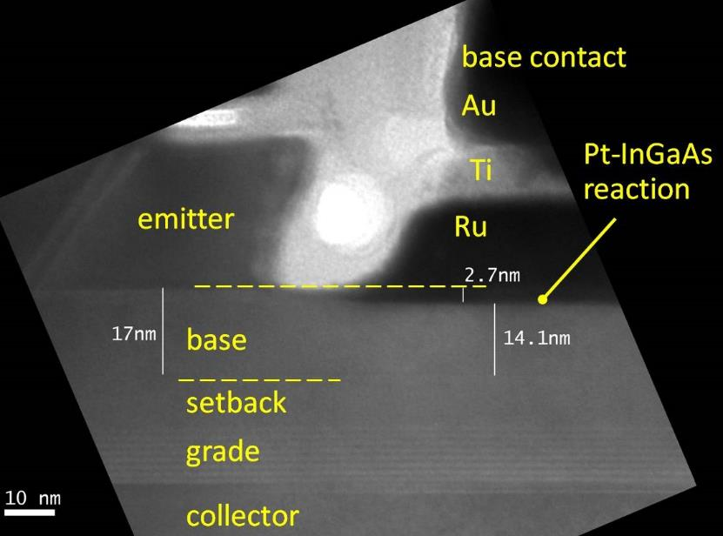
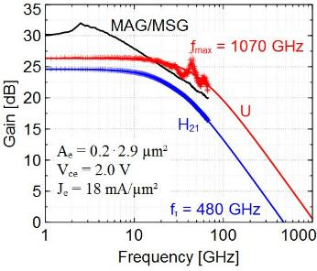
Rode et al., IEEE TED, Aug. 2015 (UCSB)
InP HBTs: 1.07 THz @ W_{e}= 200 nm
?

Slide 21
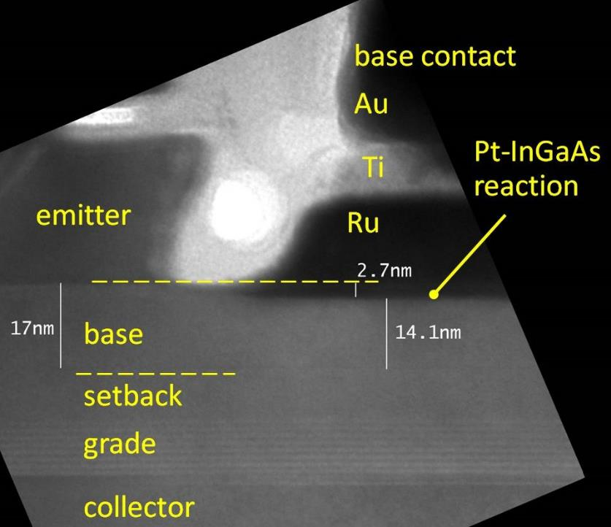
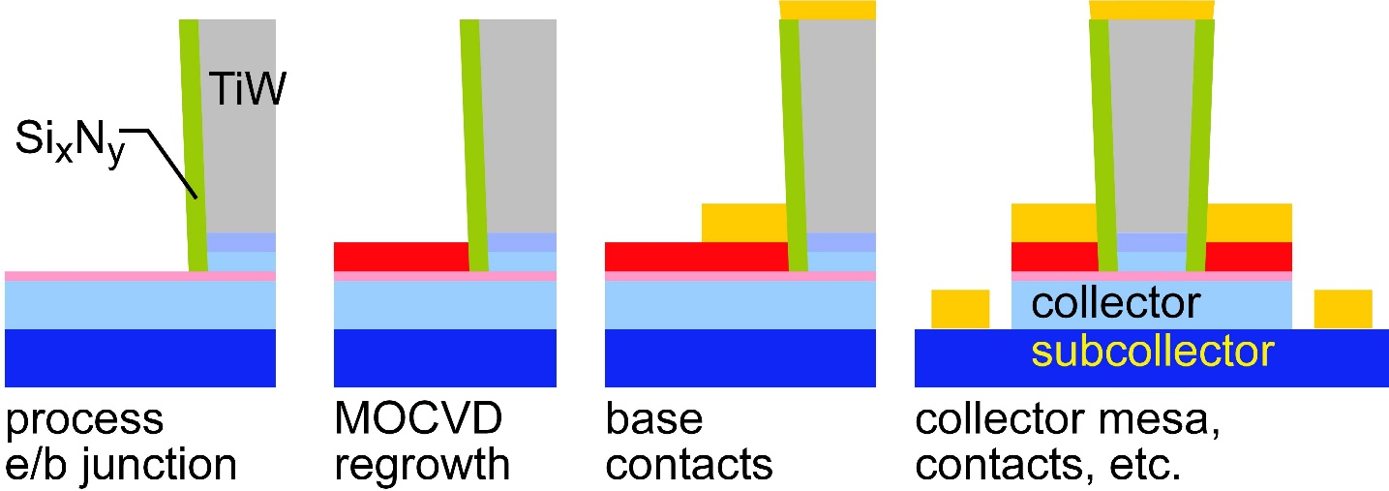
Challenges at the 64nm/2THz & 32nm/3THz Nodes
Need high base contact doping
>10²⁰/cm³ for good contacts
high Auger recombination
very low β.
Need moderate contact penetration
Pd or Pt contacts
react with 3++ nm of base
penetrate surface contaminants
too deep for thin base
Solution: base regrowth:
thin, moderately-doped intrinsic base
InGaAs or GaAsSb @ 10¹⁹-10²⁰/cm³
thick, heavily-doped extrinsic base
P-GaAs, ~10²¹/cm³
Baraskar et al, Journal of Applied Physics, 2013
Rode et al., IEEE TED, Aug. 2015

Slide 22
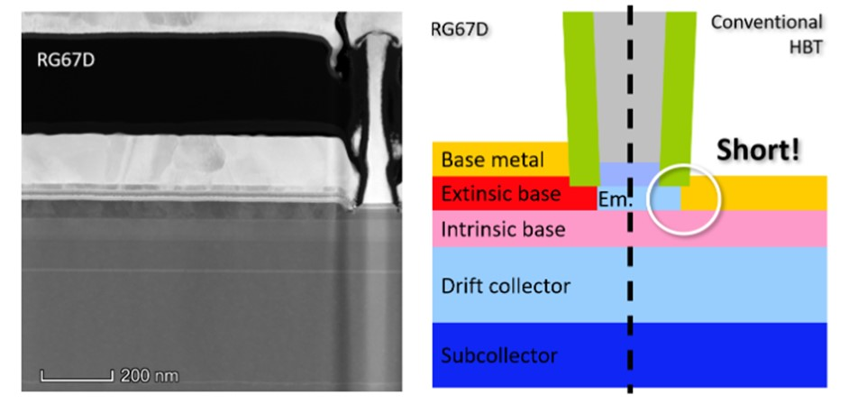
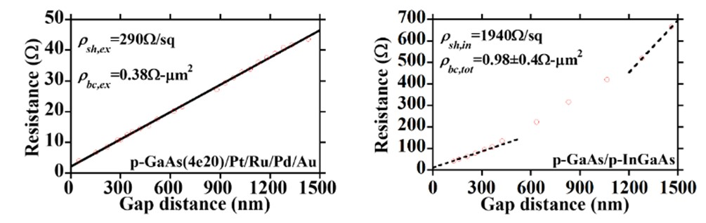
Regrown-Base InP HBTs: status at end of effort.
Good DC data: even given regrowth
refractory Mo/W/TiW emitter contact
maintains low ρ_{c}.
Y. Fang et al, 2019 IEEE DRC (UCSB)
Excellent base contacts; but hydrogen base passivation
0.4 Ω−μm² resistivity for GaAs/metal contact✓
290 Ω sheet resistivity for regrown base ✓
0.60Ω−μm² resistivity for InGaAs/GaAs contact✘
1940Ω/ sheet resistivity for intrinsic base ✘
(hydrogen anneal needed further adjustment)
W_{e}= 80 nm,
L_{e} =5 μm

Slide 23
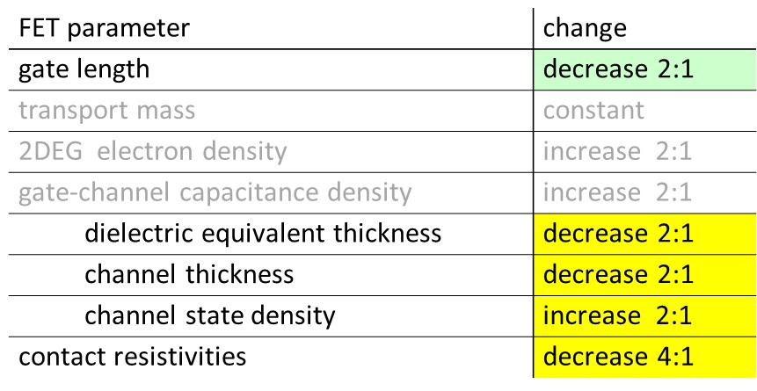
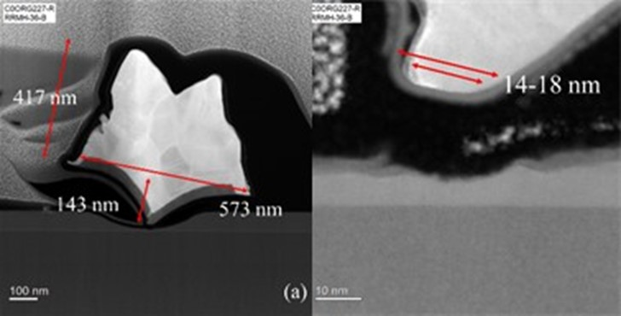
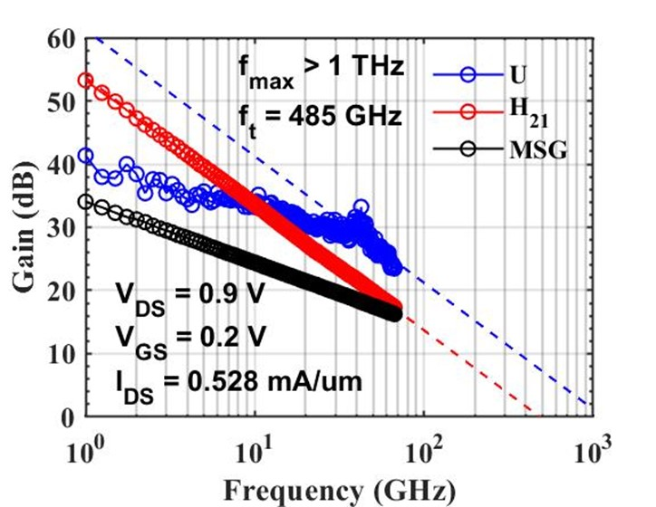
Making faster field-effect transistors
Scaling laws: Rodwell, IEEE DRC 2010
1.5 THz HEMTs: Deal, 2016 IEDM
1 THz MOS-HEMT: Whitaker, IEEE DRC 2023
III-V FET scaling laws to double bandwidth
Needs:
shorter gates
thinner channels
less resistive contacts
thinner (equivalent) gate dielectric
greater channel charge
State of art: 32 nm gate length HEMT
1.5 THz f_{max} (Northrop-Grumman)
semiconductor gate dielectric limits further scaling
Further scaling may be feasible
target ~2 THz f_{max}
lower F_{min} @ 100-300 GHz
high-K ZrO₂ gate dielectric
increased charge: InP channel ?

Slide 24






THz InGaAs-channel MOS-HEMT
L. Whitaker et al, 2023 IEEE DRC (UCSB)
Gate dielectric:
0.83 nm Al_{x}O_{y}N_{z} / 1.7 nm ZrO₂
improved electrostatics vs. ~6 nm InAlAs.
potential for improved (f_{τ}, f_{max}) with scaling
Remaining scaling barrier:
Limited (low) state density of InGaAs channel
Barrier to necessary g_{m}/W_{g} increase with scaling
Theory (right/wrong ?) suggests using InP channel

Slide 25



Transistor layouts: I, V, Z, and P.

Slide 26



IC Design Basics

Slide 27




100-300 GHz: transistor requirements, IC design
Transmitters need:
high power-added efficiency $PAE=(P_{out}−P_{in})/P_{DC}$
high added power density (P_{out}-P_{in})/(gate width, emitter length)
Receivers need:
low cascaded noise $F_{casc}=F+{(F−1)}/G+{(F−1)}/{G^{2}+…}$
Need reasonable gain/stage.
die area, power,
accumulated gain compression
At 100-300 GHz, transistor performance is marginal…
…how do we design PAs, LNAs, for performance close to transistor limits ?

Slide 28




Where the IC designer can't help
mm-wave transistor gain is low: gain-boosting is common
Common-source vs. common-gate.
Capacitive neutralization. Unconditionally stable positive feedback (Singhakowinta, Int. J. Electronics, 1966)
Such circuits don't improve the parameters that matter the most.
The circuit* doesn't change the transistor minimum cascaded noise figure. (Haus, Adler, Proc. IRE, 1958)
The circuit* doesn't change the transistor maximum efficiency vs. added power curve.
$$F_{casc}=1+M=F+{(F−1)}/G+{(F−1)}/{G^{2}+…}$$
*If lossless, and given the correct source and load impedances.

Slide 29

Noise Measure Invariance
H. A. Haus and R. B. Adler, "Optimum Noise Performance of Linear Amplifiers," in Proceedings of the IRE, vol. 46, no. 8, pp. 1517-1533, Aug. 1958.
N. Baniasadi and A. M. Niknejad, "Noise Measure Revisited for Design of Amplifiers Close to Activity Limits," in IEEE Transactions on Circuits and Systems I: Regular Papers, vol. 69, no. 6, pp. 2276-2283, June 2022.

Slide 30

Noise Measure Invariance: Implications

Slide 31

Cascode LNAs and noise measure invariance

Slide 32








LNA design for noise close to transistor limit
1) Goal: low noise measure, not noise figure
4) Capacitance in common-base; just like
inductance in common-emitter, allows simultaneous
tuning for zero reflection coefficient and minimum M.
5) Write ADS Python code to display
source impedance for minimum M.
2) Find bias (J,V) for lowest noise measure
6) Scale transistor size to eliminate series tuning element.
Less input tuning→ less noise from passive element loss.
@210GHz,
F_{cascade,min}= 6.57 dB
given:
J_{e}=0.5 mA/um,
V_{cb}=0.3V
3) Minimum M is independent of circuit configuration*;
pick for high bandwidth or high gain/stage (= low P_{DC})
7) Result: F_{C,LNA}= 7.4 dB (F=7.2 dB, G=13 dB) given F_{C,transistor}= 6.6 dB
<-- all give the same minimum M…
…but common-base gives highest gain (InP HBT @210GHz).
U. Solyu et. al, 2021 EuMIC
*HA Haus, RB Adler, Proceedings of the IRE, 1958

Slide 33






100-300 GHz Power combining: what is best ?
Corporate T-line
Direct series-connected
M. Shifrin: 1992 IEEE μWave/mmWave Monolithic Circuits Symp. (Raytheon)
Cascaded combining
A. Ahmed 2018 EuMIC, 2021 RFIC (UCSB)
Distributed Active Transformer
I. Aoki, IEEE Trans MTT, Jan. 2002 (CalTech)
Balun series-connected
λ/4 baluns: Y. Yoshihara, 2008 IEEE Asian Solid-State Circuits Conference (Toshiba)
sub-λ/4 baluns: H. Park, et al., IEEE JSSC, Oct. 2014 (UCSB)

Slide 34

On-Wafer Interconnect Losses

Slide 35

Invariance of PAE vs. added power
Given the correct source and load impedances,
all (lossless) power amplifier circuits have the same
maximum efficiency vs. added power curve.
…which is that of the transistor itself.
Things that don't change PAE:
Source/emitter inductance in common-source/emitter
Base/gate capacitance in common base/gate.
Capacitive neutralization
Singhakowinta's unconditionally stable positive feedback.
Design for highest PAE:
Pick topology with smallest tuning loss.
Real PAE design:
PAE, accumulated gain compression, bandwidth, IM3, …

Slide 36


Transistor stacking. Why ? Why not ?
 | Lower frequencies | Higher frequencies
Corporate combining | length $∝1/f$→ large die area ✘ dB loss $∝1/\sqrt{f}$→ high loss ✘ | length $∝1/f$→ small die area ✓ dB loss $∝1/\sqrt{f}$→ low loss ✓
Series-connected | more transistor fingers per cell → ok ✓ | more transistor fingers per cell→ parasitics ✘

Slide 37





Cascade Combining: Why ? Why not ?
 | Lower frequencies | Higher frequencies
Corporate combining | length $∝1/f$→ large die area ✘ dB loss $∝1/\sqrt{f}$→ high loss ✘ | length $∝1/f$→ small die area ✓ dB loss $∝1/\sqrt{f}$→ low loss ✓
Series-connected | more transistor fingers per cell → ok ✓ | more transistor fingers per cell→ parasitics ✘
Cascade combining | large interstage matching networks✘ | small interstage matching networks ✓ small # transistor fingers per cell → ok ✓ cascade cell pass-though losses ✘

Slide 38



100-300 GHz ICs

Slide 39


InP HBT Amplifier: 500 mW, 14.9% PAE, 150 GHz
Teledyne 250 nm InP HBT; 2 mm x 1.5 mm
adaptive class-AB bias
Alizadeh 2023 IEEE BCICTS
combination of corporate
and cascade power-combining

Slide 40





InP HBT Amplifier: 78 mW, 18.4% PAE, 220 GHz
Alizadeh 2024 IEEE MTT Trans. ; to be published
Teledyne 250 nm InP HBT (reduced base post)
Thermally ballasted 4-finger common-base cell:
increases maximum V_{ce}.
0.78 mm x 0.75 mm
combination of corporate and cascade power-combining

Slide 41

Record PAE @ 220 GHz
Key finding: RF breakdown > DC breakdown (thermal effects)

Slide 42





InP HBT Amplifier: 16.8 dBm, 4.0% PAE, 266 GHz
Ahmed et al, 2021 RFIC
Teledyne 250 nm InP HBT
4-stage capacitively degenerated common-base
Cascade combining:
~40% of Pout from output stage
~40% from driver
~20% from pre-driver.
Improved PAE feasible with re-design, or using 130 nm node

Slide 43





200 GHz Low-Noise Amplifier: 130 nm InP HBT
Unpublished data: do not distribute outside this workshop.
5-stage common-emitter design.
F = 6.3-5.5 dB over 180-217 GHz; record for bipolar transistor
-22 dBm IP1dB at 210 GHz.
12-16 dB gain over 170-220 GHz
7 mW DC power dissipation.
Alizadeh, Park, Urteaga, Rowell, Rodwell, to be submitted
F_{cascade,LNA} = 6.4-5.6 dB

Slide 44


210 GHz Transmitter and Receiver ICs
Seo, 2021
IEEE IMS
Teledyne 250nm InP HBT
Size: 2.9 x 0.75 mm²
Size: 2.3 x 0.85 mm²
~ 20 GHz bandwidth
~ 16 dBm P_{sat}
~ 20 GHz bandwidth
~ 8.5 dB noise figure

Slide 45




280 GHz Transmitter and Receiver ICs
Soylu;
2023 RFIC,
2023 EuMIC
Teledyne 250nm InP HBT
~ 10-12 dB noise figure
~ 13-14 dBm P_{sat}

Slide 46


1D and 2D
Array Design

Slide 47





The mm-wave module design problem
How to make the IC electronics fit ?
How to avoid catastrophic signal losses ?
How to remove the heat ?
Not all systems steer in two planes...
...some steer in only one.
Not all systems steer over 180 degrees...
...some steer a smaller angular range

Slide 48


Do we need 2D arrays ? 1D steering might be fine.
1/sin²φ sidelobes provide strong signals to tall buildings.
Providing sidelobes reduces broadside gain by less than 3dB.
→ Don't need 2D arrays to serve tall buildings

Slide 49

2D vs. 1D: Don't aim beams in useless directions
With most users on the ground, 2D array wastes spatial degrees of freedom on unoccupied directions.
Need some 2D beamsteering to avoid ground reflections.

Slide 50






100-300 GHz IC-package connections
type | Frequency | technology | cost | heatsinking
micromachined waveguide interface | 1000 GHz | Research. Cheap one day ? | high ✘ | good
ribbon, mesh bond | 200 GHz | Handcrafted. | high ✘ | good
wafer-scale fan-out package | >200 GHz | Industry standard | low | good
Cu stud flip-chip | >200 GHz | Industry standard | low | ok, marginal for PA ✘
hot vias | 200 GHz | Development | low ? | good
(ball) wirebonds | 100 GHz ✘ | Industry standard | low | good
Deal, IEEE Trans THz,
Sept 2011

Slide 51



140 GHz

Slide 52


140 GHz Hub Demonstration
Concept: 128 elements, 64 x 10 Gb/s/user, 70 meters.
Demonstration (Samsung + UCSB)
8-element receiver*: 22 nm SOI CMOS
8-element transmitter*: 22 nm SOI CMOS + 100 mW InP HBT PAs
2.3 Gb/s @ 120 meters*
PTFE lens used to extend link range
Globalfoundries: 22FDX CMOS
Teledyne: 250 nm InP HBT
Kyocera: LTCC, assembly
*Modules: Farid et al, IEEE BCICTS 2021, IEEE Trans MTT 2022,
Demo: Abu-Surra et. al. (Samsung) 2022 IEEE International Conference on Communications, 16 -20 May 2022, Seoul, Korea

Slide 53


210 GHz and 280 GHz
ICs, Modules, Links

Slide 54
Concept: 640 Gb/s, 210 GHz MIMO backhaul
Concept
8 x 80 Gb/s MIMO with 2.1 m baseline
16-element subarrays (7λ x 7λ antennas)
500 meters range in 50 mm/hr. rain
14 dB margins: (obstruction, operating, aging, packaging)
LNAs: 8 dB noise figure
PAs: 50 mW =P_{1dB}
Demonstrated to date:
no subarrays, 1 channel
Ongoing demonstration efforts:
no subarrays, 4 x 4 MIMO

Slide 55




200 GHz link demonstration
Soylu, 2023 IEEE BCICTS (UCSB)
Teledyne 250 nm InP HBT
Kyocera module assembly
8 Gbaud
32 Gb/s
13.4% error vector magnitude
→ BER < 10⁻³
attenuator
Now working towards
4 x 4 MIMO demo.

Slide 56

What's next:
100-300 GHz

Slide 57
What's Next ? Large Arrays, Dense Arrays
λ/2-pitch 2D arrays at 200-300 GHz
Not all systems need 2D arrays, but many do.
very small spacing: hard to fit in the circuits
Highest-frequency ~ λ/2-pitch 2D arrays: 140 GHz CMOS (Rebeiz group, UCSD)
Target: large-scale λ/2-pitch 220 GHz 2D arrays in InP HBT
Massive inexpensive arrays at 70-140 GHz
Motivation: difficulties even with 5G @ 39 GHz
Goal: greatly increase P_{received}/P_{transmit.}
longer range, greater margins against blocking and fading.
Approach: greatly increase # transmit, receive elements.
low cost: need very low die area per element
low DC power: need very low DC power per element

Slide 58


ICs and Transceivers
for 100–300 GHz Wireless

Slide 59
100-300 GHz Wireless
Massive (near Tb/s) aggregate capacities: large spectral bandwidths, massive spatial multiplexing .
Limited range: ~100-500 m; atmospheric loss, λ²/R² loss.
Easily-blocked beams: need redundant paths.
IC technologies: CMOS, InP, SiGe (GaN)
Near-term commercial impact:
range is too short, cost is too high
capacity (Gb/s/km²) is much more than needed
Research (long-term):
demonstrate 100+ Gb/s capacity, reduce cost, reduce power, increase range and operating margins.
(λ/2) pitch arrays at 200+ GHz
massive low-cost arrays

