Slide 1
2025 IMS Workshop WSL "Sub-THz Power Amplifiers in CMOS, SiGe, and III-V"
100-300 GHz power amplifiers:
transistor limits, circuit topologies
Mark Rodwell
Doluca Family Chair
University of California, Santa Barbara
rodwell@ece.ucsb.edu
Co-authors: Amirreza Alizadeh (Keysight/UCSB), Ahmed Samir Sayed Ahmed (Cairo University/ Analog Devices / UCSB), Yuya Nemoto (UCSB), Utku Soylu (UCSB/IBM), Miguel Urteaga (Teledyne)

Slide 2
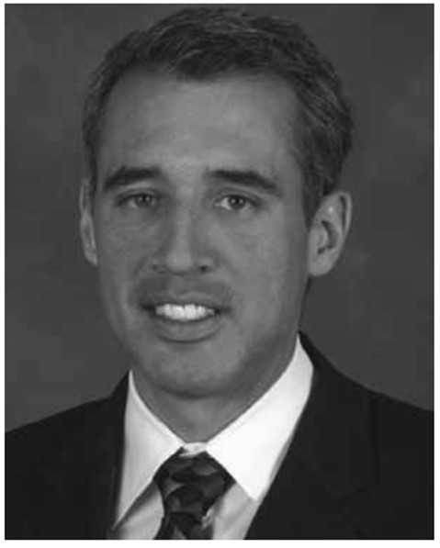




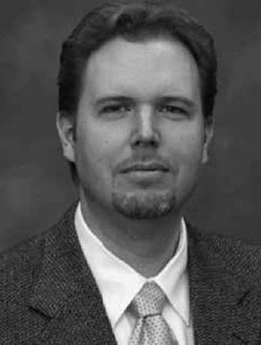
Co-Authors
Dr. Miguel Urteaga
Teledyne Scientific
130 nm & 250 nm
InP HBT technology
Dr. Amirreza Alizadeh
Now with Keysight
140 GHz 0.5 W amplifiers
220 GHz high-efficiency PAs
220 GHz LNAs
Prof. Ahmed S. S. Ahmed
Now with Cairo Univ. & ADI
140, 200, 270 GHz
power amplifiers
cascade power-combining
capacitively degenerated CB
Dr. Utku Soylu
Now with IBM Yorktown
LNA design principles
220 GHz LNAs
Yuya Nemoto
UCSB
Also acknowledging:
Dr. Zachary Griffith
Teledyne Scientific
100-300 GHz InP PAs
250 nm InP HBT technology

Slide 3
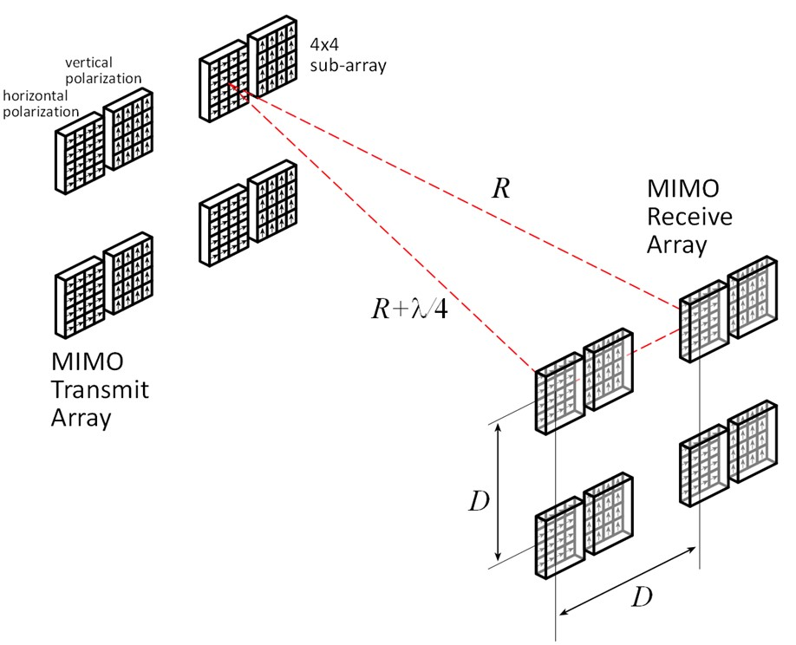
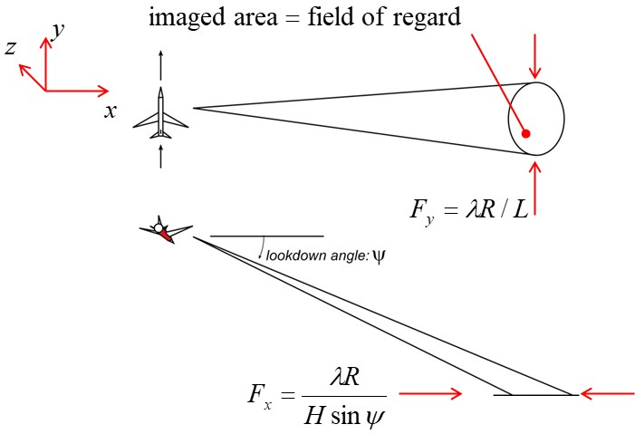
applications

Slide 4
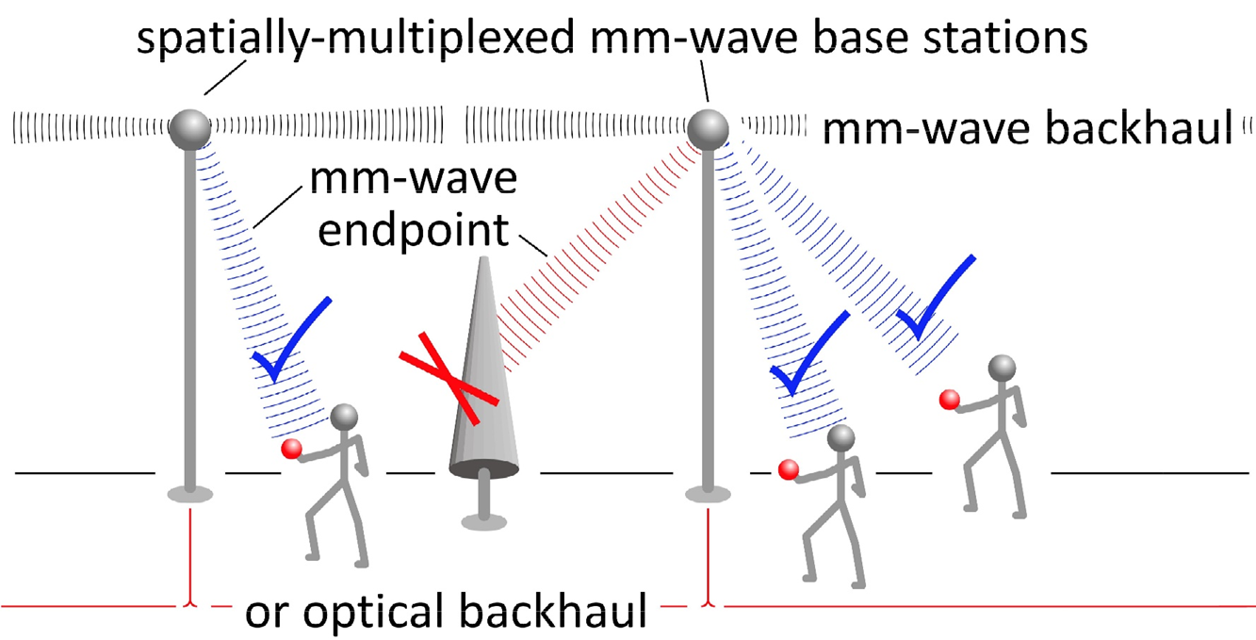
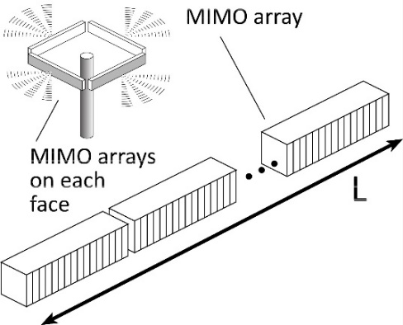
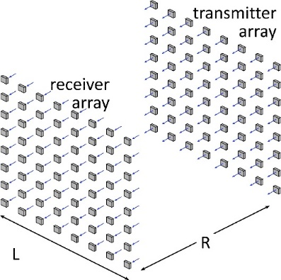

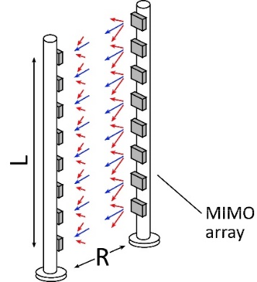


100-300 GHz Wireless
High capacity:
potentially wide available bandwidth
many simultaneous signal beams even with compact arrays
Limited range: (max 500-1000 m)
high λ²/R² Friis (beam diffraction) losses
high worst-case atmospheric attenuation
Need:
arrays with very many elements
low receiver noise figure
efficient medium-power amplifiers
Terminology:
30-300 GHz → λ = 10 to 1 mm→ "millimeter-waves"

Slide 5
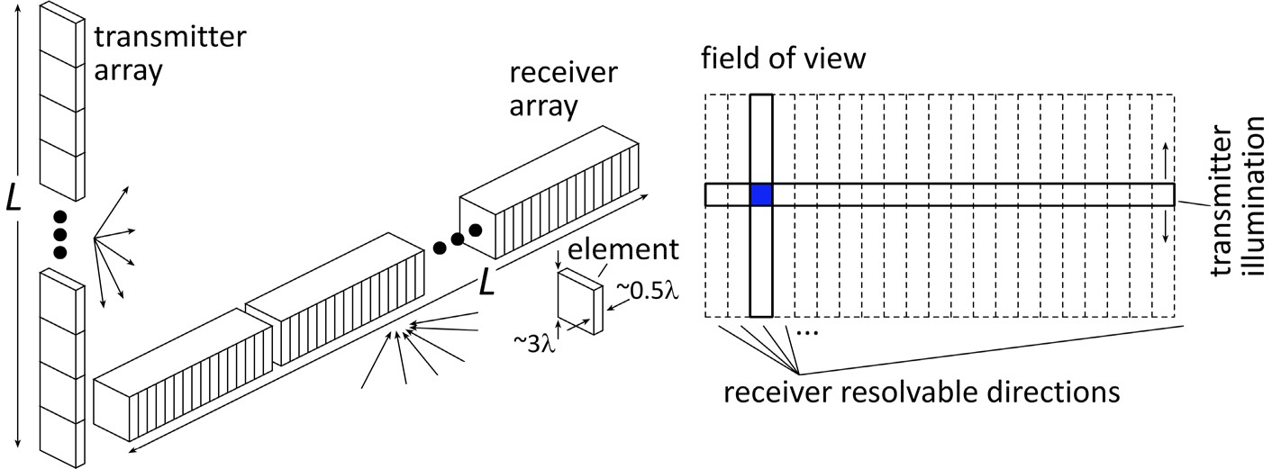

220 GHz FMCW crossed-array imaging radar
36 × 1 transmit array, 6" long
1 × 216 receive array, 6" long
36 × 216 image; 10º ×90º field of view
0.3º beamwidth
Sees soccer ball
@ 200 meters range,
in heavy fog.
P_{1dB} = 17 dBm PAs
F = 6 dB LNAs
17 dBm PAs, F=6 dB LNAs , 2 dB TX packaging losses, 2 dB RX packaging losses, 4 dB operating margins, 40 Hz scan, 10 dB SNR, -10 dB target reflectivity, 22 dB/km fog. soccer ball is 22 cm diameter

Slide 6
Video Rate Synthetic Aperture Radar
Video-rate, video-resolution SAR
like infrared: high-resolution, real-time images
better: sees even through fogs/cloud
2012 DARPA VISAR program:
220 GHz, 1km range system
transmitter: 50 W vacuum tube.
Feasible now: InP HBT solid-state-source
2 tiles x (16 x 16 elements) x 100 mW/element
P_{1dB} = 20 dBm PAs
F = 7 dB LNAs

Slide 7
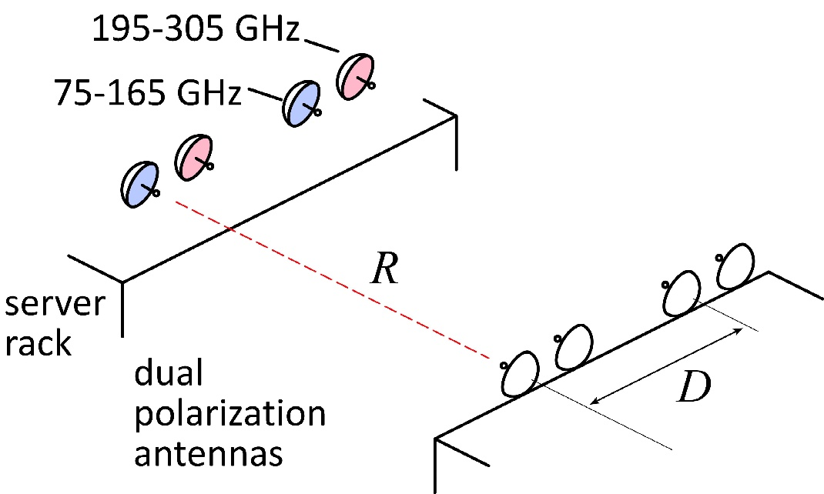
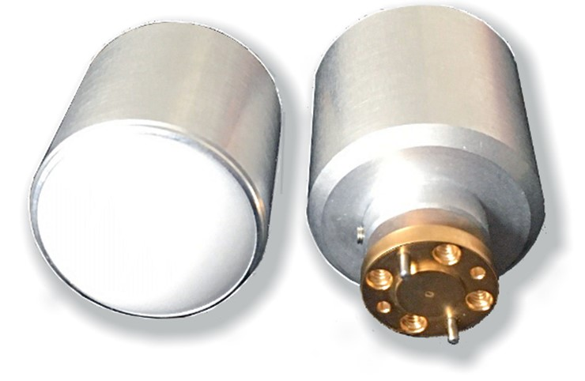
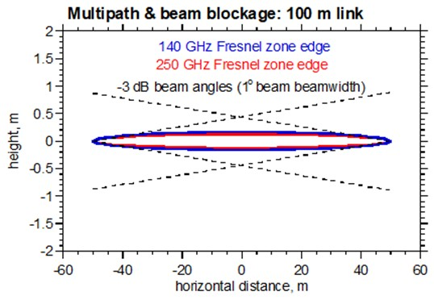
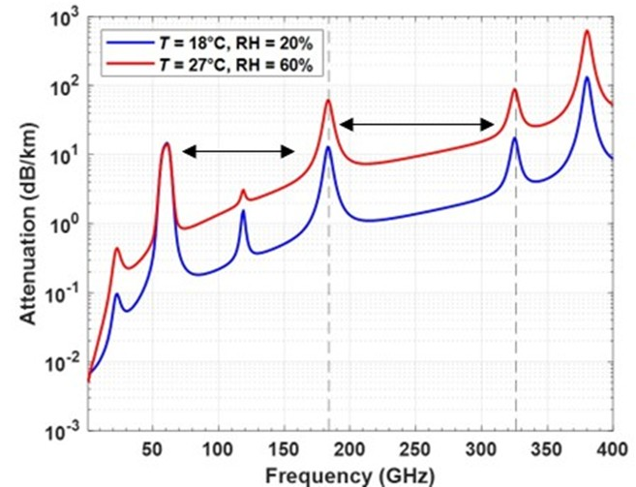
1.6 Tb/s wireless data center links ?
75-165, 195-305 GHz → 200 GHz bandwidth
16QAM→ 4 bits/Hz→ 800 Gb/s
2 polarizations→ 1.6 Tb/s
100 m range
pJ/bit = ?
blockage ? crosstalk ?
P_{1dB} = 12 dBm PAs
F = 7 dB LNAs
~10 dBm PAs, F=7 dB LNAs , 2 dB TX packaging losses,
2 dB RX packaging losses, 10 dB operating margins,
1⁰ beamwidhs, 10⁻³ uncoded BER.
mechanical alignment
P1dB =12 dBm if 5 dB backoff from Ppeak

Slide 8
250 GHz, 1.0 Tb/s, 1.5 km MIMO Backhaul
8-element MIMO array
~ 1m baseline
125 Gb/s/subarray; 1.0 Tb/s total
1.5 km range in 50 mm/hour rain
P_{1dB} = 25 dBm PAs
F = 6 dB LNAs
25 dBm P1dB PAs (5 dB backoff), F=6 dB LNAs , 2 dB TX packaging losses, 2 dB RX packaging losses, 10 dB operating margins, 8λ × 8λ sub-array elements → 7 degree beamsteering

Slide 9
500 m, 640 Gb/s backhaul: 220, 90, 35 GHz
High frequencies
competitive
if αR < about 5-10 dB

Slide 10
Radio link design: Implications
50 GHz or 250 GHz ?
Worst-case losses similar at 50 & 250 GHz
Same link budget at 250 GHz if
slightly more elements @ 250 GHz
or less spectrally efficient modulation
and if we can make good PAs and LNAs.
Any terrestrial > 50 GHz system will be short-range.
Low frequency (6-12 GHz) or high (28-50, 110-270 GHz)?
Low communications density (Gb/s/km²) ?
low deployment costs: widely spaced hubs
long link distances → use lower frequencies.
High communications density (Gb/s/km²) ?
can afford more closely spaced hubs
short link distances → can used high frequencies

Slide 11
Transistor performance comparison

Slide 12
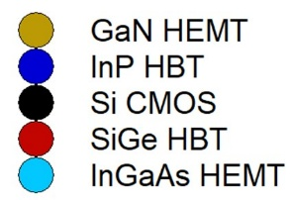
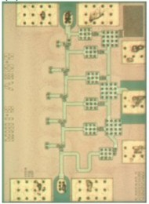
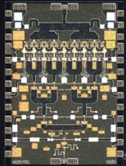
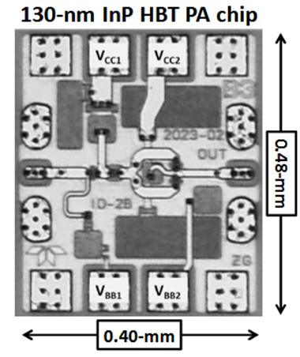
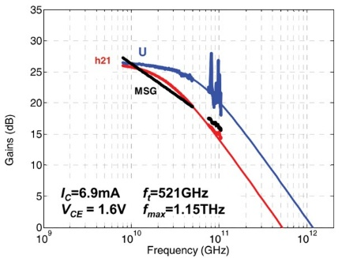
100-300 GHz IC Technologies
Results compiled 3/22/2025
Urteaga, 2011 DRC
Alizadeh, 2024 BCICTS
Alizadeh, 2023 BCICTS
Griffith, 2024 IMS
130 nm
InP HBT
f_{max}=1.15 THz
What parameters are important
for high PAE at 100-300 GHz ?
47 mW,
25% PAE,
220 GHz
F~5.75 dB,
@215 GHz
500 mW,
15% PAE,
150 GHz

Slide 13
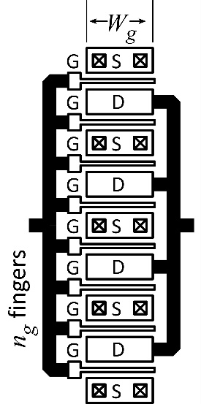
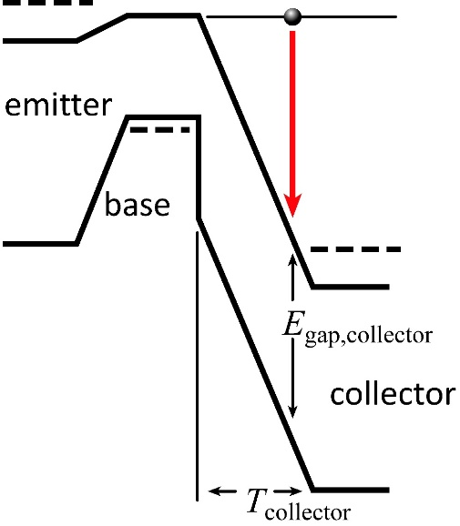
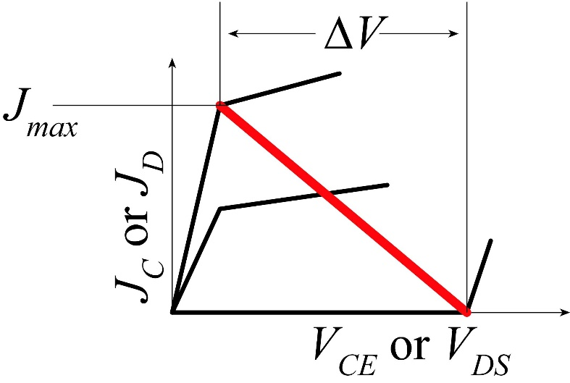
transistor\circuit
co-design

Slide 14
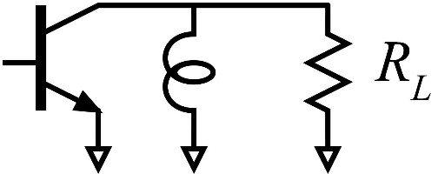
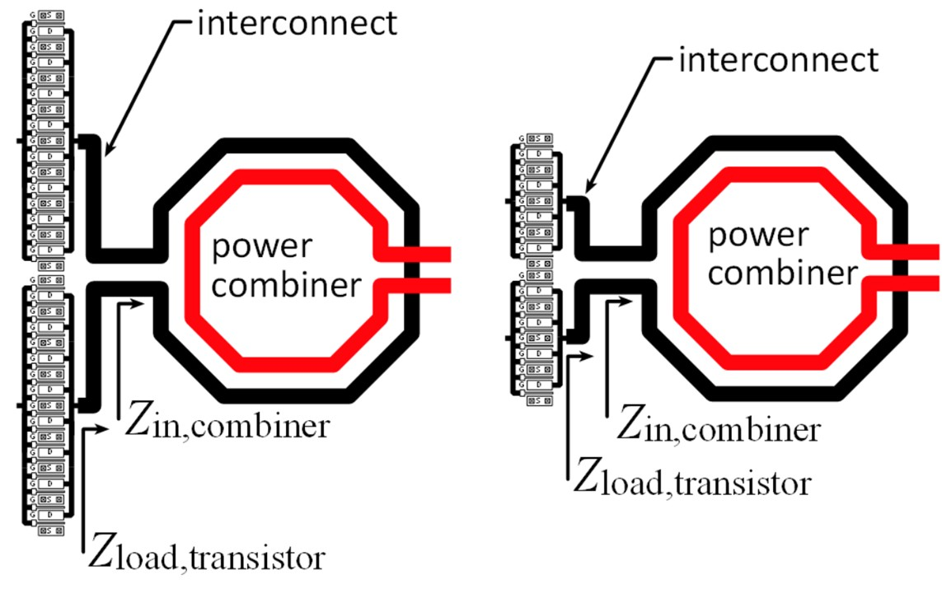
Voltage, current, impedance, power

Slide 15
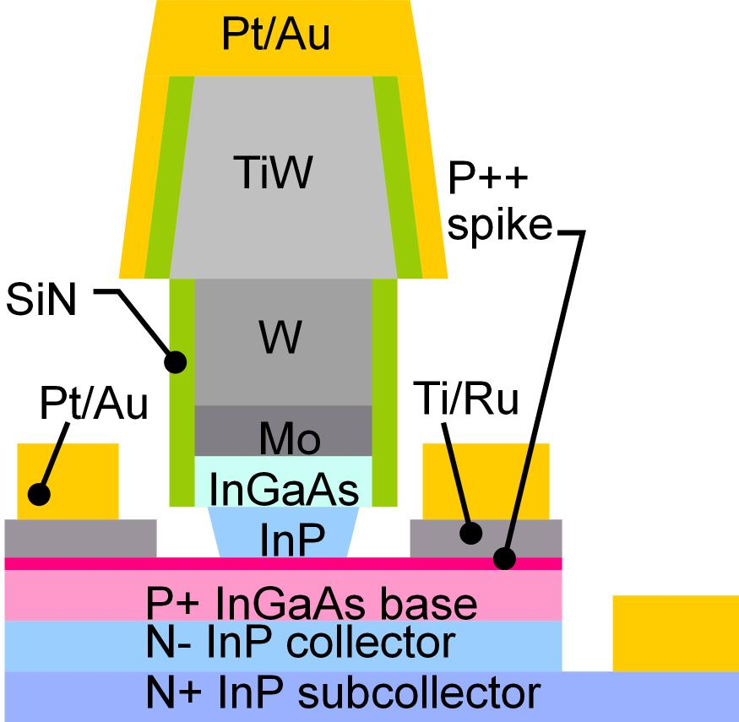
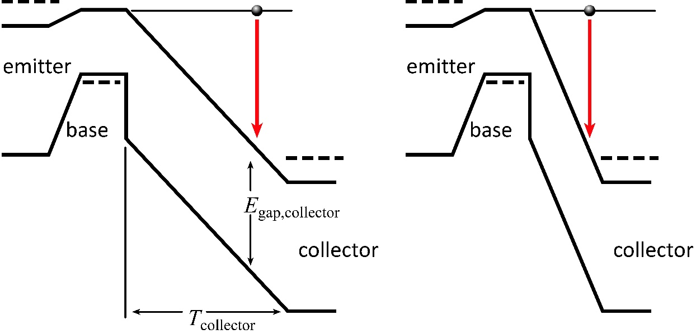
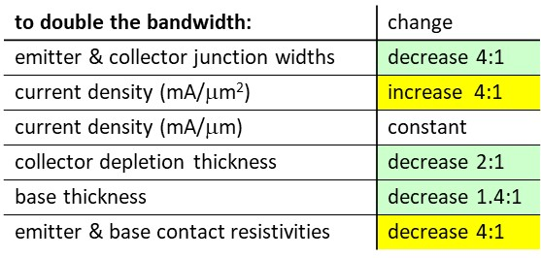
Increasing bipolar transistor bandwidth
Increased transistor bandwidth:
Thinner collector depletion layers
→ reduced breakdown voltage

Slide 16
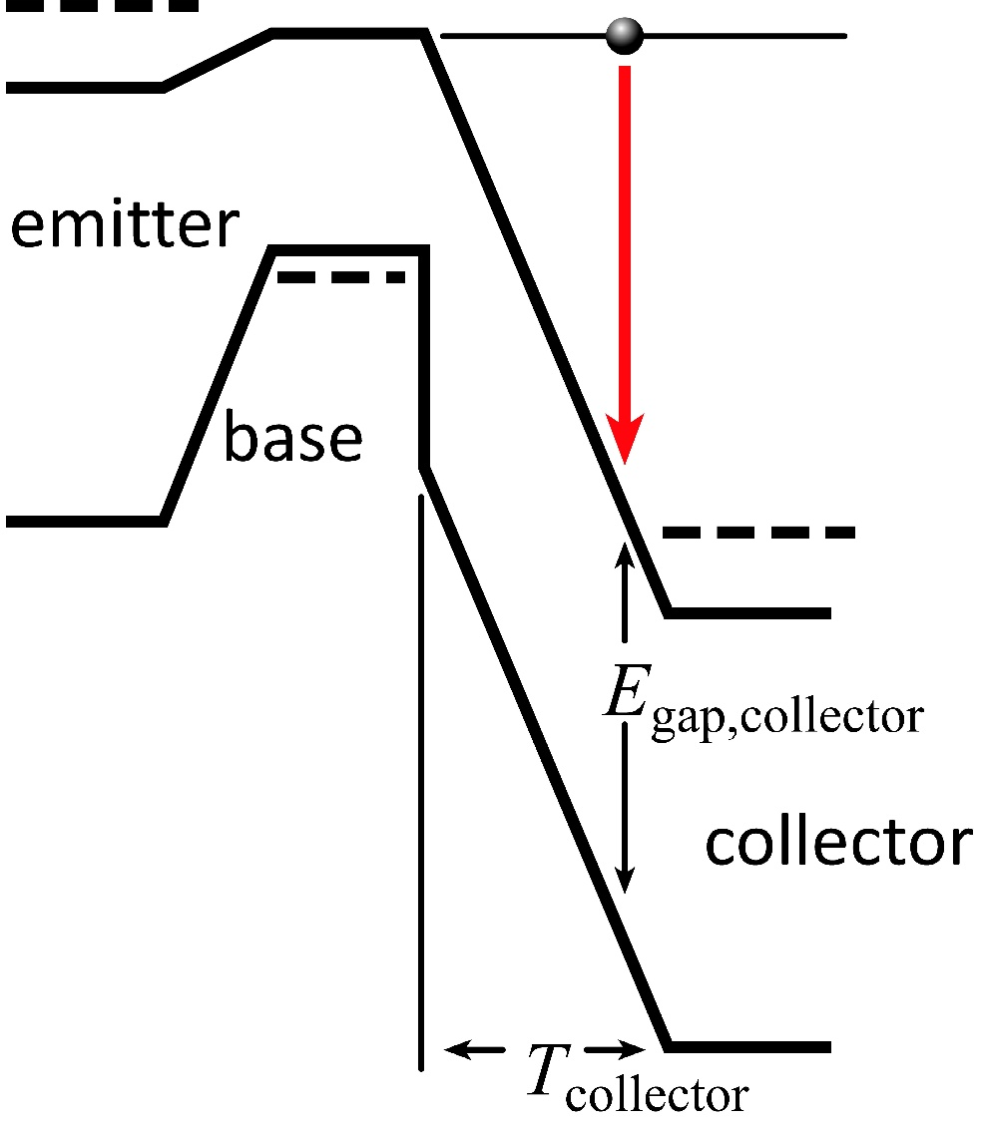
Johnson figure of merit

Slide 17
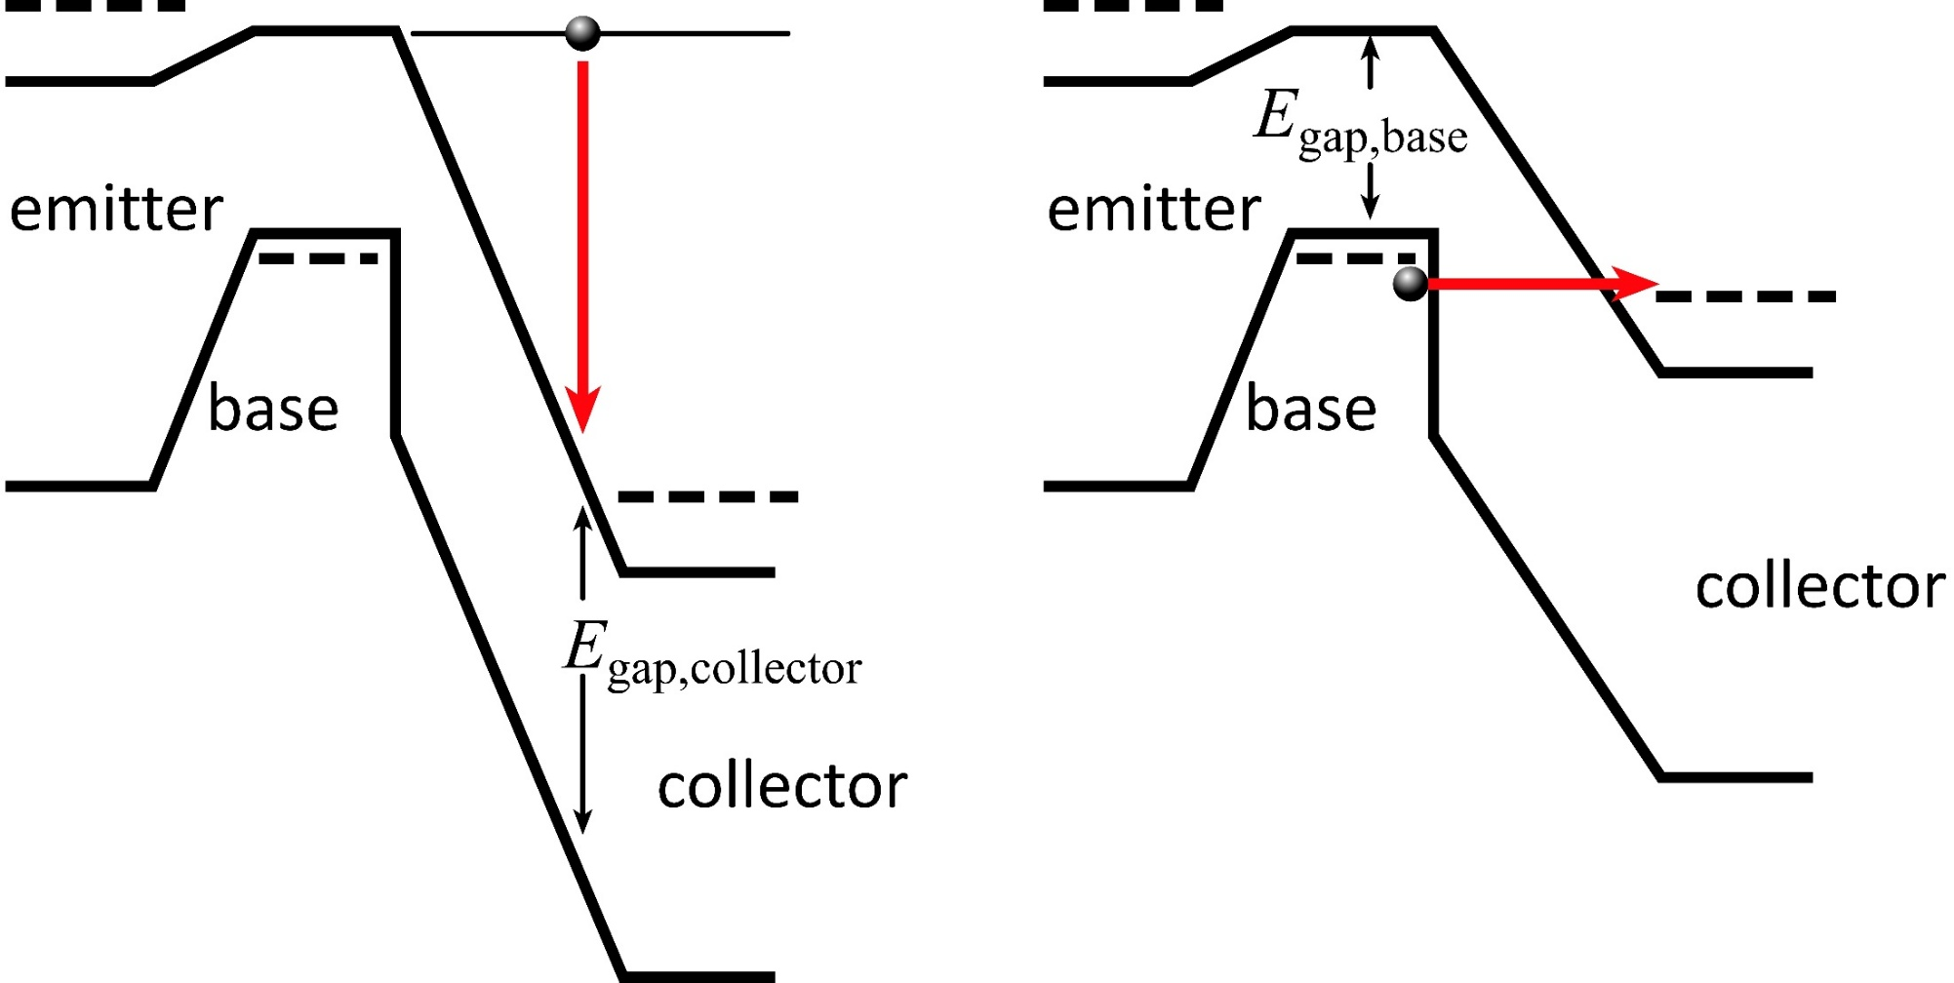
Breakdown is never less than the bandgap

Slide 18
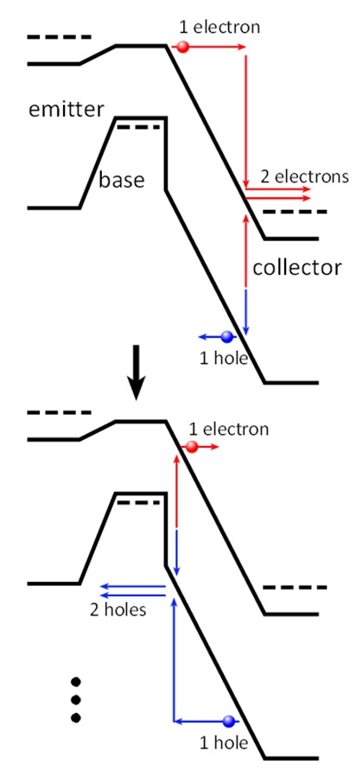
Impact Ionization vs. Avalanche, BCVEO vs. BVCBO

Slide 19
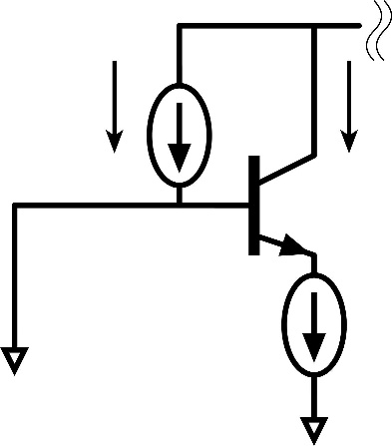
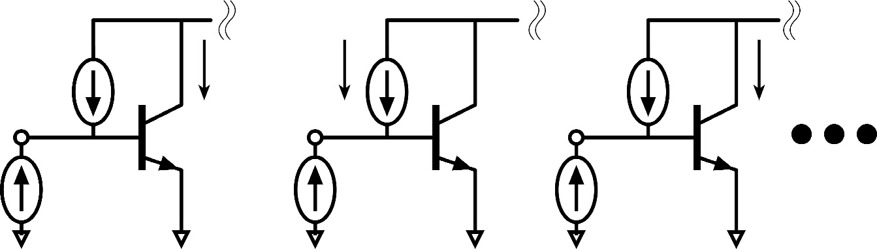
BVCBO vs. BVCBO depends on base impedance.
BVCBO
Breakdown varies between
BVCBO and BVCEO
as the impedance
presented to the base
varies from zero to infinity.
BVCEO

Slide 20
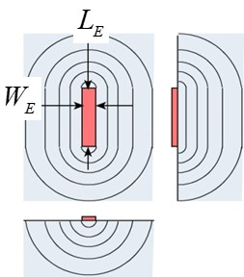
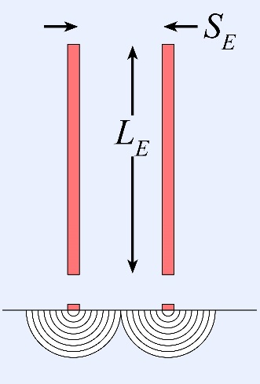
HBT thermal resistance
Rodwell, IEEE Proceedings, 2008
Carslaw & Jaeger 1959
W. Liu, IEEE TED, June 1995
Formula from Carslaw & Jaeger, Conduction of heat in solids, 1959, page 265

Slide 21
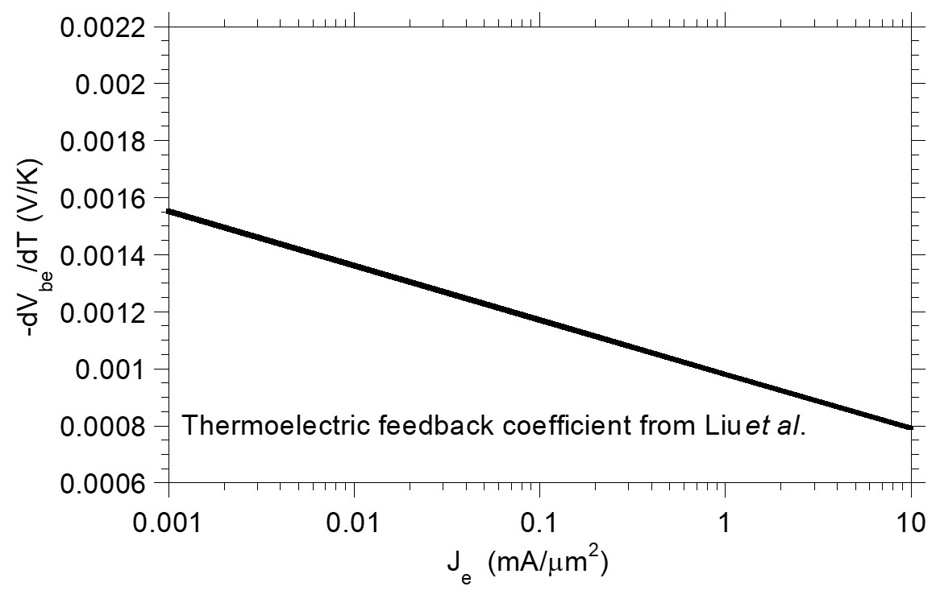
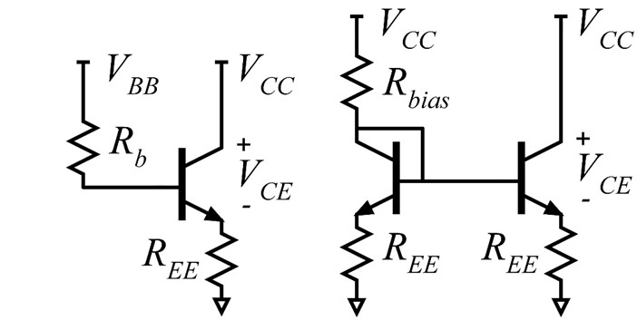
HBT electrothermal runaway
W. Liu, IEEE TED, March 1996
Griffith, 2007 IEEE IPRM

Slide 22
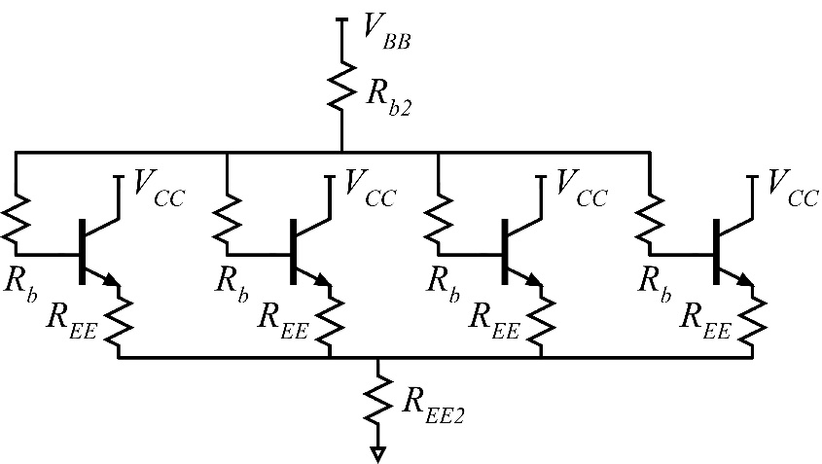
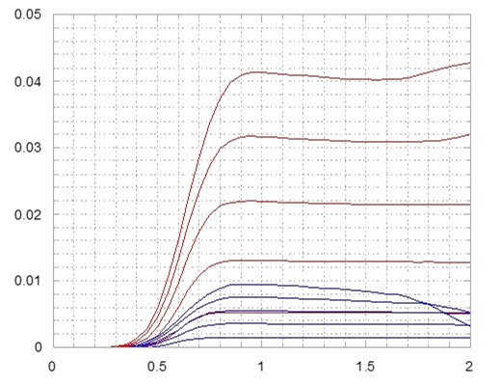
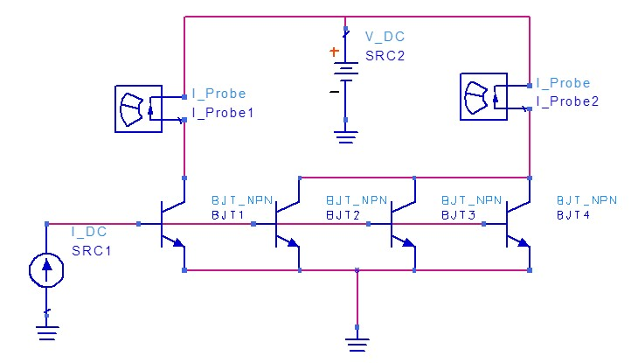
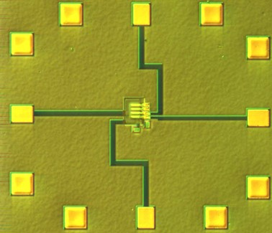
HBT electrothermal runaway
Yun Wei, PhD. thesis, UCSB, 2003

Slide 23
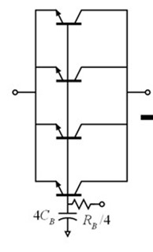
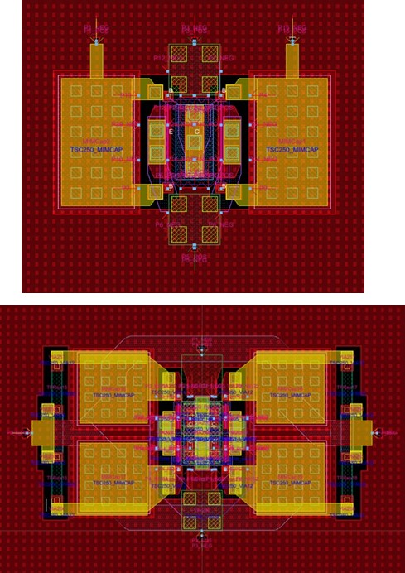
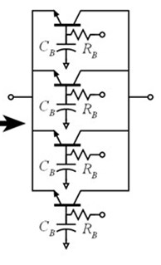
Electrothermally segmented common-base layout
4 finger cell (4 x 0.25 μm x 6 μm); 250 nm InP HBT
Normal cell:
parallel RF connection
parallel DC connection
prone to electro-thermal runaway
Segmented cell:
parallel RF connection
independent DC connection
reduced electro-thermal runaway
no degradation in high-frequency performance.
operates at higher currents at a given Vce.
Amirreza, IEEE Trans MTT 2024

Slide 24
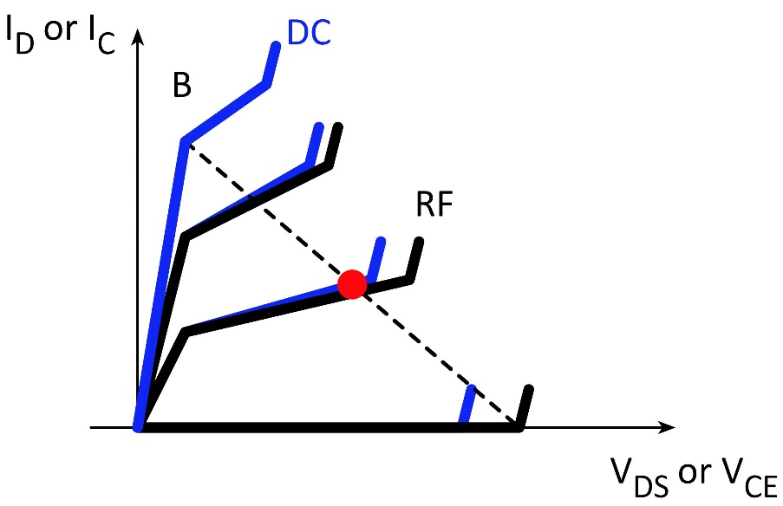
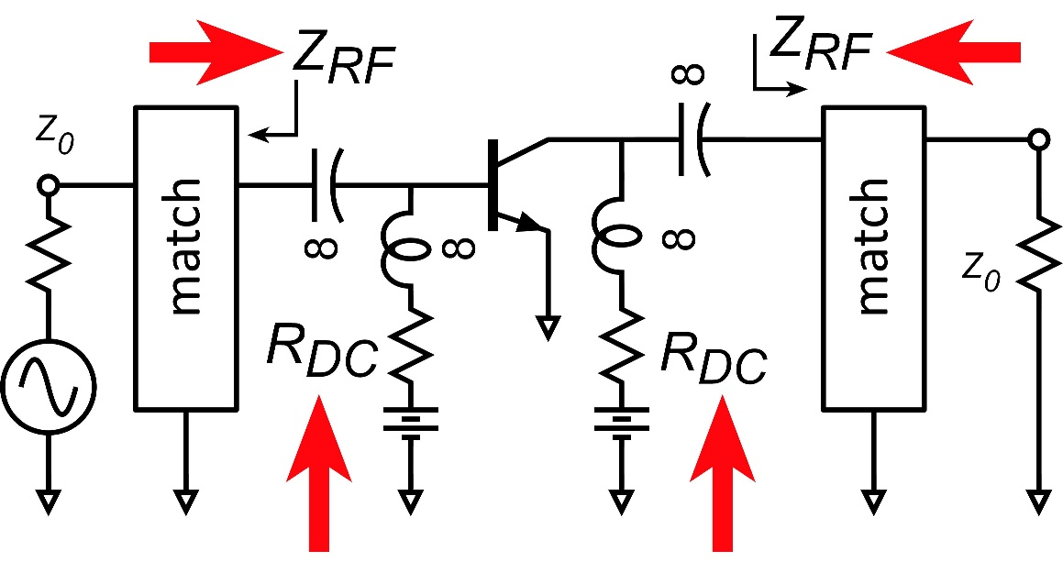
DC and RF breakdown are not the same
Thermal time-constants
breakdown depends on temperature
temperature can't track RF cycle
Electrothermal runaway (thermal positive feedback)
contributes to breakdown
temperature can't track RF cycle
Avalanche multiplication
impact ionization is fast (electron transit time)
avalanche is slower (hole + electron times)
BVCEO vs. BVCBO
depends on RF impedances,
not on DC impedances.

Slide 25
What do 100-300 GHz power transistors need ?
RF/microwave emphasis (DC-30 GHz)
need high V_{br} for high output power
need high V_{br}/V_{sat} for high drain\collector efficiency
need high gain for high PAE (hence high fmax)
These are insufficient at 100-300 GHz.
need high current density for compact transistor layout
transistor cell parasitics, circuit layout parasitics
need high current density for adequate large-signal gain

Slide 26
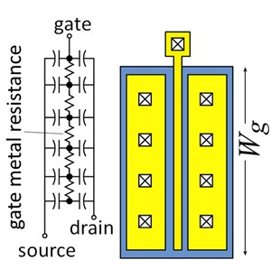
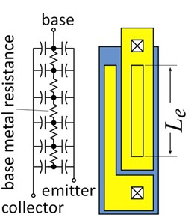
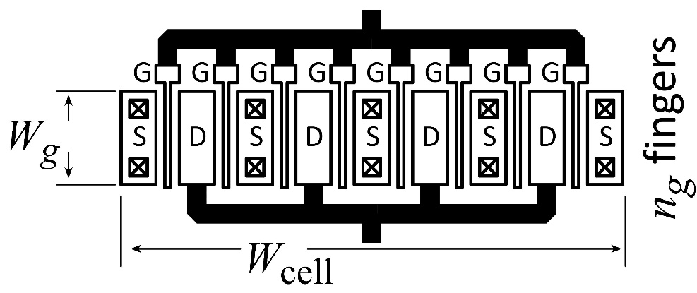
Current density, finger pitch limit cell output power

Slide 27
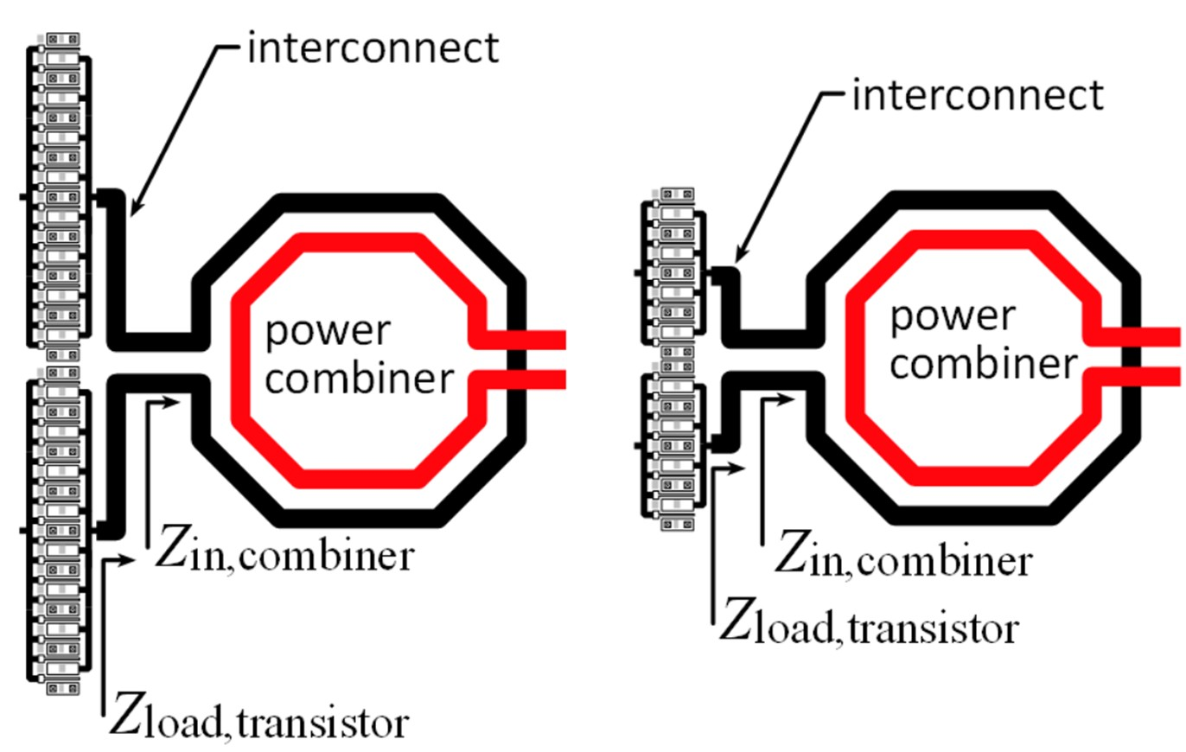
Low mA/μm→ transistor and circuit layout problems
Low mA/μm → many fingers
Transistor layout:
large interconnect parasitics
uncontrolled, unmatched impedances
degraded f_{τ}, f_{max}, G, F, P_{sat}, PAE…
IC layout:
large transistor footprint
longer interconnects to combiner
impairs low-Z (high power) design
reduces feasible P_{out}

Slide 28
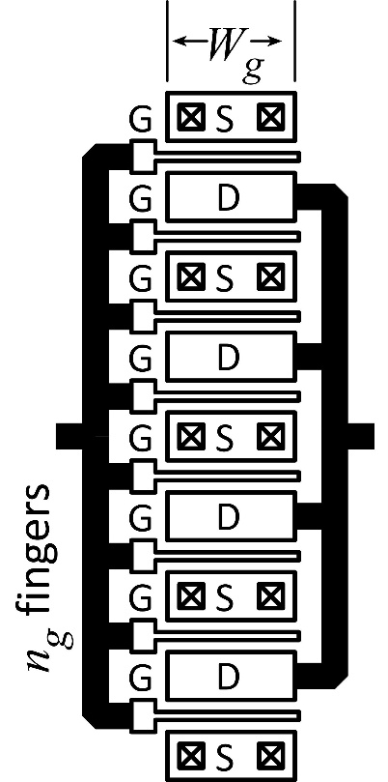
Power-added efficiency

Slide 29
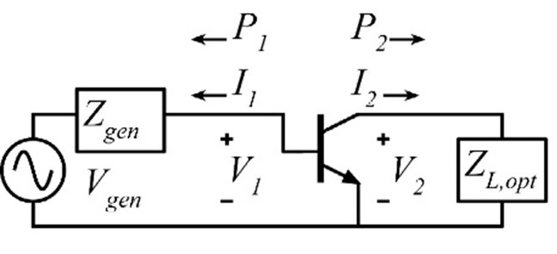



Invariance of PAE & added power
Alizadeh, IEEE Trans. MTT, 2025
PAE and (P_{out}-P_{in}) are network invariant:
no change given lossless passive embedding.
Given correct Z_{L},
All (lossless) PAs the same PAE and same (P_{out}-P_{in}).
PAE and (P_{out}-P_{in}) are that of the transistor itself.
Things that do not change PAE:
CE/CS emitter/source inductance
CB/CG base/gate capacitance
Neutralization
Unconditionally stable positive feedback
For highest PAE pick circuit with smallest loss.
(Singhakowinta 1966)

Slide 30

Maximum transistor PAE

Slide 31



Current Drive capabilities

Slide 32
Theory vs. simulation…and vs. measurement
Theory works reasonably for InP HBT; less well for Ga-polar GaN. Why ?
Should use large-signal, not small-signal f_{max}. (s.s. is optimistic)
CAD and measurements: heavily saturated; enhances PAE
Harmonic tuning, when feasible, further enhances PAE
4-finger HBTs are ~3% less efficient that 1-finger HBTs
150-300 GHz PAs are ~10% less efficient than 4-finger HBTs (InP)
InP HBT PA measurements are reasonably close to simulation.

Slide 33
Max PAE analysis: Caveats

Slide 34



power amplifier design

Slide 35




100-300 GHz Power combining: what is best ?
Corporate T-line
Direct series-connected
M. Shifrin: 1992 IEEE μWave/mmWave Monolithic Circuits Symp. (Raytheon)
Cascade combining
A. Ahmed 2018 EuMIC, 2021 RFIC (UCSB)
Distributed Active Transformer
I. Aoki, IEEE Trans MTT, Jan. 2002 (CalTech)
Balun series-connected
λ/4 baluns: Y. Yoshihara, 2008 IEEE Asian Solid-State Circuits Conference (Toshiba)
sub-λ/4 baluns: H. Park, et al., IEEE JSSC, Oct. 2014 (UCSB)

Slide 36



Example: 4:1 Balun Series-Connected @ 81 GHz
λ/4 baluns: Y. Yoshihara, 2008 IEEE Asian Solid-State Circuits Conference (Toshiba)
sub-λ/4 baluns: H. Park, et al, IEEE JSSC, Oct. 2014 (UCSB)
81GHz, 17 dB Gain
470 mW P_{sat} , 23% PAE
Teledyne 250 nm InP HBT
2 stages, 1.0 mm²(incl pads)

Slide 37

On-Wafer Interconnect Losses

Slide 38


100-300 GHz: corporate power-combining often best

Slide 39
100-300 GHz: series combining often inferior

Slide 40

100-300 GHz: series combining often inferior

Slide 41


Coupled Lines vs. Transformers
Balun:
ports connected in series
shunt loading by shorted stubs.
1:1 transformer:
ports connected in series
shunt loading by shorted stubs.
series loading by shorted stub

Slide 42



Cascade combining
Reduced stage gain
local negative feedback
reactive, no loss in PAE
reduces P_{out}/P_{in}.
does not change (P_{out}-P_{in})
→ P_{out} increases
Requires higher-power driver stages
Driver power contributes to output power

Slide 43




Cascade combining as stacking plus matching
A. S. H. Ahmed et al.,
2018 EuMIC (UCSB)
204 GHz
Also: A. S. H. Ahmed, "8.6-13.6 mW Series-Connected Power Amplifiers Designed at 325 GHz Using 130 nm InP HBT Technology," 2018 IEEE BCICTS

Slide 44






Capacitively degenerated common-base = cascade combining
Lower gain, same peak PAE, higher PAE at P_{1dB}.
This is the same as a stack with internal matching

Slide 45

Capacitive degeneration: optimum gain
Capacitive degeneration:
no effect on peak PAE
No capacitive degeneration:
more gain compression @ P_{1dB}. ✘
more gain @ P_{1dB} ✓
input matching losses have less effect on PAE ✓
With capacitive degeneration:
less gain compression @ P_{1dB}. ✓
less gain @ P_{1dB} ✘
input matching losses have more effect on PAE ✘
Design for greatest PAE @ P_{1dB}
balances these two considerations.

Slide 46


examples

Slide 47






PAs with corporate & cascade combining
Teledyne 250nm InP HBT technology
Ahmed et al., 2020 IMS, 2020 EuMIC, 2021 IMS, 2021 RFIC
140GHz, 20.5dBm, 20.8% PAE
130GHz, 200mW, 17.8% PAE
194GHz, 17.4dBm, 8.5% PAE
266GHz, 16.8dBm, 4.0% PAE

Slide 48


Class-B biasing of HBT power amplifiers

Slide 49

Common-base adaptive bias circuit
Q1: RF gain & adaptive bias
Q2: adaptive bias
Q1-4: current mirror; sets I_{c1}
RF drive:
V_{be1}, V_{be2} decrease
I_{c1} increases
Why use Q2 for adaptive bias ?
More RF→ DC rectification
R₁ can be larger for given dI_{c1}/dP_{RF}
→ greater electrothermal stability

Slide 50


0.5 W, 150 GHz Power Amplifier: 250 nm InP HBT
adaptive class-AB bias
Alizadeh, 2023 IEEE BCICTS
2 mm x 1.5 mm

Slide 51

InP HBT Amplifier: 78 mW, 18.4% PAE, 220 GHz
Alizadeh, 2023 IEEE MTT Trans
Key record result: Z. Griffith, 2024 IMS: 25% PAE, 16.7 dBm @ 220 GHz, 130 nm InP HBT

Slide 52




37%, 29%, 24% PAE is feasible @ 150, 220, 280 GHz
130 nm InP HBT technology
Design: Amirreza Alizadeh
Transistors, IC technology: Miguel Urteaga
150 GHz
225 GHz
280 GHz
simulated
49.9%
HBT cell PAE
simulated
39.4%
HBT cell PAE
simulated
32.6%
HBT cell PAE
estimated
Same passive element losses ?
simulated
9.9% PAE drop
HBT cell→ power amplifier
estimated
Same passive element losses ?
37.5 % amplifier PAE ?
(19 dBm design, estimated)
29.5% amplifier PAE
(19 dBm design, simulated)
24.5% amplifier PAE ?
(19 dBm design, estimated)

Slide 53





200 GHz LNA:130 nm InP HBT
Alizadeh, 2024 IEEE BCICTS
F = 6.3-5.5 dB over 180-217 GHz; record for bipolar transistor
F_{cascade,LNA} = 6.4-5.6 dB, 7 mW DC power .
~5.5-6 dB LNA noise @ 200 GHz
F_{LNA, cascade}~ F_{LNA} +0.15 dB=5.6-6.1 dB
given that G_{LNA}=15 dB

Slide 54


100-300 GHz Power Amplifiers

Slide 55
100-300 GHz Power Amplifiers
Power amplifier performance limited by transistor: PAE invariance
Design: pick topologies to minimize passive element loss.
Corporate combining is compact and low-loss
Series techniques at best moderately helpful (may be more compact)
Transistors: more mA/μm→ fewer fingers
less parasitics, better transistor performance.
smaller footprint, better circuit performance
Transistors need high V_{br} and high mA/μm
if not, layout problems
if not, either can't use full V_{br} or can't benefit from f_{max}.
Better transistors make better power amplifiers

Slide 56
End

Slide 57


R_{ce}, R_{ds} can't be part of power transistor model

