Slide 1
Silicon Photonics Meeting - Ring Isolator with Bonded YIG
7/12/2010
Jason Tien

Slide 2
Nonreciprocal propagation constant in ring resonators
Top view
Cross-section
YIG
I
Metal wire
y₁
B
YIG
B
y₀
Si
Si
y
BOX
x
Magnetic field with radial direction is required!

Slide 3
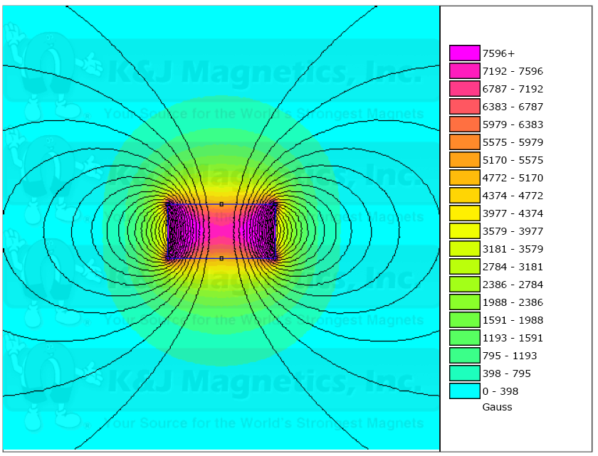
How to apply radial magnetic field?
Permanent magnet
CeYIG
1.6 mm
0.8 mm
CeYIG
Si
Si
Ring resonator
BOX
The diameter of the ring matches that of the cylinder magnet
- magnet: 1.6 mm
- ring: 1.8mm
Material of ring can be silicon (or SiN?)
Better quality of Ce:YIG can be bonded to ring resonator

Slide 4
Ring resonators with horizontal YIG film
Approach 1)
Wafer bond YIG-film on to Si ring resonators
Approach 2)
Fabricate a-Si ring resonators on the GGG substrate with YIG
GGG
Si
Si
a-Si
a-Si
BOX
GGG
YIG-Si bonding needs to be developed.
Low-loss a-Si waveguide is required.

Slide 5
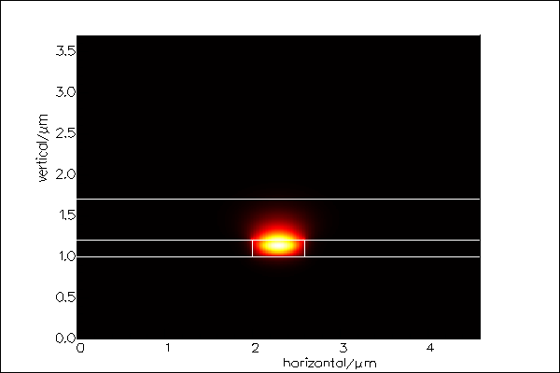
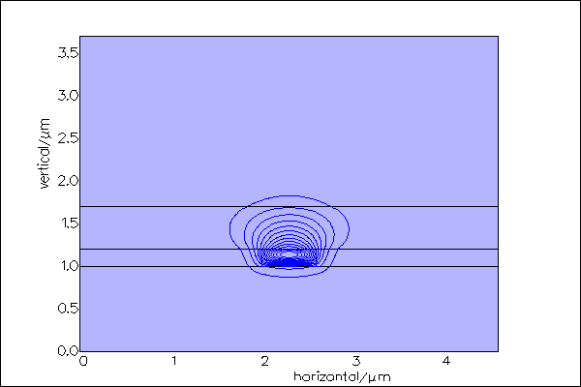
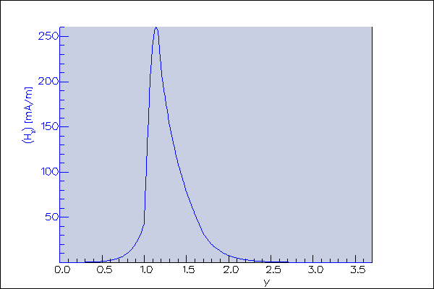
Ce:YIG bonded to SOI
A’
GGG
CeYIG
Si
BOX
A
A
A’
0.5um CeYIG on GGG substrate
Bond CeYIG to SOI Si waveguide
Si waveguide: 0.6um * 0.2um
Resonance wavelength split: 0.37nm

Slide 6
Faraday Effect
Resonance wavelength shift 0.37nm as Ce:YIG is 0.5 um thick
10X larger than that in Si disk

Slide 7
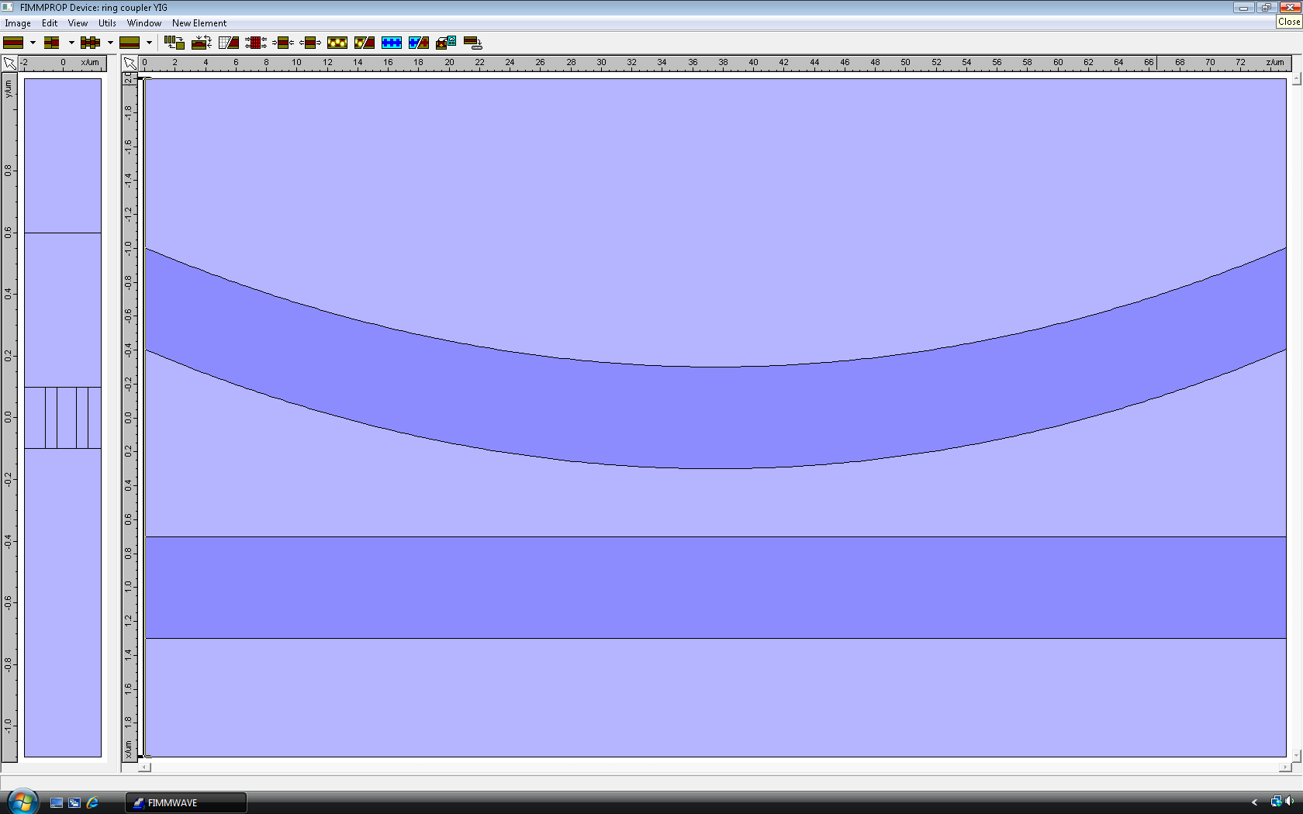
Coupling calculation by FIMMPROP
0.5um CeYIG on GGG substrate
Bond CeYIG to SOI Si waveguide
Si waveguide: 0.6um * 0.2um
Radius : 1 mm

Slide 8
Device layout
CeYIG on GGG
Magnet
1.8mm
5mm
4mm
1.6mm
4mm

Slide 9
Conclusions
Advantages:
> 10X wavelength split than that on Si disks
Better CeYIG quality because of lattice match, similar thermal expansion coefficient, and same crystal structure
Challenge:
Bonding between CeYIG and silicon waveguides
Potential issue:
A large ring is not a resonator anymore if the waveguide loss is too high (loss > 10 dB/cm for 1-mm-radius ring)

