Slide 1
Process Issues
03/01/12

Slide 2
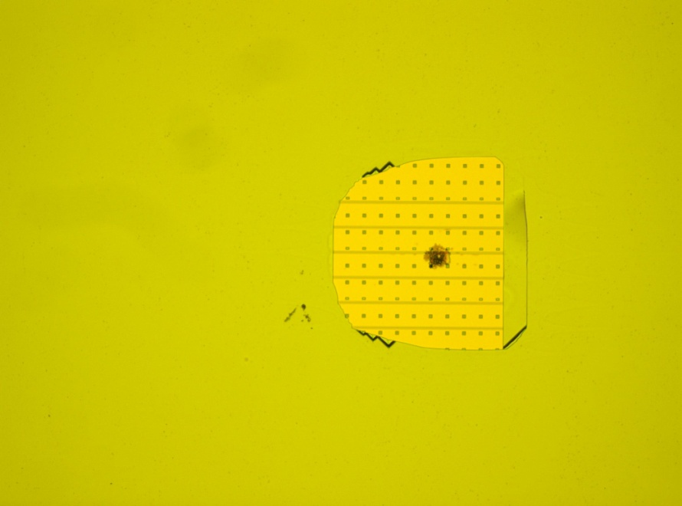
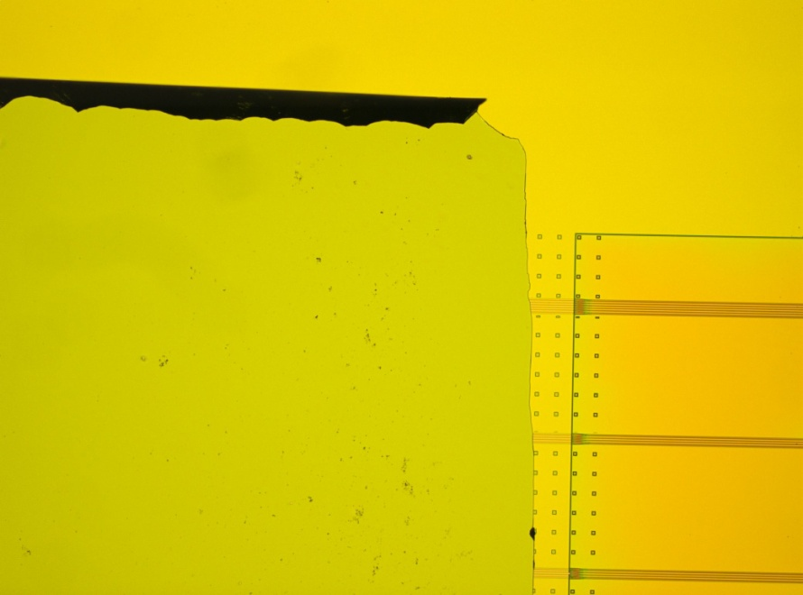
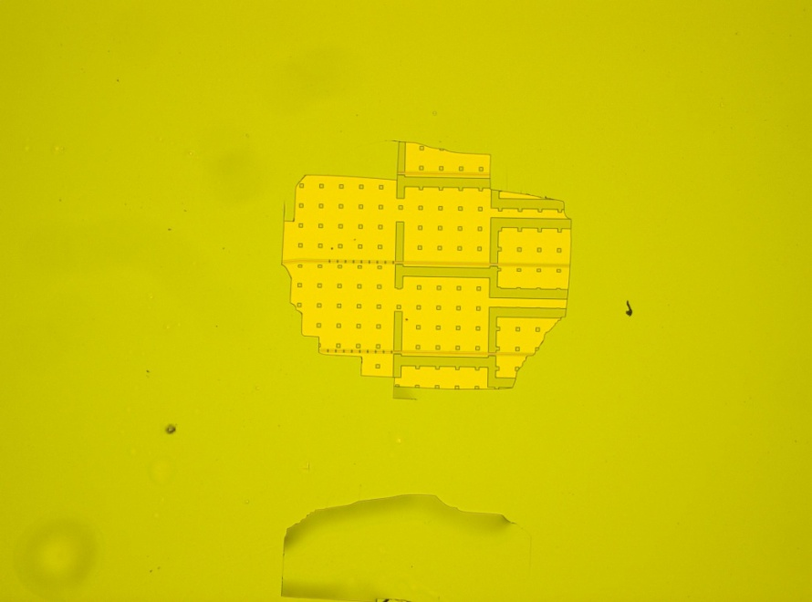
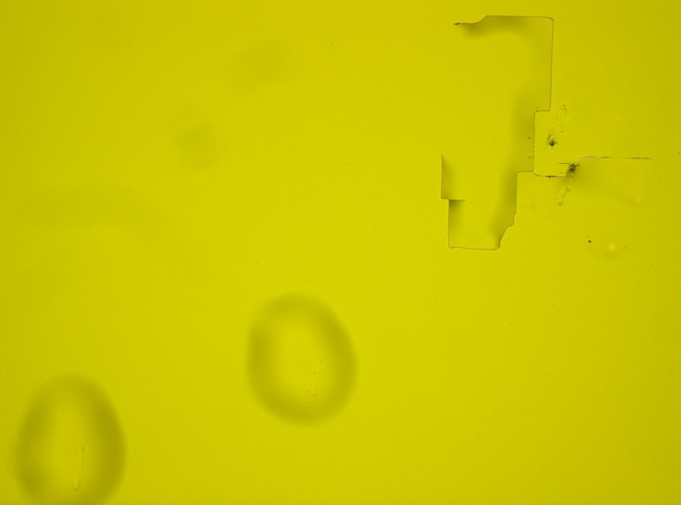
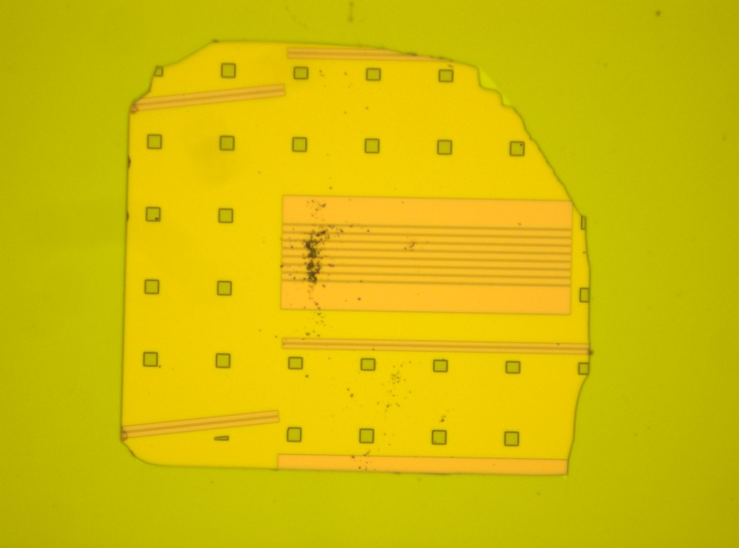
Post Bond and HCL etch S2A2 and S2A3
Mountains
Particle
Unknown
Particle/Contamination
Unknown, possibly scratch

Slide 3
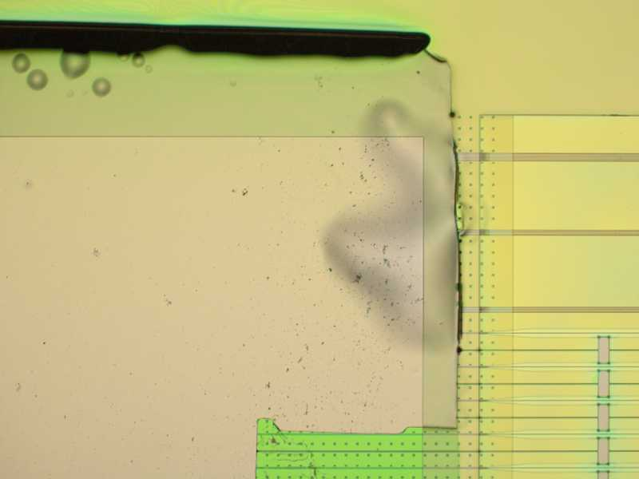
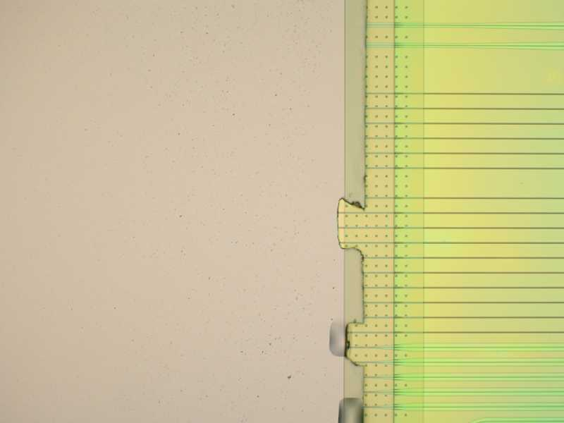
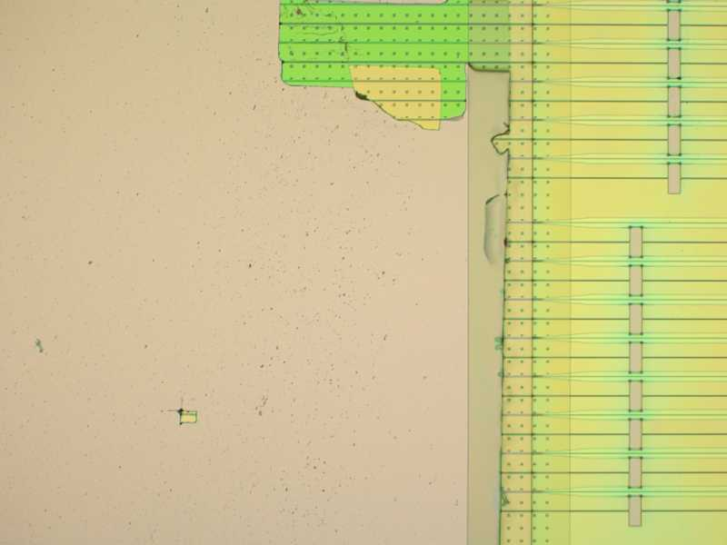
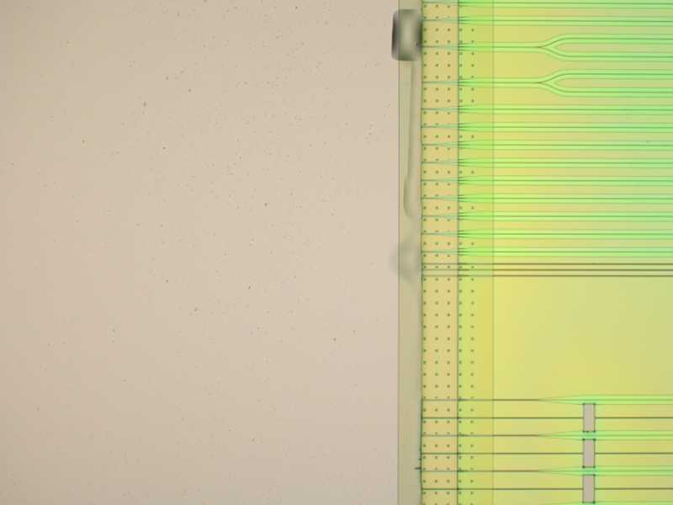
S2A2 Left Die at Gap Fill Litho
Resist Bubble
SPR 220 3 um Resist edges

Slide 4
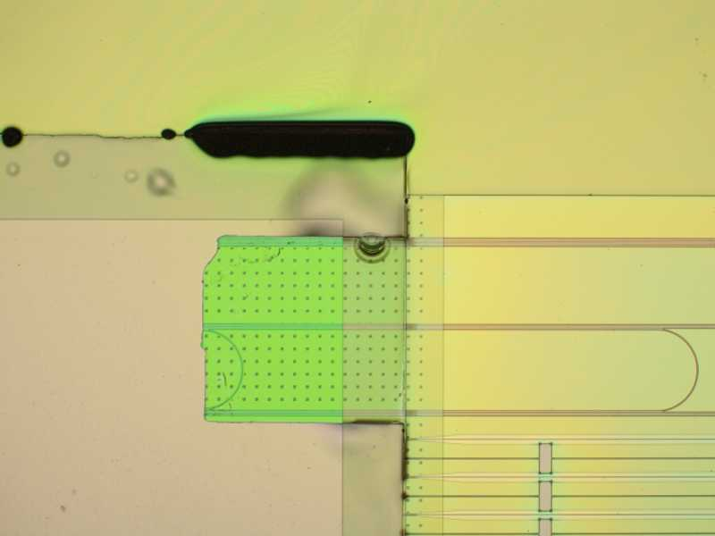
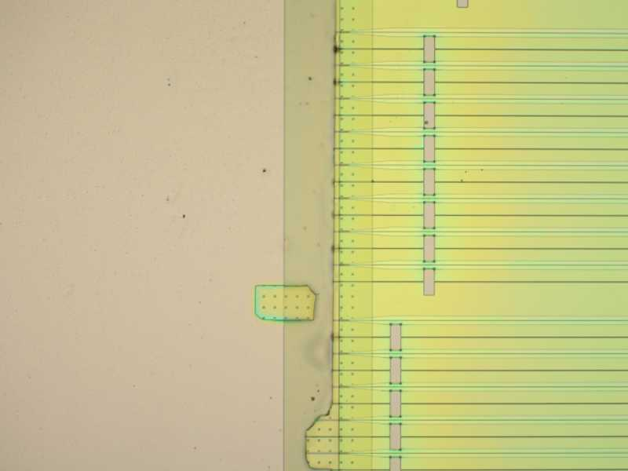
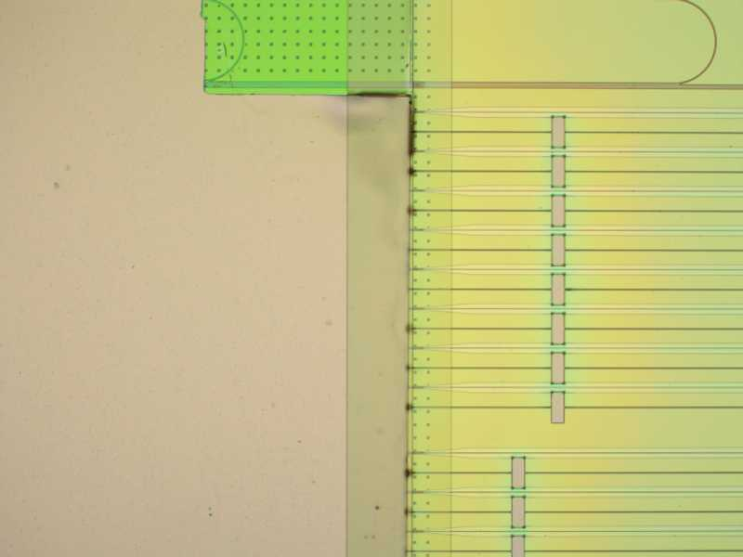
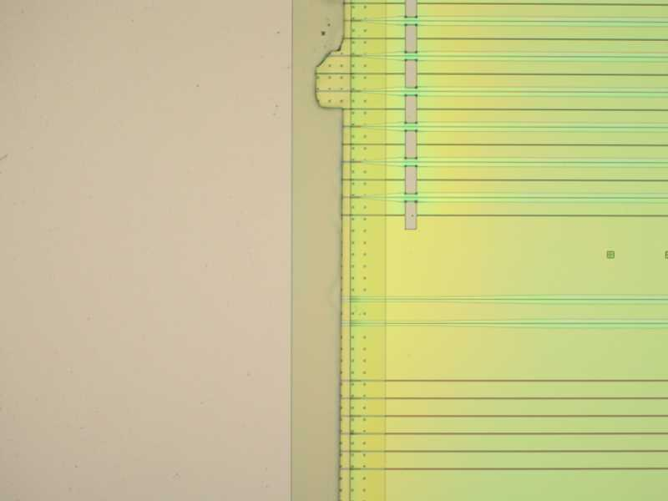
S2A2 Right Die at Gap Fill Litho

Slide 5
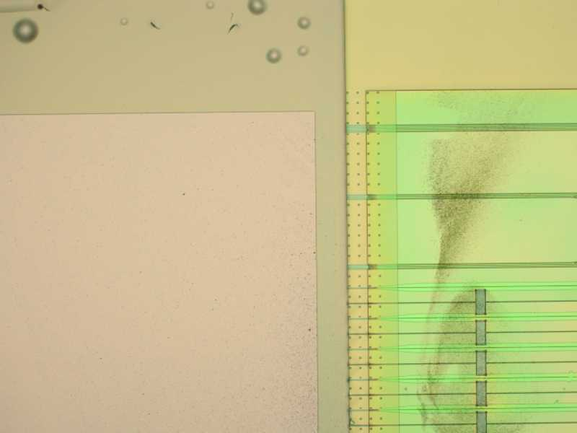
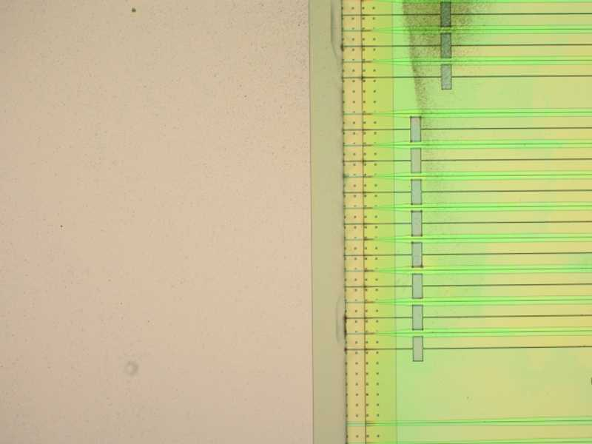
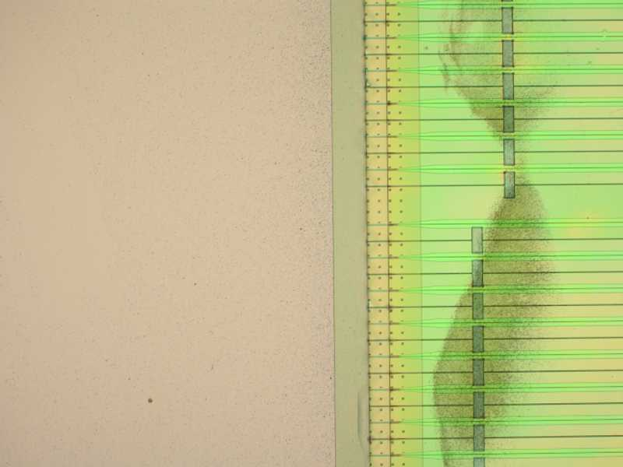
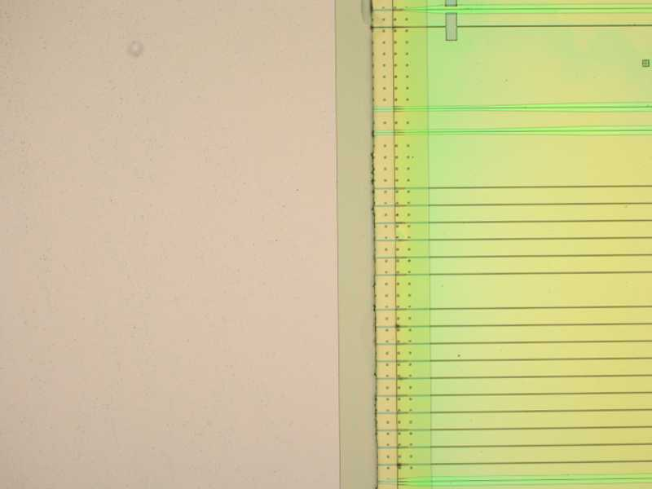
S2A3 Right at Gap Fill Litho
? Wax-Thinning residue

Slide 6
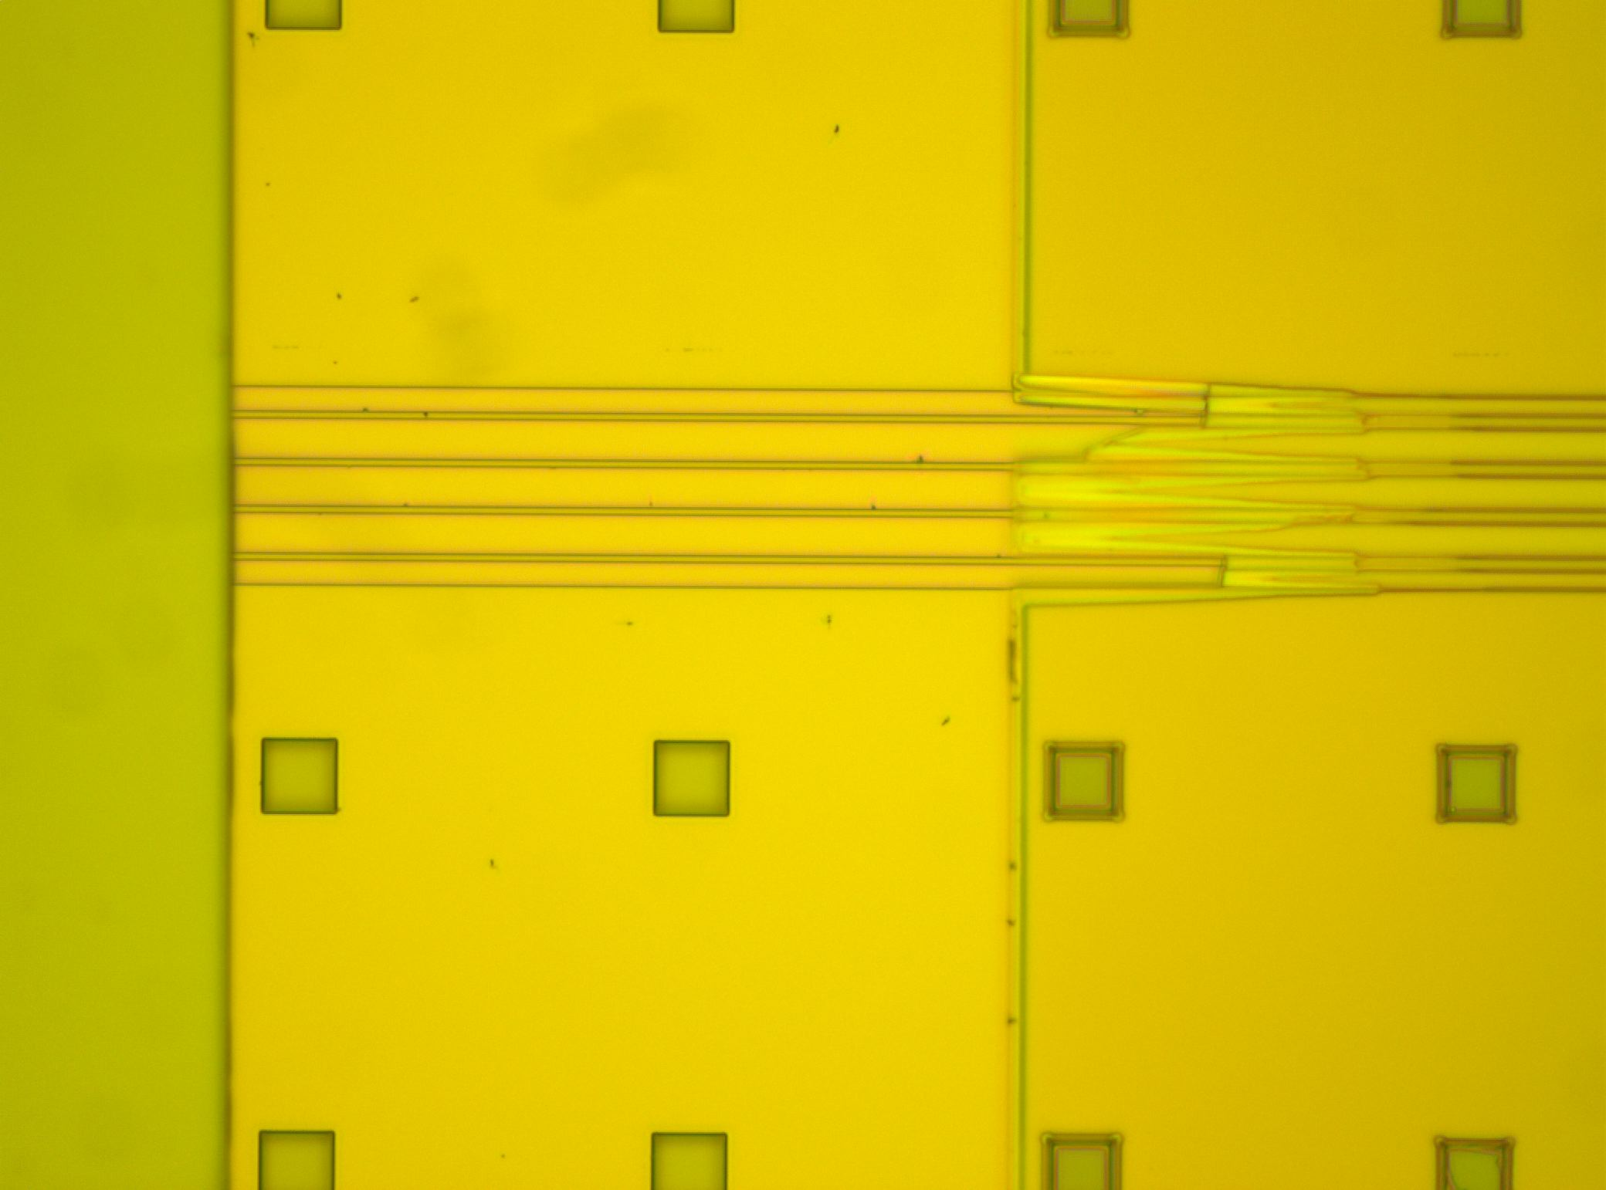
Post BHF Protection Layer
Etch Wicking (BHF under SiO2/SiN

Slide 7
Post Implant Strip
This is after 2.5 hours 1165 with 40 min Medium U/S, Acetone-ISO-DI and 1 Hour plus Piranha

Slide 8
Patterns to avoid?
Non Bonded Die
Bonded Die post HCl etch

Slide 9
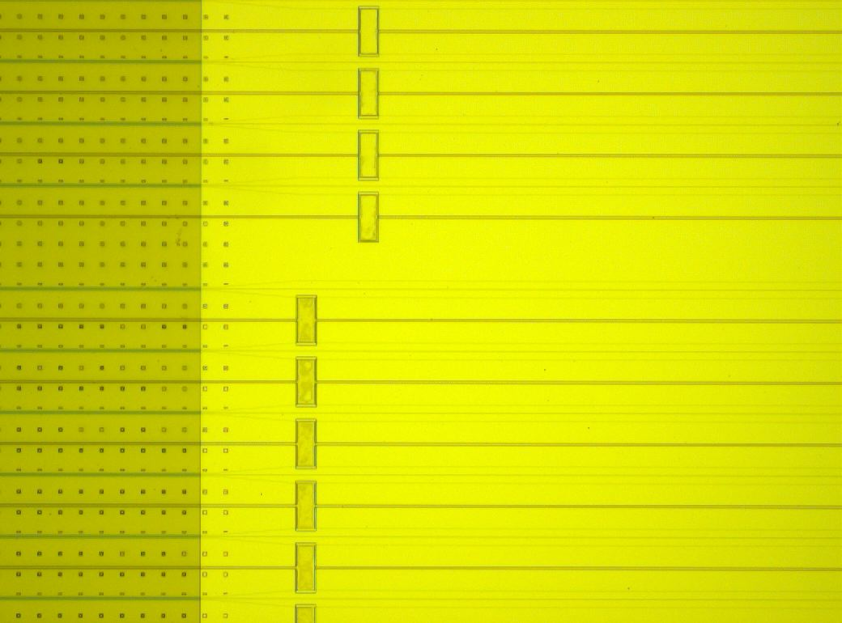
Deep Etched Features Resist Coverage
These Thermal Shunt areas are etched down to the BOX. Further BHF etches causes undercut and further etching of the BOX. Areas tend to form bubbles or noncoating issues during SPR 1.8 resist coating. This is seen at Ndope and Pdope lithography. Coating issues seem not to happen if HF dip done prior to coating but current process of 50nm SIO2 does not allow us to do this.

Slide 10
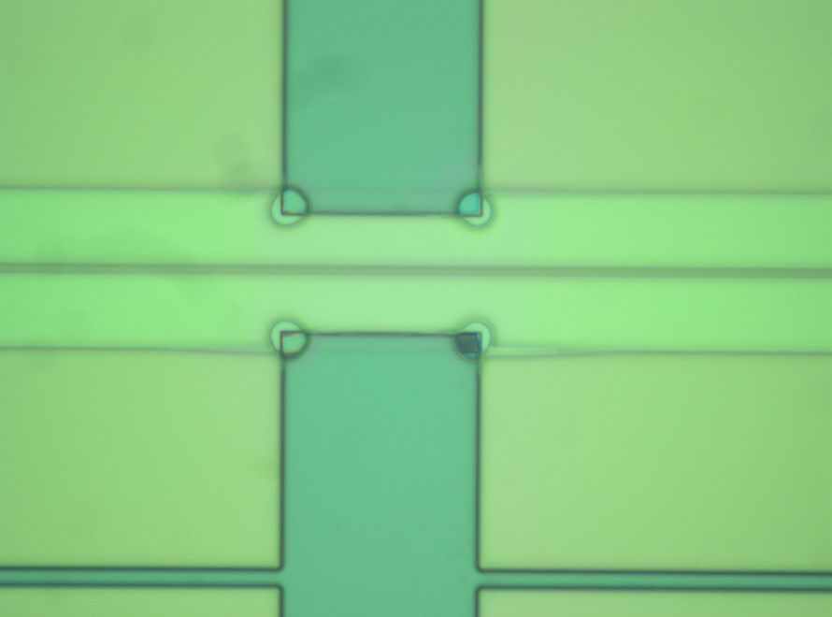
Resist coverage of Deep (~1um) corners

Slide 11
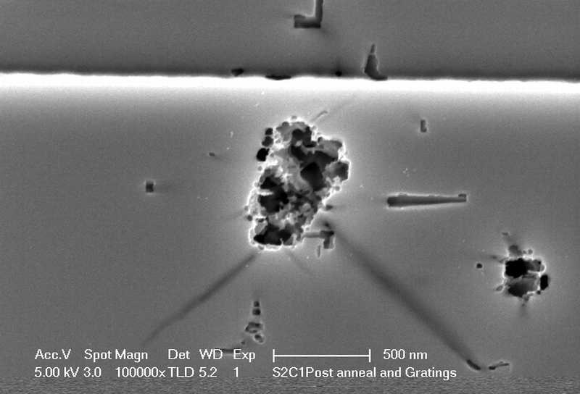
Silicon Defects Post Anneal

