Slide 1
2x2 E-PHI MMI Characterization
Geza Kurczveil

Slide 2
Chip layout
Passive WG
2x2 MMI (long ~300 μm)
11 devices, vary L in 5 μm steps
…
2x2 MMI (short ~100 μm)
11 devices, vary L in 2.5 μm steps
…
Straight facet (1.0 μm wide WG @ input)
no AR coating
Top cladding: air

Slide 3
Setup
ASE
DUT
BPF
PM
4 nm centered on 1550 nm

Slide 4
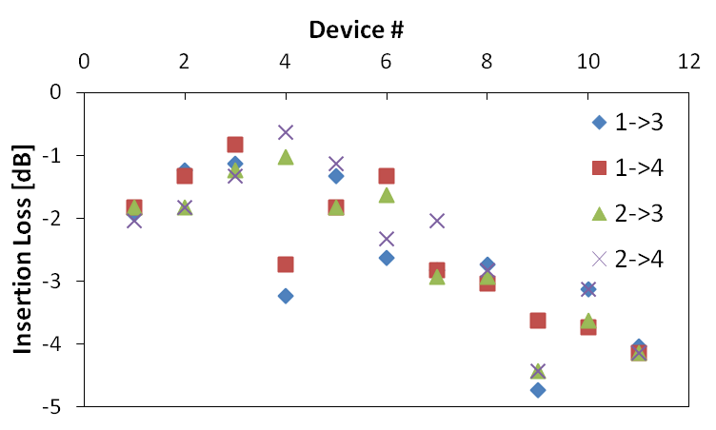
Long 2x2 MMIs
1
3
2
4
Device #4 has lowest insertion loss
Too few reference wageguides to be certain on absolute insertion loss

Slide 5
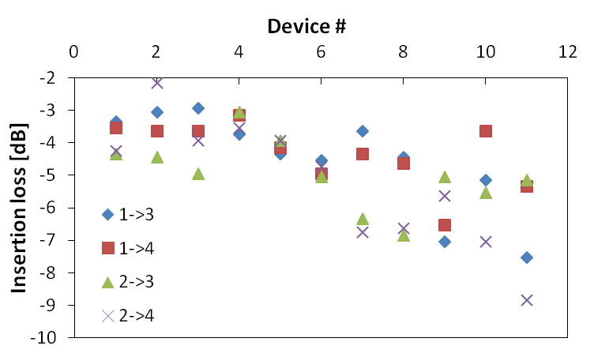
Short 2x2 MMIs
1
3
2
4
Device #3 or 4 has lowest insertion loss

Slide 6
Wa/W = 0.3 theoretically gives lowest imbalance and lowest insertion loss for 2x2 coupler.
Long design: Wa/W = 4/15 = 0.266
Short design: Wa/W = 2.5/9 = 0.277
Q: Why not always use Wa/W = 0.3?
A: For 2x2 coupler, access waveguides centered on W/3 and 2W/3. If Wa/W = 0.3, access WG separation is 0.033*W. Must be large enough to be resolved, and for light to not couple between WGs. This increases footprint.
Martin T. Hill et al., “Optimizing Imbalance and Loss in 2x2 3-dB Multimode Interference Couplers via Access Waveguide Width,” JLT 2003

