Slide 1
Optoelectronic Oscillators
X. Steve Yao and Lute Maleki (1996)
Presented by: Danielle Guerra
10/28/2011

Slide 2
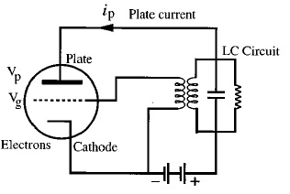
Oscillators
Convert energy from a continuous source to a periodically varying signal
Electronic Oscillator:
‘Van der pol oscillator’ invented by L. De Forest in 1912

Slide 3
Oscillator Theory
Oscillators can be modeled using linear feedback theory
+
+
A(s)
S_{i}(s)
S_{o}(s)
-
β(s)
$$\frac{S_{o}(s)}{S_{i}(s)}=\frac{A(s)}{1+β\left(s\right)A(s)}$$
If $1+β\left(s\right)A(s$) = 0, then $S_{o}$ can have a value without having an input S_{i}(s)! In other words the circuit oscillates, this is known as the Barkhausen criteria.

Slide 4
Types of Oscillators
Solid-state counterparts are pervasive in virtually every application of electronic devices
Limitations
Relatively noisy
Lack adequate stability and high spectral purity
Solutions: Add a high quality factor (Q) resonator
Mechanical (Quartz)
Electromagnetic (Dielectric cavities)
Electrical delay lines
Notes:
Q=2*pi*f*taud

Slide 5
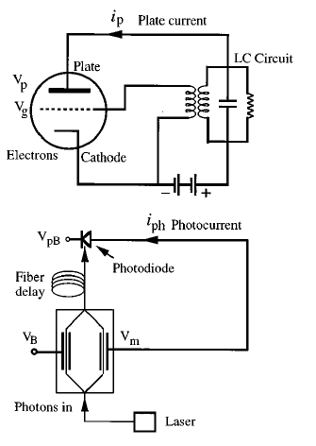
Types of Oscillators
Resonator of choice: Quartz
High-Q resonant modes are at low frequencies
Impractical for generation of high frequency signals
Alternative: Photonic Oscillator
Lower noise
Higher stability

Slide 6
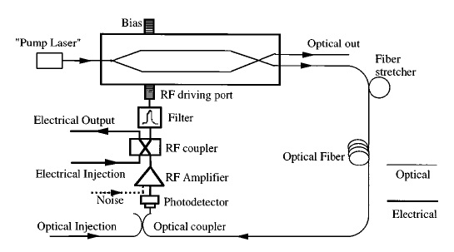
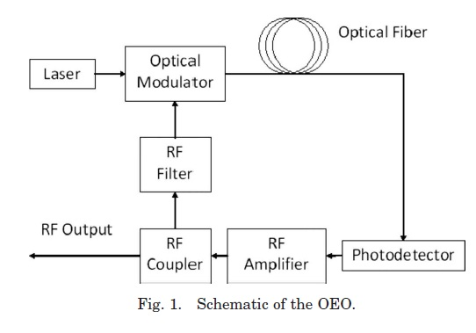
Optoelectronic Oscillator (OEO)
Yao-Maleki model (1996)
Notes:
Frequency determined by the fiber delay length, bias setting, and the bandpass characteristics of the filter
Conditions for self-sustained oscillations: coherent addition of partial waves each way around the loop, and loop gain exceeding losses for the circulating waves in the loop

Slide 7
Quasi-linear Theory of the OEO
Assumptions
Only concerned with final steady-state operation of OEO
Signal at any point in the OEO does not depend on time
Cannot take into account non-white noise sources
Limitations
Cannot take into account dynamical effects
Noise fluctuations
Mode-hopping between cavity modes
Temporal amplitude oscillations
Flicker noise (1/f) cannot be analyzed
Notes:
In order to study the dynamics and the noise of the OEO
Cannot use this model to study the start-up from noise

Slide 8
What do we need?
Need to know the open loop gain of the loop
Find out the condition under which the Barkhausen criteria will be met.
Introduce noise and analyze the effects

Slide 9
Quasi-linear Theory of the OEO
Open-loop characteristics (Gain)
Modulator’s transfer function
Photodiode power-current relationship
Small-signal open-loop gain
Oscillation threshold voltage
Close loop/invoke the quasi-linear theory (Barkhausen)
Include the filter in the loop
Amplitude and frequency of oscillation
Expression for spectral density
Dominated by phase noise

Slide 10
Analyzing open-loop characteristics
Modulator’s power to voltage relationship
Photodiode’s voltage to power relationship
Small-signal open-loop gain of OEO

Slide 11
Analyzing open-loop characteristics
Oscillation threshold
Note: Amplifier in loop is not a necessary condition for oscillation.
Optical power from the pump that supplies the necessary energy for oscillation.
Reduce noise by removing the electrical amplifier.

Slide 12
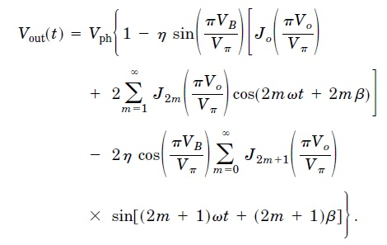
Closing the loop
Open-loop transfer function is non-linear.
To linearize, assume the input is sinusoidal with no harmonics and expand with Bessel functions

Slide 13
Closing the loop
To ensure linearity, signal must pass through a narrow enough filter to eliminate harmonic components
Even though gain is non-linear, we can still recover the small signal gain if we assume the V₀<<V_{π} by a Taylor’s series expansion.

Slide 14
Including frequency dependence
In general, there is dependence on the frequency of the RF input signal
Complex form of transfer function
Nonlinear effect of the modulator is not lost—it is contained in nonlinear gain coefficient G(V_{o})

Slide 15
Oscillation frequency/amplitude
Noise transient viewed as a collection of sine waves with random phases and amplitudes
Superposition holds—sufficient to analyze response to a single frequency component
After circulating the loop, recurrence relation is:
Total field at any instant of time is the summation of the circulating fields.

Slide 16
Oscillation frequency/amplitude
Signal measured at the RF input:
Frequency response of OEO has equally spaced peaks similar to that of a Fabry-Perot resonator

Slide 17
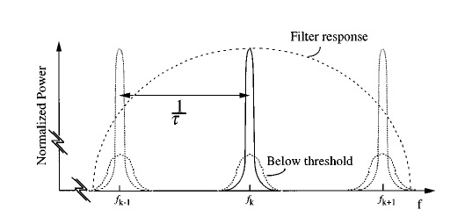
Oscillation frequency/amplitude
These peaks are located at:

Slide 18
Oscillation frequency/amplitude
Assume only one mode, k, is allowed to oscillate
Oscillation frequency:
Oscillation power:
To get oscillation amplitude, set gain coefficient to unity

Slide 19
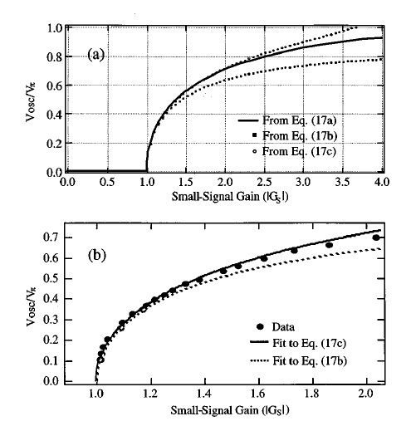
Oscillation frequency/amplitude
Approximations
Third-Order:
Fifth-Order:

Slide 20
Oscillation frequency/amplitude
Corresponding oscillation frequency
Oscillation frequency depends on the biasing polarity of the modulator

Slide 21
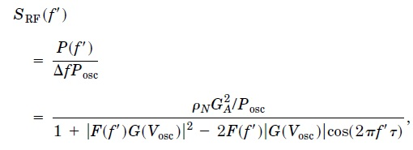
Spectrum
Fundamental noise:
Thermal noise
Shot noise
Laser’s intensity noise
Compute spectrum of oscillator by determining PSD of noise in the oscillator

Slide 22
Spectrum
After normalizing:
Assumed the spectral width of oscillating mode is much smaller than the mode spacing of the oscillator
Assumed that |F(f’)|=1 in the frequency band of integration
Using typical values, closed-loop gain is just under one, so the assumption for V_{osc} is accurate
To get the RF power spectral density in terms of noise-signal ratio, substitute into previous PSD equation

Slide 23
Spectrum
Case when 2πf’τ <<1, simplify by Taylor’s expansion
Lorentzian function of frequency with full width half-maximum at
Quality factor of the oscillator

Slide 24
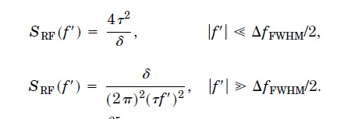
Spectrum
From the PSD we can approximate the spectrum in two different frequency ranges
Phase noise decreases quadratically with the frequency offset
For a fixed offset, phase noise decreases quadratically with the loop delay time
Oscillator phase noise is independent of the oscillation frequency!

Slide 25
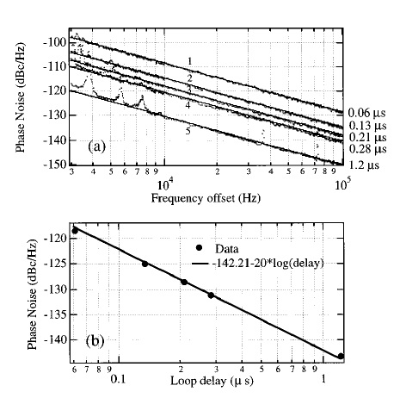
Measurements
Phase Noise as Function of Offset Frequency and Loop Delay

Slide 26
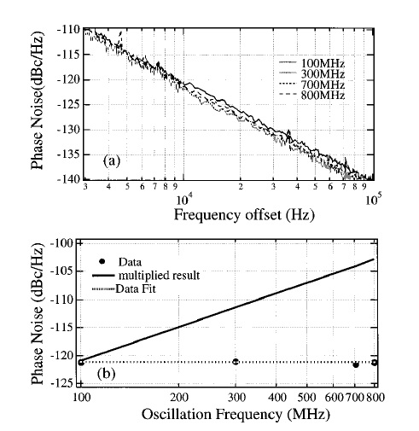
Measurements
Phase Noise Independence on Oscillation Frequency

Slide 27
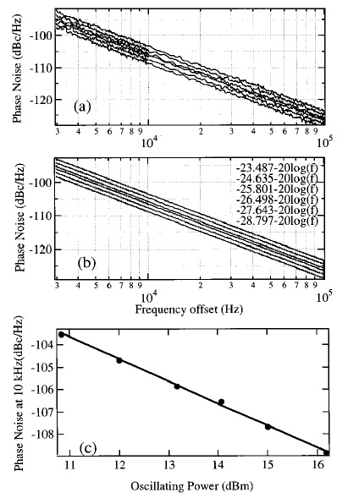
Measurements
Phase Noise as a Function of Oscillation Power

Slide 28
Conclusion
OEO features
High-frequency
High-stability
High spectral purity
Widely tunable oscillator
Model developed can be used to analyze other modulation schemes
Many applications
VCO-Voltage controlled oscillator
High-frequency carrier generation
High-speed clock recovery
Photonic RF systems
More ….

