Slide 1
RAINBOW 2.1um Directional Coupler Simulations
Eric Stanton
06/26/2013

Slide 2
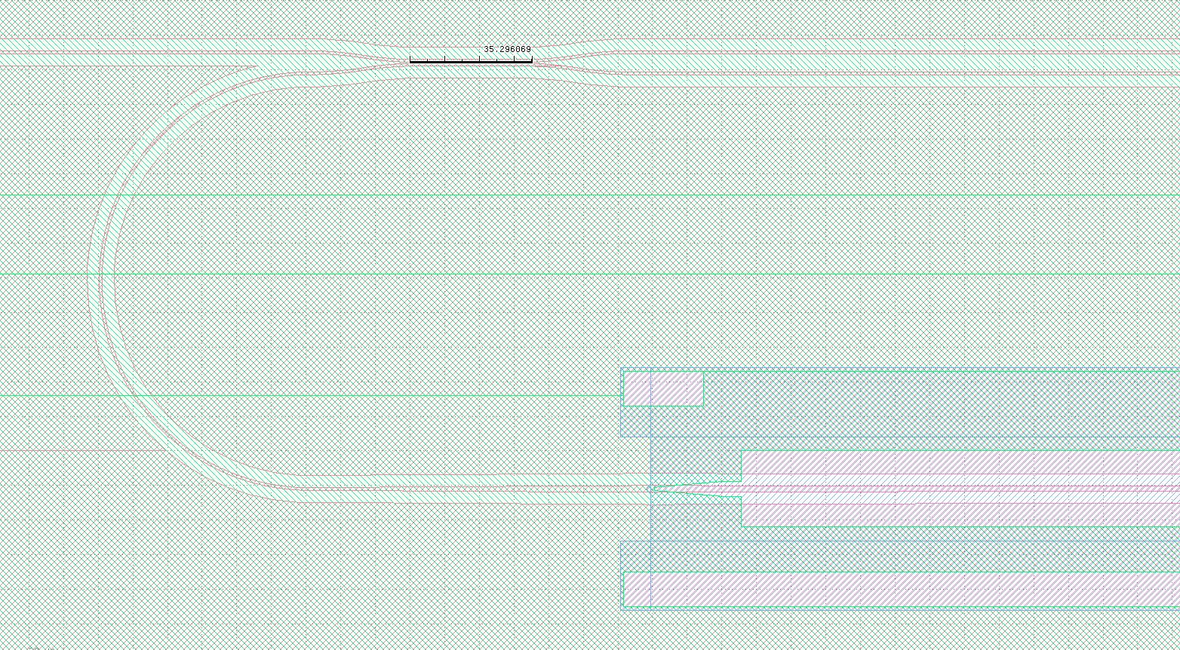
Simulation Parameters
0.5um Si on Si0₂
Etch depth: 0.3um
Center-to-center wg spacing: 0.55um and 6.65um

Slide 3
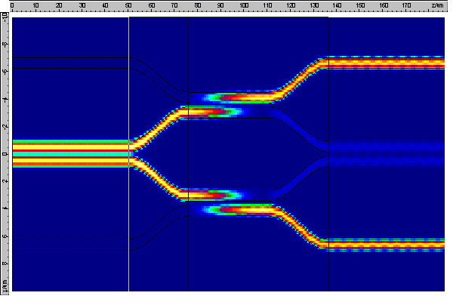
Length: 35um (5 on the mask)

Slide 4
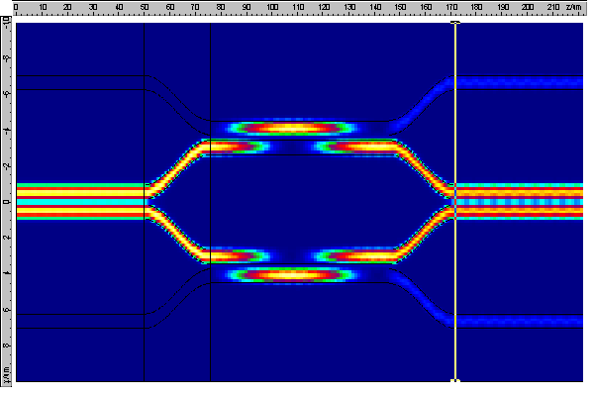
Length: 70um

Slide 5
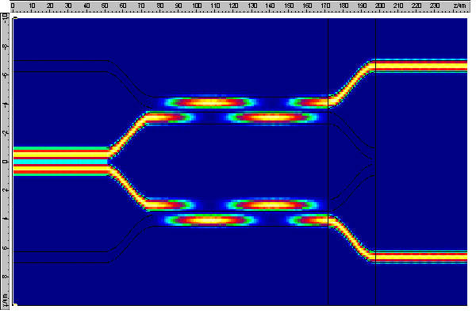
Length: 96um (not on the mask!)

Slide 6
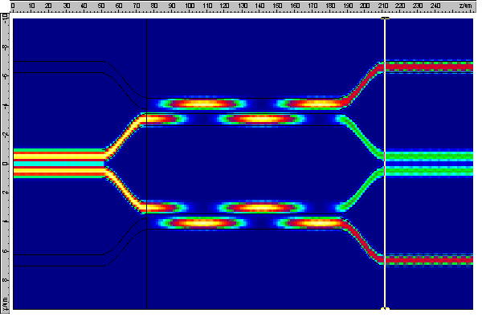
Length: 110um

