Slide 1
SiP Meeting – Isolator
Jason
2/16/2010

Slide 2
Process flow –post LioniX
`
`
Si3N4/SiO2 waveguides
Pattern Cr as hardmask
`
`
`
`
`
Sputter Ce:YIG or BIG magnetic material
Deep etch SiO2 and strip Cr hardmask

Slide 3
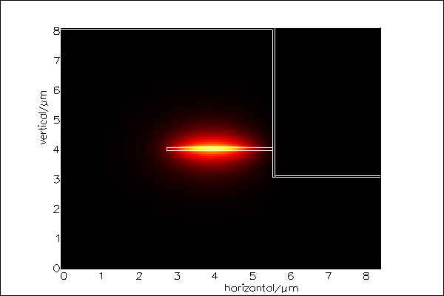
Optical mode profile
SiN core: 80nm
SiO2 cladding: 4um
Etch depth : 5um
Ce:YIG
Film thickness: 50nm
Magnetic film
5um
Si₃N₄ core
SiO₂ cladding

Slide 4
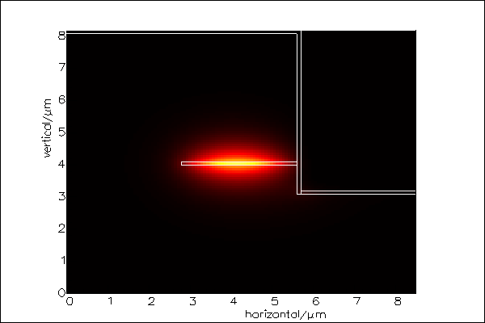
Optical mode profile
SiN core: 80nm
SiO2 cladding: 4um
Etch depth : 5um
Ce:YIG
Film thickness: 100nm

Slide 5
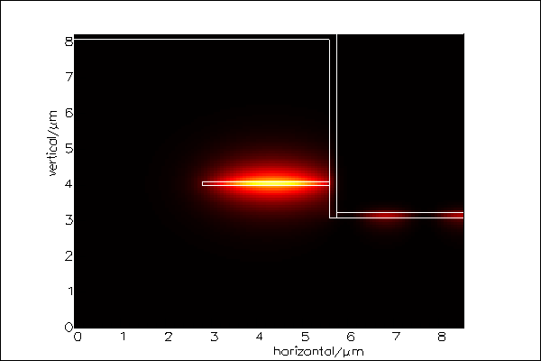
Optical mode profile
SiN core: 80nm
SiO2 cladding: 4um
Etch depth : 5um
Ce:YIG
Film thickness: 150nm

Slide 6
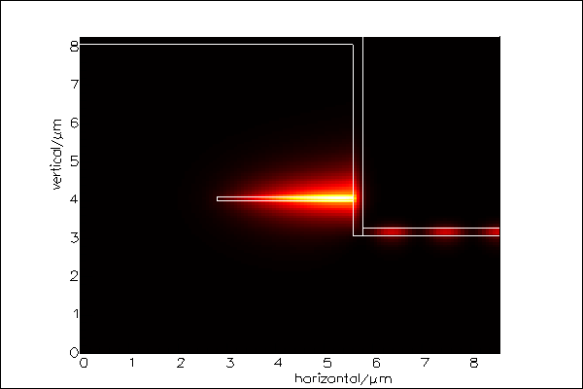
Optical mode profile
SiN core: 80nm
SiO2 cladding: 4um
Etch depth : 5um
Ce:YIG
Film thickness: 200nm

Slide 7
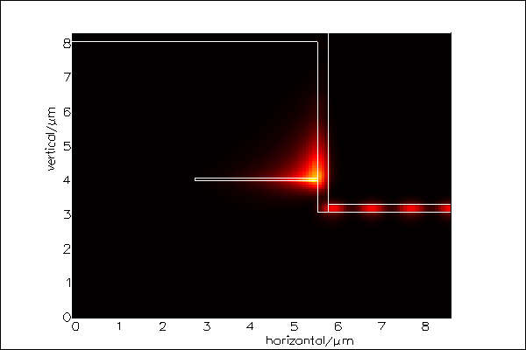
Optical mode profile
SiN core: 80nm
SiO2 cladding: 4um
Etch depth : 5um
Ce:YIG
Film thickness: 250nm

Slide 8
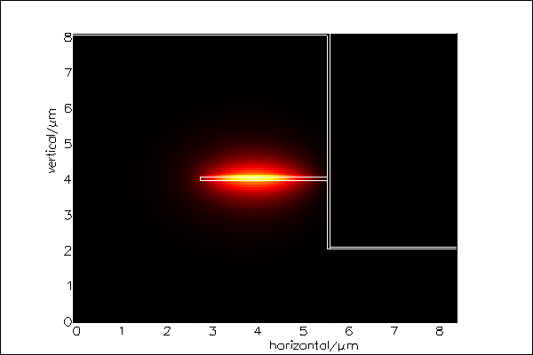
Optical mode profile
SiN core: 80nm
SiO2 cladding: 4um
Etch depth : 6um
Ce:YIG
Film thickness: 50nm
Magnetic film
6um
Si₃N₄ core
SiO₂ cladding

Slide 9
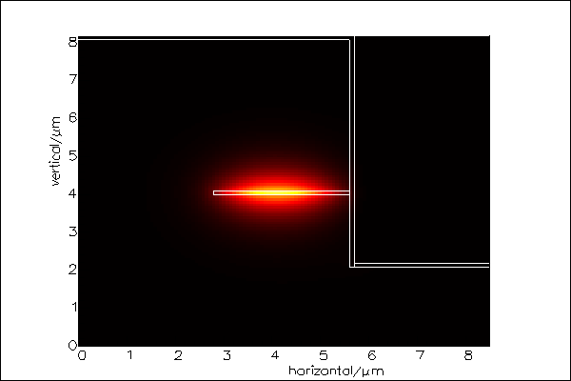
Optical mode profile
SiN core: 80nm
SiO2 cladding: 4um
Etch depth : 6um
Ce:YIG
Film thickness: 100nm

Slide 10
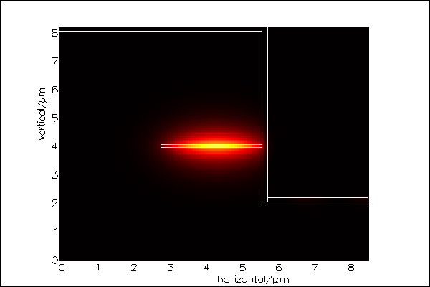
Optical mode profile
SiN core: 80nm
SiO2 cladding: 4um
Etch depth : 6um
Ce:YIG
Film thickness: 150nm

Slide 11
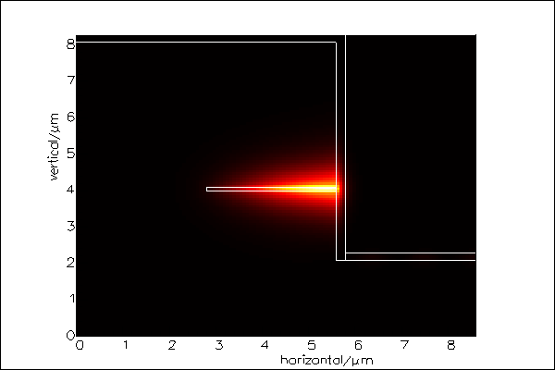
Optical mode profile
SiN core: 80nm
SiO2 cladding: 4um
Etch depth : 6um
Ce:YIG
Film thickness: 200nm

Slide 12
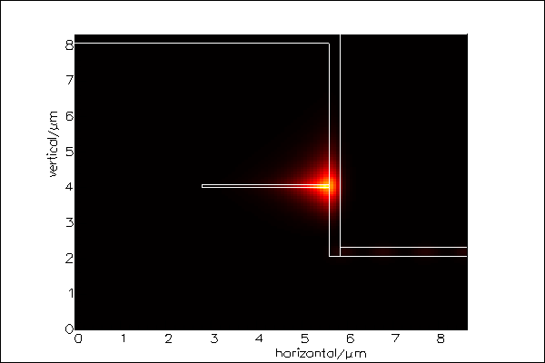
Optical mode profile
SiN core: 80nm
SiO2 cladding: 4um
Etch depth : 6um
Ce:YIG
Film thickness: 250nm

Slide 13
Optical modes in Si₃N₄ waveguides
Magnetic film
Magnetic film thickness : 150 nm
Si₃N₄ core
5 um etch
6 um etch
Thicker magnetic film will suck optical field from Si₃N₄ (n=2) core to Ce:YIG (n=2.22) layer.
Shallower etch causes leak mode to the horizontal magnetic film, which doesn’t contribute to Faraday effect but extra optical loss!

Slide 14
Design plot for magnetic film thickness
MO material : Ce:YIG
refractive index =2.22
Loss: 20 cm-1

Slide 15
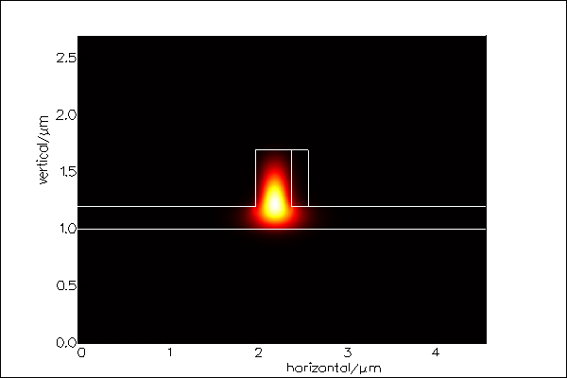
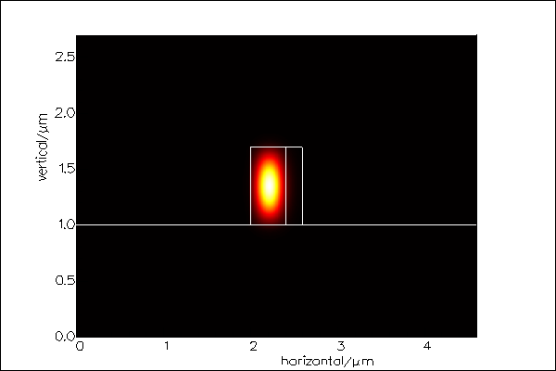
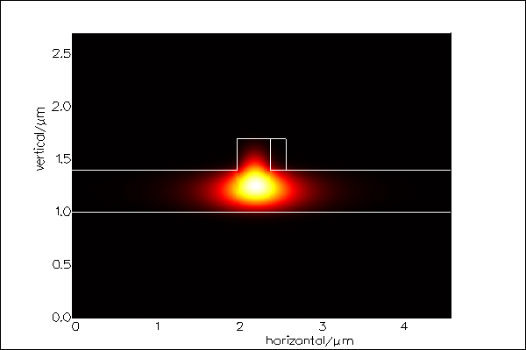
Design of Si waveguide
W
H=0.7um
Ce:YIG
Slab height
MO material : Ce:YIG
refractive index =2.22
Loss: 20 cm-1
thickness: 200nm

Slide 16
Comparison between confinement factor and wavelength splitting
Analytic calculation
(rectangular waveguide like)
FIMMWAVE calculation
W=0.3um
W=0.4um
W=0.5um
W=0.6um

Slide 17
Process plan
Ce:YIG target will arrive this week.
Material sputtering test
X-ray diffraction
Deep oxide etch
Photomask design
Etch test using Cr as hardmask

