Slide 1
Heterogeneous Integration for Reduced Phase Noise and Improved Reliability of Semiconductor Lasers
Sudharsanan Srinivasan
Ph.D. Defense
Electrical and Computer Engineering Department
University of California, Santa Barbara

Slide 2
Outline
Preview
Introduction
Lowering phase noise of:
Mode locked lasers
Tunable lasers
Reliability of hybrid silicon DFB lasers
Conclusion and Future Work

Slide 3
Outline
Preview
Introduction
Lowering phase noise of:
Mode locked lasers
Tunable lasers
Reliability of hybrid silicon DFB lasers
Conclusion and Future Work

Slide 4
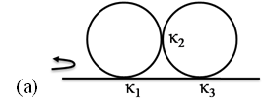
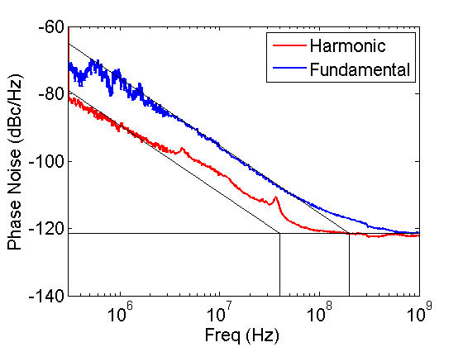
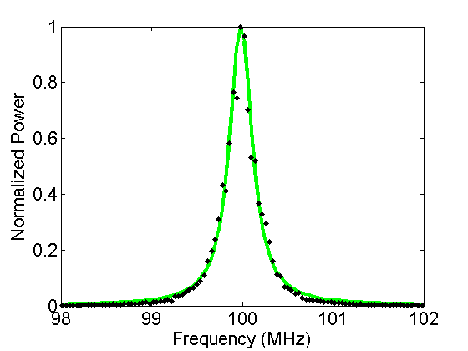
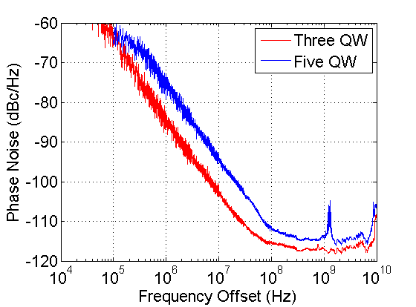
Mode-locked Lasers
Tunable Lasers
14dB phase noise reduction
Linewidth → 160kHz
8dB phase noise reduction
Linewidth → <100kHz

Slide 5
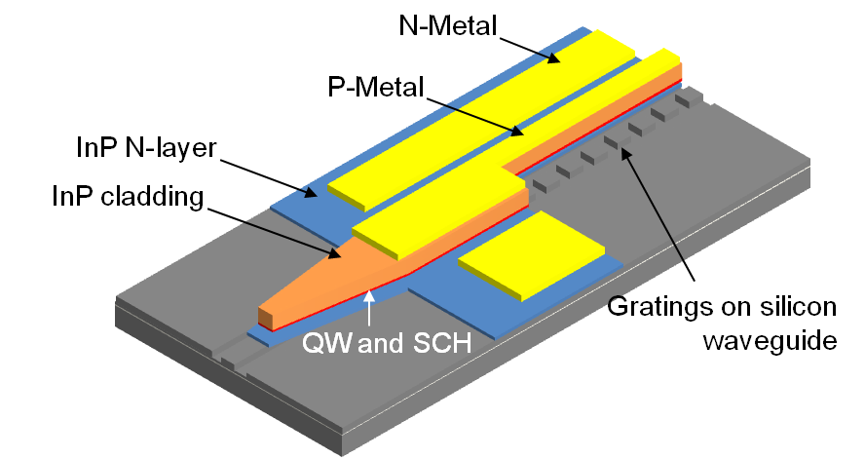
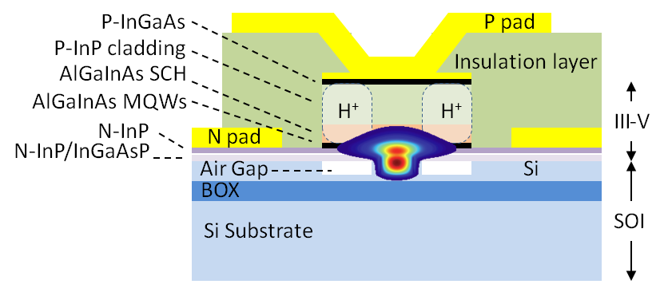
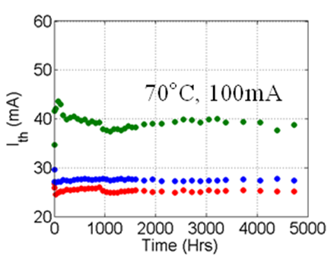
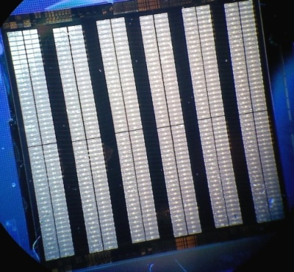
Evanescent coupling for gain/loss
Transition to silicon guides
Processed die of 300 DFB lasers
MTTF >40000 hrs

Slide 6
Outline
Preview
Introduction
Lowering phase noise of:
Mode locked lasers
Tunable lasers
Reliability of hybrid silicon DFB lasers
Conclusion and Future Work

Slide 7
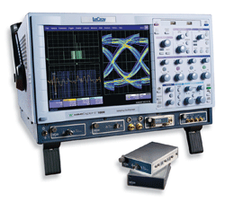
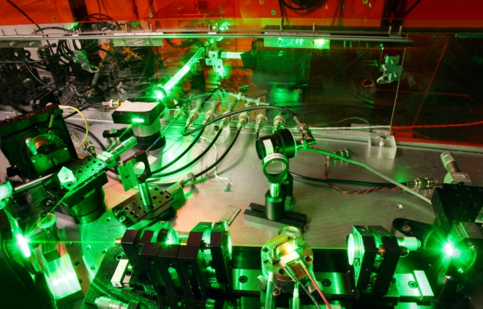
Introduction
High speed & high ENOB ADC
Spectral efficiency in telecom
Low phase noise
microwave and laser sources
High Speed Communications
Sensing
Metrology
Spectroscopy
Frequency standards
Wind LIDAR
Oil & Gas Sensing
Pipeline Monitoring
Notes:
Thermal, mechanical and acoustic sensors.

Slide 8
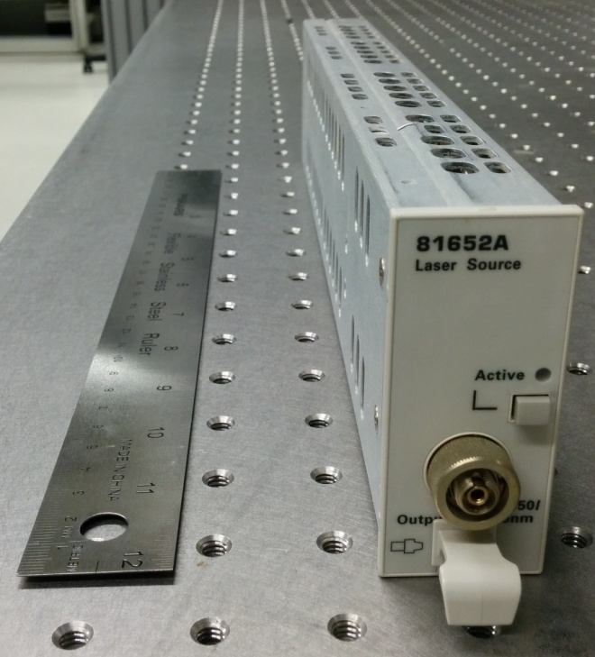
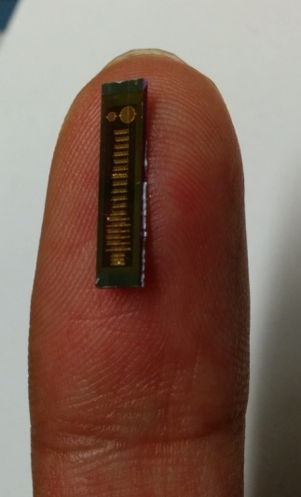
Introduction
Low phase noise microwave and laser sources
Requirements
Low cost
Small Size
Mechanically stable
Low power consumption
Enabled by INTEGRATION!
Notes:
Thermal, mechanical and acoustic sensors.

Slide 9
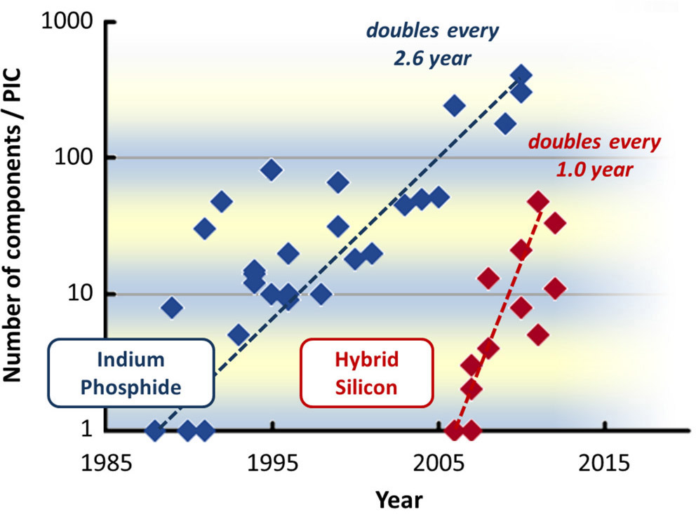
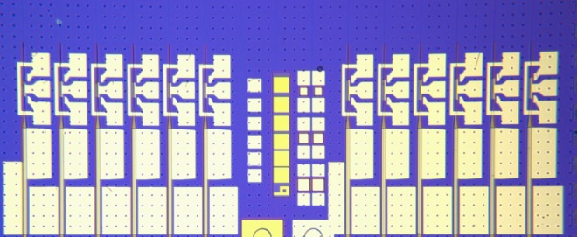
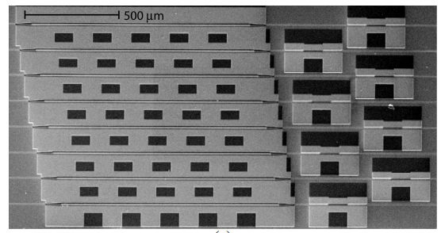
Introduction
Silicon Photonics
InP Photonics
Ultra-small size
Low cost
Convergence with electronic devices
Lasers, optical amplifiers
Wavelength conversion
Ultra-fast modulators and switches
Hybrid Silicon Platform
DFB/EAM/PD Array
Optical preamplifier PD array
Optical buffer
Hybrid Silicon Photonic Integrated Circuit Technology
M. J. R. Heck et al. JOURNAL OF SELECTED TOPICS IN QUATUM ELECTRONICS, vol. 19(4), 2013.

Slide 10
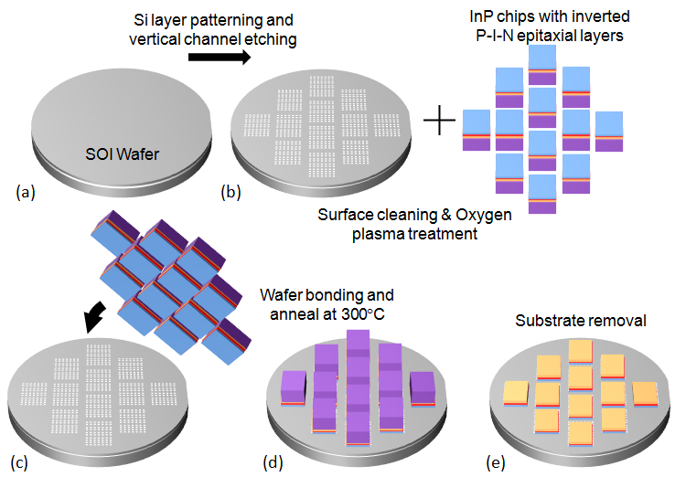
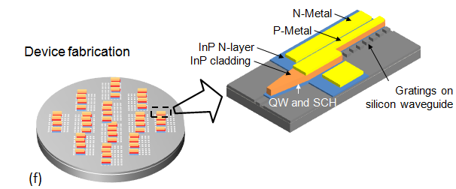
Introduction
Cross-section of
the hybrid laser
Heterogeneous Integration of III-V material to Silicon

Slide 11
Outline
Preview
Introduction
Lowering phase noise of:
Mode locked lasers
Tunable lasers
Reliability of hybrid silicon DFB lasers
Conclusion and Future Work

Slide 12
Phase Noise of an Oscillator
Ideal Oscillator
Real world Oscillator
Semiconductor Laser Linewidth
Frequency
Frequency
Time
Time
Total Oscillator noise is the sum of amplitude and phase noise.
Close to the true carrier frequency phase noise dominates.
ASE is dominant source of noise in semiconductor lasers.

Slide 13
Noise Dilution - Analogy
W₁
W₂
A
B
A
B
For a fixed W₁

Slide 14
Current Injection Semiconductor Laser
Input current
Carrier leakage
Spontaneous emission into other wavelengths
Non-radiative recombination
Carrier Density (N)
Spontaneous emission into lasing mode
Stimulated emission into lasing mode
Absorption
Photon Density of Lasing Mode (N_{p})
Laser output
Photon density →Carrier density
ΔN_{p}→ ΔN

Slide 15
Negative Optical Feedback
Mirror reflectivity
Δν_{FR}
Δν_{o}
Frequency
Δν_{FB}
β
Frequency →Mirror reflectivity/Feedback strength →Photon density →Carrier density →ref. index → Frequency
Δν →ΔR→ ΔN_{p}→ ΔN→ Δn→ Δν

Slide 16
ASE Noise Dilution
W₁
A
B
Laser confinement factor
W₂
A
B
L
W
t
N Wells
Carrier confined volume
L_{x}
Optical mode volume
L_{y}
L_{z}

Slide 17
Long Laser Cavity
Fundamental cavity
Harmonic cavity
Linewidth reduction is inversely proportional to the square of the cavity length.
Short cavity
Cavity loss
Long cavity
<α_{i}> → internal loss

Slide 18
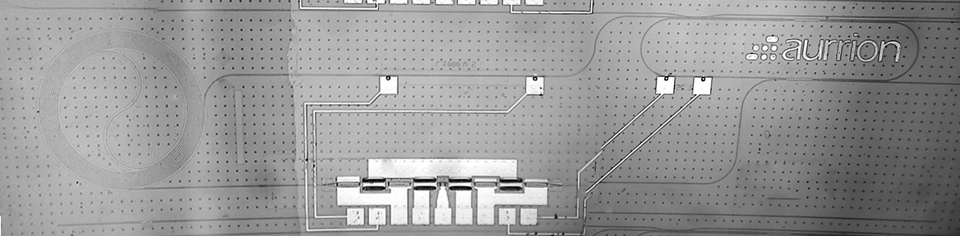
Harmonic Cavity Mode-Locking
Directional coupler
90:10
4cm cavity length
Multi-Mode
Interference
Coupler – 50:50
50μm absorber
1.5mm
7mm

Slide 19
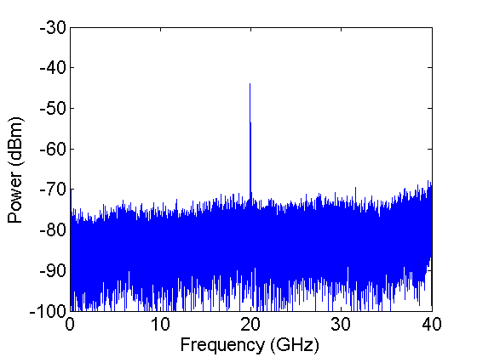
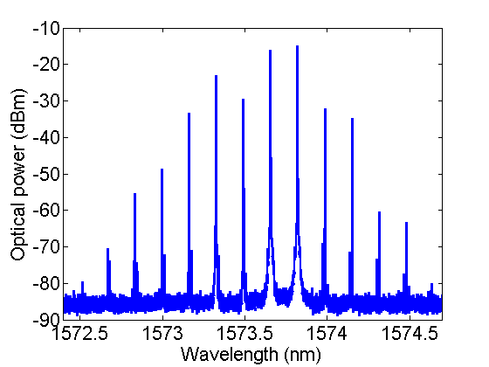
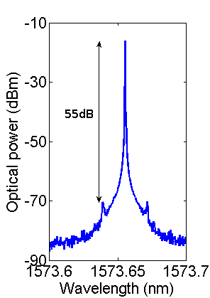
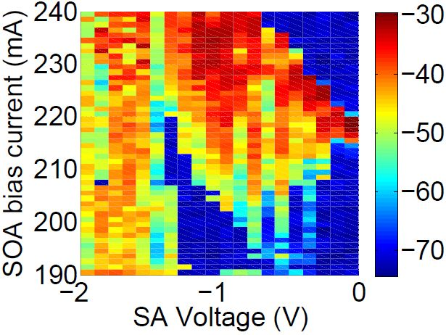
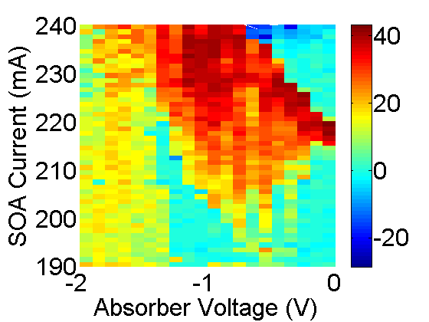
Characterization
Electrical
spectrum
RBW-3MHz
Optical
spectrum
RBW-20MHz
RF Peak Power
SMSR
SOA current: 220mA
SA voltage: -0.5V

Slide 20
Optical Linewidth
Fundamental cavity
Harmonic cavity
DUT
ESA
Fiber Laser
OSA
10x
Linewidth improvement 10MHz → 1MHz (10x)

Slide 21
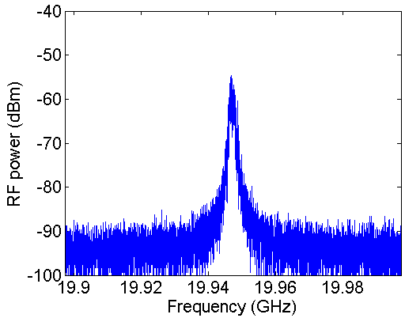
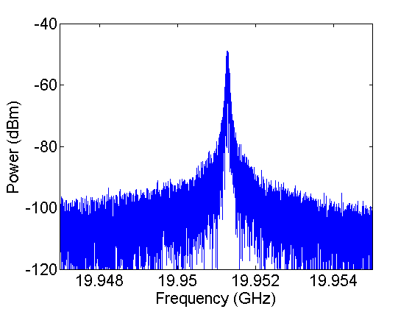
Microwave Linewidth
Fundamental cavity
Harmonic cavity
SOA lengths 900μm and 1.4mm respectively.
Absorber length 50μm in both cases
20G cavity –
188mA, 0 V
2G cavity with filter -220mA, -0.5V
Linewidth improvement – 1.5MHz → 52kHz (30x)

Slide 22
Microwave Phase Noise
Fundamental cavity
Harmonic cavity
Passive locking
Integrated jitter (100kHz→100MHz)
reduced from 4.3ps to 1.3ps
14dB
5x

Slide 23
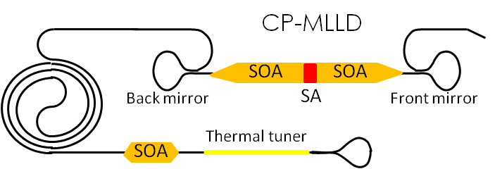
Coupled Cavity Mode-Locking
Advantages
Lower threshold
Better slope efficiency
Laser acts as the filter
Δν
L_{e}
0
1/2α

Slide 24
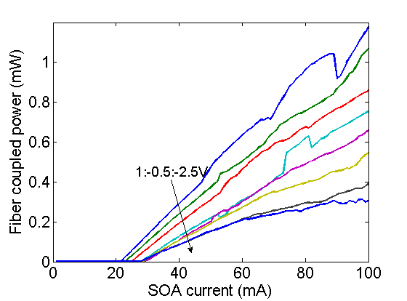
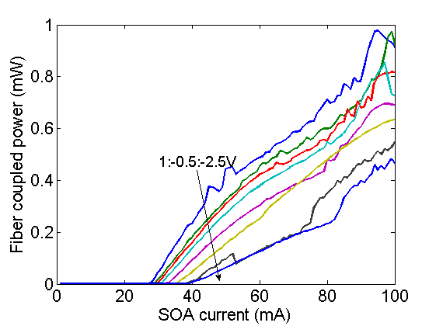
Transverse Confinement
Laser confinement factor
Reduce number of MQW to reduce transverse confinement
Three QW
Five QW

Slide 25
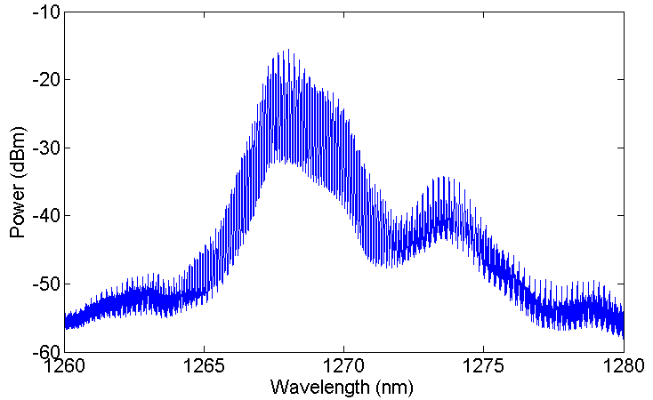
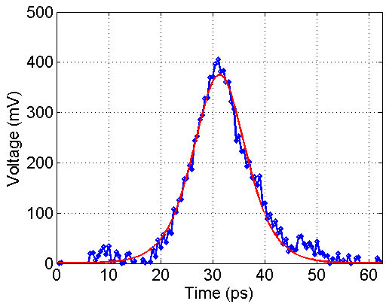
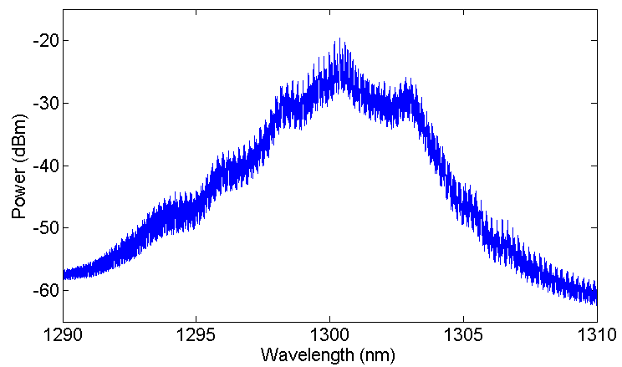
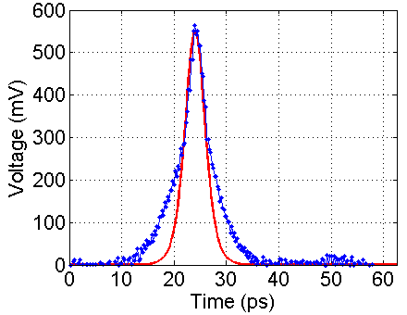
Characterization
7.7ps pulsewidth
Three QW
Three QW
4ps pulsewidth
Five QW
Five QW

Slide 26
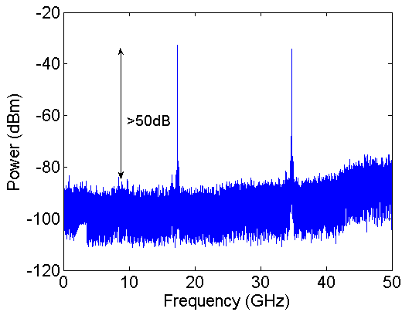
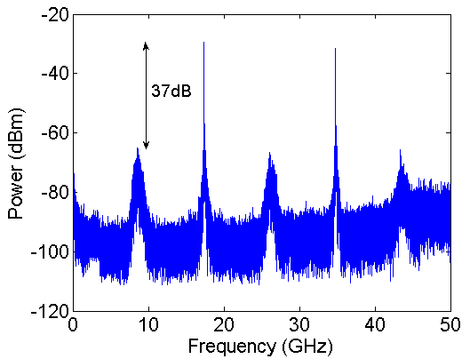
Characterization
Three QW
Five QW
8dB reduction in phase noise

Slide 27
Longitudinal Confinement
Laser confinement factor
Amplitude control
Phase
control

Slide 28
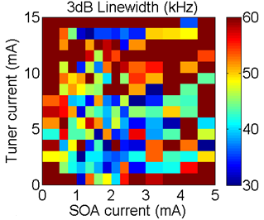
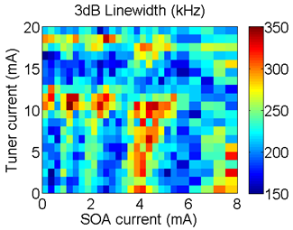
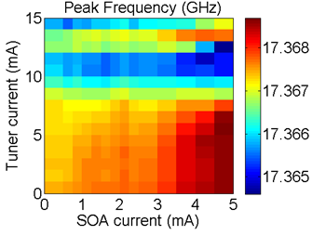
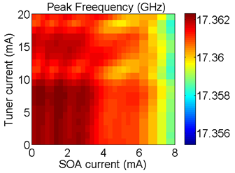
Feedback Cavity
Optimum bias
Three QW
Five QW

Slide 29
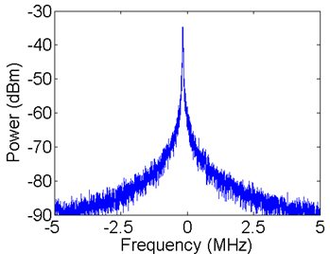
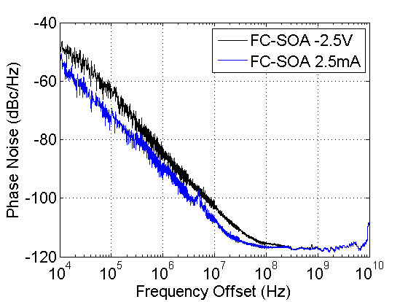
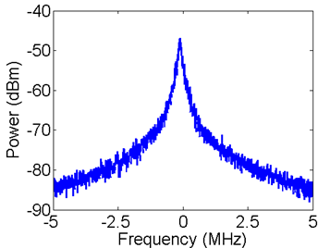
Longitudinal Confinement
Three QW
Three QW
6dB
Integrated jitter (100kHz→100MHz)
reduced from 2.7ps to 1.2ps
Five QW
RF linewidth (kHz) measured @ | Without feedback | With feedback
 | Three QW device
3dB | 44 | 29
10dB | 103 | 60
20dB | 292 | 159
 | Five QW device
3dB | 200 | 136
10dB | 607 | 409
20dB | 2010 | 1356

Slide 30
Outline
Preview
Introduction
Lowering phase noise of:
Mode locked lasers
Tunable lasers
Reliability of hybrid silicon DFB lasers
Conclusion and Future Work

Slide 31
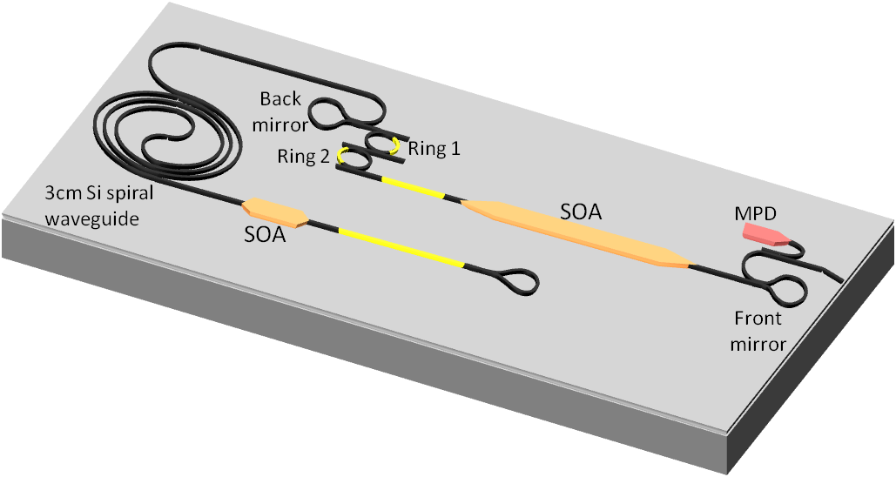
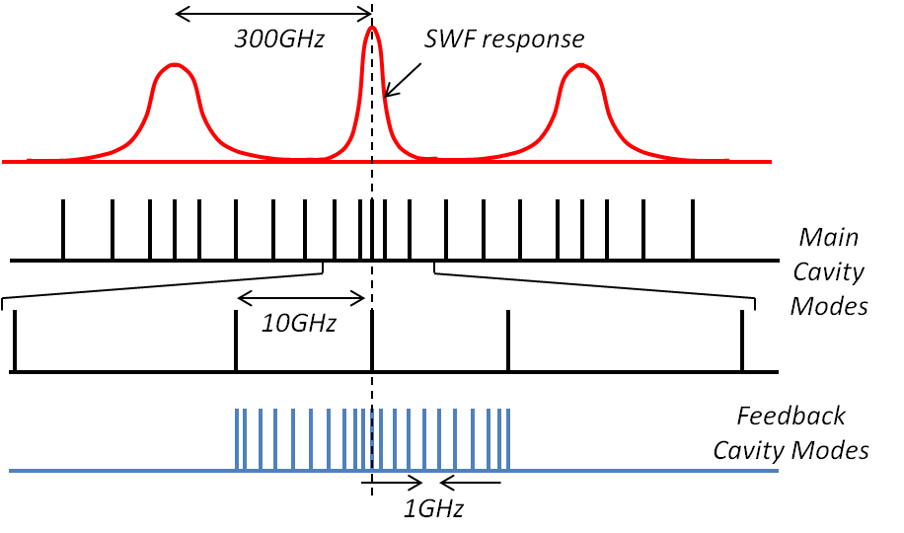
Coupled Cavity Tunable Laser
Filter response
Front mirror – 10%
Rear mirror – 60%
Laser SOA Length – 1.2mm
Feedback SOA Length - 560μm

Slide 32
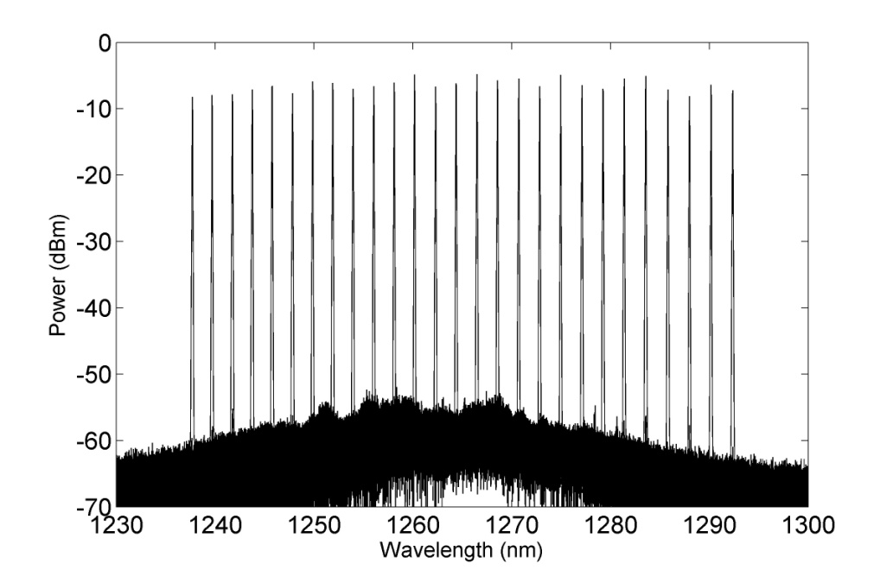
Coupled Cavity Tunable Laser
54+ nm tuning
>45 dB SMSR
~30 mA threshold current
10+ mW output power
Without coupled cavity

Slide 33
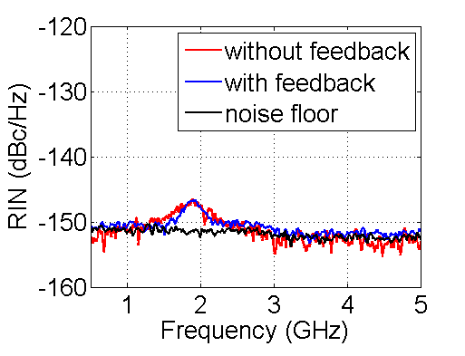
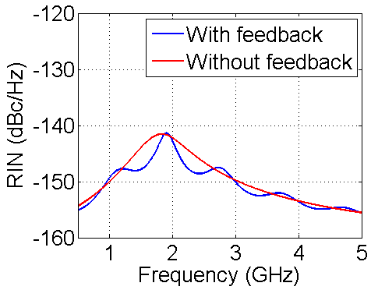
Relative Intensity Noise
RIN <-150dBc/Hz from 10MHz→18GHz except from 1GHz→3GHz

Slide 34
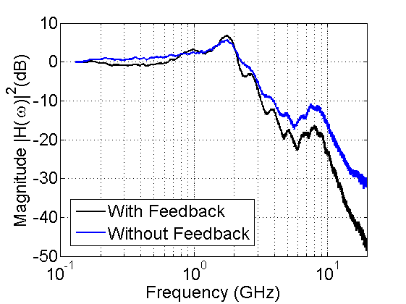
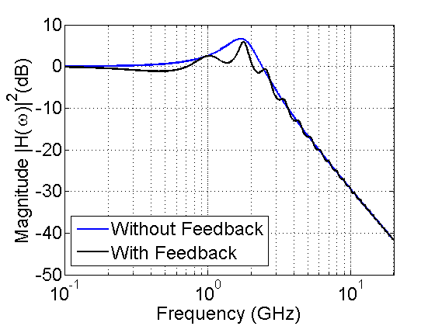
Modulation Response
Photon-photon resonance

Slide 35
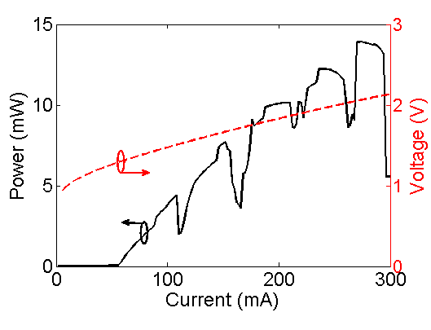
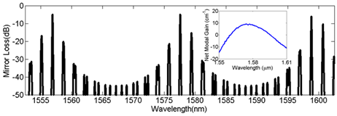
Coupled Ring Resonator Mirrors
Thermal tuners
SOA

Slide 36
Cavity Length Enhancement
Cavity appears longer as we tune into resonance

Slide 37
Characterization
29 nm tuning
>40 dB SMSR
160kHz linewidth
50-60× lower than natural linewidth
We only predict
~(1+3)²=16×

Slide 38
Negative Optical Feedback
Free-running
Output
Δν_{FR}
Δν_{o}
Δν_{FB}
β
Linewidth is narrowest before mode-hop
Noise dilution
Negative feedback

Slide 39
Outline
Preview
Introduction
Lowering phase noise of:
Mode locked lasers
Tunable lasers
Reliability of hybrid silicon DFB lasers
Conclusion and Future Work

Slide 40
Bonding Defect Propagation
Test integrity of MQW with aging
D. Liang, S. Srinivasan, J. Peters, A. Fang and J. Bowers, ECS Trans. volume 33,issue 4, 421-426 (2010)

Slide 41
Reliability Experiment
Strategy for pinning defects → strained super-lattice layers
D. Liang, S. Srinivasan, J. Peters, A. Fang and J. Bowers, ECS Trans. volume 33,issue 4, 421-426 (2010)

Slide 42
Laser Characterization
300 DFB Lasers + 300 monitor photodiodes
×
10 dies with different interface super-lattice structures
Wafer level tested L-I curves

Slide 43
Laser Packaging
15°C to 65°C in steps of 5°C

Slide 44
Results
Green → No super-lattice, Red → Strained super-lattice, Blue → Unstrained super-lattice

Slide 45
Results
Time to reach 50% degradation in threshold current at 70°C is ~40,000hrs

Slide 46
Cross-sectional TEM
Defects < 10⁷ cm⁻²
No visible signs of MQW degradation

Slide 47
On-chip Photodiode Dark Current
Before aging
After aging

Slide 48
Outline
Preview
Introduction
Lowering phase noise of:
Mode locked lasers
Tunable lasers
Reliability of hybrid silicon DFB lasers
Conclusion and Future Work

Slide 49
Conclusions
14dB microwave phase noise reduction at 20GHz using 10× mode-locked-laser cavity length and an intra-cavity filter.
8dB reduction in microwave phase at 17.36GHz with reduced number of quantum wells
<100kHz optical linewidth on a widely tunable o-band laser using coupled cavity tunable laser.
160kHz optical linewidth on a coupled ring resonator mirror based tunable laser using negative optical feedback.
No degradation seen in threshold current of DFB lasers after aging for 5000hrs at 70°C and 100mA.
MTTF_{estimate} for hybrid silicon DFB lasers >40000hrs.

Slide 50
Future Work
Coupled cavity laser limitations from waveguide loss and filter bandwidth. Low loss high aspect ratio silicon nitride waveguides can be used for longer delays and sharp filters. However, “Do not design for more Q than you can chew.”
Exploit on-chip negative feedback from ring resonator structures both within the cavity and external to the main laser cavity.
Remove optical amplifier in the feedback cavity to remove spontaneous emission noise. Passive solutions are quieter.

Slide 51
Acknowledgement
Adviser: John Bowers (Doc) PILL → (P)assion to cure (I)gnorance (L)ethargy (L)assitude
Committee: Luke Theogarajan, Larry Coldren, Rod Alferness.
Faculty: Nadir Dagli, Dan Blumenthal, Dan Cohen, Milan, Petroff, Palmstrom, Van-de-Walle, Mark Rodwell.
Staff: Ceanna, Alyssa, Christine, Shannon, Val, Jon Magnani, Paul Gritt and many other lovely people in the ECE and Grad. Division who work magic with paperwork.
Aurrion friends: Alex, Byungchae, Jeff Wise, John Hutchinson, Eric Hall, Greg Fish, Erik Norberg, Alfredo.
Bowers Alumni: Anand, Andy, Sid, Di Liang, Geza, Molly, Ben, Jared B, Martijn, Daoxin, Yongbo, Hui-Wen, Tony (Chieh-Ting), Jon Doylend, Jock, Nick J.
Bowers group: Michael Davenport, Daryl, Chong, Jared H, Tin K, Eric, Alex S, Emmett, Minh, Lin, Tony H, Yichen, Alan, Justin.
Luke’s group: Aaron, Avantika.
Dan Blumenthal’s group: Kim, John Garcia, Erica, Wenzao, Henrik, Demis, Michael Belt, Renan.
Dagli’s group: Selim.
Larry Coldren’s group: John Parker, Rob Guzzon, Abi, Chinhan.
Engineers: Jon Peters, Andy.
Cleanroom Staff: Jack, Tom, Tony, Don, Mike, Adam, Aidan, Bill.
Interns: Alois, Bassem, Ardit, Sylvia, Rui.

Slide 52
Acknowledgments
Collaborator at U Surrey: Prof. Sweeney, Graham Read, Nadir Hossain
Screening study group: Matt L, Joe Nedy, Jeong, Han-Wei.
Room-mates: Scott Dirkse, John Smith Mac-Donald, Shawn Owens, Dinesh, Aseem.
Volleyball crew: Keith, Hannah, Saiph, D Morales, Jacob Adams.
Indian friends through Raagmala and IASB: Karthick Santhanam, Karthikeyan, Tejaswi, Madhukar, Vineeth, Karthik Malasani, Kumar Bhargav, Sandeep & Malavika, Ramya, Dilip.
Last but not the least → My Parents.
THANK YOU ALL!

Slide 53
Phase Noise is Important!
Original Image
Phase Switched
Amplitude Switched

Slide 54
Back-up

Slide 55
Hybrid Locking
Hybrid locking with RF signal generator
ESA
SOA current: 206mA
SA voltage: -1.4V
OSA

Slide 56
Characterization
Electrical
spectrum
RBW-3MHz
Optical
spectrum
RBW-20MHz
RF Peak Power
SMSR
SOA current: 220mA
SA voltage: -0.5V

Slide 57
Coupled Opto-Electronic Oscillator
Electro-Optic Feedback
40dB gain
~20m feedback fiber delay

Slide 58
Coupled-Cavity Tunable Laser

Slide 59
External Cavity Multi-Moding
Complex Plane
For higher SOA bias currents the coupled cavity starts to multi-mode
Decreasing loss in ext. cavity

Slide 60
Cavity Mode Locations

Slide 61
Heater Cross-Talk

