Slide 1
SWEEPER – process flow
Martijn Heck

Slide 2
General approach
Pattern >2 dies with waveguides;
e-beam on >4 dies;
Pattern >2 other dies with waveguides;
Optionally: take out 2 dies after SU8 → dice, polish and measure;
Heaters on remaining samples

Slide 3
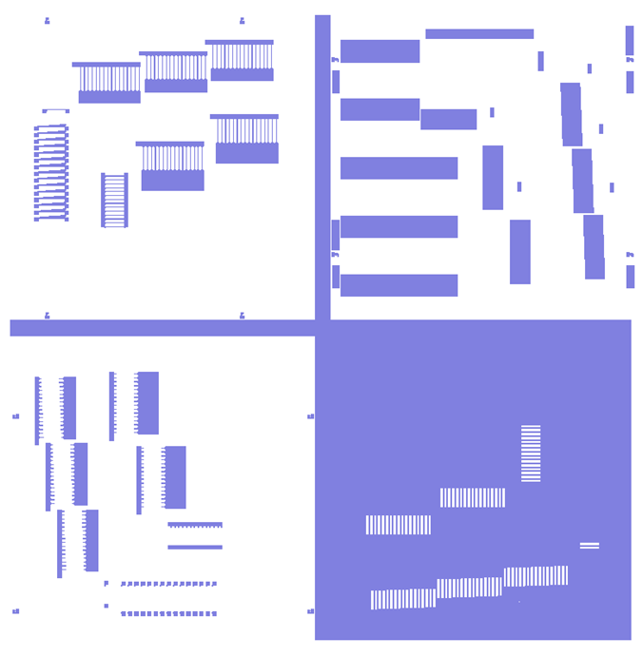
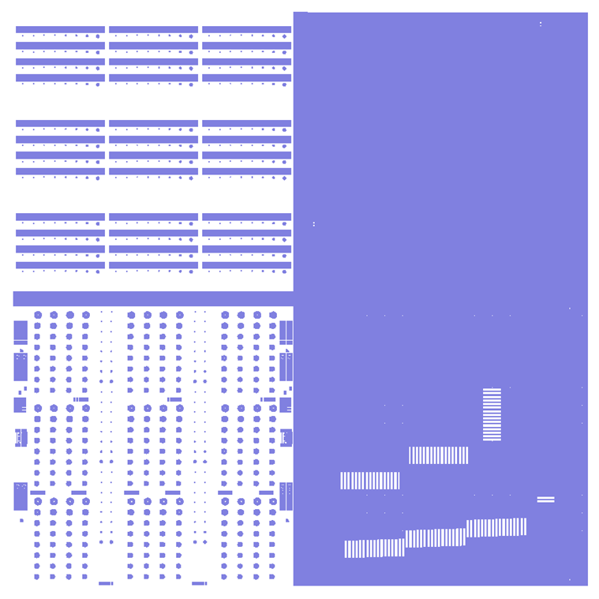
Masks
Heater
Su-8
Sweeper mask 1
Sweeper mask 2
3
2
4
1
5
Probe Pad
WG
Isolation

Slide 4
Mask coordinates (in μm)
Sweeper mask 1
A
x = 1107.16
y = -7891.84
B
x = 6107.16
y = -7891.84
Distance = 5000 um
3
2
4
1
A
B

Slide 5
Process flow – grating etch
masking (e-beam);
etch 100 nm

Slide 6
Process flow – waveguide etch
oxide deposition;
positive resist, mask 1;
etch (275 ± 25) nm into silicon;

Slide 7
Process flow – isolation etch
keep the oxide;
etch to the BOX, mask 5;
deep e-beam marks aligned to waveguides;
remove oxide;

Slide 8
Process flow – grating etch
masking (e-beam);
align to local alignment marks;
etch 100 nm

Slide 9
Process flow – polymer masking
mask crossovers with SU8 (negative photoresist) → positive mask, mask 2;
open gratings;
check rounding (for step coverage);
helps with polishing;

Slide 10
Process flow – heater deposition
4-um wide Ni-Cr heaters (standard heater?);
check sidewall coverage;
lift-off mask (w/ negative resist), mask 3;

Slide 11
Process flow – probe pad deposition
thick gold (>> 1 μm) for probe pad metallization;
covers sidewalls;
lift-off mask (w/ negative resist), mask 4;

Slide 12
Summary
Waveguide etch on Die 1+2, using mask 1, 5;
Grating etch on Die 1,2,3 and 4 using e-beam;
Waveguide etch on Die 3+4, using mask 1, 5;
SU8 or BCB deposition and etch using mask 2;
Heater deposition and lift-off using mask 3;
Probe pad deposition and lift-off using mask 4.

