Slide 1
Process Notes
EBeam # 3 deposited only 20-40nm instead of 137 nm at Mesa Meta deposit ( Pd/Ti/Pd/Au at 3/17/17/100 nm ) Several users experienced similar issues and equipment being checked.
Rework
Gold etch 20 sec ( Etch Au and Pd)
DI rinse 15 min
N2 Dry
EBeam 4 Mesa Metal deposit ( Full thickness of Pd/Ti/Pd/Au)
300nm PE-CVD SiN
Mesa Litho
ICP2 GC-SiN etch
GaSonics 2 min at 250C
1165 solvent at 80C for 1 hour ( Test chip not done, only chips D2 and E)
Measure Test chip to see if bulk remained on top of the SiN Mesa. Measured ~291-299nm which indicates little or no resist present.
HCL:DI with 1:10 ratio for 40 sec on Test piece only to check for color change. A thin residue has often been present in the past when using the RIE3 to etch the SiN instead of the new process with the ICP. The old process also had a 10 min O2 in RIE3 which was replaced with a 2 min GaSonics on this run.

Slide 2
Notes
Test Chip (Slide 3) Test chip had gone through the same exact process as Chips D2 and E EXCEPT that post GaSonics it did not have the 1165 Solvent soak for 1 hour. The main purpose of the dilute HCL dip experiment was to see if there was a color change to the SiN which might indicate thin residue which we have seen in the past post strip. No change seen but it might have been better to have done the 1165 strip to verify. The Dektak reading preHCL dip read 291nm-299nm which indicates that no bulk resist remained on the ~300nm SiN post GaSonics.

Slide 3
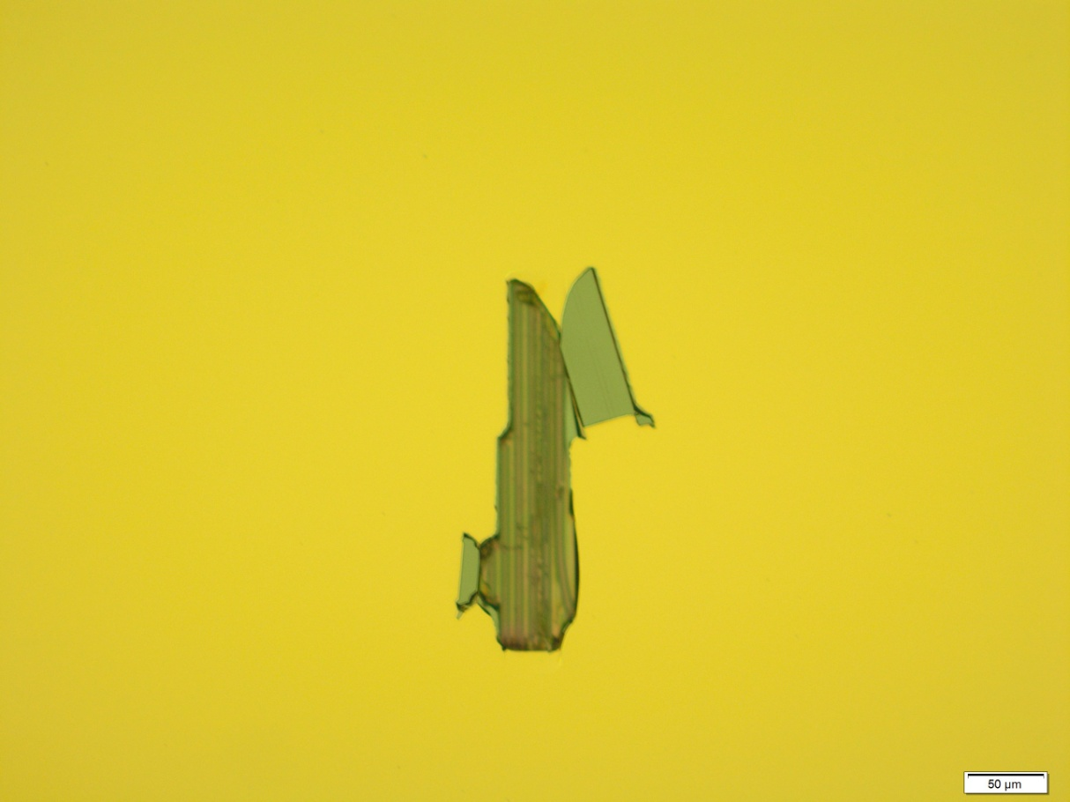
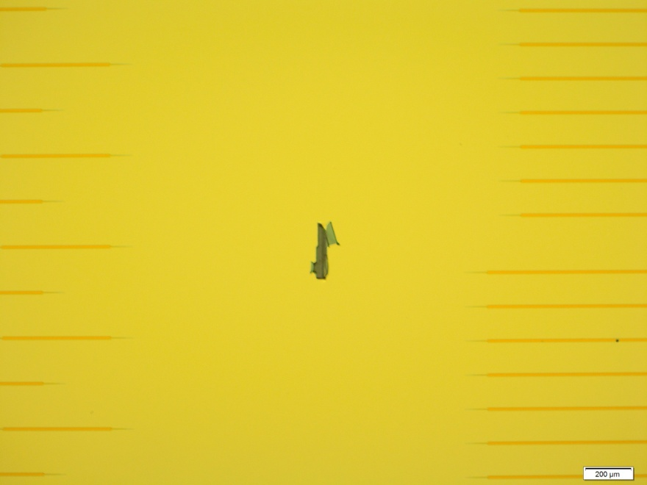
D2 Left Die (3rd Sweeper from top?) Post SiN Dry Etch, GaSonics, and 1165 Strip
Metal appears to have burst in this region post SiN etch. The etch area may get damaged during any dry etches and the flaps will be hard to remove due to them folding over causing double thickness and possible InP redep.

Slide 4
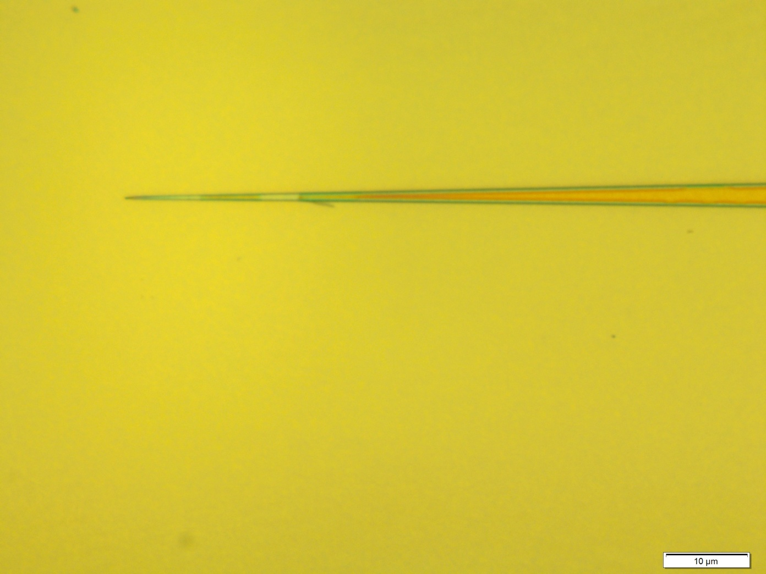
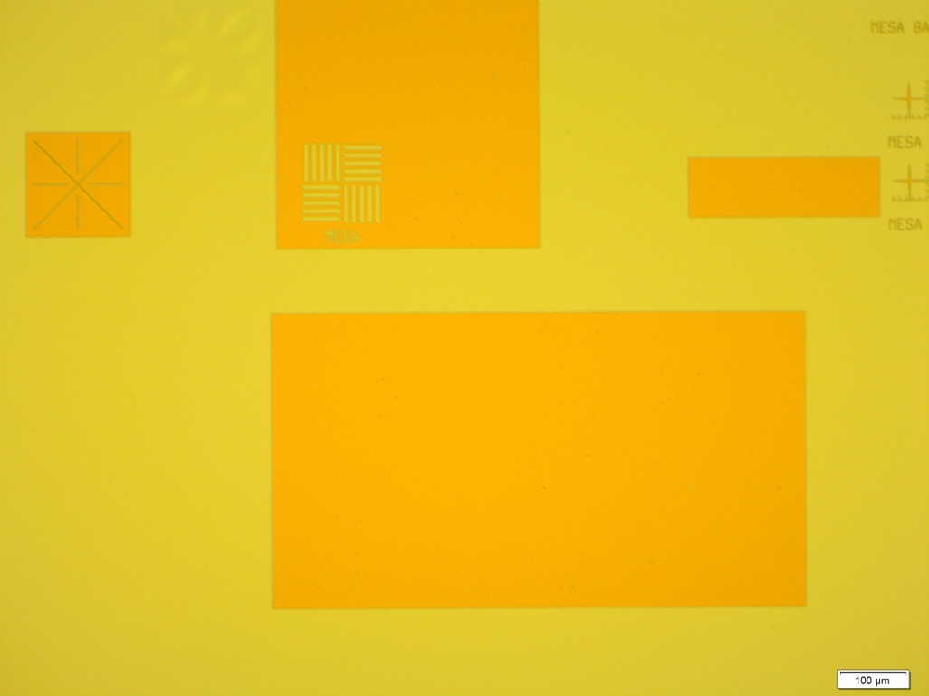
D2 Right Die Post SiN Dry Etch, GaSonics, and 1165 Strip
SiN Hardmask seems ok, no obvious residue
Residue or peeling SiN ?

Slide 5
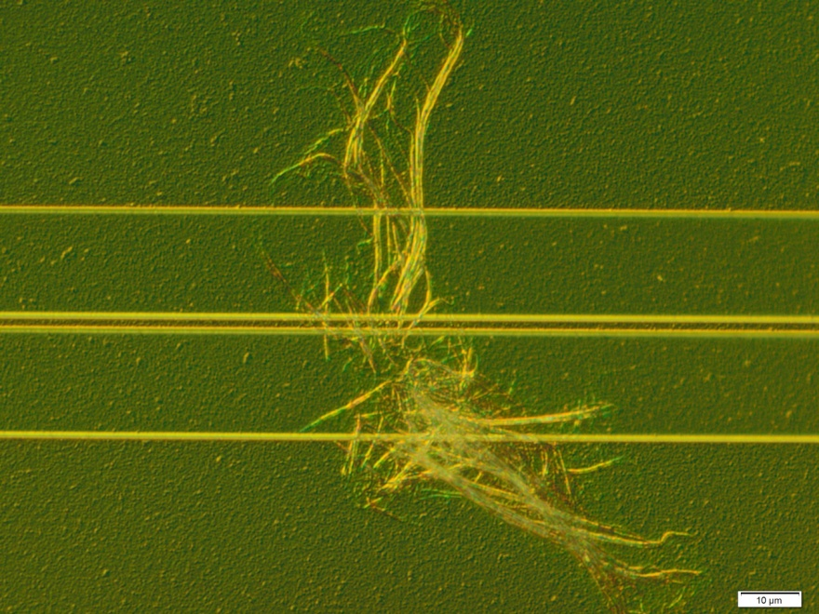
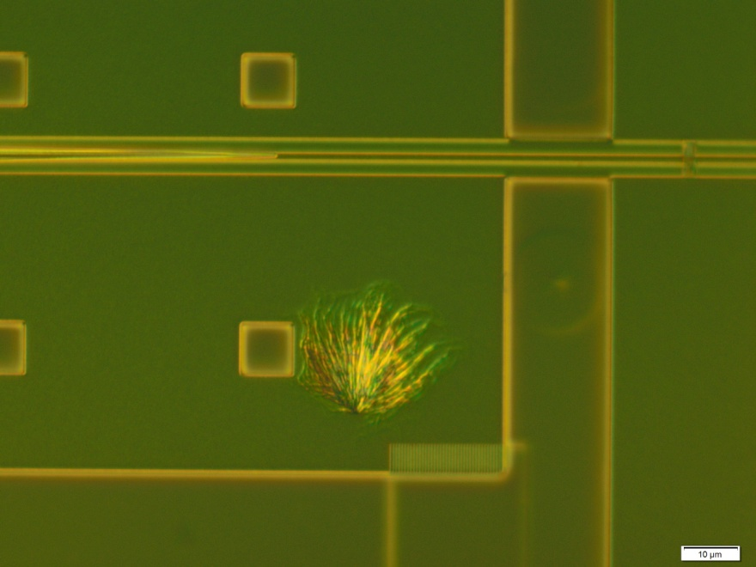
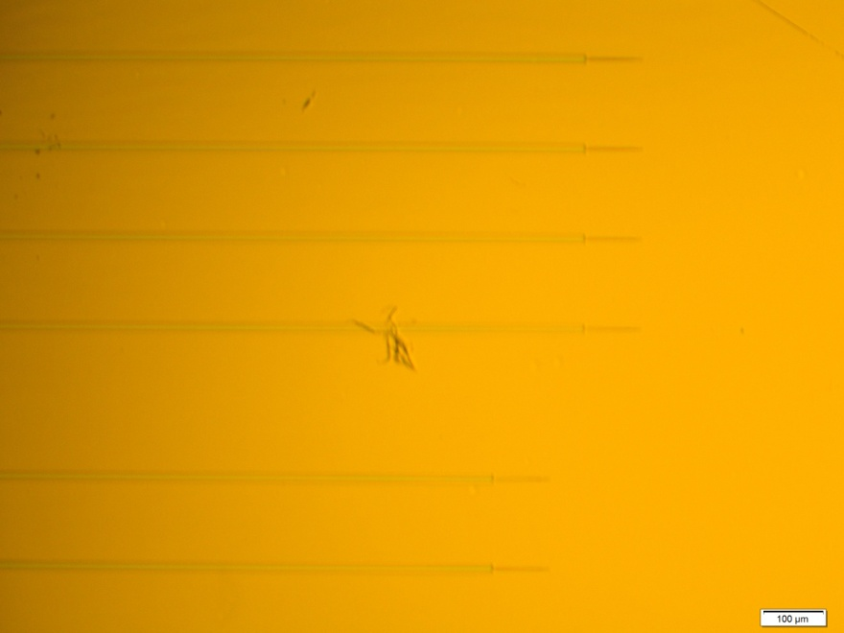
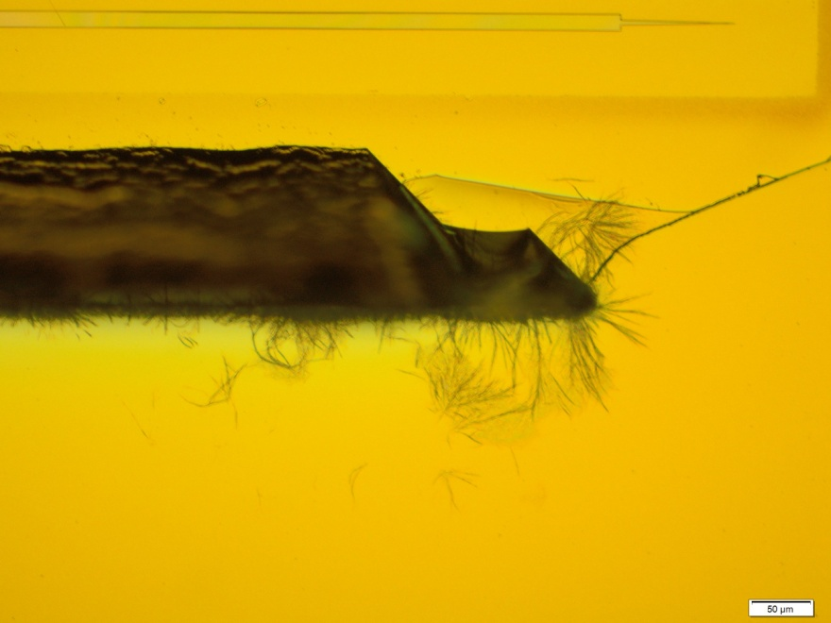
Wispy Resist Post Develop
An one minute PE-II 100W plasma cleared 90% of these wispy residues.
We generally use positive resist so this may be a negative resist issue (5510) Not the only time this has been seen with this resist

Slide 6
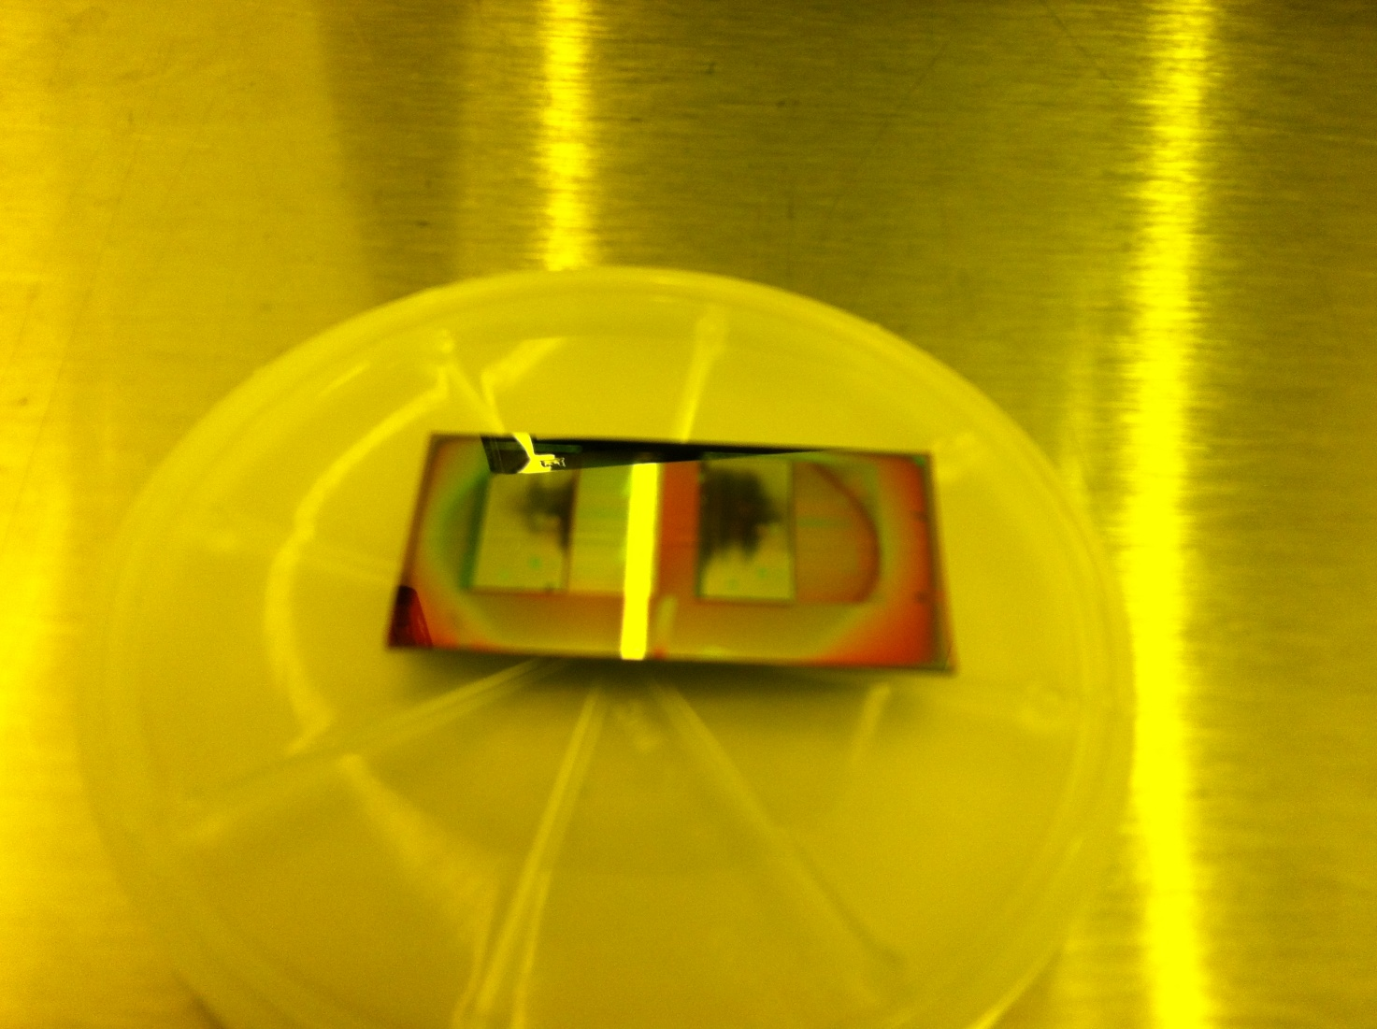
D2 Chip underetch at Mesa Etch

