Slide 1
Ce:YIG characterization
Jason Tien
8/24/2010

Slide 2
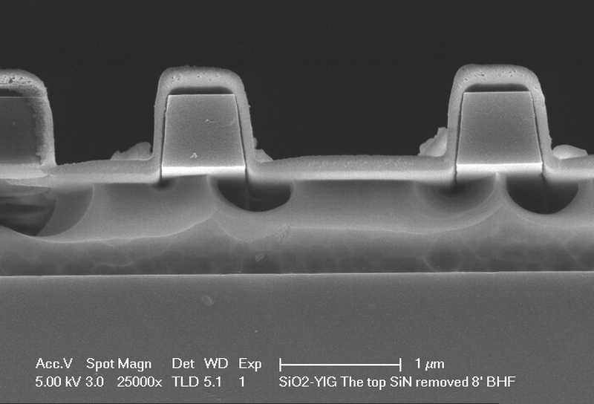
Sputtered Ce:YIG
Sputter Ce:YIG for 2 hours in AJA#3 followed by 900C RTA annealing
Cleave and dip in BHF before SEM
Ce:YIG
Si
Box

Slide 3
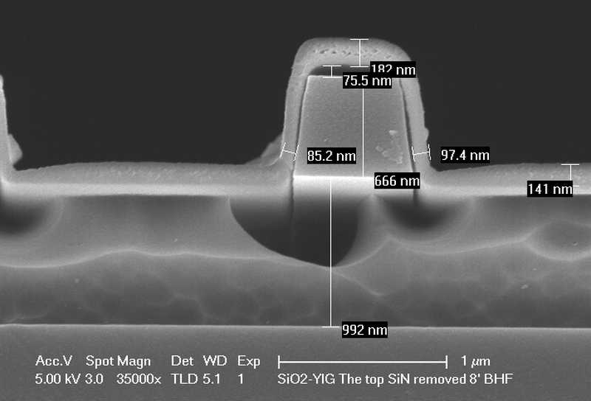
Sputtered Ce:YIG
Vertical-to-lateral thickness: 2:1
Deposition rate: 90 nm/hr

Slide 4
XRD of Sputtered Ce:YIG on Si
Film was sputtered on a bare silicon chip
(420)
10min
5 min
(400)

Slide 5
XRD of Sputtered Ce:YIG on Si (Cont.)
1min
1 min

Slide 6
XRD of Sputtered Ce:YIG on GGG
Room temperature sputtering + 900C annealing gives the strongest XRD

Slide 7
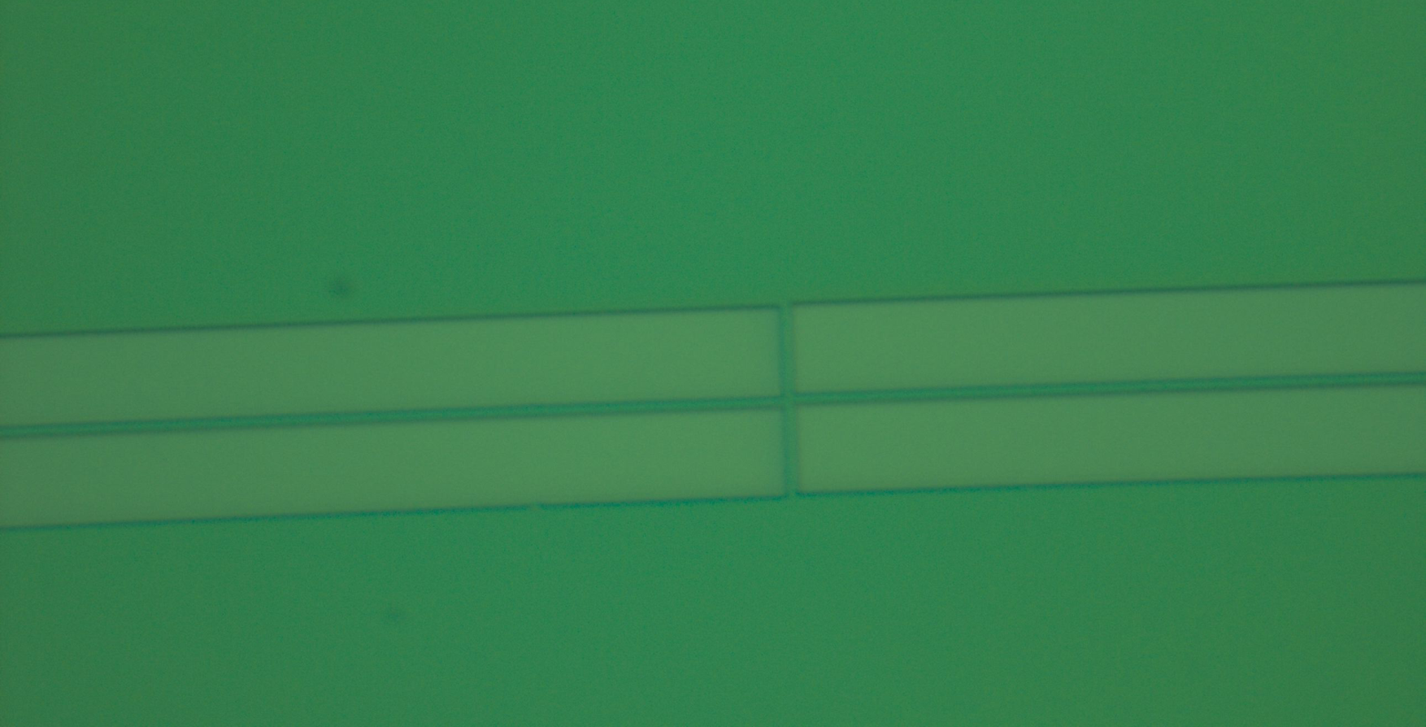
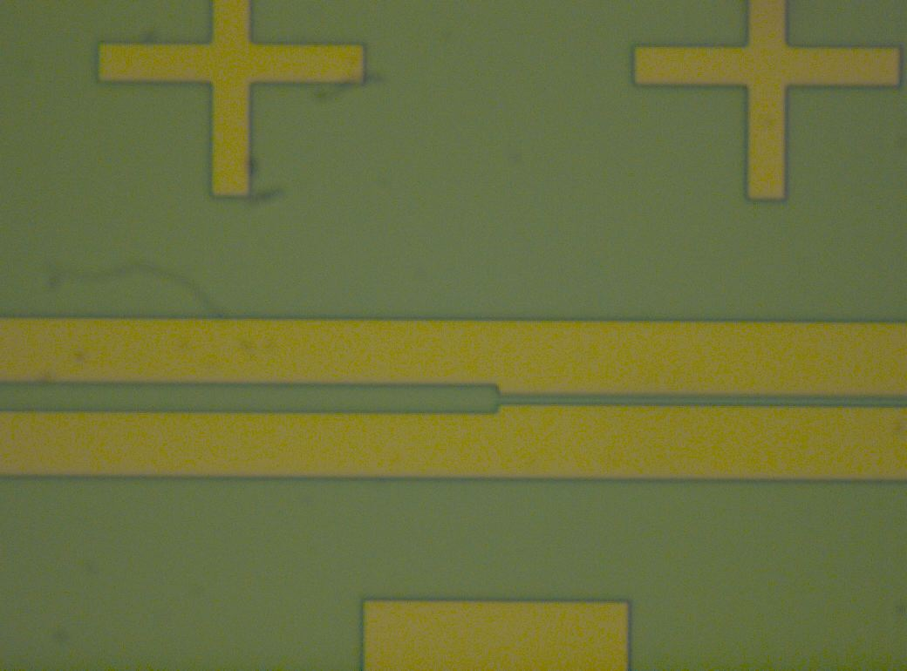
E-beam Litho
ZEP positive E-beam resist
Coat with Au to avoid charging
Smaller sample holder without atuo-height correction
Smaller sample holder with atuo-height correction
Stitch error?
Resist
Developed area
600um
Two possible reasons:
Wrong e-beam focus plan
Stage over movement
No observable stitch error under 150X microscope

Slide 8
Plan for the next
Measure the waveguide loss and estimate the Q for large-radius ring resonators
Fabricate large-radius ring resonators
Add Im-balance MZI structure to distinguish the material properties

Slide 9
Imbalanced MZI Test Structure
L1
ΔL=290um
Δn=7e-4 ➔ Δλ~0.5nm
L2
External magnetic field
As a test pattern to measure Faraday coefficient
Easy to apply external magnetic field
Waveguide loss doesn’t matter

