Slide 1
Hybrid Silicon Photonic Circuits using
Quantum Well Intermixing
Siddharth Jain
Qualifying Examination: 04/07/10
Committee
Dr. John E. Bowers
Dr. Matthew N. Sysak
Dr. Nadir Dagli
Dr. Larry A. Coldren
Dr. Daniel Blumenthal

Slide 2
Outline
Thesis proposal
Motivation
Background work
  Gen 1 Integrated DFB-EAM
Further work
Summary
CMOS compatible metal contacts

Slide 3
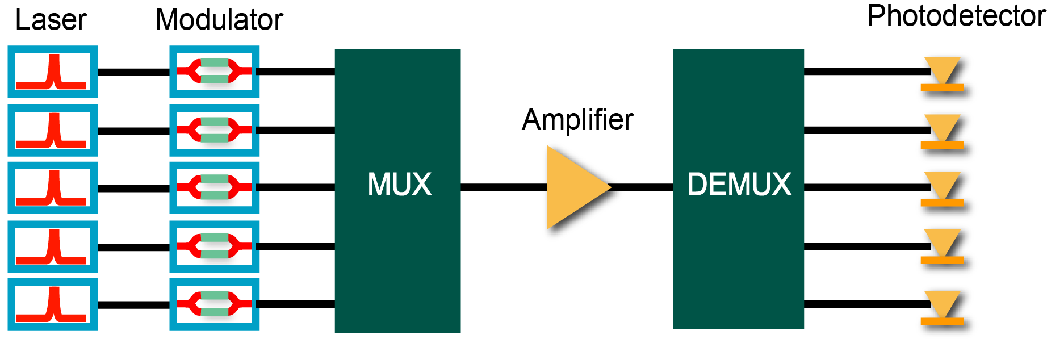
Thesis Proposal
Hybrid Silicon Photonic Circuits using
Quantum Well Intermixing
Hybrid Silicon Evanescent Platform

Slide 4
Thesis Proposal
Hybrid Silicon Photonic Circuits using
Quantum Well Intermixing
100 nm+
DFB – EAM Integration on single chip
Integrate on single chip

Slide 5
Thesis Proposal
Hybrid Silicon Photonic Circuits using
Quantum Well Intermixing
100 nm+
On Hybrid Platform using a Single Bond Step
Integrate on single chip

Slide 6
Thesis – Key Aspects
Broadband optical transmitter at 1.3 µm
  Integrate 4 lasers (over 90 nm) + 4 modulators with single bond
  Low power consumption < 5mW/Gb/s/channel
  High speed > 20Gb/s per channel
  High temperature CW operation
  Explore InGaAsP & AlGaInAs designs
Multiple band gaps using single bond
Integrate on single chip

Slide 7
Motivation
Hybrid Silicon Platform
  Drivers and Photonics on same platform
  Take advantage of Si fabrication
  E.g. Gratings, waveguides, passive devices in Si
  Need integration to realize full potential
  E.g. Broad-band DFB array
  DBR Lasers with low cavity loss
Integration on Hybrid platform ?
=
Multiple band-gaps on Hybrid platform ?

Slide 8
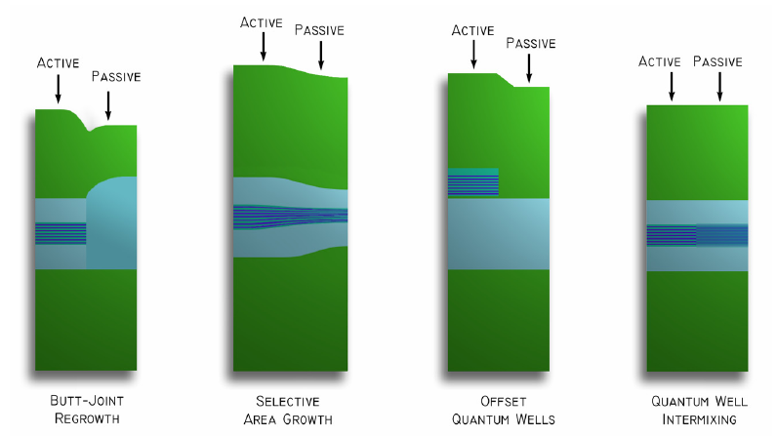
Integration on Hybrid Platform
Methods of monolithic integration
  Re-growth
  Selective Area Growth
  Offset/Dual Quantum Well Structures
  Quantum Well Intermixing
Constraints –
Hybrid platform needs a planar surface
Bonding interface degrades at growth temperatures
* Fig. Short-Cavity DBR Lasers Integrated with
High-Speed EAMs using QWI, Chad Wang

Slide 9
Integration on Hybrid Platform
Quantum Well Intermixing
  Planar surface
  Multiple band-gaps across wafer
  Simpler fabrication techniques
Methods of QWI
  Ion Implantation Disordering
  Impurity-Free Vacancy Disordering
  Laser-Induced Disordering

Slide 10
Integration on Hybrid Platform
Quantum Well Intermixing
  Planar surface
  Multiple band-gaps across wafer
  Simpler fabrication techniques
Methods of QWI
  Ion Implantation Disordering
  Impurity-Free Vacancy Disordering
  Laser-Induced Disordering
Ion Implantation Disordering
Good resolution
Controllable
UCSB expertise

Slide 11
QWI –The technology
Multiple band-gaps by Atomic Inter-diffusion
  Utilize concentration gradient between well and barriers to diffuse
  atoms
  Change in atomic distribution changes potential profile and hence the
  band-gap
Potential profile – QW laser gain region
Concentration profile – QW laser gain region
E_{e1}
E_{c}
Indium
Concentration gradient
QW Band gap (E1-HH1)
E_{hh1}
Arsenic
E_{v}
Barr
Well
Barr

Slide 12
QWI –The technology
Multiple band-gaps by Atomic Inter-diffusion
  Utilize concentration gradient between well and barriers to diffuse
  atoms
  Change in atomic distribution changes potential profile and hence the
  band-gap
Potential profile – QW laser gain region
Concentration profile – QW laser gain region
E_{e1}
E_{c}
Indium
Concentration gradient
QW Band gap (E1-HH1)
E_{hh1}
Arsenic
E_{v}
Barr
Well
Barr

Slide 13
Ion Implant Enhanced Intermixing
    Implantation from N side – Closer to QWs
    Phosphorous implant generates vacancies in InP buffer layer
    Dielectric stack used to mask implant to preserve as-grown band-gap
    RTA diffuses vacancies through QWs/barriers for mass transfer
    Intermixing can be stopped by removing source of vacancies
    Steps can be repeated for multiple band-gaps across III-V wafer
Phosphorus ion implant 100 keV
SiON_{x}/SiO₂/SiON_{x} dielectric stack ( 40 nm )
SiON_{x} dielectric ( 300 nm )
InP buffer ( 500 nm )
InGaAsP Stop etch ( 40 nm )
2x InGaAsP / InP Super lattice ( 7.5 nm )
InP n-contact ( 100 nm )
10x QW ( 6.5 nm ) 11x Barriers ( 8nm )
InGaAsP SCH ( 250 nm )
InP p-cladding ( 1.5 µm )
InGaAs p-contact ( 10 nm )
InP substrate (350 µm)
1
1
2
1
2
1
2
3
1
2
3
1
Implant
Anneal
Etch buffer
Anneal
Remove buffer

Slide 14
Generation 1
Integrated DFB - EAM

Slide 15
Generation 1
QW structure similar to Skogen/Raring, moved to 1360 nm
Implant dose was optimized for shift and PL intensity
Net PL shift @ 725 C,300sec ~ 60 nm
  100 nm – 40 nm
  Target shift > 120 nm
DFB gratings splits 1250-1370 nm
Integrated lumped element EAMs
EAM B 1290 nm
EAM A 1310 nm
Laser B 1325 nm
Laser A 1345 nm

Slide 16
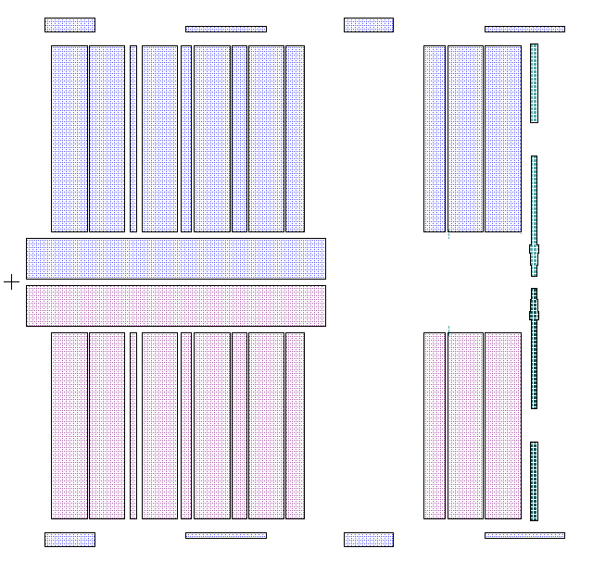
Device Layout - Pre-Bond
Laser band-gap A
Modulator band-gap A
Modulator band-gap B
Laser band-gap B
Active region definition across a die

Slide 17
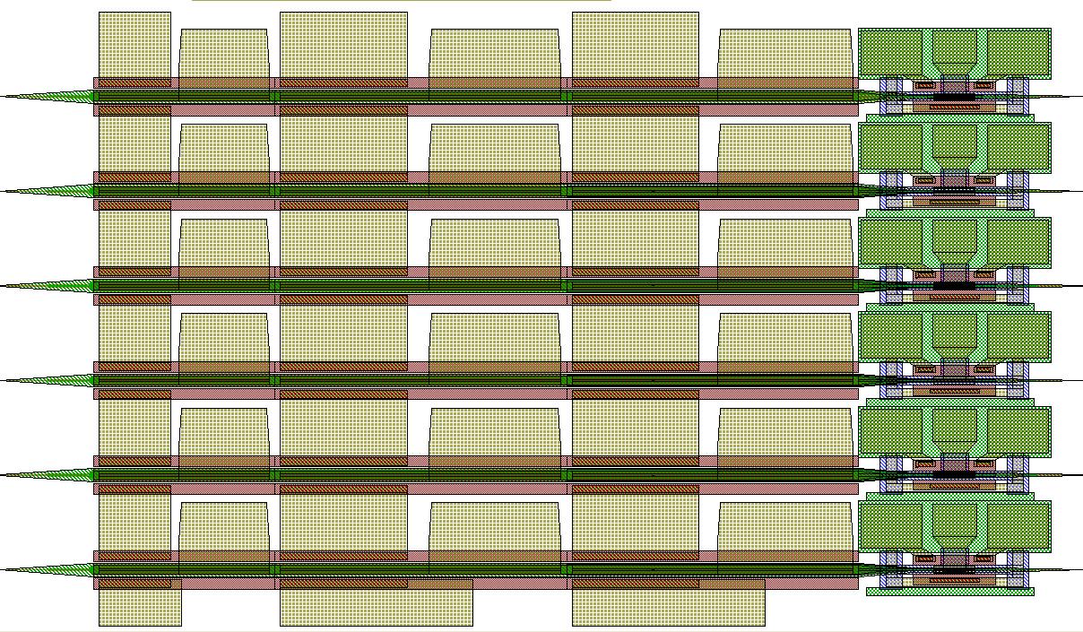
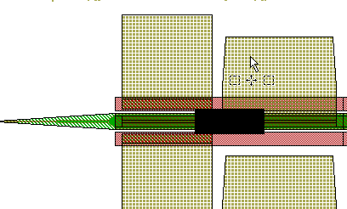
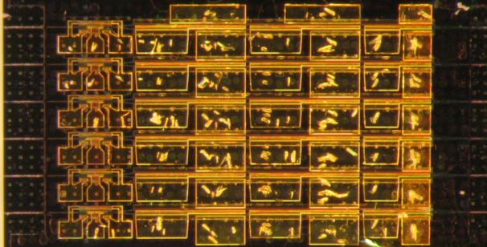
Device Layout
L _{grating}
1350 nm
P N P N P N
1310 nm
P N
EAM
DFB 1
DFB 2
PD
L _{active}
High simulated ‘kappa’ ( 400 cm⁻¹), total grating length
had to be limited
Pumped active sections act as SOAs, but are
electrically connected
Contributes to device heating, most designs worked only
under pulsed mode

Slide 18
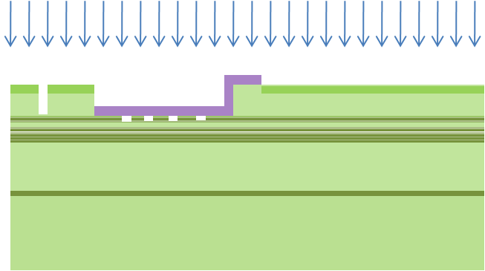
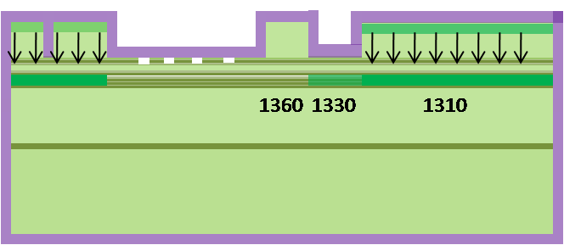


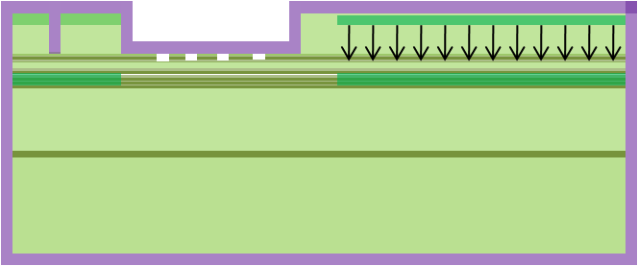

Device fabrication : Pre-bond
Implantation, protected regions
Etch buffer to remove source, anneal cycles
Encapsulation
Backside alignment marks
Anneal to diffuse
Gratings in InP

Slide 19

Device fabrication : Aligned bonding
Challenge implicit to QWI on Hybrid platform
Bonding SOI waveguides to patterned III-V requires
alignment
Flip-chip aligner used for < 6 µm alignment accuracy
< 0.1 deg rotational alignment
But, with QWI it is possible to build in an alignment
tolerance !
Tapers and sections between lasers can be made passive
0.8 µ m
2x InGaAsP / InP Super lattice ( 7.5 nm )
InP n-contact ( 100 nm )
10x QW ( 6.5 nm ) 11x Barriers ( 8nm )
InGaAsP SCH ( 250 nm )
InP p-cladding ( 1.5 µm )
InGaAs p-contact ( 10 nm )
InP substrate (350 µm)
Si ( 400 nm )
Oxide ( 1 µm)
Si substrate

Slide 20
Experimental results

Slide 21
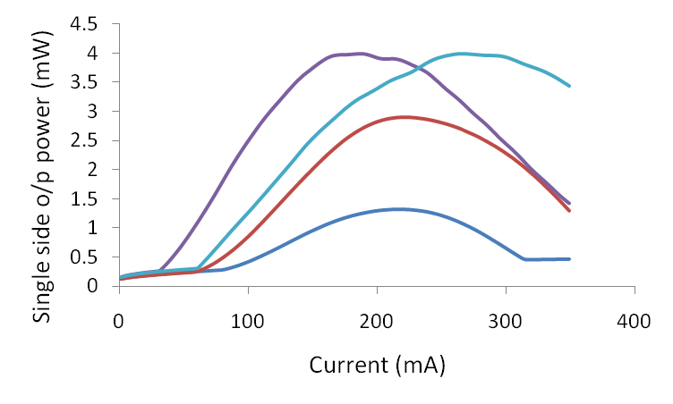
Gen 1 Device Results
4 Band-gaps
  2 Laser band-edges
  2 Modulator band-edges
  Grating splits 1250-1360 nm
  CW laser operation 20 C
  Max o/p single side = 6 mW
  I_{th} min 30 mA
  Side mode suppression > 35 dB

Slide 22
Gen 1 - DFBs
A
Grating split over two band-gaps
  Operational over 100 nm range [ Pulsed ]
B
Plotting spectra from all working lasers, pulsed operation

Slide 23
Gen 1 - DFBs
A
DFBs over a wide band with small
( < 20 mA ) variation in threshold
B
B
A
Pulsed threshold current for one laser design
Plotting spectra from all working lasers, pulsed operation

Slide 24
Gen 1 - EAMs
Lumped element design
-10 dB extinction ratio at 5 V
  [ Highest on-chip detuning ]
Expect high insertion loss due to
small detuning for most devices
Expect 3dB bandwidth ~ 2 GHz
Wide-band DFB array demonstrated but need
more PL shift for EAM detuning
Bandgap A @ 30 nm detuning
Bandgap B @ 30 nm detuning
Bandgap B @ 50 nm detuning (max)

Slide 25
Further work
Questions to be answered
Maximum possible gain band-width ?
InGaAsP or AlGaInAs platform ?
Efficiency / High temperature performance ?
Laser-Modulator performance trade-offs ?

Slide 26
Issues to be addressed
Achieve 120+ nm shift
AlGaInAs Intermixing
High temperature laser operation
Modulator performance
Low power laser operation

Slide 27
Issues to be addressed
Achieve 120+ nm shift
High temperature laser operation
AlGaInAs & InGaAsP
Larger shift ?
Narrower wells
Larger band offsets
Effect of strain on
intermixing
Notes:
Coldren & Corzine pg 176. Decrease in eta_d at smaller well widths. Note – that happens because the first state of narrow wells is squeezed to the very top and barrier states start to fill up.
But in Gen 2 design, target is to have just about 2 states ( actually only one, but very close to two) . 1st state sits deep in to the well and barrier filling should not be an issue.

Slide 28
Issues to be addressed
Achieve 120+ nm shift
High temperature laser operation
Low power laser operation
Modulator performance
Current design 65 nm well
AlGaInAs & InGaAsP
Larger shift ?
Narrower wells
Larger band offsets
Effect of strain on
intermixing
Simulated variation of PL shift with well width for a given structure (InGaAsP)
Gen I epi design at 65 A – Net shift 70 nm
Gen II epi design at 40 A – Net shift 200 nm
Notes:
Coldren & Corzine pg 176. Decrease in eta_d at smaller well widths. Note – that happens because the first state of narrow wells is squeezed to the very top and barrier states start to fill up.
But in Gen 2 design, target is to have just about 2 states ( actually only one, but very close to two) . 1st state sits deep in to the well and barrier filling should not be an issue.

Slide 29
Issues to be addressed
InGaAsP band-gap contour
Achieve 120+ nm shift
+1% strain
Zero strain
As (y)
-1% strain
AlGaInAs & InGaAsP
Larger shift ?
Narrower wells
Larger band offsets
Effect of strain on
intermixing
In (x)
Gen II epi to study strain effects
Difficult to isolate/understand strain role in intermixing

Slide 30
Issues to be addressed
High temperature laser operation
Low power laser operation
Modulator performance
Achieve 120+ nm shift
Use Electron blocking layer
Prevents leakage of electrons
from wells
Aids in high temperature
performance without any
adverse affects
Gen I design
Gen II design
Gen II to include AlGaInAs & InGaAsP designs, both with electron-blocking layer

Slide 31
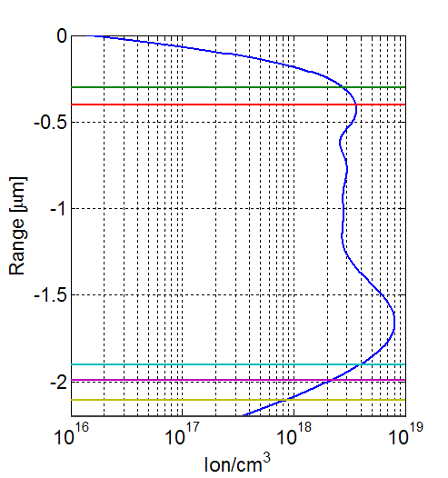
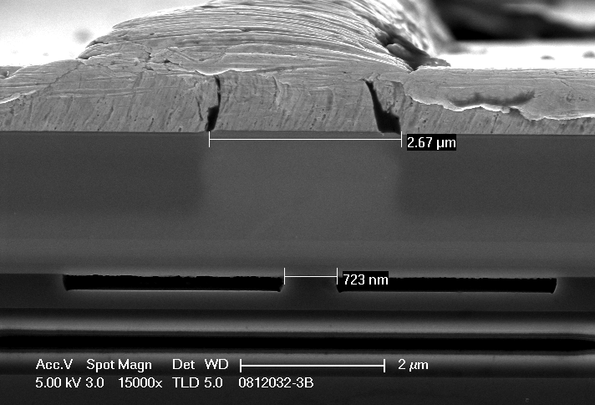
Issues to be addressed
Low power laser operation
Important to evaluate current channel and proton implant profiles for efficient operation
Net H+ implanted concentration
>2e18 cm^-3 Reqd for isolation
InGaAs
Current channel
Implant direction
MQWs
InP
Si waveguide
MQWs
Because of implant straggle, some H+ atoms inevitably end up in MQW region
Fig. courtesy of Matt Sysak

Slide 32
Issues to be addressed
Low power laser operation
Modulator performance
Achieve 120+ nm shift
High temperature laser operation
?
?
?
Target power consumption
< 5mW/Gb/s/channel
Efficiency & Threshold
To achieve –
Improved differential/injection
efficiency
Low kappa*L DFB design
DO -
Splits with different current channel widths and waveguide dimensions
  Maximize overlap of carriers and optical mode
Splits for implant channel profile
  How many H⁺ ions in the quantum well is
  acceptable ?

Slide 33


Issues to be addressed
Modulator performance
Gen 1 – Lumped element,
SiN passivation
Expect ~ 2 GHz
Gen 2 – TW design trials
Undercut QW structure to reduce device capacitance
Travelling wave structures for high speed
Optimize trade-off between insertion loss & extinction ratio
Quantify QCSE reduction in diffused QW EAMs as
compared to square QW EAMs

Slide 34
Issues to be addressed
AlGaInAs
intermixing
Suitable for high temp
operation
Possible to achieve 120 nm
shift ?
IID with Phosphorus or
Fluorine ?
IID or IFVD ?
* Focused Ion-Beam Implantation Induced Thermal Quantum-Well Intermixing for
Monolithic Optoelectronic Device Integration, Johann Peter Reithmaie et .al.

Slide 35
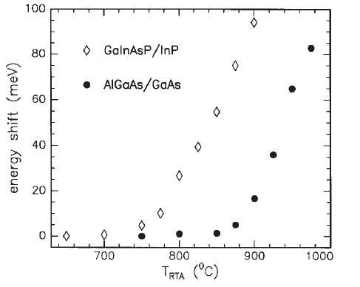
Issues to be addressed
AlGaInAs
intermixing
RTA MQW structures ( 60s )
No implantation was applied*
Suitable for high temp
operation
Possible to achieve 120 nm
shift ?
IID with Phosphorus or
Fluorine ?
IID or IFVD ?
Al-based QW structures are thermally more stable than
P-based QWs
Most Al-based QWI reported at 800 C
  - 800 C not acceptable for InP substrate
Do
  Dosage and energy splits with P and F ions
  IFVD ( Will need to change epi stack )
* Focused Ion-Beam Implantation Induced Thermal Quantum-Well Intermixing for
Monolithic Optoelectronic Device Integration, Johann Peter Reithmaie et .al.

Slide 36
Summary
Hybrid Silicon Photonic Integration
High performance broadband optical transmitter
Generation 1 – Demonstration
Scope to improve
PL shift and InGaAsP vs AlGaInAs ?
Concrete directions to improve efficiency and high temperature performance
  Can these issues be decoupled?
Laser-EAM performance trade-offs ?

Slide 37
Laser Optimization
& Material System Decision
DFB/DBR+ TWEAM
Integrated transponder /
Other Si-photonic circuits
TW EAM designs
DFB + TWEAM trial 1
Months
Gen II epi PL shift experiments
FP - Fab run II – Current channel optimization
FP testing – Max Gain Bandwidth ?
Gen III epi design if needed
Simulation of TW EAM designs
Mask layout for integrated transponder
EML - Fab run III
Testing
Simulation/Mask design for modulator
Modulator - Fab run IV
Testing
Mask design & Fab run V
Complete characterization
4 | 5 | 6 | 7 | 8 | 9 | 10 | 11 | 12 | 1 | 2 | 3 | 4 | 5 | 6
2010
2011

Slide 38
Backup

Slide 39
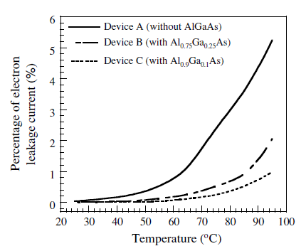
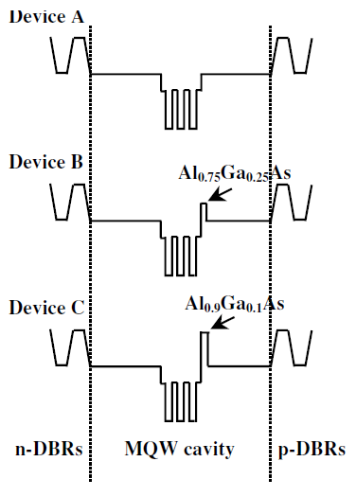
Issues to be addressed
High temperature laser operation
Low power laser operation
Modulator performance
Increasing e-block height
 | η(110C) / η(20C) (%) | T_{o} (I_{th}) (20-80C) (80-130C) | T_{max}
With e-block layer | 60 | 88 K 72 K | 155 C
Without e-block later | 30 | 77 K 54 K | 135 C
*High Temperature Operation of AlGaInAs Ridge Waveguide Lasers with a p-AlInAs Electron Stopper Layer , Takemasa et al, Jpn. J. Appl. Phys. 38 (1999) 1230

Slide 40
Background work
CMOS fab compatible metal contacts for the hybrid Si platform
  Goals and constraints
  P-InGaAs contacts
  N-InP contacts
  Summary of results

Slide 41
Metallization
Goal
  Develop metal stack that can be used in a CMOS fab to contact n-InP and related quaternaries
Constraints
  No Gold. Majority of III-V devices at UCSB use gold based contacts –
  Eg - Ni/Au/Ge
  Ti/Pt/Au,
  Pd/Ti/Pd/Au
  Metals
  → Ti, Co, Ta, Cu, W, Al ,Pd, Ge
  → Max anneal temp – 350 C
  → Doping levels fixed for Hybrid Silicon Laser

Slide 42
Mask design
Multiple TLM patterns
Concentric Circles
Elongated TLM pattern
Concentric Squares
Concentric patterns remove the need for isolation etch
42

Slide 43
TLM Pattern effects (Ti/Pt/Au)
TLM Shape | Measured r_{c} [Ω cm²] | Comments
Square pads (75*75μm) | 1.5 * 10 ⁻⁵ | Current fringing → high r_{c}
Bar pads (500*100 μm) | 4.5 * 10 ⁻⁶ | Current fringing is almost negligible w.r.t contact length (500 μm )
Circular pads (well spaced ) | 2.7* 10 ⁻⁶ | No current fringing, pad separation 10 times transfer length
43

Slide 44
Metal Stack | Material | Measured r_{c} (Ω/cm²) | Theory/Typ. r_{c} (Ω/cm²)
Ti / Pt / Au | p-InGaAs | 2.7*10⁻⁶ | 8*10⁻⁷ - 4*10⁻⁶
Ti/Al | p-InGaAs | 9.6x10⁻⁶ | None
Ti/W/Al | p-InGaAs | 3.3x10⁻⁶ | None
W/Al | p-InGaAs | 3.4x10⁻⁵ | 6x10⁻⁵
Ta/Al | p-InGaAs | 3.4x10⁻⁵ | None
Ni/Ge/Au | n-InP | 1.7x10⁻⁵ | 1x10⁻⁵
Ti/Al | n-InP | 4.5x10⁻³ | None
Ti/W/Al | n-InP | 4x10⁻³ | None
W/Al | n-InP | 1x10⁻⁴ | Mid 10⁻⁴
Pd/Ge/W/Al (Ratio 2.7) | n-InP | 7.510⁻⁵ | None
Pd/Ge/W/Al (Ratio 0.9) | n-InP | 1.2x10⁻⁶ | None
All above measure after 350 C anneal

Slide 45
Common stack to p and n layers ?
Ge acts as n-type dopant in InP
But !
Pd/Ge contacts work
even for p-InGaAs through
a different mechanism
Multiple theories to explain
why Ge doping does not
result in diode behavior
in p-InGaAs
But !
p and n contacts require
different ratios for low r_{c}
45

Slide 48
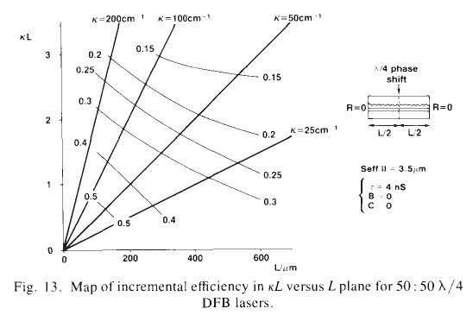
Affect of kL on differential efficiency

