Slide 1
SF6 Etch
June 07, 2012

Slide 2
Purpose and Notes
Purpose:
To test BCB on BCB adhesion
To test BCB on Su8 adhesion
To test for cracking-what stage?
Etched Silicon to target 2.2 um depth to replicate Mesa etch depth of 2.2 um
Notes:
Selectivity of PE-CVD oxide to Si etch is 330 nm: 2600 nm or ~1:8
Selectivity of 4210 resist to Si etch ? Enough to protect.
Etch rate of Silicon moves from run to run. I saw a range of 285-358nm/min.
Uniformity of etch across 4X4 dies on one chip 2.40 +/- .03 um
Using PR plus Oxide for SiOVert and Si etch gives a stepped vertical profile.
Using Oxide only during Si etch shows vertical sidewall with slight step?
Si etch shows rough sidewalls
Delays:
Restart due to poor silicon (used test silicon)
Equipment: N2 Oven signup
Equipment: EBeam 3 issues (low gold causing high power-shut off). Did not run.
Rework due to lifting Mesa patterns and misalignment error
Equipment: Getting time due to heavy use by Fab (ICP2, Stepper)-rework of schedule

Slide 3
PR and Oxide during Si etch
Stepped Sidewall . Less pronounced at thicker widths?
Edge of Die

Slide 4
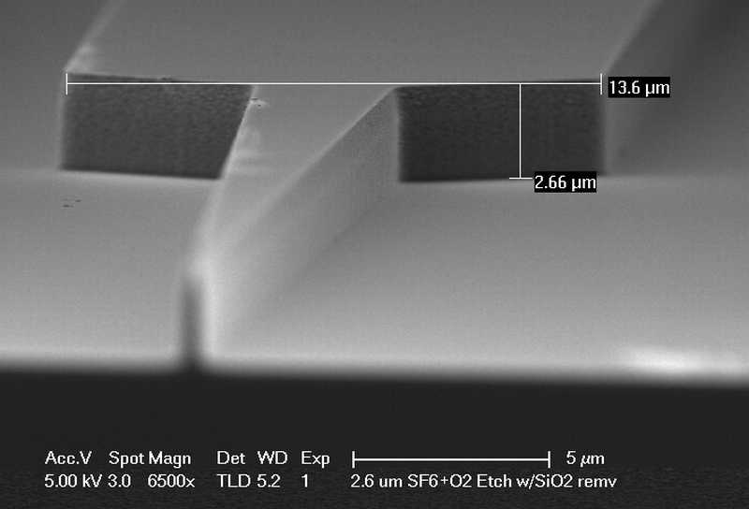
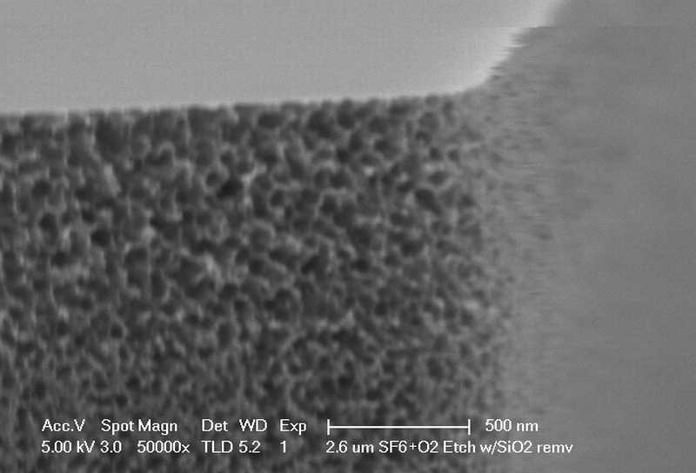
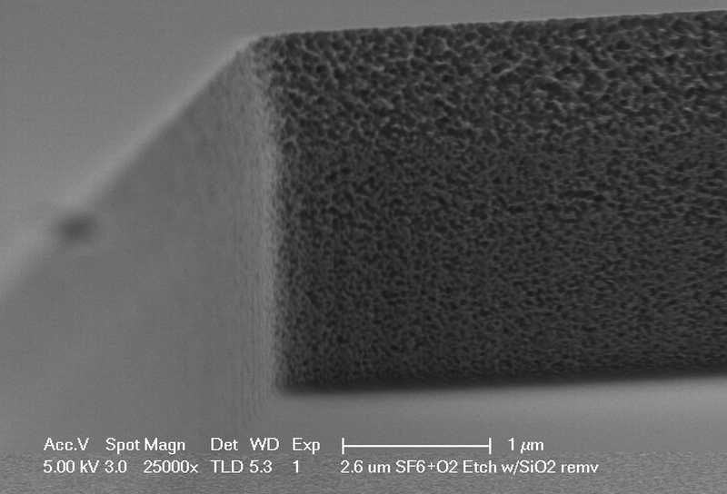
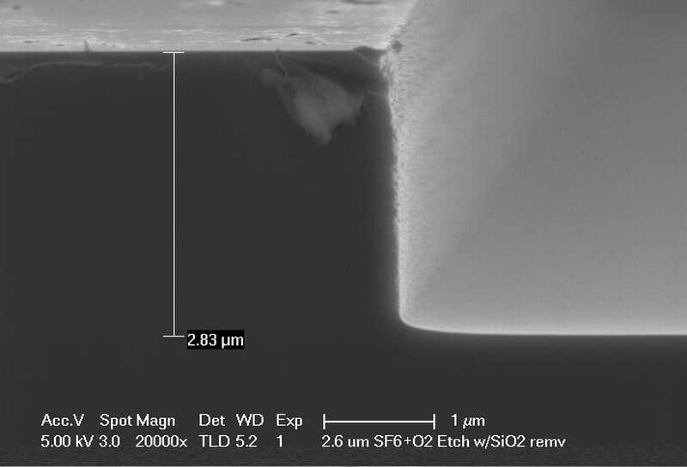
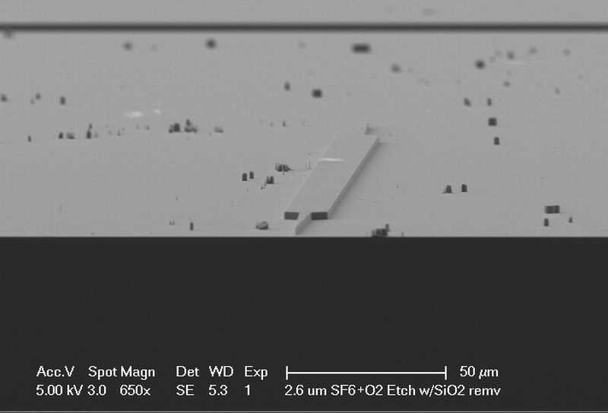
Oxide only during Si etch
Slight step etch pattern

Slide 5
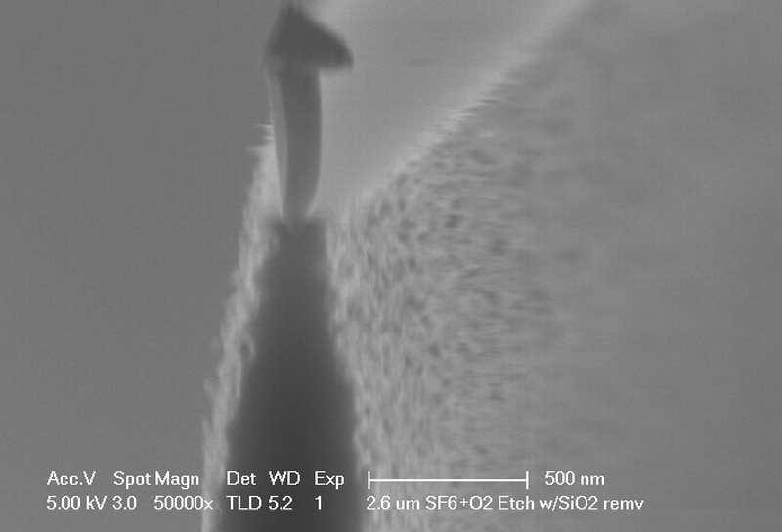

Slide 6
Processing Notes
Measure Si wafer thickness: = _______um Used combination of 500nm Test grade silicon 4pieces and 270nm 2 inch wafers 4 pieces.
•Prepare an additional test piece to recharacterize Si etch rate (ICP1 - #157)
•Hard Mask Deposition
–Clean - ACE/ISO/DI
–Deposit Oxide
•PlasmaTherm PECVD 5000A Used 400nm for my pieces. Changed to 500nm just in case selectivity during etch was low.
–Measure Oxide Thickness in Ellipsometer: = _______nm Also did four pieces in PE_CVD Advanced system. Measured ~450nm
•P-Mesa Lithography
–Clean
•ACE/ISO/DI
•Dehydration bake: Hotplate 150C, 2-5min
•O2 Descum 30s, 300mT, 100W
–Spin HMDS (5000rpm, 30s) (let sit for 30s on chip before spinning)
–Spin AZ4210 (4000rpm, 30s)
–Pre-Exposure Bake (95C, 1min)
–Lithography
•Use P-Mesa Mask – EPHI-dev-2-1 – Quadrant I
–Put Quadrant I in the bottom right of the mask holder
•Litho Tool: Autostepper
–Program: JAREDH\PROT 10,242 EPHI\1
–Exposure: 1sec
–Focus Offset: 0
•NO POST-EXPOSURE BAKE
•Develop (AZ400K 1:4 diluted, 120sec)
•DI Rinse
–Inspect in microscope Some lifting, especially on the smaller width Mesas. Reworked
–Dektak PR height: = ______nm

Slide 7
Processing Notes
Hardmask Etch - SiO2 Etch target 500nm
–Etch Tool: ICP#2
–Clean: O2 Clean, 5min
–Season (Recipe, Time): Bowers Sioxvert etch # 101, 5min (CHF3 etch so check gases)
–Etch(Recipe, Rate): (Bowers Sioxvert etch # 101, 250nm/min = 4.16nm/s) over etch by 20% => Etch for 2’30”
•Inspect in microscope
•Dektak height: = ______nm
•Strip PR (I kept the resist on all dies for easier Si depth measurement at Si etch except for one lead die)
–ACE/ISO/DI Rinse
–1165 Soak at 80C in covered bath - 10min
–ISO/DI Rinse
–PEII - O2 Descum (100W, 300mTorr, 60-120sec)
•Inspect in microscope
•Dektak height: = ______nm
•Si Etch target 2um
–Characterize etch rate:
•Etch Tool: ICP#1 ICP#2
•Switch gas CF4->SF6
•Clean: O2 Clean, 5min (10’ if last etch was Cl-based)
•Season (Recipe, Time): Si etch # 157, 3min (400W, 50W RF, 30/10sccm SF6/O2, 1Pa) Recipe #124 ICP2
•Etch Test Piece 1: (Si etch # 157) 8min at ~300nm/min (target = 2350nm = 7’50”) Did etch for 8 min, measured 2.65 um post BHF HM removal. Reduced time on next four pieces to 7 min 15 sec but still measured 2.60 um post etch. Following day etch on last four pieces showed 2.0 um for 7 min 4 sec etch. Reetched for 45 sec with just SiO2 Hardmask on.
–BHF dip (300nm/min): Dip for 2 min
–Dektak measure etch depth _____ nm/min
•Etch Sample: (Si etch # 157) 2350nm based on characterized etch rate
•Switch gas SF6->CF4
•Clean: O2 Clean, _______ min
•Inspect in microscope
•Dektak height: = ______nm 2.65 um on four pieces ( One 2 inch and 3 square), 2.2 um on other four ( Three 2inch and one square)
•Remove Oxide (~500nm) 8 min of etch = 330 nm of Oxide so 70-120 nm SiO2 left. If Pr and Sio2 during etch, no oxide was etched.
–BHF dip (~300 nm/min) => Dip for 2 min GaSonics 250C 120 sec X 2 to remove resist
–DI Rinse
•Inspect in microscope

Slide 8
Processing Notes
•Inspect in microscope
•Sticking Layer Deposition
–Clean - ACE/ISO/DI
–Deposit SiN
•PlasmaTherm PECVD 20nm
N-metal Lithography
–Clean
•ACE/ISO/DI
•Dehydration bake: Hotplate 150C, 2-5min
•O2 Descum 30s, 300mT, 100W
–Spin on resists
•PMGI SF-11: 4000rpm/1 min
–Bake 170C/1min
•PMGI SF-11: 4000rpm/1min
–Bake 170C/2min
•AZ4210 Resist: 4000rpm/30sec
•Pre-Exposure Bake (95C, 1min)
–Lithography
•Use N-Metal Mask – EPHI-dev-2-2 – Quadrant II
–Put Quadrant II in the bottom right of the mask holder
•Litho Tool: Autostepper
–Program: JAREDH\PROT
–Align to center of P-Mesa Vernier (closest to the top left of the die)
»Vernier center is (1.264325,.317175) from top left
–Exposure: 1sec
–Focus Offset: 0
•NO POST-EXPOSURE BAKE
–Develop Resist
•AZ400K 1:4 diluted, 120sec
•DI Rinse
–DUV Expose SF-11: 300sec/1000W
•Develop in SAL101 70sec
–DUV Expose SF-11: 300sec/1000W
•Develop in SAL101 60sec
–DUV Expose SF-11: 300sec/1000W
•Develop in SAL101 60sec
–Inspect in microscope
–Repeat DUV and develop as

