Slide 1
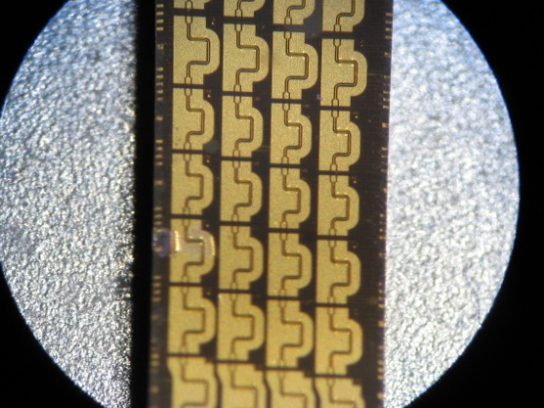
1.3μm Hybrid Silicon Electroabsorption Modulator with Bandwidth beyond 67 GHz
Yongbo Tang*, Jonathan D. Peters, and John E. Bowers
Dept. of Electrical and Computer Engineering, UC Santa Barbara, CA, USA
ytang@ece.ucsb.edu
Supported by DARPA MTO EPHI project (Scott Rodgers) and Intel
Notes:
Thank you for the Chair’s introduction. At first, we wanna thank our colleagues and the funding support from DARPA and INTEL

Slide 2
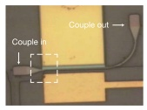
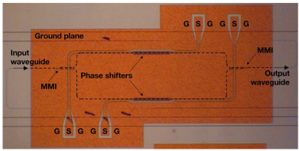
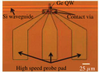
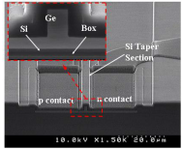
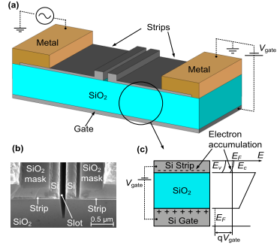
Silicon Modulator
High Speed and High Efficiency?
Graphene/Si EAM
Si MZM
Ge/Si QW EAM
D. Thomson et al. Surrey, 2012
Ge EAM
M. Liu et al. UCB, 2011
S. Ren et al. Stanford, 2012
Polymer/Si PM
N. Feng et al. Kotura, 2011
L. Alloatti et al. KIT, 2011
Notes:
OK, the introduction. As we known, silicon photonics has many advantages, but also a few disadvantages. One issue is that how to make a high speed and high efficient（强调） modulators. There are many impressive studies under this topic, like these modulators based on all-silicon, Ge, Ge/Si, EO polymers and novel material like the Graphene. However, regarding the high speed operation, they are still not good enough.

Slide 3
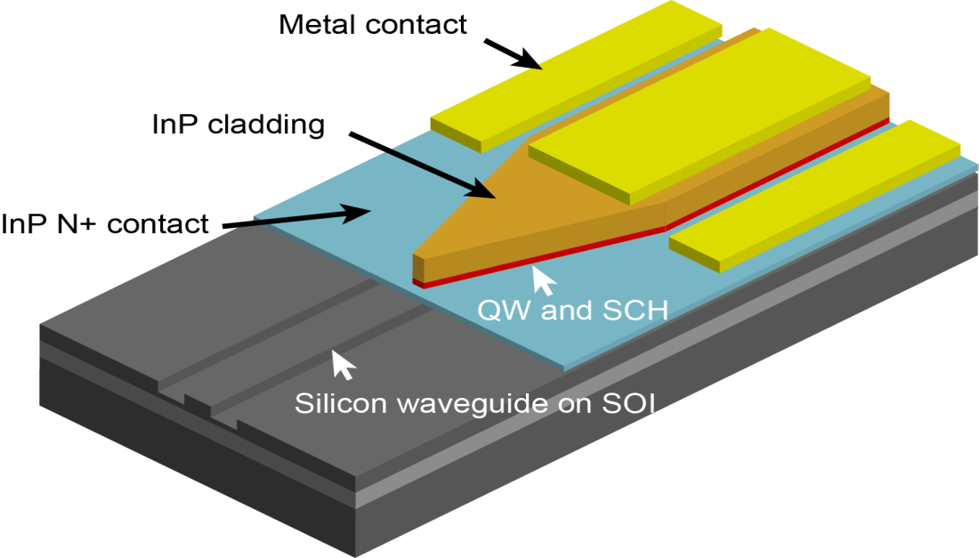
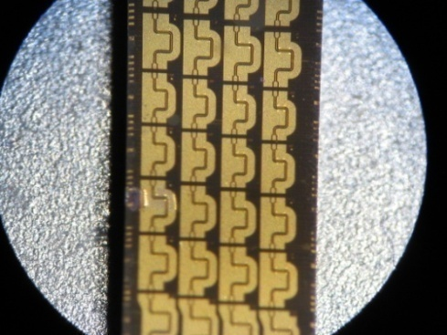
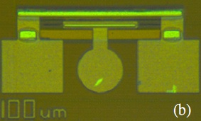
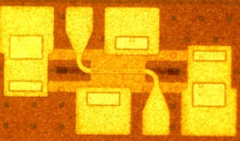
Hybrid Silicon Modulator
Segmented： > 67 GHz
lumped: ~20 GHz
TW: ~42 GHz
Y. Kuo, et al., OE 16(13), 9936 (2008)
Y. Tang, et al., OE 19(7), 5811(2011)
This work, OFC2012
Notes:
So here is our solution: making a III-V quantum wells modulator on silicon based on the hybrid silicon platform. On 2008, we reported our first demonstration based on lumped electrode. It has a bandwidth of ~20GHz. Then, last year, we developed the distributed modulator based on traditional traveling-wave configuration. The bandwidth has been improved to ~42GHz. And today, we will report our new generation based on segmented electrode. Its bandwdith has exceeded 67GHz.

Slide 4
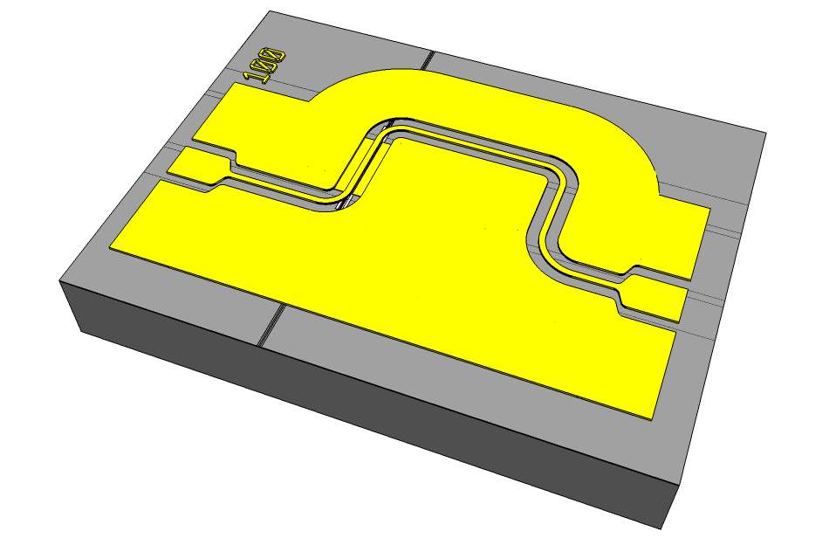
Schematic and SEMs
Light out
Target:
Higher speed and longer distance transmission
RF in
Passive TML B
Active TML
Passive TML A
440μm
655μm
RF out
Si
Light in
20μm
2 μm
QW/SCH
p-Electrode
l_{p2}=490μm
SU-8
n-Electrode
p-InP
SCH/MQW
l_{a}=100μm
n-InP
n-InP
SiO₂
Si ridge
air trench
l_{p1}=165μm
p-InP
Si substrate
200μm
Notes:
this slide shows the schematics of the new design. The whole footprint is 655x440um2. Note that we use CPW. Most of the pad metal is on the surface. The area underneath is free for optical component. For the practical operation, the light will go from here to there. And the RF signal goes from this port to that port, and terminated by a 50ohm load.
The SEM figures at the bottom shows the topview, cross section and the multiple-level taper for the practical device. For the target of a higher speed and a longer transmission distance, we made two main improvements: the material and the elctrode.

Slide 5
Material System
Notes:
This slide shows the detailed tructure for the III-V EPI and the SOI wafer. We use AlGaInAs quantum well. It gives strong electroabsorption effect and allows us to use a short modulator length. Compressive QW is used for TE mode. to be compatible with the laser integration. The photoluminance peak of the quantum well is 1247nm. This setting can support the modulation operation in the 1.3um wavelength window. So we can get rid of dispertion limitation and reach a longer transmission distance.

Slide 6
Asymmetric Segmented Electrode
200μm
50μm
490μm
W_{QW}=2.35μm
Za ~18Ω
100μm
Zp ~ 90 Ω,
RF Source
off-chip 50Ω Load
Active
Passive
165μm
Standing-wave effect
Passive
Active
Passive
165
265
755μm
Position [μm]
Notes:
Let us look at the detailed of the electrode. We use a 100um active segment.Its characteristic impedance is 18ohm. two passive coplanar waveguides segments with high impedance of ~90ohm are inserted before and after the active part. The input CPW length is 165um and the output is 490um. They are chosed by a generic algorith for a maximal modulation bandwidth. The figure left bottom shows the calculated response versers the frequency. The modulation bandwidth exceeds 75GHz. This large bandwidth comes from several factors. First is the impedance matching at the input port due to the insert of high impedance CPWs and the use of 50ohm load, the S11 shows that the reflection is less than -10 dB up to 60GHz.It means a good feed-in efficiency. Second is the positive standing-wave effect. The positive standing-wave effect comes from the high-low-high impedance configuration. In the low impedance part, the reflection from the high impedance part is constructively added to the forward voltage and gives a higher voltage on the low impedance part. It can compensate the high frequency roll-off due to the increased microwave loss and intrinsic RC penalty and extend the modulation bandwidth. The figure right bottom gives the voltage distribution across the electrode. We can see that as the frequency increases, the voltage in the active part goes up and then goes down. This lead to the uplift on the left figure as marked.

Slide 7
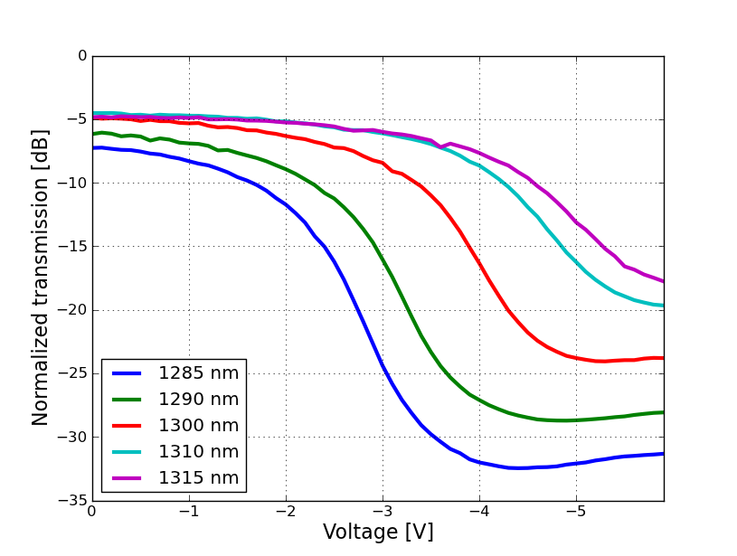
Static Extinction Ratio
4.9dB
Normalized to the reference Si waveguide
15dB/2V
Notes:
OK, now let us look at the measurement results for this modulator. Here is the static extinction ratio. We lauch the wavelengths across 30nm window and get the transmission curves as a function of the reversed bias. Those data are normalized to the insertion loss of a reference silicon waveguide. We can see that the modulator has a loss of ~4.9dB. For the extinction ratio with 2V is changed from 10dB to 20dB as the wavenlength is reduced.

Slide 8
Measured S-Parameters
S22
S12
S21
S11
Bias = -3.5V
Measurement calibrated to the probe tips
Notes:
Here is the measured Scattering parameters for the electrode. Similar as the simulation, we got S11 less than -10dB for more than 60GHz. S22 actually is not very good but it will not affect the modulator’s performance. The S21 shows is a 4.5dB transmission loss, mainly from the active part and the long output CPW.

Slide 9
EO Response
Standing-wave enhanced
74GHz
Vb = -3.7V, Ip=0.42mA.
Pin= ~-1dBm @ 1300nm;
Notes:
This slides show the measured EO modulation response. We can see the uplift induced by the standing-wave here. The measured data gives a drop of 2dB at 67GHz, which is the upper limit of our equipment. The extrapolated curve gives a 3 dB bandwidth of around 74GHz. With this bandwidth, theorectically, the device can support a transmission bit rate of 100Gb/s. But due to the limiation of the equipment, the large signal measurement is done at 25, 40 and 50Gb/s.

Slide 10
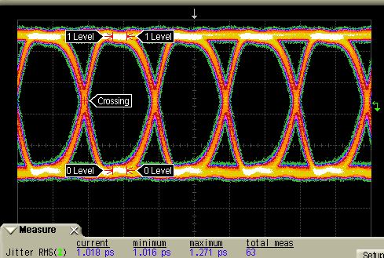
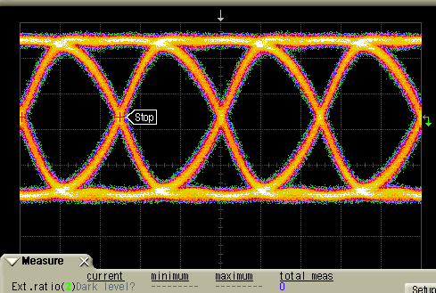
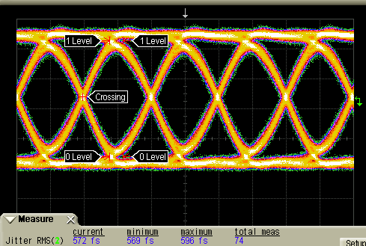
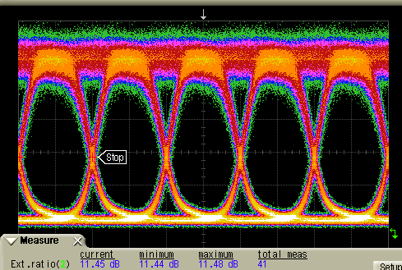
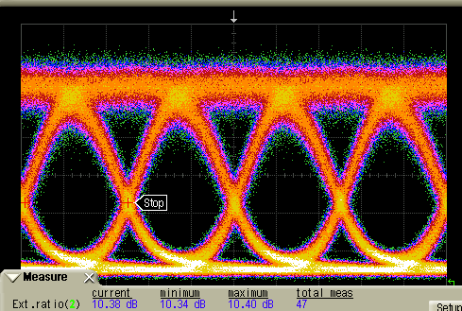
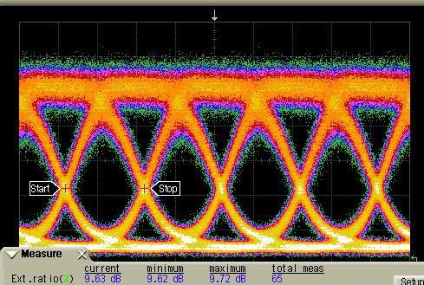
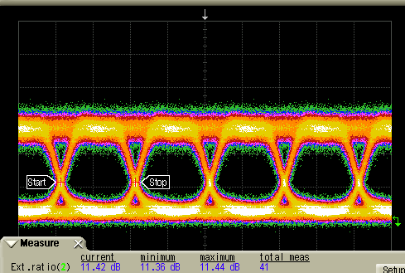
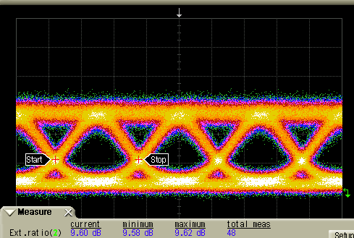
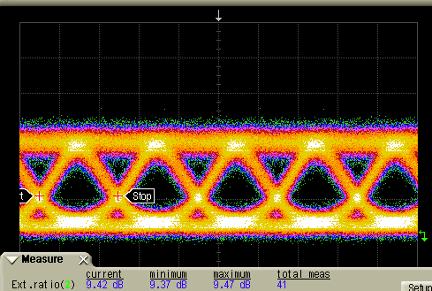
Large Signal Transmission
EE
(15dB att.)
Eye Amp.=426mV
Eye Amp.=407mV
Eye Amp.=388mV
ER=11.4dB
ER=10.3dB
ER=9.6dB
B2B
ER=11.4dB
ER=9.6dB
ER=9.4dB
20 ps
10 ps
10 ps
16km
(a) 25Gb/s
(b) 40Gb/s
(c) 50Gb/s
Bias=-4.0V, Ip=~ 1.55mA, Pin=~4dBm @1300nm
Terminated by DC block + 50Ω standard off–chip load
Absorption maximized, Booster SOA
Notes:
Here are the eye diagrams. The first line is the drive electrical signal. It is measured with additional 12dB attenuator. We can see that at 50Gb/s, the eye amplitude is 388mV, corresponding to the practical drive voltage of 1.55V on the modulator. I have to appologize that I made a mistake in our paper. 2.2Vpp should be 1.55Vpp. The second line is the back to back optical eye diagram and the third line is the eye after 16km transmission. All of these eyes are very open. Especially for the 50Gb/s, it has extinctio ratio of ~9.4dB for both the B2B and the 16km transmission.

Slide 11
Summary
COGO’12
MZM
IIIV/Si
Utoronto’11
Ring*
This work
NTT’05
MZM
*estimated
Notes:
here comes our summary with comparsion of the modulators on InP substrate and Si substrate. The x axis is the bandwidth, the y axis is the dynanmic modulation efficiency. I updated it with some new results like surrey’s 50Gb/s Si modulator and the Cogo’s 40Gb/s MZM modulator. For our work, it is here. It has a bandwidth beyond 67GHz and modulation efficiency of 6dB/V.

Slide 12

Thank you

Slide 13
Backup

Slide 14
Power consumption
Distributed EAM
Equavilent Circuit
Assume square pattern, 50% ‘1’ Level
Mainly from the photocurrent;
Power delivered from the source
For impedance matching at the input port
P = 605fJ/bit

Slide 15
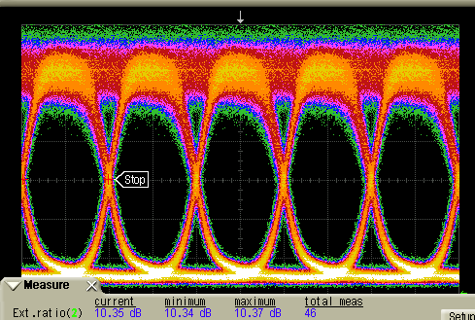
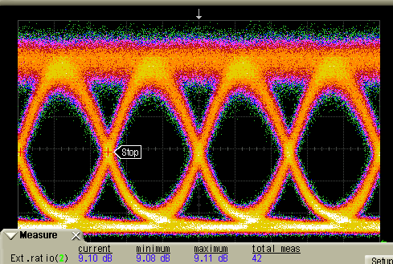
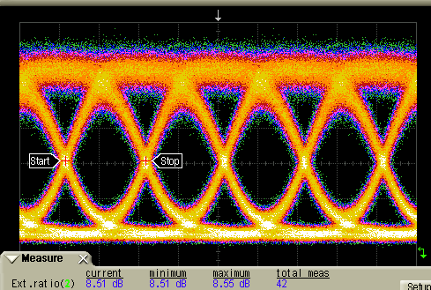
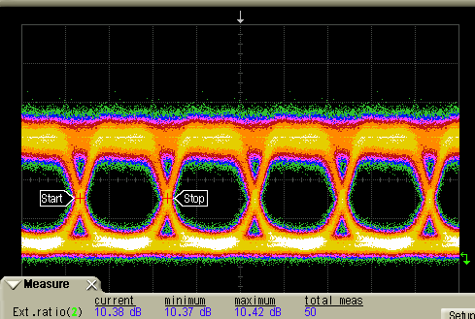
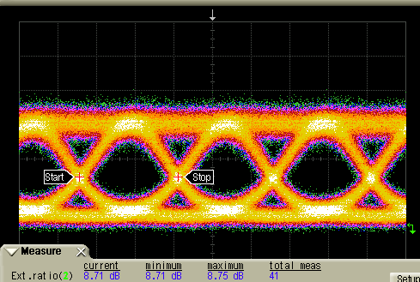
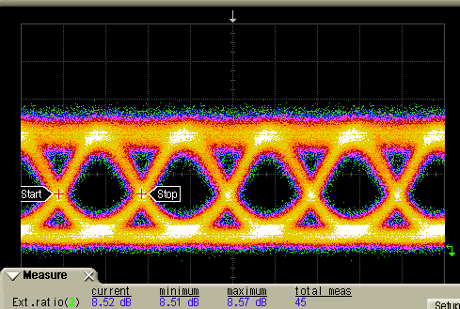
Symmetric Eye Diagrams
EE
(15dB att.)
Eye Amp.=426mV
Eye Amp.=407mV
Eye Amp.=388mV
ER=10.4dB
ER=9.1dB
ER=8.5dB
B2B
20 ps
ER=10.4dB
10 ps
ER=8.7dB
10 ps
ER=8.5dB
16km
(a) 25Gb/s
(b) 40Gb/s
(c) 50Gb/s
Bias=-3.8V, Ip=~1.42mA, Pin=~4dBm @1300nm
Terminated by DC block + 50Ω standard off –chip load
Absorption maximized, , Booster SOA

Slide 16
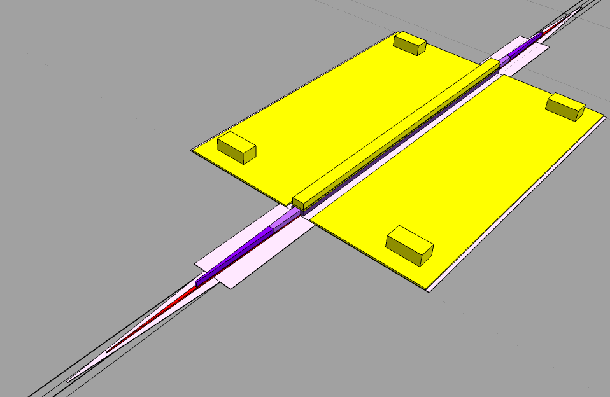
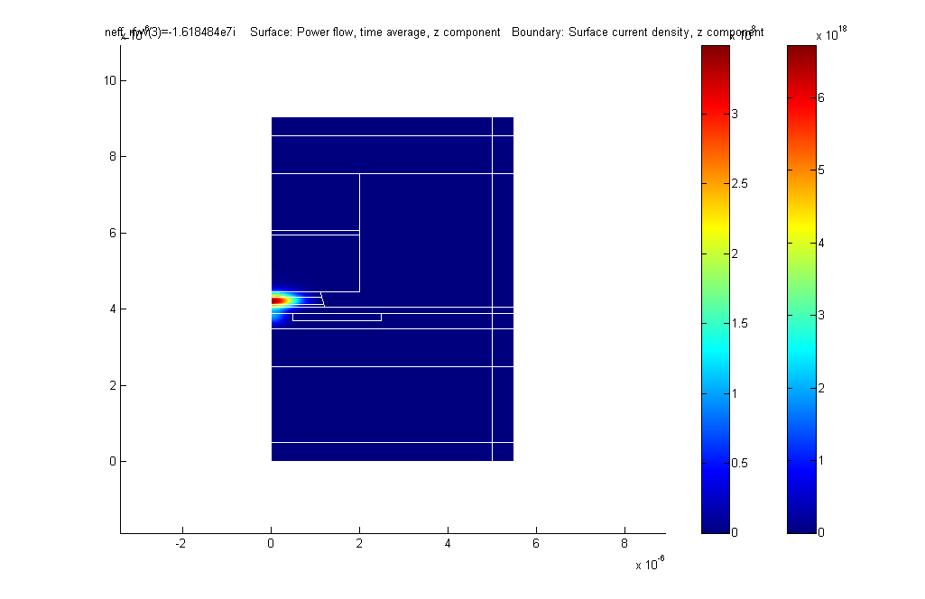
Optical Structure
Si
Ground Via
p-InP/H+
100 μm
Γ_{well}=24%
p-InP
QW/SCH
60μm
n-InP
Si, n-InP, QW/SCH, p-InP 4-level taper
QW/SCH taper tip is less than 100nm, defined by wet etching
Notes:
Background

Slide 17
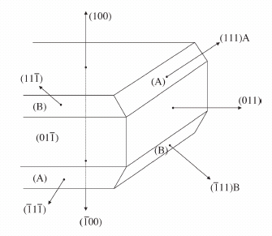
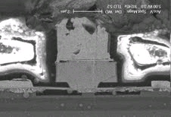
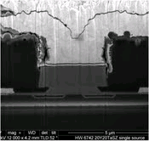
Undercut shape
(111)A, III group element: slower etch speed
(111)B, V group element: faster etch speed
III-V Die
Si Waveguide
III-V Epi
Green
Blue
Major Flat
D. Pasquariello, et al, JLT, 24(3), 2006

Slide 18
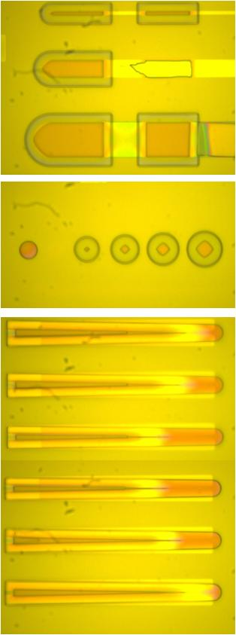
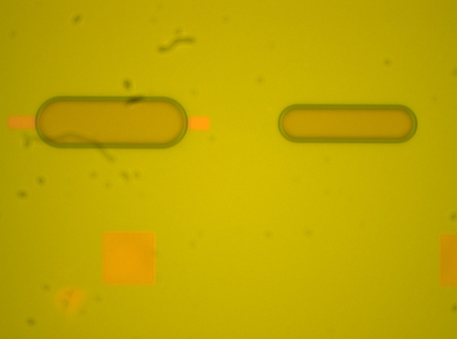

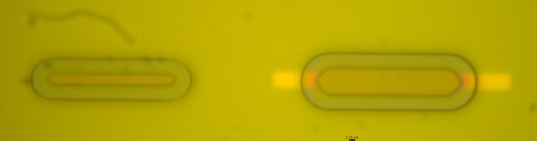
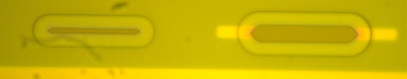
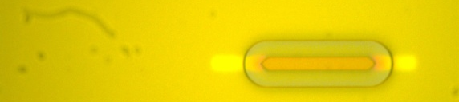
Detailed about QW undercut
30 Sec
90 Sec
225 Sec
150 Sec
210 Sec
225 Sec
Etch speed: ~0.66 μm/min for 1250nm Epi

Slide 19
Voltage Distribution on Active Segment
Lumped
TW
Segmented

