Slide 1
Bonding Issues
November 3, 2011

Slide 2
Defects and Solutions
Catastrophic Initial Bond Pre Anneal and Post Substrate Wet Etch:
Surface roughness >1 nm. Initial roughness >1nm or processing steps caused roughness to
increase. Check roughness prior to processing. You may need to check prior to bond if any
unusual steps taken such as thermal oxidation thinning.
Large Particle between mating surfaces. Check before bonding.
Scribe or identification mark on backside of III-V. Do not mark the backside.
Bubbles/Lifting Post Substrate Removal:
Particles or defects on materials. Keep bonding surfaces clean and note any defects prior to bonding.
Rapid and large temperature increase during PE-CVD deposition. Dehydrate post substrate removal and pre PE-CVD deposition.
Pattern geometry. Certain geometries tend to causes poor bonding. Need to identify patterns.
Bond Edge Issues:
Etch undercutting. Removing wax before substrate removal will increase the undercutting. Any open geometries will wick the etching solution in further. Removing the wax prior to substrate removal will help reduce “mountains”. Keep critical features away from III-V bond edge. It may be possible to thin further to reduce these issues.

Slide 3
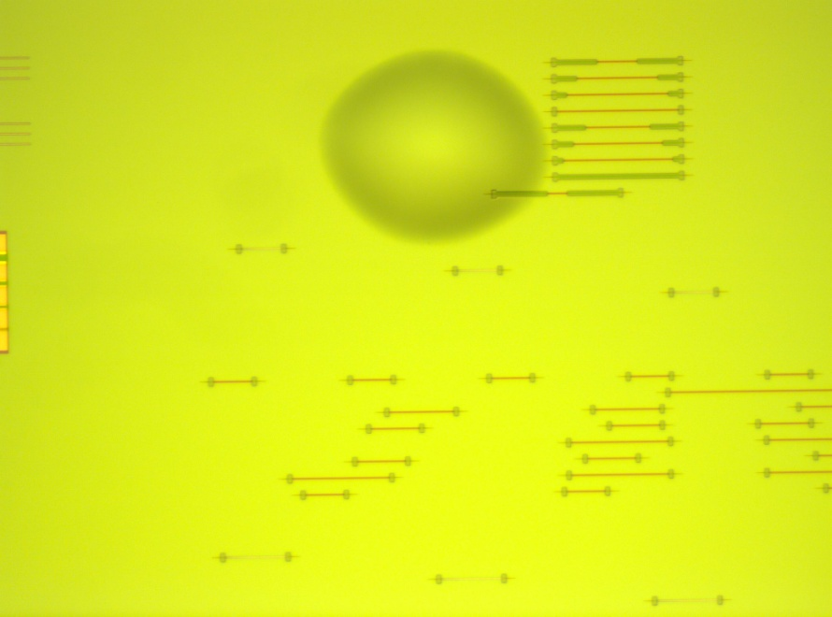
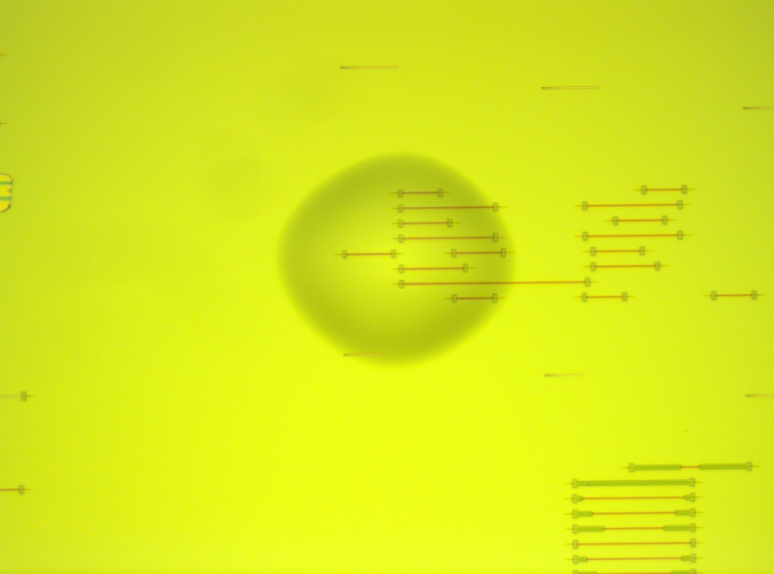
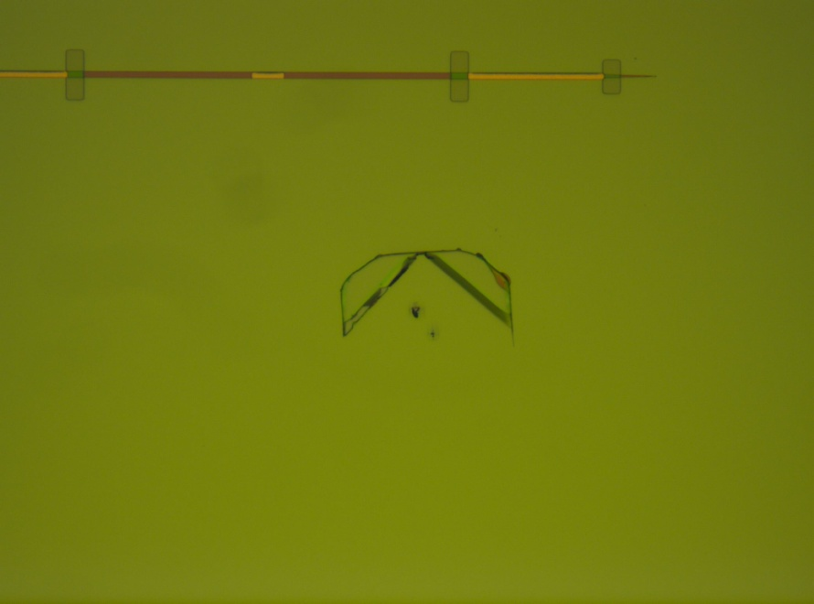
Bubbles/Lifting
Images taken of EAM Run 2 at Post Mesa Hardmask etch

Slide 4
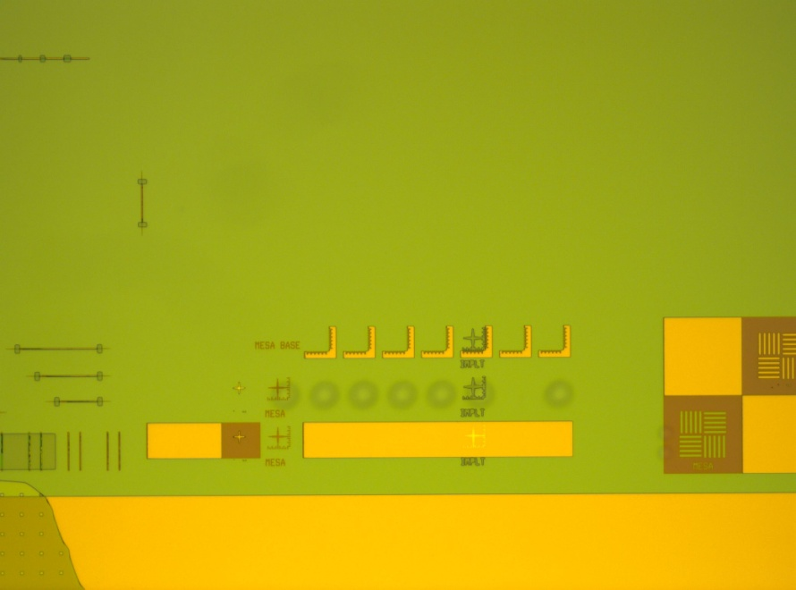
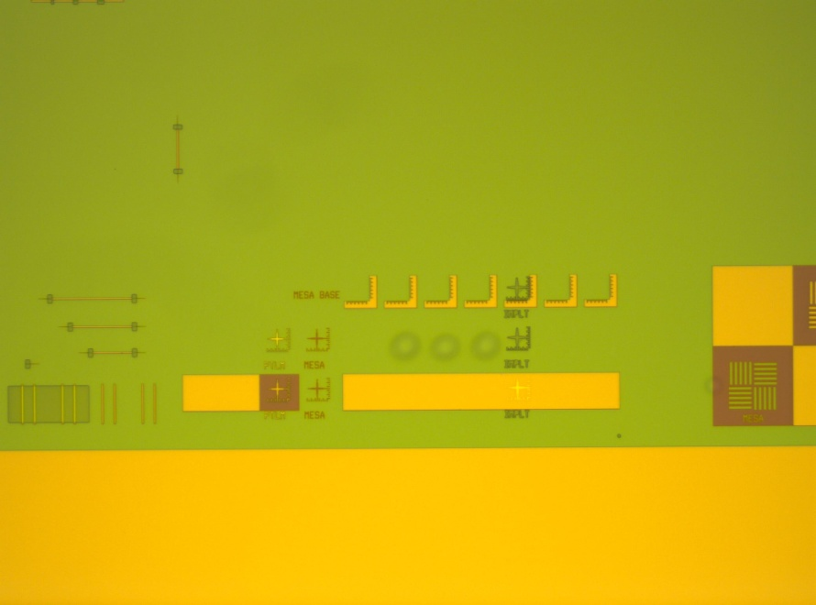
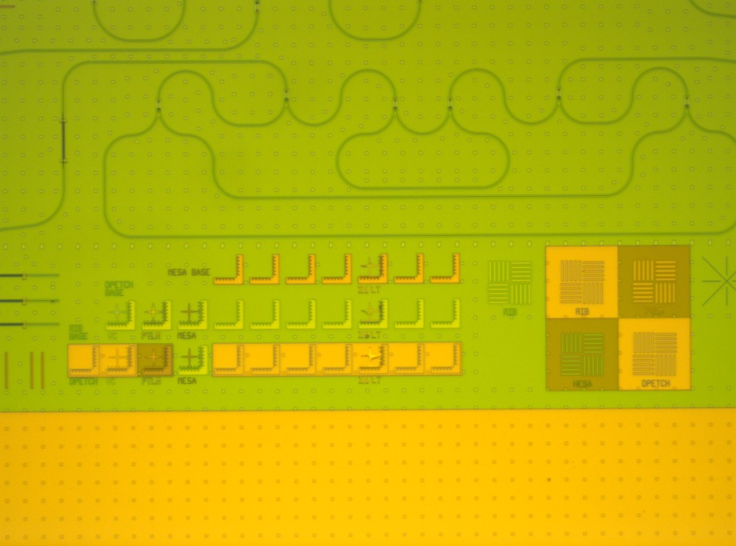
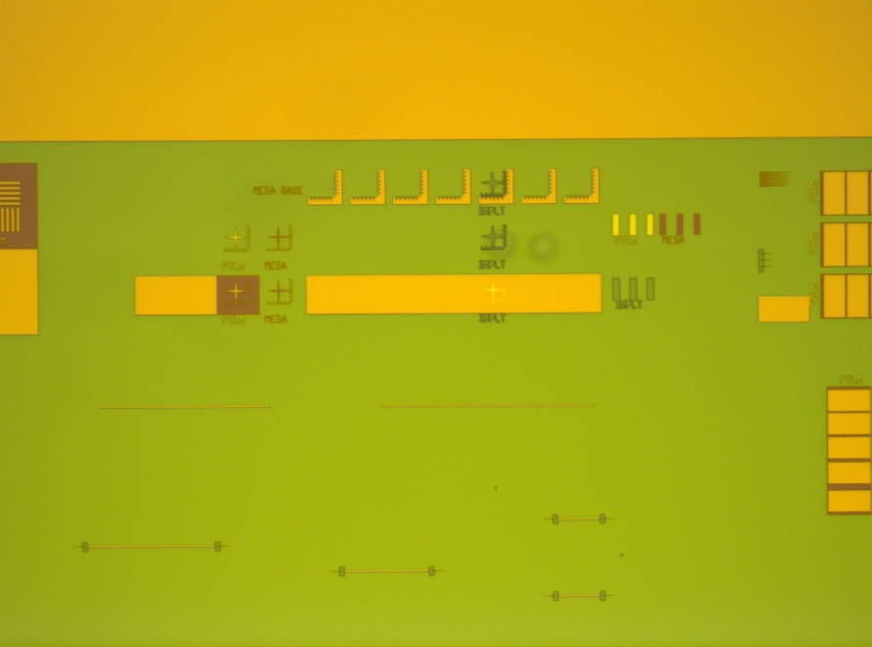
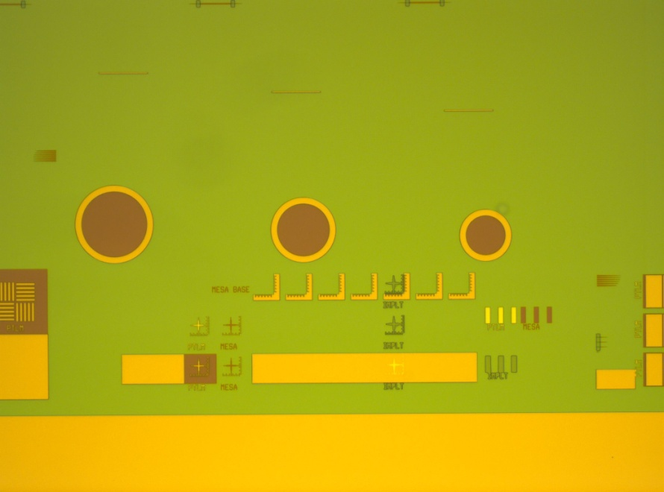
Bubbles/Lifting
Reference Non Bonded Area
Not always present in every vernier

Slide 5
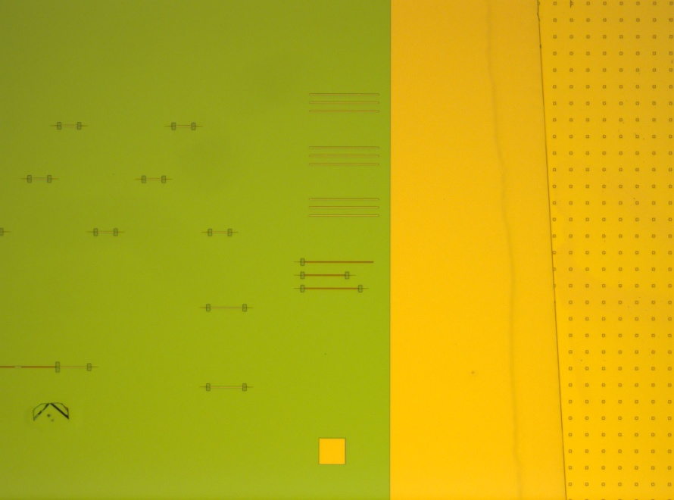
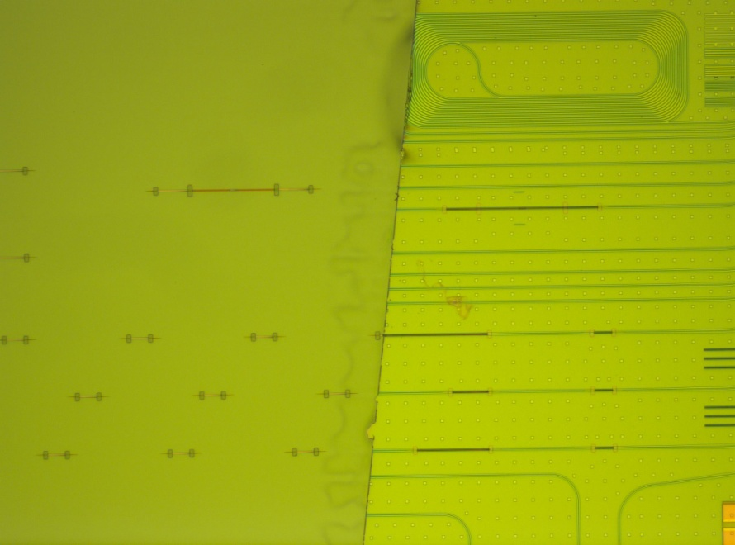
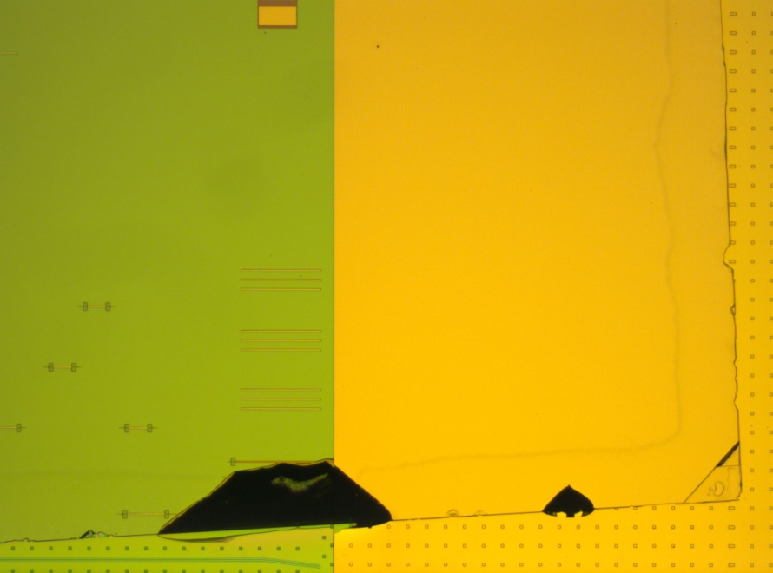
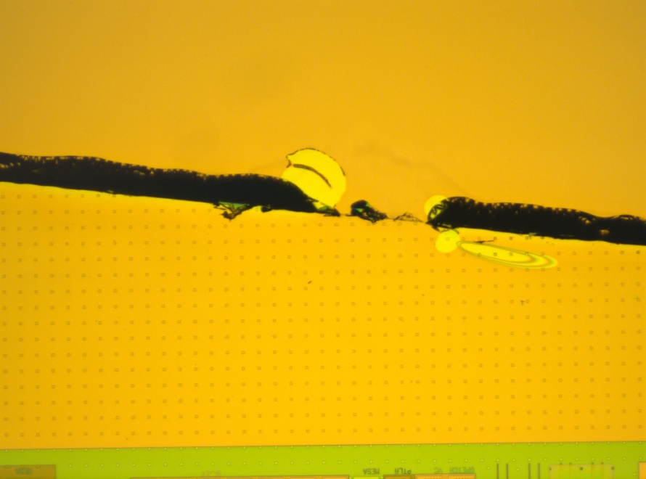
Edge etch undercutting during Substrate removal
Incomplete substrate (InP) removal along one axis typically Substrate removal done using HCL:DI 3:1 with wax on borders

Slide 6
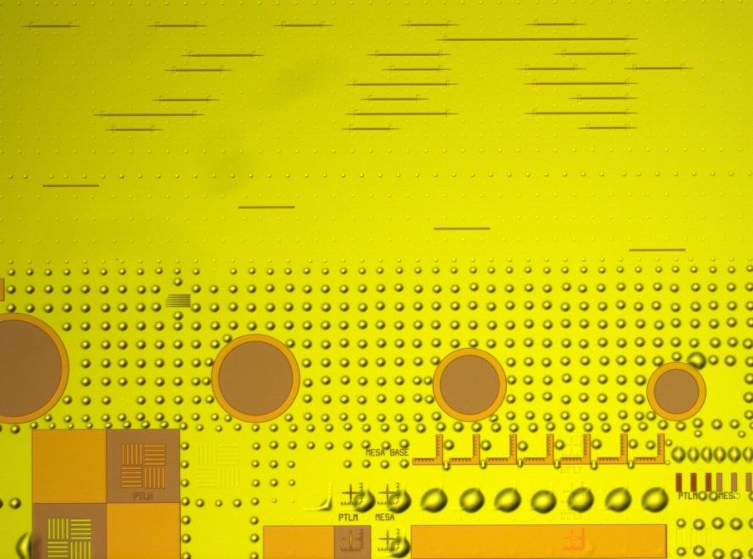
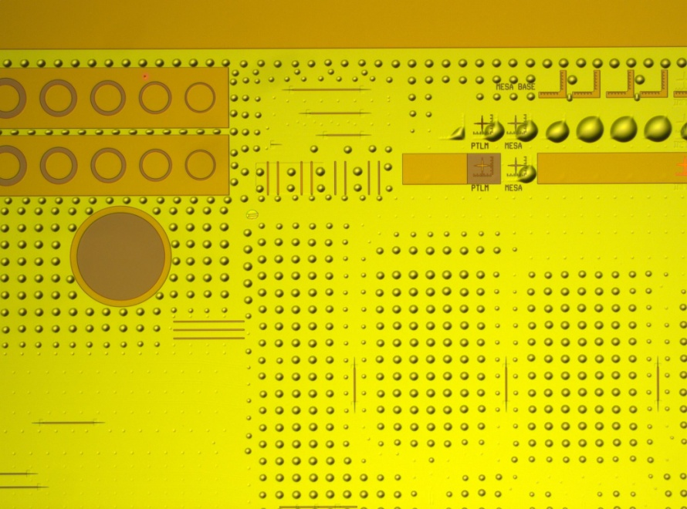
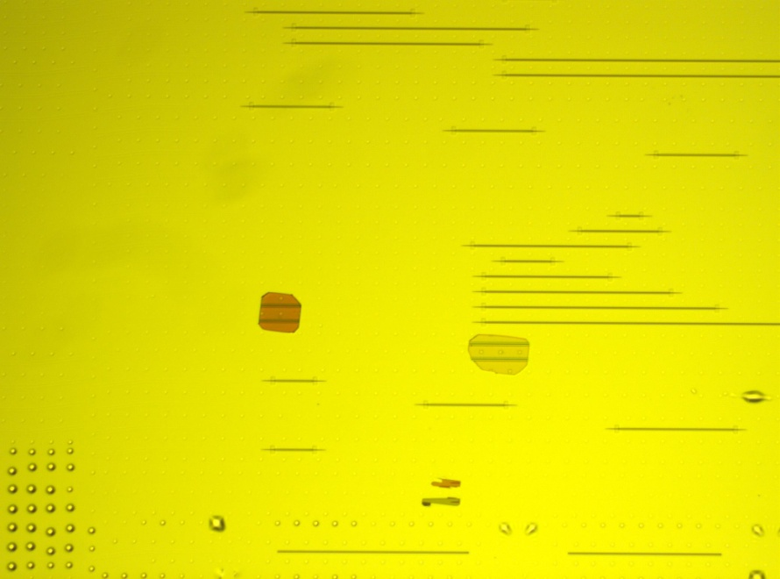
Post MHA Etch to QW
?
Missing EPI post MHA etch, not seen prior to etch

