Slide 1
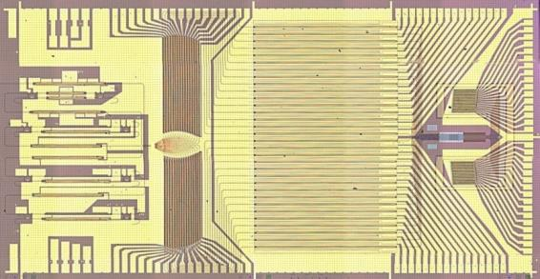
Hybrid III-V Silicon Quantum Dot
and Quantum Well Lasers
John Bowers
Director, Institute for Energy Efficiency
University of California, Santa Barbara
http://optoelectronics.ece.ucsb.edu/
UCSB: Jared Bauters, Dan Blumenthal, Daoxin Dai, Mike Davenport, Art Gossard,
Martijn Heck, Jared Hulme, Alan Liu, Jon Peters, Daryl Spencer, Sudha Srinivasan
SLIDES:Arai, Arakawa, Baets, Fang, Gaeta, Inoe, Kippenberg, Koch, Krishnamoorthy,
Liang, Paniccia, Roelkins, Vahala, VanThourhout, Yariv
Research supported by Josh Conway and Jag Shah at DARPA MTO, Intel, Google, TE Connectivity, Aurrion
4 tunable lasers, 4x32 splitter, 32 amplifiers,
32 phase shifters, 32 grating emitters, 32 photodetectors

Slide 2
Outline
Silicon Photonics
Lasers on Silicon
  Er doped
  Patterned
  Ge
  Bonded
  Epitaxially grown
Quantum dot lasers
Tunable Lasers
Integration
Commercialization
Future
Summary

Slide 3
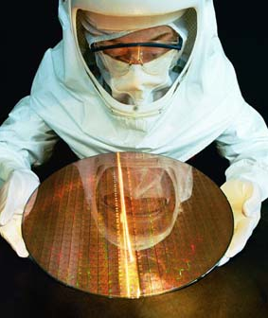
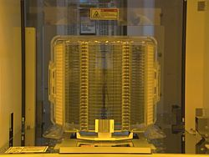
What is Silicon Photonics?
Making photonic integrated circuits on Silicon using CMOS process technology in a CMOS fab
Merging photonics and CMOS
The issue is not InP or GaAs versus Si. The issue is
Scaling photonics to high levels of integration with improved performance and better process control at low cost.
Solving electrical interconnect limits in Data centers, Supercomputers and ICs with higher capacity, lower cost optical interconnects

Slide 4



















2014: Silicon Photonics Participants
Silicon Photonics
Foundries
Silicon Photonics Companies
Silicon &
Systems Co’s
PETRA
This is not exhaustive list
Numerous Silicon Photonics Entrants
Across Start-ups, Products, Foundries and Research
© 2014, Intel Corporation. All Rights Reserved

Slide 5
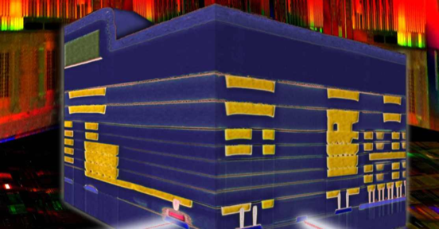
Why Silicon Photonics?
Integrate photonics with electronics
  Same wafer
  Bump bonding of silicon PIC with silicon IC
    Same coefficient of thermal expansion
  3D stacking
Reduce cost by going to larger diameter wafers (300 mm)
  InP limited by wafer breakage to 100 mm diameter
Reduce cost by sharing VLSI facility with electronics
Improve yield by taking advantage of silicon process development
Volume driver: Solve IC interconnect bottleneck (from 4 Tbps to 1 Pbps). Optical transmitters/receivers on processors, memories, switches.
Cross-sectional view of an IBM Silicon Nanophotonics chip combining optical and electrical circuits
Vlasov et al. IEDM postdeadline

Slide 6
Chip I/O bandwidth requirements
~2x every 2yrs

Slide 7

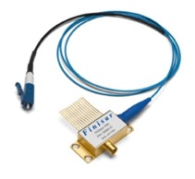
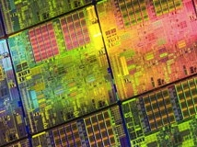
Bringing Si Manufacturing to the Laser
Lasers
Si Manufacturing
Very high bandwidth
Long distances
Immunity to electrical noise
High volume, low cost
Highly integrated
Scalability
InP Photonic Integrated circuits
Silicon Photonic Integrated circuits
Six Generations
Courtesy: Rattner (Intel)

Slide 8
Needs
What is needed is a photonics platform for interconnects and switching that is scalable to
  Low power
  High capacity
  Low cost
  High volume
  High yield
  High reliability

Slide 9
Silicon Photonic Components
Passives
  Low loss waveguides
  Splitters
  Wavelength selective combiners/splitters
  Isolators/Circulators
  Comb generators
Actives
  Lasers (Pump and single frequency)
  Modulators
  Switches
  Amplifiers
  Photodetectors

Slide 10
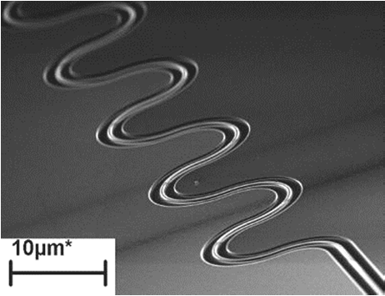
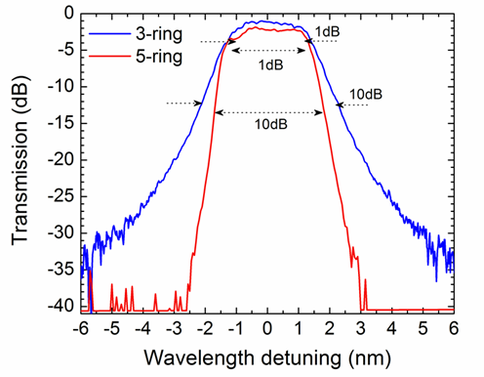
Superior Passive Si Photonic Devices
Si/SiO2 High index contrast:
Small wires
Small passive devices
High coupling loss
High propagation loss
Example of losses for high-index-contrast “wire” waveguides:
For 6.5 μm radius bends, losses are 0.0043 dB per 180º turn
Source: Y. Vlasov, IBM

Slide 11
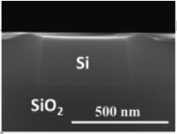
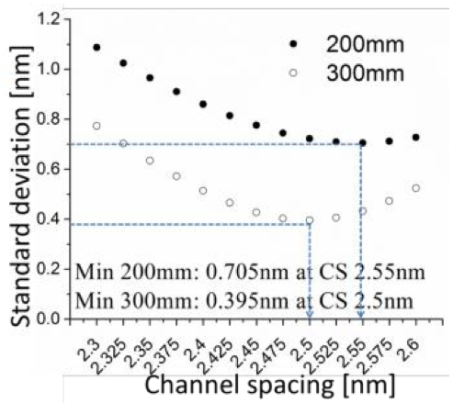
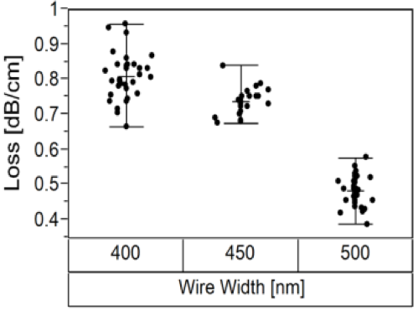
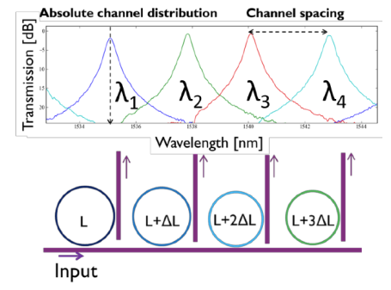
Move to 193nm immersion lithography, 300mm wafers
Lower loss waveguides
More uniform channel spacing in ring demux
Also:
< 0.15dB/cm loss in ridge waveguides
<2dB/cm loss in slot waveguides
S. Selvaraja e.a., OFC ‘14
Selvaraja e.a. 17th OptoElectronics and Communications Conference (OECC 2012)
P. De Heyn, PhD Thesis UGent, May ‘14

Slide 12
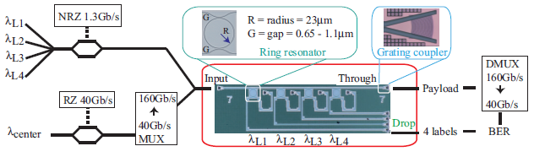
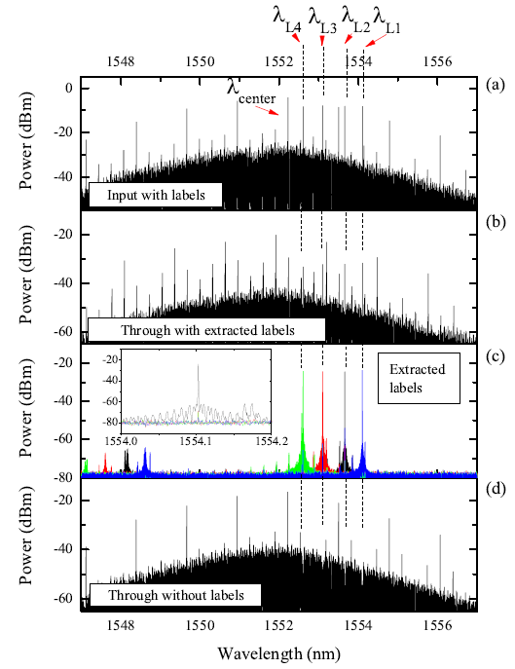
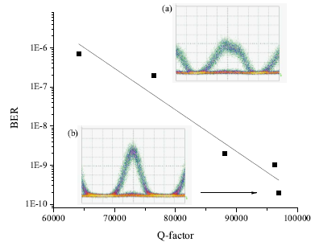
A four in-band label extractor for 160 Gb/s optical packets
De Heyn e.a., IEEE JLT, 2014
(collaboration with TU/e)

Slide 13
Silicon Photonic Components
Passives
  Low loss waveguides
  Splitters
  Wavelength selective combiners/splitters
  Isolators/Circulators
  Comb generators
Actives
  Lasers (Pump and single frequency)
  Modulators
  Switches
  Amplifiers
  Photodetectors

Slide 14
Silicon light emission – limits
Indirect band gap - inefficient for light emission
Auger recombination
Free carrier absorption
Energy
Low internal quantum efficiency in bulk silicon (10⁻⁶)
Conduction band
e⁻
hν
hν
Absorption
Indirect radiation recombination
Valence band
h⁺
Wavevector
14

Slide 15
Silicon light emission – How?
Bulk silicon
Low dimension Silicon
  Silicon nanocrystal (Pavesi, …)
  Periodic nanopatterned crystalline silicon (Jimmy Xu)
Er dopants (Dal Negro,…)
Raman laser (Noda, Kyoto, UCLA, Intel)
Another material for gain (hybrid approach)
  Epitaxial
    Ge
    GeSn
    Quantum Dot
    Pillars
  Bonding
    Dice level
    Wafer level (BCB or Molecular)
15

Slide 16
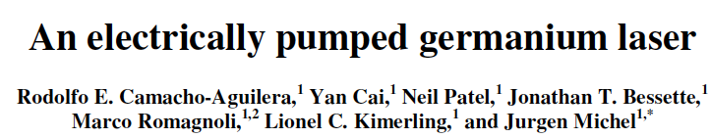
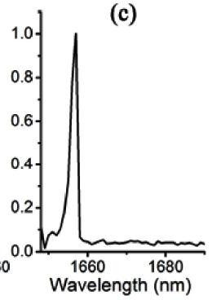
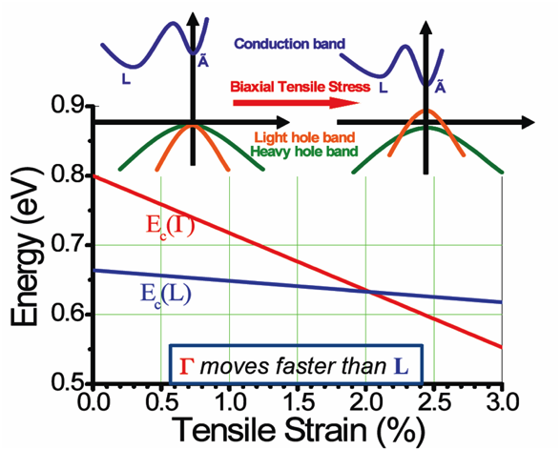
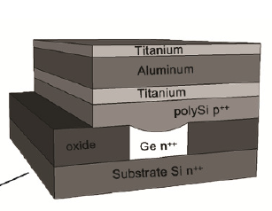
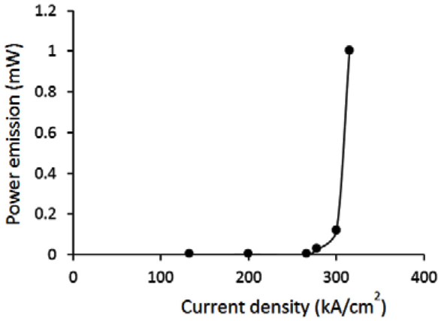
Pulsed Lasing

Slide 17
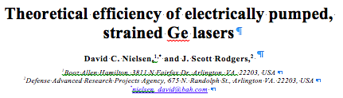
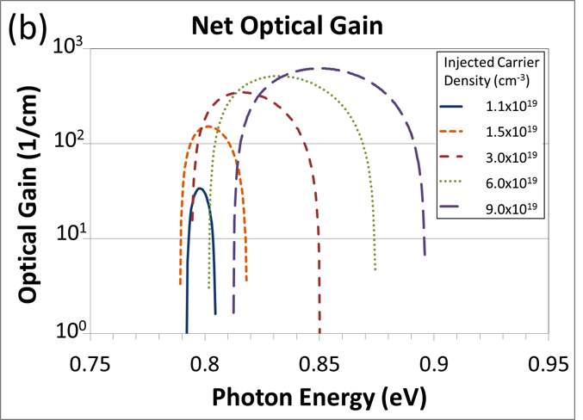
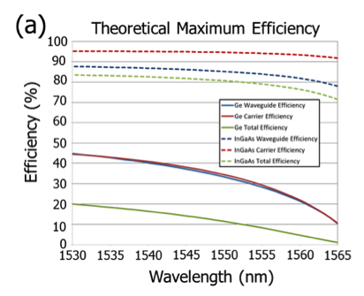
InGaAs
Ge

Slide 18
Heterogeneous Integration
Quantum Well (UCSB, Ghent, Caltech,
Tokyo Inst. Of Tech, Intel, HP, Aurrion)
Quantum Dot (Univ. Tokyo, UCSB)

Slide 19
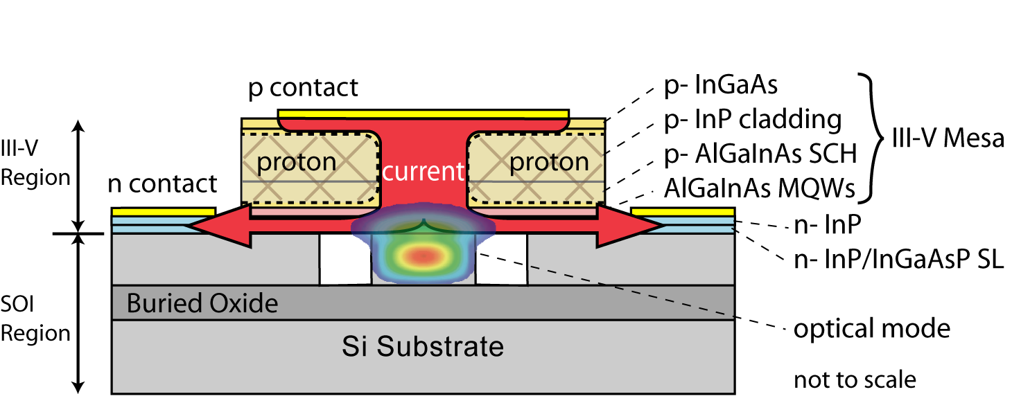


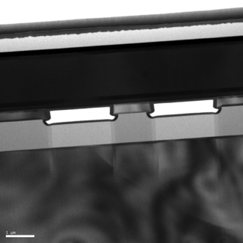
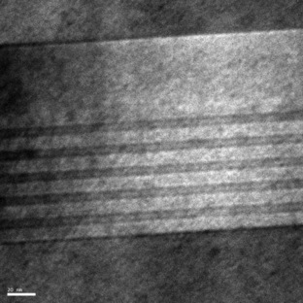
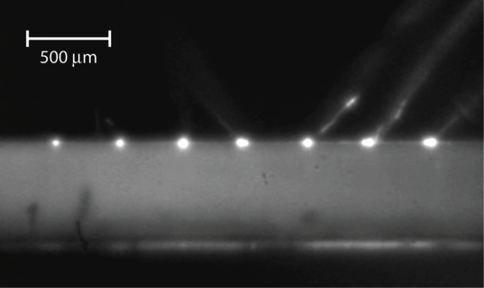
Hybrid Silicon Photonics
Direct Gap III-V
III-V active region
Silicon
Silicon rib waveguide on SOI wafer
  Optical gain from III-V Material
  Efficient coupling to silicon passive photonic devices
  No bonding alignment necessary: suitable for high volume CMOS
  All back end processing low temperature (<350 C)
7 lasers operating c.w. simultaneously
Alex Fang
A.W. Fang, et al., “A Continuous Wave Hybrid AlGaInAs-Silicon Evanescent Laser,” IEEE Photonics Technology Letters, 18 (10), 1143-1145, May 15, 2006

Slide 20
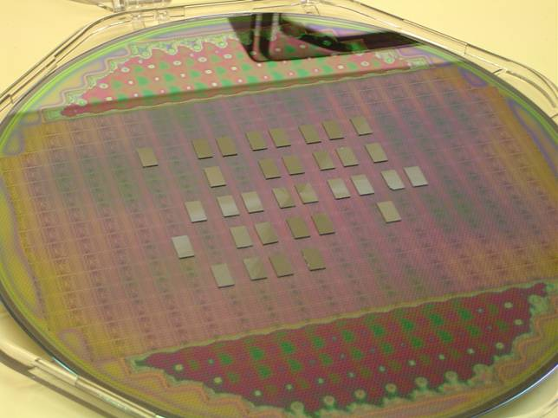
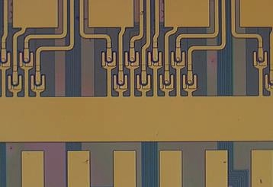
Heterogeneous integration
UCSB, Intel, HP, Ghent, TIT, Caltech
Step 1: Bond InP-dies on SOI waveguide
InP
III-V dies
Si
Step 2: Remove substrate
SOI-waveguide wafer
BCB or SiO₂
SiO₂
Si
8 lasers
Step 3: Process lasers at wafer scale
SiO₂
Waveguide bundel
Si
20
IMEC/Ghent

Slide 21

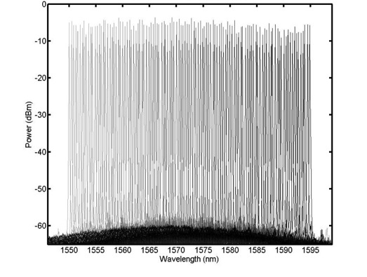
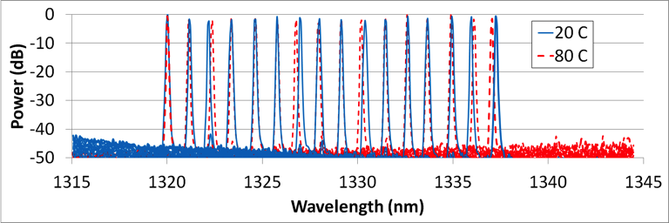
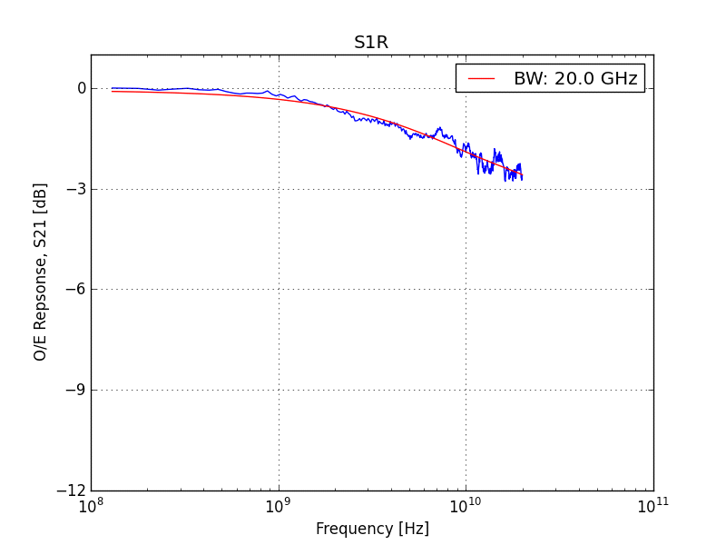
Aurrion PIC Integration
Brian Koch et al., OFC Postdeadline 2013
Telecom Tunable Lasers
Datacom uncooled WDM laser arrays
Modulators: 23 GHz, >15 dB ER, 1.3 V_{pi}
>36 GHz, 0.8 A/W Photodetectors

Slide 22
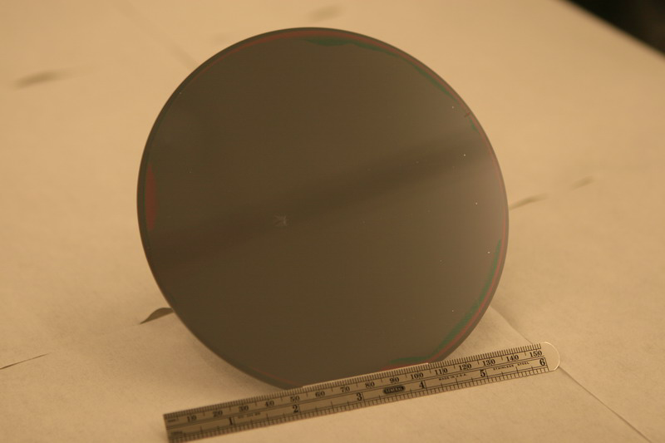
Quantum Well Epi on 150 mm Silicon
Oxygen Plasma Enhanced Molecular Bonding

Slide 23
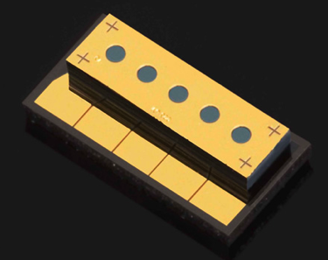
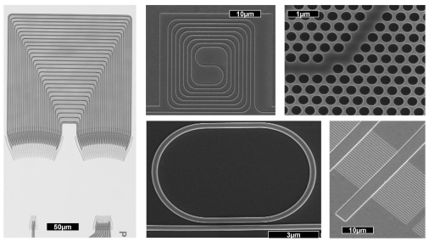
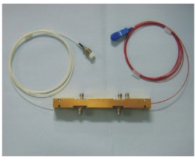
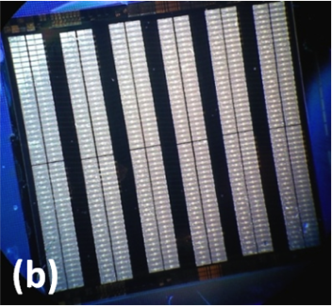
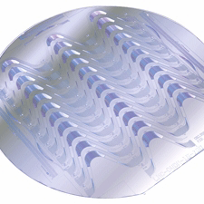
Heterogeneous Integration of
6 Photonic Platforms
GaAs
Silicon
LiNbO₃
SiN/SiON/SiO2
Ce:YIG Isolator
InP
Input
Top view
B
Ce:YIG

Slide 24
UCSB Shuttle Run
Taper test structures
Loop mirror lasers
FP-MLLs
DBR lasers
Tunable laser microwave generators
Feedback stabilized MLLs
DBR MLLs

Slide 25
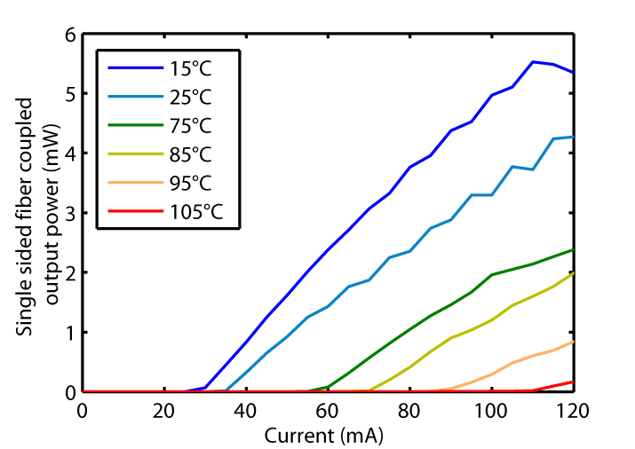
Hybrid Silicon Quantum Well Lasers
105 C CW 1310 nm laser
Max fiber coupled output power: 5.5 mW/facet
T0: 80 °C
Injection efficiency: 52 %
Chang et al., Optics Express 15(18), 11466, August (2007).

Slide 26
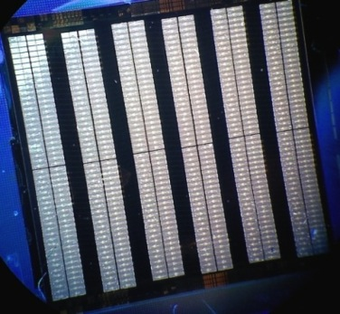
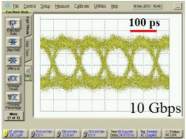
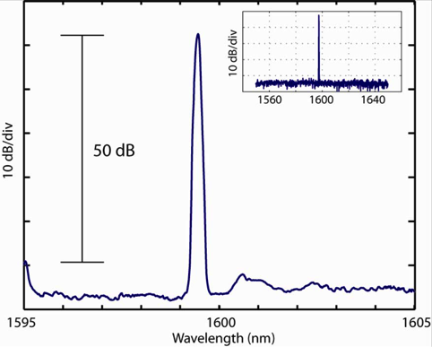
DFB Quantum Well Hybrid Silicon Lasers
[A. Fang-Racetrack]
[S. Jain-DFB]
[M. Sysak-FP]
[M. Sysak-FP]
[A. Fang-DFB]
[S. Srinivasan-DFB]
[D. Liang-Microing]
[C. Zhang-DFB]
Chip showing 300 DFB lasers
with yield >95%
10Gbps direct modulation of a 200μm DFB laser
C. Zhang, et al. "Low threshold and high speed short cavity distributed feedback hybrid silicon lasers", Optics Express 2014

Slide 27
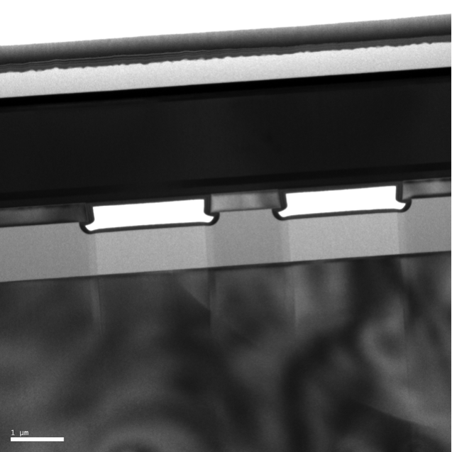
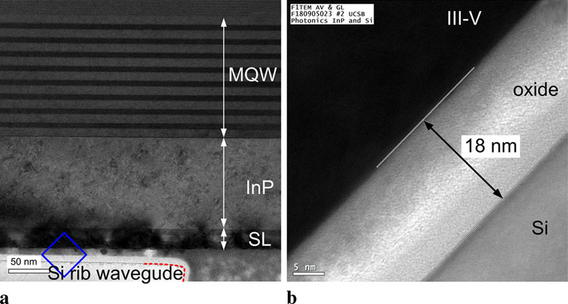
Aging: Bonded III-V on Si
Epitaxial growth on InP or GaAs followed by bonding to Si results in edge dislocations, which are not problem for laser lifetime.

Slide 28
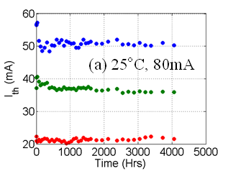
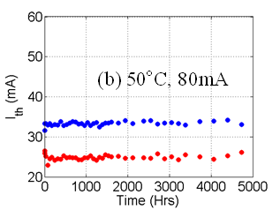
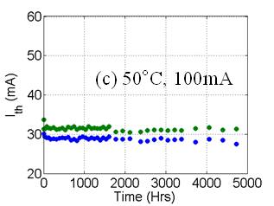
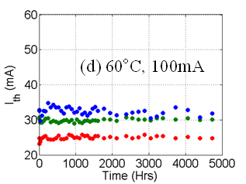
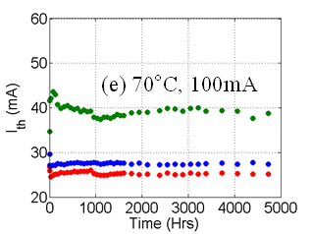
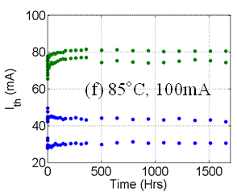
Temperature Dependence of DFB Aging
Time to reach 50% degradation in threshold current at 70°C is >40,000hrs
S. Srinivasan and J.E. Bowers , "Reliability of hybrid III-V on Si distributed feedback lasers," International Semiconductor Laser Conference (ISLC) 2012 , San Diego, 2012

Slide 29
DFB-type hybrid lasers
Keyvaninia, Opt Lett. 2013

Slide 30






Slide 31


LCI Membrane DFB Lasers
BCB Bonding

Slide 32



Bonded with oxygen plasma assisted bonding.
Then regrown with MOCVD.
1.5 mW cw output power
40 Gbit/s

Slide 33
Quantum Dot Lasers

Slide 34

Threshold Current Densities of Semiconductor Lasers
  m
QD-based photonic devices are less power hungry
Notes:
the active region of this laser consists of 15 stacks of In(Ga)As Quantum Dots in a so call dot in a well which enables to shift the emission wavelength to 1290 nm
in addition the active region is p-doped providing a temperature stable operation and a high characteristic temperature.
a further QD benefit for lasers is the low threshold
but, …

Slide 35







Univ Tokyo: QD lasers on silicon optical interposers
1 × 2 optical
splitters
Optical modulators
Optical waveguides
PDs
Trident SSCs
Arrayed QD-LD
Wavelength is 1.3μm.
5 mm

Slide 36
Hybrid QD laser on silicon by wafer bonding technique
@100 ºC
K. Tanabe et al, Sci. Rep. 2, 349 (2012)
- Lasing at telecom O-band 1.3 mm (GS transition of InAs QDs)
Realized lasing operation at over 100 ºC
K. Tanabe et al, Appl. Phys. Express 6, 082703 (2013)

Slide 37


III-V Laser Growth on Silicon
[1]
CMOS processing of photonics is already happening, yet high cost and small size of III-V wafers remains an issue.
Goal: Grow III-V lasers on larger and cheaper silicon substrates without sacrificing laser performance for lower cost and higher throughput.
[1] Bowers, John E., et al. "A Path to 300 mm Hybrid Silicon Photonic Integrated Circuits.” OFC 2014
300 mm Silicon - ~$0.2 cm⁻²
100 mm GaAs - ~$2.0 cm⁻²
(Courtesy of Dr. Jordan Lang, Yale)

Slide 38


III-V growth on 300 mm Silicon Wafers
GaP on 300 mm Silicon by NAsP III/V GmbH using MOVPE (AIXTRON CRIUS CCS reactor)
World’s 1st 12” GaAs on Si epiwafer by IQE, using MBE (Veeco Gen-2000 reactor).
B. Kunert et al. 69th Device Research Conference,
Santa Barbara (2011)
Amy Liu, IQE Inc.

Slide 39

III-V Laser Growth on Silicon
Polarity, lattice & thermal expansion mismatch between silicon and III-Vs result in high dislocation densities
  High thresholds (or no lasing), and poor reliability for QW lasers.
Dangling bond/ threading dislocation
Bulk GaAs: a=0.565 nm
GaAs
Silicon substrate
Bulk Si: a=0.543 nm
Si substrate

Slide 40
Solution: Use Quantum Dots!
SCH
SCH
QW
QDs
SCH
SCH
Dislocations
In-plane band diagram:
E_{c}
Dislocation trap states
E_{v}

Slide 41
Solution: Use Quantum Dots!
1991 – “Semiconductor Structure for Optoelectronic Components with Inclusions” (Jean Gerard & Claude Weisbuch), U.S. Patent No. 5,075,742
3D confinement provided by quantum dots prevents carriers from migrating to dislocations.
SCH
SCH
QW
QDs
SCH
SCH
Dislocations
In-plane band diagram:
E_{c}
Dislocation trap states
E_{v}
41

Slide 42


History of Quantum Dot Lasers on Silicon
1991 – “Semiconductor Structure for Optoelectronic Components with Inclusions” (Jean Gerard & Claude Weisbuch), U.S. Patent No. 5,075,742
1999 – First laser operation with In_{.4}Ga_{.6}As QDs on Si@ 1 μm. Pulsed at 80 K (Michigan)
2000 – RT CW operation of quantum-dot like laser on Si @ 0.854 μm (Nagoya IT)
2005 – RT Pulsed operation with In_{.5}Ga_{.5}As QDs on Si@ 1 μm (Michigan)
2011-Present – RT Pulsed & CW operation with wafer bonded InAs QDs on Si (U. of Tokyo)
2011-Present – RT Pulsed & CW operation with InAs QDs on Si & Ge/Si @ 1.3 μm (UCL)
Lee, Andrew, et al. "Continuous-wave InAs/GaAs quantum-dot laser diodes monolithically grown on Si substrate with low threshold current densities." Optics express 20.20 (2012): 22181-22187.
Tanabe, Katsuaki, and Yasuhiko Arakawa. "1.3 μm InAs/GaAs Quantum Dot Lasers on SOI Waveguide Structures." CLEO: Science and Innovations. Optical Society of America, 2014.

Slide 43


UCSB Quantum Dot Growth
1993 – First ever self assembled InGaAs quantum dots reported by D. Leonard, S. Denbaars, P. Petroff et al. (Appl. Phys. Lett. 63)
1995 – First 1.3 μm photoluminescence from InGaAs by R. Mirin, A. C. Gossard, J. E. Bowers et al. (Appl. Phys. Lett. 67)
1996 - R. P. Mirin, A. Gossard, and J. E. Bowers, “Room Temperature Lasing From InGaAs Quantum Dots,” Electronics Letters, 32 (18), 1732,
2014 – High Performance continuous wave 1.3 μm quantum dot lasers on silicon by A. Y. Liu, A. C. Gossard, J. E. Bowers et al. (Appl. Phys. Lett 104)
Quantum
Well
Quantum
Dot

Slide 44

MBE growth of InAs Quantum Dots
InAs/GaAs self assembled quantum dots by Stranski-Krastanov layer/island growth mode
Average quantum dot density: ~5x10¹⁰ cm⁻²
PL peak around 1285nm on GaAs and 1255nm on Si
  47nm/35 meV PL linewidth
On GaAs
On Silicon
A. Y. Liu et al, “MBE growth of P-doped 1.3 μm InAs quantum dot lasers on silicon”. J. Vac. Sci. Technol. B. 2014

Slide 45

GRINSCH QDLs on Ge/Si
Two graded index separate confinement heterostructure (GRINSCH) lasers were grown on GaAs-on-Ge-on-Si virtual substrates provided by IQE Inc.
In one wafer, the QD barrier layers were p-doped with beryllium to improve T₀.
GaAs
Al_{0.4}Ga_{0.6}As
7x QDs
Al_{0.4}Ga_{0.6}As
GaAs

Slide 46



GRINSCH QDLs on Ge/Si
TEM images of unprocessed laser material
>10⁸ cm⁻² dislocation density in the QD active region
Plan-view TEM of QD active region
Cross-sectional view of the laser epi
GaAs
Al_{0.4}Ga_{0.6}As
QDs
Al_{0.4}Ga_{0.6}As
GaAs
1 μm
1 μm
Ge
Notes:
Total cross section length: 1.8/30 = 16.6um.
Cross sectional area: (16.6x0.1um) = 1.66um^2
Dislocation density: 7/(1.66um^2) =

Slide 47


GRINSCH QDLs on Ge/Si
TEM images of unprocessed laser material
>10⁸ cm⁻² dislocation density in the QD active region
Plan view of QDs
Cross-sectional view of QDs
InAs
QDs
50 nm

Slide 48



Device Fabrication
Epi processed into ridge lasers 4-12 μm wide, 700-1200 μm long cavities.
Facets were polished, rear facet HR coated (~95%).

Slide 49


QD vs QWs on silicon
Direct comparison: Grow on both substrates; first quantum dots,
then quantum wells. Fabricate together
SCH
SCH
QW
QDs
SCH
SCH
Dislocations
In_{0.2}Ga_{0.8}As (8 nm) /GaAs QW
InAs/GaAs QDs

Slide 50


QD vs QWs on silicon
An In_{0.2}Ga_{0.8}As (8nm)/GaAs (3x) QW laser was grown for comparison.
Substrate, epi stack, device design, and fabrication all identical. Only difference is active region type (QW vs QD)
Similar dislocation density by TEM.
(a)
GaAs
Dislocations
GaAs
(b)
Al_{0.4}Ga_{0.6}As
Al_{0.4}Ga_{0.6}As
QW
QDs
Al_{0.4}Ga_{0.6}As
Al_{0.4}Ga_{0.6}As
GaAs
GaAs
Ge
Ge
1 μm
1 μm

Slide 51



QD vs QWs on silicon
No lasing for QWs on Si (all LEDs).
  Reference QW lasers on GaAs worked fine.
SCH
SCH
QW
QDs
SCH
SCH
1000x
QW
QDs

Slide 52
Continuous Wave Threshold Data
Over 300 working lasers measured from two wafers.
Uniform threshold current densities across die/wafers.
937x4 μm² undoped device.
Liu, Alan Y., et al. "High performance continuous wave 1.3 μm quantum dot lasers on silicon."
Applied Physics Letters 104.4 (2014): 041104.
Notes:
Device is 130815B 1000um HR Polish A55, threshold current density for this device is 426.89 A/cm^2

Slide 53
Output powers
CW powers over 100 mW routinely achieved.
Nearly 180 mW maximum CW single side output power at 20 ºC from HR coated 1130x10 μm² intrinsic active region (undoped) device.
  33% differential efficiency and 18% WPE (at 150 mA)
1130x10 μm².
36 mA threshold
Notes:
Conservative estimate of average differential efficiency: 17% for p-doped (dashed line) and 22% for undoped (solid line) devices.

Slide 54

High Temperature Performance
P-doping the active region improves thermal performance.[1]
Continuous wave lasing up to 119ºC
  (dual state lasing at high currents/temperatures).
Without p-doping
With p-doping
993x5 μm²
[1] Alexander, Ryan R., et al. "Systematic study of the effects of modulation p-doping on 1.3-μm quantum-dot lasers." Quantum Electronics, IEEE Journal of 43.12 (2007): 1129-1139.

Slide 55


Lifetimes of Previous GaAs based lasers on Silicon
GaAs based lasers are very sensitive to defect density and susceptible to failure by recombination enhanced defect reactions (REDR)[1][2]
First GaAs lasers on silicon had lifetimes of ~10 seconds (RT, pulsed) (1987) [3]
Longest lifetime reported for GaAs based laser on Si (853 nm) is 80 hours (RT, CW) (2000) [4]
GaAs/AlGaAs laser on Ge/Ge_{x}Si_{1-x}/Si substrates: 4 hours at (RT, CW) (2003) [5]
[5] Groenert, Michael E., et al. "Improved room-temperature continuous wave GaAs/AlGaAs and InGaAs/GaAs/AlGaAs lasers fabricated on Si substrates via relaxed graded GeSi buffer layers." Journal of Vacuum Science & Technology B: Microelectronics and Nanometer Structures 21 (2003): 1064.

Slide 56
Reliability Studies of QD lasers on Silicon
Stress conditions: 30ºC continuous wave under constant 100 mA injection current (~1.25-3x I_{th}(0), ~1-20 mW initial output power)
Degradation monitored by periodic light-current-voltage (LIV) sweeps at 30 ºC
Over 2100 hours of continuous operation (testing stopped)
  >26x improvement over best reported lifetime for GaAs laser on Si:
  (2100 hours at 30ºC, 2 kA cm⁻² vs 80 hours at RT, 1.3 kA cm⁻²)
No catastrophic failures observed.

Slide 57
Heterogeneously Integrated Quantum Well Transmitters
Modulators
Photodetectors
Integrated Transmitters

Slide 58




Active Elements needed for PICs
Range of components for PICs:
  Lasers
  Modulators
  Amplifiers
  Photodetectors
Integration
High yield
Good reliability
DFB/EAM/PD Array
Optical preamplifier PD array
Optical buffer
DQPSK Receiver

Slide 59




III-V active region
Silicon waveguide on SOI wafer
8 AMPs
8 detectors
H. Park et al., PTL, 19(4), 230, February (2007).

Slide 60

III-V on silicon optical amplifiers
18dB small signal gain for 100mA drive current

Slide 61


Hybrid Silicon Switch: Use III-V Material
Si
=
Plasma
+….
>10x
III-V
=
Plasma
+
BF
+
Pockels
+
Kerr
+….
* Silicon phase shift is calculated from “High speed optical modulation based on carrier depletion in a silicon waveguide,” A. Liu et. Al, Opt. Express, 15 (2), 2007
Notes:
61
This figure shows the index change of a carrier change based modulator. As you can see, it includes different mechanism such as pockels, kerr, plasma, and bandfilling effects. For a given carrier density change, the plasma effects inside si and IIIV are about the same order. However, due to indirection bandgap of si, the bandfilling effect is ignorable compared to IIIV. Thus for a carrier change, we can roughly compare the purple and red curves in this figure. It shows that we can have 3 times larger index change in IIIV if carrier injection or depletion is applied to the device.
加圖(epi)

Slide 62



Hybrid Silicon MZMs
2008
2009
2011
2013~2014
Gen 1 Hybrid silicon MZM:
AlGaInAs QW
Coplanar waveguide
QW undercut
Performance:
8 GHz bandwidth
VπL = 2Vmm
6.3 dB ER @ 10Gb/s
Gen 2 Hybrid silicon MZM:
Capactively-loaded slot line
Electric-isolation by Implantation
Push-pull operation
Performance:
~12.5 GHz bandwidth
11 dB ER @ 25 Gb/s
Gen 3 Hybrid silicon MZM:
Improved implantation profile
Improved contact resistance
Improved MMI
Performance:
27 GHz bandwidth
11 dB ER @ 40 Gb/s
Application:
large scale non blocking optical switch array
Vector-modulated Tx
H. Chen, et al., OE 16(25), 20571(2008)
L. Chen et al., Photonic J. 2011
H. Chen, et al., OE 18(2)), 1070(2010)
H. Chen, et al., OE 19(2)), 14552011)

Slide 63




Hybrid Si
Electroabsorption Modulators
2008
2011
2012
2013-2014
Gen 1 Hybrid silicon EAM:
AlGaInAs QW
Lumped electrode
QW undercut
Performance:
>16 GHz bandwidth
sub-voltage operation (250μm)
Gen 2 Hybrid silicon EAM:
Distributed electrode
Electrically-isolated taper
Improved contact resistance
Performance:
~42 GHz bandwidth
9.8 dB ER @ 50 Gb/s
Gen 3 Hybrid silicon EAM:
New epitaxy design for 1300 nm
Segmented electrode
Gradually-doping p-InP
Performance:
bandwidth > 67 GHz
modulation efficiency > 5 dB/V
power consumption < 1mW/Gb/s
transmission distance > 10km
Gen 4 Hybrid silicon EAM:
1x16 EML Array+Mux
<1pJ/bit @ 25Gb/s
Y. Tang, et al., OE 19(7)), 5811(2011)
Y. Kuo, et al., OE 16(13), 9936 (2008)
Y. Tang, et al., OE 20(10), 11529(2012)

Slide 64

Hybrid Silicon HSEAM
Light out
(a)
Segmented electrode
Length: 100 μm
>67 GHz Bandwidth
RF in
RF out
Active Part
Light in
9 dB/V
2 Vpp Drive
74GHz
ER=9.6dB/1.55Vpp
ER=9.4dB/1.55Vpp
330 fJ/bit
Tang, Peters, Bowers OFC Postdeadline 2012

Slide 65


Integrated Transmitters
Using Quantum Well Intermixing
200 nm

Slide 66




Optics Letters 2014

Slide 67


Integration of DFB and EAM on hybrid silicon platform
Low power, high speed, integrated photonic transmitter based on hybrid silicon platform
  High capacity optical interconnects between processors and memory.
  Low power optical transmitters with high impedance modulators Integrate arrays of lasers with arrays of modulators to reduce the power required for off-chip lasers.
  Flip chip bonding with CMOS driver chip *
* HD Thacker, ‎2010

Slide 68

Hybrid Silicon Electro-absorption Modulators
 | C-band Lumped EAM | O-band Lumped EAM
Wavelength [nm] | 1550 | 1300
Active Length [μm] | 100 | 100
Bandwidth [GHz] | 18 | 30
ER [dB/1V] | > 5 | > 9
Footprint [μm²] | 55×220 | 210×310
Insertion Loss | 3 | 5
Current under bias [mA]* | < 0.1 | ~ 0.1
C-Band
O-Band
5 dB/V
9 dB/V
1 Vpp Drive
2 Vpp Drive
YB Tang, ‎2012

Slide 69



Direct modulation of short cavity DFB
Maximum 3 dB bandwidth is about 9.5 GHz
The slope of f_{r} curve is about 1.185 GHz/mA^{1/2}
Open eye diagrams up to 12.5 Gbps.
200 ps
21 mA
35 mA
12 mA
56 mA
5 Gbps
-3 dB
EO response (dB)
60 mA
100 ps
2.8 dB
Frequency (GHz)
12.5 Gbps
C Zhang, ‎2014

Slide 70
Tunable Lasers
UCSB
Ghent

Slide 71







Widely Tunable Vernier Ring Laser
J. C. Hulme, J. K. Doylend, and J. E. Bowers, "Widely tunable Vernier ring laser on hybrid silicon," Opt. Express 21, 19718-19722 (2013)

Slide 72



Widely Tunable Vernier Ring Laser
2.5
J. C. Hulme, J. K. Doylend, and J. E. Bowers, "Widely tunable Vernier ring laser on hybrid silicon," Opt. Express 21, 19718-19722 (2013)

Slide 73



III-V/Si extended cavity laser
III-V/silicon tunable laser
  8nm tuning range, based on thermo-optic tuning of silicon ring resonator
  > 40dB SMSR
  threshold of 35mA
  4mW optical output power
  co-integrated with 10G silicon electro-optic modulator
  Realized in EU-project HELIOS (jointly with CEA-LETI, III-V labs)
Keyvaninia, Opt Express 2012

Slide 74

Multi-frequency lasers
4-channel ring-laser
4-channel AWG-laser
Keyvaninia, Opt Express 2013
4-channel AWG-laser
4-channel ring-laser

Slide 75
Integration
2D Scanners
Triplexers
Buffer Memories
Mode Locked Lasers

Slide 76


Fully Integrated hybrid silicon free-space beam steering source using a tunable laser phased array
2D Scanning with
Tunable laser and grating for θ
Phased array emitter for ψ
Scaling: N+1, not N²!
4 tunable lasers, 32 amplifiers,
32 phase shifters, 32 photodetectors
1 (wavelength)
N (number of emitters)

Slide 77


2D Beam Scanning
1° angular tuning resolution, 1.6° FWHM beam width
Beam angle can be arbitrarily chosen within a 20° x 14° window
Doylend et al., SPIE 2013.
Notes:
Emphasize the right-side map (animate perhaps)

Slide 78




Hybrid Silicon Triplexers
Laser, 1310/1500 nm MUX MMI, MZI 1550/1490 MUX, PDs integrated
Chang et al. OFC 2010
78

Slide 79





Optical Buffer Memory

Slide 80

Lower Loss Waveguides for Low Jitter Mode Locked Lasers
Possible with low loss waveguides

Slide 81





Long cavity mode-locked lasers
Harmonically mode-locked laser
14dB reduction in phase noise
RF linewidth → 52kHz @ 20GHz

Slide 82

Long cavity mode-locked lasers
Coupled cavity mode-locked laser
4 cm
RF linewidth
1MHz→ 15kHz @ 10 GHz

Slide 83


Integration of Ultralow loss waveguides with hybrid silicon: 400 Gbps (8x50 Gbps) Receiver
Davenport et al., OFC Postdeadline (2013)
Micrograph of completed device
AWG
46 cm
Detector array
Input waveguide

Slide 84


Coherent communication with SiN combs
Kerr comb coherent transmission:
392 Gb/s using QPSK and 16 QAM with BER < 7.5 x10(-4)
1 Tb/s using 20 channels derived from a single laser module
Pfeiffle, et al. Kippenberg, Koos Nature Photonics 2014

Slide 85
Integration with Electronics

Slide 86

IBM Network on a Chip:
Optical Interconnects
3D layer stacking will be prevalent in the 22nm timeframe
Intra-chip optics can take advantage of this technology
Layers can be separately optimized for performance and yield
Optical I/O
On-chip optical traffic
Off-chip optical signals
Photonic Plane
Memory Plane
Logic Plane
Kash, “Photonics in Supercomputing:
the Road to Exascale,” IPNRA, 2009

Slide 87


CMOS Integration in Photonic IC
“Smart Photonics” ̶ Integrated electronic w/ photonic ICs
Avoid driving 50Ω terminations
Active feedback control
Self-calibration
EIC-PIC Interface
CMOS
Interconnects
Hybrid Silicon PIC from Aurrion
L. Chen, A. Sohdi, J. E. Bowers, and L. Theogarajan, “Electronic and photonic integrated circuits for fast data center optical circuit switches”, IEEE Communications Magazine , Invited Paper, Volume: 51 Issue: 9 Pages: 53-59, 5, September 2013
Notes:
Enable any heterogeneous ICs, for example, CMOS controlling HEMT, unified integration platform where the functionality is greater than the sum of it’s parts

Slide 88
Commercialization
Aurrion
Intel
Hewlett Packard
Oracle

Slide 89

Integrated Lasers
III-V gain integrated on silicon waveguides
High power/High efficiency
  >25% at 30C
  15% at 80C
  >20mW

Slide 90

WDM Laser Arrays
High yield integrated laser breaks cost barrier
  Large WDM arrays processed in parallel
Uncooled operation
  Wavelength-locking across temperature (20-80C) without a TEC
  200GHz (or 800GHz) grid

Slide 91

100G PIC Links

Slide 92

Scaling to 400G+
Uncooled 16x laser arrays on silicon demonstrated
  Locked to 200GHz grid from 20-80C = no TEC required
3dB bandwith of EAMs & PDs >37 GHz
  Supports 50Gb/s

Slide 93

Integrated Transmitter Chip
Integrates Hybrid Silicon Lasers
With Modulators for data encoding and a Multiplexer to put 4 optical channels onto 1 fiber
Electrical data in…
Up to 12.5 Gbps/channel
1101001110
Hybrid Laser
Modulator
Alignment Pin
50Gbps
out on one
optical fiber
Hybrid Laser
Modulator
Indium Phosphide Layer
Multiplexer
Hybrid Laser
Modulator
Hybrid Laser
Modulator
Connector
  Parallel channels are key to scaling bandwidths at low costs
93
© 2013, Intel Corporation. All Rights Reserved

Slide 94
Sept. 2014: Intel Developer Forum
Arista: Showing Network Products with 100G Intel Silicon Photonics
Advantech: Showing Network Security Appliance with 100G Intel Silicon Photonics
Altera: Showing FPGAs with embedded 100G Intel Silicon Photonics
Corning: Showing the breadth of innovative MXC optical cable technology, along with 100G Intel Silicon Photonics running over a 300m+ distance
Fujitsu: Showing an Application-Optimized Server that enables pooled resources capability provided by Intel Silicon Photonics optical PCI
Quanta: Showing a 100G TOR switch and server with 100G Intel Silicon Photonics
Tabula: Showing a functional demo with 800Gbps of interconnectivity in one box, based on 100G Intel Silicon Photonics

Slide 95



Hewlett Packard: “The Machine”

Slide 96







Supercomputing:
HP hybrid silicon technologies
Hybrid microring laser
Silicon PIC
On-chip interconnect
Active cable
Optical bus
Rx
Rx
Rx
Rx
Rx
Rx
Rx
Rx
Tx
Now
1 Year
3 Years
5 Years
7 Years
10 Years
Notes:
96

Slide 97










100G Si photonic WDM transmitter
X. Zheng et. al., OFC, PDP5C.9, 2013
Off chip
On SiP chip
Laser1
Laser2
Laser3
Laser4
Laser5
Laser6
GC
GC
Laser7
Laser8
Modulation pads
Tuning pads
Total tuning power of 24mW
Clean and open “eyes” at 12.6 Gbps using on-chip PLL
  Modulator “ON” state losses 4~5dB & Dynamic ER >5dB
  ~1mW for every channel, or 80fJ/bit modulation energy efficiency

Slide 98
The Future of Hybrid Silicon Photonics

Slide 99
Key focus areas:
Bandwidth/speed
25G today moving to 100G
Also need to be thinking >1Tbps +
2) Power
CMOS voltages scaling below .9V
How do you drive your devices?
How do you reduce overall power consumption ?
Exascale targeting <1mW/Gbps (total I/O)
© 2014, Intel Corporation. All Rights Reserved

Slide 100

The Path to Tera-scale Data Rates
Today: 25 Gbps x 4 = 100Gbps
50Gbps x 4 = 200Gbps
25G
50G
25G
50G
200G
25G
Scale UP
50G
25G
50G
Speed | Width | Rate
25 | x4 | 100G
25 | x8 | 200G
25 | x16 | 400G
50 | x25 | 1.25T
Scale OUT
Consumer
Data Center
HPC
Scale up AND out
25G
25 Gbps x 8 = 200Gbps
Laser
25G
Laser
25G
Laser
25G
Future
Terabit+ Links
Scale up AND out
25G
25G
25G
25G
  Low cost integrated photonics allows for
  Scaling from 50Gbps to >1Tbps
x16, x32…
100
© 2014, Intel Corporation. All Rights Reserved
Notes:
Copper cable example

Slide 101

Photonic Integration
Meint Smit Data
Heck JSTQE (2013)

Slide 102
Hybrid Silicon Record Performance
2013 Narrowest DFB linewidth: 18 kHz Yariv et al. (Caltech)
2011 Lowest waveguide loss on silicon: 0.04 dB/m Jared Bauters et al.
2012 Highest level of integration: 160 devices Jared Hulme et al.
2012 Best reliability: >40,000 hours at 70C Srinivasan et al.
2012 Highest laser yield: 99% Srinivasan et al.
2012 Fastest Si modulator: 74 GHz Tang et al.
2013 Highest receiver capacity: 400 Gbit/s Piels et al.
2013 Largest laser array bandwidth: > 200 nm Jain et al.
2014 Largest LED bandwidth: >200 nm DeGroote et al.(Ghent and UCSB)
2014 Highest temperature: 119C Alan Liu et al.
2014 Highest power: 180 mW Alan Liu et al.

Slide 103

Acknowledgements
UCSB:
Former students and postdocs: Alex Fang, Jared Bauters, Hui Wen Chen, Daoxin Dai, Jon Doylend, Martijn Heck, Sid Jain, Geza Kurzveil, Brian Koch, Di Liang, Hyundai Park, Molly Piels, Paolo Pintus, Matt Sysak, Yongbo Tang, Jason Tien
Present students: Jock Bovington, Mike Davenport, Jared Hulme, Alan Liu, Jon Peters, Daryl Spencer, Alex Spott, Eric Stanton, Sudha Srinivasan, Chong Zhang
Colleagues: Rod Alferness, Dave Auston, Dan Blumenthal, Larry Coldren, Nadir Dagli, Steve Denbaars, Art Gossard, Herb Kroemer, Chris Palmstrom, Mark Rodwell, Adel Saleh, Luke Theogarajan
Intel : Richard Jones, Yimin Kang, Mario Paniccia, Matt Sysak
Aurrion: Alex Fang, Greg Fish, Rob Guzzon, Eric Hall, Brian Koch, Erik Norberg, Anand Ramaswamy, John Roth, Dan Sparacin
Hewlett Packard: Di Liang, Geza Kurzveil, Ray Beausoleil
Slides: Arai, Arakawa, Baets, Fang, Gaeta, Koch, Kippenberg, Liang, Paniccia, Roelkins, Vahala, VanThourhout, Yariv

Slide 104
Summary
III-Vs layers on Silicon have key advantages for
  Low threshold, high power lasers
  High gain amplifiers
  High speed modulators
  Electronics
Integration is essential for size, weight, power and cost reduction and improved yield and reliability
Photonics can allow lower power and higher capacity for
  Sensors
  Data communication and switching

Slide 105


Output powers
Highest yielding laser bar: 37/55 working devices (62%, the rest lost due to facet polishing imperfections and metallization shorts)
One bar numerically summed (e.g. ignoring thermal cross talk):
  >3.5 watts of combined CW power at 20 ºC.

Slide 106


Lifetimes of Previous GaAs based lasers on Silicon
GaAs based lasers are very sensitive to defect density and susceptible to failure by recombination enhanced defect reactions (REDR)[1][2]
[1] Lester, S. D., et al. "High dislocation densities in high efficiency GaN‐based light‐emitting diodes." Applied Physics Letters 66.10 (1995): 1249-1251.
[2] Sugiura, Lisa. "Comparison of degradation caused by dislocation motion in compound semiconductor light-emitting devices." Applied physics letters 70.10 (1997): 1317-1319.

Slide 107

Reliability Studies of QD lasers on Silicon
Stress conditions: 30ºC continuous wave under constant 100 mA injection current (~1.25-3x I_{th}(0), ~1-20 mW initial output power)
Degradation monitored by periodic light-current-voltage (LIV) sweeps at 30 ºC

Slide 108

Quantum Dot Summary
Repeatable high performance quantum dot lasers on silicon demonstrated
  Low thresholds (16 mA )
  CW output power ~180 mW (previous record on silicon: 45 mW)
  CW lasing up to 120 ºC (previous record on silicon: 105 ºC)
  T₀ 100-200K from 20-40 ºC
  >2100 hours operation under aging at 30ºC & 100 mA.
Quantum dot lasers are a promising light source for silicon photonics
QDs
Si WG

Slide 109

Lifetimes of Previous GaAs based lasers on Silicon
GaAs based lasers are very sensitive to defect density and susceptible to failure by recombination enhanced defect reactions (REDR)[1][2]
First GaAs lasers on silicon had lifetimes of ~10 seconds (RT, pulsed) (1987) [3]
Pulsed current required for 2 mW peak power as a function of cumulative pulsed operating time.
[3] Van der Ziel, J. P., et al. "Degradation of GaAs lasers grown by metalorganic chemical vapor deposition on Si substrates." Appl. Phys. Lett. 51 (1987): 89-91.
[4] Kazi, Zaman Iqbal, et al. "First Room-Temperature Continuous-Wave Operation of Self-Formed InGaAs Quantum Dot-Like Laser on Si substrate Grown by Metalorganic Chemical Vapor Deposition." Japanese Journal of Applied Physics 39 (2000)

Slide 110


Silicon nanoclusters: waveguides
Si-nc embedded in SiO₂ can provide optical gain (red wavelengths);
Slot waveguides provide high SiO₂ confinement and small cross-section;
Si-nc creates localization of injected carriers at luminescent centers (Er³⁺ for infrared)
N. Daldosso and L. Pavesi, Laser & Photon. Rev., 2009

Slide 111

Lifetimes of Previous GaAs based lasers on Silicon
GaAs based lasers are very sensitive to defect density and susceptible to failure by recombination enhanced defect reactions (REDR)[1][2]
First GaAs lasers on silicon had lifetimes of ~10 seconds (RT, pulsed) (1987) [3]
Longest lifetime reported for GaAs based laser on Si (853 nm) is 80 hours (RT, CW) (2000) [4]
[3] Van der Ziel, J. P., et al. "Degradation of GaAs lasers grown by metalorganic chemical vapor deposition on Si substrates." Appl. Phys. Lett. 51 (1987): 89-91.
[4] Kazi, Zaman Iqbal, et al. "First Room-Temperature Continuous-Wave Operation of Self-Formed InGaAs Quantum Dot-Like Laser on Si substrate Grown by Metalorganic Chemical Vapor Deposition." Japanese Journal of Applied Physics 39 (2000)

Slide 112


Device Fabrication
Epi processed into ridge lasers 4-12 μm wide, 700-1200 μm long cavities.
Facets were polished, rear facet HR coated (~95%).
Probe metal
P contact
p cladding
n cladding
SiO₂
7 μm
Cross sectional view of the laser device.
Silicon

Slide 113

Continuous Wave Threshold Data
Lowest CW threshold at 20 ºC is 16 mA for an HR coated 937x4 μm² device with an intrinsic active region (undoped).
Greater than 50 mW output power from same device.
937x4 μm² undoped device.
Liu, Alan Y., et al. "High performance continuous wave 1.3 μm quantum dot lasers on silicon."
Applied Physics Letters 104.4 (2014): 041104.
Notes:
Device is 130815B 1000um HR Polish A55, threshold current density for this device is 426.89 A/cm^2

Slide 114
Modulator Survey
UToronto,’11
Ring*
~74GHz†
NTT,’05
MZM
*, estimated
†, extrapolated

Slide 115



QWI to Integrate DFBs and EAMs
Laser A bandgap
EAM bandgap
Laser B bandgap
EAM bandgap
8 Integrated PD-DFB-EAM
16 DFB/PD laser array
ISLC 2010, Kyoto , Japan
WA3 9.15 - 9.30 Integrated Broadband Hybrid Silicon DFB Laser Array using Quantum Well Intermixing

Slide 116




Hybrid silicon microring laser
Confinement: MQW: 5.5%; silicon: 52%
III-V
Si
N
P
N
{
D. Liang, OE 17, 20355 (2009)
D. Liang, OE 17, 20355 (2009)

