Slide 1
Directional Coupler Passive Run Mask Splits
7/1/15

Slide 2
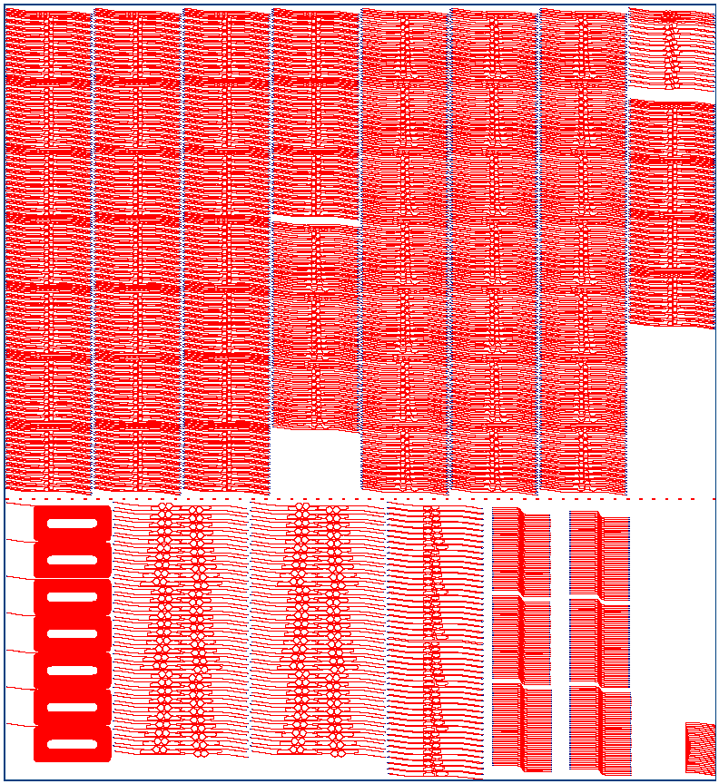
Straight Directional Couplers
Curved Directional Couplers
Y-branch
Half-wave Couplers
Teardrop Fabry-perot
Ring Filters
Waveguide loss spirals
Nitride Coupling

Slide 3
Straight DCs
WG_w = 0.4, 0.6, 0.7, 0.8
Gap_w = 0.3, 0.35, 0.4, 0.6, 0.8, 1.0
Coupler_L = 10, 15, 20, 25, 30, 35, 40, 45, 50, 55, 60, 70, 80, 90, 100, 115, 130, 150, 170, 190
Grating couplers
DC loss structures
Dice Line for
angled facet
UMZI

Slide 4
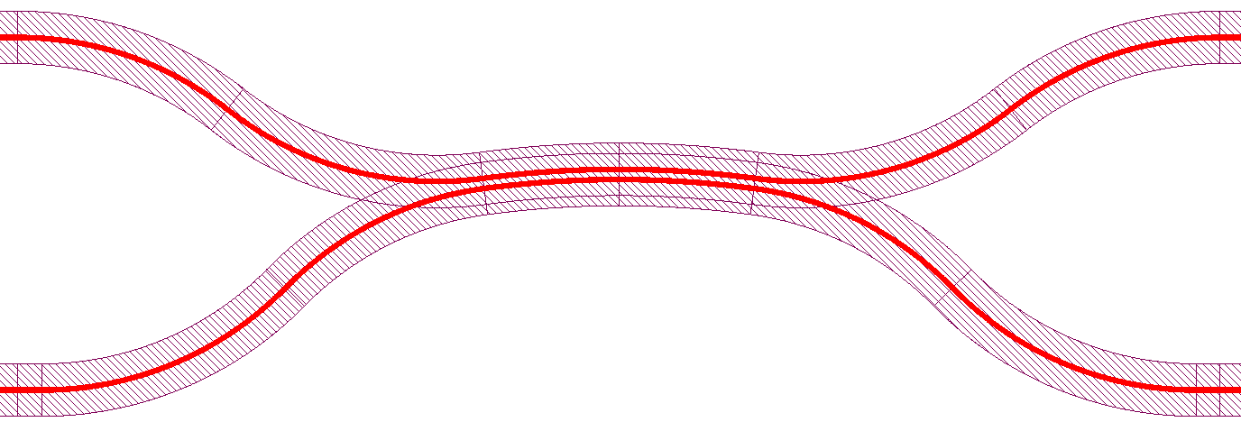
Curved DCs
WG_w = 0.4, 0.6, 0.7, 0.8
Gap_w = 0.3, 0.35, 0.4, 0.6, 0.8, 1.0
Coupler_L = 10, 15, 20, 25, 30, 35, 40, 45, 50, 55, 60, 70, 80, 90, 100, 115, 130, 150, 170, 190
Grating couplers
DC loss structures
Dice Line for
angled facet
UMZI

Slide 5
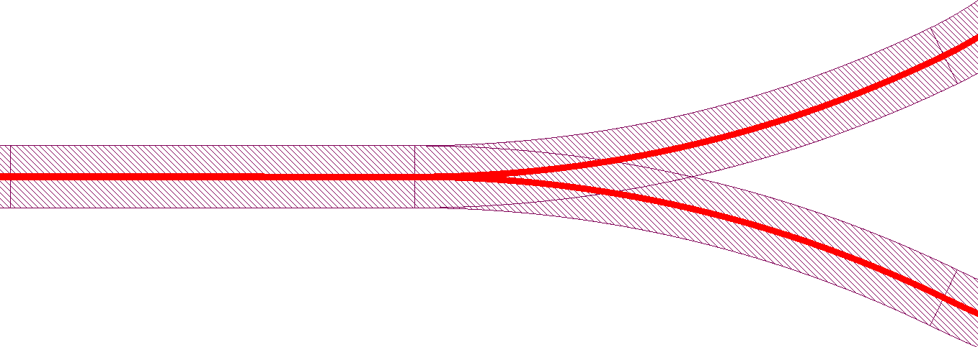
Y-branch splitters
WG_w = 0.4, 0.5,0.6, 0.7, 0.8
Bend_radius = 25, 50, 75, 100, 125, 150
Grating couplers
Y-branch loss structures
Dice Line for
angled facet
UMZI

Slide 6
Half-wave Couplers
WG_w = 0.4, 0.6
Gap_w = 0.35, 0.4, 0.5
Coupler_L = 50, 60, 70, 80, 90, 100, 110, 120, 130, 140, 150, 160, 170, 180, 190, 200
Grating couplers
Half-wave coupler
loss structures
Dice Line for
angled facet
UMZI

Slide 7
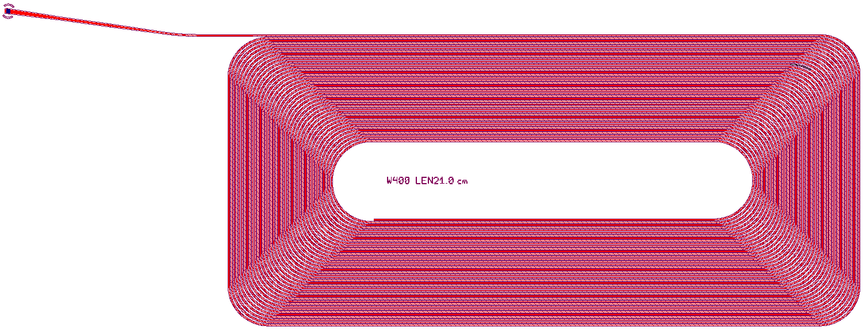
Waveguide loss measurement structures
WG_w = 0.4, 0.5, 0.6, 0.7, 0.8, 0.9, 1.0
Length = 21 cm
Grating coupler

Slide 8
Teardrop Mirror
WG_w = 0.4, 0.6
Gap_w = 0.35, 0.4, 0.5
Coupler_L = 50, 60, 70, 80, 90, 100, 110, 120, 130, 140, 150, 160, 170, 180, 190, 200
Fabry-perot with teardrop mirrors
Grating couplers
Dice Line for
angled facet

Slide 9
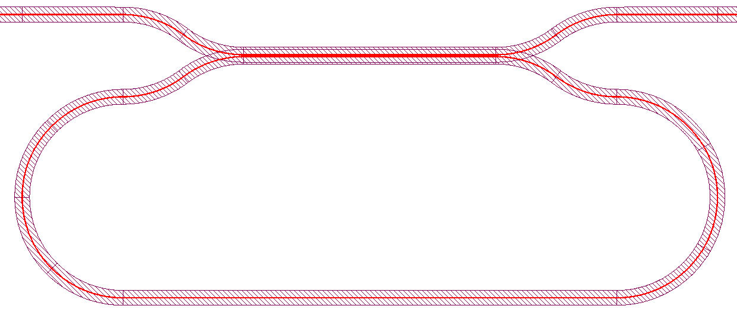
Coupled Ring Resonators
WG_w = 0.4, 0.6
Gap_w = 0.35, 0.4, 0.5
Coupler_L = 10, 15, 20, 25, 30, 35, 40, 45, 50, 55, 60, 70, 80, 95, 125, 150
Grating couplers
Coupled Ring Resonator
Dice Line for
angled facet

Slide 10
Output Grating Couplers
Coupler_w = 12
WG_w = 0.4, 0.8
Pitch = 470, 475, 480, 485, 490, 500, 510, 520, 530
DutyCycle = 0.50, 0.55, 0.60, 0.65, 0.70, 0.75
Grating couplers

Slide 11
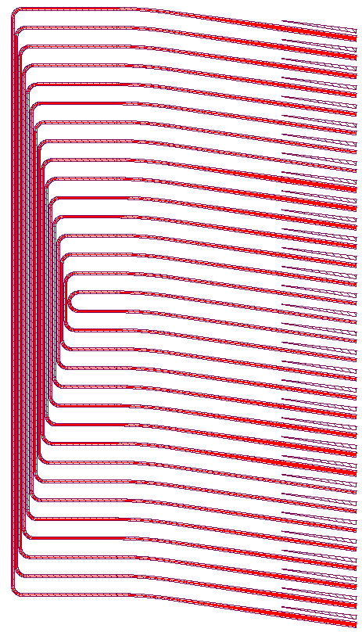
Nitride butt-coupling test
WG_w = 0.8
Facet_w = 1, 2, 3, 4, 5, 6, 7, 8
Additional split on nitride chip

