Slide 1
Lasers on Silicon
John Bowers
Dept of Electrical and Computer Engineering
University of California, Santa Barbara
bowers@ece.ucsb.edu
http://optoelectronics.ece.ucsb.edu/

Slide 2
Acknowledgements
Slides
Lionel Kimmerling (MIT), Tom Koch (Lehigh), David Miller (Stanford), Justin Rattner (Intel), Radha Nagarajan (Infinera), Garry Epps (Cisco), Donn Lee (Facebook), Keren Bergman (Columbia), Jeff Kash (IBM), Lorenzo Pavesi (Univ. of Trento), Haisheng Rong (Intel), Roel Baets (Ghent), Connie Chang Hasnain (UC Berkeley), Dal Negro (Boston University), Pallab Battacharya (Michigan), Meint Smit (IMEC)
Collaborators
UCSB: Jock Bovington, Hui-Wen Chen, Hsu Chang, Daoxin Dai, Martijn Heck, Sid Jain, Geza Kurzveil, Jon Peters, Jason Tien, Yongbo Tang
Intel : Richard Jones, Yimin Kang, Mario Paniccia, Brian Koch, Hyundai Park, Matt Sysak
Aurrion Collaboration: Alex Fang, Greg Fish, Eric Hall
Hewlett Packard: Di Liang, Marco Fiorentino, Ray Beausoleil
Financial Support
DARPA MTO (Rodgers, Shah, Esman), Intel, Hewlett Packard, Rockwell Collins

Slide 3
Outline
Why Silicon?
Light emission on silicon
Silicon photonic devices
  Lasers
  Amplifiers
  Modulators
  Switches
  Photodetectors
Silicon Photonic Integrated Circuits

Slide 4
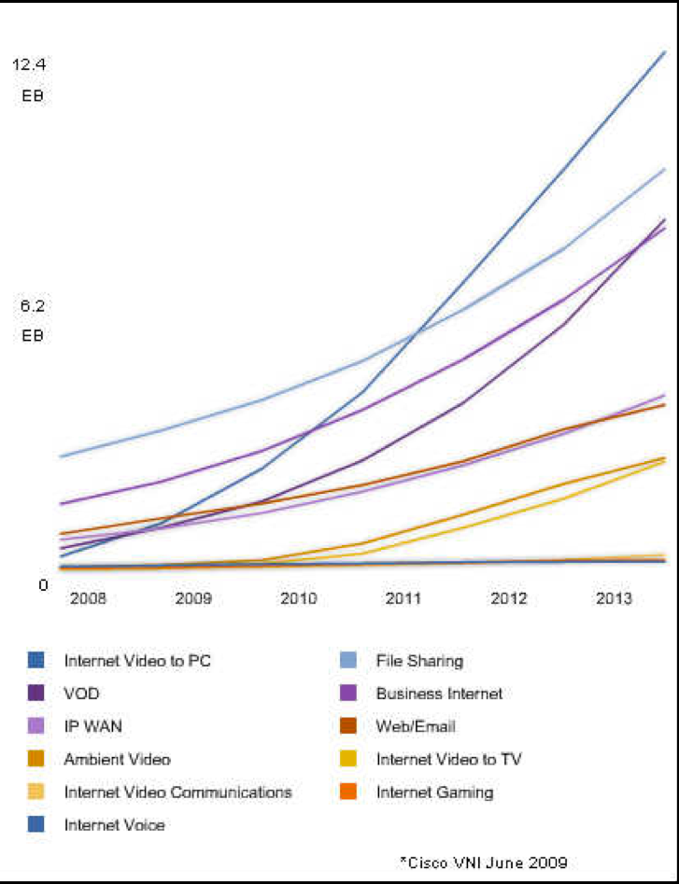
Economic Driver for Photonics:
IP Traffic Growth
Internet video to pc
Internet traffic (exabit ps (1000 Tbps)
File sharing

Slide 5
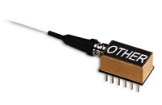


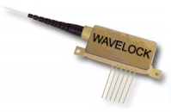

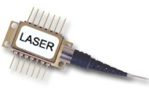
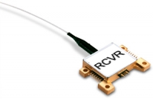
Value of Photonic Integration
Infinera: InP
100 Gb/s Transmit
100 Gb/s Receive
Infinera
Solution
100 Gb/s
Receive
100 Gb/s
Transmit
R. Nagarajan, Infinera ECOC 2007

Slide 6
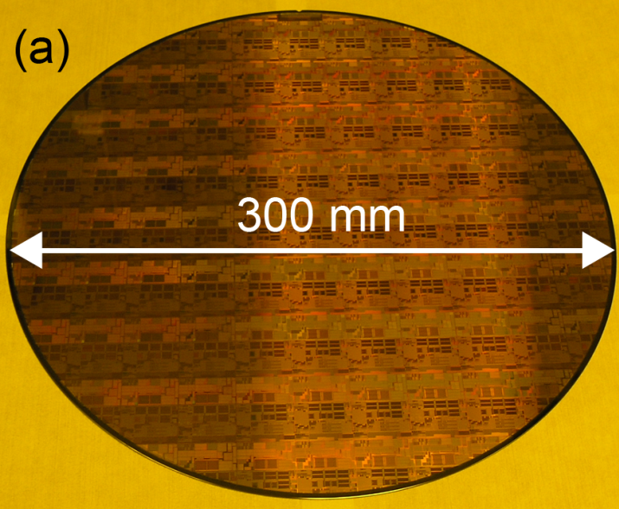
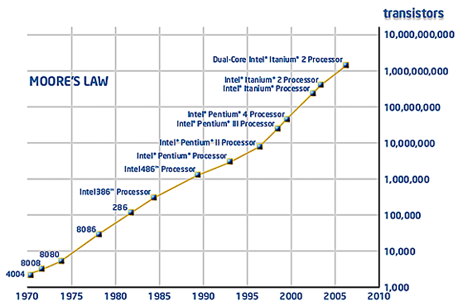
Why Silicon Photonics?
Utilize advanced fabrication technologies for low cost, high volume integrated photonics.

Slide 7
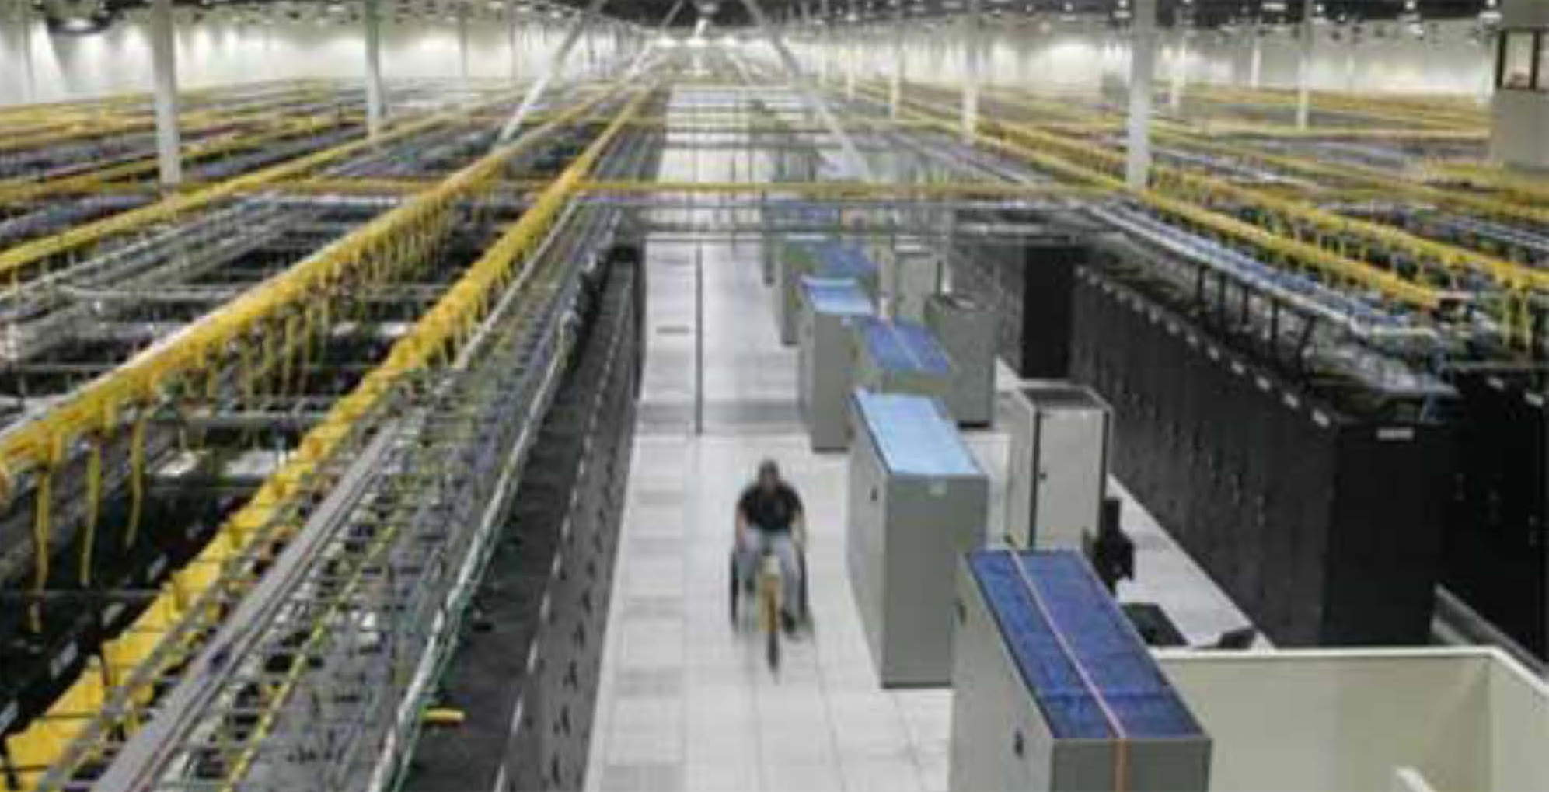
Modern Data Center
100 MW power
Million of servers
Tens of thousands of fibers
From Donn Lee (Facebook)

Slide 8
The Other Problem: Power Density

Slide 9
The solution to the heat problem is multiple cores with a Terabit optical bus

Slide 10
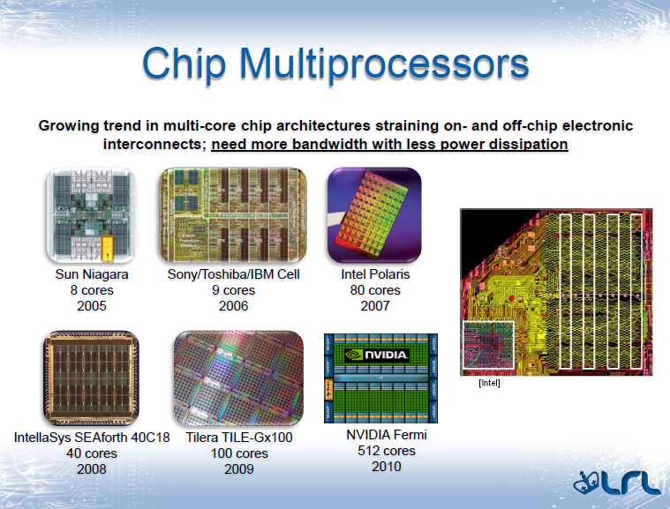
200 data lines x 5 GHz = 1 Tbps
500 cores x 1 Tbps = 500 Tbps
Bergman Photonics in Switching (2010)

Slide 11
The Solution: Optical Interconnects
InP: dominant technology for interconnects today.
  Not CMOS compatible
Silicon photonics:
  CMOS compatible
  Integrable with CMOS electronics

Slide 12
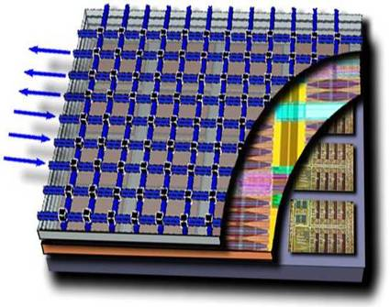
The Solution: Optical Interconnects
3D layer stacking will be prevalent in the 22nm timeframe
Intra-chip optics can take advantage of this technology
Photonics layer (with supporting electrical circuits) more easily integrated with high performance logic and memory layers
Layers can be separately optimized for performance and yield
Optical I/O
BUT: Silicon is reciprocal. How to make an isolator?
On-chip optical traffic
BUT: SiO2 is thermally resistive. So, power dissipation of active devices is a problem, particularly for rings and DWDM
Off-chip optical signals
BUT: Silicon is centrosymmetric (not electro-optic)!
So, how to integrate modulators?
Photonic Plane
Memory Plane
Logic Plane
BUT: Silicon has an indirect gap and is a poor absorber (not 1.55 μm)! So, what about photodetectors?
Kash, “Photonics in Supercomputing:
the Road to Exascale,” IPNRA, 2009
BUT: Silicon has an indirect gap and doesn’t emit light!
So, how to integrate sources?

Slide 13
Challenges
Light emission-Lasers and amplifiers
Light detection: BW-Efficiency Product poor
Light modulation BW-voltage product
Integrated Isolators
Thermal resistance
CWDM and Thermal tuning
CMOS Compatibility

Slide 14

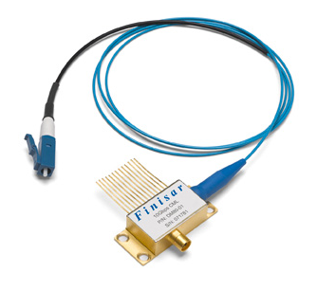
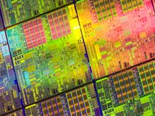
Bringing Si Manufacturing to the Laser
Lasers
Si Manufacturing
OPTICAL
ANYWHERE,
INCREDIBLE
POTENTIAL
Very high bandwidth
Long distances
Immunity to electrical noise
High volume, low cost
Highly integrated
Scalability
InP Photonic Integrated circuits
Silicon Photonic Integrated circuits
Six Generations
Courtesy: Rattner (Intel)

Slide 15
Silicon Does Have Advantages…
Cheaper substrates
Larger substrates (>300 mm)
Large fabrication infrastructure (32 nm 300 mm fabs)
Improved process control-critical for large scale integration.
Reduced two photon absorption (100x less)
Lower loss waveguides: <0.3 dB/cm
Higher thermal conductivity (κ) of
  Waveguides (Si has 30x higher κ than InGaAsP)
  EAMs or PD Absorbers: Ge has 16x higher κ than InGaAs
Excellent APD characteristics
  K factor: 0.02 versus 0.6
  Gain bandwidth product: 850 GHz versus 160 GHz

Slide 16
Silicon light emission – limits
Indirect band gap - inefficient for light emission
Auger recombination
Free carrier absorption
16

Slide 17
Silicon light emission – limits
Energy
Low internal quantum efficiency in bulk silicon (10⁻⁶)
Conduction band
e⁻
hν
hν
Absorption
Indirect radiation recombination
h⁺
Wavevector
Valence band
17

Slide 18
Silicon light emission – limits
Energy
Conduction band
e⁻
e⁻
Auger recombination prevent population inversion
Wavevector
Valence band
18

Slide 19
Silicon light emission – limits
Energy
Conduction band
hν
e⁻
Free carrier absorption prevent stimulated emission
Wavevector
Valence band
W. P. Dumke, Physical Review, 127 (1962) 1559
19

Slide 20
Silicon light emission – How?
Bulk silicon
Low dimension Silicon
  Silicon nanocrystal (Pavesi, …)
  Periodic nanopatterned crystalline silicon (Jimmy Xu)
Er dopants (Dal Negro,…)
Avoid direct interband transition
  Raman laser (UCLA/Intel)
Another material for gain (hybrid approach)
  Epitaxial
    Ge
    Quantum Dot
    Pillars
  Bonding
    Dice level
    Wafer level (BCB or Molecular)
20

Slide 21
Bulk silicon LED
Solar cell forward bias
~1% external quantum efficiency
M. A. Green et al., Nature 412, 805 (2001)

Slide 22
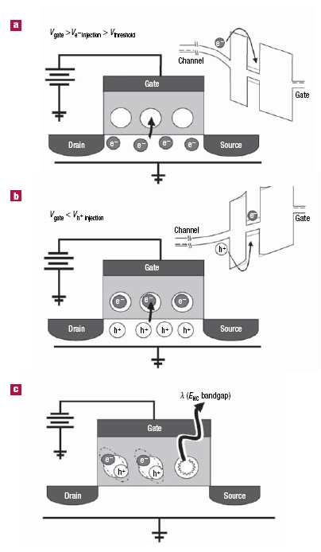
Field effect electroluminescence
Sequential injection of electron and hole
22
R. J. Walters, G. I. Bourianoff and H. A. Atwater, Nature Materials 4, 143 (2005)

Slide 23
Nanopatterned Crystalline Silicon
23
S. G. Cloutier, P. A. Kossyrev and J. Xu, Nature Materials 4, 887 (2005)

Slide 24
Emission mechanism
Nano-patterning creates a densely packed array of Emissive Structural Deformation (ESD) zones in the side-wall region of the nano-holes
J. Xu, IEEE International Conference on Group IV Photonics, Ottawa, Canada (2006), FA1.
24

Slide 25
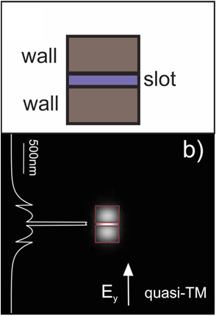
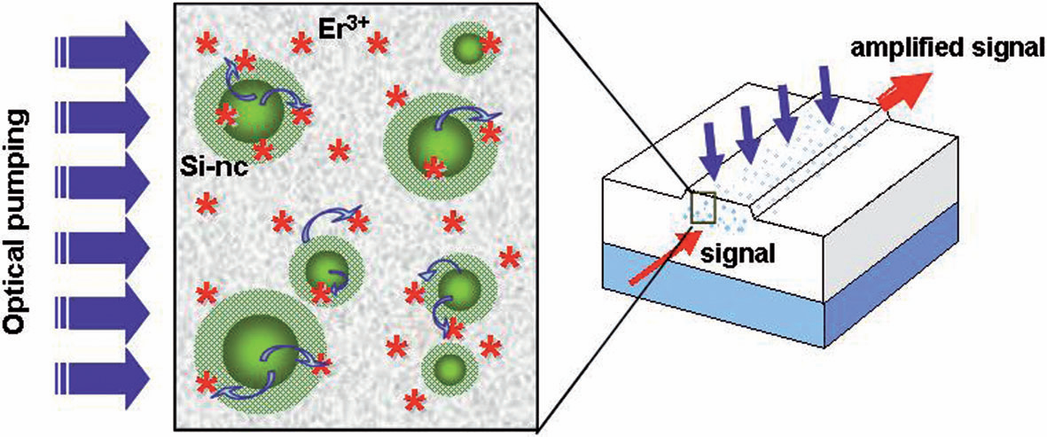
Silicon nanoclusters: waveguides
Si-nc embedded in SiO₂ can provide optical gain (red wavelengths);
Slot waveguides provide high SiO₂ confinement and small cross-section;
Si-nc creates localization of injected carriers at luminescent centers (Er³⁺ for infrared)
N. Daldosso and L. Pavesi, Laser & Photon. Rev., 2009

Slide 26
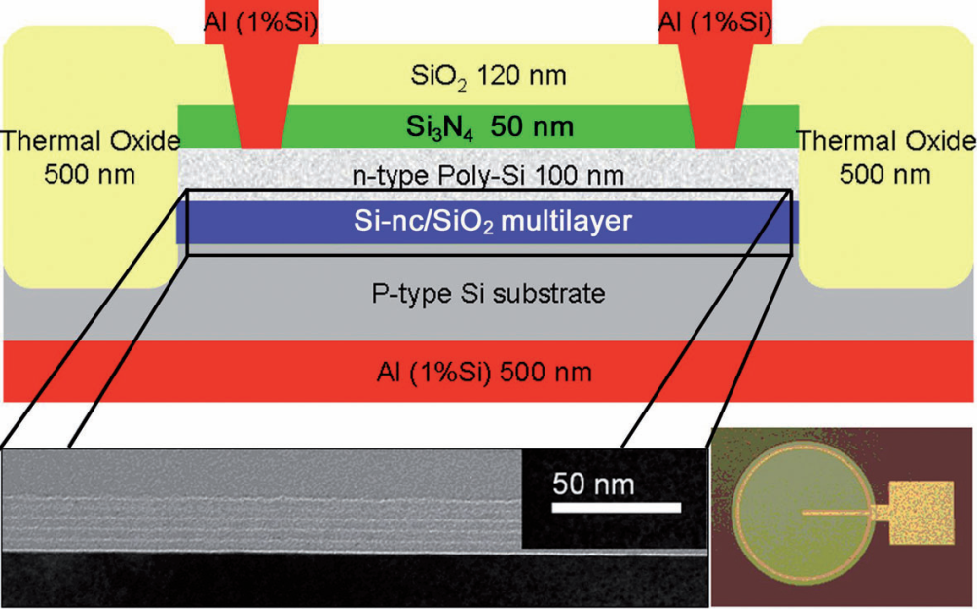
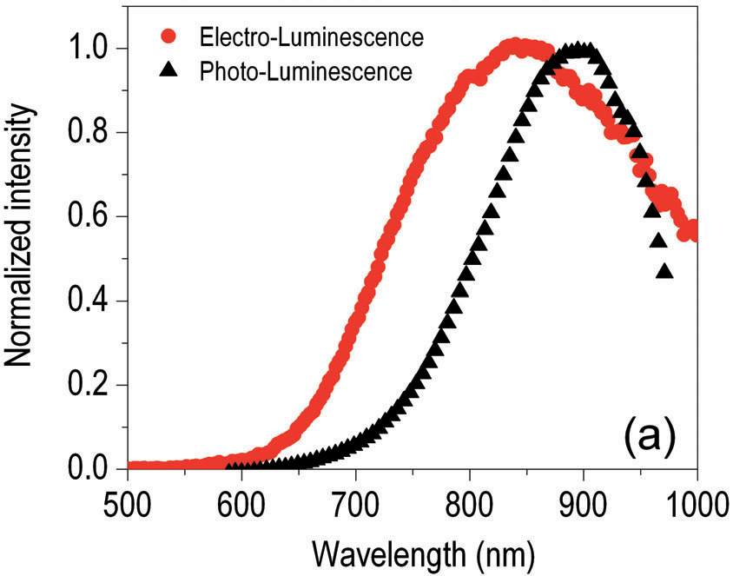
Silicon nanoclusters: LED
EL power efficiency values for LED devices:
  0.01–0.03% for pure Si-nc;
  0.2–0.3% for rare-earth ion doped
For high EL efficiency: bipolar injection needed
  issue: electron tunneling barrier << hole barrier
N. Daldosso and L. Pavesi, Laser & Photon. Rev., 2009

Slide 27
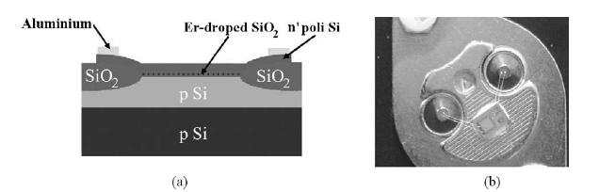
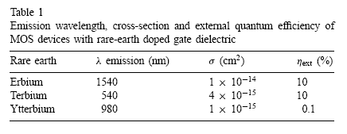
Rare earth doped light emitting MOS
M.E. Castagna et al., Materials Science and Engineering B 105, 83 (2003)
27

Slide 28
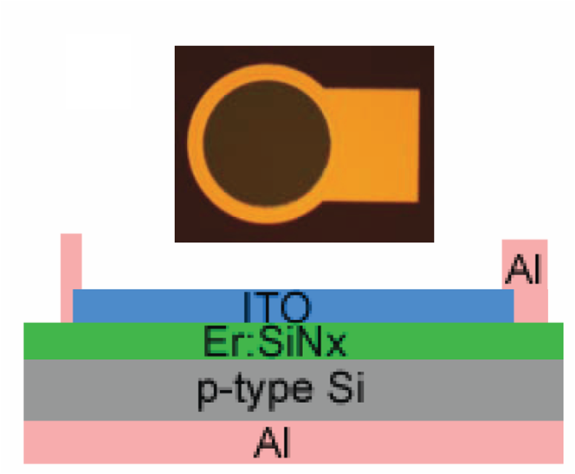
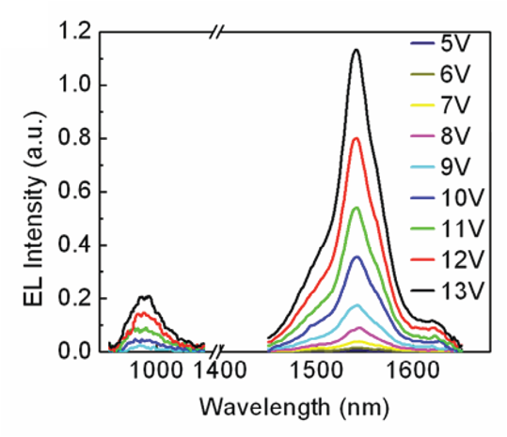
Use Er:SiN
Dal Negro (Boston Univ)
EL centered at 1535 nm (Er ⁴I_{13/2})
  Small peak at 980 nm (Er ⁴I_{11/2})
S. Yerci et al., IPR 2010

Slide 29
CW Ring Raman silicon laser
Directional coupler
Pump
Laser output
n-region
V bias
23% slope efficiency
p-region
Ring cavity
70dB
A pump laser is still needed
H. Rong, et al, Opt. Express 14, 6705-6712 (2006)
29

Slide 30
Hybrid Approaches:
Use another material for gain
Epitaxial growth on Si substrate
  Strained Germanium (MIT)
  Quantum Dot (Michigan)
  MOCVD nanopillars on Si (UC Berkeley)
Bonded III-V layers on Si substrate
  BCB (Ghent)
  Molecular (UCSB, Intel, Caltech, TIT)
30

Slide 31
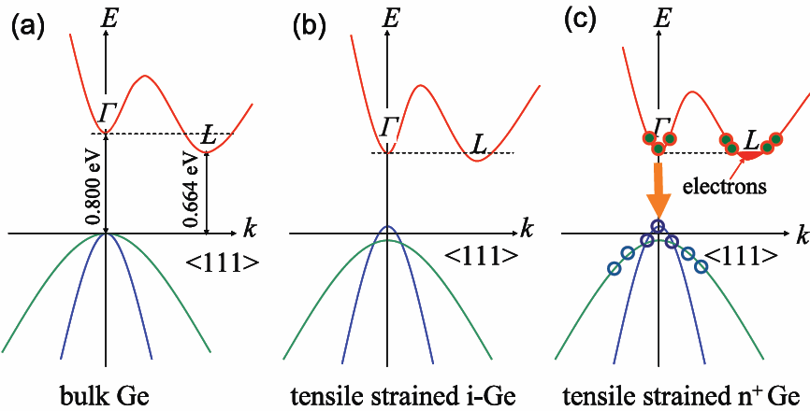

Direct Gap Transition of Ge by Tensile Strain and n-type doping
Liu et al, Opt. Express. 15, 11272 (2007)
• Efficient emission at 1550-1620 nm: 0.2-0.3% tensile strain plus
• n-type doping to compensate energy difference between Γ and L valleys.
L. Kimmerling, MIT

Slide 32
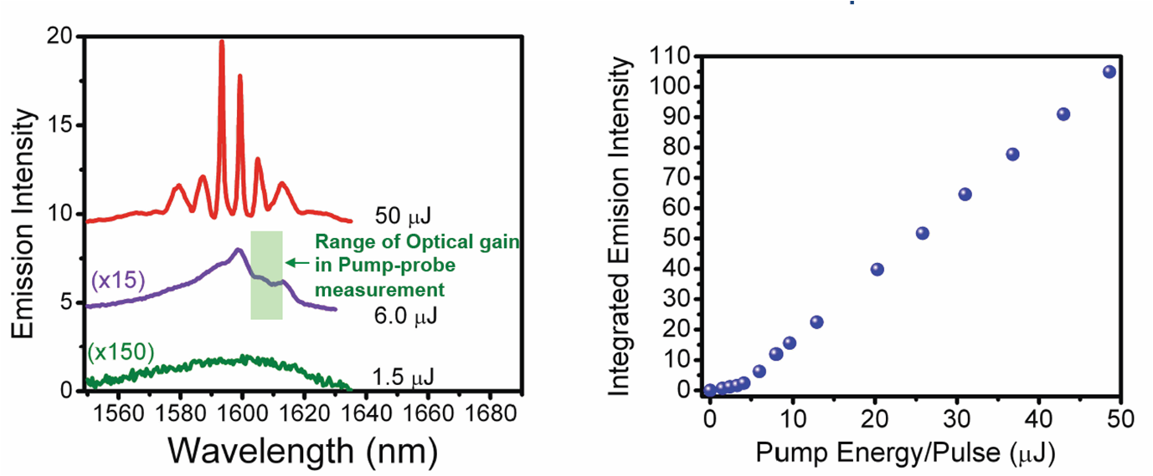
Emission Spectra from Ge Waveguide
Resonators: 1.5ns, 1064nm Pump
Liu et al, Opt. Lett. 35, 679 (2010)
Spectra evolve from broad emission band to sharp emission peaks with increasing pump excitation level.
Polarization evolves from mixed TE/TM to dominantly TE (TE:TM=10:1)
Threshold also observed at ~5μJ/pulse (30 kW/cm²).
Slide courtesy of L. Kimmerling, MIT

Slide 33
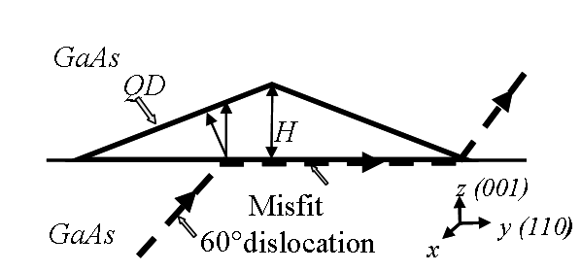
Quantum Dot Lasers on Si
Bhattacharya
Advantages of QD Lasers
Low threshold currents
Temperature-independent operation
“Potentially” large modulation bandwidth
Low chirp
Reduced optical feedback sensitivity
Self-organized quantum dots, by virtue of the large strain fields, can inhibit the propagation of dislocations.
Discrete density of states
33

Slide 34
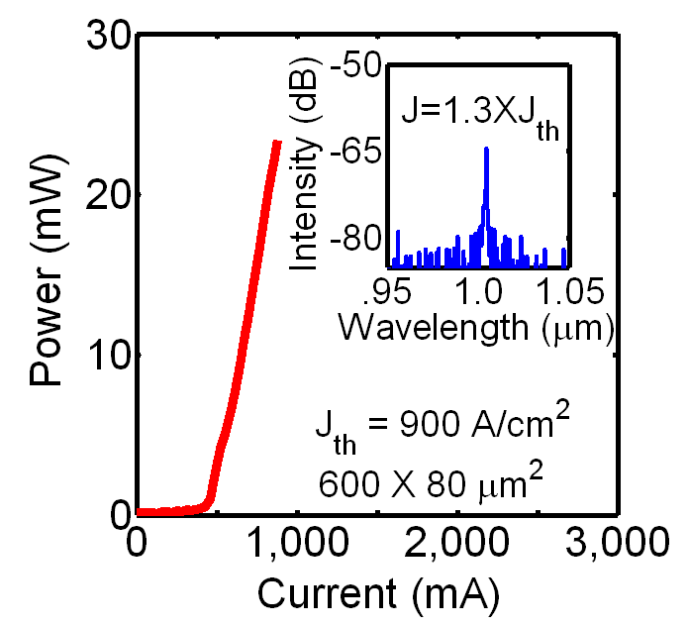
Quantum Dot Lasers on Silicon
Bhattacharya, University of Michigan
Active
region
QD buffer
layer
(001)-oriented Si substrates misoriented 4º towards [111] are used to eliminate the formation of antiphase domains and stacking faults at the GaAs/Si interface.
QD dislocation filters, efficiently blocking dislocation propagation, lead to improved lasers on silicon.
QD lasers on silicon have relatively low threshold current (J_{th} ~ 900 A/cm²), high output power (~150 mW), and very large T₀ (278 K).
These devices also exhibit -3dB bandwidth of 5.5 GHz, comparable to typical QD lasers on GaAs substrates.
Z. Mi, J. Yang, P. Bhattacharya, Proc. IEEE 97, 1239 (2009)

Slide 35
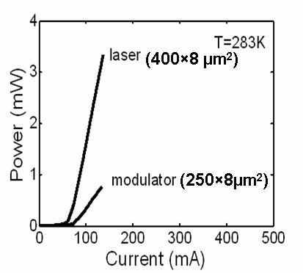
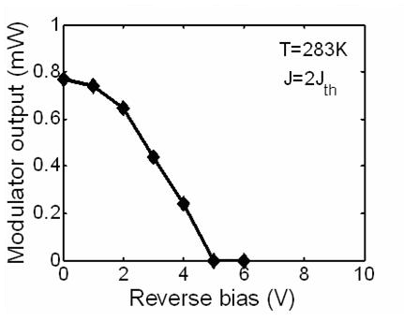
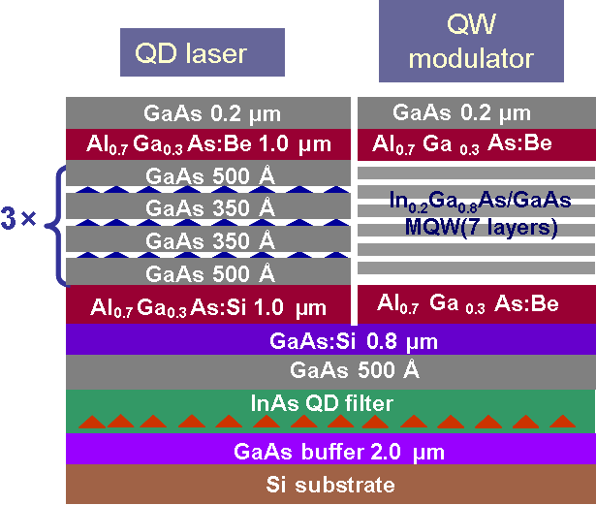
Integrated Laser/Modulator on Silicon
Bhattacharya, University of Michigan
Quantum dot laser
Etched facets
Quantum well modulator
L-I characteristics
Modulator output
I_{bias}
V_{bias}
Si
λ/4 Al₂O₃ AR Coating (n~1.6)
Si
Substrate
Substrate
Modulator regrowth from n contact layer
SEM of integrated laser/a:Si-H waveguide on Si
MBE re-growth, PECVD deposition of a:Si-H waveguides.
J. Yang, P. Bhattacharya,, Optics Exp 16, 5136 (2008)
Notes:
35

Slide 36
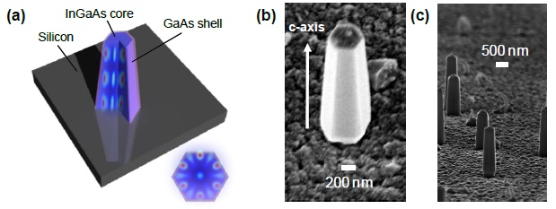
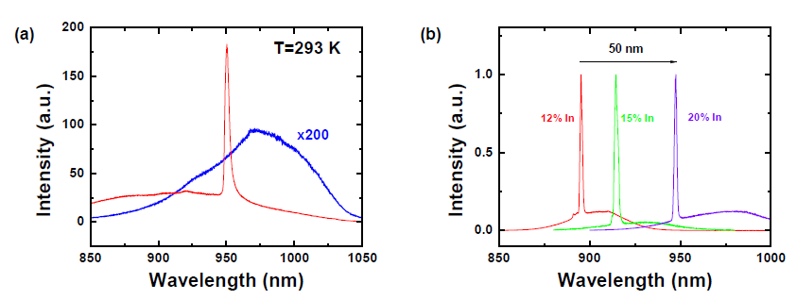
Nanopillar InGaAs Growth on (111)Si
Chang-Hasnain
MOCVD growth on (111) Si
Chen et al., IPR (2010)

Slide 37
Silicon light emission – How?
Another material for gain (hybrid approach)
  Bonding: Die level
    Flip-chip bonding
37

Slide 38
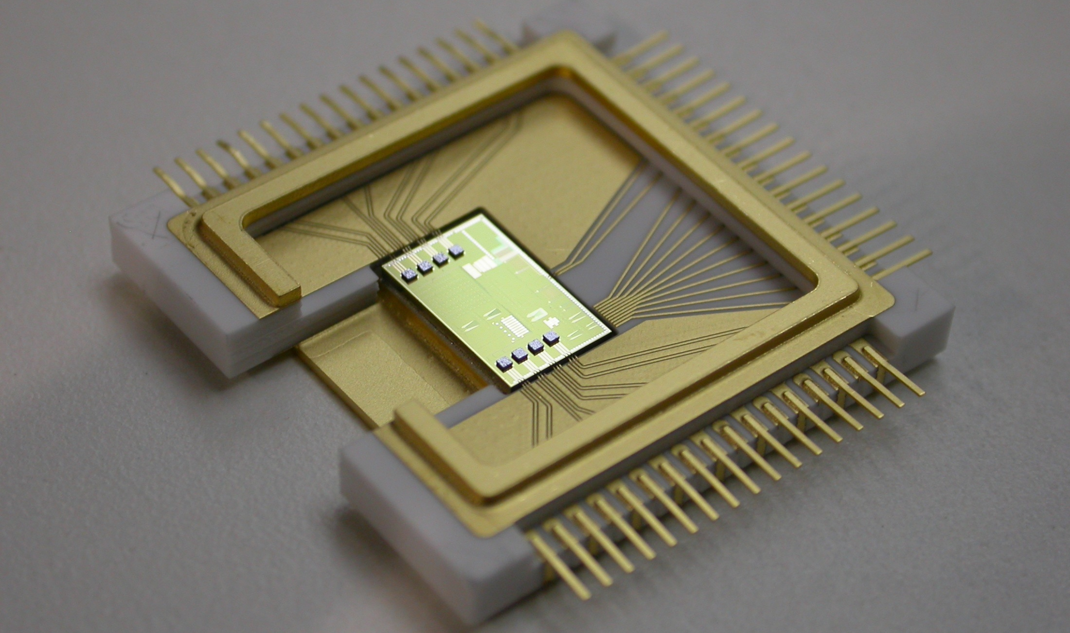
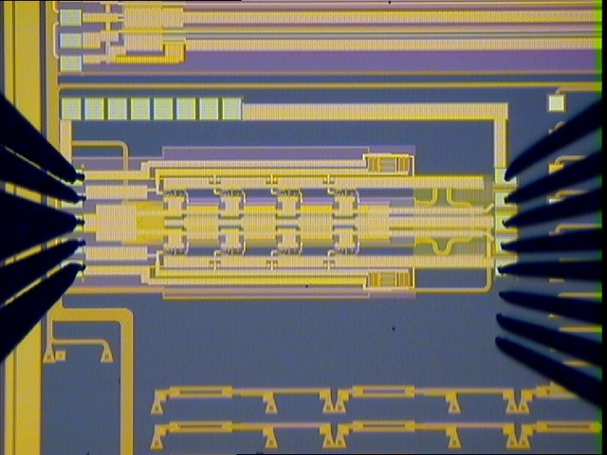
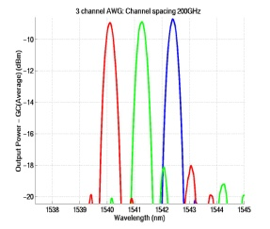
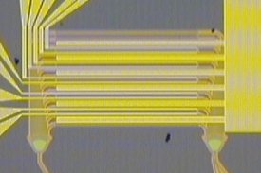
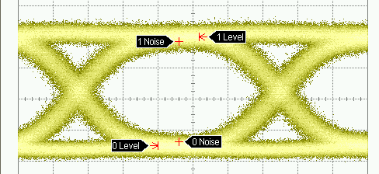
Die bond lasers one at a time (Luxtera)
Flip-chip bonded lasers
wavelength 1550nm
passive alignment
non-modulated = low cost/reliable
Fiber cable plugs here
Ceramic Package

Slide 39
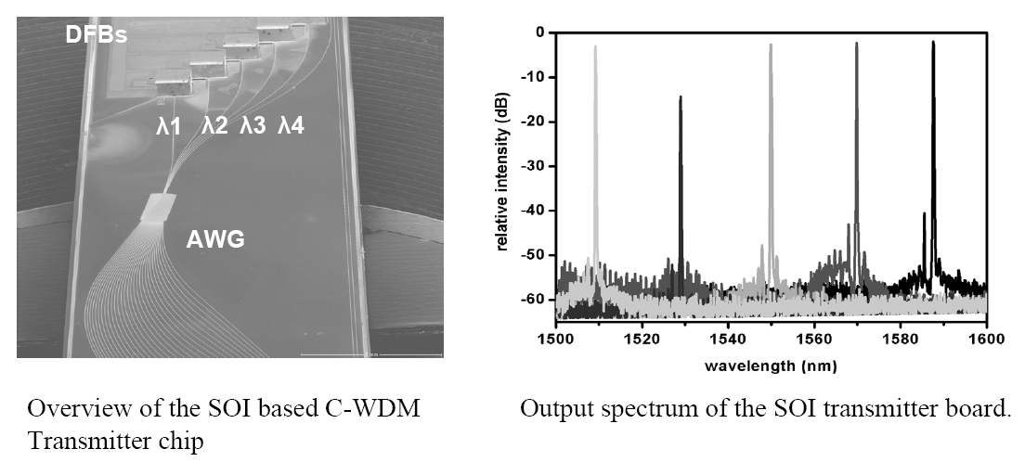
C-WDM transmitter chip
39
Torsten Mite et al., IEEE Journal of Selected Topics in Quantum Electronics 12, 983 (2006)

Slide 40
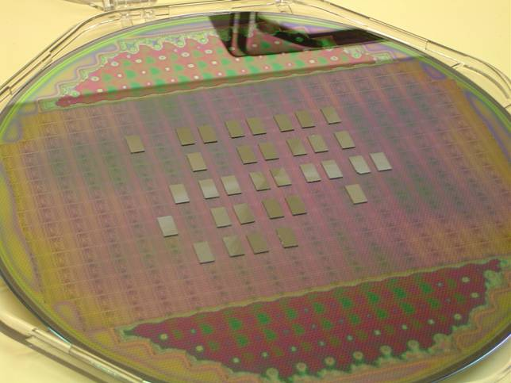
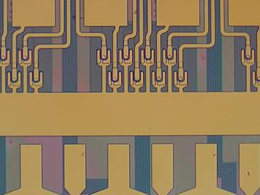
Heterogeneous integration
Step 1: Bond InP-dies on SOI waveguide
InP
III-V dies
Si
Step 2: Remove substrate
SOI-waveguide wafer
BCB or SiO₂
SiO₂
Si
8 lasers
Step 3: Process lasers at wafer scale
SiO₂
Waveguide bundel
Si
40

Slide 41
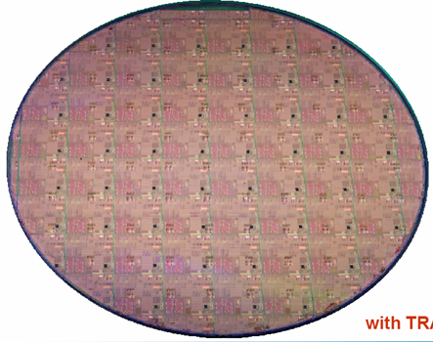
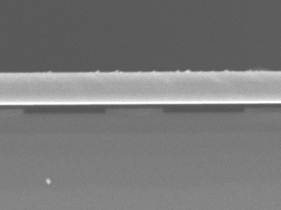
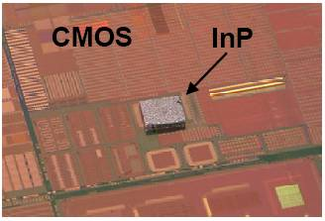
Heterogeneous integration
Two alternatives for the die-to-wafer bonding process
Adhesive layer bonding
  Planarization and bonding in single step (IMEC-Ghent University)
  Ultra-thin bonding layers (sub 200nm demonstrated) [1]
Molecular bonding
  InP on SOI-waveguides (UCSB, Intel, CEA-LETI, TRACIT) [2,3]
InP-layer
Si-wire
[1] G. Roelkens et al., “Adhesive Bonding of InP/InGaAsP Dies to Processed Silicon-On-Insulator Wafers using DVS-bis-Benzocyclobutene”, J. Electrochem. Soc., Volume 153, Issue 12, pp. G1015-G1019 (2006)
[2] D. Liang469. D. Liang, G. Roelkens, R. Baets, J. E. Bowers , "Hybrid Integrated Platforms for Silicon Photonics," Materials , 3 ( 3 ), 1782-1802 , March 12 , 2010
[3] M. Kostrzewa et al., 'InP dies transferred onto silicon substrate for optical interconnects application ', Sensors & Actuators A 125 (2006) 411-414
41

Slide 42
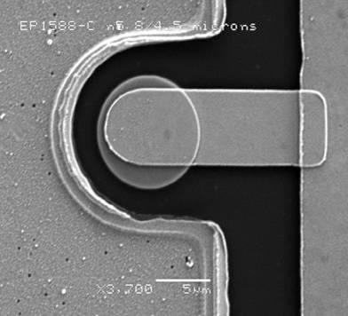
Microdisk laser
IMEC-Ghent University, CNRS-LEOM, CEA-LETI, TRACIT
Spectral power [a.u.]
Pulse width = 360ns
Period = 3600ns
T = 15°C
42
Rojo Romeo, P., “Heterogeneous integration of electrically driven microdisk based laser sources for optical interconnects and photonic ICs”,Optics Express, 14(9), p.3864-3871 (2006)

Slide 43
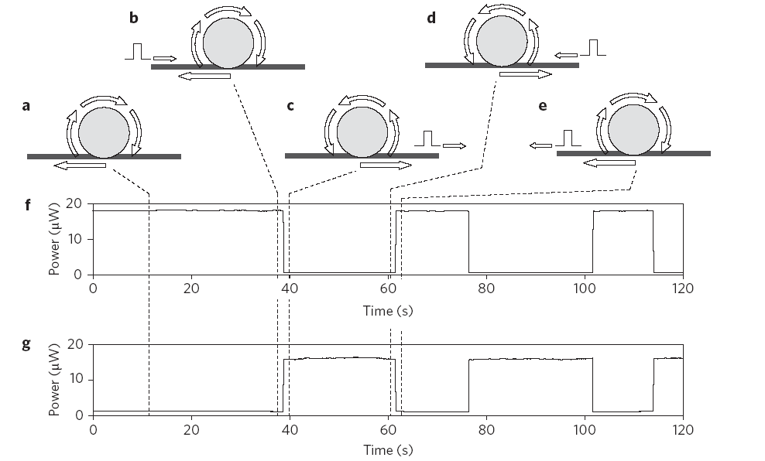
Flip flop operation: Coupled Disks
Slow switching
Fast switching
Waveform of optical signal at one end of SOI waveguide
Switching energy: 1.8fJ
Total power consumption: 6mW
Switch-off time: 60ps
Switch-on time < 100ps
Extinction ratio: 11dB

Slide 44
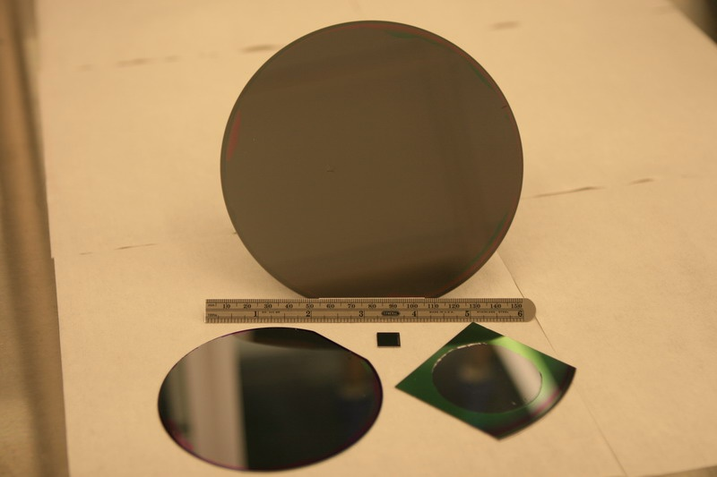
Scaling of Bonded Wafers
150 mm (6”)
100 mm (4”)
50 mm (2”)
2 cm
These wafers have patterned optical waveguides on SOI with 2 micron GaInAsP layer on top.
Oxygen plasma enhanced bonding: 300 C, 30 minutes
D. Liang, G. Roelkens, R. Baets, J. E. Bowers , "Hybrid Integrated Platforms for Silicon Photonics," Materials , 3 ( 3 ), 1782-1802 , March 12 , 2010

Slide 45
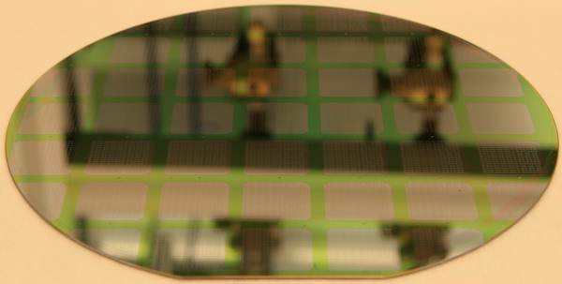
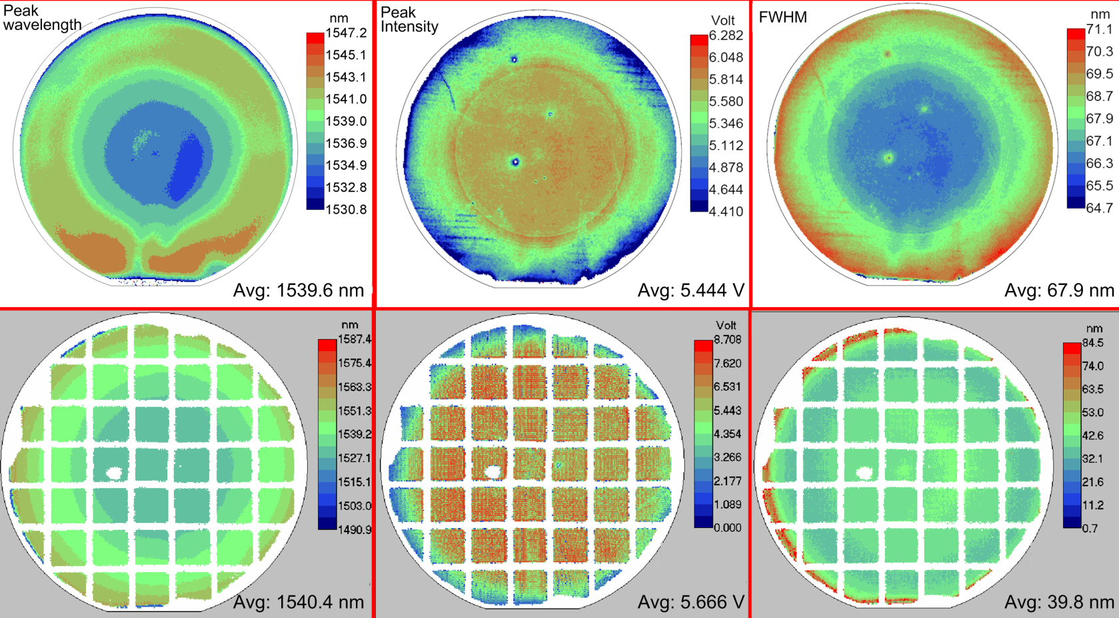
Photoluminescence study
Epi Grown by Oakley et al.
Lincoln Labs
PL improves after bonding
Before
bonding
5.4 V
68 nm
After
bonding
5.7 V
40 nm
Wavelength
Intensity
FWHM

Slide 46

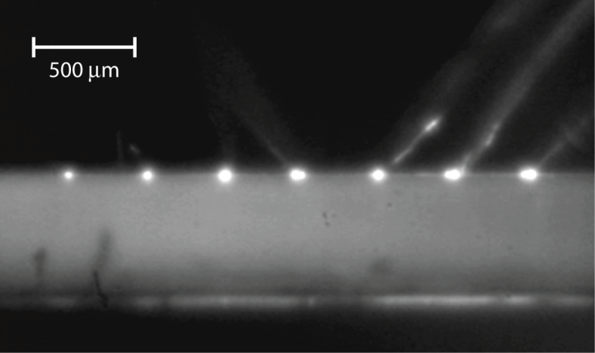
Hybrid Silicon Photonics
Direct Gap III-V
InGaAlAs
III-V active region
Silicon
Silicon rib waveguide on SOI wafer
  Optical gain from III-V Material
  Efficient coupling to silicon passive photonic devices
  No bonding alignment necessary: suitable for high volume CMOS
  All back end processing low temperature (<350 C)
  CW lasing to 105 C
7 lasers operating c.w. simultaneously
Liang and Bowers, Nature Photonics, 4, 511, Aug. 2010.

Slide 47
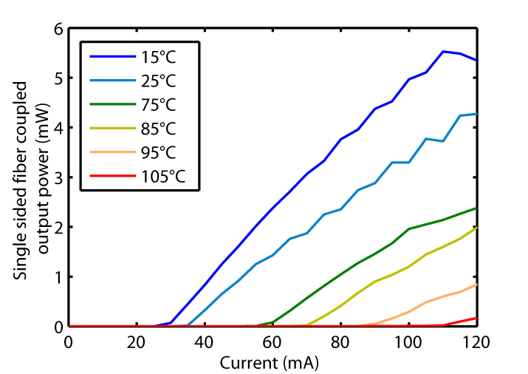
105 C CW 1310 nm laser
1310 nm important for FTTH and data communications.
Max fiber coupled output power: 5.5 mW
Max operation temperature: 105 °C
T0: 80 °C
Injection efficiency: 52 %
Chang et al., Optics Express 15(18), 11466, August (2007).

Slide 48
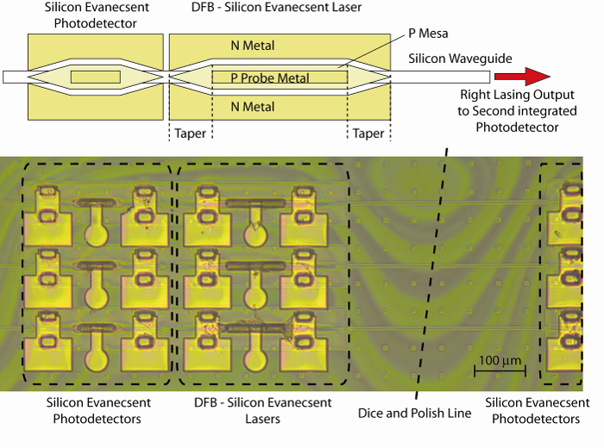
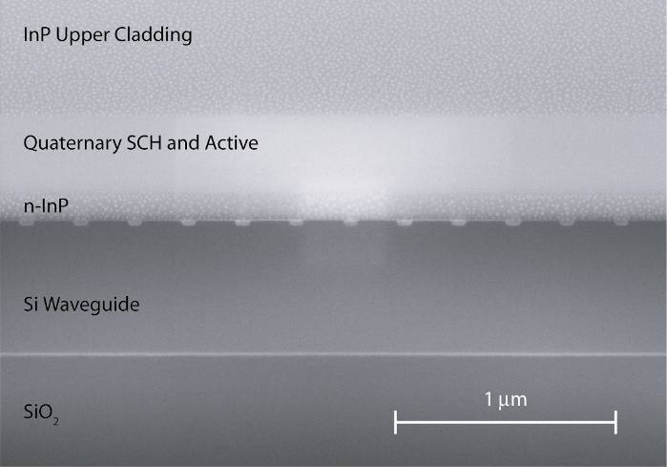


Silicon Evanescent DFB Lasers

Slide 49




Multiple bandgaps: Quantum Well Intermixing
Hybrid Silicon Sampled Grating DBR Tunable Laser
Six electrically isolated regions
Three III-V material bandgaps
  Gain/backside absorber
  Electroabsorption modulator
  Front/rear mirrors and mode transformer
Multiple bandgap functionality
  Carrier injection for wavelength tuning
  Shift mode transformers outside laser cavity
3.
1.
2.
1.
2.
3.
EA efficiency
Low loss
Si WG
1.
3.
1.
3.
2.
3.
Sid Jain (ECOC): 16 DFB Lasers and Modulators
Absorber
Rear mirror
Gain/Phase
Front mirror
EAM
Mode transformer
M. Sysak, J.O. Anthes, J.E. Bowers, O. Raday, R. Jones , Optics Express , 16 ( 17 ), 12479-12486 , August 18 , 2008
49

Slide 50

QWI DFB Array
  Broadband DFB array
  - 13 CW operational lasers using two bandgaps over 90+ nm spectrum.
  - Coarse WDM optical source on Si
Bandgap B
Bandgap A
Gain
Gain
ISLC 2010, Kyoto , Japan
WA3 9.15 - 9.30 Integrated Broadband Hybrid Silicon DFB Laser Array using Quantum Well Intermixing
Notes:
Use both bandgaps for gain and use an array of gratings → broadband laser source

Slide 51









Hybrid Silicon Racetrack Ring Laser with Integrated Photodetectors
0
Propagation distance
L= μm
0
10
20
30
40
50
-50
Bending loss (cm⁻¹)
R=50 μm
III-V
-100
Si
-150
50
100
150
200
250
A. W. Fang, OE, 15, 2315 (2007).
Radius (μm)
51

Slide 52




Hybrid Silicon Microring Laser
Confinement: MQW: 5.5%; silicon: 52%
III-V
Si
D. Liang, et al. Optics Express , 17 ( 22 ), 20355-20364 , October 23 , 2009

Slide 53


Threshold Improvement
D. Liang et al., Group IV Photonics 2009

Slide 54

Hybrid Silicon Evanescent Optical Amplifiers
III-V active region
Silicon waveguide on SOI wafer
Impact
  Electrically pumped amplifiers (unlike Raman or Erbium amplifiers)
  Wider wavelength range than erbium amps: 1310 nm, S, C, L band operation
Issues:
  Minimize reflections at transitions for spectrally flat gain, and high gain.
8 AMPs
8 detectors
H. Park et al., PTL, 19(4), 230, February (2007).

Slide 55



Silicon optical modulators
(1) MZ silicon modulator
Intel. A. Liu. 40Gbps
IBM. W. Green. 10Gbps
(2) Microring/disk modulator
HKUST. A. Poon. 0.5 Gb/s
Cornel Univ. M. Lipson. 12.5Gpbs
Notes:
However, the light source is a problem….

Slide 56


Index Change by Carrier Depletion
Si
Si
=
Plasma
+….
>10x
III-V
=
Plasma
+
BF
+
Pockels
+
Kerr
+….
H.-W. Chen et al., “25Gbps Hybrid silicon switch using a capacitively loaded traveling wave electrode,” Opt. Exp. 18, 1070 (2010).
Notes:
56
This figure shows the index change of a carrier change based modulator. As you can see, it includes different mechanism such as pockels, kerr, plasma, and bandfilling effects. For a given carrier density change, the plasma effects inside si and IIIV are about the same order. However, due to indirection bandgap of si, the bandfilling effect is ignorable compared to IIIV. Thus for a carrier change, we can roughly compare the purple and red curves in this figure. It shows that we can have 3 times larger index change in IIIV if carrier injection or depletion is applied to the device.
加圖(epi)

Slide 57



Capacitively Loaded Slotline MZI
Modulation is done by loaded “T” section
  Implant is used to isolate different T sections
Bragg frequency is around 10 THz
Velocity match and increase impedance to 50 ohm
25 Gb/s
  25 Gbit/s
  2³¹-1 NRZ
Notes:
57

Slide 58





High Speed Hybrid Silicon Switch
40Gb/s data stream
1→3 (35ps) | 1→4 (25ps)
2→3 (35ps) | 2→4 (25ps)
BER test
  Pattern: 2³¹-1 NRZ PRBS at 40Gb/s
  Switch voltage : 2V
  Power penalty : <1.5 dB for all ports configuration

Slide 59


Hybrid Silicon EAM Modulator
Use electroabsorption in InGaAlAs quantum wells
10Gbps
3dB BW > 18GHz (capacitance ~0.1pF; RC limited)
ER ~ 6.3dB (with 3.2V swing at 3V bias)
Eye diagram: 10Gb/s with 2³¹-1 PRBS
Y.-H. Kuo et al., "High speed hybrid silicon evanescent electroabsorption modulator,"
Opt. Exp. 16, 9936 (2008).

Slide 60



Hybrid Silicon Filters
Cell response with thermal tuning
Lower loss waveguides
More compact design

Slide 61




Integrated optical buffers and synchronizers
Integrated optical random access memory (ORAM) was demonstrated at 40 Gb/s with 40-byte packets for up to 64 ns of delay
Autonomous contention resolution between two 40-byte packet streams
  Two concatenated buffers
  Two buffered inputs
back-to-back
5 circulations
Buffer
AWG
Digital
Tunable
Laser

Slide 62

Triplexers
Laser, 1310/1500 nm MUX MMI, MZI 1550/1490 MUX, PDs integrated
Chang et al. OFC 2010
62

Slide 63


Resonant SiGe APDs
  Y. Kang et al., Nature Photonics 3, 59-63 (2008)
Dai, et al., Optics Express, Vol. 17, Issue 19, pp. 16549-16557

Slide 64
The Avalanche Multiplication Process
-
-
-
-
-
-
-
-
-
-
-
-
+
+
+
+
-
-
-
-
+
-
-
+
-
+
+
P+
-
N+
P+
N+
+
-
-
-
+
-
+
+
+
+
+
+
-
-
Si Multiplication Layer
-
+
The process is relatively deterministic i.e. not noisy.
The transit time is 2T, independent of gain i.e. no first order gain bandwidth limit.
InP Multiplication Layer
This has limited gain bandwidth product. Twice the gain requires twice the time.

Slide 65
Dependence of Gain Bandwidth on k factor
850 GHz
Dai, JSTQE (2009).
350 GHz
Kang et al. Nature Photonics (2008).
Hawkins et al. APL, (1997).
Commercial
Devices

Slide 66

Rattner, IPR Plenary, Postdeadline (2009)

Slide 67

Rattner, IPR 2009

Slide 68

Next Generation Lightpeak-Optical USB
Every computer, SAN, Display,…
Rattner, IPR 2009

Slide 69
High Performance Computing Scaling enabled by Optical Interconnects
10 Peta-FLOPS
OI at ~100 fJ/bit*
“Peta-FLOPS in
a rack”
1 Peta-FLOPS
OI at ~1 pJ/bit
100 TFLOPS
Computational Throughput
HPC performance space expanded by Chip-to-Chip
Optical Interconnects
10 TFLOPS
electrical inter-chip interconnect barrier overcome by OI
1 TFLOPS
100 GFLOPS
10 MW
1 MW
100 kW
10 kW
1 kW
Power Consumption
*D. A. B. Miller, IEEE Proc., 2009
100 x lower power!
Notes:
As the level of OI integration continues to increase through the advancement of Photonic Integrated Circuit (PIC) technologies, we may now consider “flat” optical interconnect fabrics in which the chain of Electrical-to-Optical-to-Electrical transductions happens only once at any length-scale across the computer.
Benefits of such a computing architecture:
Maintaining computation and communication bandwidth balancing,
Ease the programmability challenges of large systems – a critical issue impacting scaling of supercomputers to the Exascale [5].

Slide 70
Remaining Challenges
Light emission-Lasers and amplifiers
  Lower threshold (0.1 mA). Higher gain (1 dB/mA)
Light detection: BW-Efficiency Product poor
  100 GHz
Integrated Isolators
Thermal resistance (DWDM on chip)
CMOS Compatibility
  Widespread photonics in CMOS process lines

Slide 71
Summary
Power and power density are big problems limiting the growth of the Internet
CMOS compatible silicon photonics combines two great inventions:
  The transistor microprocessor
  The laser optical communications
and enable >100x lower power and lower power density.
A suite of devices demonstrated
  Fabry Perot, DFB, Ring and Mode Locked Lasers
  Optical amplifiers and integrated preamplifier arrays
  24 GHz bandwidth modulators demonstrated

