Slide 1
Capacity and Power Efficiency Increases in Fiber Optic Communications
The Institute for Energy Efficiency
University of California, Santa Barbara
11 February 2011
Chris Cole
chris.cole@finisar.com

Slide 2
Outline
Non-optical Datacom Examples:
Voiceband, Wireline & Wireless
Fiber Optic Communication Categories:
Telecom, Short Wave & Long Wave Datacom
Today’s Optical Datacom:
1Gb/s & 10Gb/s
Next Gen Optical Datacom:
40Gb/s & 100Gb/s
Optical Datacom Architecture Limits:
Laser & IC
Beyond 100Gb/s Crystal Ball:
400Gb/s & >1Tb/s
Summary

Slide 3
Non-optical Datacom
Early Voiceband and Wireline Datacom
single channel with simple modulation
limited by Nyquist
limited by symbol distortion
Modern Voiceband, Wireline and Wireless Datacom
multi-channel
removes Nyquist per channel limit
implemented as parallel (wires) or FDM
complex modulation
approaches Shannon limit
reverses symbol distortion
uses extensive DSP

Slide 4
Voiceband Datacom
ITU standard | V.22 (1980) | V.32 (1984)
bit rate (b/s) | 1200 | 9600
Baud (Bd) | 600 | 2400
bits/symbol | 2 (4 state QPSK) | 4 (16 state QAM)
channels | 1 (unidirectional, split-band over 1 wire pair) | 1 (bi-directional, full-band over 1 wire pair)
DSP | none | Echo cancellation, adaptive equalization and forward error correction (FEC)

Slide 5
Wireline Datacom
IEEE standard | 100BASE-TX (1995) | 1000BASE-T (1999)
bit rate (Mb/s) | 100 | 1000
Baud (MBd) | 125 | 125
bits/symbol | 1 (3 state PAM) | ~2 (5 state PAM)
channels | 1 (unidirectional over 2 wire pairs) | 4 (bi-directional over 4 parallel wire pairs)
DSP | 4B/5B encoding | Echo cancellation and trellis coding across all channels

Slide 6
Wireless Datacom
IEEE standard | 802.11b (WiFi) | 802.11a (WiFi)
bit rate (Mb/s) | 11 (simplex) | 54 (simplex)
Baud (KBd) | 1400 | 208
bits/symbol | 8 (64 state QPSK x 4 state DQPSK CDMA) | 6 (64 state QAM)
channels | 1 (unidirectional, CCK, CSMA/CA full-band) | 48 (unidirectional, OFDM, CSMA/CA full-band)
DSP | Walsh/Hadamard coding, adaptive rate selection | FFT coding, adaptive rate selection

Slide 7
Outline
Non-optical Datacom Examples:
Voiceband, Wireline & Wireless
Fiber Optic Communication Categories:
Telecom, Short Wave & Long Wave Datacom
Today’s Optical Datacom:
1Gb/s & 10Gb/s
Next Gen Optical Datacom:
40Gb/s & 100Gb/s
Optical Datacom Architecture Limits:
Laser & IC
Beyond 100Gb/s Crystal Ball:
400Gb/s & >1Tb/s
Summary

Slide 8
Telecom
Single Mode Fiber (SMF) DWDM multi-channel transport
100km, 500km, 2000km enterprise, metro, long haul transmission applications
1550nm tunable CW laser with MZ Modulator per lambda
Optical Amplifiers and Dispersion Compensation
Moderate volume (1ks to 10ks / year)
Stringent performance requirements
10Gb/s & lower are Serial NRZ per lambda
40Gb/s & 100Gb/s are complex modulation per lambda
DSP used in many implementations
Not subject of this presentation

Slide 9
Short Wave (SW) Datacom
Multi Mode Fiber (MMF) point to point interconnect
10m, 100m, 300m, intra-rack, inter-rack, data-center applications
850nm Vertical Cavity Surface Emitting Laser (VCSEL)
High volume (100ks to 1Ms / year)
Very stringent cost requirements
1Gb/s & 10Gb/s are Serial NRZ over duplex MMF
40Gb/s & 100Gb/s are Serial NRZ over parallel MMF
Orders of magnitude below fiber Nyquist and Shannon limits

Slide 10
Long Wave (LW) Datacom
Single Mode Fiber (SMF) point to point interconnect
2km, 10km, 40km inter-rack, data-center, central office, campus and inter-office applications
1310nm Distributed Feedback (DFB) Laser
High volume (100ks to 1Ms / year)
Stringent cost requirements
1Gb/s & 10Gb/s are Serial NRZ over duplex SMF
40Gb/s and 100Gb/s are WDM NRZ over duplex SMF
Orders of magnitude below fiber Nyquist and Shannon limits

Slide 11
Outline
Non-optical Datacom Examples:
Voiceband, Wireline & Wireless
Fiber Optic Communication Categories:
Telecom, Short Wave & Long Wave Datacom
Today’s Optical Datacom:
1Gb/s & 10Gb/s
Next Gen Optical Datacom:
40Gb/s & 100Gb/s
Optical Datacom Architecture Limits:
Laser & IC
Beyond 100Gb/s Crystal Ball:
400Gb/s & >1Tb/s
Summary

Slide 12
1G Mainstream Optical Datacom
IEEE standard | 1000BASE-SX (SW) 1998 | 1000BASE-LX (LW) 1998
Laser | 850nm VCSEL | 1310nm DFB
bit rate (Gb/s) | 1 | 1
Baud (GBd) | 1.25 | 1.25
bits/symbol | 1 (2 state NRZ) | 1 (2 state NRZ)
channels | 1 (unidirectional Serial on 2 MMFs) | 1 (unidirectional Serial on 2 SMFs)
DSP | 8B/10B coding | 8B/10B coding

Slide 13
10G SW Optical Datacom
Standard | “SFF POP4 MSA” 2002 Niche | IEEE 10GBASE-SR 2002 Mainstream
Laser | 850nm VCSEL | 850nm VCSEL
bit rate (Gb/s) | 10 | 10
Baud (GBd) | 3.1 | 10.3
bits/symbol | 1 (2 state NRZ) | 1 (2 state NRZ)
channels | 4 (unidirectional Serial on 8 parallel MMFs) | 1 (unidirectional Serial on 2 MMFs)
DSP | 8B/10B coding | 64B/66B coding

Slide 14
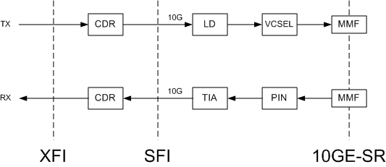
10Gb/s SW Transceiver

Slide 15
10G LW Optical Datacom
IEEE standard | 10GBASE-LX4 2002 Niche | 10GBASE-LR 2002 Mainstream
Laser | 1310nm DFB | 1310nm DFB
bit rate (Gb/s) | 10 | 10
Baud (GBd) | 3.1 | 10.3
bits/symbol | 1 (2 state NRZ) | 1 (2 state NRZ)
channels | 4 (unidirectional WDM on 2 SMFs or MMFs) | 1 (unidirectional Serial on 2 SMFs)
DSP | 8B/10B coding | 64B/66B coding

Slide 16
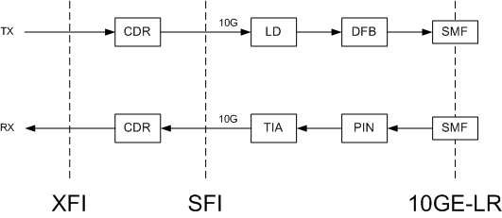
10Gb/s LW Transceiver

Slide 17
Outline
Non-optical Datacom Examples:
Voiceband, Wireline & Wireless
Major Fiber Optic Communication Categories:
Telecom, Short Wave & Long Wave Datacom
Today’s Optical Datacom:
1Gb/s & 10Gb/s
Next Gen Optical Datacom:
40Gb/s & 100Gb/s
Optical Datacom Architecture Limits:
Laser & IC
Beyond 100Gb/s Crystal Ball:
400Gb/s & >1Tb/s
Summary

Slide 18
40G SW Optical Datacom
IEEE standard |  | 40GBASE-SR4 2010 Mainstream
Laser |  | 850nm VCSEL
bit rate (Gb/s) |  | 40
Baud (GBd) |  | 10.3
bits/symbol |  | 1 (2 state NRZ)
channels |  | 4 (unidirectional Serial on 8 MMFs)
DSP |  | 64B/66B coding

Slide 19
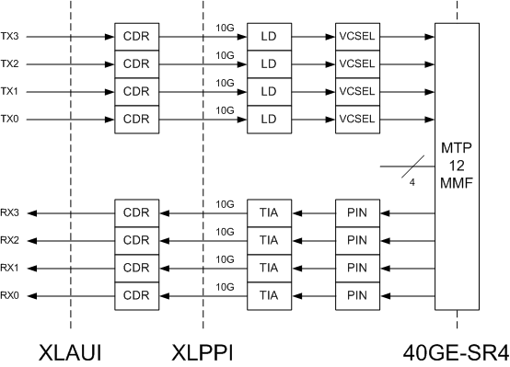
40Gb/s SW Parallel Transceiver

Slide 20
100G SW Optical Datacom
IEEE standard | 100GE-SR10 2010 Niche | 100GE-SR4 ~2013 Mainstream
Laser | 850nm VCSEL | 850nm VCSEL
bit rate (Gb/s) | 100 | 100
Baud (GBd) | 10.3 | 25.8
bits/symbol | 1 (2 state NRZ) | 1 (2 state NRZ)
channels | 10 (unidirectional Serial on 20 parallel MMFs) | 4 (unidirectional Serial on 8 parallel MMFs)
DSP | 64B/66B coding | 64B/66B coding

Slide 21
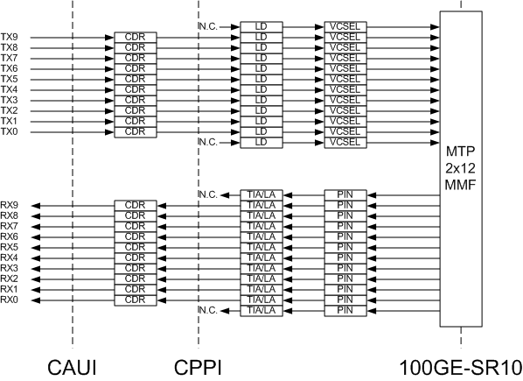
100Gb/s SW Parallel 24MTP Transceiver

Slide 22
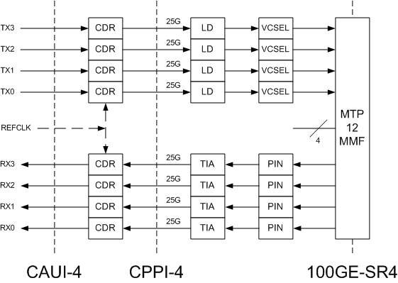
100Gb/s SW Parallel 12MTP Transceiver

Slide 23
Key Technology for 40G and 100G SW
High yield Photonic Integrated Circuit (PIC*) parallel quad VCSEL array
Ex. monolithic InP quad 850nm VCSEL array, 0.25mm x 1.0mm PIC, Finisar Corp.
* The “C” in PIC is a stretch since there are no optical connections.

Slide 24
40G LW Optical Datacom
Standard | Telcordia OC-768 ~2000 Niche | IEEE 40GBASE-LR4 2010 Mainstream
Laser | 1550nm EML | 1310nm DFB
bit rate (Gb/s) | 40 | 40
Baud (GBd) | 40 | 10.3
bits/symbol | 1 (2 state NRZ) | 1 (2 state NRZ)
channels | 1 (unidirectional Serial on 2 SMFs) | 4 (unidirectional WDM on 2 SMFs)
DSP | SONET Framing | 64B/66B coding

Slide 25
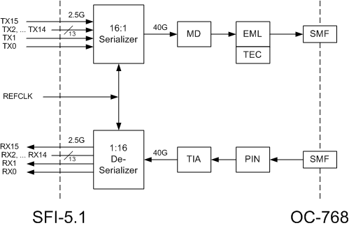
40Gb/s LW Serial Transceiver

Slide 26
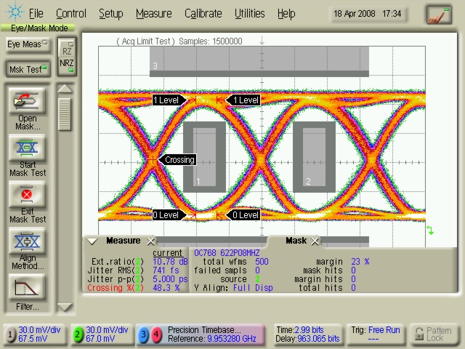
40Gb/s LW Serial Transceiver Ex. Data
Test conditions:
1550nm λ, 75ºC, 39.81312Gb/s PRBS 2^31 -1 pattern
TX Eye mask margin: 23%
RX average sensitivity: -10.3dBm

Slide 27
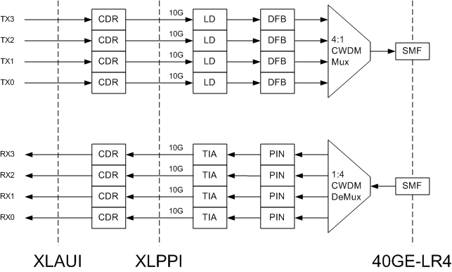
40Gb/s WDM Transceiver

Slide 28
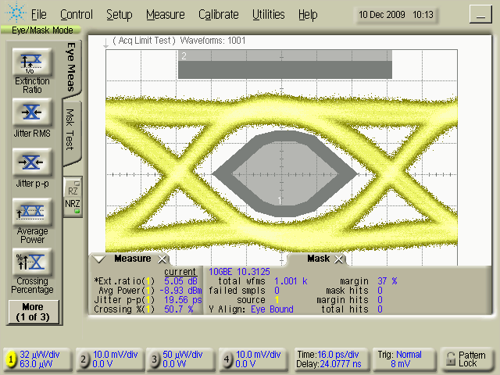
40Gb/s WDM Transceiver Ex. Data
Test conditions:
1310nm λ, 55ºC, 10.3125Gb/s PRBS 2^31 -1 pattern
TX Eye mask margin: 37%
RX OMA sensitivity: -15.6dBm

Slide 29
100G LW Optical Datacom
IEEE standard | 100GE-LR4 Gen1 2010 | 100GE-LR4 Gen2 2010
Laser | 1310nm EML (2009) | 1310nm DFB (2011)
bit rate (Gb/s) | 100 | 100
Baud (GBd) | 25.8 | 25.8
bits/symbol | 1 (2 state NRZ) | 1 (2 state NRZ)
channels | 4 (unidirectional WDM on 2 SMFs) | 4 (unidirectional WDM on 2 SMFs)
DSP | 64B/66B coding | 64B/66B coding

Slide 30
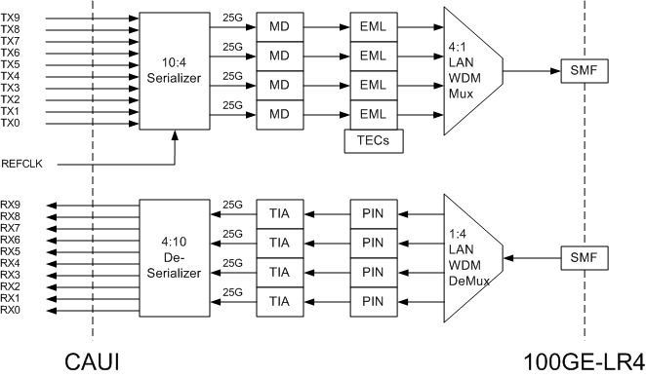
100Gb/s WDM EML Transceiver

Slide 31
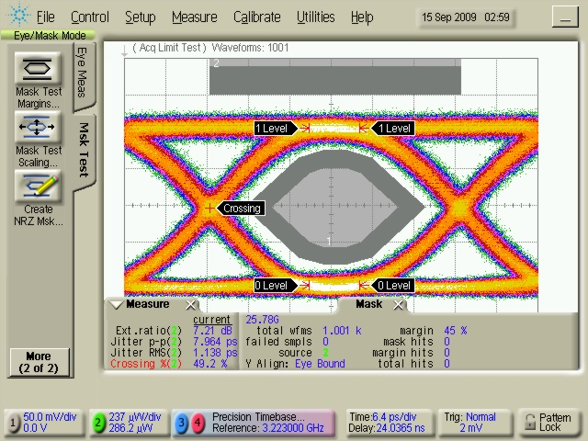
100Gb/s WDM EML Transceiver Ex. Data
Test conditions:
1310nm λ, 55ºC, 25.78125Gb/s PRBS 2^31 -1 pattern
TX Eye mask margin: 45%
RX OMA sensitivity: -11.2dBm

Slide 32
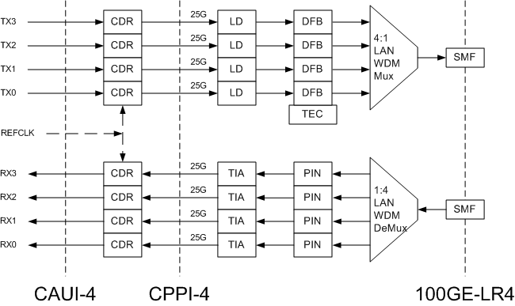
100Gb/s WDM DFB Transceiver

Slide 33
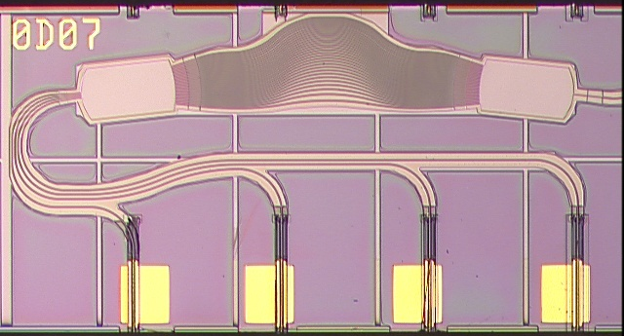
Key Technology for 40G and 100G LW
High yield Photonic Integrated Circuit (PIC) WDM quad DFB array
Ex. monolithic InP quad 1310nm band DFB laser array with AWG, 1.1mm x 2.4mm PIC, CyOptics Inc.

Slide 34
Outline
Non-optical Datacom Examples:
Voiceband, Wireline & Wireless
Major Fiber Optic Communication Categories:
Telecom, Short Wave & Long Wave Datacom
Today’s Optical Datacom:
1Gb/s & 10Gb/s
Next Gen Optical Datacom:
40Gb/s & 100Gb/s
Optical Datacom Architecture Limits:
Laser & IC
Beyond 100Gb/s Crystal Ball:
400Gb/s & >1Tb/s
Summary

Slide 35
Optical Datacom Architecture Q&A
Data Rate = no. of channels * baud * bits/symbol
(baud = symbols/sec)
Why do all rates use NRZ modulation?
ON/OFF keying is simplest and cheapest to implement
Why are 1G and 10G rates Serial?
1 channel is simplest and cheapest to implement
If that is true, why are 40G and 100G Parallel and WDM?
Sometimes conventional wisdom bites the dust
Min no. of channels is at max baud that is simplest and cheapest to implement, which in this case is more than 1
Will faster rates use modulation other than NRZ?
This conventional wisdom will also bite the dust
How to determine max baud to know min no. of channels?

Slide 36
Max Baud from Laser Limits
Reference: Larry Coldren & Scott Corzine (UCSB), Diode Lasers and Photonic Integrated Circuits, ©1995
Laser process figure of merit:
fR (relaxation resonant frequency)
fR = fR_{slope} * √(I_{operation} – I_{threshold}) (temperature dependant)
Based on fR of mainstream Laser production processes:
Max Baud ≈ fR * 1.5
Why fR * 1.5?
Max baud should be no higher than f3dB (Laser 3dB BW)
f3dB = fR * 1.55 (when fR = fPeak)
(fPeak = Laser peak response frequency)
Assumes fiber dispersion is not a limitation

Slide 37
Max Baud from Laser Limits Examples
2002 - 2004
fR ≈ 9GHz (mainstream Laser production processes)
10GHz < fR * 1.5
10Gbaud Lasers were efficiently implemented
40GHz ≈ fR * 4.5
40Gbaud Lasers were not feasible
2008 - 2010
fR = ~17GHz (mainstream Laser production processes)
(due to improvements in fR_{slope} and reliability of higher I_{operation})
25GHz ≈ fR * 1.5
25Gbaud Lasers for 100G are efficiently implemented
40GHz ≈ fR * 2.5
40Gbaud Lasers are feasible but very challenging

Slide 38
Max Baud from SiGe IC Limits
Reference: Paul Gray & Robert Meyer (UCB), Analysis and Design of Analog Integrated Circuits, ©1977
IC process figure of merit:
fT (transition frequency)
fT = unity magnitude short circuit current gain
Based on fT of mainstream SiGe production processes:
Max Baud ≈ fT/10
Why fT/10?
All optical IC communication building blocks such as TIAs, Laser Drivers, CDRs, CMUs, Logic require gain
10x gain at baud gives efficient, low power circuits
3x gain is difficult; requires cascading gain stages
1x gain is not usable
Assumes electrical signal integrity is not a limitation

Slide 39
Max Baud from SiGe Limits Examples
2002 – 2006
fT ≈ 110GHz (mainstream 250nm SiGe production processes)
10GHz < fT/10
10Gbaud ICs were efficiently implemented
40GHz ≈ fT/3
40Gbaud ICs were very difficult and expensive
2008 - 2012
fT = ~220GHz (mainstream 130nm SiGe production processes)
25GHz ≈ fT/10
25Gbaud ICs for 100G are efficiently implemented
40GHz ≈ fT/6
40Gbaud ICs are feasible but challenging

Slide 40
Max Baud from CMOS IC Limits
Reference: Thomas Lee (Stanford), The Design of CMOS Radio-Frequency Integrated Circuits, ©1998
IC process figure of merit:
fT (unity magnitude short circuit current gain)
[ fMax (unity magnitude power gain) is better but not general]
Based on fT of mainstream CMOS production processes:
[fT ≈ 10THz/L_{nm}; for “short” channel gate length L in nm]
Max Baud ≈ fT/10
Why fT/10?
All optical IC communication building blocks such as TIAs, Laser Drivers, CDRs, CMUs, Logic require gain
10x gain at baud gives efficient, low power circuits
3x gain is not usable; low CMOS g_{m} makes cascading gain stages impractical

Slide 41
Max Baud from CMOS Limits Examples
2004 - 2006
fT ≈ 120GHz (mainstream 90nm CMOS production processes)
10GHz < fT/10
10Gbaud ICs were efficiently implemented
40GHz ≈ fT/3
40Gbaud ICs were not feasible
2010 - 2012
fT = ~240GHz (mainstream 40nm CMOS production processes)
25GHz ≈ fT/10
25Gbaud ICs for 100G are efficiently implemented
40GHz ≈ fT/6
40Gbaud ICs are feasible but challenging

Slide 42
Outline
Non-optical Datacom Examples:
Voiceband, Wireline & Wireless
Major Fiber Optic Communication Categories:
Telecom, Short Wave & Long Wave Datacom
Today’s Optical Datacom:
1Gb/s & 10Gb/s
Next Gen Optical Datacom:
40Gb/s & 100Gb/s
Optical Datacom Architecture Limits:
Laser & IC
Beyond 100Gb/s Crystal Ball:
400Gb/s & >1Tb/s
Summary

Slide 43
Requirements Beyond 100Gb/s
Requirements from end users
Provide meaningful data rate increase
Maintain parity with 100GE bit/sec cost
Requirements from developers
Leverage 100GE R&D investment
Leverage ramping 100GE product volumes
Next data rate products should be based on 100GE technology to control R&D and unit costs
400GE meets these requirements
Technology for data rates above 400GE (ex. 1TE) requires extensive R&D and does not exist today

Slide 44
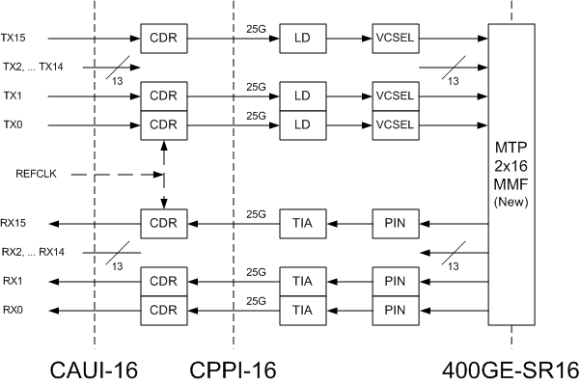
400Gb/s SW Parallel Baseline Transceiver

Slide 45
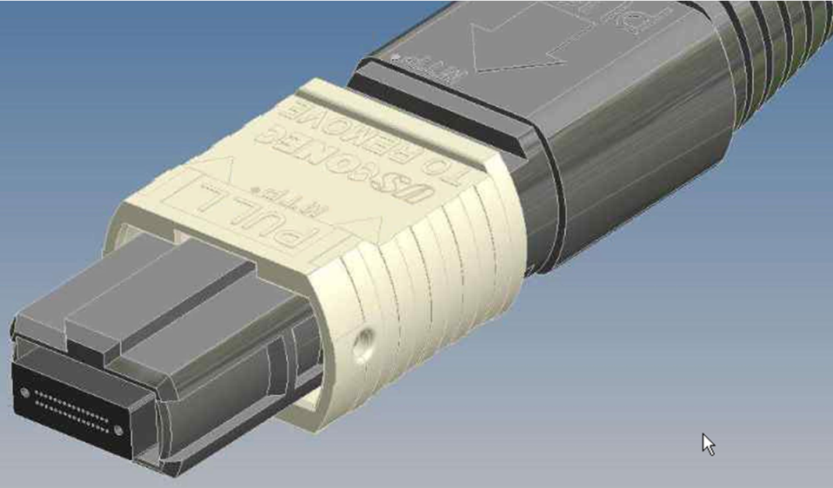
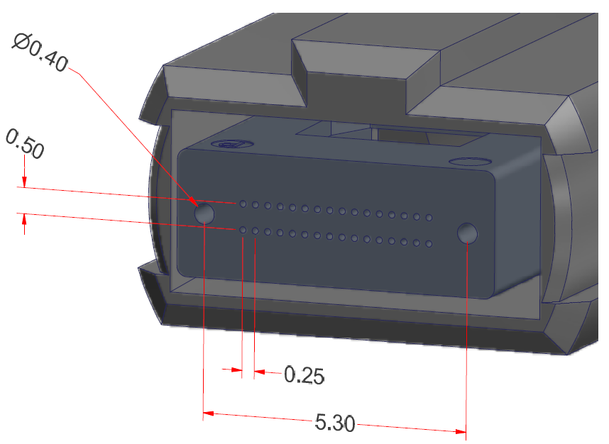
400Gb/s MTP Connector Specifications
USCONEC Proposal
Same core technology as originally developed by NTT Laboratories researchers T. Satake and colleagues
Same critical dimensions as existing MTP connectors
Width increased to support 2x16 fibers

Slide 46
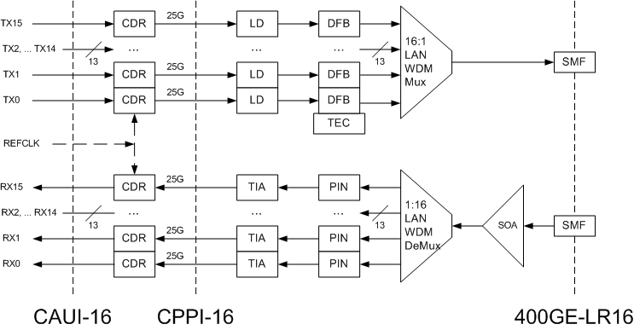
400Gb/s WDM Baseline Transceiver

Slide 47
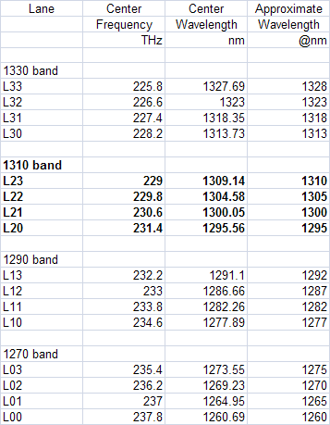
400Gb/s WDM Lambda Specifications
← 100Gb/s WDM Specification

Slide 48
400Gb/s Transceiver Alternatives
16x25Gb/s NRZ lasers (VCSEL and DFB) baseline
Linear extension of 100Gb/s technology
Only requires process yield improvements
Provides a benchmark against which all other proposals can be measured
8x50Gb/s PAM4 lasers (VCSEL and DFB)
8 electrical and optical channels with 4 level AM
Moderate DSP for dispersion compensation
Complex (amplitude and phase) modulation
Unlikely in the time frame of interest
No demonstrated technology exists that can be commercialized

Slide 49
>1Tb/s Requirements
What is the likely >1Tb/s rate if 400Gb/s is developed?
1Tb/s
2.5x is a small increase from 400Gb/s
unlikely to justify a large new technology investment
unlikely to meet bandwidth growth demands
1.2Tb/s
3x is a small increase from 400Gb/s
unlikely to justify a large new technology investment
3 is an odd number
1.6Tb/s
4x increase from 400Gb/s
Minimum step to justify a large technology investment

Slide 50
1.6Tb/s Transceiver Alternatives
64x25Gb/s NRZ lasers
Not practical
Too many channels
32x50Gb/s PAM4 lasers
Not practical
Too many channels
Complex (amplitude and phase) modulation
Only feasible alternative to control channel count
No demonstrated technology exists that can be commercialized
Excellent opportunity for huge academic research grants

Slide 51
Summary
Mainstream interfaces up to 10Gb/s are single-channel (serial) NRZ, requiring high speed ICs and single lasers (VCSEL and DFB)
Mainstream interfaces at 40Gb/s and 100Gb/s are multi-channel (WDM and parallel) NRZ, requiring high speed ICs and quad laser PICs (VCSEL and DFB)
Beyond 100Gb/s, 400Gb/s is a likely rate based on extending 100Gb/s multi-channel technology, requiring high speed ICs and multiple laser PICs (VCSEL and DFB)
Beyond 400Gb/s, 1.6Tb/s is a likely rate, requiring new multi-channel (WDM and parallel) technology, high speed ICs, complex modulation PICs, and extensive DSP

