Slide 1
QWI – Process Run 1 Mask review

Slide 2
Base structure
1.
III-V
2.
3.
Layer | Thickness | Doping | PL
1.Sacrifial InP | 500 nm | nid | N/A
2.InGaAsP stop etch | 20 nm | nid | 1.03 μm
3.n-InP | 10 nm | (n) 3x10¹⁸ cm⁻³ | N/A
4.InGaAsP/InP SL | 7.5/7.5 nm (2x) | (n) 3x10¹⁸ cm⁻³ | 1.03 μm
5.n-InP | 110 nm | (n) 3x10¹⁸ cm⁻³ | N/A
6.InGaAsP (Well/Bar) | 7x65 8x80 nm | nid | 1.54 μm
7.InGaAsP (p-SCH) | 250 nm | (p) 10¹⁷ cm⁻³ | 1 μm
8.p-InP | 1.5 μm | (p) 10¹⁸ cm⁻³ | N/A
9.p-InGaAs | 100 nm | (p) 10¹⁹ cm⁻³ | N/A
10.p-InP substrate | 300 μm | (p) 2e18 cm⁻³ | N/A
4.
5.
6.
7.
8.
9.
10.
(Material )
Si
1.
Layer | Thickness | Doping | PL
1.Si | 2 mm | nid | N/A
2.SiO₂ | 1 um | nid | N/A
3.Si | 0.4 mu | nid | N/A
2.
3.
(Material )
Notes:
SL needed ?
Thickness for reduced resistance ? Why p-Inp layer ?

Slide 3
Silicon Processing
Waveguide definition
Shallow ridge etch (to be done at UCSB)
Target waveguide width – 0.6, 0.8 microns
Si Alignment Mark 1
(Top view – patterned SOI wafer)
Silicon on Insulator Wafer
(Waveguide )

Slide 4
Q2 Goals
- Complete fabrication of integrated transponder
- Demonstrate
I_{th} < 50 mA
η_{d} > 20 %
Net module size < 1mm
- Wavelengths
1360, 1330, 1300, 1270 nm
One die Second die

Slide 5
Processing – How do we go about it ?
Pre-bond -- Bond -- Post-bond steps
QWI requires anneals up to 725 C to shift band-edges
Have to do this before bonding
Pre- bond processing steps introduce a new requirement - “backside alignment”

Slide 6
Pre-Bond III-V Processing
III-V Pre-bonding steps
III-V Alignment step
Window lithography (Dry/wet etch)
AM pattern (Dry etch)
Quantum Well Intermixing
Band-edge definition
Grating definition
Backside alignment marks
Notes:
Grating design ?

Slide 7
Mask Overview
Showing upper half only

Slide 8
Mask Details
2 lasing wavelengths per die ( Eg. 1360 & 1330 nm )
Laser length splits – 50,100,150,250,500,700 mu
10 lasers per length per band gap
Lasers with length <=250 mu integrated with 500 mu long PDs
PDs double up as backside absorbers
4 EAMs per band gap
Travelling wave design
Ctrl C + Ctrl V from Matt Sysak
3 FPs per band gap ( 7500 mu long )
Test structures
TLMs, capacitors, diodes, dektak marks
Passive tapers

Slide 9
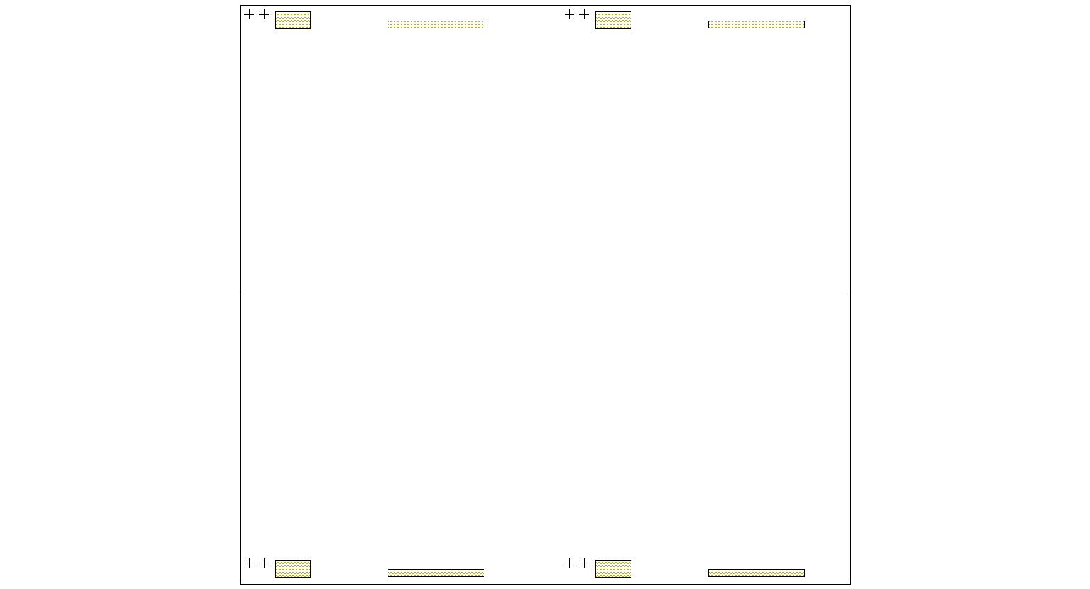
Pre-Bond fab – Step 1
Litho 1 - QWI Window Mask
Front side
Alignment marks (AM 1)
Window for verniers
Base structure cross section

Slide 10
Pre-Bond fab – Step 1
Step by step procedure
PR
SiN

Slide 11
Pre-Bond fab – Step 2
Litho 2 – QWI Alignment marks
Verniers etched into SL

Slide 12
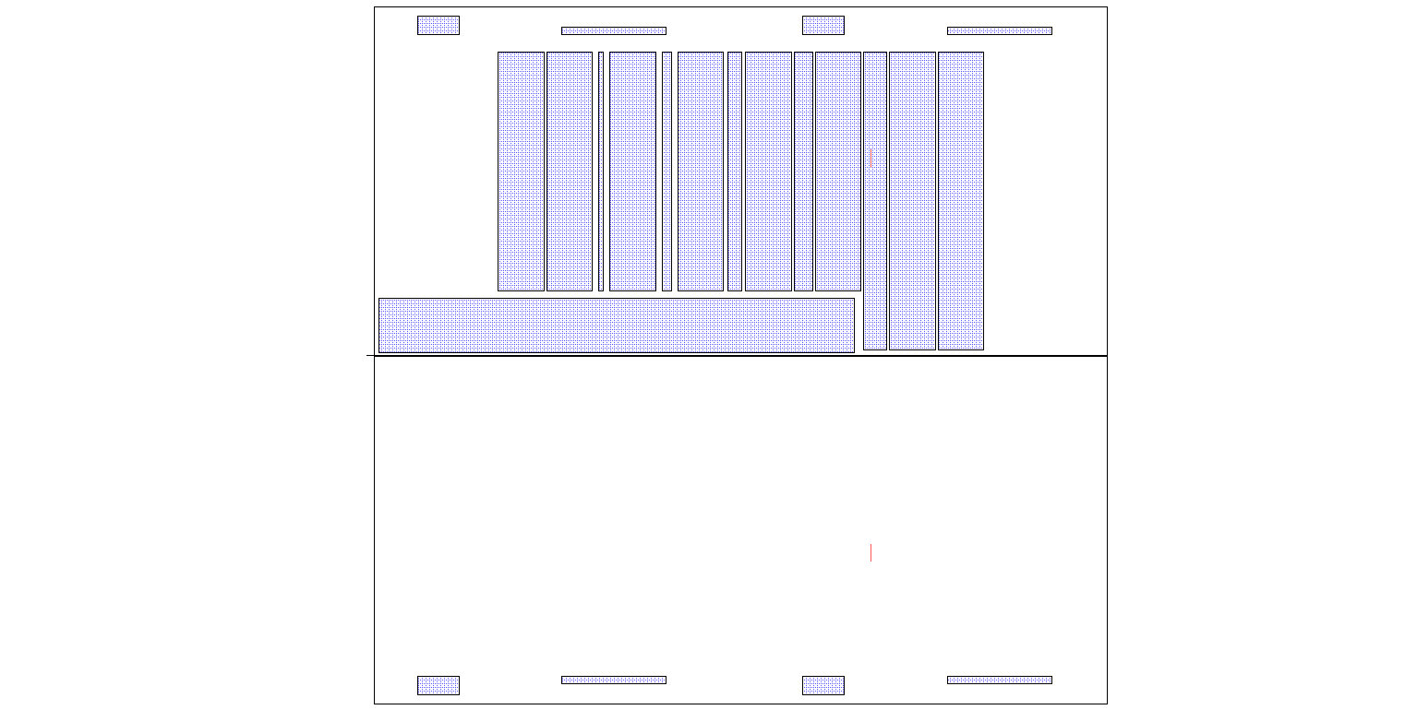
Pre-Bond fab – Step 3
Litho 3 – 1360nm Active region definition ( Laser )
DFBs
Protect AMs
FPs
Notes:
Remember – for 1300 and 1270 laser you will need a non-inverted mask !!!! 1.Everything has to be implanted except the AMs
2. Will need inverted version of this mask for 1300 def and then it’s the same…

Slide 13
Pre-Bond fab – Step 4
Phosphorus implant

Slide 14
Steps 1-4 Together

Slide 15
Pre-Bond fab – Step 5
Anneal 1 – Encapsulation and RTA anneal to 2nd band gap (1330 nm) (No litho)
Region with implants
– shifted band edge
Region without implants – no shift

Slide 16
Steps 1-5 Together
Un-shaded region at 1330 nm

Slide 17
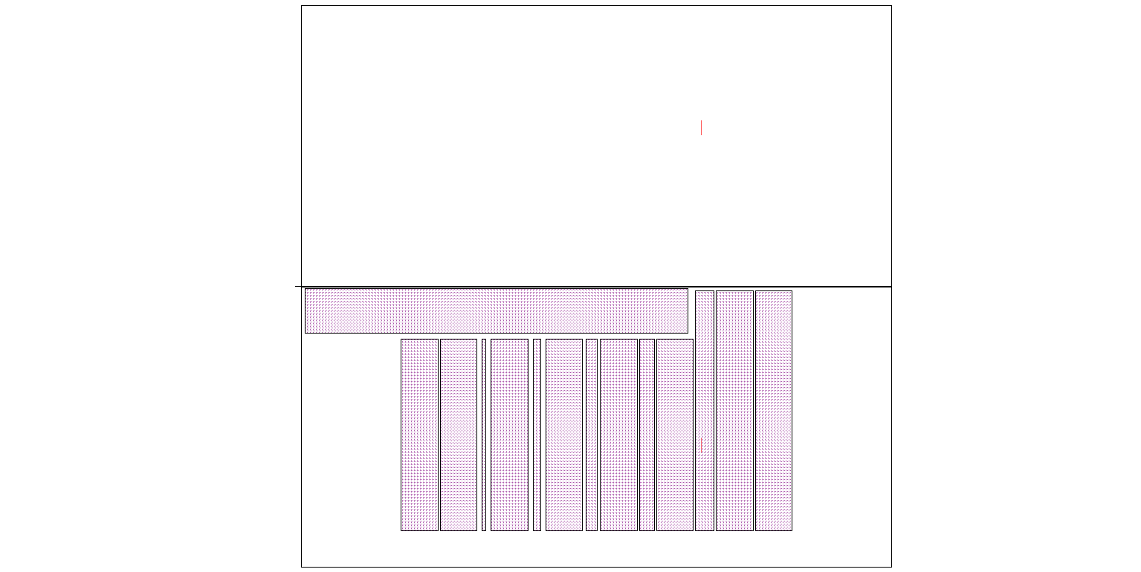
Pre-Bond fab – Step 6
Litho 4 – 1330nm Active region definition ( Laser )

Slide 18
Pre-Bond fab – Step 7
Anneal 2 -Encapsulation and RTA anneal to 1310nm (3rd band gap) (No litho)
1360 1330 1310

Slide 19
Steps 1-7 together
Un-shaded region at 1310 nm

Slide 20
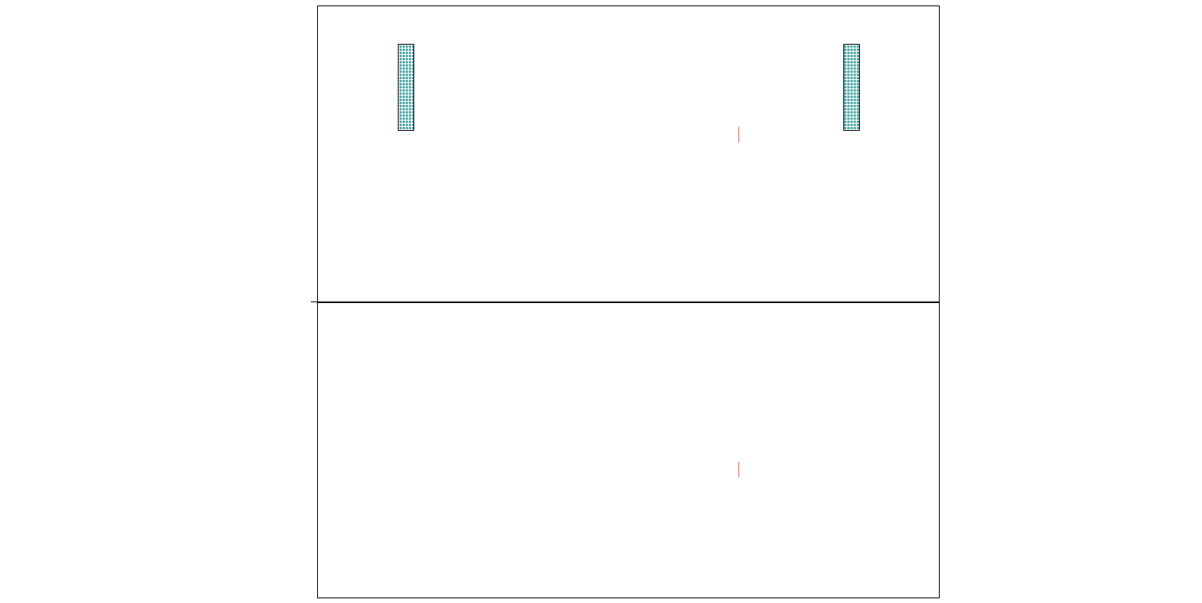
Pre-Bond fab – Step 8
Litho 5 – 1310 nm Active region definition ( EAM region for 1360 nm laser )
1360 1330 1310
Notes:
Necessary to protect regions that already have the buffer etched – ( SE is the only thing protecting the cladding from the InP wet etch !!! )

Slide 21
Pre-Bond fab – Step 9
Anneal 3 -Encapsulation and RTA anneal to 1280 nm (4th band gap) ( No litho )
1360 1330 1310 1280

Slide 22
Steps 1-9 together
Un-shaded region at 1280 nm

Slide 23
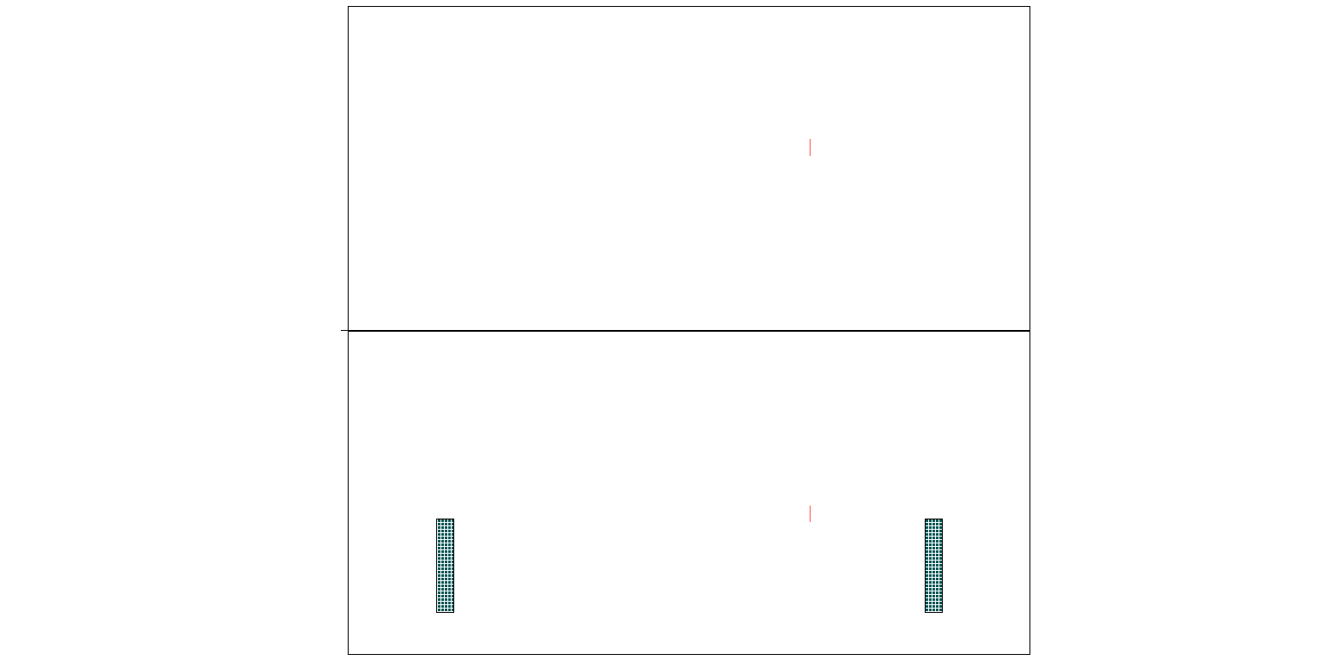
Pre-Bond fab – Step 10
Litho 6 – 1280 nm Active region definition ( EAM region for 1330 nm laser )
1360 1330 1310 1280

Slide 24
Pre-Bond fab – Step 11
Anneal 4 - Encapsulation and RTA anneal to Passive nm (No litho)
All regions that were not defined by previous lithos to be active are automatically passive
Passive
1360 1330 1310 1280 Passive

Slide 25
Steps 1-11 Together
Un-shaded region at Passive nm

Slide 26
Pre-Bond fab – Step 12
Litho 7 – Buffer + Stop etch layer removal and AM protect
1360 1330 1310 1280
Surface is now planar except for SiN over the AMs

Slide 27
Pre-Bond fab – Step 13
Litho 8 – Define III V gratings
Working on theory of grating design

Slide 28
Pre-Bond Backside Alignment
Purpose: alignment of Pre-bond III-V processing steps to Si
Window lithography – etch through InGaAsP, p-SCH,p-InP to p-InGaAs layer
Alignment mark definition – dry etch alignment mark inside window – stop in p-InP substrate
Front side
III-V Alignment Mark 1
Window mask
Window mask
Alignment mark 1
p-InP
p-InGaAs
p-InP substrate
(top view – die level)
()
()
Back side

Slide 29
Pre-Bond fab – Step 14
Litho 9 – QWI through window
Surface is now planar except for SiN over the AMs
Notes:
Remove the markers along the edges – can make it easy for subs removal solution to ruin sample..

Slide 30
Pre-Bond fab – Step 15
Litho 10 – QWI backside alignment marks

Slide 31
Pre-Bond fab – Step 16
Litho 11 – QWI backside alignment mark protection
InP
InP
Fill AM with SiN for protection during substrate removal

Slide 32
InP
InP

Slide 33
Front side – all layers

Slide 34
Bonding Bonding results in more pain than any man has ever endured – ‘Striker’ ( The Bad boy in X men Origins )
Note – After bonding patterns on III V, as seen from the backside, will be the mirror image of what it was when seen from the front side…..

Slide 35
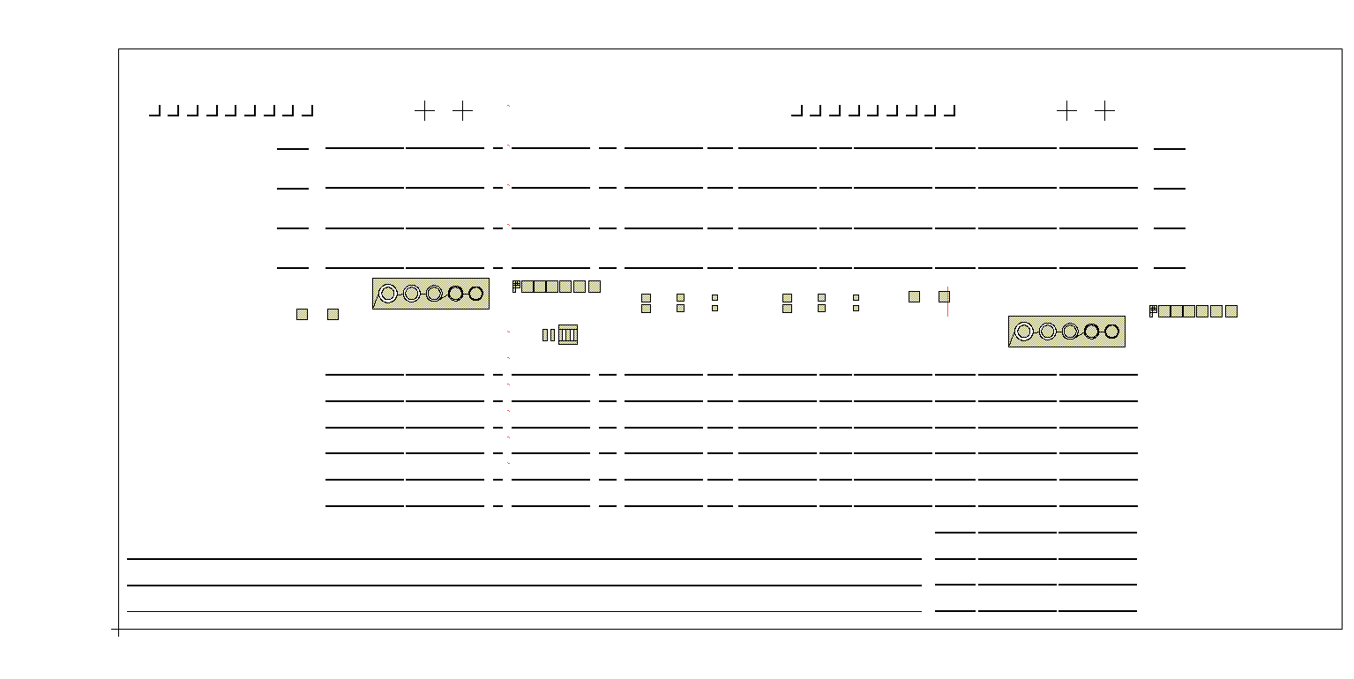
Post Bond – Step 1
Litho 1- P metal deposition
This is not the self-aligned process and tapers are not pumped as they are defined in the passive regions

Slide 36
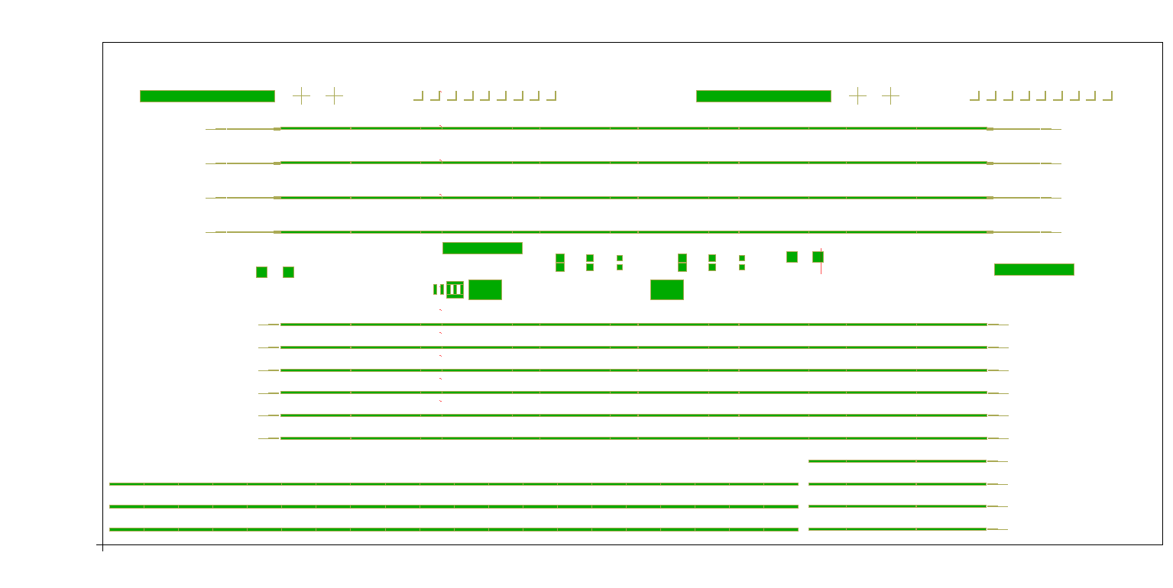
Post Bond – Step 2
Litho 2 – Mesa etch
Laser EAM
Backside AM will be lost in this step

Slide 37
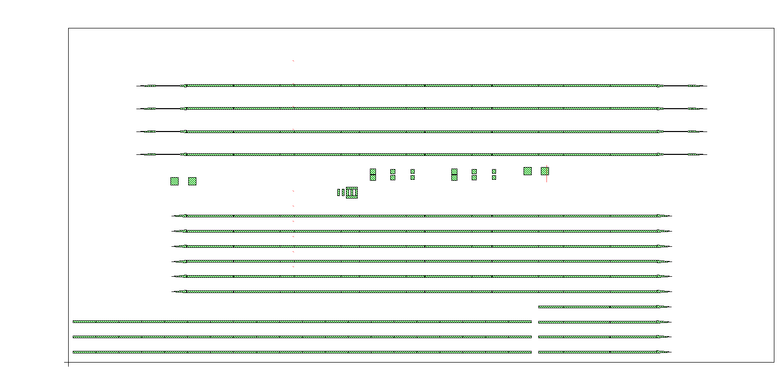
Post Bond – Step 3
Litho 3 – QW etch

Slide 38
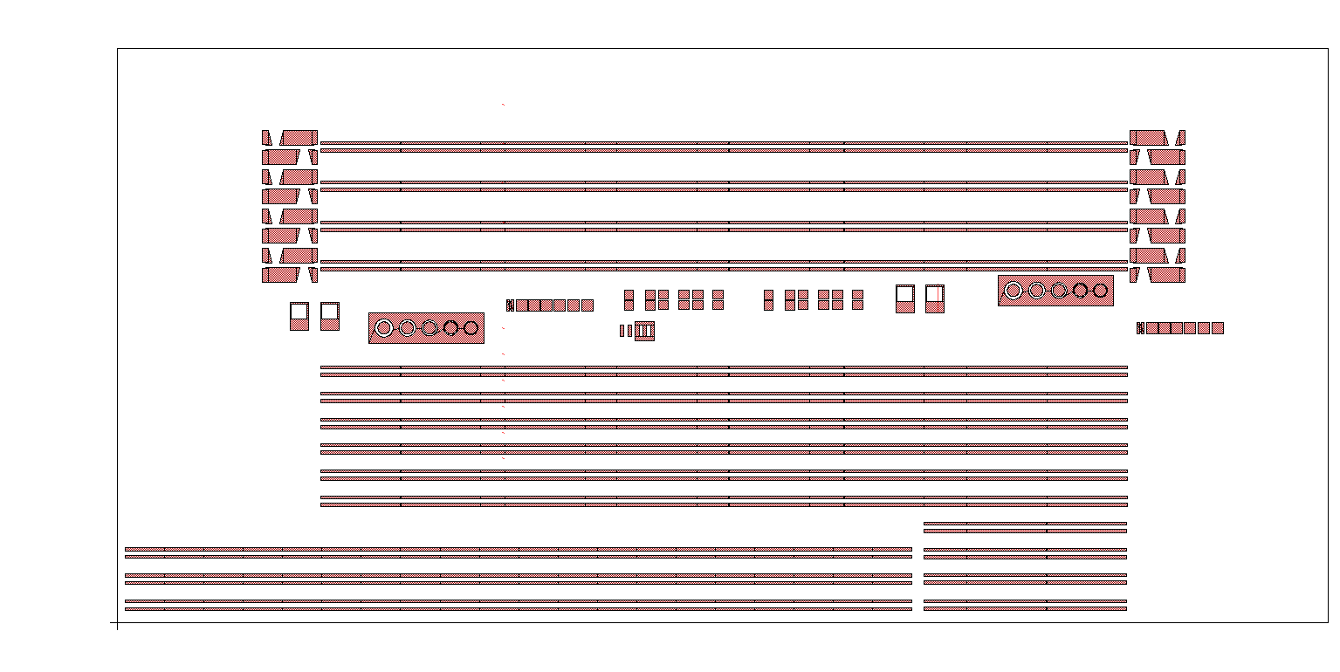
Post Bond – Step 4
Litho 4 - N contact metal

Slide 39
Steps 1-4 Together

Slide 40
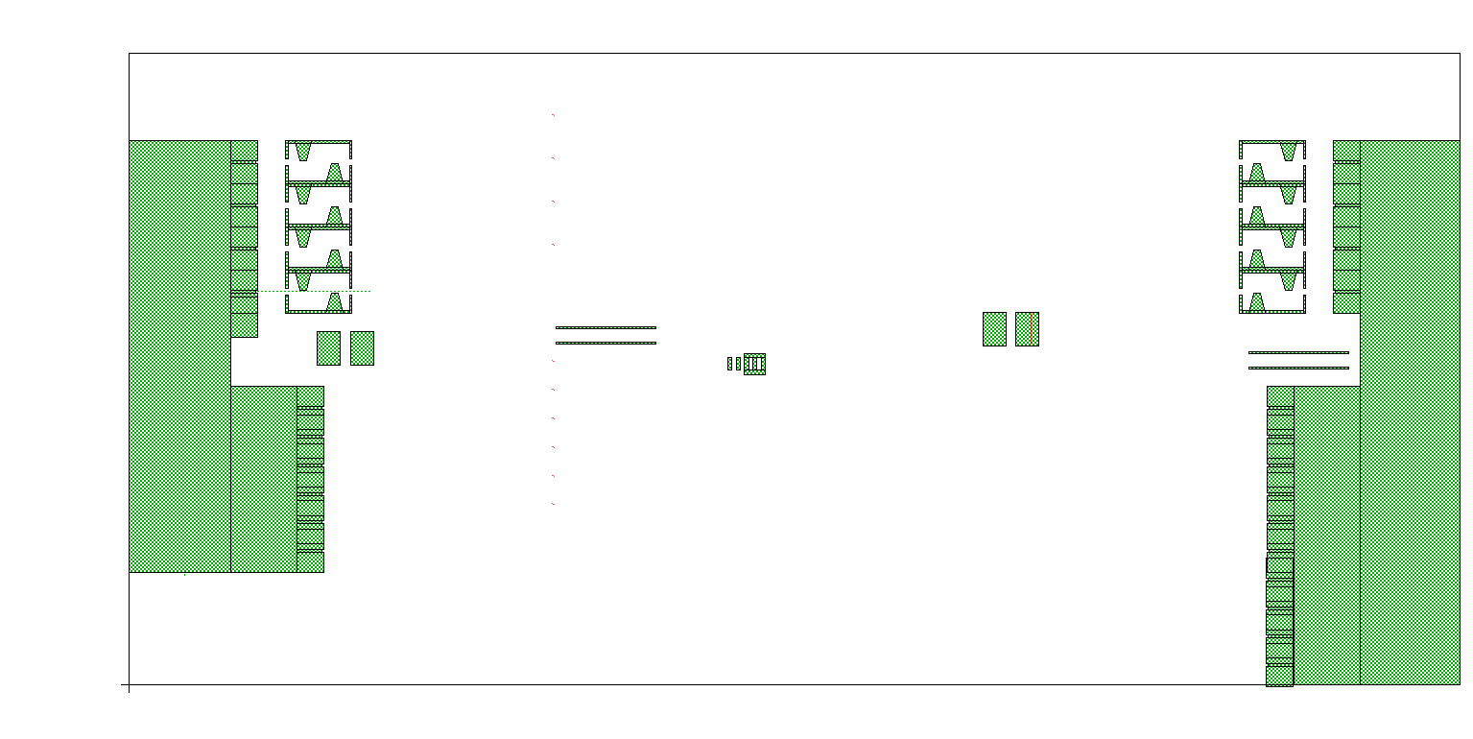
Post Bond – Step 5
Litho 5 – N contact etch

Slide 41
Steps 1-5 Together

Slide 42
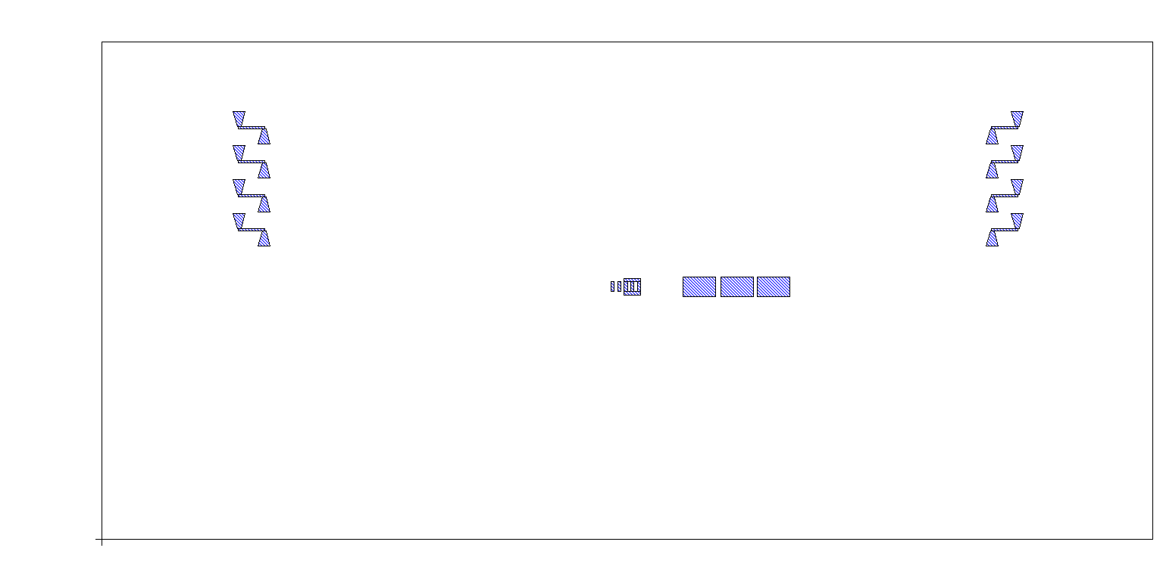
Post Bond – Step 6
Litho 6 – SU8

Slide 43
Steps 1-6 Together

Slide 44
Post Bond – Step 7
Litho 7 – P metal via + proton Implant

Slide 45
Post Bond – Step 8
Litho 8 – SU8 via large

Slide 46
Post Bond – Step 9
Litho 8 – SU8 via small

Slide 47
Steps 1-8 Together

Slide 48
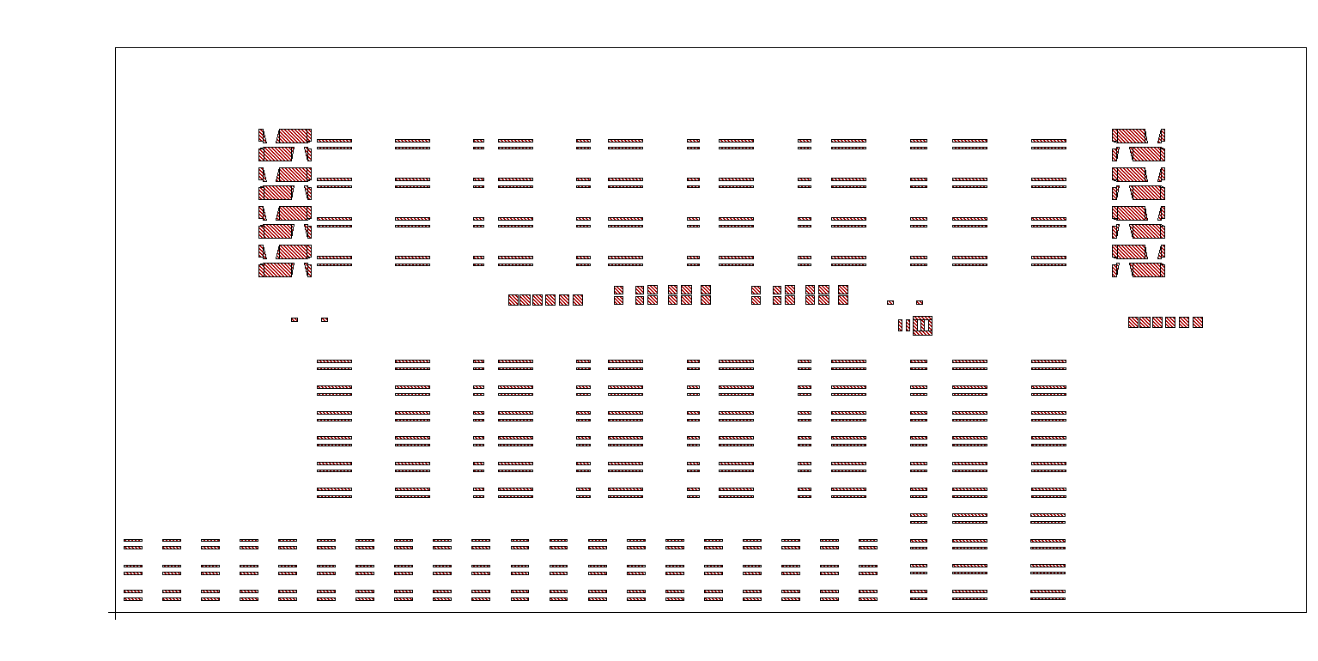
Post Bond – Step 9
Litho 9 – N Metal via

Slide 49
Post Bond – Step 10
Litho 10 – P metal via
Notes:
This p metal via mask to be diff from the previous p metal via to protect TLM fro implan t???

Slide 50
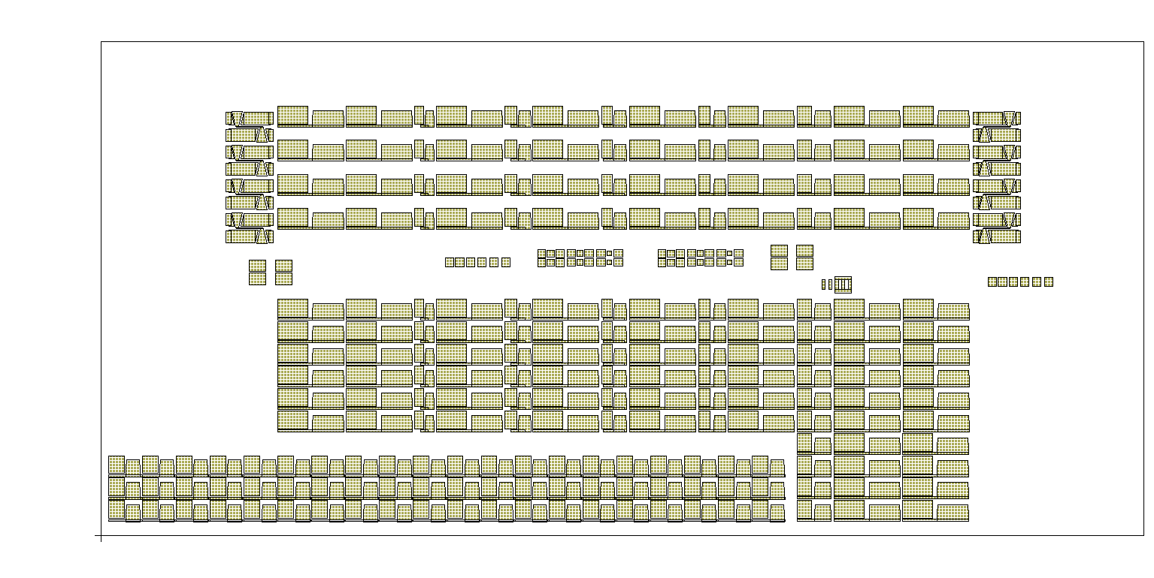
Post Bond – Step 11
Litho 11 – Probe metal

Slide 51
Backside – All layers

Slide 52
Backside + Front side

