Slide 1
Silicon Photonics Meeting - Optical Isolator update
6/15/2010
Jason Tien

Slide 2
Sputtering recipe for Si disks
Best sputtering recipe so far
Res: 0.05deg, int. time: 2sec
Sample clean: BHF/Piranha
Room temperature sputtering
Ar/O2=16/0sccm
Power: 200W
Pressure: 3mT
Time: 3min/2hr
chamber pressure: 4.6e-7 Torr
900C RTA annealing for 10 min
(420)
Film thickness: 180nm
(400)
Run seasoning recipe for 10/20 min

Slide 3
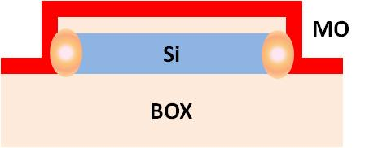
Measurement setup
Tunable laser
N
Polarization controller
magnet
Field distribution of the permanent magnet
synchronized
S
Power meter
Surface intensity: 5754 Gauss
0.5”
0.5”

Slide 4
Transmission spectrum of disk
Lots of high order resonance spectra because of multi modes of the disk
350nm
3um
Waveguide-disk gap: 125nm
Magnetic field ~ 5000 (Gauss)
Optical input is TE-polarized
Q : 2000~3000
Reverse the direction of the magnetic field and observe the spectra again
72.6 nm

Slide 5
Spectra with magnetic field
Resonance wavelength shift is within measurement error
Temperature effect: ~80pm/C
1510.59nm (field upward)
1510.63 nm (field downward)
1510.605nm (field upward)

Slide 6
Conclusions
The optical field is highly confined in the disk. Even for 3um-diameter disk, the resonance shift is around 30pm, which is difficult to see for the resonator of Q on the order of 1000.
It is better to have resonance shift ~ 100 pm. 200-nm-width ring can reach it theoretically.
CeYIG is poly-crystalline with preferred orientation direction in (420)
Temperature effect on resonance : 80pm/C
Need to control the temperature variation within 0.1C
Non-ferromagnetic fiber holder to make the setup more stable
Failure analysis
Material issue: crystallinity, saturation magnetization, low Faraday coefficient
Low optical confinement in magnetic layer
Solutions: ring structure, SiN core
Too little wavelength shift to see…
Solutions: higher Q of resonators, more stable setup (better temperature controller, magnetic field switch)

Slide 7
Next step: SiN-core isolator
`
`
Thin down the top SiO2 cladding
- BHF: 35 min (remove 4um SiO2)
Pattern Cr as hardmask
- pattern nLOF2020
- deposit Cr in EB1
- lift-off
`
`
`
`
`
Sputter Ce:YIG magnetic material
Deep etch SiO2 and strip Cr hardmask
- etch SiO2 in ICP2
- remove Cr in ICP2

Slide 8
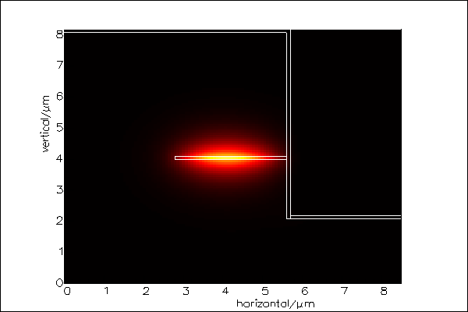
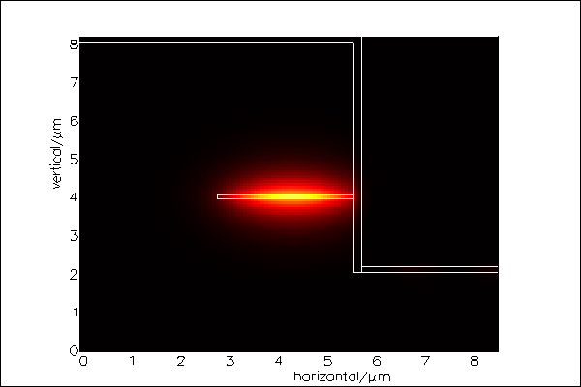
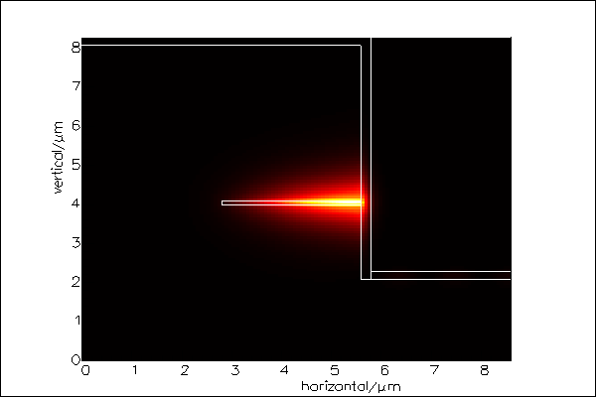
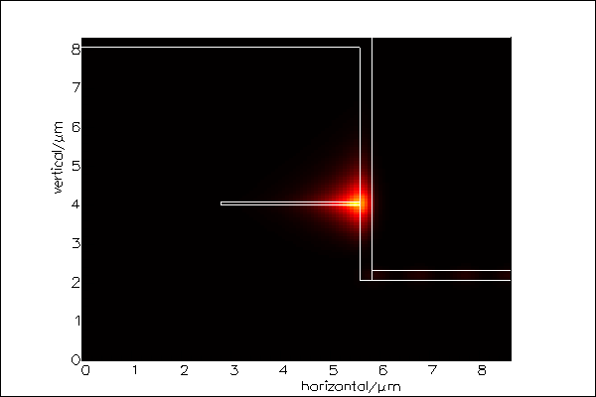
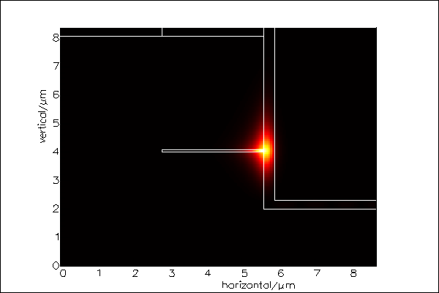
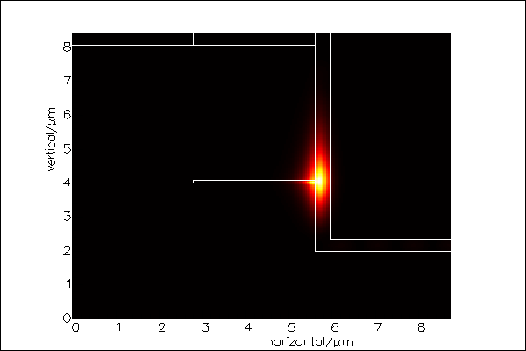
Confinement in YIG layer
*Film thickness/ confinement factor
100nm/0.65%
150nm/1%
200nm/4.4%
250nm/15.6%
300nm/35.9%
350nm/ 53%
The optimal YIG thickness is between 250 nm and 300 nm. In that case, the optical peak intensity is located on the boundary of the films. The drawback is that the scattering loss is also maximized.

Slide 9
Transmission spectrum comparison before and after thinning the top cladding
Lc=25um
Lc=50um
Limited by PD dark current
Lc=75um
Lc=100um
Transmission spectra are similar before and after top cladding thinning down
Different measurement setups are used for the 2 measurements

