Slide 1
E-Beam Lithography Grating Short loop DBR & Vertical Coupled SWEEPER Gratings
Bovington / Doylend

Slide 2
Outline
Problem: Deep etched gratings in Si for SGDBRs have proven difficult with the current grating process. A robust and repeatable deep grating process is necessary at DBR and 2nd order grating periods.
Goal: 500nm deep gratings in SOI, with a quantified etch process for long, short, and multiple etches.

Slide 3
Initial ZEP Etch Rate Tests
Bill Suggestion:
1) On a clean piece of Si, spin on some ZEP resist – say 300-400nm thick – 180C for 5 mins.
2) Use the Woollam SE system, measure the film thickness.
3) Load into the Bosch etcher and etch, using your standard single step process, for 2 min.
4) Remove and measure the film thickness using the Woollam SE system.
You should find that the film has reduced in thickness by about 50-60nm. Let me know what you get…
Planed experiment:
Quarter a 2in Si wafer
1) ZEP + VASE + Bosch + VASE
2) ZEP(2:1) + VASE + Bosch + VASE
3) ZEP(2:1) + 4210(spin, bake, flood expose, develop) + VASE + Bosch + VASE
4) ZEP(2:1) + VASE + ICP#2 Oxide Nano Etch + VASE + Bosch + VASE

Slide 4
Mask Choices
Hardmask options for patterned ribs
Ebeam Cr / PECVD SiO2
Potential issues: Ebeam Cr is not conformal.
It is preferred that Cr no be deposited on Si Surface
PECVD SiO2 / Ebeam Cr / PECVD SiO2 (PREFERRED HARD MASK)
Provides a protection for the Si when removing the Cr with a dry etch.
Required 3 dry etch to get into the Si and 1 dry etch to remove the Cr followed by BHF dip.
Cr masking may increase line edge roughness.
Thicker ZEP mask
ZEP/Anisol (2:1) – ORIGINAL PROCESS
3krpm = 200nm
Does not stand up to deep Si etch with current etch properties (Si etch under investigation, will hear back on Monday, Jan 9, 2012.)
Pure ZEP (PREFERRED SOFT MASK)
2krpm = 500nm
4krpm = 390nm

Slide 5
Design Split
1 Chip
PECVD SiO2 (2x50nm) / Ebeam Cr (100nm) / PECVD SiO2 (50nm) / ZEP(2:1)
ZEP/Anisol (2:1)
3krpm = 200nm, 180C, 4min
Conductive Polymer
3krpm, 90C, 60sec
EBL Exposure
Dose: 400uC/cm
1 Chip
ZEP Mask Only
ZEP
2krpm = 500nm, 180C, 4min
Conductive Polymer
3krpm, 90C, 60sec
EBL Exposure
Dose: Split Required

Slide 6
Calibration Goals
Due to the undercut expected in the Cr 40nm+/-20nm, a split in DC of the pattern will be added to the Cr Chips, Dose
SGDBRs (122nm target pattern)
Pattern split: 40, 60, 80, 100, 120nm patterns at 244nm period
Dose split: 300, 400, 500uC/cm²
SWEEPERs (110nm target pattern)
Pattern split: 40, 60, 80, 100, 120nm patterns at 550nm period
Dose split: 300, 400, 500uC/cm²
Given the inexperience with 500nm thick ZEP a calibration split is required for the dose and patterns. Predicting 500uC/cm² with a negative 50nm pattern bias.
SGDBRs (122nm target pattern)
Pattern split: 130, 150, 170, 190nm patterns at 244nm period
Dose split: 300, 400, 500, 600uC/cm²
SWEEPERs (110nm target pattern)
Pattern split: 100, 120, 140, 160 nm patterns at 550nm period
Dose split: 300, 400, 500, 600uC/cm²
Cleavable AFM patters
SWEEPERs (550nm period, 50% Duty Cycle)
Pattern Dimensions: 2mm tall x 50um

Slide 7
Cr Mask Layout
300uC/cm²
400uC/cm²
500uC/cm²
Redundancy
SWEEPER
SEM Patterns
SGDBR
SEM Patterns
Cleaveable
AFM
Patterns

Slide 8
ZEP Mask Layout
300uC/cm²
400uC/cm²
500uC/cm²
600uC/cm²
Redundancy
Cleaveable
AFM
Patterns
SWEEPER
SEM Patterns
SGDBR
SEM Patterns

Slide 9
Cleave Pieces
Each Chip Was Cleaved into 4 pieces for the following functions:
Shallow Etch
Deep Etch
Shallow Etch, Photo Litho, Deep Etch
Backup Sample
Naming Convention:
Z#1-Z#4
Cr#1-Cr#4

Slide 10
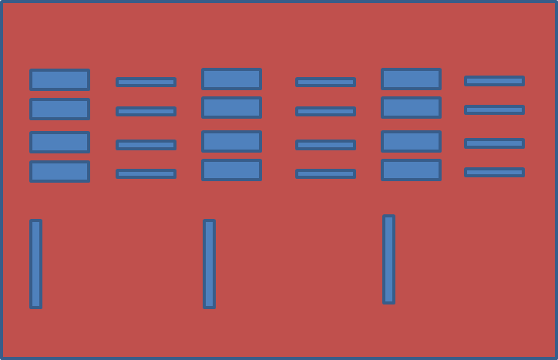
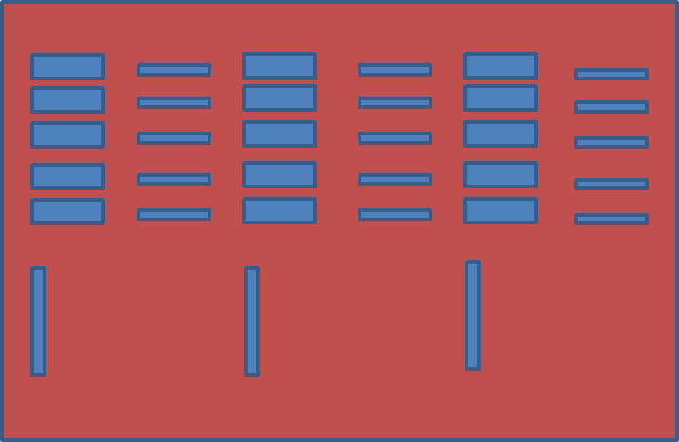
SEM results: general observations
Only 3 columns were visible on Z1, Z2 rather than the expected 4, the lowest dose did not develop.
There appeared to be no variation in duty cycle for the SWEEPER gratings on Z1, Z2.
For C1, most of the third column (i.e. highest dose) DBR’s looked ok. For Z1 and Z2, only the lowest duty cycle (50%?) top row looked ok for the chosen column, but this was deemed sufficient since we do not foresee the need for non-50% duty cycles in SGDBR gratings.
Columns are numbered left→right; rows are numbered top→bottom
Z1 / Z2 *Col 1 was a low dose and didn’t show up
Cr1
Col 2
Col 3
Col 4
r1
Col 1
Col 2
Col 3
r1
r2
r2
r3
r3
r4
r4
r5

Slide 11
SEM results: Z1 (Pure ZEP Shallow Etch Only)
Best column: col 3 (500 uC/cm^2)
500 uC/cm^2 SWEEPER: dc = 0.20
500 uC/cm^2 DBR
DC (%) (pattern/measure)
r2
69.7/ -
61.5/ -
53.3/57
r3
r4

Slide 12
SEM results: Z2 (Pure ZEP Deep Etch Only)
Best column: col 3 (500 uC/cm^2)
Col 3 SWEEPER: dc = 0.21
Col 3 DBR
DC (pattern/measure)
r2
69.7/ -
61.5/ -
53.3/66
r3
r4

Slide 13
SEM results: Z3 (Pure ZEP Shallow Etch, Photolithography and Deep Etch)
Chipping of ZEP on edge
PR Residue in gratings
Strings of PR
Conclusion: The single EBL Process with PR masking leaves irregular residue of PR that can no be removed by developer without cracking the underlying ZEP and is therefore currently considered a high risk process.
This was further validated by a repeated experiment with test sample Z4.

Slide 14
SEM results: Z4 (Shallow Etch, Photolithography and Deep Etch)
Chipping of ZEP
PR Residue in gratings
Edge bead
Strings of PR
Conclusion: The single EBL Process with PR masking leaves irregular residue of PR that can no be removed by developer without cracking the underlying ZEP and is therefore currently considered a high risk process.
This was further validated by the initial experiment with test sample Z3.

Slide 15
SEM results: Cr1 (Shallow Etch Only)
Best column: col 3 (500 uC/cm^2)
Col 3 SWEEPER
DC (%) (pattern/measure)
Col 3 DBR
DC (pattern/measure)
21.8/57
18.2/40
14.5/30
10.9/26
7.27/19
49.2/ -
41/0.79
32.8/64
24.6/51
16.4/34

Slide 16
SEM results: Cr3 (Shallow Etch, Photolithography and Deep Etch)
Best column: col 3 (500 uC/cm^2)
SWEEPER DOSE 500
DBR DOSE 500
Some proximity effects seen in r2 (worse in r1) SWEEPERs and r4 DBRs
r2
18.2/ -
14.5/35
10.9/29
7.27/23
41/84
32.8/60
24.6/ -
16.4/53
r3
r4
r5

Slide 17
AFM Results 100% ZEP Samples
 | Z1 | Z2 | Z3 | Z4
100% ZEP 2krpm Height (nm) | 557 | 557 | 557 | 557
Si Etch Time (min) | 1 | 7 |  | 1
ZEP+Si Height (nm) | 580 | 785 | 584 | -
AZ4210 Protection Exposed in Suss Contact Aligner (sec) | - | - | 30 (i-line filtered) + 30 | 30
AZ4210 removed in Developer 400K 1:4 (sec) | - | - | 120 + 120 | 120
Si Etch Time (min) | - | - | ON HOLD | ON HOLD
ZEP+Si Height (nm) | - | -
Stripped ZEP | Y | Y
Si Height (nm) | 65 | 435
Approx. 100% ZEP Etch Rate (nm/min) | 42 | 29.6
Approx. Si Etch Rate (nm/min) | 65 | 62

Slide 18
AFM Results Cr Masked Samples (1 of 2)
 | Cr1-4 |  | Nano Oxide Etch (ICP#2 – Recipe#104)
PlasmaTherm Oxide 2x50nm Height (nm) | 98 |  | Approx. Oxide Etch Rate (nm/min) | 81
Ebeam #1 Cr Dep (nm) | 100 |  | Assumed Cr Etch Rate (nm/min) | 5
PlasmaTherm Oxide 1x50nm Height (nm) | 53 |  | Si Etch Rate (nm/min) | ?
(2:1) ZEP:Anisol 3krpm Height (nm) | 220 |  | Cr Etch (ICP#2 – Recipe#145)
Oxide Etch Time (sec) | 33 |  | Approx. Cr Etch Rate (nm/min) | 35
ZEP+Oxide Height (nm) | - |  | Assumed Oxide Etch Rate (nm/min) | 0
Strip ZEP | Y |  | Assumed Si Etch Rate (nm/min) | 0
Oxide Height (nm) | 45 |  | Si Etch (Si DRIE – Recipe: BOV_J_01)
Oxide Etch Time (sec) | 5 |  | Approx. Si Etch Rate (nm/min) | 91-124
Oxide Height (nm) | 44 |  | Approx. Cr Etch Rate (nm/min)
Oxide Etch Time (sec) | 5 |  | Assumed Oxide Etch Rate (nm/min) | 0
Oxide Height (nm) | 44
Oxide Etch Time (sec) | 10
Oxide Height (nm) | 36
Cr Etch Time(sec) | 225
Oxide+Cr Height (nm) | 125
Oxide Etch Time (sec) | 96
Oxide (likely gone)+Cr+Oxide Height (nm) | 217
Cleave into 4 pieces | Y

Slide 19
AFM Results Cr Masked Samples (2 of 2)
 | Cr1 | Cr2 | Cr3 | Cr4
Si Etch Time (min) | 1 | 7 | 1 | ON HOLD
Cr+Oxide+Si Height (nm) | 308 | 786 | -
AZ4210 Protection Exposed in Suss Contact Aligner (sec) | - | - | Y
AZ4210 removed in Developer 400K 1:4 (sec) | - | - | Y
Si Etch Time (min) | - | - | 6
Cr+Oxide+Si Height (nm) | - | - | 831
Cr Etch Time (sec) | 225 | ON HOLD | 225
Oxide+Si Height (nm) | 216 |  | 739
BHF Time (sec) | 120 |  | 120
Si Height (nm) | 124

Slide 20
VASE Results Thin Films
 | AV Ox 1 | AV Ox 2 | AV Ox 3 | AV Ox 4 | 100% ZEP 1 | 100% ZEP 2 | (2:1) ZEP 1 | (2:1) ZEP 2
Spin Rate (krpm) | - | - | - | - | 2 | 2 | 3 | 3
Deposition Time (sec) |  |  |  |  | - | - | - | -
Initial Thickness (nm) | 1996 | 1996 | 1996 | 1996 | 582 | 582 | 225 | 225
Si Etch CAO_N_01 Time (sec) | 300 | - |  |  | 120 | - | 120 | -
Si Etch BOV_J_01 Time (sec) | - | 300 |  |  | - | 120 | - | 120
Thickness (nm) |  |  |  |  | 509 | 505 | 157 | 156
Nano Oxide Etch Time (sec) |  |  | 300 |  |  | 60 | 30 | 60
Thickness (nm) |  |  | ? |  |  | 363 | 85.5
Si Etch BOV_J_01 Time (sec) |  |  | 300 |  |  | 60 | 60
Thickness (nm) |  |  | ?
Cr Etch Time (sec)
PLANNED EXPERIMENT
NEED TO BE MEASURED

Slide 21
AFM Results Cr Masked Samples (1 of 2)
Nano Oxide Etch (ICP#2 – Recipe#104)
Oxide Etch Rate (nm/min) | ~80
Si Etch Rate (nm/min) | ?
100% ZEP Etch Rate (nm/min) | 142
(2:1) ZEP:Anisol Etch Rate (nm/min) | 143
Cr Etch (ICP#2 – Recipe#145)
Oxide Etch Rate (nm/min) | negligible
Si Etch Rate (nm/min) | ?
100% ZEP Etch Rate (nm/min) | Cl bad for resist
(2:1) ZEP:Anisol Etch Rate (nm/min) | Cl bad for resist
Si Etch (Si DRIE – Recipe: BOV_J_01)
Si Etch Rate (nm/min) | ~77 (50-130)
Oxide Etch Rate (nm/min) | 21
100% ZEP Etch Rate (nm/min) | 37
(2:1) ZEP:Anisol Etch Rate (nm/min) | 35.5
Si Etch (Si DRIE – Recipe: CAO_N_01)
Si Etch Rate (nm/min) | ?
Oxide Etch Rate (nm/min) | 17.8
100% ZEP Etch Rate (nm/min) | 36.5
(2:1) ZEP:Anisol Etch Rate (nm/min) | 34
All Measurement were done on single etches of 2” quarters with unpatterned thin films or scrap SOI in the case Si. Measurements used the Woolum VASE
KEY
PLANNED EXPERIMENT
NEED TO BE MEASURED

Slide 22
Conclusions
The Cr masking process is preferred with 40nm patterns for both DBRs and SWEEPER gratings at 500uC/cm^2 dose.
The ICP#2 “Nano Oxide Etch” is >30% slower that assumed for the last batch of SWEEPER chips.
There is still some irregularity to the Si etch rate with the majority of Si sample ~65nm but evidence poitns as high as 124nm/min

