Slide 1
BCB Planarization Process Using EPHI SOA Masks
Jared Hulme
6/2/12

Slide 2
Process for BCB SOA Mask Run
Resist
SiO2
SiO2
SiO2
Si Substrate
Si Substrate
Si Substrate
Si Substrate
1. Silicon wafer
2. Deposit Hardmask 400nm SiO2
3. Spin AZ4210
4. Hardmask Litho
Si Substrate
Si Substrate
Si Substrate
Si Substrate
8. Remove Hard Mask
7. Mesa Etch
6. Remove PR
5. Hardmask Etch
Si Substrate
Si Substrate
Si Substrate
Si Substrate
9. Deposit 200nm SiN Sticking Layer
10. Spin 2 layers SF11PMGI+AZ4210
11. N-metal Litho
12. SiN Dry Etch
BCB
Si Substrate
Si Substrate
Si Substrate
Si Substrate
16. BCB Ash-back
15. Apply BCB
14. Liftoff
13. N-metal Deposition

Slide 3
Si Substrate
Si Substrate
Si Substrate
Si Substrate
17. Nitride Removal (Dry)
18. Spin 2 layers SF11PMGI+AZ4210
19. P-Metal Lithography
20. P-metal Deposition
Si Substrate
Si Substrate
Si Substrate
Si Substrate
24. Deposit 30nm SiN Sticking Layer
23. SU-8 Via Litho
22. Spin on SU-8
21. Liftoff
Si Substrate
Si Substrate
Si Substrate
Si Substrate
25. Spin on AZ4210
26. Via Litho
27. SiN Dry Etch
28. BCB Ash
Si Substrate
Si Substrate
Si Substrate
Si Substrate
32. Probe Metal Deposition
31. Probe Metal Litho
30. Spin 2 layers SF11PMGI+AZ4210
29. Strip PR
Si Substrate
33. Liftoff

Slide 4
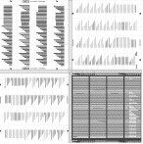
Hard Mask Dep & Lithography
Measure Si wafer thickness: = _______um
Prepare an additional test piece to recharacterize Si etch rate (ICP1 - #157)
Hard Mask Deposition
Clean - ACE/ISO/DI
Deposit Oxide
PlasmaTherm PECVD 5000A
Measure Oxide Thickness in Ellipsometer: = _______nm
P-Mesa Lithography
Clean
ACE/ISO/DI
Dehydration bake: Hotplate 150C, 2-5min
O2 Descum 30s, 300mT, 100W
Spin HMDS (5000rpm, 30s) (let sit for 30s on chip before spinning)
Spin AZ4210 (4000rpm, 30s)
Pre-Exposure Bake (95C, 1min)
Lithography
Use P-Mesa Mask – EPHI-dev-2-1 – Quadrant I
Put Quadrant I in the bottom right of the mask holder
Litho Tool: Autostepper
Program: JAREDH\PROT
Exposure: 1sec
Focus Offset: 0
NO POST-EXPOSURE BAKE
Develop (AZ400K 1:4 diluted, 120sec)
DI Rinse
Inspect in microscope
Dektak PR height: = ______nm
Si Substrate
SiO2
Si Substrate
Resist
II
I
SiO2
Si Substrate
III
IV
SiO2
Si Substrate

Slide 5
Hardmask Etch and Inspect
Hardmask Etch - SiO2 Etch target 500nm
Etch Tool: ICP#2
Clean: O2 Clean, 5min
Season (Recipe, Time): Bowers Sioxvert etch # 101, 5min (CHF3 etch so check gases)
Etch(Recipe, Rate): (Bowers Sioxvert etch # 101, 250nm/min = 4.16nm/s) over etch by 20% => Etch for 2’30”
Inspect in microscope
Dektak height: = ______nm
Strip PR
ACE/ISO/DI Rinse
1165 Soak at 80C in covered bath - 10min
ISO/DI Rinse
PEII - O2 Descum (100W, 300mTorr, 60-120sec)
Inspect in microscope
Dektak height: = ______nm
Si Substrate
Si Substrate

Slide 6
Mesa Etch and Inspect
Si Etch target 2200nm
Characterize etch rate:
Etch Tool: ICP#2
Switch gas CF4->SF6
Clean: O2 Clean, 5min (10’ if last etch was Cl-based)
Season (Recipe, Time): Si etch # 124, 5’ (400W, 50W RF, 30/10sccm SF6/O2, 1Pa)
Etch Test Piece 1: Si etch # 124, 6’30” at ~333nm/min
BHF dip (300nm/min): Dip for 2 min
Dektak measure etch depth _____ nm/min
Etch Sample: (Si etch # 124) 2200nm based on characterized etch rate
Switch gas SF6->CF4
Clean: O2 Clean, _______ min
Inspect in microscope
Dektak height: = ______nm
Remove Oxide (~500nm)
BHF dip (~300 nm/min) => Dip for 2 min
DI Rinse
Inspect in microscope
Sticking Layer Deposition
Clean - ACE/ISO/DI
Deposit SiN
PlasmaTherm PECVD 200A
Si Substrate
Si Substrate
Si Substrate

Slide 7
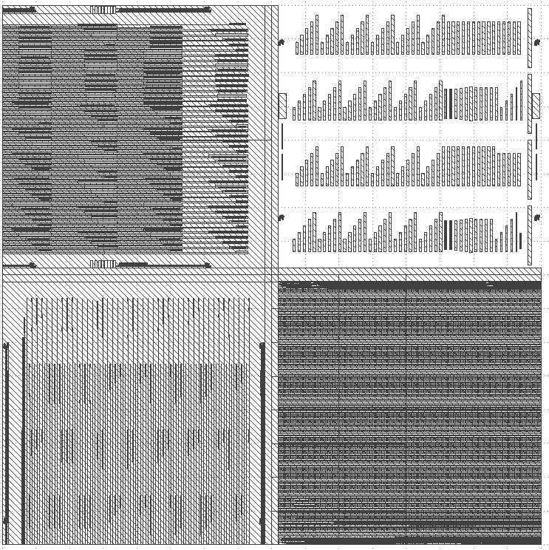
N-metal Litho for Nitride
N-metal Lithography
Clean
ACE/ISO/DI
Dehydration bake: Hotplate 150C, 2-5min
O2 Descum 30s, 300mT, 100W
Spin on resists
PMGI SF-11: 4000rpm/1 min
Bake 170C/1min
PMGI SF-11: 4000rpm/1min
Bake 170C/2min
AZ4210 Resist: 4000rpm/30sec
Pre-Exposure Bake (95C, 1min)
Lithography
Use N-Metal Mask – EPHI-dev-2-2 – Quadrant II
Put Quadrant II in the bottom right of the mask holder
Litho Tool: Autostepper
Program: JAREDH\PROT
Align to center of P-Mesa Vernier (closest to the top left of the die)
Vernier center is (1.264325,.317175) from top left
Exposure: 1sec
Focus Offset: 0
NO POST-EXPOSURE BAKE
Develop Resist
AZ400K 1:4 diluted, 120sec
DI Rinse
DUV Expose SF-11: 300sec/1000W
Develop in SAL101 70sec
DUV Expose SF-11: 300sec/1000W
Develop in SAL101 60sec
DUV Expose SF-11: 300sec/1000W
Develop in SAL101 60sec
Inspect in microscope
Repeat DUV and develop as needed
Dektak height: ____nm
II
I
III
IV
Si Substrate
Si Substrate

Slide 8
Nitride Etch & N-Metal Deposition
Nitride Etch - SiN Etch target 20nm
Etch Tool: ICP#2
Clean: O2 Clean, 5min
Season (Recipe, Time): Bowers Sioxvert etch # 101, 5min (CHF3 etch so check gases)
Etch(Recipe, Rate): (Bowers Sioxvert etch # 101, 310nm/min = 5.16nm/s) => Etch 10”
Inspect in microscope
Dektak height: = ______nm
Pre-metal clean
O2 Descum 30s, 300mT, 100W)
BHF dip
E-beam 3 metal deposition
Ni: 50Å @.2Å/sec
Ge: 300Å @ .5Å/sec
Au: 300Å @
Ni: 200Å @
Au: 1.5um @ 2/5 Å/sec for 200/remainder
Liftoff
1165 soak @ 80˚C for 20min
Gently agitate with pipette
ISO/DI rinse
Inspect in microscope
Repeat liftoff steps as needed
Si Substrate
Si Substrate
Si Substrate

Slide 9
BCB Application and Cure
NOTES:
There must not be any pauses from sample surface preparation to loading the spun sample w/ BCB into the Blue oven
Any delays will allow increased surface oxide to regenerate on the semiconductor, increasing leakage currents
Oxygen contaminates BCB and prolonged exposure will compromise the cure and ruin the sample
If oven temperature is above room temperature, BCB will bubble during the cure
Program sequence for HARD CURE (Total time in oven: ~7 hours)
(a) 5 min ramp to 50_C, 5 min soak
(b) 15 min ramp to 100_C, 15 min soak
(c) 15 min ramp to 150_C, 15 min soak
(d) 60 min ramp to 250_C, 60 min soak
(e) Natural cool down (NOTE TIME OF COOL DOWN: ~3.5 Hours)
(f) Oven off
BCB application
Prepare the ‘Blue Oven’
Check that the oven is ~25C before beginning
Confirm program sequence is correct for Program 5
Place Aluminum Baking Table in ‘Blue Oven’
Run N2 through chamber at 100%
Set alarm temperature to greater than 250C
Clean
ACE/ISO/DI
Dehydration bake: Hotplate 150C, 2-5min
O2 Descum 30s, 300mT, 100W
Apply BCB 3022-46 (Let sit on surface for 30 sec) – thickness ~3-4 μm
Spin (500 rpm, 100 rpm/s, 5 sec)
Spin (1500 rpm, 150 rpm/s, 30 sec)
BCB Cure
Place sample on Aluminum Baking Table
Reduce N2 flow to 60% after 3 min
Load and run Program 5
Wait for natural cool-down to 25C
Remove sample and inspect under the microscope
Turn off the ‘Blue Oven’
BCB
Si Substrate

Slide 10
P-Mesa Exposure
Wafer planarization ash back
Clean carrier wafer
ICP1 ash (Recipe 308: CF4/O2 50:200 sccm, 40 Pa, 1000W) 7 min
Load sample on carrier wafer
ICP1 ash(Recipe 308: CF4/O2 50:200 sccm, 40 Pa, 1000W) 2 min
Ash rate ~ 400nm/min (it does take some time to heat up the sample before the full rate kicks in)
Inspect sample in Microscope/Dektak/FEI SEM to see if both large and small mesas are exposed
Repeat as needed
Carrier clean (7min), ash (1 min), inspection
Variation in BCB height should be under 200nm
Nitride Etch - SiN Etch target 20nm
Etch Tool: ICP#2
Clean: O2 Clean, 5min
Season (Recipe, Time): Bowers Sioxvert etch # 101, 5min (CHF3 etch so check gases)
Etch(Recipe, Rate): (Bowers Sioxvert etch # 101, 310nm/min = 4.16nm/s) => Etch 10”
Inspect in microscope
Dektak height: = ______nm
Si Substrate
Si Substrate

Slide 11
Sticking layer & P-Metal Lithography
P-metal Lithography
Clean
ACE/ISO/DI
Dehydration bake: Hotplate 150C, 2-5min
O2 Descum 60s, 300mT, 100W)
Spin on resists
PMGI SF-11: 4000rpm/1min
Bake 170C/2min
AZ4210 Resist: 4000rpm/30sec
Bake 95C/1min
Lithography
Use P-Metal Mask – EPHI-dev-2-2 – Quadrant III
Put Quadrant III in the bottom right of the mask holder
Litho Tool: Autostepper
Program: JAREDH\PROT
Align to P-Mesa Vernier (closest to the top left of the die)
Vernier center is (1.264325,.317175) from top left
Exposure: 1sec
Focus Offset: 0
NO POST-EXPOSURE BAKE
Develop Resist
AZ400K 1:4 developer 120sec
DI Rinse
DUV Expose SF-11: 300sec/1000W
Develop in SAL101 60sec
DUV Expose SF-11: 300sec/1000W
Develop in SAL101 60sec
Inspect in microscope
Repeat DUV and develop as needed
Dektak height: ____nm
II
I
Si Substrate
III
IV
Si Substrate

Slide 12
P-Metal Deposition & Anneal
Pre-metal clean
O2 Descum 60s, 300mT, 100W)
Remove Native Oxide
Etch Tool: ICP#2
Clean: O2 Clean, 5min
Season (Recipe, Time): Bowers Sioxvert etch # 101, 5min (CHF3 etch so check gases)
Etch(Recipe, Rate): (Bowers Sioxvert etch # 101, 250nm/min = 4.16nm/s) => Etch 5 sec
E-beam 3 metal deposition
Pd: 30Å @1Å/sec
Ti: 170Å @ 1Å/sec
Pd: 170Å @ 1Å/sec
Au: 1000Å @ 2/5 Å/sec for 200/remainder
Liftoff
1165 soak @ 80˚C for 20min
Gently agitate with pipette
ISO/DI rinse
Inspect in microscope
Repeat liftoff steps as needed
RTA (Rapid Thermal Anneal)
360˚C / 30s
Inspect in microscope
Si Substrate
Si Substrate

Slide 13
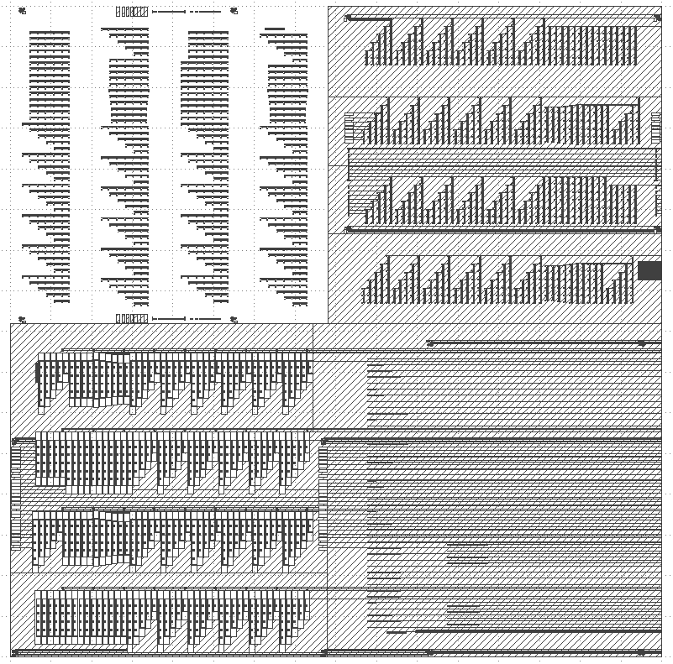
Apply SU-8
Clean
ACE/ISO/DI (3 min each)
Dehydration bake: Hotplate 120C,3min
O2 Descum 30s, 300mT, 100W
Spin-coat SU-8 2002 (~2um)
10s@500rpm (ramp 100rpm/s)
30s@3000rpm(ramp 500rpm/s)
Bake 95C 3min
SU-8 Lithography
Litho Tool: Autostepper
Use Via Mask(negative) – EPHI-dev-2-3 – Quadrant II
Put Quadrant II in the bottom right of the mask holder
Program: JAREDH\PROT
Align to P-Mesa Vernier (closest to the top left of the die)
Vernier center is (1.264325,.317175) from top left
Exposure: .4sec
Focus Offset: -10
Post-exposure bake:
65C, 1min
95 C, 2min
Develop (SU-8 Developer)
60s dip and shake + 15s pipette flush
ISO/DI rinse and N2 dry
Inspect vernier tips are open
Repeat using 30s dip and shake + 10s pipette flush until vernier tip open
Inspect via’s are open over contacts
Hard Bake (Hotplate)
95 C Starting point
Ramp to 150 C, hold 5 min
Ramp to 205 C, hold 5 min
Ramp to 260 C, hold 30 min
Ramp down 205 C, hold 5 min
Ramp down 150 C, hold 5 min
Ramp down 95 C, remove from hot plate
Color should be dark red
Si Substrate
II
I
III
IV
Si Substrate

Slide 14
Via Lithography
Sticking Layer Deposition
Clean - ACE/ISO/DI
Deposit Oxide
PlasmaTherm PECVD 300A
Oxide Thickness: = _______nm
Via Lithography
Clean
ACE/ISO/DI
Dehydration bake: Hotplate 150C, 2-5min
O2 Descum 30s, 300mT, 100W)
Spin HMDS (5000rpm, 30s) (let sit for 30s on chip before spinning)
Spin AZ4210 (4000rpm, 30s)
Pre-Exposure Bake (95C, 1min)
Litho Tool: Autostepper
Use Via Mask (positive) – EPHI-dev-2-3 – Quadrant I
Put Quadrant I in the bottom right of the mask holder
Program: JAREDH\PROT
Align to center of P-Mesa Vernier (closest to the top left of the die)
Vernier center is (1.264325,.317175) from top left
Exposure: 1sec
Focus Offset: 0
Develop (AZ400K 1:4 diluted, 120sec)
DI Rinse
Inspect in microscope
Dektak height: = ______nm
II
I
Si Substrate
III
IV
Si Substrate
Si Substrate

Slide 15
Via Etch
Sticking Layer Etch - SiO2 Etch target 30nm
Etch Tool: ICP#2
Clean: O2 Clean, 5min
Season (Recipe, Time): Bowers Sioxvert etch # 101, 5min (CHF3 etch so check gases)
Etch(Recipe, Rate): (Bowers Sioxvert etch # 101, 250nm/min = 4.16nm/s) => Etch for 20 sec
Inspect in microscope
Dektak height: = ______nm
BCB Ash – target ~1000nm
Clean carrier wafer in Panasonic ICP #1 (Recipe 308: CF4/O2 50:200 sccm, 40 Pa, 1000W) 7 min
Load sample on carrier wafer
ICP ash (Recipe 308: CF4/O2 50:200 sccm, 40 Pa, 1000W) 2 min
Ash rate BCB ~ 400nm/min
Inspect sample in Microscope/Dektak to check that N-metal is exposed
Repeat as needed
Carrier clean (7min), sample ash (1 min), inspection
Strip PR
1165 soak @ 80˚C for 20min
Gently agitate with pipette
ISO/DI rinse
Inspect in microscope
Repeat liftoff steps as needed
Si Substrate
Si Substrate
Si Substrate

Slide 16
Probe Metal Litho
Probe-metal Lithography
Clean
ACE/ISO/DI
Dehydration bake: Hotplate 150C, 2-5min
O2 Descum 60s, 300mT, 100W)
Spin on resists
PMGI SF-11: 4000rpm/1 min
Bake 170C/1min
PMGI SF-11: 4000rpm/1min
Bake 170C/2min
AZ4210 Resist: 4000rpm/30sec
Bake 95C/1min
Lithography
Use Probe-Metal Mask – EPHI-dev-2-3 – Quadrant III
Put Quadrant III in the bottom right of the mask holder
Litho Tool: Autostepper
Program: JAREDH\PROT
Align to P-Mesa Vernier (closest to the top left of the die)
Vernier center is (1.264325,.317175) from top left
Exposure: 1sec
Focus Offset: 0
NO POST-EXPOSURE BAKE
Develop Resist
AZ400K 1:4 developer 120sec
DI Rinse
DUV Expose SF-11: 300sec/1000W
Develop in SAL101 70sec
DUV Expose SF-11: 300sec/1000W
Develop in SAL101 60sec
DUV Expose SF-11: 300sec/1000W
Develop in SAL101 60sec
Inspect in microscope
Repeat DUV and develop as needed
Dektak height: ____nm
II
I
III
IV
Si Substrate
Si Substrate

Slide 17
Probe-Metal Deposition
Pre-metal clean
O2 Descum 60s, 300mT, 100W)
E-beam 4 metal deposition
Ti: 50Å @.2Å/sec
Pt: 200Å @ .5Å/sec
Au: 1.5um @ 2/5 Å/sec for 200/remainder
Liftoff
1165 soak @ 80˚C for 20min
Gently agitate with pipette
ISO/DI rinse
Inspect in microscope
Repeat liftoff steps as needed
Si Substrate
Si Substrate

Slide 18
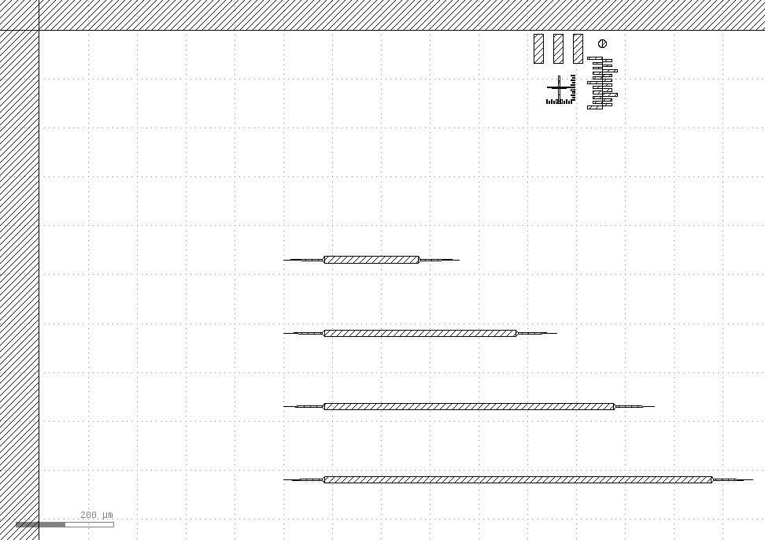
P-Mesa Vernier
(1264.325.,-317.175)
Vernier Center when This mask quadrant is in the lower right.

Slide 19
Mask Layout EPHI-dev-2-1
QW-Etch1
P-Mesa (Positive)
QW-Etch2
Si-Waveguide

Slide 20
Mask Layout EPHI-dev-2-2
N-Metal
(Positive)
N-Substrate
VCs
P-Metal
(Positive)

Slide 21
Mask Layout EPHI-dev-2-3
Via-Etch
Negative
Via-Etch
Positive
Implant
Probe-Metal
Positive

Slide 22
Questions
Double check all metal stacks
How long to develop AZ4210 (70s or 2min)
Fix E-beam 4 dep rate info on slide 17
Is this a good SU8 thickness?

Slide 23
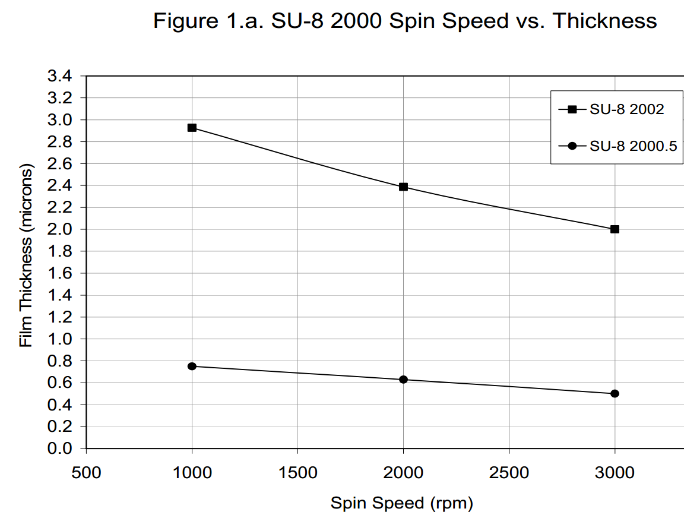
http://www.microchem.com/pdf/SU-82000DataSheet2000_5thru2015Ver4.pdf

