Slide 1
Sweeper Run#2B Grating Process Report
Jock Bovington

Slide 2
Sweeper Chip Layout
S2B#1
S2B#2

Slide 3
Etch Targets (S2B#2)
75 nm
50 nm
Dicing and grating etch.

Slide 4
Current State of Sweeper Chips
S2B#1
S2B#2
S2B#1a1
32nm
ON HOLD
43nm
75nm
105nm
54nm
S2B#1a2
S2B#1b
S2B#1c
S2B#2a
S2B#2b
S2B#2c
All etch depths are approximate and from a single measurement of a 50% DC Grating on the first column of the die.

Slide 5
Etch Results
 | SWEEPER RUN#2B
 | Sample | Etch time (s) | Ech Depth (nm)
 | S2B#1a1 | 10 | 32
 | S2B#1a2 | 40 | 54
 | S2B#2a | 23 | 43
 | S2B#2b | 68 | 105
 | S2B#2a | 49 | 75
Reference from Run#1
 | S1#1 | 35 | 83

Slide 6
Before Cleaning Polymer
Note that the horns are much higher that the flat top

Slide 7
After Cleaning Polymer with Gasonics
Note that the horns are basically removed. Further cleaning would improve this.

Slide 8
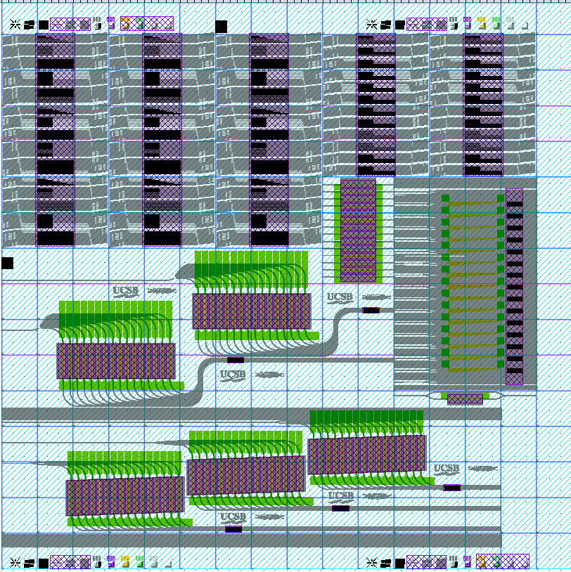
1. 50 % dc
2. 20% dc (left)
3. Smallest width
4. 80% dc
5. 50% dc for comparison across the die.
1
2 (left side)
3 (left side)
4 (bottom-most grating in this group)
5 (bottom-most grating in this group)

Slide 9
Characteristic AFM Data
All data was taken on S2B#1a2
The following 5 scans are representative of all of the data collected on this sample.
Note that there is evidence that this sample will look better if cleaned further as it was simply stripped and O2 Descummed for 30s. See data at position #4.

Slide 10
Characteristic AFM Data Position #1

Slide 11
Characteristic AFM Data Position #2

Slide 12
Characteristic AFM Data Position #3

Slide 13
Characteristic AFM Data Position #4
Note peak of this tooth to the gap is much higher that the typical etch depth. This suggests that this is simply polymer.

Slide 14
Characteristic AFM Data Position #1

Slide 15
Characteristic SEM Data

Slide 16
Characteristic SEM Data

Slide 17
Characteristic SEM Data

Slide 18
Measurement Recommendations
As I need further results for my thesis project, I can not take time to do the following analysis. However, I see it as vital to further understanding of the grating process.
There are 2 “optical die” which will not continue the process through the metal and other processing. Below are some recommended measurements:
A proper analysis of the proximity effects the would impact the duty cycle of the beginning vs. the middle of the grating. I have done this on a planer surface, but not on a patterned surface. This will give predictive capability of the pattern bias between the make and actual pattern.
Rough map of alignment error. Note that gratings were grouped into local and global alignment groups based on whether they had gratings narrower than the waveguide width. Martijn has the details.
AFM study of etch depth vs. pattern size. The data collected so far with Jonathan is not enough to be conclusive.
Cross-sectional SEMs of multiple duty cycles of the gratings.

