Slide 1
DUV Stepper Waveguides Si Dummy Run
Jock Bovington
&
Jared Hulme

Slide 2
Overview
Design of Experiment
Device Layout
SEM Results
Conclusions

Slide 3
Design of Experiment
Jock Bovington

Slide 4
Design of Experiment
Using (3) Si wafer (NOT SOI)
Split DBARC bake temperature (160,170,180C)
Split dose energy (16,17,18…31mJ/cm²)
Hold focus (-0.15um)
Etch 250s
Run (1) SOI wafer given the results

Slide 5
Process Follower
Clean Wafers
Nano Strip, DI rinse, BHF, Di rinse, SRD
Dehydration bake (132C, >1min)
Spin DBARC (5krpm, 30s)
Hot plate bake temp = XC, 60s
Spin UV210 (5krpm, 30s)
Soft bake temp = 132C, 60s
DUV stepper exposure (YmJ/cm², -0.15$µ$m)
Post exposure bake (132C, 90s)
Develop 300MIF (120s, minimal agitation)
PEII O2 Descum (100W, 300mT, 30s)
Si Deep RIE “Bosch” single step etch BOV_J_01 (250s, ~250nm)
Dektak step height
Gasonics Strip (recipe #7, 120s, 1-3 repeats)
Dektak step height
SEM

Slide 6
Device Layout
Jared Hulme

Slide 7
Device Layout – Dose Energy
26 | 27 | 28 | 29 | 30
25 | 24 | 23 | 22 | 21
16 | 17 | 18 | 19 | 20

Slide 8
Pattern Layout
PTPNSL-EPhi1.2_DUV2.gds
EPhi 1.2 points of interest
Coupler gaps
300nm period gratings
Star Coupler points
Taper Tips

Slide 9
SEM Results
Jared Hulme

Slide 10
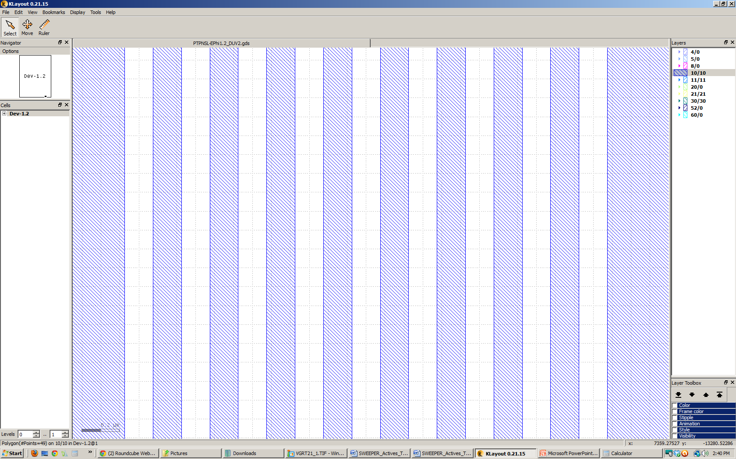
Pattern Layout
PTPNSL-EPhi1.2_DUV2.gds
EPhi 1.2 points of interest
Coupler gaps
300nm period gratings
Star Coupler points
Taper Tips
12um
2.55um
.3um
.15um
.15um

Slide 11
SEMs – 160C Bake time
Die 26
Die 27
Die 28
Die 29

Slide 12
SEMs – 170C Bake time
Die 24
Die 25
Die 28

Slide 13
SEMs – 180C Bake time
Die 25
Die 26
Die 27
Die 28

Slide 14
SEMs – 180C Bake time
Die 29

Slide 15
Pattern Layout
PTPNSL-EPhi1.2_DUV2.gds
EPhi 1.2 points of interest
Coupler gaps
300nm period gratings
Star Coupler points
Taper Tips
12um
3um
1.425um
.15um
.15um
.15um

Slide 16
SEMs – 160C Bake time
Die 26
Die 27
Die 28
Die 29

Slide 17
SEMs – 170C Bake time
Die 24
Die 25
Die 26

Slide 18
SEMs – 180C Bake time
Die 25
Die 26
Die 27
Die 28

Slide 19
SEMs – 180C Bake time
Die 29

Slide 20
Pattern Layout
PTPNSL-EPhi1.2_DUV2.gds
EPhi 1.2 points of interest
Coupler gaps
300nm period gratings
Star Coupler points
Taper Tips
.28um
.6um
.6um

Slide 21
SEMs – 160C Bake time
Die 26
Die 27
Die 28
Die 29

Slide 22
SEMs – 170C Bake time
Die 24
Die 25
Die 26
Die 27

Slide 23
SEMs – 180C Bake time
Die 25
Die 26
Die 27
Die 28

Slide 24
SEMs – 180C Bake time
Die 29a
Die 29b

Slide 25
Pattern Layout
PTPNSL-EPhi1.2_DUV2.gds
EPhi 1.2 points of interest
Coupler gaps
300nm period gratings
Star Coupler points
Taper Tips

Slide 26
SEMs – 160C Bake time
Die 26
Die 27
Die 28
Die 29

Slide 27
SEMs – 170C Bake time
Die 24
Die 25
Die 26

Slide 28
SEMs – 170C Bake time
Die 27a
Die 27b

Slide 29
SEMs – 180C Bake time
Die 25
Die 26
Die 27
Die 28

Slide 30
SEMs – 180C Bake time
Die 29

Slide 31
Pattern Layout
PTPNSL-EPhi1.2_DUV2.gds
EPhi 1.2 points of interest
Coupler gaps
300nm period gratings
Star Coupler points
Taper Tips

Slide 32
SEMs – 160C Bake time
Die 26
Die 27
Die 28
Die 29

Slide 33
SEMs – 170C Bake time
Die 24a
Die 24b
Die 25

Slide 34
SEMs – 180C Bake time
Die 25
Die 26
Die 27
Die 28

Slide 35
SEMs – 180C Bake time
Die 29

Slide 36
Conclusions
Jared Hulme & Jock Bovington

Slide 37
Si Litho Conclusions – Bad News
It appears that at low DBARC bake temp (160C) there is often severe undercut during development which destroys fine features.
For gratings and narrow gaps high DBARC bake temp (180C) leaves webbing which partially masks these area.
All wafers have residue that was not removed after 3x Recipe#7 in Gasonics.
Follow-up Experiment
(1) 25min Nanostrip Dip + 1min BHF dip
SEM both cleaned wafers

Slide 38
Si Litho Conclusions – Good News
DUV Stepper SOI should be set around
25mJ/cm^2
170C DBARC Bake Temp
Run (1) SOI wafer with Focus/Energy array to measure offsets for all patterns
Energy: 23, 24, 25, 26, 27
Focus: -0.35, -.25, -0.15, -0.05, 0.05

Slide 39
DUV Stepper Waveguides PR Strip Test Run
Jock Bovington
&
Jared Hulme

Slide 40
Overview
Design of Experiment
SEM Results
Conclusions

Slide 41
Design of Experiment
Jock Bovington

Slide 42
Design of Experiment
Using (4) Si wafer (NOT SOI)
DBARC bake temperature 170C
Hold dose energy 28mJ/cm²)
Split focus (-0.15um)
Etch 250s
Split PR strip
1165 soak + u/s
Flood expose + develop
Hold (2) wafers
Clean SOI wafer given the results

Slide 43
SEM Results – PR Strip
Jared Hulme

Slide 44
PR Strip - SEMs – DUV Si 160C_0
-Gasonics 350C, 2min x 3

Slide 45
PR Strip - SEMs – DUV Si 160C_0
-Gasonics 350C, 2min x 3
-Nanostrip 25 min
-BHF 1min

Slide 46
PR Strip - SEMs – DUV Si 170C_1
-PEII 2min
-1165 @80C 30min
-1165 @80C u/s 10min
(U/S on high,freq 5,int 5)
-PEII 2min

Slide 47
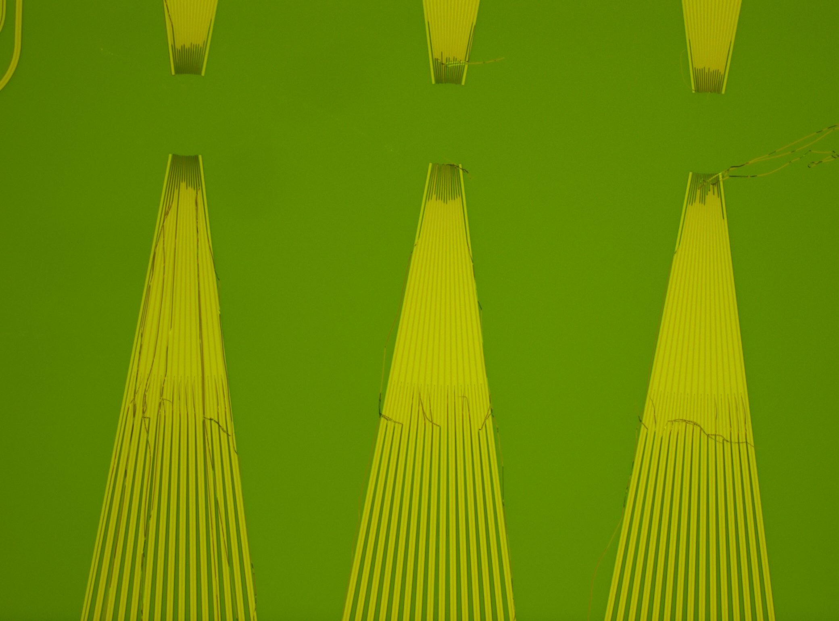
PR Strip - DUV Si 170C_2
-DUV flood expose before etch 90sec
-Etch
-AZ300MIF 3min

Slide 48
Side Wall SEM Results DUV_Si_170C_1 die 25
Jared Hulme

Slide 49
Sidewall DUV_Si_170C_1
Die 25

Slide 50
Sidewall DUV_Si_170C_1
Die 25

Slide 51
Sidewall DUV_Si_170C_1
Die 25

Slide 52
Sidewall DUV_Si_170C_1
Die 25

Slide 53
Sidewall DUV_Si_170C_1
As an aside, these are the zig zag gratings designed by Mike Davenport on Die 25

Slide 54
Conclusions
Jared Hulme & Jock Bovington

Slide 55
PR Strip Conclusions
1165 stripper appears to remove UV210 and DBARC very effectively
Follow-up experiment
Reduce time of 1165 soak
Developer had little effect on the PR post etch
Sidewalls look good on waveguides, but not ideal on grating features

Slide 56
DUV Stepper Waveguides SOI Test Run
Jock Bovington
&
Jared Hulme

Slide 57
Overview
Design of Experiment
Device Layout
SEM Results
Conclusions

Slide 58
Design of Experiment
Jock Bovington

Slide 59
Design of Experiment
Using (3) Si wafer (NOT SOI)
Split DBARC bake temperature (160,170,180C)
Split dose energy (16,17,18…31mJ/cm²)
Hold focus (-0.15um)
Etch 250s
Run (1) SOI wafer given the results

Slide 60
Process Follower
Clean Wafers
Nano Strip, DI rinse, BHF, Di rinse, SRD
Dehydration bake (132C, >1min)
Spin DBARC (5krpm, 30s)
Hot plate bake temp = XC, 60s
Spin UV210 (5krpm, 30s)
Soft bake temp = 132C, 60s
DUV stepper exposure (YmJ/cm², -0.15$µ$m)
Post exposure bake (132C, 90s)
Develop 300MIF (120s, minimal agitation)
SRD
PEII O2 Descum (100W, 300mT, 30s)
Si Deep RIE “Bosch” single step etch BOV_J_01 (250s, ~250nm)
Dektak step height
Gasonics Strip (recipe #7, 120s, 1-3 repeats)
Dektak step height
SEM

Slide 61
Device Layout
Jared Hulme

Slide 62
Device Layout – Dose Energy
 | 23 | 24 | 25 | 26 | 27
-.35
-.25
-.15
-.05
0.5

Slide 63
Pattern Layout
PTPNSL-EPhi1.2_DUV2.gds
EPhi 1.2 points of interest
Coupler gaps
300nm period gratings
Star Coupler points
Taper Tips

Slide 64
SEM Results
Jared Hulme

Slide 65
Pattern Layout
PTPNSL-EPhi1.2_DUV2.gds
EPhi 1.2 points of interest
Coupler gaps
300nm period gratings
Star Coupler points
Taper Tips
12um
2.55um
.3um
.15um
.15um

Slide 66
SEMs – DUV SOI 170C-1

Slide 67
Pattern Layout
PTPNSL-EPhi1.2_DUV2.gds
EPhi 1.2 points of interest
Coupler gaps
300nm period gratings
Star Coupler points
Taper Tips
12um
3um
1.425um
.15um
.15um
.15um

Slide 68
SEMs – DUV SOI 170C-1

Slide 69
SEMs – DUV SOI 170C-1

Slide 70
SEMs – DUV SOI 170C-1

Slide 71
Pattern Layout
PTPNSL-EPhi1.2_DUV2.gds
EPhi 1.2 points of interest
Coupler gaps
300nm period gratings
Star Coupler points
Taper Tips
.28um
.6um
.6um

Slide 72
SEMs – DUV SOI 170C-1

Slide 73
Pattern Layout
PTPNSL-EPhi1.2_DUV2.gds
EPhi 1.2 points of interest
Coupler gaps
300nm period gratings
Star Coupler points
Taper Tips
.5um

Slide 74
SEMs – DUV SOI 170C-1

Slide 75
Pattern Layout
PTPNSL-EPhi1.2_DUV2.gds
EPhi 1.2 points of interest
Coupler gaps
300nm period gratings
Star Coupler points
Taper Tips
.15um

Slide 76
SEMs – DUV SOI 170C-1

Slide 77
Conclusions
Jared Hulme & Jock Bovington

Slide 78
SOI Litho Conclusions
Energy = 25mJ/cm^2 looks best for SOI and Si
Focus = -.15 looks best for SOI and SI
Future plans
Try DBARC above and below resist
Attempt bonding to surface after cleaning

